Slide 1
Benasque XLIII International Meeting
16 – 20 March 2015
Cosmic Rays: the current position -
from AMS to the Auger Observatory
Alan Watson
University of Leeds
a.a.watson@leeds.ac.uk

Slide 2
Lecture 1: Overview of the cosmic ray scene
The energetics
Measurements of cosmic rays from balloons and space
Lecture 2/3: Studies of high energy cosmic rays using air-showers
Features of the energy spectrum
Mass composition
Arrival Directions
What does it all mean?
The future

Slide 3
Cosmic Rays discovered in 1912
Crucial in many areas, e.g. development of particle physics
and astrophysics
Discovery of positron, muon, pions, strange particle (K andΛ) etc
Synchrotron radiation
Carbon dating
Space Weather ............

Slide 4
Flux of Cosmic Rays
1 particle m⁻² s⁻¹
Air-showers
Direct
Measurements
AMS
ATIC
PAMELA
CREAM
Argo
KASCADE-Grande
Auger
Telescope Array
32 decades
in intensity
‘Knee’
1 particle m⁻² per year
Ankle
1 particle km⁻² per year
S Swordy
(Univ. Chicago)
LHC
12 decades
In energy

Slide 5
Energy Density, W_{CR} ~ 1 eV cm⁻³
Galactic Magnetic Field, W_{B} ~ 1 eV cm⁻³
There is a strong connection here – propagation of cosmic rays
in the galaxy is an important part of the story.
Also similar energy densities in 2.7 K radiation
and starlight
Overall aim is to discover the sources of the cosmic rays,
their energetics, how they propagate etc

Slide 6
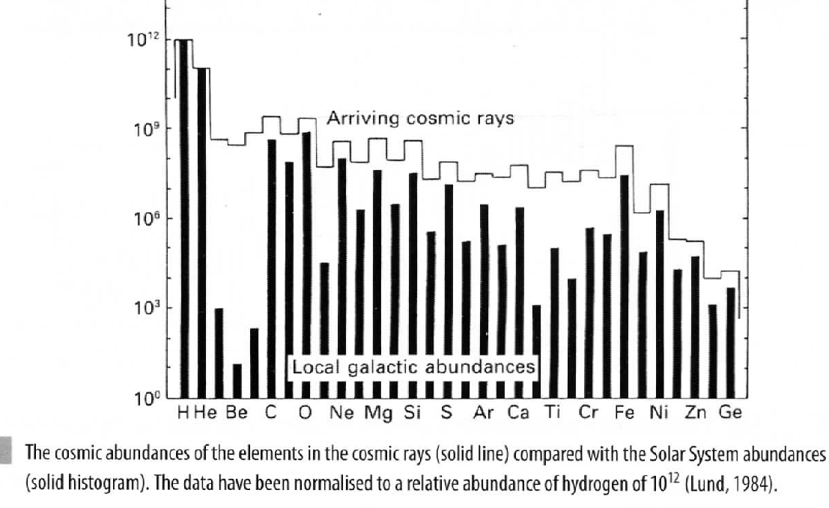
Chemical composition
Spallation – cosmic rays traverse
a few g cm⁻² of material

Slide 7
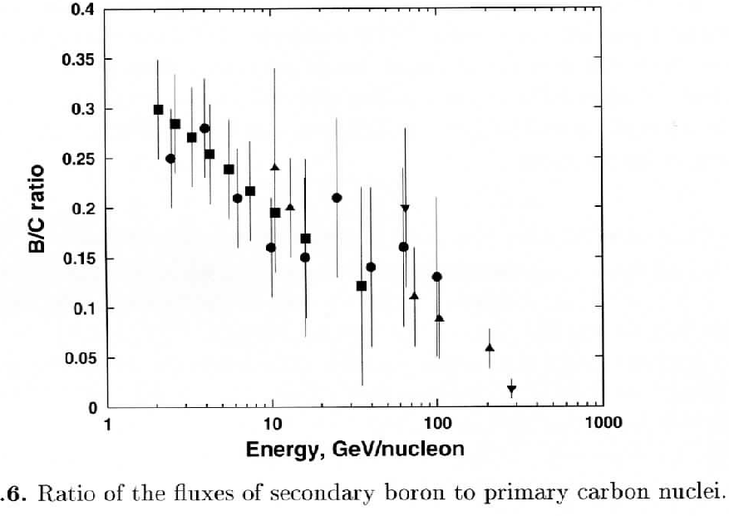
Rigidity, R = Pc/Ze,
where P is the momentum
B/C ratio can be used to infer
amount of material traversed
between injection and observation
This is a general observation for
the secondary to primary ratios
From Stanev, Ultra High Energy Cosmic Rays

Slide 8
Energetics of Cosmic Rays
Age from ratio of Be¹⁰/B ~ few x 10⁶ years
Power required to maintain observed CR flux
0.3 x 10³⁴ W < L_{GCR} < 3 x 10³⁴ W (~ 10⁴¹ ergs)
Different estimates depend on propagation model
How hard is injection spectrum?
Is there 2nd order Fermi re-acceleration during propagation?
Mechanical Energy in SN explosion ~ 10³⁵ W: ~ 3 per century
Baade and Zwicky (1934), Ginzburg and Syrovatsky (1960s)

Slide 9
No other plausible sources at lower energies
Pulsars and OB winds at 10% level
Acceleration thought to occur as SN shock expands into ISM
Diffusive Shock acceleration works to 3 x 10¹⁵ eV
Evidence from observations of SN remnants by such as Fermi
gamma-ray satellite and TeV observatories
By contrast:-
Accelerators at higher energies are something of a mystery
- much speculation

Slide 10
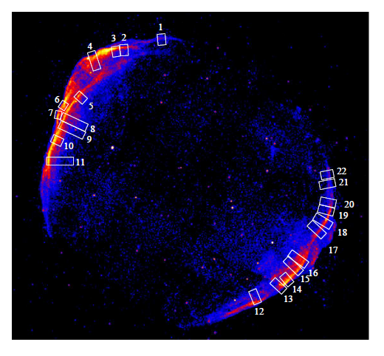
SN 1006
Ressler et al: arXiv 1406.3630: Magnetic amplification in X-ray rims of SN1006

Slide 11
Large improvement in data quantity and quality from AMS-02
(ISS) and CREAM (circum-polar balloon flights)
AMS results on elements not yet available (next month at CERN)
AMS results on positrons and electrons of great interest
Composition results from CREAM

Slide 12
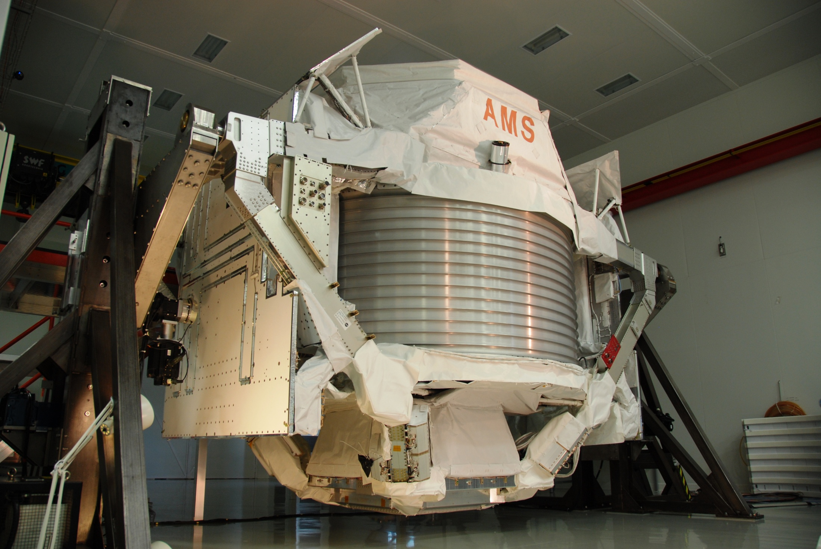
6
M Pohl, 2014
15ft x 12ft x 9ft
7.5 tons

Slide 13
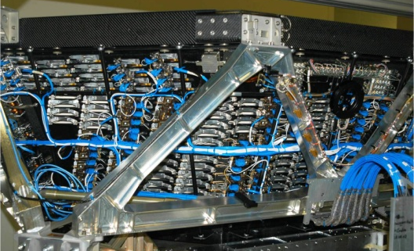
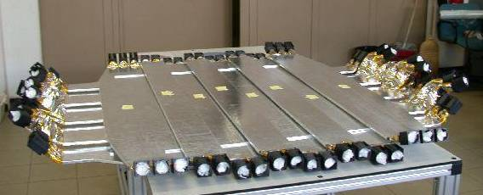
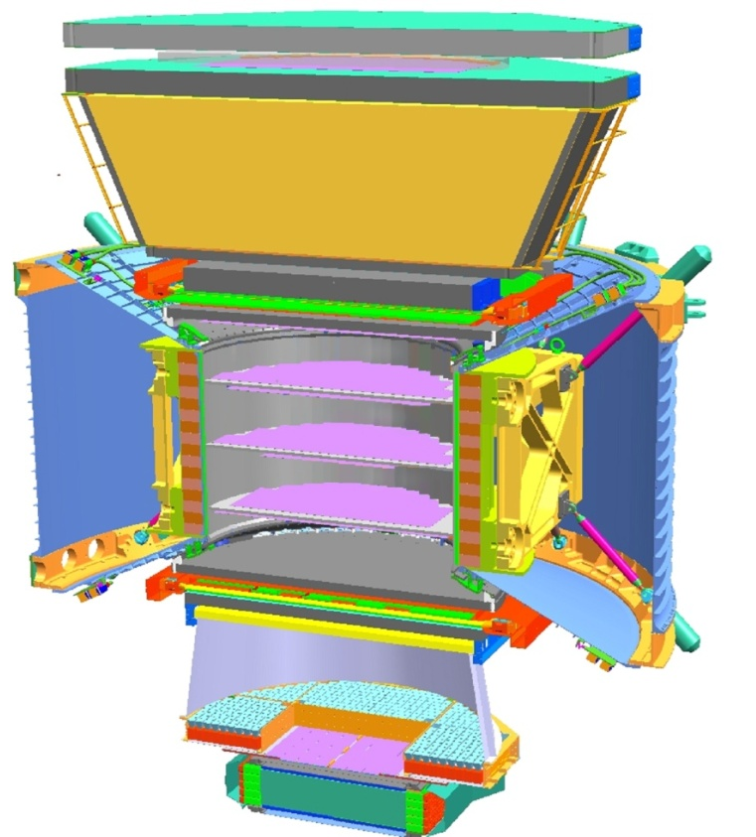
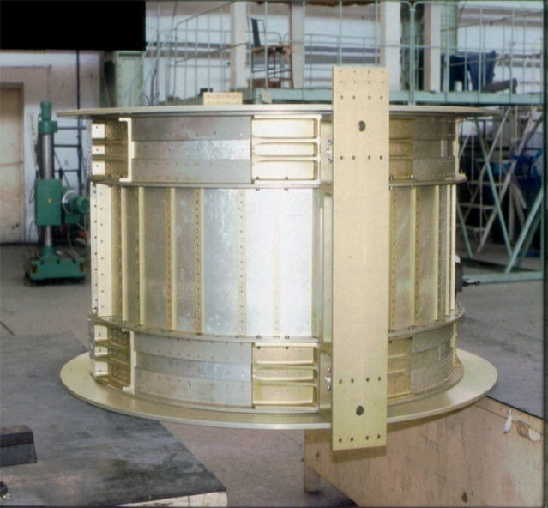
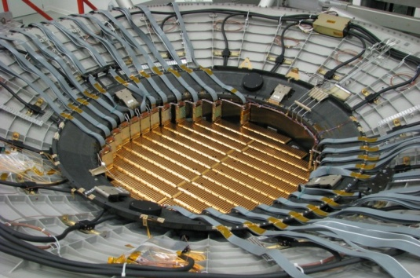
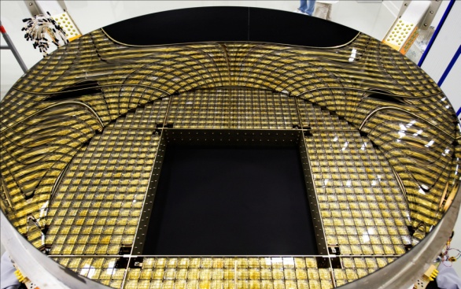
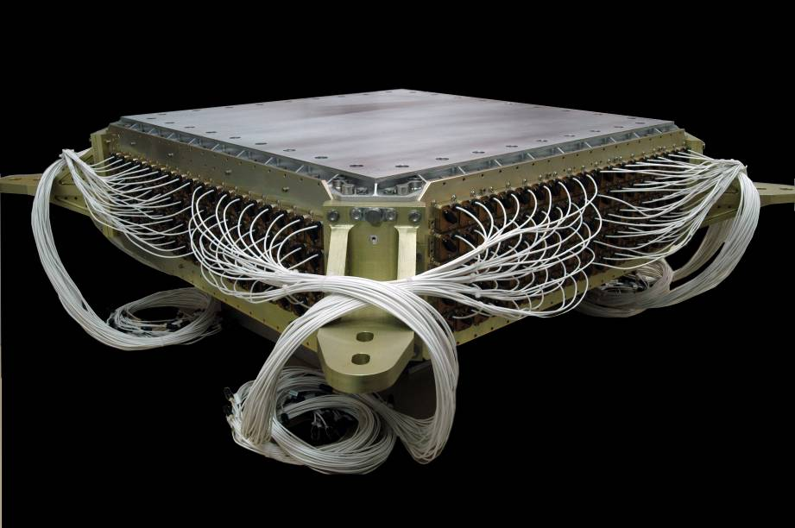
AMS: GeV to TeV precision multipurpose spectrometer
TRD
Identify e⁺, e⁻
TOF
Z, E
M Pohl 2014
1
Magnet
±Z
Silicon Tracker
Z, P
TRD
TOF
2
M Pohl 2014
M Pohl 2014
3-4
5-6
Tracker
7-8
TOF
RICH
Z, E
ECAL
E of e⁺, e⁻, γ
RICH
9
ECAL
Z, P are measured independently by the Tracker, RICH, TOF and ECAL
Notes:
13
13
13

Slide 14
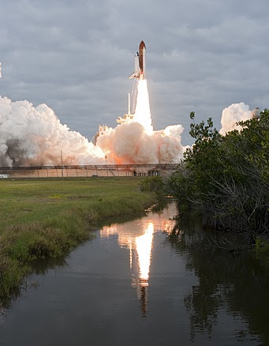
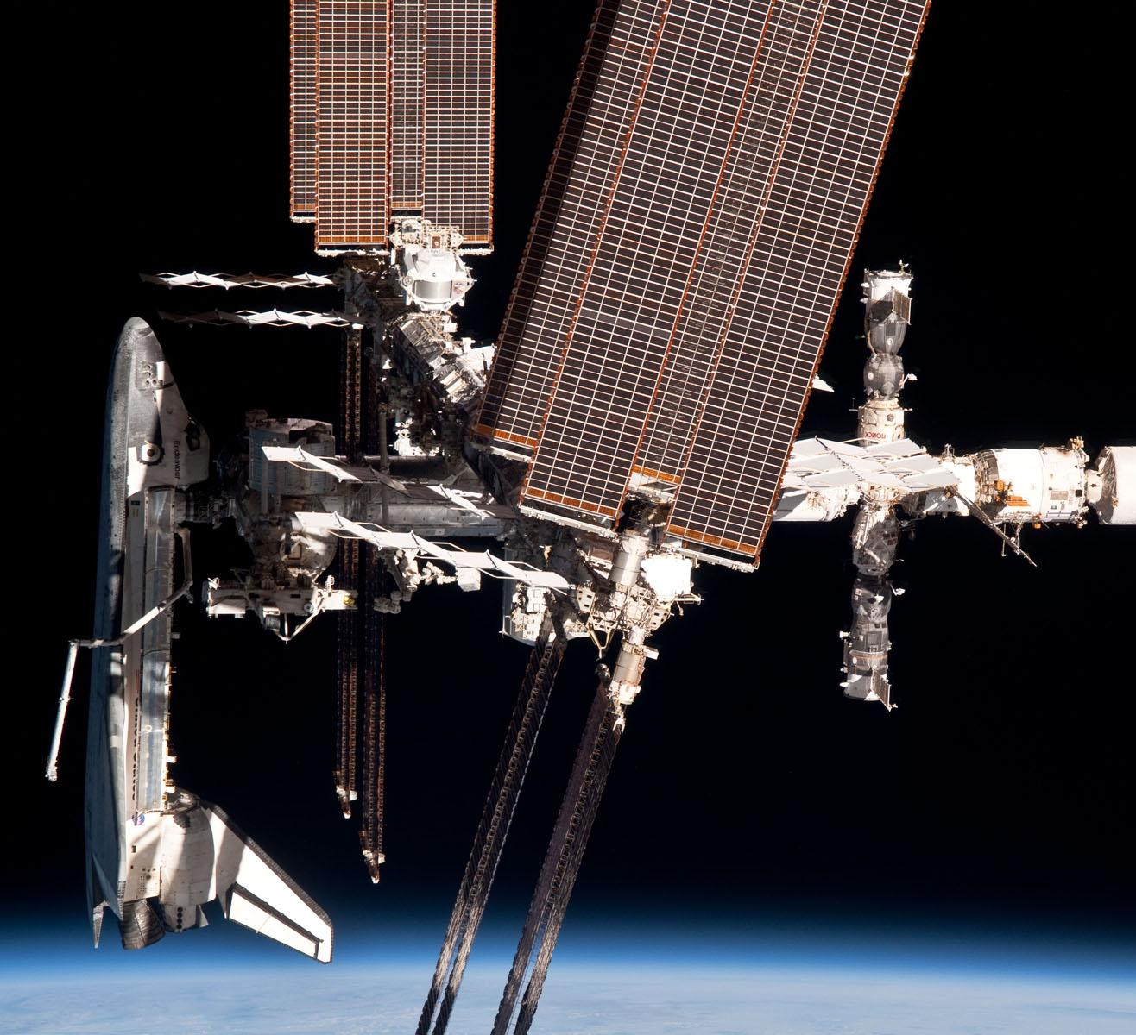
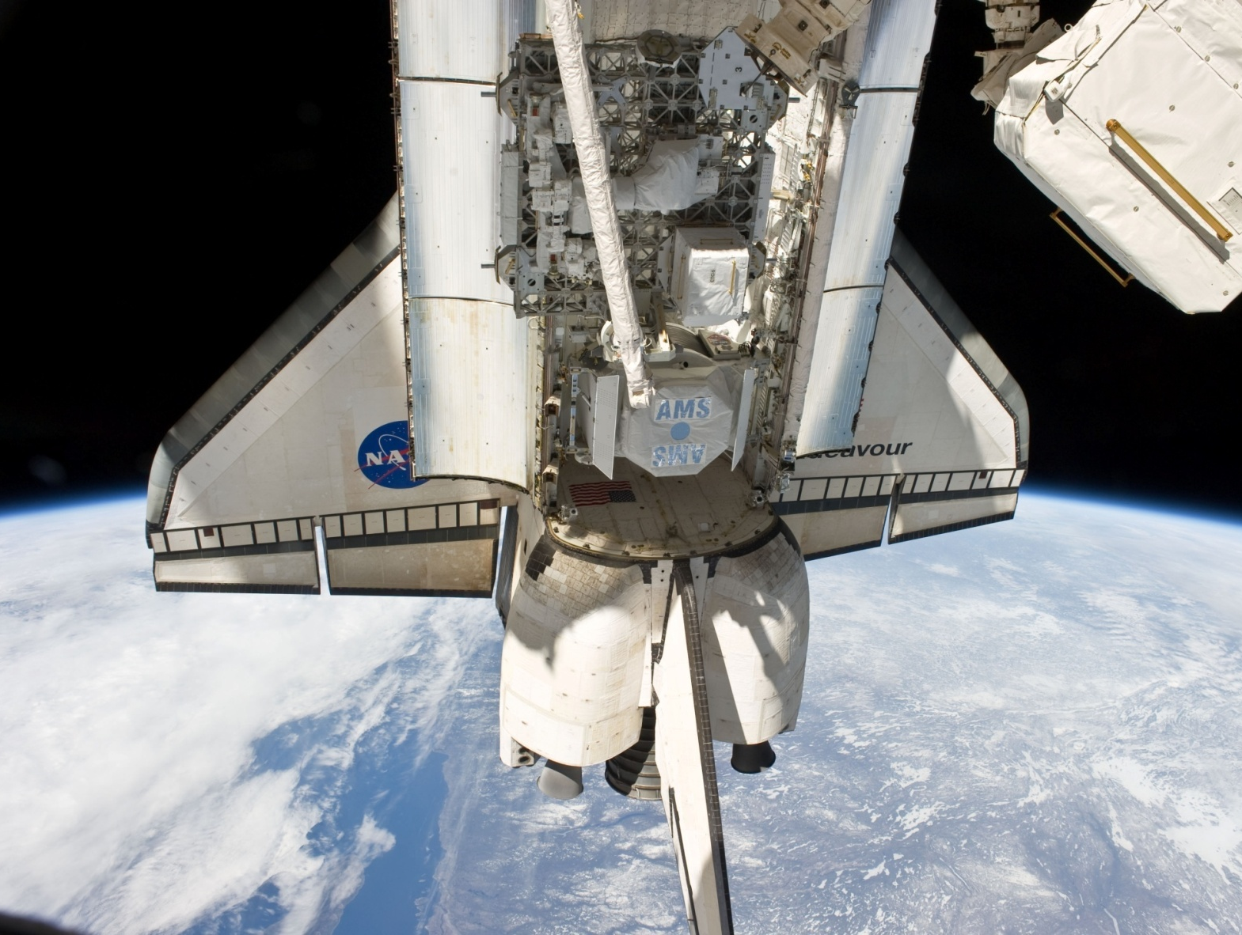
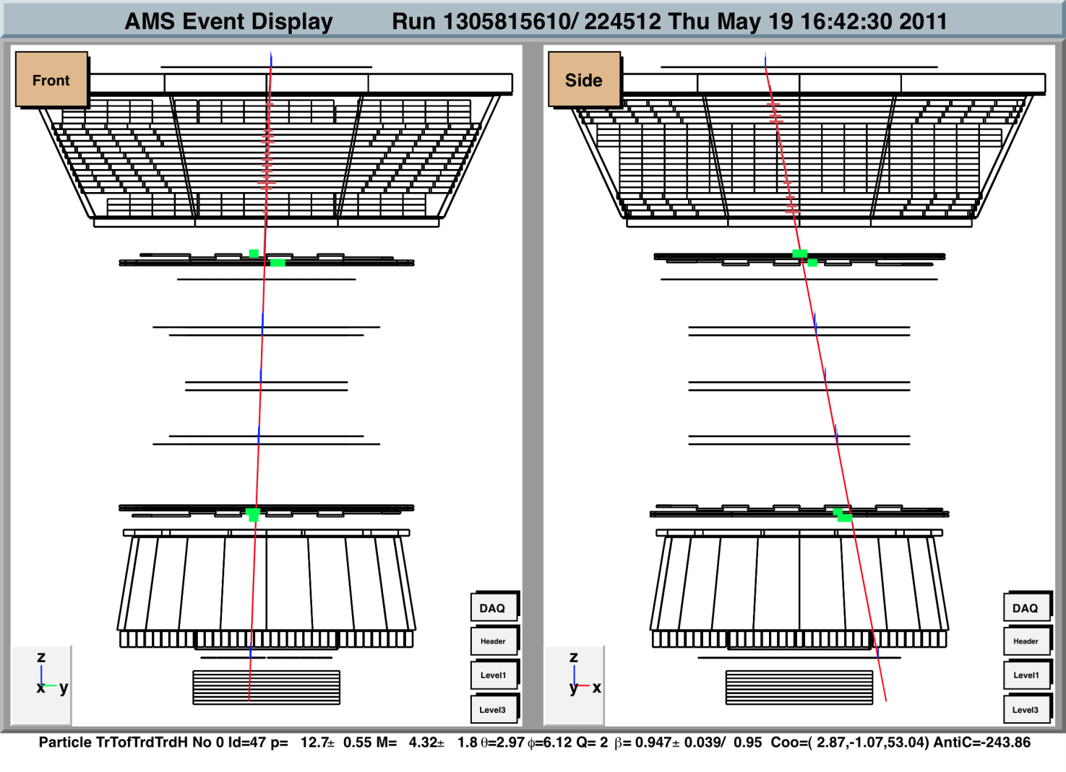
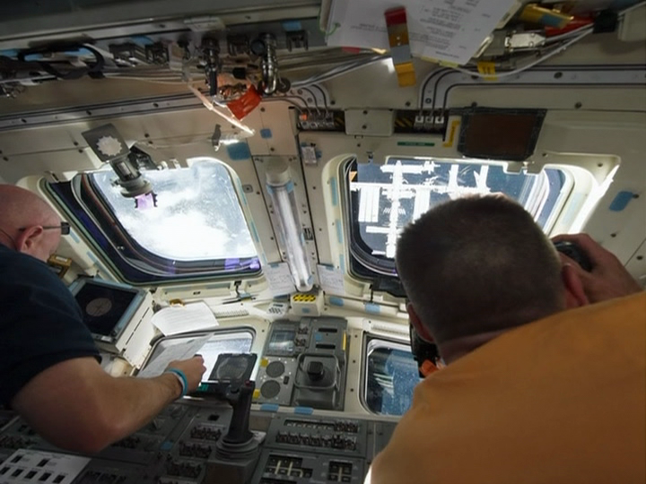
AMS-02 Launch
M Pohl 2014
After 12 years of construction, integration, test…
STS-134 Endeavour:
Successful launch: May 16, 2011, 14:56
Docking with ISS: May 17, 17:59
AMS installation complete: May 19, 11:46
AMS up and running: May 19, 16:38
First He nucleus: May 19, 16:42
In 3 years AMS has collected 50 billion cosmic rays,
much more than all cosmic rays collected over the last century. Every day there are 44 million more…

Slide 15
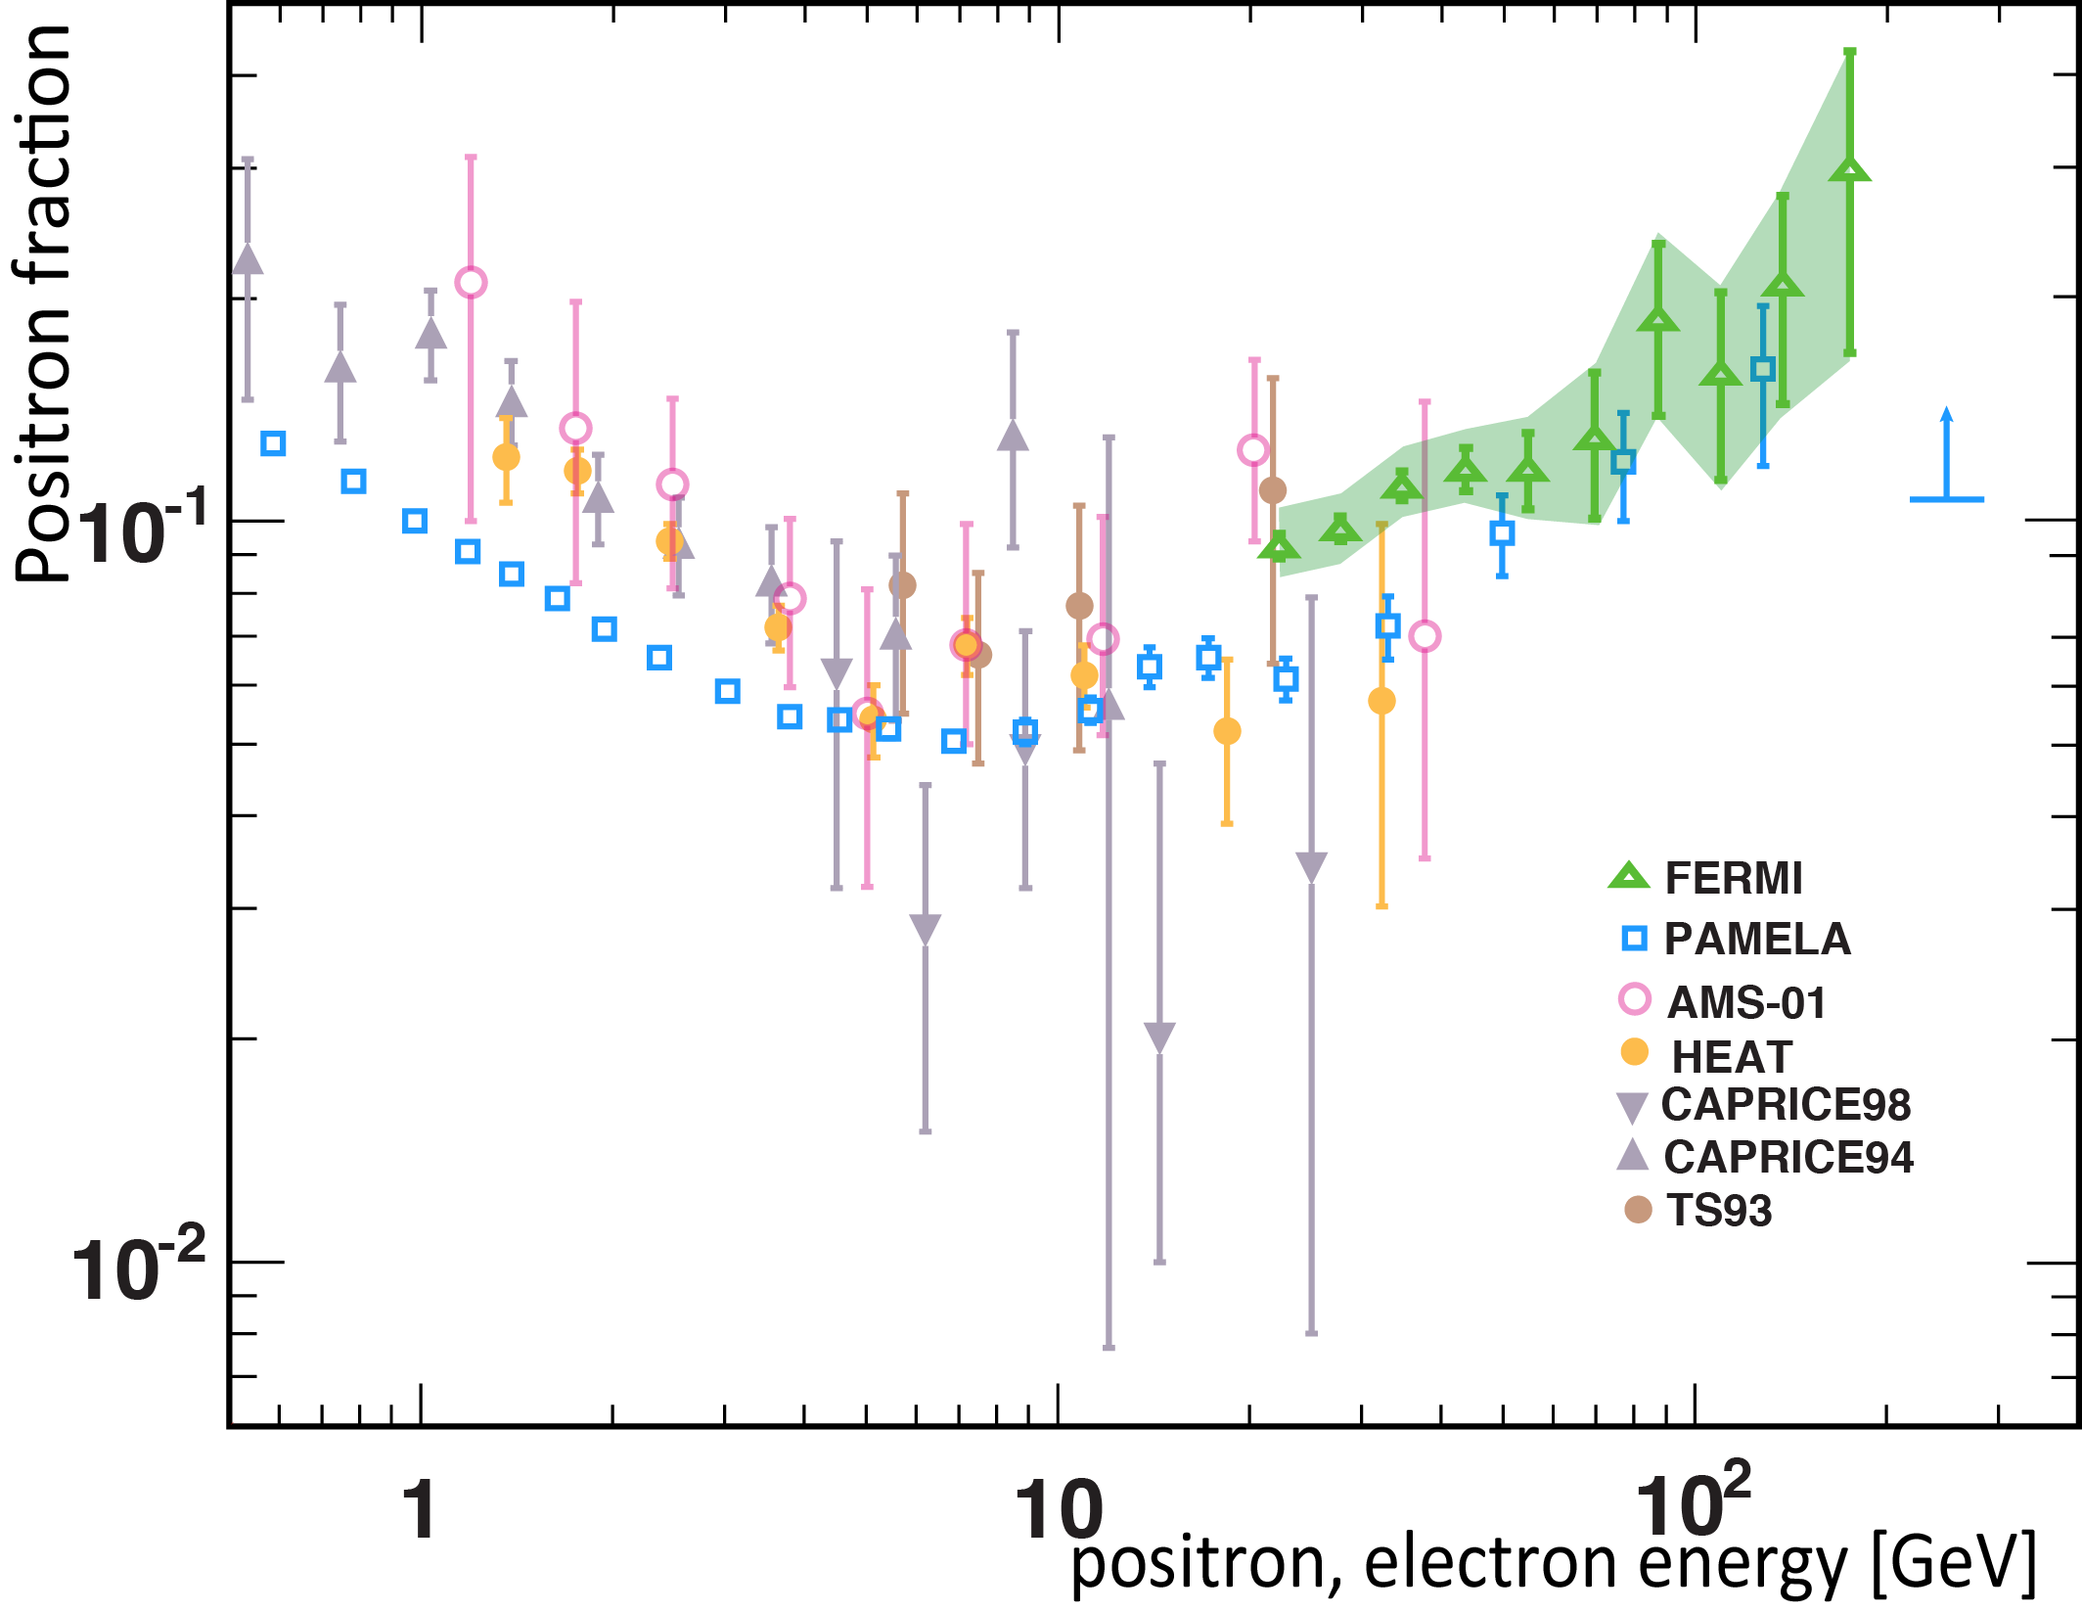
Positron Fraction = Φ(e⁺) / [Φ(e⁺) + Φ(e⁻)]
Additional source?
Diffuse background
Experimental situation before AMS

Slide 16
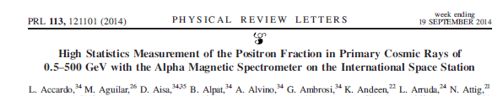
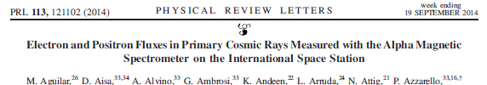
Recent AMS-02 papers on electrons and positrons
Positron fraction = e⁺/(e⁺ + e⁻)
Based on 30 months of operation: data to 500 GeV

Slide 17
Event Selection:-
Track in the TRD
β ~ 1
|Z| = 1
Energy x 1.2 of Størmer cut-off
Acceptance for electron and positrons nearly constant from 3 to 500 GeV

Slide 18
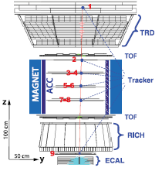
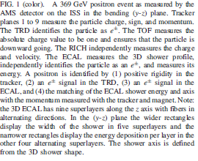
A 369 GeV positron

Slide 19
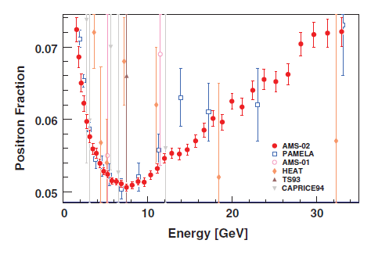
Positron fraction from 1 to 35 GeV
AMS, PRL 113 121101 2014

Slide 20
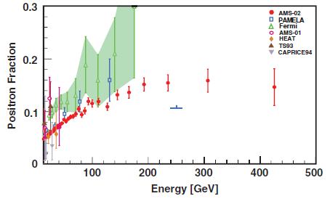
Positron fraction above 10 GeV
271
225
135
72
228
178

Slide 21
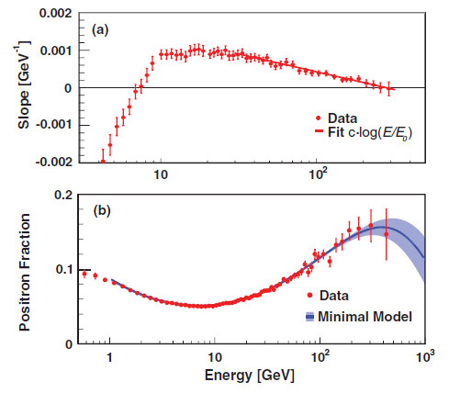
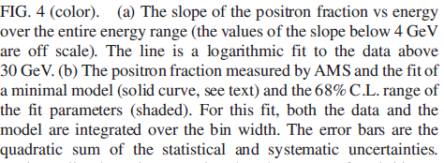


E₀ = 275 ± 32 GeV
Position where positron fraction
is maximal
Change of
Diffuse power law spectrum and common source term: MINIMAL MODEL

Slide 22
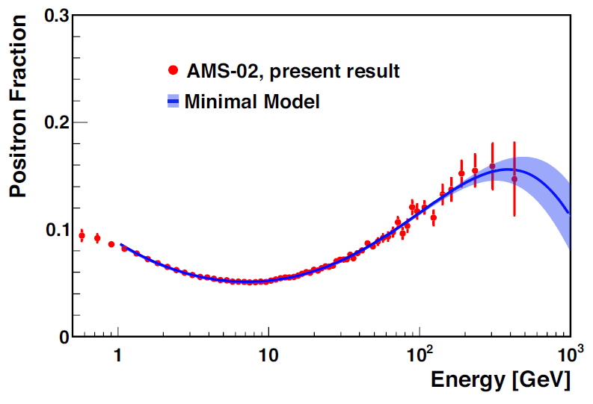

AMS Positron Fraction 2014 vs Minimal Model
Φ_{e}+ = C_{e}+ Ε ^{−γe+} + C_{s}Ε ^{−γs} e ^{-E/Es}
Φ_{e}- = C_{e}- Ε ^{−γe-} + C_{s}Ε ^{−γs} e ^{-E/Es}

Slide 23
C_{e+}/C_{e-} = 0.091 ± 0.0001
:diffuse positron is about10% of diffuse electrons
C_{s}/C_{e-} = 0.0061 ± 0.0009
:common source is 0.6% of diffuse electron flux
γ_{e-} - γ_{e+} = - 0.56 ± 0.03
: positron spectrum is softer than electron spectrum
γ_{e-} - γ_{s} = 0.72 ± 0.04
:source spectrum is harder than diffuse spectrum

Slide 24
Interpretation of AMS-02 data– huge number of papers
Two popular models
Excess of e⁺ from pulsars
After flattening with energy the positron fraction will slowly start to decrease
Dipole anisotropy expected
2. Dark Matter collisions
After flattening there will be a rapid steepening because of finite mass of DM
No dipole anisotropy
Anisotropy will reach δ ~ 0.01 at 95% CL over lifetime of AMS-02
But Blum, Katz and Waxman – secondary origin of positrons – in galaxy

Slide 25
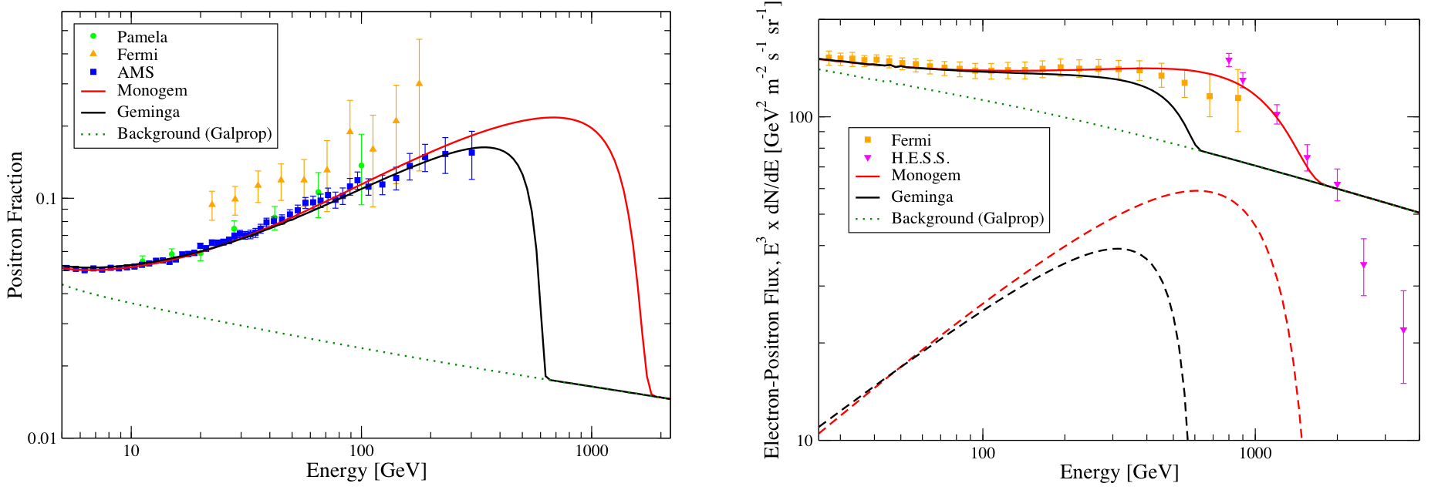
Interpretation Example: Single Pulsar
Tim Linden and Stefano Profumo arXiv:1304.1791v1 [astro-ph.HE] 5 Apr 2013
AMS Data: e⁺ fraction
Fermi/HESS: e⁻+e⁺
See also: Cholis and Hooper, arXiv:1304.840v1 [astro-ph.HE] 6 Apr 2013

Slide 26
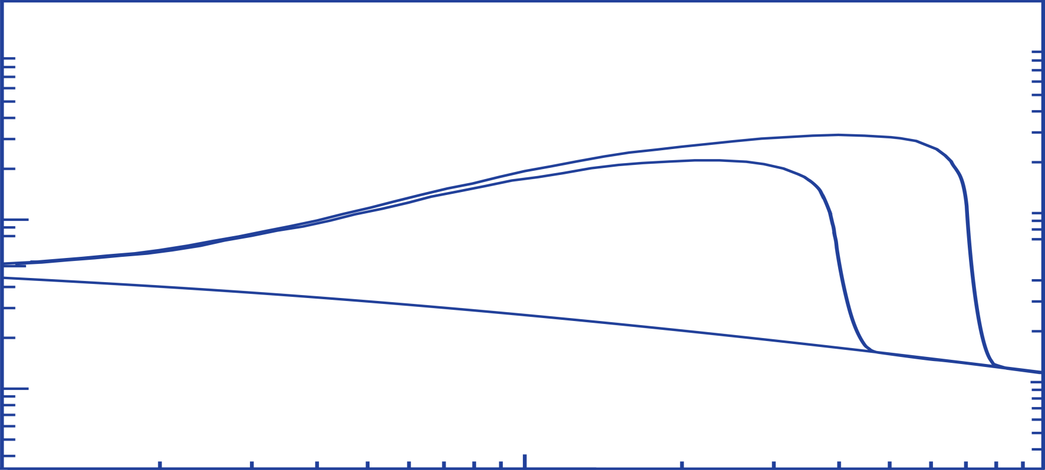
Physics of Positron Fraction
M. Turner and F. Wilczek, Phys. Rev. D42 (1990) 1001;
J. Ellis, 26th ICRC Salt Lake City (1999) astro-ph/9911440;
H. Cheng, J. Feng and K. Matchev, Phys. Rev. Lett. 89 (2002) 211301;
S. Profumo and P. Ullio, J. Cosmology Astroparticle Phys. JCAP07 (2004) 006;
D. Hooper and J. Silk, Phys. Rev. D 71 (2005) 083503;
E. Ponton and L. Randall, JHEP 0904 (2009) 080;
G. Kane, R. Lu and S. Watson, Phys. Lett. B681 (2009) 151;
D. Hooper, P. Blasi and P. D. Serpico, JCAP 0901 025 (2009) 0810.1527; B2
Y–Z. Fan et al., Int. J. Mod. Phys. D19 (2010) 2011;
M. Pato, M. Lattanzi and G. Bertone, JCAP 1012 (2010) 020.
e⁺ /(e⁺ + e⁻)
χ + χ → e⁺ + ….
mχ=800 GeV
0.1
mχ=400 GeV
Diffuse secondary positrons
Positron fraction
Dark Matter model based on I. Cholis et al., arXiv:0810.5344
10
10²
e± energy [GeV]

Slide 27
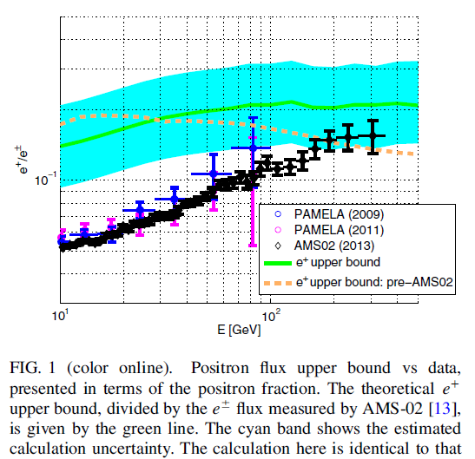
Waxman et al: PRL 111 211101 2013

Slide 28
Conclusion
Data on positron fraction can be understood quite well in terms of
conventional physics and cosmic ray propagation at present
Does not appear to be a need for Dark Matter

Slide 29
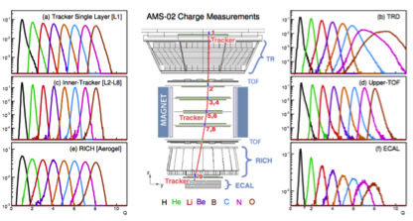
Flux of Nuclei: Redundant Charge Measurements
Low systematics, control of nuclear fragmentation

Slide 30
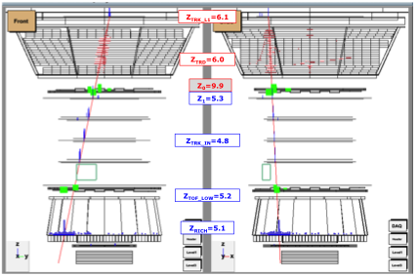
Flux of Nuclei: Control of Nuclear Fragmentation

Slide 31
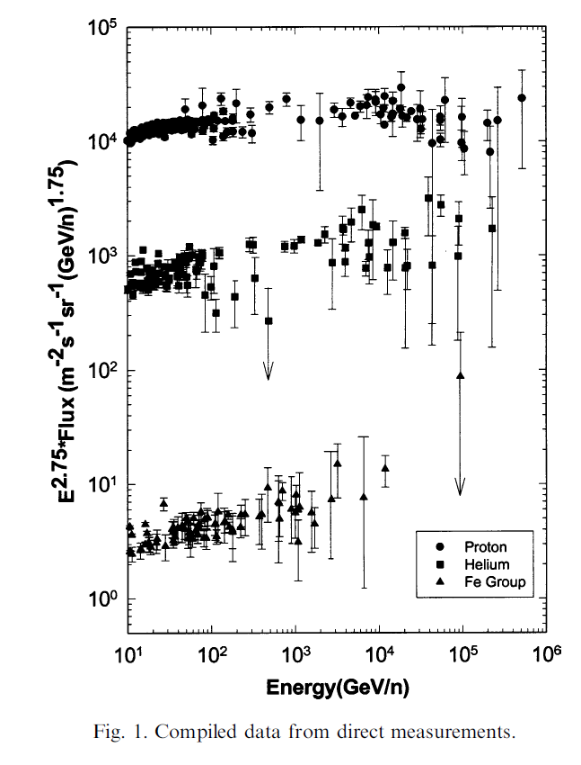
Chemical Composition at higher energies: CREAM
Data shown are pre-CREAM
Features:-
Spectrum of heavier elements appear
to flatten as energy increases
Γ = 2.5 to 2.6
Mean escape length, λ_{e} ,decreases with
Energy
λ_{e} ~ R^{-δ} where R = rigidity and δ ~ 0.6

Slide 32
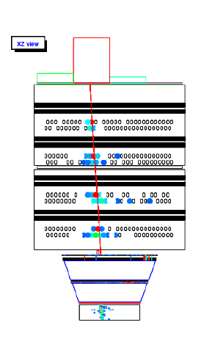
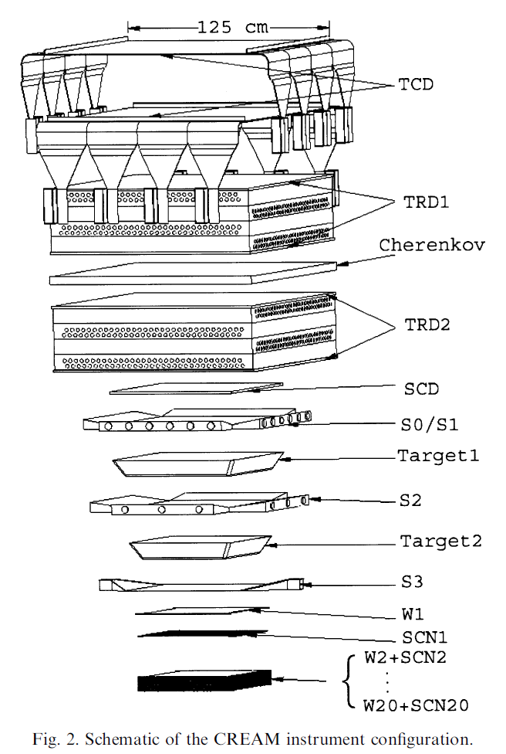
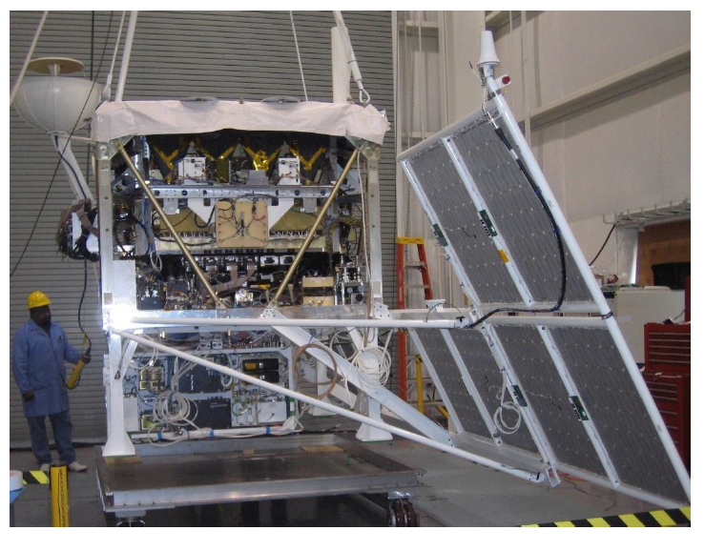
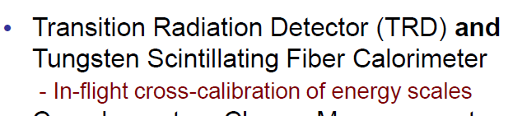
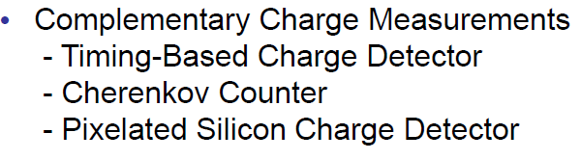
The CREAM Detector
161 days of data

Slide 33
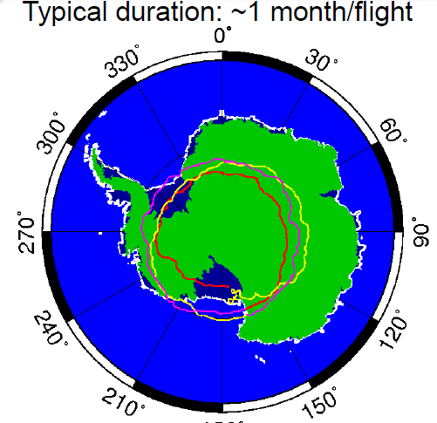
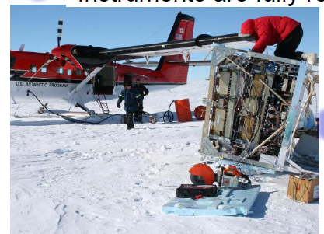
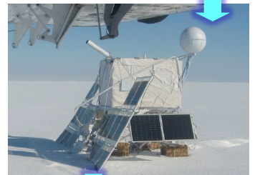

Slide 34
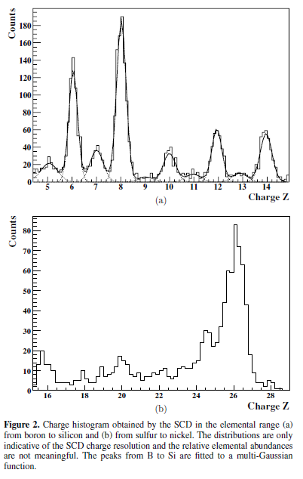

Slide 35
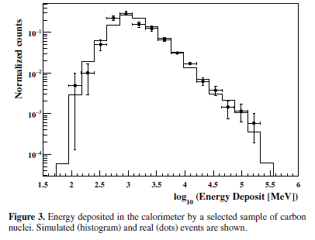
CREAM Collaboration ApJ 2009

Slide 36
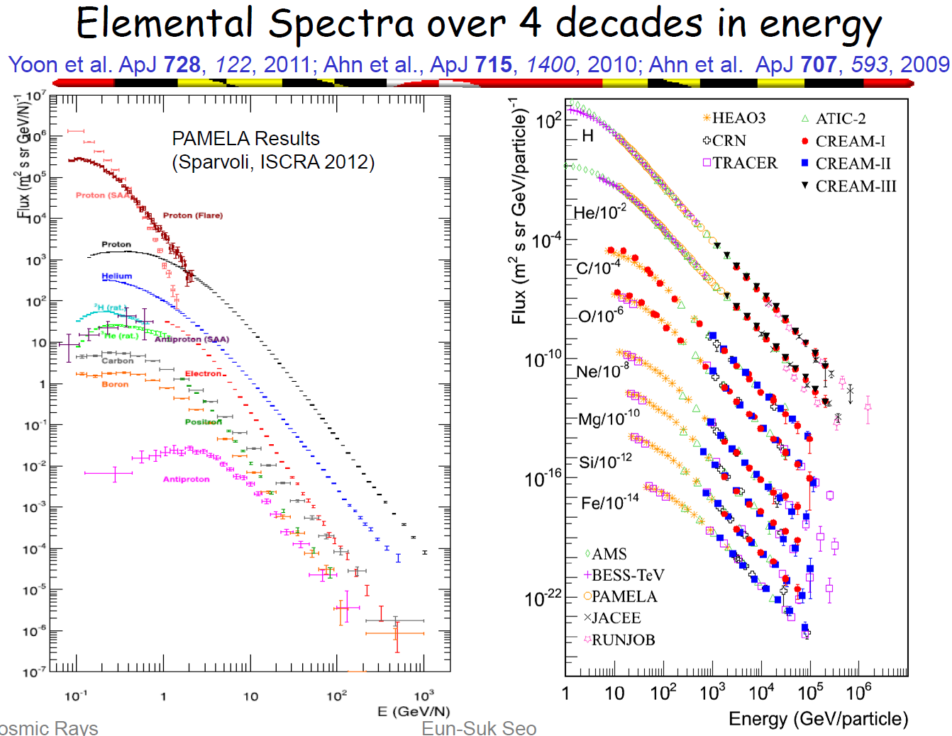

Slide 37
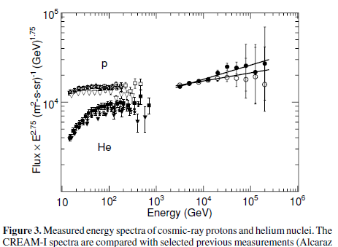
proton slope = 2.66 ± 0.02
helium slope = 2.58 ± 0.02

Slide 38
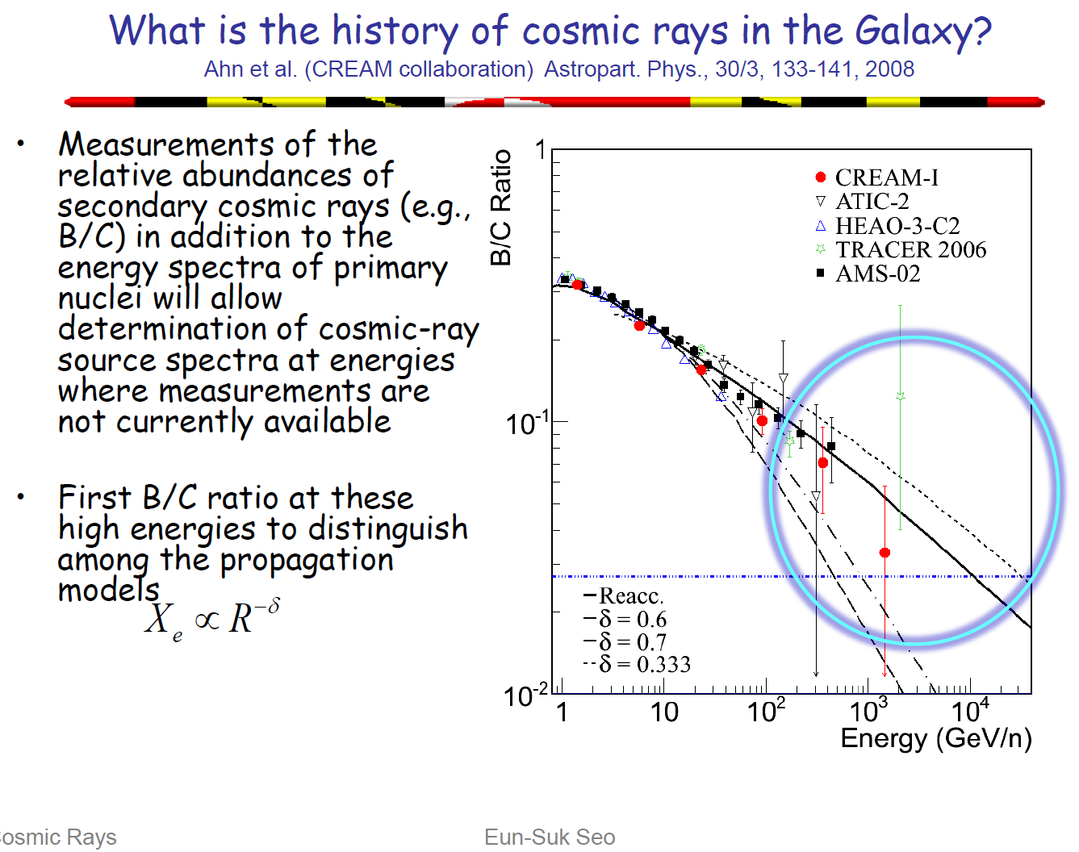

Slide 39
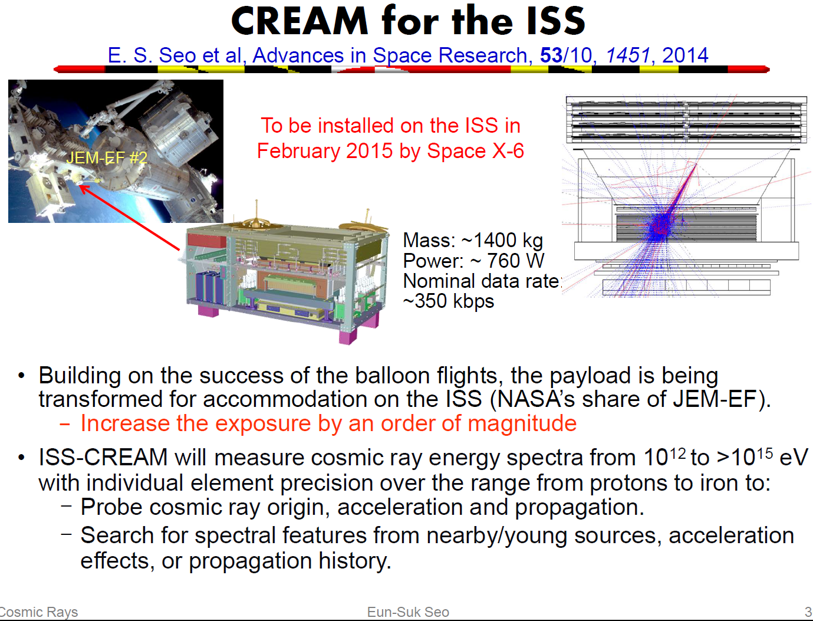

Slide 40
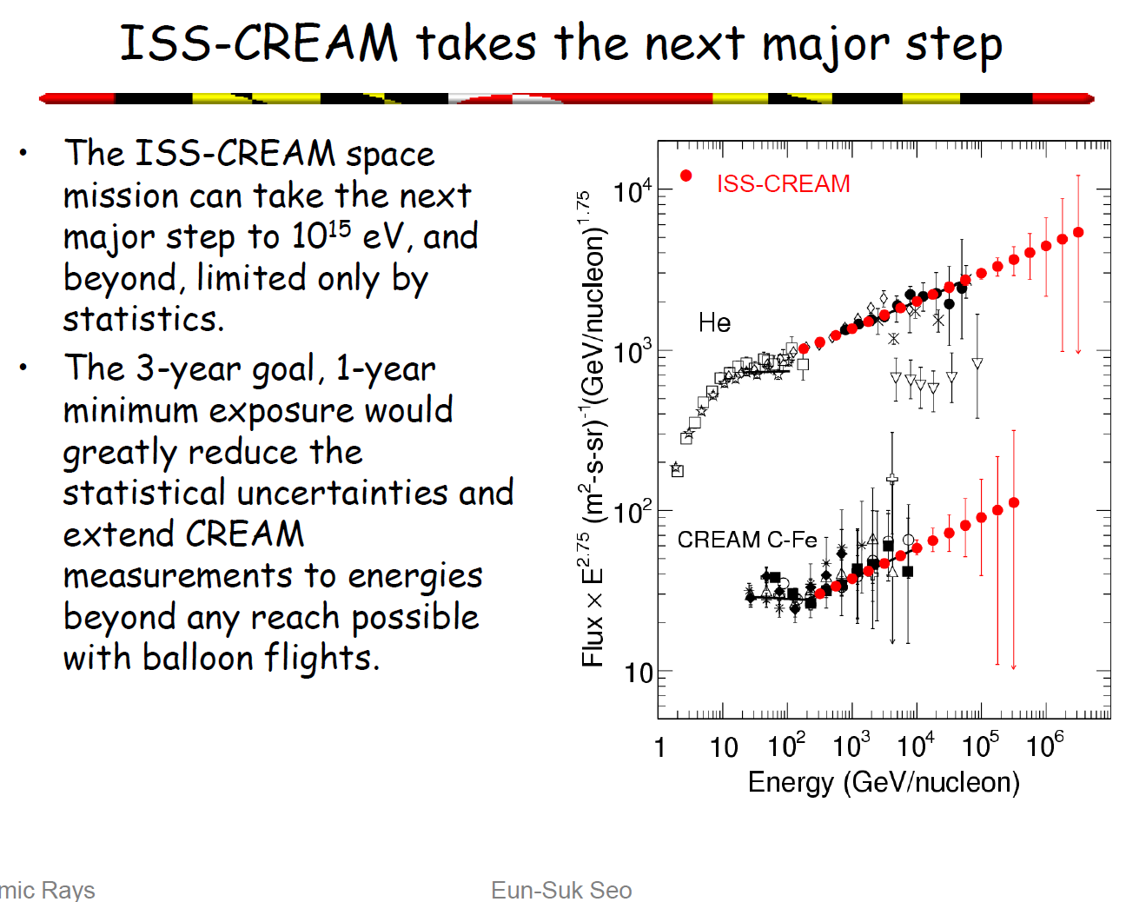

Slide 41
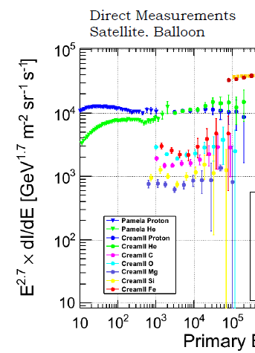
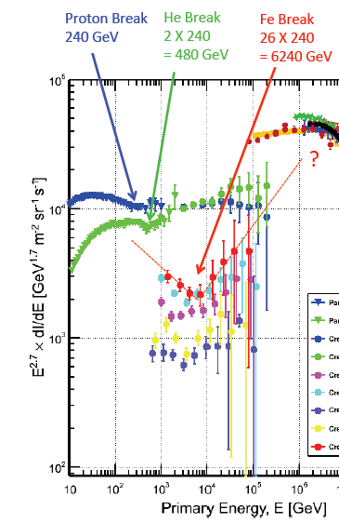
From S Tilav: Zion meeting October 2014
Perfect example of the Peter’s Cycle: E^{z}_{max} = ZeR = ZE^{p}_{max}
where rigidity, R = Pc/Ze, where P is the momentum

Slide 42
Summary of Lecture 1
There has been an enormous increase of data and a huge
improvement in data quality in recent years on low energy
cosmic rays
Notable projects have been Pamela, ATIC (not discussed),
AMS-02 and CREAM
Other experiments have led the way
I will defer trying to draw some conclusions and
explanations for the whole spectrum of cosmic rays until
the third lecture
Next lecture – air-showers and beyond ‘the knee’

