Slide 1
Benasque:
Alan Watson
18 March, Lecture 3

Slide 2
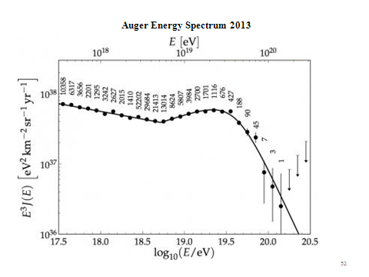

Slide 3
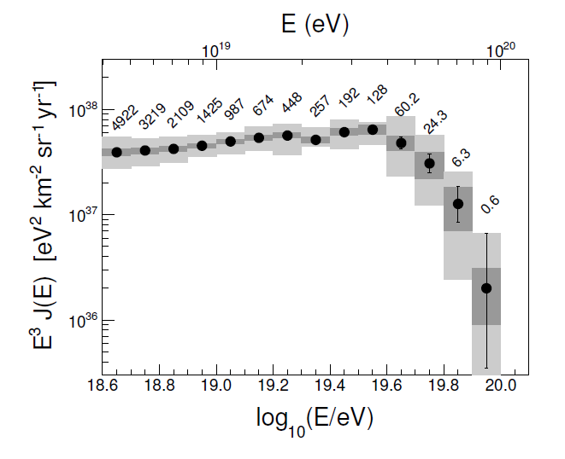
Spectrum measured by different method using inclined shower
60 < θ < 80 ° submitted for publication

Slide 4
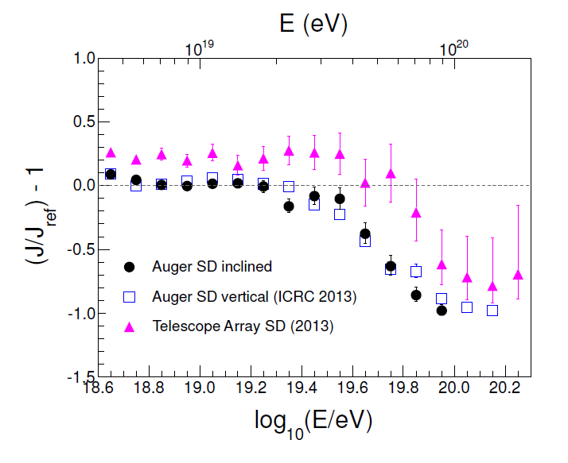

Slide 5
However the steepening itself is INSUFFICIENT for us to claim
that we have seen the Greisen-Zatsepin-Kuz’min
Effect
Steepening is significant at 6 sigma level – and up-date is even stronger
It might simply be that the sources cannot raise particles
to energies as high as 10²⁰eV – Nature could be teasing us!
It would be enormously helpful if the arrival directions were
anisotropic
Also knowing the mass composition would be useful

Slide 6
Does the steepening mark the limit that the accelerators can reach – or is it the GZK effect?
What are the accelerators?
Synchrotron Acceleration
E_{max} = ZeBRβc
Single Shot Acceleration
E_{max} = ZeBRβc
Diffusive Shock Acceleration
E_{max} = kZeBRβc, with k<1

Slide 7
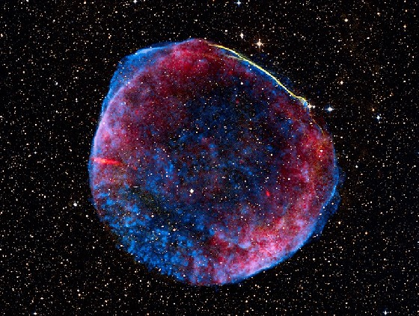
Diffusive Shock Acceleration
E_{max} = kZeBRβc, with k<1
(e.g. Shocks near AGNs, near Black Holes, Supernova……?)
SN1006
Hillas 1990

Slide 8
Ultra High Energy Cosmic Rays are difficult to accelerate
Diffusive Shock Acceleration may not work (Hillas diagram - next)
(ii) Greisen’s argument (1965)
(i) accelerator > Larmor radius
(ii) synchrotron losses < Energy Gain
W_{magnetic}> 300Γ⁵ ergs,
so for 10²⁰ eV, W_{magnetic} > 10⁵⁷ ergs
Notes:
Problems with UHECR

Slide 9
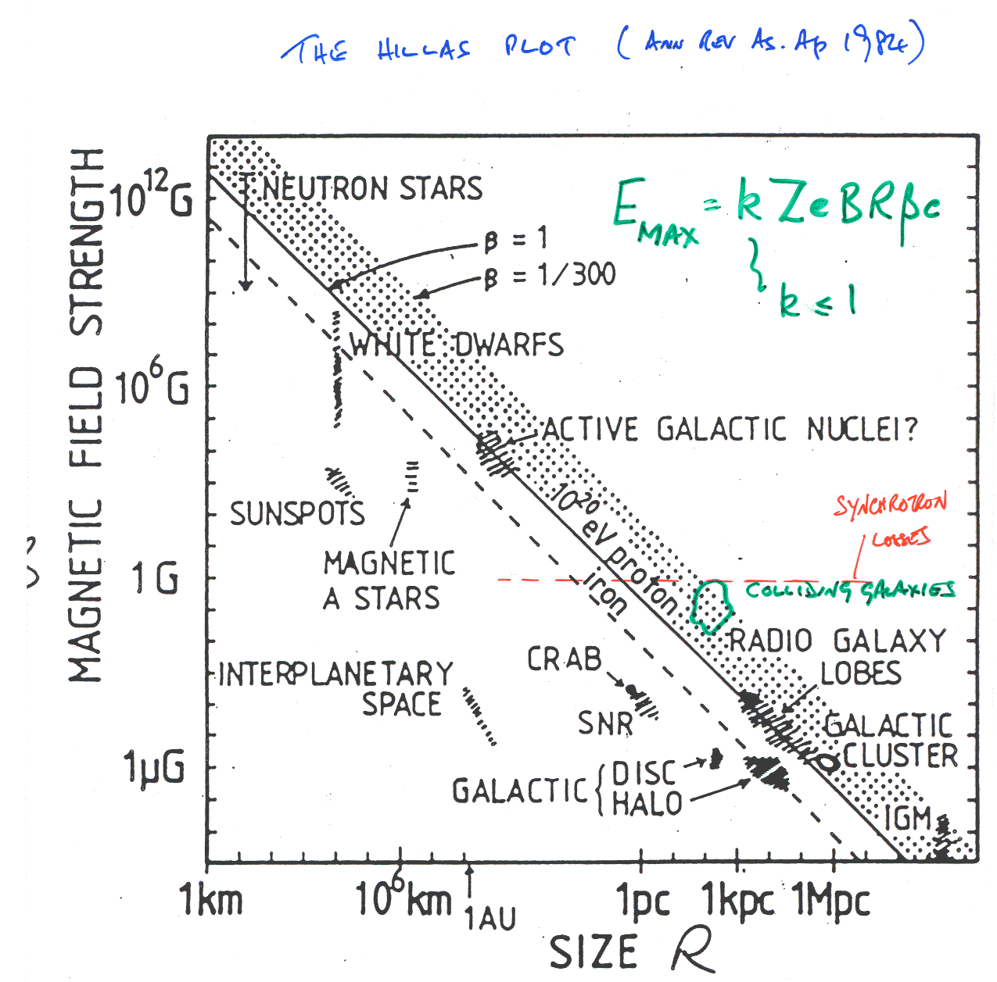
Magnetars
E_{max} = kZeBRβc
k < 1
Hillas 1984
ARA&A
B vs R
Synchrotron Losses
B
Colliding Galaxies
R

Slide 10
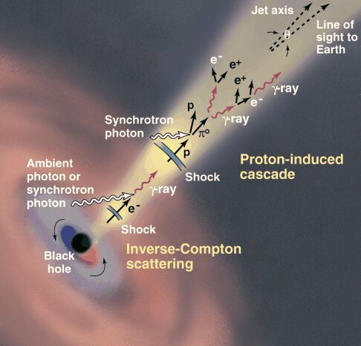
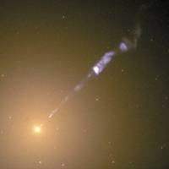
Decided to use catalogue of
galaxies like this and see if they lined
up with the directions of our event
image of M87 with
Hubble Space Telescope
Active Galactic Nuclei

Slide 11
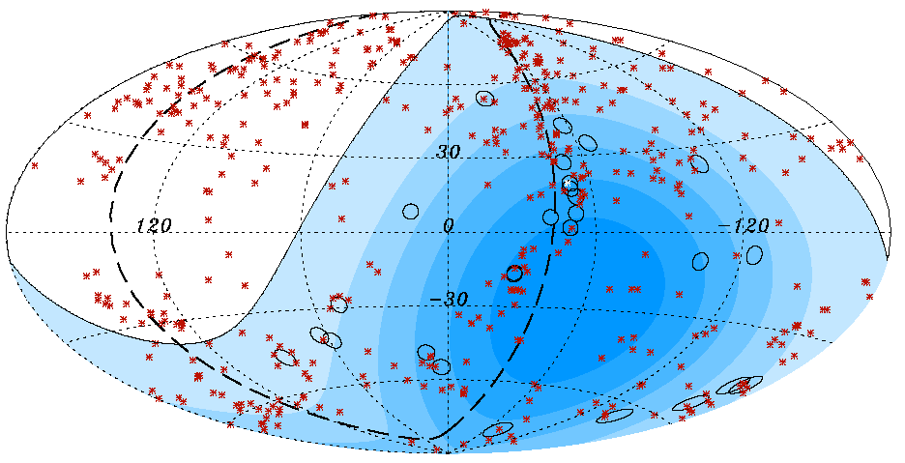
Science: 9 November 2007
First scan gave ψ < 3.1°, z < 0.018 (75 Mpc) and E > 56 EeV

Slide 12
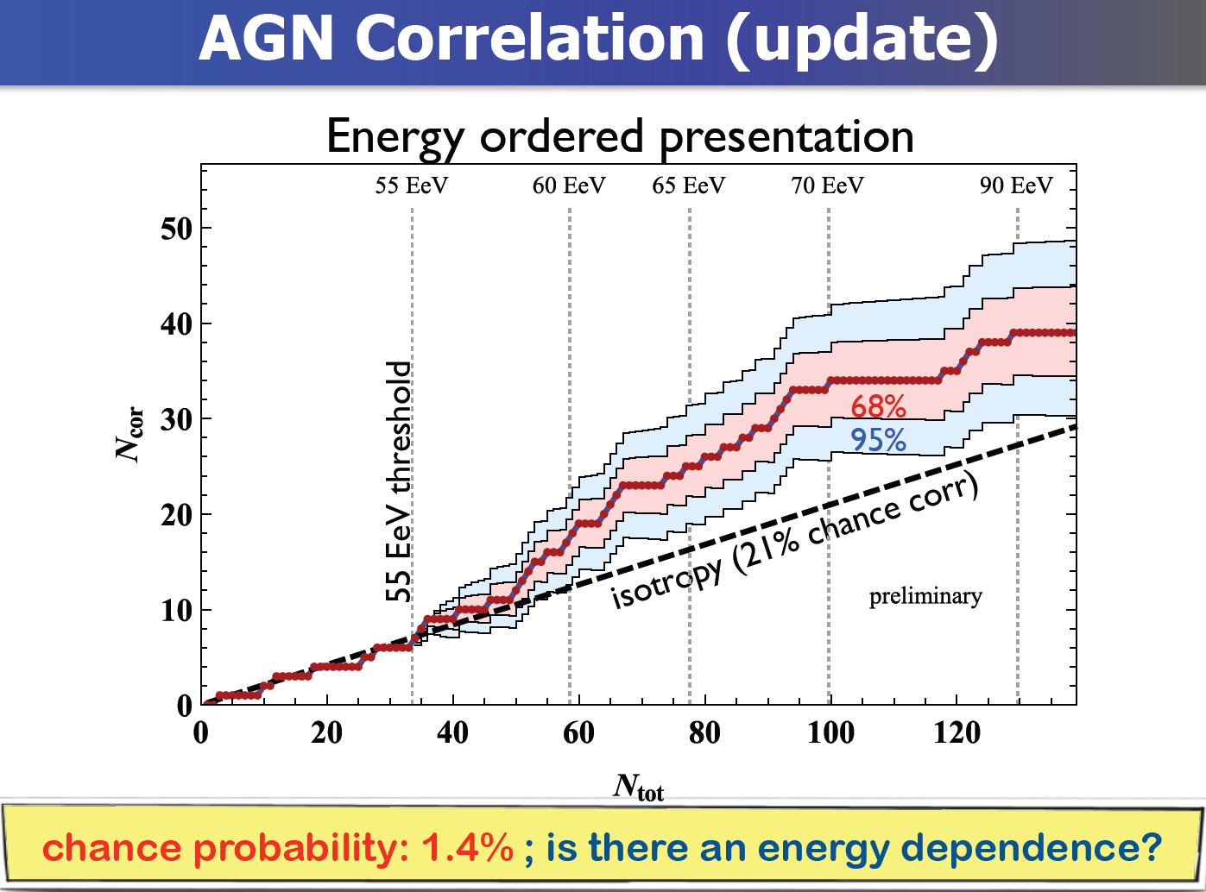

Slide 13
Correlation has fallen from ~ 68% to ~ 28% (2007 –> 2014)
compared with 21% for isotropy: about 1.4% probablity
Cen A may be a source: in 13º circle around: 12 seen/1.7
A clear message from the Pierre Auger Observatory:-
We made it too small (2 per month at energy of interest)

Slide 14
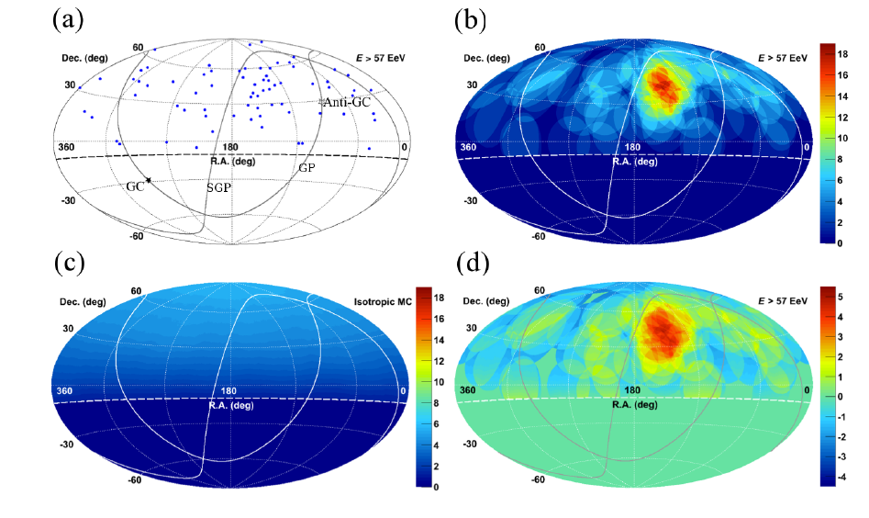
Hot Spot from Telescope Array: E > 57 EeV
The 72 events
20⁰ smoothing
Background
Significance

Slide 15
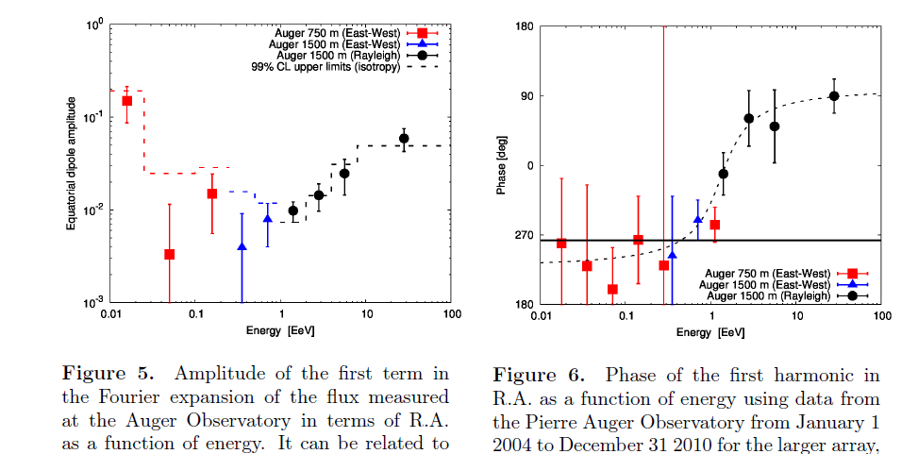
Broad anisotropy search in right ascension

Slide 16
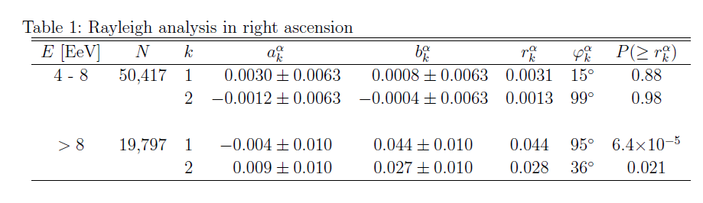
Latest News (Astrophysical Journal to be published)
Recently the Santiago group have completed analysis of inclined events above
4 EeV and the addition of 30% more data has
given a broader sky coverage and
improved the significance of the largest energy bin
Note that the phase is in good agreement with previous work

Slide 17
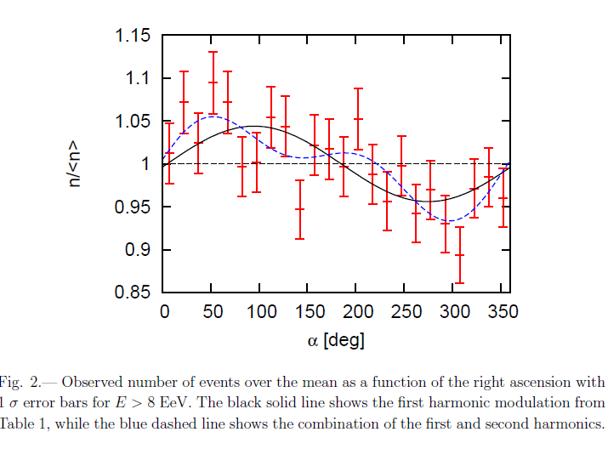

Slide 18
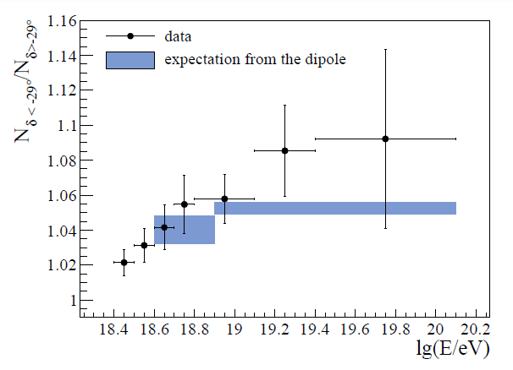
An anisotropy implies that the energy spectrum changes across the sky
Result, to be shown in summer conferences (Ioana Maris – Granada)

Slide 19
To interpret these arrival direction data a crucial question is
“What is the mass of the cosmic ray primaries
at the highest energies?”
Answer is dependent on unknown hadronic interaction
physics at energies up to ~ 30 times CM energy at LHC
In particular, cross-section, inelasticity and multiplicity
Here is an important link between particle physics and
astroparticle physics

Slide 20
How we try to infer the variation of mass with energy
X_{max}
photons
< 1% above 10 EeV
protons
Data
Fe
dX_{max}/log E = elongation rate
Energy per nucleon is crucial
Need to assume a model
log (Energy)

Slide 21
Some Longitudinal Profiles measured with Auger
1000 g cm⁻² = 1 Atmosphere ~ 1000 mb
rms uncertainty in X_{max} < 20 g cm⁻² from stereo-measurements

Slide 22
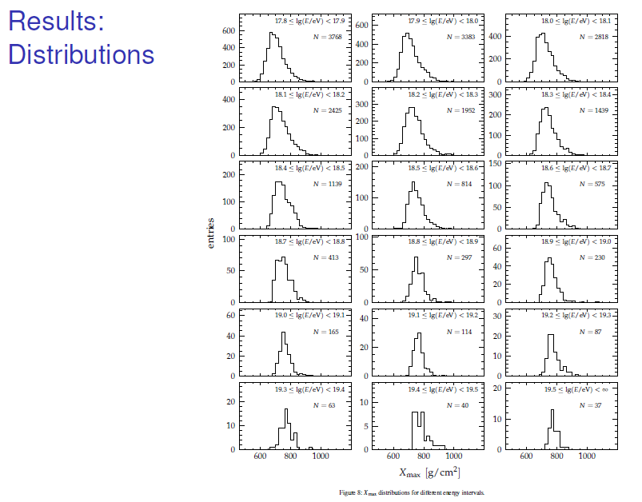
Distribution of X_{max}
as function of energy
PRD 90 1220005 2014
19759 events
above 6 x 10¹⁷ eV

Slide 23
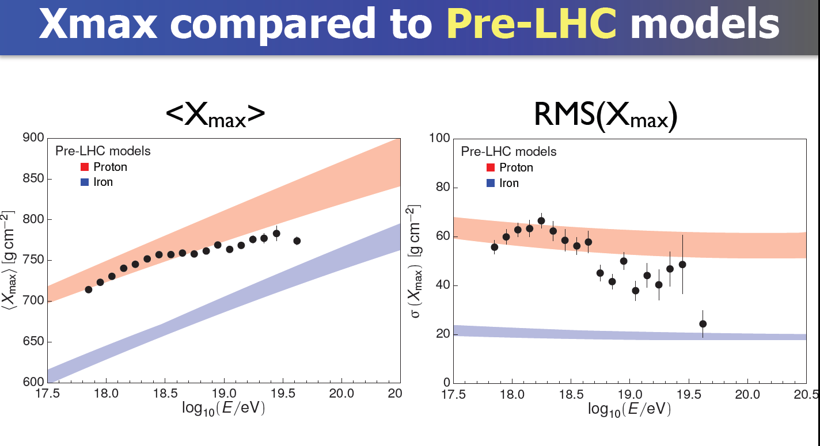
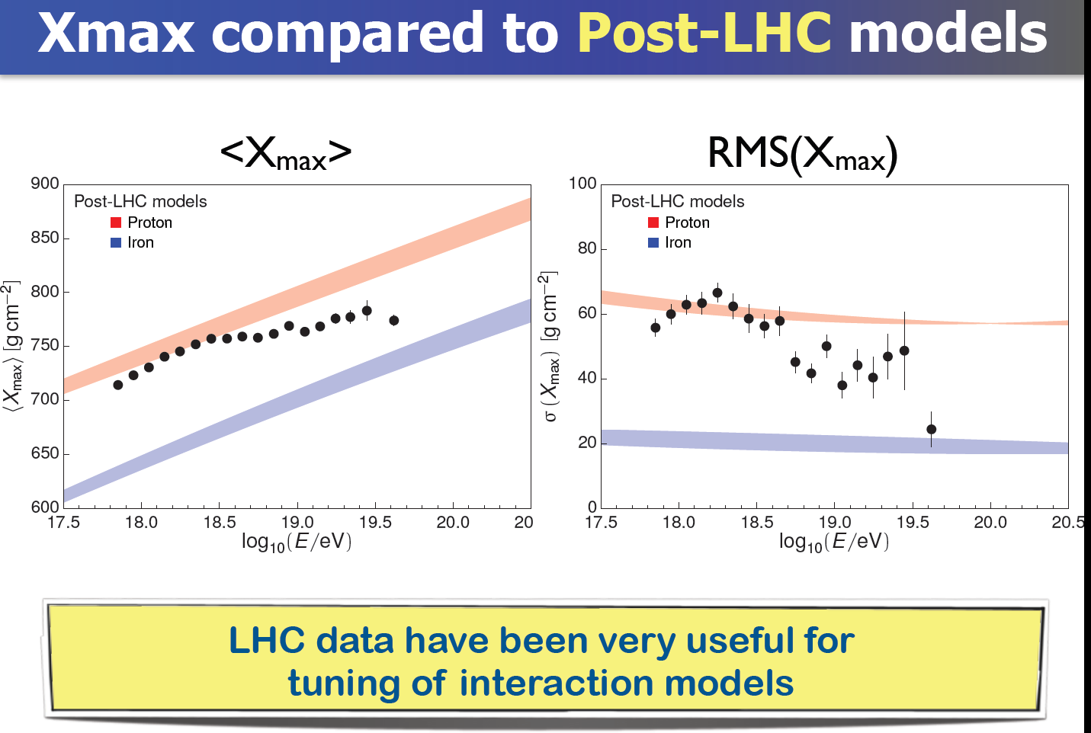

Slide 24
Question of Mass Composition
“We remain with the dilemma: protons versus heavy nuclei. A clear cut decision cannot be reached yet. I believe that up to the highest energies the protons are the most abundant in the primary cosmic rays. However, I must confess that a leak proof test of the protonic nature of the primaries at the highest energies does not exist. This is a very important problem. Experimentally it is quite a difficult problem.”
“Fere libenter homines id, quod volunt, credunt!”
G Cocconi: Fifth International Cosmic Ray
Conference, Guanajuato, Mexico, 1955

Slide 25
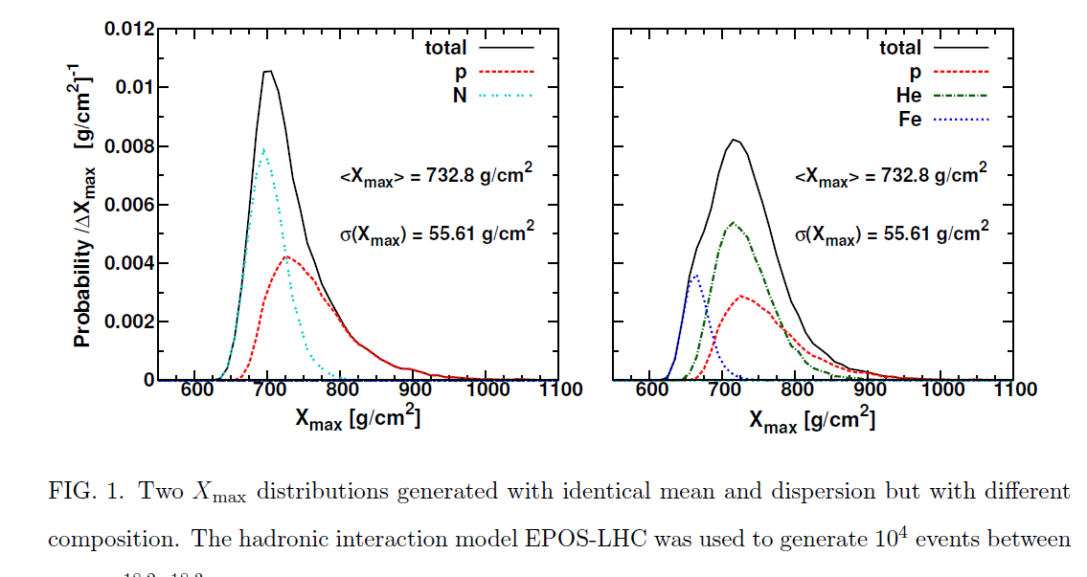
Detailed study of X_{max} distributions are required

Slide 26
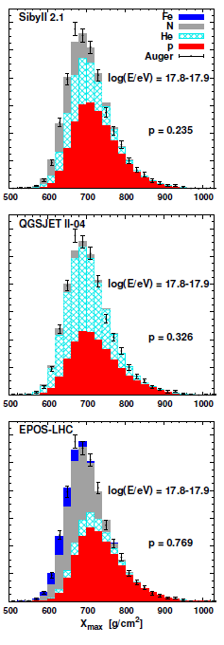
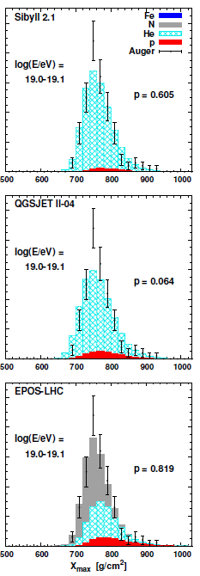
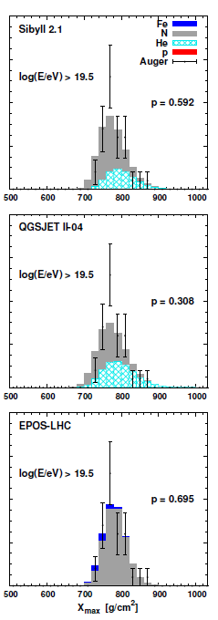
Auger Interpretation: Phys Rev D 90 1222006 2014 (arXiv 1409.5083)
165
3768
37

Slide 27
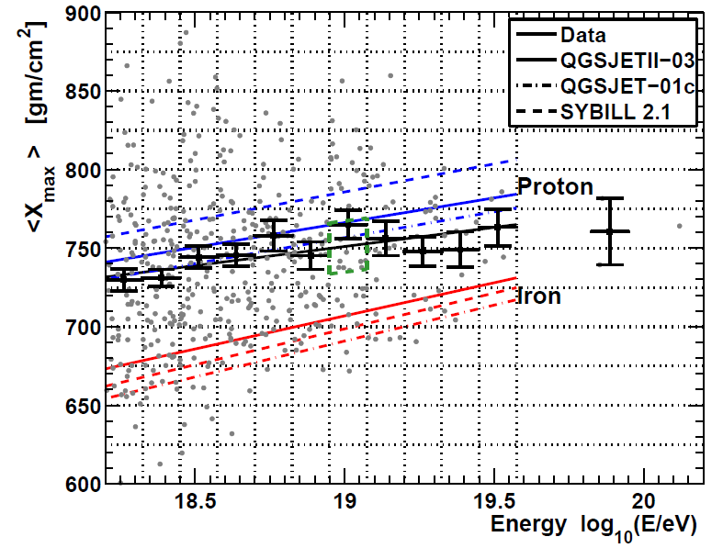
Recent Result from TA: arXiv 1408.1726
822 events

Slide 28
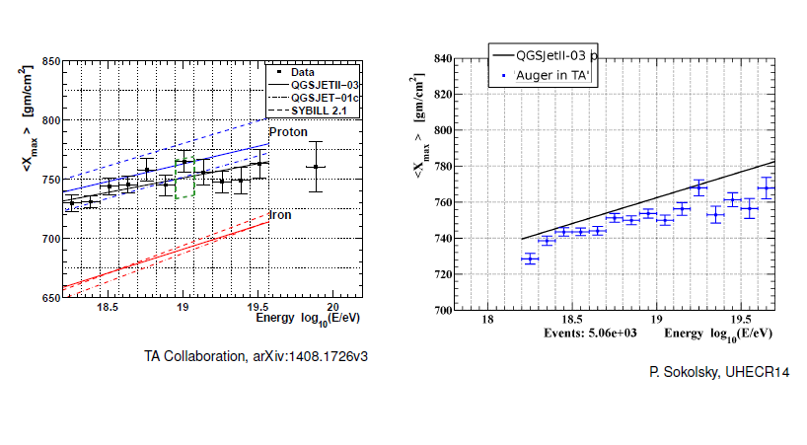
TA analysis using Auger Mass Composition

Slide 29
The conclusions on the mass are dependent on assumptions about the particle
physics at energies well-beyond anything that will be reached by man-made
accelerators
However small fraction of protons may be present and is needed to explain
the anisotropy seen
Searching for protons at highest energy is an important feature of future plans
for the Observatory

Slide 30
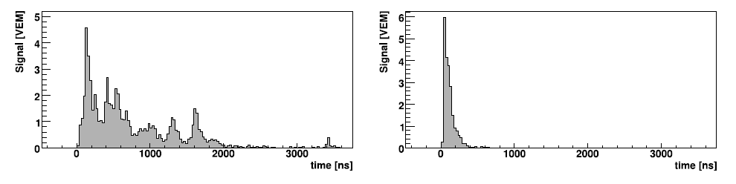
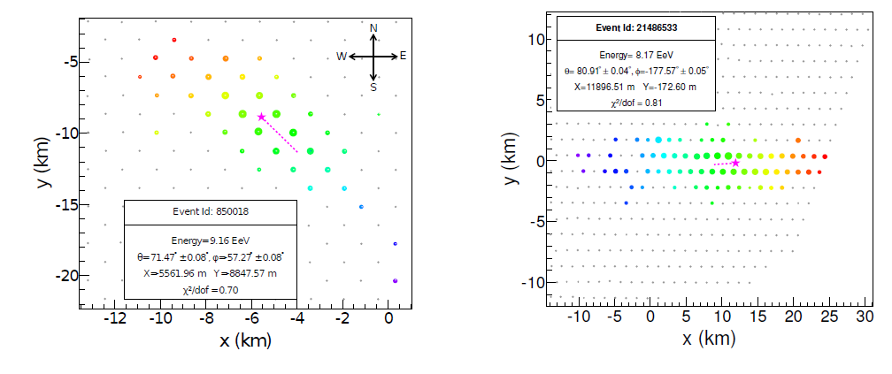
Using inclined showers
1 km, 22°
1 km, 80°: ~ 5000 g cm⁻²
37 stations
69 stations

Slide 31
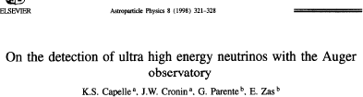
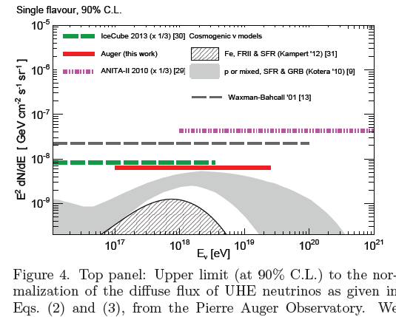
1998

Slide 32
Hadronic Interactions
Some demonstrations of problems

Slide 33
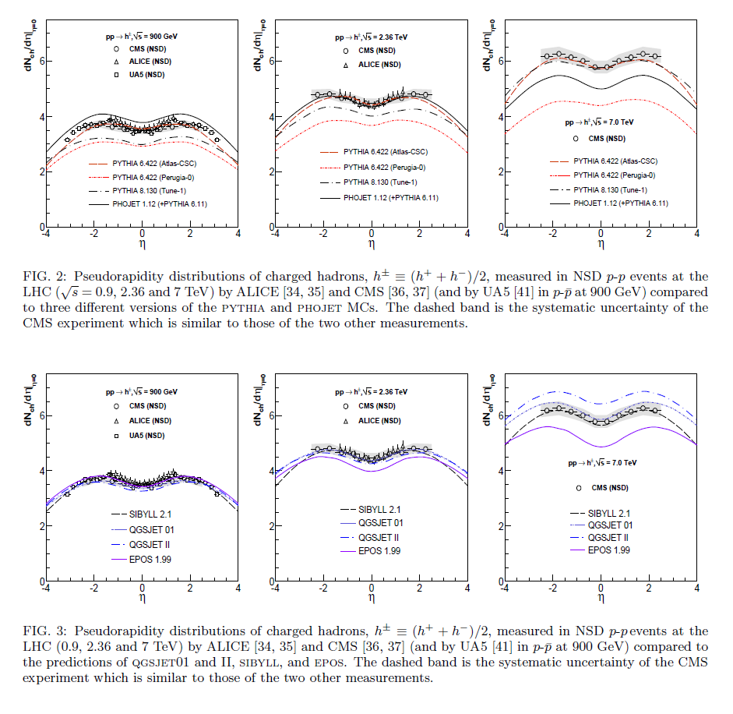
d’Enterria, Engel, Pierog, Ostapchenko and Werner (2011)

Slide 34
Inclined showers are proving very useful to test models
We find that there are problems with models at high energies and large angles
where muon numberin showers can be measured can be fairly readily explained
Summary of following papers:-
Inclined Reconstruction: JCAP 08 019 2014
Inclined Muon Number: arXiv 1408.1421
MPD paper: Phys Rev D 90 (2014) 012012

Slide 35
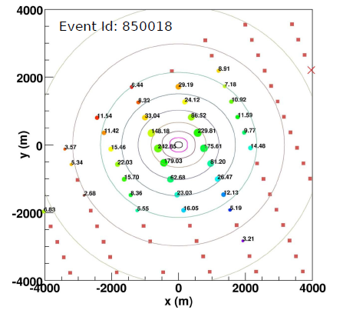
37 stations
71°
54 EeV
Fit made to density
distribution
Energy measured
with ~20 % accuracy

Slide 36
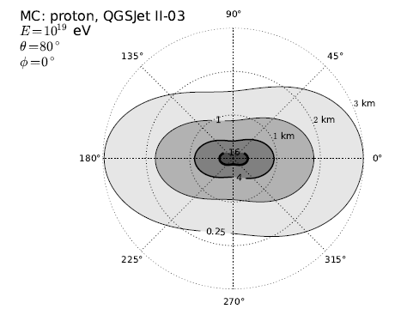

Slide 37
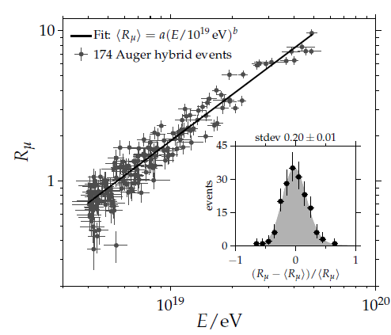

Slide 38
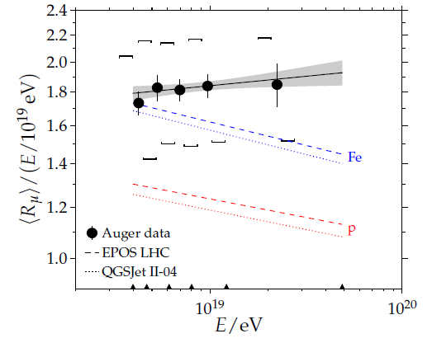
Muon numbers predicted by models are under-estimated
by 30 to 80% (20% systematic)

Slide 39
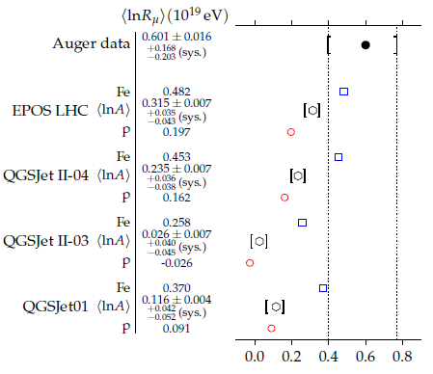

Slide 40
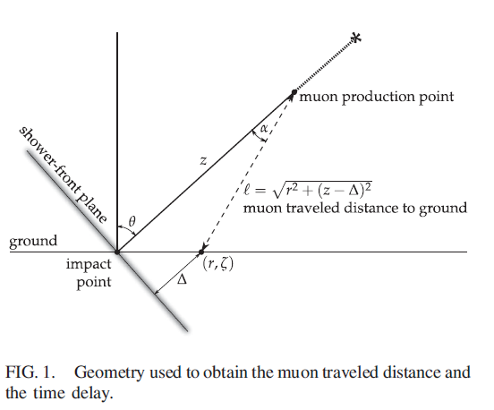
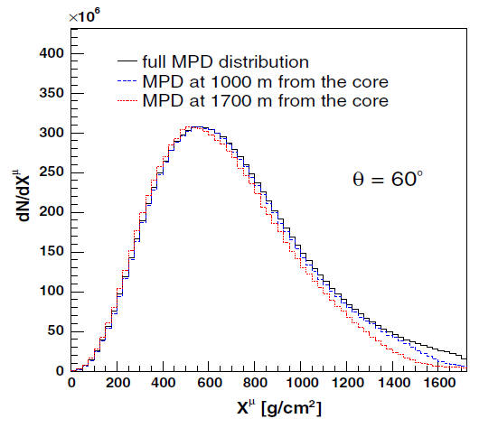
Second method of testing models:
Muon Production Depth (MPD)
log (E/eV) = 19.5

Slide 41
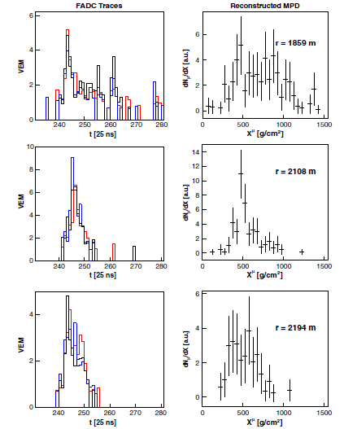
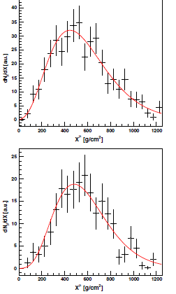
91 EeV
33 EeV

Slide 42
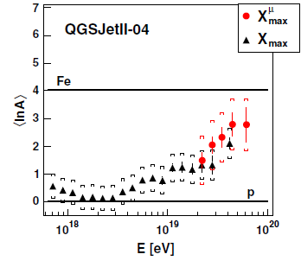
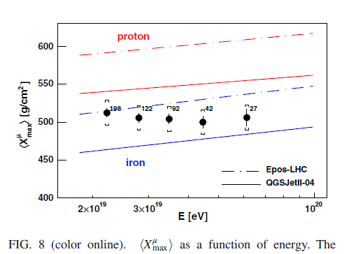
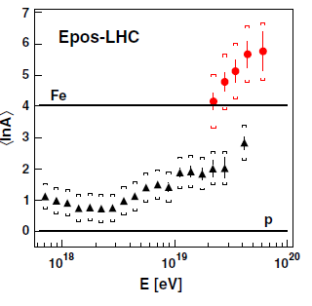

Slide 43
How can we interpret the data at all energies?
There are many interpretations – an indication of how weakly constraining the data are – particularly at the highest energies
Models range across
ALL particles from Cen A above a few from galaxy at low energies (Biermann and de Souza)
All produced in GRB within our galaxy 10⁵ years ago (Calvez et al)
Succession of different sources in different energy ranges

Slide 44
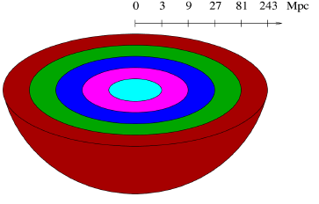
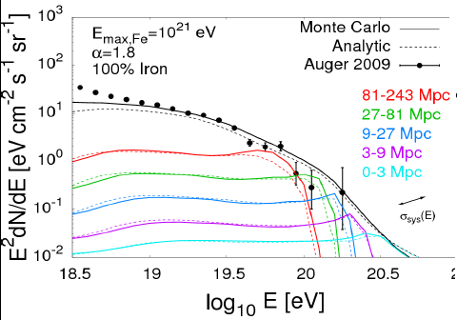
Taylor, arXiv:1107.2055

Slide 45
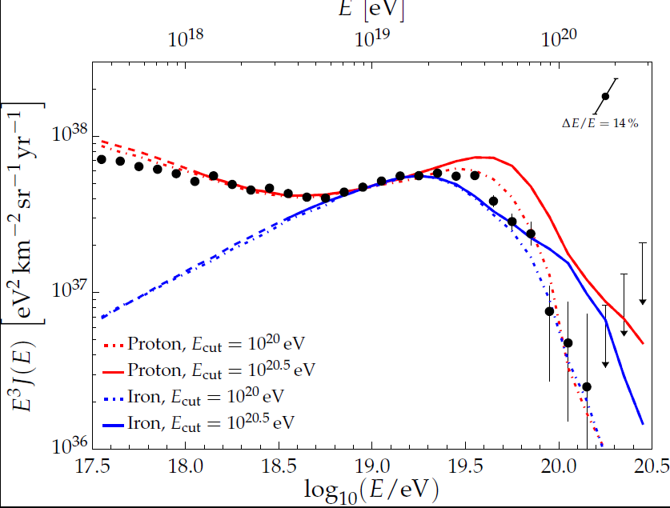

Slide 46
Model of successive Peter’s Cycles
Gaisser ApJ 35 801 2012
Gaisser, Stanev and Tilav Front. Phys 8 (6) 748 2013
Rigidity, R = Pc/Ze, where P is the momentum

Slide 47
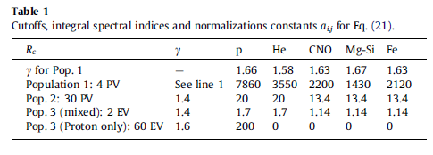


Slide 48
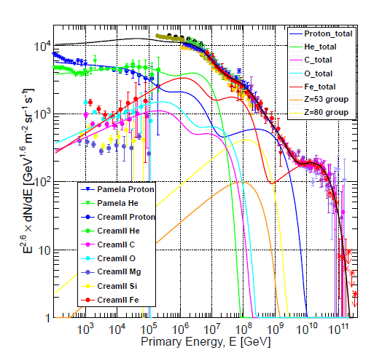

Slide 49
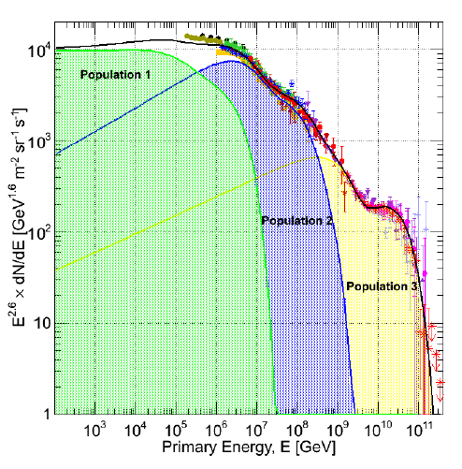

Slide 50
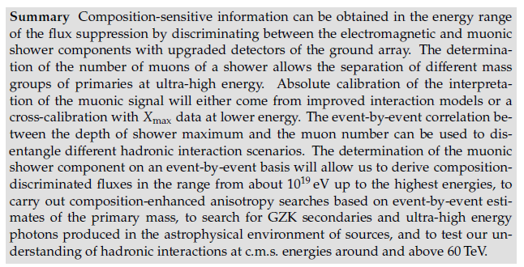
The Future for the Auger Observatory

Slide 51
Puzzles:
Large number of protons near ankle but low anisotropy
suggests that they must be extragalactic (phase plot)
Protons diminish around 10 EeV and helium becomes more
dominant
Protons needed to explain anisotropy (AGN and Cen A correlations)
at highest energies
SO:
NEED TO KNOW MORE ABOUT THE MASS
Must measure muons
Proposal is to augment water-Cherenkov detectors by scintillators
and to get muon component by subtraction

Slide 52
But we clearly need more exposure at the highest energies
Hope had been that JEM-EUSO would succeed
establish sources and neutrinos
Then case for huge array(s) on ground might be made
Presently the EUSO program is delayed
EUSO – Extreme Universe Space Observatory that was proposed
to ESA as a free-flyer
Fluorescence Detector in Space

Slide 53
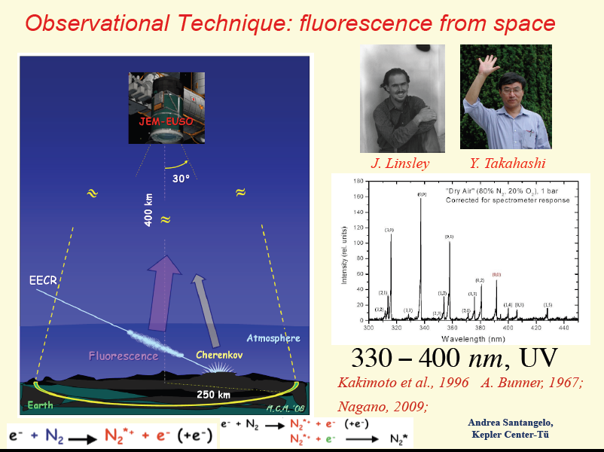

Slide 54
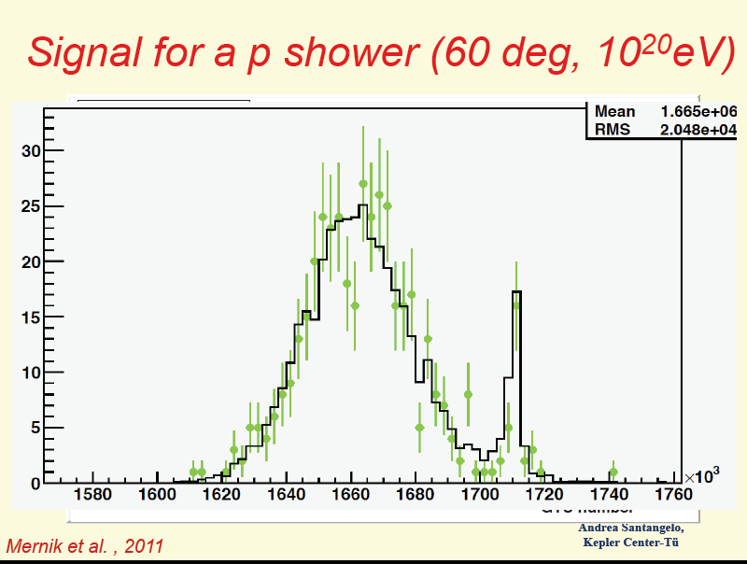

Slide 55
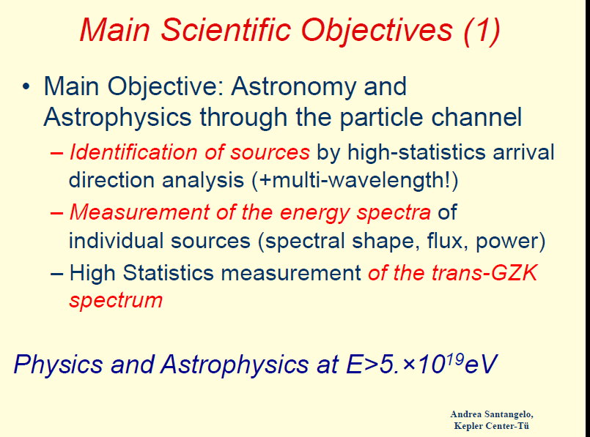

Slide 56
JAXA finally (late 2013) – despite strong pressure from NASA
and ESA - decided against JEM-EUSO
However the collaboration is still alive:-
Project had a successful balloon flight last year and is now
proceeding on two fronts
Many of the Collaboration have joined forces with the Russians
2. US Groups proceeding towards long-duration balloon flight
and then to free-flyer

Slide 57
The test flight in 2014 went well
From Timmins in Canada
Plane below balloon with Xenon laser to produce artificial showers
Spanish IR camera (for clouds etc) worked well
No reconstructions yet reported

Slide 58
.
US groups (PI Angela Olinto) working towards LDF from
New Zealand with NASA Super-Pressure balloon
2 – 4 week flight
Long enough to observe showers from above
March 2016 – 2017
Then aim would be for a free-flyer

Slide 59

Japanese and Europeans have joined forces with Russians
European Leader: Piergiorgio Picozza

Slide 60


Slide 61
Summary
We have hugely better data than 10 years ago at all energies –
leading to improved ideas about sources
At low energies AMS will continue and ISS-CREAM will extend
spectrum of directly-measured particles to close to 1 PeV
In the knee region the KASCADE and KASCADE-Grande data
may be reanalysed with more modern models.
Other projects such as LHASSO in China will increase data
Plans for UHECR in the very long term depend on success of
Auger phase II and fluorescence detection, possibly from K-EUSO

