Slide 1
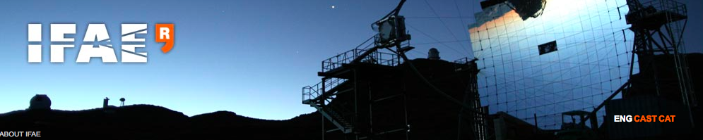

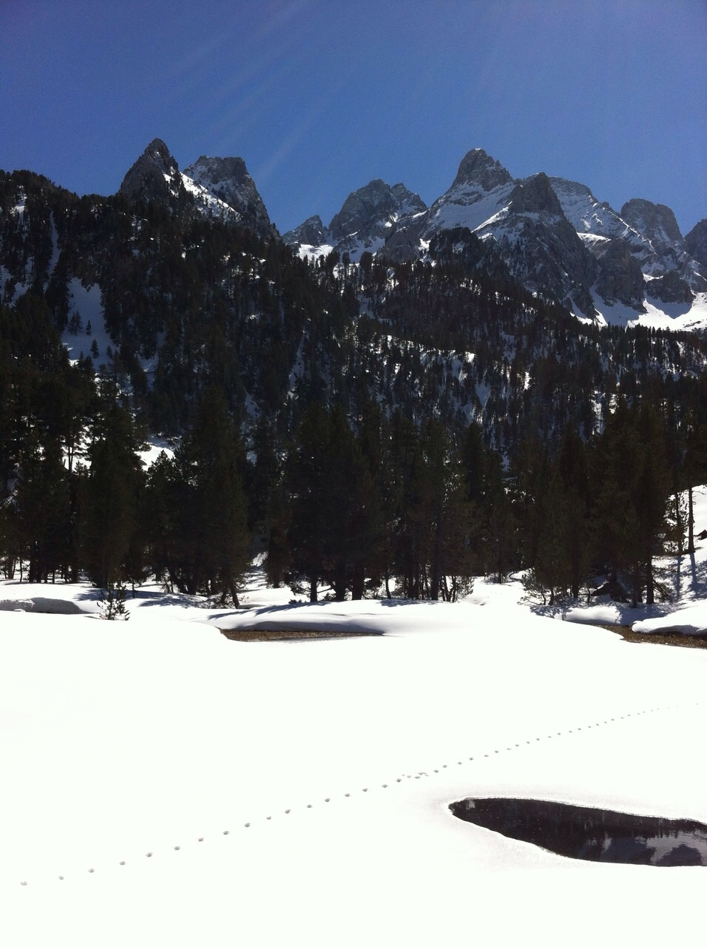
Present and future of VHE gamma astronomy
Manel Martinez
43rd Winter Meeting
March 2015-Benasque

Slide 2
Outline
1) Introduction
2) Basics on VHE Gamma Astronomy physics
3) VHE gamma observatories
4) CTA
5) Conclusions

Slide 3
1) INTRODUCTION

Slide 4
2015 International year of Light -> VHE gamma rays = highest-energy light
2015 may be the year in which Spain “conquers” CTA North…
I’m probably the culprit of the excitation about VHE gamma astronomy in Spain:
Let me provide the arguments for my defence…

Slide 5
2) BASICS ON VHE GAMMA RAY PHYSICS

Slide 6
VHE Cosmic Gamma rays:
highest energy electromagnetic radiation from our Universe
Originally: Particle Physics domain (Eγ > few GeV):
* INSTRUMENTS: Particle detectors
* TECHNIQUES: Experimental particle physics analysis
* PHYSICS: Address questions on the frontiers of our fundamental physics knowledge.

Slide 7
VHE Cosmic Gamma rays:
highest energy electromagnetic radiation from our Universe
Presently: (Still) highest energy messengers detectable from our universe which:
- Are stable particles
- Interact enough to be “easily” detected
- Are not deflected by cosmic magnetic fields
=> allow to pinpoint and identify the source

Slide 8
VHE Cosmic Gamma rays:
highest energy electromagnetic radiation from our Universe
=> Highest energy open window for the observation of our universe
VHE GAMMA-RAY ASTRONOMY

Slide 9
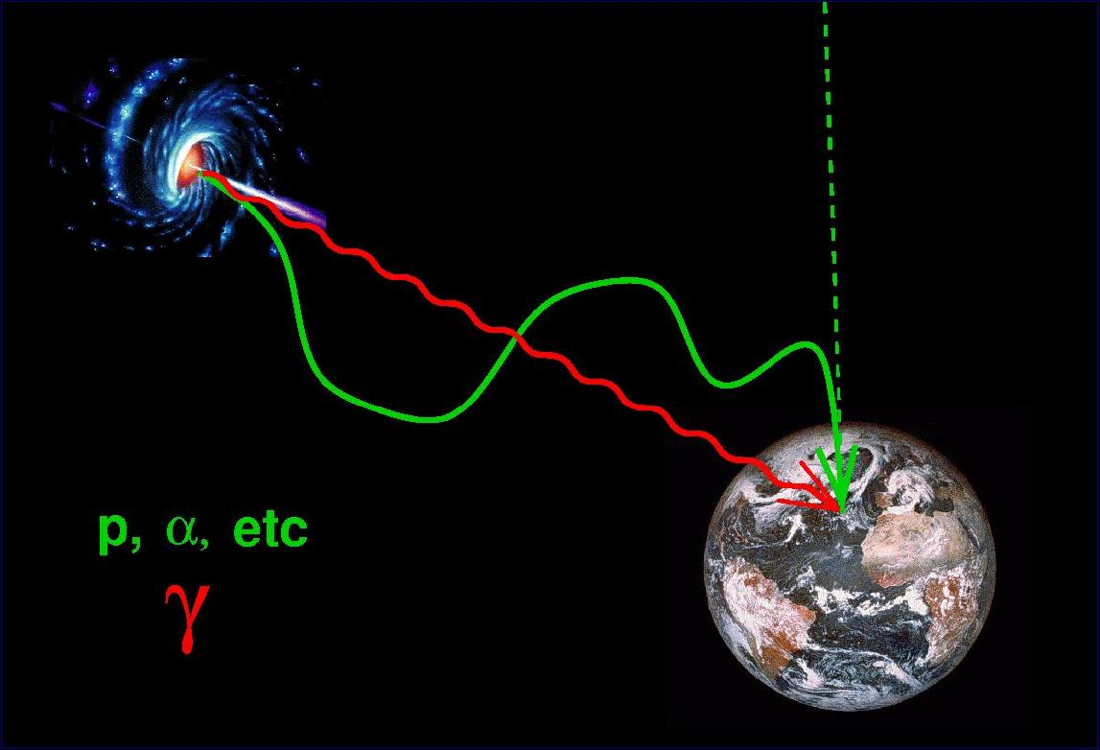
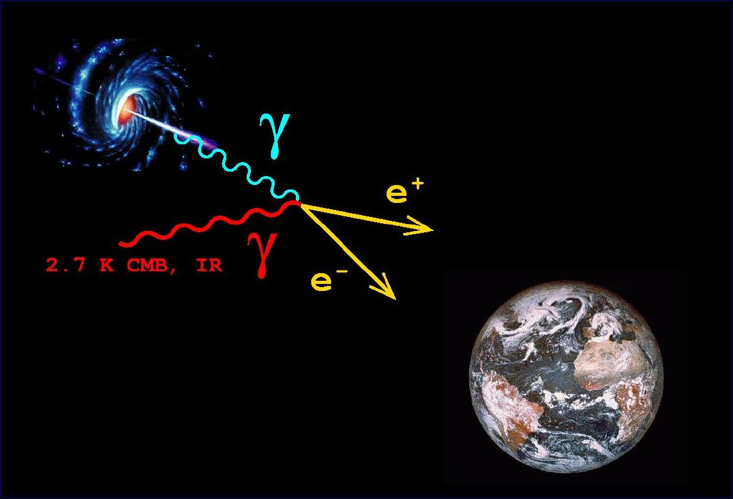
Origen
Source Studies
Propagation Studies

Slide 10
1) Study the source:
production mechanisms
VHE gamma rays are produced in the most energetic and violent phenomena in the universe:
A ) COSMIC ACCELERATORS
- Hadron accelerators: p X -> π -> gamma
hadronic acceleration
p⁺ (>>TeV)
π⁰
γγ (TeV)
matter
π⁻
π⁺

Slide 11
- electron accelerators:
synchrotron: e B -> e gamma
+ inverse Compton: e gamma -> gamma e
leptonic acceleration
e⁻ (TeV)
Synchrotron
γ (eV-keV)
log(energy density)
B
Sy
IC
γ (TeV)
Inverse Compton
γ (eV)
eV keV MeV GeV TeV
log(E)
Notes:
Worth mentioning is that leptonic models are favored.
The reason is twofold: good X-ray/TeV correlation found in Mkns (pointing that the same population of particles is responsible for Sync and IC)
And short doubling times (down to minutes), which are very difficult to achieve with hadron scenarios due to longer cooling times of hadrons.
To give you an idea of a simplest leptonic model, I sketch here an Self-Synchr-Compton model, i.e. seed photons for the IC scattering are the Sy photons.
The free parameters are limited to the choice of the electron spectrum, ....
It is expected to find a good correlation between the two bumps. For the HBLs, i.e. Syncr emission is in X-rays, correlation between X-ray and TeV is expected
and seen in Mkns. Now in order to understand what is responsible for the variability, the correlation and the variability scales have to be studied

Slide 12
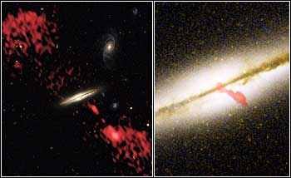
1 - Through conversion of the strongest gravitational potential energies into particle accelerations near compact accreting objects (Black Holes, Neutron Stars,..)
=> Unique LAB to study extreme accreting
GRAVITATIONAL INTERATION
QUASAR:
Galaxy 0313-192

Slide 13
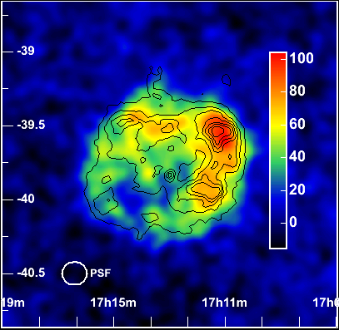
2 - In shocks due to big explosions in compact object formation (supernovae, hipernovae, collapses,…)
=> Acceleration in expanding shock waves
Supernova Remnant:
RX J1713-3946

Slide 14
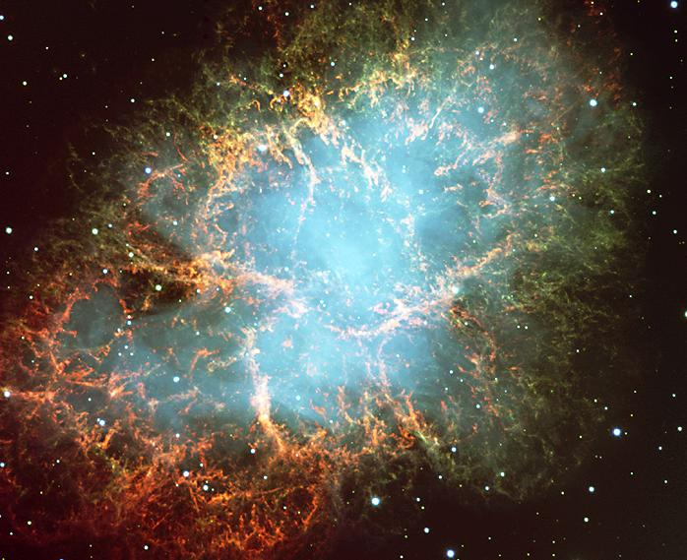

3 - In interactions of strong plasma winds with magnetic fields or other winds (plerions, wind shocks,…)
=> Acceleration in wind collisions
Pulsar Wind Nebula:
Crab

Slide 15
B ) HEAVY PARTICLE ANNIHILATION OR DECAY
Through the annihilation or decay of very massive or energetic objects:
dark matter, very massive particles at unification scales, relics of universe phase transitions, primordial black holes,…
=> Tool to search for new, massive, particles and objects.

Slide 16
2) Study the propagation in the cosmic medium
VHE gamma rays are, so far, the most energetic messengers reaching us through a determinable path: explore the structure of intergalactic medium:
- at long distances: produced in sources at cosmological distances from us: explore relic fields
- at the shortest distances: probe space-time at the highest energies
=> they allow us to address important questions in fundamental physics and cosmology

Slide 17
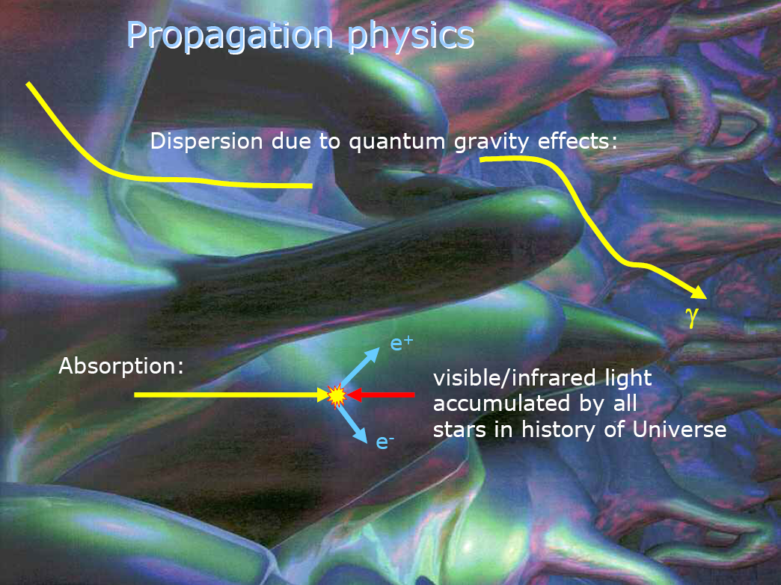
conversion into axions in
Intergalactic magnetic fields
B

Slide 18
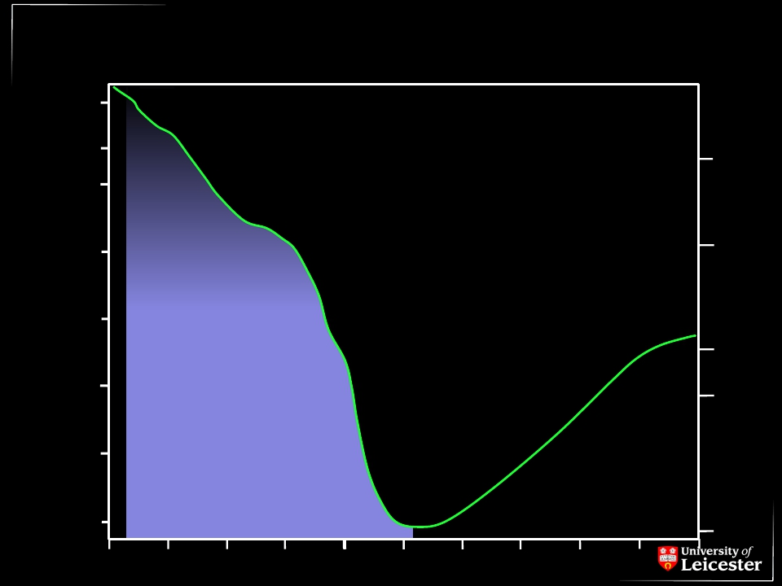
The
γ Horizon : a nuissance ?
z=5
z=1
UV
NIR
γ + γ → e++ e-
3C 279
1 Gpc
100 Mpc
Can be used to measure:
- EBL
- EG magnetic fields
- search for axions
-…
FIR
Mrk 421
Mean Free Path
Radio
10 Mpc
Ground
-based
detectors
Cen A
M 31
GC
1 Mpc
100 kpc
10 kpc
CMB
10 GeV
100 GeV
1 TeV
10 TeV
100 TeV
1 PeV
10 PeV
100 PeV
1 EeV
10 EeV
100 EeV

Slide 20
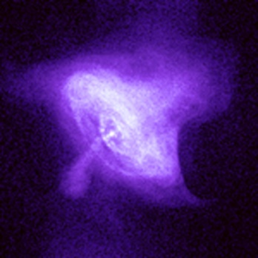
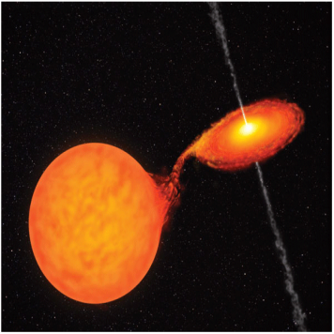
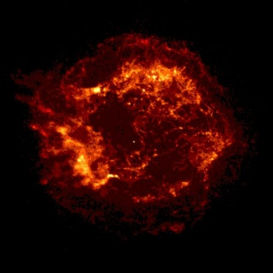
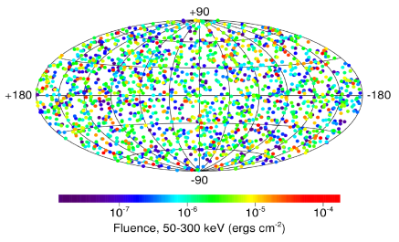
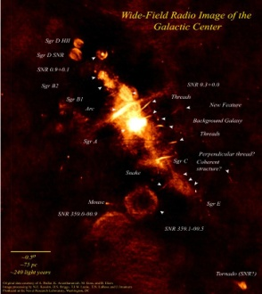
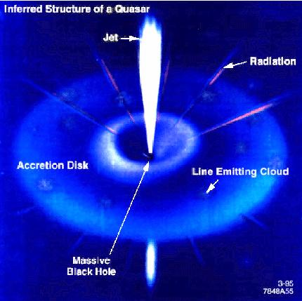
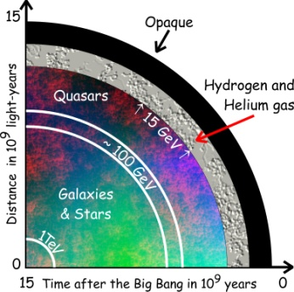
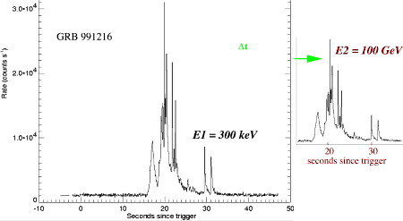
The VHE γ-ray Physics Program
SNRs
Origin of Cosmic Rays
Pulsars
Galactic
Binary systems
GRBs
Extragalactic
Cold Dark Matter
AGNs
Cosmological
γ-Ray Horizon
Test of the speed of light invariance

Slide 21
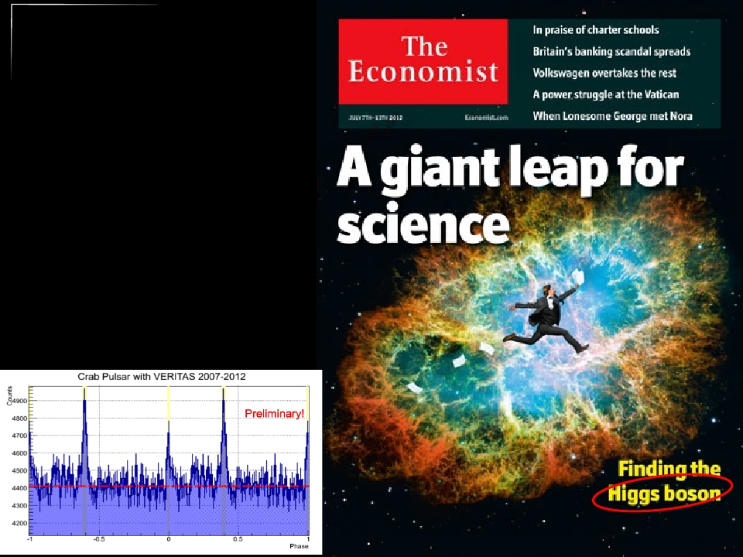
The Crab
● Crab Pulsar+Nebula
} GeV Flaring
} VHE extension of
pulsed emission
● Prospects?
} Detection of flares at
>TeV energies?
} >200 GeV pulsed
emission common in
pulsars??
VERITAS
Always open to the unexpected…

Slide 22
3) VHE GAMMA OBSERVATORIES

Slide 23
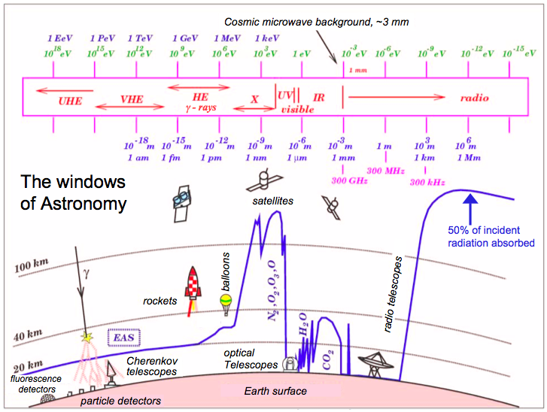

Slide 24
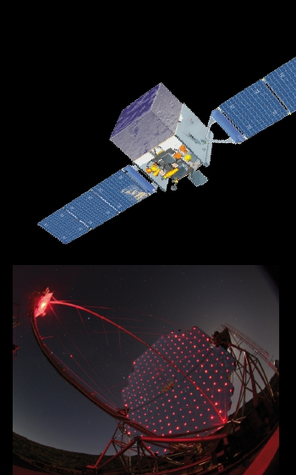
Why (mainly) ground-based?
● High energies
} Only way to build sensitive >TeV instruments
● High statistics /short timescales
} Large collection areas O(km2)
● Precision (IACTs)
} Superior angular resolution
● Limitations?
} IACTs
› Smallish duty cycle
› Smallish field of view
} Ground particle detectors
› Modest resolution and background rejection power
} Complementary approaches

Slide 25
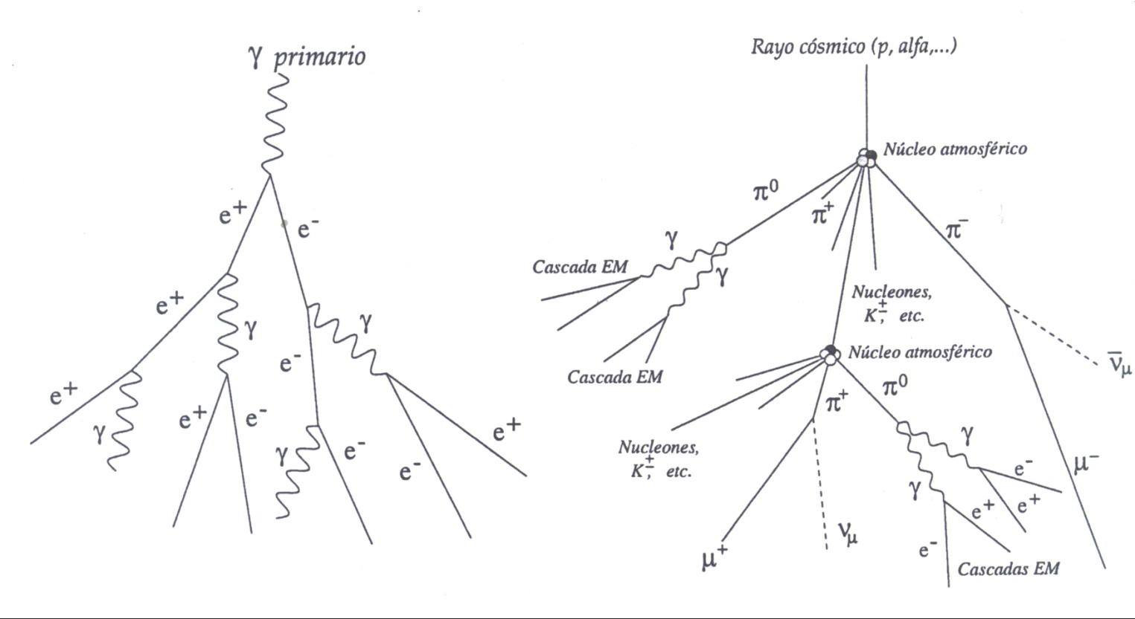
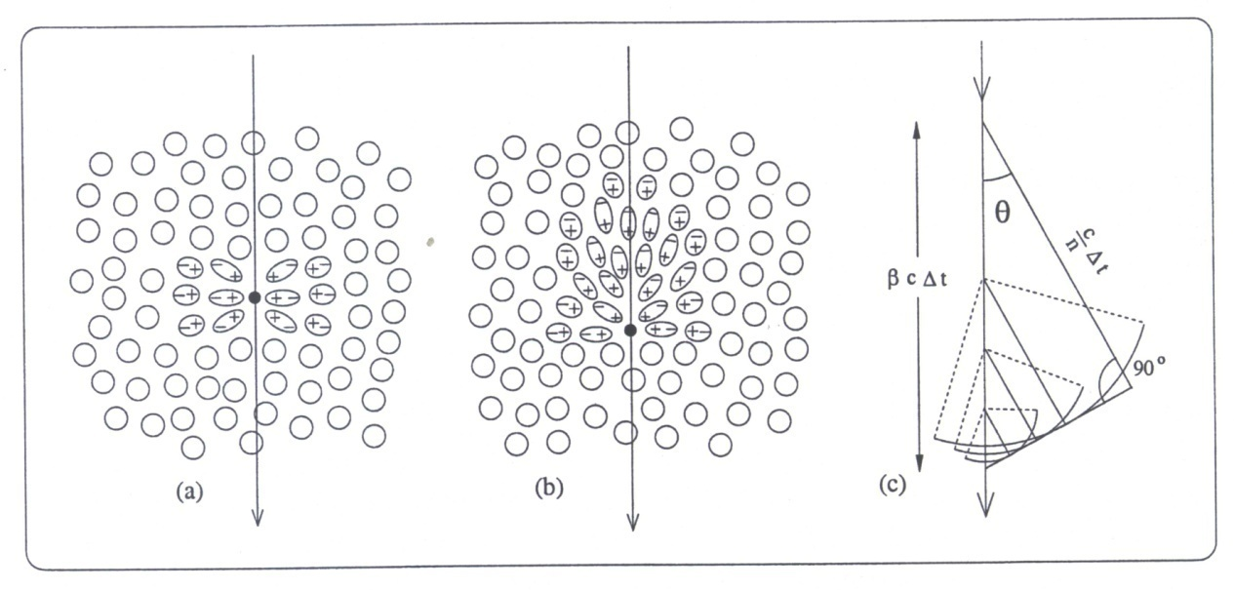
Electromagnetic Shower
Hadronic Shower
Cherenkov Effect

Slide 26
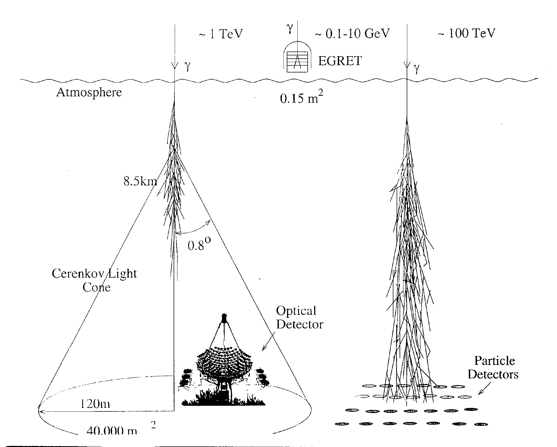

Slide 27
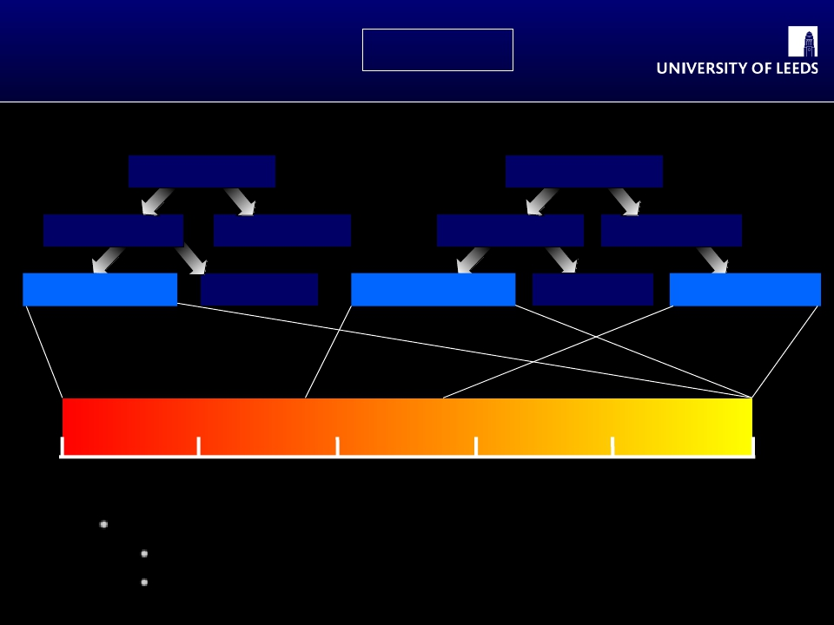
Techniques
HDGS2008
Air Cherenkov
Shower Particles
Imaging
TelescopeArrays
Sampling
Mono
Full Coverage
Water Cherenkov
Sparse
ScintillatorArrays
Carpet
5 GeV
50 GeV
0.5 TeV
5 TeV
50 TeV
0.5 PeV
Many different approaches have been tried
Not all have stood the test of time
Major projects planned using three of them

Slide 28
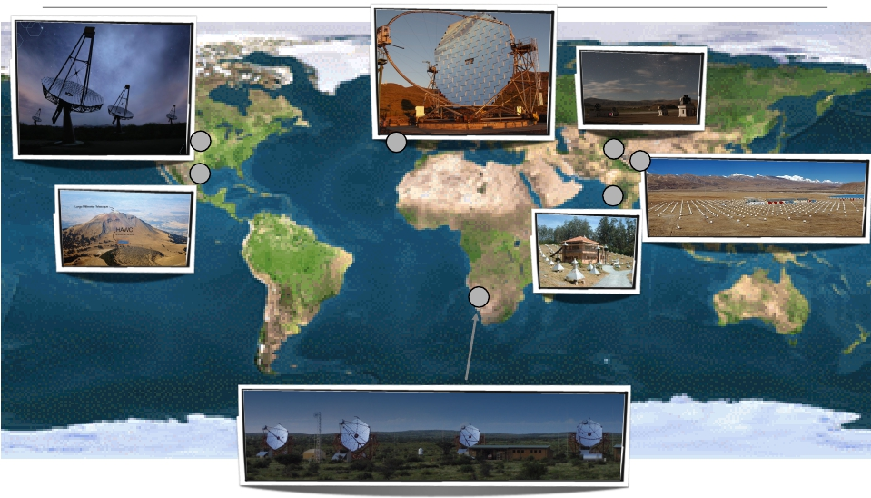
VHE Instruments currently in operation
MAGIC-II
VERITAS
HAGAR
TIBET-AS /
ARGO-YBJ
GRAPES
HAWC
H.E.S.S. (2)
Stefan Funk, August 18th 2011, 32nd ICRC Beijing

Slide 29
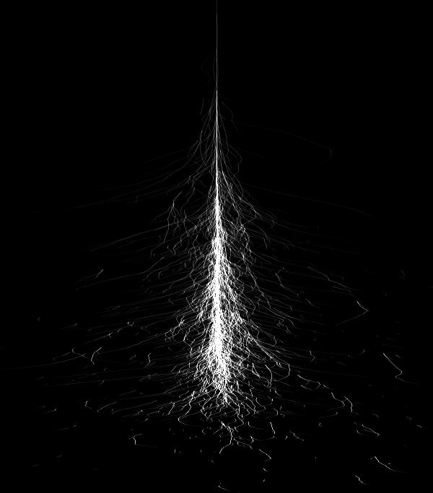
Detection of TeV gamma rays using Cherenkov telescopes
Observation Technique
Gamma-
ray
Particle
shower
~ 10 km
~ 1º
Cherenkov light
~ 120 m

Slide 30
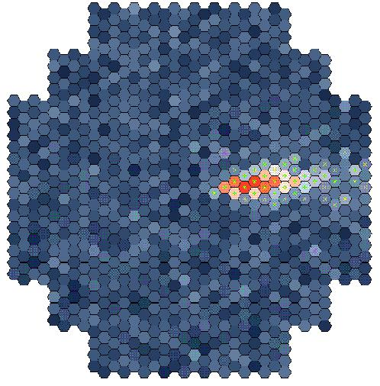
Image intensity
↓ Shower energy
Image orientation
↓ Shower direction
Image shape
↓ Primary particle

Slide 31
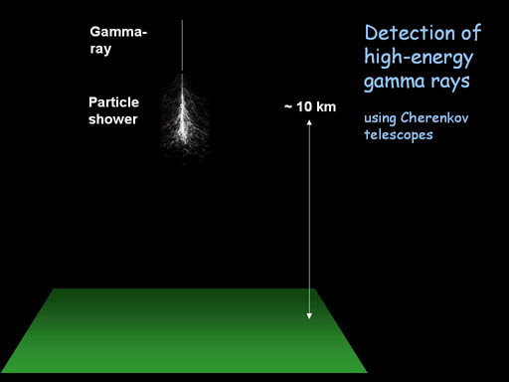
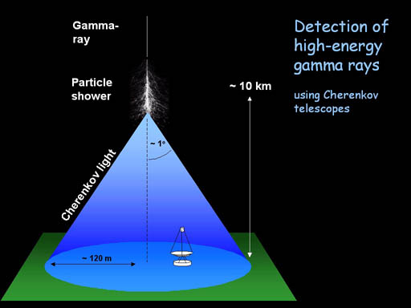
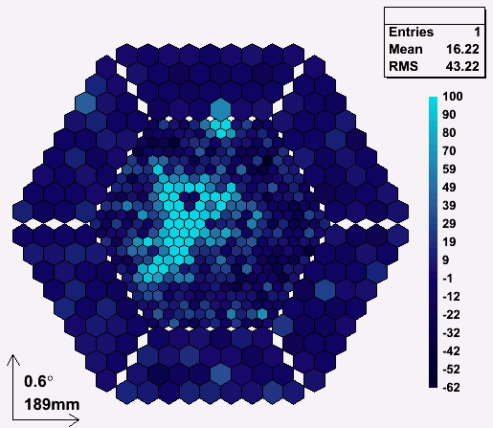
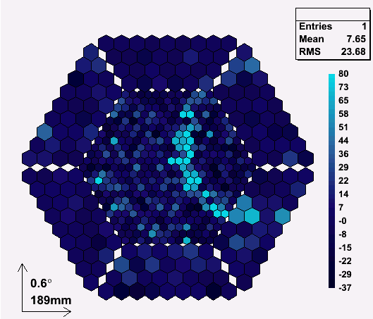
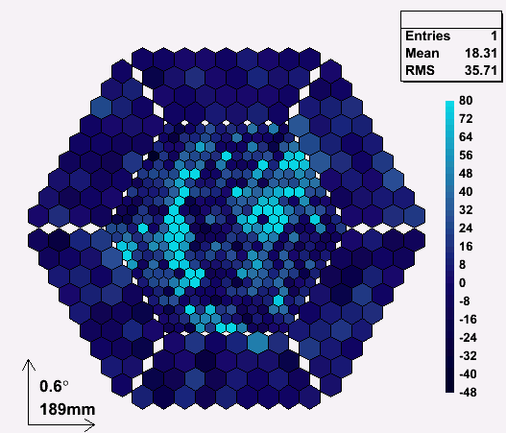
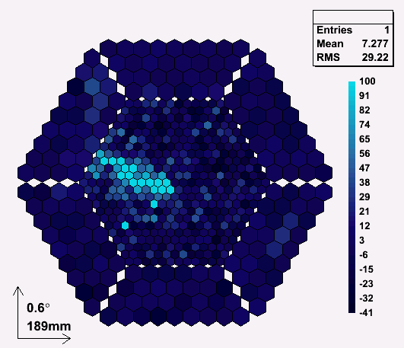
IACT Detection principle
g candidate
h candidate
m candidate
h with m

Slide 32
Systems of Cherenkov telescopes
Better bkgd reduction
Better angular resolution
Better energy resolution
Slide fro Pr W. Hofmann

Slide 33
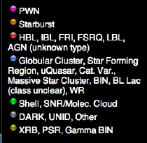
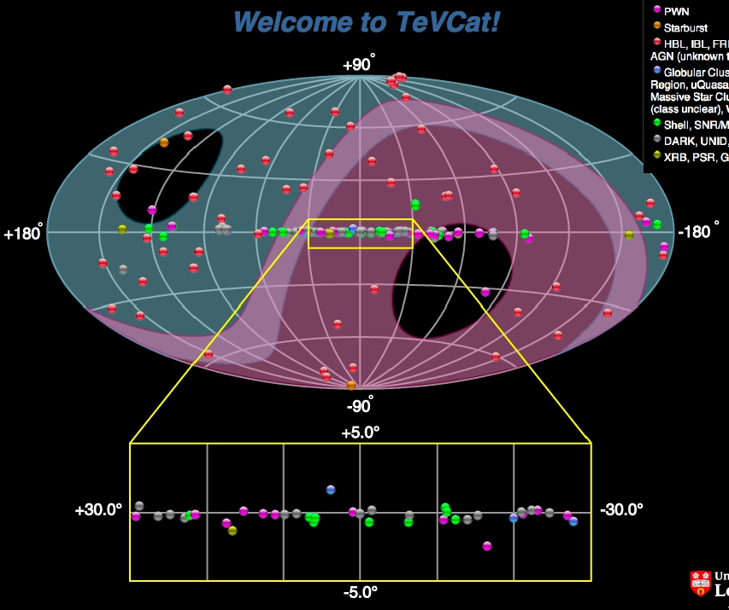

157 sources detected
by ground-based
instruments
Not impressive versus
3FGL (O(2K)), but…

Slide 34

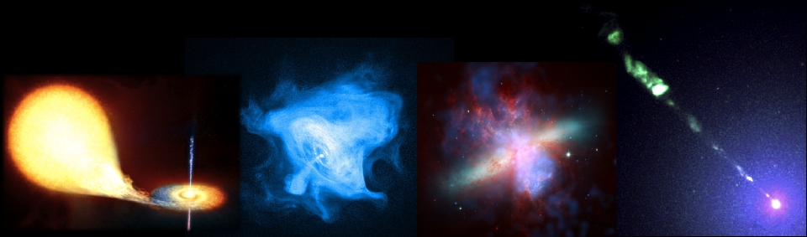
TeV Impact
Highlights from HESS, MAGIC,
VERITAS & MILAGRO
●
●
●
●
●
●
●
●
●
●
●
Microquasars: Science 309, 746 (2005), Science 312, 1771 (2006)
Pulsars: Science 322, 1221 (2008), Science 334, 69 (2011)
Supernova Remnants: Nature 432, 75 (2004)
The Galactic Centre: Nature 439, 695 (2006)
The Magellanic Cloud: Science 347, 406 (2015)
Surveys: Science 307, 1839 (2005), PRL 95, 251103 (2005)
Starbursts: Nature 462, 770 (2009), Science 326,1080 (2009)
AGN: Science 314,1424 (2006), Science 325, 444 (2009), Science 346, 1080 (2014)
EBL: Nature 440, 1018 (2006), Science 320, 752 (2008)
Dark Matter: PRL 96, 221102 (2006), PRL 106, 161301 (2011)
Lorentz Invariance: PRL 101, 170402 (2008)
Cosmic Ray Electrons: PRL 101, 261104 (2009)

Slide 35
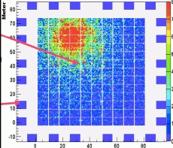
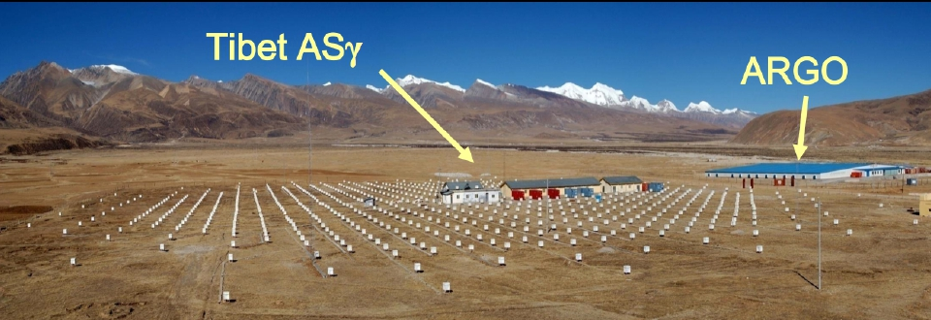
Tibet ASγ and ARGO
● Tibet air-shower array
} High altitude – 4300 m a.s.l.
● Muon detector expansion underway for ASγ
● ARGO-YBJ: Resistive Plate Chamber Carpet
} ~100 m x ~100 m , ~1 TeV threshold for gammas
} Interesting results from 5 year northern sky survey

Slide 36
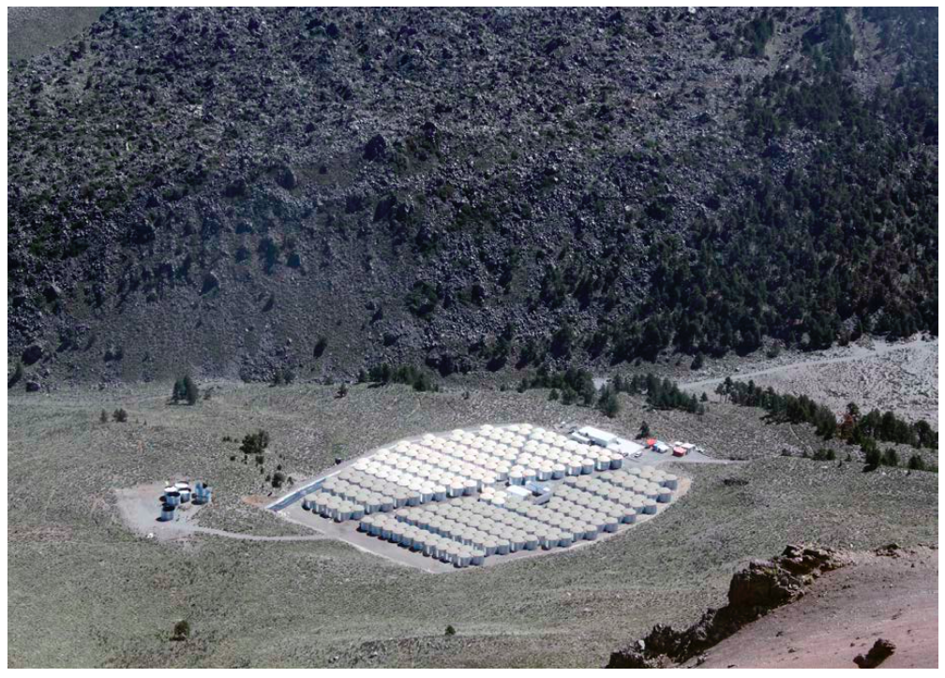

Water Cherenkov Detector
Wide ﬁeld, very high duty cycle
Sierra Negra, Mexico
(19º north, 4100m alt.)
300 water Cherenkov tanks
~22,000m² detection area
~15x more sensitive than Milagro!

Slide 37
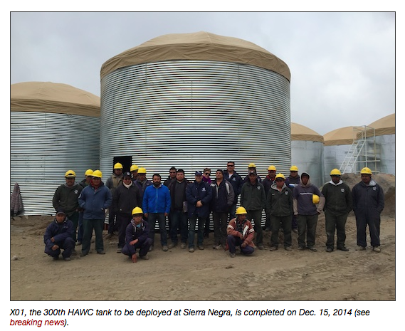
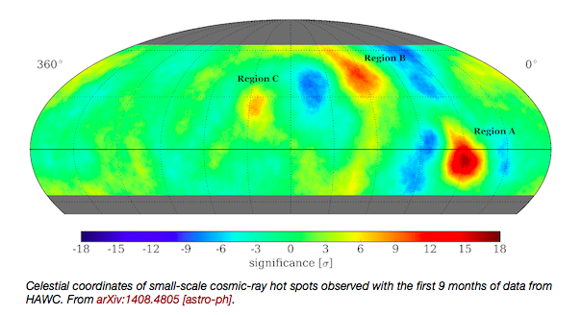
HAWC
● Instrument completion end 2014
● Physics already started:
} Moon shadow and CR anisotropy
} Narrow miss with GRB 130427A
(z=0.34)

Slide 38
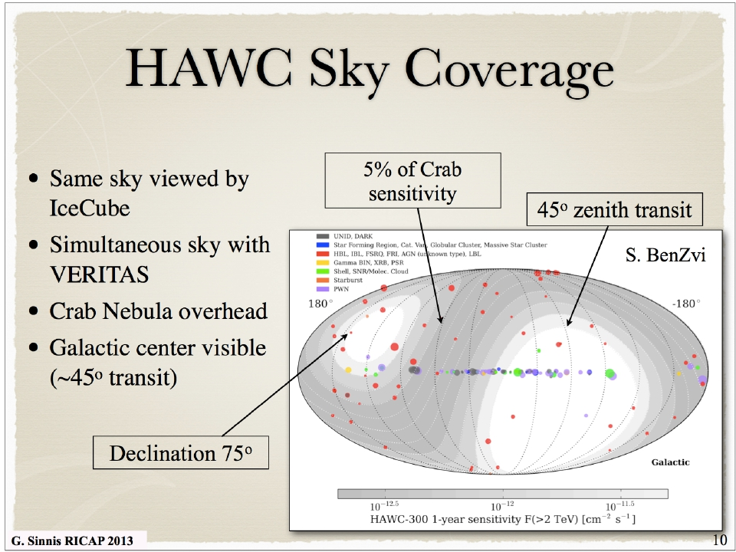
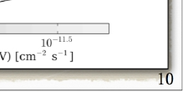

Slide 39
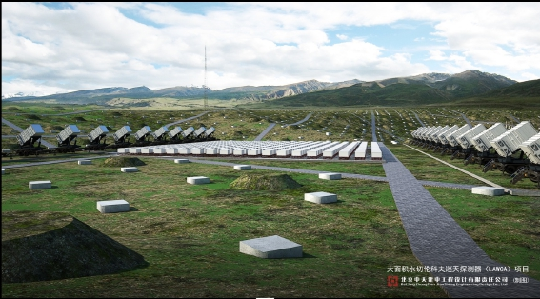
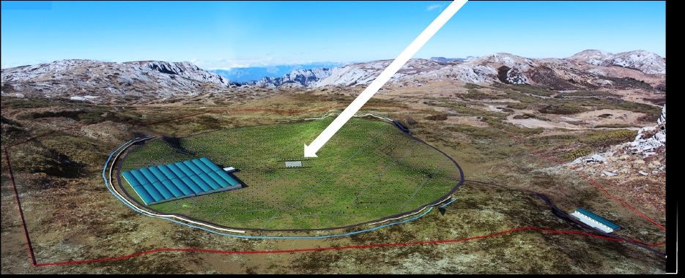
LHAASO
Gamma-ray surveys &
Cosmic ray studies
90k m2 Water Cherenkov dets
1 km2 Surface EAS detector array
++

Slide 40
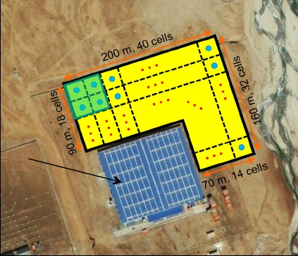
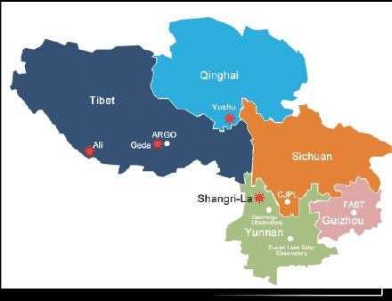
LHAASO
● Phase-0: Large Area Water
Cherenkov Array (LAWCA)
} YangBaJing, Tibet: around the
ARGO detector
} Completion end 2014
} HAWC-like, but with access to
somewhat lower energies
● Phase-1
} Final site: Shangri-La
› 4.3 km altitude
} Sensitivity?
› Will depend on background
rejection power achieved in
practice, but will be a very
powerful instrument

Slide 41
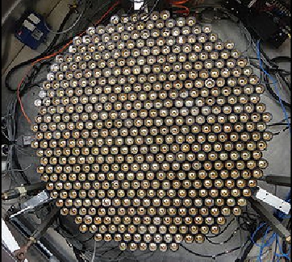
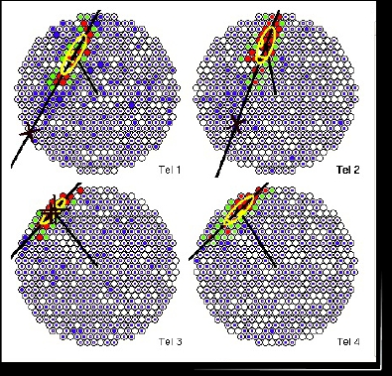
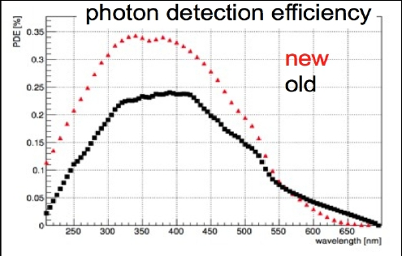
VERITAS
● 4x 12m telescopes in Arizona
● Upgrade completed Sept. 2012
} New PMs and new trigger system
for all four cameras
} Lower threshold, improved
sensitivity

Slide 42

MAGIC
● 2nd 17 m telescope
finished 2009
● Upgrade DAQ + new
MAGIC-I camera finished
fall 2013
} Both now 1039 pixel,
3.5 degree FoV

Slide 43


HESS
HESS-1: 4×12m tels
HESS-2: +28m tel.
Completed mid-2012

Slide 44

How to do better with
IACT arrays?
● More events
} More photons = better
spectra, images, fainter
sources
› Larger collection area for
gamma-rays
● Better events
} More precise
measurements of
atmospheric cascades and
hence primary gammas
› Improved angular
resolution
› Improved background
rejection power
☛ More telescopes !
Simulation:
Superimposed images
from 8 cameras

Slide 45
The answer is CTA !!!
BUT
is CTA the only possible venue ?

Slide 46

IACTs are pointing instruments
The whole sky = 42000 deg²
Field of View (FOV) of a typical IACT (HESS ~20 deg², CTA-MST~40 deg²)
Fermi sky (photons in 2 years)
J. Cortina

Slide 47


MACHETE
Meridian Atmospheric CHErenkov TElescope array
J. Cortina, R. López-Coto, A. Moralejo, submitted to Astrop Phys
Two fixed IACTs with a very large FOV of 300 sq.deg aligned with the meridian.
Sky drifts through FOV: it surveys 43% of the sky along a year.
Reaches 0.55% crab sensitivity after 5 years operation.
For sources observable in a single night it reaches a sensitivity of 8% crab: perfect to trigger other telescopes
Camera of 15000 pixels covering 5°x60°
15 m
17 m
you
45 m
J. Cortina

Slide 48
IACTs are pointing instruments
The whole sky = 42000 deg²
MACHETE: instantaneous (300 deg²)
Field of View (FOV) of a typical IACT (HESS ~20 deg², CTA-MST~40 deg²)
Fermi sky (photons in 2 years)
J. Cortina

Slide 49
IACTs are pointing instruments
The whole sky = 42000 deg²
MACHETE one year (~20000 deg²)
Field of View (FOV) of a typical IACT (HESS ~20 deg², CTA-MST~40 deg²)
Fermi sky (photons in 2 years)
J. Cortina

Slide 50

GAMMA-400
A VHE gamma ray telescope on the sky

Slide 51


Slide 52


Slide 53


Slide 54


Slide 55




Fermi versus GAMMA-400

Slide 56
Science Goals: Dark Matter
General Searches to be conducted:
  Study dSph and galaxy clusters
  Measurement of the ɣ-ray spectrum from DM halo and comparing it with diffuse background spectrum
  Search for unidentified ɣ-ray sources (“dark accelerators”)
  Search for ɣ-ray lines in the continuum spectrum
  Analysis of extra-galactic ɣ-ray background; check for unaccounted fraction
  Study of the fine structure of the high-energy electron spectrum
Main target for the mission is to conduct a sensitive search for signatures of particle DM in diffuse ɣ-radiation (> ~ 1 GeV) and electron + positron spectrum (> ~ 10 GeV)
Expected to provide a more sensitive search than current Fermi-LAT observations due to better PSF and energy resolution

Slide 57
Science Goals:
Gamma-Ray Astronomy
Optimized for 100 GeV; angular resolution ~0.01º and energy resolution ~1%
MeV-range observations also interesting (Pion bump, diffuse emission, morphology, discovery potential)
Final orbit will be approximately circular with median altitude of ~150, 000 km, no Earth occultation meaning long-term observations possible
Plan for deep observations of Galactic center, Cygnus constellation, Crab and “other extended and variable Galactic and extragalactic sources”
SNR, Pulsars, accreting objects, microquasars, AGN

Slide 58

Science Goals:
Cosmic-Ray Nuclei
To measure fluxes of Galactic nuclei up to Fe
Study the chemical composition up to the CR knee
Is CR spectrum a convolution of single spectra weight by their relative abundances?
Is it due to propagation/leakage from the galaxy? i.e. is the knee at lower energies for light nuclei

Slide 59
In summary:
A telescope (pointing rather than surveying) with 10-fold better energy and angular resolution than Fermi.
Study with high precision the most important/intriguing sources Fermi has detected but has been unable to perform conclusive studies.
Study with high energy and angular resolution the most important CTA sources.
Not a continuation of Fermi but a qualitative step ahead.
A perfect complement for CTA.

Slide 60
… a Spanish participation in GAMMA-400 ?

Slide 61
A bit of history (1/2):
Main (personal) motivation: high-resolution (angular and energy) search for dark matter annihilation signatures in gamma rays.
Very hot subject in 2012 (Fermi lines), now not so hot but still alive.
Many of us felt a lost opportunity not participating in extremely successful Fermi mission -> try to avoid that in the next mission.
In addition: natural space-program complement to CTA for the future of HE gamma ray astronomy. So far no NASA or ESA alternative after Fermi. Just recently Chinese start talking about alternatives: a satellite called DAMPE (Dark Matter Particle Explorer) and a detector for the Chinese Space Station called HERD (High Energy cosmic Radiation Detector).

Slide 62
A bit of history (2/2):
=> Action promoted in the Gamma Ray community:
First discussions/plans in the IFAE gamma group about joining in during 2012
Contact with ICC Astronomers in spring 2013 -> Josep Maria Paredes very active in astrophysics prospects for GAMMA-400, and ICC group very engaged but fundamentally to participate in Astrophysics and not construction -> construction should be led by IFAE.

Slide 63
Answer to our first joining request.
From: Nikolay Topchiev ‪<tnp51@yandex.ru>‬
Date: 2013-06-11 14:24 GMT+02:00
Subject: Re: GAMMA-400
To: "Josep M. Paredes" <jmparedes@ub.edu>
Cc: Manel Martinez <martinez@ifae.es>, "moralejo@ifae.es" <moralejo@ifae.es>, Гальпер Аркадий Моисеевич <amgalper@mephi.ru>
Dear Josep Maria,
Sorry for some delay.
The GAMMA-400 project is open to the participation of specialists from different countries. We know and appreciate the contribution of the Spanish specialists in various international projects, in particular, CTA. For us, it would be useful the participation of Spanish specialists in the GAMMA-400 project in expertise and simulations.
However, currently we negotiate about the design and manufacture of some telescope detectors in Europe. At the same time, due to the high cost of the project would also be useful for Russian side that the Spanish side would partially pay for designing and manufacturing some detectors or other elements of the telescope.
We think that joint contribution of different countries will promote to the successful implementation of the GAMMA-400 project.
--
Sincerely yours
Arkadiy M. Galper
GAMMA-400 PI
Nikolay Topchiev
GAMMA-400 Deputy PI, Project Manager and Chief Designer
tnp51@yandex.ru, tnp51@rambler.ru
http://www.lebedev.ru
http://npad.lebedev.ru/
http://gamma400.lebedev.ru

Slide 64
What may be the gain for the spanish VHE Gamma Ray community ?
Possibility of working in a (small) collaboration gamma satellite experiment and learning all aspects of space science.
Complementary to CTA and good successor of MAGIC (MAGIC will not last forever…).
Possibility of a privileged scientific situation: CTA<-> GAMMA-400 link.
Possibility of participating with a contribution in construction regardless on the final CTA North site decision.
IFAE shall provide the backbones for the Spanish participation in GAMMA-400 (ICC, ICE and UCM already supporting actively the proposal).
Possibility of consolidating funding source diversification. Space Program is presently more generous that FPA or AyA…

Slide 65

Submitted

Slide 66


