Slide 1
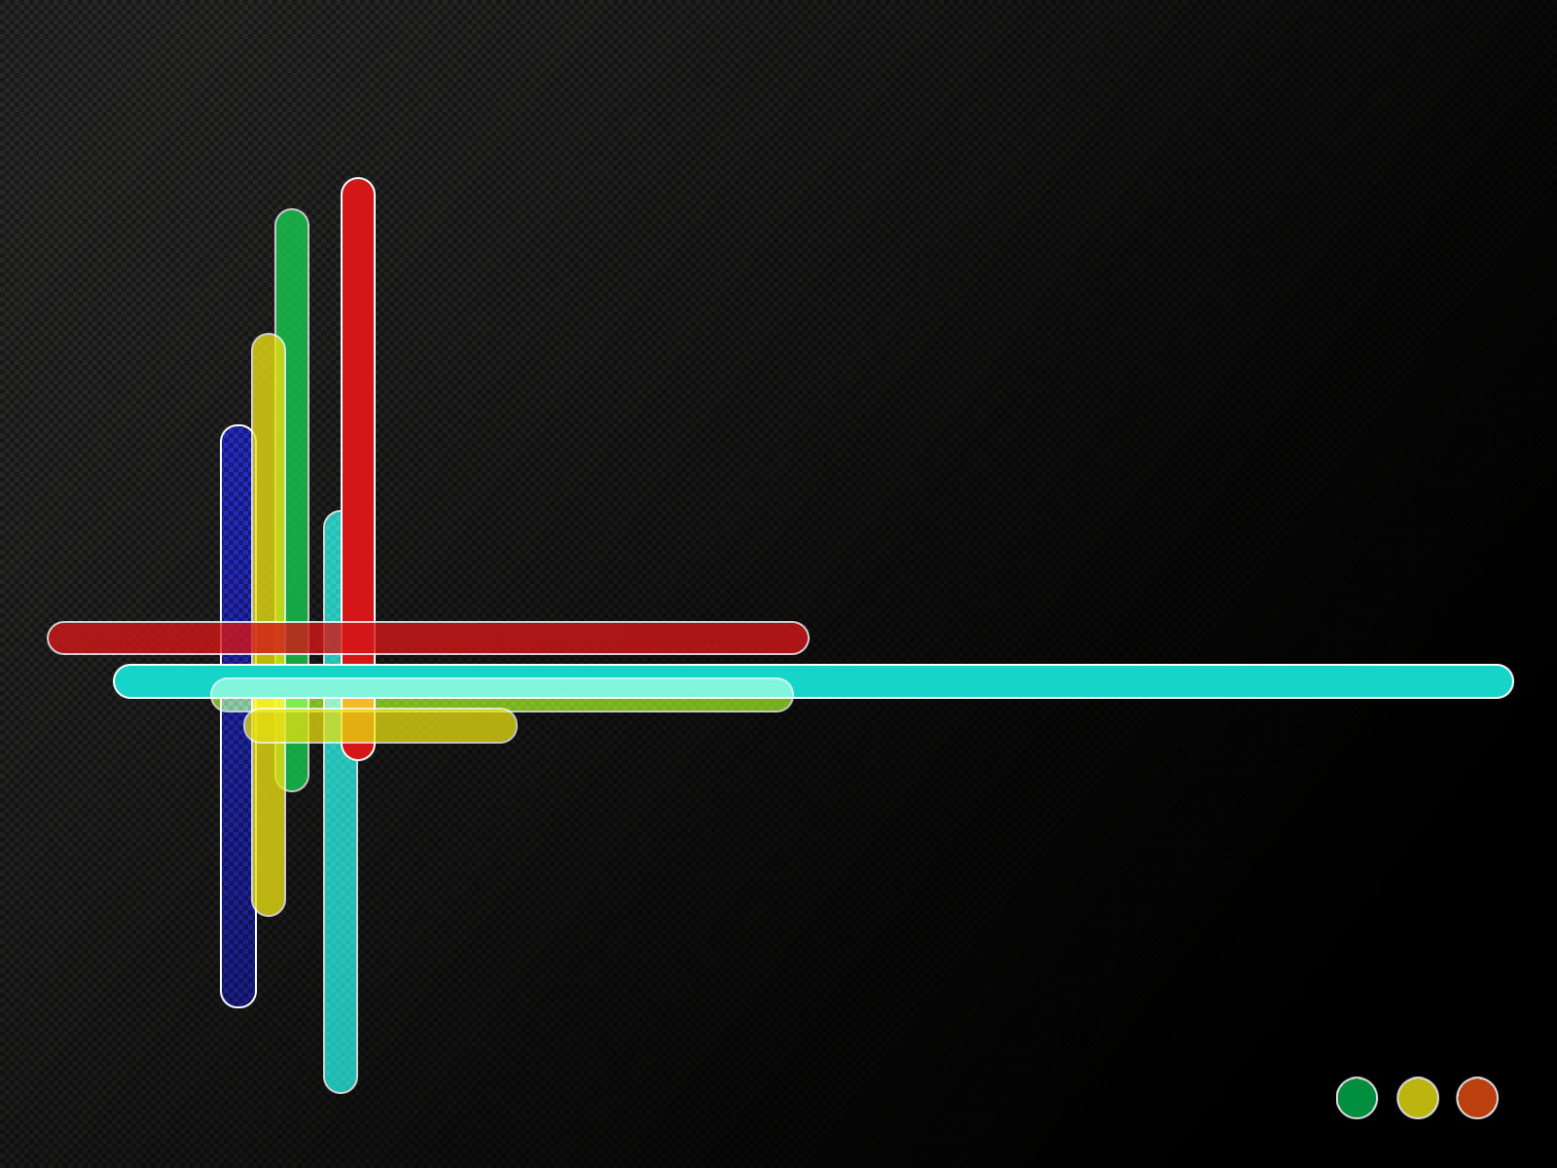
CT10, CT14 parton distributions and beyond
Parton distributions for the LHC, Benasque, 2015-02-16
Pavel Nadolsky
Southern Methodist University
On behalf of CTEQ-TEA group
S. Dulat, J. Gao, M. Guzzi, T.-J. Hou, J. Huston,
J. Pumplin, C. Schmidt, D. Stump, C. -P. Yuan

Slide 2
Participants in the CT14 analysis
Argonne National Laboratory: Jun Gao
University of Manchester: M. Guzzi
Michigan State University: J. Huston, J. Pumplin, D. Stump, C. Schmidt, C.-P. Yuan
Southern Methodist University: P. Nadolsky, Tie-Jiun Hou
Xinjiang University: Sayipjamal Dulat

Slide 3

Recent CTEQ-TEA publications and studies
CT10 NNLO general-purpose PDFs J. Gao et al., PRD. D89 (2014) 3, 033009
PDF uncertainty for $gg→H$ Dulat et al, arXiv:1309.002
Constraints on heavy-quark masses from CT10 NNLO analysis Gao et al., Eur.Phys.J. C73 (2013) 8, 2541
CT10 NNLO PDFs with intrinsic charm Dulat et al, PRD 89, 073004 (2014)
CT14 NNLO PDFs with LHC data (in progress)
NNLO PDFs with electromagnetic contributions (in progress)
…

Slide 4
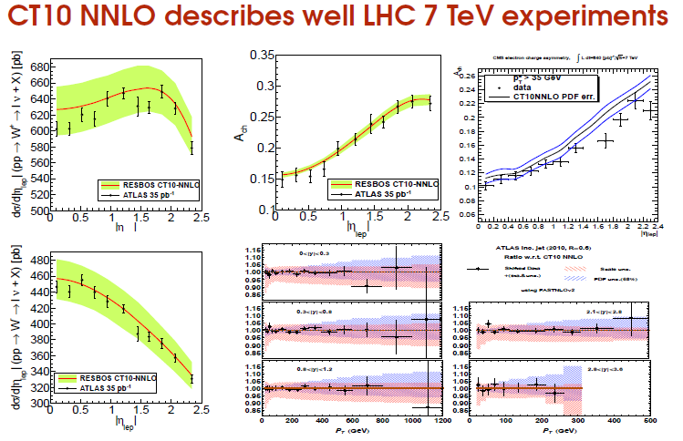
Our most recent published PDF ensembles, CT10/CT10W NLO [arXiv:1007.2241] and CT10 NNLO [arXiv:1302.6246] are in good agreement with LHC Run-1 data
LHC 7 TeV data vs CT10 NNLO PDFs

Slide 5
CT14 PDFs (in progress)
Candidate CT14 ensembles have been internally available since 12/2014. Fine-tuning, inclusion of new data sets, and final cross checks/updates of look-up tables since then.
The short-term goal is to finalize the CT14 analysis at (N)(N)LO. I will show some PRELIMINARY results.
The long-term target is to reach a qualitatively new level in the understanding of PDFs by a multi-prong effort.

Slide 6
Comparison of CT14 and CT10 PDFs
Main features of CT10 sets preserved in a wide x range, for all flavors
CT14 NNLO predictions for LHC observables are within CT10 uncertainties
Some changes in quark flavor composition as a result of new experimental data, benchmarked CC DIS cross sections, and more flexible PDF parametrizations
Some changes in the PDF uncertainty bands as a result of including new data, imposing spectator counting rules at large x

Slide 7
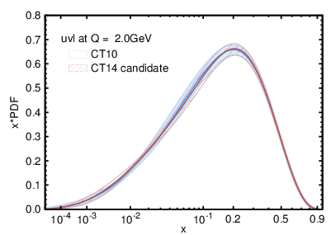
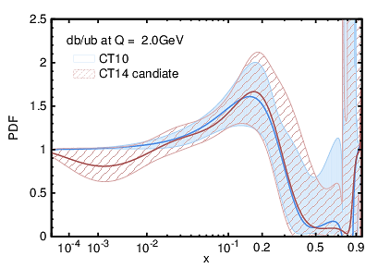
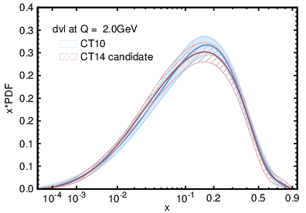
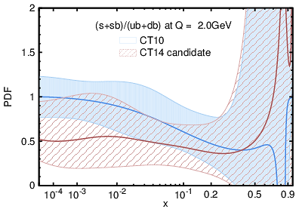

Effects on the candidate quark PDFs
PRELIMINARY
E866 DY
LHC W/Z
+ new parametrization
ATLAS/CMS
W asymmetry
PRELIMINARY
LHC W/Z
+ new parametrization
Update on NLO $F_{3}^{CC}(x,Q)$
+ new parametrization

Slide 8

Selection of experiments
Experimental measurements are selected so as to reduce dependence on any theoretical input beyond the leading power in perturbative QCD
  New sets in CT14
  HERA-2 $F_{2c}(x,Q)$
  D0 Run-2 electron W asymmetry ($9.7 fb^{−1}$)
    Supersedes the $0.7 fb^{−1}$ data set
  ATLAS W/Z cross sections
  CMS W asymmetry, 4.7 fb⁻¹
  LHCb 7 TeV W asymmetry
  ATLAS inclusive jet 7 TeV R=0.6
  CMS inclusive jet 7 TeV R=0.7
  ATLAS jet ratio 2.76 TeV/7 TeV R=0.6

Slide 9
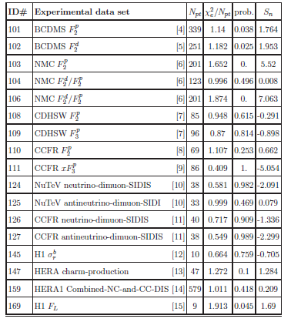
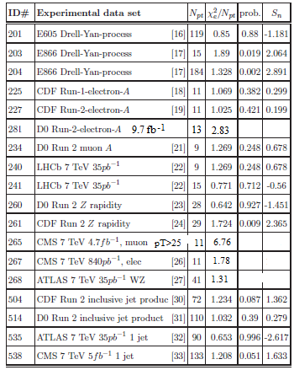
$χ^{2}/N_{pt}$ from a candidate CT14 fit
PRELIMINARY
Good agreement with DIS, jet production experiments. Description of HERA-1 DIS data has improved in CT14 compared to CT10

Slide 10
$χ^{2}/N_{pt}$ from a candidate CT14 fit
PRELIMINARY
Indications of some tensions between W asymmetry measurements at D0, ATLAS, CMS (to be confirmed). Perhaps, reflecting high statistical precision of the W asy data or subtleties in flavor composition.

Slide 11
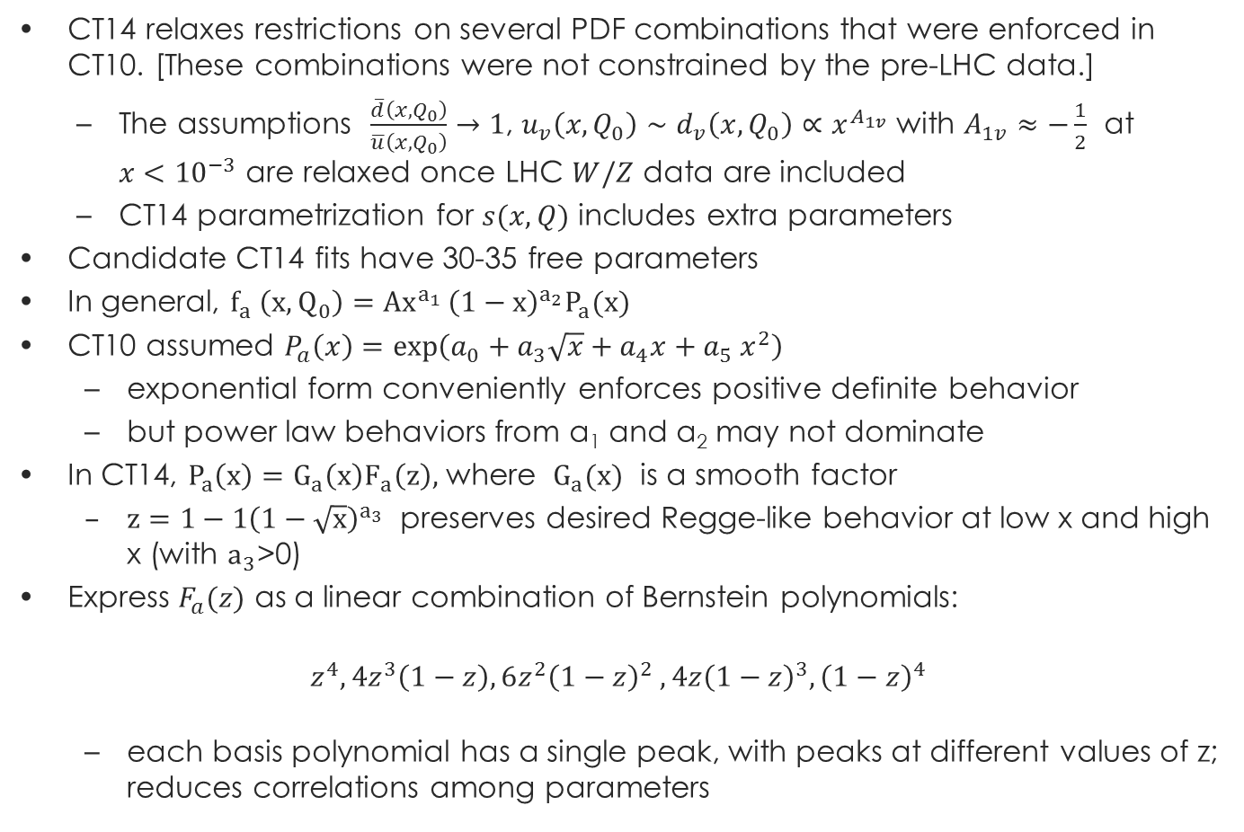
CT14: new parametrization forms
CT14 relaxes restrictions on several PDF combinations that were enforced in CT10. [These combinations were not constrained by the pre-LHC data.]
  The assumptions $\frac{\overline{d}\left(x,Q_{0}\right)}{\overline{u}\left(x,Q_{0}\right)}→1$, $u_{v}\left(x,Q_{0}\right)∼d_{v}\left(x,Q_{0}\right)∝x^{A_{1v}}$ with $A_{1v}≈−\frac{1}{2}$ at $x<{10}^{−3}$ are relaxed once LHC $W/Z$ data are included
  CT14 parametrization for $s(x,Q)$ includes extra parameters
Candidate CT14 fits have 30-35 free parameters
In general, $f_{a} \left(x,Q_{0}\right)=Ax_{}^{a_{1} }{\left(1−x\right)}^{a_{2}}P_{a}(x)$
CT10 assumed $P_{a}\left(x\right)=\exp\left(a_{0}+a_{3}\sqrt{x}+a_{4}x+a_{5} x^{2}\right)$
  exponential form conveniently enforces positive definite behavior
  but power law behaviors from a₁ and a₂ may not dominate
In CT14, $P_{a}\left(x\right)=G_{a}\left(x\right)F_{a}\left(z\right),$ where $G_{a}(x)$ is a smooth factor
  $z=1−1{\left(1−\sqrt{x}\right)}_{}^{a_{3}}$ preserves desired Regge-like behavior at low x and high x (with $a_{3}$>0)
Express $F_{a}(z)$ as a linear combination of Bernstein polynomials:
$$z^{4}, 4z^{3}\left(1−z\right), 6z^{2}{\left(1−z\right)}^{2} ,4z{\left(1−z\right)}^{3},{\left(1−z\right)}^{4}$$
  each basis polynomial has a single peak, with peaks at different values of z; reduces correlations among parameters

Slide 12
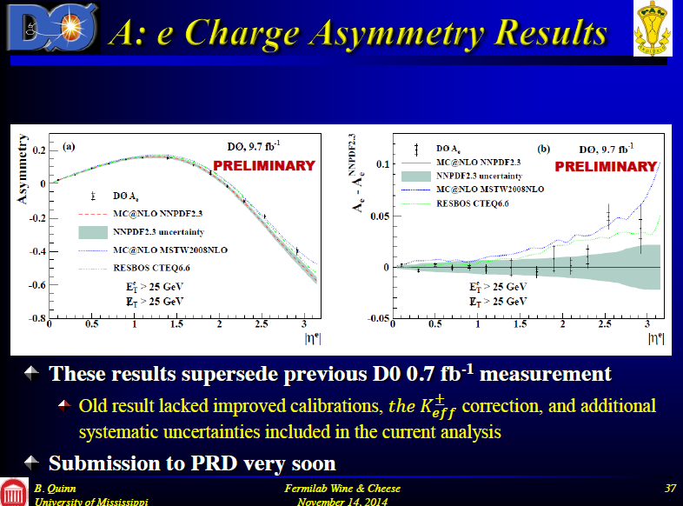

Slide 13
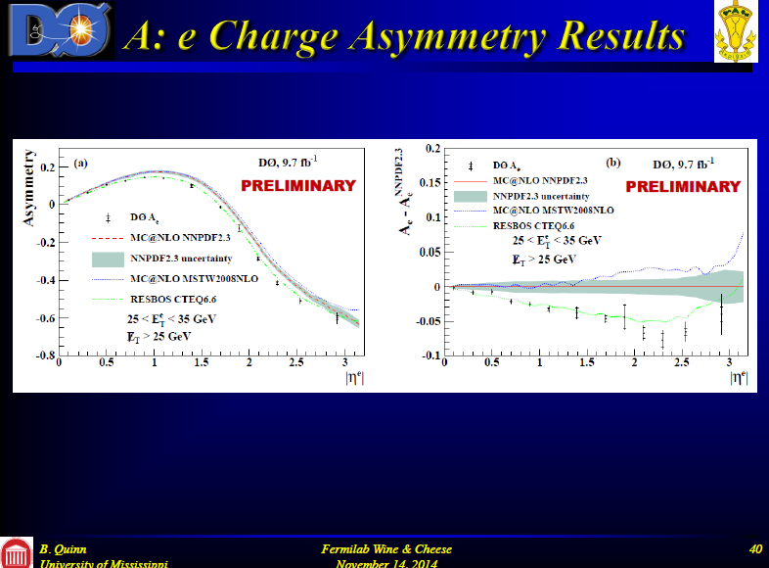

Slide 14
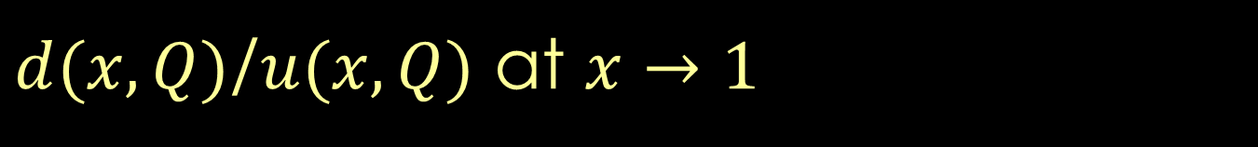
$d(x,Q)$/$u(x,Q)$ at $x→1$
Blue: CTEQ6.6 NLO
Green: CJ 12 NLO
(Owens et al., 1212.1702)

Slide 15


$d(x,Q)$/$u(x,Q)$ at $x→1$
D0 $0.7 fb^{−1}$W lepton asymmetry (in CT10) is superseded by $9.7 fb^{−1}$ data, which prefers a different $d/u$ shape
No data
D0 W lepton asy, $0.7 fb^{−1}$
Blue: CT10 NNLO
Green: CJ 12 NLO
(Owens et al., 1212.1702)

Slide 16

$d(x,Q)$/$u(x,Q)$ at $x→1$
No data
D0 W lepton asy, $0.7 fb^{−1}$
Parametrization
Blue: CT10 NNLO
Green: CJ 12 NLO
(Owens et al., 1212.1702)

Slide 17
$d(x,Q)$/$u(x,Q)$ at $x→1$
Blue: CT14 NNLO
candidate
Green: CJ 12 NLO
(Owens et al., 1212.1702)

Slide 18

$d(x,Q)$/$u(x,Q)$ at $x→1$
Compatible with D0 Wasy 9.7 fb⁻¹ data; $\lim_{x→1}\left(\frac{d\left(x\right)}{u\left(x\right)}\right)=const,$ parametrized according to spectator counting rules
Blue: CT14 NNLO
candidate
Green: CJ 12 NLO
(Owens et al., 1212.1702)

Slide 19
$d(x,Q)$/$u(x,Q)$ at $x→1$
Blue: CT14 NNLO
candidate
Green: CJ 12 NLO
(Owens et al., 1212.1702)
Positivity

Slide 20
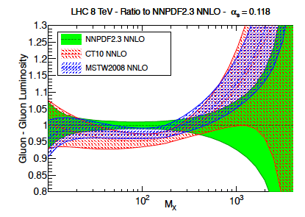
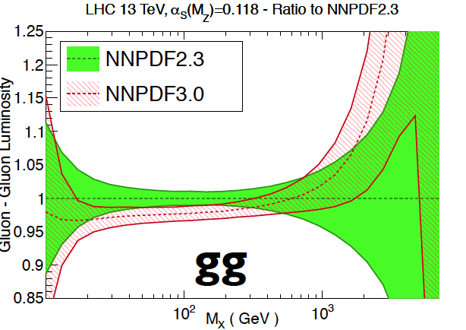
Now to CT14 gluon distribution
Reminder: CT10 gg luminosity forms lower bound for LHC combination, for m< 400 GeV
  NNPDF3.0 decreases by 2-3% compared to NNPDF2.3
CT14 predictions for Higgs cross sections at 8, 14 TeV will increase by 1-1.5%, thus further reducing the size of the envelope
parameterization, new data
Top cross sections will increase by roughly 2%
 | CT10 | CT14
7 TeV | 172.5 pb | 176.1 pb
8 TeV | 246.3 pb | 251.3 pb
13 TeV | 805.7 pb | 819.6 pb
J. Gao top++ m_{top}=173.3 GeV

Slide 21
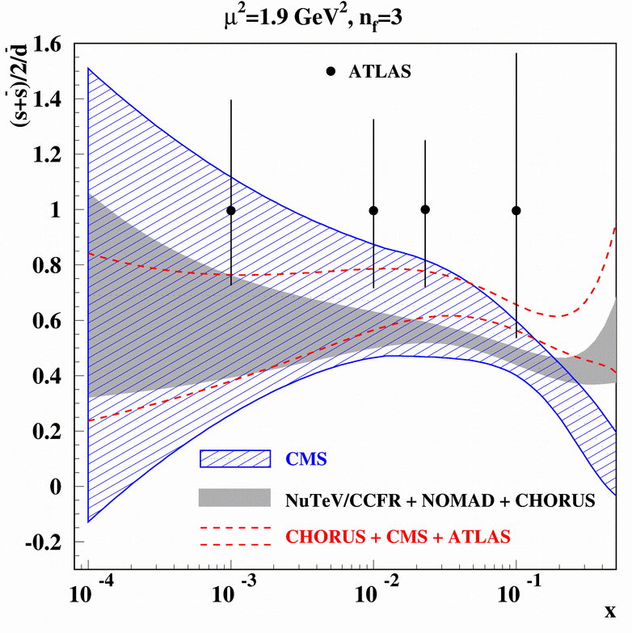
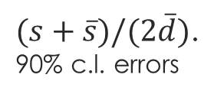

Strangeness PDF from ABM and CT14
Alekhin et al., hep-ph/1404.6469
68%c.l. errors, $Δχ^{2}=1$
$(s+\overline{s})/(2\overline{d})$.
90% c.l. errors

Slide 22
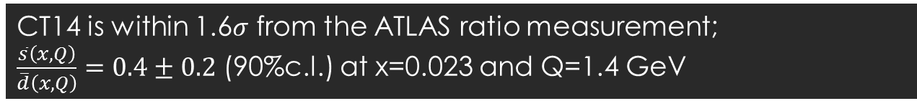
Strangeness PDF from ABM and CT14
Alekhin et al., hep-ph/1404.6469
68%c.l. errors, $Δχ^{2}=1$
$(s+\overline{s})/(2\overline{d})$.
90% c.l. errors
CT14 is within 1.6$σ$ from the ATLAS ratio measurement;
$\frac{\overline{s}\left(x,Q\right)}{\overline{d}\left(x,Q\right)}=0.4±0.2$ (90%c.l.) at x=0.023 and Q=1.4 GeV

Slide 23
Next steps: after CT14
add 2011 7 TeV ATLAS jet, dijet, trijet data with mutual correlations
add 2011 7 TeV CMS jet data (after revision of errors)
  hopefully 8 TeV analysis will have public errors soon after
add 2011 CMS Drell-Yan data
add HERA2 combined data once it comes out
fit differential top data from ATLAS and CMS using the approximate or even exact NNLO calculation (DiffTop+FastNLO)

Slide 24
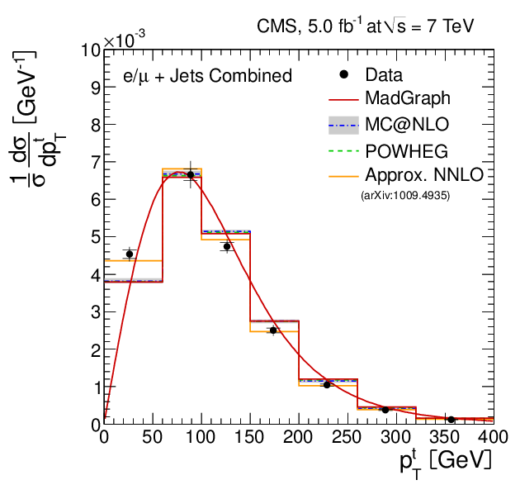


$t\overline{t}$ mass and rapidity distributions
gg channel is dominant; differential predictions at NNLO will help constrain high x gluon distribution
At NLO $t\overline{t}$ differential distributions prefer weaker high x gluon than does the jet data
  Approximate NNLO corrections are available from DiffTop+FastNLO (Guzzi, Lipka, Moch, 1406.0386)

Slide 25
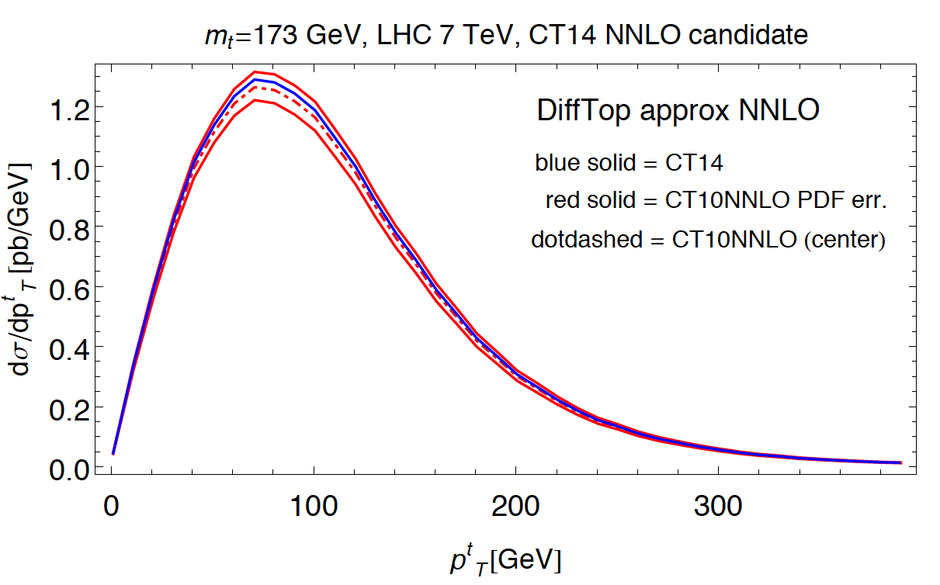
Top differential distributions
CT14NNLO are a few percent higher than CT10NNLO for differential distributions
NB: DiffTop in general gives a result 2-3% higher than NNLO
M. Guzzi

Slide 26
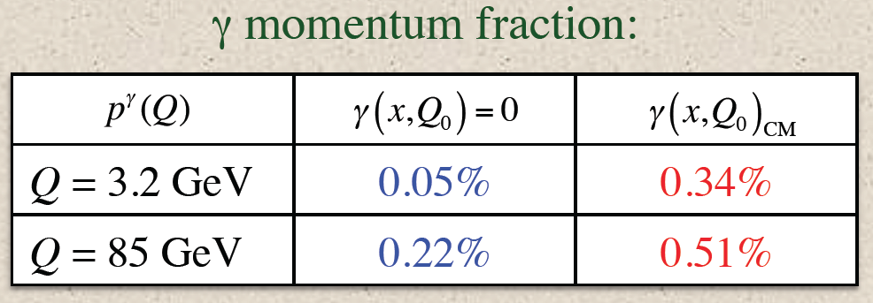
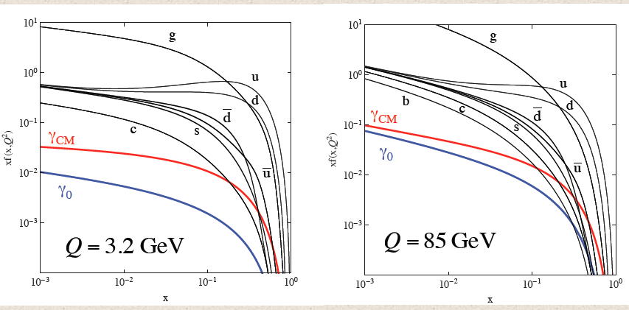
Next steps: Photon PDFs
Photon PDFs: photon PDFs can be larger than antiquark distributions at high x; the LHC is a γγ collider; even more true of a 100 TeV collider
CT14 release will include photon PDFs for first time
    fitting to photon production in DIS
See talk of C. Schmidt at DIS2014
allow for non-perturbative
component of photon
at Q_{o}

Slide 27
Long-term plans
With some bias toward my personal interests

Slide 28
Long-term issues: theory
Implementation of (N)NNLO QCD + NLO EW radiative contributions and fast interfaces. Validation and “benchmarking” of theoretical computations. Support of open-source codes (HERA Fitter, etc.) Switching to NNLO/NLO lookup tables, when unavoidable.
1. The CT14 fit implements…
…Applgrid to compute ATLAS jet ratio data, and ATLAS low-mass and high-mass DY data sets
…fastNLO to compute all other jet data sets
Benefit: new theoretical cross sections available in Applgrid/FastNLO can be easily included in the CTXX fits
Disadvantage: the fits are slowed down after the point-by-point NLO/LO correction tables are replaced by the “fast” NLO interfaces
2. Benchmark comparisons of CT, MSTW, NNPDF codes for DiS and jet data results in the expected much better agreement between CT14, MMHT’14, NNPDF3.0 than with the previous generation of NNLO PDFs

Slide 29

Long-term: coupled physics issues
Constraints on $d/u$, $g/d$, $\overline{u}/\overline{d}$, $(s+\overline{s})/(\overline{u}+\overline{d})$ ratios at $x>0.2−0.5$.
Massive quark contributions at NNLO in CC DIS, N3LO in NC DIS,
Better control of correlated systematic effects, their additive vs. multiplicative nature

Slide 30
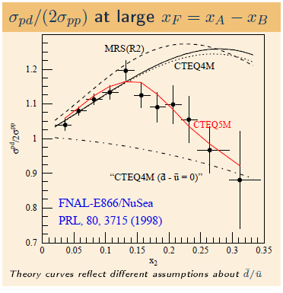

SU(2) and charge symmetry breaking
E866 Drell-Yan pair production:
$\overline{d}\left(x\right)−\overline{u}\left(x\right)≠0$ at $x>0.1$
(large difference)
E866 constraints will
be strengthened by SeaQuest
LHC $W/Z$ production:
$\overline{d}\left(x\right)−\overline{u}\left(x\right)≠0$ at $x<0.1$
(a few percent)
?

Slide 31

SU(2) and charge symmetry breaking
$\overline{d}\left(x\right)≠\overline{u}\left(x\right),$ $q(x)≠\overline{q}(x)$
May be caused by
DGLAP evolution
Fermi motion
Electromagnetic effects
Nonperturbative meson fluctuations
Chiral symmetry breaking
Instantons
…

Slide 32
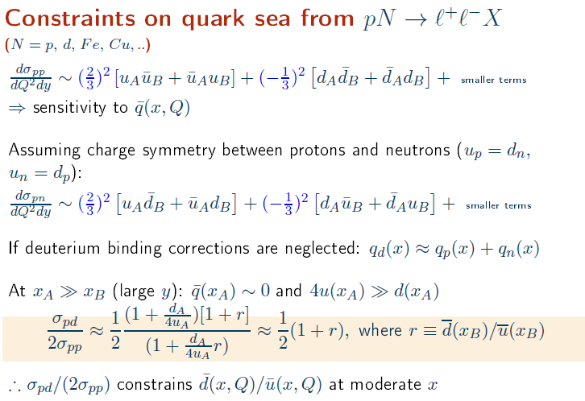

Slide 33
At a few-percent accuracy, charge symmetry violation and nuclear corrections must be explicitly estimated in the future if the data on the neutron/nuclei are used

Slide 34



Extrinsic and intrinsic sea PDFs
“Extrinsic” sea
(maps on disconnected diagrams of lattice QCD for both
heavy and light flavors?)
“Intrinsic” sea (excited Fock
nonpert. states, maps on connected
diagrams of lattice QCD?)
$$\overline{q}$$
p
$$\overline{q}(x)$$
Extrinsic
Intrinsic
p
$$\overline{q}$$
0.1
x

Slide 35
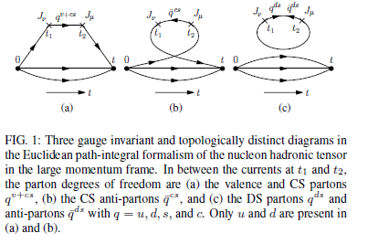
(Dis)connected topologies in lattice QCD
Liu, Chang, Cheng, Peng, 1206.4339

Slide 36
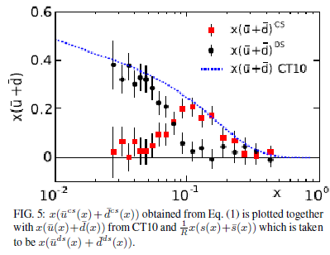
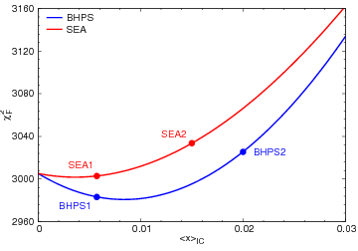

Extrinsic and intrinsic sea PDFs
Smooth $\overline{u}+\overline{ d}$ parametrizations can hide existence of two components
Liu, Chang, Cheng, Peng, 1206.4339
Intrinsic charm (IC) can carry up to 1%
of the proton momentum
CT10 IC NNLO PDFs, S. Dulat et al., 1309.0025

Slide 37
Long-term issues: experimental data
New measurements can in principle resolve fine details of sea PDFs (e.g., “intrinsic” and “extrinsic” contributions)
In practice, this is difficult if data are presented in large bins only (even with vanishing statistical uncertainties).and with large systematic uncertainties
It is interesting to explore opportunities for…
updating or phasing out old data sets
using finer experimental bins
Implement ratios of observables and correlations between experiments
quantify biases in experimental reconstruction due to prior PDF sets assumed in the data analysis

Slide 38

We hope to see you all at
Abstract submission deadline: March 1 (in two weeks)
Early Registration deadline: March 15

Slide 39
Back-up slides

Slide 40
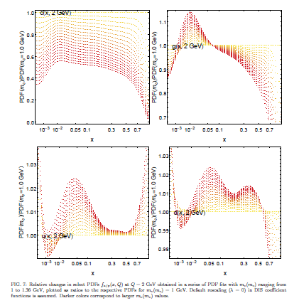
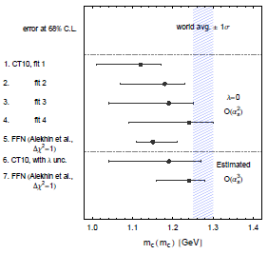
Dependence of $χ^{2}$and PDFs on MS-bar charm mass
J. Gao, M. Guzzi, P.N.,
arXiv:1304.0494

