Slide 1
META PDFs as a framework for PDF4LHC combinations
Parton distributions for the LHC, Benasque, 2019-02-19, 2015
Jun Gao, Joey Huston,
Pavel Nadolsky (presenter)
arXiv:1401.0013, http://metapdf.hepforge.org

Slide 2
What is the PDF meta-analysis?
A meta-analysis compares and combines LHC predictions based on several PDF ensembles. It serves the same purpose as the PDF4LHC prescription. It combines the PDFs directly in space of PDF parameters. It can significantly reduce the number of error PDF sets needed for computing PDF uncertainties and PDF-induced correlations.
CTEQ,MSTW,NNPDF
JR,CJ…
LHC
ABM, HERAPDF
The number of input PDF ensembles that can be combined is almost unlimited
Meta PDFs: a fit to PDF fits

Slide 3
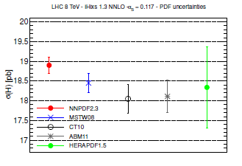
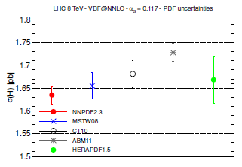
2010 PDF4LHC recommendation for combination of PDF uncertainties (M. Botje et al., (2011), arxiv:1101.0538; R. Ball et al., arXiv:1211.5142)
$$gg→H^{0}$$
$H^{0}$ via VBF
The combined PDF$+α_{s}$ uncertainty on a LHC observable at NLO is determined using CT10, MSTW’08, NNPDF2.3 error PDF ensembles
Predictions for QCD observables are computed for each of 30-100 PDF member sets from each group. Predictions for central PDFs are averaged. Combined PDF+$α_{s}$ uncertainty is the envelop of individual uncertainties computed according to three prescriptions of the input ensembles.
Resulting computations are lengthy, repeated for many PDF sets that contribute little to the total PDF uncertainty

Slide 4
2015: A concept for a new PDF4LHC recommendation
Do you need to know detailed
PDF or $α_{s}$
dependence?
Is a reduced PDF4LHC PDF ensemble available for this observable?
No
No
Yes
Yes
Choose:
Compute the observable and its PDF+$α_{s}$uncertainty with…
…>3 independent PDF ensembles, using their native $α_{s}\left(M_{Z}\right)$and PDF uncertainties
…the reduced PDF4LHC ensemble, its $α_{s}(M_{Z})$ (~10-30 member sets)
…the general-purpose PDF4LHC ensemble and its $α_{s}\left(M_{Z}\right)=0.118±0.0012$
($≥$100 member sets)
Input (N)NLO ensembles (CT14, MMHT14, NNPDF3.0,…) with their respective $α_{s}\left(M_{Z}\right)±δα_{s}(M_{Z})$
This procedure applies both at NLO and NNLO

Slide 5
Combination of the PDFs into the future PDF4LHC ensemble
PDFs from several groups are combined into a PDF4LHC ensemble of error PDFs before the LHC observable is computed. This simplifies the computation of the PDF+$α_{s}$ uncertainty and will likely cut down the number of the PDF member sets and the CPU time needed for simulations.
The same procedure is followed at NLO and NNLO. The combination was demonstrated to work for global ensembles (CT, MSTW, NNPDF). We also did preliminary studies to explore inclusion of non-global ensembles.
The PDF uncertainty at 68% c.l is computed from error PDFs at central $α_{s}\left(M_{Z}\right)$.
Two additional error PDFs are provided with either PDF4LHC ensemble to compute the $α_{s}$ uncertainty using $α_{s}\left(M_{Z}\right)=0.118±0.0012$ at the 68% c.l.

Slide 6
Alternative to the 2010 PDF4LHC prescription
Combination based on MC replicas
(G. Watt, R. Thorne,1205.4024; R. Ball et al., 1108.1758; S. Forte, G. Watt, 1301.6754)
Many Monte-Carlo PDF replicas are generated for each input ensemble
The cross sections are still computed for each of many (>100) replicas and combined based on the probability distribution in the PDF space. The number of replicas grows with the number of input ensembles.

Slide 7
Alternative to the 2010 PDF4LHC prescription
2. Reduction of MC replicas
Starting from step 1, the number of input MC replicas is reduced to a much smaller number while preserving as much input information as possible
Two reduction methods are being explored:
1. Meta-parametrizations + MC replicas + Hessian data set diagonalization
(J. Gao, J. Huston, P. Nadolsky, 1401.0013, ; update by P.N.)
2. Compression of Monte-Carlo replicas
(G. Watt, R. Thorne,1205.4024; R. Ball et al., 1108.1758; S. Forte, G. Watt, 1301.6754; update by S. Carrazza)
The final combination prescription will probably retain the best features of both approaches.

Slide 8
META1.0 PDFs: A working example of a meta-analysis See arXiv:1401.0013 for details
Select the input PDF ensembles (CT, MSTW, NNPDF…)
Fit each PDF error set in the input ensembles by a common functional form (“a meta-parametrization”)
Generate many Monte-Carlo replicas from meta-parametrizations of each set to investigate the probability distribution on the ensemble of all meta-parametrizations (as in Thorne, Watt, 1205.4024)
Construct a final ensemble of 68% c.l. Hessian eigenvector sets to propagate the PDF uncertainty from the combined ensemble of replicated meta-parametrizations into LHC predictions.
Only in the META set
Only in the META set

Slide 9
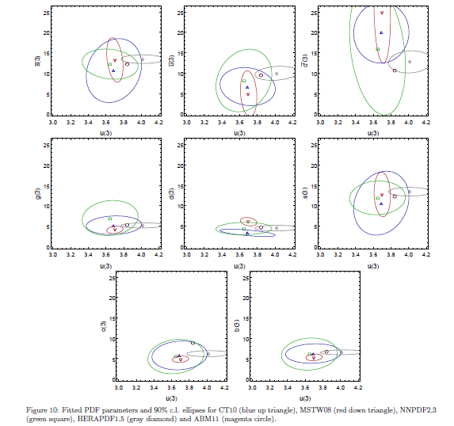
The logic behind the META approach
Emphasize simplicity and intuition
When expressed as the meta –parametrizations, PDF functions can be combined by averaging their meta-parameter values
Standard error propagation is more feasible, e.g., to treat the meta-parameters as discrete data in the linear (Gaussian) approximation for small variations
The Hessian analysis can be applied to the combination of all input ensembles in order to optimize uncertainties and eliminate “noise”

Slide 10
META PDFs can be provided with asymmetric errors
Although only symmetric META errors have been discussed so far, asymmetric Hessian errors can be also determined as in CTEQ analyses
Find eigenvectors of the Hessian matrix of the approximate Gaussian $χ^{2}$
Compute PDF eigenvector sets by traveling along the eigenvector directions of the approximation $χ^{2}$, but stopping when the prescribed $Δχ^{2}$ for the true $χ^{2}$ is reached
$$a_{2}$$
$$z_{1}^{+}$$
$$z_{2}^{+}$$
$$χ_{min}^{2}$$
$$z_{2}^{−}$$
$$z_{1}^{−}$$
$$a_{1}$$

Slide 11
Specific realization (META1.0)
Take NNLO (or NLO) PDFs
Choose a meta-parametrization of PDFs at initial scale of 8 GeV (away from thresholds) for 9 PDF flavors (66 parameters in total)
Generate MC replicas for all 3 groups and merge with equal weights, finding meta parameters for each of the replicas by fitting PDFs in x ranges probed at LHC
PDF uncertainties for above three groups are all reasonably consistent with each other (see next slide)
can add other sets, perhaps with non-equal weights to take into account more limited data sets and thus larger uncertainties

Slide 12
Merging PDF ensembles
The ensembles can be merged by averaging their meta-parameters. For CT10, MSTW, NNPDF ensembles, unweighted averaging is reasonable, given their similarities.
For any parameter $a_{i} ,$ ensemble $g$ with $N_{rep}$ initial replicas:
Central value on g
Standard deviation on g

Slide 13
Reduction of the error PDFs
The number of final error PDFs can be much smaller than in the input ensembles
In the META1.0 study:
200 CT, MSTW, NNPDF error sets
$⇒$ 300 MC replicas for reconstructing the combined probability distribution
$⇒$100 Hessian META sets for most LHC applications (general-purpose ensemble META1.0)
$⇒$ 13 META sets for LHC Higgs production observables (reduced ensemble META LHCH)

Slide 14
General-purpose META PDF ensemble
meta-PDF uncertainty band
50 eigenvectors (100 error sets) provide a very good representation of the PDF uncertainties for all of the 3 PDF error families above
The META PDFs provide both an average of the chosen central PDFs, as well as a good estimation of the 68% c.l. total PDF uncertainty
Can re-diagonalize the Hessian matrix to get 1 orthogonal eigenvector to get the α_{s} uncertainty (H.-L. Lai et al., 1004.4624)

Slide 15
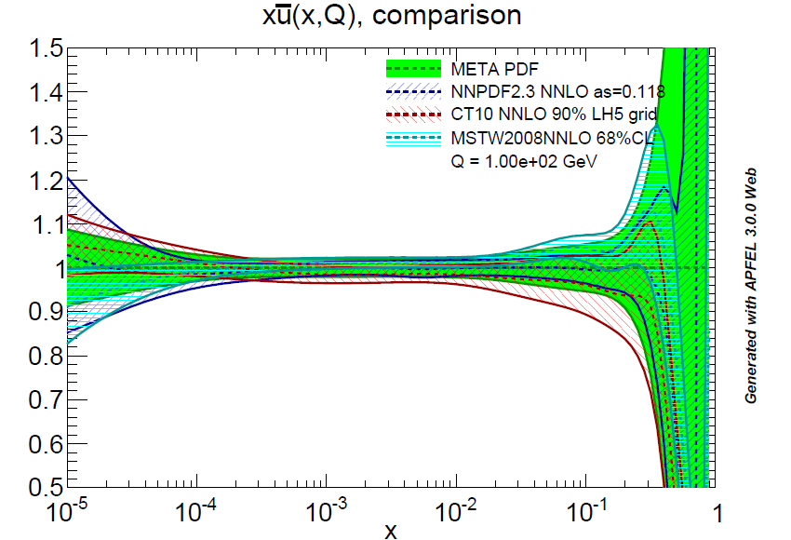
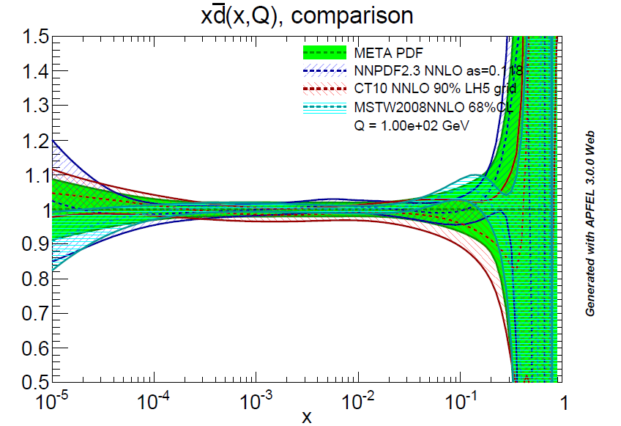
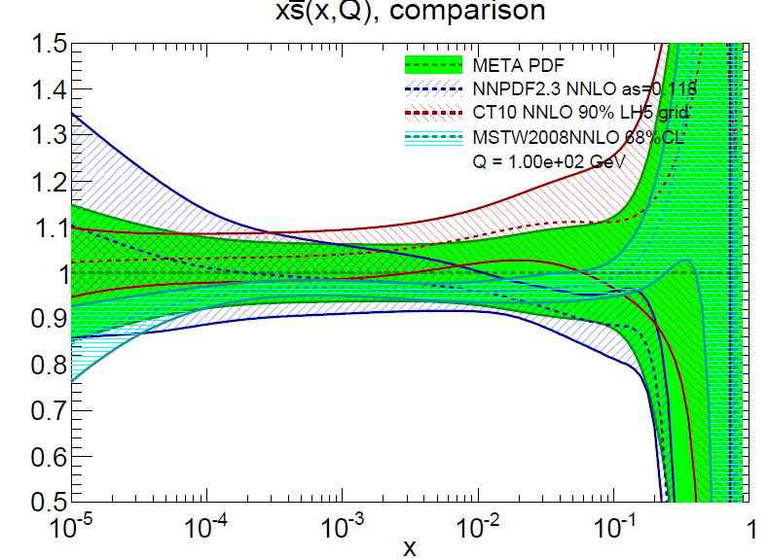
PDFs for sea quarks

Slide 16
Reduced META ensemble
Already the general-purpose ensemble reduced the number of error PDFs needed to describe the LHC physics; but we can further perform a data set diagonalization to pick out eigenvector directions important for Higgs physics or another class of LHC processes
Select global set of Higgs cross sections at 8 and 14 TeV (46 observables in total; more can be easily added if there is motivation)

Slide 17
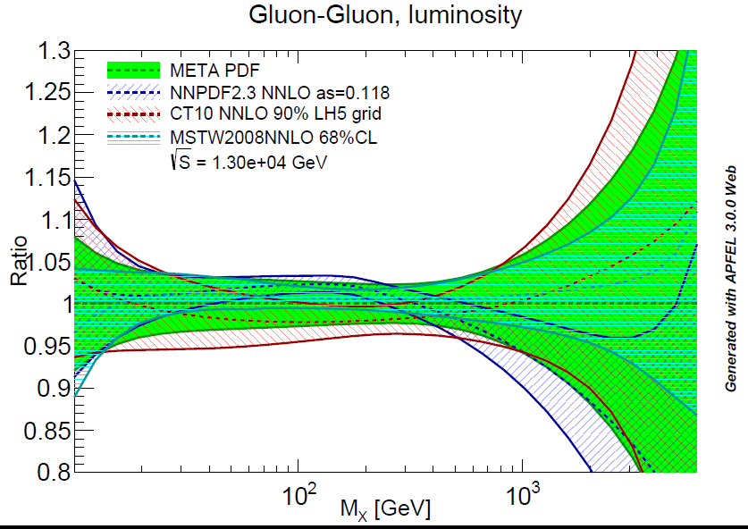
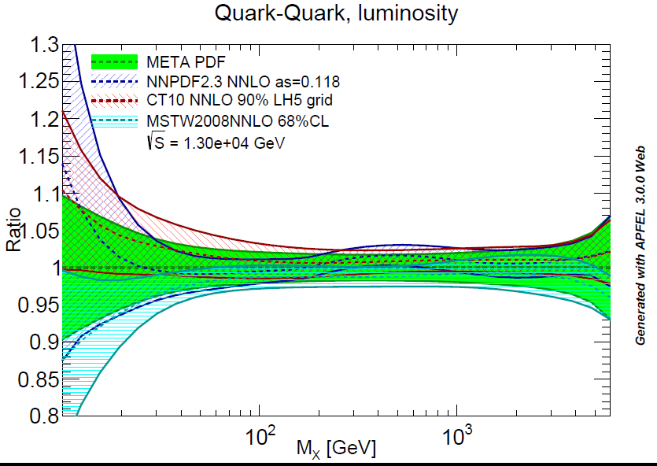
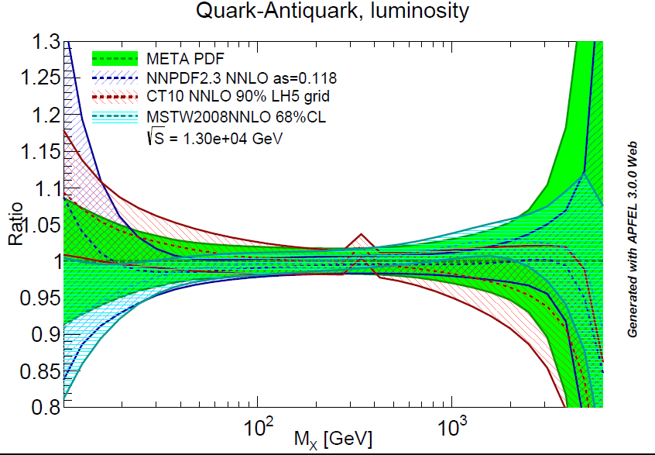
Some parton luminosities
Plots are made
with APFEL WEB
(apfel.mi.infn.it;
Carrazza et al.,
1410.5456)

Slide 18
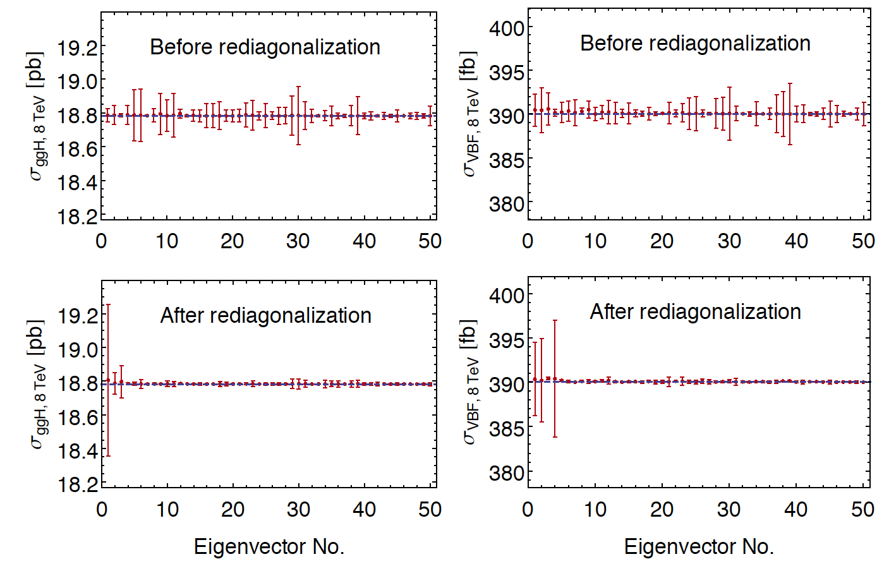
Data set diagonalization (Pumplin, 0904.2424)
There are 50 eigenvectors, but can rediagonalize the Hessian matrix to pick out directions important for the Higgs observables listed on previous page; with rotation of basis, 50 important eigenvectors become 6
J. Gao,
J. Huston
P. Nadolsky
(in progress)

Slide 19
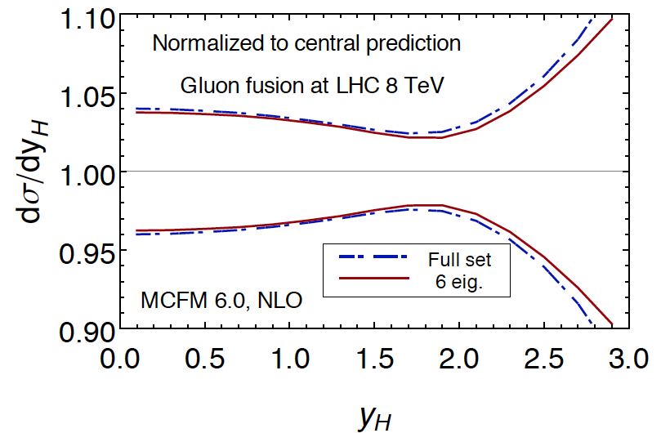
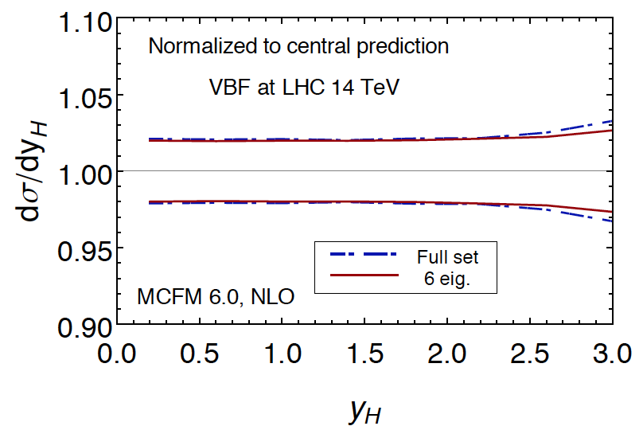
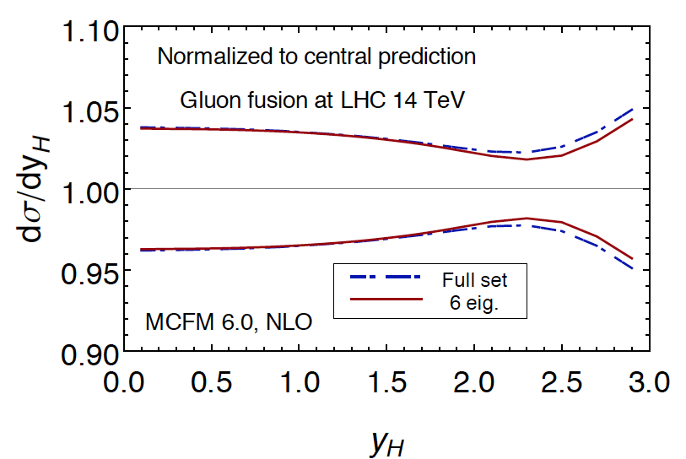
Higgs eigenvector set
The reduced META eigenvector set does a good job of describing the uncertainties of the full set for typical processes such as ggF or VBF
But actually does a good job in reproducing PDF-induced correlations and describing those LHC physics processes in which $g, \overline{u},$ $\overline{d}$ drive the PDF uncertainty (see next slide)
high y
not included
in original
fit

Slide 20
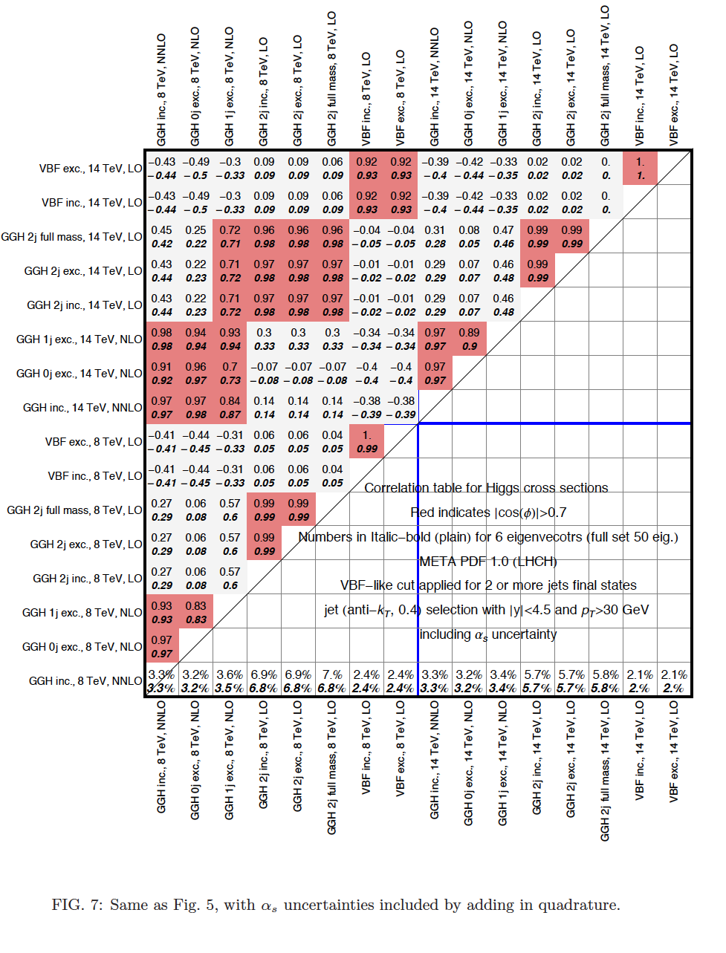

Slide 21
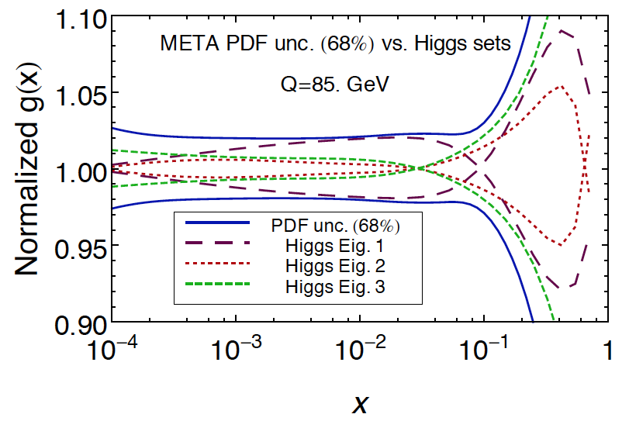
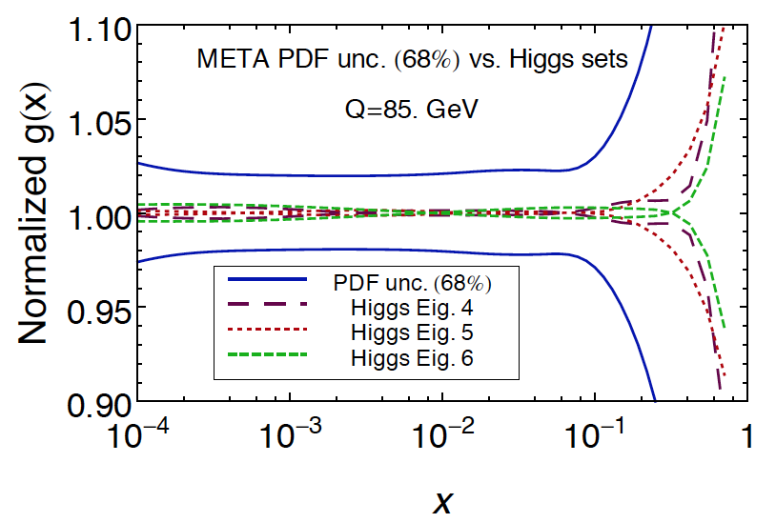
Re-diagonalized eigenvectors…
…are associated with the parameter combinations that drive the PDF uncertainty in Higgs, W/Z production at the LHC
Eigenvectors 1-3 cover the gluon uncertainty. They also contribute to $\overline{u},$ $\overline{d}$ uncertainty.
Eigenvector 1 saturates the uncertainty for most of the $gg→H$ range.

Slide 22
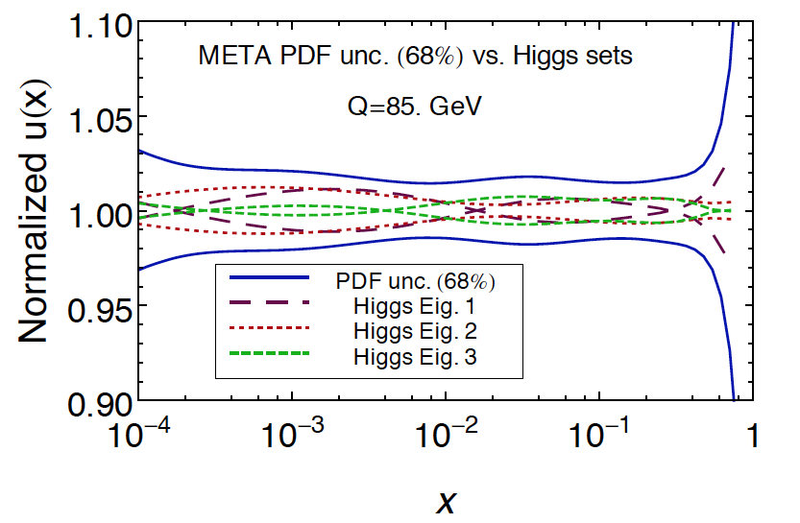
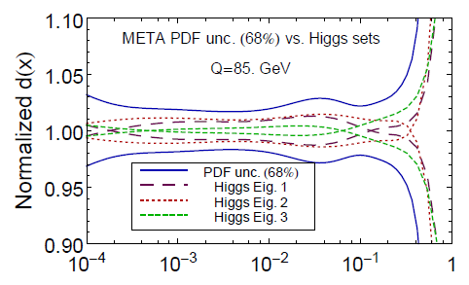
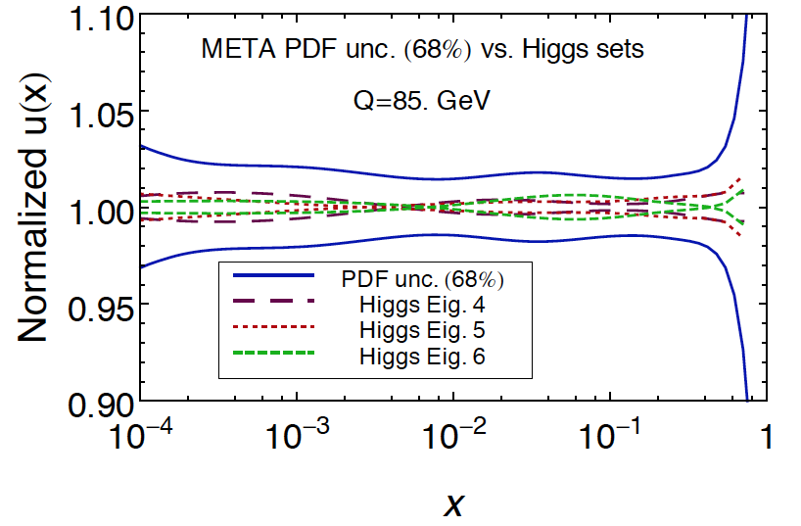
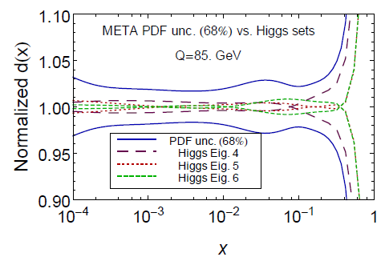
$u,$ $d$ quark uncertainties are more distributed

Slide 24
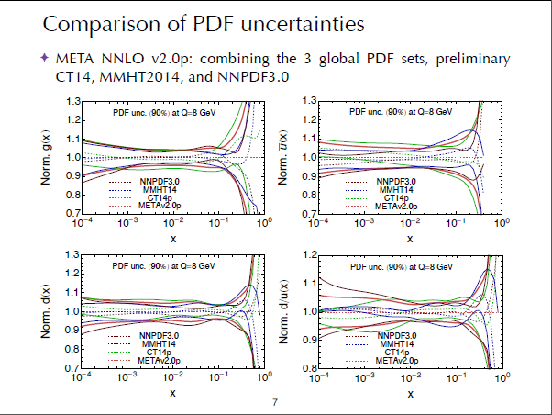

Slide 26
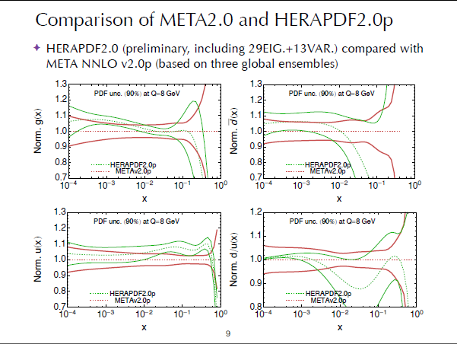

Slide 27
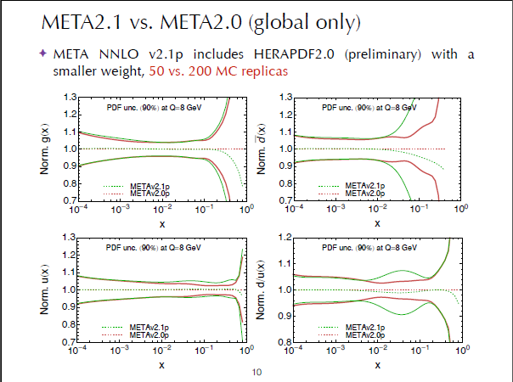

Slide 29
A Mathematica package MP4LHC
Includes all tools for the META analysis
Will be public

Slide 30
To summarize, the meta-parametrization and Hessian method facilitate the combination of PDF ensembles even when the MC replicas are introduced at the intermediate stage
Benefits of the meta-parametrization
The PDF parameter space of all input ensembles is visualized explicitly.
Data combination procedures familiar from PDG can be applied to each meta-PDF parameter

Slide 31
To summarize, the meta-parametrization and Hessian method facilitate the combination of PDF ensembles even when the MC replicas are introduced at the intermediate stage
Benefits of the Hessian method
It is very effective in data reduction, as it makes use of diagonalization of a semipositive-definite Hessian matrix in the Gaussian approximation. [The unweighting of MC replicas is both more detailed and nuanced.]
Correlations between Higgs signals and backgrounds are reproduced with just 13 META PDFs. Asymmetric Hessian errors can be computed.

Slide 32
According to Joey, some of the discussion of META & CMC PDFs spilled into an episode of the Big Bang theory sitcom on January 29: http://www.cbs.com/shows/big_bang_theory/video/83E77ED3-3483-D7AC-09A3-36D84D053DAC/the-big-bang-theory-the-anxiety-optimization

Slide 33
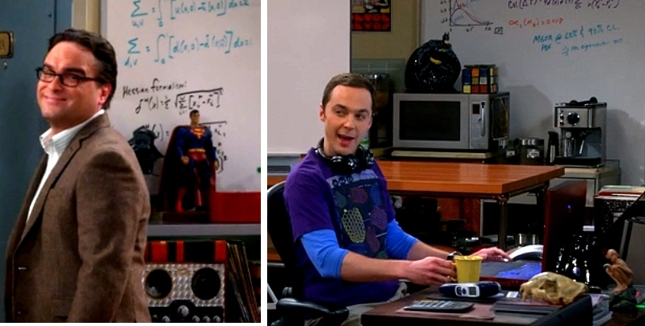
The Big Bang Theory. The Anxiety Optimization. S8, Ep. 13
/
Sheldon accepts the META PDF’s, but only at the 68% c.l. His recommended $α_{s}\left(M_{Z}\right)=0.1118$ is too low. Joey.

Slide 34
Even Leonard accepts some strengths of the Hessian formalism.
We have a hope of reaching a consensus on the PDF combination methods soon!

Slide 35
Back-up slides

Slide 36
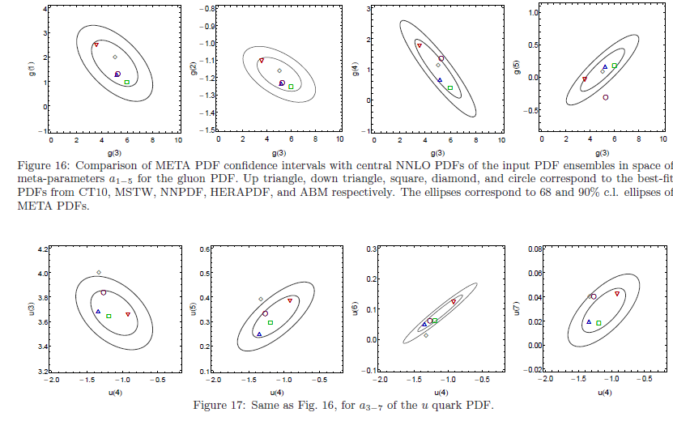
Meta-parameters of 5 sets and META PDFs

