Slide 1



Microcavity plexcitons:
Far–field coupling of plasmons and excitons
Daniel E. Gómez, Xinghui Yin, Frank Neubrech, Daniel Dregely, Klas Lindfors, Timothy J. Davis, and Harald Giessen

Slide 2
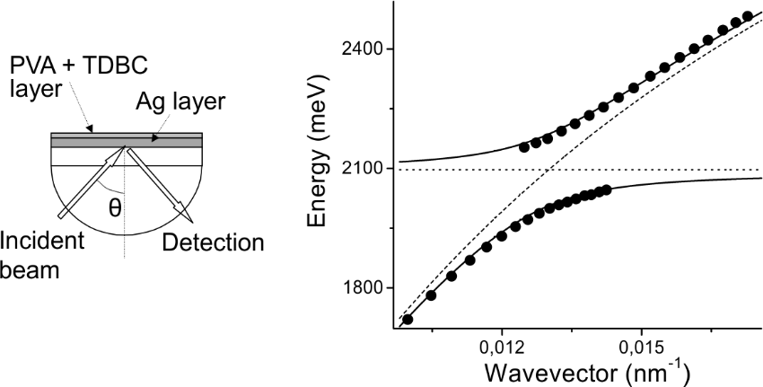
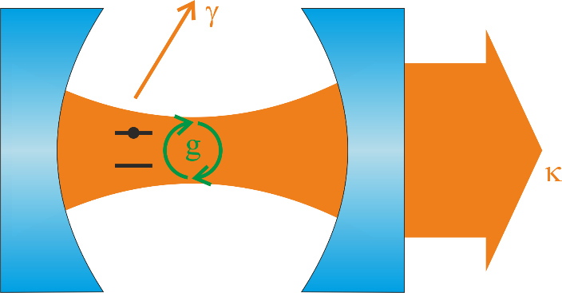
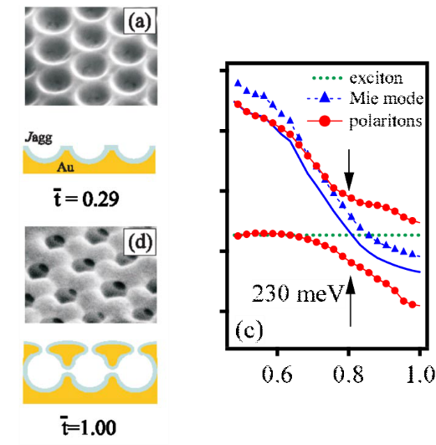
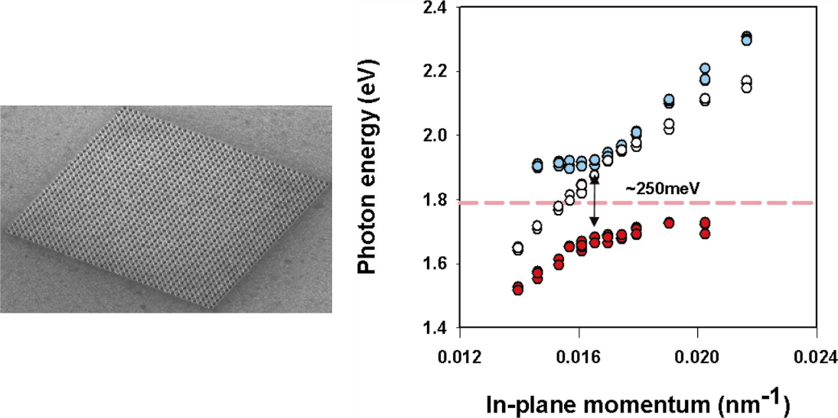


Motivation
$$g∝\frac{1}{\sqrt{V}}$$
$$g>γ,κ$$
Phys. Rev. Lett. 93, 036404 (2004).
Phys. Rev. Lett. 97, 266808 (2006).
Phys. Rev. B 71, 035424 (2005).

Slide 3
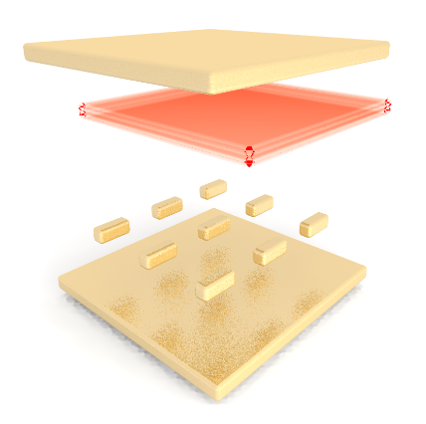
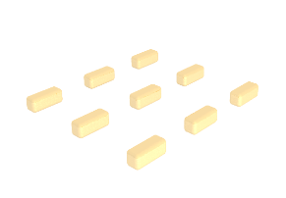
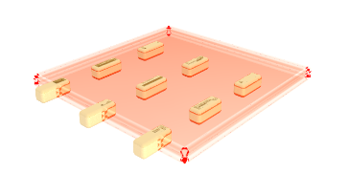
Motivation
$$g∝\frac{1}{\sqrt{V}}$$
$$g>γ,κ$$

Slide 4
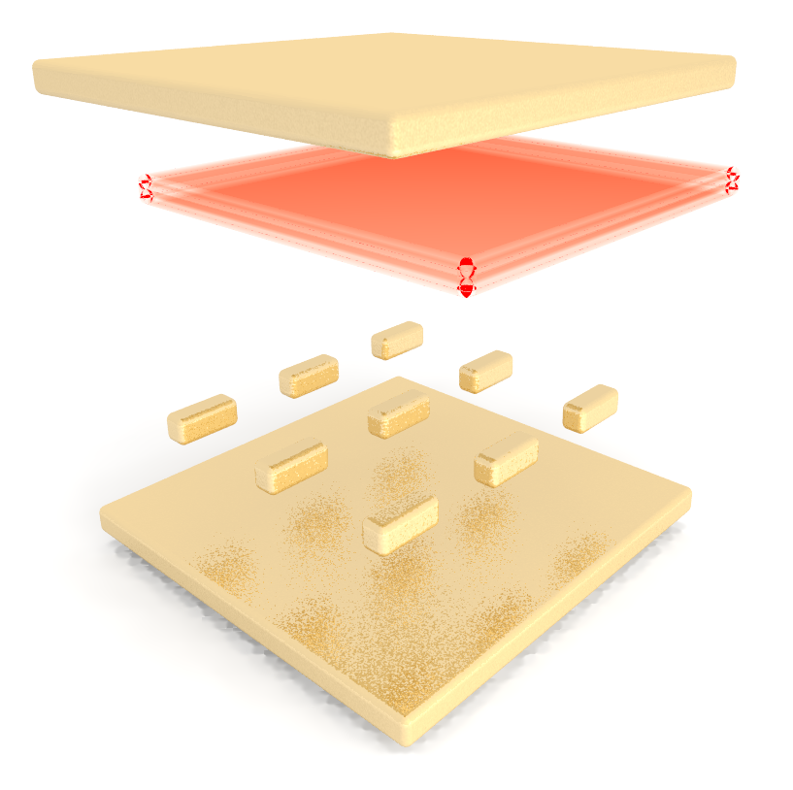
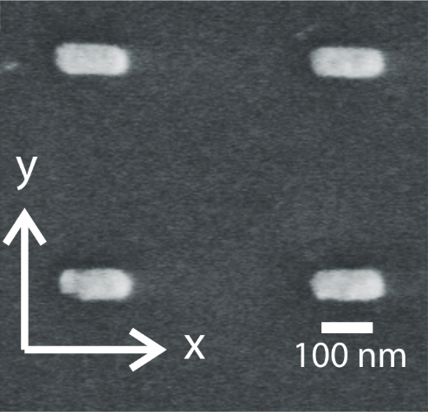


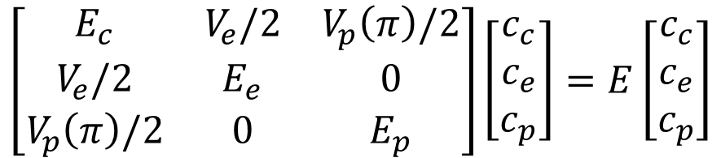
Theory
$$\left[\begin{matrix}E_{c} & V_{e}/2 & V_{p}\left(π\right)/2 \\ V_{e}/2 & E_{e} & 0 \\ V_{p}\left(π\right)/2 & 0 & E_{p}\end{matrix}\right]\left[\begin{matrix}c_{c} \\ c_{e} \\ c_{p}\end{matrix}\right]=E\left[\begin{matrix}c_{c} \\ c_{e} \\ c_{p}\end{matrix}\right]$$
$$V_{p}\left(y\right)=0$$
$$V_{p}\left(x\right)≠0$$

Slide 5

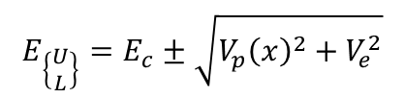



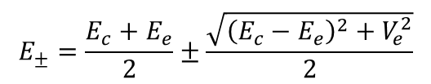

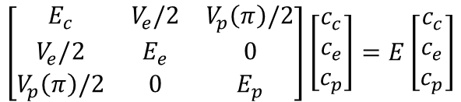


Theory
$$\left[\begin{matrix}E_{c} & V_{e}/2 & V_{p}\left(π\right)/2 \\ V_{e}/2 & E_{e} & 0 \\ V_{p}\left(π\right)/2 & 0 & E_{p}\end{matrix}\right]\left[\begin{matrix}c_{c} \\ c_{e} \\ c_{p}\end{matrix}\right]=E\left[\begin{matrix}c_{c} \\ c_{e} \\ c_{p}\end{matrix}\right]$$
$$V_{p}\left(y\right)=0$$
$$V_{p}\left(x\right)≠0$$
$${E_{0}=E}_{p}$$
$${E_{M}=E}_{c}$$
$$E_{±}=\frac{E_{c}+E_{e}}{2}±\frac{\sqrt{{\left(E_{c}−E_{e}\right)}^{2}+V_{e}^{2}}}{2}$$
$$E_{\left\{\begin{matrix}U \\ L\end{matrix}\right\}}=E_{c}±\sqrt{{V_{p}\left(x\right)}^{2}+V_{e}^{2}}$$
$$\left|\left.M\right\rangle \right.=\frac{1}{\sqrt{2}Ω}\left(V_{p}\left(x\right)\left|\left.e\right\rangle \right.−V_{e}\left|\left.p\right\rangle \right.\right)$$
$$\left|\left.\begin{matrix}U \\ L\end{matrix}\right\rangle \right.=\frac{1}{\sqrt{2}Ω}\left(Ω\left|\left.c\right\rangle \right.±V_{e}\left|\left.e\right\rangle \right.±V_{p}\left(x\right)\left|\left.p\right\rangle \right.\right)$$
$$Ω=\sqrt{{V_{p}\left(x\right)}^{2}+V_{e}^{2}}$$

Slide 6
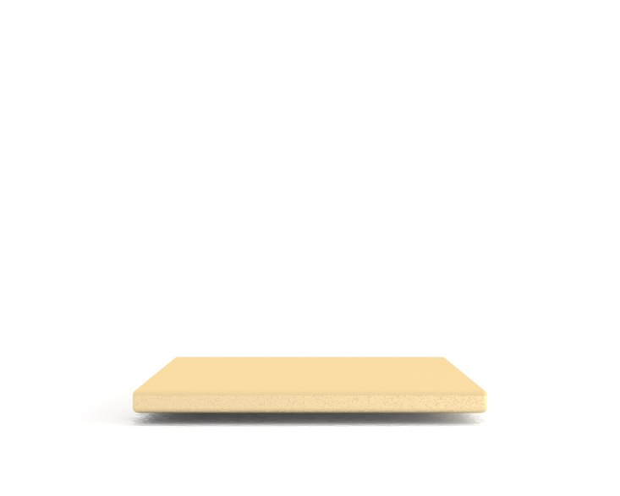
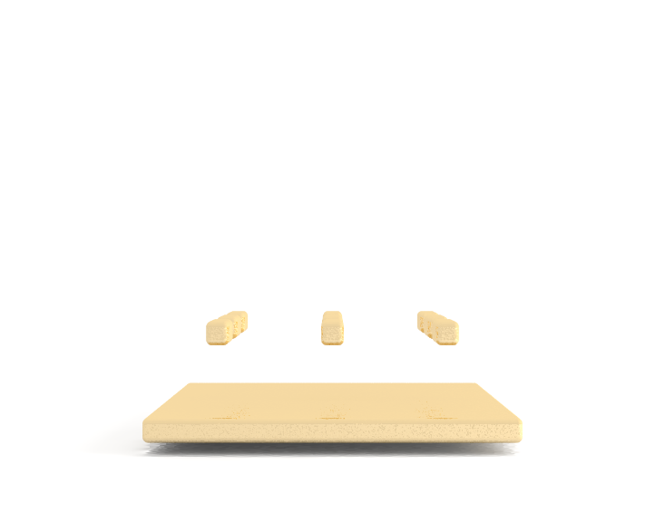
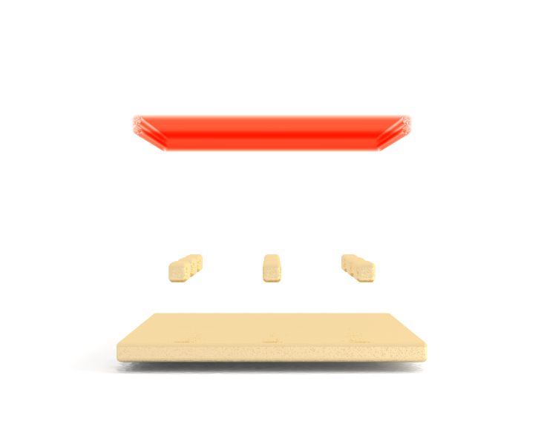
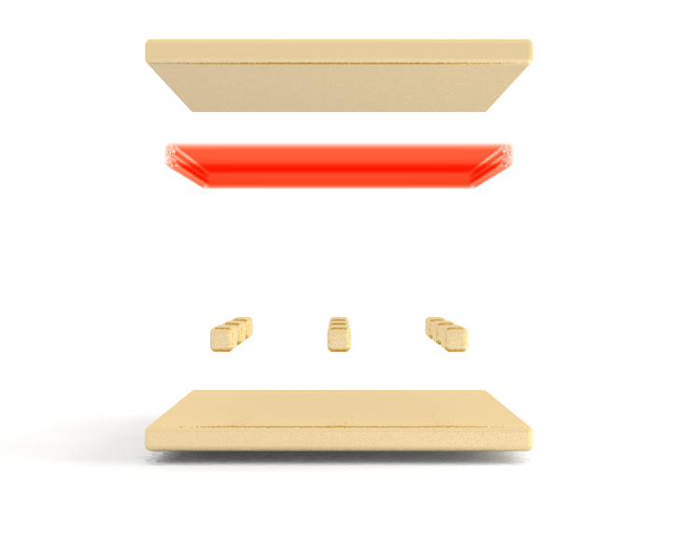
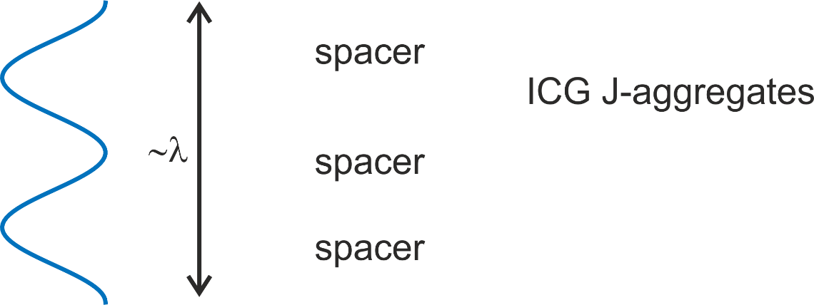
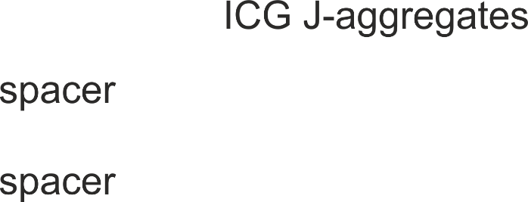

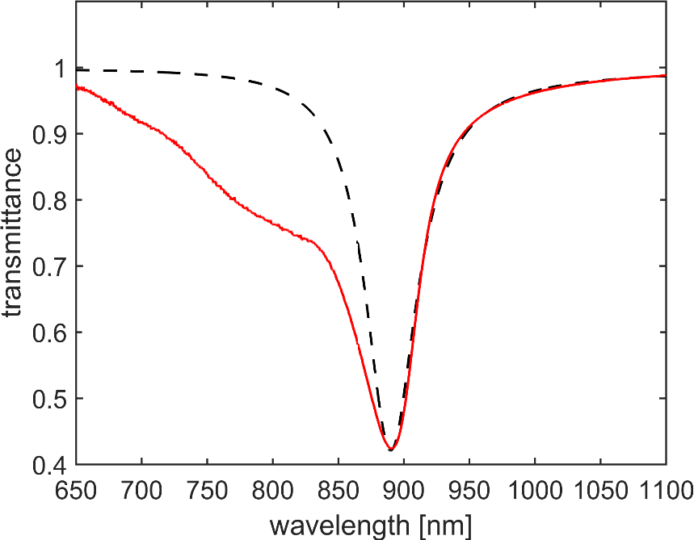
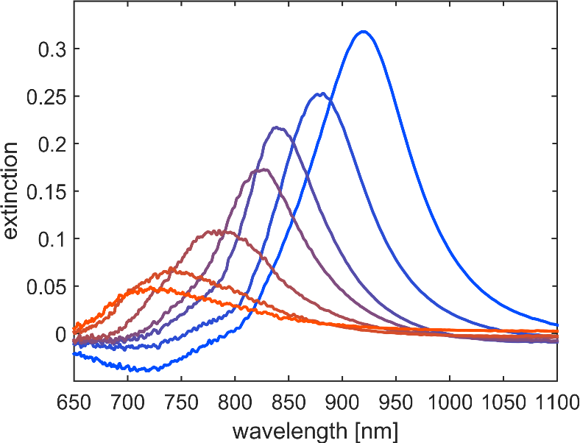
Sample and sample fabrication

Slide 7
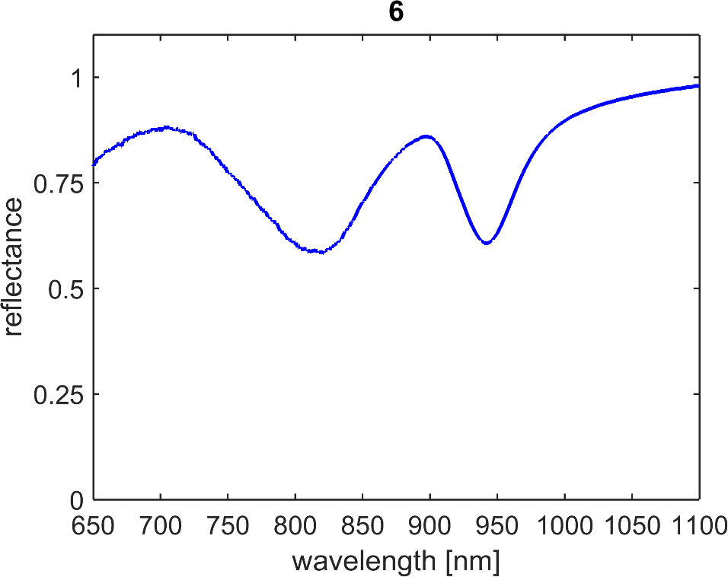
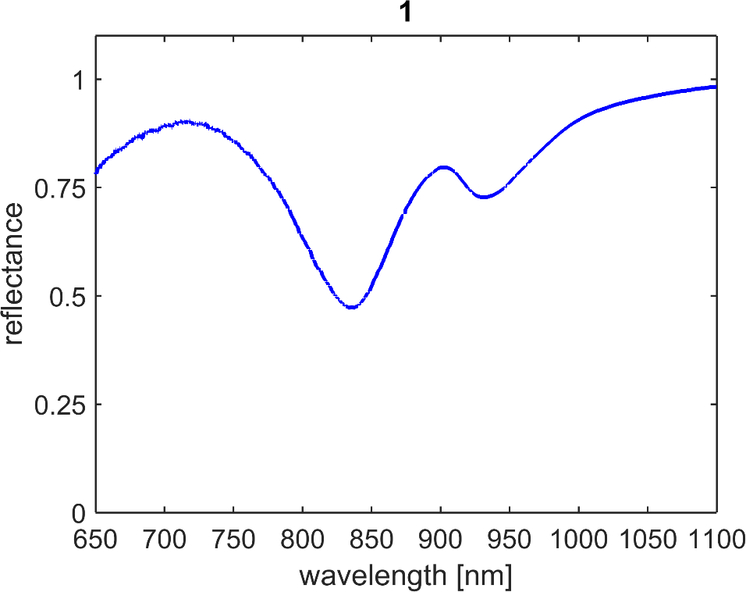
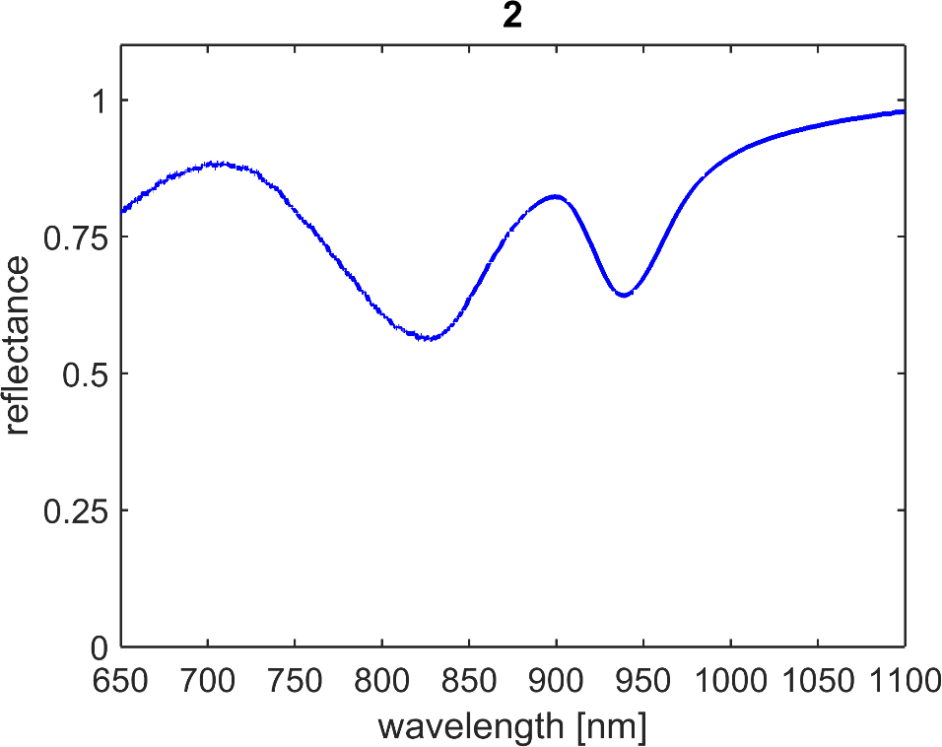
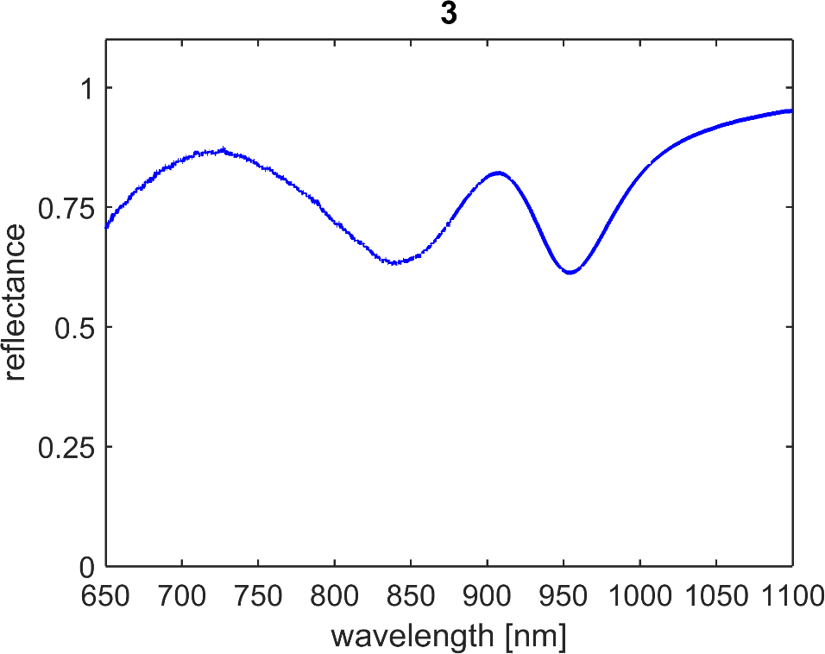
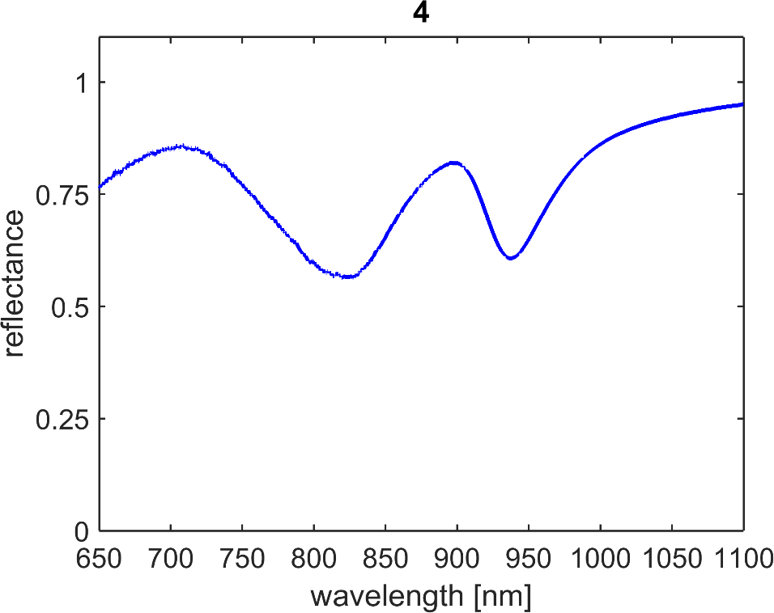
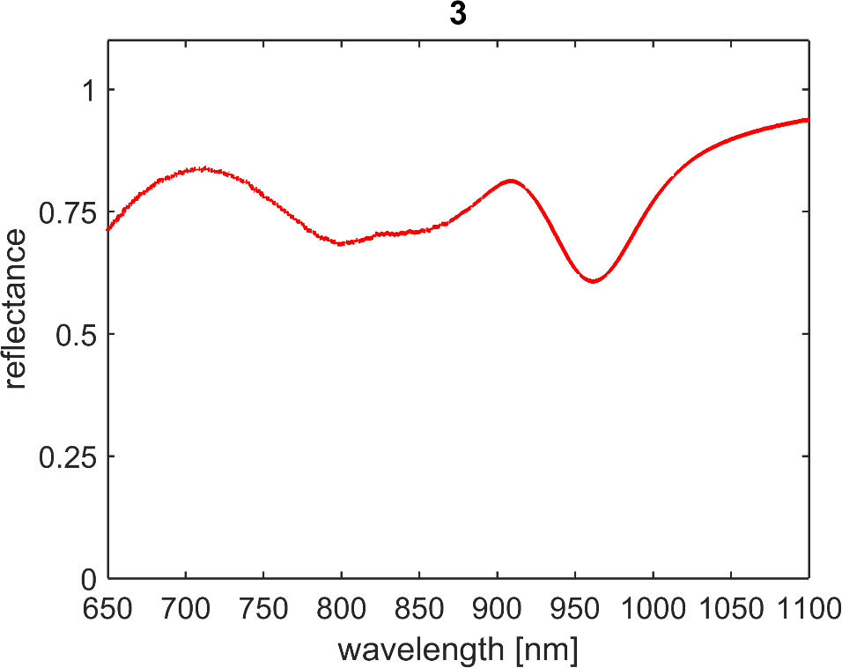
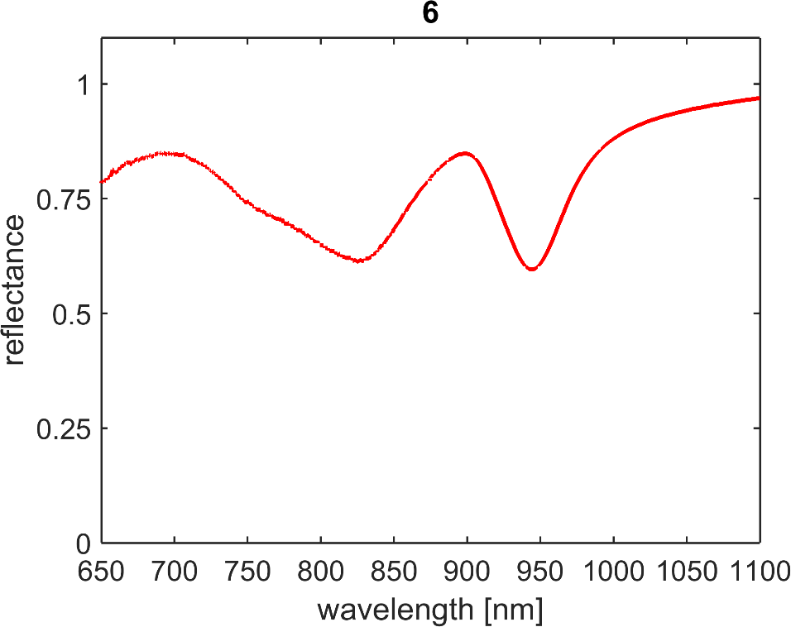
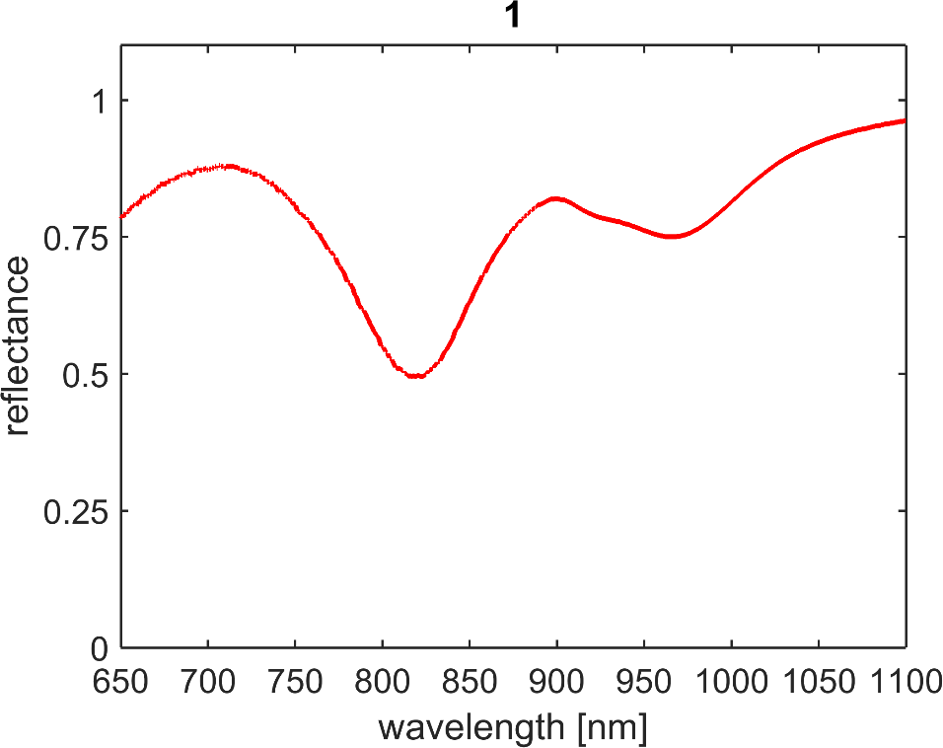
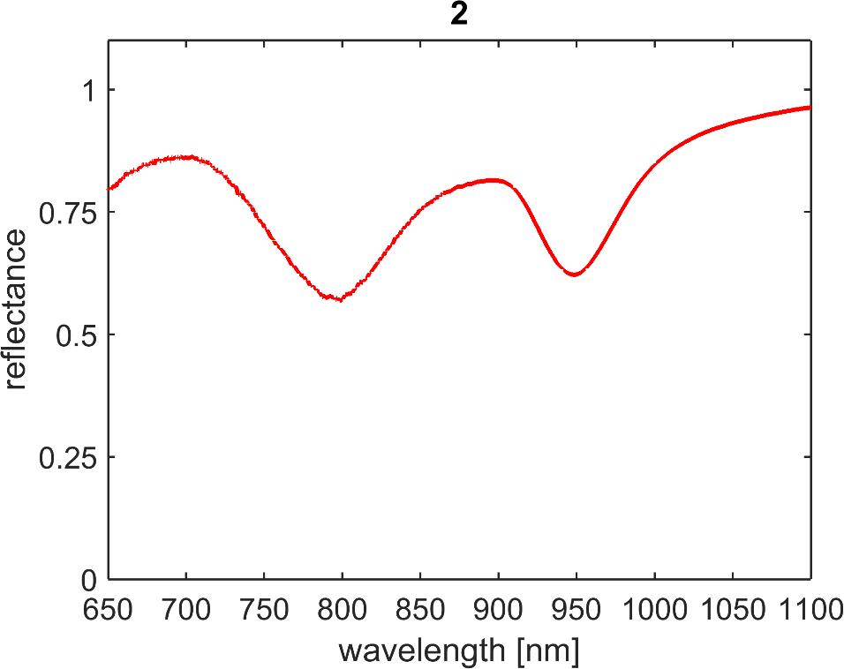
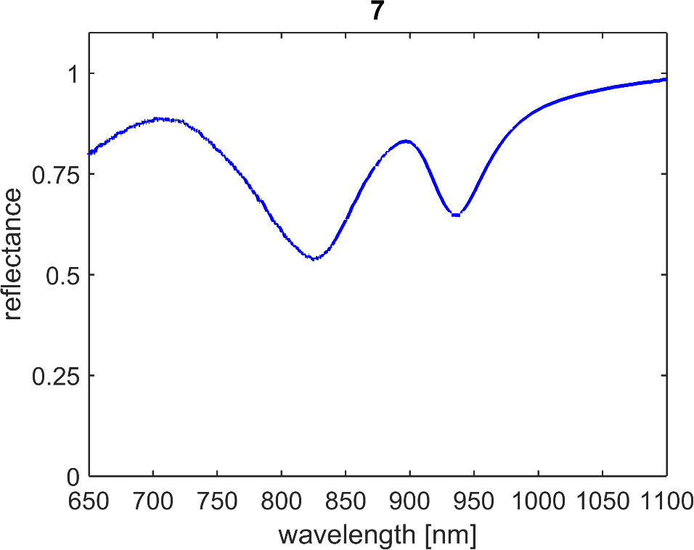
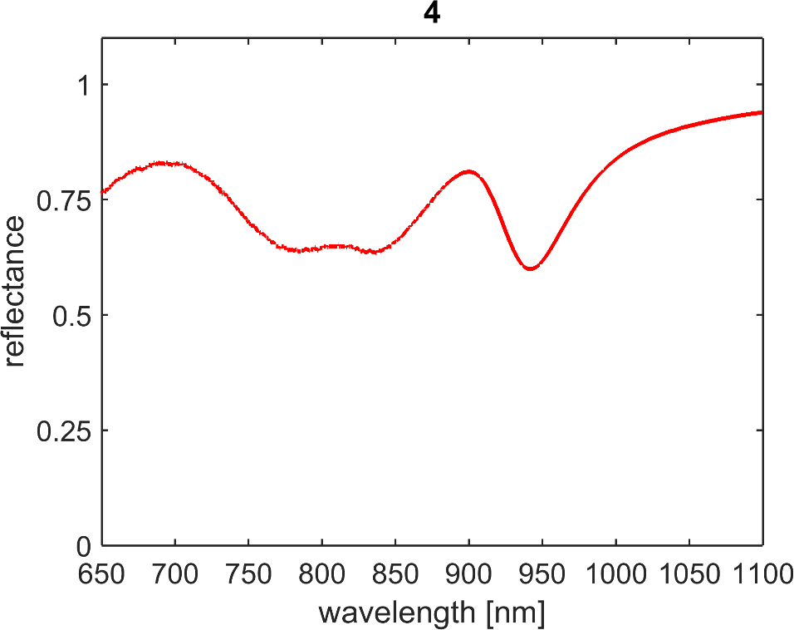
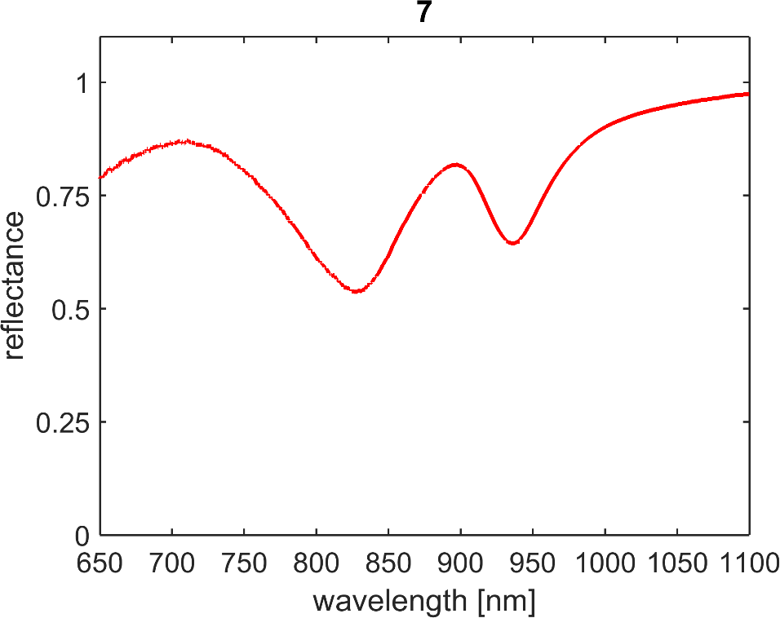
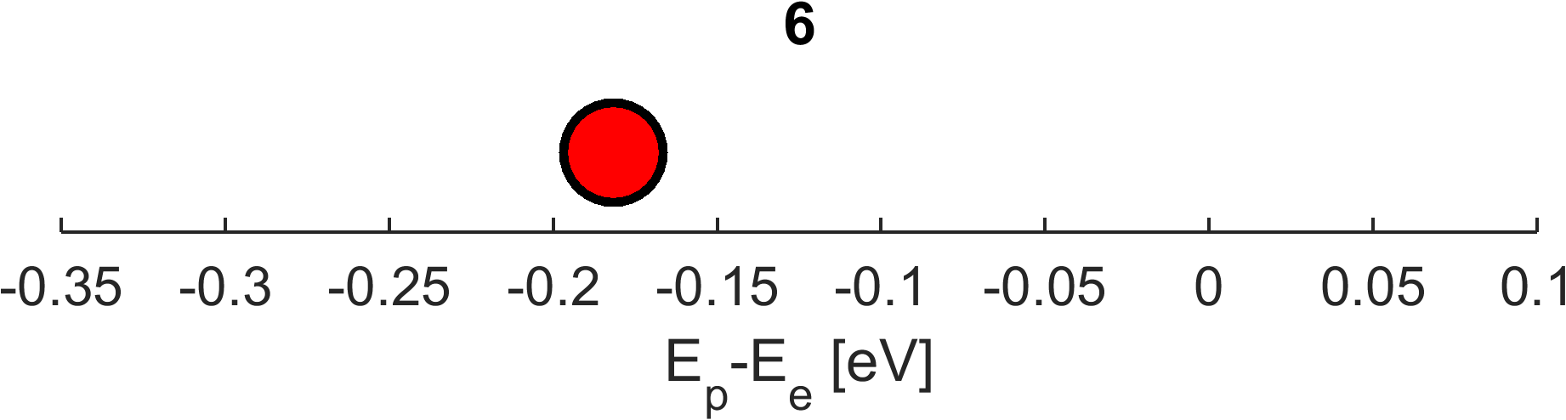
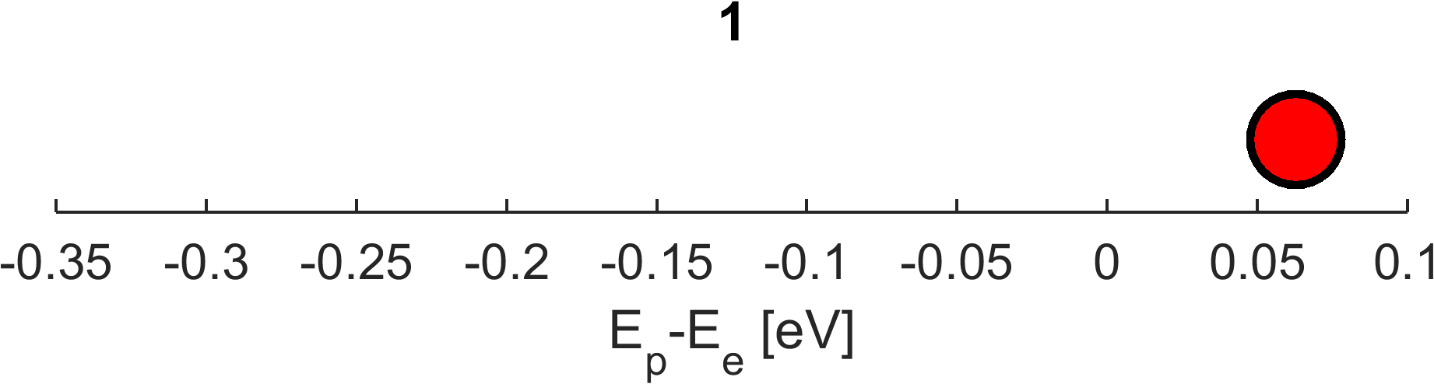
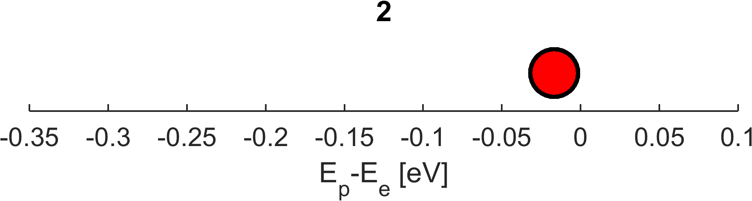
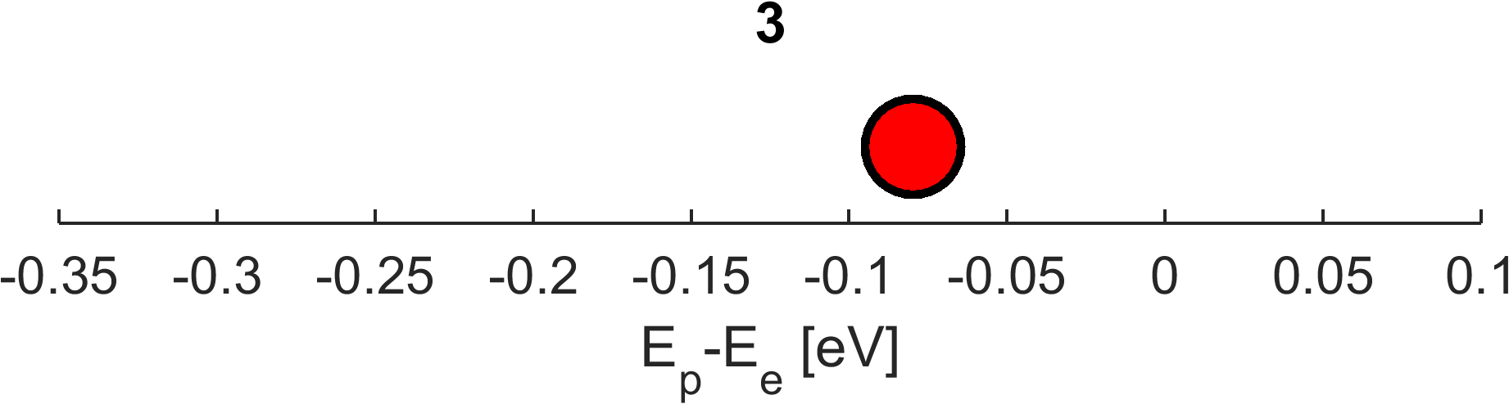
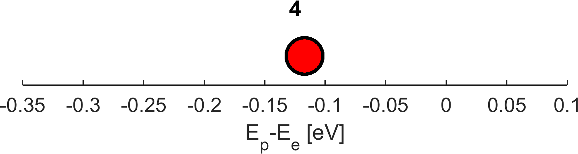
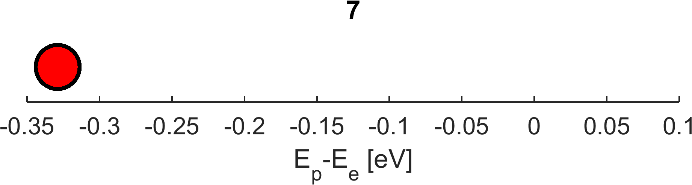


Results
$$V_{p}\left(y\right)=0$$
$$V_{p}\left(x\right)≠0$$

Slide 8
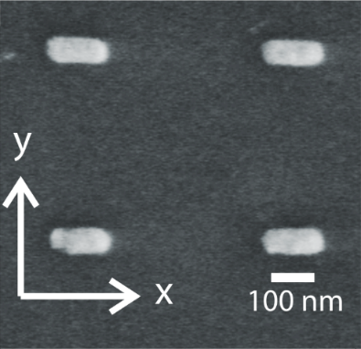
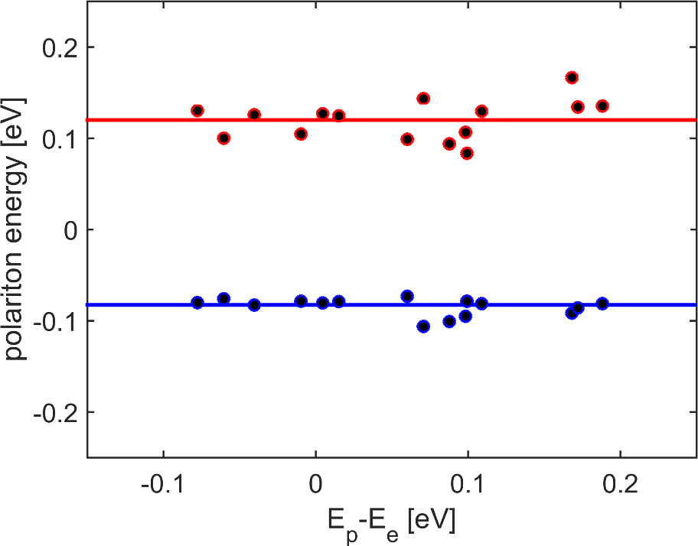
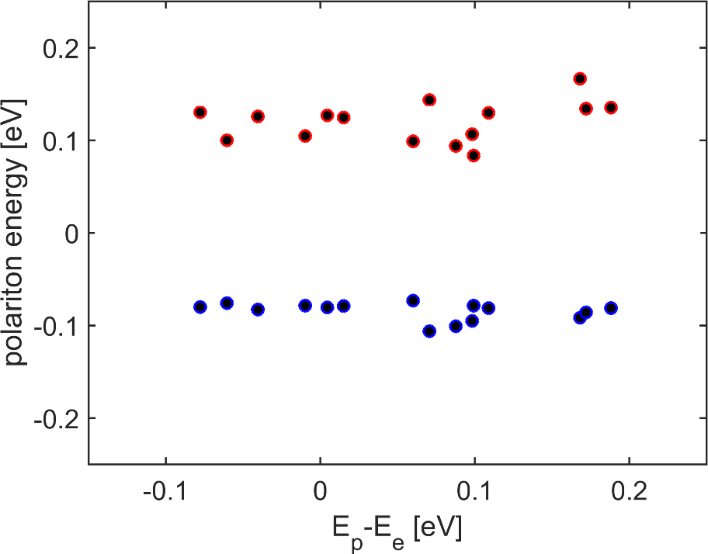
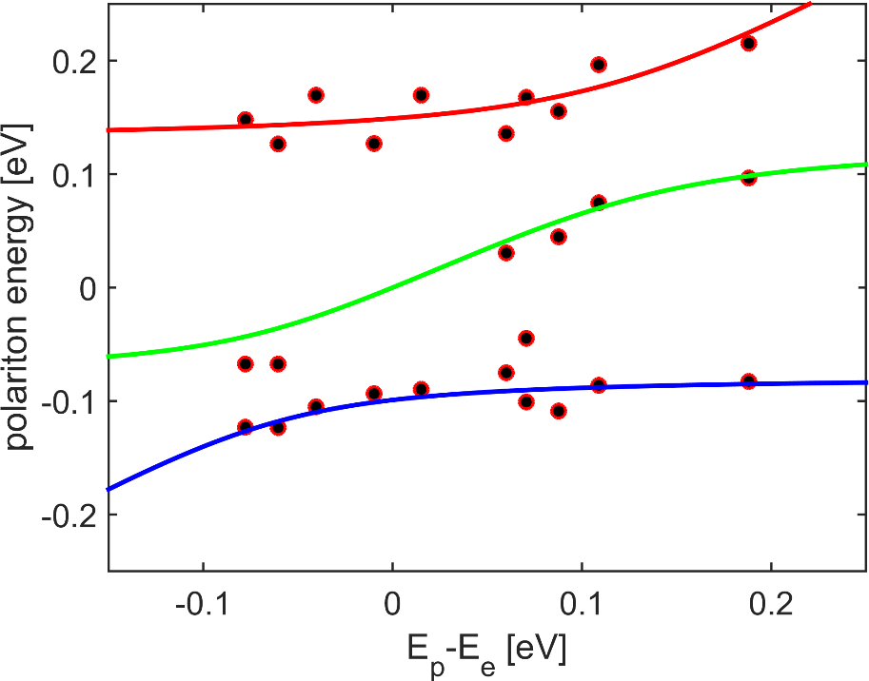
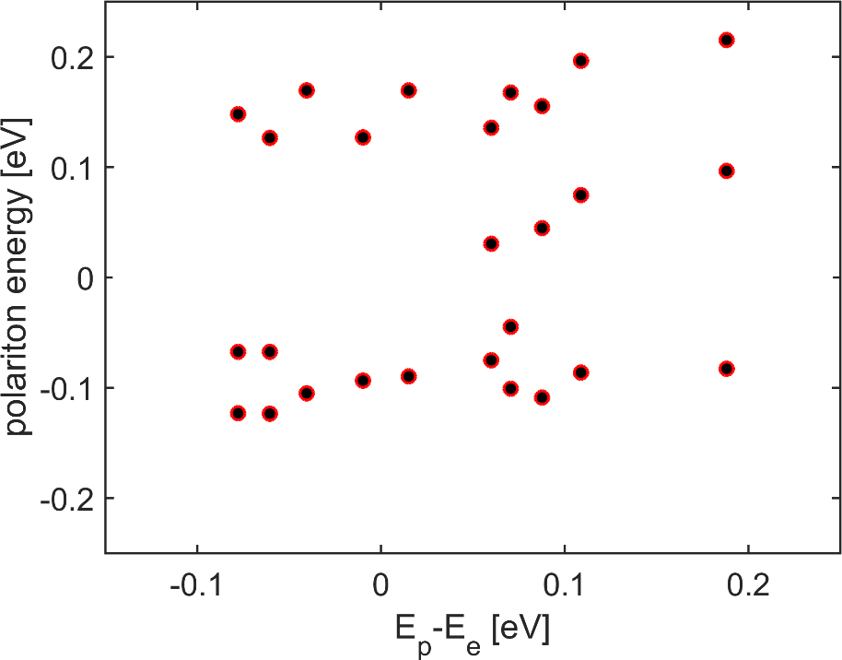




Results
$$V_{p}\left(y\right)=0$$
$$V_{p}\left(x\right)≠0$$
$$V_{e}≈200 \text{meV}$$
$$V_{p}≈142 \text{meV}$$

Slide 9

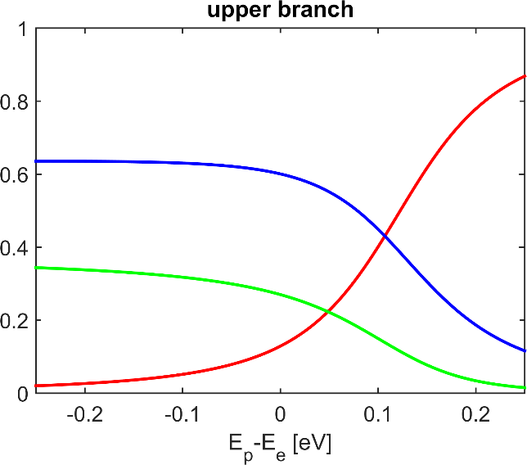
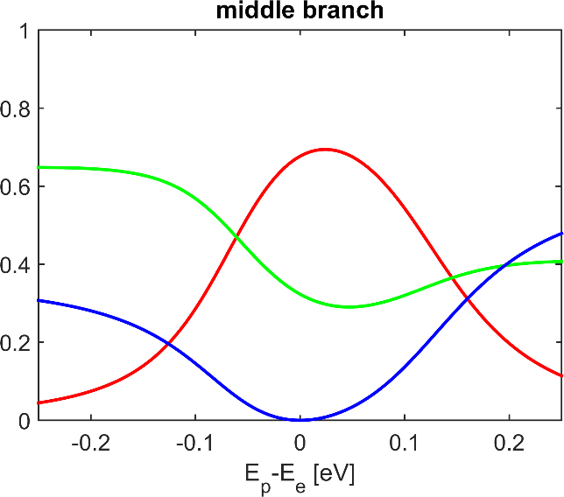
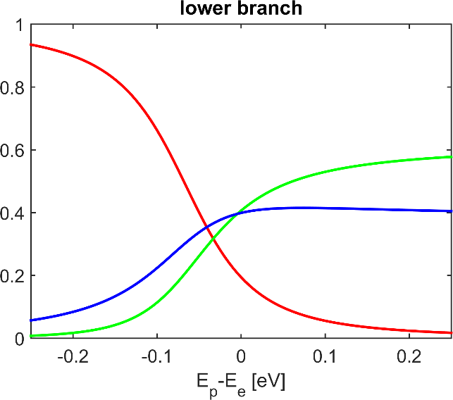
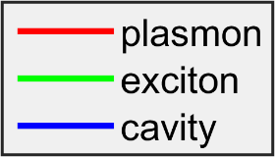
Results

Slide 10

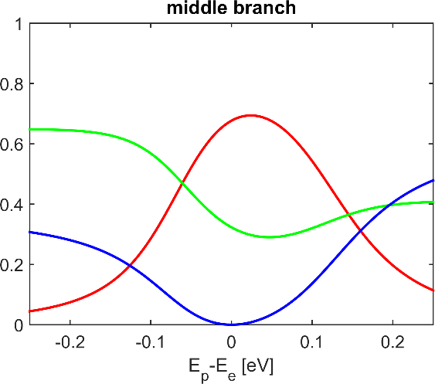







Conclusions

