Slide 1
Theoretical formalism for multi-photon quantum transport in nanophotonic structures
Shanhui Fan, Shanshan Xu, Eden Rephaeli
Department of Electrical Engineering
Ginzton Laboratory
Stanford University

Slide 2
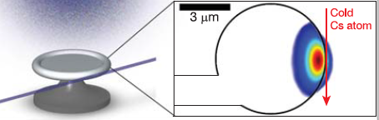
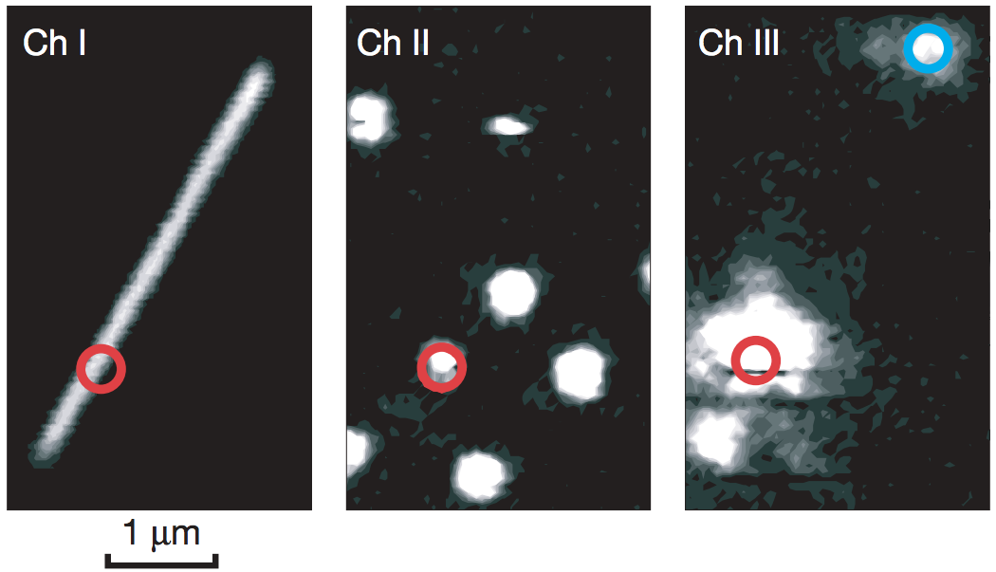
Nanophotonics coupled with quantum multilevel systems
cavity
atom
fiber
T. Aoki et al, Nature 443, 671-674 (2006)
Quantum dot
Silver nanowrire
A. Akimov et al, Nature 450,402-406 (2007).
Notes:
I am wonder whether there are too many figures in this slide or not. Maybe you only need two figures. I also attached two more figures in slide 19 for your choice.

Slide 3
Motivation: photon-photon interaction at a few photon level
In the weak coupling regime
waveguide
Single photon completely reflected on resonance.
Two photons have significant transmission probabilities.
Two-level system
J. T. Shen and S. Fan, Optics Letters, 30, 2001 (2005); Physical Review Letters 95, 213001 (2005); Physical Review Letters 98, 153003 (2007).

Slide 4
From experiments to theory
Experimental System
Quantum dot
Silver nanowrire
local system
Theoretical Model
waveguide

Slide 5
Outline
local system
waveguide
How to systematically compute photon-photon interaction in these systems?
How to understand some aspect of photon-photon interaction without explicit computation?

Slide 6
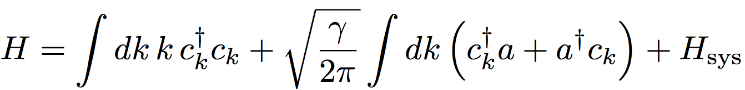
Hamiltonian
local system
waveguide
waveguide photon
coupling between waveguide and local system
local system

Slide 7
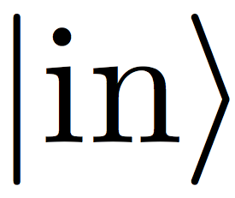
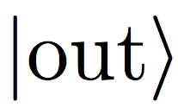
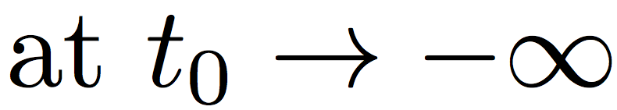
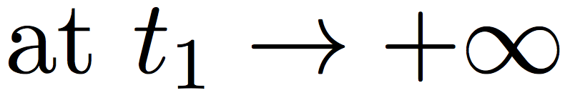

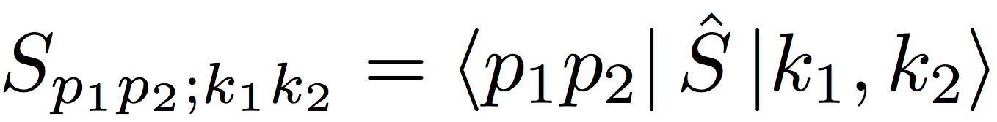
Photon-photon interaction is described by the S matrix
‘in’ state
‘out’ state
Two-photon S matrix:

Slide 8
A very large literature exists on computing few-photon S-matrix
Shen and Fan, PRL 98 153003 (2007)
D. E. Chang et al, Nature Physics 3, 807 (2007)
Shi and Sun, PRB 79, 205111 (2009)
Liao and Law, PRA 82, 053636 (2010)
H. Zheng, D. J. Gauthier and H. U. Baranger, PRA 82, 063816 (2010)
P. Longo, P. Schmitteckert and K. Busch, PRA 83, 083828 (2011).
P. Kolchin, R. F. Oulton, and X. Zhang, PRL 106, 113601 (2011)
D. Roy, PRA 87, 063819 (2013)
E. Snchez-Burillo et al, arXiv:1406.5779
…….
But
Many methods are highly dependent on the system details. (Particularly true for wavefunction approach such as the Bethe Ansatz approach)
Most calculations are restricted to one or two-photons.

Slide 9
Input-output formalism
Local system
waveguide
Well-known approach in quantum optics for treating open systems.
  Gardiner and Collet, PRA 31, 3761 (1985).
Mostly used to treat the response of the system to coherent or squeezed state input.
Adopted to compute S-matrix for few-photon Fock states
  S. Fan et al, PRA 82, 063821 (2010).
Here we show how to use this for systematic treatment of N-photon transport.
  S. Xu and S. Fan, http://arxiv.org/abs/1502.06049

Slide 10
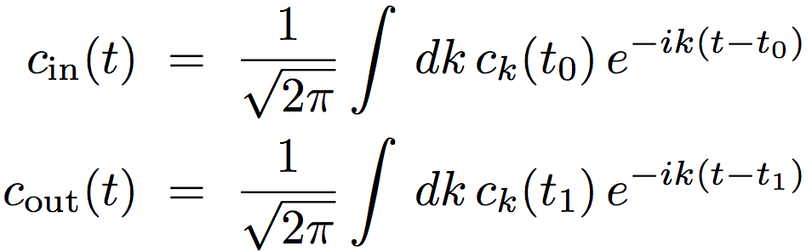
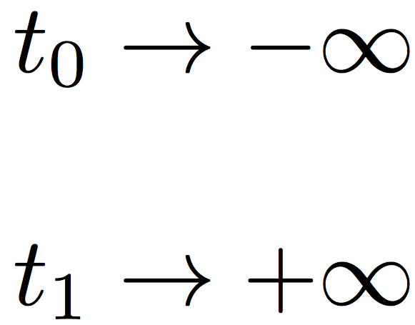
Waveguide
Input and output operators of waveguide photons
The input operators consist of photon operators in the Heisenberg picture at remote past
The output operators consist of photon operators in the Heisenberg picture at remote future

Slide 11
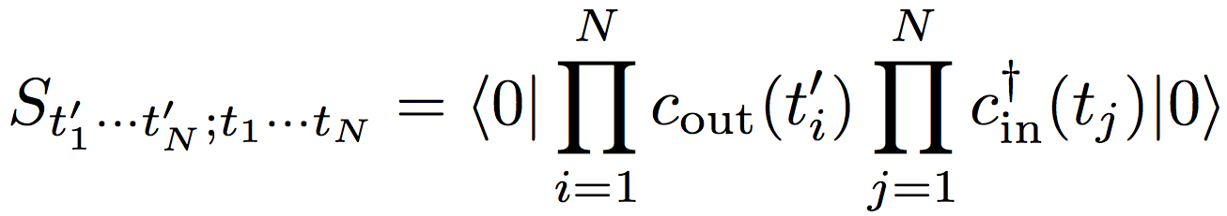
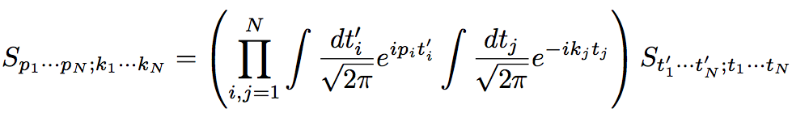
N-photon S matrix in input-output formalism
Remove N photons
Inject N photons
  S. Fan et al, PRA 82, 063821 (2010).

Slide 12
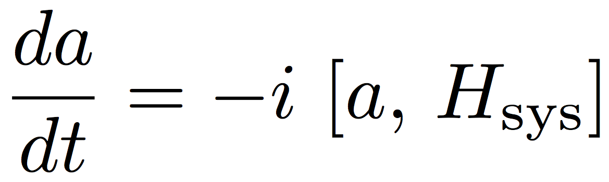
Local System

Slide 13
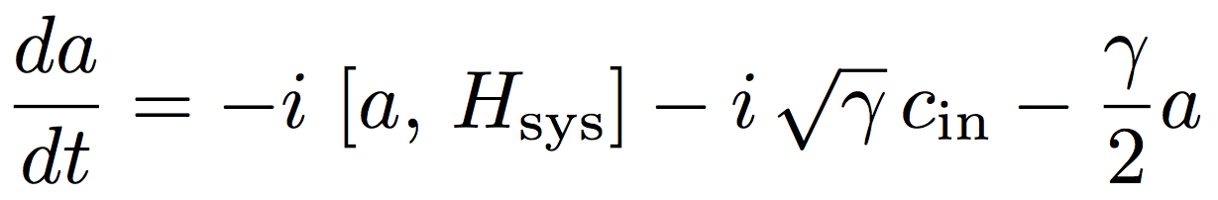
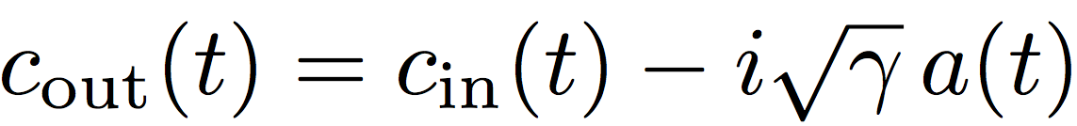
Input-Output Formalism
Local system
waveguide
  Gardiner and Collet, PRA 31, 3761 (1985).
  Identical in form to the classical temporal coupled mode theory, e.g. S. Fan et al, Journal of Optical Socieity of America A 20, 569 (2003)

Slide 14
Main Result
Local system
waveguide
N-photon S-matrix:
    S. Xu and S. Fan, arxiv: 1502.06049

Slide 15
Main result in a picture
All three photons by-pass the local system
One photon couples in and out of the local system
=
+
Two photons couple in and out of the local system
All three photons couple in and out of the local system
+
+

Slide 16
S-matrix in terms of Green function of the local system
First photon by-pass the local system
The remaining two photons couple into the local system
All we need is to compute the Green functions of the local system
for all

Slide 17


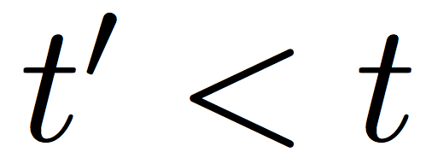

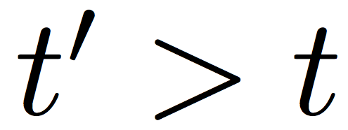
Quantum Causality
The physical field in the localized system:
depends only on the input field with ,
and generates only output field with .
  Gardiner and Collet, PRA 31, 3761 (1985).

Slide 18
Sketch of the proof
N-photon S matrix
The Green’s function of the local system
Apply
Expand, for each term, simplify with quantum causality
Apply
Expand, for each term, simplify with quantum causality
    S. Xu and S. Fan, arxiv: 1502.06049

Slide 19
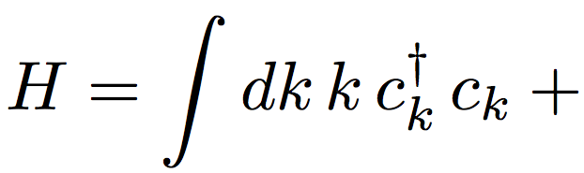

An example: Kerr nonlinearity
Example: Kerr nonlinearity in a cavity
Input
Output
waveguide photon
coupling between waveguide and ring resonator
ring resonator with Kerr nonlinearity

Slide 20
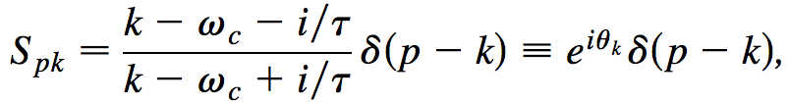
Single-Photon Transport
Single-photon response: pure phase response
Cavity photon operator
Requires computation of a two-point green function
A pure phase response

Slide 21
Single-Photon Transport
Two-photon response
Cavity photon operator
Requires computation of a four-point green function

Slide 22
Two separate contributions to the two-photon Green function
Add two photons to the cavity and then remove two photons, involve two-photon excitation in the cavity
Add one photon to the cavity, remove it, and then add the second photon. Involve only one-photon excitation in the cavity

Slide 23
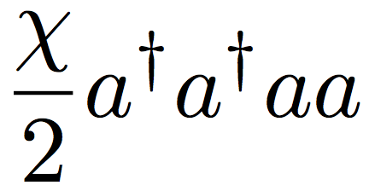

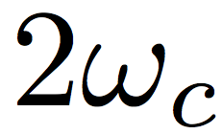



Analytical Properties
One and two-photon excitation inside the cavity
Single-photon excitation
Two-photon resonance

Slide 24

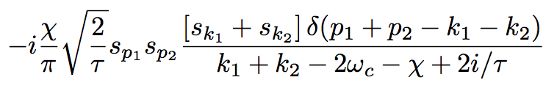

Two-Photon S-matrix
Computed two-photon response
Two-photon pole
: cavity amplitude under single photon excitation
Single-photon pole

Slide 25
Three photons
Depending on time-ordering, has terms like:
Involves three-photon excitation in the cavity
Involves two and one-photon excitation in the cavity
Involves only one-photon excitation in the cavity
    S. Xu and S. Fan, arxiv: 1502.06049

Slide 26
Outline
local system
waveguide
How to systematically compute photon-photon interaction in these systems?
How to understand some aspect of photon-photon interaction without explicit computation?

Slide 27
Two-Photon S-matrix
Computed two-photon response
Two-photon pole
: cavity amplitude under single photon excitation
Single-photon pole

Slide 28
Interaction cannot preserve single-photon energy
Interaction does not preserve single-photon energy
Exact two-photon S-matrix always has the form
It never looks like this:
Single-photon frequency is not conserved in the interaction process: there is always frequency broadening and entanglement.

Slide 29
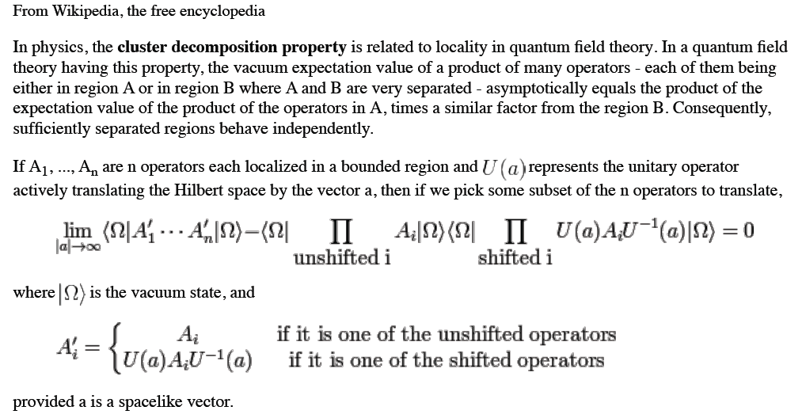
Cluster decomposition theorem
Cluster Decomposition Theorem
E. H. Wichmann and J. H. Crichton, Physical Review 132, 2788 (1963).

Slide 30
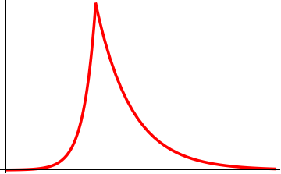
A thought experiment: Assuming a localized interacting region
A thought experiment: assuming a localized interacting region
Excitation
t
Incident single photon pulse
t
E. Rephaeli, J. T. Shen and S. Fan, Physical Review A 82, 033804 (2010).

Slide 31
Two-photon pulses
Two-photon pulses
Photon 2
Photon 1
t
One should expect, on physical ground, that
This is cluster decomposition theorem.

Slide 32
Local interaction can not preserve single-photon frequency
Photon 2
Photon 1
t=0
t
Assume
One can check that
And does not vanish in the
limit.

Slide 33
Constraint from cluster decomposition theorem
Constraint from the cluster decomposition principle
Photon 2
Photon 1
t=0
t
The two-photon scattering matrix cannot never have the form
It can only has the form
For any device where interaction occurs in a local region
    S. Xu, E. Rephaeli and S. Fan, Physical Review Letters 111, 223602 (2013).

Slide 34
Heuristic argument on the form of two-photon scattering matrix
Single-photon excitation
Excitation
t
Incident single photon pulse
t
At
Atomic excitation

Slide 35
Heuristic argument of the form of the two-photon S-matrix
Photon-photon interaction requires two photons
Photon 2
Photon 1
t
t=0
One should expect
    S. Xu, E. Rephaeli and S. Fan, Physical Review Letters 111, 223602 (2013).

Slide 36
Analytic structure of the form of the two-photon S-matrix
The analytic structure of the two-photon scattering matrix
The T-matrix has the analytic structure
Two-excitation poles of the localized region
Single excitation poles of the localized region

Slide 37
Two-Photon S-matrix
Computed two-photon response
Two-photon pole
: cavity amplitude under single photon excitation
Single-photon pole

Slide 38




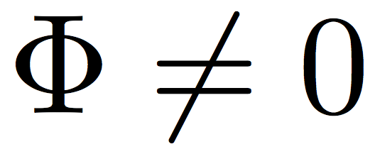
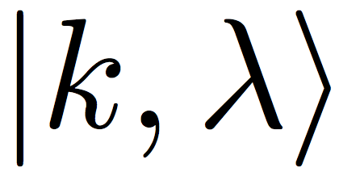
Two Qubit Phase Gate
Photon Phase Gate:
Implementation of the phase gate by photon state s .

Slide 39
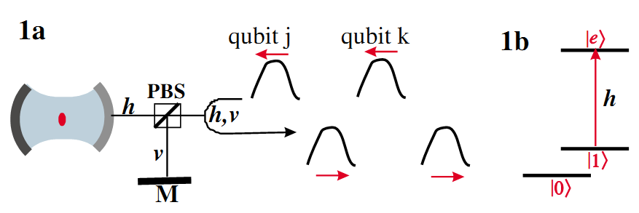
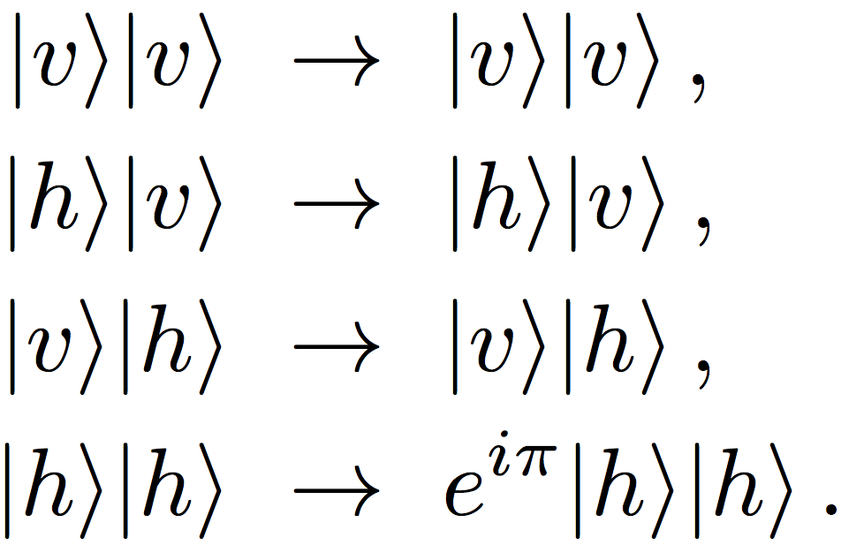
One Workable Proposal for Polarization-Based Photon Phase Gate
Polarization-based photon phase gate: implementation
L.-M. Duan, H. J. Fiore, Phys. Rev. Lett. 92, 127902 (2004).

Slide 40

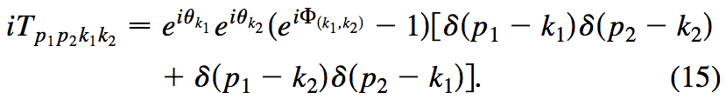

S matrix of Frequency-Based Photon Phase Gate
S-matrix of a frequency-based phase gate
Non-interacting part:
Conservation of single-photon frequency
Photon-photon interaction:
Extra phase factor
This form of S-matrix violates cluster decomposition principle.

Slide 41



Single-Photon Transport
Single-photon response: pure phase response

Slide 42
Two-photon response
Naively, one might expect
Kerr nonlinearity

Slide 43
Two-Photon S-matrix
Computed two-photon response
Two-photon pole
: cavity amplitude under single photon excitation
Single-photon pole

Slide 44
Summary
We have developed input-output formalism into a tool for computation of N-photon S-matrix.
We also show that the N-photon S-matrix in general is very strongly constraint by the cluster decomposition principle, which arises purely from the local nature of the interaction.
The combination of computational and theoretical understanding should prove useful in understanding and designing quantum devices.
    S. Fan, S. E. Kocabas, and J. T. Shen, Physical Review A 82, 063821 (2010).
    S. Xu, E. Rephaeli and S. Fan, Physical Review Letters 111, 223602 (2013).
    S. Xu and S. Fan, http://arxiv.org/abs/1502.06049

Slide 45
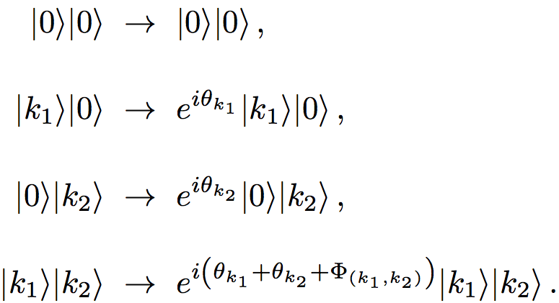
Frequency-Based Photon Phase Gate
Frequency-based photon phase gate?
Such a gate can NOT be constructed.

Slide 46
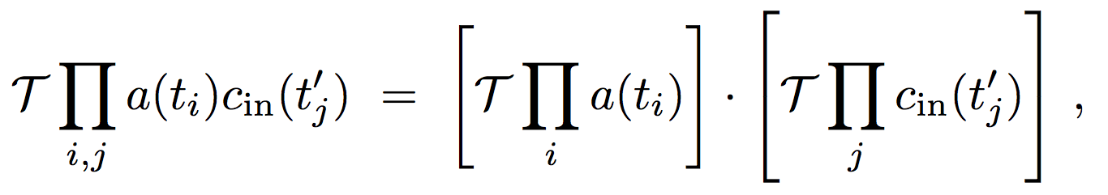
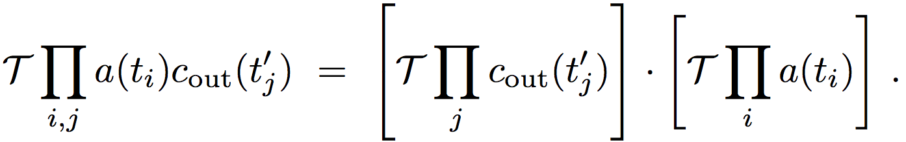
Time-Ordered Relation
Notes:
I am not sure whether you need this slide or not. In your original plan, there is only one slide for time-ordering content.

Slide 47

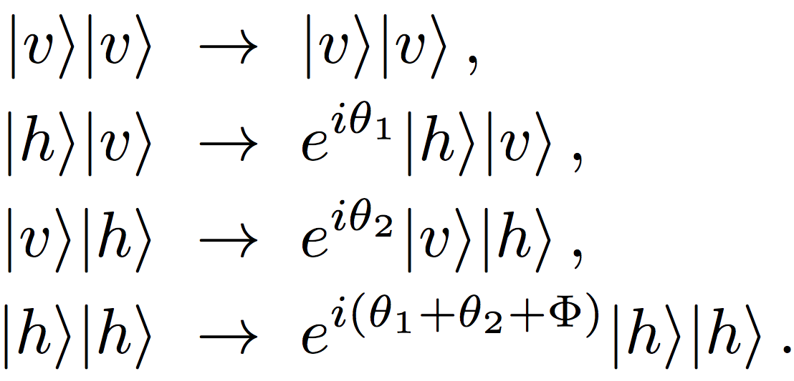
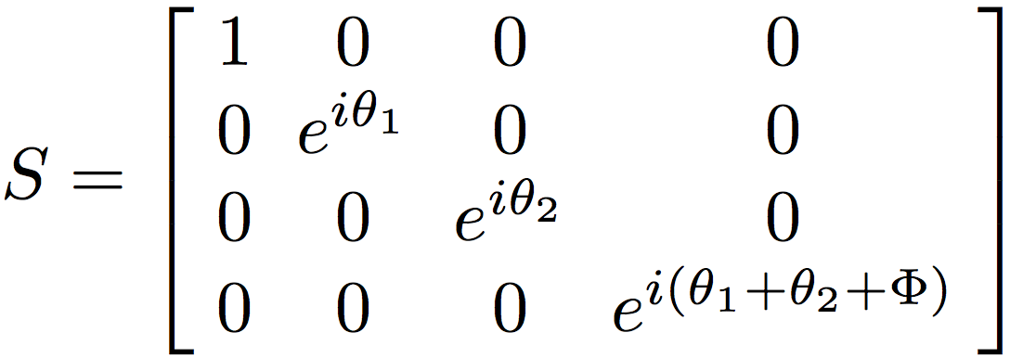
Polarization-based photon phase gate
Basis states:
Single photon’s polarization states
L.-M. Duan, H. J. Fiore, Phys. Rev. Lett. 92, 127902 (2004).

