Slide 1
1. Confinement-Induced Loss – Penultimate Limit in Plasmonics
2. Demystifying Hyperbolic Metamaterials using Kronig Penney Approach
Jacob B Khurgin
Johns Hopkins University, Baltimore –MD

Slide 2
Confinement (a.k.a.) surface absorption of SPP in metals
E
Δk~ω/v_{F}
If the SPP has the same wave vector k_{p}=Δk~ω/v_{F} Landau damping takes place
Δk
E_{F}
Since k_{p} =ω/v_{P} the phase velocity of SPP should be equal to Fermi velocity or about c/250….
For visible light λ_{eff} ~λ₀/250~2nm –too small
k
ε_{m}<0
But due to small penetration length there will be Fourier component with a proper wave-vector – absorption will take place
w_{met}
w_{d}
ε_{d}>0

Slide 3
Confinement (a.k.a.) surface absorption of SPP in metals
q
E(x)
One can think of this as effect of momentum conservation violation due to reflection of electrons from the SMOOTH surface
E_{F}

Slide 4
Phenomenological Interpretation
Lindhard Formula
In K-space – two peaks at
25
ε_{r}
20
15
Arbitrary units
10
2q
Δω
ω
5
0
-5
ε_{r}(K)
ε_{r}(0)
-10
-1.5K₀
-K₀
-0.5K₀
0
0.5K₀
K₀
1.5K₀
Wavevector K
In frequency space the resonance shifts from 0 to
Integration over Lindhard function gives the same result

Slide 5
Influence of nano-confinement on dispersion
λ_{spp}~345nm
w_{met}
Confinement (surface) scattering is the dominant factor!
w_{d}
ε_{d}~5
Ideal
Ag*
Au*
AlGaN
Au
Ag* γ=3.2×10¹³ s⁻¹
no confinement effect
38
Ag
Ag γ=3.2×10¹³ s⁻¹
with confinement effect
36
Light line in dielectric
Wave vector in dielectric (μm⁻¹)
Au* γ=1×10¹⁴ s⁻¹
no confinement effect
34
Au γ=1×10¹⁴ s⁻¹
with confinement effect
32
Ideal γ=0 s⁻¹
with confinement effect
30
0
100
200
300
400
SPP wave vector (μm⁻¹)

Slide 6
Influence of nano-confinement on loss
λ_{spp}~345nm
w_{met}
Ideal
10
2
w_{d}
ε_{d}~5
Ag
AlGaN
10
0
Propagation Length (μm)
Ag*
Au
10
-2
Au*
10
-3
10
-2
10
-1
Effective width (μm)
Confinement (surface) scattering is the dominant factor !
Close to SPP resonance los sdoes not depend on Q of metal itself! !

Slide 7
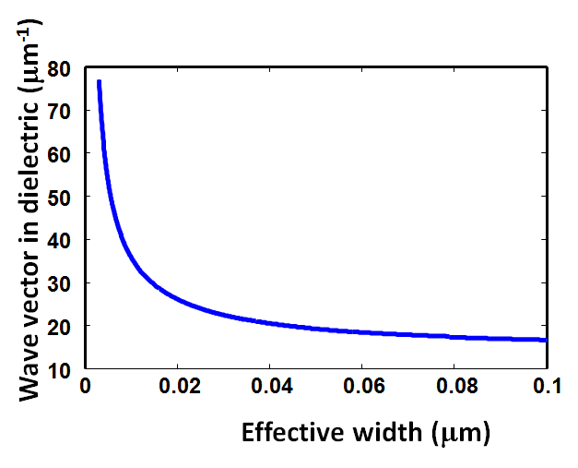
Influence of nano-confinement on loss of gap SPP
w_{met}
λ_{spp}~1550nm
10
2
Ideal
ε_{d}~12
w
Ag*
InGaAsP
10
1
Au*
Ag
Propagation Length (μm)
10
0
Au
10
-1
10
-2
10
-1
Effective width (μm)
Surface-induced absorption dominates for narrow gaps
Dispersion is the same for all metals

Slide 8
For more involved shapes
PHYSICAL REVIEW B 84, 045415 (2011)
Field concentration is achieved when higher order modes that are small and have small (or 0) dipole and hence normally dark gets coupled to the dipole modes of the second particle. But, due to the surface (Kreibig, confinement) contribution the smaller is the mode the lossier it gets and hence it couples less. One can think about it as diffusion-main nonlocal effect!

Slide 9
Conclusions 1
Presence of high K-vector components in the confined field increases damping and prevents further concentration and enhancement of fields…
For as long as there exists a final state for the electron to make a transition…it probably will
The effect of damping of the high K-components is equivalent to the diffusion

Slide 10
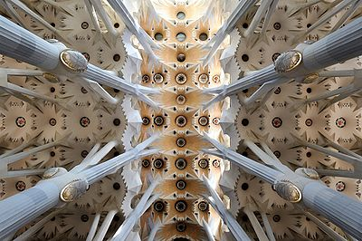
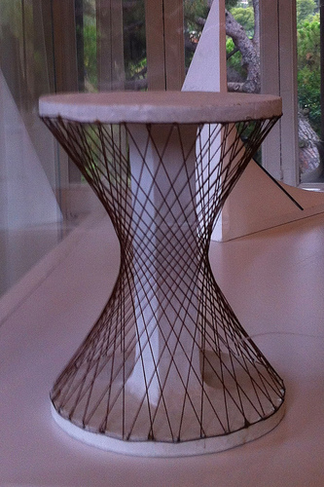
2. Demystifying Hyperbolic metamaterials – Kronig Penney approach
Gaudi, Sagrada Familia

Slide 11
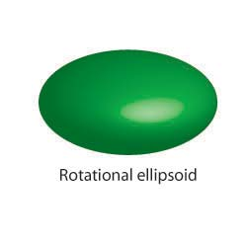
Hyperbolic Dispersion
k_{z}
k_{z}
Hypebolic k-unlimited
k_{z}
Elliptical k-limited
k_{x}
k_{x}
k_{x}
k_{y}
k_{y}
k_{y}
Jacob, Z., Alekseyev, L. V. & Narimanov, E. Optical hyperlens: far-field imaging beyond the diffraction limit. Opt. Express 14, 8247–8256 (2006).
Salandrino, A. & Engheta, N. Far-field subdiffraction optical microscopy using metamaterial crystals: theory and simulations. Phys. Rev. B 74, 075103 (2006).

Slide 12
Hyperbolic materials and their promise
High k implies high resolution
– beating diffraction limit -hyperlens
High k implies large density of states – Purcell Effect
If ε_{i}~0 ENZ material
Problems: negative ε is usually associated with high loss

Slide 13
Natural Hyperbolic Materials
Natural hyperbolic materials: CaCO3, hBN, Bi – phonon resonances in mid-IR
(also plasma in ionosphere –microwaves)

Slide 14
Hyperbolic Metamaterials
(effective medium theory)
Z
X
Y
ε_{m}<0
b
e_{d}>0
k_{z}
k_{z}
a
k_{x}
k_{x}
k_{y}
k_{y}

Slide 15
Granularity
ε_{m}<0
b
e_{d}>0
When effective wavelength becomes comparable to the period – k~π/(a+b) non locality sets in and effective medium approach fails (Mortensen et al, Nature Comm 2014), Jacob et al (2013) (Kivshar’s group).
a
Alternatively, according to Bloch theorem π/(a+b) is the Brillouin zone boundary and thus defines maximum wavevector in x or y direction. (Sipe et al, Phys Rev A (2013)B

Slide 16
Gap and slab plasmons
(a.k.a. transmission lines)
Slab SPP
Gap SPP
ε_{m}<0
b
ε_{d}>0
a
There must be a relation.
So, what happens in hyperbolic material that makes it different from coupled SPP modes?

Slide 17



When does the transition occur and magic happen?
Here?
or maybe here?

Slide 18


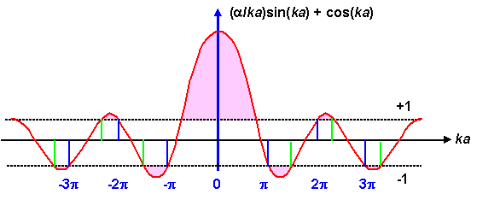
Kronig Penney Model
Lord W. G. Penney

Slide 19
Set Up Equations
Periodic boundary conditions
-b
0
a
a+b
E_{x}
E_{z}
Characteristic Equation
H_{y}

Slide 20
Wave surfaces for different filling ratios
λ=520 nm Ag ε_{m}=-11+0.3i Al₂0₃ ε_{d}=1.82
Effective medium
Effective medium works for small k’s
k_{x} (μm-¹)
K-P
a=15nm
b=15nm
ε_{z}=8.6 ε_{x,y}= -3.4
k_{z} (μm-¹)

Slide 21
Wave surfaces for different filling ratios
λ=520 nm Ag ε_{m}=-11+0.3i Al₂0₃ ε_{d}=1.82
Effective medium
Effective medium works for small k’s
k_{x} (μm-¹)
K-P
a=18nm
b=12nm
ε_{z}=6.4 ε_{x,y}= -2.5
k_{z} (μm-¹)

Slide 22
Wave surfaces for different filling ratios
λ=520 nm Ag ε_{m}=-11+0.3i Al₂0₃ ε_{d}=1.82
Effective medium
Effective medium works for small k’s
k_{x} (μm-¹)
K-P
a=21nm
b=9nm
ε_{z}=5.0 ε_{x,y}= -1.13
k_{z} (μm-¹)

Slide 23
Wave surfaces for different filling ratios
λ=520 nm Ag ε_{m}=-11+0.3i Al₂0₃ ε_{d}=1.82
Effective medium
Effective medium theory predicts
ENZ negative material – but we observe both elliptical and hyperbolic dispersions
k_{x} (μm-¹)
K-P
a=23.4nm
b=6.6 nm
ε_{z}= 4.31 ε_{x,y}= -0.003
k_{z} (μm-¹)

Slide 24
Wave surfaces for different filling ratios
λ=520 nm Ag ε_{m}=-11+0.3i Al₂0₃ ε_{d}=1.82
Effective medium theory predicts
ENZ positive material – but we observe both elliptical and hyperbolic dispersions
k_{x} (μm⁻¹)
K-P
a=23.7nm
b=6.3 nm
ε_{z}= 4.23 ε_{x,y}= 0.13
Effective medium
k_{z} (μm⁻¹)

Slide 25
Wave surfaces for different filling ratios
λ=520 nm Ag ε_{m}=-11+0.3i Al₂0₃ ε_{d}=1.82
K-P
Effective medium theory predicts elliptical dispersion
But in reality there is always a region with hyperbolic dispersion at large k_{x} – coupled SPP’s?
k_{x} (μm⁻¹)
a=27nm
b=3 nm
ε_{z}= 3.6 ε_{x,y}= 1.7
Effective medium and K-P
k_{z} (μm⁻¹)

Slide 26
Effect of changing filling ratios form 10:1 to 1:1
200
λ=520 nm Ag ε_{m}=-11+0.3i Al₂0₃ ε_{d}=1.82
a+b=30nm
150
Notice: hyperbolic region is always there!
k_{x} (μm⁻¹)
100
50
k_{z} (μm⁻¹)
0
0
20
40
60
80
100

Slide 27
Effect of granularity
λ=520 nm Ag ε_{m}=-11+0.3i Al₂0₃ ε_{d}=1.82
a:b=7:3
For small period elliptical region disappears and the curve approaches the effective medium
k_{x} (μm⁻¹)
k_{z} (μm⁻¹)

Slide 28
Explore the fields at different points
Fields:
Effective impedance:
Energy density:
Poynting vector
Fraction of Energy in the metal:
Effective loss:
Propagation length:
Group velocity

Slide 29
Near k_{x}=0
Magnetic Field
Electric Field
E_{z}
H_{y}
|E|/η_{d}~|H|
V_{g}=0.70V_{d}
η=1.12η_{d}
f=.22
τ=54 fs
L=6.5 μm
E_{x}
Energy Density
Poynting Vector
U_{E}
S_{x}
S_{Z}
Sign Change
In metal
U_{M}

Slide 30
Near k_{x}=k_{max}/2
Magnetic Field
Electric Field
E_{z}
V_{g}=0.22V_{d}
η=3.25η_{d}
f=.56
τ=21fs
L=0.83μm
H_{y}
Less magnetic field
|E|/η_{d}>|H|
E_{x}
Energy Density
Poynting Vector
U_{E}
S_{x}
S_{Z}
Sign Change
In metal –S small
More energy in metal
U_{M}

Slide 31
Near k_{x}=k_{max}
Magnetic Field-small
Electric Field
V_{g}=0.17V_{d}
η=3.78η_{d}
f=.57
τ=20fs
L=0.64μm
E_{z}
H_{y}
|E|/η_{d}>>|H|
E_{x}
More than half of energy in metal
Energy Density
E-field is nearly normal to wave surface –longitudinal wave!
Poynting Vector
U_{E}
S_{x}
Sign Change
In metal –S small
U_{M}
S_{Z}

Slide 32
Density of states and Purcell Factor
20
15
10
Density of states
5
Spatial Frequency (relative to k_{d})
0
1.5
2
2.5
3
3.5
4
4.5
5
6
5
Purcell Factor=22
4
n/V_{g}
Slow down factor and impedance
η
3
However, most of the emission is into lossy waves that do not propagate well and in addition they get reflected at the boundary
2
Spatial Frequency (relative to k_{d})
1
1.5
2
2.5
3
3.5
4
4.5
5
10
2
Lifetime (fs)
Propagation Length (μm)
τ=1/γ_{eff}
10
1
This is quenching!
L
10
0
10
-1
1.5
2
2.5
3
3.5
4
4.5
5

Slide 33
A Better Structure?
Purcell Factor=200!
But…it looks simply as a set of decoupled slab SPP’s
U_{E}
λ=400 nm
a=12nm
b=8nm
k_{x} (μm⁻¹)
U_{M}~0
Metamaterial that aspires to be ENZ
Virtually no magnetic field – hence a tiny Poynting vector
With half of energy inside the metal
V_{g}=0.055 V_{d}
η=6.34 η_{d}
f=.68
τ=20fs
L=0.18 μm
U_{M}
This wave does not propagate
k_{z} (μm⁻¹)

Slide 34
Assessment
100
35
80
30
25
n/V_{g}
60
Slow Down and Impedance (rel.unit)
Density of states
20
40
15
10
η
20
5
0
0
1
2
3
4
5
6
7
8
0
0
1
2
3
4
5
6
7
8
Spatial Frequency (rel. to k_{d})
Spatial Frequency (rel. to k_{d})
2
The states with high density and large spatial frequency
have propagation length of about 100-200nm
So, all we can see is quenching
This is no wonder – new states are not pulled out of the magic hat – they are simply the electronic degrees of freedom coupled to photon…and they are lossy
10
τ=1/γ_{eff}
1
Lifetime in fs and Propagation in mcm
10
10
0
L
10
-1
0
1
2
3
4
5
6
7
8
Spatial Frequency (rel. to k_{d})

Slide 35
In plane dispersion 1200-400 nm
250
200
150
k_{x} (μm⁻¹)
100
50
U_{M}
0
0
50
100
150
k_{z} (μm⁻¹)
It looks exactly as gap SPP or slab SPP

Slide 36
Normal to the plane dispersion 1200-400 nm
250
200
150
k_{x} (μm⁻¹)
100
50
U_{M}
0
0
50
100
150
k_{z} (μm⁻¹)
It looks exactly as coupled waveguides should look….or as conduction and valence bands

Slide 37
Parallels with the solid state
The wave function of electron in the band is
For transport properties we often ”homogenize” the wave function by introducing the effective mass
But to understand most of the properties one must the consider periodic part of Bloch function
Similarly, for metamaterials, effective dielectric constant gives us a very limited amount of information – we must always look at local field distribution, especially because it is so damn easy.

Slide 38
Conclusions
Hyperbolic metamaterials are indeed nothing but coupled slab (or gap) SPP’s. If it looks like a duck, walks like a duck, and quacks like a duck, it is probably a duck. Why use more than 3 layers is unclear to me
The Purcell factor is no different from the one near simple metal surface – most of radiation goes into the slowly propagating (low v_{g}) and lossy(short L) modes that do not couple well to the outside world (high impedance). There are easier ways of modifying PL
In general, outside the realm of magic, new quantum states cannot appear out of nowhere – states are degrees of freedom. Density of photon states can only be enhanced by coupling with electronic (ionic) degrees of freedom (of which there are plenty) That makes coupled modes slow and dissipating heavily. There is no way around it unless one can find materials with lower loss.
In general, Bloch (Foucquet) theorem states that if one has a periodic structure with period d, one may always find a solution
F(x)=u(x)e^{jkx} where u(x) is a periodic function with the same period. But it does not really mean that one has a propagating wave if the group velocity is close to zero.
It is important to analyze the periodic “tight binding” function u(x) and Kronig Penney method is a nice and simple tool for it

