Slide 1
Identifiers and servers to facilitate visualization and data exchange
Craig L. Zirbel
Bowling Green State University
Bowling Green, Ohio
Services from the BGSU RNA group
New alignment server
“Random access” to data

Slide 2
BGSU RNA Group – rna.bgsu.edu
Neocles Leontis, Chemistry
Craig Zirbel, Mathematics and Statistics
Students from Biology, Chemistry, Computer Science, Statistics
We analyze and annotate RNA 3D structures
Watson-Crick and non-Watson-Crick basepairs
Base stacking, base-backbone interactions
Equivalence classes and non-redundant lists
3D motif search (FR3D) and the 3D Motif Atlas
Ultimate goal: predict 3D motifs from sequence
Wednesday talk (JAR3D)

Slide 3
Annotation pipeline
Retrieves and annotates new structures each week
On holiday since December 2014 while we re-tool to read and analyze mmCIF files
Moving to a new server, nearly done
Improvements to non-redundant lists coming soon

Slide 4
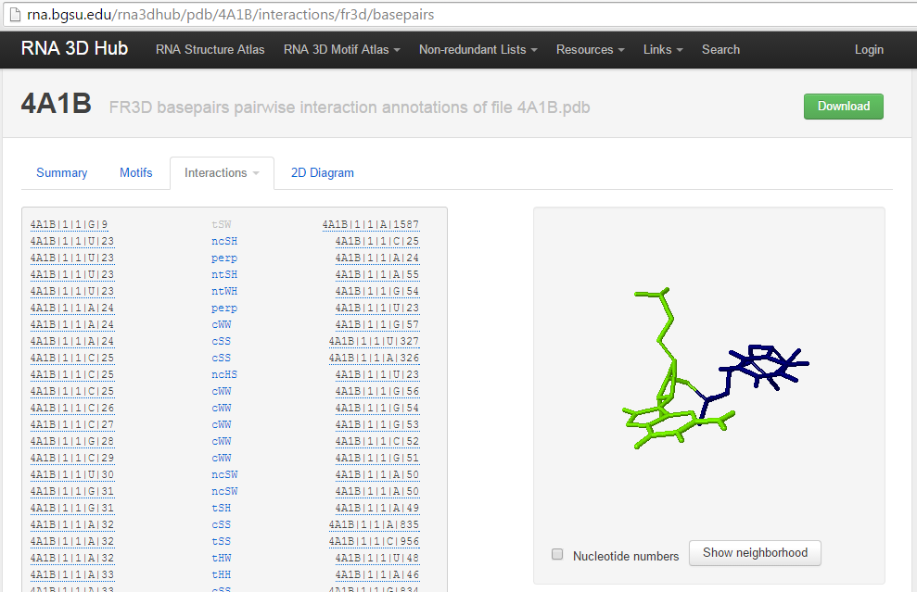
Annotations of pairwise interactions
Basepairs in 3D structure file 4A1B – Tetrahymena LSU

Slide 5
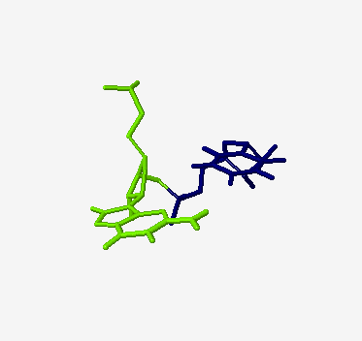
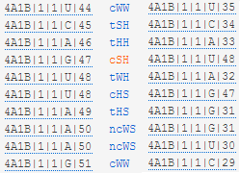
Annotations of pairwise interactions
3D structure file 4A1B - Tetrahymena
cSH interaction between G47 and U48
Basepair list for an internal loop
JSMol window for selected basepair

Slide 6
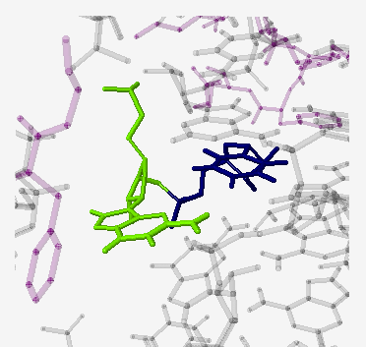
Annotations of pairwise interactions
3D structure file 4A1B - Tetrahymena
cSH interaction between G47 and U48
Basepair list for an internal loop
Neighborhood of selected basepair

Slide 7
Unit ID is a unique string
3D structure file 4A1B - Tetrahymena
cSH interaction between G47 and U48
4A1B|1|1|G|47
Basepair list for an internal loop
Neighborhood of selected basepair

Slide 8
Annotations of pairwise interactions
Basepairs in 3D structure file 4A1B – Tetrahymena
Download all annotations from all structures at: http://rna.bgsu.edu/rna3dhub/data/interactions.csv.gz

Slide 9
RNA Basepair Catalog at NDB

Slide 10
RNA Basepair Catalog at NDB
UG is by far the most common base combination in the cHS family

Slide 11
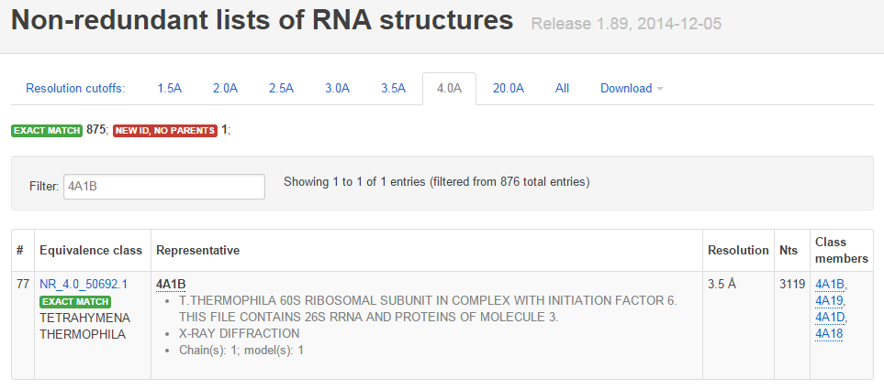
Equivalence classes and NR lists
Identify 3D structures of the same molecule from the same organism; “equivalent”
4A1B is the representative of this equivalence class

Slide 12
Equivalence classes and NR lists
Choosing one representative from each equivalence class gives a “non-redundant list”
89 weekly releases from February 2012 to December 2014
Improvements and new releases coming soon!

Slide 13
RNA 3D Motif Atlas
Extract internal loops and hairpin loops and arrange them into “motif groups”
19 releases, every four weeks, between March 2013 and December 2014
Improvements and new releases coming soon!

Slide 14
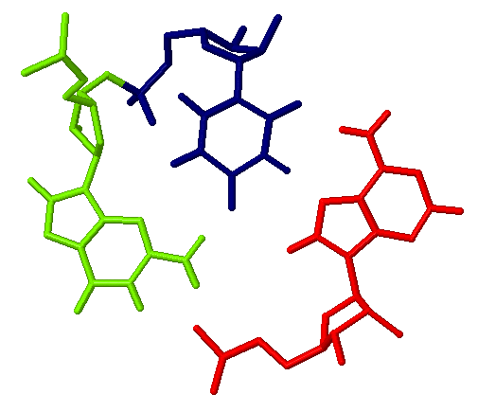
RNA 3D Motif Atlas
Tetra
Pig
Top view
Notes:
This is the internal loop that contains the UG cHS basepair shown earlier. The G shown here is highly conserved in Sarcin-Ricin or G-bulge internal loops like you are seeing here, usually near 100% conservation in sequence alignments. It is part of a base triple.

Slide 15
Homologous location, different eukaryotes
Yeast
Kluyveromyces
Plasmodium
A49 is bulged out
A in yeast and K.l. U in Plasmodium
Notes:
What does the corresponding place in yeast look like? What was G in Tetrahymena is now A, and the base triple does not form, but rather the A is bulged out. Same with Kluyveromyces lactis and Plasmodium falciparum.

Slide 16
A little science …
Across eukaryotes, what base occurs at this position most often?
Are different bases at this position frozen evolutionary accidents, or do they change more freely?
Look at the column of a multiple sequence alignment that corresponds to this nucleotide.
The R3D-2-MSA alignment server retrieves columns of an alignment corresponding to given nucleotide IDs.

Slide 17
Identifiers and servers to facilitate visualization and data exchange
Craig L. Zirbel
Bowling Green State University
Bowling Green, Ohio
Services from the BGSU RNA group
New alignment server
“Random access” to data

Slide 18
rna.bgsu.edu/r3d-2-msa alignment server
Select a 3D structure by its PDB ID

Slide 19
rna.bgsu.edu/r3d-2-msa alignment server
Select chain and/or alignment
Select nucleotide range or ranges

Slide 20
rna.bgsu.edu/r3d-2-msa alignment server
Summary of the corresponding column of the alignment from Robin Gutell’s group
A occurs most often; G occurs least often!

Slide 21
rna.bgsu.edu/r3d-2-msa alignment server
Look only at Fungi
A, G, and U all occur in Fungi. Similar variety occurs in other phylogenetic groups.

Slide 22
Identifiers and servers to facilitate visualization and data exchange
Craig L. Zirbel
Bowling Green State University
Bowling Green, Ohio
Services from the BGSU RNA group
New alignment server
“Random access” to data

Slide 23
Implementation of visualizations
Visualizations are done by JSMol and PV (Protein Viewer)
We do not store PDB fragments for each possible view
3D coordinates are retrieved from the coordinate server hosted at rna.bgsu.edu

Slide 24
Coordinate server URL access
Coordinates of requested nucleotides or amino acid residues are stored in Model 1.
Coordinates of nearby nucleotides, amino acids, ions, etc. are stored in Model 2.
Anton Petrov’s jmolTools makes it easy to insert visualizations into web pages using the coordinate server.

Slide 25
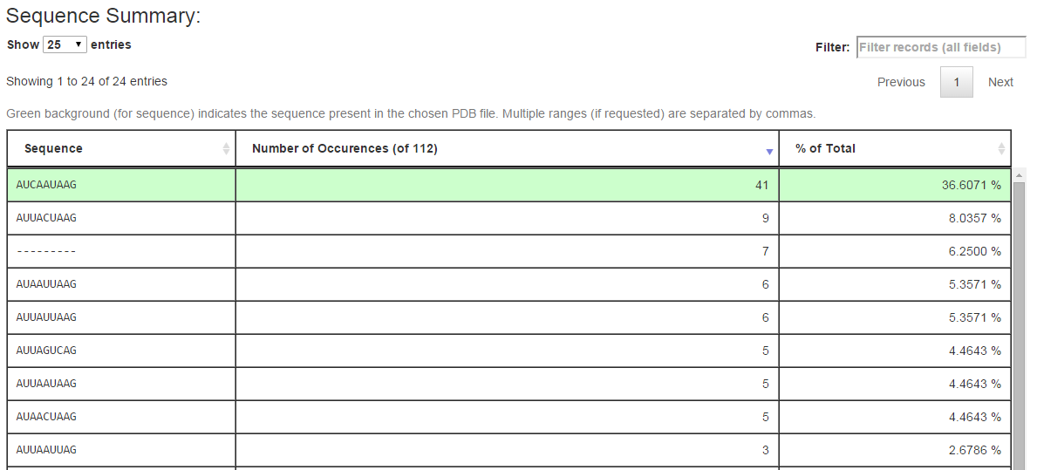
Alignment server URL access
Get alignment server results by specifying the right URL. For example, sequences of the longer strand of the Sarcin-Ricin internal loop can be retrieved from the URL:
http://rna.bgsu.edu/r3d-2-msa?units=3U5H|1|5||45:3U5H|1|5||53

Slide 26
Alignment server programmatic access
Python input
response = fetch("http://rna.bgsu.edu/r3d-2-msa",
params={'units': '3U5H|1|5||49'}, headers=headers)
data = response.json()
Output in JSON format
{'status': 'succeeded',
'full': [{'AccessionID': 'D17810', 'TaxID': 3072, 'SeqVersion': 1, 'SeqID': 15, 'ScientificName': 'Pseudochlorella pringsheimii', 'LineageName': 'root \\ cellular organisms \\ Eukaryota \\ Viridiplantae \\ Chlorophyta \\ Trebouxiophyceae \\ Chlorellales \\ Chlorellaceae \\ Pseudochlorella \\ Pseudochlorella pringsheimii \\ ', 'CompleteFragment': 'A'}, {'AccessionID': 'U34340', 'TaxID': 7907, 'SeqVersion': 1, 'SeqID': 3590, 'ScientificName': 'Acipenser brevirostrum', 'LineageName': 'root \\ cellular organisms \\ Eukaryota \\ Opisthokonta \\ Metazoa \\ Eumetazoa \\ Bilateria \\ Deuterostomia \\ Chordata \\ Craniata \\ Vertebrata \\ Gnathostomata \\ Teleostomi \\ Euteleostomi \\ Actinopterygii \\ Actinopteri \\ Chondrostei \\ Acipenseriformes \\ Acipenseroidei \\ Acipenseridae \\ Acipenserinae \\ Acipenserini \\ Acipenser \\ Acipenser brevirostrum \\ ', 'CompleteFragment': '-'}, …

Slide 27
Random access to data
Full PDB/CIF file
Retrieve 3D coordinates for given Unit IDs via the coordinate server
Full multiple sequence alignment
Retrieve columns of an alignment for given nucleotide Unit IDs via the R3D-2-MSA server
Retrieve columns of an alignment for given sequence positions in a secondary-structure diagram

Slide 28
Planned services
Annotations: Retrieve a partial list of annotations of pairwise interactions for given nucleotide IDs
3D to 3D alignments: Retrieve a list of nucleotides in 3D structure B corresponding to a list of nucleotide IDs in 3D structure A
First for 3D structures of the same molecule from the same organism
Later for 3D structures from different organisms

Slide 29
Possible services
Random access to Rfam, Silva, GreenGenes, and other RNA multiple sequence alignments
Random access to protein alignments
Random access to electron density near given nucleotides and/or amino acids
Your suggestions?

Slide 30
Acknowledgments
Anton Petrov
Unit IDs, Coordinate server, jmolTools
Blake Sweeney
R3D-2-MSA alignment server
Conversion to mmCIF, retooling our pipeline
Looking for a postdoc in the next year
Jamie Cannone (Robin Gutell’s group)
Database queries to retrieve alignment slices
Adding 3D sequences to sequence alignments
Robin Gutell, University of Texas at Austin
Neocles Leontis, BGSU

