Slide 1
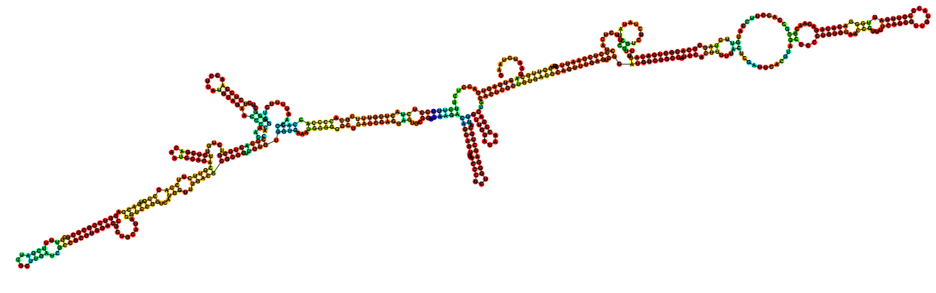
Identifying novel sequence variants of RNA 3D motifs
Craig L. Zirbel
Bowling Green State University
Bowling Green, Ohio
Goal: Given the sequence and secondary structure of an RNA, identify known 3D motifs in the hairpin and internal loops.

Slide 2
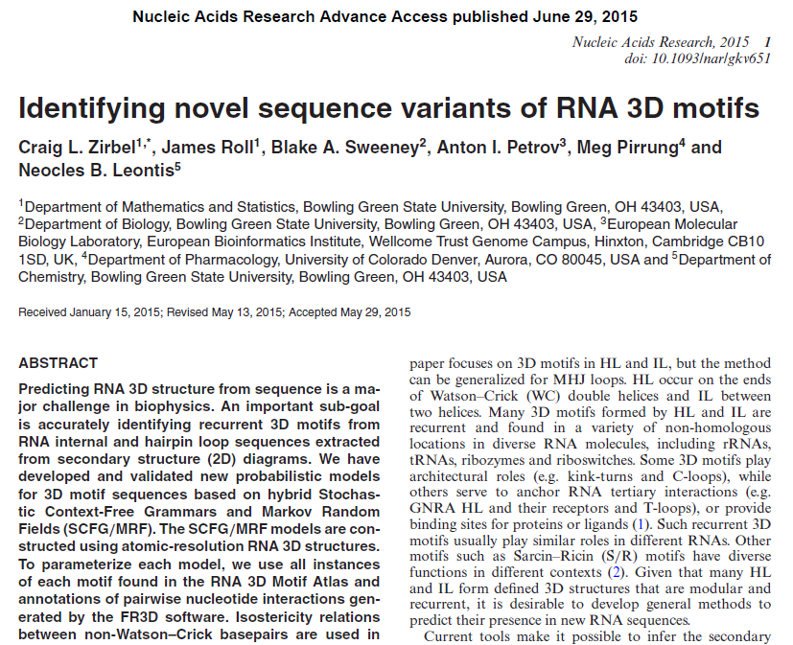
All new slides!

Slide 3
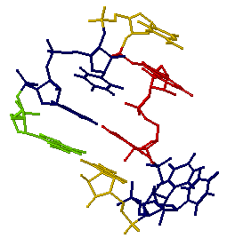
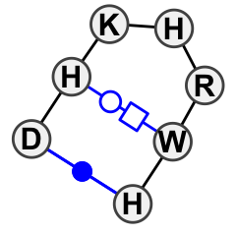
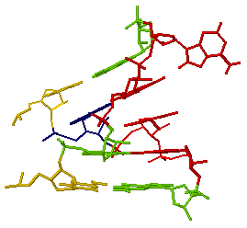
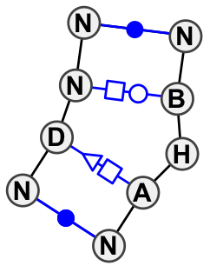
RNA hairpin and internal loops are structured in 3D
“T-loop with two bulged bases” hairpin loop; HL_72498.12
“tSH-inserted-tHW” internal loop; IL_93424.4

Slide 4
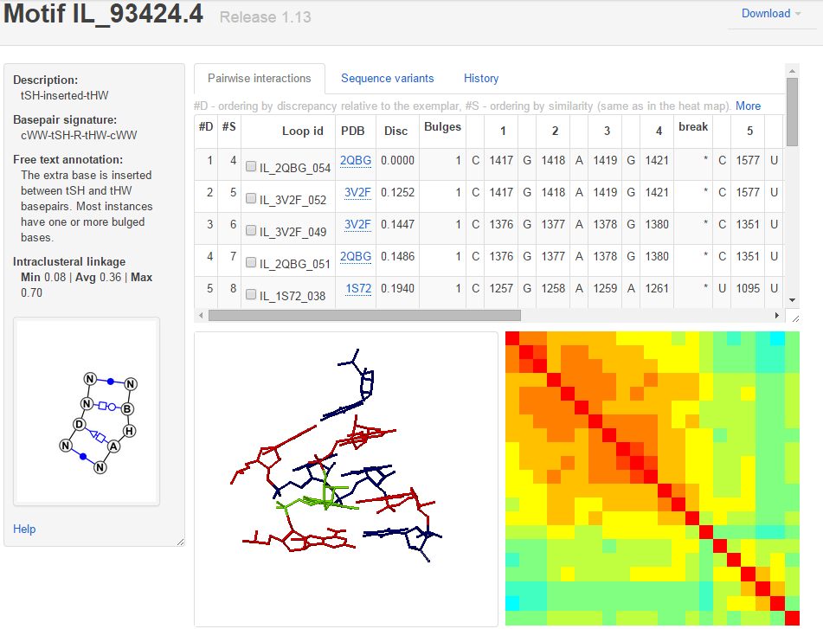
RNA 3D Motif Atlas
Instances in each motif group share the same overall geometry and the same pattern* of basepairs.
Updated every four weeks to present the most up to date collection of motifs.

Slide 5
Ideal situation – exact sequence match
Occasionally it will happen that the sequence of a loop in a new RNA sequence exactly matches a known RNA loop.
Only about 1500 unique internal loop sequences across 276 motif groups, and fewer still when you pay attention only to the interior (non-Watson-Crick) part of the loop.
Exact sequence matches will be rare.

Slide 6
Finding likely sequence variants of known 3D motifs
RMDetect (Cruz and Westhof, Nature 2011)
  Use sequence variants in trusted alignments
  Limited availability of such alignments, due to
  Circularity challenge: how to align well, except by understanding the 3D motif the sequences form?
Our approach:
  Use geometric considerations to predict likely sequence variants
  Test our predictions against alignments

Slide 7
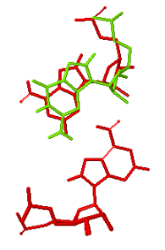
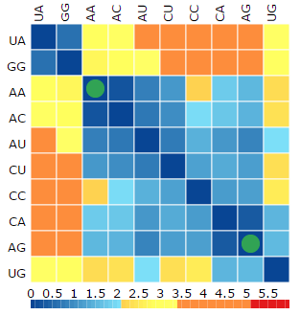
Physical basis for predicting variability
Basepair isostericity (Stombaugh, Zirbel, Westhof, Leontis NAR 2009)
  Basepair family tends to be conserved at corresponding positions in homologues
  When base combinations change, the new basepair tends to still have similar backbone connections
  AU, UA, GC, CG cis WC/WC basepairs reign supreme
  tHS AG and AA,
    Superimposed:
Superposition and heat map from the RNA Basepair Catalog

Slide 8
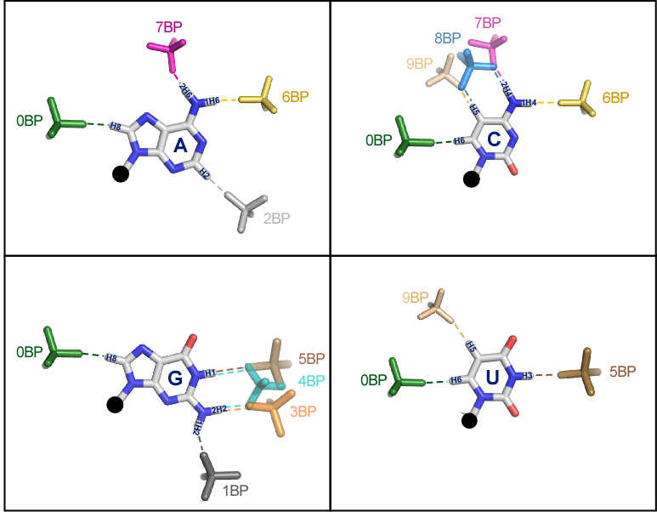
Physical basis for predicting variability
(Zirbel, Sponer, Sponer, Stombaugh, Leontis NAR 2009)
Base-phosphate interactions
Notes:
Strong base-specific interactions with phosphate oxygens
Base making the interaction tends to be highly conserved in sequence alignments

Slide 9
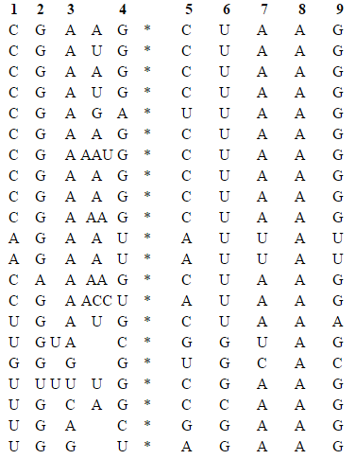
Physical basis for predicting variability
Location and number of insertions in 3D motif instances
Alignment of 3D sequences from motif group IL_93424.4 to the 9 conserved positions in the motif group.
Note the variable-length insertions between positions 2 and 3, and between positions 3 and 4.
Strand 1
Strand 2

Slide 10
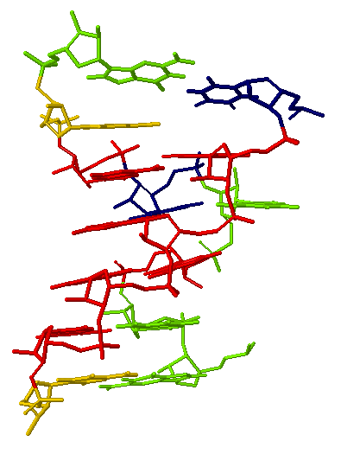
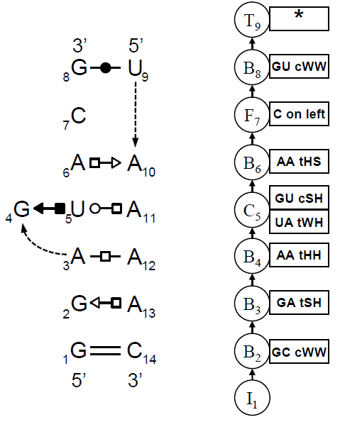
Probabilistic model
SCFG for nested basepairs, fixed bases, variable-length insertions
Instance IL_2AW7_041 from IL_95652.3 Sequence: GGAGUACG*UAAAAC

Slide 11
Probabilistic model
Markov random field / Gibbs ensemble for base triples and locally crossing basepairs
Instance IL_2AW7_041 from IL_95652.3 Sequence: GGAGUACG*UAAAAC

Slide 12
Availability
JAR3D (Java-based Alignment using RNA 3D structure) jar file and model files are available at http://rna.bgsu.edu/data/jar3d/models/
Source code is available at https://github.com/BGSU-RNA/JAR3D
JAR3D web server is available at http://rna.bgsu.edu/jar3d/

Slide 13
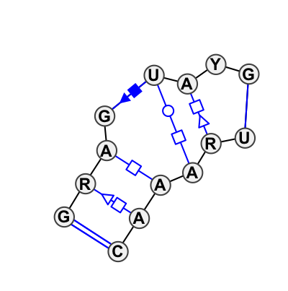
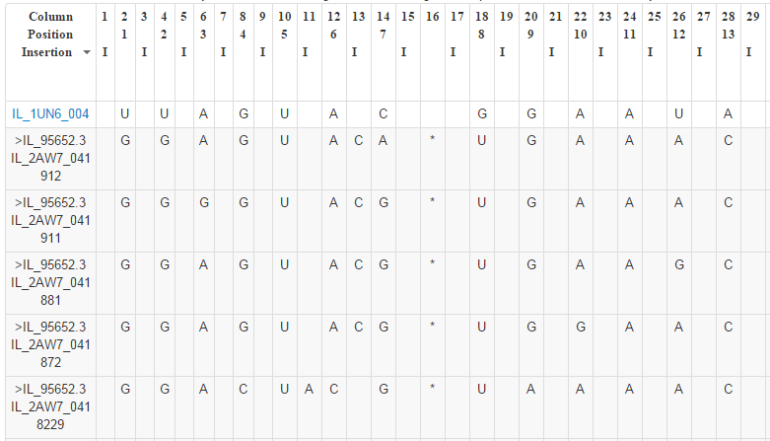
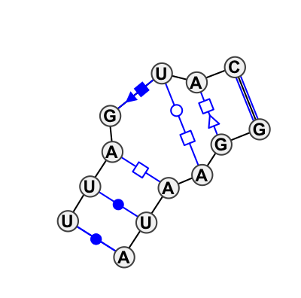
Alignments via JAR3D web server
Sequences from a multiple sequence alignment of instance IL_2AW7_041 from motif group IL_95652.3, having 14 nucleotides, aligned to the model for motif group IL_97191.1, a Sarcin-Ricin motif with 13 nucleotides.

Slide 14
Scoring sequences against a model
Score sequences against
  the model for IL_93434.4
 | Sequence | Alignment score | Deficit
Best 3D sequence | CGAUG*CUAAG | -5.412 | 0
Novel sequence #1 | UGAUG*CUAGC | -12.959 | 7.546
Interior edit distance = 1
Minimum interior edit distance = 1

Slide 15
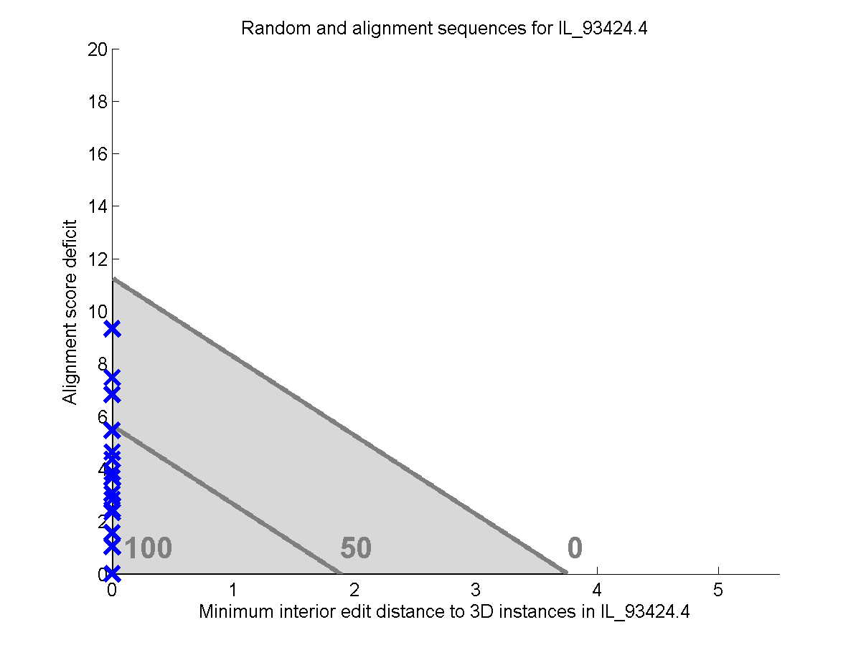
Scoring sequences, acceptance region
Novel sequence
Cutoff score 6.4 tells how far into the acceptance region the sequence falls
Best 3D sequence

Slide 16
Trouble with alignment sequences
Alignment sequence GUCCC*GAACG
Alignment sequence CAAUG*CUAGC
Alignment sequence
UGAUG*CUAGC
Best 3D sequence

Slide 17
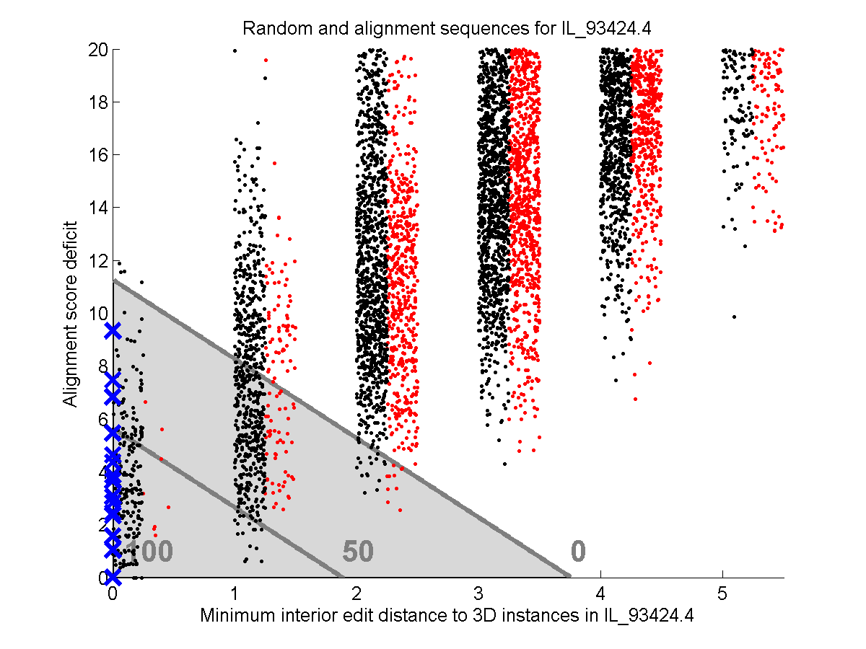
3D, alignment, random sequences
Note: Dots are shifted to the right by uniformly-distributed numbers to aid visualization

Slide 18
3D, alignment, random sequences
Note: Acceptance region is based only on the randomly-generated sequences,
4% match rate

Slide 19
Match rate of randomly-generated sequences on 200+ models
High match rate for short sequences, like single base bulges such as GAC*GC
High match rate for symmetric internal loops like CGAAU*ACAAG
  Matches 16 motif groups
  22 motif groups have sequences this length
  Sequence can also match as ACAAG*CGAAU,
  So 44 possibilities to match
Low match rate for longer loops

Slide 20
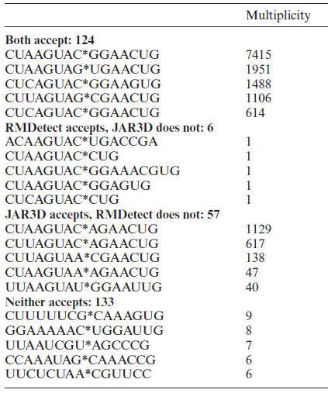
Comparison to RMDetect acceptance
CCUAGUAC*GGAACCG
(------(*)-----)
JAR3D input
RMDetect input
Good agreement on
  G-bulge (Sarcin-Ricin)
  Tandem sheared (tSH-tHS)
JAR3D identifies more
  Kink turn
  C-loop
GCGCCCUAGUACGCGAGAGCGGAACCGGCGC
(((((------(((----)))-----)))))

Slide 21
Test ability to recognize novel sequences
Take one 3D instance from motif group G
Retrieve columns of a multiple sequence alignment corresponding to the instance, from Silva, RNAStar, GreenGenes
Exclude any rows whose interior sequence exactly matches a known 3D instance from group G
Score sequences against all 200+ motif groups, keep those which accept it, and match to the group having the highest alignment score (log of generation probability)
Record the percentage of novel alignment sequences which are matched to “original motif group” G

Slide 22
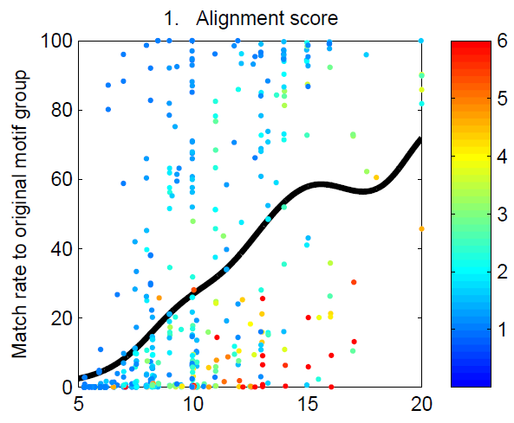

Test ability to recognize novel sequences
Each dot is one alignment extract
Horizontal tells how many nucleotides are in the motif
Vertical tells what percentage of rows are matched to the original motif group
Dots are colored by average minimum internal edit distance
Black curve is a running average
All novel sequences – no exact interior sequence matches

Slide 23
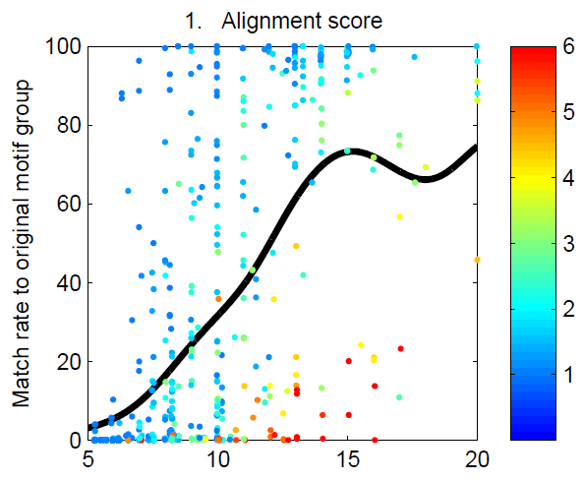
Test ability to recognize novel sequences
Matching an equivalent motif is counted as a success
Omit alignment sequences whose flanking pairs are not AU, GC, or GU

Slide 24
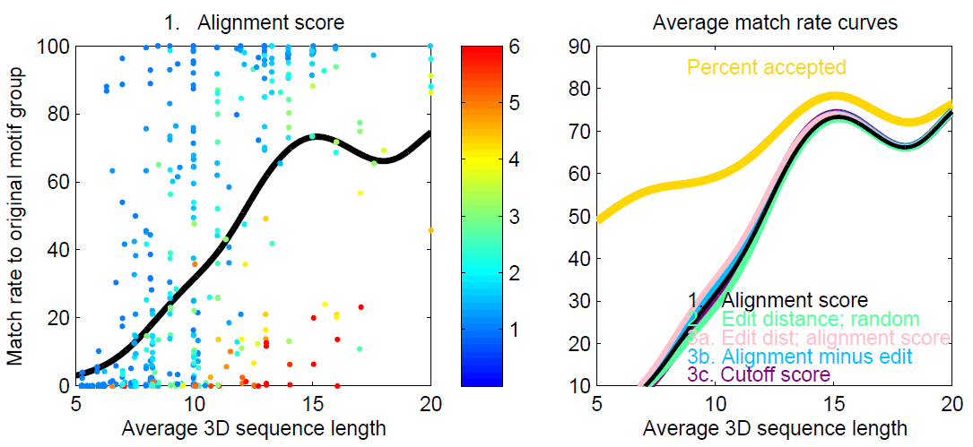
Gold standard – percentage accepted

Slide 25
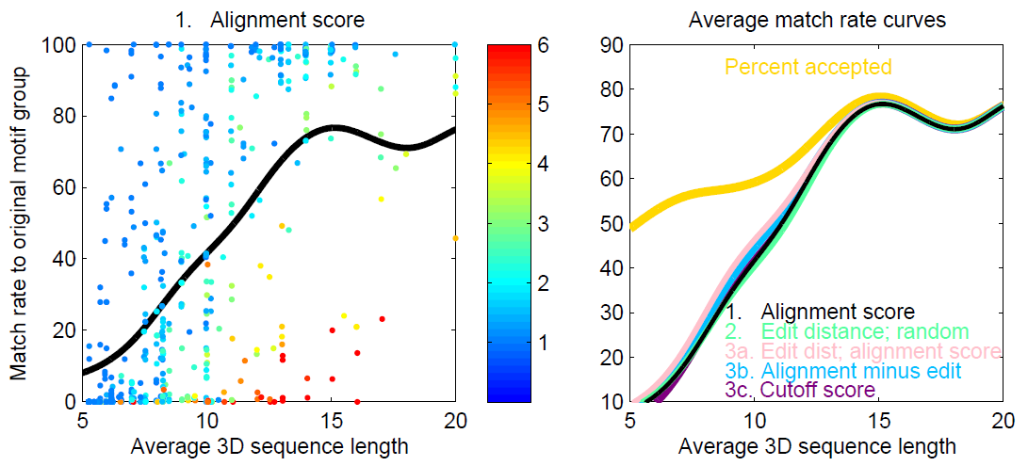
Let JAR3D make two guesses

Slide 26
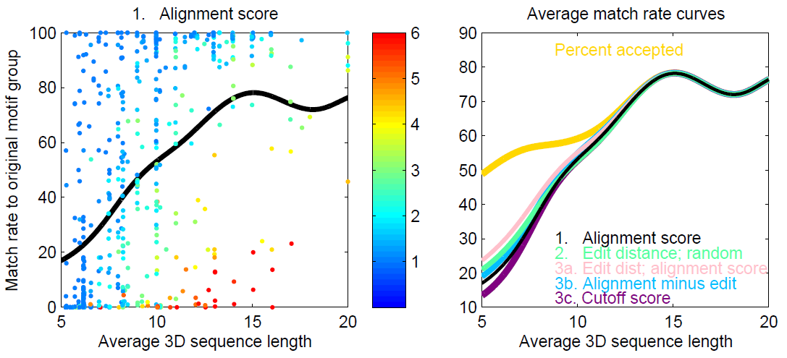
Let JAR3D make five guesses

Slide 27
Multiple sequences of the same motif
With RNA double helices, covariation gives you additional confidence
With internal and hairpin loops, each distinct interior sequence narrows the range of possible motifs
The probability of getting the correct motif relaxes to 1 exponentially quickly as the number of distinct sequences increases*

Slide 28

Acknowledgments
Development
  Michael Sarver (SCFG development)
  Megan Pirrung (Java coding)
  James Roll (SCFG development, Java, webserver)
  Blake Sweeney (webserver)
  Anton Petrov (RNA 3D Motif Atlas)
  Neocles Leontis (inspiration and guidance)
Testing
  Biao Ding, in memoriam (RNA viroid)
  Corinna Theis, Jan Gorodkin (genome scanning)
  Peter Kerepdjiev at TBI (3D structure prediction)
  Rhiju Das (loop prediction)
Hosting
  Ivo Hofacker and the TBI (sabbatical 2013-2014)

