Slide 1
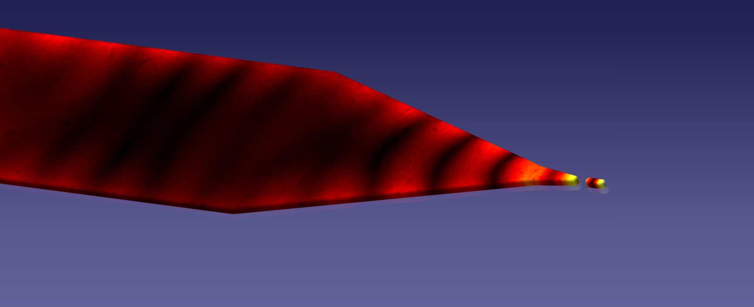
Boosting local field enhancement
by on-chip nanofocusing and impedance-matched plasmonic antennas
Vladimir A. Zenin, Ilya P. Radko, Valentyn S. Volkov and Sergey I. Bozhevolnyi Centre for Nano Optics, University of Southern Denmark, Campusvej 55, 5230 Odense M, Denmark zenin@iti.sdu.dk
Andrei Andryieuski, Radu Malureanu and Andrei V. Lavrinenko DTU Fotonik, Technical University of Denmark, Oersteds pl. 343, 2800 Kongens Lyngby, Denmark
Dmitri K. Gramotnev Nanophotonics Pty. Ltd., GPO Box 786, Albany Creek, Queensland 4035, Australia.
Nanolight 2016, Benasque

Slide 2
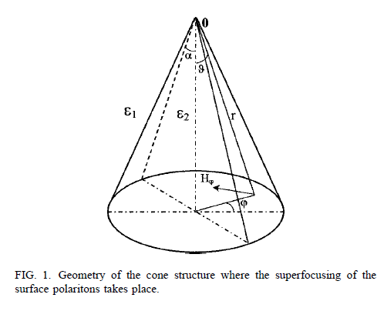
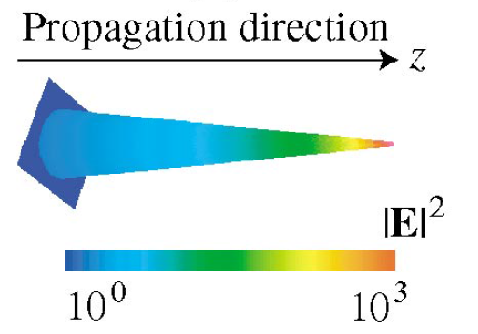
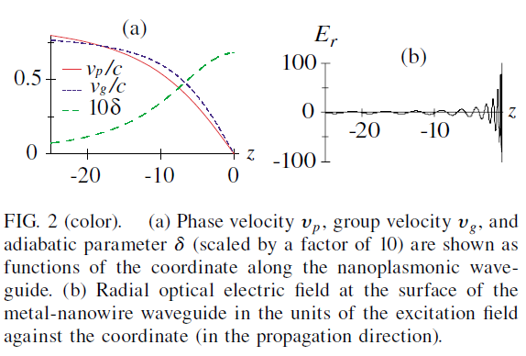
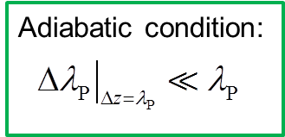
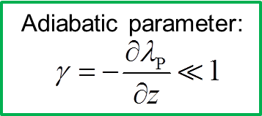
Theoretical principles of adiabatic nanofocusing

Slide 3
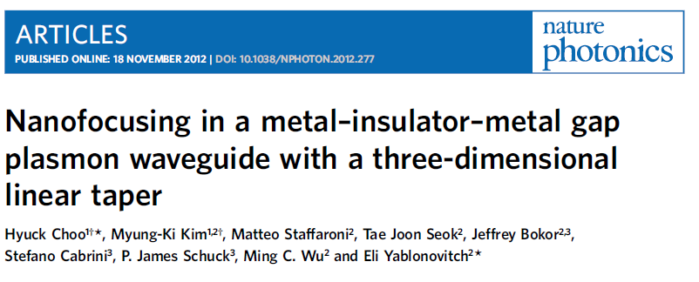
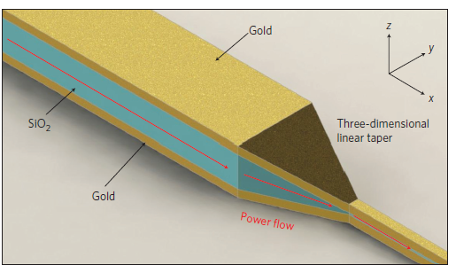
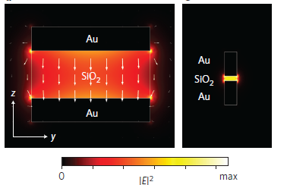
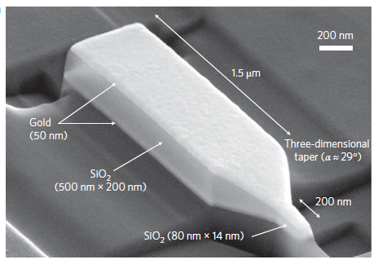
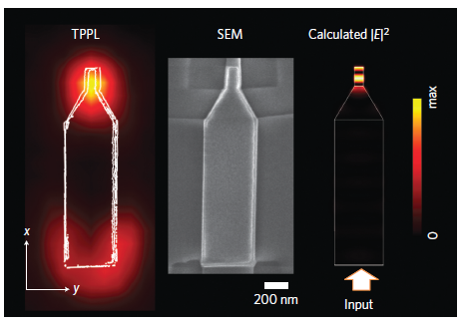
Focusing of gap-SPP

Slide 4
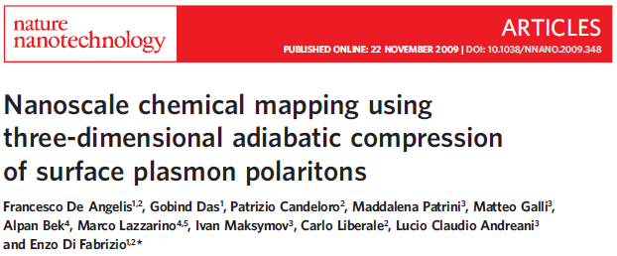
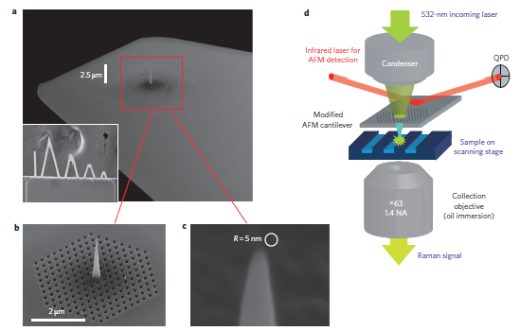
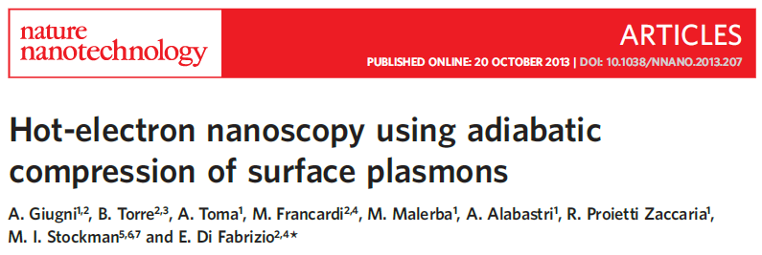
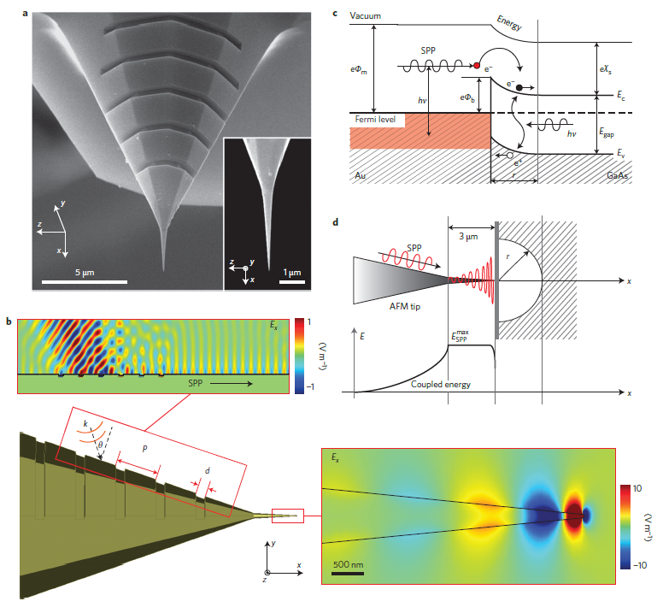
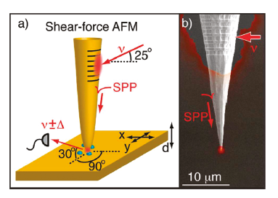
Focusing of SPP along metal cone

Slide 5
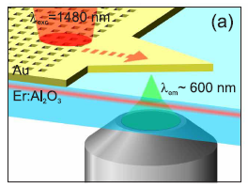
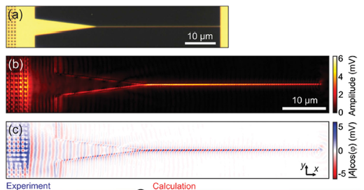
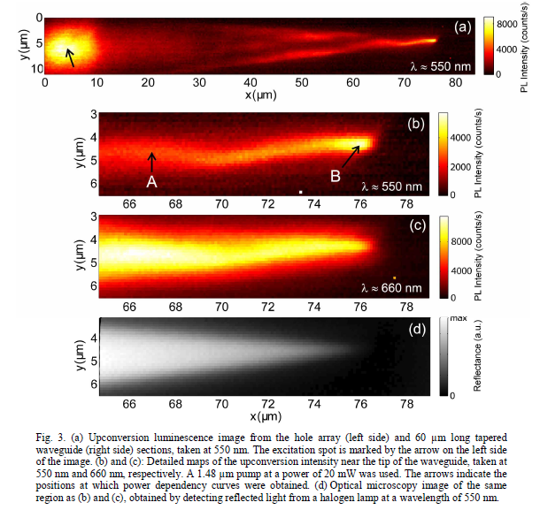
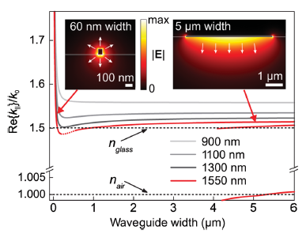
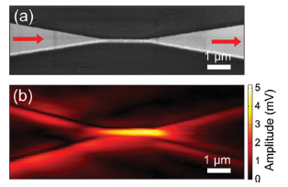
Focusing of SPP along metal strip

Slide 6
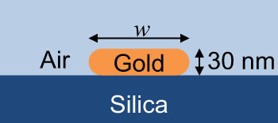
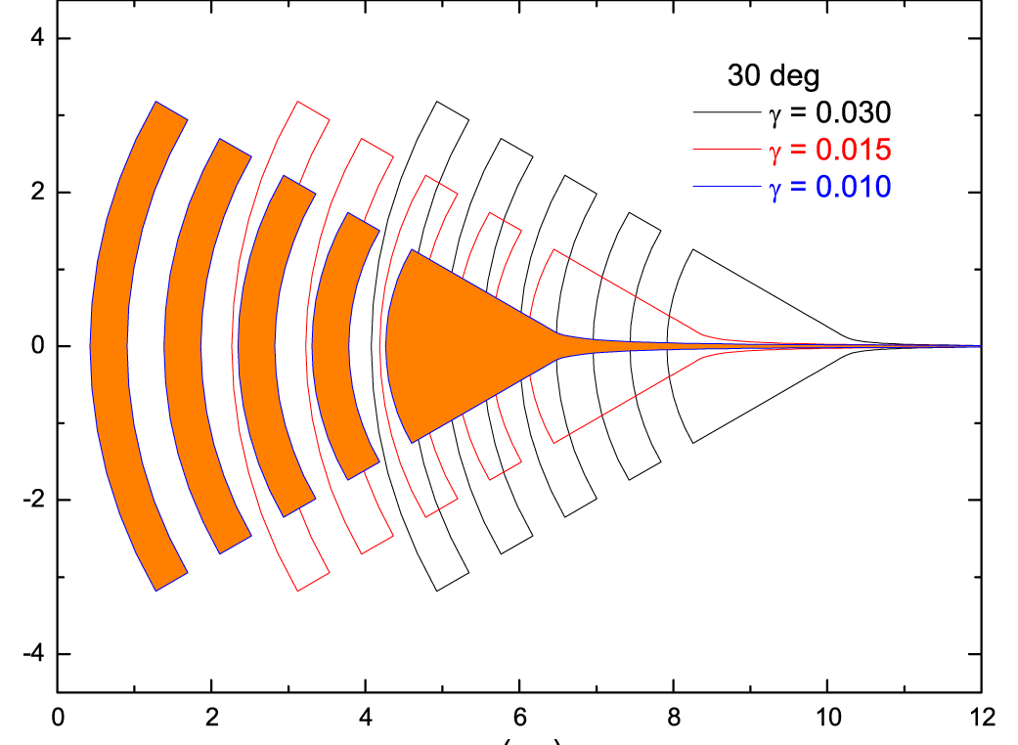
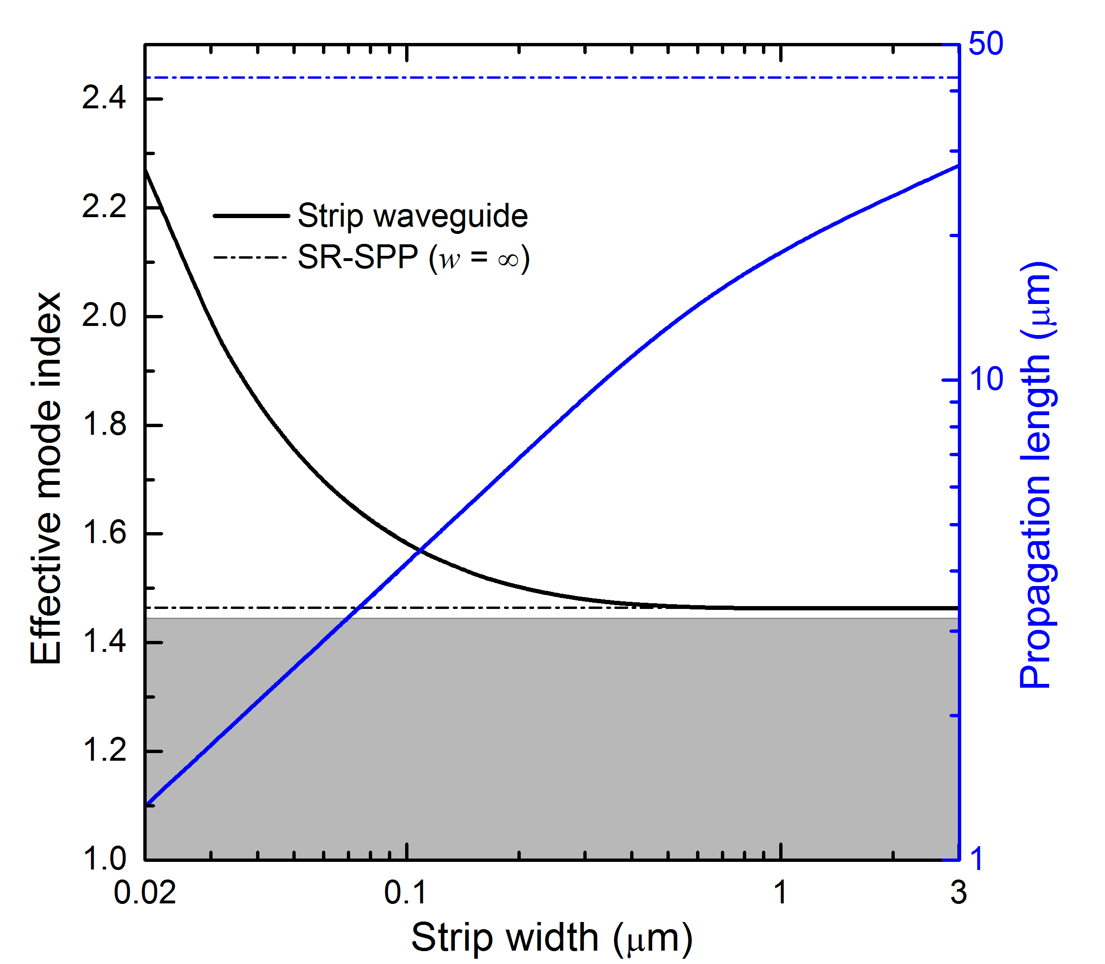
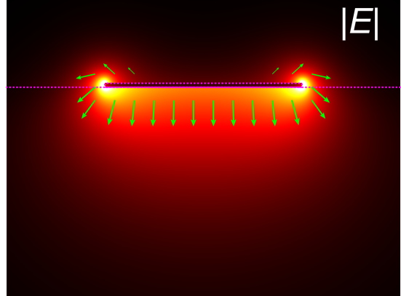
Nanofocusing with constant adiabatic parameter
λ = 1500 nm
n_{Silica}
γ = 0.015
max
Amplitude
1 μm
0
π
Phase
0
−π
w = 30 nm
w = 1.5 μm
Ohmic losses should be taken into account!

Slide 7
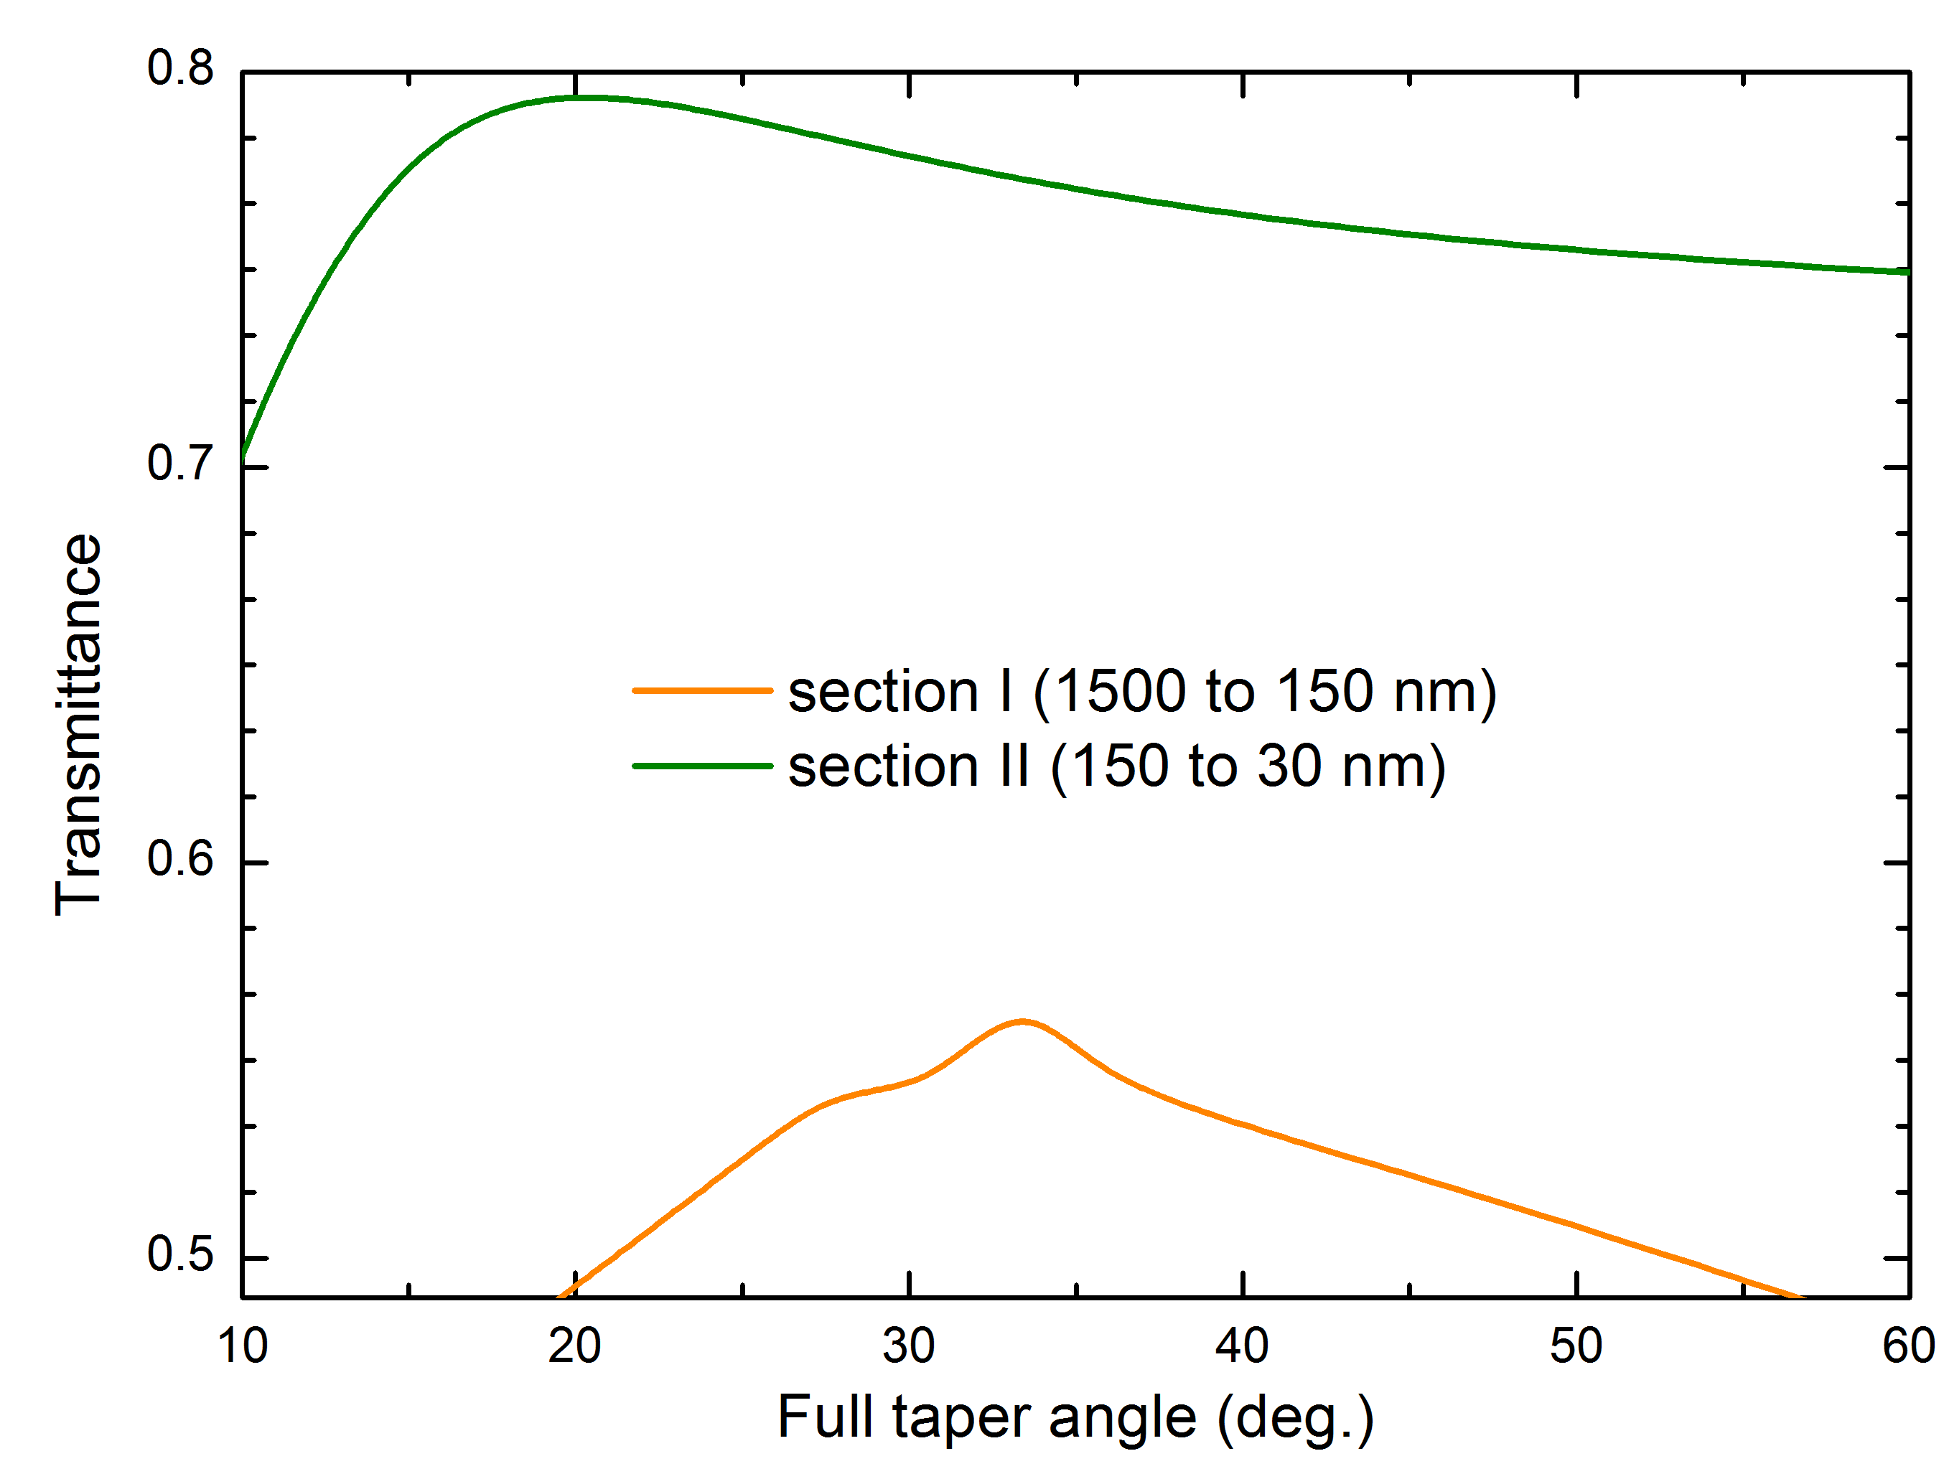
1500 nm
Optimization of the combined taper
L₁
150 nm
L₂
Andrei Andryieuski
30 nm
For optimum parameters:
Transmittance T_{total} ≈ 40%
Total FE ≈ 12

Slide 8
Transmission-mode s-SNOM
Towards detector
AFM tip
Silica

Slide 9
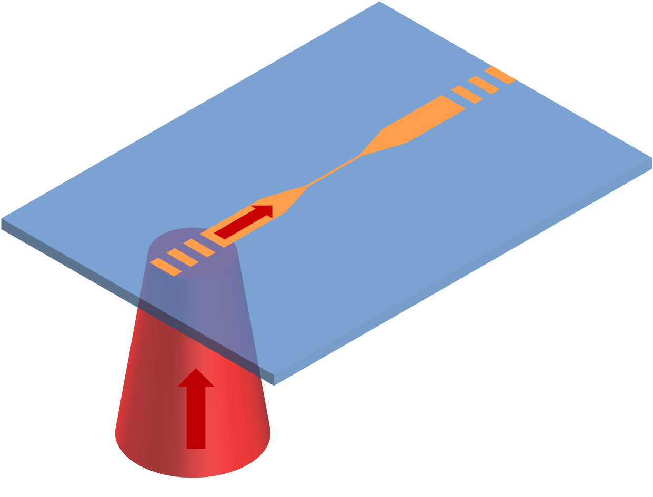
Transmission-mode s-SNOM
Parabolic mirror
Beam splitter
Detector
Polarizer
AFM tip
Demodulation
Amplitude |E|
Phase φ
Beam splitter
Parabolic mirror
Telecom laser
1425-1640 nm
Oscillating mirror

Slide 10
Nanofocusing to strip waveguides
Topo
|E|
Arg[E]
|E|
Arg[E]
|E|
Arg[E]
|E|
Arg[E]
2 µm
2 µm
30 nm
60 nm
100 nm
200 nm
Radu Malureanu

Slide 11
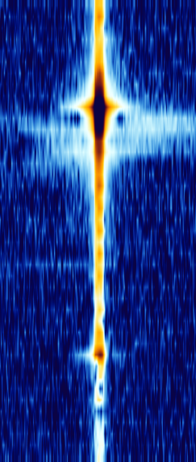
Processing data
|E|
Arg[E]
|E|
10|E|
|E|
Discrete Fourier Transform (log scale)
+
=
k_{z}
100 nm
1.6k₀
x
Global fitting parameters (complex): n, r
Re[n] = 1.60
L_{prop} = 4.5 μm
R = |r|² = 0.10
-1.6k₀

Slide 12
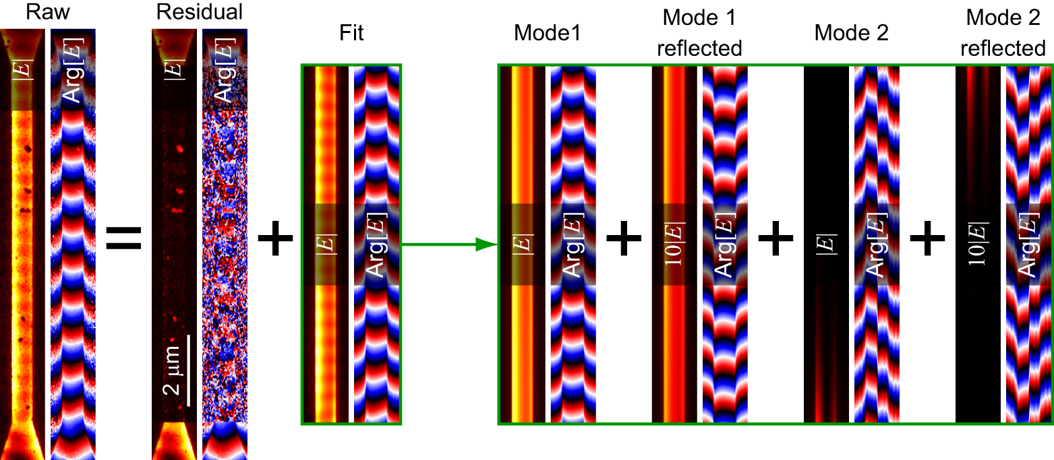
Fitting with two modes

Slide 13
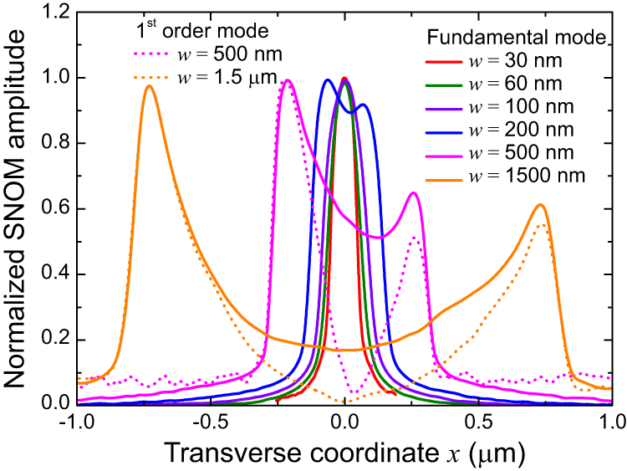
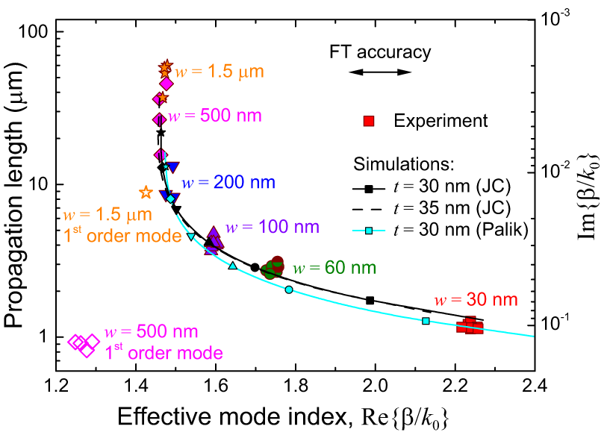
Strip waveguide properties
Mode profile
Mode dispersion
V. A. Zenin, R. Malureanu, I. P. Radko, A. V. Lavrinenko, and S. I. Bozhevolnyi, “Near-field characterization of bound plasmonic modes in metal strip waveguides,” Opt. Express, 24(5), 4582-4590 (2016).

Slide 14
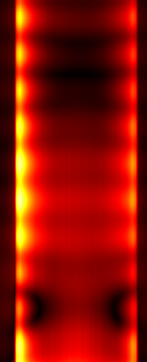
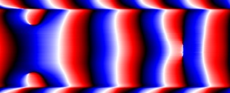
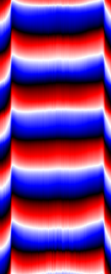
Estimation of the transmittance
T_{out}
R_{out}
z
1.5 µm
x
R_{in}
In
Fit
T_{total} ≈ 20%
T_{single} ≈ 81%
T_{total} ≈ 31%
T_{single} ≈ 56%

Slide 15
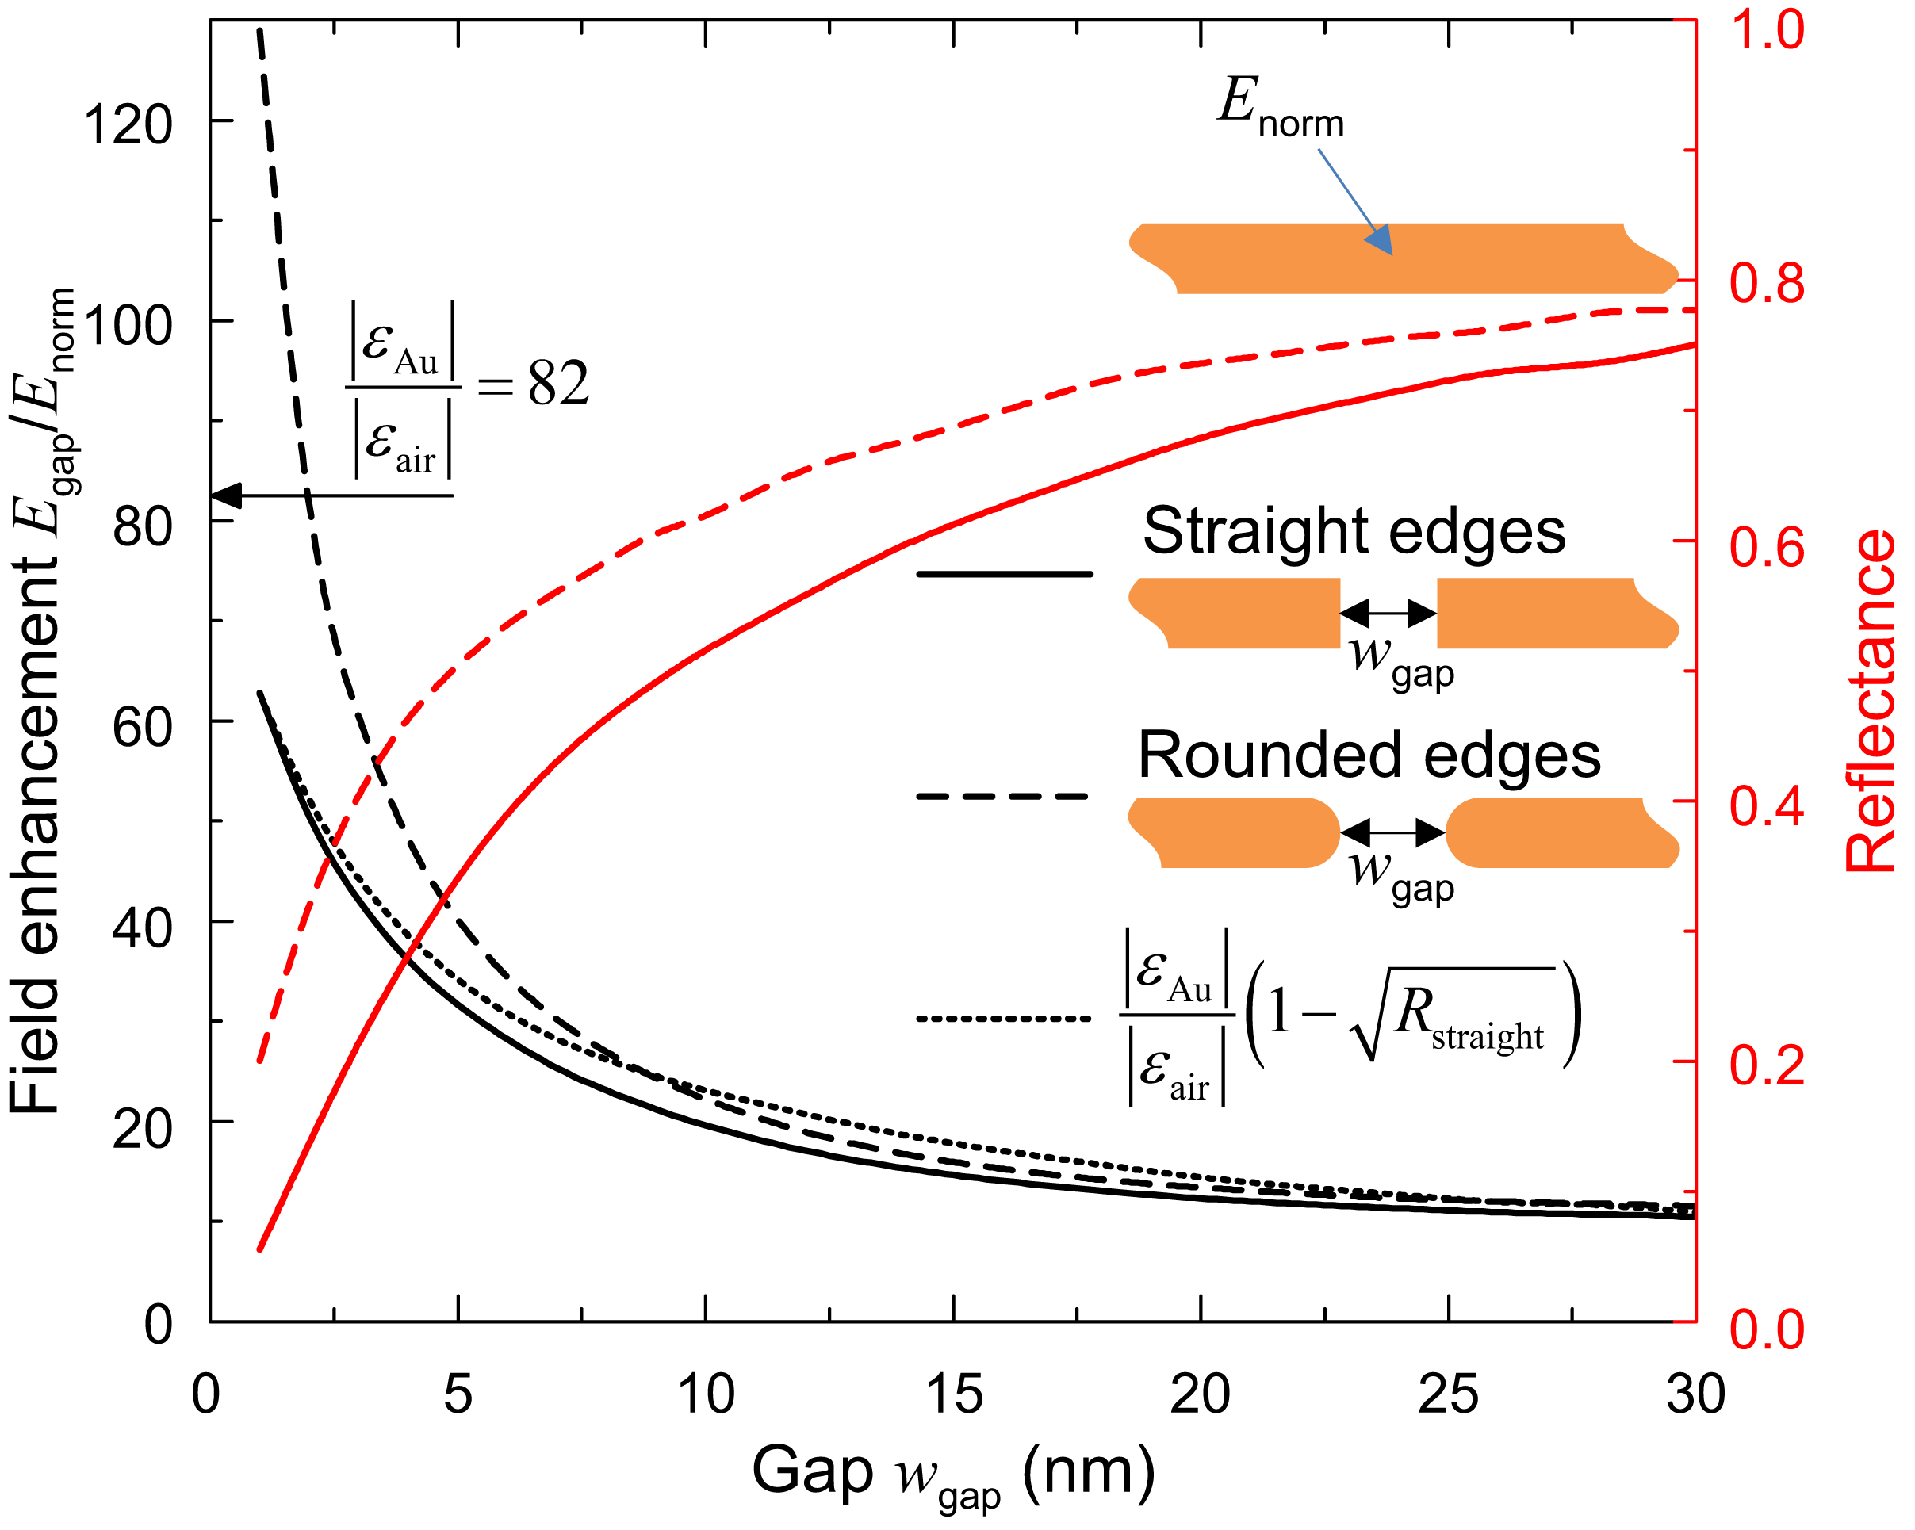
Further increase in FE: gap in the nanowire
Boundary conditions:
E₂
E₁
ε₁E₁ = ε₂E₂
E₂ = E₁ε₁/ε₂
For 10 nm gap longitudinal FE ~ 22; FE = 22/3.8 ≈ 6.

Slide 16
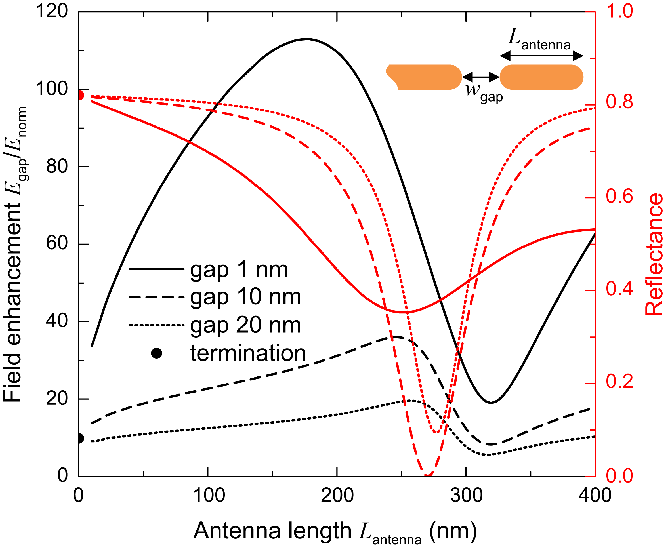
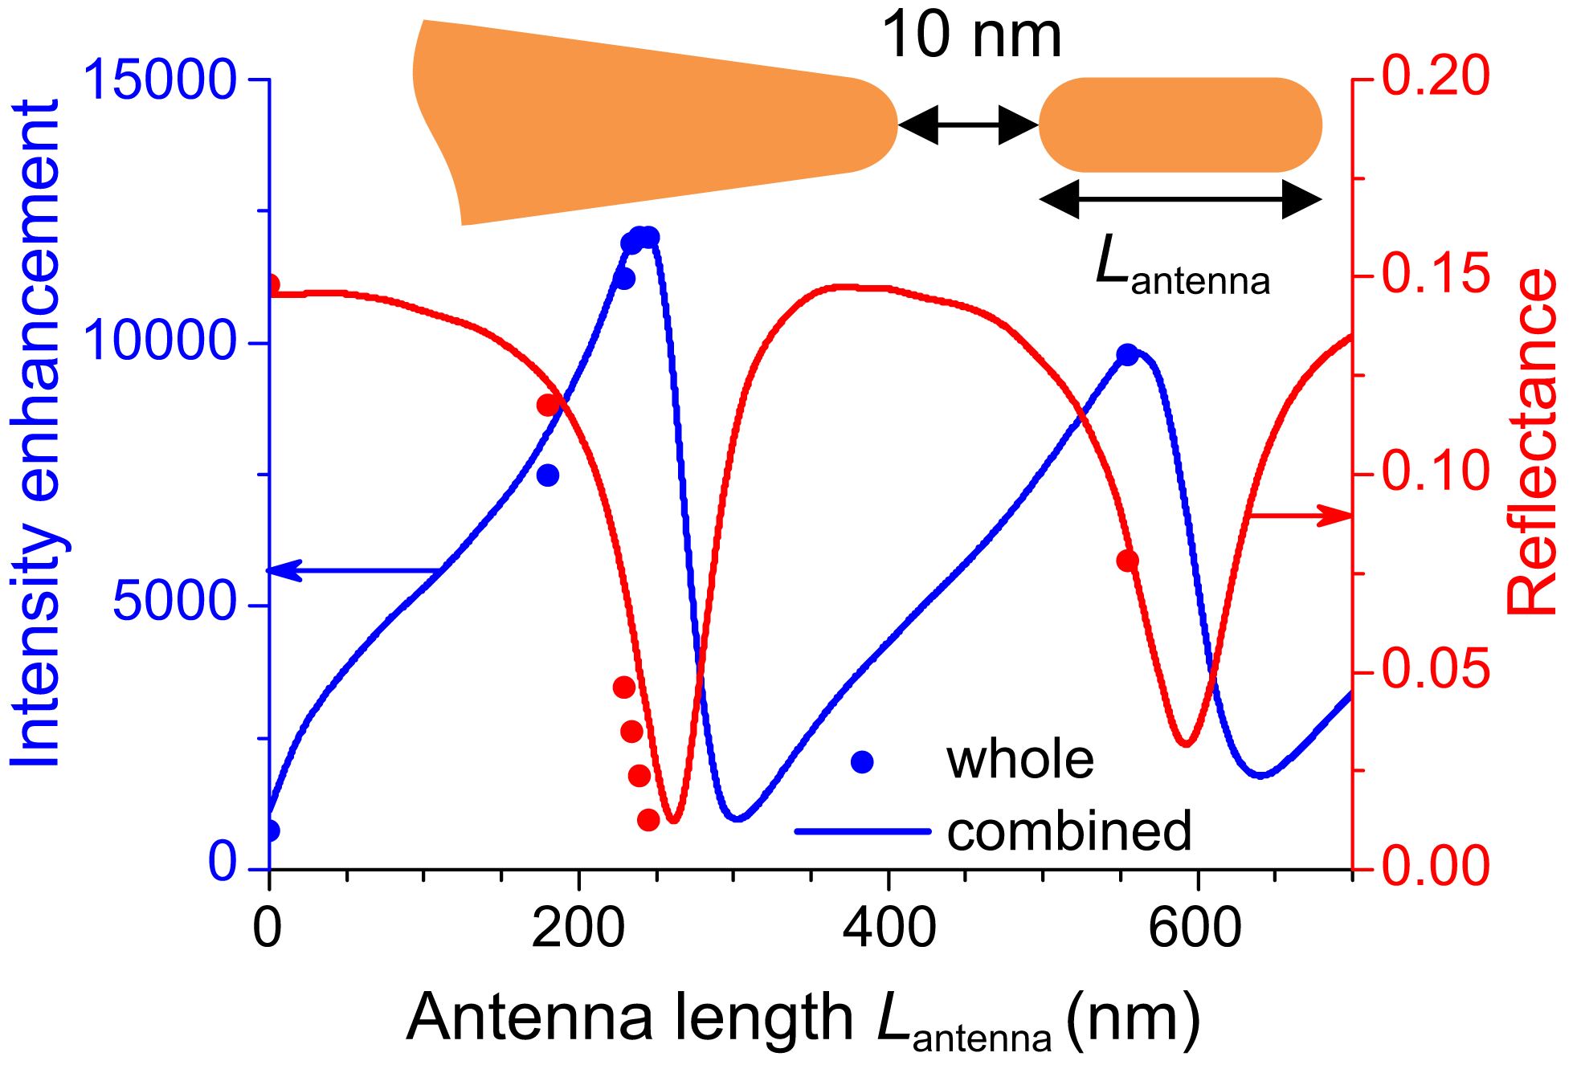
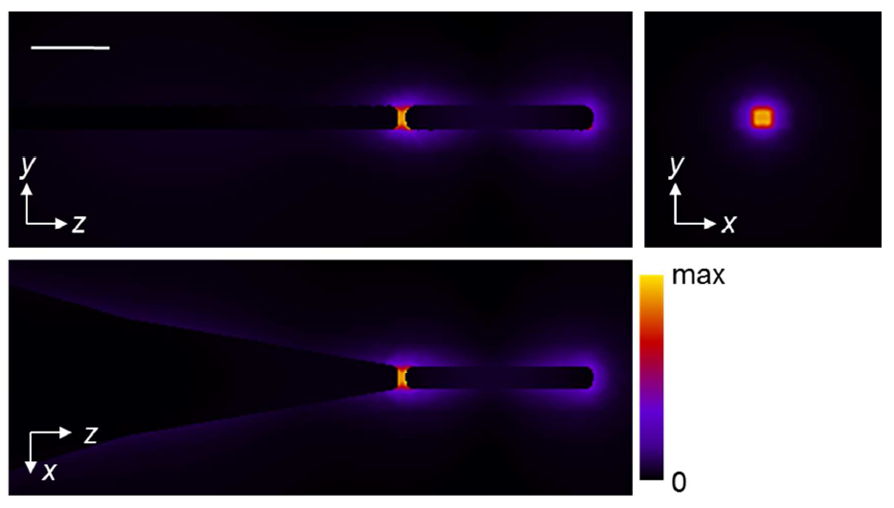
Further increase in FE: antenna excitation
Antenna-coupled nanowire
Antenna-coupled nanofocuser
100 nm
|E|
For 10 nm gap at resonant antenna length (240 nm) total FE ≈ 9.

Slide 17
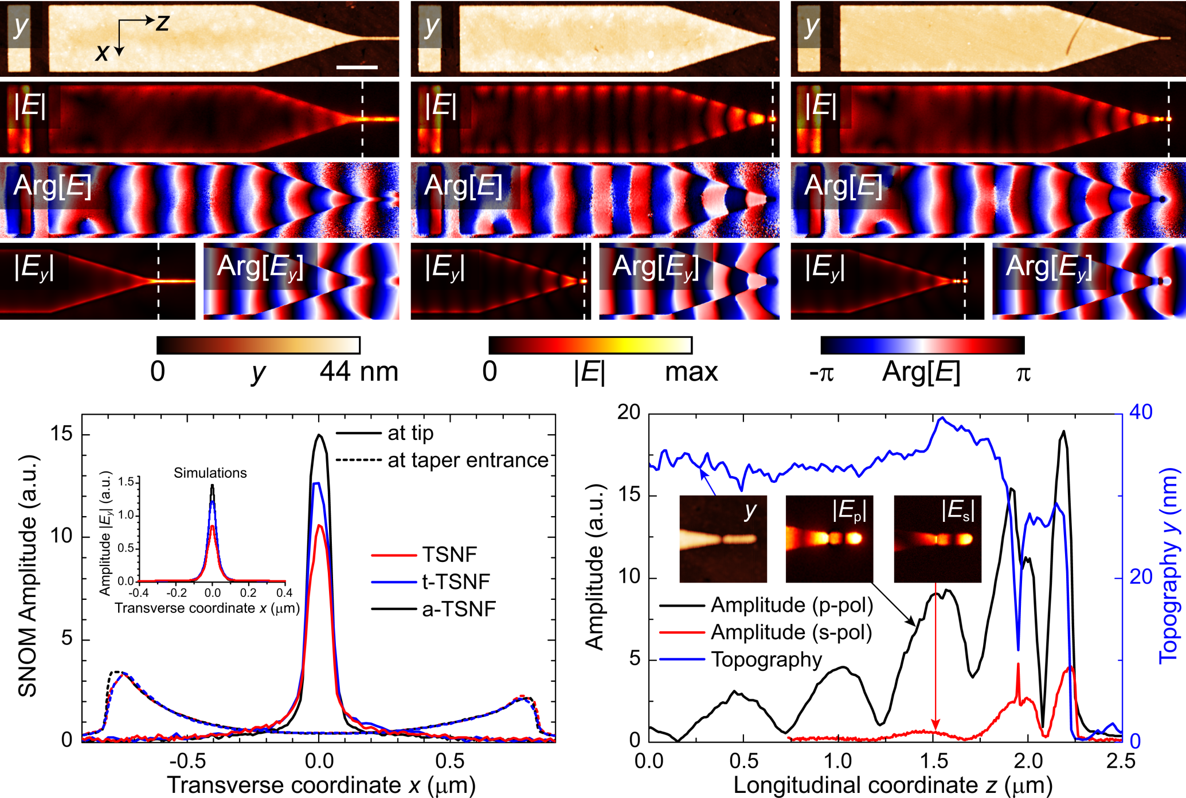
Experimental comparison
TSNF
t-TSNF
a-TSNF
V. A. Zenin, A. Andryieuski, R. Malureanu, I. P. Radko, V. S. Volkov, D. K. Gramotnev, A. V. Lavrinenko, and S. I. Bozhevolnyi, “Boosting local field enhancement by on-chip nanofocusing and impedance-matched plasmonic antennas,” Nano Lett. 15, 8148-8154 (2015).

Slide 18
Conclusions
Dispersion properties of strip waveguides (w = 30, 60, 100, 200, 500, and 1500 nm) are investigated
Optimized 2-section taper with transmittance T > 40% (sim. + exp.) results in the FE of ~12 (intensity enhancement of ~140)
Resonantly coupled antenna further boosts intensity enhancement up to ~12000, with the enhanced field being evenly distributed over the gap volume of 30×30×10 nm³
Thank you!

