Slide 1


Memory in TDDFT :
History and Initial-State Dependence
Neepa T. Maitra
Hunter College and the Graduate Center of the City University of New York

Slide 2
Plan
– introduction to what is memory
-- adiabatic & non-adiabatic approximations and a few exact conditions
-- initial-state dependence example
-- history-dependence example
See Ch. 8 and Ch. 24 in “Fundamentals of TDDFT” book;
Also, Perspective article in J. Chem. Phys. 144, 220901 (2016).

Slide 3
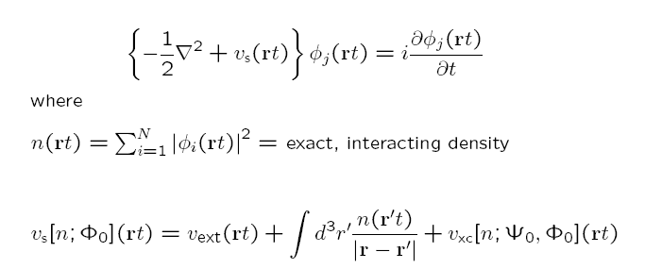
Whence Memory?
Ψ₀
Runge-Gross:
n v_{ext}
true system
1-1
Φ₀
n v_{s}
KS system
1-1
Hartree is naturally adiabatic – depends only on instantaneous density
Actually, v_{ext} [n,Ψ₀] (rt)
History: n(r t’<t), and, initial states Ψ₀, and Φ₀ of true and KS systems
but v_{ext} is prescribed by problem at hand, so functional dependence not so important.
Ψ₀: the true initial state
Φ₀: the initial state to start the KS calculation in -- essentially any state that has same n(r,0) and n(r,0) as Ψ₀
.
usually choose Slater determinant but not necessary

Slide 4
Memory
functional depends on history, n(r t’<t), and on initial states of true and KS systems
Also, for a general observable: A[n; Φ₀]
Memory can be thought to arise from using a reduced variable, n(r,t): tracing over N-1 spatial variables → memory-dependence.
Special, and common, case:
Ψ₀ = Ψ_{GS}
Φ₀ = Φ_{GS}
Then, by the Hohenberg-Kohn theorem, Ψ₀ = Ψ₀[n(0)] and Φ₀ = Φ₀ [n(0)]
-- no explicit initial-state-dependence → v_{xc}[n](r,t)
e.g. linear response regime.

Slide 5


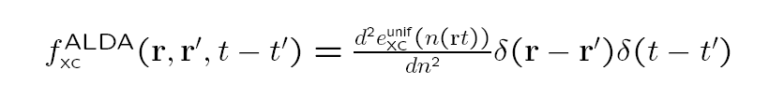
The Adiabatic Approximation
Almost all calculations today ignore memory, and use an
adiabatic approximation:
input instantaneous density into a ground-state approximation
Two sources of error:
Adiabatic approximation itself
Ground-state functional approximation
To disentangle, study “adiabatically-exact” potential:
v_{xc}^{A-ex} (r,t) = v_{xc}^{exact-gs}[n(t)](r)

Slide 6

Development of Memory-Dependent Functionals…
linear-response kernel of the homogeneous electron gas at finite frequency
Gross-Kohn (1985)
Phys. Rev. Lett. 55, 2850 (1985)
Non-adiabatic -- time-non-local although spatially local; “finite-frequency LDA”
Violates exact conditions: harmonic potential theorem, zero-force theorem
Notes:
GK assumes slowly varying GS density (so can use hom kernel) as well as slowly varying density-response (q=0)

Slide 7
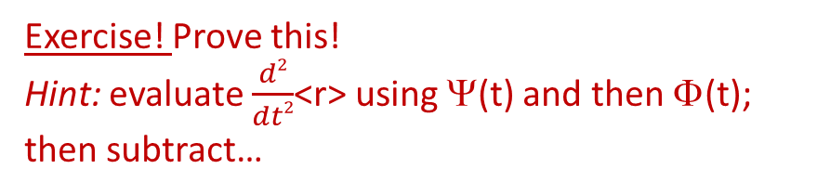
A couple of exact conditions in TDDFT:
Harmonic Potential Theorem (Dobson (PRL 73, 2244, (1994); Vignale PRL 74, 3233, (1995))
N electrons in a harmonic well subject to a TD uniform electric field, E(t)
→ density rigidly sloshes back and forth following classical center of mass oscillations
n(r,t) = n_{GS}(r – r_{CM}(t))
Zero Force Theorem (Vignale PRL 74, 3233, (1995); Phys. Lett. A, 209, 206 (1995) )
xc field cannot exert a net force on itself
Exercise! Prove this!
Hint: evaluate $\frac{d2}{dt2}$<r> using Ψ(t) and then Φ(t); then subtract…
Linear response regime:
Another exercise! Prove this too!
Notes:
HPT violation: Dobson found GK gives an n-dep shift in the CM motion which becomes damped. Problem is because local density can’t distinguish btn compression/rarefaction (squeezing, breathing, as in a long-wavelength plasmon) and global translation (sloshing). GK “chooses” breathing, so get dissipation where there is none.

Slide 8

Returning now to Memory-Dependent Functionals…
linear-response kernel of the homogeneous electron liquid at finite frequency
Gross-Kohn (1985)
Phys. Rev. Lett. 55, 2850 (1985)
Non-adiabatic -- time-non-local although spatially local; “finite-frequency LDA”
Violates exact conditions: harmonic potential theorem, zero-force theorem
E.g. zero-force:
Using GK:
f_{xc}^{hom}[n₀(r)](q=0,ω)
ω-dependent
ω-independent
The exact conditions imply time-non-locality → spatially non-local n-dependence, i.e. a local density approximation with memory does not exist.
even in limit of slowly-varying densities → “ultra-non-locality”
Notes:
Ultranonloc also regardless of range of interaction

Slide 9
… Development of Memory-Dependent Functionals
R’,t’
r,t
Dobson-Bünner-Gross (1997)
Phys. Rev. Lett. 79, 1905 (1997)
Apply Gross-Kohn in frame that moves along with local velocity of electron fluid: memory resides with the fluid element.
Spatially-local relative to where a fluid element at (r,t) was at earlier times t’, R’(t’|r,t)
Non-adiabatic, and satisfies harmonic potential theorem, zero-force theorem
Vignale-Kohn (VK) (1996) – spatially local approx in terms of the current-density, j(r,t) → TD-current-density-FT Phys. Rev. Lett. 77, 2037 (1996)
Ψ₀
Based on map:
j A_{ext}
1-1
VK constructed from dynamical longitudinal and transverse responses to slowly-varying perturbations of uniform electron liquid; involves Navier-Stokes-like eqn with complex viscosity coefficients.
Non-adiabatic, and satisfies harmonic potential theorem, zero-force theorems…

Slide 10
… A little more about Vignale-Kohn and TDCDFT…
Note that RG’s 1st step was j ←→ v_{ext}
Using A instead of v makes it easier to satisfy non-interacting representability: many currents of interacting systems in scalar potentials can only be reproduced by a non-interacting systems in vector potentials
Note that spatially local knowledge of current j → spatially ultra-nonlocal dependence on density n
E.g.
So even for static response (no memory), VK can help when spatial-non-locality important.
Seen some success for: correcting overestimate of LDA polarizabilities in long-chain polymers, dissipation in extended systems, spin-Coulomb drag, stopping power in metals….BUT problems for finite systems due to spurious damping
Vignale-Ullrich-Conti (1997) – extended VK to non-linear regime.
G. Vignale, C.A. Ullrich, and S. Conti, PRL 79, 4878 (1997)
Ch. 24 of TDDFT book

Slide 11
… Other Memory-Dependent Functionals
Kurzweil & Baer (2004, 2005, 2006) – Galilean- invariant “memory action functional”, J. Chem. Phys. 121, 8731 (2004).
Tokatly (2005, 2007) –TD-deformation-FT
Ch. 25 in “Fundamentals of TDDFT” book, I.V. Tokatly, PRB 71, 165104 and 165105 (2005); PRB 75, 125105 (2007)
Formulate density & current dynamics in a Lagrangian frame. Since moving with the flow, spatially local xc is sensible & all complications including memory are contained in Green’s deformation tensor g_{i j}
Orbital functionals v_{xc}[{φ_{i}(t)}]
– instantaneous KS orbitals incorporate “infinite KS memory”
Computationally more involved: TDOEP
Development of true ISD-Functionals? none yet!
Nevertheless, ISD and history-dependence are intimately entangled….next slide..

Slide 12
“Memory” condition
History and initial-state dependence are entangled
Maitra, Burke, Woodward, PRL 89, 023002 (2002)
Vxc [n_{t’} ; Ψ₀ = Ψ(t’), Φ₀ = Φ(t’) ] (r,t) independent of t’ (for t>t’)
density n_{t’} defined only from t’ onward
n (t)
t’
t’
t’
t
This is a very hard condition to satisfy for non-adiabatic functionals.
Exercise! Does ALDA satisfy this? Do you think VK satisfies this?

Slide 13
Trading ISD for more history
Evolve initial states backward in time, in some potential, to a ground-state → no ISD due to Hohenberg-Kohn → instead, must tack on extra piece of “pseudo pre-history”
“memory condition”
~
V_{xc}[n;Ψ₀,Φ₀](r t) = V_{xc}[n](r t)
Starts at t=0 in initial true state Ψ₀ and KS evolves from initial state Φ₀
Starts at some time –T from some ground state:
~
n (r t)
n (r t)
pseudoprehistory
t
t
-T’
-T
“initial” ground-state (any)
The pseudoprehistory is not unique – may find many ground-states that evolve to the same state at t=0, in different amounts of time, in different v’s.
Eqn applies to all – gives a strict exact test for approximate functionals.

Slide 14
So far, have done a lot of formalism.
Now let’s take a look at some examples where memory is at play.

Slide 15

Initial-state dependence (ISD)
The 1-1 n-v mapping formally depends on the initial-state.
But is there ISD in actuality?
Evolve Ψ₀ in v(t) →
n (r t)
The answer is:
No! for one electron, but,
Yes! for 2 or more electrons
t
~
? Does there even exist another Ψ₀ s.t.
~
~
evolving Ψ₀ in v (t) → same n ?
If no, then ISD redundant, i.e. the functional dependence on the density is enough.
N.T. Maitra and K. Burke, Phys. Rev. A. 63 042501 (2001); ibid. 64 039901 (E) (2001)
Notes:
The time-evol of the one-body denity actually contain a lot of information – could it be that the ay it evolve actually tell u all about the initial tate itelf? If o, then no ID. Even at the initial time alone, there I a limited cla of initial tate that integrate to the initial denity – then if e are alo prescribing that the tate evolve ith a certain denity evoln under ome form for H, that rule out even more poible initial tate.

Slide 16
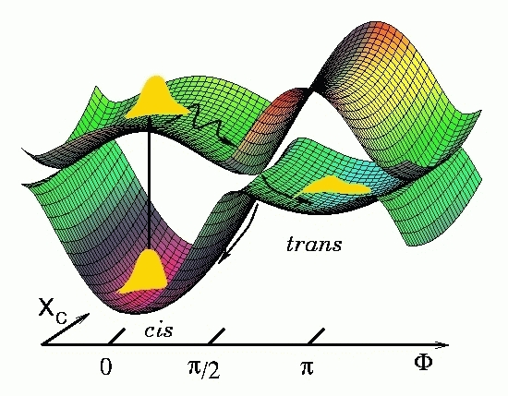
More than one electron: n(r,t) does not uniquely define the potential, need ISD
v_{xc}[n;Ψ₀,Φ₀](r,t)
Implications for the Adiabatic Approximation:
Adiabatic approx designed to work for initial ground-states
-- For initial Ψ₀ an excited state, say, these use v_{xc} derived for a ground-state of the same initial n(r).
Important in photoinduced dynamics generally: start the actual dynamics simulation after initial photo-excitation.
How big is the resulting error?
depends on the choice of the initial KS state
Notes:
Initial State Dep in TDDFT arises because the 1-1 density potential map depends on the initial state of the system. The xc potential then depends on both the initial interacting state and the choice of initial KS state used.
If begin in the ground-state (both true and KS) as in linear response, then by HK, there is no ISD – the states are themselves functionals of the gs density. But more generally, this dependence needs to be accounted for.
An adiab fnal is designed to work for ground-states, so if you start in initial excited state, these use a vxc corresp to a ground-state of the same initial density. How big is the resulting error?

Slide 17
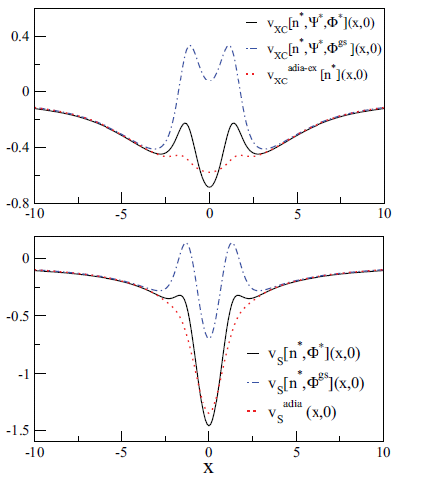
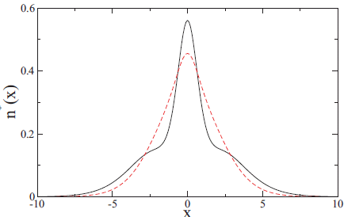
For a given initial excited Ψ₀, how different are the exact Vxc’ s for different choices of KS initial Φ₀ ?
Is there a “best choice” of KS initial state to use if stuck with an adiabatic approx?
e.g.
xc potential
Initial exact v_{xc} for Φ^{gs}
for Φ*
Start in 1st interacting excited state of 1D He
density, n*
v_{c} ^{A-ex}
quite wrong
But it’s closer to
choice of Φ* than
Φ^{gs}
KS potential
Many different choices of initial KS state: e.g:
Φ* = singlet excited state (two orbitals)
Φ^{gs} = singlet ground state (one orbital)
All must have density n*
P. Elliott and N. T. Maitra, PRA 85, 052510 (2012)

Slide 18
More examples, including ensuing time-development, recently demonstrated using a new fixed-point iteration method to find the v(r,t) for a given n(r,t) & Ψ₀ and different choices of Φ₀:
M. Ruggenthaler, S. E. B. Nielsen, R. van Leeuwen, PRA 88, 022512 (2013).
S. E. B. Nielsen, M. Ruggenthaler, R. van Leeuwen, EPL, 101 (2013) 33001
J. I. Fuks, S. E. B. Nielsen, M. Ruggenthaler, N. T. Maitra, PCCP 18, 20976 (2016)

Slide 19
Next an example illustrating history-dependence; we’ll look at this now starting in ground-state in both the interacting and KS systems.

Slide 20
Finding the exact xc potential for a given known density-evolution
Generally, not so easy.
One can show:
into TDKS
orbital-density and orbital-phase of any one of the occupied orbitals
Exercise: show this!
where
In 1D, can express in terms of orbital-density and orbital-”velocity”, u_{i} = j_{i} /n_{i}
So, problem becomes finding the exact KS orbitals -- generally difficult, but possible, Nielsen, Ruggenthaler, van Leeuwen, Europhys. Lett. 101, 33001 (2013)
One easy case: 2 electrons spin-singlet in 1D, in a doubly-occupied KS orbital
n_{i}(x,t) → ½ n(x,t), the exact density, and u_{i}(x,t)→ j(x,t)/n(x,t), where j is the exact current-density

Slide 21
Expression directly for the exact exchange-correlation potential …
Those expressions are directly for v_{s}; to find v_{xc} we must subtract Hartree and v_{ext}
Note there is also an expression directly for v_{xc}:
Equate equation of motion for $∂^{2}$n(r,t)/$∂t^{2}$ coming from interacting system,
with that of the KS system, and then subtract →
TD one-body density-matrix: interacting, KS
TD exchange-correlation hole

Slide 22


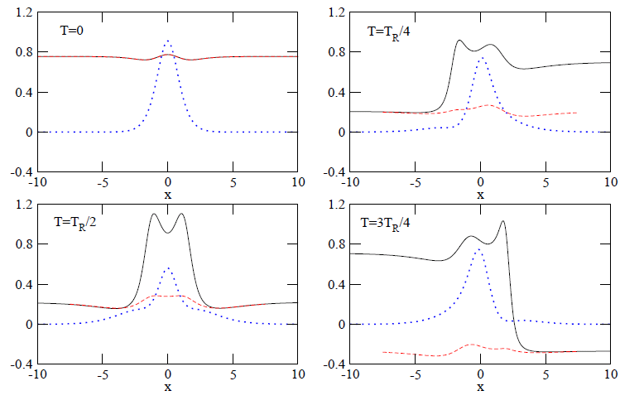
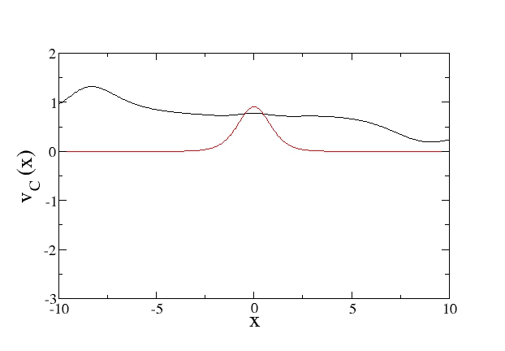

An example of history dependence
Weak on-resonant driving of 1D He atom:
2 soft-Coulomb interacting fermions living in and subject to
A = 0.00667 au
ω = 0.533 au (1st excn.)
exact v_{c}
“adiabatically-exact” v_{c}^{adia-ex}=v_{c}^{exact-gs}[n(t)]
density
Movie, directed by Peter Elliott
density
Vc
Notes:
Say what the example is

Slide 23
Non-adiabatic features in v_{c} appear generically in non-perturbative dynamics: resonantly-driven processes, charge-transfer dynamics, field-free evolution of non-stationary states, quasiparticle propagation in wires…
…but missing in all adiabatic approximations
E.g.
Elliott, Fuks, Rubio, Maitra, PRL 109, 266404 (2012)
Ramsden, Godby, PRL 109, 036402 (2012)
Fuks, Elliott, Rubio, Maitra J. Phys. Chem. Lett. 4, 735 (2013)
Hodgson, Ramsden, Chapman, Lillystone, Godby PRB 88, 241102(R) (2013)
Hessler, Maitra, Burke, J. Chem. Phys. 117, 72 (2002).
Ullrich, J. Chem. Phys. 125,234108 (2006).
Wijewadarne, Ullrich, PRL 100, 056404 (2008).
….
What is the impact on dynamics?? Propagate with adiabatically-exact approximation to compare…
Notes:
Say what the example is

Slide 24
Example: Propagating with the adiabatically-exact functional
2-site asymmetric Hubbard model:
CT in real-space molecule
CT in Hubbard molecule
AEXX
ω=
Dipole Moments versus Time
Despite extremely accurate CT excitation energies, CT is not achieved by the adiabatically-exact approximation.
J.I. Fuks and Maitra, PRA 89, 062502 (2014); Phys. Chem. Chem. Phys. 16, 14504 (2014)

Slide 25
Example: Propagating with the adiabatically-exact functional
Comparison for a real molecule: LiCN
S. Ragunathan, M. Nest, J. Chem. Th. Comput. 7 2492 (2011).
CT in real-space molecule
LiCN
Dipole Moments versus Time
Charge-transfer dynamics beginning in the ground-state is particularly difficult for TDDFT approximations to capture.

Slide 26
Summary
Exact xc functionals in TDDFT are generally memory-dependent – but adiabatic approximations are not.
There are a number of known exact conditions related to memory.
Several recent attempts to develop history-dependent functionals, but none are commonly used.
History-dependence and initial-state dependence are entangled with each other.
Memory appears to be an important feature to capture in many applications – orbital functionals may be a good approach – but more study needed.

