Slide 1


Beyond Standard Approximations in Linear Response
a. Double Excitations b. Charge Transfer Excitations
f_{xc}
Neepa T. Maitra
Hunter College and the Graduate Center of the City University of New York

Slide 2


TDDFT for Linear Response
Unprecedented balance between accuracy and efficiency for electronic excitations
E.g. a novel application:
Visual degradation in Leonardo da Vinci’s self-portrait:
A. Mosca Conta et al, App. Phys. Lett. 104, 224101 (2014).
But it doesn’t always work!

Slide 3
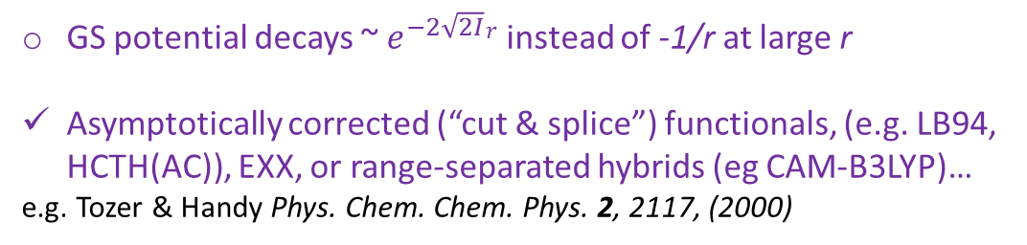
Where the usual approxs give poor excitations
i.e. the usual xc approxs that are semi-local in space and local in time
GS potential decays ~ $e^{−2\sqrt{2I}}r$ instead of -1/r at large r
Asymptotically corrected (“cut & splice”) functionals, (e.g. LB94, HCTH(AC)), EXX, or range-separated hybrids (eg CAM-B3LYP)…
e.g. Tozer & Handy Phys. Chem. Chem. Phys. 2, 2117, (2000)
Rydberg states
Polarizabilities of long-chain molecules
Optical response of solids
GS fnal needs non-local density-dependence
EXX, SIC-LDA, TD current-DFT
e.g. van Gisbergen et al. PRL 83, 694 (1999), van Faassen et al. PRL 88, 186401 (2002).
Primary problem above is the ground-state xc potential….what about cases where the problem is the f_{xc} ? We have…
Need “ultra-long-ranged” kernel ~ 1/q² to reveal excitons and to open the gap.
More in Carsten Ullrich’s lectures.

Slide 4

Where the usual approxs give poor excitations cont.
Long-range charge transfer
Double excitations
Conical intersections
Derivative Couplings
Exponentially-small overlap between donor and acceptor orbitals → fxc correction vanishes
Range-separated hybrids and other approaches for some cases.
More shortly
Adiabatic approx for fxc fails.
Frequency-dependent kernel developed → “dressed TDDFT” More shortly
Both the GS fnal is poor due to near-degeneracy – static correlation – and adiabatic fxc fails.
Levine et al. Mol. Phys. 104, 1039 (2006); Tapavicza et al, J. Chem. Phys. 129., 124108 (2008)
Needed in coupled electron-ion dynamics using surface-hopping – excited-to-excited non-adiabatic couplings are not accessible in linear resp, but adiabatic quadratic response gives divergences.
Ou, Bellchambers, Furche, Subotnik, J. Chem. Phys. 142, 064114 (2015); Li, Liu, JCP 141, 244105 (2014); Zhang, Herbert JCP 142, 064109 (2015)

Slide 5



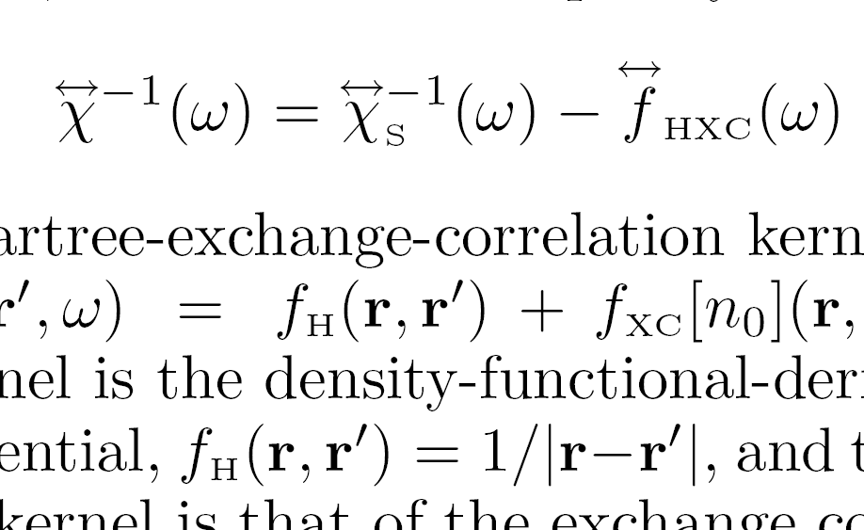
First, quick recall of how we get excitations in TDDFT: Linear response
Petersilka, Gossmann & Gross, PRL 76, 1212 (1996)
Casida, in Recent Advances in Comput. Chem. 1,155, ed. Chong (1995)
Poles at true excitations
Poles at KS excitations
n₀
adiabatic approx: no ω-dep
Need (1) ground-state v_{S,0}[n₀](r), and its bare excitations
(2) XC kernel
~ δ(t-t’)
Yields exact spectra in principle; in practice, approxs needed in (1) and (2).
Notes:
Actually, poles of chi and zeros of chi_inverse etc.
Approxs – in particular, adiabatic, where memory dep negelected entirely, or, in freq domain, this fhxc is constant

Slide 6


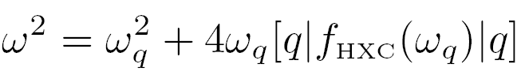

TDDFT linear response in quantum chemistry codes:
q =(i→ a) labels a single excitation of the KS system, with transition frequency ω_{q} = ε_{a} - ε_{i} , and
Eigenvalues → true frequencies of interacting system
Eigenvectors → oscillator strengths
Useful tool for analysis
Zoom in on a single KS excitation, q = i→ a
Well-separated single excitations: SMA
When shift from bare KS small: SPA

Slide 7
Types of Excitations
Non-interacting systems eg. 4-electron atom
Eg. single excitations
Eg. double excitations
near-degenerate
Interacting systems: generally involve combinations of (KS) determinants that may have 1,2,3…electrons in excited orbitals.
single-, double-, triple- excitations

Slide 8

Double (Or Multiple) Excitations
How do these different types of excitations appear in the TDDFT response functions?
Consider:
χ – poles at true states that are mixtures of singles, doubles, and higher excitations
χ_{S} -- poles at single KS excitations only, since one-body operator can’t connect Slater determinants differing by more than one orbital.
χ has more poles than χ_{s}
? How does f_{xc} generate more poles to get states of multiple excitation character?

Slide 9
Simplest Model:
Exactly solve one KS single (q) mixing with a nearby double (D)
Notes:
Add an eqn for Psi i.t.o Phi?

Slide 10
Invert and insert into Dyson-like eqn for kernel →dressed SPA (i.e. ω-dependent):
strong non-adiabaticity!
This kernel matrix element, by construction, yields the exact true ω’s when used in the Dressed SPA,

Slide 11
χ ⁻¹ = χ_{s}⁻¹ - f_{Hxc}

Slide 12
An Exercise!
Deduce something about the frequency-dependence required for capturing states of triple excitation character – say, one triple excitation coupled to a single excitation.

Slide 13
Practical Approximation for the Dressed Kernel
Diagonalize many-body H in KS subspace near the double-ex of interest, and require reduction to adiabatic TDDFT in the limit of weak coupling of the single to the double:
usual adiabatic matrix element
dynamical (non-adiabatic) correction
So: (i) scan KS orbital energies to see if a double lies near a single,
apply this kernel just to that pair
apply usual ATDDFT to all other excitations
N.T. Maitra, F. Zhang, R. Cave, & K. Burke JCP 120, 5932 (2004)

Slide 14
Alternate Derivations
M.E. Casida, JCP 122, 054111 (2005)
M. Huix-Rotllant & M.E. Casida, in Density-Functional Methods for Excited States, ed. N. Ferre, M. Filatov, and M. Huix- Rotllant (Springer 2016)
-- from second-order polarization propagator (SOPPA) correction to ATDDFT
P. Romaniello, D. Sangalli, J. A. Berger, F. Sottile, L. G. Molinari, L. Reining, and G. Onida, JCP 130, 044108 (2009)
-- from Bethe-Salpeter equation with dynamically screened interaction W(ω)
O. Gritsenko & E.J. Baerends, PCCP 11, 4640, (2009).
-- use CEDA (Common Energy Denominator Approximation) to account for the effect of the other states on the inverse kernels, and obtain spatial dependence of f_{xc}-kernel as well.

Slide 15
When are states of double-excitation character important?
(i) Some molecules eg short-chain polyenes
Lowest-lying excitations notoriously difficult to calculate due to significant double-excitation character.
??
R. Cave, F. Zhang, N.T. Maitra, K. Burke, CPL 389, 39 (2004);
More implementations and tests:
G. Mazur, R. Wlodarczyk, J. Comp. Chem. 30, 811, (2008); Mazur, G., M. Makowski, R. Wlodarcyk, Y. Aoki, IJQC 111, 819 (2010);
M. Huix-Rotllant, A. Ipatov, A. Rubio, M. E. Casida, Chem. Phys. 391, 120 (2011) – extensive testing on 28 organic molecules.

Slide 16
When are states of double-excitation character important?
(ii) Coupled electron-ion dynamics
- propensity for curve-crossing means need accurate double-excitation description for global potential energy surfaces
Levine, Ko, Quenneville, Martinez, Mol. Phys. 104, 1039 (2006)
(iii) Certain long-range charge transfer states!
Stay tuned!
(iv) Near conical intersections
- near-degeneracy with ground-state (static correlation) gives double-excitation character to all excitations
(v) Certain autoionizing Fano resonances
e-e.g. even in simple He atom, lowest double-excitation lies in the continuum

Slide 17
Long-Range Charge-Transfer Excitations
(& Molecular Dissociation)

Slide 18
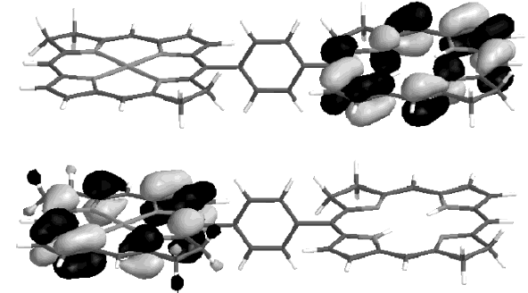
Eg. Zincbacteriochlorin-Bacteriochlorin complex (light-harvesting in plants and purple bacteria)
TDDFT typically severely underestimates Long-Range CT energies
TDDFT predicts CT states energetically well below local fluorescing states. Predicts CT quenching of the fluorescence.
! Not observed !
TDDFT error ~ 1.4eV
Dreuw & Head-Gordon, JACS 126 4007, (2004).
But also note: excited state properties (eg vibrational freqs) might be quite ok even if absolute energies are off (eg DMABN, Rappoport and Furche, JACS 2005)
Notes:
Should I put the energies??
I(ZnBC) = 5.57eV; A(BC) = -0.42eV;expect w_CT = 2.69eV
B3LYP TDDFT gives w = 1.33eV so error at least 1.36 eV

Slide 19
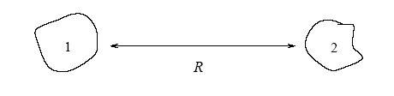
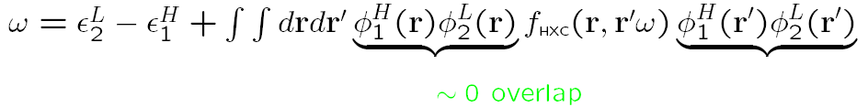

Why usual TDDFT approx’s fail for long-range CT:
First, we know what the exact energy for charge transfer at long range should be:
Ionization energy of donor
e
Electron affinity of acceptor
Now to analyse TDDFT, use single-pole approximation (SPA):
-A_{s,2}
-I₁
i.e. get just the bare KS orbital energy difference: missing xc contribution to acceptor’s electron affinity, A_{xc,2}, and -1/R
Also, usual ground-state approximations underestimate I
Dreuw, J. Weisman, and M. Head-Gordon, JCP 119, 2943 (2003)
Tozer, JCP 119, 12697 (2003)

Slide 20

Functional Development for CT…
E.g. Tawada, Tsuneda, S. Yanagisawa, T. Yanai, & K. Hirao, J. Chem. Phys. (2004): “Range-separated hybrid” with empirical parameter μ
Short-ranged, use GGA for exchange
Long-ranged, use Hartree-Fock exchange (gives -1/R)
Correlation treated with GGA, no splitting
E.g. Optimally-tuned range-separated hybrid
choose μ: system-dependent, chosen non-empirically to give closest fit of donor’s HOMO to it’s ionization energy, and acceptor anion’s HOMO to it’s ionization energy., i.e. minimize
Stein, Kronik, and Baer, JACS 131, 2818 (2009);
Baer, Livshitz, Salzner, Annu. Rev. Phys. Chem. 61, 85 (2010)
Gives reliable, robust results. Some issues, e,g. size-consistency
Karolweski, Kronik, Kűmmel, JCP 138, 204115 (2013)
See Sivan Refaely-Abramson’s talk next week!

Slide 21
…Functional Development for CT:
E.g. Many others…some extremely empirical, like
Zhao & Truhlar (2006) M06-HF – empirical functional with 35 parameters!!!.
Others, are not, e.g. Heßelmann, Ipatov, Görling, PRA 80, 012507 (2009) – using exact-exchange (EXX) kernel .
What has been found out about the exact behavior of the kernel?
E.g. Gritsenko & Baerends JCP 121, 655, (2004) – model asymptotic kernel to get closed—closed CT correct, switches on when donor-acceptor overlap becomes smaller than a chosen parameter
E.g. Hellgren & Gross, PRA 85, 022514 (2012): exact f_{xc} has a ω-dep. spatial step in f_{xc} whose size grows exponentially with separation (latter demonstrated with EXX)
E.g. Maitra JCP 122, 234104 (2005) – form of exact kernel for open-shell---open-shell CT

Slide 22
2 electrons in 1D
Let´s look at the simplest model of CT in a diatomic molecule
→ try to deduce the exact f_{xc} to understand what´s needed in the approximations.

Slide 23


Simple Model of a Diatomic Molecule
Model a hetero-atomic diatomic molecule composed of open-shell fragments (eg. LiH) with two “one-electron atoms” in 1D:
“softening parameters”
(choose to reproduce eg. IP’s of different real atoms…)
First: find exact gs KS potential (→χ_{s})
Can simply solve exactly numerically Ψ(r₁,r₂) → extract ρ(r) →
→ exact

Slide 24
Molecular Dissociation (1d “LiH”)
n
Vs
Vext
x
“Peak” and “Step” structures.
(step goes back down at large R)
Vext

Slide 25
peak
V_{Hxc}
R=10
asymptotic
step
x
J.P. Perdew, in Density Functional Methods in Physics, ed. R.M. Dreizler and J. da Providencia (Plenum, NY, 1985), p. 265.
C-O Almbladh and U. von Barth, PRB. 31, 3231, (1985)
O. V. Gritsenko & E.J. Baerends, PRA 54, 1957 (1996)
O.V.Gritsenko & E.J. Baerends, Theor.Chem. Acc. 96 44 (1997).
D. G. Tempel, T. J. Martinez, N.T. Maitra, J. Chem. Th. Comp. 5, 770 (2009) & citations within.
N. Helbig, I. Tokatly, A. Rubio, JCP 131, 224105 (2009).

Slide 26
The Step
bond midpoint peak
step, size ΔI
Step has size ΔI and aligns the atomic HOMOs
Prevents dissociation to unphysical fractional charges.
v_{s}(r)
ΔI
n(r)
Vext
ΔI
LDA/GGA – wrong, because no step!
“Li”
“H”
At which separation is the step onset?
Step marks location and sharpness of avoided crossing between ground and lowest CT state..
peak
v_{Hxc} at R=10
step
asymptotic

Slide 27





A Useful Exercise!
To deduce the step in the potential in the bonding region between two open-shell fragments at large separation:
Take a model molecule consisting of two different “one-electron atoms” (1 and 2) at large separation. The KS ground-state is the doubly-occupied bonding orbital:
where φ₀(r) and n(r) = φ₁²(r) + φ₂²(r) is the sum of the
atomic densities. The KS eigenvalue ε₀ must = ε₁ = −I₁ where I₁ is the smaller ionization potential of the two atoms.
Consider now the KS equation
for r near atom 1, where and again for r near atom 2, where
Noting that the KS equation must reduce to the respective atomic KS equations in these regions, show that v_{s}, must have a step of size ε₁ − ε₂ = I₂ –I₁ between the atoms.

Slide 28
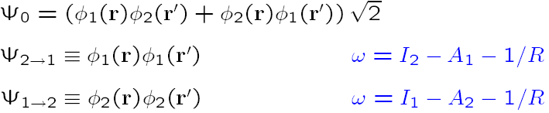
So far for our model:
Discussed step and peak structures in the ground-state potential of a dissociating molecule : hard to model, spatially non-local
Fundamentally, these arise due to the single-Slater-determinant description of KS (one doubly-occupied orbital) – the true wavefunction, requires minimally 2 determinants (Heitler-London form)
In practise, could treat ground-state by spin-symmetry breaking→ good ground-state energies but wrong spin-densities
Next: What are the consequences of the peak and step beyond the ground state?
Response and Excitations

Slide 29
What about TDDFT excitations of the dissociating molecule?
Recall the KS excitations are the starting point; these then get corrected via f_{xc} to the true ones.
Step → KS molecular HOMO and LUMO delocalized and near-degenerate
But the true excitations are not!
“Li”
“H”
LUMO
HOMO
Δε~ e^{-cR}
Near-degenerate in KS energy
Static correlation induced by the step!
Find: The step induces dramatic structure in the exact TDDFT kernel ! Implications for long-range charge-transfer.

Slide 30
Recall, why usual TDDFT approx’s fail for long-range CT:
First, we know what the exact energy for charge transfer at long range should be:
Ionization energy of donor
e
Electron affinity of acceptor
Now to analyse TDDFT, use single-pole approximation (SPA):
-A_{s,2}
-I₁
i.e. get just the bare KS orbital energy difference: missing xc contribution to acceptor’s electron affinity, A_{xc,2}, and -1/R
Also, usual ground-state approximations underestimate I
Dreuw, J. Weisman, and M. Head-Gordon, JCP 119, 2943 (2003)
Tozer, JCP 119, 12697 (2003)

Slide 31
Wait!!
!! We just saw that for dissociating LiH-type molecules, the HOMO and LUMO are delocalized over both Li and H → f_{xc} contribution will not be zero!
Important difference between (closed-shell) molecules composed of
open-shell fragments, and
those composed of closed-shell fragments.
HOMO delocalized over both fragments
HOMO localized on one or other
Revisit the previous analysis of CT problem for open-shell fragments:
Eg. apply SMA (or SPA) to HOMO→LUMO transition
But this is now zero !
q= bonding → antibonding
Now no longer zero – substantial overlap on both atoms. But still wrong.

Slide 32
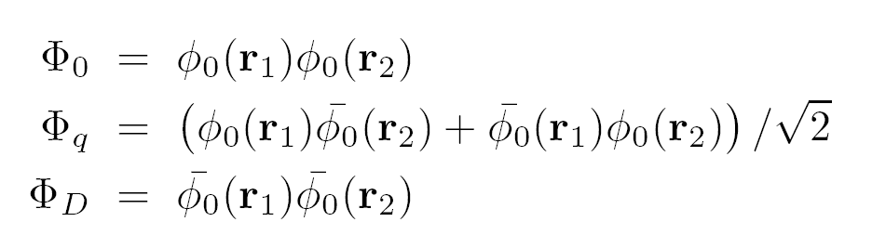
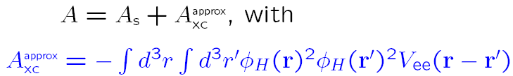

Undoing KS static correlation…
“Li”
“H”
φ₀ LUMO
φ₀ HOMO
Δε~ e^{-cR}
These three KS states are nearly degenerate:
The electron-electron interaction splits the degeneracy: Diagonalize true H
in this basis to get:
atomic orbital on atom2 or 1
Heitler-London gs
CT states
where
Extract the xc kernel from:
Notes:
Haven’t define phi_H, or Vee, or Hs…but no time.
“States rotate…”

Slide 33
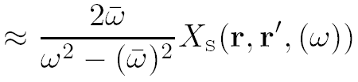

What does the exact fxc looks like?
Diagonalization is (thankfully) NOT TDDFT! Rather, mixing of excitations is done via the f_{xc} kernel...recall double excitations lecture…
KS density-density response function:
only single excitations contribute to this sum
Finite overlap between occ. (bonding) and unocc. (antibonding)
Vanishes with separation as e^{-R}
Interacting response function:
Vanishing overlap between interacting wavefn on donor and acceptor
Finite CT frequencies
Extract the xc kernel from:

Slide 34

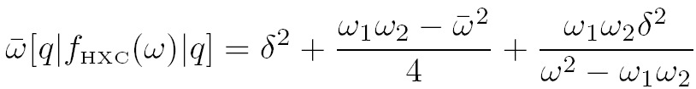
Exact matrix elt for CT between open-shells
Within the dressed SMA
the exact f_{xc} is:…
…
…
_
Interacting CT transition from 2 to 1, (eg in the approx found earlier)
φ₀φ₀ - nonzero overlap
KS antibonding transition freq, goes like e^{-cR}
δ = (ω₁ − ω₂)/2
Note: strong non-adiabaticity!
Upshot: (i) f_{xc} blows up exponentially with R, fxc ~ exp(cR) (ii) f_{xc} strongly frequency-dependent
Maitra JCP 122, 234104 (2005)

Slide 35

How about higher excitations of the stretched molecule?
Since antibonding KS state is near-degenerate with ground, any single excitation φ₀ → φ_{a} is near-generate with double excitation (φ₀ → φ_{a}, φ₀ → φ_{a})
Ubiquitous doubles – ubiquitous poles in f_{xc}(ω)
Complicated form for kernel for accurate excited molecular dissociation curves
Even for local excitations, need strong frequency-dependence.
N. T. Maitra and D. G. Tempel, J. Chem. Phys. 125 184111 (2006).

Slide 36
Summary of CT
Long-range CT excitations are particularly challenging for TDDFT approximations to model, due to vanishing overlap between the occupied and unoccupied states; optimism with non-empirically tuned hybrids
Require exponential dependence of the kernel on fragment separation for frequencies near the CT ones (in non-hybrid TDDFT); Range-separated hybrids work for CT between closed-shell fragments.
Strong frequency-dependence in the exact xc kernel enables it to accurately capture long-range CT excitations
Origin of complicated ω-structure of kernel is the step in the ground-state potential – making the bare KS description a poor one. Static correlation.
Static correlation problems also in conical intersections.

Slide 38
Autoionizing Resonances
When energy of a bound excitation lies in the continuum:
KS (or another orbital) picture
ω
ω
bound, localized excitation
continuum excitation
True system:
Electron-interaction mixes these states → Fano resonance
ATDDFT gets these – mixtures of single-ex’s
M. Hellgren & U. van Barth, JCP 131, 044110 (2009) → Fano parameters directly implied by Adiabatic TDDFT
(Also note Wasserman & Moiseyev, PRL 98,093003 (2007), Whitenack & Wasserman, PRL 107,163002 (2011) -- complex-scaled DFT for lowest-energy resonance )

Slide 39
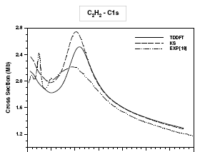
Auto-ionizing Resonances in TDDFT
Eg. Acetylene: G. Fronzoni, M. Stener, P. Decleva, Chem. Phys. 298, 141 (2004)
But here’s a resonance that ATDDFT misses:
Why? It is due to a double excitation.

Slide 40
ω
a
ω = 2(ε_{a}−ε_{i})
i
bound, localized double excitation with energy in the continuum
single excitation to continuum
Electron-interaction mixes these states → Fano resonance
ATDDFT does not get these – double-excitation
e.g. the lowest double-excitation in the He atom (1s² → 2s²)
A. Krueger & N. T. Maitra, PCCP 11, 4655 (2009);
P. Elliott, S. Goldson, C. Canahui, N. T. Maitra, Chem. Phys. 135, 104110 (2011).

Slide 41

Simple Model System: 2 el. in 1d
Vext = x²/2
Vee = λ δ(x-x’)
λ = 0.2
Exact: ½ : ½
½: ½
Exact: 1/3: 2/3
2/3: 1/3
Dressed TDDFT in SPA, f_{xc}(ω)

Slide 42
Summary on Doubles**
ATDDFT fundamentally fails to describe double-excitations: strong frequency-dependence is essential.
Diagonalizing in the (small) subspace where double excitations mix with singles, we can derive a practical frequency-dependent kernel that does the job. Shown to work well for simple model systems, as well as real molecules.
Likewise, in autoionization, resonances due to double-excitations are missed in ATDDFT.
Next: Long-Range Charge-Transfer Excitations

