Slide 1

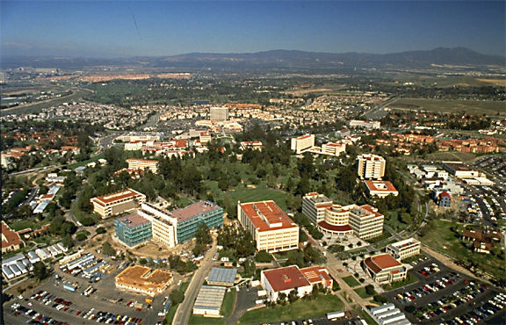
Coherent Multidimensional Core Spectroscopy of
Molecules with Multiple X-ray pulses
Shaul Mukamel
University of California, Irvine
BENASQUE 7th Time-Dependent
Density-Functional Theory:
Prospects and Applications
Sept 22, 2016

Slide 2
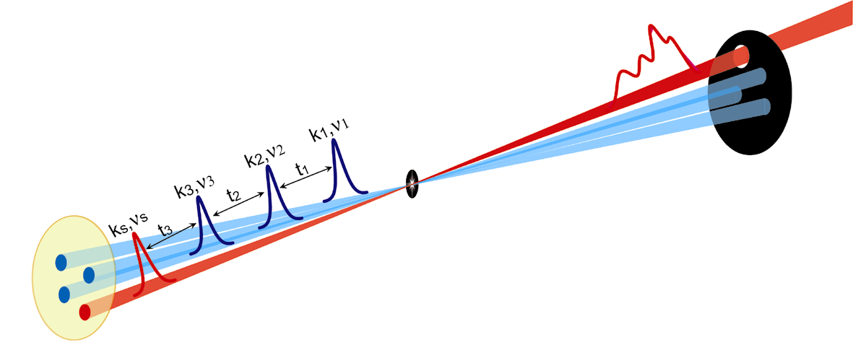
Heterodyne-Detected Four Wave Mixing

Slide 3
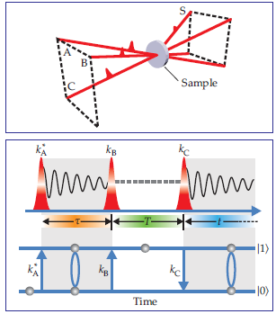
Optical 2D spectroscopy
2D spectrum:
Signal (τ,t) Fourier transform
ks=-kA+kB+kC
excited state
ground state
Rephasing spectrum:
conjugate pulse arrives 1st
Nonrephasing spectrum:
Coherent superposition
conjugate pulse arrives 2nd

Slide 4
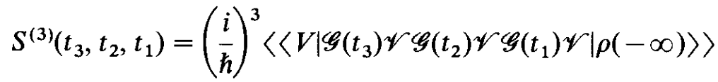
The Nonlinear Response Function
t

Slide 5
2D Correlation Plots
Double Fourier transform
Useful for displaying structural and dynamical information
Ultrafast (50 fs) time resolution
Probe intra- and intermolecular interactions
Spreading transitions in multiple dimensions
Lineshapes reveal environmental fluctuations

Slide 6
Multidimensional Spectroscopy
Radio | NMR, atomistic structure, slow (millisecond) dynamics
Microwave | Rotational structure of molecules,Electron Spins EPR
Infrared | Protein structure and folding, picosecond kinetics, hydrogen bonding THz spectroscopy: Low frequency motion in liquids, intersuband transitions in semiconductors
Visible | Charge and energy transfer in photosynthetic complexes, solvation dynamics, femtosecond relaxation, quantum wells and dots
UV | Protein structure through backbone (FUV) and aromatic side chain (NUV) transitions, base stacking and photophysics in nucleic acids, DNA
X-Ray | Attosecond dynamics of core and valence electrons, atomistic structure
Gamma ray | Nuclear structure

Slide 7
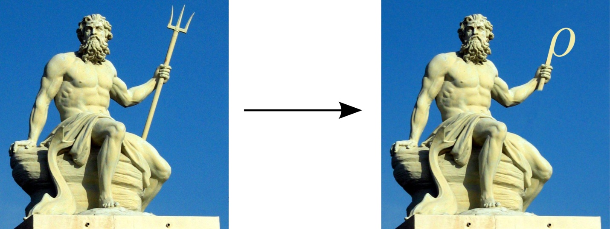
Wavefunction
Density Matrix
N-component state vector
N²-component state vector

Slide 8


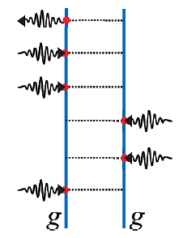
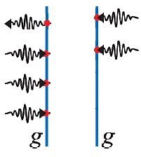
The Nonlinear Response to a classical field
Quantum pathways correspond to n field-matter interactions with m+1 interactions from left and n-m interactions from right
2^{n} Ladder Diagrams
n+1 Loop Diagrams
m+1
interactions
n-m
interactions
m+1
n-m
Move forward in time
Density matrix ~N² space
Can eliminate bath (reduced description)
Keep track of complete time ordering (more terms)
Move forward and backward in time
Wave function ~N space
Must include all degrees of freedom
Partial time ordering (fewer terms)

Slide 9
The relevant exciton space for third-order measurements
|g⟩
single
exciton
1
|f⟩
|e⟩
two
exciton
|g⟩
|g⟩
The exciton level scheme
Block-diagonal Hamiltonian matrix

Slide 10
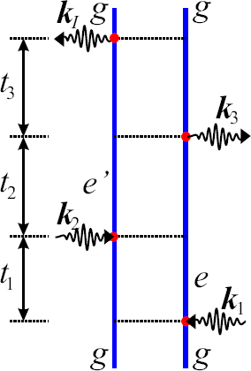
Ladder Diagram Rules
1. The diagrams represent all possible interaction configurations
2. Time propagates from bottom – up.
3. Wave-vectors pointing right mark + , left -
4. Wave-vectors, pointing into diagram: absorption
5. Wave-vectors, pointing out of diagram: emission
6. Intervals between interactions:
7. The state of the density matrix at any time is
given by labels on vertical bars.
8. The initial and final states must be populations.
9. The response function is a product of density matrix
propagations in each interval.
10. The amplitude of the pathway is an ordered
product of transition dipoles for
each interaction.
11. Odd number of interactions on the right
“brings” “-” overall sign.
emission
propagation
absorption
absorption

Slide 11
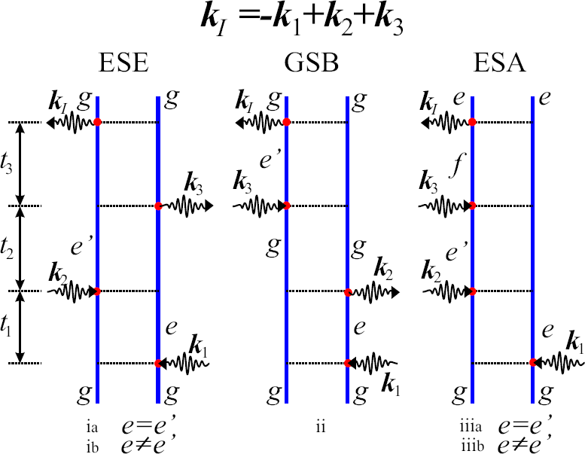
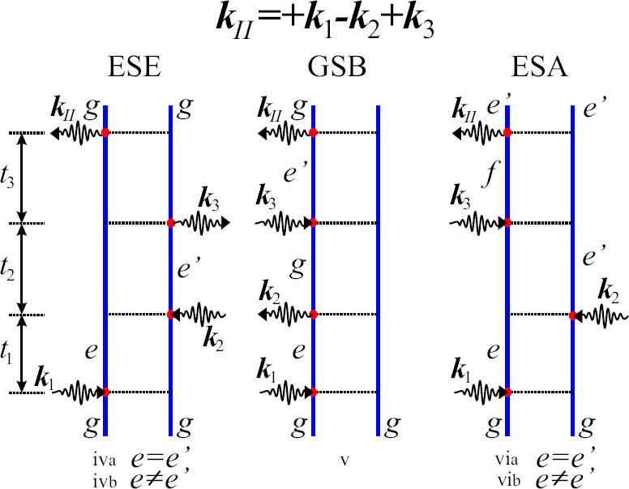
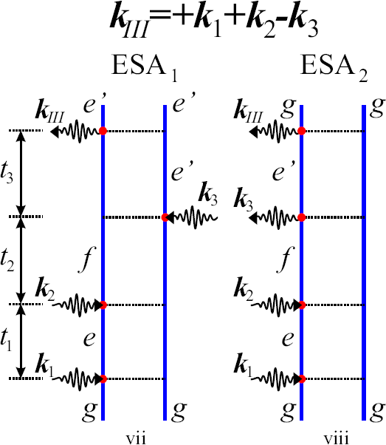
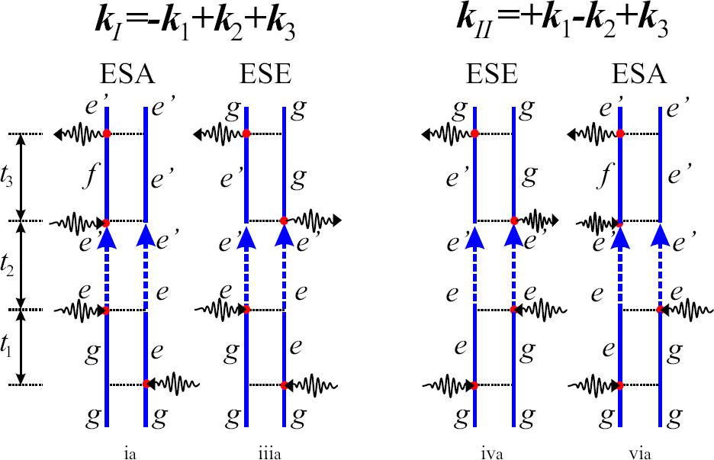
Feynman diagrams for various multidimensional signals
Exciton transport diagrams

Slide 12
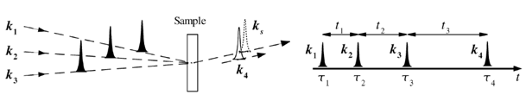
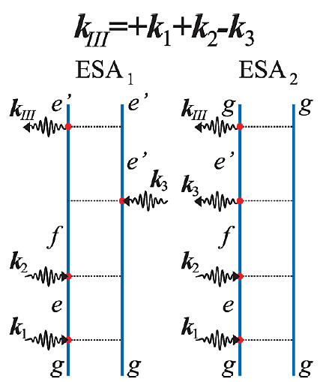
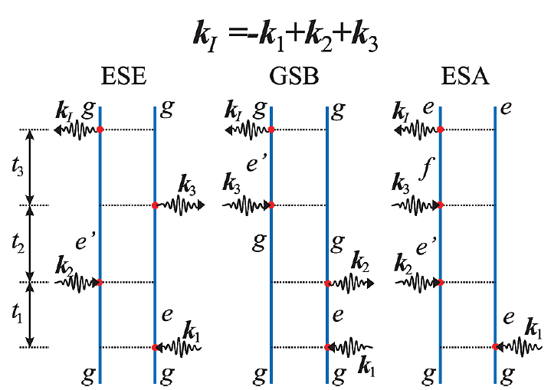
Exciton Quasiparticles in Multidimensional Spectroscopy of Aggregates
2D spectroscopy
Double-quantum coherence process
Rephasing process
Coherent state |f><g|
Coherent states |g><g| or |’e><e|

Slide 13
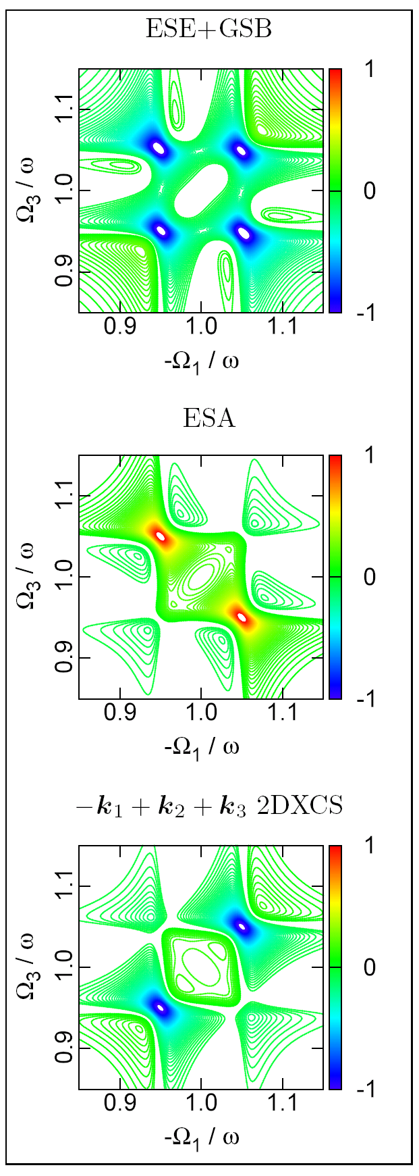
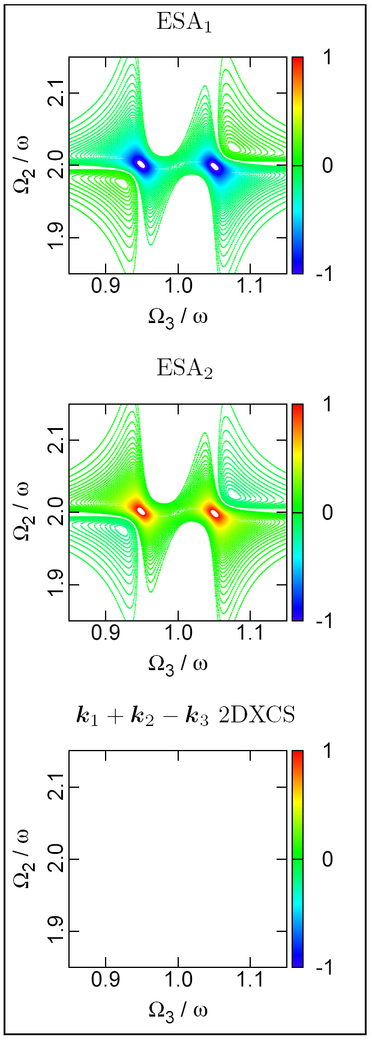
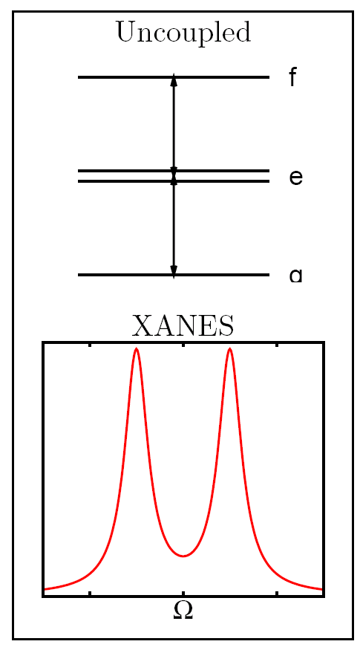
Interference of Pathways in
2D Electronic Spectroscopy
k_{I} and k_{III} of an uncoupled system
Photon-Echo
Double-Quantum
opposite signs
off diagonal peaks in photon echo cancel exactly
…as does the k_{III} signal.

Slide 14
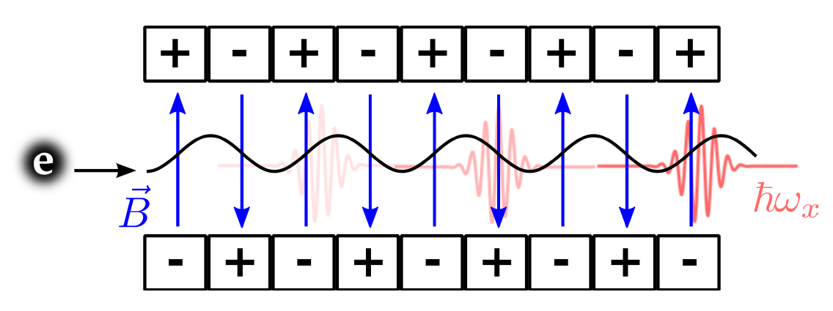
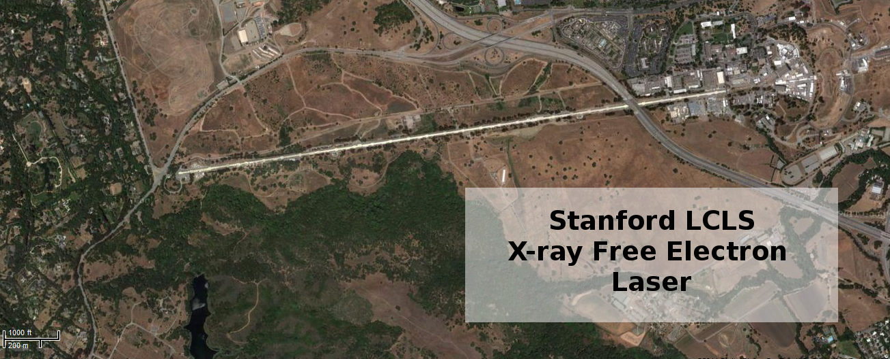
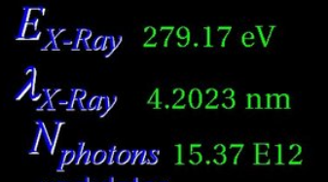
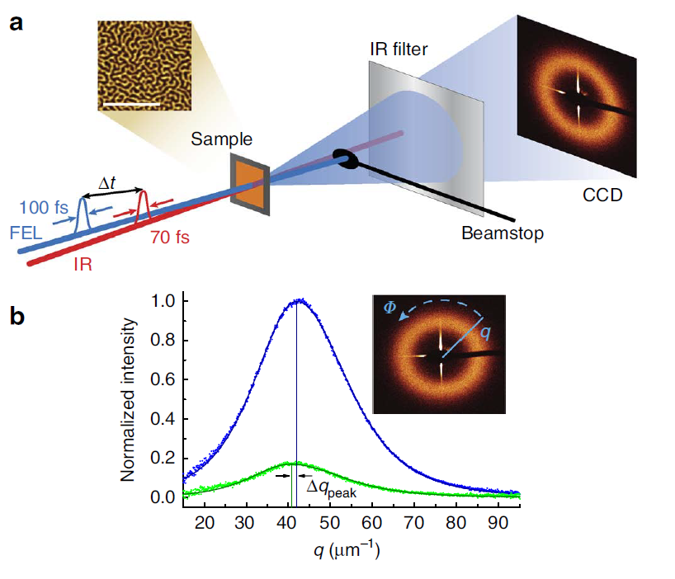
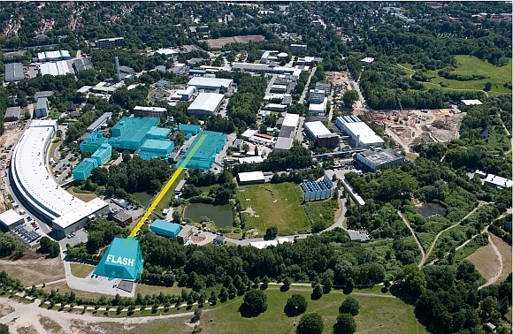
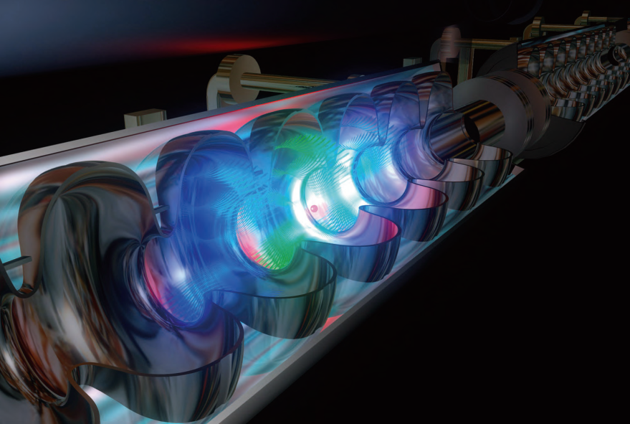
X-ray Free Electron Lasers
P. Luchini and H. Motz. Undulators and Free-electron Lasers(Oxford University Press, USA, 1990)
Nat. Phot., 4(12):802–803, December 2010
P. Emma, et. al. Nat. Phot. 4, 641 (2010)
https://slacportal.slac.stanford.edu/sites/lcls_public/Pages/status.aspx
~60eV
http://flash.desy.de/photon_science/
Nature Comm. 3:1100 (2012) DOI: 10.1038/ncomms2108
http://flash.desy.de/sites2009/site_vuvfel/content/e395/e2188/FLASH-Broschrefrs_web.pdf

Slide 15
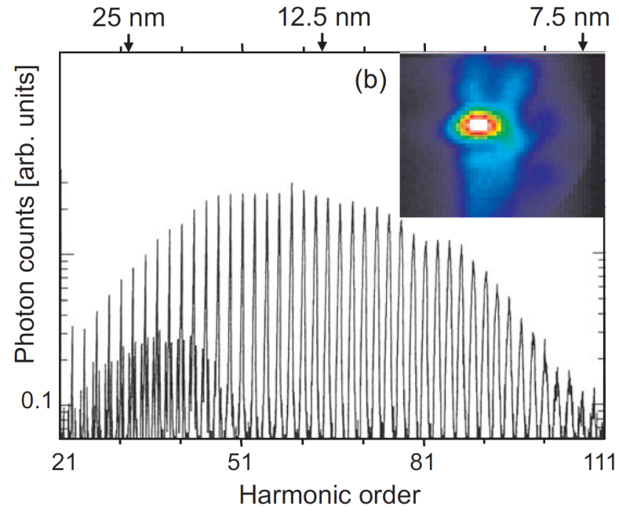
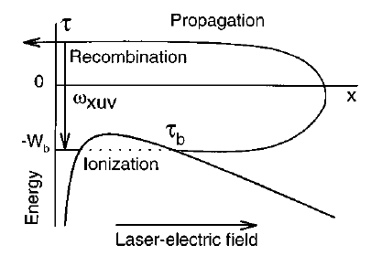
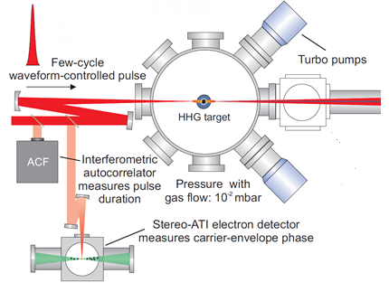
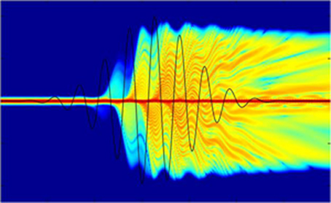
High-Harmonic Generation Sources
Spectral distribution of HHG (inset: spatial intensity profile)
F. Krausz and M. Ivanov. "Attosecond physics." Rev. Mod. Phys. 81.1 (2009): 163.
Schematic of AS-1 beamline at Max Planck Institute of Quantum Optics
F. Krausz and M. Ivanov. "Attosecond physics." Rev. Mod. Phys. 81.1 (2009): 163.
Schematic depiction of HHG process.
T. Brabec and F. Krausz. "Intense few-cycle laser fields: Frontiers of nonlinear optics." Rev. Mod. Phys. 72.2 (2000): 545.
Time-Dependent electron density of simple atom in HHG (taken from website of Ultrafast X-ray group at University of Southampton http://www.orc.soton.ac.uk/xray.html)

Slide 16
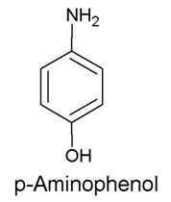
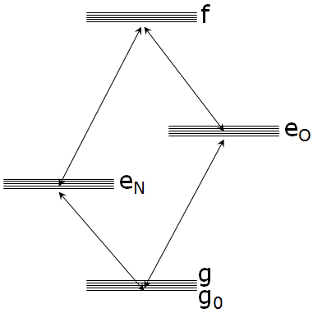
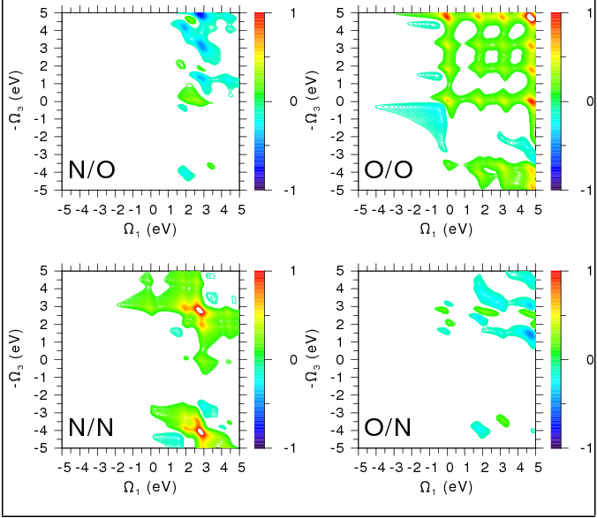
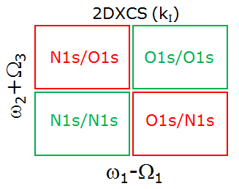
Simulated 2DXCS signal of para-aminophenol
Simulation:
- Equivalent-core approx.
- B3LYP/6-311G** orbitals
- Bandwidth: 6 eV
- Dephasing: 0.3 eV
6.9eV
5.9eV
g.s.

Slide 17
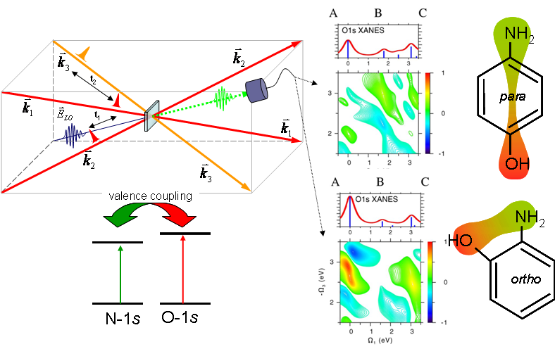
Left: Proposed four-wave mixing of ultrashort x-ray pulses resonant with the O-1s and N-1s levels; Middle: theoretically predicted two-dimensional spectra the lower of which exhibits the coupling of excitations on the oxygen with those of the nitrogen in para and ortho-aminophenol molecules at right [from S. Mukamel].

Slide 18
2D O1s/N1s photon echo signal (t2=0) of p- and o-aminophenol

Slide 19
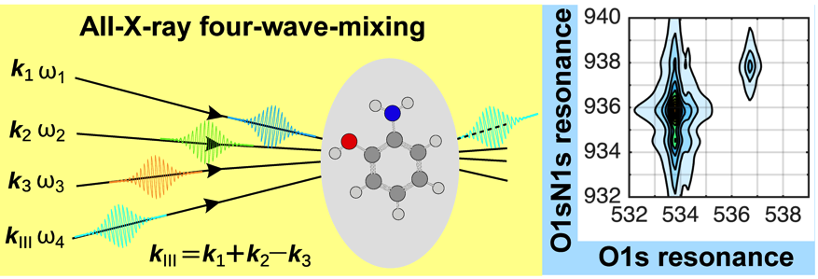
Study of double core hole excitations in molecules by
X-ray double-quantum-coherence (XDQC) signals: a multi-configuration simulation
Hua, Bennett, Zhang, Luo, Mukamel,
Chem. Sci., 2016, DOI: 10.1039/C6SC01571A

Slide 20
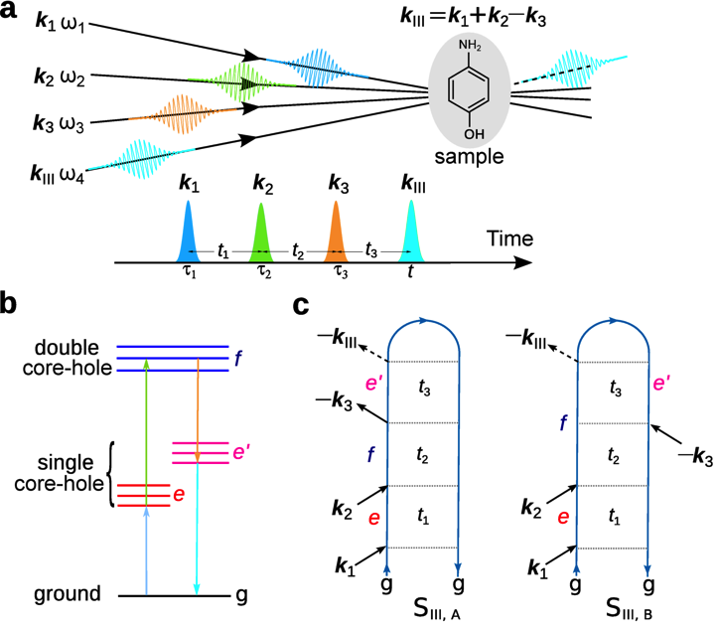
XDQC set-up

Slide 21
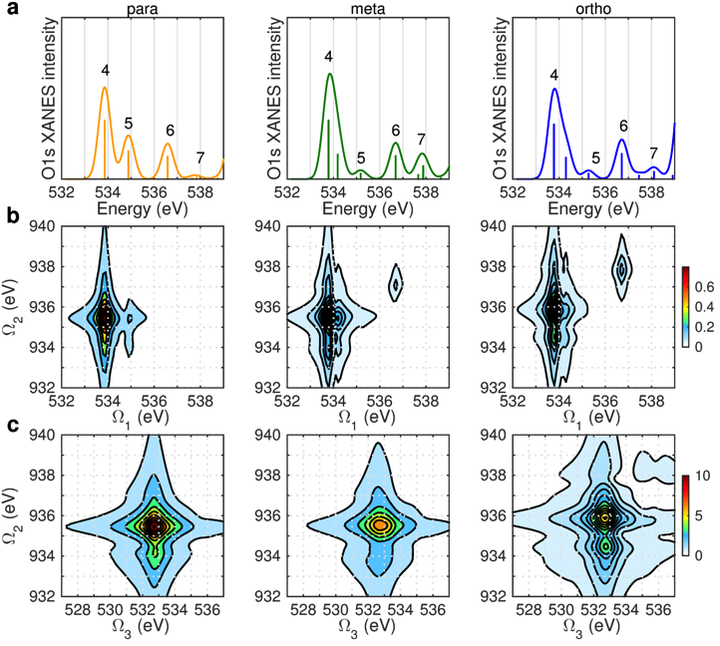
ON-B XDQC signals of 3 isomers:
O1s XANES
Ω₁-Ω₂ plot:
directly probes
correlation
between the
N1s SCH &
N1sO1s DCH
states
Ω₂-Ω₃ plot

Slide 22
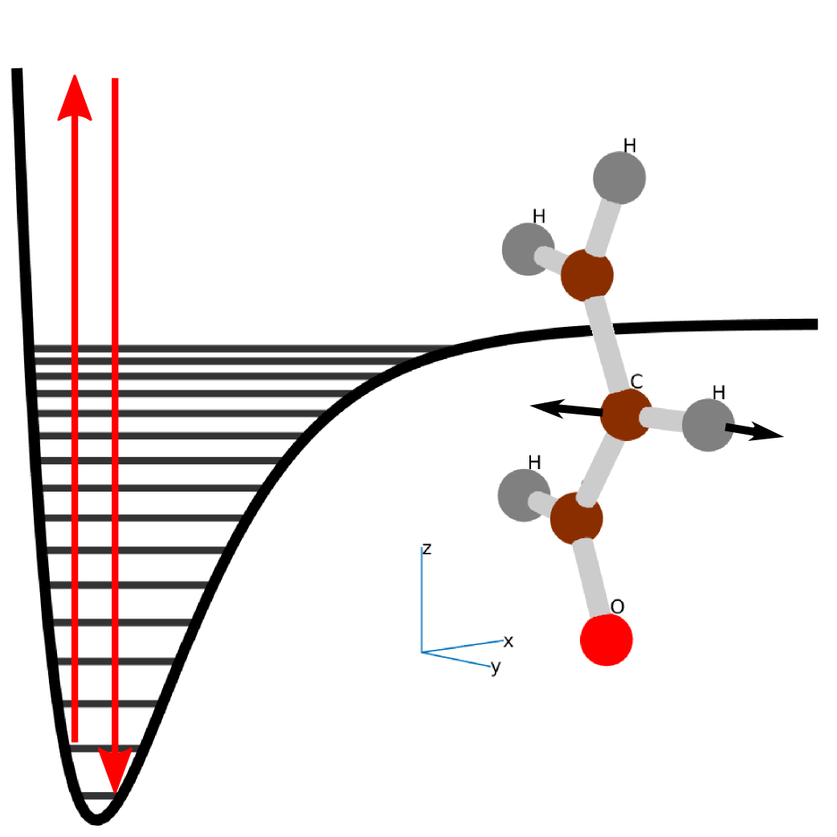
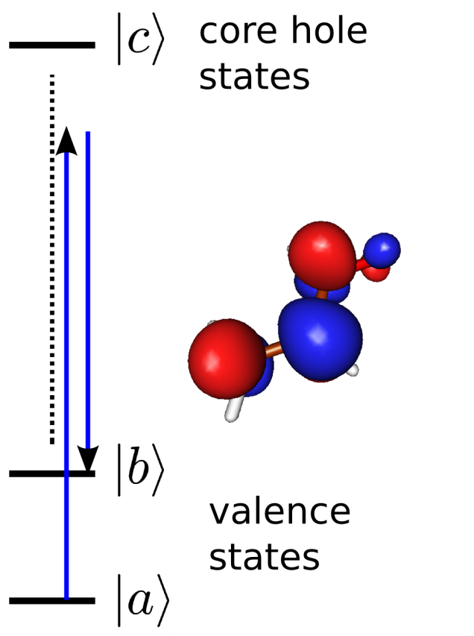
Vibrational (optical) vs. Electronic ( X-Ray) Stimulated Raman Processes
Vibrational Raman
X-Ray Raman
Vib. transitions
Optical frequencies
femtoseconds
Electronic transitions
XUV/X-Ray
attoseconds

Slide 23

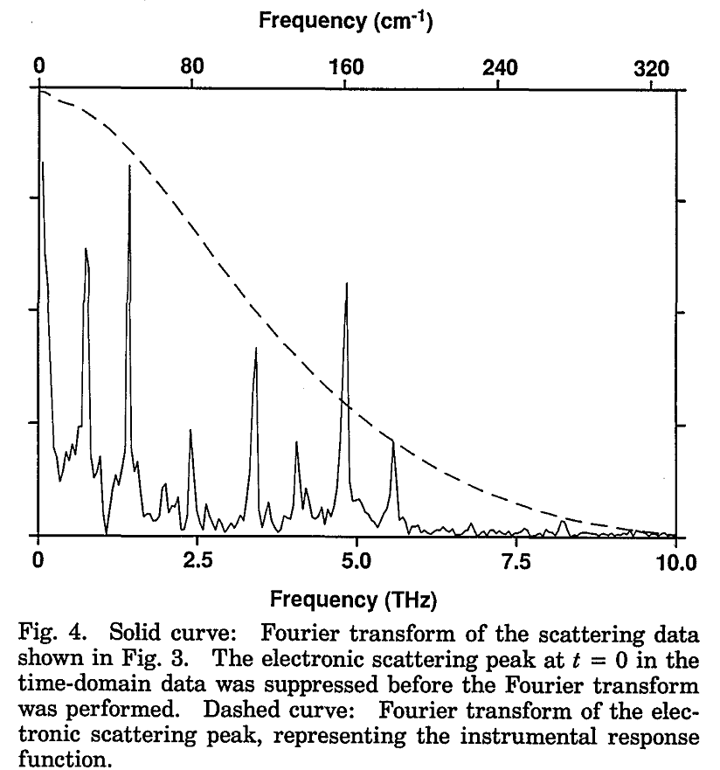
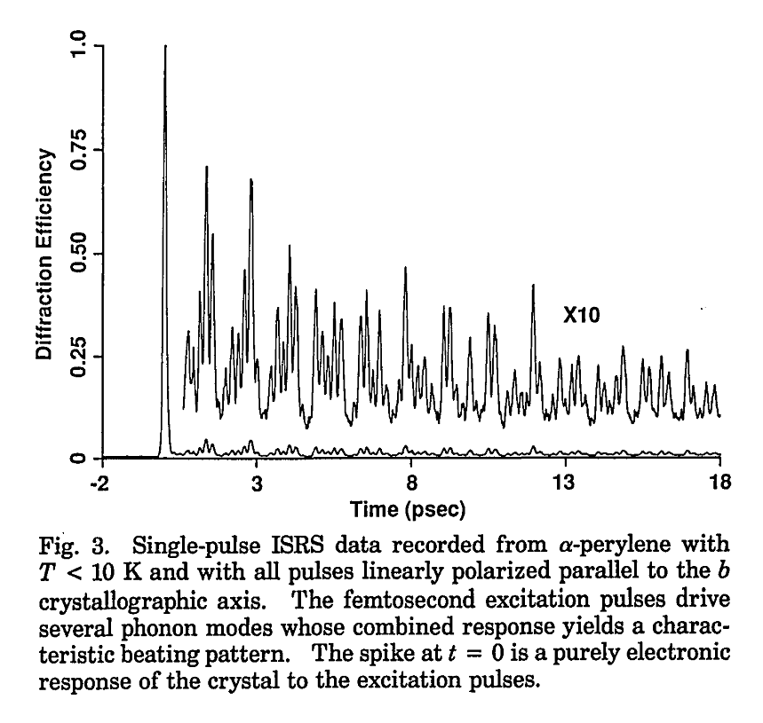
Integrated 2-Pulse Stimulated X-ray Raman
The signal is measured by scanning the interpulse delay rather than the detection frequency
The observation window is controlled by the pulse bandwidths
Keith Nelson et al. α-perylene (1991)
Fourier Transform

Slide 24
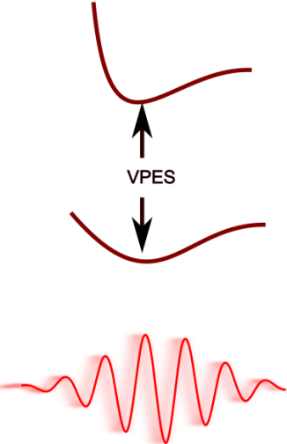
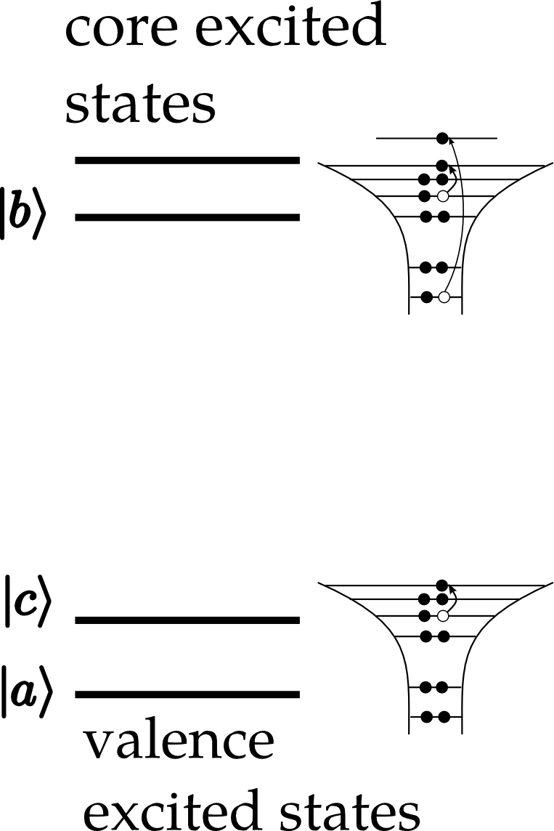
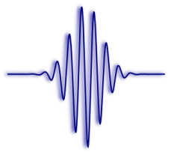
UV/Vis
X-ray
Pulse Duration: | ~10fs | ~100as
Energies: | 1-10eV | +100eV
Dynamics probed: | nuclear wavepackets on different valence PESs. | probes valence excitations with different core occupations
Decay Mechanisms: | Fluorescence, IVR | Fluorescence, Auger
Slow, Low Frequency System: | vibrations / IR | valence electrons / UV-VIS
Fast, High Frequency System: | valence electrons /UV-VIS | core-electrons / X-ray
Absorption | Infrared | XANES
Direct Probe of slow system: | Infrared | UV-Vis
Impulsive Excitation | Raman | RIXS
Molecular vibrations
Valence Electrons

Slide 25

The Polarizability
Optical Raman
Boson creation and annihilation operators for vibrations
X-Ray Raman (RIXS)
Fermi creation (annihilation) operators of valence orbitals

Slide 26
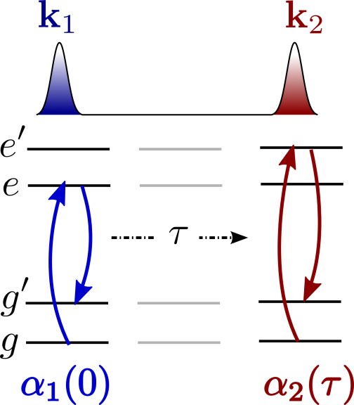
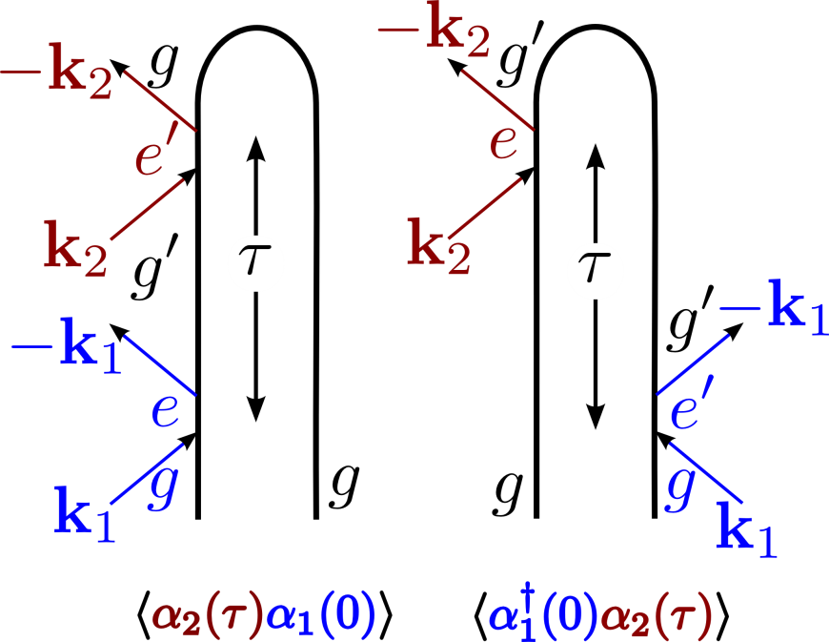

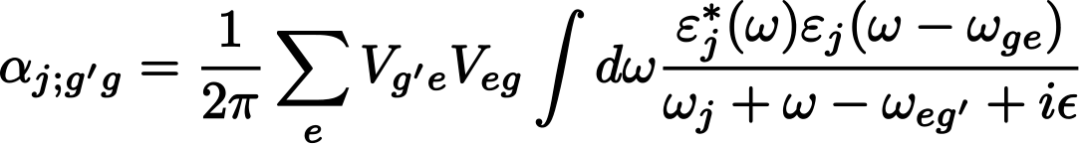
Impulsive Time-Domain Stimulated Raman Spectroscopy (1D)
A common picture for X-rays and vibrations
signal generated using broadband (femtosecond or attosecond) laser pulses, monitored in the time domain
The system interacts twice with the pump and twice with the probe. No phase control is required.
The resonannt pump creates a wavepacket of valence-excited states which then evolves for a time before the arrival of the probe pulse.
The effective polarizability depends on the pulse envelopes.

Slide 27
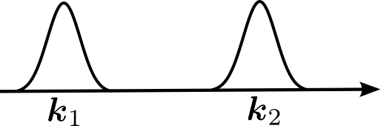
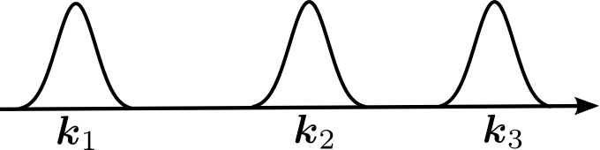
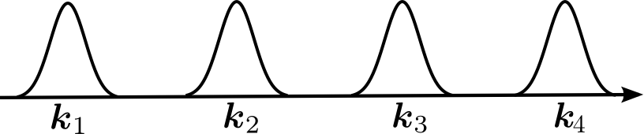
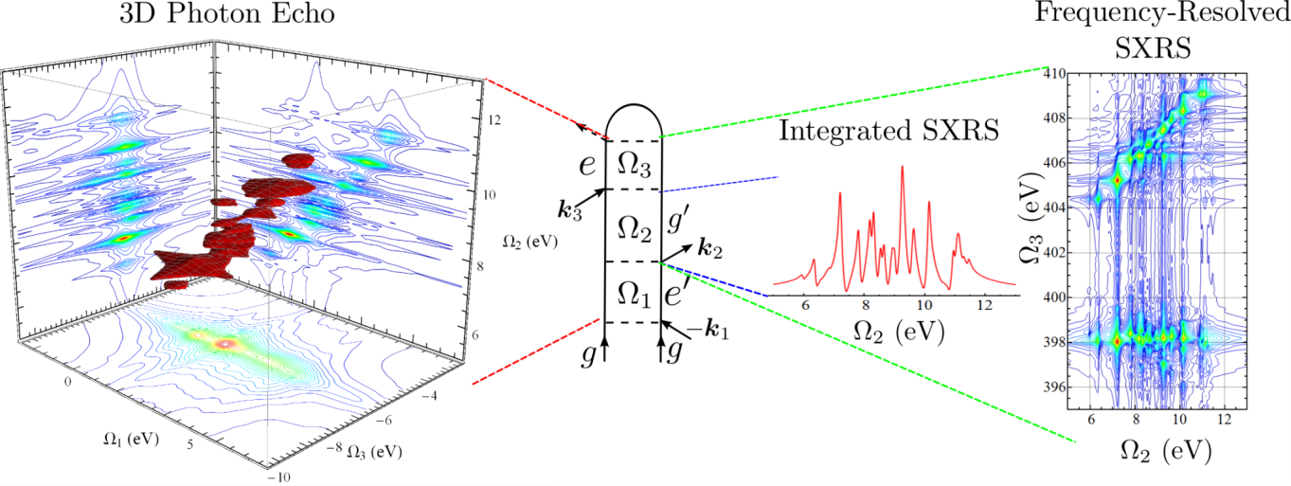
Multidimensional X-Ray Raman Spectroscopy
One Dimensional | Two Dimensional | Three Dimensional
Integrated two-pulse Stimulated X-Ray Raman Scattering (I2P-SXRS) | Dispersed two-pulse SXRS | Frequency-Dispersed three-pulse SXRS
 | Integrated three-pulse SXRS | Heterodyne-detected four-wave mixing
Two-pulse
Three-pulse
Four-pulse
Heterodyne-detected Four-wave mixing
Simulated experiments on the nitrogen K-edge of cysteine. Lower dimensional signals are projections of higher dimensional signals.
Dispersed SXRS

Slide 28


Restricted Excitation Window Time-Dependent
Density Functional Theory (REW-TDDFT)
Allows for the efficient calculation of core-excited states, and valence-excited states using a common theoretical framework.
Was applied to Cysteine, focusing on the nitrogen, oxygen, and sulfur core transitions.
Notes:
The molecule shown is cysteine, with its nitrogen, oxygen, and sulfur atoms shown in blue, red, and yellow. Below it are the calculated absorption spectra in four different spectral regions; UV, Sulfur L-edge, Nitrogen K-edge, and Oxygen K-edge. I put them together like this to highlight that TD-DFT can handle all these single excitations in a consistent way. If you prefer I can send you a copy of the picture from the cysteine manuscript, that shows comparison with experiment.

Slide 29


Cysteine I2P-SXRS
With four spectrally isolated core edges, SXRS can prepare localized valence wavepackets at different atomic sites in this important amino acid.
Yu Zhang, et al. JCP 137, 194306 (2012)

Slide 30

Reduced Densities immediately
following X-ray Raman Excitation of cysteine
Isosurface σ(r)=0.005 a.u.
for sulfur and oxygen, electrons and holes are local to their resonant atom. For nitrogen, the particle is spread over backbone
Holes seem more spread out, especially for oxygen.
Both electron and hole distributions after excitation at S K-edge are spread over thiol, its neighboring carbon and the carbonyl group.
Pulses tuned to K-edge of :

Slide 31

Reduced Density Movies of Cysteine
For nitrogen and sulfur, the hole stays localized on that atom
For oxygen excitation, rapidly delocalized hole and particle.

Slide 32

integrate reduced electron and hole densities over angular regions of the molecule
Thiol
τ = 0
Amine
Carboxyl
τ
τ

Slide 33

Projected Reduced Electron and Hole Densities of cysteine as a function of Time
for sulfur and oxygen the electrons and holes prefer regions near the resonant atom.
The hole remains on nitrogen for that excitation.
For other techniques both electron and hole quickly spread out over the molecule.

Slide 34


D2P-SXRS from Cysteine at the nitrogen K-edge
This signal allows us to “open up” the probe polarizability.
Peaks show which core-excited and valence-excited states are coupled to each other.
Unlike the integrated signal, contributions from the two contributing diagrams are spectrally isolated from each other.
The 1D-SXRS signal is obtained simply by summing over the dispersed frequency
N1s pump, N1s probe, L-cysteine

Slide 35


I3P-SXRS of Cysteine
x-ray pulse polarizations are all-parallel (VVV)
trans-NMA: a model of the protein backbone
pulses1 and 2 tuned to Nitrogen K-edge, pulse 3 to Oxygen K-edge
Notes:
2D-SXRS signals from trans-NMA, from JCP paper. In depth look at one spectrum on the next slide.

Slide 36






Energy Transfer in Porphyrin Heterodimers
Core-excited states calculated using restricted excitation window time-dependent
density functional theory (REW-TDDFT), which allows for the efficient calculation of core-excited states, and valence-excited states using a common theoretical framework.
K-edge XANES
L-edge XANES
UV Absorption
X-ray Raman probes valence-excitations, but through a core-excited intermediate. The same states show up in the UV/visible absorption spectrum, but with vastly different amplitudes.
Pulse power spectra shown in blue
FWHM of 166 as (10.9 eV)

Slide 37

Integrated 2-Pulse Stimulated X-ray Raman
The pump pulse creates a valence wavepacket by scattering off a manifold of core-excited states within the pulse bandwidth
This superposition of valence-excited states then evolves during the interpulse delays
The probe pulse then returns the system to the ground state by scattering off of core-excited states. In a two-color setup, these core-excited states are different than those accessed by the pump
choose long delays: core-ionized states are off-resonance
Biggs, Zhang, Healion, and Mukamel;
J. Chem. Phys. 136, 174117 (2012)

Slide 38





Integrated 2-Pulse Stimulated X-ray Raman – cont’d
Time Domain:
The signal is determined by the effective isotropic polarizability, which is averaged over the finite bandwidth of the excitation pulses.
Frequency Domain:
Real part of the polarizability – responsible for off-resonance Raman scattering.
Imaginary part of the polarizability – goes to zero off resonance.
polarizbility for the j^{th} ultrafast pulse
Since the I2P-SXRS signal is defined as the change in the integrated intensity of the probe pulse, the probe must be on resonance. Therefore the signal only depends on the imaginary part of the probe polarizability.

Slide 39

One-color SXRS: Pump and Probe at same edge
One color SXRS from porphyrin dimer
Time Domain Frequency Domain
time-independent window created by probe
time-dependent doorway created by pump
One-color SXRS measures the autocorrelation of the doorway. Only the Zn2p/Zn2p signal exhibits strong low-frequency oscillations indicative of energy transfer. Other on-color signals show only exponential decay.
Zinc metal: K-edge, L-edge
Nickel metal: K-edge, L-edge

Slide 40


Two-color SXRS: Pump and Probe at different edges
Time Domain Frequency Domain
Two-color signals vanish when the two core electrons are not coupled to the same valence manifold. For the porphyrin dimer, a nonzero signal is evidence of energy or charge transfer.
Time Domain Frequency Domain
Switching the order in which the two pulses arrive results in nearly identical signals.

Slide 41



Time-reversal symmetry in 2-color SXRS
Time Ordered Signals
Difference Signals
In the time domain, the difference signals (in purple) resemble the time-ordered signals (in red). In the frequency domain, the difference signals report upon the interference between the real and imaginary polarizabilities for the two different core edges considered.

Slide 42











Natural Orbitals Decomposition
Interaction with the pump creates the doorway, a wavepacket of valence excited states
The time-dependent operator K(τ) acts upon the ground state to create the doorway.
Valence excitations written in MO basis
A singular value decomposition of provides the most compact representation of the doorway in the space of single excitations.
creation operator for virtual orbital a
annihilation operator for occupied orbital i
The participation ratio R⁻¹ is a useful measure of the degree to which the electron and hole are entangled. When the state is described by a single electron-hole pair, they are not entangled at all and R⁻¹=1. Higher values indicate greater entanglement.
Through a rotation of the MO basis, a new set of natural orbitals is achieved which minimizes the number of electron-hole pairs needed to describe the state.

Slide 43




Natural Transition Orbitals for Valence Eigenstates
The eigenstates which show up in the Fourier-Transform spectra are delocalized valence states.
Natural transition orbitals provide the most compact representation of these states. Orbital rotations which result from a singular-value decomposition of the transition density matrices in the space of single excitations

Slide 44



Time-dependent Natural Orbitals for Valence Wavepackets
Zn2p/Zn2p Signal –Time Domain
1
1
3
5
2
4
2
3
4
The superposition of delocalized electronic eigenstates resulting from Raman excitation is localized in space. Maxima and minima in this signal correspond to times when the excitation is on the zinc and nickel monomers, respectively.
5
The electron-hole pairs comprising the wavepacket become increasingly entangled following excitation

Slide 45

Charge density vs. signal
There is a correspondence between the nonequilibrium charge density and the spectroscopic signal. The electron and hole densities move across monomers together, indicating energy transfer rather than charge transfer.

Slide 46

Animation – short simulation

Slide 47
Coherent Control of Long-range Photoinduced Electron Transfer by Stimulated X-ray Raman
“Stimulated X-ray Raman Coherent Control of Long-range Photoinduced Electron Transfer”, K. E. Dorfman, Y. Zhang and S. Mukamel, PNAS (2016)

Slide 48


Control Schemes
Control on either the donor, the bridge, or the acceptor, is possible.
ET processes could be either enhanced or hindered. ET pathways could be switched on and off.
acceptor control
donor control

Slide 49

Control Schemes
ET pathways can be switched on and off by the X-ray Raman process.
Bridge control
Red solid and blue dashed lines represent the strong and weak interactions between the orbitals, respectively.

Slide 50


Control Scheme
Controlling Pulses and the corresponding diagram
The two Gaussian pulses E₁ and E₂ arrive at the sample at the same time. E₁ is resonant with the local core excitation at the acceptor and E₂ is resonant with the bridge-to-acceptor transition. The two pulses induce an X-ray Raman process which facilitates the ET between the bridge and the acceptor.

Slide 51

Molecular Comlex
[(CN)₄Ru^{II}(tpphz)Co^{III}(CN)₄]³⁻: to mimic [(bpy)₂Ru^{II}(tpphz)Co^{III}(bpy)₂]^{3-,}, which has artificial light harvesting applications.
CN⁻ replaces bpy, to save computing time and conserve the essential photophysics. Complicated spin-crossover does not exist.
ET parameters were estimated by TDDFT calculations as well as experimental measurements of the photodynamics.

Slide 52

Control Scheme
Controlling Pulses and the corresponding diagram
The controlling pulse has two Gaussian components E₁ and E₂ which arrive at the sample at the same time. E₁ is nearly resonant with the local core excitation at the acceptor and E₂ is nearly resonant with the bridge-to-acceptor transition. The two components induce an X-ray Raman process which facilitates the ET between the bridge and the acceptor.

Slide 53

Simulation Details
Incremental acceptor population
R represents the real part, g is the Liouville space Green’s function matrix element and alpha is the generalized polarizability tensor:

Slide 54


Simulation Results:
Acceptor Population (I)
The acceptor population in the model complex vs. t1 at t2 = 3 fs (after the X-ray pulses).
The acceptor population without the X-ray pulse.
The incremental acceptor population due to X-ray ΔP_{A} for different phases.
Same as in b., but for different amplitude ratio and zero phase.
Same as in c., but for phase = pi.

Slide 55


Simulation Results: Acceptor Population (II)
The incremental acceptor population vs. t2 for different t1 without the X-ray pulse.
The incremental acceptor population vs. t2 for different t1.
Same as in b., but for different phases.
Same as in c., but for amplitude ratios.

Slide 56
Conclusions
Stimulated X-ray Raman process can induce transitions between sites thus enhance the D -> B -> A ET.
X-ray pulse delays, shapes, phases and intensities are all control knobs of ET.
IR pulses weakly perturb the electronic structure of the studied system, while X-ray strongly change the electron population.
UV-vis excitations lack the element selectivity of X-ray excitations, and also can not trace the ultrafast motion of electron, which can be captured by using ultrashort X-ray pulses.
X-ray pulses offer us a powerful tool to precise control ET in molecules.

Slide 57


Broadband Raman probes of excited-state vibrational dynamics
Shaul Mukamel, Konstantin E. Dorfman, Benjamin P. Fingerhut

Slide 58
Stimulated Raman Signals with Broad- and Narrowband pulses
Ultrashort pulse 1 initiates a chemical reaction in an excited electronic state
Pulses 2 (narrowband) and
3 (broadband) induce a Raman transition.
The spectral resolution (Δω) is determined by the monochromator into which the signal is dispersed
The apparent time resolution (Δt) is determined by the delay time T between broadband pulses k1 and k3
Apparently there is no lower limit to the product ΔωΔt
Does the technique offer perfect snapshots of the changing vibrational frequency ωca at time T?
R. Mathies Annu. Rev. Phys. Chem. 58, 461 (2007),
T. Tahara Yellow protein: J. Phys. Chem. Lett. 3, 2025 (2012),
pNA, pDNA: P. Gilch, Optics Communications 202, 209 (2002),
CO2: M. Dantus, Journal of Raman Spectroscopy 41, 1194 (2010),
Bacterial endospores: M. Scully Science 316, 265 (2007),
Cell imaging: Sunney Xie Phys. Rev. Lett. 82, 4142 (May 1999),
Multiplex CARS: J.-X. Cheng, J. Phys. Chem. B 106, 8493 (2002)
M. Müller, J. Phys. Chem. B 106, 3715 (2002)

Slide 59

Conical intersections (CoIns)
A fundamental concept for chemical reaction dynamics that controls the rates and yields of photochemical processes
Points where the molecule reaches a geometry for which potential energy surfaces of different electronic states come close in energy and may even become degenerate.
Born-Oppenheimer approximation breaks down.
The electronic and nuclear motions are strongly coupled
Direct characterization of CoIns is essential to the understanding of ultrafast photo-induced chemical reactions.
Direct detection of this ultrafast event is still lacking, only indirect circumstantial evidence exists.
Review books: Domcke, W., Yarkony, D. R., and Koppel, H., editors.
Conical Intersections: Electronic Structure, Dynamics & Spectroscopy. World scientific (2004).
Conical Intersections: Theory, Computation and Experiment. World scientific (2011)

Slide 60

Conical Intersections (CoIns)
Responsible for fast, radiationless decay
Very common in polyatomic molecules
Important in bio-molecules
Protects DNA from UV-damage
Not directly probed
Inferred from fast rates

Slide 61
Conical Intersections
Requires 3 atoms or more
Point of degeneracy
Branching space, 2 vib. DOF:
gradient difference vector (g)
non-adiabatic coupling vector (h)
N-2 dim. seam space

Slide 62
Spectroscopic Signatures of CoIns
Conventional Methods are based on Populatiom dynamics
Infrared/Optical pulses
Change of vibrational Frequencies
Transient Absorption
Challenge: rapidly decreasing energy gap
→ huge bandwidth needed
Solution X-ray pulses (FEL, HHG sources)

Slide 63


Probing Conical Intersections via Electronic coherence in Stimulated Optical Raman Spectroscopy

Slide 64

Catching Conical Intersections in the Act
Monitoring Transient Electronic Coherences by Attosecond X-Ray Raman Signals
M. Kowalewski, K. Bennett, K. E. Dorfman, S. Mukamel, Phys. Rev. Lett. 115, 19003 (2015)

Slide 65

TRUECARS
Transient Redistribution of Ultrafast Electronic
Coherences in Attosecond Raman Signals
→ attoseconds, several eV bandwidth
→ sensitive to coherences, background free

Slide 66


TRUECARS
A preparation process (gray box) leaves the system in a nonstationary state.
A hybrid pulse with broadband () and narrowband () components probes the dynamics.
The frequency-dispersed transmission of the broadband component is plotted versus the delay time

Slide 67

TRUECARS vs SXRS
TRUECARS is linear (left) and provides background-free measurement of electronic coherence. TCRR depends on relative phase and requires phase-control to observe.
SRS is quadratic (right) and contains contributions due to populations. The field phases come in pairs and cancel.

Slide 68


TRUECARS – Similar to CARS (Half CARS)
CARS (right): Electronic coherence generated with a pair of pulses and probed with a second pair after a fixed delay.
TRUECARS (left): A nonstationary state is prepared and electronic coherence is generated internally through the propagation

Slide 69
TRUECARS
Initial state preparation followed by delay and probe with hybrid broadband (as) narrowband (fs) pulse
Coherences created by laser pulse or system coupling (CoIn)
Frequency-dispersed photon number change of broadband pulse is detected
Signal is off-resonant and Linear in probe
Energy splitting appears as Raman shift between observed and central pulse frequencies

Slide 70


TRUECARS - Formalism

Slide 71


TRUECARS - Signal
Signal depends on x-ray polarizability, electronic coherences:

Slide 72
TRUECARS – Spectroscopic information
Frequency-dispersion of broadband pulse compromises time resolution granted by broadband pulse in the SRS (quadratic) case
Instead, both temporal and spectral resolution are set by the narrowband pulse and are not independent
Each transition gives two Raman peaks, positive and negative, that oscillate with a relative π phase
Signal oscillates in time between Stokes and anti-Stokes
UV or x-ray probes possible
→ Clock the CoIn, map the reaction path

Slide 73



Simple Model System
Model resembles wave packet passing through CoIn/avoided crossing:

Slide 74


Simple Model System - Hamiltonian
Model Hamiltonian in diabatic represntation
Harmonic model
Time stepping (Short Iterative Lanczos)
Gaussian coupling resembles avoided crossing

Slide 75

TRUECARS Signal
Spectrum resembles the time-dependent splitting

Slide 76
Model System – Conical Intersection
Two vib. Modes in branching space
Typical CoIn parameters
Acrolein S2/S1 CoIn as role model
sa4-CAS(6/5)/6-31+G*
Diabatic states
Fitted by 3. order Poly.

Slide 77
Model System – Conical Intersection
Quantum Dynamics
→ Vib .Wave packet
Diabatic states
Short iterative Lanczos
Coherences: Overlap integral
of vib. Wave packets in S2, S1

Slide 78


Model System – Hamiltonian
Fitted diabatic PESs

Slide 79
TRUECARS - Formalism

Slide 80


TRUECARS Signal for CoIn Model
Signal turns on when WP reaches CoIn
Cohernce is created
Different gradients
in S2/S1
→ coherences decay
PES separation visible
in Raman shift
Energy separation
Populations
Coherences

Slide 81
Conclusions
TRUECARS signal provides background-free measurement of coherences
Off-resonant technique
Like CARS but the detected coherence is internally generated by propagation through the CoIn
Energy splitting of PES directly visible in signal
Maps reaction path of the molecule
Determine topology/shape of a CoIn
UV or X-ray probe pulses

Slide 82
Novel photochemistry of molecular polaritons in optical cavities
Markus Kowalewski Kochise Bennet
Shaul Mukamel
University of California, Irvine
Ultrafast Imaging of Photochemical Dynamics
Faraday Discussions
Aug 31-Sept 2, 2016

Slide 83


Molecules in Cavities ;Utilizing The Quantum Nature of Light
Markus Kowalewski, Kochise Bennett, Prasoon Saurabh,
Shaul Mukamel

Slide 84


Cavity QED
Enhancement of stim. Emission
Purcell effect
Cavity QED: Well studied for atoms
Coupling to Vacuum field
Quantum nature of the field
E. M. Purcell, Phys. Rev. 69, 674 (1946)
H. J. Kimble, Phys. Scripta T76, 127 (1998)
S. Haroche, Rev. Mod. Phys. 85, 1083 (2013)

Slide 85



Motivation
Extend to molecules
Large Rabi splitting possible
Photochemistry, Spectroscopy, Cooling
G. Morigi et al., Phys. Rev. Lett. 99, 073001 (2007)
J. Galego et al., Phys. Rev. X, 5, 041022 (2015)
J. A Hutchison et al., Angew. Chem. Int. Ed., 51, 1592 (2012).

Slide 86

Recent Experimental Developments
Strong coupling in ensemble (700 meV, el. transition)
Enhancement of Raman Scattering
Scaling: Number of particles, mode volume
vibrational strong coupling electronic strong coupling
A. Shalabney et al., Angew. Chem. Int. Ed., 54, 7971 (2015).
J. A Hutchison et al., Angew. Chem. Int. Ed., 51, 1592 (2012).

Slide 87



Molecules in Cavities – Strong Coupling
Modify Potential Energy Surfaces
Manipulate molecular properties/photochemistry
Create photonic catalyst, photonic stabilizers Light induced intersection etc.
Resolve vibrational spectra
Single molecule strong coupling: Nano technology
M. Kim et al., Nano Lett., 15, 4102 (2015)
S. Faez et al., PRL, 113, 21601 (2014)
A. Greentree et al., Nature Phys., 2, 856 (2006)

Slide 88



The Jaynes-Cummings Model
Jaynes-Cummings Hamiltonian
Quantized Radiation Field
Polariton (Dressed) States

Slide 89


Nonadiabatic couplings
Nonadiabatic couplings in the curve crossing region
Depends on: Detuning, gradient difference, derivative of dipole
M. Kowalewski et al., J. Chem. Phys. (2016)

Slide 90

Perspectives for Photochemistry
Different scenarios:
Cavity induced dissociation
Cavity induced stabilization of unbound states
Cavity modification to reaction barriers
Photoninduced conical intersections
M. Kowalewski et al., J. Chem. Phys. (2016)

Slide 91

Nonadiabatic Dynamics at Avoided Crossings
Cavity coupling beyond the rotating wave approximation
Ultra-strong coupling regime
Manipulate wave packet branching at avoided crossings/CoIns
Extended Formalism required

Slide 92


Sodium Iodide
Zewail’s landmark experiment
T. S. Rose, M. J. Rosker, and A. H. Zewail, J. Chem. Phys. 91, 7415 (1989)

Slide 93





Beyond the Rotating Wave Approximation
Full Hamiltonian:
Block Structure
RWA conserves excitation number
Blocks mix due to Counter-rotating terms

Slide 94


Nonadiabatic dynamics of molecules in optical cavities
A Perspective for a New Kind of Photochemistry
Markus Kowalewski, Kochise Bennett, and Shaul Mukamel

Slide 95
Dynamics beyond the RWA - Formalism
Three approaches:
Diagonalization via Fock states
  Natural basis within RWA; facilitates analogy
  Too many states needed at ultrastrong coupling
Diagonalization via photon-added coherent states
  Can handle ultrastrong coupling with much fewer states
  Requires large number of states at low coupling strengths
Discretize Cavity mode in real space
  Elegant solution to obtain dynamical quantities and observables
  Potential surfaces and NACs are never calculated so can’t use this picture to interpret

Slide 96






Dynamics beyond the RWA - Formalism
Diagonalization via photon-added coherent states
Ansatz in matter-field product space
is the parity of state
is the truncation order, and
Hamiltonian has a parity symmetry exploited in this ansatz
Solve truncated eigenvalue problem to obtain coherence parameters, linearly related to energies

Slide 97

Dynamics beyond the RWA - Formalism
Discretize Cavity mode in real space
  Write electron-cavity Hamiltonian via quadrature coordinates
Cavity mode is treated like molecular vibrations
Computational cost of non-RWA dynamics is equivalent to adding a single harmonic mode to the bare system
M. Kowalewski, K. Bennett, S. Mukamel, J. Phys. Chem. Lett. 7, 2050 (2016)

Slide 98


Electron Harpooning– Sodium Iodide
Couple cavity to covalent
and ionic state.
Modify branching ration

Slide 99


Sodium Iodide – Dressed Potential Surfaces
Positive (red) and negative (black) parity dressed states for gmax=200 and 600meV
Vertical lines are at n-photon resonances (n=1…5 from right to left)
Induced NAC spikes at n=odd (same-parity avoided crossings)
Ultrastrong coupling opens up a dip at the original avoided crossing
  Can act as a barrier/trap to wavepackets
  All states connected in this region via transformed NACs

Slide 100

Sodium Iodide - Dynamics
Population dynamics for different coupling strengths
No Cavity
0.05, 0.13 ω_{c}
0.19, 0.25, 0.38 ω_{c}
M. Kowalewski, K. Bennett, S. Mukamel, J. Phys. Chem. Lett. 7, 2050 (2016)

Slide 101

Sodium Iodide – Modified Branching Ratio
Dissociation can be suppressed by cavity coupling
Branching
Photon number

Slide 102




Conclusions
Strong coupling of single molecules
Formalism for nonadiabatic quantum dynamics in cavities
Quantities easily available from Quantum Chemistry
Photochemical modifications possible
New kind of light induced conical intersections (PhCoIn)
Explore collective effects: scaling

