Slide 1
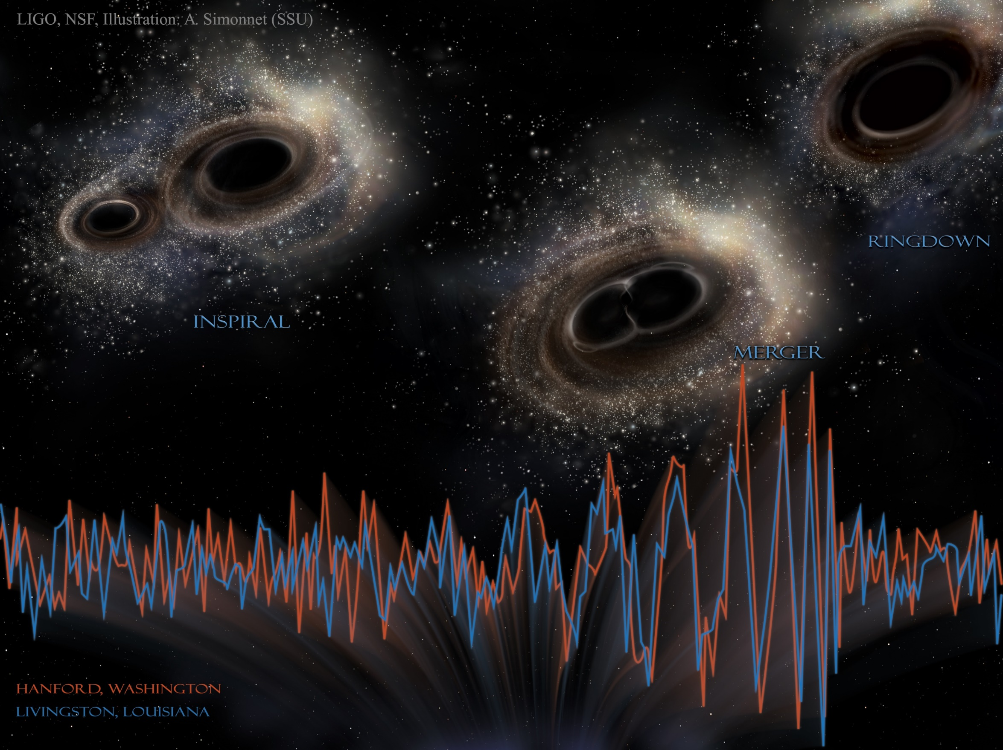
Induced density correlations in a sonic black hole condensate
Yi-Hsieh Wang, Ted Jacobson, Mark Edwards, and Charles W. Clark
arXiv:1705.01907

Slide 2
Mechanisms of stimulated Hawking radiation in laboratory Bose-Einstein condensates
Black hole explosions?
Experimental black-hole evaporation?
Black hole lasers
Implementation in Bose-Einstein condensates
Enhancing Hawking radiation in BECs
Effect of induced density correlations

Slide 3
Mechanisms of stimulated Hawking radiation in laboratory Bose-Einstein condensates
Black hole explosions?
Experimental black-hole evaporation?
Black hole lasers
Implementation in Bose-Einstein condensates
Enhancing Hawking radiation in BECs
Effect of induced density correlations

Slide 4
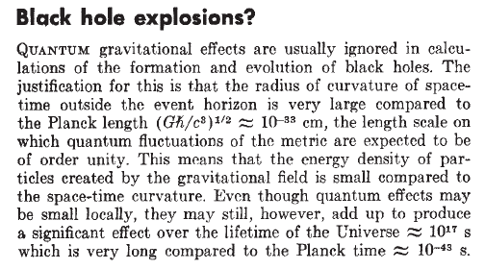
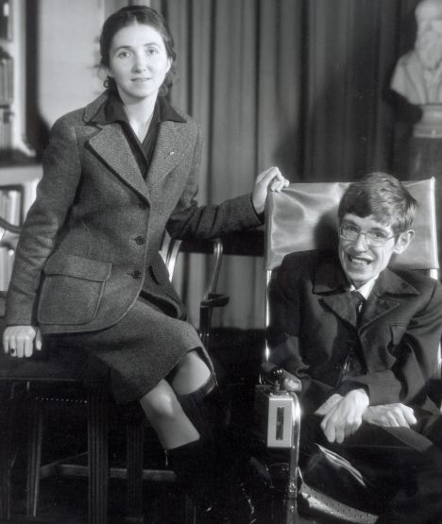
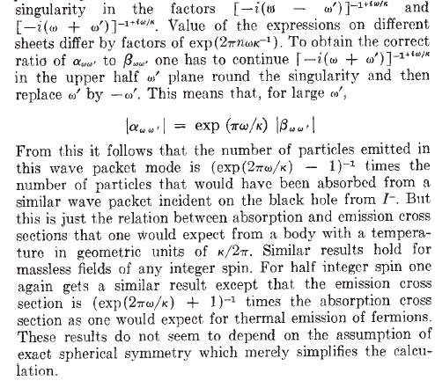
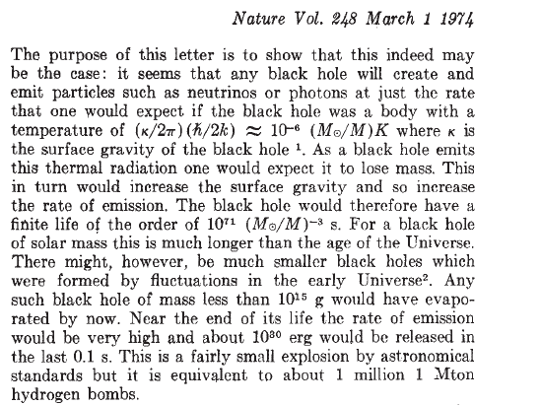
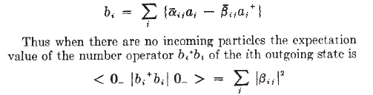
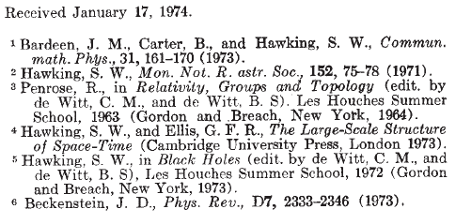

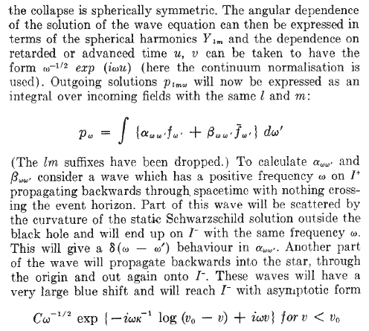
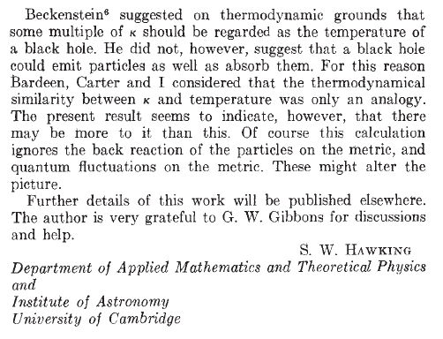
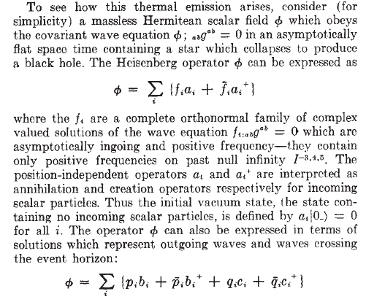
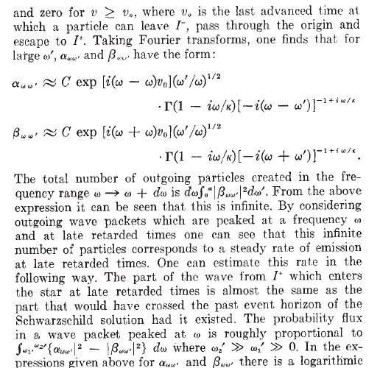
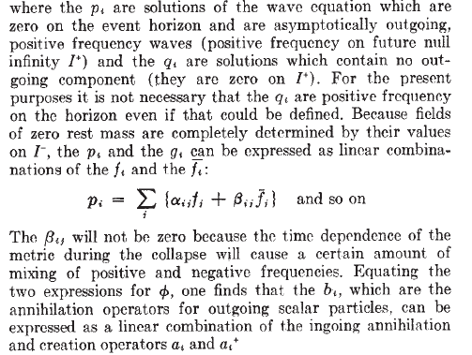
. . . . .
Daily Mail
Jane and Stephen Hawking
March 1974

Slide 5
Hawking Radiation
New observable at the intersection of gravitation, thermodynamics and quantum field theory.
Hard to see: effective temperature of black hole of mass M is
T ≈ 60 nK (M_{Sun}/M)
. . . . .

Slide 6
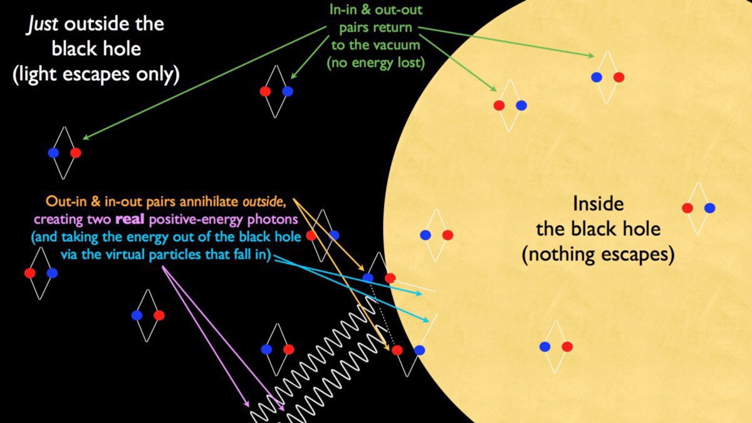
Schematic of Hawking radiation from a black hole
Hawking radiation
Analog gravity
The black hole laser
Implementation in Bose-Einstein condensates
Enhancing Hawking radiation in BECs
vice.com

Slide 7
Mechanisms of stimulated Hawking radiation in laboratory Bose-Einstein condensates
Black hole explosions?
Experimental black-hole evaporation?
Black hole lasers
Implementation in Bose-Einstein condensates
Enhancing Hawking radiation in BECs
Effect of induced density correlations

Slide 8
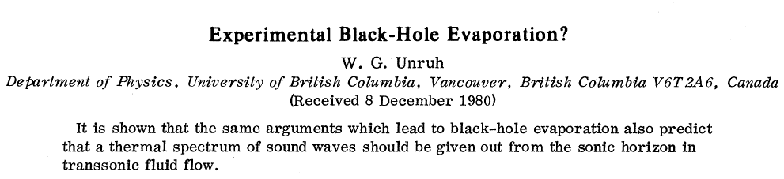
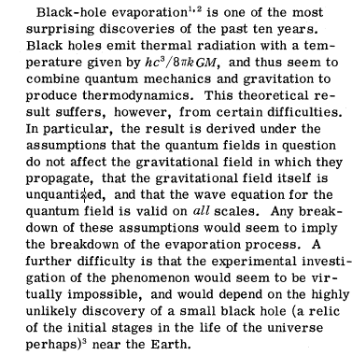

Physical Review Letters 46, 1351 (1981)
Good exercise for the students:
Using dimensional analysis, find the temperature T of Hawking radiation emitted by a black hole of mass M:
k T = [M] [L]² [T]⁻² = h^{α} c^{β} G^{γ} M^{δ}
General relativity
Special relativity
Thermodynamics
Quantum mechanics

Slide 9
Physical Review Letters 46, 1351 (1981)
Good exercise for the students:
Using dimensional analysis, find the temperature T of Hawking radiation emitted by a black hole of mass M:
k T = [M] [L]² [T]⁻² = h^{α} c^{β} G^{γ} M^{δ}
General relativity
Special relativity
Thermodynamics
Quantum mechanics
Dimensional analysis is underdetermined –solution requires physical insight:
k T = [M] [L]² [T]⁻² = h c³ (GM)⁻¹ /8π

Slide 10

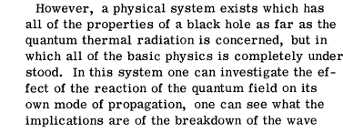
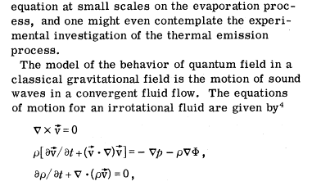
Physical Review Letters 46, 1351 (1981)
“Analog gravity” in classical acoustics!

Slide 11
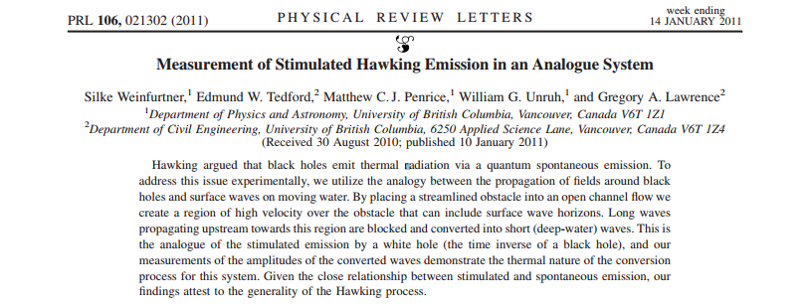
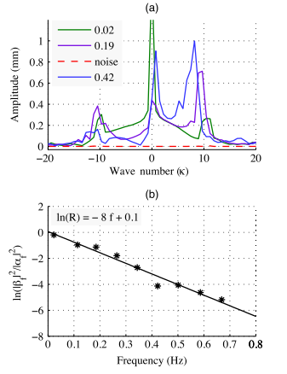
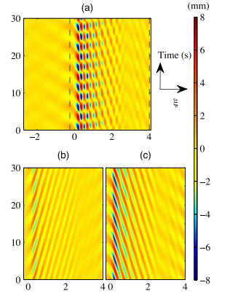
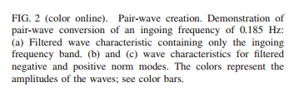

30 years later, an experiment in water . . .

Slide 12
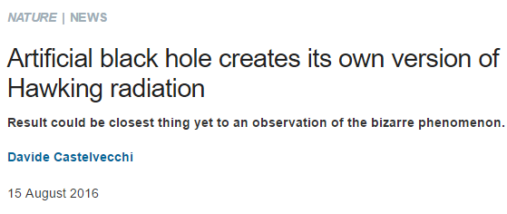
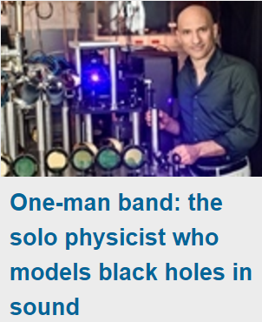
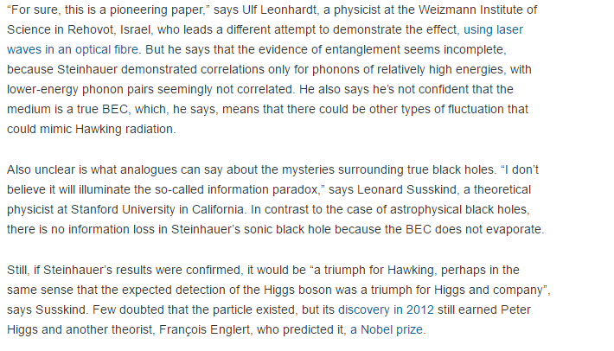
. . . and just recently
Jeff Steinhauer
Technion

Slide 13
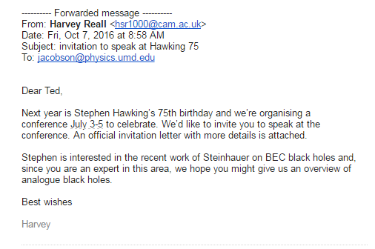
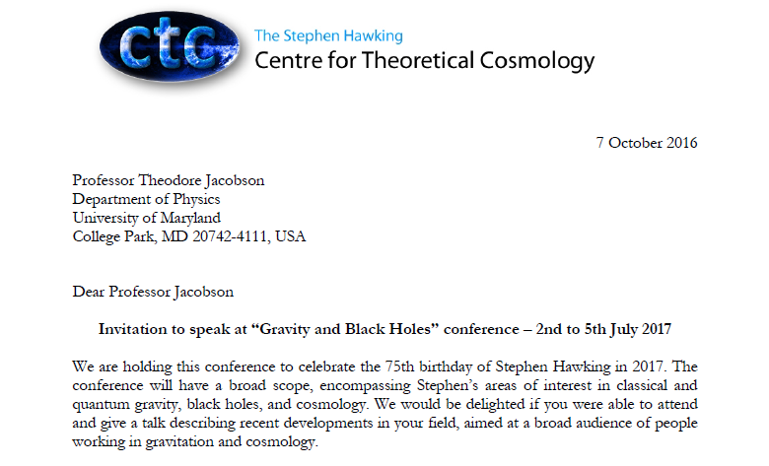
Stephen Hawking’s 75th Birthday

Slide 14
Mechanisms of stimulated Hawking radiation in laboratory Bose-Einstein condensates
Black hole explosions?
Experimental black-hole evaporation?
Black hole lasers
Implementation in Bose-Einstein condensates
Enhancing Hawking radiation in BECs
Effect of induced density correlations

Slide 15
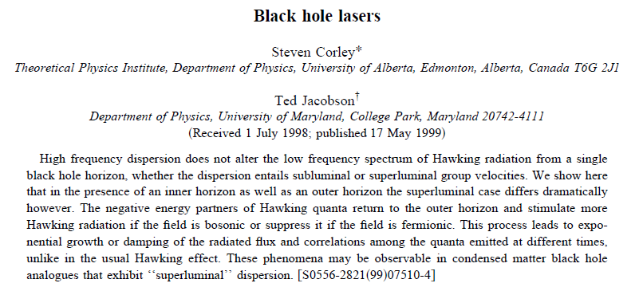

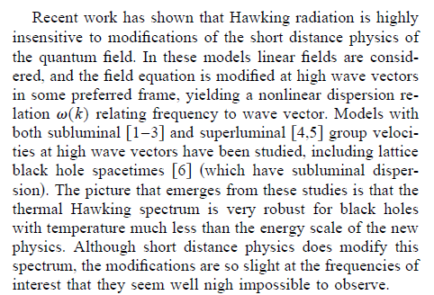
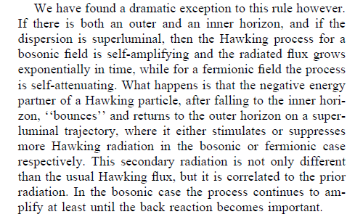
Why not make a black hole LASE?

Slide 16
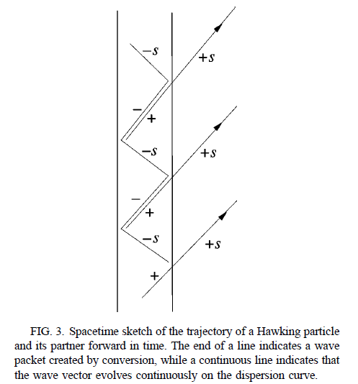
WH
BH
Use black hole and white hole event horizons to create resonant cavity

Slide 17
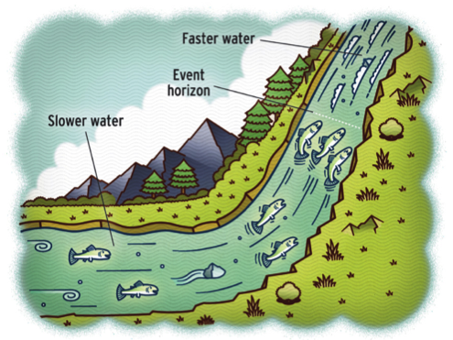
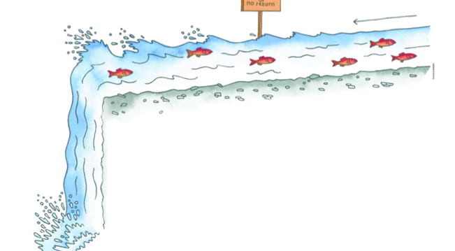
Black hole and white hole event horizons created in flowing fluids
Black-hole horizon (BH)
v>c
v<c
White-hole horizon (WH)
HR partner
(p)
Hawking radiation (HR)
S. J. Robertson, ”The theory of Hawking radiation in laboratory analogues,”
Tutorial, J. Phys. B: At. Mol. Opt. Phys. 45, 163001 (2012)

Slide 18
Mechanisms of stimulated Hawking radiation in laboratory Bose-Einstein condensates
Black hole explosions?
Experimental black-hole evaporation?
Black hole lasers
Implementation in Bose-Einstein condensates
Enhancing Hawking radiation in BECs
Effect of induced density correlations

Slide 19
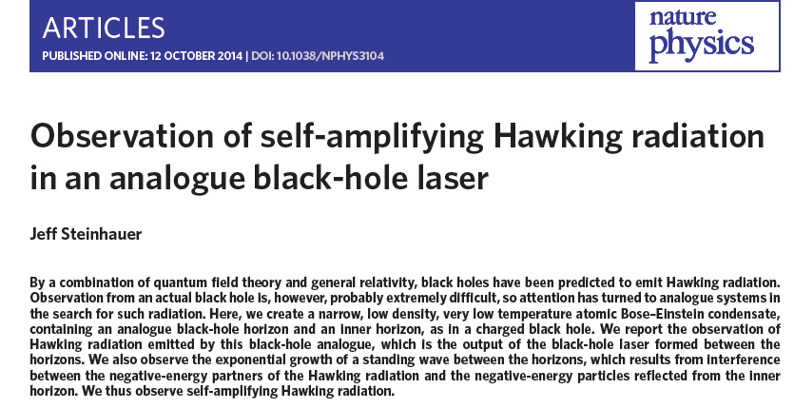
Experimental implementation of the analog black-hole laser

Slide 20
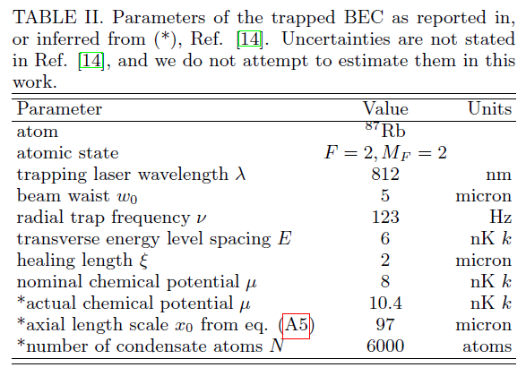
Our analysis of the system
(arXiv:1605.01027)

Slide 21
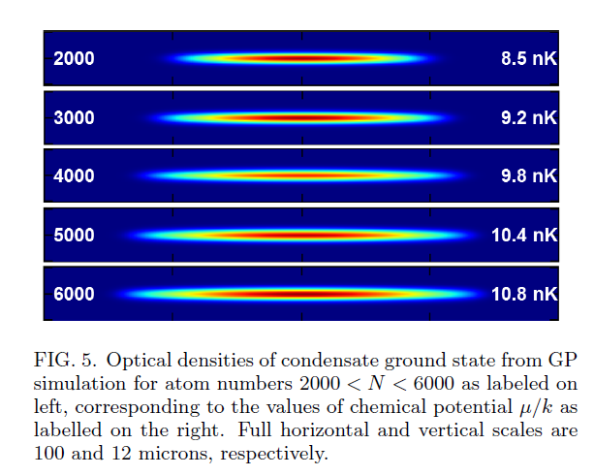
Our analysis of the system
(arXiv:1605.01027)

Slide 22
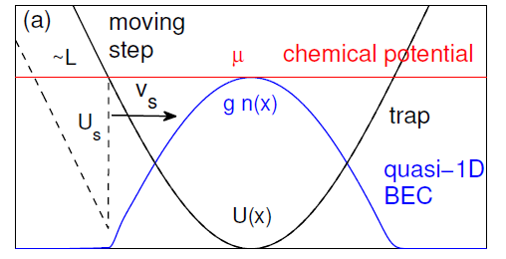
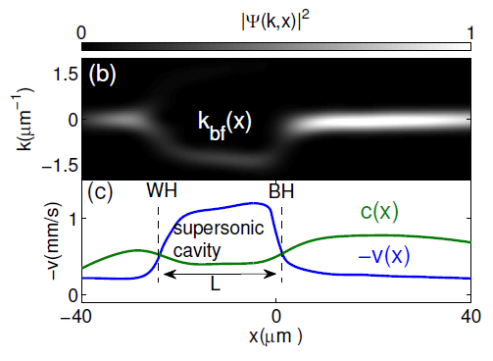
Black-hole/white-hole pair made with a swept-step optical potential
arXiv:1605.01027
Moving step swept through condensate. Black hole event horizon is in the vicinity of the moving step edge.
Windowed Fourier Transform used to subtract slowly-varying background condensate density.
Black-hole cavity created by supersonic and subsonic flow structures.

Slide 23
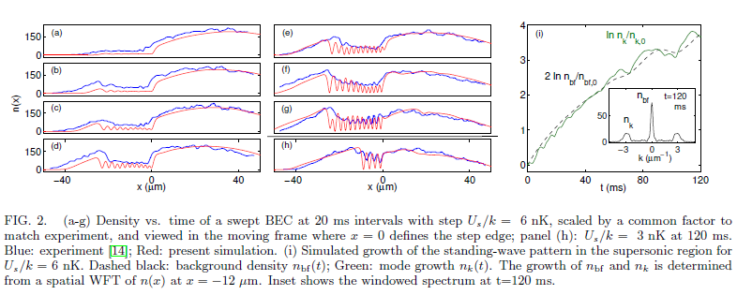
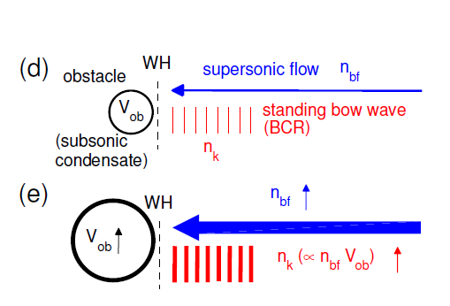
Buildup of a Bolgoliubov-Cerenkov standing wave between WH and BH
arXiv:1605.01027
The mode growth is due to the buildup of the BCR mode. The black-hole laser mechanism plays no role.
I. Carusotto et. al. 2006 Bogoliubov-Cerenkov radiation in a Bose-Einstein condensate flowing against an obstacle. Phys. Rev. Lett. 97, 260403

Slide 24
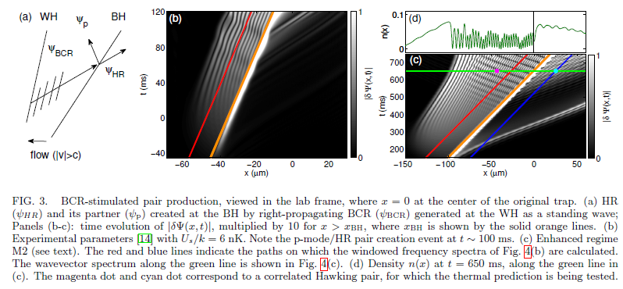
The p-mode does not return sufficiently
quickly to support laser action
arXiv:1605.01027

Slide 25
Mechanisms of stimulated Hawking radiation in laboratory Bose-Einstein condensates
Black hole explosions?
Experimental black-hole evaporation?
Black hole lasers
Implementation in Bose-Einstein condensates
Enhancing Hawking radiation in BECs
Effect of induced density correlations

Slide 26
Identification of experimental regimes with enhanced visibility of Hawking radiation

Slide 27
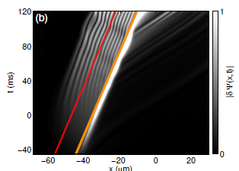
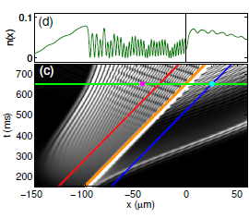
Identification of experimental regimes with enhanced visibility of Hawking radiation
Parameters of Steinhauer 2014
Enhanced regime identified by scaling laws: BEC is twice as long, step size is halved, step speed the same.

Slide 28
Stimulated pair creation
WH
BH
Relative velocity :
Pair creation frequency:

Slide 29
Spectral analysis/ Bogoliubov-de Gennes (BdG) dispersion relation
BdG modes (HR, p, BCR):
BdG dispersion relation:
Windowed Fourier transform (WFT)

Slide 30
Mechanisms of stimulated Hawking radiation in laboratory Bose-Einstein condensates
Black hole explosions?
Experimental black-hole evaporation?
Black hole lasers
Implementation in Bose-Einstein condensates
Enhancing Hawking radiation in BECs
Effect of induced density correlations

Slide 31
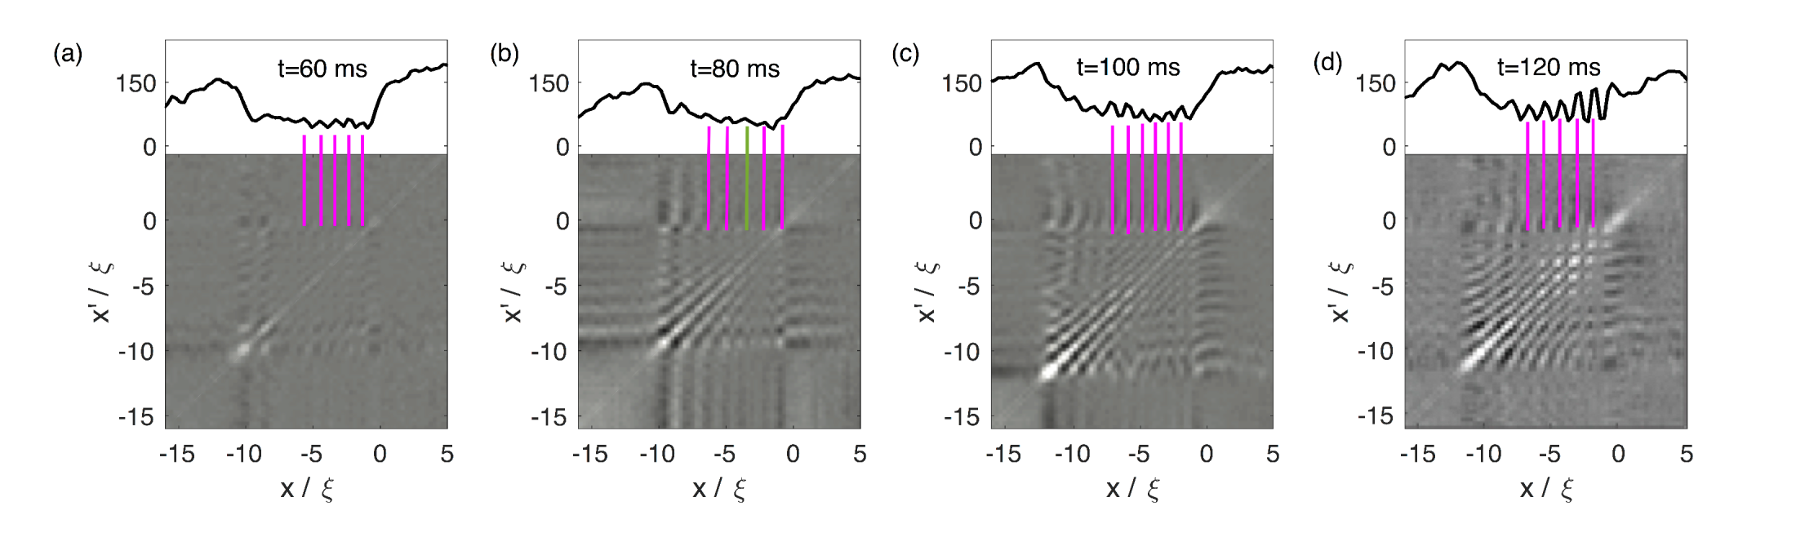

Density-density correlations and
noise spectroscopy
Experiments measure atomic density n(x) vs. position x.
For each time t, make R repetitions of the experiment with the same nominal initial conditions in order to build up signal. Here, R = 80.
Then calculate the correlation function from the average over the R repetitions:

Slide 32
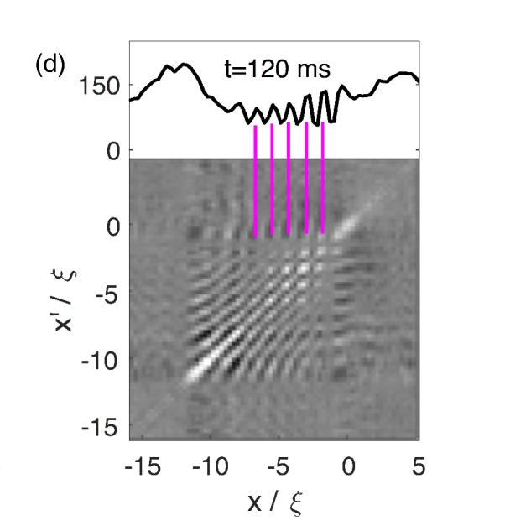





Density-density correlations and
noise spectroscopy
At first glance, it seems that the GP equation should yield G⁽²⁾(x,x’) = 0.
It is a deterministic equation,
that gives the same result for each of the R identical repetitions. Thus

Slide 33



Density-density correlations and
noise spectroscopy
At first glance, it seems that the GP equation should yield G⁽²⁾(x,x’) = 0.
The nonlinear term,
is proportional to the number of atoms, N , which varies randomly by repetition.

Slide 34
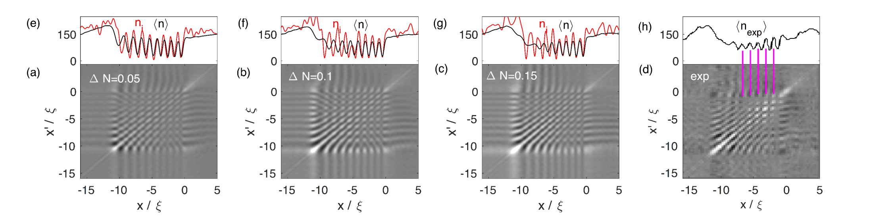
Density-density correlations and
noise spectroscopy
Experiments measure atomic density n(x) vs. position x.
For each time t, make R repetitions of the experiment with random fluctuations of N between repetitions. Here, R = 80, ΔN = 5%, 10%, 15%, t = 120 ms.
Then calculate the correlation function from the average over the R repetitions:

Slide 35
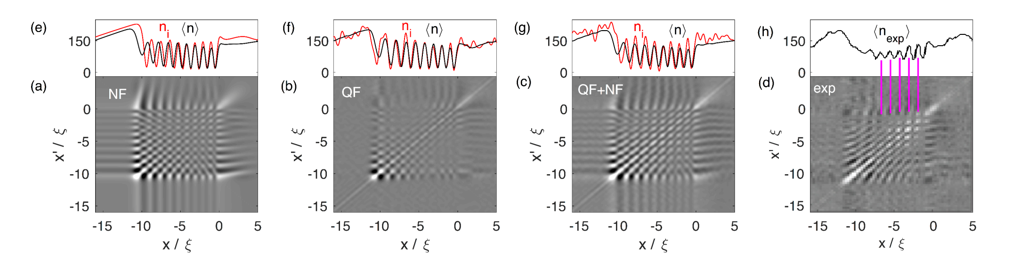
Density-density correlations and
noise spectroscopy
Experiments measure atomic density n(x) vs. position x.
For each time t, make R repetitions of the experiment with random N and quantum fluctuations (TWA). Here, R = 80, ΔN = 5%, 10%, 15%, t = 120 ms.
Then calculate the correlation function from the average over the R repetitions:

Slide 36
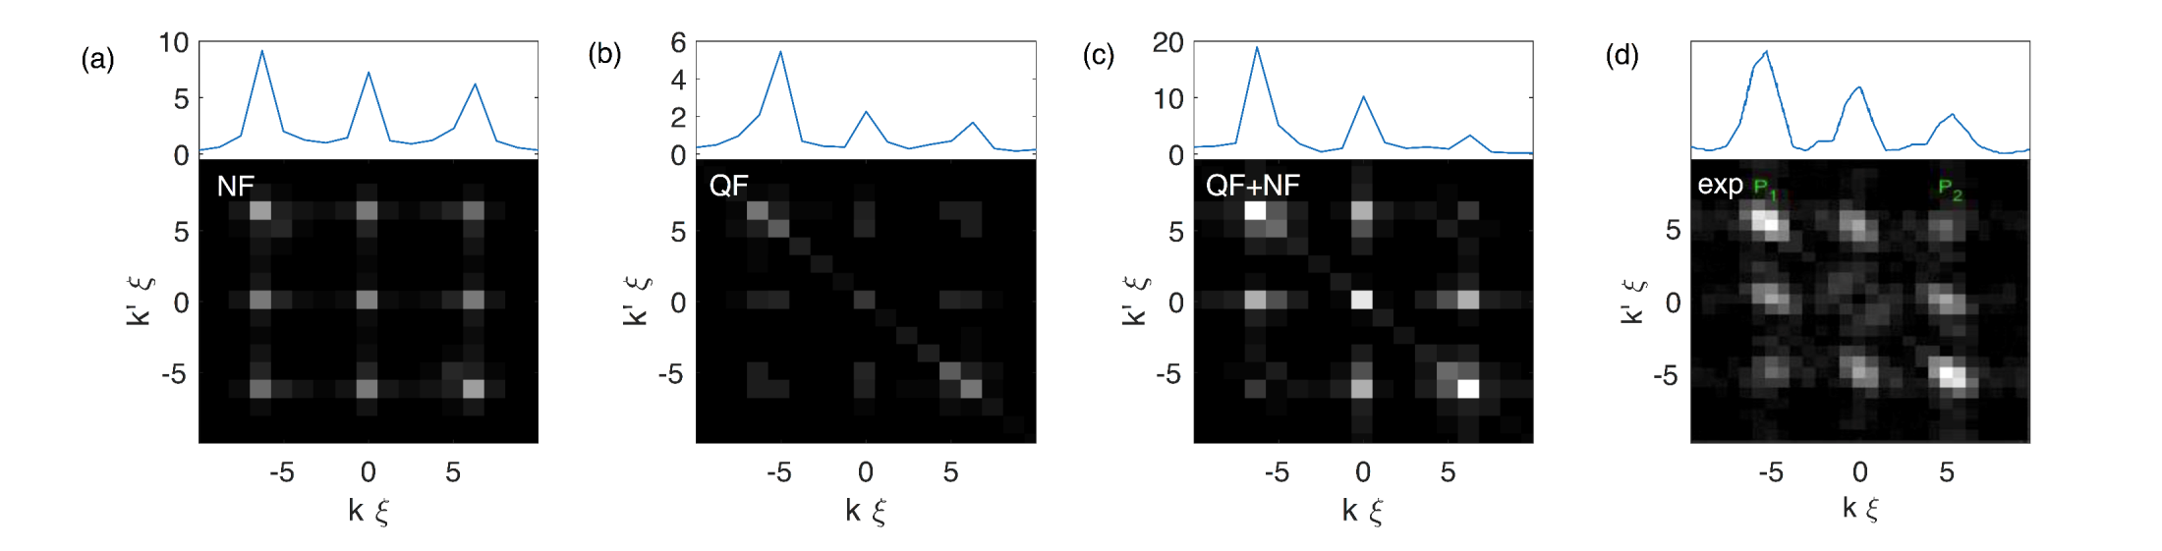
Density-density correlations and
noise spectroscopy
2D wavevector spectra of the correlation function.

Slide 37
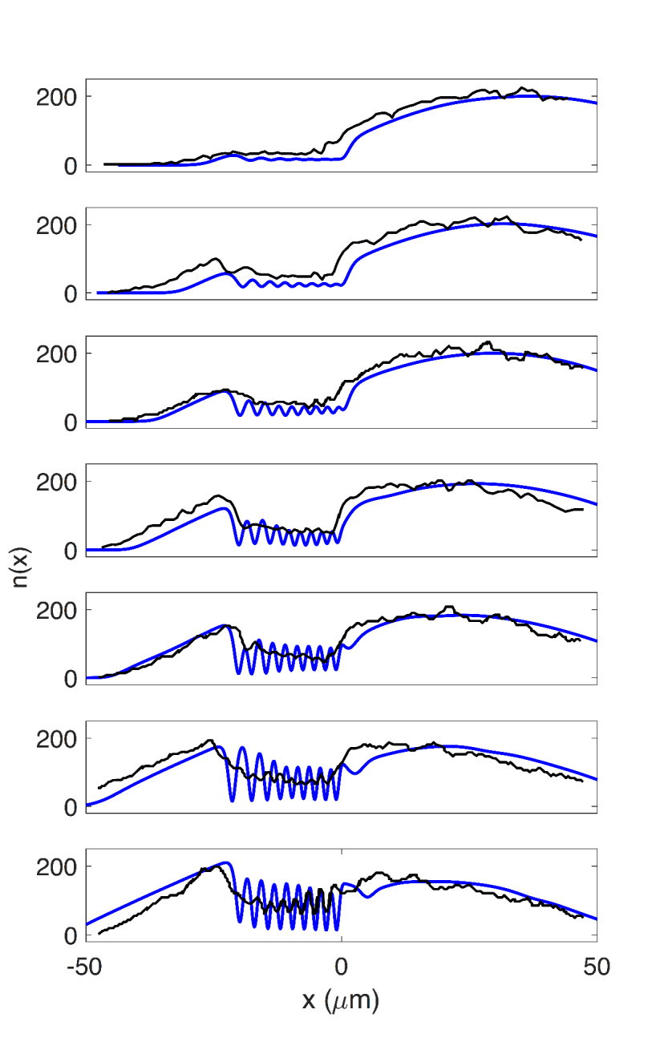
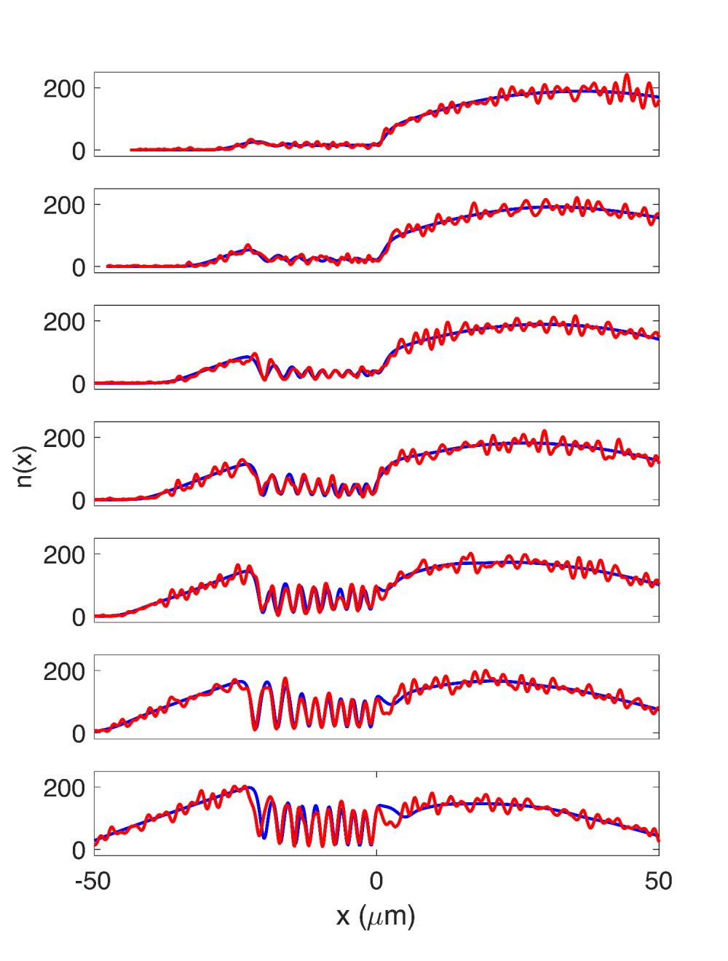
Density vs. time
GP vs. experiment
GP vs. truncated Wigner

Slide 38
Mechanisms of stimulated Hawking radiation in laboratory Bose-Einstein condensates
Black hole explosions?
Experimental black-hole evaporation?
Black hole lasers
Implementation in Bose-Einstein condensates
Enhancing Hawking radiation in BECs
Effect of induced density correlations

Slide 39
Summary
The GP equation captures key features of the experiment, and the growth of the standing wave.
The standing wave is Bogoliubov-Cerenkov radiation (BCR), which is generated at the WH, and grows with increasing condensate density.
The Hawking radiation pair is stimulated by the BCR. The black-hole laser plays no role.
HR visibility can be enhanced in experimentally realizable regimes.
arXiv: 1605.01027 and 1705.01907

