Slide 1
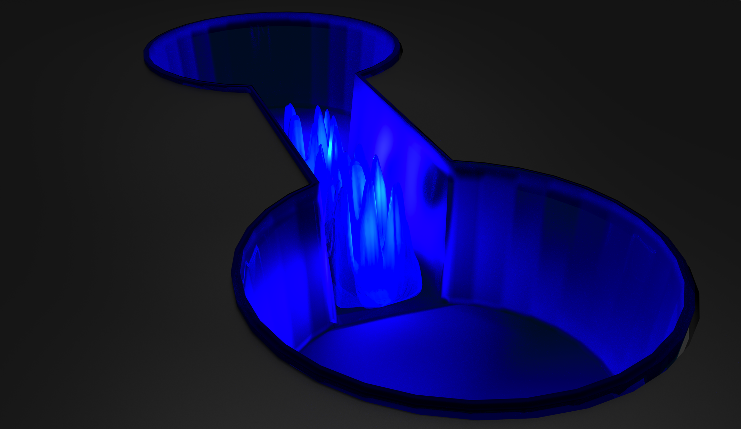


A Versatile SLM Enabled Atomtronic Device for Quantum Simulation in 2D
Thomas Haase, Donald White, Dylan Brown,
Ivan Herrera and Maarten Hoogerland

Slide 2
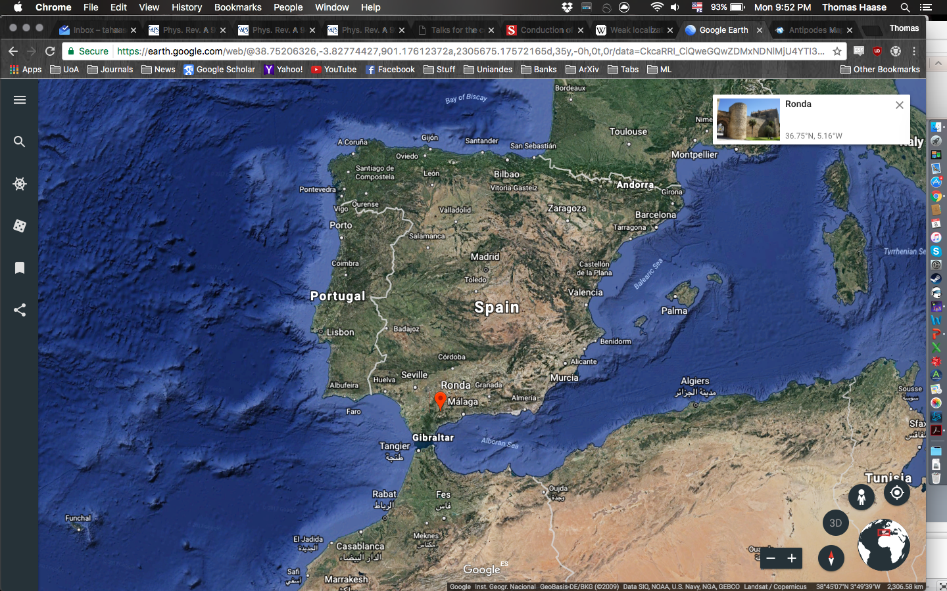
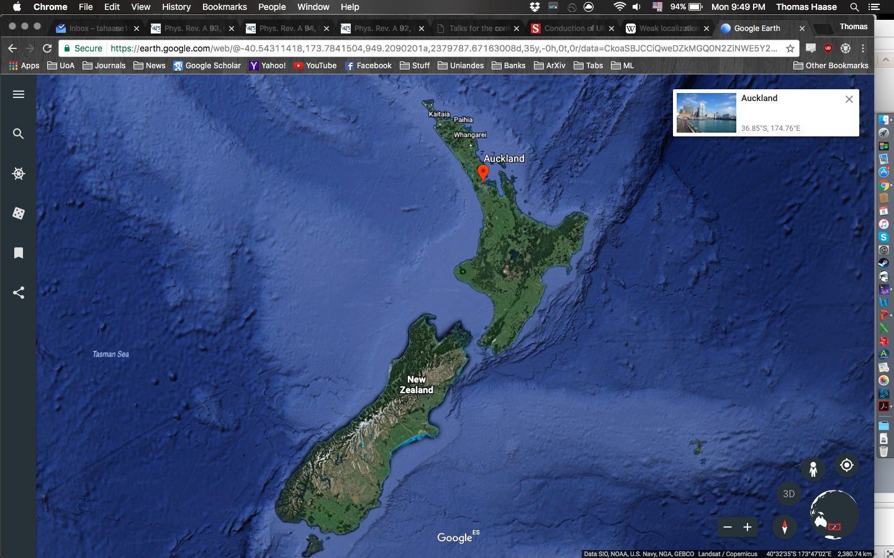
Antipodes
Source: Google Earth

Slide 3
Goals
Overall:
Create a versatile system that will enable a wide range of experiments with the goal of quantum simulation of two dimensional systems.
Current project:
Utilize an atomtronic RLC circuit to study the effects of Anderson localization in 2D.

Slide 4
Contents
Background
Experimental Setup
Current Results

Slide 5

Background
Queenstown

Slide 6
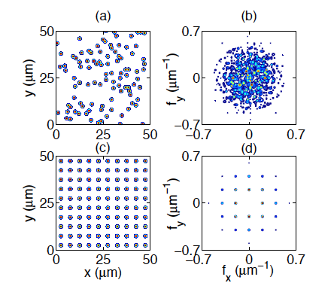
Anderson Localization
Anderson localization – Absence of diffusion in a disordered medium.
Disorder
Disorder broadens the spatial frequency spectrum.
Fourier Transform
Ordered Lattice

Slide 7
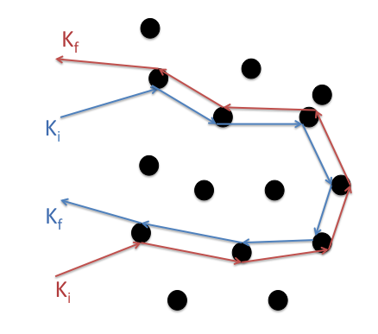
Weak Localization
If k_{i} = -k_{f} then phase difference between both paths is zero.
Quantum paths will constructively interfere when scattering in the reverse direction.
Coherent backscattering.
Quantum interference adds a correction from ‘looped’ paths.
Occurrence of multiple scattering effects.
Precursor to Anderson localization.

Slide 8

Creating an Anderson insulator
For a wave traveling in a highly disordered medium (strong scattering limit) - the disorder completely suppresses the diffusive transport.
To create an Anderson insulator we need to introduce disorder into the system.
Localized wave function decays as:

Slide 9
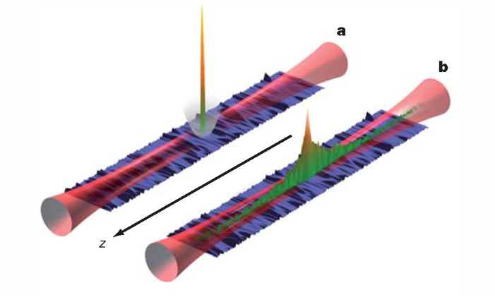
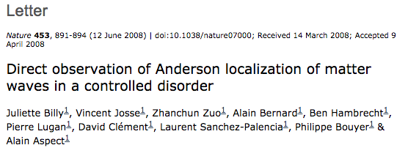
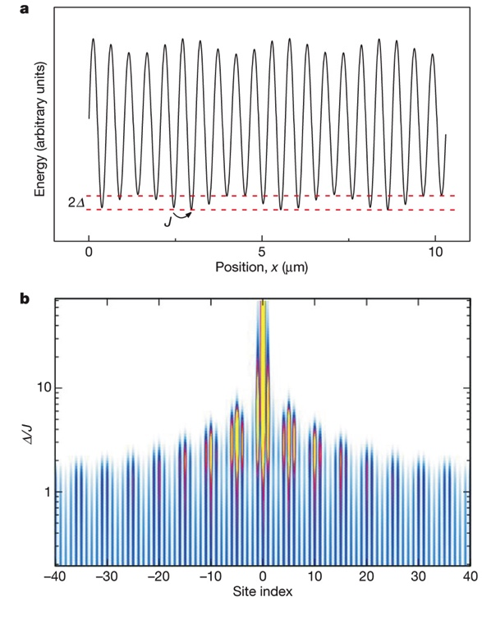
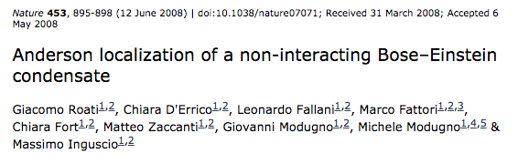
Anderson Localization in Matter Waves
1D expansion experiments

Slide 10
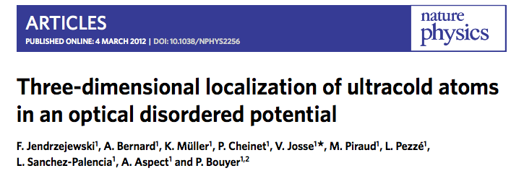
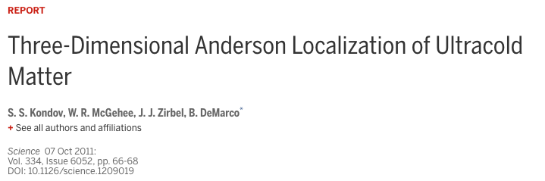
Anderson Localization in Matter Waves
3D expansion experiments

Slide 11



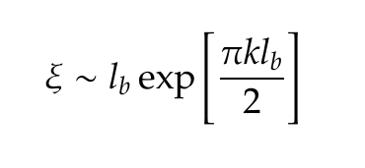
Anderson Localization in Matter Waves
Define 3 length scales:
The scattering mean-free path:
Boltzmann mean-free path:
Localization length:
Localization length > scattering mean-free path.
In 2D:

Slide 12
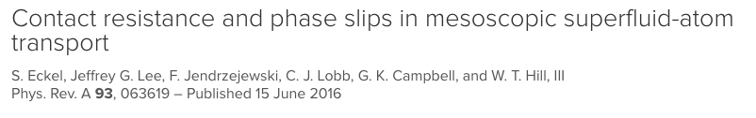
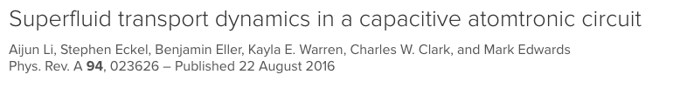
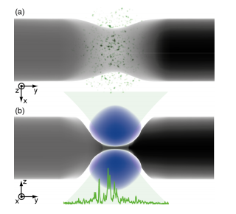
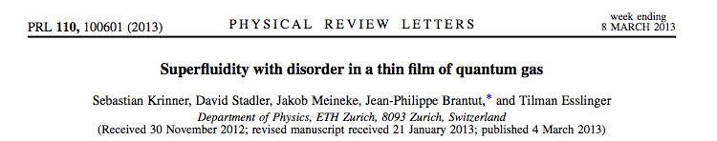
Atomtronic RLC Circuit

Slide 13

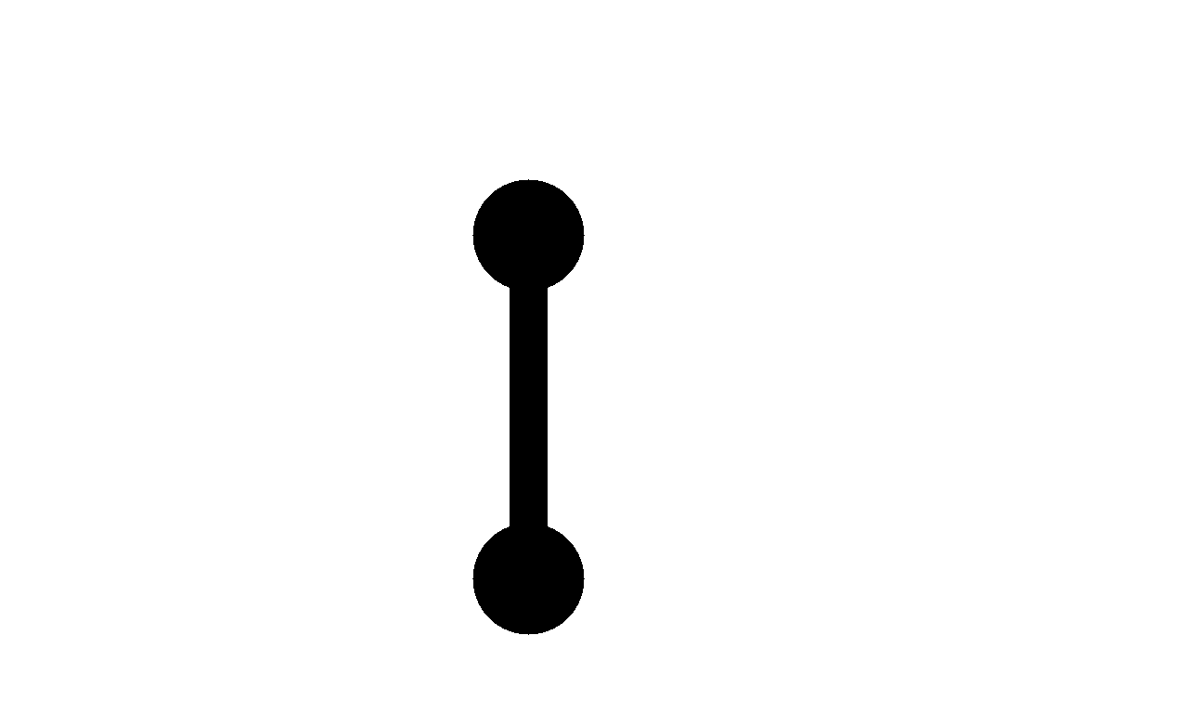


Atomtronic RLC circuit
Chemical potential drives motion from one reservoir to the other.
Final Reservoir
Initial Reservoir
Channel
Imbalance:
Capacitance:
Resonant frequency:
A.Li et al PRA 94 023626

Slide 14
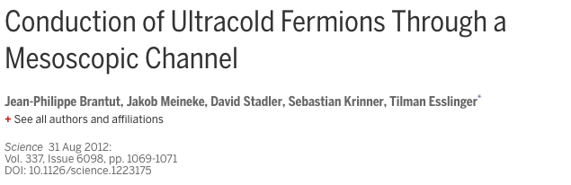

Atomtronic RLC circuit
Exponential decay model
Enables us to investigate Anderson localization using a transmission experiment.

Slide 15
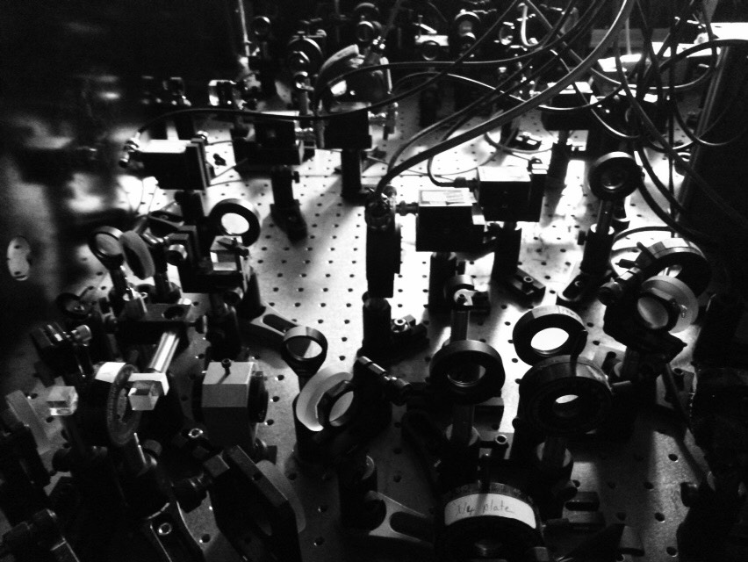
Experimental Setup

Slide 16
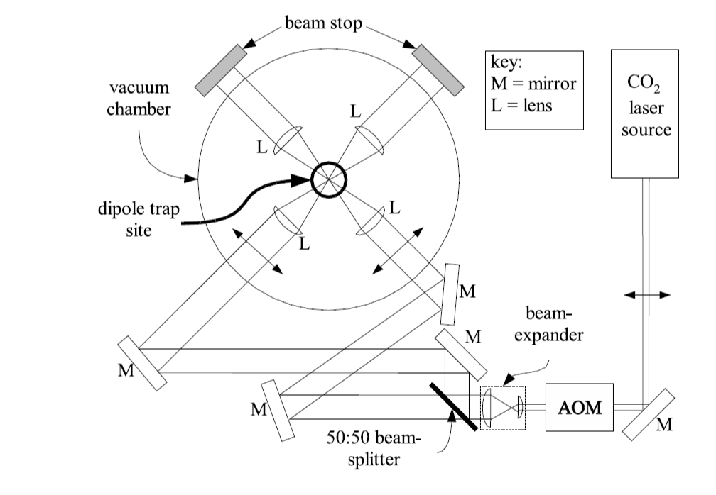
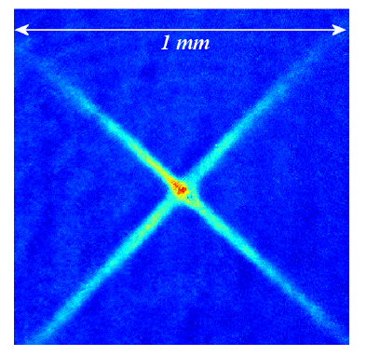
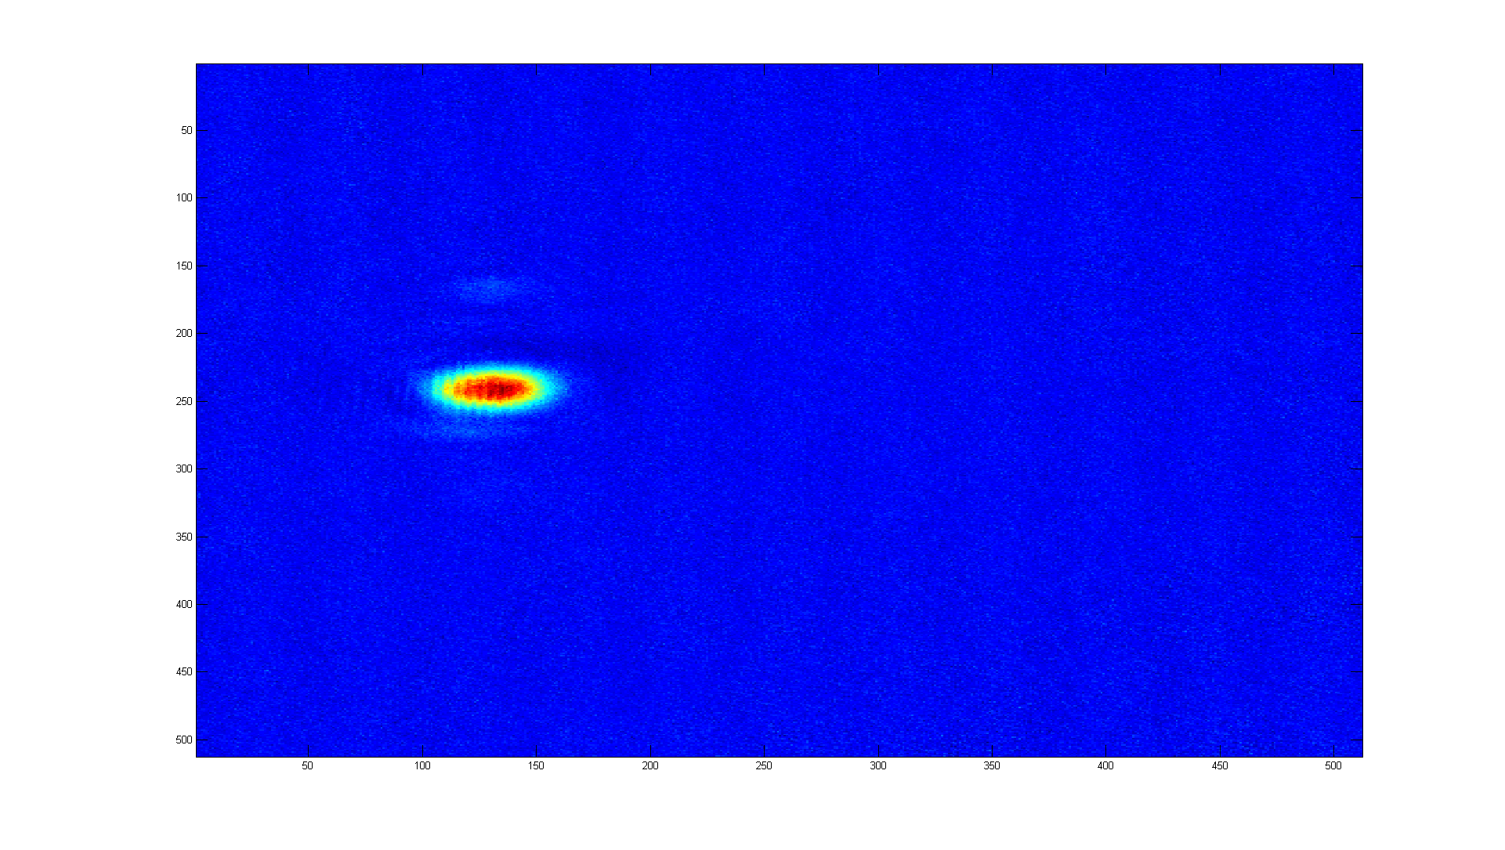
THE BEC
⁸⁷Rb Bose Einstein Condensate ~ 20,000 atoms

Slide 17
Overview
SLM
Setup
2D-Trap
Setup
ArXiv:1702.01860

Slide 18
2d Trap
Stacked ‘pancake’ traps.
Stability Measurements.
Normal
operation
8 μm
The finale of
Tchaikovsky's 1812 Overture played at 80 dB

Slide 19
2D trap
Summary of parameters:
Trap |  | Beam
Trap Frequency (ν_{x}) | 1 Hz | Beam Waist (w_{x}) | 4 mm
Trap Frequency (ν_{y}) | 1 Hz | Beam Waist (w_{z}) | 200 μm
Trap Frequency (v_{z}) | 900 Hz | Intersection Angle | 6°
Depth | 2 μK | Laser power | 10 W
Spacing | 8 μm
Rayleigh Range | 1.6 mm
Temperature of 2D degenerate gas: 8±0.5 nK
Loading efficiency of 70±1%

Slide 20
Overview
SLM
Setup
2D-Trap
Setup
ArXiv:1702.01860

Slide 21
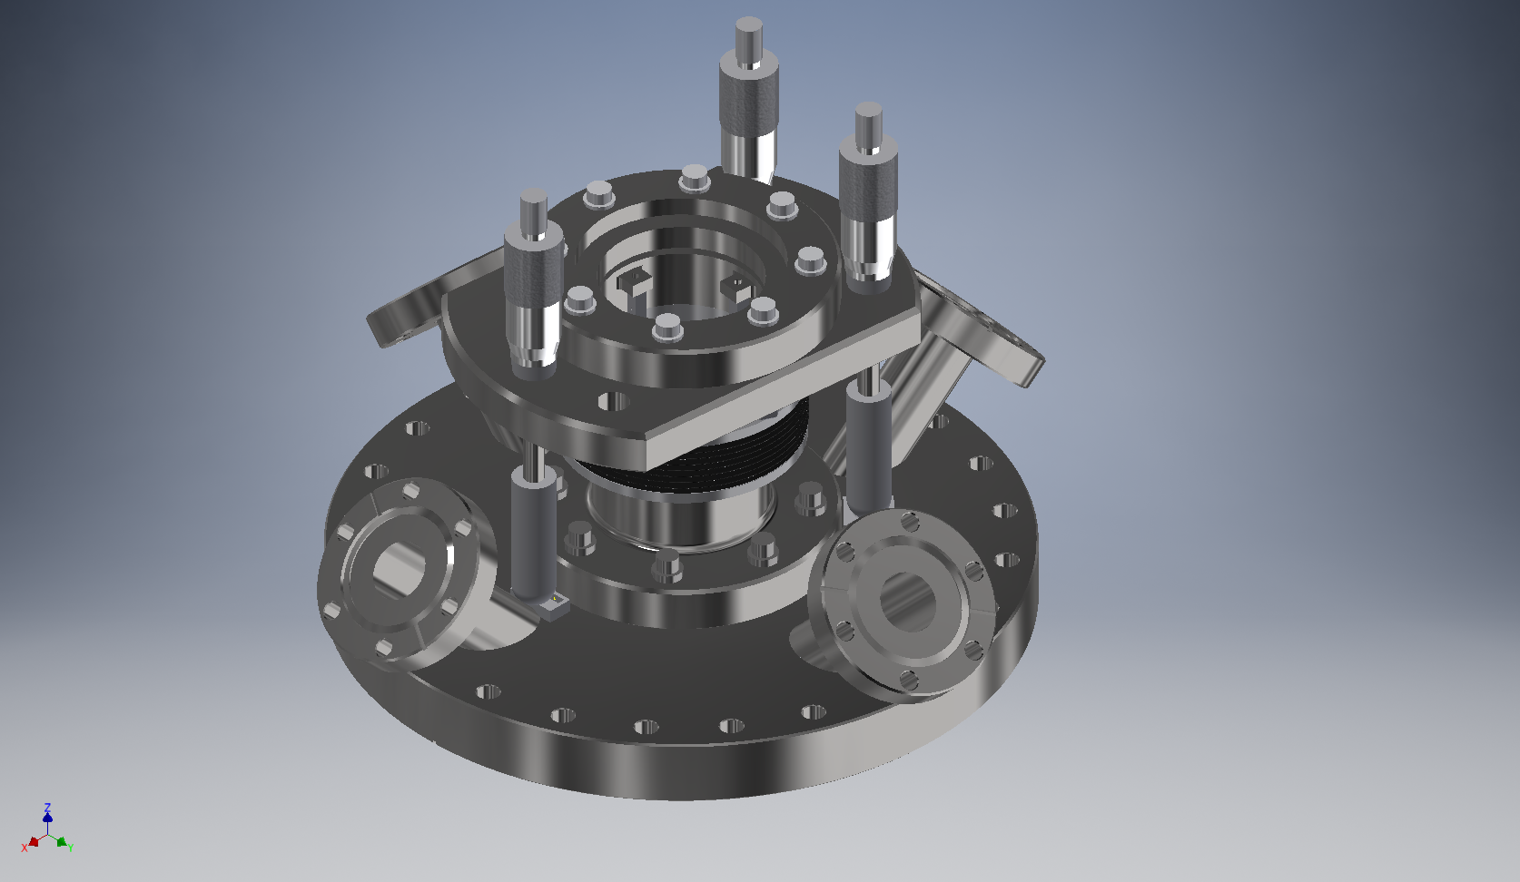
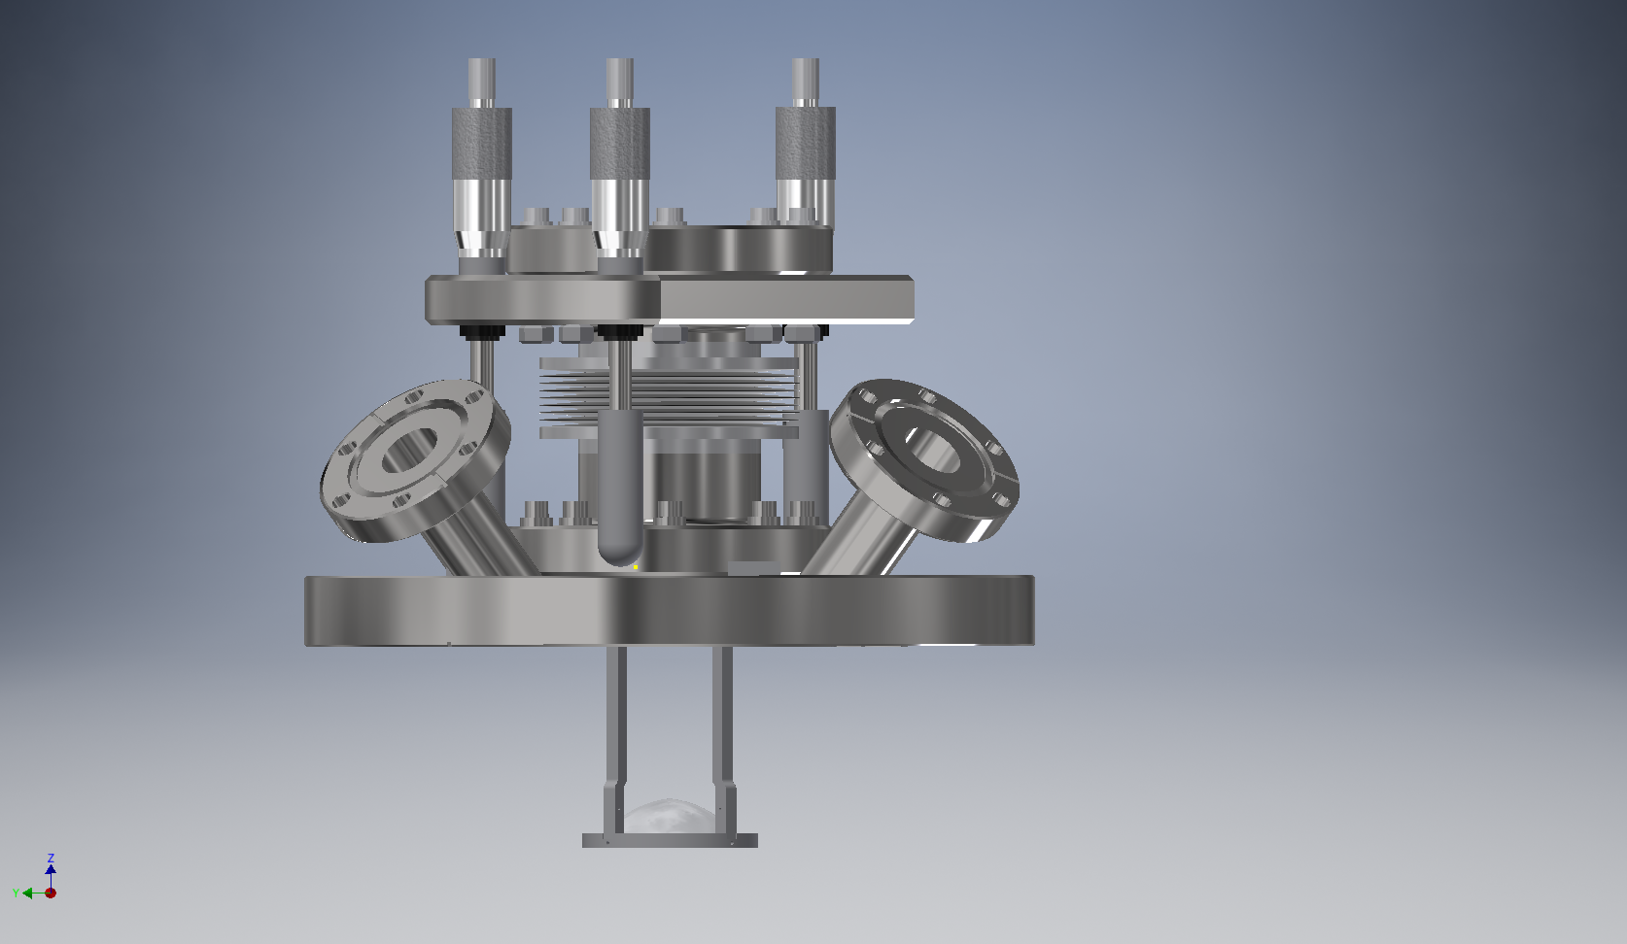
SLM Setup
Potential depth: 2.5 μK
Total magnification: 0.036x
Resolution ~1.2 μm
Custom built mounting of the lens allows for control of the vertical positioning.

Slide 22
Customizable Potentials
Atoms expand into the customizable potential.
Require a defined path.
84 μm
42 μm
Kiwi potential

Slide 23
Experimental Sequence
Sequence after BEC ramp
Spatial positioning of the beams.

Slide 24

Initial RESULTS
Sandfly Bay,
Otago Peninsula

Slide 25
Dimensions
Dimension of the ‘dumbbell’ potential:
60 μm
20 μm
Length varied from 20-200 μm

Slide 26
RCL Circuit
Two transport regimes:
Initial ballistic expansion.
Exponential decay coupled to an ‘oscillation’.
Channel length of 20 μm

Slide 27

Adding Disorder
Initial reservoir
Final Reservoir
Channel
Point scatterer disorder.
(1.4 μm x 1.4 μm)
Scatterer size ~ Atomic de Broglie wavelength.

Slide 28
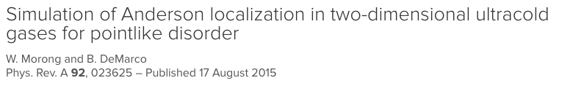
Adding Disorder
Different approach to using a speckle potential as done in previous studies.
Point scatterer disorder.
(1.4 μm x 1.4 μm)
Avoid percolation threshold issues.
‘Amount’ of disorder is described by fill factor.

Slide 29
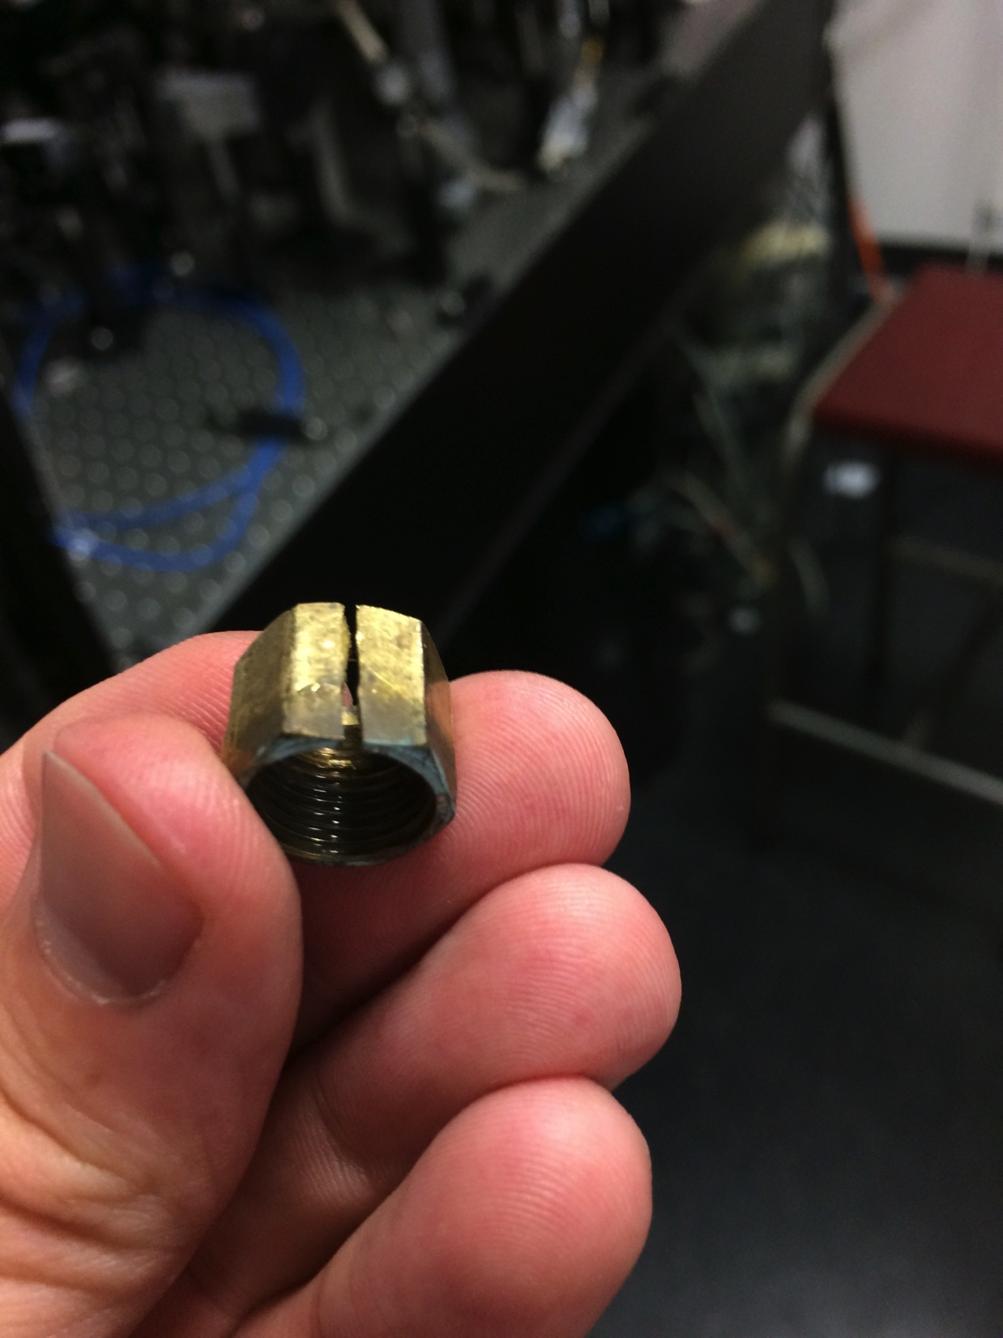

Slide 30
Summary
Presented our setup to conduct transmissive experiments.
Presented initial results towards investigating resistance induced by the addition of disorder.
Evidence of increasing resistance linked to increasing disorder in an RLC model.

