Slide 1

Quantum nanophotonics conference
Weak and strong coupling
in Plasmon-based CQED
Ying Gu
Department of Physics, Peking University Beijing, China
*email: ygu@pku.edu.cn 2017.02. 27 Benasque

Slide 2
Quantum optics
Nano
photonics
Quantum nanophotonics
Microscale
nanoscale
Controlling photon emission
Quantum coherence
Reversible interaction
Quantum informatoin
Atomic trapping

Slide 3




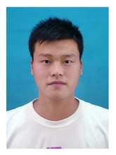

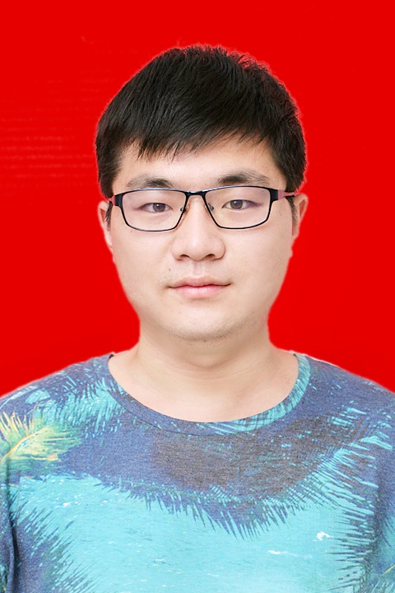

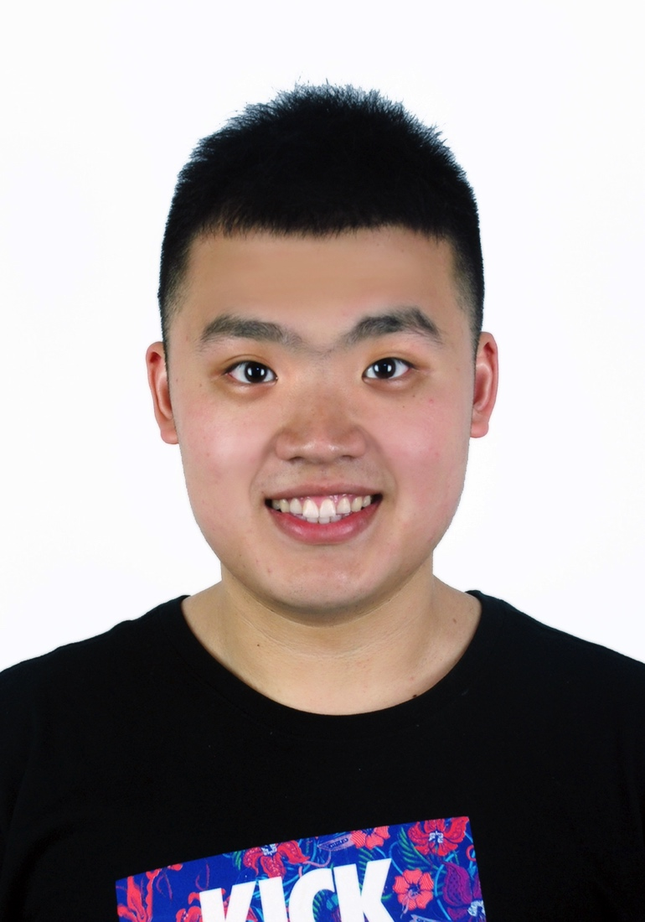

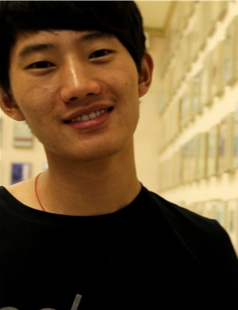

Prof. Ying Gu Quantum nanophotonics
Institute of Modern Optics, School of Physics, Peking University Phone number：010-62752882 ygu@pku.edu.cn
Strong coupling
Single photon
emission
Quantum
information
Active control of
Photon emission
With LC in
nanostructures
Mediate couple
Of QD and
nanostructures
Weak coupling
1 Postdoc. and 6 PH.D candidates

Slide 4
Students (PKU):
Liangliang Chen, Pengfei Yang, Haixi Zhang, Jia Li, Rui Luo, Xiankuo Li, Hang Lian, Luojia Wang, Pan Ren, Hongyi Chen, Juanjuan Ren, Dongxing Zhao, Jiarui Wu…..
Collaborators :
Qihuang Gong, Xiaoyong Hu PKU
Yiping Cui, Jiayu zhang Southeast University, China
Junxiang Zhang, Tiancai Zhang ShanXi Univ., China
Limin Tong Zhejiang Univ. China
Jingping Xu Tong ji Univ., China
Shiyao Zhu CRSC, China
Olivier J. F. Martin EPFL, Switzerland
Brian D. Gerardot Heriot-Watt University, UK
Iam-Choon Khoo, Yi Ma Pennsylvania State Univ. US
Nongjian Tao, Xiaonan Shan Arizona Univ. , US

Slide 5
Outline:
1. Background
2. Weak coupling
Efficient Single Photon Emission and Collection
High-contrast switching of spontaneous emission (poster)
3. Strong coupling
Evanescent-vacuum-enhanced photon-exciton
coupling and fluorescence collection
4. Summary

Slide 6
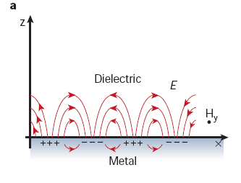
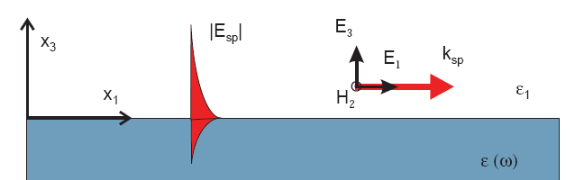
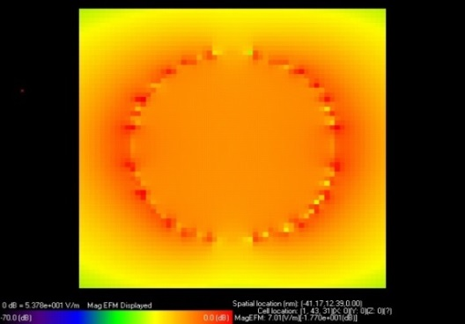
Surface plasmon polariton (SPP)
SPP: collective oscillations of free electrons
evanescent EM mode bound to surface
Localized SP or SPR:
localized oscillation
strong local field
local field effects below λ
William L. Barnes, Alain Dereux & Thomas W. Ebbesen, nature, 424, 824 (2003);
V. Zayatsa, et al, Phys Rep. 2005, 408:131–314;

Slide 7
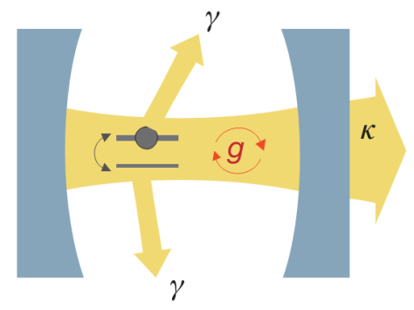

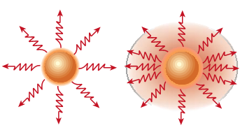
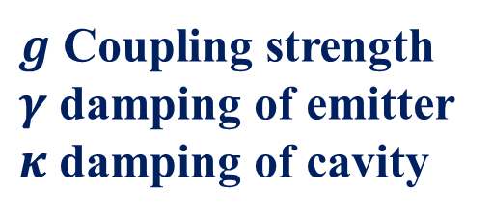
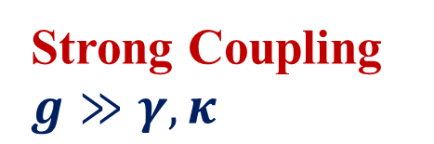
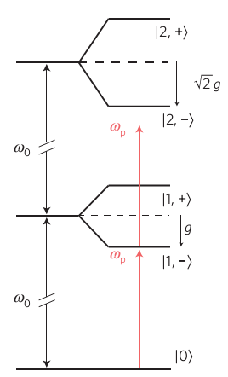

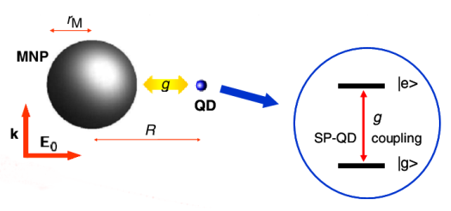
With local field effects, What’s new for light-quantum emitter interaction?
Purcell effect
Rabi splitting
Nature 480,193(2011); Nature 424,839(2003); Nphy 9,329(2013)
Notes:
在弱耦合情况下，即耦合大于损耗时，原子的自发辐射是不可逆的，但由于腔的存在，改变了原子周围的模式密度，使得原子的自发辐射收到增强或抑制，这就是purcell效应。在强耦合情况下，原子自发辐射的能量会以2g的频率在腔模与原子之间交换，即使场的初始状态为真空态，这种振荡依然能够发生，这种现象称为真空拉比振荡（Vacuum Rabi Oscillation）。

Slide 8

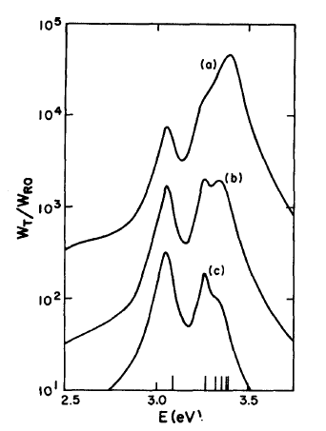
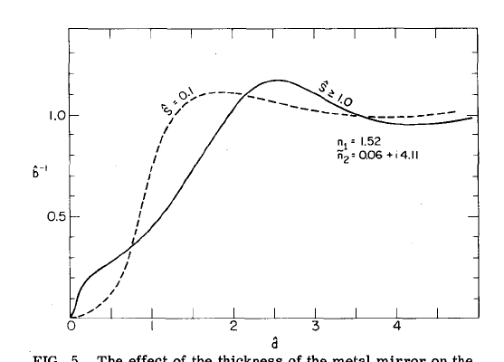
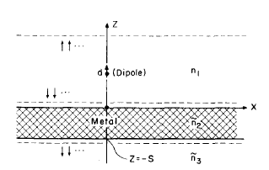
In weak coupling, what happens?
Decay rate modification of quantum emitter
Features of plasmon structures:
1. large Purcell factor 2. anisotropic decay rates
R.R.Chance et al, the journal of cheimical physics, 62,2245 (1975);R. Ruppin, J. Chem.Phys. 76,1681 (1982).

Slide 9
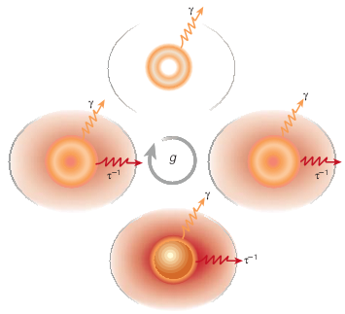
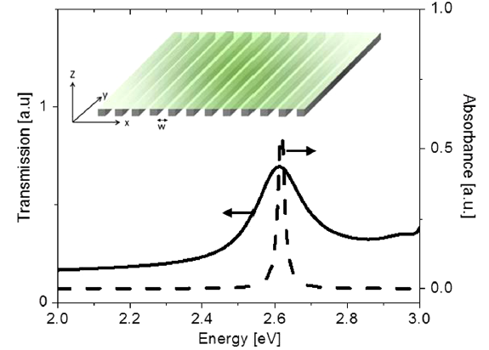
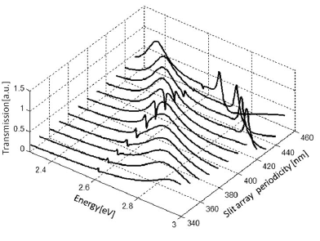
In strong coupling, what happens?
Due to:
Very compact local field
distribution
Change from the usual irreversible spontaneous emission to a reversible
exchange of energy between
the emitter and the cavity mode
Observation of the Rabi splitting with SPP
Nature 424. 839(2003)
Phys.Rev.Lett.109.073002(2012 )

Slide 10
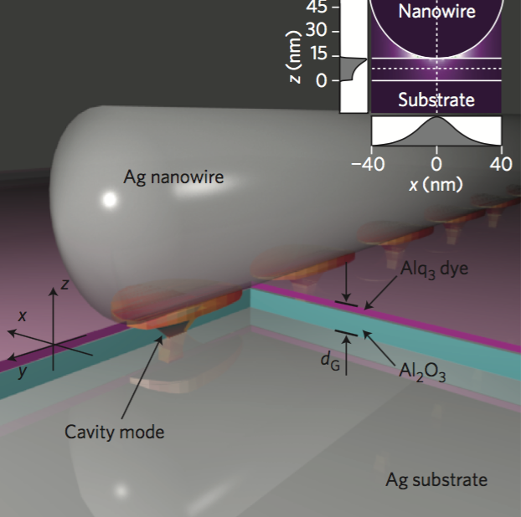
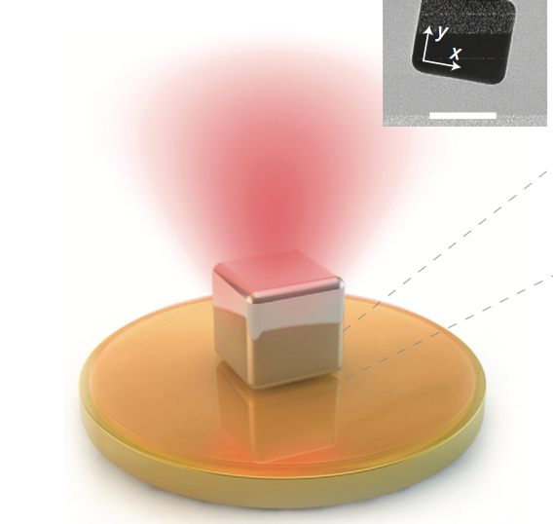
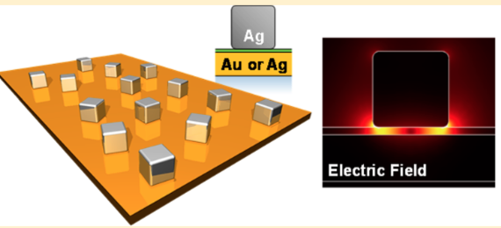
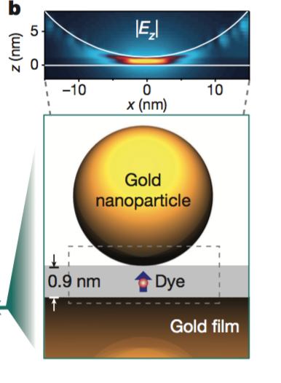
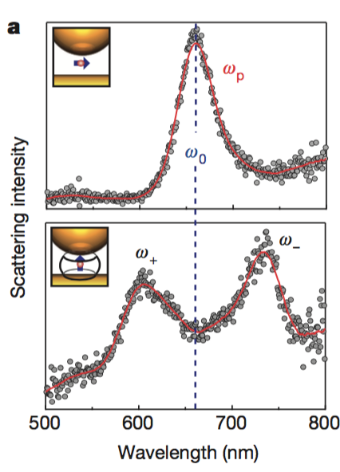
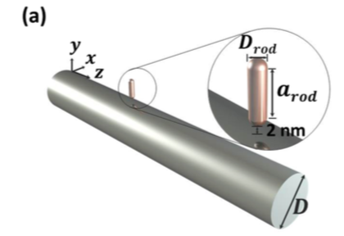
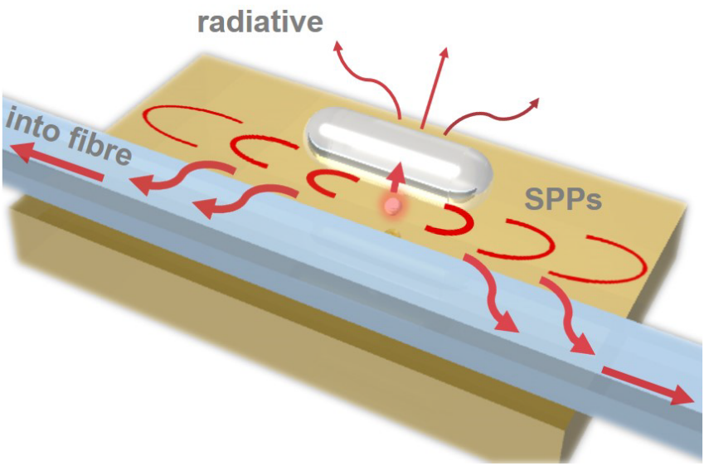
What happens in gap plasmon nanostructures?
Gap surface plasmon
Nano Lett. 13, 5866 (2013)
Enhanced spontaneous emission
Nat. Photon. 6, 459 (2012)
Nat. Photon. 8, 835 (2014)
Weak: Single photon collection
PRL 114, 193002 (2015)
Strong coupling
Nature 535, 127 (2016)
Strong: Evanescent vacuum
PRL 118, 073604 (2017)

Slide 11
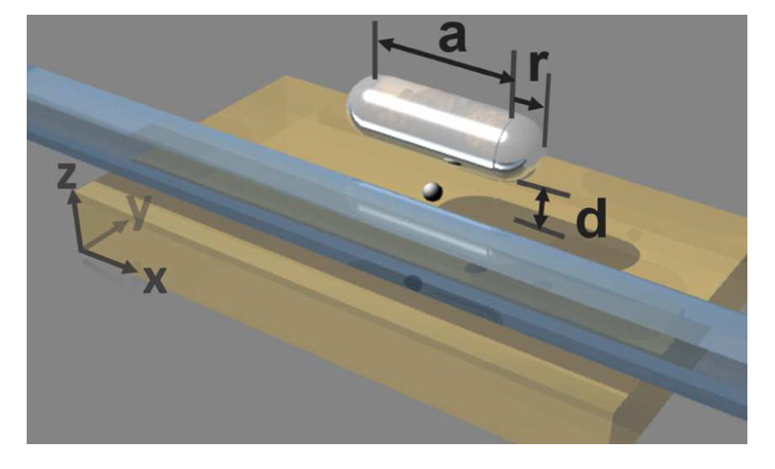
Weak coupling :
Efficient Single Photon Emission and Collection
Hang Lian, Ying Gu et al, PRL 114,193002 (2015).

Slide 12
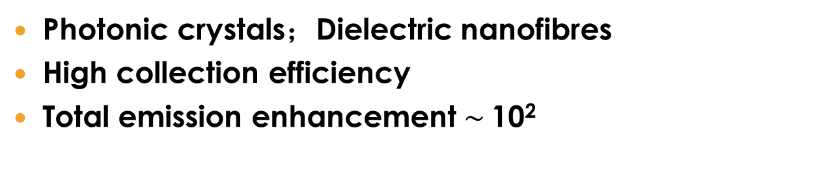
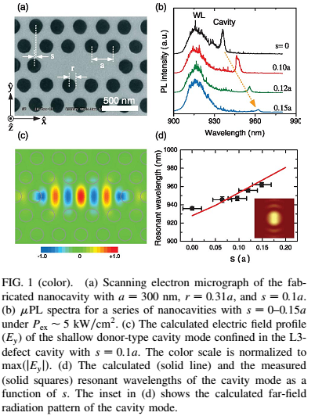
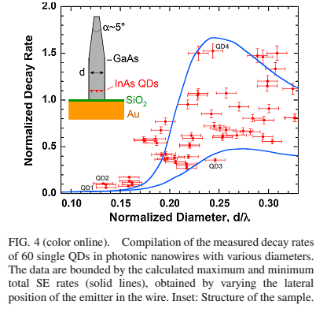
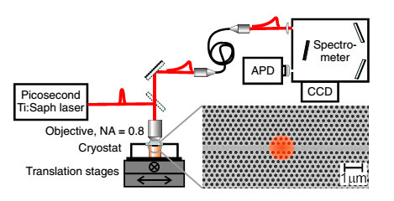
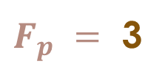
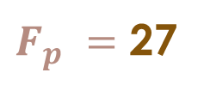
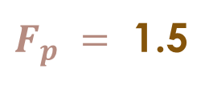
Dielectric nanostructures
Space of
improvement
Photonic crystals
Dielectric nanofibres
PRL,96,117401 (2006). PRL,101, 113903 (2008) PRL,106,103601 (2011)
4

Slide 13
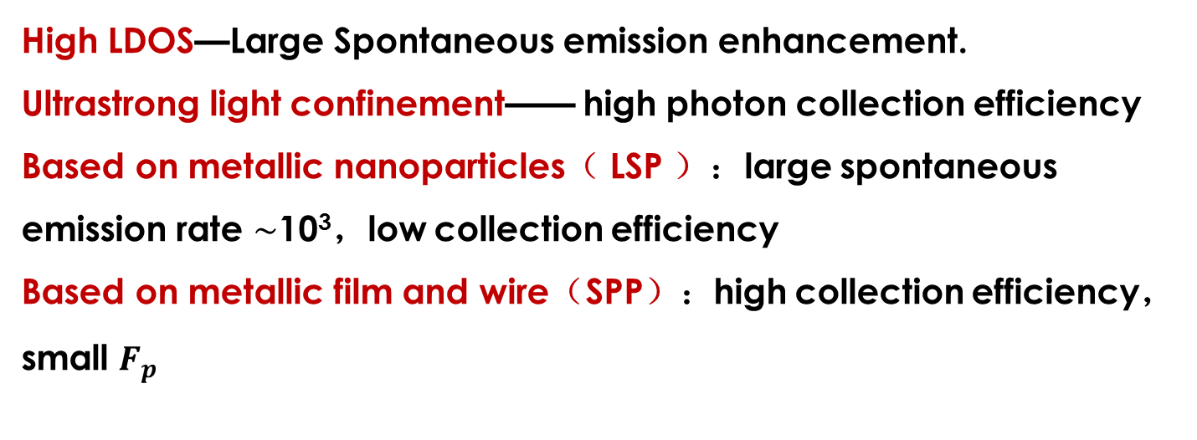
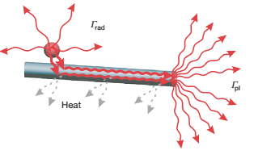
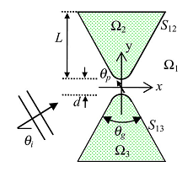
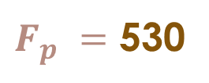
smaller？brighter？
Plasmonic nanostructures
LSP

Slide 14
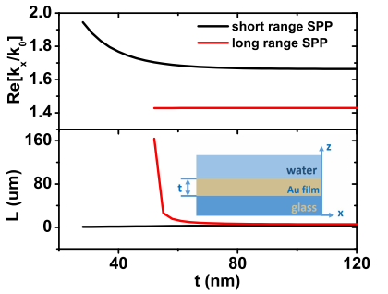
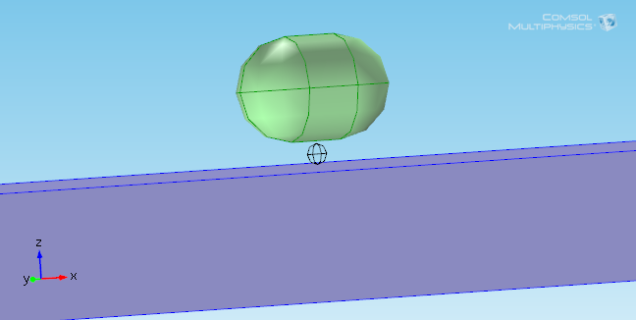
Design of Gap Surface Plasmons
water
gold
glass
Film thickness at cutoff thickness：long propagation length for long range SPP
Nanorod：silver Nanofilm: gold
First use plane wave excitation to excite only the long range SPP of nanofilm, wavelength is 680 nm.
Hang Lian, Ying Gu et al, PRL 114,193002 (2015).

Slide 15
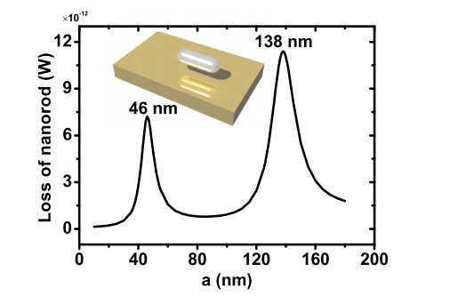
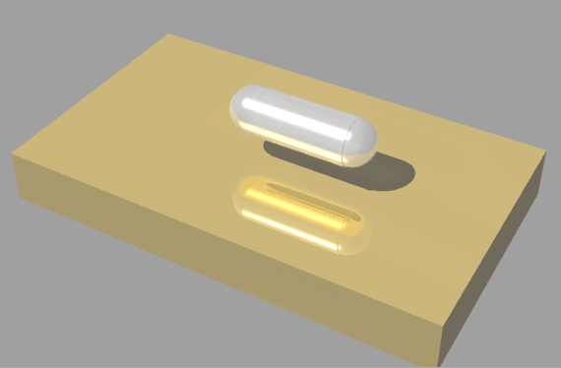
a
z
r
y
x
d
t
Absorption spectrum：dipolar and quadrupolar excitation of nanorod in evanescent wave
One kind of gap plasmons
（PRB,89,075136,Nat.photonics,6,459）：
Next Step for using both hot spots of gap plasmon and guided properties of ultralong SPP.

Slide 16

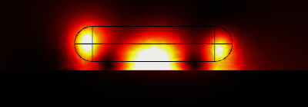

Hot Spots
2
Nanofilm —— enhanced field
Nanorod —— enhanced twice
Cascading enhanced electric field
Hot spot 1：center of nanorod when quadrupole mode is excited
Hot spot 2：ends of nanorod when both dipole and quadrupole modes are excited
Dipole mode
1
2
Quadrupole mode
z
x

Slide 17
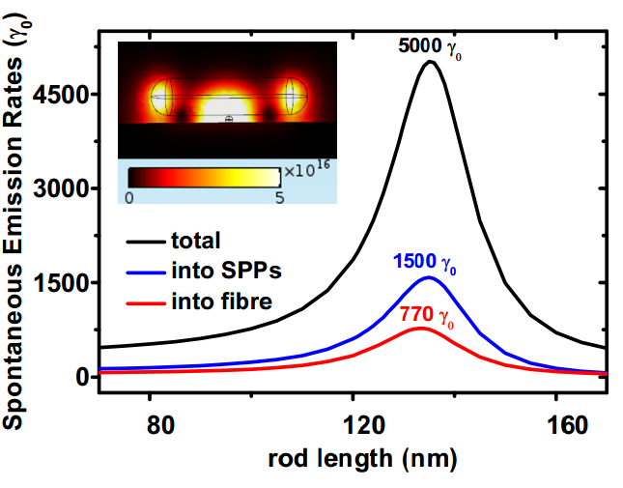
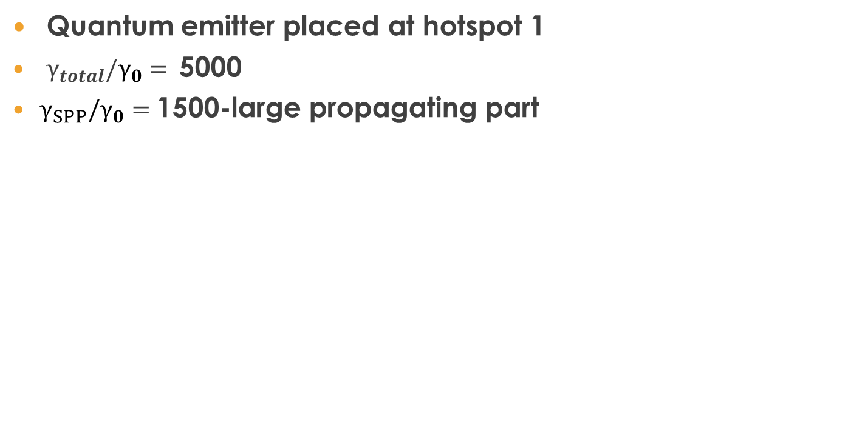
Efficient Single Photon Emission and Collection
Hang Lian, Ying Gu et al, PRL 114,193002 (2015).

Slide 18
1.The Perfect fit of quadrupole resonance length (135 and 138 nm)
2.Electric patterns
3.Energy flux ratio (discuss later)
Excitation of gap surface plasmon by emitter
135 nm
Both efficient emission and one dimensional nanoscale guiding of single photons
11

Slide 19
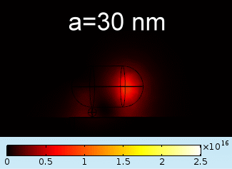
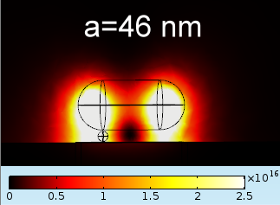

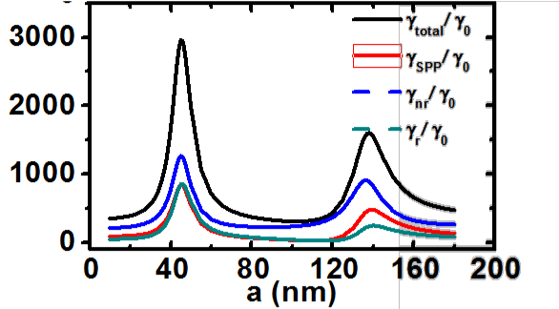
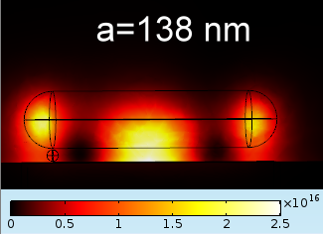
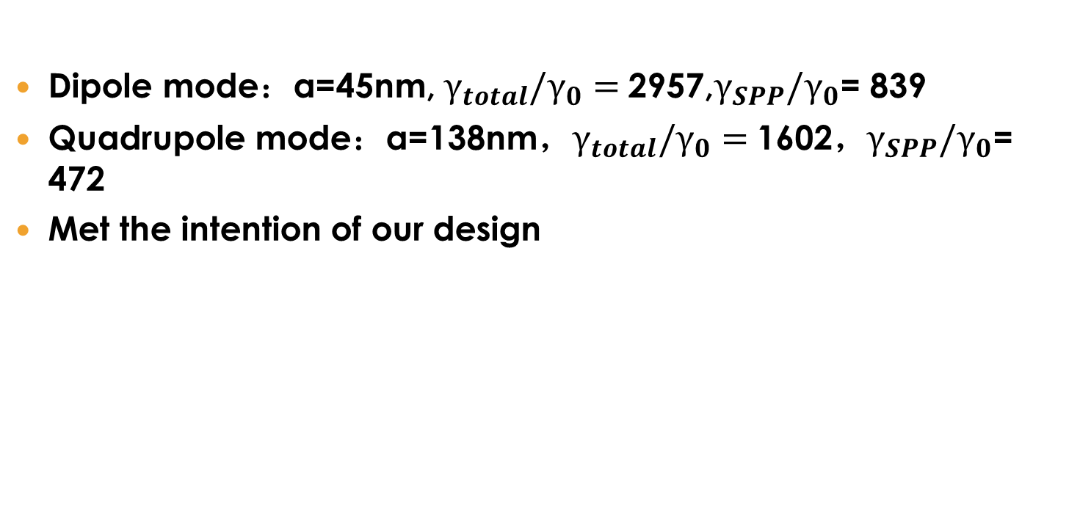
12

Slide 20


SPP Propagation direction and angle – with and without fibre
Hang Lian, Ying Gu et al, PRL 114,193002 (2015).
15

Slide 22

Strong coupling :
Evanescent vacuum enhanced exciton-plasmon interaction and fluorescence collection
Juanjuan Ren, Ying Gu et al, PRL 118, 073604 (2017)

Slide 23


Bakground
Application of strong coupling regime in CQED
Take the atom as quantum storage node and take the photon as flying qubit；single-photon sources and quantum entanglement
For scalable quantum network and on-chip quantum information processing
Plasmon nanostructures with ultra-small optical mode volume enable to greatly enhance the light-matter interactions
atom
PRA, 82, 043845 (2010)

Slide 24


Basic idea
vacuum
vs
evanescent electromagnetic vacuum
Ag nanorod
Ag nanorod
atom
atom
nanowire
Evanescent wave is confined in one dimension or two dimension, the plasmon mode of Ag nanorod will be more localized than that in general vacuum.
(1) more localized field will enhance the coupling coefficient
(2) Efficiently collect and guide the photons via evanescent wave
nanowire
Metallic film

Slide 25

Enhanced coupling coefficients via Evanescent vacuum
1) one-dimensional evanescent electromagnetic field of the nanowire.
2) Stronger field at the nanogap with nanowire.
Juanjuan Ren, Ying Gu et al, PRL 118, 073604 (2017)

Slide 26

Enhanced coupling coefficients via nanowire
Within the penetration length of evanescent wave, the longer nanorod can receive the larger attenuation of electric field.
1) The coupling coefficient with nanowire is 1.9~4.2 times larger than that without nanowire.
2) The influence of evanescent wave on the longer nanorod is greater.
Juanjuan Ren, Ying Gu et al, PRL 118, 073604 (2017)

Slide 27


Mode coupling
Mode decoupled for small AgNR: no peak splitting and consistent coupling coefficients with two excitation methods.
Mode coupled for larger AgNR: with peak splitting and inconsistent coupling coefficients with two excitation methods.
Juanjuan Ren, Ying Gu et al, PRL 118, 073604 (2017)

Slide 28



Reversible interaction
µ = 0.15 enm, starting to
exchange energy and Rabi spliting appears;
µ = 0.5 enm, they exchange the energy reversibly accompanying by larger Rabi splitting.

Slide 29


Collection of the emitted photons via evanescent wave
1) Channeling efficiency is increased from 12% to 47%.
2) Larger efficiency for Ag nanowire,
Juanjuan Ren, Ying Gu et al, PRL 118, 073604 (2017)

Slide 30



Experimental support for our theory
Nature 535, 127 (2016)
g₀ ^{mid} = 47.84 meV VS 45meV in Experiment
Rabi frequencies is 288 meV for ten emitters VS 300 meV in Experiment

Slide 31
Summary
Weak coupling
Efficient Single Photon Emission and Collection
Strong coupling
Evanescent-vacuum-enhanced photon-exciton
coupling and fluorescence collection
Need Experiment support !
31

Slide 32



