Slide 1
Symmetric tensor-networks and topological phases
Shenghan Jiang
Boston College
Benasque
February, 09, 2017

Slide 2
Symmetric tensor-networks and topological phases
Collaborators:
Ying Ran (Boston College)
Panjin Kim, Hyungyong Lee, Jung Hoon Han (Sungkyunkwan University)
Brayden Ware, Chao-Ming Jian, Michael Zaletel (Staionq)
References:
arXiv: 1505.03171 , S. Jiang, Y. Ran
arXiv: 1509.04358, P. Kim, H. Lee, S. Jiang, B. Ware, C. Jian, M. Zaletel, J. Han, Y. Ran
arXiv: 1610.02024, S. Jiang, P. Kim, J. Han, Y. Ran
arXiv: 1611.07652, S. Jiang, Y. Ran

Slide 3
Outline
Motivation & Introduction
Spin liquids on the kagome lattice
SPT phases & anyon condensation
Summary

Slide 4
Motivation
Goal: determine the quantum phases for a local Hamiltonian?
Quantum phases: quantum states of matter at zero temperature → ground states
Focus: symmetric gapped bosonic quantum phases
Models (Hamiltonian)
???
Quantum phases
Notes:
From a practical point of view, one of central problems for condensed matter theorists is to determine the quantum phases of real materials .

Slide 5
Variational method
Trial wavefunctions
Numerical
algorithm
The optimal wavefunction
(lowest energy density)
Measuring
observables
Identify quantum phase
Notes:
Numerical algorithm that allows search minimal energy wavefunctions in the variational wavefunction space

Slide 6
Tensor networks as trial wavefunctions
$$i$$
$$β$$
tensor
$$α$$
$$γ$$
$=A_{αβγδ}^{i}$ ~ $∑A_{αβγδ}^{i}|i〉⊗|αβγδ〉$
$$δ$$
$$A$$
$$i$$
$$i′$$
$$β$$
$$β′$$
tensor contraction
$$α$$
$$γ$$
$$γ′$$
$$=\sum_{γ}{A_{αβγδ}^{i}⋅B_{γβ′γ′δ′}^{i^{′}}}$$
$$A$$
$$B$$
$$δ$$
$$δ′$$
$$|ψ〉=\sum_{\left\{i\right\}}{c_{i_{1}i_{2}…i_{n}}|i_{1},i_{2},…,i_{n}〉 }$$
$$d$$
PEPS
(2D TN)
$$D$$
Parameters:
$dD^{4}$ ~ $d^{n}$
$$⋯⋯⋯$$
$$|ψ〉$$
Notes:
Tensor networks are good trial wavefunctions for many body ground states of quantum systems

Slide 7
Tensor network method
MPS, PEPS, MERA
DMRG (S. White, Schollwock,…)
iTEBD, CTM, TRG… (Cirac, Verstraete, Vidal, Orus, Schuch, Poilblanc, Corboz …)
The optimal tensor wavefunction
To be improved:
Imposing symmetries? Analytical understanding?
Fixing gauge redundancy?
Measuring
observables
Identify quantum phase
Notes:
Numerical algorithm that allows search minimal energy wavefunctions in the variational wavefunction space

Slide 8
A general framework
Symmetries (on-site and lattice) of the model
(Partially) classification of symmetric tensor networks and generic trial wfs for each class
Class with lowest energy optimal wf
Identify the quantum phase by observables
Short-range difference
Class-A
Class-B
Phase-AI
Phase-AII
...
Phase-BI
Phase-BII
...
Long-range difference
$$⋯⋯$$
Quantum phases of Hamiltonian
with a given symmetry group
Notes:
Our classification scheme can be understood as a partial classification of symmetric quantum phases -- for example SPT, SET,… -- for a given symmetry group $SG$.
How about symmetry breaking phase? A class actually contains a unique symmetric phases and its neighboring symmetry breaking phases, which are connected to the symmetric phase by Landau-Ginzburg like phase transition. Notice, our symmetric classes also constrain the possible forms for Landau-Ginzburg field theory, so have some implication on the symmetry breaking pattern.
Symmetry breaking only happens on thermodynamic limit. Namely, on finite size, there is no sharp difference between symmetry breaking phases and their parent symmetric phases.
Our strategy is to first identify the right symmetric class and the ground state wavefunction. And symmetry breaking patterns can be identified by measuring correlators and do finite size scaling.

Slide 9
Problems to be solved
Classify symmetric phases (SPT & SET) in the presence of both lattice symmetries and on-site symmetries?
1D SPT are first classified by MPS (Chen, Gu, Wen, Schuch, Pérez-Garcı́a, Cirac, Pollman, Turner)
Easy to capture lattice symmetries
How to construct generic symmetric wavefunctions for every class?
Numerical algorithms for symmetric PEPS?

Slide 10
Summary of results
Obtain 32 classes of $Z_{2}$ spin liquids on the kagome lattice & numerical simulation on four classes
Numerical result consistent with $U(1)$ Dirac spin liquid
Obtain cohomological SPT: $H^{d+1}(SG,U\left(1\right))$
$SG$: on-site and lattice symmetries (onsite (Chen, Liu, Gu, Wen), lattice (Chen, Hermele, Fu, Qi, Furusaki…))
$T$ and $P$(mirror) act nontrivially (complex conjugate)
Generic tensor wavefunctions for every class
A by-product: SPT from conventional SET by condensing anyons

Slide 11
Outline
Motivation & Introduction
Spin liquids on the kagome lattice
SPT phases & anyon condensation
Summary

Slide 12
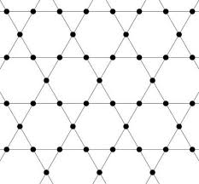
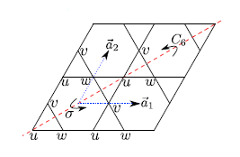
The kagome Heisenberg model
For systems on the kagome lattice with spin-$\frac{1}{2}$ per site, what is the quantum phase of the following Hamiltonian?
$$H=J\sum_{\left\langle ij\right\rangle }{{\vec{S}}_{i}∙{\vec{S}}_{j}}$$
Symmetries: on-site spin rotation, time reversal,
lattice translation, rotation, reflection
Sachdev, Marston, Senthil, Singh, Evenbly, Vidal, Ran, Hermele, Wen, Lee, Wang, Vishwanath, Iqbal, Becca, Sorella, Poilblanc, White, Huse, Depenbrock, McCulloch, Schollwock, Jiang, Balents, Mei, Xiang, He, Zaletel, Pollmann… and many more
DMRG → spin liquid phase (SET for both onsite and lattice symmetries)?
Which spin liquid???
Notes:
Let us focus on this particular problem, and the tensor framework will be developed when we try to solve this problem.

Slide 13
We focus on classification & simulation of gapped $Z_{2}$ spin liquids

Slide 14
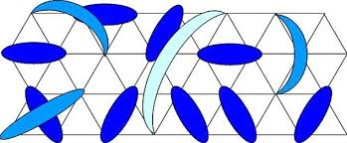
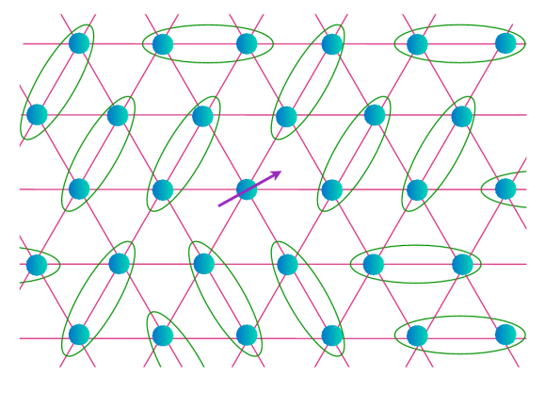
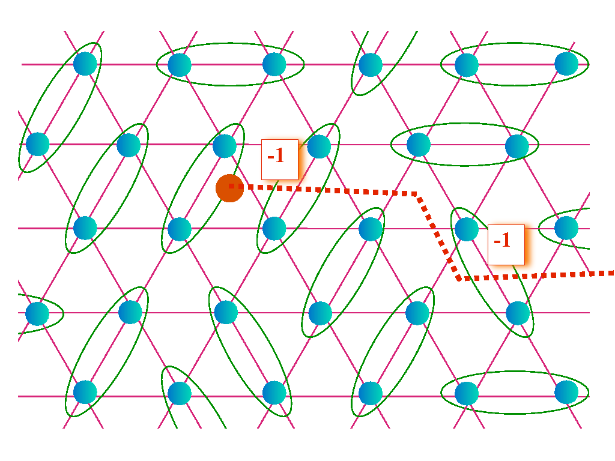
$Z_{2}$ spin liquid phases
$$|ψ〉=\sum{}$$
$$=\frac{1}{\sqrt{2}}\left(|↑↓〉−|↓↑〉\right)$$
No SSB on ground state
Toric code topological order. Elementary excitations: $1,e,m,em$
Spinons($e$) and visons($m$) (Fig. from Sachdev)
Toric code + symmetry → Many different $Z_{2}$ spin liquid phases (symmetry enriched topological phases)

Slide 15
Result: kagome $Z_{2}$ spin liquids
32 classes ($Z_{2}^{5}$)
$χ_{σ} ,{ χ}_{T}$ → new classes, “weak SPT” index
$η_{12}$ , $η_{c6}$ , $η_{σ}$ → symmetry fractionalization of $e$, consistent with Schwinger boson results
For every class, constrained Hilbert space for a local tensor
→ generic wavefunctions
$$d=2$$
For $D=6$, can realize four classes
Unconstraint: $D_{tot}=d^{2}D^{6}≈5000$
Constraint: $D_{constraint}=19$
$$D=6 (0⊕\frac{1}{2}⊕1)$$

Slide 16
How do we implement symmetries on tensor networks?
Basic assumption:
Symmetries on physical wavefunctions
Gauge transformation on internal legs
~

Slide 17
Gauge redundancy
=
$$V V^{−1}$$
$$A$$
$$B$$
$$A$$
$$B$$
One internal leg ~ $GL(D,C)$ gauge redundancy
Gauge redundancy
~ ${\left[GL\left(D,C\right)\right]}^{2N_{s}}$
$$d$$
$$D$$

Slide 18
Gauge redundancy & symmetry
$$\left|ψ\right\rangle =g|ψ⟩$$
global symmetries on physical wavefunctions
~
gauge transformation on internal legs
$$g$$
$$⋯⋯$$
$$g$$
$$⋯⋯$$
$$⋯⋯$$
$$⋯⋯$$
$$W_{g}^{2}$$
$$W_{g}^{5}$$
$$⋯⋯$$
$$⋯⋯$$
=
$$⋯⋯$$
$$W_{g}^{1}$$
$$W_{g}^{3}$$
$${\left(W_{g}^{3}\right)}^{−1}$$
$$W_{g}^{6}$$
$$⋯⋯$$
$$⋯⋯$$
$$⋯⋯$$
$$W_{g}^{4}$$
$$W_{g}^{7}$$
$$⋯⋯$$
$$⋯⋯$$
$$T^{a}=W_{g}g∘T^{a}$$
Classify symmetric wavefunctions by different symmetry transformation rules of local tensors.
What are consistent conditions for $W_{g}$?
Notes:
How to implement symmetries on PEPS?
Symmetries include both on-site symmetry and lattice symmetry. For time reversal symmetry, we make complex conjugate on every tensor.
$W_{g}$ is the symmetry action on local tensor we want to find. Different classes corresponding to different $W_{g}$ solution.
If we can solve $W_{g}$, then, by solving the linear equation $T^{a}=W_{g}g∘T^{a}$, we get the constraint sub-Hilbert space for local tensor! Thus, we obtain the generic wavefunctions!
To obtain $W_{g}$, we should first obtain the consistent equation for $W_{g}$.

Slide 19
Invariant gauge group
Invariant gauge group
a pure gauge transformation
leaves every tensor invariant
Nontrivial $IGG$ → discrete gauge theory (Swingle, Wen, Poilblanc, Schuch, Pérez-García,Cirac ….)
“trivial"$IGG$
=
$$e^{iθ}$$
$$e^{−iθ}$$
$$J$$
$Z_{2} IGG$
=
$$J$$
$$J$$
$$J^{2}=I$$
$$J$$

Slide 20
Natural emergence of $Z_{2} IGG$
$$U_{θ \vec{n}}$$
$$W_{θ\vec{n}}$$
=
$$W_{θ\vec{n}}$$
$$W_{θ\vec{n}}$$
$$W_{θ\vec{n}}$$
$W_{θ\vec{n}}$: representation of SU(2) symmetry → Local tensors are spin singlets
$$\frac{1}{2}$$
$$\frac{1}{2}$$
$$\frac{1}{2}$$
$$0⊕\frac{1}{2}$$
$$\frac{1}{2}$$
$$\frac{1}{2}$$
$$0⊕\frac{1}{2}$$
$$0⊕\frac{1}{2}$$
$$\frac{1}{2}$$
$$0⊕\frac{1}{2}$$
Notes:
To see how we obtain the consistent equation for $W_{g}$. We consider a spin-1/2 system on square lattice. We want to construct states which are spin-singlet, and preserves translation symmetry.
The symmetry condition indicates that the every tensor is a spin singlet.

Slide 21
Natural emergence of $Z_{2} IGG$
$2π$ spin rotation:
$$J$$
$J$ $=\left(\begin{matrix}1 & 0 & 0 \\ 0 & −1 & 0 \\ 0 & 0 & −1\end{matrix}\right)\begin{matrix}| 0 ⟩ \\ |↑ ⟩ \\ |↓ ⟩\end{matrix}$
=
$(−)$ $J$
$$J$$
$$J$$
Minimal required $Z_{2}$ $IGG$ in spin-1/2 kagome system ~ no featureless symmetric phase (Hasting-Oshikawa-Lieb-Schultz-Mattis theorem)
$Z_{2} IGG$ ~ $Z_{2}$ gauge theory (toric code), $J$~ flux line
4-fold GSD on torus:
: $J$ action
=
Notes:
To construct SET classes, we should first figure out the way to represent topological order in tensor networks. We introduce a concept $IGG$ which will be defined below.
Consider PEPS defined on square lattice. $J$ is some nontrivial matrix, and $J^{2}=I$. …
Before interpret the physical meaning of this $Z_{2} IGG$, let me give you an example, where the $Z_{2}$ $IGG$ naturally emerges.

Slide 22
Interpretation of $IGG$
Topological excitations:
$$J$$
$$1$$
=
$(−)$ $J$
$$J$$
$$J$$
$$J$$
$e$(spinon)
=
$(+)$ $J$
$$J$$
$$J$$
$m$(vison)
$$m$$
$$m$$
$f$ = $e×m$
deconfined → spin liquid
confined → ordered phase (VBS, magnetic order)

Slide 23
Tensor equations:
interplay between symmetries and $IGG$

Slide 24
Tensor equations: interplay between symmetries and $IGG$
$$W_{T_{1}}$$
=
$$W_{T_{1}}$$
$$W_{T_{1}}$$
$$T^{(x,y,s)}$$
$$W_{T_{1}}$$
$$T^{(x−1,y,s)}$$
$$W_{T_{2}}$$
=
$$W_{T_{2}}$$
$$W_{T_{2}}$$
$$T^{(x,y,s)}$$
$$W_{T_{2}}$$
$$T^{(x,y−1,s)}$$
translation form a $Z×Z$ group, defined by $T_{1}T_{2}=T_{2}T_{1}$
$$T^{(x,y,s)}=W_{T_{1}}T_{1}W_{T_{2}}T_{2}∘T^{\left(x,y,s\right)}=W_{T_{2}}T_{2}W_{T_{1}}T_{1}∘T^{(x,y,s,)}$$
$W_{T_{1}}T_{1}W_{T_{2}}T_{2}=χη⋅W_{T_{2}}{T_{2}W}_{T_{1}}T_{1}$
$χ:$ leg dependent $U\left(1\right)$, $η=I or J$
Notes:
So, we conclude, the local transformation rule of tensors satisfy group multiplication rule up to an $IGG$ element!

Slide 25
Physical interpretation for tensor equations
$$W_{T_{1}}T_{1}W_{T_{2}}T_{2}=χη⋅W_{T_{2}}{T_{2}W}_{T_{1}}T_{1}$$
$χ$ can always be set to 1 by redefining $W$
$η$ label symmetry fractionalization of spinon $e$
$η=I$ → zero flux spin liquid
$η=J$ → $π$ flux spin liquid
Solving equations by fixing gauge
zero-flux class: $W_{T_{1}}=W_{T_{2}}=I$ → tensors translation invariant
$π$-flux class: $W_{T_{2}}=I, W_{T_{1}}(x,y,i)=η^{y}$ → unit cell of tensors doubled
$π$-flux class
$$r_{2}$$
$$r_{3}$$
$$Ω_{2}(g)$$
$$r_{1}$$
$$Ω_{3}(g)$$
$$Ω_{1}(g)$$
$$r_{4}$$
……
$$Ω_{4}(g)$$

Slide 26
Symmetry fractionalization from tensor equations
$W_{T_{1}}T_{1}W_{T_{2}}T_{2}=η⋅W_{T_{2}}{T_{2}W}_{T_{1}}T_{1}$
$η=I$, trivial SET
$η=J$, $e$ carries fractional “translational” quantum number
$$T_{2}^{−1}T_{1}^{−1}T_{2}T_{1}→J$$
$$J$$
$$J$$
=
$$−$$
$$e$$
$$J$$

Slide 27
symmetries
of the model
Identify $IGG$
List tensor equations
$$W_{g_{1}}g_{1}W_{g_{2}}g_{2}=χ(g_{1},g_{2})η\left(g_{1},g_{2}\right)W_{g_{1}g_{2}}g_{1}g_{2}$$
solve $W_{g}$ by fixing gauge
gauge inequivalent $W_{g}$ (crude classes)
$$W_{g}g∘T^{a}=T^{a}$$
constraint sub-Hilbert space for every class (generic wavefunctions)
tensor numerics
determine quantum phase
Notes:
Now let us summarize

Slide 28
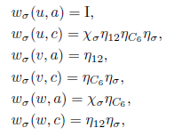
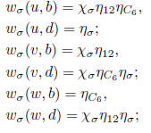
Kagome symmetry transformation
……

Slide 29
Kagome Heisenberg model
$χ_{σ} ,{ χ}_{T}$
“weak SPT” index, 2D AKLT like physics
$η_{12}$ , $η_{c6}$ , $η_{σ}$
label symmetry fractionalization of spinon-$e$ in the $Z_{2}$ QSL member phase.
$$d=2$$
For $D=6$, can realize four classes
Unconstraint: $D_{tot}=d^{2}D^{6}≈5000$
Constraint: $D_{constraint}=19$
$$D=6 (0⊕\frac{1}{2}⊕1)$$

Slide 30
Symmetric iPEPS algorithm
Focus on infinite PEPS (iPEPS)
Optimization
Minimize “approximate” energy densities within constrained Hilbert spaces of four promising classes (modified simple update method)
Measurement
Measure energy density accurately for the optimized state
Tensor RG + variational Monte Carlo

Slide 31
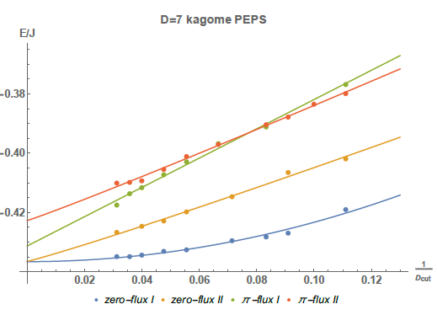
Energy densities for optimal state of four classes
$D_{cut}$ ~ virtual states kept when performing tensor contraction
For $D=7$, $8×8×3$ lattice size, $E\sim −0.4366(3)J$, comparable to DMRG result
Two zero-flux classes have competing energy
Which class?
Notes:
We develop a tensor algorithm, which is suitable for the symmetric PEPS. It took us one year to get this picture…

Slide 32
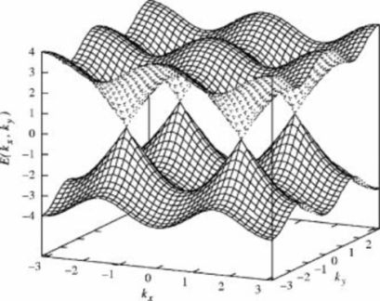
Competing spin liquids?
Two possibilities:
Their energy densities are different. But our numerics is not good enough to distinguish them.
They indeed share degenerate energy. Any physical reason?
Future work:
Long-range behavior?
Excitation spectrum?
More advanced optimization method
$U(1)$ Dirac spin liquid?
(Ran, Hermele, Lee, Wen)
Higgs I
Higgs II
(Lu, Ran, Lee)
zero-flux I
zero-flux II

Slide 33
Outline
Motivation & Introduction
Spin liquids on the kagome lattice
SPT phases & anyon condensation
Summary

Slide 34
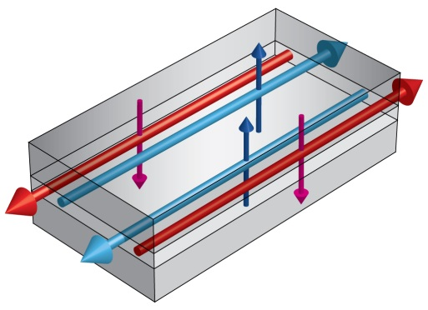
Cohomological SPT phases
Symmetry Protected Topological Phases (SPT)
gapped symmetric phase under symmetry $SG$
trivial if $SG$ explicitly broken
nontrivial edge states
Quantum Spin Hall
$S=1$ Haldane chain
spin-$\frac{1}{2}$
spin-$\frac{1}{2}$
Protected by $SO\left(3\right)$
Protected by $Z_{2}^{T}$
Notes:
It turns out that

Slide 35
Cohomological SPT phases
In our framework, SPT: $H^{d+1}(SG,U\left(1\right))$ (not complete)
$SG$: on-site and lattice symmetries (onsite symmetries (Chen, Liu, Gu, Wen))
$T$ and $P$(mirror) act as complex conjugate on $U(1)$
Example:
1d, ${H^{2}(Z}_{2}^{T} ,U(1))={H^{2}(Z}_{2}^{P} ,U(1))=Z_{2}$, the “Haldane phase”
2d, $P \& T$ → $H^{3}\left(Z_{2}^{T}×Z_{2}^{P},U\left(1\right)\right)=Z_{2}^{2}$
Generic wavefunctions (constrained tensor Hilbert space) for every class
A by-product: a general connection between (conventional) SET and SPT phases in 2D.
Notes:
Our tensor construction also indicates a useful connection between SET and SPT phases. This byproduct can be understood beyond tensor language. So let us come to this byproduct first

Slide 36
SPT from tensor networks
SPT has no intrinsic topological order → trivial $IGG$?
$$χ_{u}$$
$\prod_{i}{χ_{i}}=1$, loop of phases
=
$$χ_{l}$$
$$χ_{r}$$
decompose to
plaquette $IGG$
$$χ_{d}$$
Conclusion: trivial $IGG$ are only able to construct “weak SPT”(such as 2D AKLT). For “strong SPT”, one needs a richer structure of $IGG$: “matrix plaquette” $IGG$.
$$χ_{1}$$
$$χ_{2}$$
$$χ_{3}$$
$$χ_{4}$$
Notes:
Chain, $χ$ phase invariance
2D, more complicate than 1D. At least infinite phase invariance. Loop of matrix (picture) .
Matrix invariance, global invariance, vison cost energy. Plaquette IGG condense vison. Z_2 SPT example, tensor equations → anyon condensation. Justify $Z_{2}$ SPT, 1. K matrix 2. gauge Z_2 symmetry, get double semion. D=4 512, Z_2 16
Spatial symmetry, plaquette invarinace describe all cohomological SPT. Can treat spatial symmetry. General formulation. Three cocyle from tensor network

Slide 37
Plaquette $IGG$
$$λ_{u}^{−1}$$
$$λ_{u}$$
$$λ_{r}$$
$$λ_{l}$$
$$λ_{r}^{−1}$$
=
$$λ_{l}^{−1}$$
$$λ_{r}$$
$$λ_{d}^{−1}$$
$$λ_{d}$$
$$λ_{d}^{−1}$$
matrix plaquette $IGG$
No topological order $←$ every $IGG$ can be decomposed to plaquette $IGG$
$IGG$ decomposition:$J=\prod_{p}{λ_{p}}$
$J\sim$flux line
$$λ$$
$$λ$$
=
$$λ$$
$$λ$$
$$J$$
$$λ_{r}^{−1}λ_{l}$$

Slide 38
Plaquette $IGG$ and anyon condensation
plaquette $IGG$ → anyon condensation!
$$J$$
$$J$$
$$J$$
: $J$ action
: $λ$ action
$$λ$$
$$λ$$
Condensation of bound state $m \& λ$
``
=
=
For $Z_{2} IGG$, add $Z_{2}$ symmetry $g^{2}=I$
$$H^{3}\left(Z_{2},U\left(1\right)\right)=Z_{2}$$
tensor equations for nontrivial SPT:
$W_{g}^{2}=J$ ~ $e$ carry fractional $Z_{2}$ sym charge
$W_{g}λ=−λW_{g}$ ~ $λ$ carry odd $Z_{2}$ sym charge
$d$=2
$$D=4$$
16 dimensional Hilbert space for nontrivial $Z_{2}$ SPT

Slide 39
A by-product: anyon condensation – from SET to SPT
condense $m$ particle
Toric code
Trivial phase
Toric code with global $Z_{2}$ symmetry
condense $m$ particle
???
${\left[g\left(e\right)\right]}^{2}=−1, {\left[g\left(m\right)\right]}^{2}=1$
Condense $m$ with $g\left(m\right)=−1$ → nontrivial $Z_{2}$ SPT
$$\left(W_{g}^{2}=J, W_{g}λ=−λW_{g}\right)$$
Why the phase we obtain is nontrivial SPT?
Notes:
Instead of keep going on tensor network wavefunctions, let me talk about a by-product of our main results, which can be formulated in more conventional languages.
Starting from a rather conventional gauge theory (an SET phase like $Z_{2}$ spin liquid), if one condense certain bosonic anyon to confine the gauge field, under certain conditions, the resulting phase is necessary an SPT phase.
General result for anyon cond

Slide 40
Anyon condensation and duality
Why the phase we obtained is nontrivial SPT? We can justify it by gauging the $Z_{2}$ symmetry $\left\{1,g\right\}$! (Levin, Gu)
 | $Z_{2}$ SPT?? | double semion??
$$g (g×g=m)$$ | $Z_{2}$ symmetry defect | $Z_{4}$ gauge flux
$$m (m×m=1)$$ | $Z_{2}$ gauge flux | double-$Z_{4}$ gauge flux
“Parent” phase | SET with $e$ carry fractional quantum number | $Z_{4}$ gauge theory
$$λ\left(g\right)=−1$$ | $Z_{2}$ symmetry charge | double-$Z_{4}^{ }$ charge
Condensing object | $m$ with $Z_{2}\left(m\right)=−1$ | double-$Z_{4}$ charge & double-$Z_{4}$ flux

Slide 41
Double semion from anyon condensation
 | $$0e$$ | $$1e$$ | $$2e$$ | $$3e$$
$$0m$$ | $$I$$ | X | $$b$$ | X
$$1m$$ | X | $$s$$ | X | $$\overline{s}$$
$$2m$$ | $$b$$ | X | $$I$$ | X
$$3m$$ | X | $$\overline{s}$$ | X | $$s$$
No gauging picture for time reversal or spatial symmetries.
But nontrivial SPT can be obtained from anyon condensation.
condense $m$ with
$$Z_{2}^{TP}\left(m\right)=−1$$
toric code with $Z_{2}^{T}×Z_{2}^{P}$
$e$ fractionalized in several ways
four types of SPT
Notes:
Dimension of sub-Hilbert space for classes

Slide 42
Anyon condensation: more examples
$$P$$
Toric code & $SG=Z_{2}^{T}×Z_{2}^{P}$
$$H^{3}\left(Z_{2}^{T}×Z_{2}^{P},U\left(1\right)\right)=Z_{2}^{2}$$
$e$ nontrivial SF
$${T\left(e\right)}^{2}=−1$$
$${P\left(e\right)}^{2}=−1$$
$${T\left(e\right)}^{2}={P\left(e\right)}^{2}=−1$$
Resulting Phases
SPT-A
SPT-B
SPT-C
Condensing $T⋅P$ odd vison m
General Criteria for anyon condensation?
Notes:
We can write generic tensor wavefunctions for every class.

Slide 43
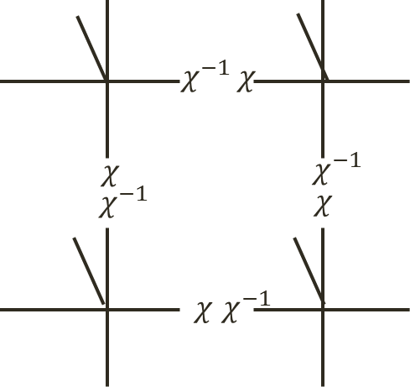
General formulation
$$W_{g_{1}}g_{1}W_{g_{2}}g_{2}=η\left(g_{1},g_{2}\right)W_{g_{1}g_{2}}g_{1}g_{2}$$
$$η\left(g_{1},g_{2}\right)η\left(g_{1}g_{2},g_{3}\right)={}_{}^{W_{g_{1}}g_{1}}{η\left(g_{2},g_{3}\right)η (g_{1},g_{2}g_{3})}$$
“Global” $IGG$ can be decomposed to plaquette $IGG$: $η=\prod_{p}{λ_{p}}=\prod_{p}{χλ_{p}}$
$$λ_{p}\left(g_{1},g_{2}\right)λ_{p}\left(g_{1}g_{2},g_{3}\right)=$$
$$ω\left(g_{1},g_{2},g_{3}\right) {}_{}^{W_{g_{1}}g_{1}}{λ_{p}\left(g_{2},g_{3}\right)λ_{p}(g_{1},g_{2}g_{3})}$$
Construct d-dim bosonic SPT ${\left[ω\right]∈H}^{d+1}[SG,U(1)]$, where $SG$ is the full symmetry group
$T$ & $P$ anti-unitary
Generalize to 3+1D. “Cubic $IGG$”
$$P$$
Notes:
Now, let us try to generalize the result to arbitrary symmetry group.
3D, cubic invariance picture

Slide 44
Outline
Motivation & Introduction
Spin liquids on the kagome lattice
SPT phases & anyon condensation
Summary

Slide 45
Summary
32 gapped $Z_{2}$ spin liquid
Competing energy densities for two classes
SPT partially classified by $H^{d+1}[SG,U\left(1\right)]$
$SG$: on-site & spatial symmetries
$T$ and $P$ act as complex conjugate
SET
anyon condensation
SPT

Slide 46
Discussion & future directions
Classify and simulate fermion phases? General string-net model?
Combine the state-of-art numerical techniques with our analytical method (Vanderstraeten, Verstraete, Corboz…)
More accurate energy density, correlators, …
Excitation spectrum?
Possible realization of SPT?
Numerical simulation for SPT tensor wavefunctions
Condensing visons carrying nontrivial quantum number in spin liquid phases → SPT-VBS phase?

