Slide 1
Massive non-classical states and the observation of quantum gravity
Daniel Carney
JQI, University of Maryland
QuICS, NIST

Slide 2
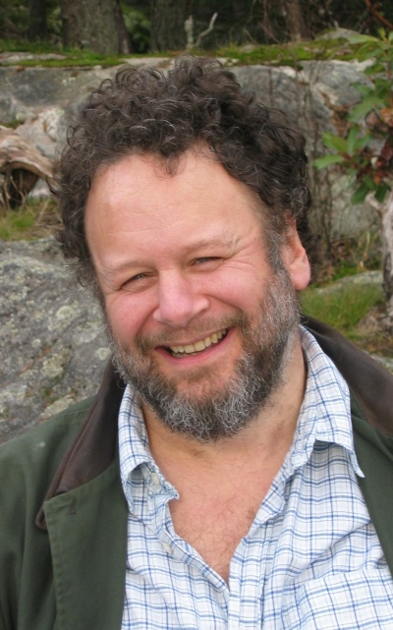
Based on 1807.11494 now w/ Jacob Taylor (UMD/NIST), Philip Stamp (UBC)

Slide 3
Macroscopic quantum objects
There is a wildly new state of matter available in experiment: large, coherent, non-classical systems.
Rapid progress is being driven by eg. competition for good quantum computer architectures.

Slide 4
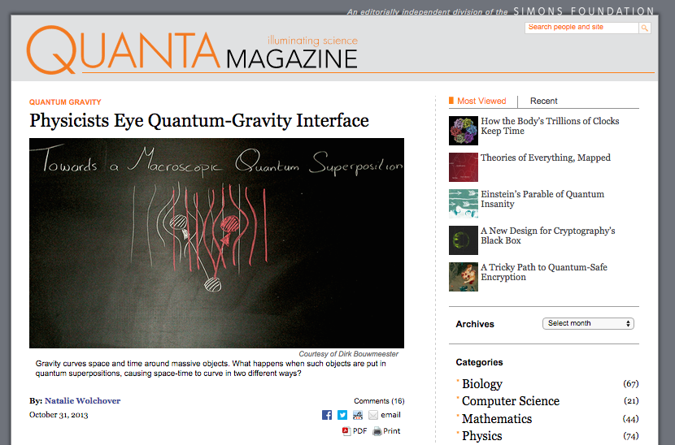
Low-energy quantum gravity

Slide 5
Theory space (at low energy)
GR as EFT: universal low-energy limit of anything with spin-2 massless states. In these experiments, E/M_{pl} << 1, very good approximation.
Alternatives:
Gravity is “fundamentally classical”
Gravity is “emergent” (*not necessarily an alternative)
Gravity is causes a breakdown of quantum mechanics
Etc?

Slide 6
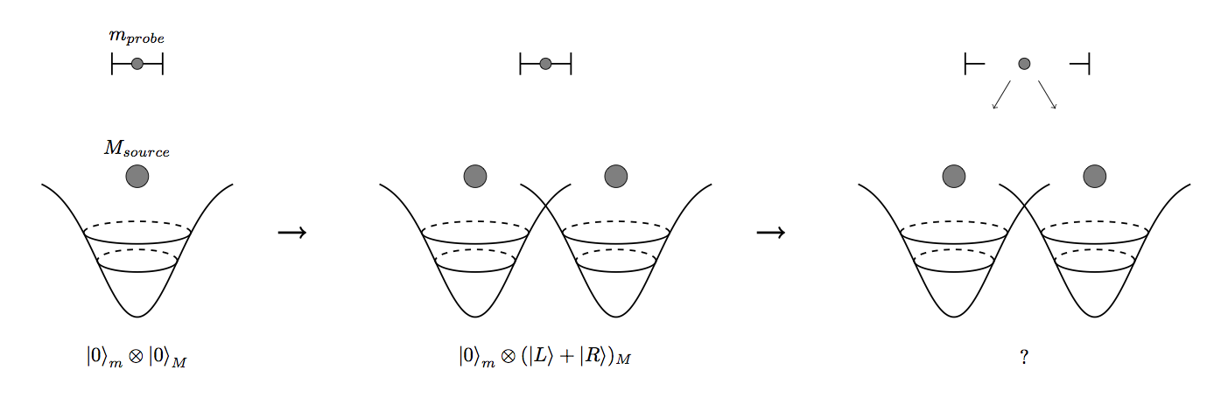
Two types of experiment:
Superpose mass, check coherence time → constrain decoherence models
Superpose mass, entangle with another → check ability of gravity to superpose/entangle
Goal here: spell out some models and predictions

Slide 7
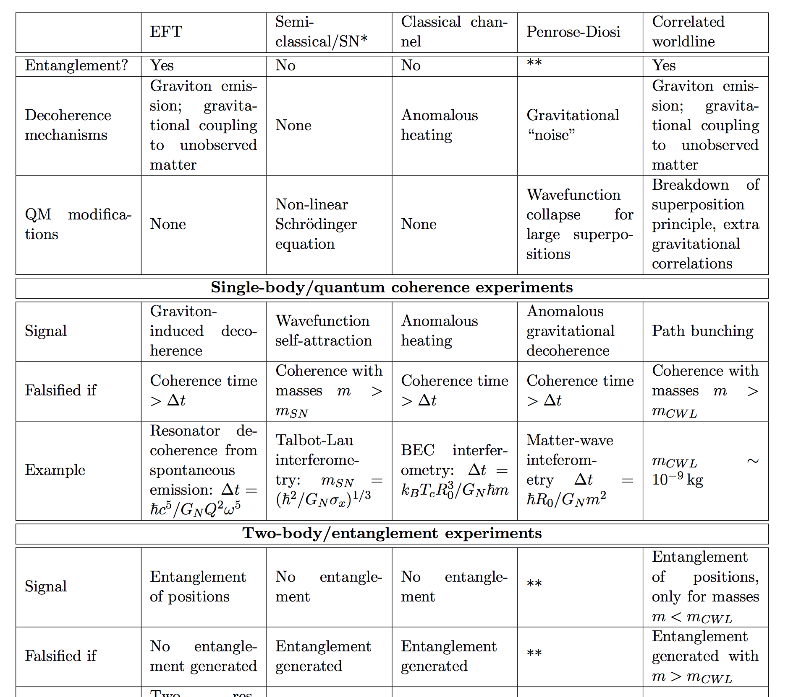

Slide 8
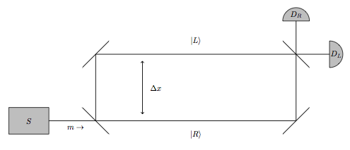
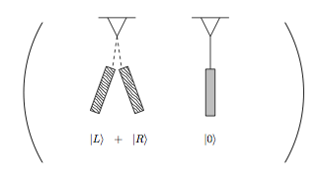
Example implementations
Matter-wave interferometry
M ~ 10⁵⁻⁹ amu
Cavity optomechanics
M up to kg

Slide 9
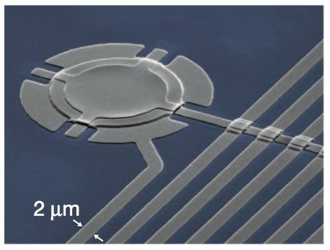
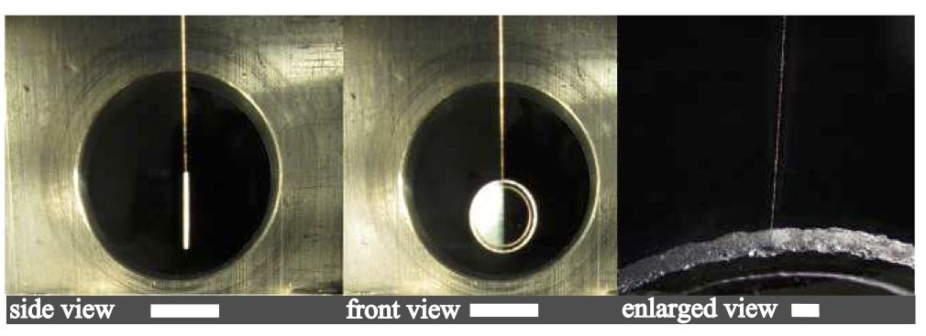
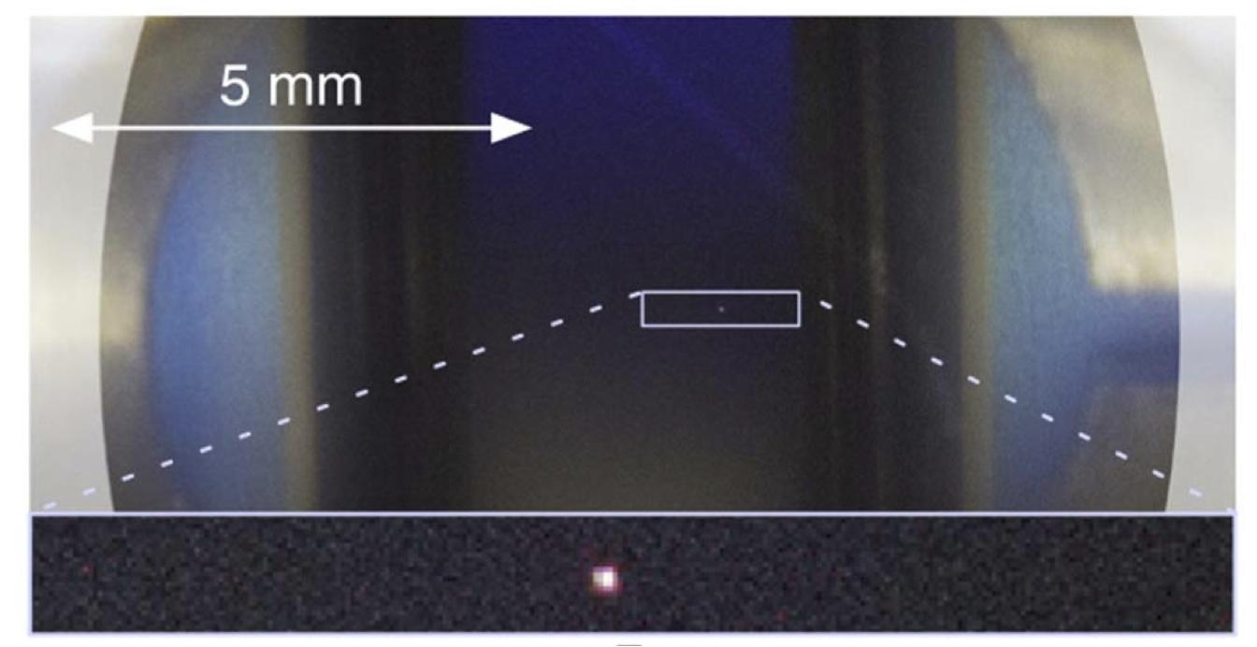
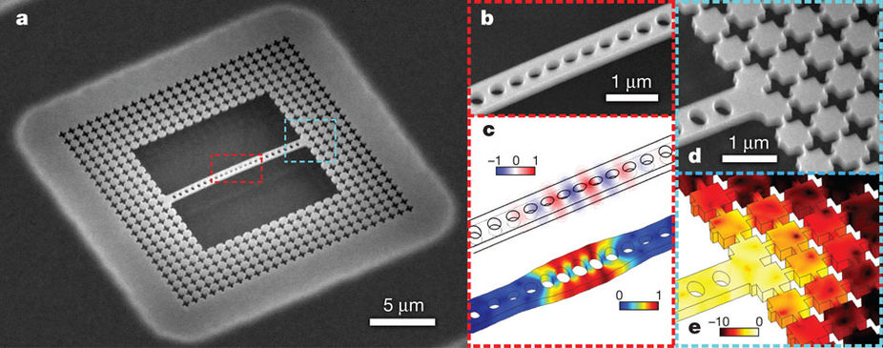
Teufel et al, Nature 2011
Matsumoto et al, PRA 2015
Aspelmeyer ICTP slides 2013
Painter et al, Nature 2011

Slide 10
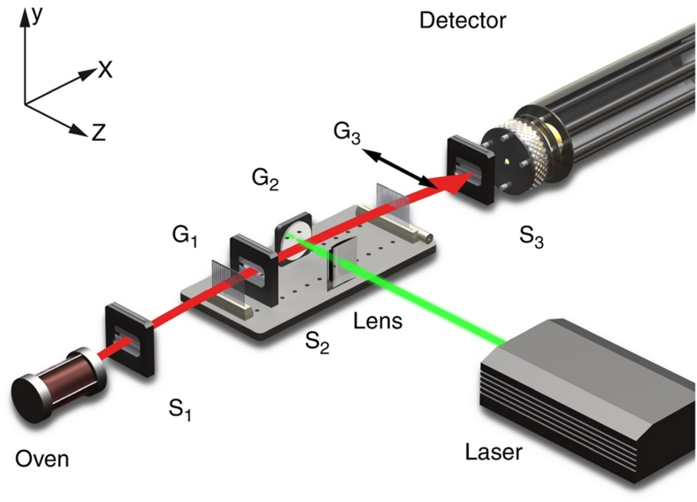
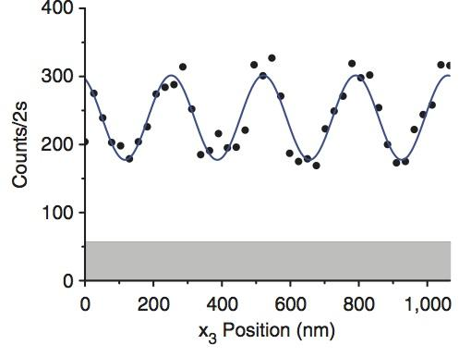
Matter-wave interferometry
Virus interference:
R ~ 60 Å, M ~ 5000 amu, ∆X ~ 10⁻⁶ m
Gerlich, Arndt et. al Nature Comm. 2011

Slide 11
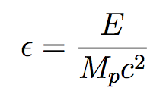
Perturbative GR as EFT
Perturbative GR is non-renormalizable → must be viewed as effective quantum field theory (EFT)
Predictions are Taylor series in ϵ, higher-order coefficients correspond to R², … terms in the Einstein-Hilbert action
For small ϵ can neglect higher terms, for ϵ > 1 lose predictability
Small ϵ description: massive objects exchange gravitons; integrate gravitons out to obtain Newton interaction
Energy transfer
Donoghue PRD 1994
Review: Burgess LRR 2004

Slide 12
EFT single-body example: graviton decoherence
Trace soft gravitons

Slide 13
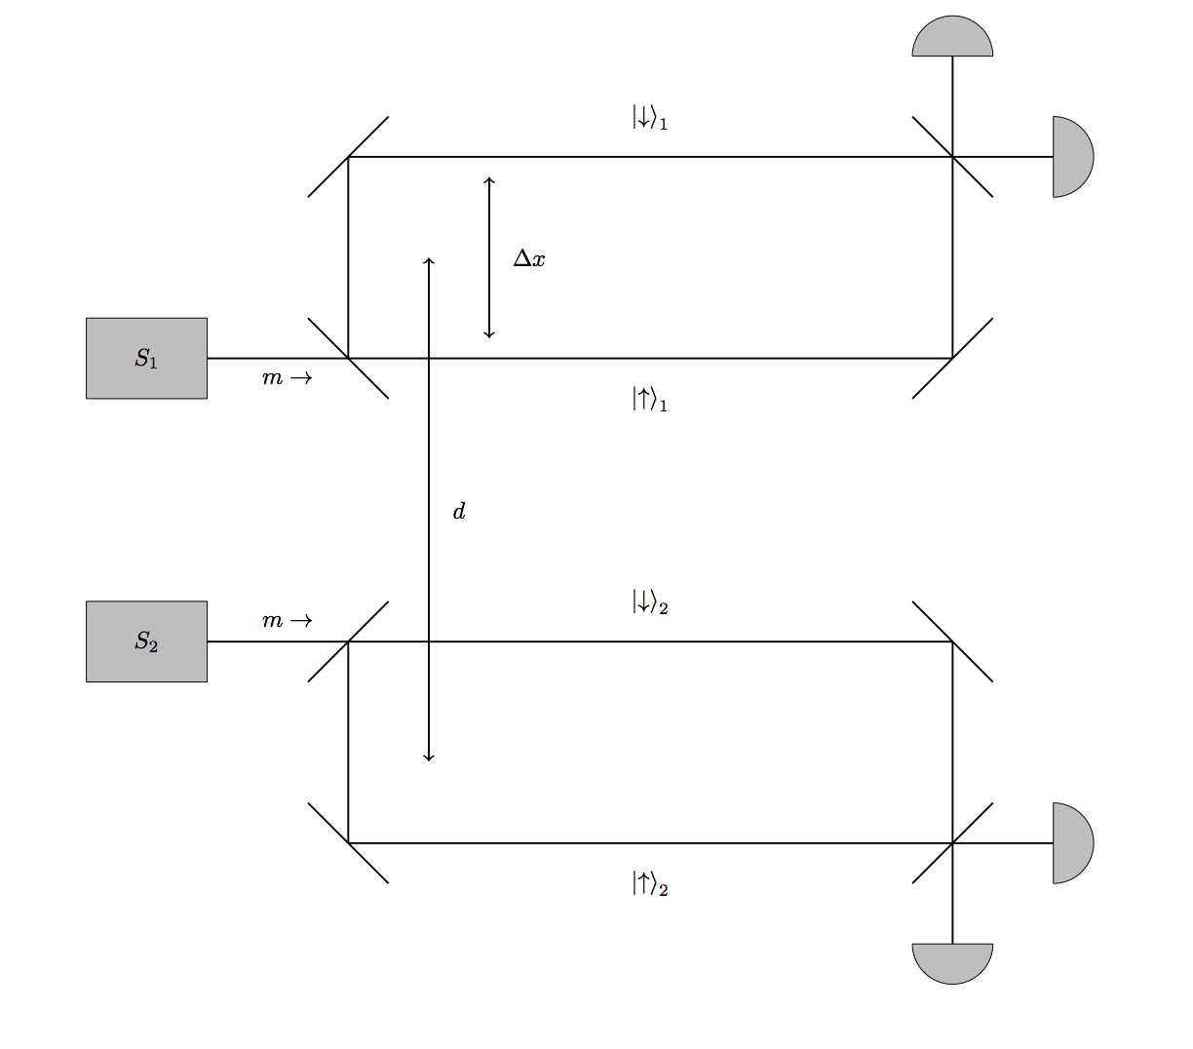
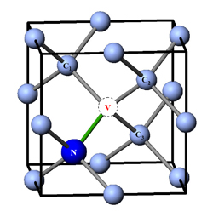
EFT two-body example: Newtonian entanglement
S. Bose et al PRL 2017
Marletto, Vedral 1707.06036

Slide 14
Entangled state of the two interferometers
Verifiable via an entanglement witness: Bell inequality in the spin DOF

Slide 17
“Classical”/“semiclassical” gravity
So far no experimental evidence that gravity is quantum, so, can it “be classical”?
What does this actually mean? Need a precise model!

Slide 18
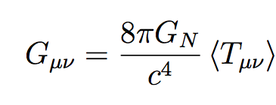
Schrodinger-Newton equation
Simplest idea:
Non-relativistic, single particle

Slide 19
Cf. quantum/EFT prediction: entangled state
“Classical” interaction prediction
No entanglement generated
=> no Bell inequality violation

Slide 20
Models of gravity → QM breakdown
Perhaps gravity is somehow fundamentally incompatible with QM, causes breakdown of some aspects of quantum theory given these kinds of large superpositions?
Eg. perhaps gravity can explain why we don’t witness large macroscopic quantum objects?
Penrose/Diosi: fundamental wavefunction collapse on some timescale set by gravitational interactions
Concrete models are testable

Slide 21
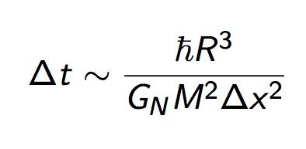
Diosi: (eg. J. Phys. A 2007)
Cold molecular beam interferometry:
R ~ 60 Å, M ~ 5000 amu, ∆X ~ 10⁻⁶ m
---> ∆t ~ 10⁻²⁻³ sec!
Other variants of this model give different predictions, see the paper
Gerlich, Arndt et. al Nature Comm. 2011

Slide 22
Summary
Trying to probe quantum superpositions of the gravitational field, two basic types of experiment:
Single-body experiment, test decoherence
Two-body experiment, test entanglement
Combination of these two experiments can basically falsify/constrain variety of low-energy QG models
Some limited information about UV QG
Experiments will happen in near future, based on technology that is being developed for many reasons beyond gravity

Slide 23
SCG is a problem
Gravity is classical
Nonlinear modification to Schrodinger equation: many known problems (energy spectra distortions, superluminal signalling, …)
Born rule ceases to be well-defined
Ok, but let’s just pretend we could make sense of this (will do something like this shortly). What would it predict?

Slide 24
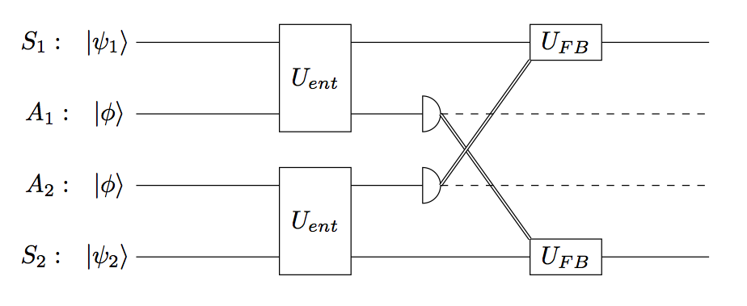
Sensible classical gravity
“Embed” SCG into a normal, unitary quantum system engineered such that the semiclassical limit comes out for some subsystems (Kafri, Milburn, Taylor 2014, see also Tilloy, Diosi 2014)
Price of this: irreducible noise from measurements => anomalous heating in eg. Bose condensate

