Slide 1


Gapless Spin Liquid Ground State in the S=1/2 Kagome Antiferromagnet
Hai-Jun Liao
Institute of Physics, Beijing
23 Feb 2018, Benasque

Slide 2
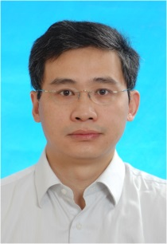

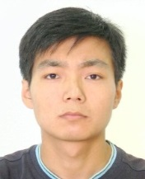

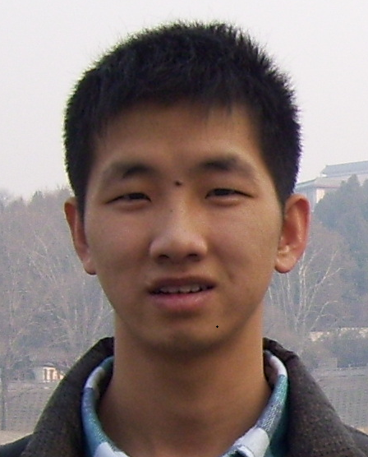
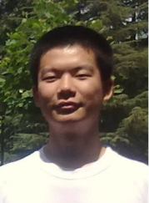
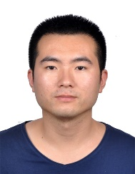
Collaborators
Tao Xiang
Institute of Physics, Chinese Academy of Sciences (IOP, CAS)
Bruce Normand
Paul Scherrer Institute
Zhiyuan Xie
Renmin University of China
Jing Chen
IOP, CAS
Zhi-yuan Liu
ITP, CAS
Hai-dong Xie
IOP, CAS
Rui-zhen Huang
IOP, CAS

Slide 3
Outline
Part I—Algorithm: New Scheme for Fast Contracting a TNS ~ D⁸
Brief review of the TNS Algorithms for ground state
Bottleneck of TNS Algorithms: High Cost ~ D¹⁰⁻¹⁴ → D~6-10
3. Fast contraction scheme for TNS ~ D⁸ → D~25-30
Part II—Application: Kagome Spin Liquid Problem
Numerical evidence of gapless spin liquid ground state
in the S = 1/2 Kagome antiferromagnet

Slide 4
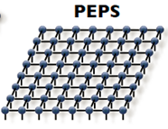
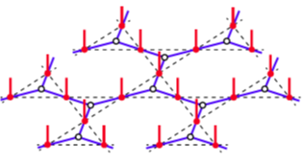

Tensor Network Algorithms for 2D Ground States
TN algorithms usually contain three steps :
PESS
TN ansatz:
(trial wavefunction)
Imaginary time evolution
Optimize TNS
Energy minimization
Compute Observables
Contraction of TN
Notes:
In 1D, DMRG, MPS and MERA are very successful and also very familiar to everybody. So here I just mention the 2D Tensor network Algorithms

Slide 5

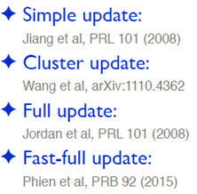


Optimization of TNS
Imaginary time evolution
cheap cost, local SVD (mean approximation)
medium, balance between accuracy and cost
very expensive, consider full environment
expensive, recycle previous environment
Energy minimization
expensive, CTMRG + variational optimization
Corboz, PRB 94 (2016)
expensive, channel environments + CG
Vanderstraeten et al,
PRB 94 (2016)
@ Corboz’s ppt in ISSP
Notes:
In 1D, DMRG, MPS and MERA are very successful and also very familiar to everybody. So here I just mention the 2D Tensor network Algorithms

Slide 6
Optimization of TNS
Imaginary time evolution
Except simple-update method and cluster update method, the other optimization methods all have very expensive costs. Because they consider the full environment which involves the contraction of the whole TN.
This is one of the reasons that usually only small bond dimension D (~6-10) can be accessible.
Energy minimization
Corboz, PRB 94 (2016)
Vanderstraeten et al,
PRB 94 (2016)
Notes:
In 1D, DMRG, MPS and MERA are very successful and also very familiar to everybody. So here I just mention the 2D Tensor network Algorithms

Slide 7
Core Issue of TN Algorithms: TN Contraction
TN algorithms contain three steps :
PESS
TN ansatz:
(trial wavefunction)
Imaginary time evolution
Optimize TNS
Energy minimization
Compute Observables
Contraction of TN
Notes:
In 1D, DMRG, MPS and MERA are very successful and also very familiar to everybody. So here I just mention the 2D Tensor network Algorithms

Slide 8
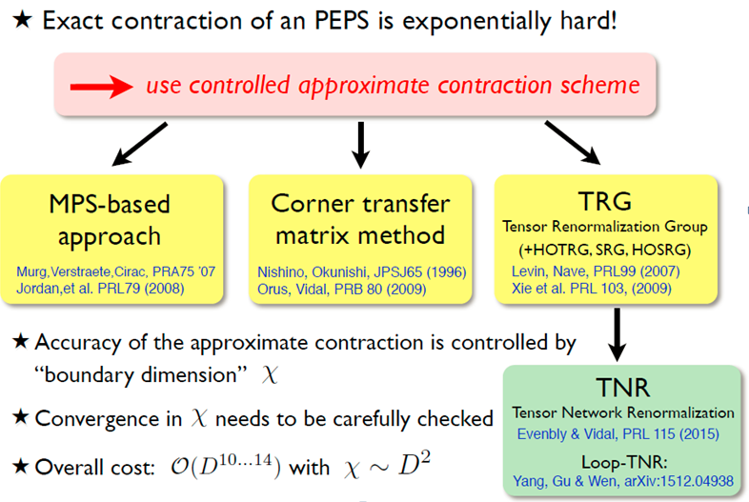
Core Issue of TN Algorithms: TN Contraction
The optimization of TNS and the expected values of the observables both involve the TN Contraction. Thus TN Contraction is the Core Issue of TN algorithms.
The two most commonly used methods in 2D
Main bottleneck of TN methods
@ Corboz’s ppt in ISSP
Notes:
Involves this kind of contraction, it is clear that this high cost of the contraction is the main bottleneck that limits the application of almost all tensor-network algorithms.
This is one of the reasons that we can only reach small bond dimension D (~6-10).

Slide 9
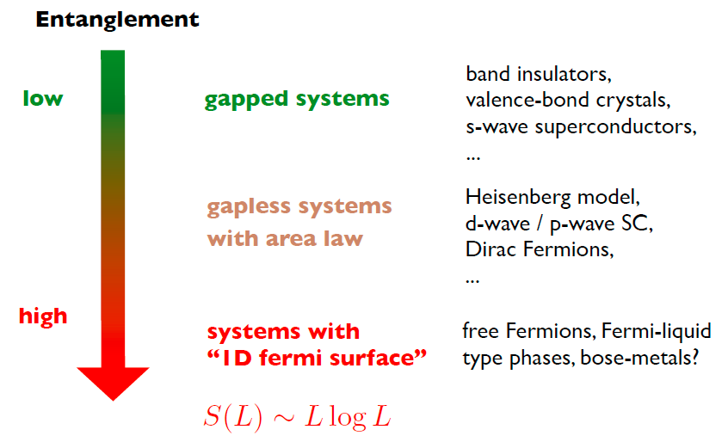

The Need of Large D
@ Corboz’s ppt in ISSP
Higher entanglement
Larger dimension D
The entanglement in PEPS:
Notes:
Involves this kind of contraction, it is clear that this high cost of the contraction is the main bottleneck that limits the application of almost all tensor-network algorithms. This is one of the reasons that we can only reach small bond dimension D (~6-10).

Slide 10
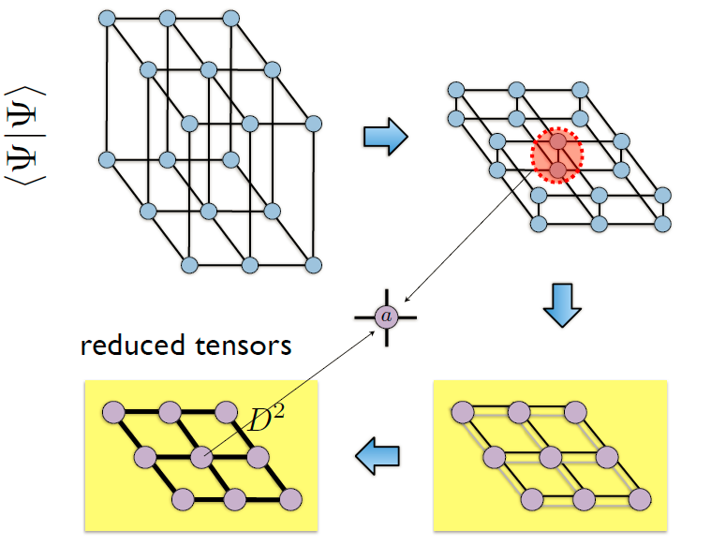
Reason for expensive costs of TN Contraction
Old Algorithms: We have to contract a TN with bond dimension D² by Boundary-MPS, CTMRG/CTM, and TRG, ….
@ Corboz’s ppt in ISSP

Slide 11
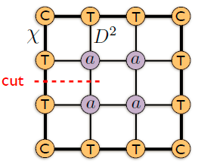
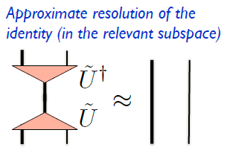

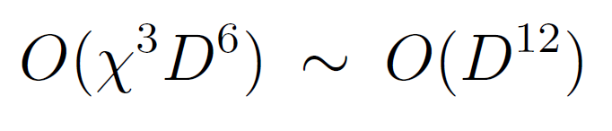
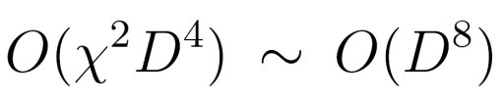

Reason for expensive costs of TN Contraction
Old Algorithms: Cost of contracting a TN with bond dimension D² by Boundary-MPS, CTMRG is about D¹²
Take CTMRG as an example:
$$ρ_{L}$$
To obtain the isometry, we have to obtain the density matrix and perform SVD for it. The computational and memory costs are:
Computational Cost
Memory Cost
Accessible D (~6-10)

Slide 12
How make D as large as possible?
The main reason of the expensive costs in old algorithms is that we have to contract a TN with bond dimension D² by Boundary-MPS, CTMRG/CTM, and TRG, ….
Computational Cost

Slide 13
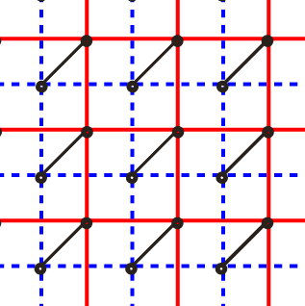
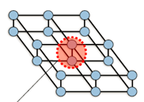
A New Scheme for Fast Contracting a TNS
Key idea of the new algorithm is to reshape the double-layer TN
into a nested single-layer TN with only bond dimension D but not D²
Z. Y. Xie et al., PRB 96, 045128 (2017).
d = 2
D
D
We don’t sum over the physical indices!!
Instead, we shift one-layer(red) to the center of another layer(blue) along the diagonal direction, and then compress the red layer into the plane of the blue
layer. Finally, we obtained a nested single-layer TN with only bond dimension D.

Slide 14
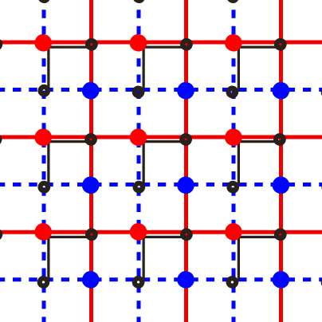
Nested TN Contraction Method
Key idea of the new algorithm is to reshape the double-layer TN
into a nested single-layer TN with only bond dimension D but not D²
Z. Y. Xie et al., PRB 96, 045128 (2017).
Further
reshape
D
D
Nested Single-layer TN with D
New Single-layer square TN with D
To avoid long-range bond, we introduce the swap tensors (red and blue points)

Slide 15
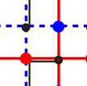
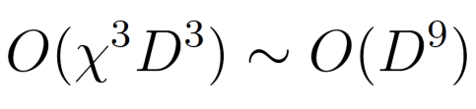


Nested TN Contraction Method
Eventually we contract the nested single-layer TN with only bond dimension D by usual Boundary-MPS, CTMRG/CTM, and TRG, ….
D
Old algorithm
New algorithm
Computational Cost
Memory Cost
Limit of D
13
25 (not use symmetry)
Z. Y. Xie et al., PRB 96, 045128 (2017).

Slide 16
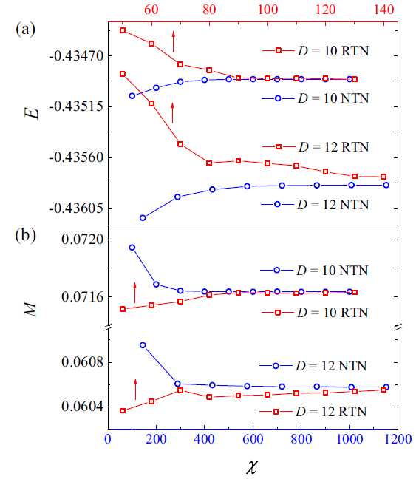
Comparison of the results
The TNS are obtained by simple update method for S=1/2 Kagome Heisenberg model.
The red curves corresponding to the top X-axis are obtained by the old algorithms.
The blue curves corresponding to the bottom X-axis are obtained by the new algorithm.
Z. Y. Xie et al., PRB 96, 045128 (2017).

Slide 17
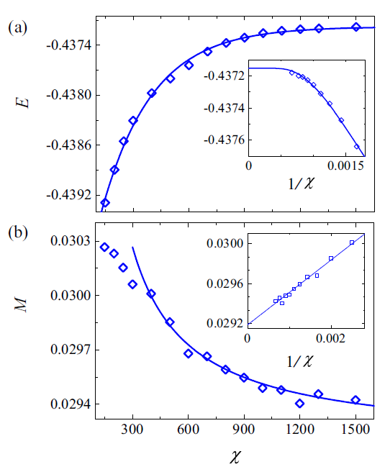
Results of D=24
The D=24 TNS are obtained by simple-update method for S=1/2 Kagome Heisenberg model. .
The top curve is the ground state energy as a function of X
The bottom curve is the M.
Z. Y. Xie et al., PRB 96, 045128 (2017).

Slide 18
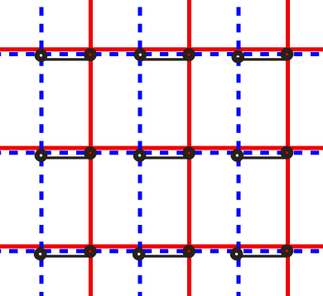
Nested TN Contraction Method
Advantages:
Simple and efficient: only reshape TN
Flexible: we also shift one-layer along the X( or Y) direction
however, cost slightly higher than the diagonal-shift TN.
Advantages:
Apply to finite PEPS algorithm.
Can also accelerate the computation of expectation value of TPO or PEPO.
also accelerate full-update method and energy minimization methods.
X-shift TN with
D in y direction
but D² in x direction

Slide 19
Outline
Part I—Algorithm: New Scheme for Fast Contracting a TNS ~ D⁸
Brief review of the TNS Algorithms for ground state
Bottleneck of TNS Algorithms: High Cost ~ D¹⁰⁻¹⁴ → D~6-10
3. The need of large D, minimal bond dimension Dc
4. Optimized contraction scheme for TNS ~ D⁸ → D~25-30
Part II—Application: Kagome Spin Liquid Problem
Numerical evidence of gapless spin liquid ground state
in the S = 1/2 Kagome antiferromagnet

Slide 20
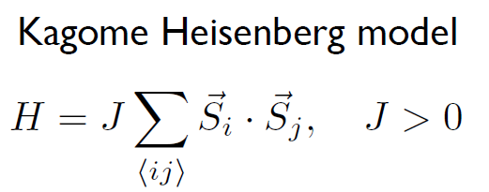
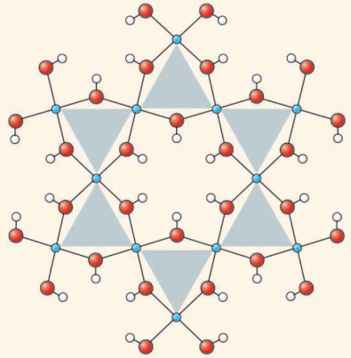
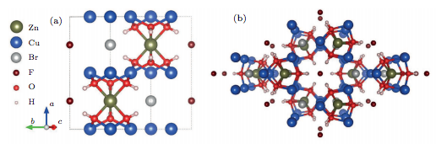
Application: Kagome Spin Liquid Problem
Herbertsmithite: ZnCu₃(OH)₆Cl₂
New material：ZnCu₃(OH)₆FBr
Shores, et al., J. Am. Chem. Soc. (2005).
Feng Z, et al., Chin. Phys. Lett. 34 077502 (2017).

Slide 21
Theoretically, the nature of the ground state remains unclear
Non-Spin-Liquid
Spin-Liquid(SL)
VBS/VBC
Marston et al., J.A.P. 1991
Zeng et al., PRB 1995
Nikolic et al., PRB 2003
Singh et al., PRB 2008
Poilblanc et al., PRB 2010
Evenbly et al., PRL 2010
Schwandt et al., PRB 2011
Iqbal et al., PRB 2011
Poilblanc et al., PRB 2011
Iqbal et al., New J. Phys. 2012
Gapped SL
Jiang, et al., PRL 2008
Yan, et al., Science 2011
Depenbrock, et al., PRL 2012
Jiang, et al., Nature Phys. 2012
Nishimoto, Nat. Commu. (2013)
Gong, et al., Sci. Rep. 2014
Li, arXiv 2016
Mei, et al., PRB 2017
……
Gapless SL
Hastings, PRB 2000
Hermele, et al., PRB 2005
Ran, et al., PRL 2007
Hermele, et al., PRB 2008
Tay, et al., PRB 2011
Iqbal, et al., PRB 2013
Hu, et al., PRB 2015
Jiang, et al., arXiv 2016
Liao, et al., PRL 2017
He, et al., PRX 2017
……
Is the ground state truly magnetic order free ?
Is the ground state gapped or gapless SL?

Slide 22
Difficulty in the study of Kagome Heisenberg model
Mean field or variational approach:
need accurate guess of the wavefunction
Quantum Monte Carlo:
suffers from the minus sign problem
Density Matrix Renormalization Group (DMRG):
strong finite size effect
the number of states need to be retained grows exponentially with the circumference (area law of entanglement entropy)

Slide 23
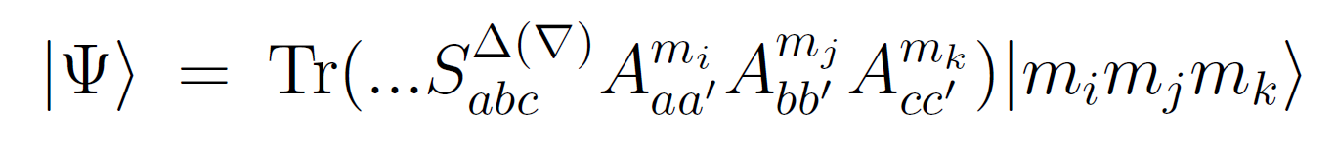
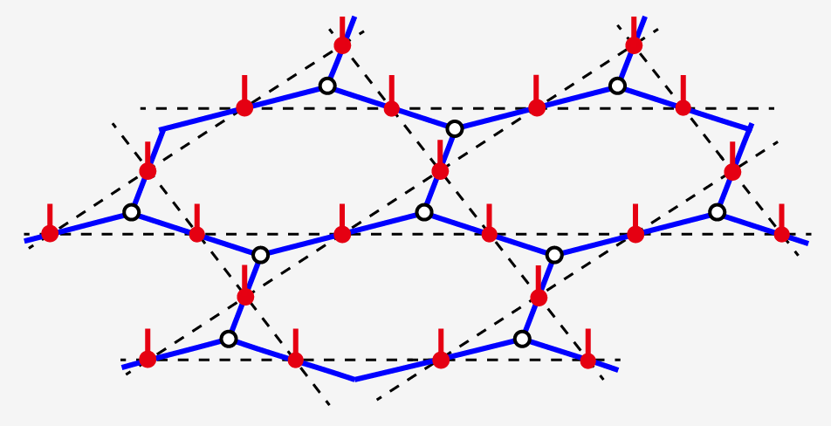
Tensor Network States
            Projected Entangled Simplex States (PESS)
            Z. Y. Xie et al, PRX 4, 011025 (2014)
Advantages: infinite system size, area law
sign problem free, …

Slide 24
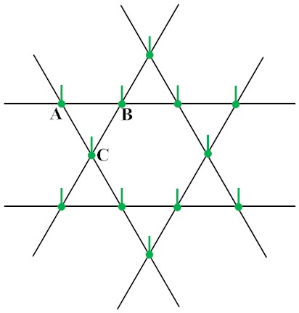
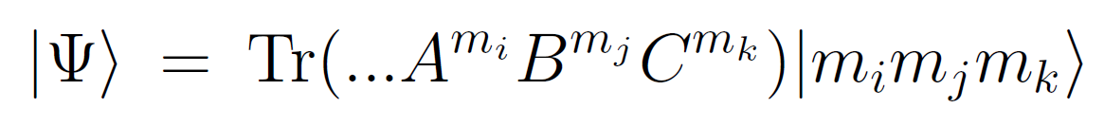
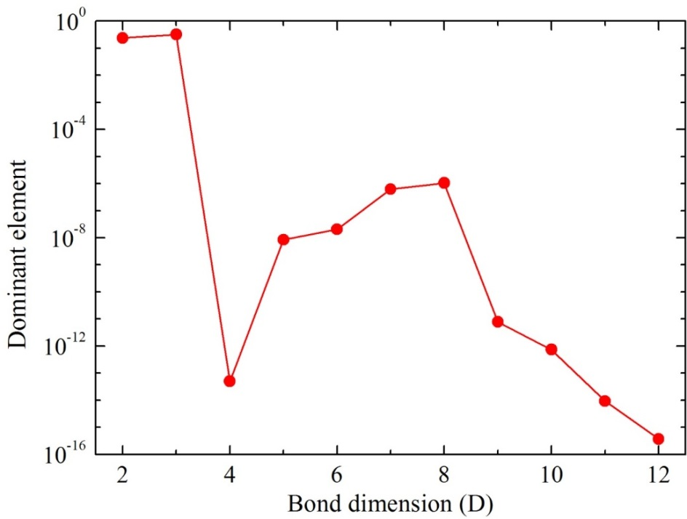
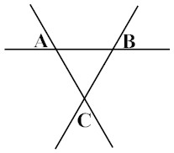
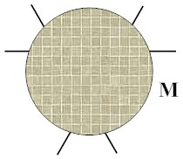

Why don’t We Use PEPS?
PEPS ansatz:
Information cancelation:
The dominant element of A, B and C are all 1, but the dominant element of M is very small

Slide 25
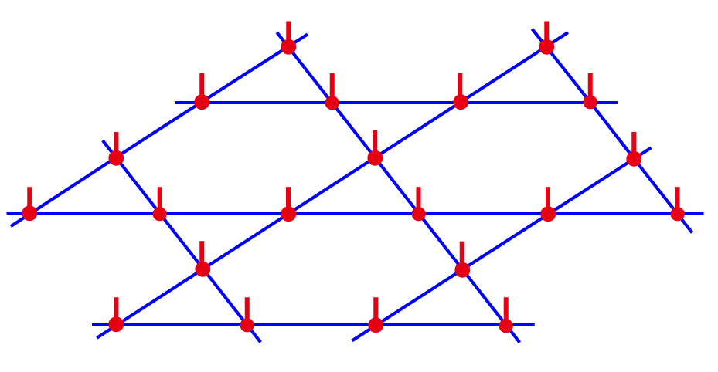
Other advantages of PESS
PEPS is defined on the original lattice ( maybe frustrated lattice )
PESS is defined on a new unfrustrated lattice, which is a
honeycomb lattice if the original lattice is kagome lattice.
PEPS representation
PESS representation
Lower cost: tensors in PESS are rank-3 rather than rank-5 as in PEPS

Slide 26
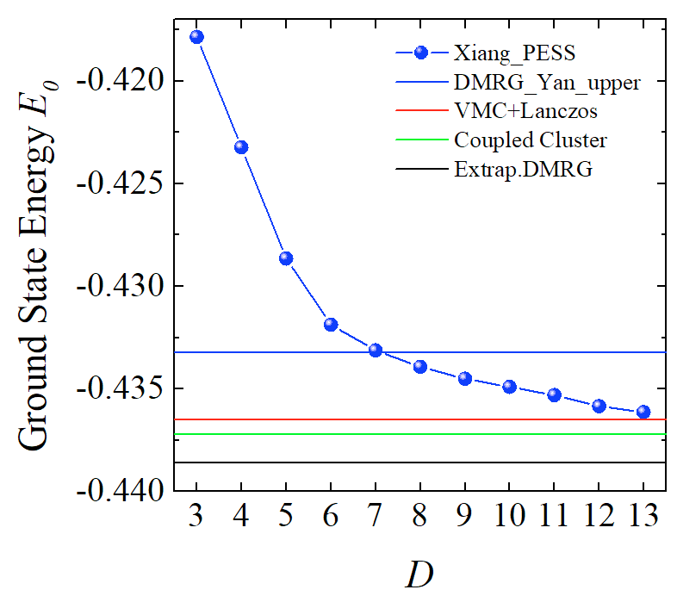
Tensor Network States
            Z. Y. Xie et al, PRX 4, 011025 (2014)

Slide 27
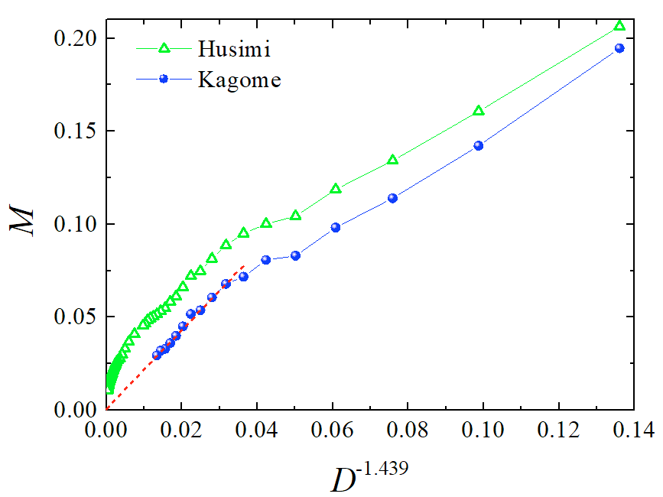
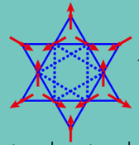
Absence of magnetic order in the infinite D limit
H. J. Liao et al. PRL 118, 137202 (2017).
Notes:
（分三页ppt,详细说明每件事，给人印象深刻，还要强调三年就做了这么一件事－－解决Kagome问题）

Slide 28
How to Judge if the ground state is gapped or gapless
Area Law of Entanglement Entropy for PEPS:
The higher the entanglement, the larger the need for D
Notes:
Involves this kind of contraction, it is clear that this high cost of the contraction is the main bottleneck that limits the application of almost all tensor-network algorithms. This is one of the reasons that we can only reach small bond dimension D (~6-10).

Slide 29
How to Judge if the ground state is gapped or gapless
In the framework of tensor network renormalization, the gap nature can be revealed by the bond dimension D dependence of the ground state energy and the magnetization
Gapless: Power law dependent on D
Gapped: Exponential law dependent on D
PS: D is directly related to the number of variational parameters, and controls the accuracy of TNS method.

Slide 30
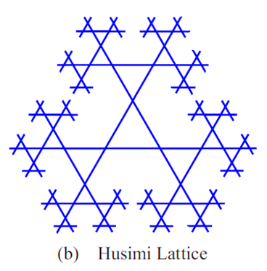
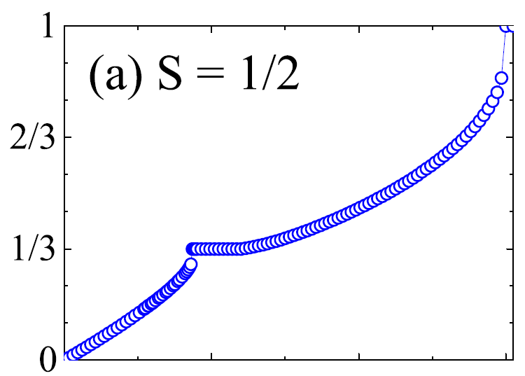


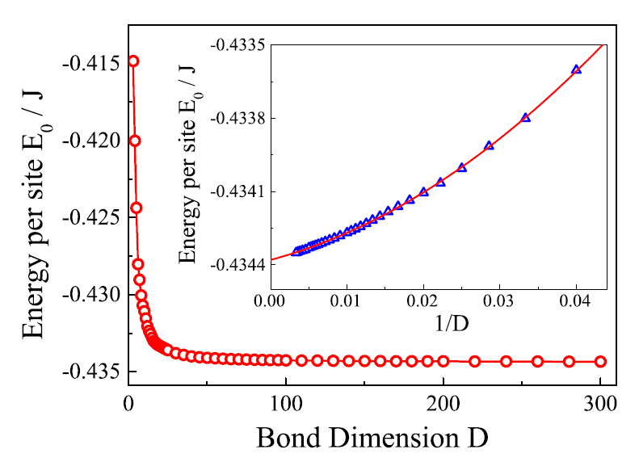
S=1/2 Husimi: Gapless Ground State

Slide 31
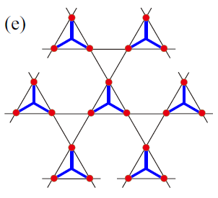
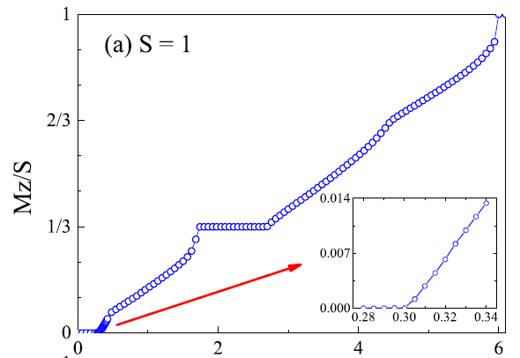
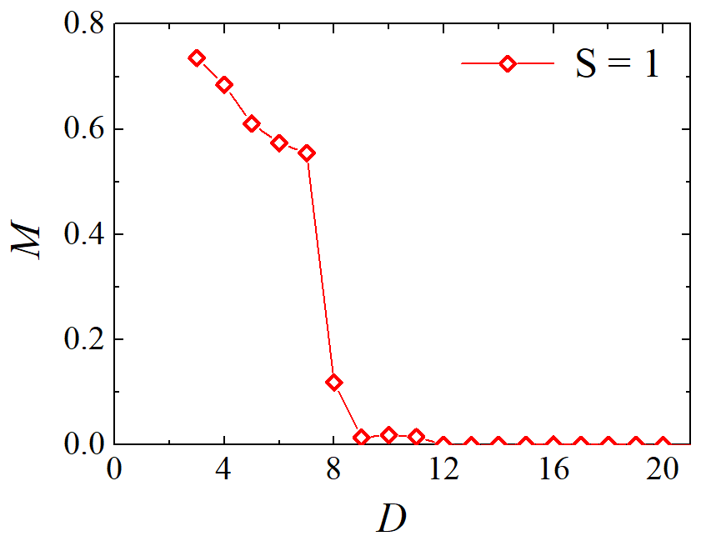
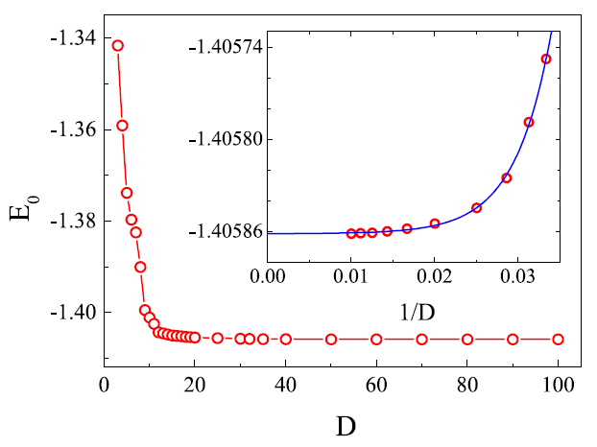
S=1 Husimi: Gapped Ground State

Slide 32

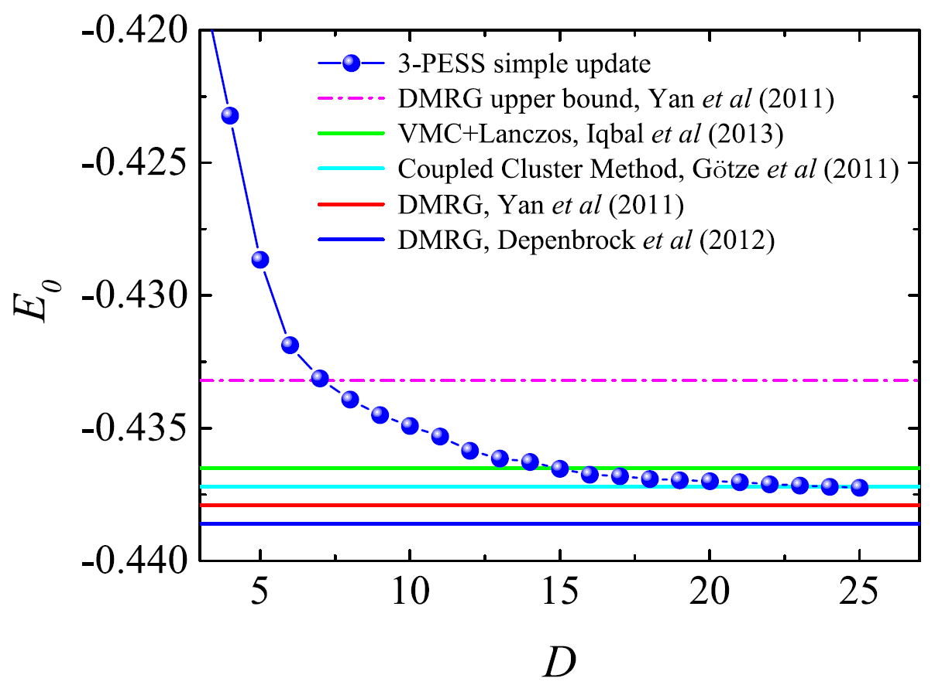
S=1/2 Kagome Heisenberg: Ground State Energy
H. J. Liao et al. PRL 118, 137202 (2017)

Slide 33
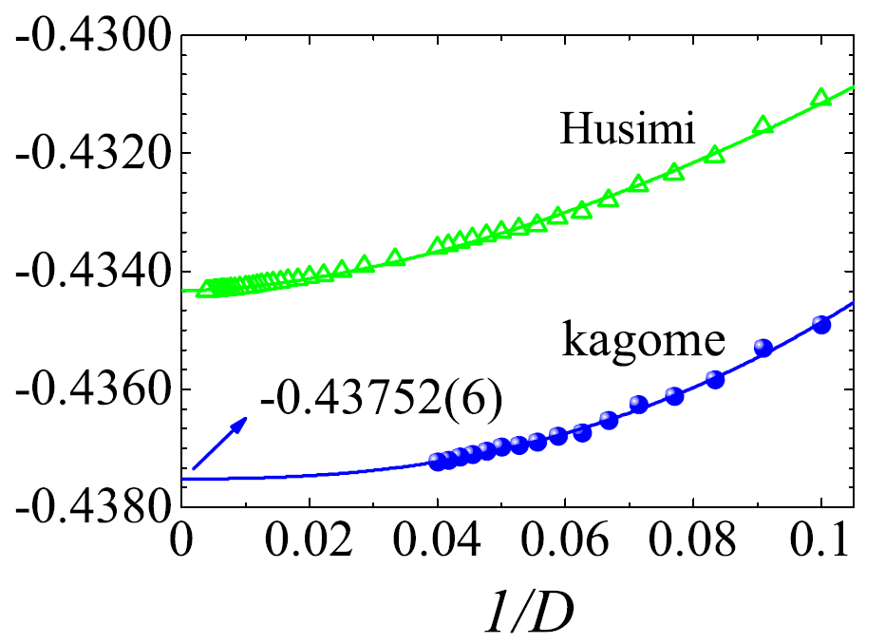
Gapless: Power Law Dependence of E₀ on D
Ground State Energy E₀
Energy converges algebraically with the bond dimension

Slide 34
Gapless: Power Law Dependence of M on D
H. J. Liao et al. PRL 118, 137202 (2017).

Slide 35
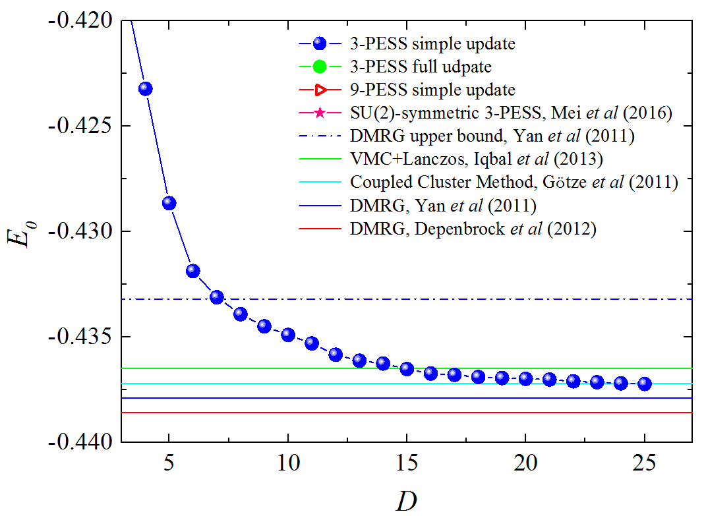
Comparison with full-update data

Slide 36
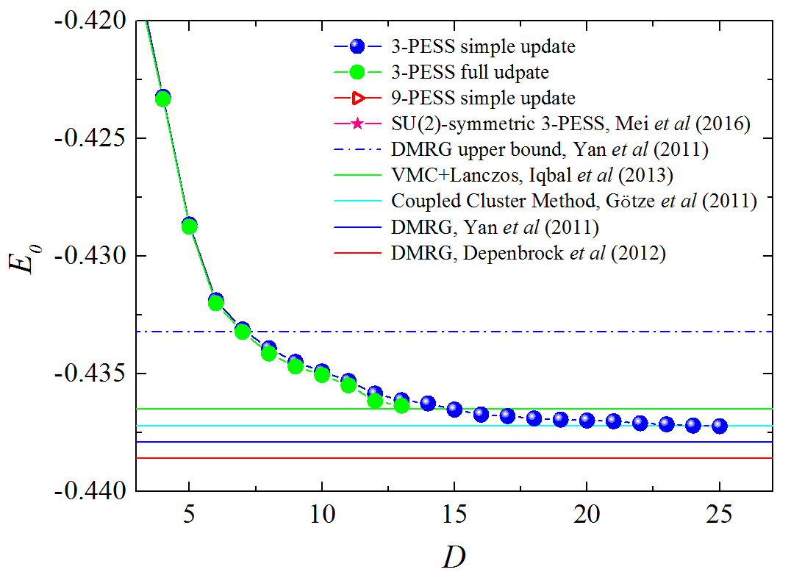
Comparison with full-update data

Slide 37
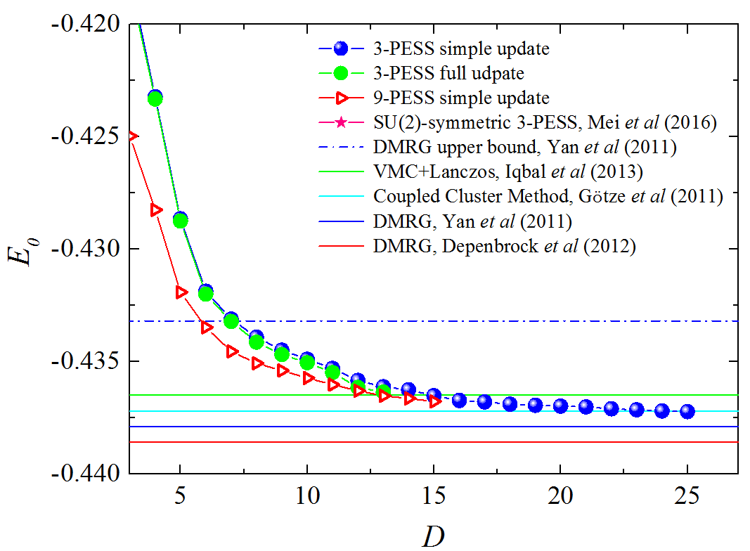
Comparison with 9-PESS data

Slide 38
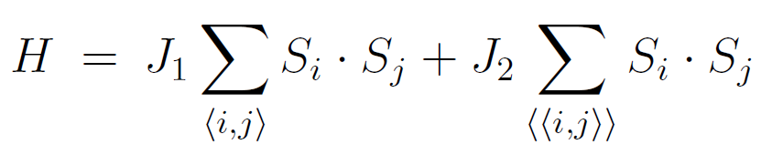

Magnetic orders of the J₁ –J₂ Heisenberg model

Slide 39

Extrapolation of Magnetization

Slide 40


Kagome J₁ –J₂ model: phase diagram in infinite D limit

Slide 41

Summary
    Part I: We proposed a fast contraction method for TNS
    Computational cost ~ D⁸ and memory cost ~ D⁶
    Part II: We apply the new method to study the S=1/2 Kagome Heisenberg
    Model.
    By studying the ground state energy, the staggered magnetization and the effects of a second neighbour coupling, our result suggests that the ground state of this system is a gapless quantum spin liquid.

Slide 42
Thanks for your attention!

