Slide 1
Approximations to the exchange-correlation functional

Slide 2
Local density approximation (LDA)
Result: lattice constants and bonding distances much too large (20%-50%)
LDA (Kohn and Sham, 1965)
xc energy per particle of a uniform electron gas of density ρ
(known from quantum Monte-Carlo and many-body theory)
Result: decent lattice constants, phonons, surface energies of metals

Slide 3
Quantity | Typical deviation (from expt)
Atomic & molecular ground state energies |  | < 0.5 %
Molecular equilibrium distances |  | < 5 %
Band structure of metals, Fermi surfaces |  | few %
Lattice constants |  | < 2 %

Slide 4
Quantity | Typical deviation (from expt)
Atomic & molecular ground state energies |  | < 0.5 %
Molecular equilibrium distances |  | < 5 %
Band structure of metals, Fermi surfaces |  | few %
Lattice constants |  | < 2 %
Systematic error of LDA: Molecular atomisation energies too large and bond lengths
and lattice constants too small

Slide 5
One would expect the LDA to be good only for weakly
inhomogeneous systems, i.e., systems whose density satisfies:
and
Why is the LDA good also for strongly inhomogeneous systems?
Answer: Satisfaction of many exact constraints (features of exact xc fctl)
coupling-constant-averaged xc hole density
Important constraints:
are satisfied in LDA

Slide 6
Generalized Gradient Approximations (GGA)
Langreth, Mehl (1983), Becke (1986), Perdew, Wang (1988)
PBE: Perdew, Burke, Ernzerhof (1996)
Construction principle: Satisfaction of exact constraints
(important lesson from LDA and from gradient expansion of E_{xc} )
Results: GGAs reduce the LDA error in the atomisation energy
significantly (but not completely) while LDA bond lengths are
over-corrected (i.e. are in GGA too large compared with expt)

Slide 7
Detailed study of molecules (atomization energies)
B. G. Johnson, P. M. W. Gill, J. A. Pople, J. Chem. Phys. 97, 7847 (1992)
32 molecules (all neutral diatomics from first-row atoms only and H₂ )
Atomization energies (kcal/mol) from:
mean deviation from experiment 0.1 1.0 -85.8
mean absolute deviation 4.4 5.6 85.8
for comparison: MP2
-22.4
22.4

Slide 8
LIMITATIONS OF LDA/GGA
Not free from spurious self-interactions: KS potential decays more rapidly than r⁻¹ for finite systems
Consequences: – no Rydberg series
– negative atomic ions not bound
– ionization potentials (if calculated from highest occupied orbital energy) too small
Dispersion forces cannot be described
W_{int} (R) e^{-R} (rather than R⁻⁶)
band gaps too small: G
E_{gap} (LDA/GGA) ≈ 0.5 E_{gap}(expt)
Energy-structure dilemma of GGAs
atomisation energies too large
bond lengths too large
(no GGA known that gets both correct!!)
Wrong ground state for strongly correlated solids, e.g. CoO, La₂CuO₄ predicted as metals

Slide 9
Meta Generalized Gradient Approximations (MGGA)
Result: Solves energy-structure dilemma of GGAs

Slide 10
Jacob’s ladder of xc functionals (John Perdew)
heaven
(exact functional)
RPA-like
occupied & unoccupied KS orbitals + energies
hybrid
occupied orbitals (e.g. fraction of EXX)
MGGA
GGA
LDA
earth
(Hartree )

Slide 11
DFT description of quantum phases:
Magnetism and
Superconductivity

Slide 12
MAGNETIC SYSTEMS
Quantity of interest: Spin magnetization density m(r)
In principle, Hohenberg-Kohn theorem guarantees that m(r) is a
functional of the density: m(r) = m[ρ](r). In practice, good
approximations for the functional m[ρ] are not known.
Include m(r) as basic variable in the formalism, in addition
to the density ρ(r).

Slide 13
Start from fully interacting Hamiltonian with Zeeman term:
HK theorem
total energy:
universal

Slide 14
KS scheme
For simplicity:
,
v_{xc}(r)
B_{xc}(r)
v_{xc}[ρ,m] = δE_{xc}[ρ,m]/δ ρ
B_{xc}[ρ,m] = δE_{xc}[ρ,m]/δ m
ρ (r) = ρ₊ (r) + ρ₋ (r) ,
m (r) = ρ₊ (r) - ρ₋ (r) ,
ρ± = Σ⏐ϕ ^{j}± ⏐²
B ⎯→ 0 limit
These equations do not reduce to the original KS equations for B → 0 if, in this limit, the system has a finite m(r).

Slide 15
DENSITY-FUNTIONAL THEORY OF THE SUPERCONDUCTING STATE
BASIC IDEA:
Include order parameter, χ , characterising
superconductivity as additional “density”
L.N. Oliveira, E.K.U.G., W. Kohn, PRL 60, 2430 (1988)
Include N-body density, Γ, of the nuclei as additional “density”
T. Kreibich, E.K.U.G., PRL 86, 2984 (2001)

Slide 16
General (model-independent) characterization of superconductors:
Off-diagonal long-range order of the 2-body density matrix:
order parameter of the N-S phase transition

Slide 17
Hamiltonian

Slide 18
ANALOGY
S
Δ
N
F
B
P
χ
m
x
x
“proximity effect”

Slide 19
Hamiltonian
3 densities:
electron density
order parameter
diagonal of nuclear N_{n}-body density matrix

Slide 20
Hohenberg-Kohn theorem for superconductors
1-1
[v(r),Δ(r,r’),W(R)] ←⎯→ [ρ(r),χ(r,r’),Γ(R)]
Densities in thermal equilibrium
at finite temperature

Slide 21
Electronic KS equation
v_{s}[ρ,χ,Γ](r)
Δ_{s}[ρ,χ,Γ](r,r’)
Δ_{s}*[ρ,χ,Γ](r,r’)
v_{s}[ρ,χ,Γ](r)
Nuclear KS equation
W_{s}[ρ,χ,Γ](R)
3 KS potentials:
v_{s} Δ_{s} W_{s}
No approximation yet!
“Exactification” of BdG mean-field eqs.
KS theorem:
There exist functionals v_{s}[ρ,χ,Γ], Δ_{s}[ρ,χ,Γ], W_{s}[ρ,χ,Γ], such that the above equations reproduce the exact densities of the interacting system

Slide 22
Electronic KS equation
v_{s}[ρ,χ,Γ](r)
Δ_{s}[ρ,χ,Γ](r,r’)
Δ_{s}*[ρ,χ,Γ](r,r’)
v_{s}[ρ,χ,Γ](r)
Nuclear KS equation
W_{s}[ρ,χ,Γ](R)
Solved in harmonic approximation
3 KS potentials:
v_{s} Δ_{s} W_{s}
No approximation yet!
“Exactification” of BdG mean-field eqs.
KS theorem:
There exist functionals v_{s}[ρ,χ,Γ], Δ_{s}[ρ,χ,Γ], W_{s}[ρ,χ,Γ], such that the above equations reproduce the exact densities of the interacting system

Slide 23
CONSTRUCTION OF APPROXIMATE F_{xc} :
develop diagrammatic many-body perturbation theory on the basis of the H_{o}-propagators:
G_{s} normal electron propagator (in superconducting state)
F_{s}
F_{s}*
D_{s} phonon propagator
anomalous electron propagators
Immediate consequence:
F_{xc} = F_{xc} + F_{xc}
^{ph}
^{el}
all others diagrams
all diagrams containing D_{s}

Slide 24
Phononic contributions
First order in phonon propagator:
Input to
F_{xc}
^{ph}
: Full k,k’
resolved Eliashberg function
Calculated with Quantum Espresso code

Slide 25
Purely electronic contributions
[ ]
F
ee
ρ
,
χ
=
+
F
GGA
[
ρ
]
xc
xc
RPA-screened electron-electron interaction
Crucial point: NO ADJUSTABLE PARAMETERS

Slide 26
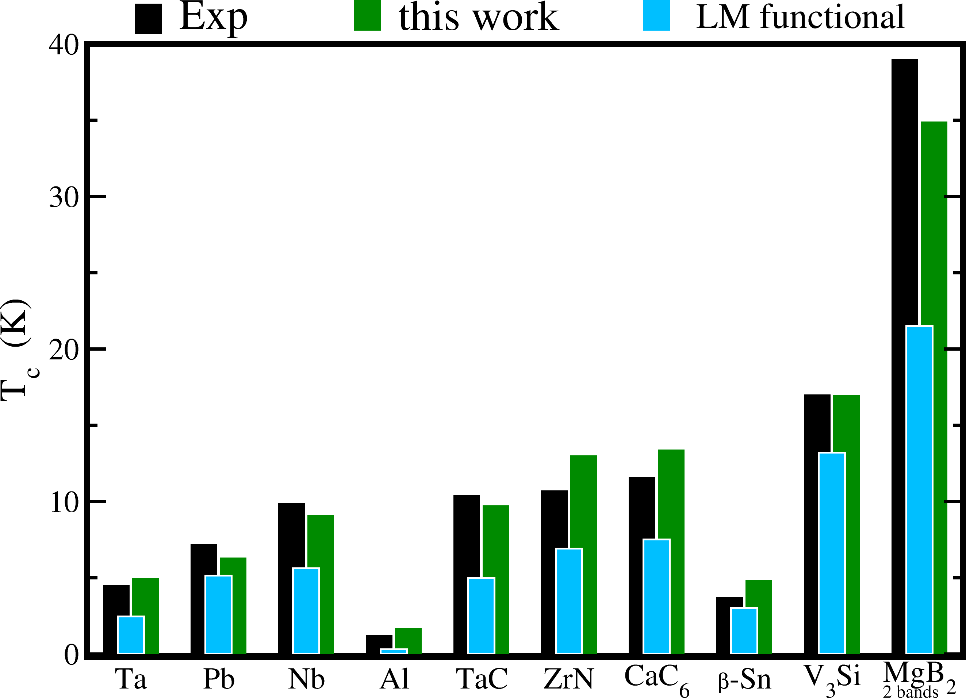
Full Green fctn
KS Green fctn

Slide 27
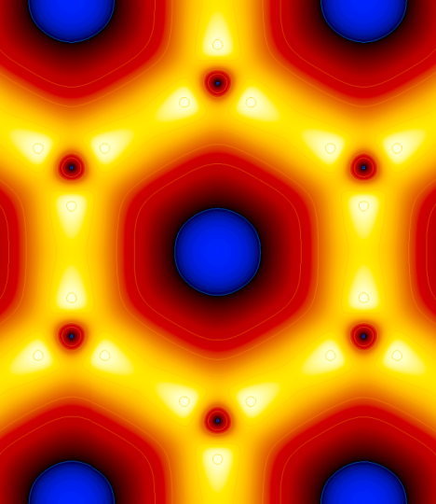
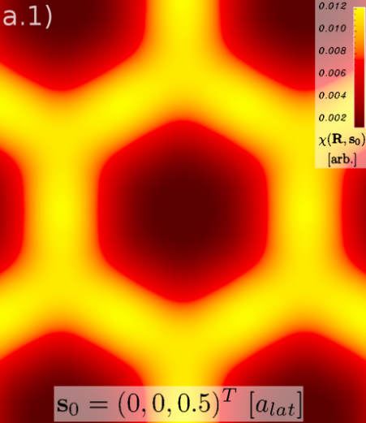
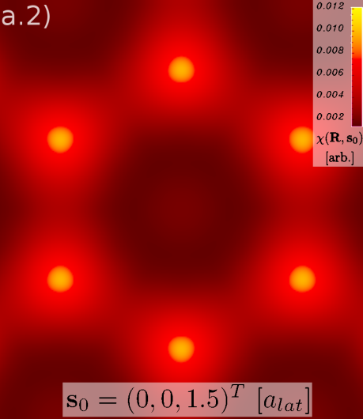
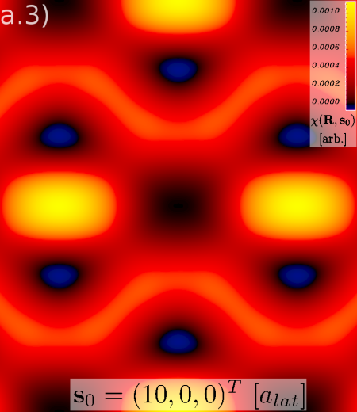
Ab-initio calculation of SC order parameter χ(r,r’) for MgB₂
χ(R,s) as function of R
for fixed s.
χ(r,r’) ≡ χ(R,s)
R = (r+r’)/2
s = r-r’
s = 0
s = (0,0, 0.5)
s = (0,0, 1.5)
s = (10,0,0)

Slide 28
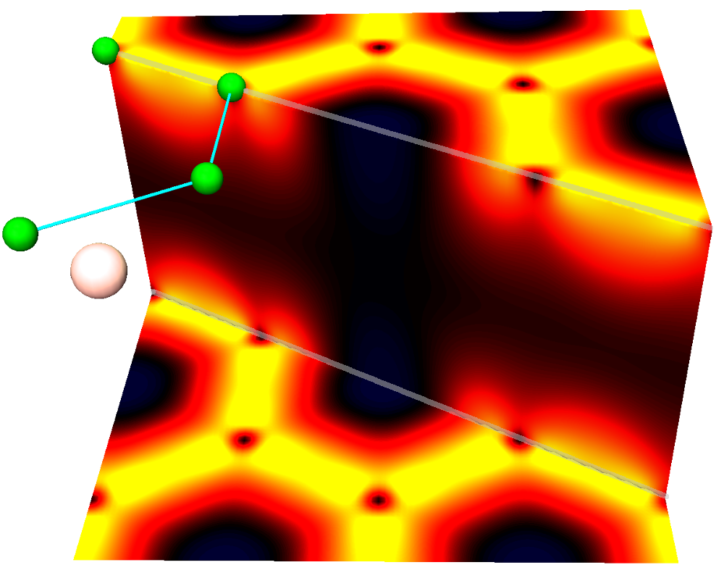
χ(R, s=0) as function of R
MgB₂
A. Linscheid, A. Sanna, E. K. U. Gross, Phys. Rev. Lett. 115, 097002 (2015).

Slide 29
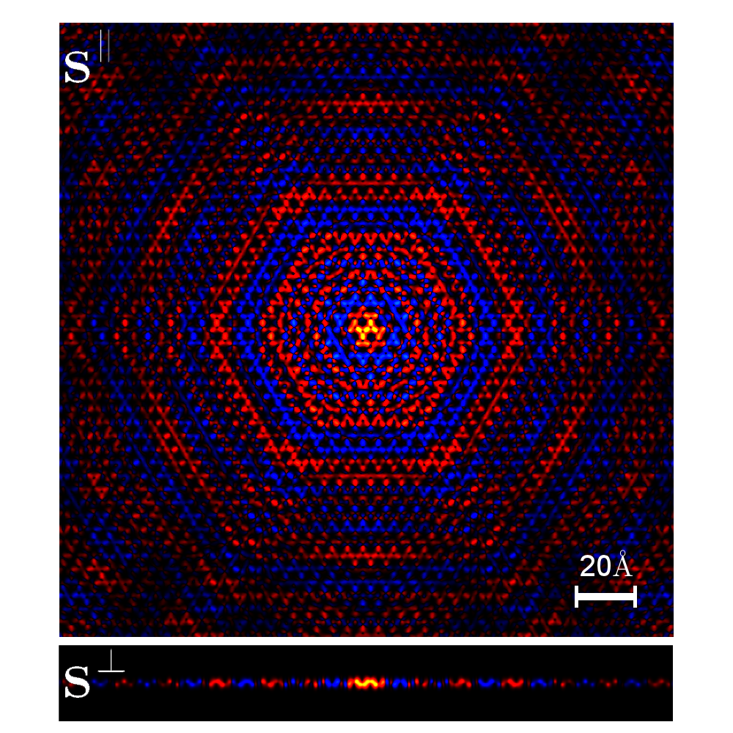
χ(R₀,s) as function of s (R₀ fixed at middle of C-C σ bond)
C₂H₂

Slide 30
Pb monolayer on Si
χ(R, s=0)

Slide 31
Pb monolayer on Si
χ(R, s=0)
superconducting
metallic band of Si

