Slide 1
Time-dependent density functional theory
(TDDFT)

Slide 2
Basic theorems of TDDFT
Linear response regime:
-- Calculation of photo-absorption spectra
Beyond the linear regime:
-- TD transport
-- Laser-driven spin dynamics
-- Combination of TDDFT with Optimal Control Theory
OUTLINE

Slide 3
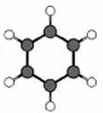
What do we want to describe?
System in laser field:
Generic situation
(t)
Z_{α} e²
|r_{j}-R_{α}|
→
→
+ r_{j}·E(t)·sin ωt

Slide 4
What do we want to describe?
System in laser field:
Generic situation
(t)
Z_{α} e²
|r_{j}-R_{α}|
→
→
+ r_{j}·E(t)·sin ωt
Electronic transport: Generic situation
central region C
left lead L
right lead R
Bias between L and R is turned on: U(t)
V

Slide 5
(t)
Z_{α} e²
|r_{j}-R_{α}|
→
→
+ r_{j}·E(t)·sin ωt
Strong laser (v_{laser}(t) ≥ v_{en}) :
Non-perturbative solution of full TDSE required
Weak laser (v_{laser}(t) << v_{en}) :
Calculate 1. Linear density response ρ₁(r t)
2. Dynamical polarizability
3. Photo-absorption cross section
→

Slide 6
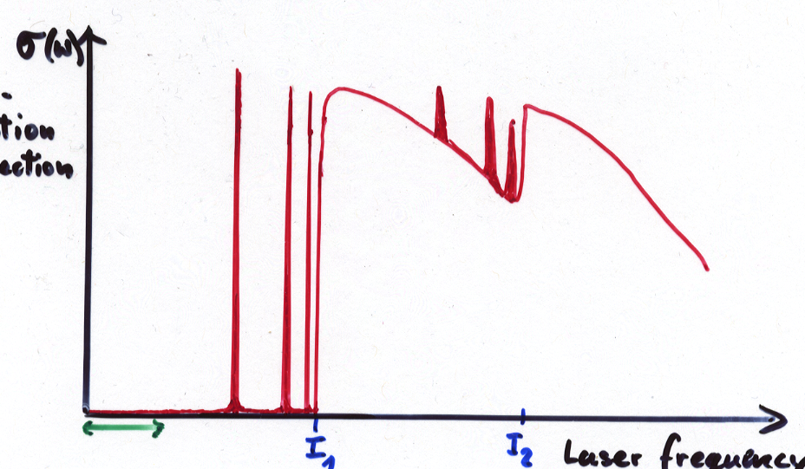
Photo-absorption in weak lasers
continuum states
σ(ω)
unoccupied bound states
I₁
photo-absorption cross section
I₂
occupied bound states
Laser frequency ω

Slide 7
Basic theorems of TDDFT
(E. Runge, E.K.U.G., PRL 52, 997 (1984))
1-1 correspondence (TD analogue of Hohenberg-Kohn theorem):
The time-dependent density determines uniquely the time-dependent external potential and hence all physical observables for fixed initial state.
TDKS theorem:
The time-dependent density of the interacting system of interest can be calculated as density
of an auxiliary non-interacting (KS) system
with the local potential

Slide 8
Basic theorems of TDDFT
(E. Runge, E.K.U.G., PRL 52, 997 (1984))
1-1 correspondence (TD analogue of Hohenberg-Kohn theorem):
The time-dependent density determines uniquely the time-dependent external potential and hence all physical observables for fixed initial state.
TDKS theorem:
The time-dependent density of the interacting system of interest can be calculated as density
of an auxiliary non-interacting (KS) system
with the local potential

Slide 9
Proof of the 1-1 correspondence between and
define maps
G
potentials
wave functions
densities
solve tdSE with fixed

Slide 10
ρ(r t)
to be shown that is impossible
i.e. v(r t) ≠ v’(r t) + c(t) ⇒ ρ(r t) ≠ ρ’(r t)
→
→
→
→
proof (basic idea):

Slide 11
use
and
→
continuity equation
equation of motion for j
to show that there exists an integer k>0 such that
ρ(t)
ρ’(t)
⇒ ρ and ρ’ will become different
from each other infinitesimally
later than t₀
ρ(t)
t₀ t

Slide 12
Simplest possible approximation for
Adiabatic Local Density Approximation (ALDA)
= xc potential of static homogeneous e-gas

Slide 13
Simplest possible approximation for
Adiabatic Local Density Approximation (ALDA)
= xc potential of static homogeneous e-gas
Any approximate ground-state-DFT xc functional can be used to generate an adiabatic approximation for TDDFT

Slide 14
LINEAR RESPONSE THEORY
t = t₀ : Interacting system in ground state of potential v₀(r) with density ρ₀(r)
t > t₀ : Switch on perturbation v₁(r t) (with v₁(r t₀)=0).
Density: ρ(r t) = ρ₀(r) + δρ(r t)
Consider functional ρ[v](r t) defined by solution of interacting TDSE
Functional Taylor expansion of ρ[v] around v_{o}:
…

Slide 15
ρ₁(r,t) = linear density response of interacting system
= density-density response function of interacting system
Lehmann representation of the full response function
with the exact many-body eigenfunctions and energies of the initial unperturbed interacting system Hamiltnian
⇒ The exact linear density response
has poles at the exact excitation energies Ω = E_{m} - E₀
ρ₁ (ω) = χ (ω) v₁

Slide 16
Analogous function ρ_{s}[v_{s}](r t) for non-interacting system
= density-density response function of non-interacting system
χ_{S} (r,r’,ω) has also poles as function of ω, but at the non-interacting
single-particle (KS) excitation energies.

Slide 17
GOAL: Find a way to calculate ρ₁(r t) without explicitly evaluating χ(r t,r't') of the interacting system
starting point: Definition of xc potential
v_{xc} is well-defined through the non-interacting and the interacting 1-1 mapping.
1-1 mapping for interacting particles
1-1 mapping for non-interacting particles

Slide 21
χ_{S} •
• χ

Slide 22
χ_{S} •
• χ

Slide 23
Act with this operator equation on arbitrary v₁(r t) and use χ v₁ = ρ₁ :
Exact integral equation for ρ₁(r t), to be solved iteratively
Need approximation for
(either for f_{xc} directly or for v_{xc})

Slide 24
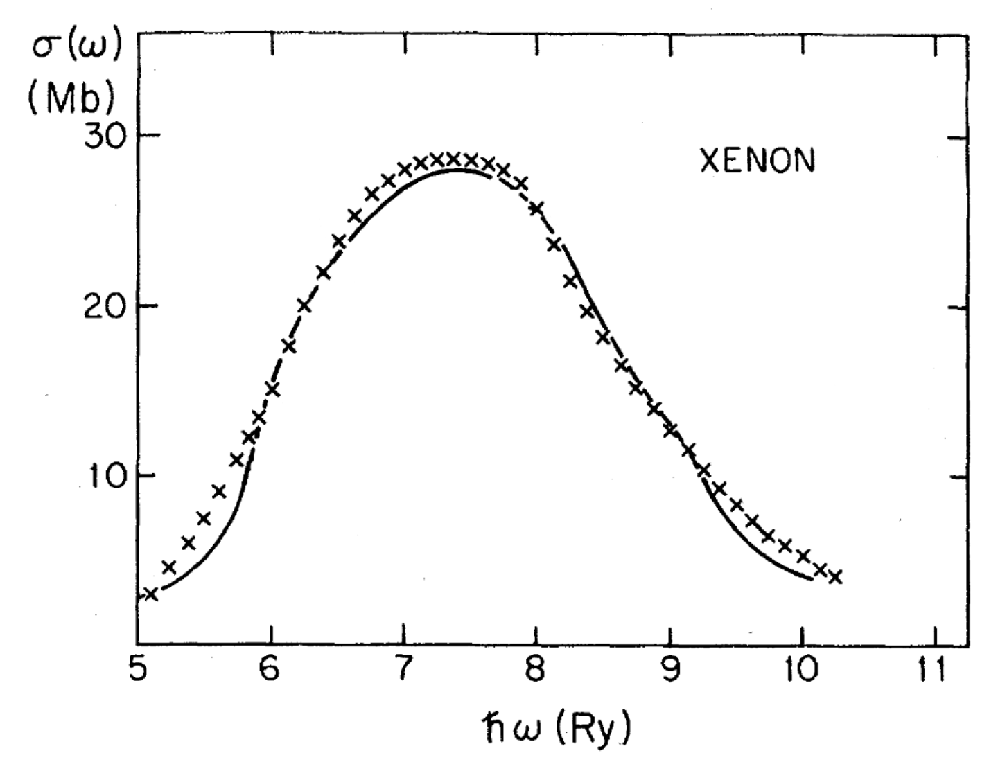
Total photoabsorption cross section of the Xe atom versus photon energy in the vicinity of the 4d threshold.
Solid line: self-consistent time-dependent KS calculation [A. Zangwill and P. Soven, Phys. Rev. A 21, 1561 (1980)]; crosses: experimental data [R. Haensel, G. Keitel, P. Schreiber, and C. Kunz, Phys. Rev. 188, 1375 (1969)].

Slide 25
Photo-absorption in weak lasers
continuum states
Previous slide
σ(ω)
unoccupied bound states
I₁
photo-absorption cross section
I₂
occupied bound states
Laser frequency ω

Slide 26
Photo-absorption in weak lasers
Discrete poles
continuum states
σ(ω)
unoccupied bound states
I₁
photo-absorption cross section
I₂
occupied bound states
Laser frequency ω

Slide 27
Looking at those frequencies, Ω, for which ρ₁(ω) has poles,
leads to a (non-linear) eigenvalue equation
M. Petersilka, U. J. Gossmann, E.K.U.G., PRL 76, 1212 (1996)
T. Grabo, M. Petersilka, EKUG, J. Mol. Struc. (Theochem) 501, 353 (2000)
M.E. Casida, Recent Advances in Density Functional Methods I, 155 (1996)
where
double index

Slide 28
TDDFT
from: M. Petersilka, U. J. Gossmann, E.K.U.G., PRL 76, 1212 (1996)

Slide 29
Excitation energies of CO molecule [mH]
State | Ω_{expt} _{KS} | KS-transition | Δϵ_{KS} | TDDFT
A ¹Π | 312.7 | 5σ→2π | 252.3 | 310.2
a ³Π | 232.3 |  |  | 221.4
I ¹Σ⁻ | 363.1 | 1π→2π | 362.6 | 362.6
e ³Σ⁻ | 363.1 |  |  | 362.6
a’ ³Σ⁺ | 312.7 |  |  | 314.9
D ¹Δ | 375.9 |  |  | 380.7
d ³Δ | 344.0 |  |  | 339.6
Molecular excitation energies from time-dependent density-functional theory
T Grabo, M Petersilka, EKU Gross, J Mol Struc-Theochem 501, 353 (2000).

Slide 30
Failures of ALDA in the linear response regime
H₂ dissociation is incorrect:
(see: Gritsenko, van Gisbergen, Görling, Baerends, J. Chem. Phys. 113, 8478 (2000))
(in ALDA)
response of long chains strongly overestimated
(see: Champagne et al., J. Chem. Phys. 109, 10489 (1998) and 110, 11664 (1999))
in periodic solids, whereas,
for insulators, divergent.
charge-transfer excitations not properly described
(see: Dreuw et al., J. Chem. Phys. 119, 2943 (2003))

Slide 31
Failures of ALDA in the linear response regime
H₂ dissociation is incorrect:
(see: Gritsenko, van Gisbergen, Görling, Baerends, J. Chem. Phys. 113, 8478 (2000))
(in ALDA)
response of long chains strongly overestimated
(see: Champagne et al., J. Chem. Phys. 109, 10489 (1998) and 110, 11664 (1999))
in periodic solids, whereas,
for insulators, divergent.
charge-transfer excitations not properly described
(see: Dreuw et al., J. Chem. Phys. 119, 2943 (2003))
These difficulties have largely been solved by xc functionals more advanced than ALDA

Slide 32
Linear-response TDDFT is now being used to predict
and to interpret experimental optical spectra in essentially all corners of physics and chemistry.
Some examples:

Slide 33
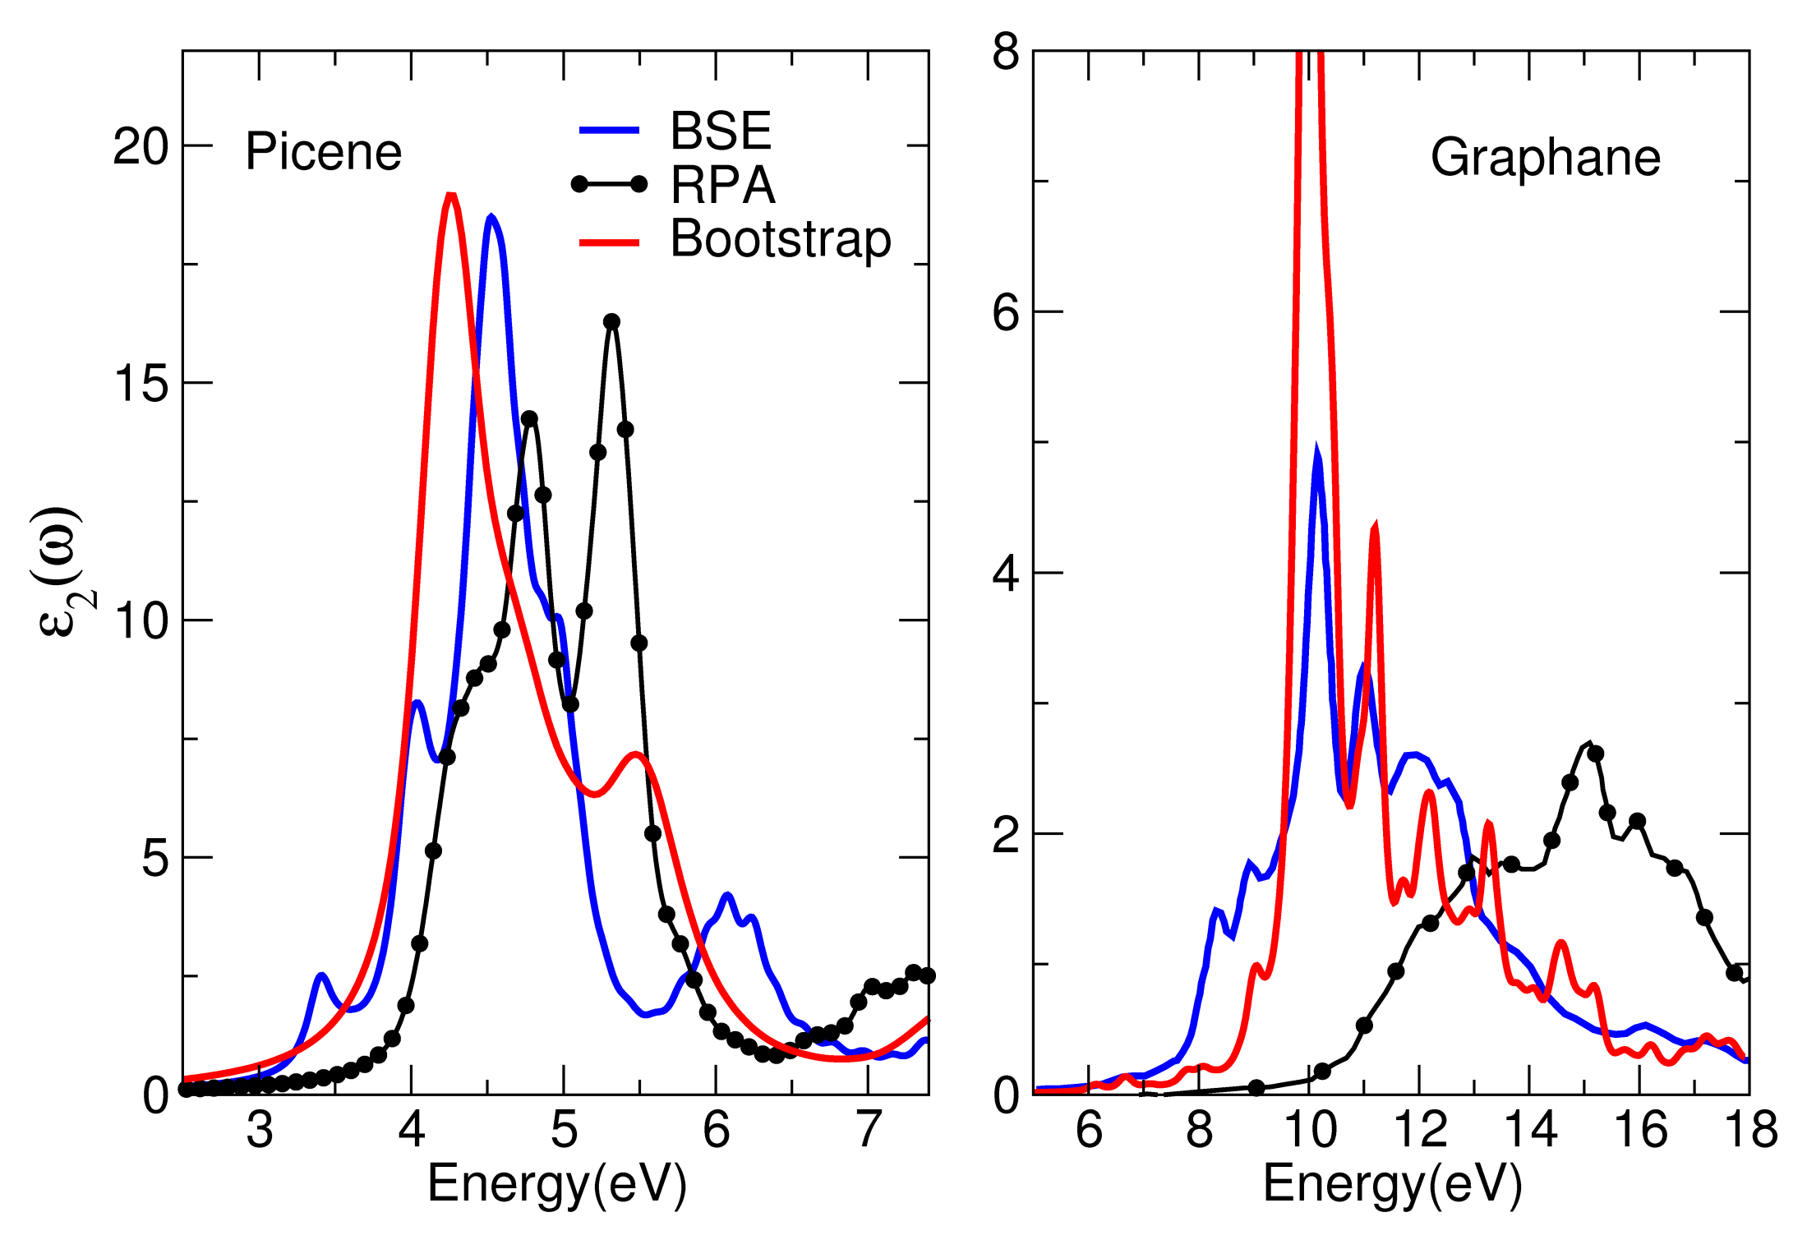
TDDFT
RPA
BSE

Slide 35
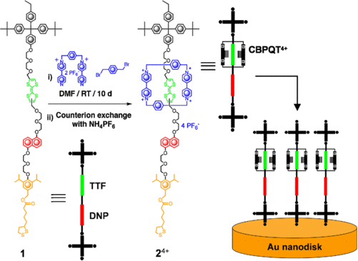
DOI: 10.1109/SENSOR.2009.5285604

Slide 37
Beyond the linear regime: Real-time TDDFT
prediction of electron dynamics
far from equilibrium

Slide 38
Example: Ultrafast laser-driven spin dynamics in solids

Slide 39
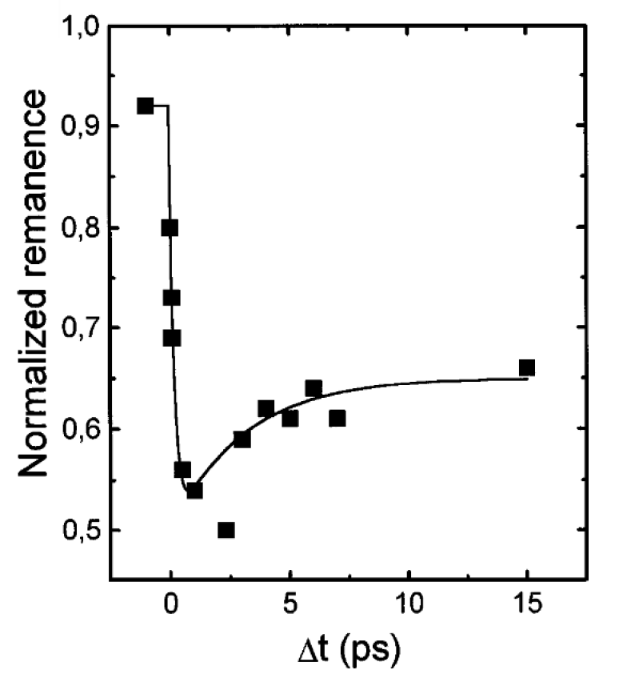
First experiment on ultrafast laser induced demagnetization
Beaurepaire et al, PRL 76, 4250 (1996)

Slide 40
First experiment on ultrafast laser induced demagnetization
Beaurepaire et al, PRL 76, 4250 (1996)
Demagnetization in less than 100 fs has been demonstrated experimentally

Slide 41
Non-collinear-Spin TDDFT with Spin-Orbit-Coupling
(weakly relativistic limit of relativistic TDDFT)
where are Pauli spinors

Slide 42
Non-collinear-Spin TDDFT with Spin-Orbit-Coupling
(weakly relativistic limit of relativistic TDDFT)
Universal
functionals
of ρ and m
where are Pauli spinors

Slide 43
Quantity of prime interest:
vector field of spin magnetization

Slide 44
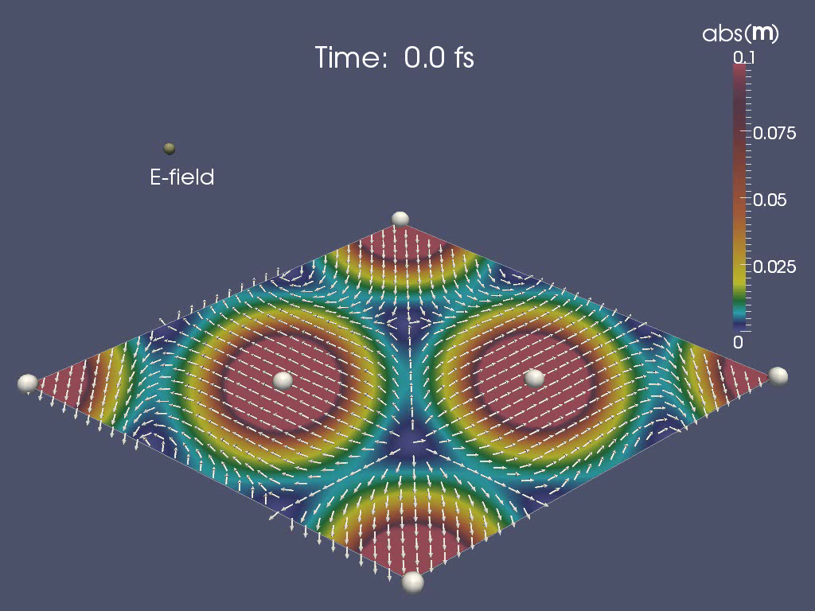
Quantity of prime interest:
vector field of spin magnetization
Cr monolayer in ground state

Slide 45
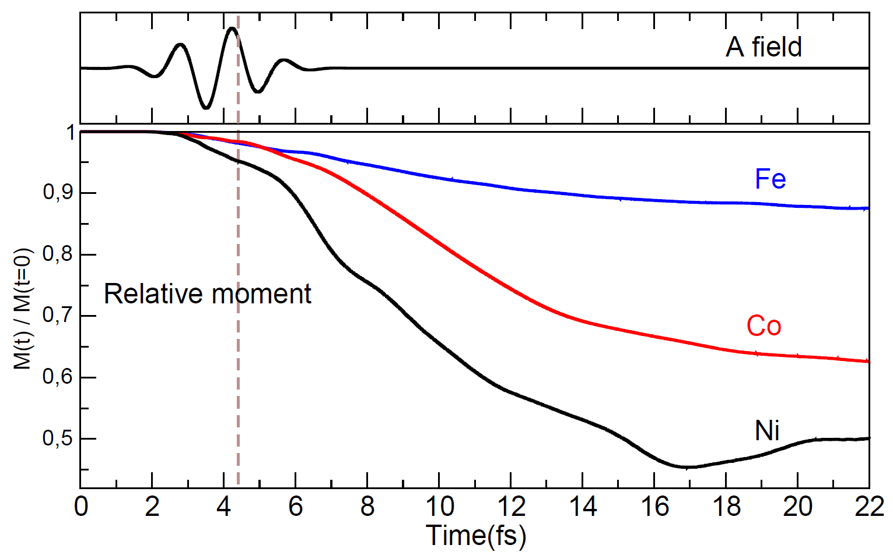
K. Krieger, K. Dewhurst, P. Elliott, S. Sharma, E.K.U.G., JCTC 11, 4870 (2015)

Slide 46
Analysis of the results

Slide 47
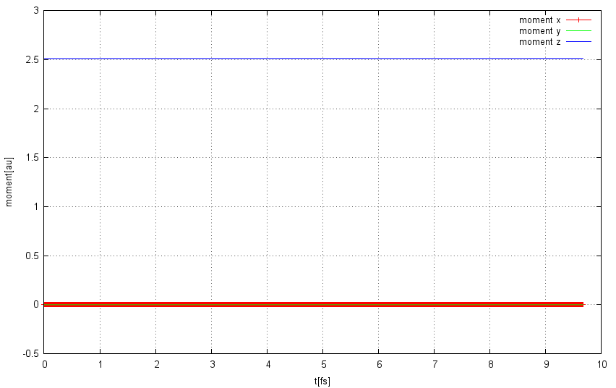
Calculation without spin-orbit coupling
components of spin moment

Slide 48
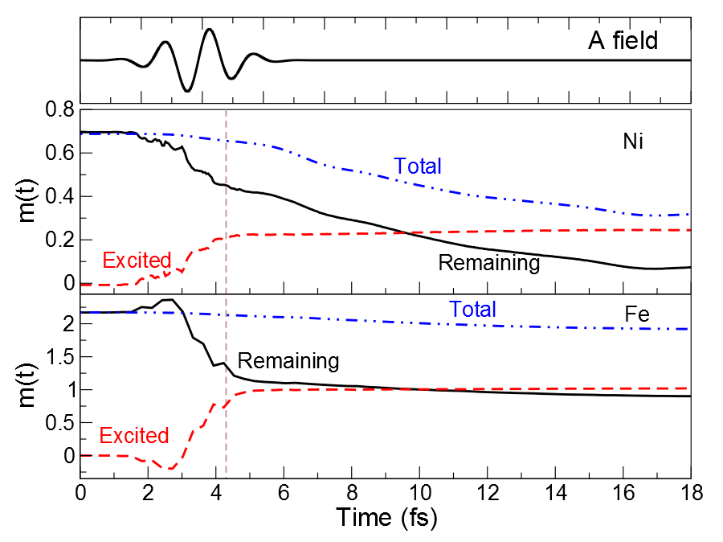

Slide 49
Demagnetization occurs in two steps:
- Initial excitation by laser moves magnetization from atomic region
into interstitial region. Total Moment is basically conserved
during this phase.
- Spin-Orbit term drives demagnetization of the more localized
electrons until stabilization at lower moment is achieved
This is a local mechanism, hence occurs in this form in essentially
all systems, e.g. magnetic clusters (Sanvito group, Dublin) or
magnetic mono-layer / few-layer systems
K. Krieger, J.K. Dewhurst, P. Elliott, S. Sharma, E.K.U. Gross,
JCTC 11, 4870 (2015).
K. Krieger, P. Elliott, T. Müller, N. Singh, J. K. Dewhurst,
E.K.U. Gross, S. Sharma, J. Phys. Cond. Matter 29, 224001 (2017).
V. Shokeen, M. Sanchez Piaia, J.Y. Bigot, T. Mueller, P. Elliott, J.K. Dewhurst,
S. Sharma, E.K.U. Gross, Phys. Rev. Lett. 119, 107203 (2017).

Slide 50
Optically induced spin transfer
(OISTR)
J.K. Dewhurst, P. Elliott, S. Shallcross, E.K.U. Gross, S. Sharma,
Nano Lett. 18, 1842-1848 (2018)
OISTR was first predicted with TDDFT and later found experimentally
(Aeschlimann group, Kaiserslautern, 2018)

Slide 51
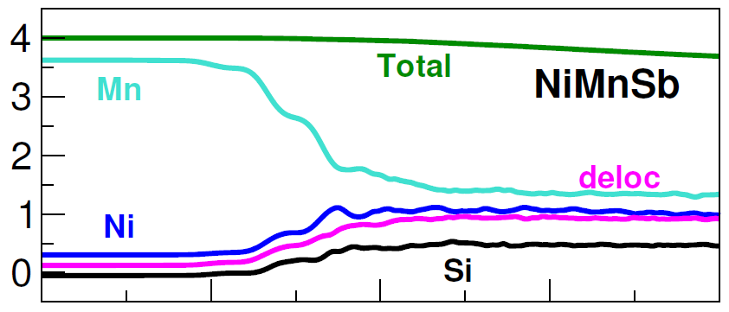
M (t) (μ_{B})
Sb
Time (fs)
Global moment |M(t)| nearly preserved
Local moments around each atom change

Slide 52
NiMnSb

Slide 53
Future aspects in the field of laser-driven (spin) dynamics:
Include relaxation processes due to el-el scattering
- in principle contained in TDDFT,
- but not with adiabatic xc functionals
- need xc functional approximations with memory
Include relaxation processes due to electron-nuclear interaction
Include relaxation due to radiative effects
simultaneous propagation of TDKS and Maxwell equations
Include dipole-dipole interaction to describe motion of domains
construct approximate xc functionals which refer to the dipole int
Optimal-control theory to find optimized laser pulses
to selectively demagnetize/remagnetize, i.e. to switch,
the magnetic moment
Create Skyrmions with suitably shaped laser pulses

Slide 54
Electronic transport with TDDFT
central region C
left lead L
right lead R
Bias between L and R is turned on: U(t)
V for large t

Slide 55
Electronic transport with TDDFT
central region C
left lead L
right lead R
Bias between L and R is turned on: U(t)
V for large t
Questions:
After switching-on, does one always reach a steady state?
Is the steady state unique?
How to deal with time-dependent external fields?

Slide 56
Electronic transport with TDDFT
central region C
left lead L
right lead R
TDKS equation
(E. Runge, EKUG, PRL 52, 997 (1984))
v_{xc}[ρ (r’t’)](r t)

Slide 57
Electronic transport with TDDFT
central region C
left lead L
right lead R
TDKS equation

Slide 58
Effective TDKS Equation for the central (molecular) region only
S. Kurth, G. Stefanucci, C.O. Almbladh, A. Rubio, E.K.U.G., Phys. Rev. B 72, 035308 (2005)
source term: L → C and R → C charge injection
memory term: C → L → C and C → R → C hopping
Note: So far, no approximation has been made.

Slide 59
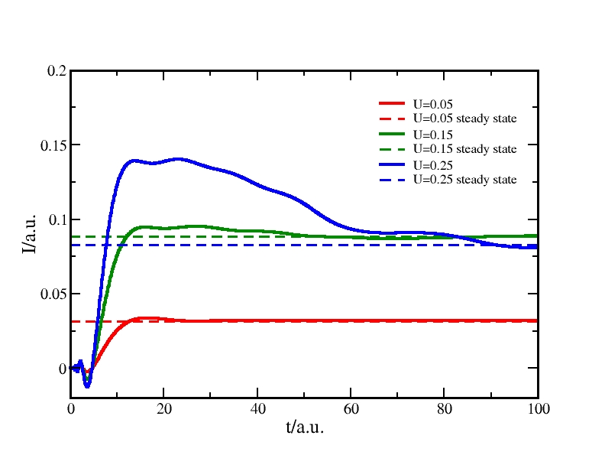
Numerical examples for non-interacting electrons
Recovering the Landauer steady state
left lead
central region
right lead
U
V(x)
U
Time evolution of current in response to bias switched on at time t = 0, Fermi energy ε_{F} = 0.3 a.u.
Steady state coincides with Landauer formula
and is reached after a few femtoseconds

Slide 60
Can there be more than one steady state?

Slide 61
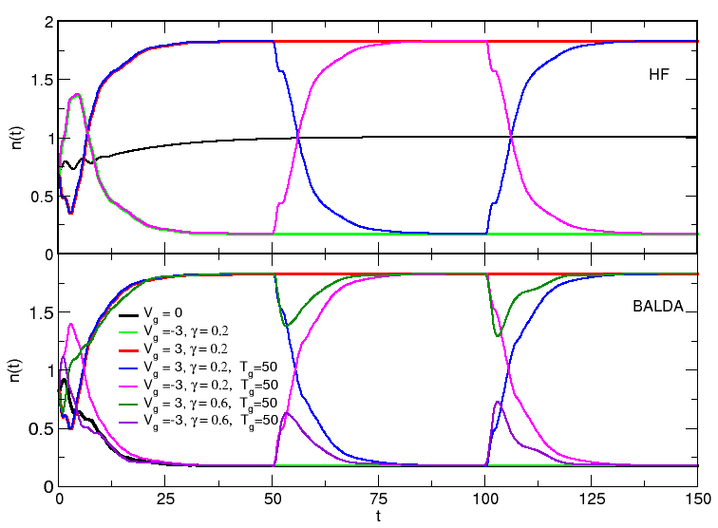
Multi-stability in TDHF and TDDFT for one-site Anderson model
E. Khosravi, A.M. Uimonen, A. Stan, G. Stefanucci, S. Kurth,
R. van Leeuwen, E.K.U.G. Phys. Rev. B 85, 075103 (2012)

Slide 62
Is there always a steady state?

Slide 63
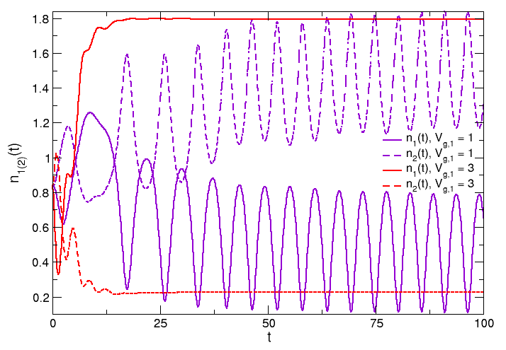
No steady state in two-site Anderson model

Slide 64
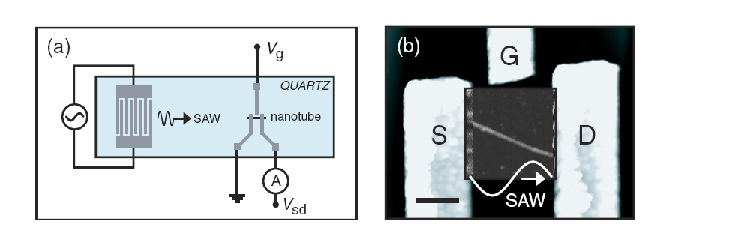
ELECTRON PUMP
Device which generates a net current between two electrodes (with no static bias) by applying a time-dependent potential in the device region
Experimental realization : Pumping through carbon nanotube by surface acoustic waves on piezoelectric surface (Leek et al, PRL 95, 256802 (2005))

Slide 65
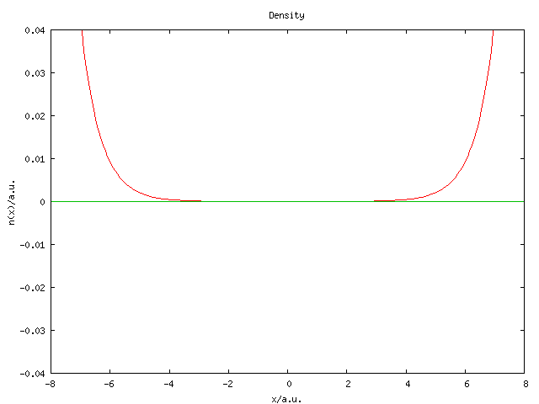
Pumping through a square barrier (of height 0.5 a.u.) using a travelling wave in device region U(x,t) = U_{o}sin(kx-ωt) (k = 1.6 a.u., ω = 0.2 a.u. Fermi energy = 0.3 a.u.)
Archimedes’ screw: patent 200 b.c.

Slide 66
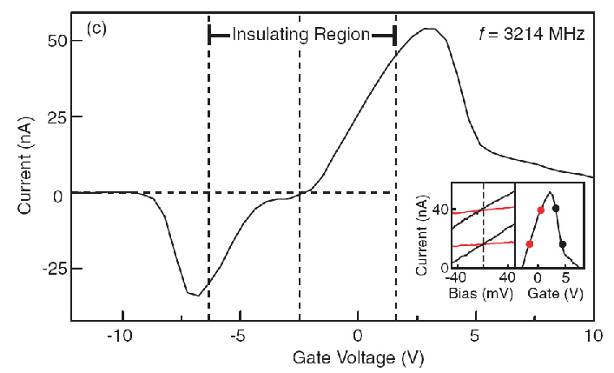
Experimental result:
Current flows in direction opposite to sound wave

Slide 68
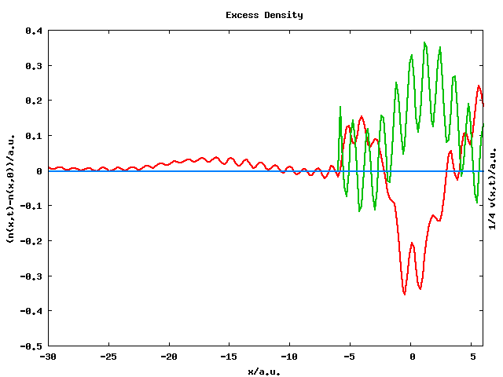
Current goes in direction opposite to the external field !!
G. Stefanucci, S. Kurth, A. Rubio, E.K.U. Gross, Phys. Rev. B 77, 075339 (2008)

Slide 69
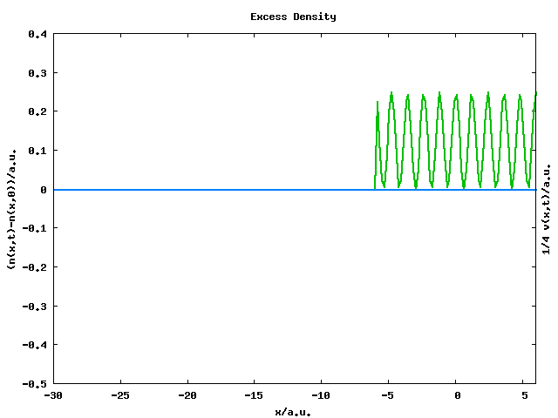
G. Stefanucci, S. Kurth, A. Rubio, E.K.U. Gross, Phys. Rev. B 77, 075339 (2008)

Slide 70
Optimal control using short laser pulses
Review Article on Quantum Optimal Control Theory:
J. Werschnik, E.K.U. Gross, J. Phys. B 40, R175-R211 (2007)

Slide 71
Optimal Control Theory (OCT)
Normal question:
What happens if a system is exposed to a given laser pulse?
Inverse question (solved by OCT):
Which is the laser pulse that achieves a prescribed goal (target)?
possible targets:
system should end up in a given final state φ_{f} at the end of the pulse
wave function should follow a given trajectory in Hilbert space
density should follow a given classical trajectory r(t)

Slide 72
Optimal control of static targets
(standard formulation)
For given target state Φ_{f} , maximize the functional:

Slide 73
Optimal control of static targets
(standard formulation)
For given target state Φ_{f} , maximize the functional:
Ô

Slide 74
Optimal control of static targets
(standard formulation)
For given target state Φ_{f} , maximize the functional:
Ô
with the constraints:
E₀ = given fluence

Slide 75
Optimal control of static targets
(standard formulation)
For given target state Φ_{f} , maximize the functional:
Ô
with the constraints:
E₀ = given fluence

Slide 76
Optimal control of static targets
(standard formulation)
For given target state Φ_{f} , maximize the functional:
Ô
with the constraints:
E₀ = given fluence
TDSE

Slide 77
Optimal control of static targets
(standard formulation)
For given target state Φ_{f} , maximize the functional:
Ô
with the constraints:
E₀ = given fluence
GOAL: Maximize J = J₁ + J₂ + J₃
TDSE

Slide 78
Set the total variation of J = J₁ + J₂ + J₃ equal to zero:
Control equations
1. Schrödinger equation with initial condition:
2. Schrödinger equation with final condition:
3. Field equation:

Slide 79
Set the total variation of J = J₁ + J₂ + J₃ equal to zero:
Control equations
Algorithm
1. Schrödinger equation with initial condition:
Forward propagation
Backward propagation
New laser field
2. Schrödinger equation with final condition:
3. Field equation:
Algorithm monotonically convergent: W. Zhu, J. Botina, H. Rabitz, JCP 108, 1953 (1998))

Slide 80
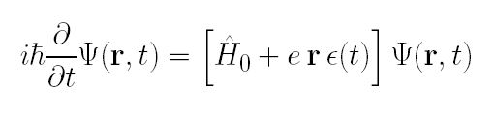


Quantum ring: Control of circular current
TDSE:
1.24
30 nm
1.12
1.04
1

Slide 81
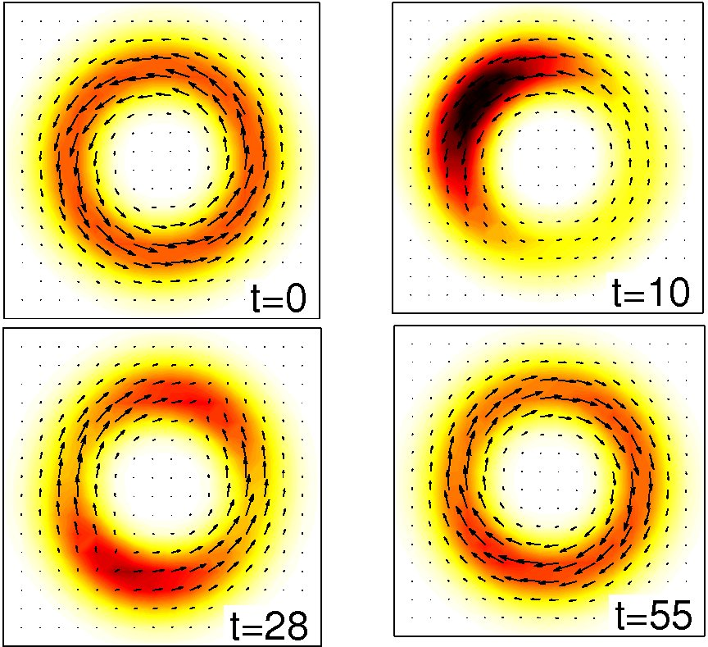
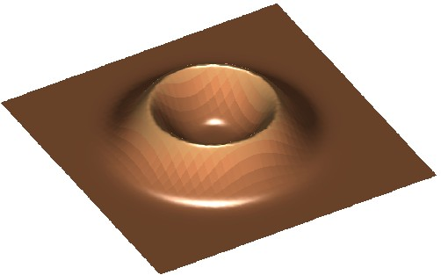
Control of currents
|ψ(t)|
2
|ψ(t)|
j (t)
and
j
l = -1
l = 1
l = 0
I ~ μA
E. Räsänen, A. Castro, J. Werschnik, A. Rubio, E.K.U.G., PRL 98, 157404 (2007)

Slide 82
OCT of ionization
Calculations for 1-electron system H₂⁺ in 3D
Restriction to ultrashort pulses (T<5fs)
  nuclear motion can be neglected
Only linear polarization of laser (parallel or perpendicular to molecular axis)
Look for enhancement of ionization by pulse-shaping only, keeping the time-integrated intensity (fluence) fixed

Slide 83
Control target to be maximized:
with
Standard OCT algorithm (forward-backward propagation) does not converge:
Acting with before the backward-propagation eliminates the smooth (numerically friendly) part of the wave function.

Slide 84
Instead of forward-backward propagation, parameterize the laser pulse to be optimized in the form
with ω₀ = 0.114 a.u. (λ = 400 nm)
with ω_{n} = 2πn/T
Choose N such that maximum frequency is 2ω₀ or 4ω₀ . T is fixed to 5 fs.
Maximize J₁ (f₁…f_{N}, g₁…g_{N}) directly with constraints:
using algorithm NEWUOA (M.J.D. Powell, IMA J. Numer. Analysis 28, 649 (2008))

Slide 85
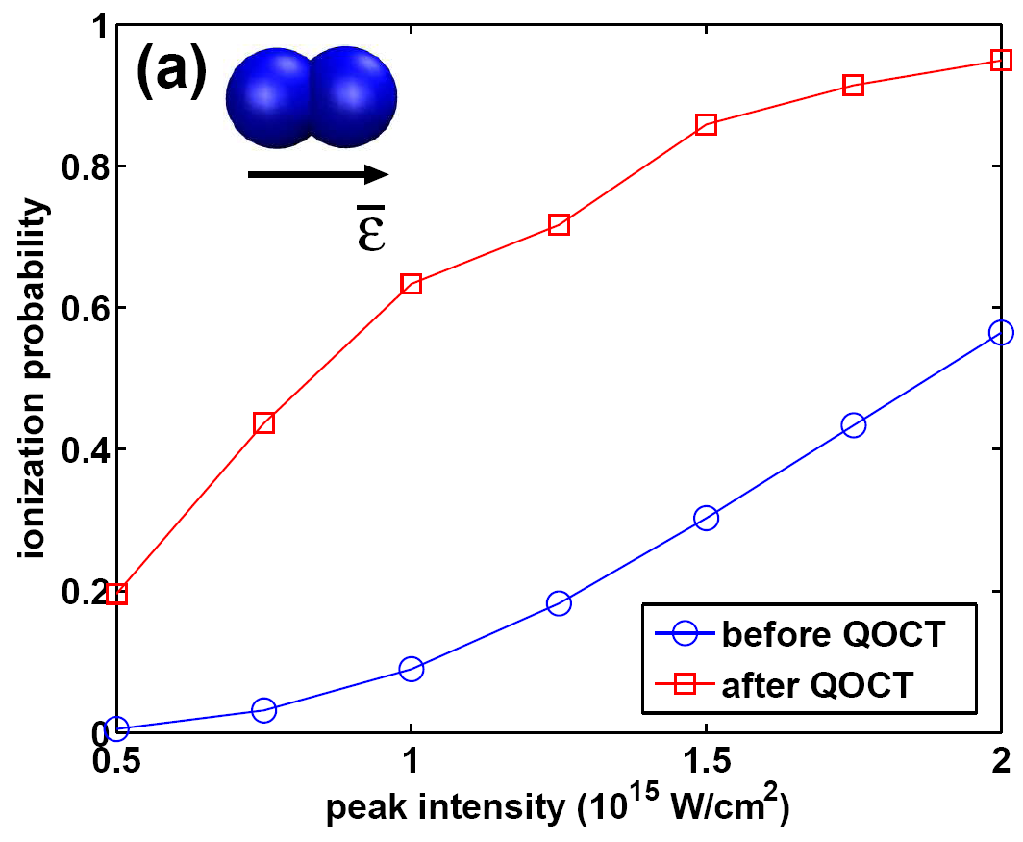
of initial pulse
of initial pulse
Ionization probability for the initial (circles) and the optimized (squares) pulse as function of the peak intensity of the initial pulse.
Pulse length and fluence is kept fixed during the optimization.

Slide 86
OPTIMAL CONTROL OF
TIME-DEPENDENT TARGETS
Maximize

Slide 87
Control equations
Set the total variation of J = J₁ + J₂ + J₃ equal to zero:
Algorithm
1. Schrödinger equation with initial condition:
Forward propagation
Backward propagation
New laser field
2. Schrödinger equation with final condition:
Inhomogenous TDSE :
3. Field equation:
Algorithm monotonically convergent:
I. Serban, J. Werschnik, E.K.U.G., Phys. Rev. A 71, 053810 (2005)

Slide 88
Control of path in Hilbert space
I. Serban, J. Werschnik, E.K.U.G. Phys. Rev. A 71, 053810 (2005)
with
given target occupation, and
Goal: Find laser pulse that reproduces |α_{o}(t)|²

Slide 89
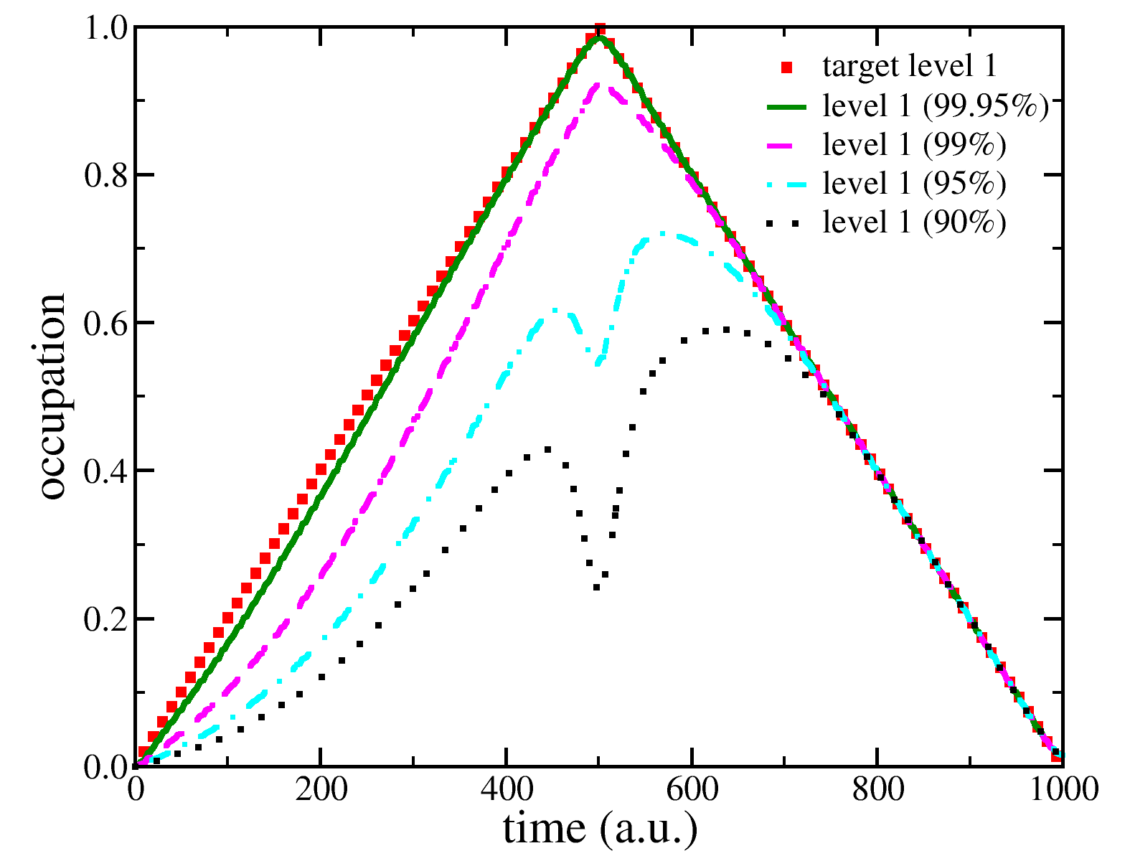

Slide 90
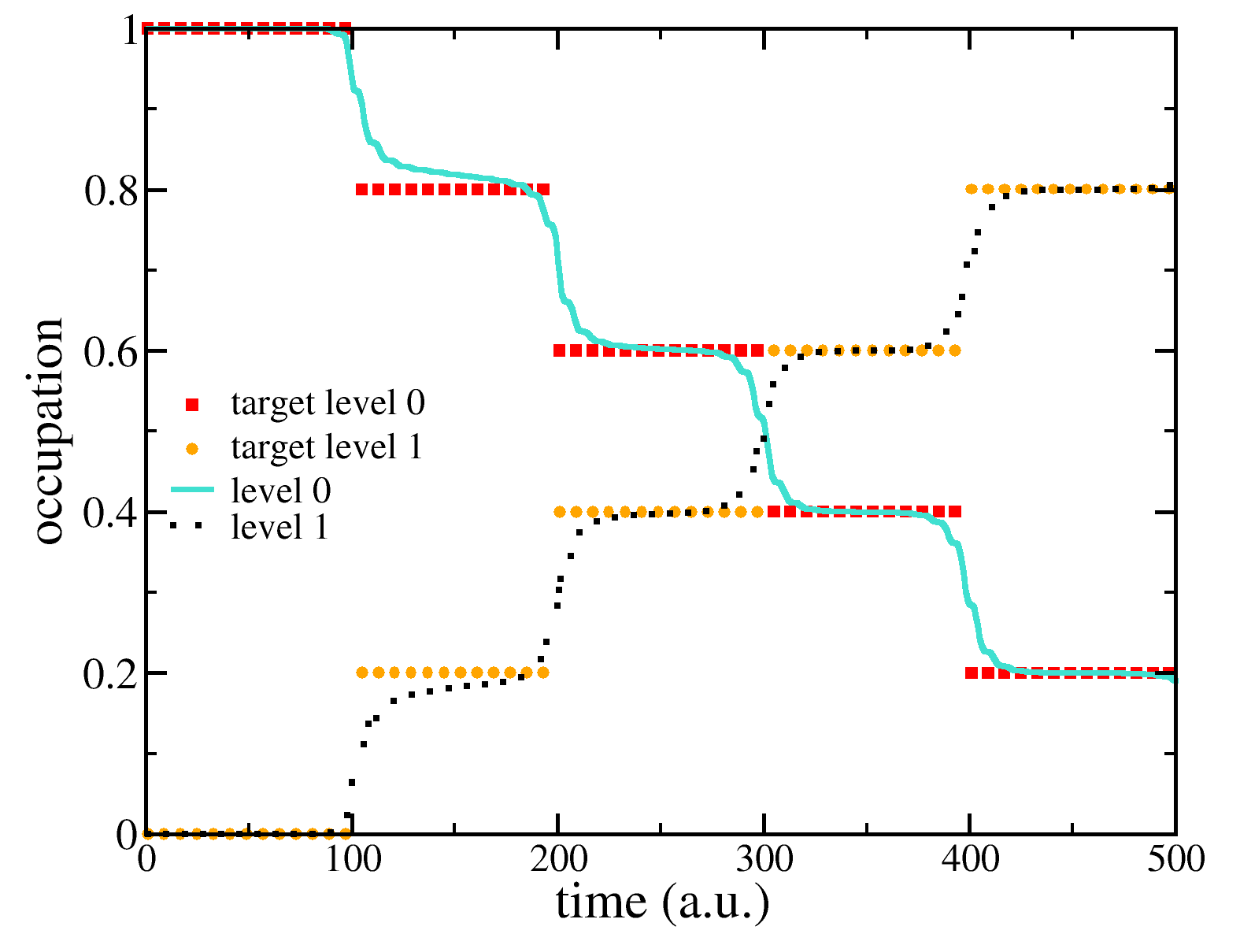
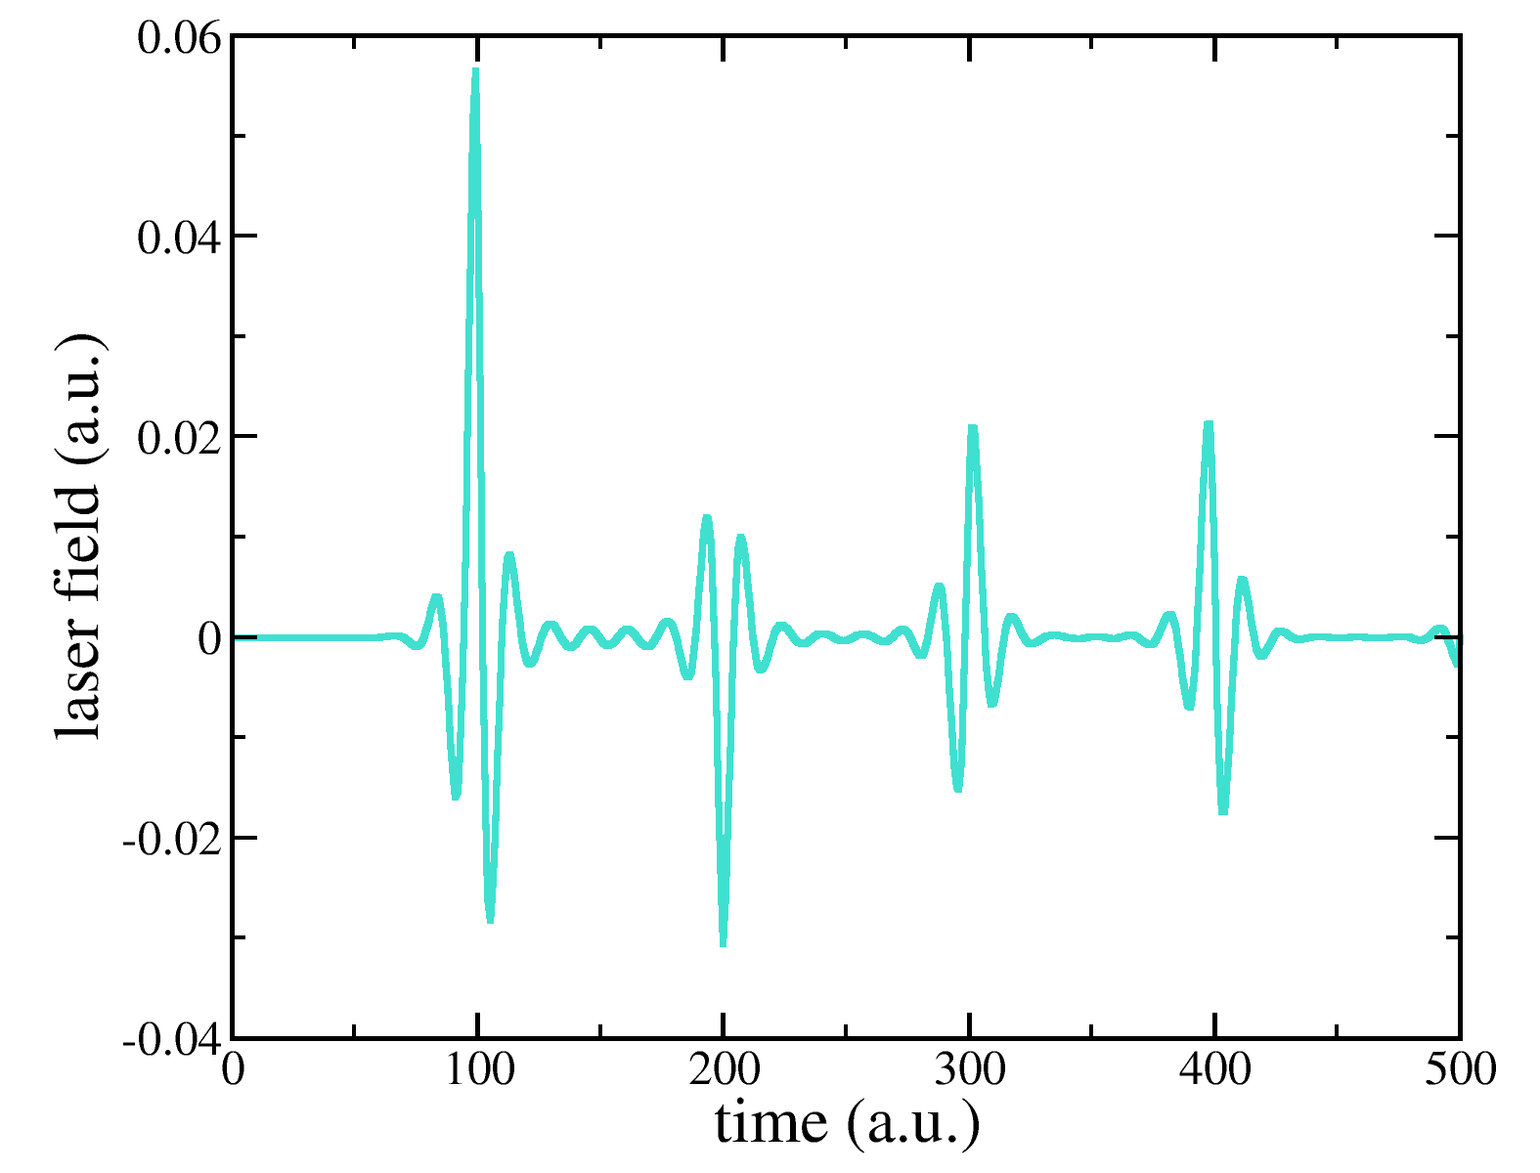

Slide 91
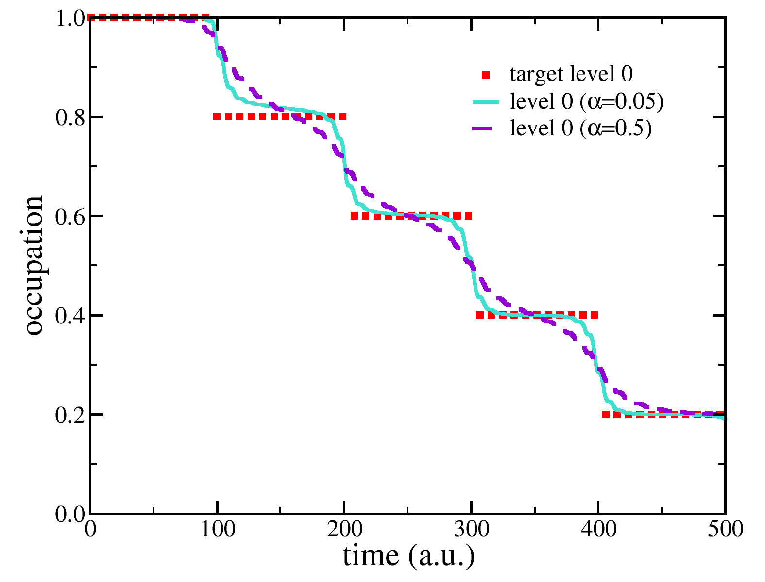
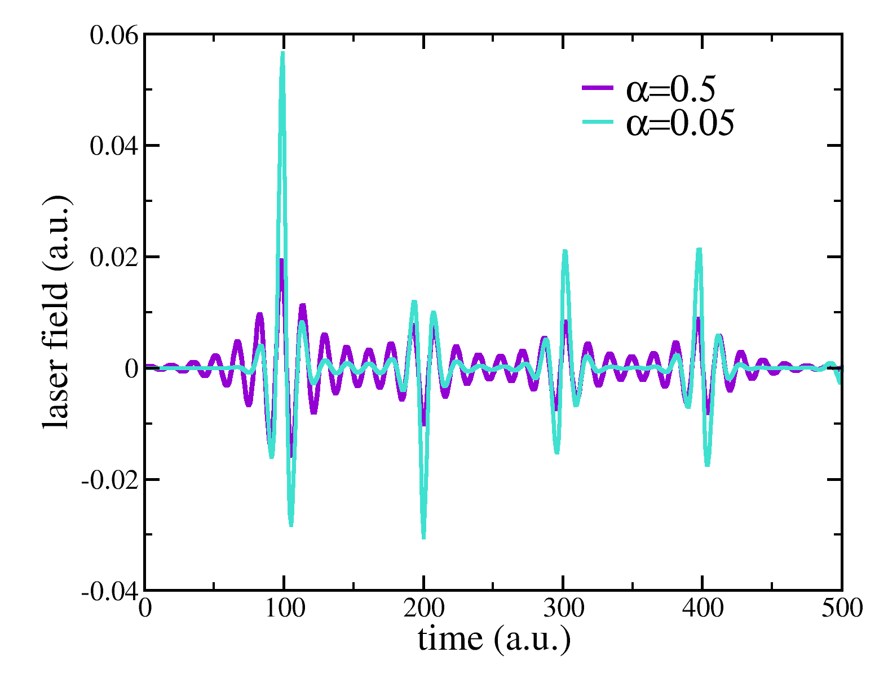

Slide 92
Control path in real space
with given trajectory r₀(t) .
Algorithm maximizes the density along the path r₀(t):
I. Serban, J. Werschnik, E.K.U.G. Phys. Rev. A 71, 053810 (2005)

Slide 93
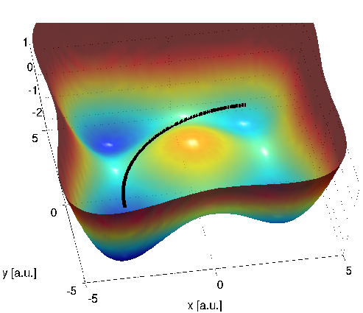

Control of charge transfer along selected pathways
Trajectory 1
Trajectory 2

Slide 94
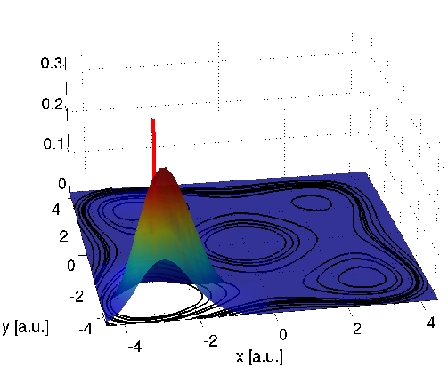
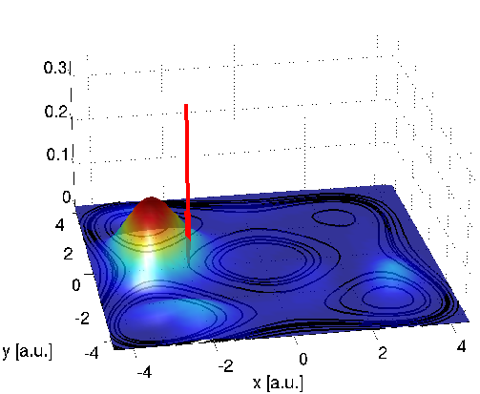
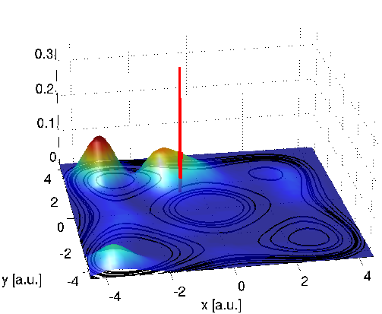
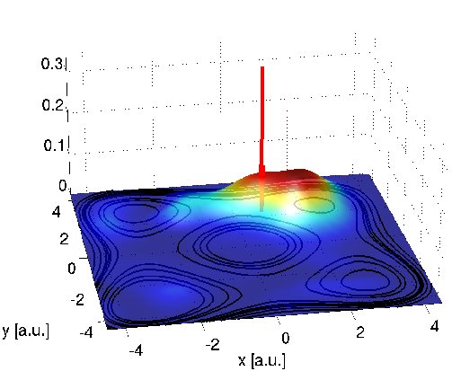
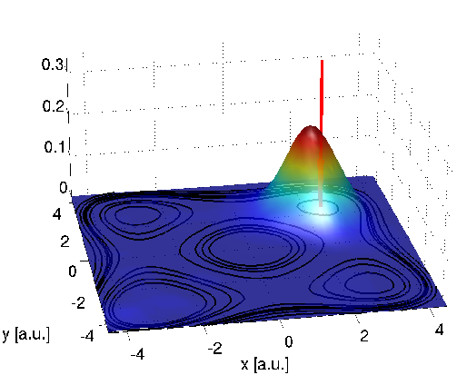
Time-evolution of wavepacket with the optimal laser pulse for trajectory 1

Slide 95
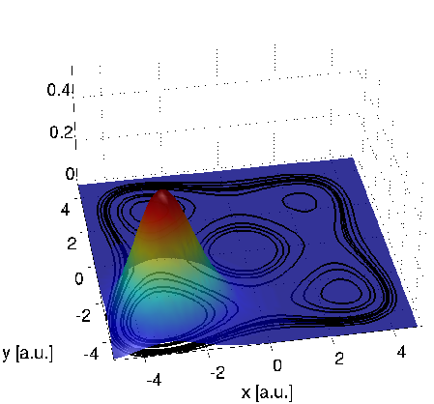
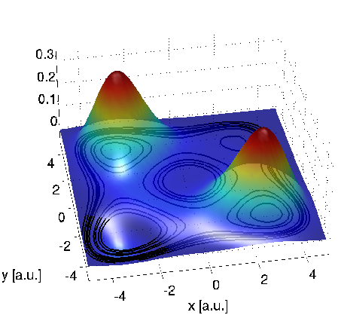
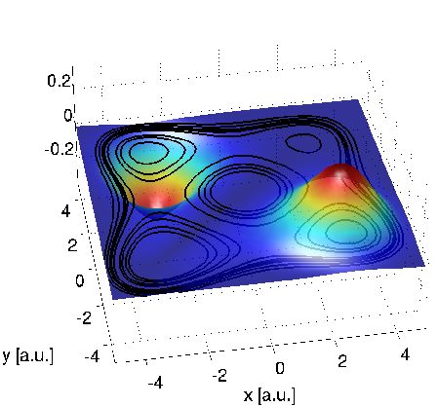
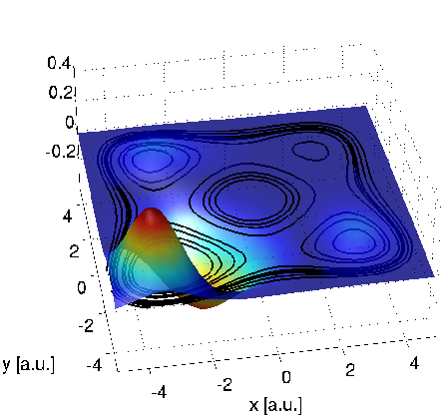
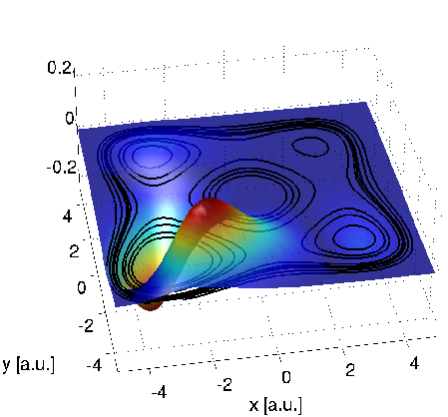
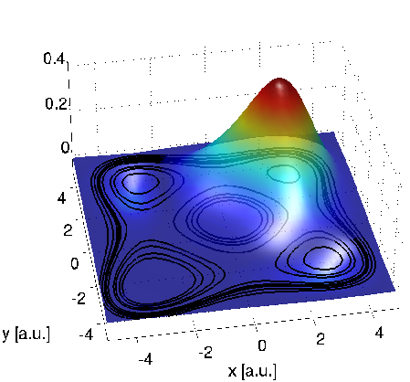
Lowest six eigenstates

Slide 96
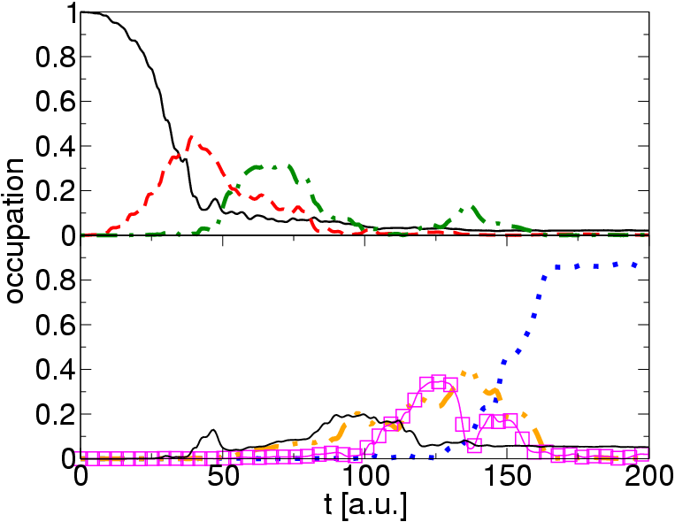
Populations of eigenstates
ground state
first excited state
second excited state
fifth excited state

Slide 97
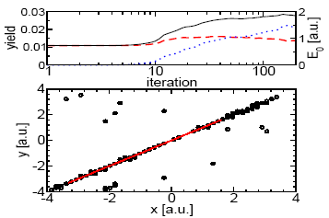
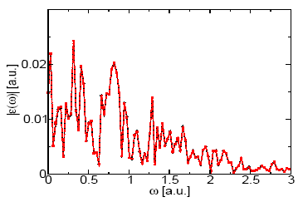
Trajectory 2
Notes:
present results, follows only in an optimal sense

Slide 98
Control of many-body systems
Formally the same OCT equations
Problem: For 3 or more degrees of freedom, the full solution of the TDSE becomes computationally very hard

Slide 99
Control of many-body systems
Formally the same OCT equations
Problem: For 3 or more degrees of freedom, the full solution of the TDSE becomes computationally very hard
Instead of solving the many-body TDSE,
combine OCT with TDDFT
A. Castro, J. Werschnik, E.K.U. Gross, PRL 109, 153603 (2012)

Slide 100
Control of many-body systems
Formally the same OCT equations
Problem: For 3 or more degrees of freedom, the full solution of the TDSE becomes computationally very hard
Instead of solving the many-body TDSE,
combine OCT with TDDFT
A. Castro, J. Werschnik, E.K.U. Gross, PRL 109, 153603 (2012)
Important: Control target must be formulated in terms of
the density!

Slide 101
Optimal Control of Harmonic Generation
(example: Helium Atom)
log(Intensity)
ω

Slide 102
Enhancement of a single harmonic peak
Harmonic Spectrum:
Maximize:
To maximize, e.g., the 7th harmonic of ω₀ , choose coefficients as
α₇= 4, α₃ = α₅ = α₉ = α₁₁ = -1

Slide 103
Measure of enhancement: Compare with reference pulse:

Slide 104
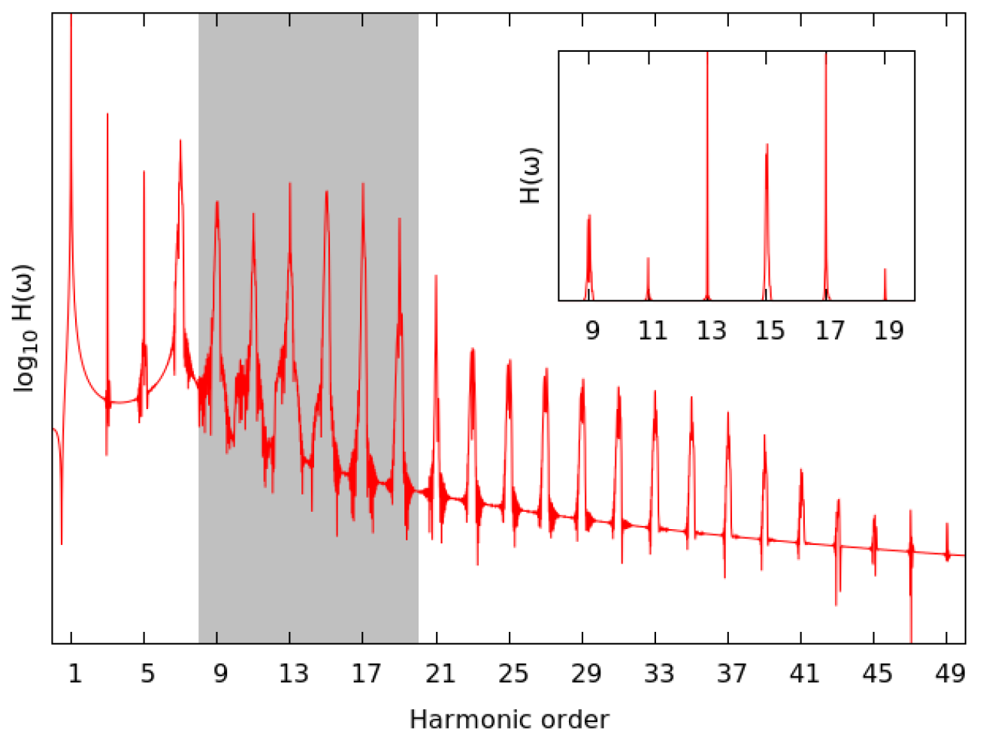
Harmonic spectrum of reference pulse for hydrogen atom

Slide 105
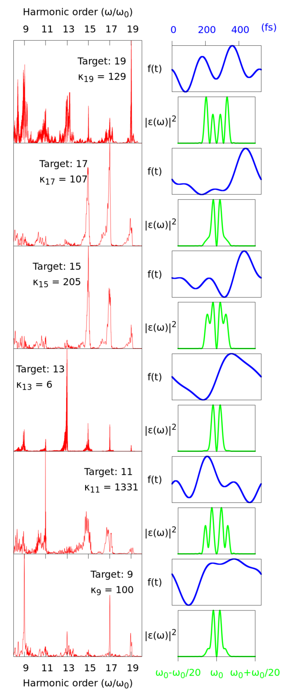
Results for Hydrogen
A. Castro, A. Rubio, E.K.U.Gross,
Eur. Phys. J. B 88, 191 (2015).

Slide 106
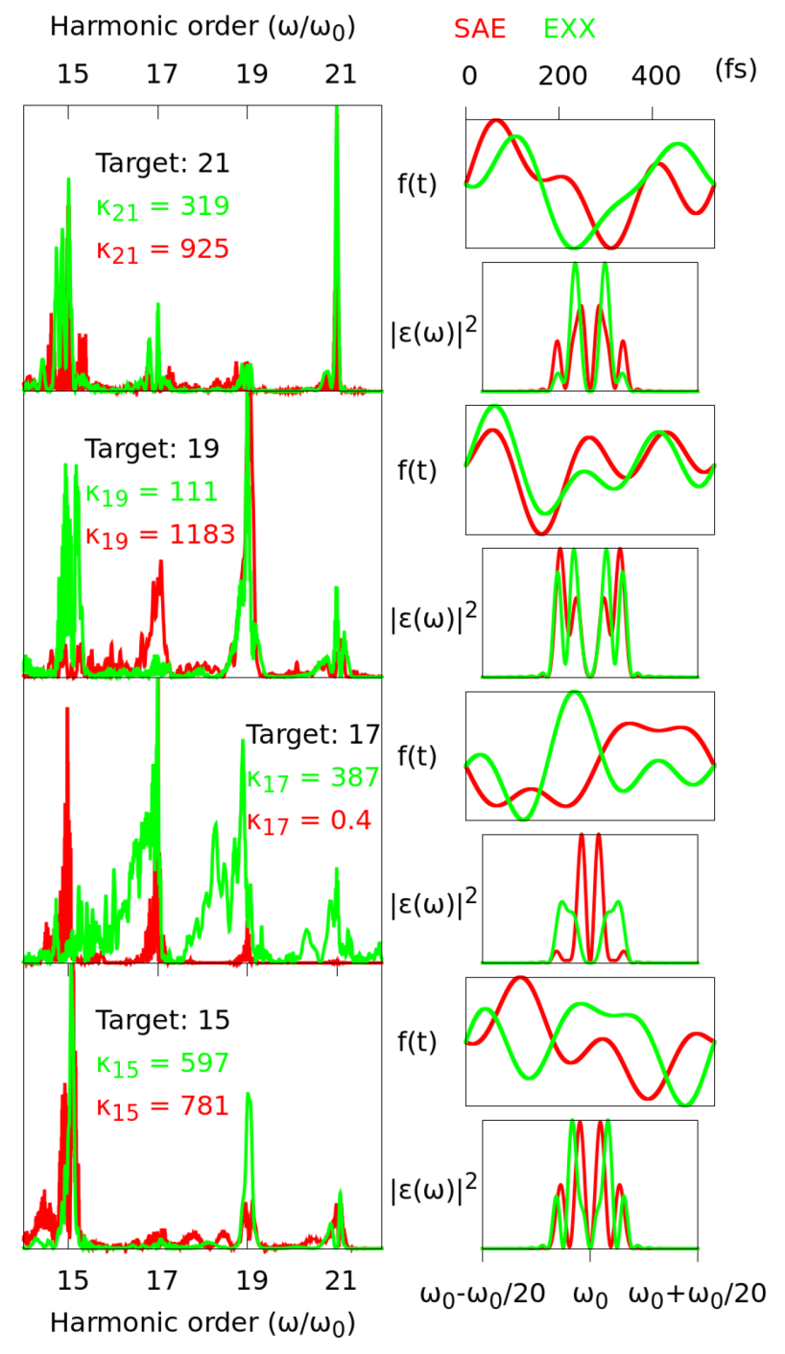
Results for Helium
(Using TDDFT with EXX functional)
A. Castro, A. Rubio, E.K.U.Gross,
Eur. Phys. J. B 88, 191 (2015).

Slide 107
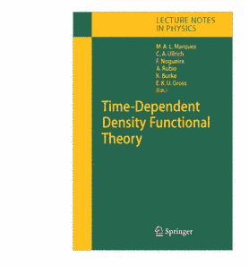
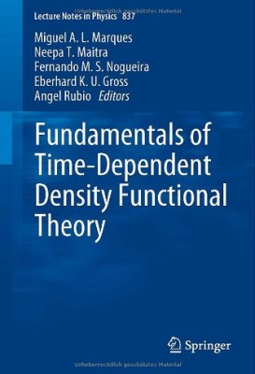
Lecture Notes in Physics 706
(Springer, 2006)
Lecture Notes in Physics 837
(Springer, 2012)

