Slide 1
Potential energy surfaces and Berry phases
beyond the Born-Oppenheimer approximation

Slide 2
"Triad molecule": Candidate for photovoltaic applications
C.A. Rozzi et al, Nature Communications 4, 1602 (2013)
S.M. Falke et al, Science 344, 1001 (2014)
TDDFT propagation with clamped nuclei

Slide 3
"Triad molecule": Candidate for photovoltaic applications
C.A. Rozzi et al, Nature Communications 4, 1602 (2013)
S.M. Falke et al, Science 344, 1001 (2014)
Moving nuclei

Slide 4
Hamiltonian for the complete system of N_{e} electrons with coordinates and N_{n} nuclei with coordinates
with
Stationary Schrödinger equation

Slide 5
Hamiltonian for the complete system of N_{e} electrons with coordinates and N_{n} nuclei with coordinates
with
Time-dependent Schrödinger equation

Slide 6
Born-Oppenheimer approximation
J=1
J=0
solve
for each fixed nuclear configuration
Make adiabatic ansatz for the complete wave function:
and find best χ^{BO} by minimizing <Ψ^{BO} | H | Ψ^{BO} > w.r.t. χ^{BO} :

Slide 7
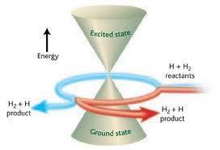
Nuclear equation
Berry connection
is a geometric phase
In this context, potential energy surfaces and the vector potential follow from an APPROXIMATION (the BO approximation).

Slide 8
Can one find a quantity –similar to the molecular Berry phase- but without making the Born-Oppenheimer approximation?

Slide 9
Standard representation of the full TD wave function
Expand full molecular wave function in complete set of BO states:
and insert expansion in the full Schrödinger equation → standard non-adiabatic coupling terms from T_{n} acting on

Slide 10
Plug Born-Huang expansion in full TDSE:
NAC-1
NAC-2

Slide 11
Plug Born-Huang expansion in full TDSE:

Slide 12
Plug Born-Huang expansion in full TDSE:

Slide 13
Plug Born-Huang expansion in full TDSE:
NAC-1
NAC-2
The dynamics is "non-adiabatic" when the NAC terms cannot be neglected

Slide 14
Na⁺+ I⁻
Na + I
When only few BO-PES are important, the BO expansion
gives a perfectly clear picture of the dynamics

Slide 15
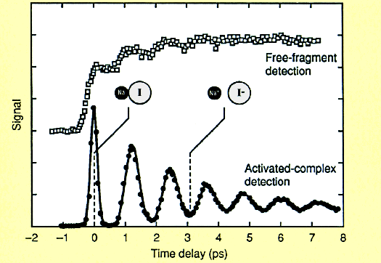
Na⁺+ I⁻
Na + I
emitted neutral Na atoms
When only few BO-PES are important, the BO expansion
gives a perfectly clear picture of the dynamics

Slide 16
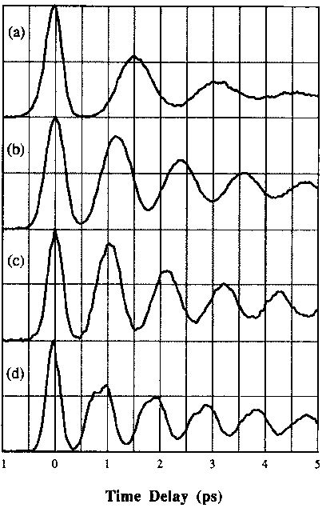
Effect of tuning pump wavelength (exciting to different points on excited surface)
λ_{pump}/nm
300
311
321
Different periods indicative of anharmonic potential
339
T.S. Rose, M.J. Rosker, A. Zewail, JCP 91, 7415 (1989)

Slide 17
For larger systems one would like to (one has to) treat the nuclear motion with cassical trajectories.

Slide 18
For larger systems one would like to (one has to) treat the nuclear motion with cassical trajectories.
But what’s the right classical force when the nuclear
wave packet splits?
Na⁺+ I⁻
Na + I

Slide 19
For larger systems one would like to (one has to) treat the nuclear motion with cassical trajectories.
But what’s the right classical force when the nuclear
wave packet splits?
Na⁺+ I⁻
Na + I
There is only one correct answer!

Slide 20
Outline
Show that the factorisation
can be made exact
Concept of exact PES and exact
Berry phase
Concept of exact and unique
time-dependent PES
Mixed quantum-classical algorithms
Laser-induced ring-opening of oxirane
Vibrational circular dichroism

Slide 21
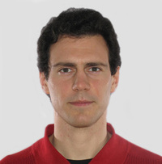
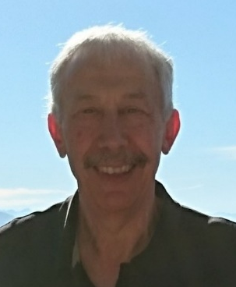
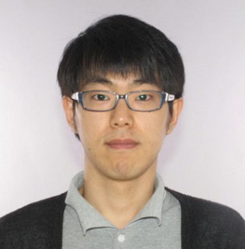
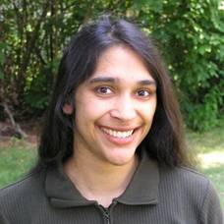
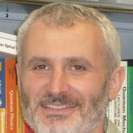
THANKS!
Ali Abedi Federica Agostini
Axel Schild
Yasumitsu Suzuki
Basile Curchod Cesar
b Proetto
Seung Kyu Min
Neepa Maitra Ivano Tavernelli
Rodolphe
Vuilleumier Ryan Requist Nikitas Gidopoulos

Slide 22
Theorem I
The exact solutions of
can be written in the form
where
for each fixed
The factors χ and Φ are unique (up to within
an R-dependent gauge transformation).
N.I. Gidopoulos, E.K.U. Gross, Phil. Trans. R. Soc. 372, 20130059 (2014)

Slide 23
Note:
The diagonal of the nuclear N_{n}-body density matrix is identical with
proof:
1
⇒ in this sense, can be interpreted as a proper nuclear wavefunction.

Slide 24
Theorem II:
satisfy the following equations:
Eq. ❶
Eq. ❷
where
N.I. Gidopoulos, E.K.U. Gross, Phil. Trans. R. Soc. 372, 20130059 (2014)

Slide 25
Theorem II:
satisfy the following equations:
Eq. ❶
Eq. ❷
Exact PES
where
Exact Berry potential
N.I. Gidopoulos, E.K.U. Gross, Phil. Trans. R. Soc. 372, 20130059 (2014)

Slide 26
How do the exact PES look like?

Slide 27
MODEL
S. Shin, H. Metiu, JCP 102, 9285 (1995), JPC 100, 7867 (1996)
R
(1)
(2)
–
+
+
+
0 Å
-5 Å
+5 Å
x
Nuclei (1) and (2) are heavy: Their positions are fixed

Slide 28
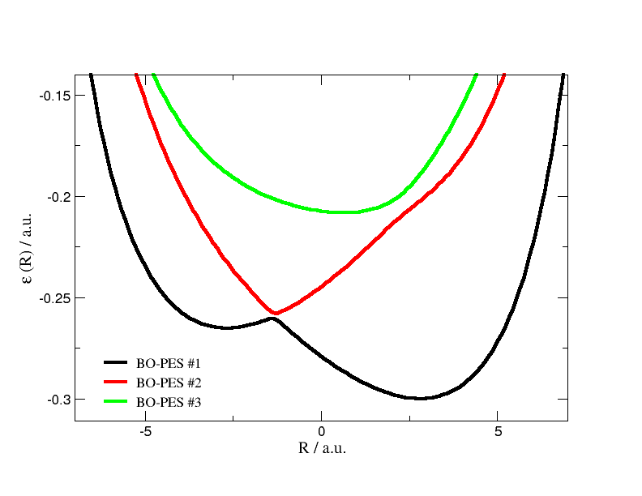

Slide 29
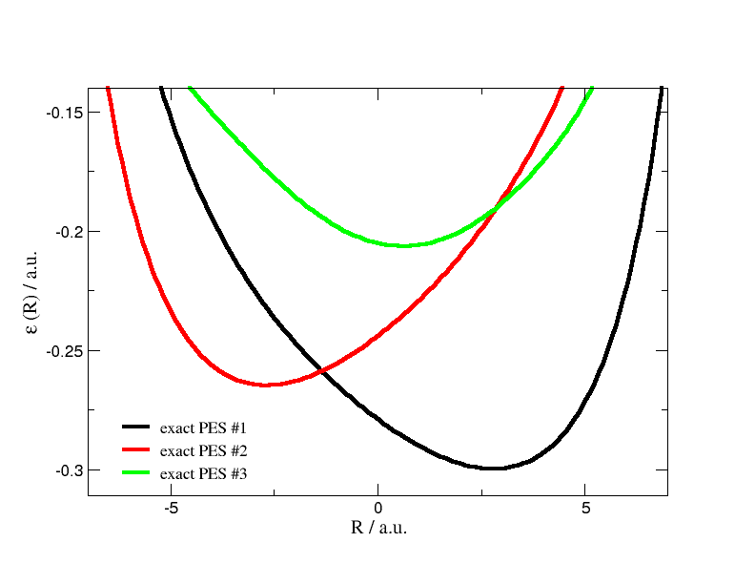

Slide 30
Exact Berry connection
Insert:
with the exact nuclear current density J_{ν}

Slide 31
Another way of reading this equation:
Conclusion: The nuclear Schrödinger equation
yields both the exact nuclear N-body density and the
exact nucler N-body current density
A. Abedi, N.T. Maitra, E.K.U. Gross, JCP 137, 22A530 (2012)

Slide 32
Question: Can the exact vector potential be gauged away,
i.e. is the associated (exact) Berry phase zero?

Slide 33
Question: Can the exact vector potential be gauged away,
i.e. is the associated (exact) Berry phase zero?
Look at Shin-Metiu model in 2D:
(1)
(2)
–
+
+
+

Slide 34
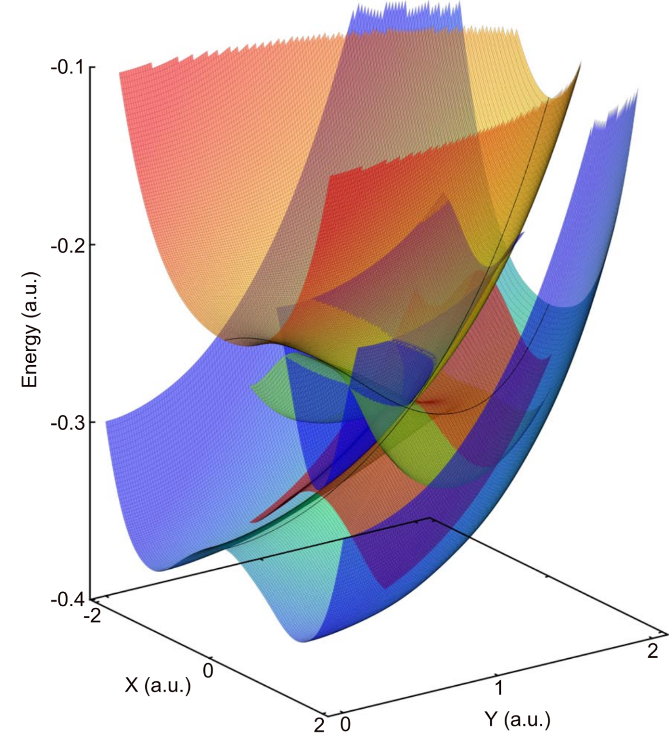
BO-PES of 2D Shin-Metiu model

Slide 35
BO-PES of 2D Shin-Metiu model
conical intersection
with Berry phase π

Slide 36
In this system, the exact vector potential can be gauged
away, i.e. the true Berry phase is zero!!

Slide 37
In this system, the exact vector potential can be gauged
away, i.e. the true Berry phase is zero!!
(although there is a proper Berry phase in BO)

Slide 38
Non-vanishing Berry phase results from a non-analyticity
in the electronic wave function as function of R.
In our example, such non-analyticity is found in the BO
approximation, but not in the exact treatment.

Slide 39
Non-vanishing Berry phase results from a non-analyticity
in the electronic wave function as function of R.
In our example, such non-analyticity is found in the BO
approximation, but not in the exact treatment.
How can this be? BO is the M →∞ limit of the full
treatment!
Look at
as function of nuclear mass M (for the 2D Shin-Metiu model).
S.K. Min, A. Abedi, K.S. Kim, E.K.U. Gross, PRL 113, 263004 (2014)

Slide 40
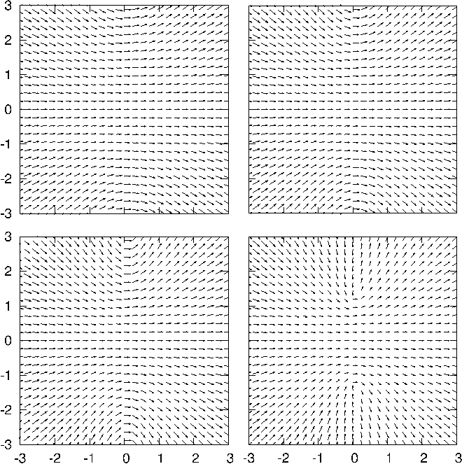
D(R)
M = ∞

Slide 41
D(R)
M = ∞

Slide 42
Question: Can one prove in general that the exact molecular
Berry phase (at finite nuclear mass) vanishes?

Slide 43
Question: Can one prove in general that the exact molecular
Berry phase (at finite nuclear mass) vanishes?
Answer: No! There are cases where a nontrivial Berry phase
appears in the exact treatment.
See lecture by Ryan Requist later this week

Slide 44
Time-dependent case

Slide 45
Theorem T-I
The exact solution of
can be written in the form
where
for any fixed .
A. Abedi, N.T. Maitra, E.K.U.G., PRL 105, 123002 (2010)
JCP 137, 22A530 (2012)

Slide 46
Theorem T-II
satisfy the following equations
Eq. ❶
Eq. ❷
A. Abedi, N.T. Maitra, E.K.U.G., PRL 105, 123002 (2010)
JCP 137, 22A530 (2012)

Slide 47
Theorem T-II
satisfy the following equations
Eq. ❶
Eq. ❷
Exact Berry potential
Exact TDPES
A. Abedi, N.T. Maitra, E.K.U.G., PRL 105, 123002 (2010)
JCP 137, 22A530 (2012)

Slide 48
How does the exact
time-dependent PES look like?

Slide 49
Example: Nuclear wave packet going through an
avoided crossing (Zewail experiment)
Abedi, F. Agostini, Y. Suzuki, E.K.U.Gross,
PRL 110, 263001 (2013)
F. Agostini, A. Abedi, Y. Suzuki, E.K.U. Gross,
Mol. Phys. 111, 3625 (2013)

Slide 50
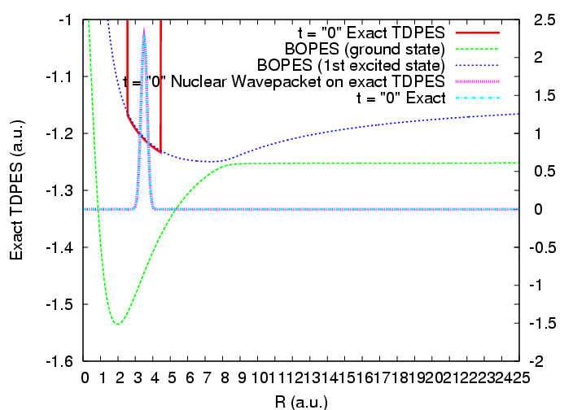

Slide 51
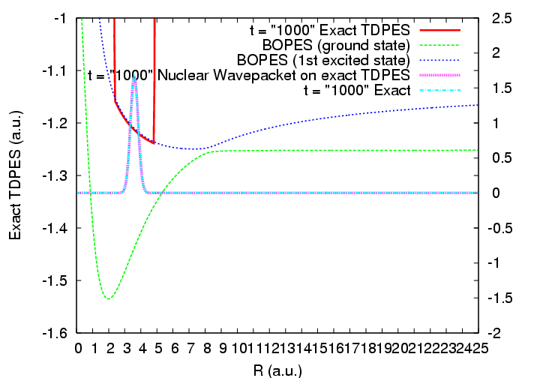

Slide 52
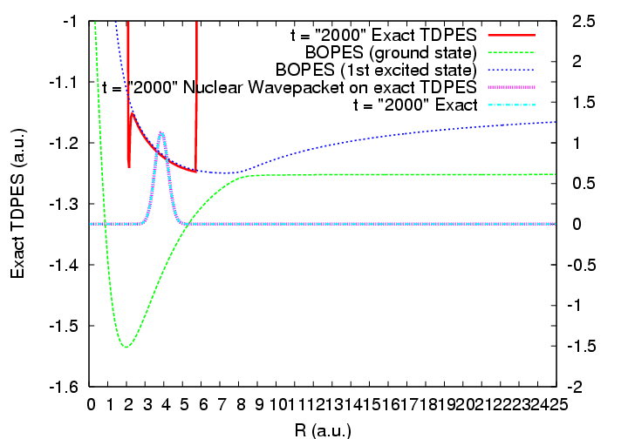

Slide 53
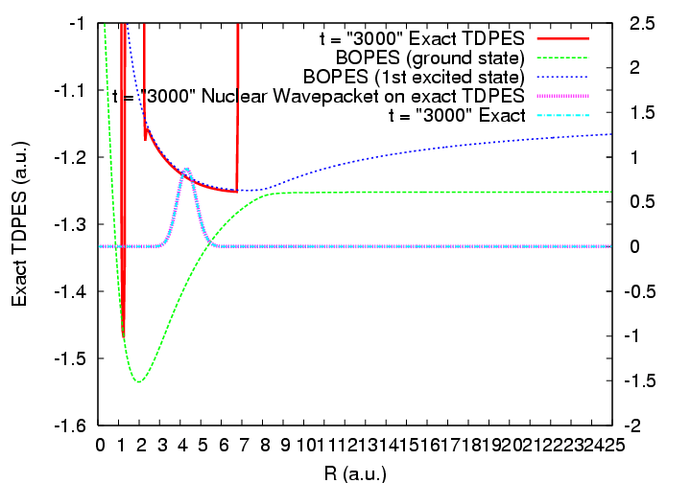

Slide 54
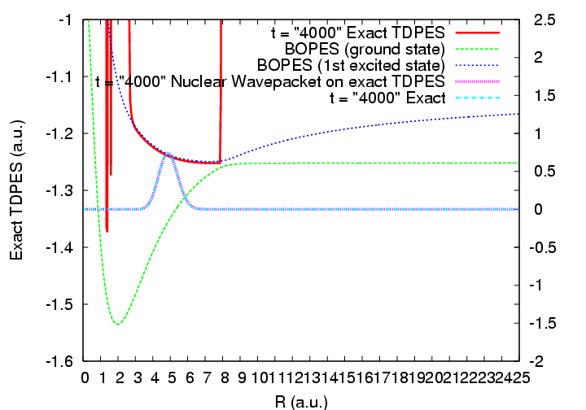

Slide 55
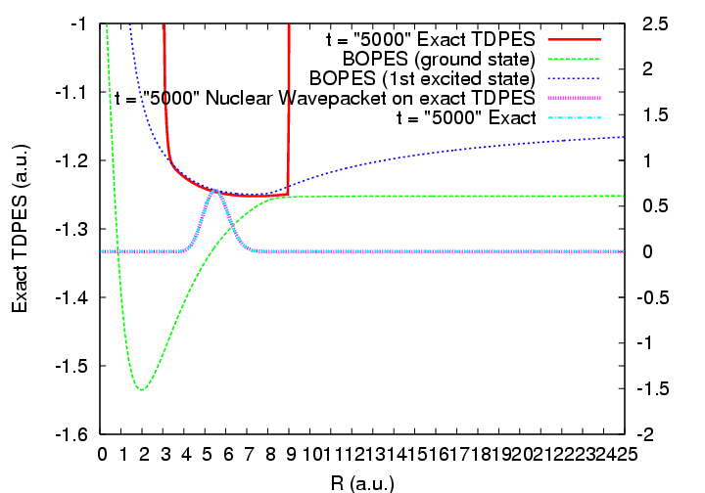

Slide 56
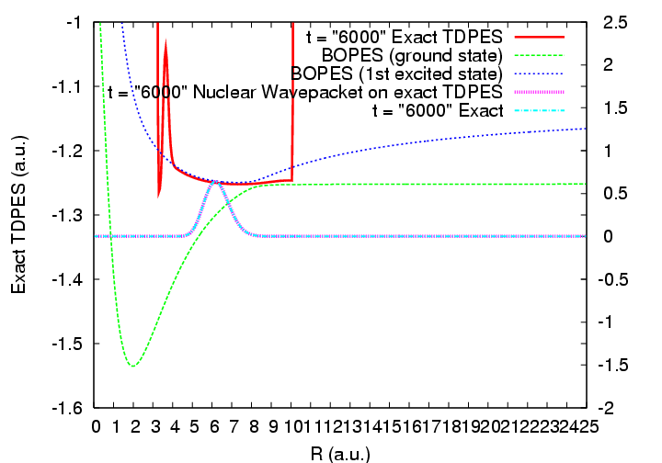

Slide 57
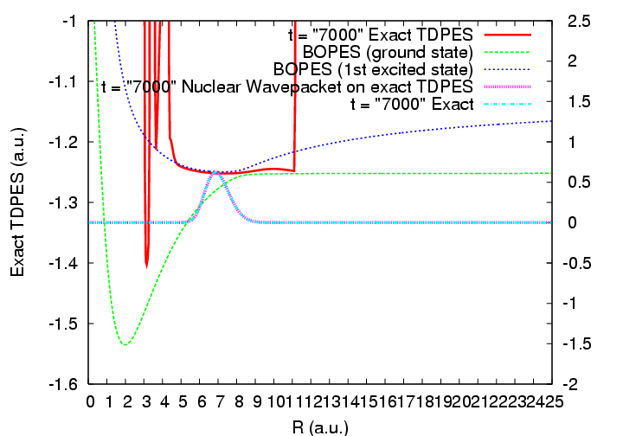

Slide 58
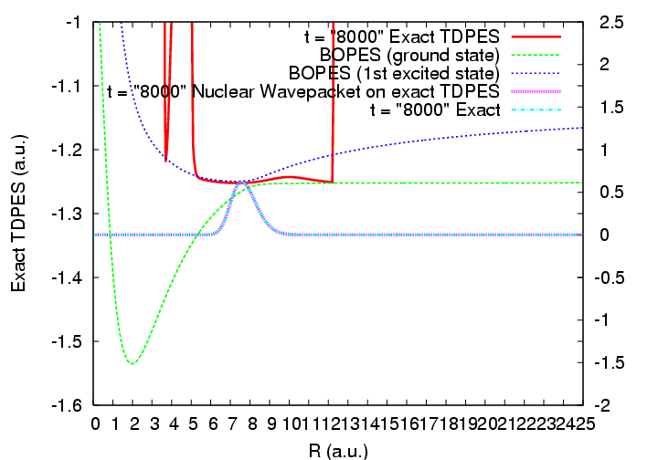

Slide 59
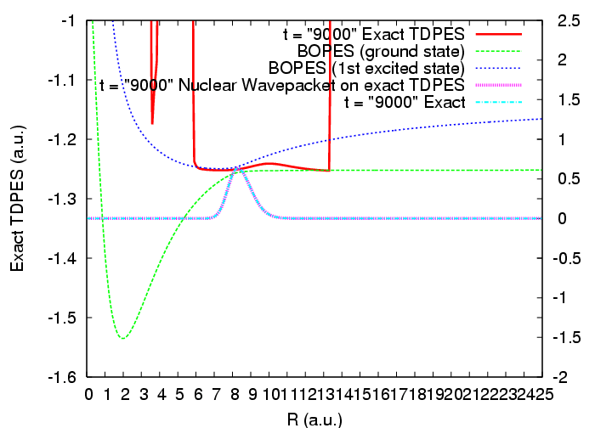

Slide 60
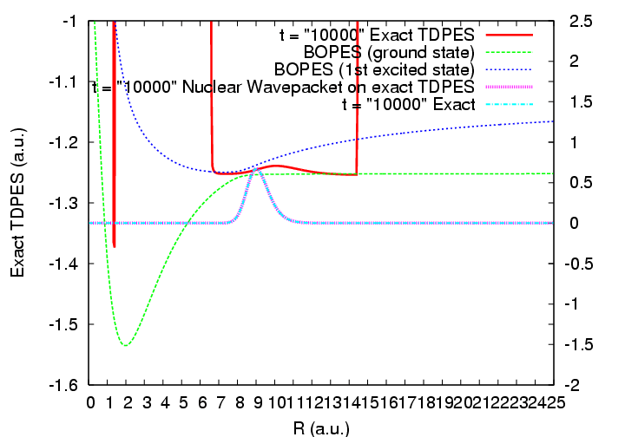

Slide 62
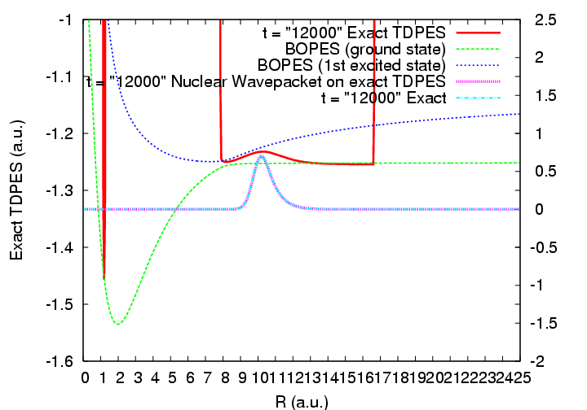

Slide 63
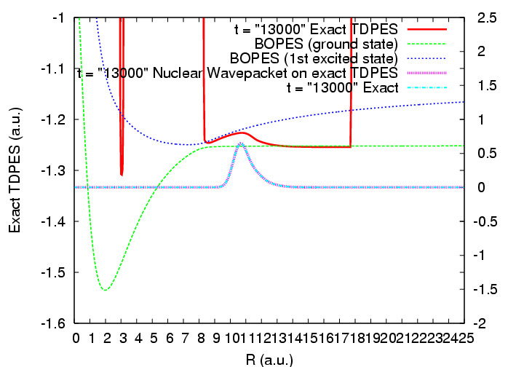

Slide 65
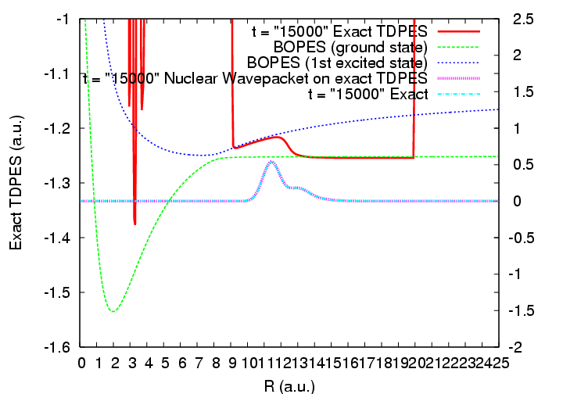

Slide 66
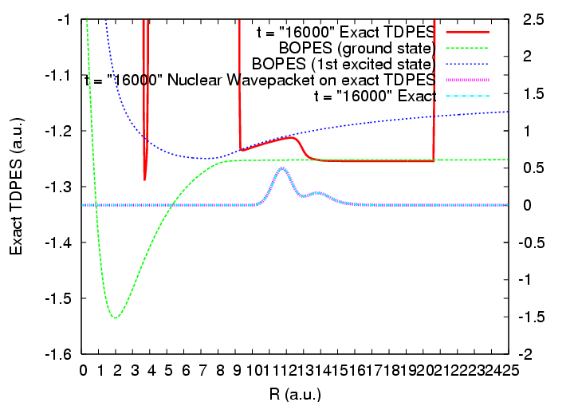

Slide 67
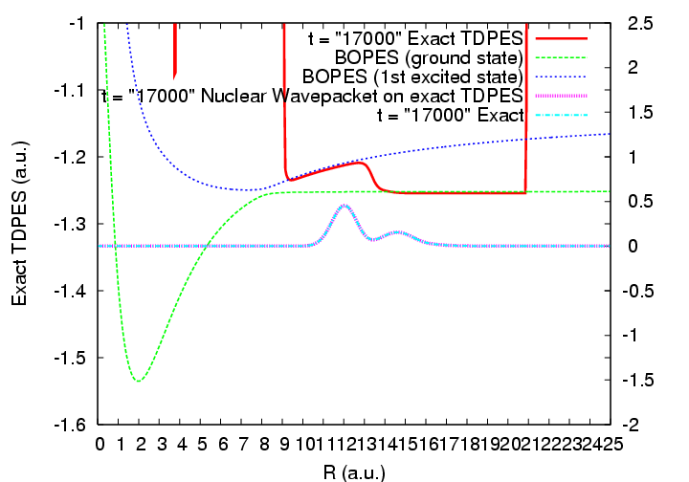

Slide 68
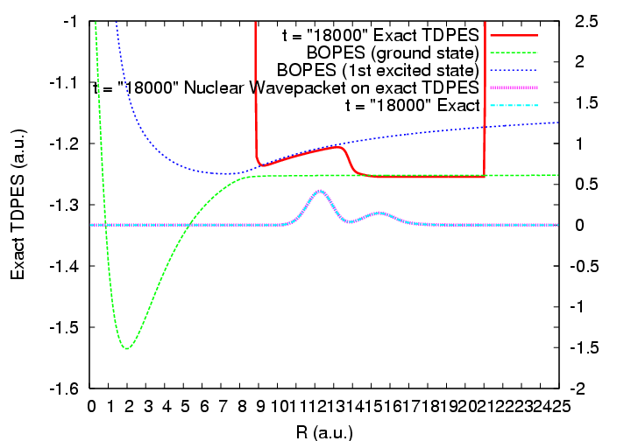

Slide 69
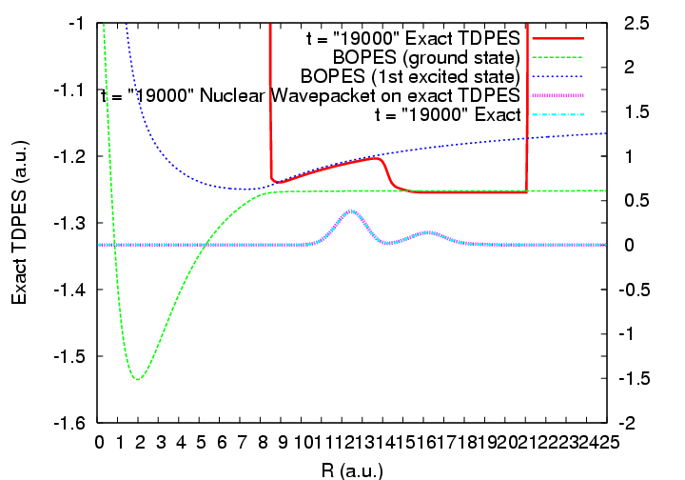

Slide 70
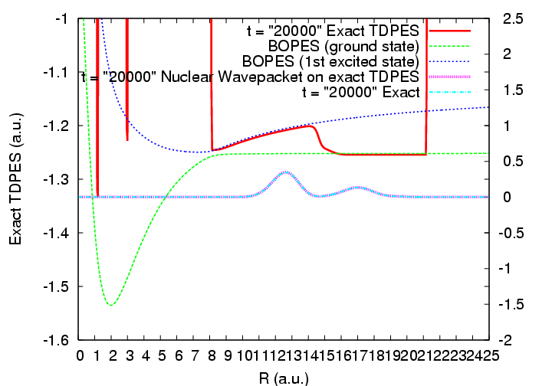

Slide 71
New MD schemes:
Treat the nuclear motion with classical trajectories, but retain
the quantum treatment of the electronic degrees of freedom.

Slide 72
New MD schemes:
Treat the nuclear motion with classical trajectories, but retain
the quantum treatment of the electronic degrees of freedom.
S.K. Min, F. Agostini, E.K.U. Gross, Phys. Rev. Lett. 115, 073001 (2015)
F. Agostini, S.K. Min, A. Abedi, E.K.U. Gross, JCTC 12, 2127 (2016)
F. Agostini, S.K. Min, I. Tavernelli, E.K.U. Gross, JPCL 8, 3048 (2017)

Slide 73
New MD schemes:
Treat the nuclear motion with classical trajectories, but retain
the quantum treatment of the electronic degrees of freedom.
S.K. Min, F. Agostini, E.K.U. Gross, Phys. Rev. Lett. 115, 073001 (2015)
F. Agostini, S.K. Min, A. Abedi, E.K.U. Gross, JCTC 12, 2127 (2016)
F. Agostini, S.K. Min, I. Tavernelli, E.K.U. Gross, JPCL 8, 3048 (2017)
Further step: "Density-functionalization":
to make the many-electron equation of motion tractable
Ryan Requist, E.K.U. Gross, PRL 117, 193001 (2016)

Slide 74
Theorem II
Eq. ❶
Eq. ❷

Slide 75
Theorem II
Eq. ❶
Eq. ❷
Classical Newton equations for nuclear trajectories

Slide 76
Theorem II
Eq. ❶
Eq. ❷
Classical Newton equations for nuclear trajectories

Slide 77
First test: Propagate classical nuclei on the exact TDPES
for an exactly solvable model

Slide 78
1D Shin-Metiu model

Slide 79
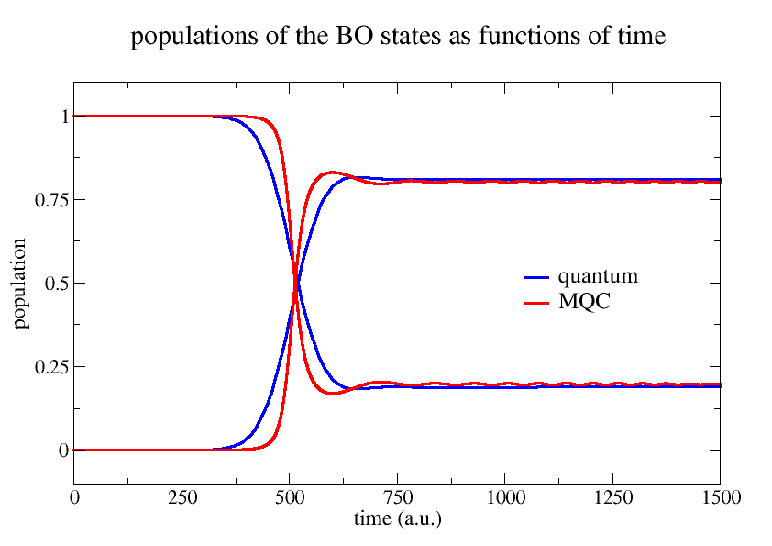
Shin-Metiu model

Slide 80
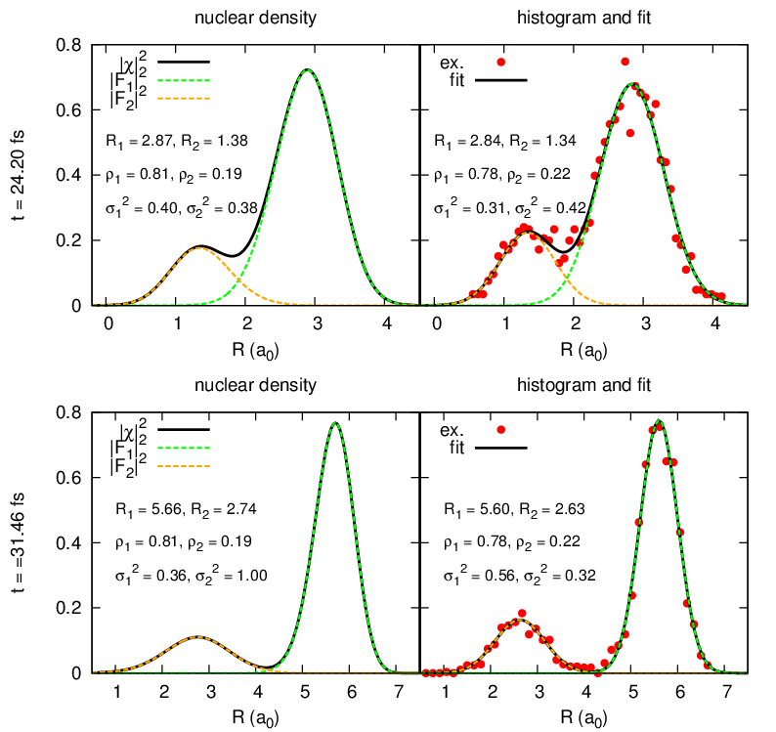
Propagation of classical nuclei on exact TDPES

Slide 81
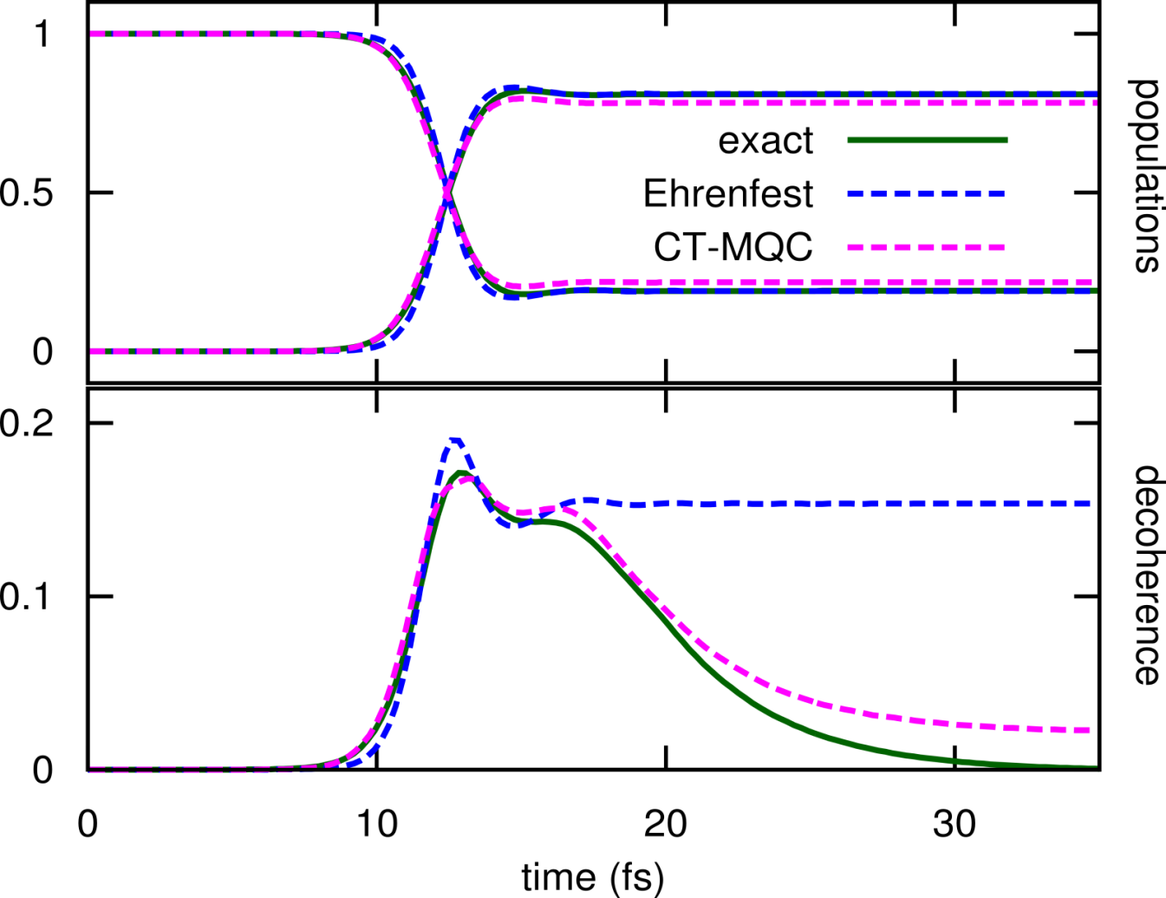
Measure of decoherence:
Quantum:
Trajectories
$$\int{d\underline{\underline{R}}{\left|C_{1}\left(\underline{\underline{R}},t\right)\right|}^{2}{\left|C_{2}\left(\underline{\underline{R}},t\right)\right|}^{2}{\left|χ\left(\underline{\underline{R}},t\right)\right|}^{2}}$$
$$N_{traj}^{−1}\sum_{I}{{\left|C_{1}^{\left(I\right)}\left(t\right)\right|}^{2}{\left|C_{2}^{\left(I\right)}(t)\right|}^{2}}$$

Slide 82
Photo-induced ring opening in Oxirane

Slide 83
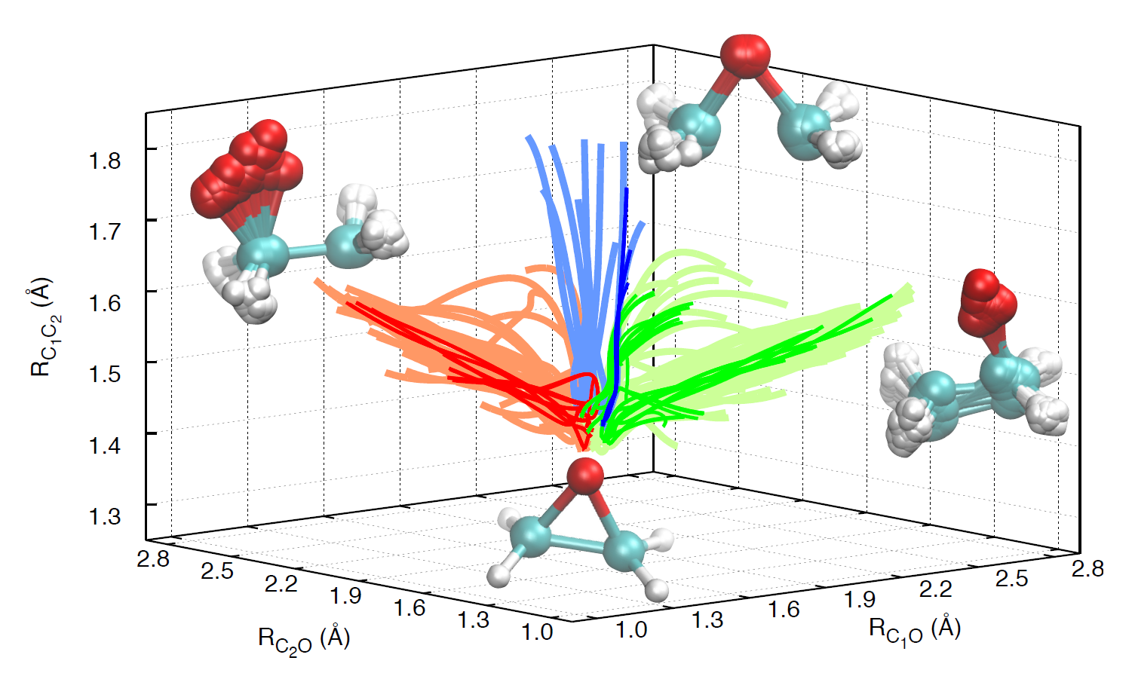
Identification of the three groups of trajectories that, starting from the initial geometries, yield right-open (red) or left-open (green) ring structures and CC-extended bond geometry (blue).
Result: Probability of ring-opening by oxygen motion is about 4 times larger than the C-C-bond stretch. Light colors identify CT-MQC trajectories and darker colors corr-FSSH trajectories.
F. Agostini, S.K. Min, I. Tavernelli, E.K.U. Gross, J.Phys.Chem. Lett. 8, 3048 (2017)

Slide 84
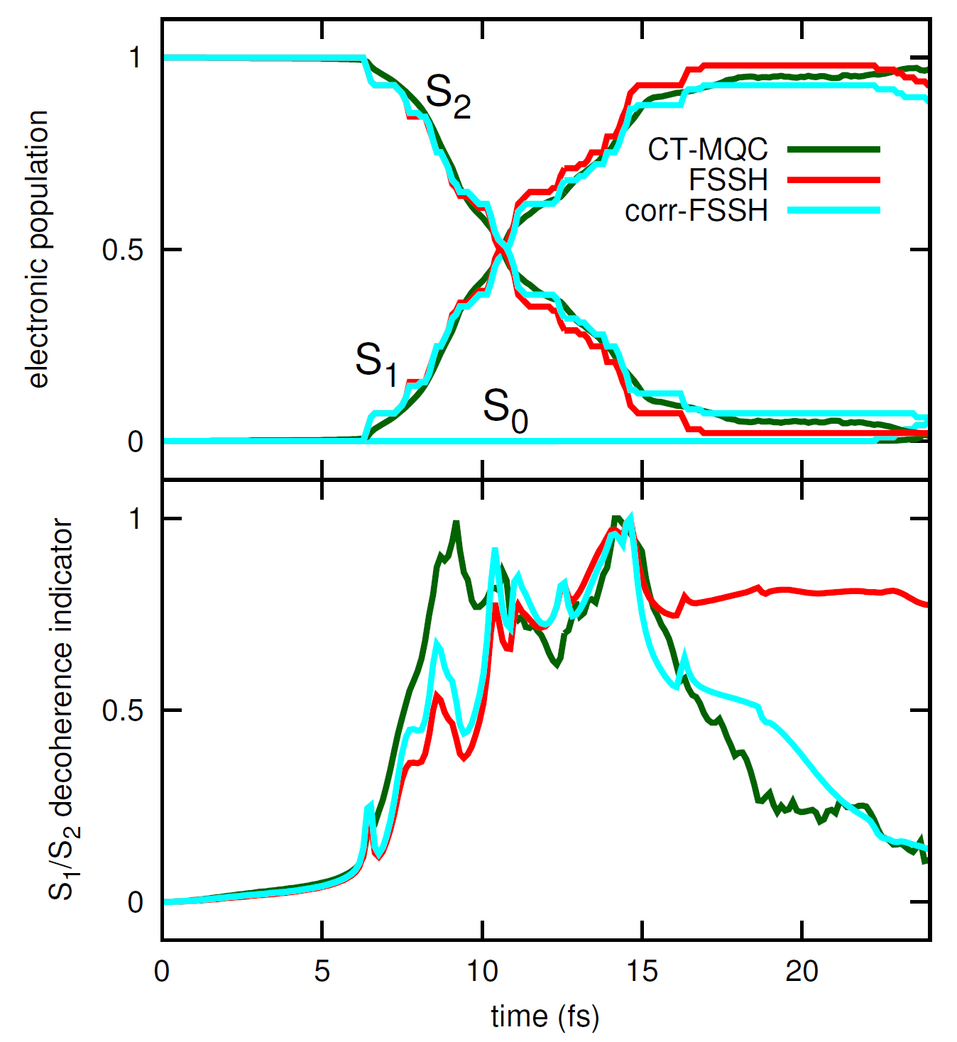
Upper panel: electronic populations of S0, S1 and S2 as functions of time. Lower panel: indicator of decoherence for the element S1=S2. Three sets of results are compared, based on the CT-MQC algorithm (dark-green lines), FSSH (red lines) and corr-FSSH (cyan lines).
F. Agostini, S.K. Min, I. Tavernelli, E.K.U. Gross, J.Phys.Chem. Lett. 8, 3048 (2017)

Slide 85
Upper panel: electronic populations of S0, S1 and S2 as functions of time. Lower panel: indicator of decoherence for the element S1=S2. Three sets of results are compared, based on the CT-MQC algorithm (dark-green lines), FSSH (red lines) and corr-FSSH (cyan lines).
Algorithm implemented
in CPMD
F. Agostini, S.K. Min, I. Tavernelli, E.K.U. Gross, J.Phys.Chem. Lett. 8, 3048 (2017)

Slide 86
Vibrational circular dichroism

Slide 87
Vibrational circular dichroism
Absorption difference between lefthanded and righthanded
circularly polarized light:
with harmonic vibrational frequencies ω_{k} and refractive index n(ω) and
Rotational strength:

Slide 88
Vibrational circular dichroism
Absorption difference between lefthanded and righthanded
circularly polarized light:
with harmonic vibrational frequencies ω_{k} and refractive index n(ω) and
Rotational strength:
Electronic contributions vanish in the adiabatic approximation!!

Slide 89
Adiabatic approximation: Nuclear dynamics on a single BO-PES

Slide 90
Time-dependent electronic (N-body, or one-body) density:
very close to true TD density
completely wrong!!
Basic strategy: Use electronic EoM of exact factorization and treat the non-adiabatic terms in 1st-order perturbation theory

Slide 91
H_{BO}

Slide 92
H_{BO}
Further simplifications:
Neglect first non-adiabatic term because it does not couple directly the electronic and nuclear motion
Time-dependence is dictated by the (slow) nuclear wave packet: aproximate Φ_{R}(r,t) by instantaeous eigenstate

Slide 93
H_{BO}
Further simplifications:
Neglect first non-adiabatic term because it does not couple directly the electronic and nuclear motion
Time-dependence is dictacted by the (slow) nuclear wave packet: aproximate Φ_{R}(r,t) by instantaeous eigenstate
Treat in perturbation theory (“Nuclear velocity PT”)

Slide 94
Employ the exact factorization:
and evaluate Φ_{R} within first-order nuclear-velocity PT, employing DFT-PT

Slide 95
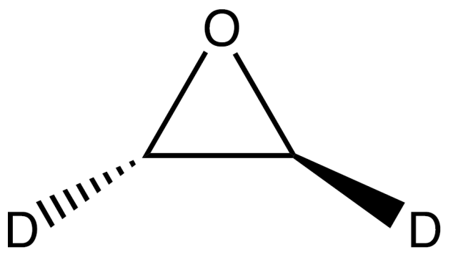
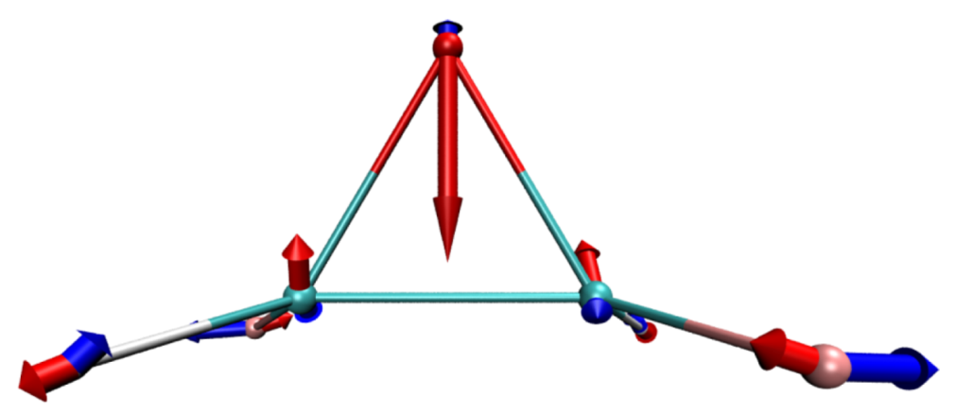
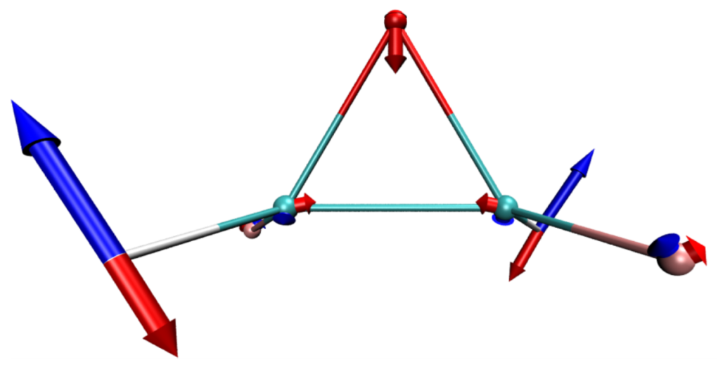
(S)-d2-oxirane
Vibrational modes at 896 cm⁻¹ (left) and at 1089 cm⁻¹ (right) for (S)-d₂-oxirane, with nuclear velocities indicated as blue arrows. The corresponding vector potential is shown as red arrows.

Slide 96
Normal modes, dipole and rotational strengths, for (S)-d₂-oxirane..
 | D_{MFP} | D_{NVP} |  | R_{MFP} |  | R_{NVP}
ῦ(cm⁻¹) | (10⁻⁴⁴ esu² cm²) |  |  | (10⁻⁴⁴ esu² cm²)
647.50 | 0.55 | 0.85 |  | −0.35 | −0.45
733.42 | 123.35 | 124.88 |  | 8.73 | 10.54
769.76 | 53.44 | 51.77 |  | 3.17 | 3.29
856.38 | 145.31 | 145.55 |  | 4.31 | 2.70
894.67 | 9.78 | 10.24 |  | −3.37 | −3.89
936.33 | 39.73 | 39.24 |  | −19.14 | −20.26
1088.21 | 3.79 | 4.44 |  | 6.95 | 8.34
1093.95 | 1.41 | 1.71 |  | −3.98 | −4.97
1210.44 | 26.26 | 26.09 |  | 9.56 | 10.45
1326.86 | 0.34 | 0.37 |  | −0.91 | −0.76
1377.38 | 11.65 | 10.78 |  | −7.50 | −8.17
2235.16 | 49.17 | 50.88 |  | −22.60 | −22.90
2244.19 | 12.63 | 12.81 |  | 16.80 | 16.78
3047.68 | 11.43 | 11.66 |  | −32.80 | −32.59
3054.15 | 58.64 | 60.16 |  | 46.63 | 47.04

Slide 97
Summary of exact factorization
is exact
Exact Berry phase vanishes in some cases and is finite in others
TD-PES shows jumps betweeen BO-PES resembling surface hopping
mixed quantum classical algorithm
Application: Ring opening of oxirane
multi-component DFT for electrons and nuclei
A. Abedi, N.T. Maitra, E.K.U. Gross, PRL 105, 123002 (2010)
S.K. Min, A. Abedi, K.S. Kim, E.K.U. Gross, PRL 113, 263004 (2014)
A. Abedi, F. Agostini, Y. Suzuki, E.K.U.Gross, PRL 110, 263001 (2013)
S.K. Min, F Agostini, E.K.U. Gross, PRL 115, 073001 (2015)
F. Agostini, S.K. Min, I. Tavernelli E.K.U. Gross, JPCL 8, 3048 (2017)
Ryan Requist, E.K.U. Gross, PRL 117, 193001 (2016)

Slide 98
Take-home messages
Exact factorization useful to settle conceptual issues such as
unique classical force on nuclei (even when the nuclear WP splits)
defines “exact geometric phase” without recourse to BO approx
Exact factorization useful to develop practical algorithms
Starting from the right Schrödinger for the nuclei (the one
that comes from the exact factorization), the resulting mixed
quantum classical algorithms give you the effects of surface
hopping and of decoherence for free.
Starting from the electronic EoM of the exact factorization,
nuclear-velocity PT is an accurate an numerically efficient
way to calculate electronic flux densities and vibrational
circular dichroism.

