Slide 1
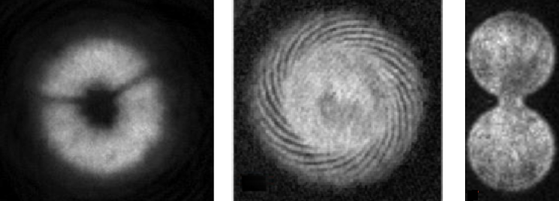
BEC superfluid dynamics in versatile optical potentials
Mark Baker^{1,3},Alexander Pritchard^{1,3},Thomas Bell^{1,3},
Guillaume Gauthier^{1,3}, Matthew Reeves^{1,2}, Stuart Szigeti⁴, Tyler Neely^{1,3}, Matthew Davis^{1,2,3}, Halina Rubinsztein-Dunlop^{1,3}
1. ARC Centre of Excellence for Engineered Quantum Systems (EQUS),
The University of Queensland, St Lucia, QLD 4072 Australia.
2. ARC Centre of Excellence for Future Low-Energy Electronic Technologies (FLEET),
The University of Queensland, St Lucia, QLD 4072 Australia.
3. School of Mathematics and Physics, The University of Queensland, St Lucia, QLD 4072, Australia
4. Department of Quantum Science, Research School of Physics and Engineering,
Australian National University, Canberra 2601, Australia

Slide 2
Outline
Part I – Atomtronic rings
- BEC@ UQ
- Time-averaged optical potentials.
- Novel optical potentials from digital micromirror device (DMD).
- Phase behaviour in time-averaged rings.
- Phase imprinting currents in a ring
- Multi-component BECs in a ring.
Part II – Atomtronic oscillators
Acoustic lumped element models for atomtronic circuits.
Dissipation and conductance models.

Slide 3
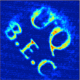
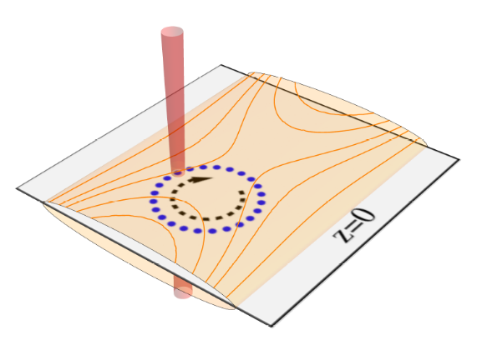
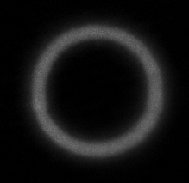

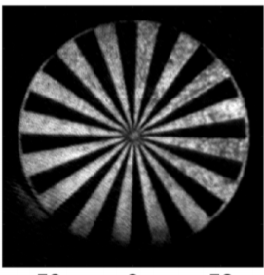
BEC@UQ
Two separate experimental systems capable of configurable optical potentials for 87Rb BEC, using time-averaged optical potentials, and spatial light modulators (digital micromirror devices (DMD).
Time-averaged optical potentials Configurable optical potentials from DMD
Research focus: Ring traps for BEC,
multi-component BEC superfluids.
Research focus: Vortex dynamics in BEC superfluids, atomtronic circuits.
Project led by M. Baker
Project led by T. Neely

Slide 4

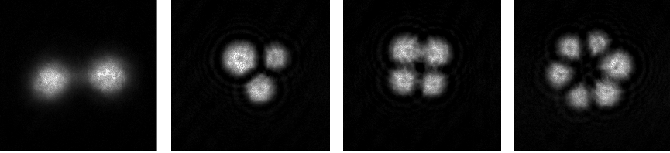
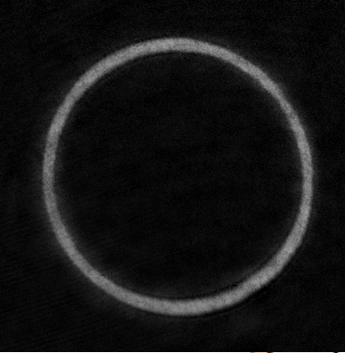
BEC with painted optical potentials
The BEC apparatus incorporates a 2D acousto-optical deflector (2D-AOD) to steer and rapidly scan (up to 8 kHz) a laser beam (1064 nm).
K. Henderson, et al, “Experimental demonstration of painting arbitrary and dynamic potentials for BEC” New Journal Physics 11(4), 043030 (2009)
S.K. Schnelle, “Versatile 2D optical potentials for ultracold atoms”, Opt. Express. 16, 1405 (2008)

Slide 5
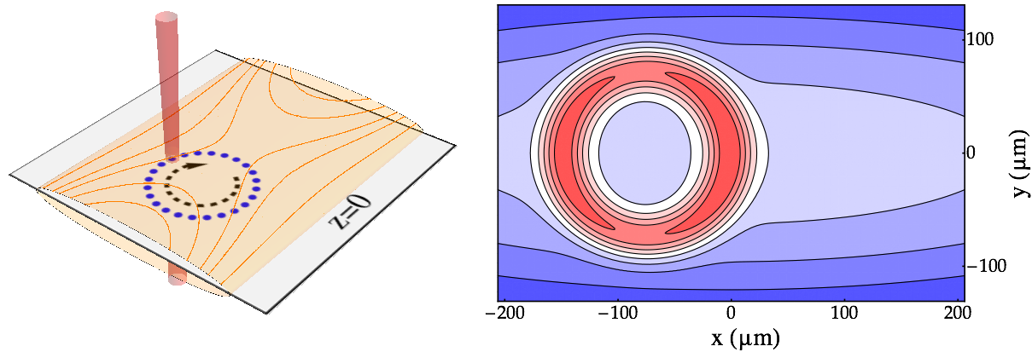
Large, smooth ring traps with BEC
The ring trap is formed from the intersection of the rapidly scanning beam with a cylindrically focused sheet beam (1064 nm).
To correct for the Gaussian potential landscape geometry of the optical sheet, and deflection efficiency of 2D-AOD, we measure the azimuthal atom density and apply step-wise feedforward correction to the ring intensity.
BEC Ring parameters
N=2.5 × 10⁶, T=60 nK.
ωr,ωz=2π (47,110) Hz.
Diameters to 400 micron.
BEC lifetime ~ 16 s.

Slide 6
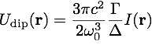
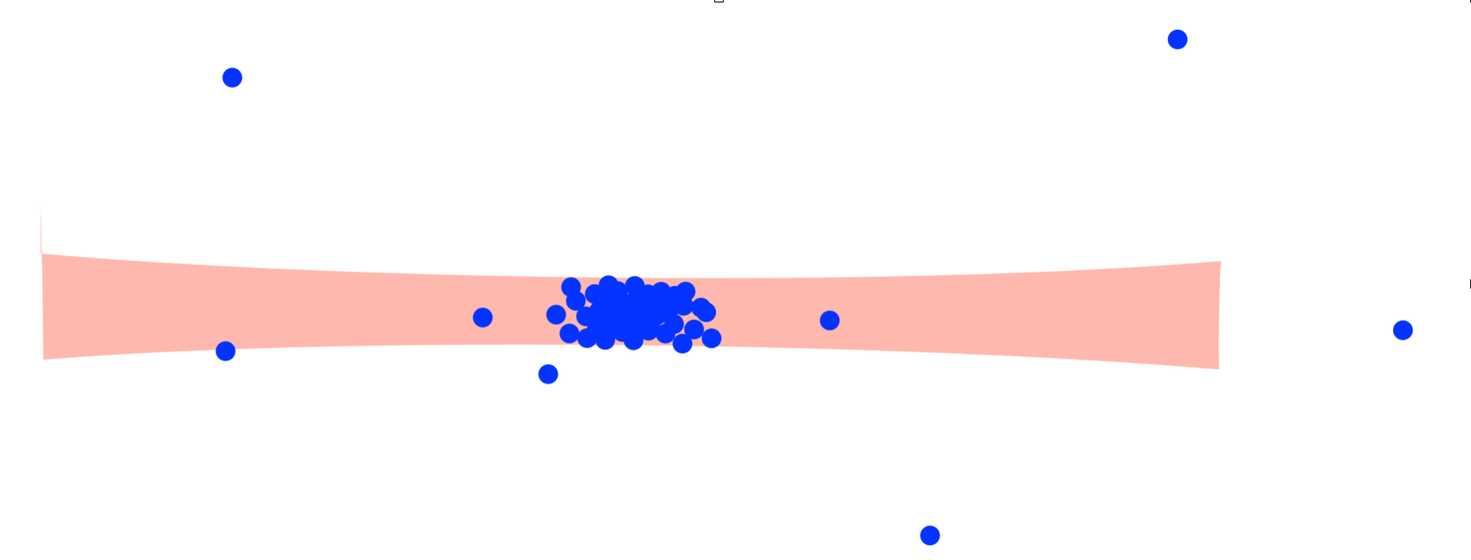
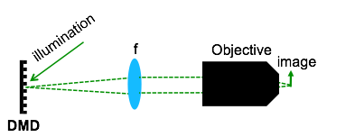
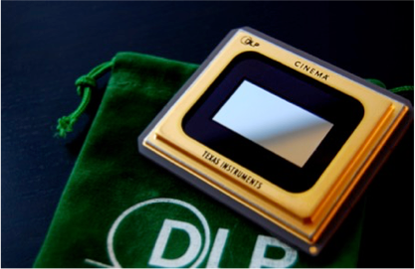
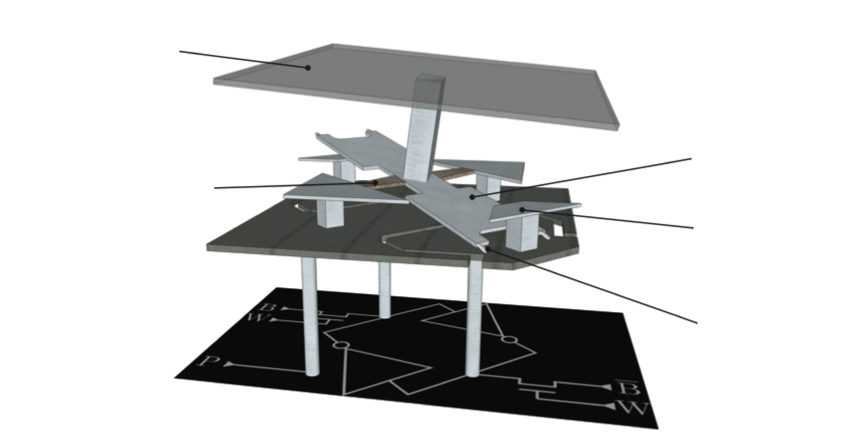
Configurable optical potentials using DMD
Optical traps — easily patterned microscopically, typically limited to Gaussian beams.
Beyond Gaussian Beams: Spatial Light Modulators (SLMs)
Direct imaging (projection):
mirror
torsion hinge
electrode
Digital micromirror device - a configurable binary object

Slide 7
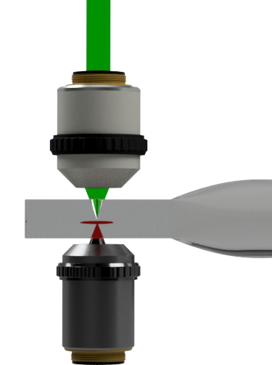
Experimental BEC production and versatile optical traps
1. Laser cool, then trap and transfer the atoms
2. Load into an optical sheet and force evaporation, confine radially with the DMD projection (532 nm light).
Features: Sub-micron projection and imaging resolution, N > 2 x 10⁶
DMD projection
Glass vacuum cell
1064 nm sheet
Recent improvements: Versatile potentials by using gray-scaling and halftoning.
Input binary
Projected light
Trapped BEC²
G. Gauthier, T.W. Neely, et al. "Direct imaging of a digital-micromirror device for configurable microscopic optical potentials." Optica 3 (2016): 1136-1143.
(To be published, in preparation)

Slide 8
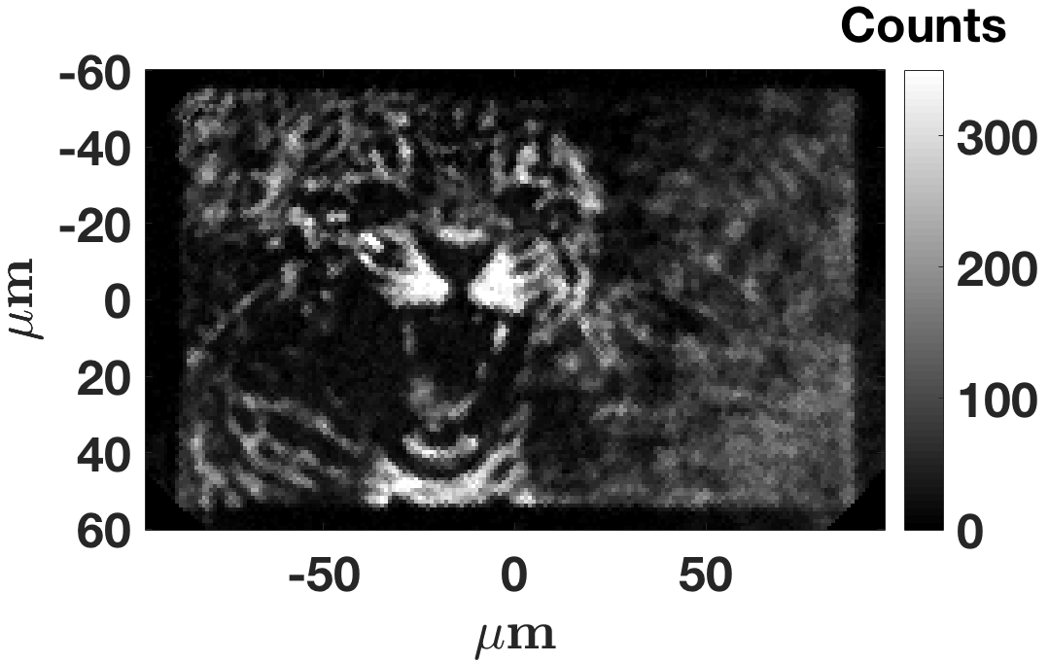
Recent results – DMD experiment
Onsager vortex clusters
G. Gauthier, M. T. Reeves, et al, Negative temperature Onsager vortex clusters in a quantum fluid, arXiv: 1801.06951 (2018) (accepted Science)
(Ashton Bradley, Thurs May 9, 12:15 )
BEC and sculpted light
(Halina Rubinsztein-Dunlop,
Fri May 17, 9:30)
Leopard

Slide 9
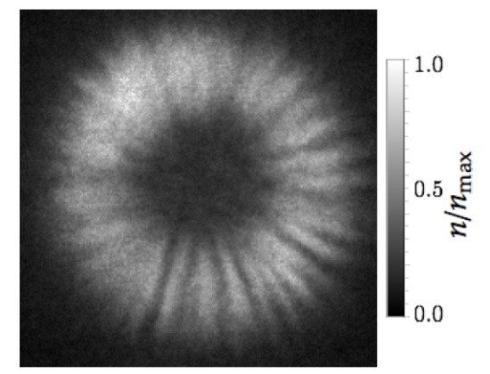
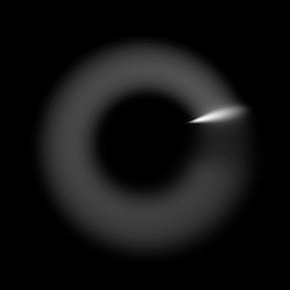
Phase behaviour in time-averaged ring trap
The in-trap density of the time-averaged ring trap is uniform. However, under long time-of-flight, “excitations” in the density can be seen, in particular, a density feature that tracks with the position of the scanning beam.
Time averaged condition is that fscan>>ftrap. True for density, but not necessarily for phase.
In trap 20 ms (fscan=6.25 kHz) 20 ms (fscan=1 kHz)
Time-varying potential V described by
Solve GPE

Slide 10
Phase behaviour in time-averaged ring traps
Top row fs=6.25 kHz,
bottom row fs=500 Hz
T.A. Bell, et al, “Phase and micromotion of BEC in a time-averaged ring trap,”, Phys Rev A 98, 013604 (2018).

Slide 11
Controlling phase of ring trap through scan order
QUESTION: Can we remove this rotating phase gradient and step in the ring
ANSWER: YES (at least, periodiocally).
SOLUTION: Use two counter-propagating beams, where the phase gradients are opposite, and cancel. Can be approximated by a raster type scan with 1 beam.
T.A. Bell, et al, “Phase and micromotion of BEC in a time-averaged ring trap,”, Phys Rev A 98, 013604 (2018).

Slide 12
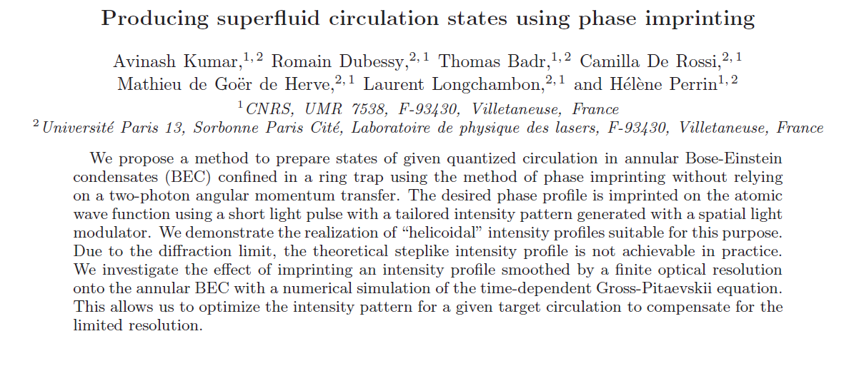
Phase imprinting superfluid circulation in a ring trap
QUESTION: Can we use this phase imprinting ideas to generate superfluid circulations in a ring?
Atomtronics 2017 talk,
H. Perrin
Quantized circulation

Slide 13
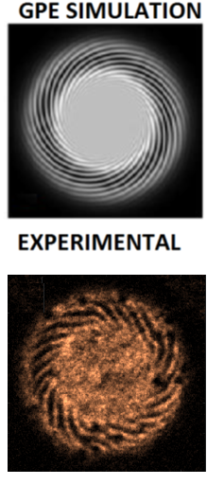
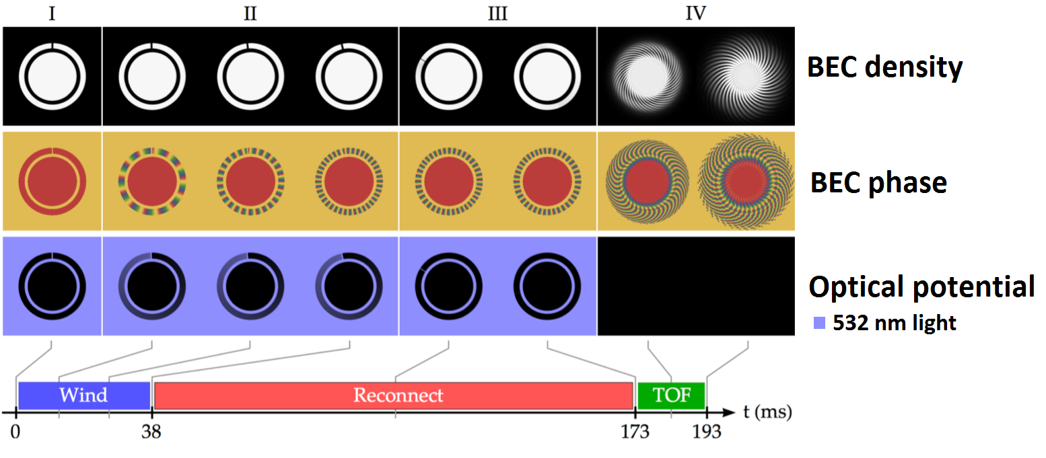
Phase imprinting protocol
Ring BEC with barrier
Using DMD, apply azimuthal gradient in optical potential (532 nm). The BEC acquires acceleration from the gradient in light potential, accumulating phase winding.
Reduce barrier to zero, reconnecting ring.
Interfere ring with target BEC, circulation observed in density (L. Corman, et al, Phys. Rev. Lett. 113, 135302 (2014).
n=22 winding
Imprint time 44 ms

Slide 14
New direction: Multi-component BEC rings
Motivation
Interested in the superfluid interactions between two BEC superfluids, confined in a ring trap.
Superfluid drag: The Andreev-Bashkin effect in Bose gases.
Entrainment, or dissipationless drag between two superfluids. The superfluid current of one component will in general depend also on the superfluid velocity of the other component. (J. Nespolo et al, Andreev-Bashkin effect in superfluid cold gas mixtures, New J. Phys. 19, 125005 (2017))
Kelvin-Helmholtz and Rayleigh Taylor instabilities at superfluid interfaces
“Crossover between Kelvin-Helmholtz and counter-superflow instabilities in two-component Bose-Einstein condensates, N Suzuki", et al, Phys Rev A 82, 063604 (2010).
Two-component BEC interferometers
P. Halkyard, et al, Rotational Response of Two-Component Bose-Einstein Condensates in Ring Traps,
Phys Rev A. 81 061602, (2010)

Slide 15
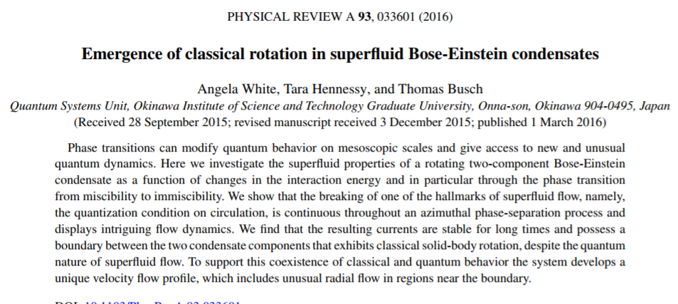
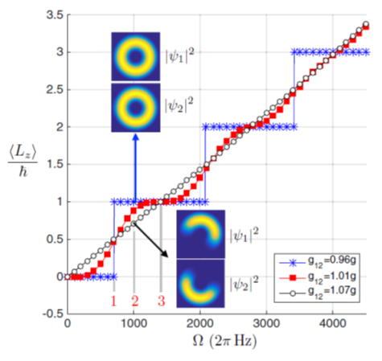
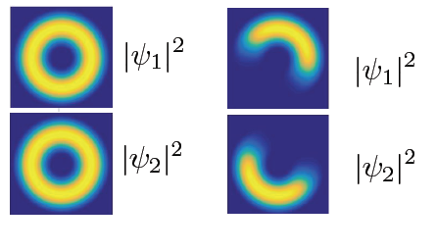
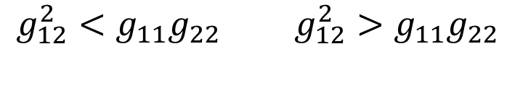
Miscible and immiscible ring condensates
Miscible Immiscible
$g_{12}^{2}<g_{11}g_{22 }$ $g_{12}^{2}>g_{11}g_{22}$
For immiscible condensates, will rotate as an
effective solid body within the two component flow

Slide 16
Phase and velocity profile of two-component ring
Ψ1 Ψ2
Miscible
Each component multiply connected
Quantized azimuthal flow
Superfluid velocity profile α 1/r
Immiscible
No longer multiply connected – can rotate with arbitrary angular momentum
Modified superfluid velocity profile - Azimuthal and radial flow.
To minimize the energy of the system, the boundary between the two condensate components has to always be aligned in the radial direction and therefore rotates as an effective solid body within the two-component flow.
A. White, et al, Phys Rev. A, 033601 (2016)

Slide 17
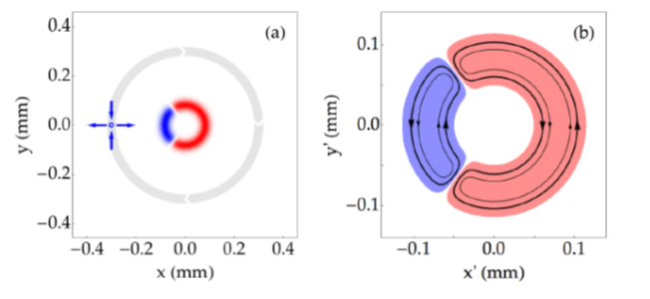
Experimental implementation
Start with |F=1,mF=-1> condensate. Use RF transitions to transfer to |F=1,mF=0> and |F=1,mF=+1> states. Use microwave pulse and imaging light to extinguish any stray unwanted component.
Rotate cloud by accelerating a rotating gradient in the magnetic field.
Separate using Stern-Gerlach gradient field in time-of-flight.
|mF=-1> and |mF=+1> are immiscible

Slide 18
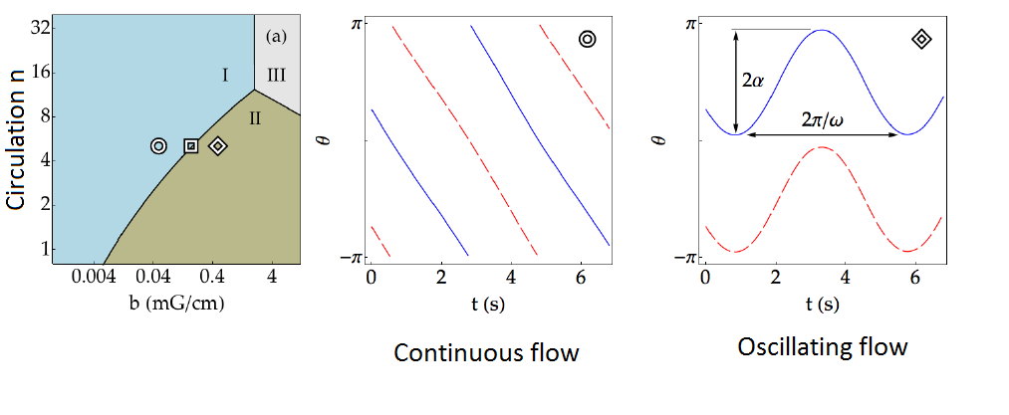
Stability of flow in presence of imperfections
Background gradients:
For large radius r, and small velocity (circulation n), the system is sensitive to stray background field gradients. The two components oscillate, and do not complete full rotation around the ring.
Ring ellipticity and constrictions
Similarly, for elliptical rings or constrictions in the ring, the phase boundary changes size – this interaction energy comes at the expenses of kinetic energy.
A. White, et al, arxiv: 1712.07363

Slide 19
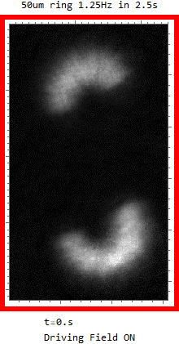
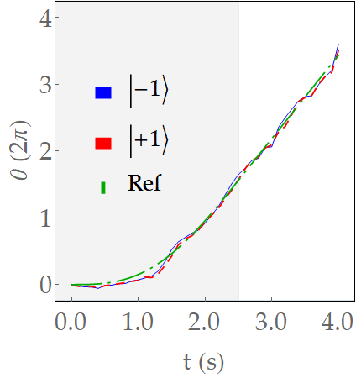
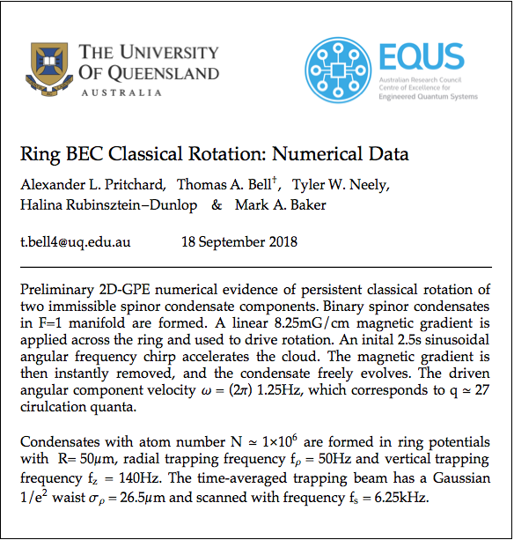
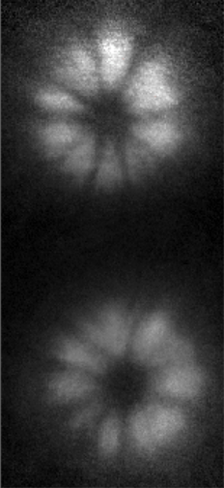
Classical rotation of a two-component superfluid
Centre of mass
100 μm
diameter,
f=1.25 Hz,
10 mG/cm
driving field
Even without rotation, but with X,Y bias fields carefully corrected (but Z field on to maintain spin polarization), we observe domain structure.
The ground state ideally should be two azimuthally separated components. Metastability?

Slide 20
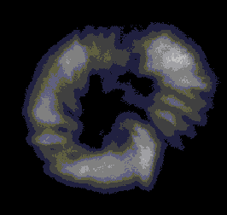
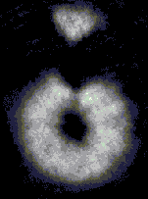

Future directions
Onset of turbulence in miscible/immiscible systems
Spin exchange collisions:
|1,-1> + |1,1> = 2 |1,0>
Tunable size barriers using immiscible mf states
Tunnel junction/weak link using one state as barrier:
Atomtronic SQUID for rotation sensing
State dependent optical dipole potentials
Use tune-out wavelengths at 790 nm, vector polarizability mF dependent
mf
-1
0
Radial phase boundary of immiscible BEC
Idea: Use rapidly rotating magnetic field gradient
Rayleigh-Taylor and Kelvin Helmholtz instabilities,

Slide 21
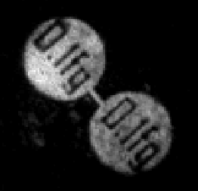
PART II
BEC dumbbell
G. Gauthier et al, “An atomtronic oscillator circuit for quantum gases”, arXiv:1903.04086 (2019)

Slide 22
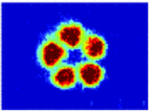
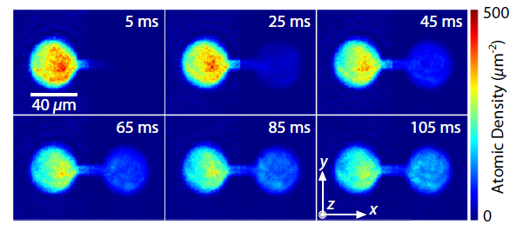
Atomtronic circuits
Understanding transport and dynamics of atomic gas superfluids is fundamental to developing atomtronic circuits.
Tunnel junctions
S. Levy, et al, Nature 449, 579-583 (2007),
C. Ryu, et al, Phys. Rev. Lett. 111, 205301 (2013).
A. Burchianti et al, Phys. Rev. Lett 120, 025302 (2018).
Weak links
S. Moulder, et al, Phys. Rev. A 86, 013629 (2012).
K.C. Wright, et al, Phys. Rev. Lett. 110, 025302 (2013).
F. Jendrzejewski, et al, Phys. Rev. Lett. 113, 045305 (2014).
Mesoscopic channels
D. Stadler, et al, Nature 491, 736 (2012)
D. Papoular, et al Phys. Rev. Lett. 113, 170601 (2014)
S. Eckel et al, Phys. Rev. A 93, 063619 (2016)
A. Li, et al Phys. Rev. A 94, 023626 (2014).

Slide 23
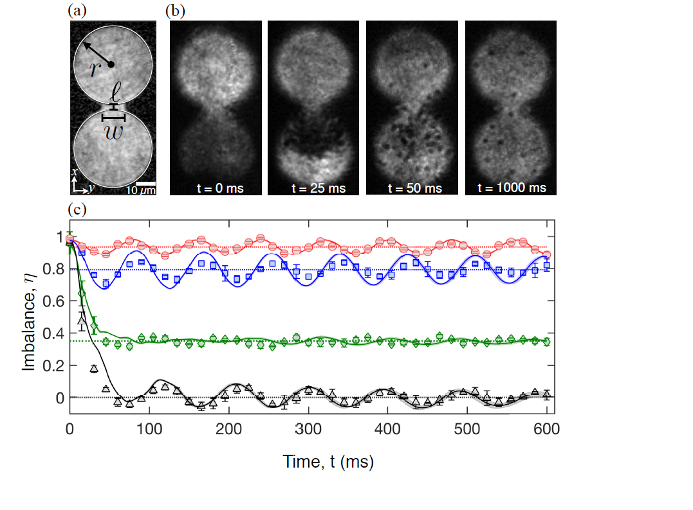
A tunable “dumbbell” oscillator
The DMD allows us to vary channel length, width, and initial imbalance of the dumbbell geometry.
Small imbalance
(undamped)
Large initial imbalance
(Dissipative regime)

Slide 24
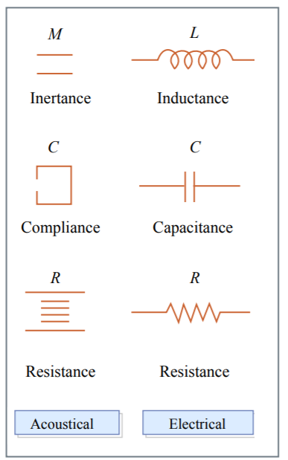
Lumped element models
Lumped element models simplify the description of complex systems by attributing properties to discrete components and approximate the behaviour of the system under certain assumptions.
The lumped element model of electrical circuits describes the behaviour in terms of independent discrete components (inductors, resistors, capacitor)
Acoustical systems can also be treated as lumped elements
A rigid-walled reservoir containing compressible fluid may be approximated as a capacitor.
A tube/channel carrying flow/current be treated as an inductor.
The viscocity/turbulence in the flow gives the resistance.
Adapted from Kinsler, Frey, Coppers & Sanders, Fundamentals of Acoustics, 3rd Ed (1982).

Slide 25

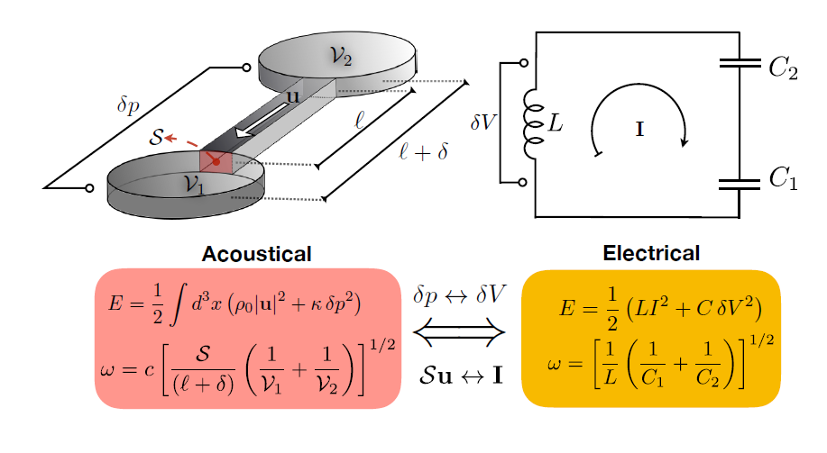
Superfluid acoustics
The geometry of our atomtronic dumbbell circuit, of rigid walled reservoirs and connecting channels, has elements amenable to an acoustic lumped element model.
Since BEC forms a compressible superfluid, the macroscopic parameters (circuit geometry, fluid density, pressure) can be modelled using acoustics.
Lumped element model applies as long as sound waves larger than length scales of system.
Mapping Acoustics to LC circuit
Pressure change dp = V
Volume velocity S.u= I

Slide 26
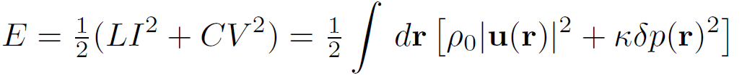




Acoustic lumped element model
Energy of sound waves in the superfluid
KINETIC
POTENTIAL
superfluid mass density (hydrostatic equilibrium)
superfluid velocity.
pressure changes under superfluid flow.
the compressibility.
Assume
For the kinetic (inductive) term, superfluid velocity uniform over the channel (the volume of interest) .
For the potential (capacitive) term, pressure changes uniform across reservoir.

Slide 27




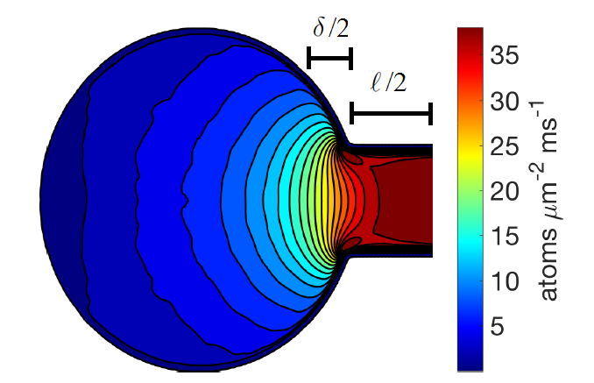
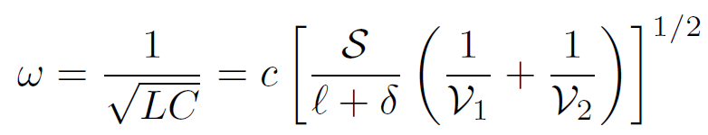

Acoustic model of atomtronic oscillator
Equating terms, and integrating KE and P.E. terms across channel and reservoirs respectively
is the effective channel length. = volume of reservoirs
This length correction accounts for the extension of the superfluid flow beyond the physical channel length; in the electronic analogy, it accounts for the residual inductance of the reservoirs.
Function of geometry, end correction, and speed of sound – the model describes acoustic Helmholtz resonator
Single GPE simulation for given channel, and fit to equation
gives end correction
For circular channel,

Slide 28
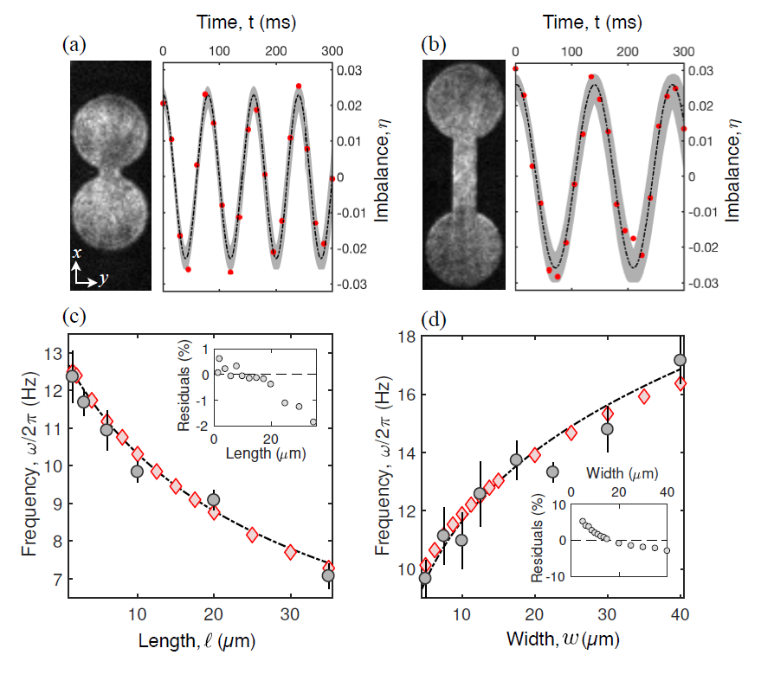

Low imbalance results
We observe undamped oscillations
Acoustic model correctly predicts the frequency of oscillation for various length and width channels
Black dash-dot line is one parameter fit of GPE data to acoustic model.
w=12.5 µm
l=1.5 µm

Slide 29








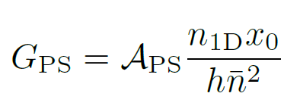


Dissipation regime – resistive flow
The superfluid velocity is given by the phase gradient along the channel,
Large initial imbalance results in v > v_{c} , critical velocity of the superfluid. Above v_{c}, it is energetically favourable for the phase to slip through 2π, resulting in excitations that dissipate energy. We can ignore microscopic details of the excitation, and state that phase slips realize an Ohmic resistive current
A. Burchianti, F. Scazza, A. Amico et al,
Physical Review Letters 120, 025302 (2018).
= chemical potential difference
= conductance in presence of phase slips
Assume each resulting excitation contains atoms. From the Josephson-Anderson relations , the rate of phase slips,
Resulting conductance for this phase-slip model, acting like a classical resistor, is
= scaling factor,

Slide 30
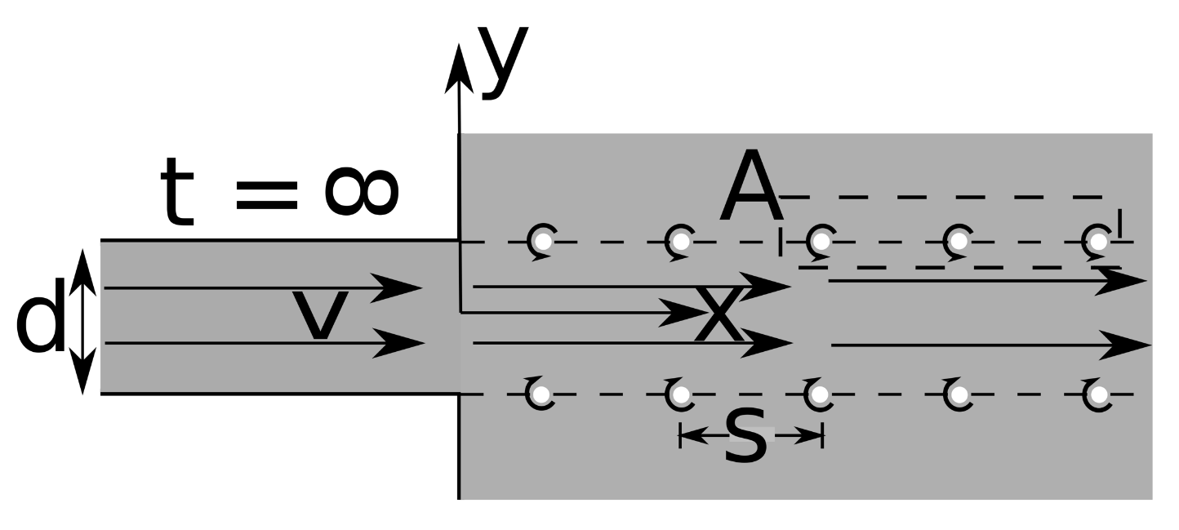
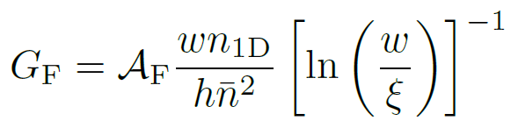




Feynman superfluid resistance model
Feynman suggested dissipation from the superfluid flow can be accounted for in the production of vortex pairs and resulting vortex-vortex interaction.
The model assumes adjacent vortex pairs do not significantly interact within the channel, satisfied if d< S.
Define Feynman conductance,
channel width
average number density of superfluid
scaling factor
healing length
S. Eckel, J. G. Lee, et al, Physical Review A 93, 063619, (2016).

Slide 31
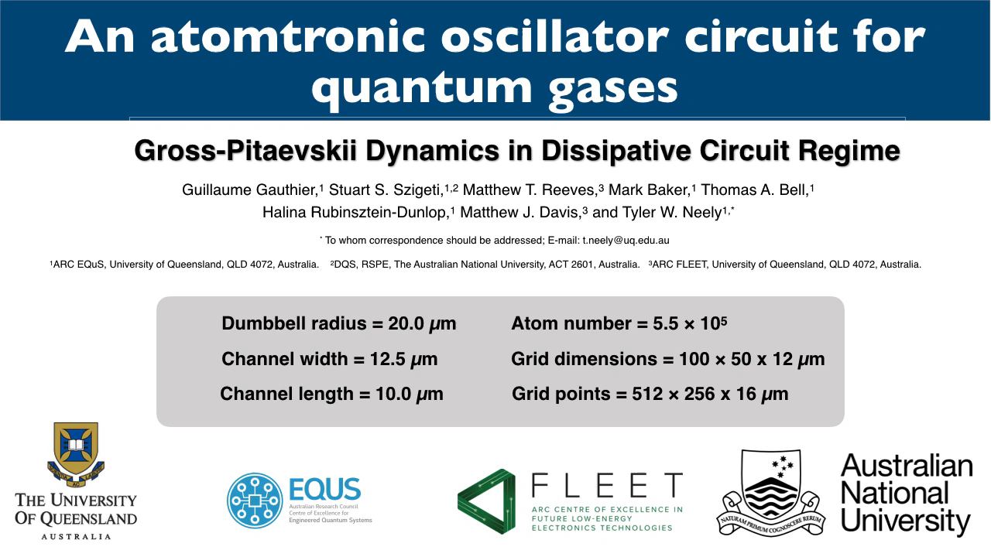
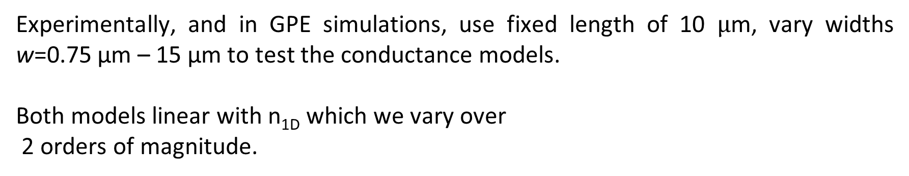
Testing conductance models
Experimentally, and in GPE simulations, use fixed length of 10 $µ$m, vary widths w=0.75 µm – 15 µm to test the conductance models.
Both models linear with n_{1D} which we vary over
2 orders of magnitude.
Conductance determined by RC decay model for decay constant time
Chemical conductance
Chemical capacitance
S. Eckel, J. G. Lee, et al, Physical Review A 93, 063619, (2016).

Slide 32
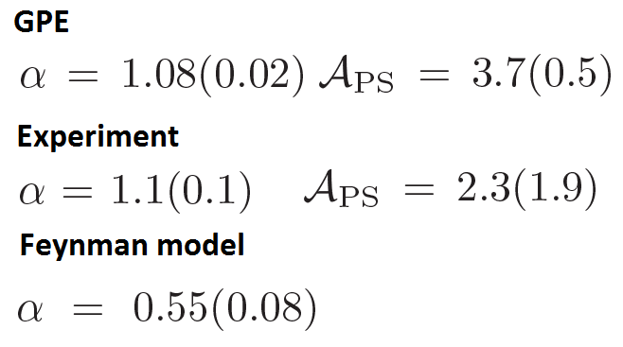

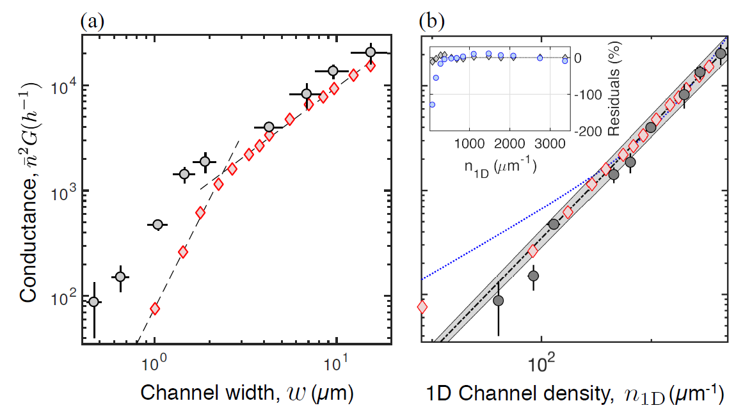
Dissipative regime conductance
Fit data to power law

Slide 33
Conclusions
At low imbalance/currents, frequency and amplitude is accurately described by acoustic lumped model (Helmholtz resonators).
At high imbalance/large currents, we observe vortices and sound in GPE and experiment. The resulting conductance is supported by a phase-slip model with excellent agreement, and consistent with previous observations.
Feynman model of (solely) vortex interactions does not explain total energy dissipation.
Future work: characterise critical velocity v_{c} more accurately as function of geometry.

Slide 34
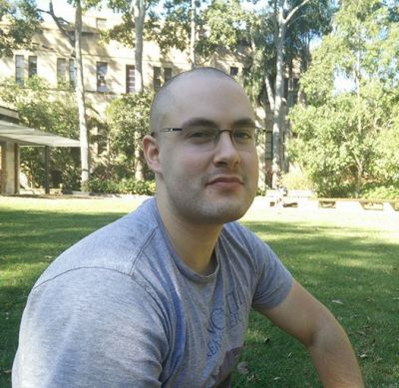









Acknowledgements
Students
Staff
Guillaume Gauthier Thomas Bell Alex Pritchard Kwan Goddard-Lee
Stuart
Szigeti (ANU)
Matt
Reeves
Tyler
Neely
Matthew
Davis
Michael
Bromley
Halina Rubinsztein
-Dunlop
Funding
Australian Research Council (ARC) Centre of Excellence for Engineered Quantum Systems (CE1101013), Centre of Excellence for Future Low Energy Technologies (CE170100039), ARC Discovery Projects (DP160102085),
Halina Rubinsztein- Dunlop

