Slide 1
Solitons and turbulence in dipolar gases
Atomtronics 2019
Newcastle University
Thomas Bland
Nick Parker
Nick Proukakis
Andrew Baggaley
George Stagg
Luca Galantucci
Ryan Doran
CFT-PAN (Warsaw)
Kazik Rzazewski
Krzysiek Pawlowski
Tel-Aviv University
Boris Malomed
University of Melbourne
Andy Martin
Sri Prasad
Mitch Knight
Keio University
Matthew Edmonds
Swinburne University
Brendan Mulkerin
McMaster University
Duncan O’Dell

Slide 2
Outline
Dipolar gases - quantum ferrofluids
Lower dimensional dipolar BECs
Dipolar dark solitons
Dipolar bright solitons
Classical field methods
Quantum ferrofluid turbulence
Tuning the DDI (if we have time)

Slide 3
Outline
Dipolar gases - quantum ferrofluids
Lower dimensional dipolar BECs
Dipolar dark solitons
Dipolar bright solitons
Classical field methods
Quantum ferrofluid turbulence

Slide 4
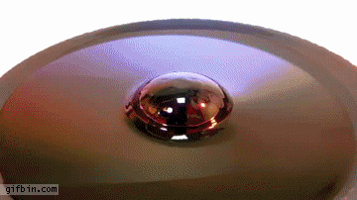
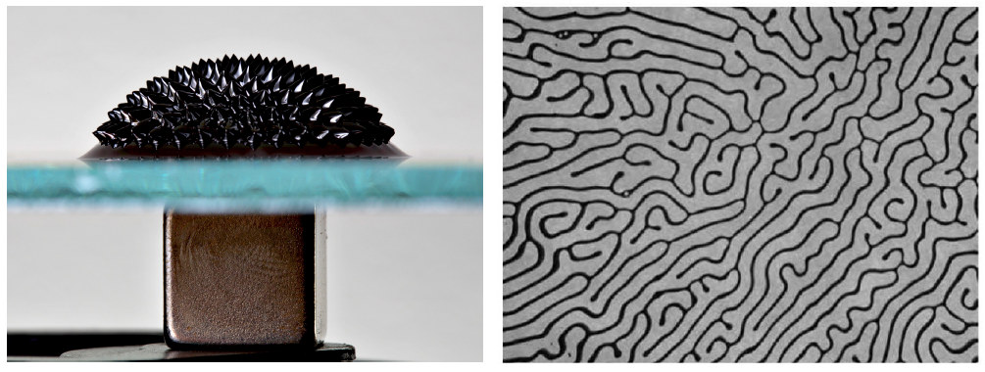
Classical and quantum ferrofluids
Classical Rosensweig instability
A ferrofluid is a collection of nanoscale ferromagnetic particles that have been suspended within a carrier solution, which coats each nanoparticle with a surfactant to inhibit aggregation.

Slide 5
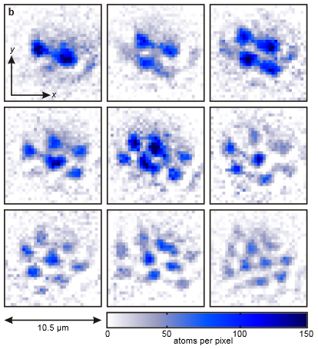
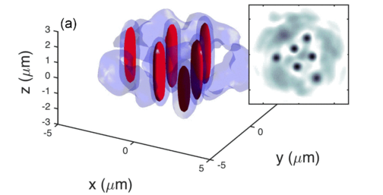
Classical and quantum ferrofluids
Classical Rosensweig instability
A ferrofluid is a collection of nanoscale ferromagnetic particles that have been suspended within a carrier solution, which coats each nanoparticle with a surfactant to inhibit aggregation.
Quantum Rosensweig instability – droplets!
Bisset+, Phys. Rev. A 92, 061603(R) (2015)
Kadau+, Nature 530, 194 (2016)

Slide 6
Ultracold Dipolar Gases
What?
Atoms with magnetic dipole moments.
Permanent or induced by electric field.
Polar (heteronuclear) molecules, e.g. Rb-Cs.
Bosons or fermions.
Why?
Novel states of matter, e.g. supersolids.
Quantum phase transitions – droplets!
Anisotropy and long-range interactions.

Slide 7
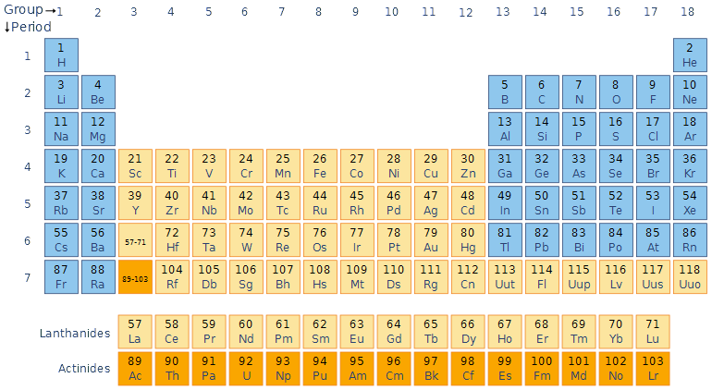
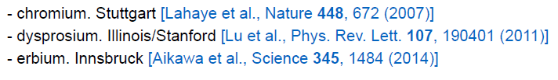
Creation of Dipolar BECs
Alkali metals
μ∼ 1μ_{B}
s-wave BECs (since 1995)
Chromium (⁵²Cr)
μ = 6μ_{B}
Condensed in 2005
First dipolar BEC / quantum ferrofluid
Dysprosium (¹⁶⁴Dy)
μ = 10μ_{B}
Condensed in 2011
Erbium (¹⁶⁸Er)
μ = 7μ_{B}
Condensed in 2012
Notes:
The first strongly dipolar degenerate gas was achieved in 2005 by the Pfau group [12]
creating a BEC of 52Cr atoms. This particular isotope of chromium has a ground state
spin quantum number of 3, giving a large magnetic dipole moment of 6B, where B is
the Bohr magneton. The non-zero quantum spin number at degeneracy also allows for a
2-body loss process — where the spin of a colliding atom is flipped, converting between
spin and orbital angular momentum — known as dipolar relaxation. Zeeman splitting
can be used to thermally freeze out spin flips, so this problem was overcome by optically
pumping the atoms into the lowest energy spin state, ms=-3

Slide 8
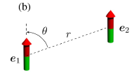
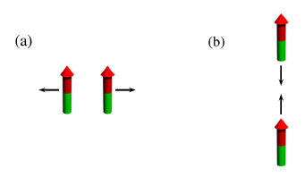
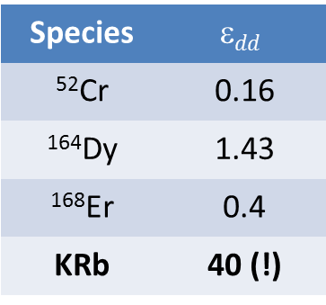
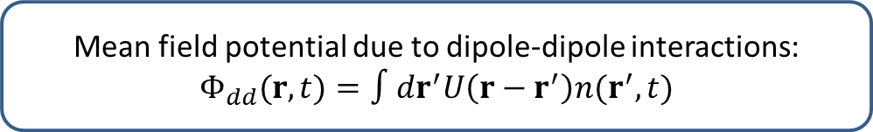
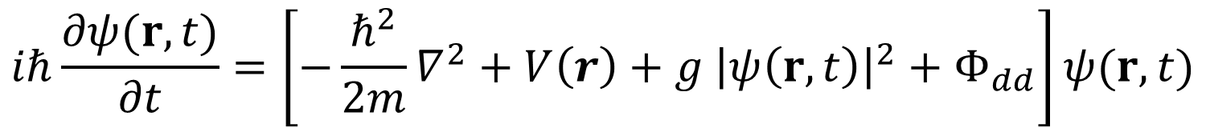
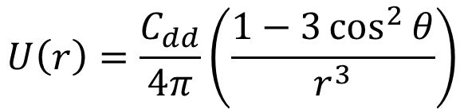
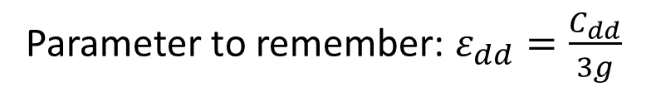
Governing equation
$$iℏ\frac{∂ψ(r,t)}{∂t}=\left[−\frac{ℏ^{2}}{2m}∇^{2}+V\left(r\right)+g {\left|ψ\left(r,t\right)\right|}^{2}+Φ_{dd}\right]ψ(r,t)$$
Mean field potential due to dipole-dipole interactions:
$$Φ_{dd}(r,t)=∫dr^{′}U\left(r−r^{′}\right)n(r^{′},t)$$
$$U\left(r\right)=\frac{C_{dd}}{4π}\left(\frac{1−3\cos^{2}{θ}}{r^{3}}\right)$$
Species | $$dd$$
⁵²Cr | 0.16
¹⁶⁴Dy | 1.43
¹⁶⁸Er | 0.4
KRb | 40 (!)
Parameter to remember: $ε_{dd}=\frac{C_{dd}}{3g}$
Lahaye, et al. "The physics of dipolar bosonic quantum gases.“
Reports on Progress in Physics 72, 126401, (2009)

Slide 9
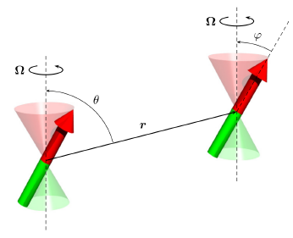


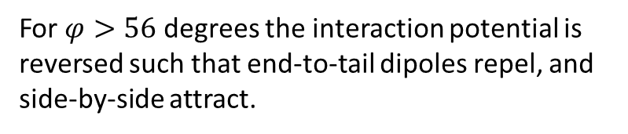
Tuning the DDI
Theoretical proposal: rotate the DDI really fast (greater than trap frequency less than Larmor frequency) – the average interaction potential is:
For $φ>56$ degrees the interaction potential is reversed such that end-to-tail dipoles repel, and side-by-side attract.

Slide 10

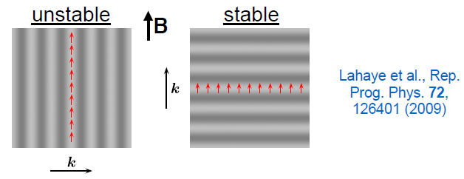

Excitation spectrum
Elementary excitations for a homogeneous gas:
Homogeneous 3D dipolar gas stable for: $−0.5<ε_{dd}<1$, otherwise phonon unstable.

Slide 11
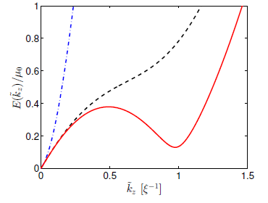

Excitation spectrum
Elementary excitations for a homogeneous gas:
Homogeneous 3D dipolar gas stable for: $−0.5<ε_{dd}<1$, otherwise phonon unstable.
Add a trap and we find rotons!
Maxons
Rotons
Phonons

Slide 12
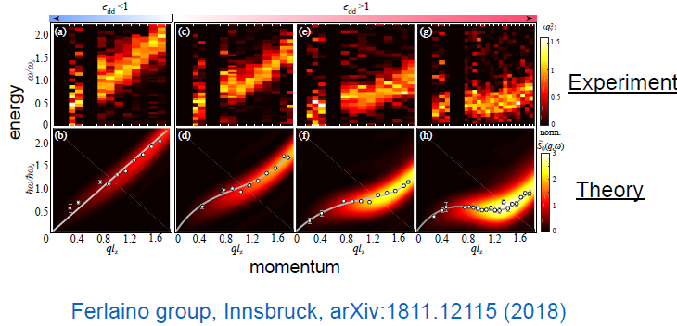
Excitation spectrum

Slide 13
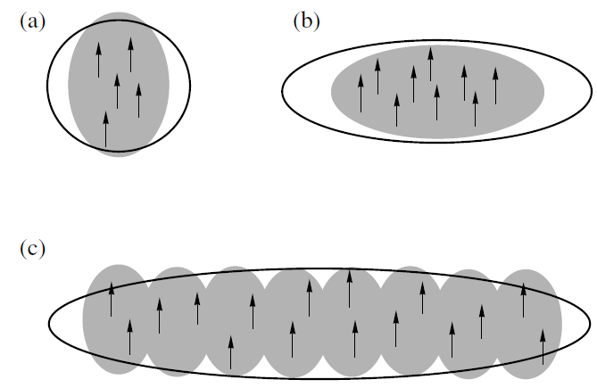
Excitation spectrum
(a)
(b)
Magnetostriction
(c)
Roton wavelength
Quasi -2D
J. Bohn, Laser Phys 19, 4 (2009)

Slide 14


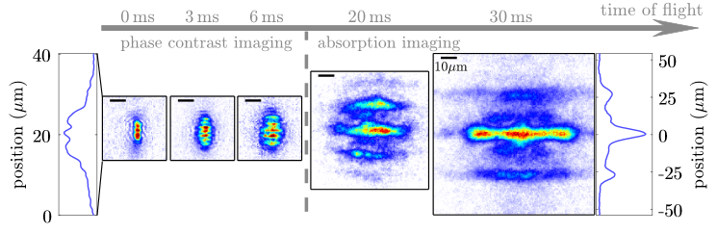
Droplets and supersolids
Gas collapses after scattering length quench BUT unexpectedly halts at a finite size – droplets!
Theory suggests that quantum fluctuations halts the collapse
Larger N
Observed droplets are not coherent with one another, therefore not supersolid.
Smoothly vary the scattering length:

Slide 15
Outline
Dipolar gases - quantum ferrofluids
Lower dimensional dipolar BECs
Dipolar dark solitons
Dipolar bright solitons
Classical field methods
Quantum ferrofluid turbulence

Slide 16
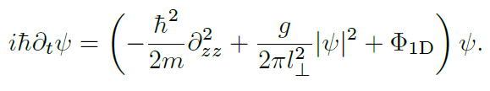
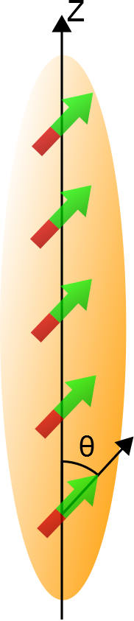
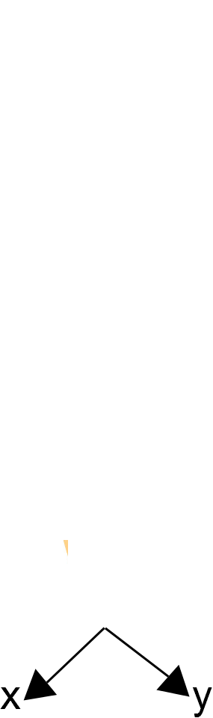
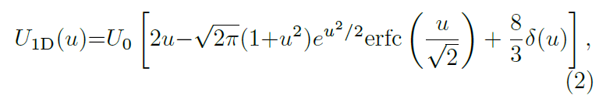


Lower dimensional systems
Assume radial Gaussian and integrate 3D dipolar GPE:
The DDI potential is now given by
$$∝u^{−3}$$
U(u)
~

Slide 17
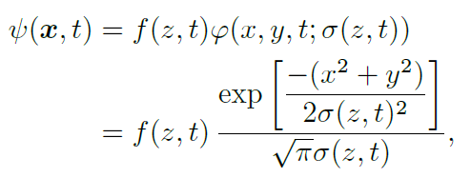
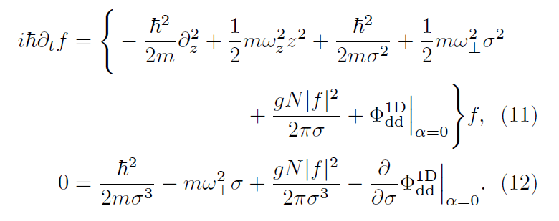
Aside: effective quasi-1D equation
What if the radial width isn’t constant? (c.f. Salasnich et al, Phys. Rev. A 65, 043614 (2002))
Minimise the 3D dipolar GPE action to reduce to an effective GPE + variational eq
M. Knight, TB, N. Parker, A. Martin in preparation

Slide 18
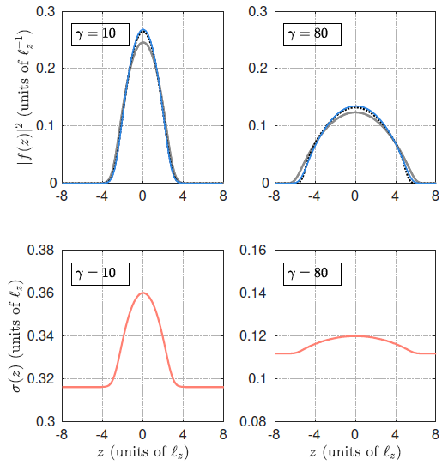
Effective quasi-1D equation
Loosely 1D
Very 1D
Blue lines: 3D GPE
Black dotted lines: effective quasi-1D
Gray lines: quasi-1D
M. Knight, TB, N. Parker, A. Martin in preparation

Slide 19
Outline
Dipolar gases - quantum ferrofluids
Lower dimensional dipolar BECs
Dipolar dark solitons
Dipolar bright solitons
Classical field methods
Quantum ferrofluid turbulence

Slide 20
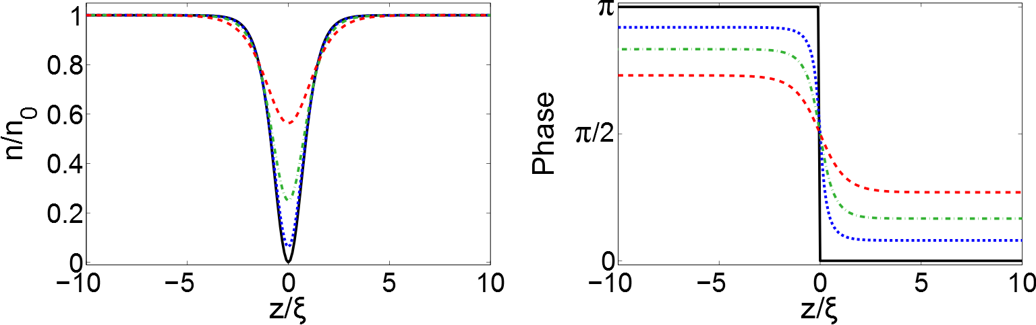
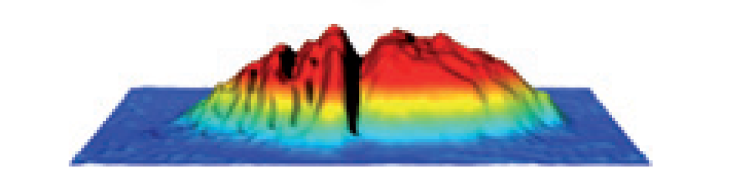

Non-dipolar dark solitons
$$v=0c \\ v=0.3c \\ v=0.6c \\ v=0.8c$$
Non-dispersive waves
Particle-like
Short-range interactions
Becker, et al., Nature Phys 4, 496 - 501 (2008)

Slide 21
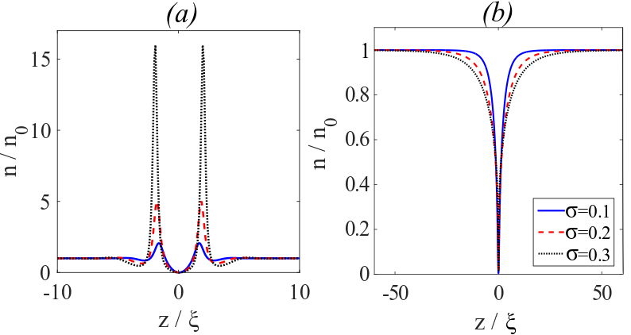
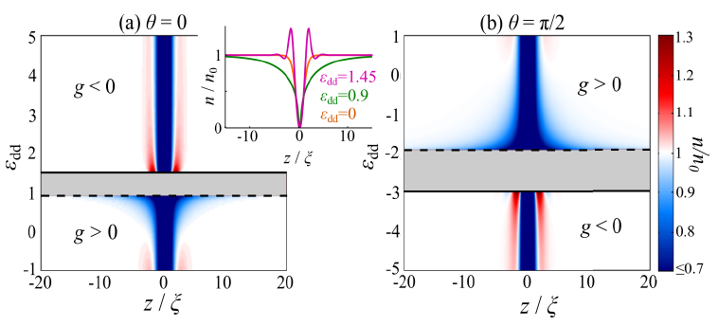

Dipolar dark soliton profiles
Near roton instability
Near phonon instability
$$σ=l_{⊥}/ξ$$

Slide 22
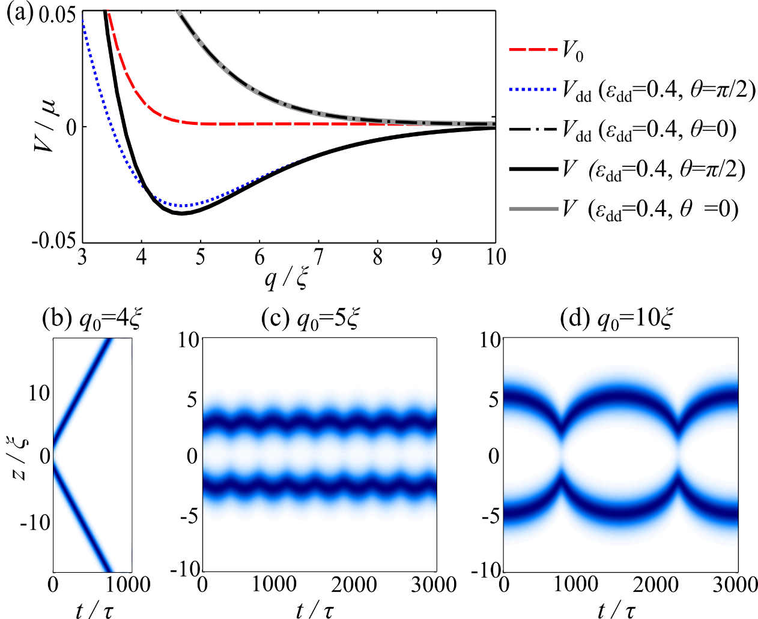


Bound states!
$$+$$
$$=$$
T. Bland et al, Phys. Rev. A 92, 063601 (2015)
M Edmonds, et al. Phys Rev A 93, 063617 (2016)

Slide 23
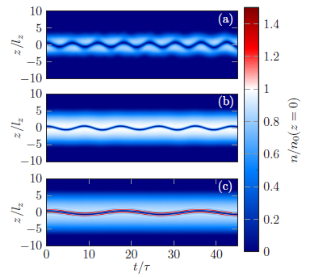



Oscillation frequencies
Add a harmonic trap and measure oscillation frequency of a dipolar dark soliton:
Phonon $ω_{s}>ω_{z}/\sqrt{2}$
Non-dipolar $ω_{s}=ω_{z}/\sqrt{2}$
Roton $ω_{s}<ω_{z}/\sqrt{2}$
Bland et al, PRA 95, 063622 (2017)

Slide 24
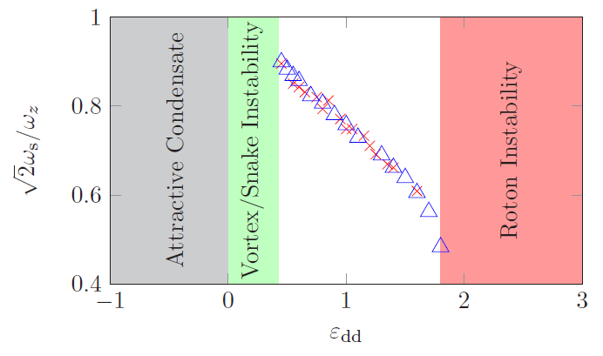
Oscillation frequencies
3D GPE simulation. Parameters chosen to match dysprosium experiment with N=10,000
Blue triangle: phase imprint imaginary time
Red cross: phase imprint real time
Bland et al, PRA 95, 063622 (2017)

Slide 25
Magnetometer?
(B)
Know how interactions scale with magnetic field
if the frequency can be measured with high precision this should give information about external magnetic field
Bland et al, PRA 95, 063622 (2017)

Slide 26
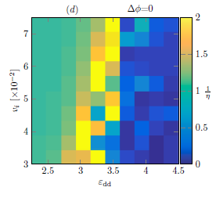
Outline
Dipolar gases - quantum ferrofluids
Lower dimensional dipolar BECs
Dipolar dark solitons
Dipolar bright solitons
M. Edmonds et al, New J. Phys. 19 023019 (2017)
Bound state
Fusion
Elastic collision

Slide 27
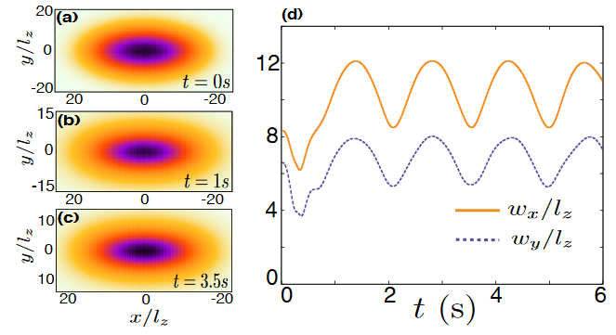
Bright soliton interferometry?
Dipolar bright solitons are stable in two dimensions!
B
Phys. Rev. A 92, 013637 (2015)

Slide 28
Bright soliton interferometry?
Dipolar bright solitons are stable in two dimensions!
B
Phys. Rev. A 92, 013637 (2015)

Slide 29
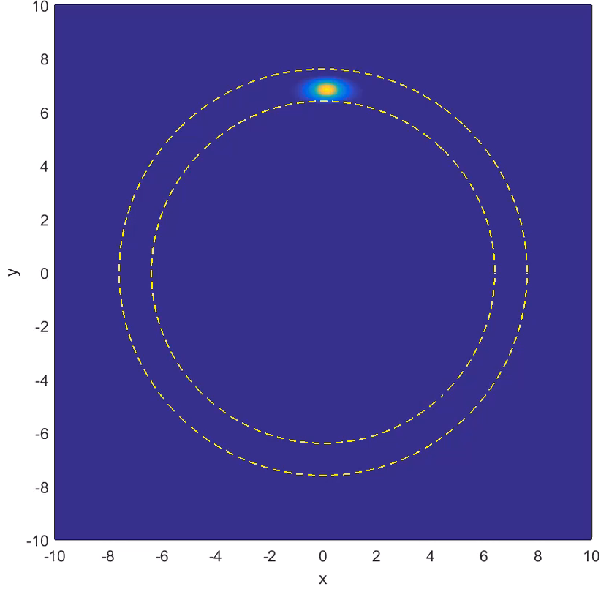
Bright soliton interferometry?

Slide 30
Outline
Dipolar gases - quantum ferrofluids
Lower dimensional dipolar BECs
Dipolar dark solitons
Dipolar bright solitons
Classical field methods
Quantum ferrofluid turbulence

Slide 31
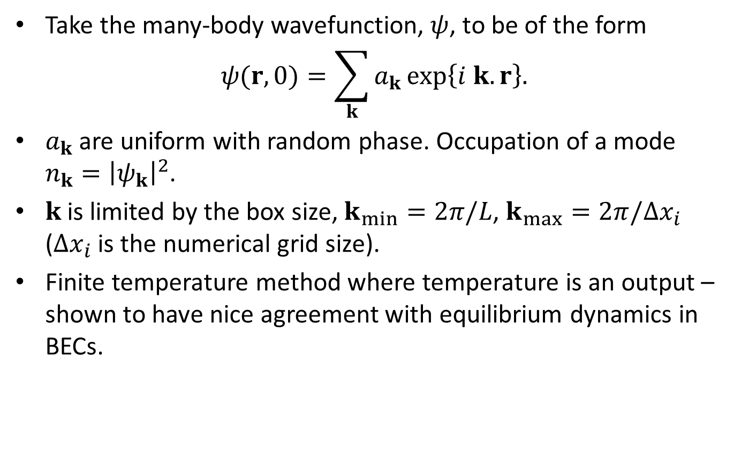
Classical field method
Take the many-body wavefunction, $ψ$, to be of the form
$$ψ(r,0)=\sum_{k}{a_{k}}exp\left\{i k.r\right\}.$$
$a_{k}$are uniform with random phase. Occupation of a mode $n_{k}={\left|ψ_{k}\right|}^{2}$.
$k$ is limited by the box size, $k_{min}=2π/L$, $k_{max}=2π/Δx_{i}$ ($Δx_{i}$ is the numerical grid size).
Finite temperature method where temperature is an output – shown to have nice agreement with equilibrium dynamics in BECs.

Slide 32
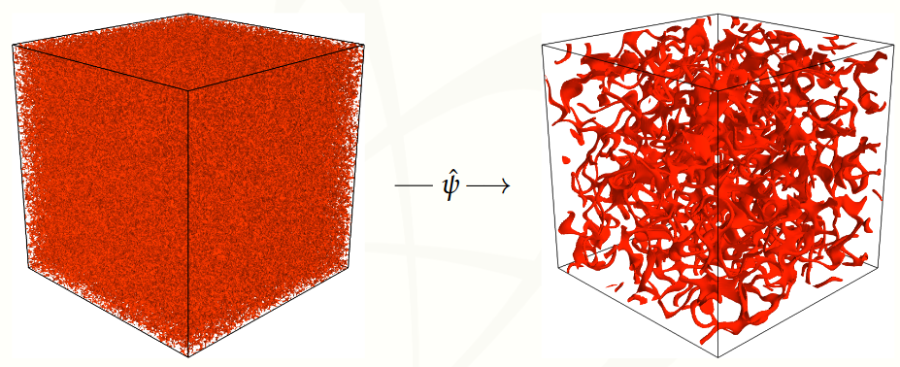
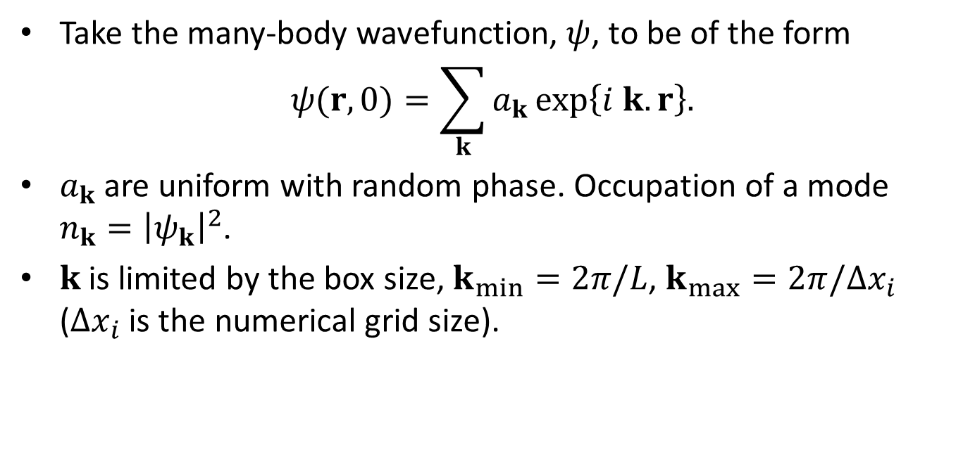
Classical field method
Take the many-body wavefunction, $ψ$, to be of the form
$$ψ(r,0)=\sum_{k}{a_{k}}exp\left\{i k.r\right\}.$$
$a_{k}$are uniform with random phase. Occupation of a mode $n_{k}={\left|ψ_{k}\right|}^{2}$.
$k$ is limited by the box size, $k_{min}=2π/L$, $k_{max}=2π/Δx_{i}$ ($Δx_{i}$ is the numerical grid size).

Slide 33
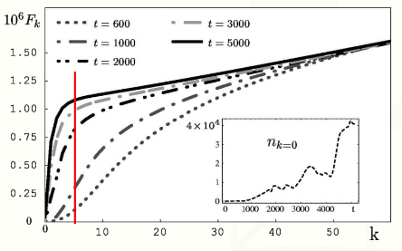



Classical field method
As $ψ$ is the sum of condensate and thermal modes we introduce the quasi-condensate $\hat{ψ}$ as a momentum cut-off
$${\hat{a}}_{k}=a_{k}×\max\left\{1−\frac{k^{2}}{k_{c}^{2}},0\right\}.$$
$$F_{k}=\sum_{i}^{k}{n_{i}}$$
$$t=0$$
N. G. Berloff and B. V. Svistunov, Phys. Rev. A. 66, 013603 (2002)

Slide 34
c-field method
(Thanks to George Stagg)

Slide 35

Outline
Dipolar gases - quantum ferrofluids
Lower dimensional dipolar BECs
Dipolar dark solitons
Dipolar bright solitons
Classical field methods
Quantum ferrofluid turbulence

Slide 36
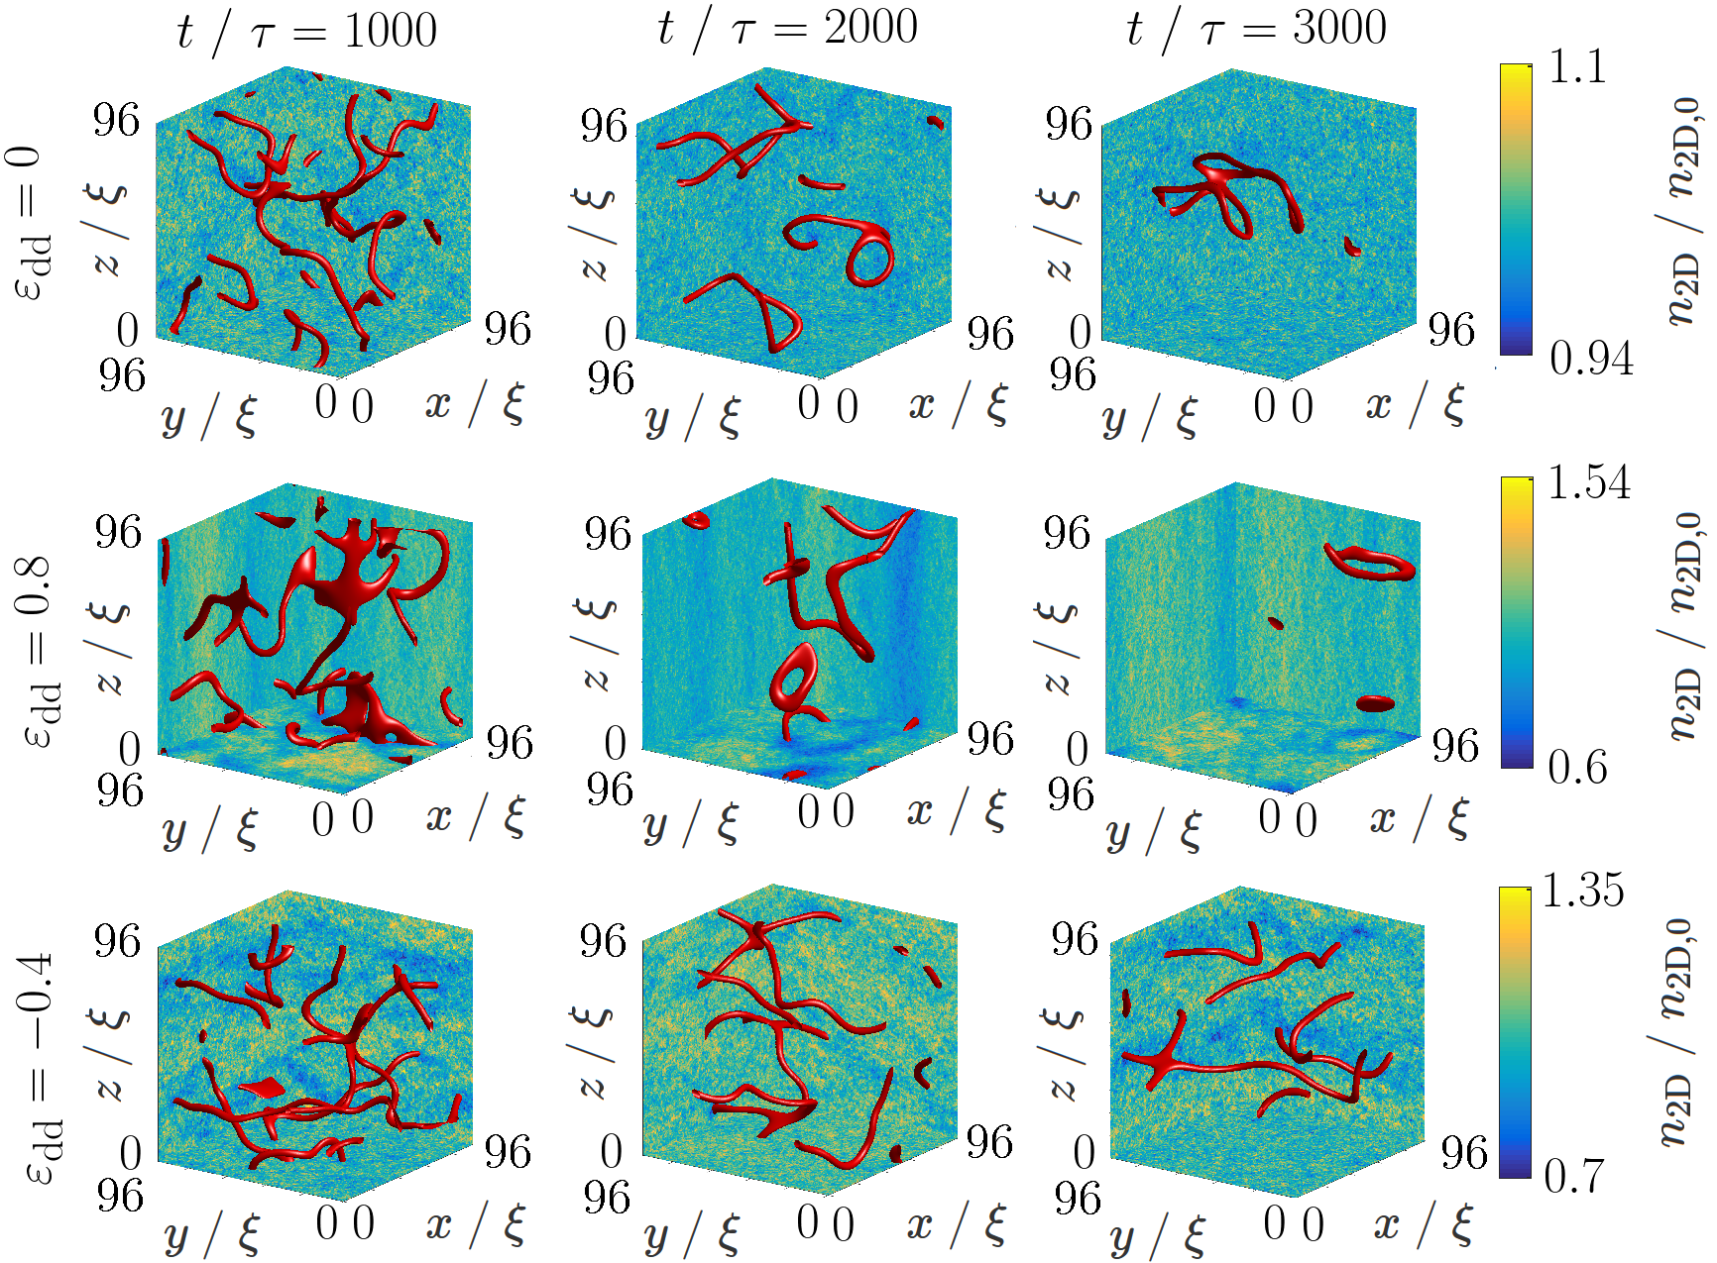
Polarised turbulence?

Slide 37
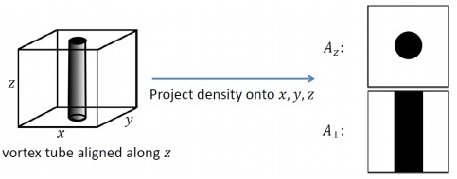
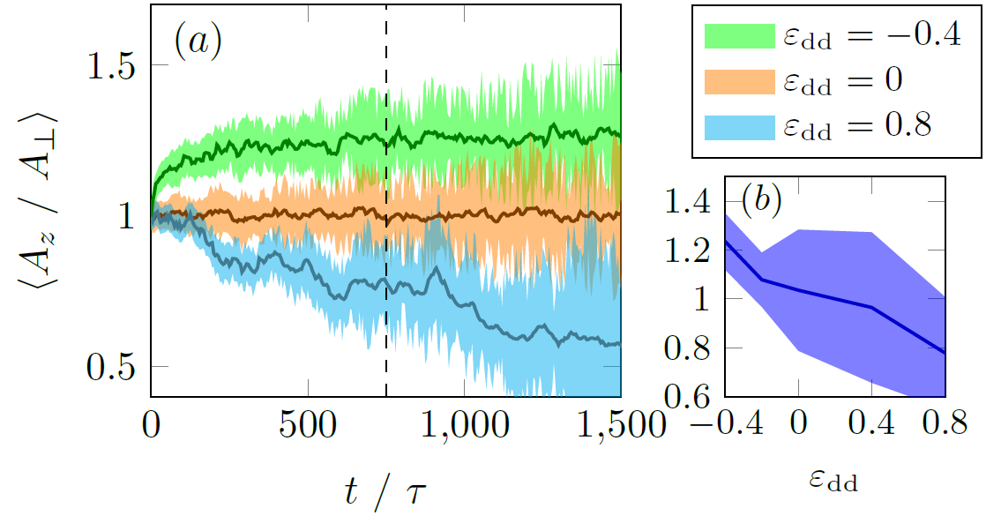

Vortex polarisation
$$A_{⊥}=0.5(A_{x}+A_{y})$$

Slide 38
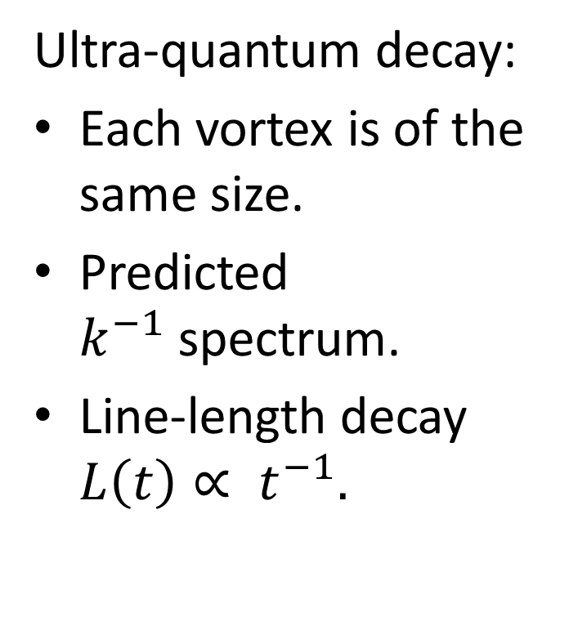

Vortex decay
Quasi-classical decay:
Most energy in the largest eddies.
Predicted $k^{−5/3}$spectrum.
Line-length decay $L\left(t\right)∝ t^{−3/2}.$
Ultra-quantum decay:
Each vortex is of the same size.
Predicted $k^{−1}$spectrum.
Line-length decay $L\left(t\right)∝ t^{−1}.$

Slide 39



Vortex decay

Slide 40
Summary
Dipolar dark solitons can form bound states
The oscillation frequency of a dipolar dark soliton is interaction dependent
Dipolar bright solitons can exist in higher dimensions
Turbulence in a 3D homogeneous gas can be polarised by an external magnetic field.
Tuning the DDI is unstable to dynamical instabilities
T. Bland et al, PRA 92, 063601 (2015)
M Edmonds, et al. PRA 93, 063617 (2016)
T Bland et al, PRA 95, 063622 (2017)
M. Edmonds et al, New J. Phys. 19 023019 (2017)
T Bland et al, PRL 121, 174501 (2018)
S Prasad et al, PRL 122, 050401 (2019)

Slide 41
Outline
Dipolar gases - quantum ferrofluids
Lower dimensional dipolar BECs
Dipolar dark solitons
Dipolar bright solitons
Classical field methods
Quantum ferrofluid turbulence
Tuning the DDI

Slide 42
Tuning the DDI
Theoretical proposal: rotate the DDI really fast (greater than trap frequency less than Larmor frequency) – the average interaction potential is:
For $φ>56$ degrees the interaction potential is reversed such that end-to-tail dipoles repel, and side-by-side attract.

