Slide 1
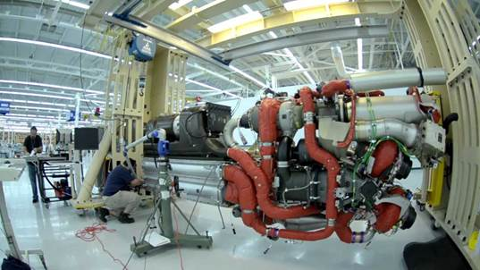
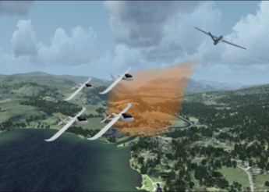


Approximation and Numerical Methods for
Industrial Control Systems Governed by Partial
and Delay Differential Equations
John A. Burns
Interdisciplinary Center for Applied Mathematics
Virginia Tech
Blacksburg, Virginia 24061-0531
Thermal Management System
DP Estimation
VIII Partial Differential Equations, Optimal Design and Numerics
Centro de Ciencias de Benasque Pedro Pascual
Benasque, Spain
August 18 – 30, 2019

Slide 2


People & Problems
Virginia Tech: Jeff Borggaard, Gene Cliff, Terry Herdman, Veronica
Gheorghe, Zack Grigorian, James Cheung,
Carnegie Mellon: Larry Biegler
Humboldt, Berlin: Carlos N. Rautenberg
Oklahoma State: Weiwei Hu
UT CCS: Trevor Bailey, Qingfan Zeng, Degang Fu, Clas Jacobson
WPI: Michael Demetriou, Nikolaos Gatsonis
Thermal Management
Systems
(heat exchangers)
PDE Control &
Estimation

Slide 3
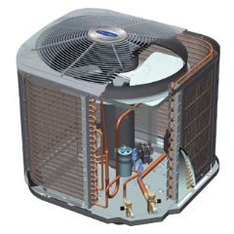
Basic Vapor Compression Cycle (components)
MOTOR
CONDENSER
Heat Exchangers (HX)
COMPRESSOR
actuator dynamics
EXPANSION VALVE
EVAPORATOR
WELL-POSEDNESS OF CLOSED CYCLE IS NOT OBVIOUS

Slide 4
Model-Based Systems Engineering
Rough idea:
Develop a “library” of (finite dimensional) mathematical models for each component (e.g. compressor, condenser, expansion valve, evaporator)
Conduct V&V on the component models (assumed well-posed)
Develop “software” to “connect” the components into a system level (finite dimensional) model
Use this (finite dimensional) system model for simulation and (hopefully) for design, control and optimization …
Examples: Simscape / Matlab for simulation, Dymola / Modelica for simulation
Some issues:
Multi-physics and requires “discretization” of PDE components
Different discretizations ⇒ different component models
Resulting system model may not be suitable for optimization, design or control

Slide 5
ODE₁ ⇒ PDE₁ ⇒ ODE₂ ⇒ PDE₂ ⇒ ODE₁: Closed Cycle
1

Slide 6
ODE₁ ⇒ PDE₁ ⇒ ODE₂ ⇒ PDE₂ ⇒ ODE₁: Closed Cycle
Well-posedness OK
Many choices for state space representation
Delay systems are rarely self-adjoint (can be highly non-normal
Numerical methods developed for delay systems offer insight into approximation of thermal management systems
Need convergence, dual convergence for optimization (what is this & why ?)

Slide 7
Control of Delay Differential Equations

Slide 8
Control of Delay Differential Equations

Slide 9
Approximating Delay Systems: A Brief History
Yu. M.Repin, On the approxima.te replacement of systems with lag by ordinary dynamical systems, Prikl. Mat. Mekh., (29) 1965, 226-235; English translation in Appl. Math. Mech., (29) 15, 254-264.
96
D. W. Ross & I. Flügge-Lotz, An optimal control problem for systems with differential-difference equation dynamics, SIAM J. Control, (7) 1969, 609–623.
J. G. Borisovic & A. S. Turbabin, On the Cauchy problem for linear nonhomogeneous differential equations with retarded argument, Soviet Math. Dokl., (10) 1969, 401–405.
H. Sasai, On the convergence of difference approximations in distributed parameter optimal control problems, Mem. Fac. Engrg. Nagoya Univ., (23) 1971, 316–325.
H. Sasai & T. Fukuda, Consideration of linear delay-differential systems by approximation systems, Trans. Soc. Instrument Control Engr., (10) 1974, 298–303.
H. T. Banks, J. A. Burns, H. A. Antosiewicz, An abstract framework for approximate solutions to optimal control problems governed by hereditary systems, in, International Conference on Differential Equations, Los Angeles, 1974 , Academic Press, New York, 10–25.
H. T. Banks & J. A. Burns, Hereditary control problems: Numerical methods based on averaging approximations, SIAM J. Control & Optimization, (16) 1978, 169-208.
H. . Banks & F. Kappel, Spline approximations for functional differential equations, J. Differential Equations, (34) 1979, 496-522.
J. Burns & E. Cliff, A Piecewise Linear Approximation Scheme for Hereditary Optimal Control Problems, Proc. 1977 Joint Automatic Control Conference, Vol. 2, 1977, 867-873 .
J. Burns & E. Cliff, Methods for Approximating Linear Hereditary Quadratic Optimal Control Problems, IEEE Trans. on Automatic Control, AC - 23, 1978, 21-36.
DG Scheme

Slide 10
Four Schemes ⇒ Four “Component Models”
Finite Volume
(Banks, Burns - 1974)
Finite Element
(Banks, Kappel - 1979)
DG Piecewise Linear
(Burns, Cliff - 1977)
Finite Element – Volume
(Ito, Kappel – 1987)

Slide 11
Control of Delay Differential Equations

Slide 12
Control of Delay Differential Equations
MINIMIZE
OPERATOR RICCATI EQUATION (PDE)
FUNCTIONAL GAIN

Slide 13
Approximation & Computational Issues
(ORE)
What approximations schemes are good for discretization of the ORE?
(ARE_{h})
What numerical algorithms are good for solving the resulting ARE_{h}? Newton?
Is Newton’s method mesh independent?
How do you select and initial estimate?
Is the ARE_{h} ill conditioned?
Is there a theory of convergence – for the control law?

Slide 14
Approximation & Computational Issues
h
h
h
h
h
h
h
h
h
h
? IMPLY ?
NO
NOT JUST A “MATH NICETY”
IMPORTANT IN NON-NORMAL PROBLEMS
MANY “STANDARD” SCHEMES FAIL
NEED DUAL CONVERGENCE

Slide 15
Computational Issues
NEED OPERATOR CONVERGENCE
Trotter – Kato (convergence)
FUNDAMENTAL
ASSUMPTIONS
Dual convergence
(1) F_CON
(2) D_CON
(3) U_STB
(4) U_DET
(5) COMPACTNESS

Slide 16
Four Schemes
Finite Volume
(Banks, Burns - 1974)
Finite Element
(Banks, Kappel - 1979)
  Both schemes satisfy Trotter Kato Theorem (F_CON)
  FV is dual convergent (D_CON) ----- FE is not
J. Burns, K. Ito & G. Propst, On nonconvergence of adjoint semigroups for control systems with delay, SIAM J. Control Optimization, (26) 1988, 1442-1454.
  ? Higher Order Dual Convergent Schemes ?

Slide 17
Four Schemes
DG Piecewise Linear
(Burns, Cliff - 1977)
Finite Element – Volume
(Ito, Kappel – 1987)
  Both schemes satisfy all conditions (1) – (5)
K. Ito & F. Kappel, A uniformly differentiable approximation scheme for delay systems using splines, Proceedings 26th IEEE Conference on Decision and Control, 1987, 541--545.
K. Ito & F. Kappel, , A uniformly differentiable approximation scheme for delay systems using splines, Applied Mathematics and Optimization, (23) 1991, 217-262.
F. Kappel, Approximations of LQR-problems for delay systems: A survey, in Computation and Control II, K. Bowers and J. Lund, eds., Birkhäuser, Cambridge, 1991, 187–224.

Slide 18
2D Example
Compare
Finite Volume (Banks, Burns - 1974)
Finite Element (Banks, Kappel – 1979)
DG Piecewise Linear (Burns, Cliff - 1977)
Finite Element – Finite Volume (Ito, Kappel – 1987)
DG Piecewise Linear (3) and Finite Element – Finite Volume (4)
have same rates of convergence ....

Slide 19
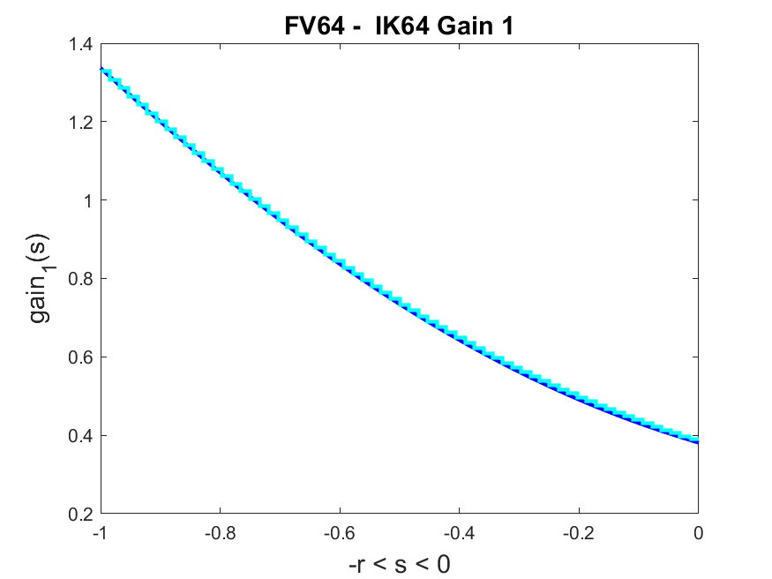
N = 64: FV and IK

Slide 20
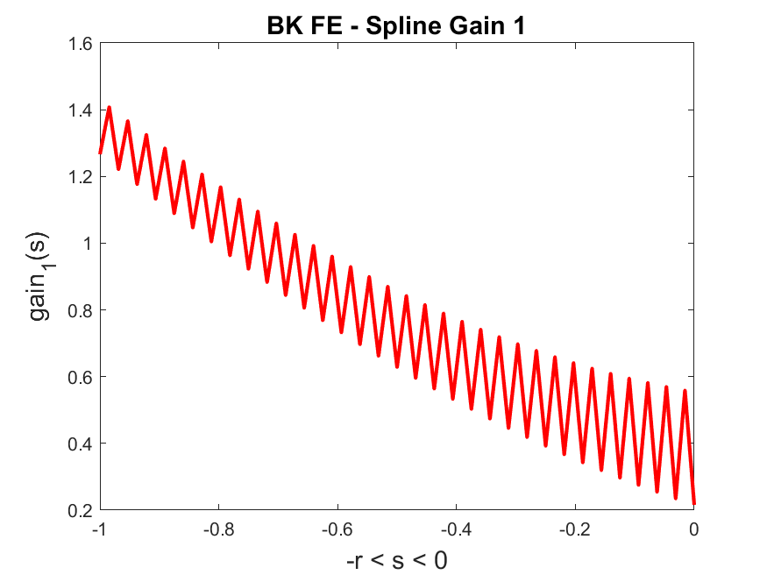
N = 64: FE

Slide 21
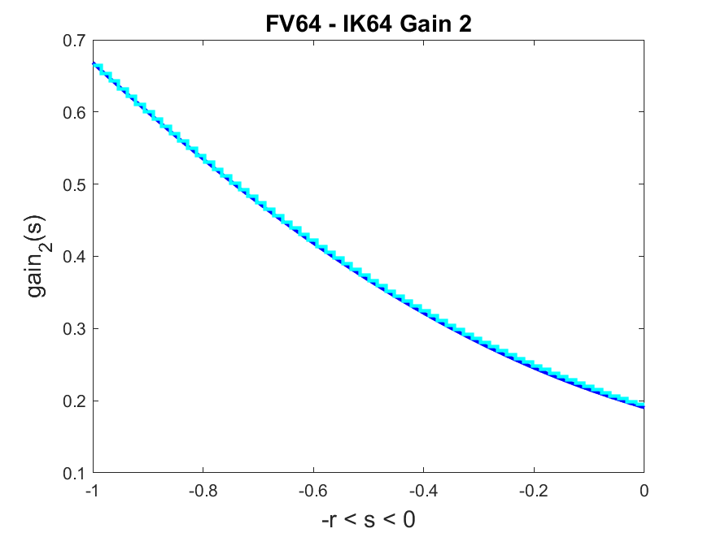
N = 64: FV and IK

Slide 22
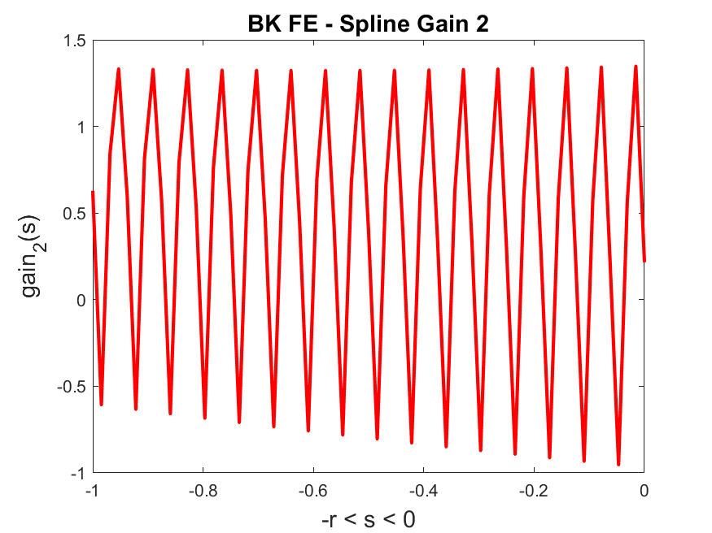
N = 64: FE

Slide 23
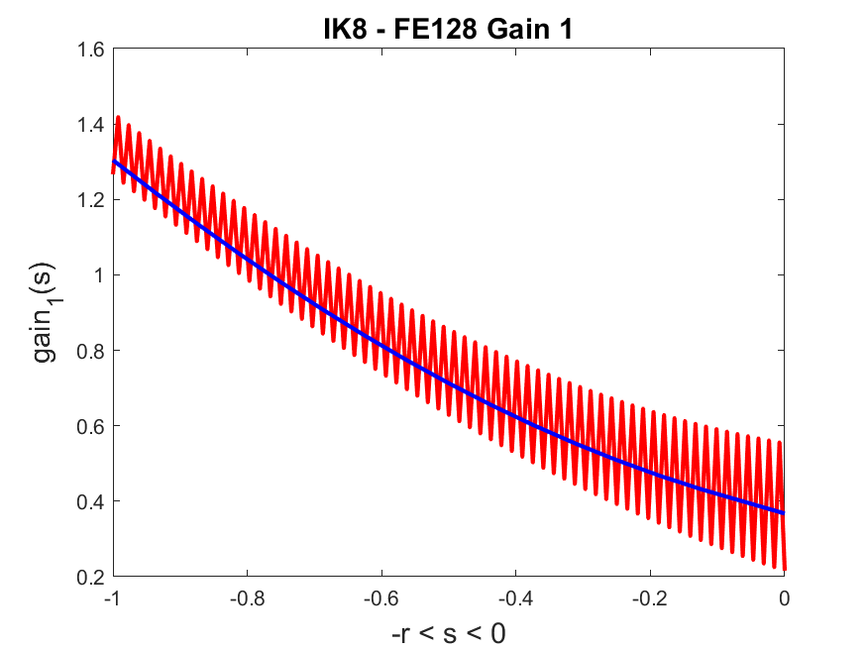
N = 128: FE and N = 8: IK

Slide 24
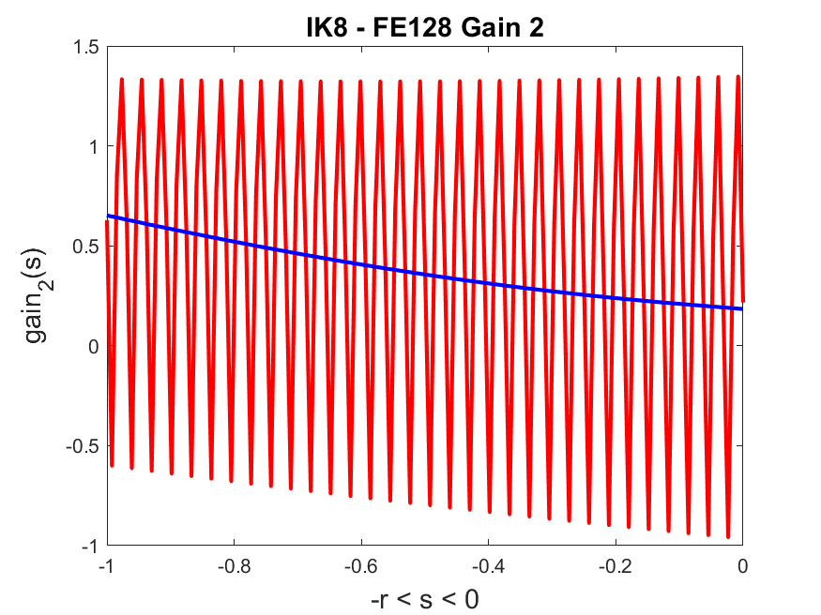
N = 128: FE and N = 8: IK
? (A) Can we construct higher order dual convergent schemes ?
? (B) Can these schemes help with thermal – fluid problems
? (C) Can these schemes help with real – time estimation?

Slide 25
Simple Counter Flow Heat Exchanger: Approximations
J. S. Hesthaven and T. Warburton, Nodal Discontinuous Galerkin Methods: Algorithms, Analysis, and Applications, Springer Science & Business Media, 2007.
J. S. Hesthaven, Numerical Methods for Conservation Laws: From Analysis to Algorithms, SIAM 2018..
Z. Grigorian, Modeling, Discontinuous Galerkin Approximation and Simulation of the 1-D Compressible Navier Stokes Equations, MS Thesis, Virginia Tech, May, 2019.
- nonlinear thermal fluids
J. Burns & E. Cliff, A Piecewise Linear Approximation Scheme for Hereditary Optimal Control Problems, Proc. 1977 Joint Automatic Control Conference, Vol. 2, 1977, 867-873 .
J. Burns & E. Cliff, Methods for Approximating Linear Hereditary Quadratic Optimal Control Problems, IEEE Trans. on Automatic Control, AC - 23, 1978, 21-36.
J. Cheung, Overcoming Geometric Limitations in the Finite Element Method by Means of Polynomial Extension: Application to Second–Order Elliptic Boundary Value and Interface Problems, PhD Thesis, Florida State University, 2018
J. Burns and J. Cheung, High Order Approximations for LQR Control and LQG Estimation of Convection Diffusion Systems, Joint Mechatronics 2019 & NolCoS 2019, to appear.
J. Burns and J. Cheung, Optimal Error Estimates for General hp - Galerkin Methods Applied to Riccati Partial Differential Equations, 2019.

Slide 26
hp – Finite Element Method
Two “requirements”:
Global basis must be continuous
(not required by DG)
Global basis should have local support
Veronica Gheorghe (p = 2, hyperbolic)
James Cheung (p > 1, parabolic)

Slide 27
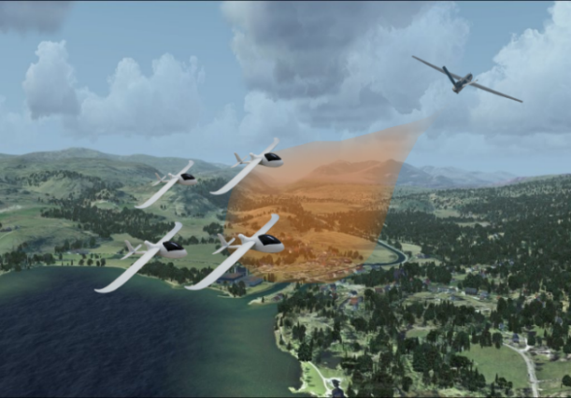
Real Time Optimization of Dynamic Sensor Systems
State estimator (observer) …
or
or

Slide 28
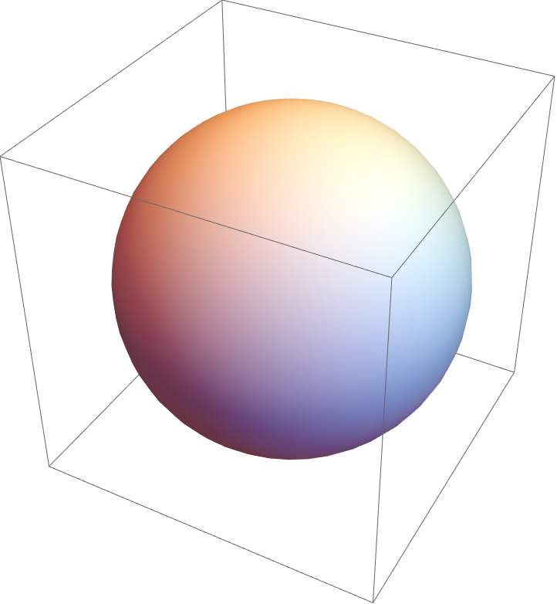

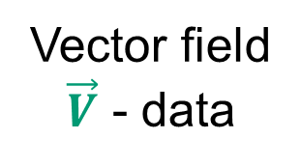
Real Time Optimization of Sensor Systems
stationary sensor
plume
Ω
Vector field
$\vec{V}$ - data
mobile sensor

Slide 29

Optimal PDE Estimation
stationary sensor
Distributed Parameter Formulation
plume
Ω
Vector field
$\vec{V}$ - data
mobile sensor
MUST BE “SOLVED”
IN REAL - TIME
Example: Optimal PDE Kalman Filter
Theoretical Basis (60s – 70s): Bensoussan, Curtain, Da Prato, Ichikawa, Pritchard, Sakawa …

Slide 30
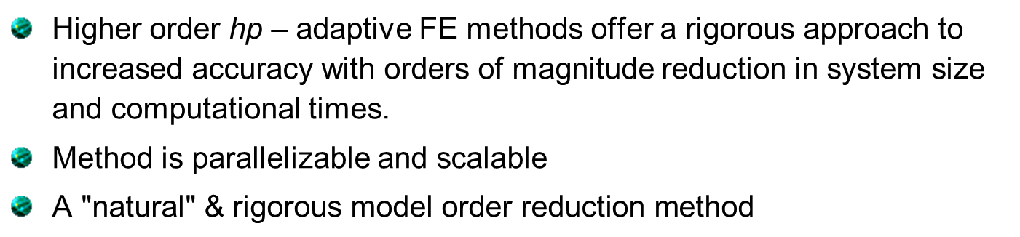
hp – Finite Element Method
    FOR ELLIPTIC BVP ON SMOOTH DOMAINS …
    B. Guo and I. Babuška, “The hp version of the finite element method”,
    Computational Mechanics, 1 (1986), 21–41.
ADAPTIVE
hp - FEM
hp - FEM
  Higher order hp – adaptive FE methods offer a rigorous approach to increased accuracy with orders of magnitude reduction in system size and computational times.
  Method is parallelizable and scalable
  $\text{A}\text{ "}\text{natural}\text{" }\text{\&} \text{rigorous} \text{model} \text{order} \text{reduction} \text{method}$

Slide 31
Real Time Optimization of Dynamic Sensor Systems
REAL TIME estimation, control & optimization ?
IMPOSSIBLE !
… MAYBE NOT ?
    Egorova, T., Gatsonis, N. A., and Demetriou, M. A., Estimation of Gaseous Plume Concentration with an Unmanned Aerial Vehicle, Vol. 39, No. 6, pp. 1314-1324, Journal of Guidance, Control, and Dynamics, 2016.
    Demetriou, M. A., Gatsonis, N. A., and Court, J., A coupled controls-computational fluids approach for the estimation of the concentration from a moving gaseous source in a 2D domain with a Lyapunov-guided sensing aerial vehicle, IEEE Transactions on Control Systems Technology, Vol. 22, 3, pp. 853 – 867, 2014

Slide 32
Stationary Sensor
Two basic issues to solving this type of optimal estimation problem:
  Accurate approximation of the filter gain (Riccati equation)
  Real – time solution of the estimator equation (convection – diffusion equation)

Slide 33
Accurate Solutions to RDE (Optimal Error Estimate)

Slide 34
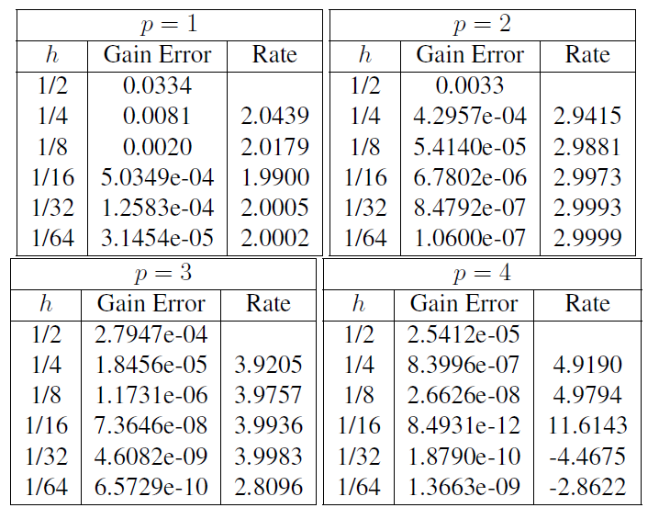
1D CD Problem: Example (DOF = p/h)
  HOWEVER, real – time solution of the estimator equation (convection – diffusion equation) must be impossible – RIGHT?

Slide 35
Computing (Parallel, DG & Spectral Element on GPUs)
This computation (a 3D heat equation) involved more than 20 million equations
and was solved in a few seconds on a single $500 GPU processor by using a DG spectral element method !
J.-F. Remacle, R. Gandham and T. Warburton, “GPU accelerated spectral finite elements on all-hex meshes”, Journal of Computational Physics 324 (2016), 246–257.
M. Kohler and J. Saak, “On GPU acceleration of common solvers for
quasi-triangular generalized Lyapunov equations”, J. Parallel Computing, 57 (2016), 212–221.
Combine HPC, adaptive & parallelizable (high order) methods with multiple GPUs is getting us close …

Slide 36
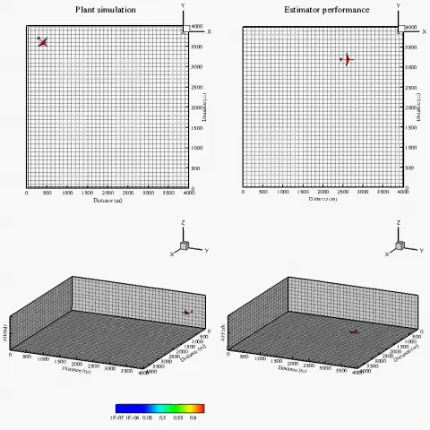
Moving Intruder & “Sub-Optimal” Luenberger Estimator
3D
Intruder with plume (Left)
Estimated Plume by a UAV carrying a noiseless sensor (Right)
Demetriou
&
Gatsonis
(WPI)

Slide 37
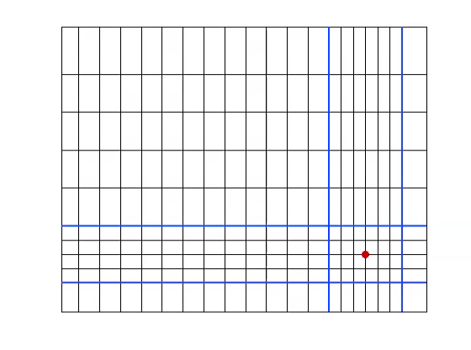
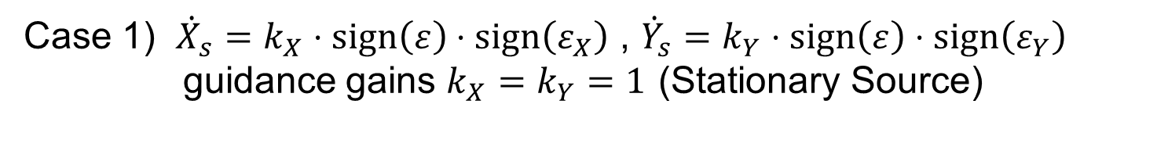
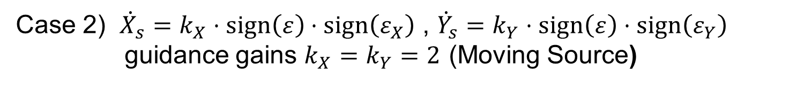
Adaptive Methods (FVM-TVD-RK)
Case 1) ${\dot{X}}_{s}=k_{X}⋅sign\left(ε\right)⋅sign\left(ε_{X}\right)$ , ${\dot{Y}}_{s}=k_{Y}⋅sign\left(ε\right)⋅sign\left(ε_{Y}\right)$
guidance gains $k_{X}=k_{Y}=1$ (Stationary Source)
Case 2) ${\dot{X}}_{s}=k_{X}⋅sign\left(ε\right)⋅sign\left(ε_{X}\right)$ , ${\dot{Y}}_{s}=k_{Y}⋅sign\left(ε\right)⋅sign\left(ε_{Y}\right)$
guidance gains $k_{X}=k_{Y}=2$ (Moving Source)
Demetriou
&
Gatsonis
(WPI)

Slide 38
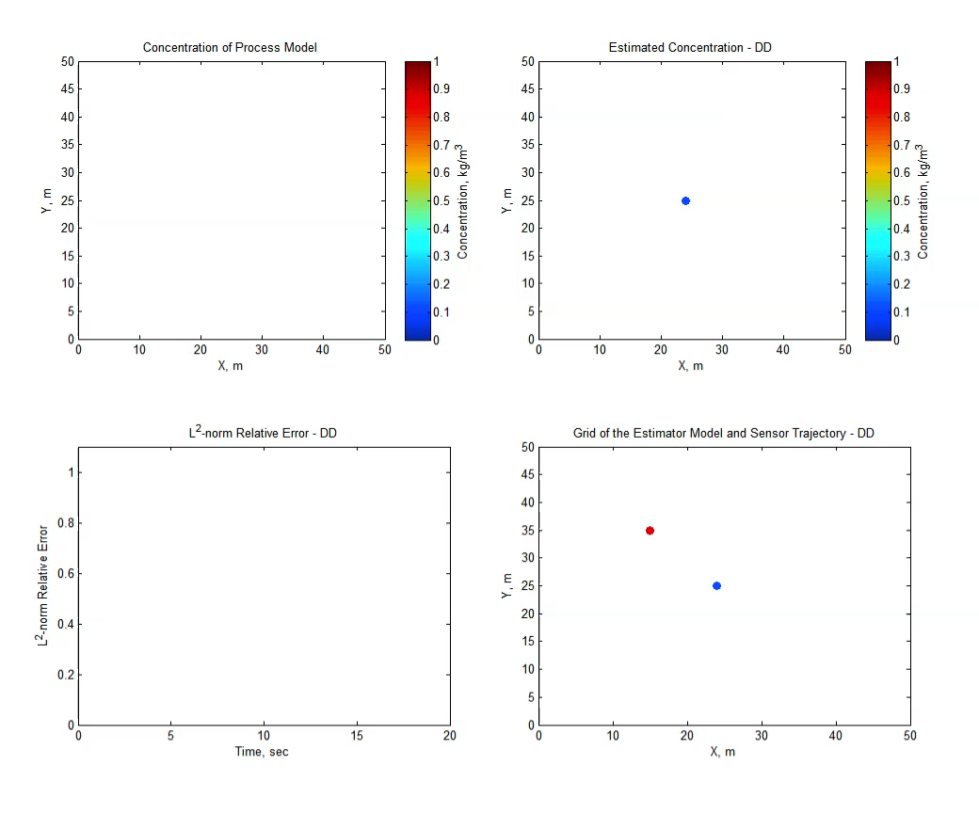
Heterogeneous DD-Hybrid Estimator-Stationary Source
Demetriou
&
Gatsonis
(WPI)

Slide 39
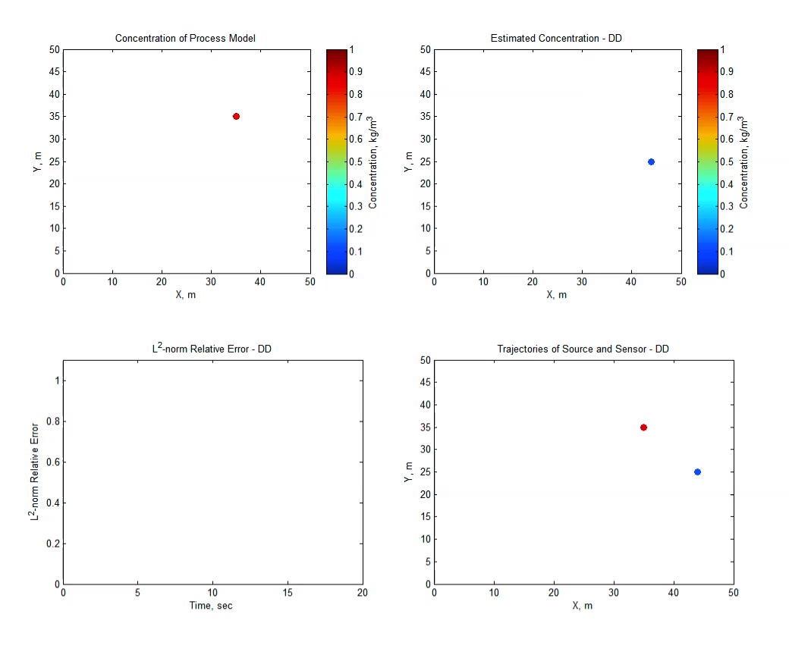
Heterogeneous DD-Hybrid Estimator-Moving Source
Demetriou
&
Gatsonis
(WPI)

Slide 40
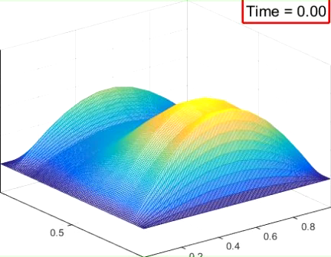
Mobile Sensor is “Better” (WPI)
Estimation over the entire domain
Stationary sensor vrs mobile sensor with a gradient-ascent guidance policy
Spatial distribution of estimation error:
stationary sensor
Spatial distribution of estimation error: mobile sensor

Slide 41
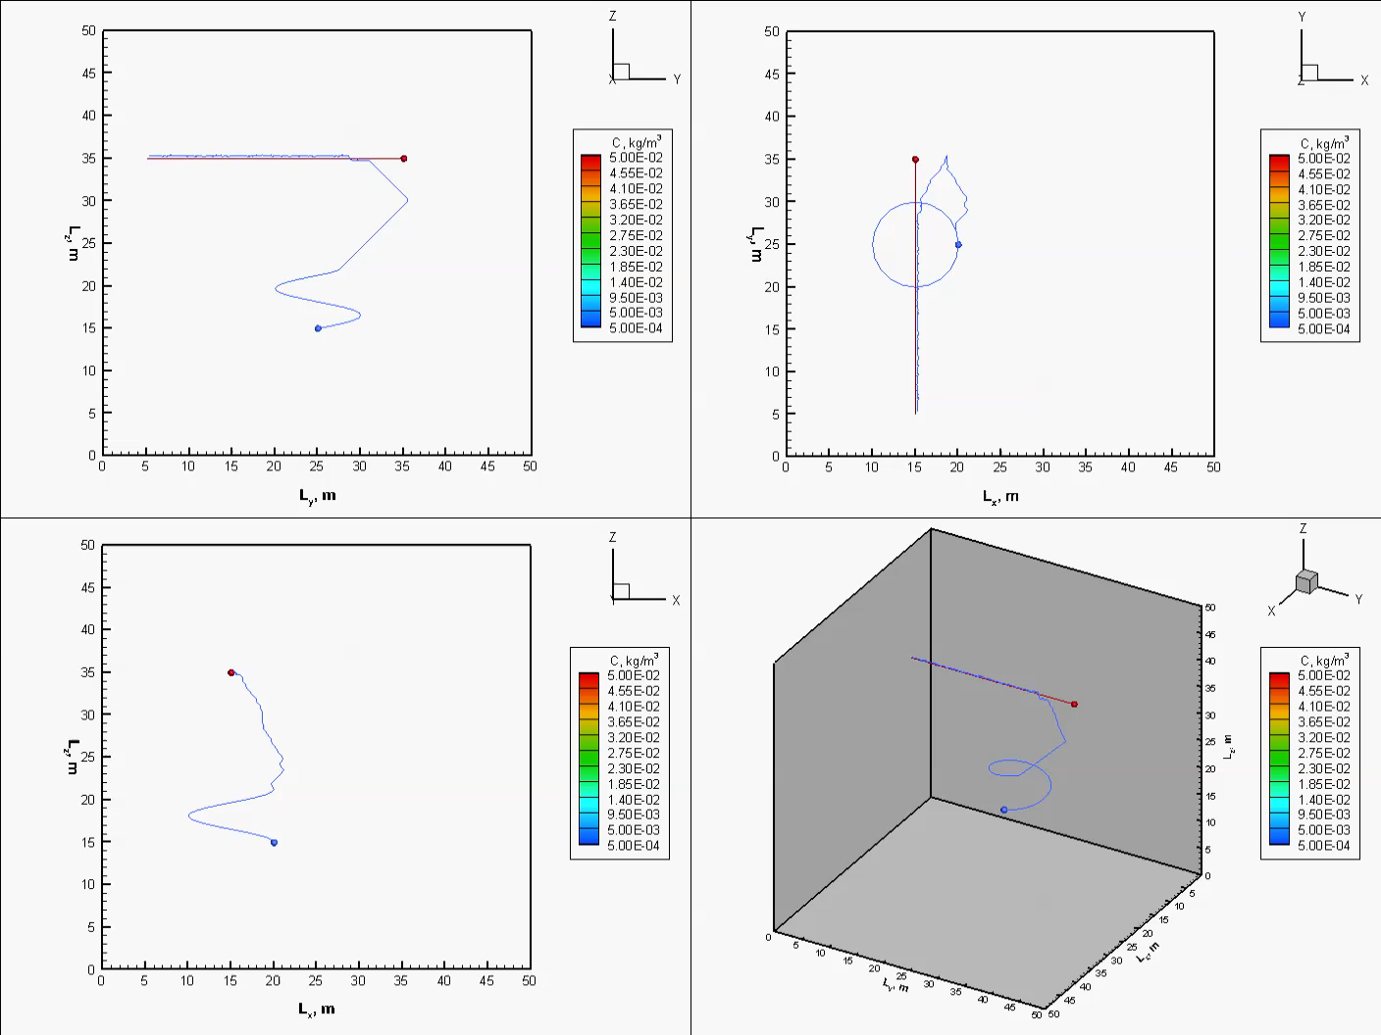
Heterogeneous DD-Hybrid Estimator-Moving Source
Estimated concentration and sensor trajectory
Demetriou
&
Gatsonis
(WPI)

Slide 42
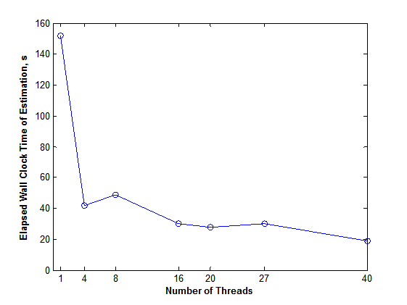
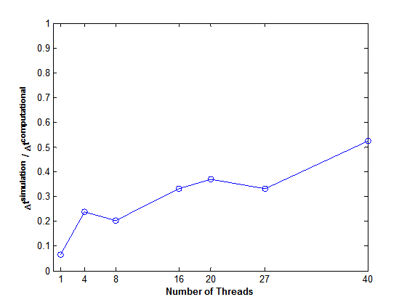
Impact of Multi-Processors
Simulation Time of 10 s
Clock Time for Estimator Only
Iteration Time Step/Iteration Clock Time for Estimator Only
Simulation Time of 30 s
Clock Time for All Operations
Key Takeaways
Higher order methods matter
Dual convergence essential for optimization (optimal control and estimation)
Good numerics enables practical computation
Demetriou
&
Gatsonis
(WPI)

Slide 43
THANKS FOR YOUR ATTENTION

