Slide 1



Data DrIven Flavour Model
TAE 2019 - COST Training School on High Energy Physics
Author:
Carlos Bouthelier Madre
Director:
Dr. Luca Merlo
May 7, 2019

Slide 2
Index
The Flavour Puzzle, BSM Flavour Problem and objectives.
Minimal Flavour Violation.
U(2) models.
Data Driven Flavour Model.
B anomalies.
Comparison, conclusion and foresights.

Slide 3
Flavour Puzzle, BSMFP and objectives.
The Flavour Puzzle BSM FP Objectives
Experimental problems: Prediction vs measurements
Theoretical problems: Naturalness principle
Mass hierarchies for fermions and not-order-one Yukawas.
Mixings in quark and lepton sector.

Slide 4
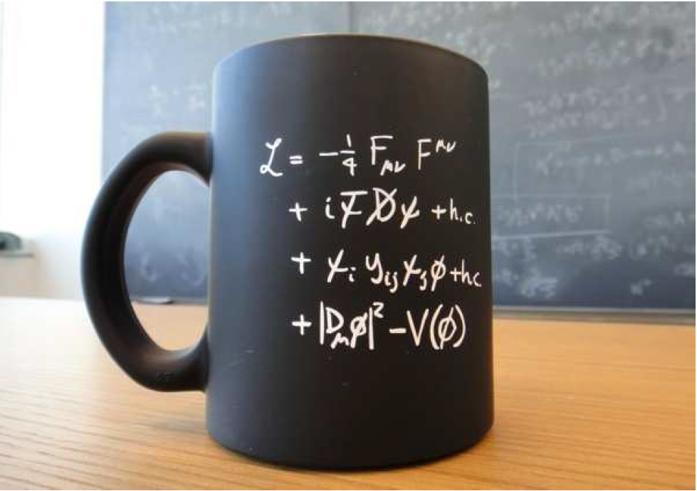
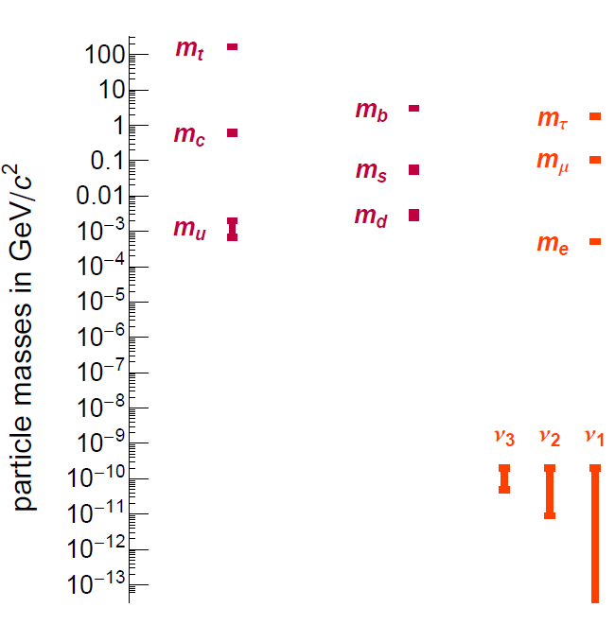

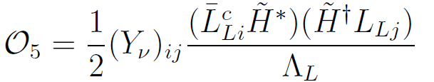
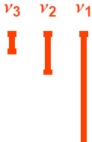

Flavour Puzzle, BSMFP and objectives.
The Flavour Puzzle BSM FP Objectives
The Flavour Puzzle BSM FP Objectives
The Flavour Puzzle Objectives
Mass hierarchy for fermions.
Expected to be order 1 Yukawa Parameters
or

Slide 5
Flavour Puzzle, BSMFP and objectives.
The Flavour Puzzle BSM FP Objectives
The Flavour Puzzle BSM FP Objectives
The Flavour Puzzle Objectives
Mass hierarchy for fermions.
Yukawa Parameters are
expected to be order 1
or

Slide 6
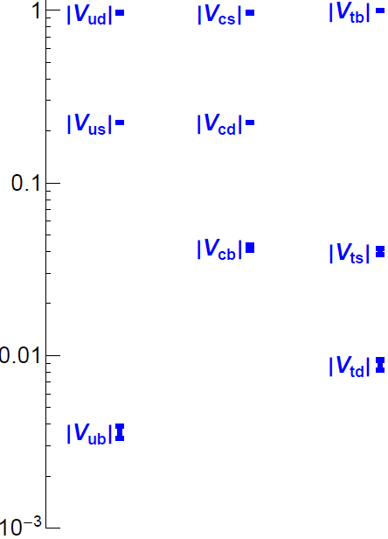
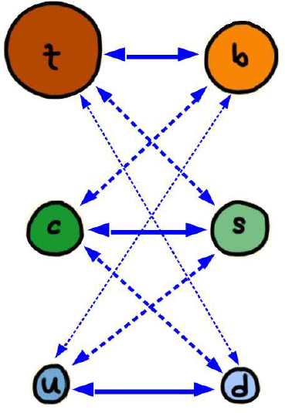
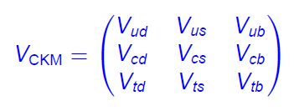
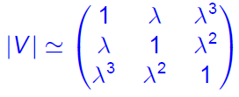

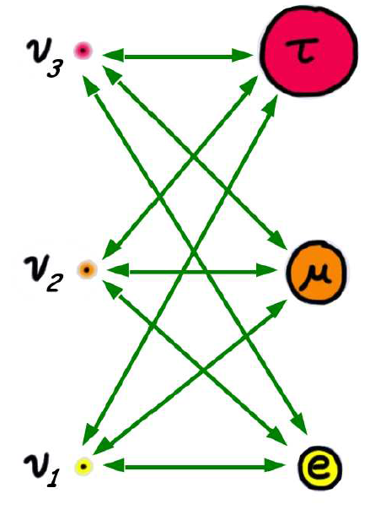
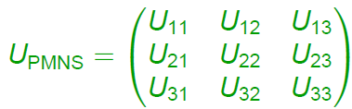
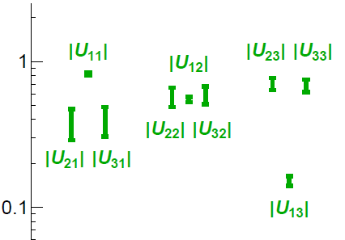
Flavour Puzzle, BSMFP and objectives.
The Flavour Puzzle BSM FP Objectives
The Flavour Puzzle BSM FP Objectives
The Flavour Puzzle Objectives
Hierarchical vs democratic mixings.

Slide 7
Flavour Puzzle, BSMFP and objectives.
The Flavour Puzzle BSM FP Objectives
BSM Flavour Problem. Objectives
Model building & Beyond Standard Model Flavour Problem.
B-Anomalies. Statistical deviations of SM prediction from measurements on B meson semileptonic decays.
New model
(Eff. Th.)
New Flavour Physics
(NR)
Experimental evidence
yields
Must be compatible
Scale of NP
Suppresses
Valid until
Without pushing too high

Slide 8
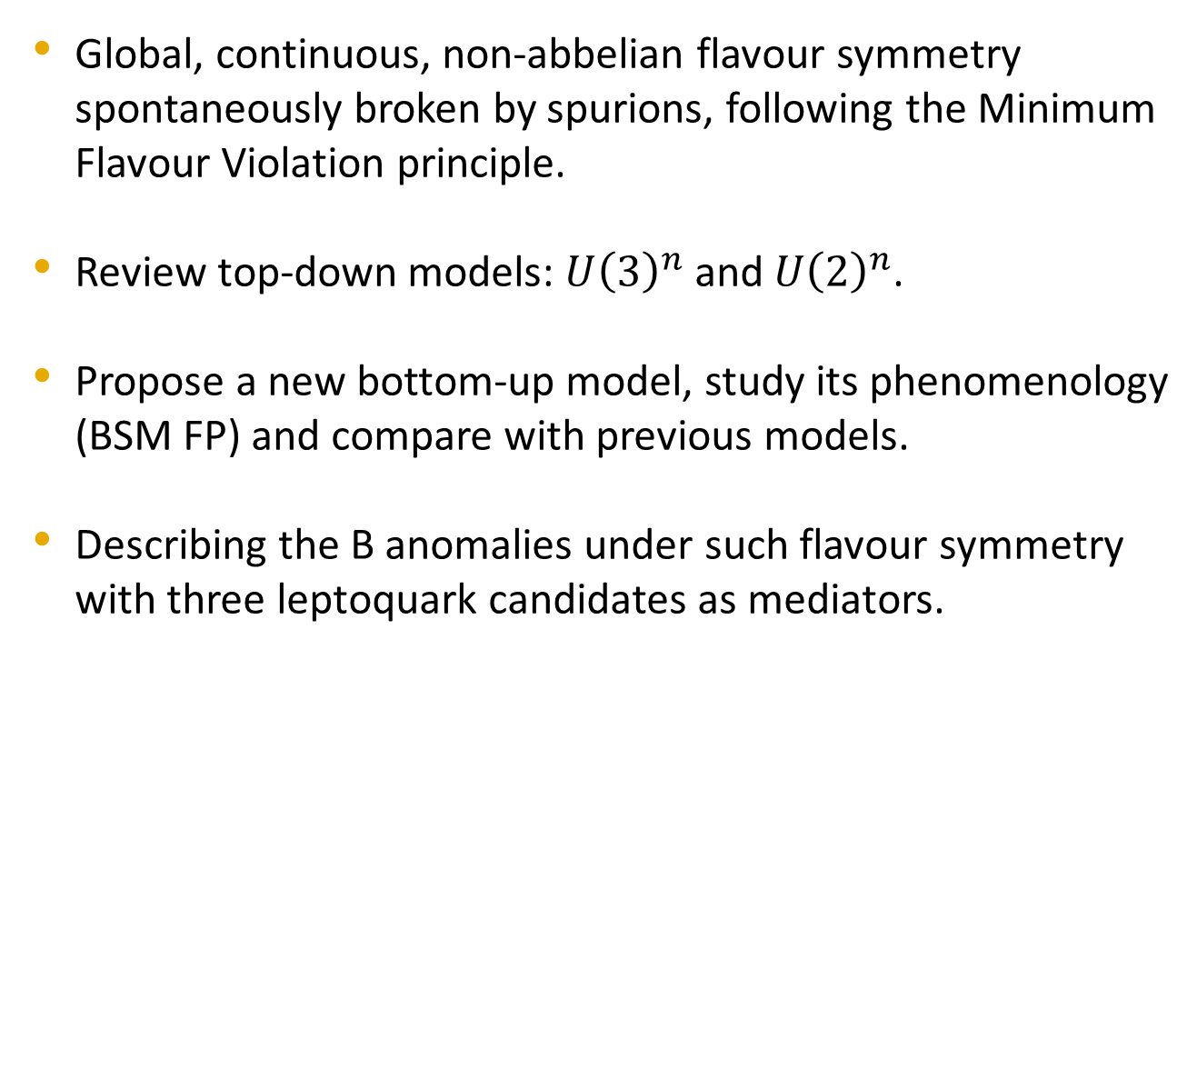
Flavour Puzzle, BSMFP and objectives.
The Flavour Puzzle BSM FP Objectives
Global, continuous, non-abbelian flavour symmetry spontaneously broken by spurions, following the Minimum Flavour Violation principle.
Review top-down models: $U{\left(3\right)}^{n}$ and $U{\left(2\right)}^{n}$.
Propose a new bottom-up model, study its phenomenology (BSM FP) and compare with previous models.
Describing the B anomalies under such flavour symmetry with three leptoquark candidates as mediators.

Slide 9
Minimal Flavour Violation
Symmetry breaking pattern Phenomenology
Minimal Flavour Violation Principle.

Slide 10
Minimal Flavour Violation
Symmetry breaking pattern. Phenomenology
Symmetry breaking pattern Phenomenology
Minimal Flavour Violation Principle.
Biggest symmetry allowed by kinetic terms:

Slide 11





Minimal Flavour Violation
Symmetry breaking pattern. Phenomenology
Symmetry breaking pattern Phenomenology
Minimal Flavour Violation Principle.
Biggest symmetry:
Quark sector:
Spurions and their BVs
SSB

Slide 12
Minimal Flavour Violation
Symmetry breaking pattern. Phenomenology
Symmetry breaking pattern Phenomenology
Minimal Flavour Violation Principle.
Biggest symmetry:
Quark sector:
Why is Yukawa top higher? 2HDM or fine tuning!
Spurions and their BVs
SSB

Slide 13

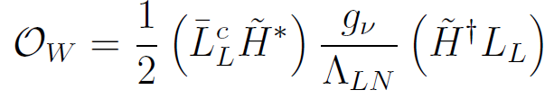

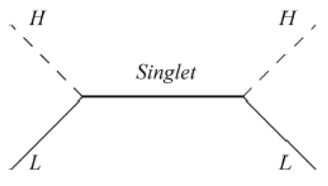
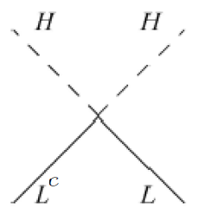
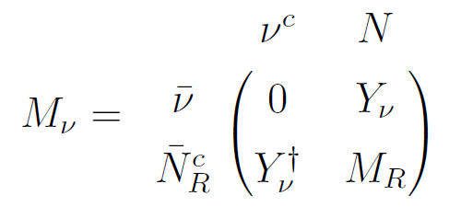

Minimal Flavour Violation
Symmetry breaking pattern. Phenomenology
Symmetry breaking pattern Phenomenology
Lepton sector.
Minimal Field Content Extended Field Content

Slide 14






Minimal Flavour Violation
Symmetry breaking pattern. Phenomenology
Symmetry breaking pattern Phenomenology
Lepton sector
Minimal Field Content Extended Field Content

Slide 15



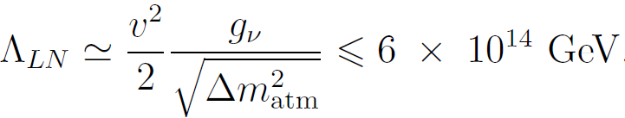

Minimal Flavour Violation
Symmetry breaking pattern. Phenomenology
Symmetry breaking pattern Phenomenology
Lepton sector
Minimal Field Content Extended Field Content
Violates MFV principle
Expanding parameter
Predictivity

Slide 16
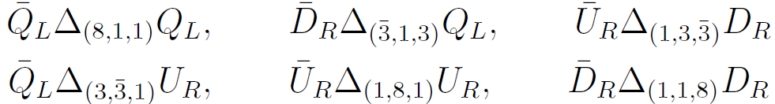
Minimal Flavour Violation
Symmetry breaking pattern Phenomenology
Quark sector. Dimension six operators built of bilinears:

Slide 17


Minimal Flavour Violation
Symmetry breaking pattern Phenomenology
Quark sector. Dimension six operators built of bilinears:

Slide 18
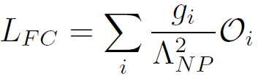
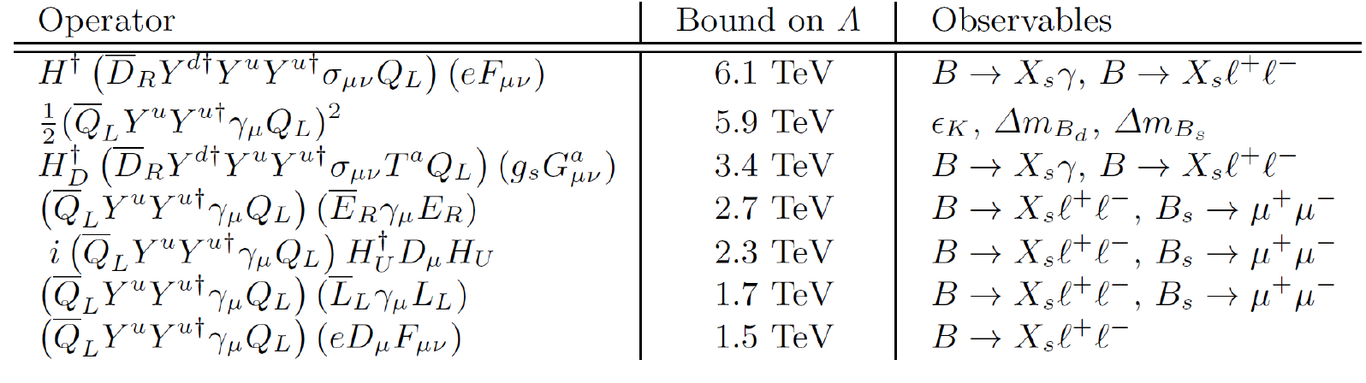
Minimal Flavour Violation
Symmetry breaking pattern Phenomenology
Quark sector. d=6 operators built of Flavour Invariant bilinears:
Flavour Factor

Slide 19

U(2)
Symmetry breaking pattern. Phenomenology
Considers MFV symmetry is already broken by third generation.
Quark sector

Slide 20


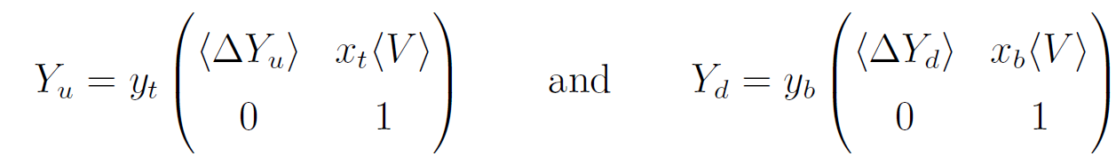
U(2)
Symmetry breaking pattern. Phenomenology
Considers MFV symmetry is already broken by third generation.
Quark sector

Slide 21
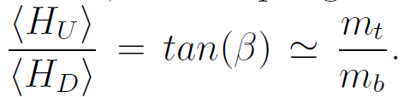
U(2)
Symmetry breaking pattern. Phenomenology
Considers MFV symmetry is already broken by third generation.
Quark sector
Needs 2HDM

Slide 22

U(2)
Symmetry breaking pattern. Phenomenology
Lepton sector. $U{\left(2\right)}^{2}?$

Slide 23

U(2)
Symmetry breaking pattern. Phenomenology
Lepton sector. $U{\left(2\right)}^{2}$. Complex SB without top-down justification.

Slide 24
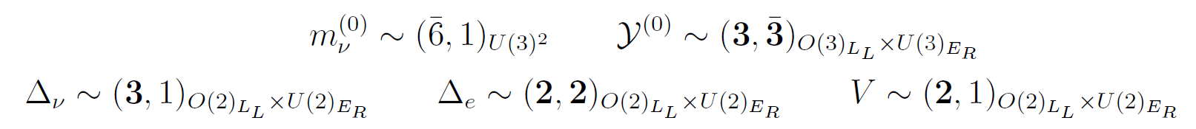

U(2)
Symmetry breaking pattern. Phenomenology
Lepton sector. $U{\left(2\right)}^{2}$. Complex SB without top-down justification.
Not minimal scenario,

Slide 25

U(2)
Symmetry breaking pattern. Phenomenology
Lepton sector. $U{\left(2\right)}^{2}$. Complex SB without top-down justification.
Not minimal scenario: a lot of spurions.
Pseudodegenerate neutrino mass spectrum.

Slide 26
U(2)
Symmetry breaking pattern. Phenomenology
Phenomenology of B and K mesons similar to MFV with 2HDM.
Unable to cope with all flavour data with SM content.
SUSY is the only way to achieve compatibility!
However, SUSY’s 2HDM does not allow

Slide 27
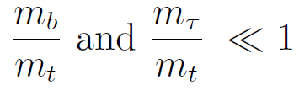


Data Driven Flavour Model
Symmetry breaking pattern. Phenomenology
Bottom-up approach looking for a minimal scenario.
Order 1 for top yukawa coupling.
Hierarchical mass structure for all fermions but for neutrinos.
sds
Hierarchical mixing in quark sector, democratic in lepton sector.

Slide 28
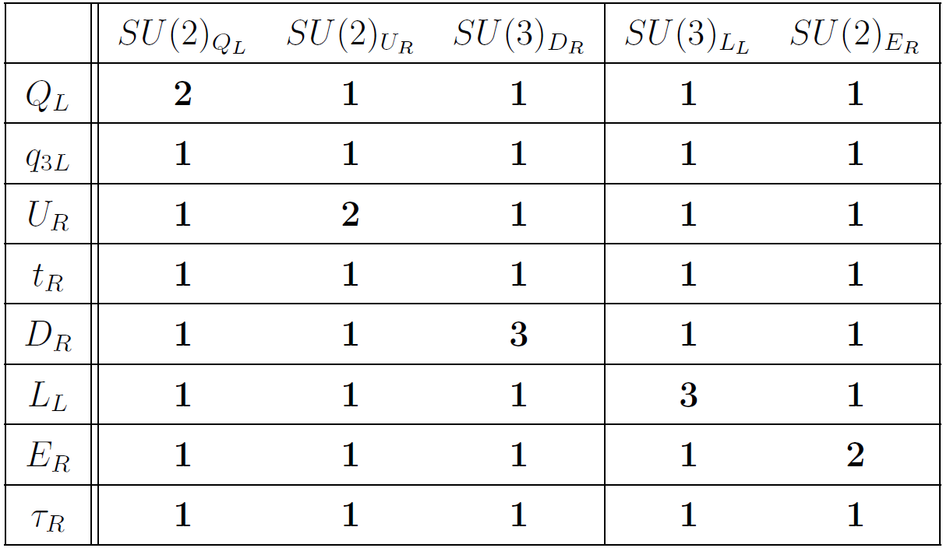
Data Driven Flavour Model
Symmetry breaking pattern. Phenomenology

Slide 29

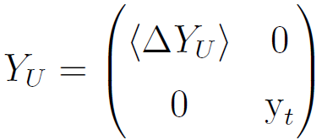
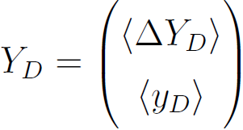
Data Driven Flavour Model
Symmetry breaking pattern. Phenomenology
Quark sector
Yukawa term for the top quark is flavour invariant w/o spurions.
3 spurions for the rest of the quark sector masses and mixing.
Up-mass basis:

Slide 30

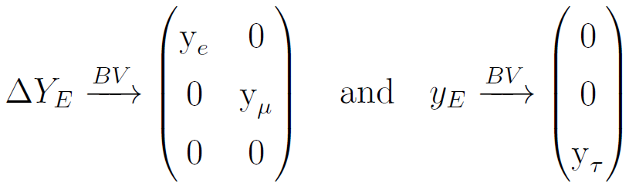
Data Driven Flavour Model
Symmetry breaking pattern. Phenomenology
Lepton sector
2 spurions for the charged lepton sector masses.
Diagonal form in mass basis:
Neutrino sector is exactly as in MFV.
Other choice of basis would lead to predictivity issues (not MFV).

Slide 31

Data Driven Flavour Model
Symmetry breaking pattern Phenomenology
FCNC for LH down quarks without spurions, less suppressed, yields the same phenomenology as MFV, and therefore
Very suppressed flavour changing phenomenology (due to spurion insertions) for RH down quarks and LH or RH up quarks. This is a prediction of the model that could be useful for its distinction in dedicated experiments.
Lepton phenomenology is as in MFV.

Slide 32
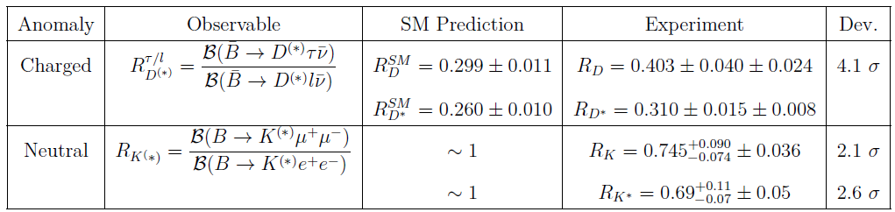
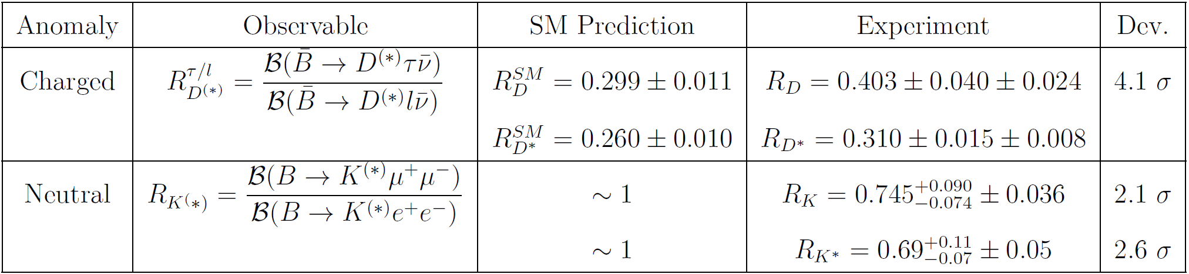
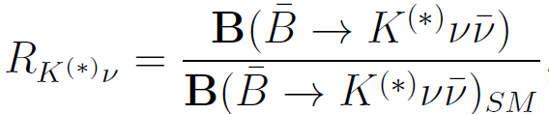

B anomalies.
The anomalies. LQ interactions Global fit

Slide 33
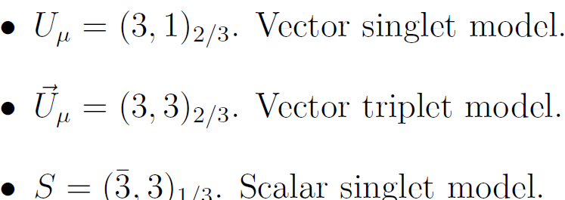
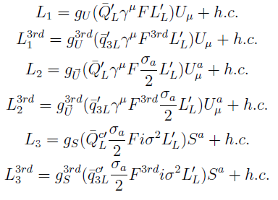
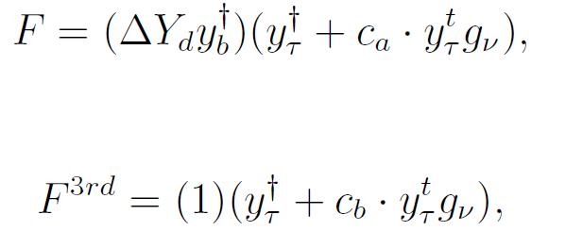
B anomalies.
The anomalies. LQ interactions Global fit
Three candidates
Flavour invariant interactions, suppressed by spurions.

Slide 34

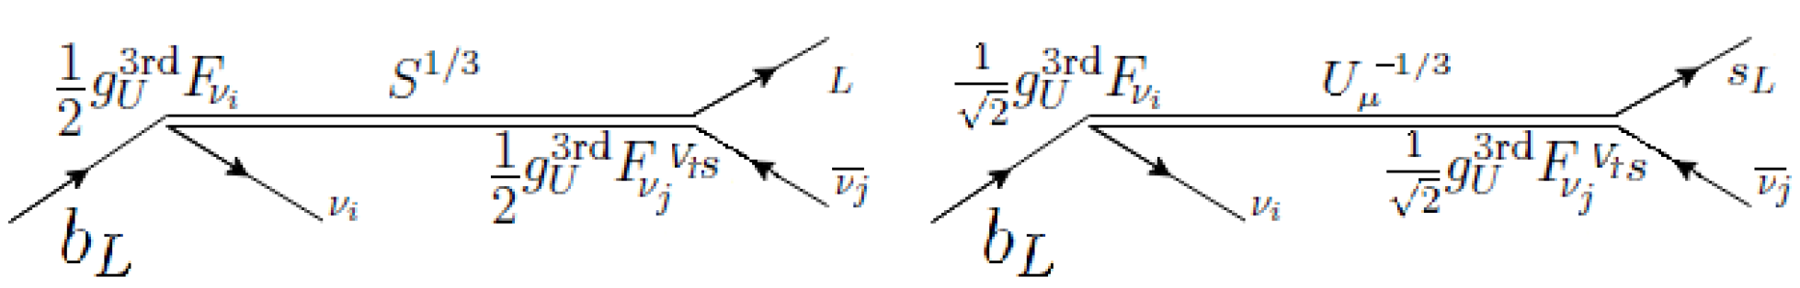
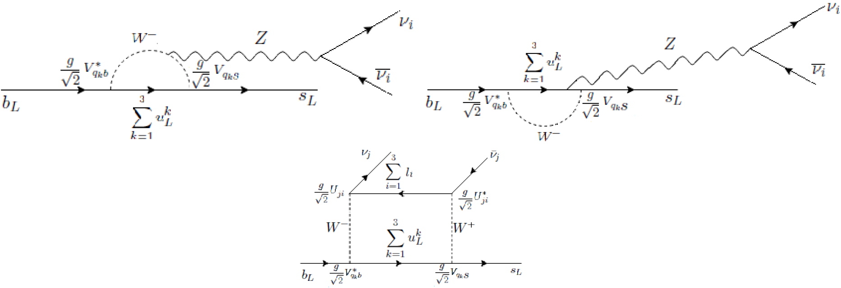
B anomalies.
The anomalies. LQ interactions Global fit
rules out the last two LQ candidates.

Slide 35

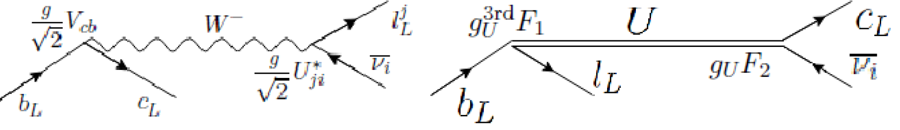

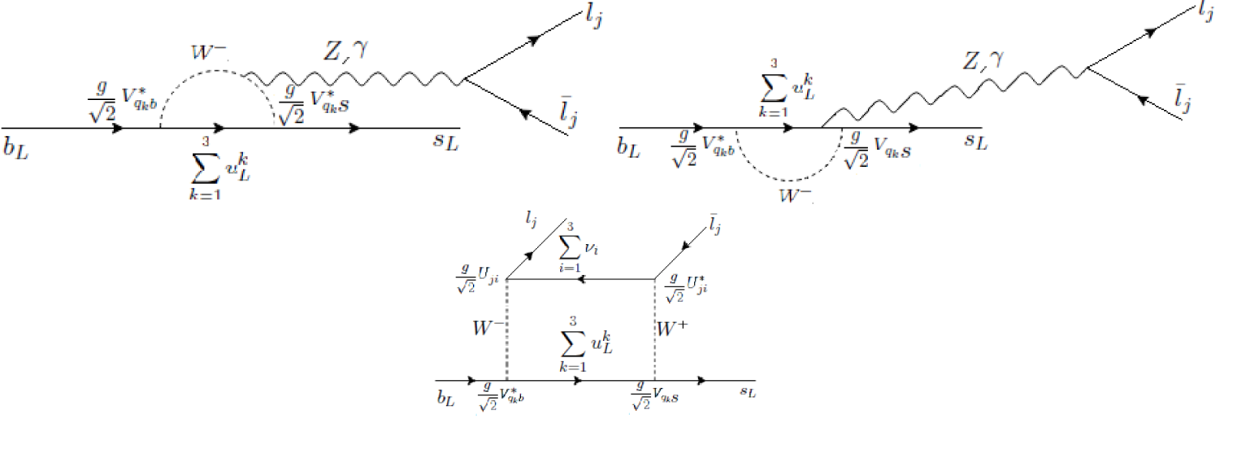
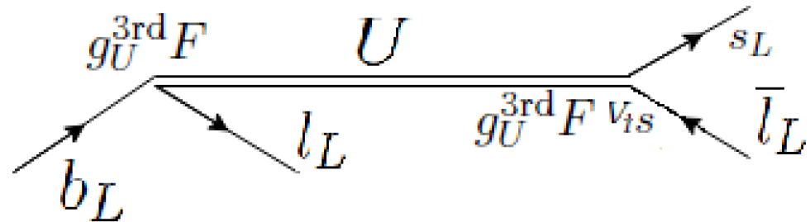
B anomalies.
The anomalies. LQ interactions Global fit
SM and LQ contributions.
SM and LQ contributions

Slide 36
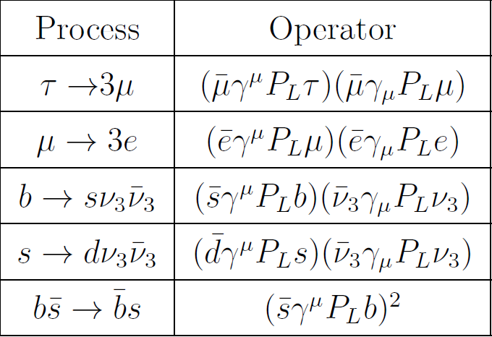
B anomalies.
The anomalies. LQ interactions Global fit
Some of the strongest constraints arise from box diagrams: MLQ>200MeV

Slide 37

B anomalies.
The anomalies. LQ interactions Global fit
Strong dependence on neutrino masses, ordering and scale of LNV.
RD cannot be described coherently with other phenomena, it needs very small LQ masses (MLQ<2 GeV).
RK is properly described within a wide phase space 6GeV<MLQ<250 GeV
${\left(g−2\right)}_{μ}$, $τ→3μ$and $μ→3e$ can be described coherently with RK within a relatively wide phase space.
Succesfully copes with other flavour constraints and LHC constraints on the mass of LQ due to the low scale of the spurions.

Slide 38
Conclusion
The Data Driven Flavour Model successfully describes the Flavour Puzzle and copes with the BSM Flavour Problem with the same scale of New Physics as Minimal Flavour Violation.
It presents unique phenomenological features, such as very suppressed FCNC for up quarks and RH down quarks that would allow to test it in future dedicated experiments.
Its buillt in a minimal way, with only one Higgs and without the non-minimal symmetry breaking pattern of adding a U(1).
Together with a vector singlet Leptoquark can describe neutral B anomalies, with a mass for such leptoquarks of a few GeVs. It also copes with the anomaly (g-2) of the muon and decays of charged leptons into three charged leptons within a wide phase space.

Slide 39
Foresights
The model, despite being a promising description of the Flavour Puzzle, lacks an ultraviolet completion to be regarded as an explanation. However it is not completely ad hoc: SU(5) GUT inspired.
It is not explained where the background values of the spurions arise from, the construction of a potential able to give such minima is necessary.
A lot of variations of the model could be considered, such as gauging the symmetry group, considering the adition of abelian symmetries to the picture, promoting the spurions to dynamical fields (and their Background values to VEVs), etc.

