Slide 1

Future accelerators
Near future and underway (10y)
Next in line (15-30y)
Further ahead (25-50y)
The common challenges: timelines, power and resources
Mostly colliders, however improvements of existing or new neutrino facilities, smaller accelerator based experiments – for example for light dark matter or strong QED or detailed SM studies – are also very central parts of our field …
Caption: Man standing at beginning of winding road
Artist: Mark Hess

Slide 2
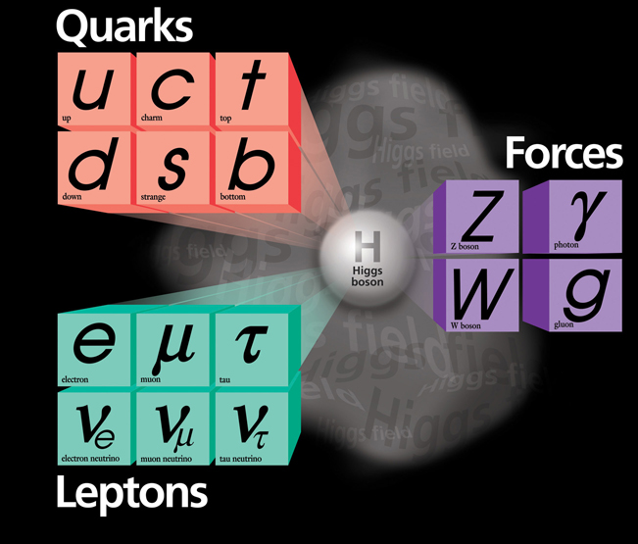
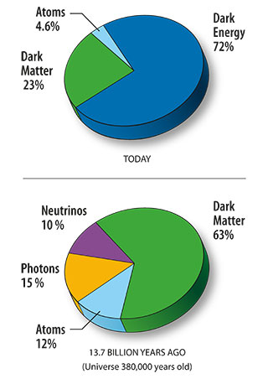
Physics
“SM rules“
Precision measurements – Higgs as the main probe, but also many other probes (luminosity a key)
BSM (energy and luminosity)
Dark matter and energy – the most striking mysteries

Slide 3

Large colliders
HL – LHC
  Higher luminosities, improved detectors, improved analysis
Other accelerators very important too: Neutrinos, SuperKEKb, the neutrino facilities, EIC, dark sector studies, light dark matter, etc ..
Seems reasonable to assume that next large accelerator in particle physics will be an e+e- collider in the 250-500 GeV range (ILC, CLIC, CEPC, FCC-ee), hopefully following directly after or possibly overlapping with HL-LHC
  Physics case clear, technologies are there, “hesitations” are due to costs and perceived link to the machine after
  In particular, the large circular e+e- machines are linked in time, design and funding to proton colliders after
But what is the next next accelerator – at much higher energies ? Physics motivations can be made (are they sufficient to approve such a large project?) and provide design study guidance, even though HL-LHC and a Higgs factory might (hopefully will) change the outlook
  Hadrons (~100 TeV or above), upgrading an e+e- LC collider (length/technology) or Muons (aiming for 10 TeV or above)

Slide 4
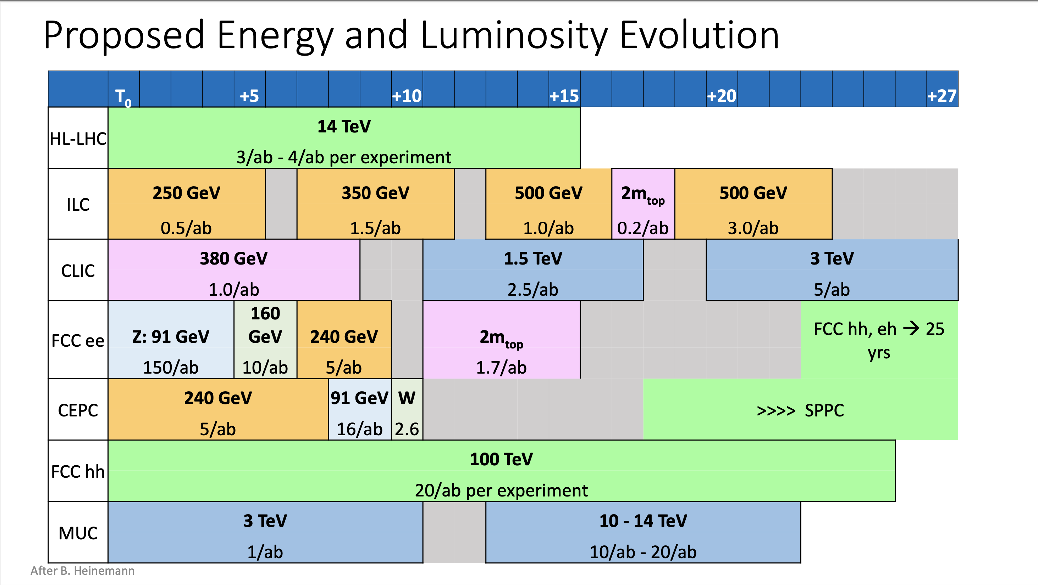

Slide 5

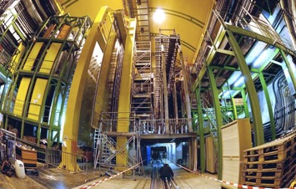
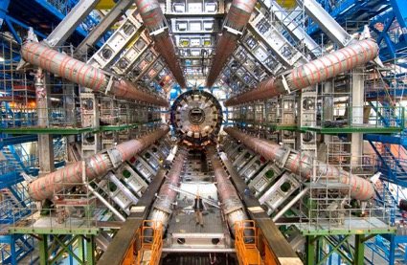

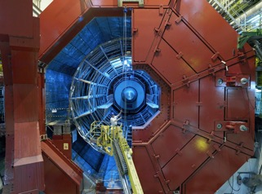


From LHC to HL LHC
LHC: a New Era in Fundamental Science
LHCb
CMS
ATLAS
ALICE
LHC ring:
27 km circumference

Slide 6
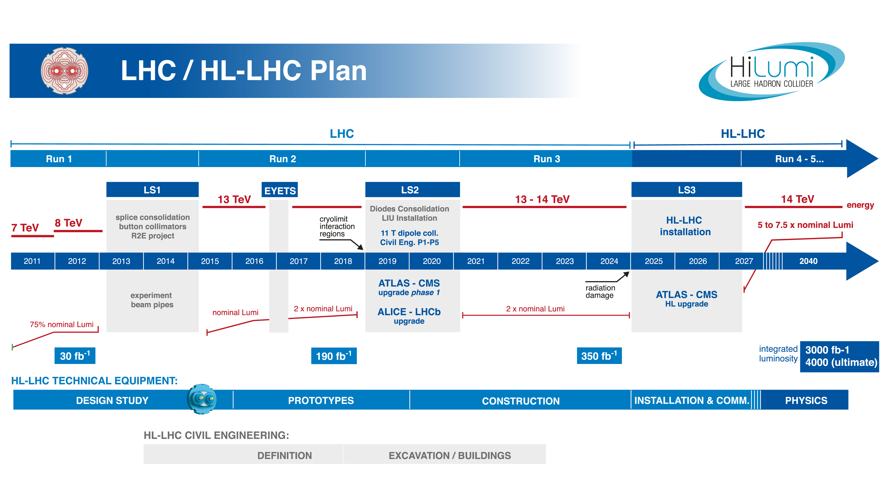
After November 2019 retreat: CERN has decided, upon request of LHC Experiments Collaborations, to shift LS3 by 1 year, starting in 2025.
eYETS
Pilot beam run in October!
LS2 extended by 2 months; LS3 starts now in 2025

Slide 7
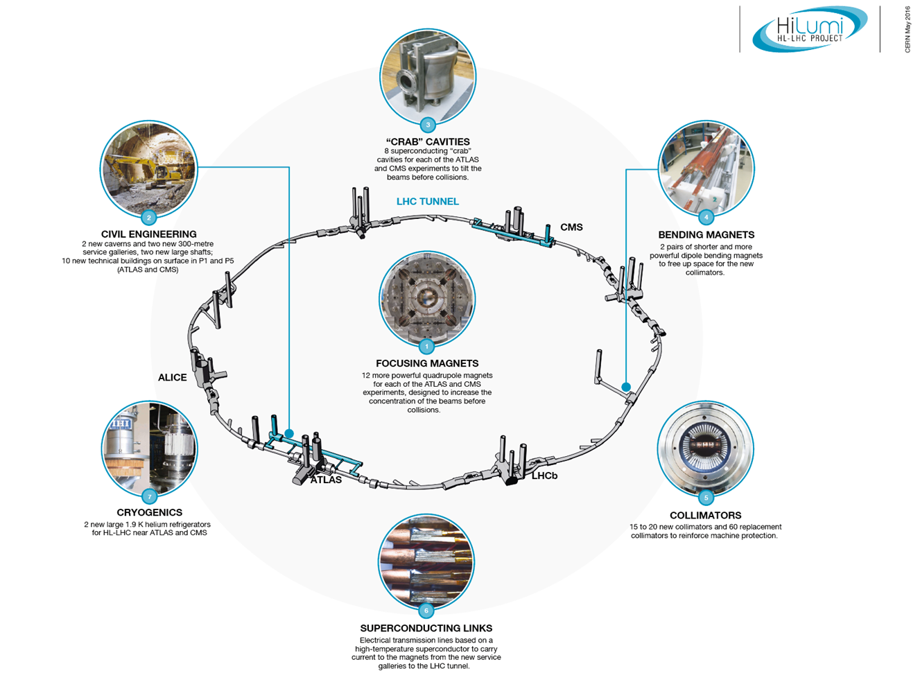
HL-LHC Upgrade:

Slide 8
From LHC to HL LHC
Long Shutdown 2
Run 3
Long Shutdown 3
Runs 4-5-6
2020
2021
2022
2023
2024
2025
2026
2027
2038
Injector upgrades
Cryo-limit on luminosity
HL-LHC installation
6.8 / 7 TeV
7 TeV
Radiation damage
Following the “loss” of 2021 to COVID, an extension of Run 3 into 2025 is under consideration, but possible radiation damage to some of the low-beta quadrupole assemblies is a worry.

Slide 9
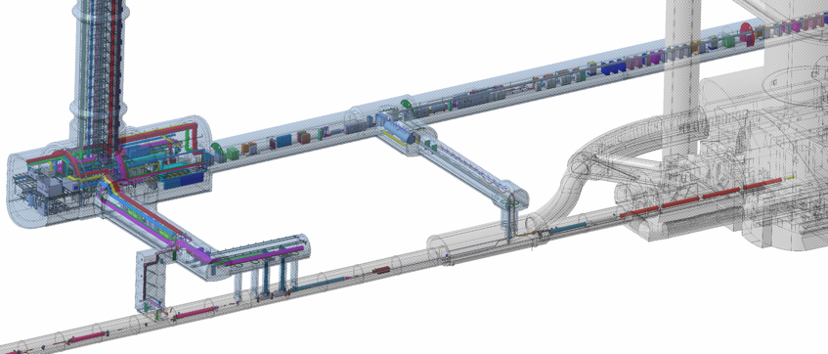
HL-LHC
Goal:
Enable LHC to deliver ~250 fb⁻¹/year in ATLAS and CMS
reaching 3000 fb⁻¹ ~2038-2040 (leveling at a pile-up of 140 events/crossing)
Complete redesign of regions next to ATLAS and CMS in order to:
  Achieve smaller beam size at the experiments,
  Withstand radiation from largely increased luminosity debris.
Profit fully from the increased beam intensity provided by the LS2 injector upgrade.
Upgrade key LHC systems to cope with the increased intensity and luminosity (collimation, cryogenics, injection and dump systems).

Slide 10
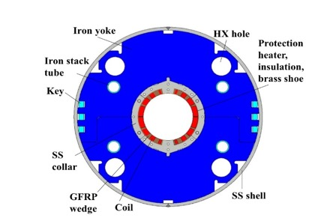
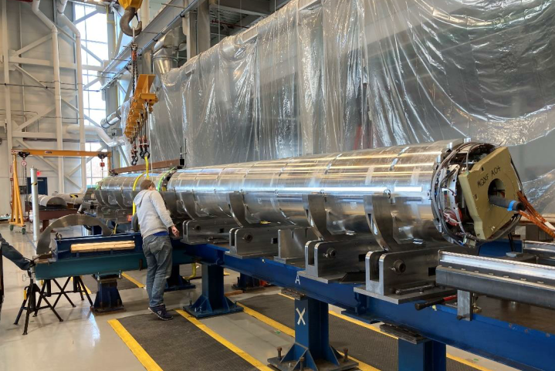
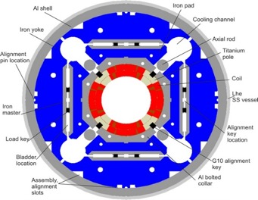
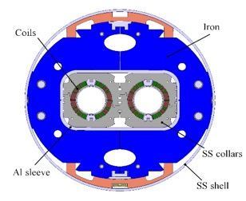



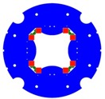
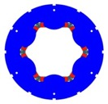
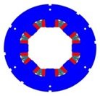

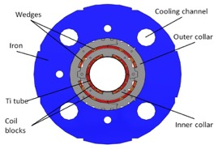
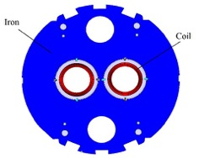


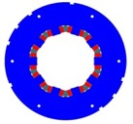

HL-LHC
New wide-aperture superconducting magnets for the experimental regions.
  In the prototyping and testing phase.
Key components of HL-LHC are new final focus quadrupoles made of Nb₃Sn.
Final focus
quadrupole
Separation/recombination dipoles
MQXFA final focus magnet assembly at FNAL
Higher order correctors
Dipole correctors

Slide 11
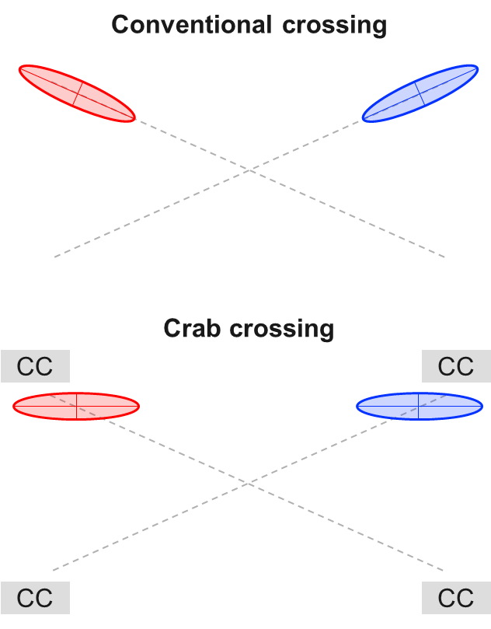
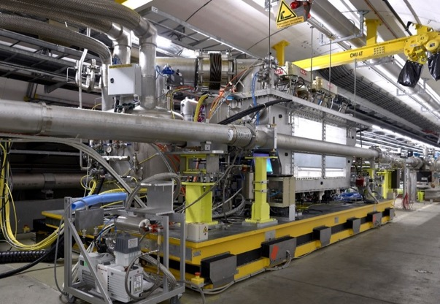
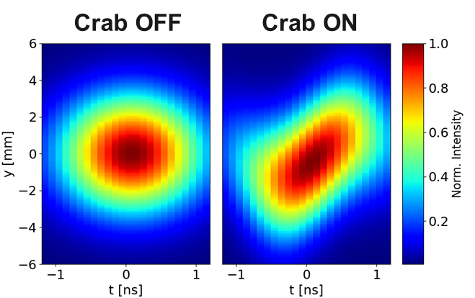
Crab cavities
In a conventional bunch crossing luminosity is lost as bunches overlap only partially – LHC runs 1 – 3 (see earlier slide).
“Crab cavities” will be installed on the sides of the interaction points to tilt the bunches and cancel this effect.
  This technology has never been applied in a hadron collider.
A prototype has been installed in the CERN SPS ring.
  First crabbing of a proton beam demonstrated in 2018.

Slide 12
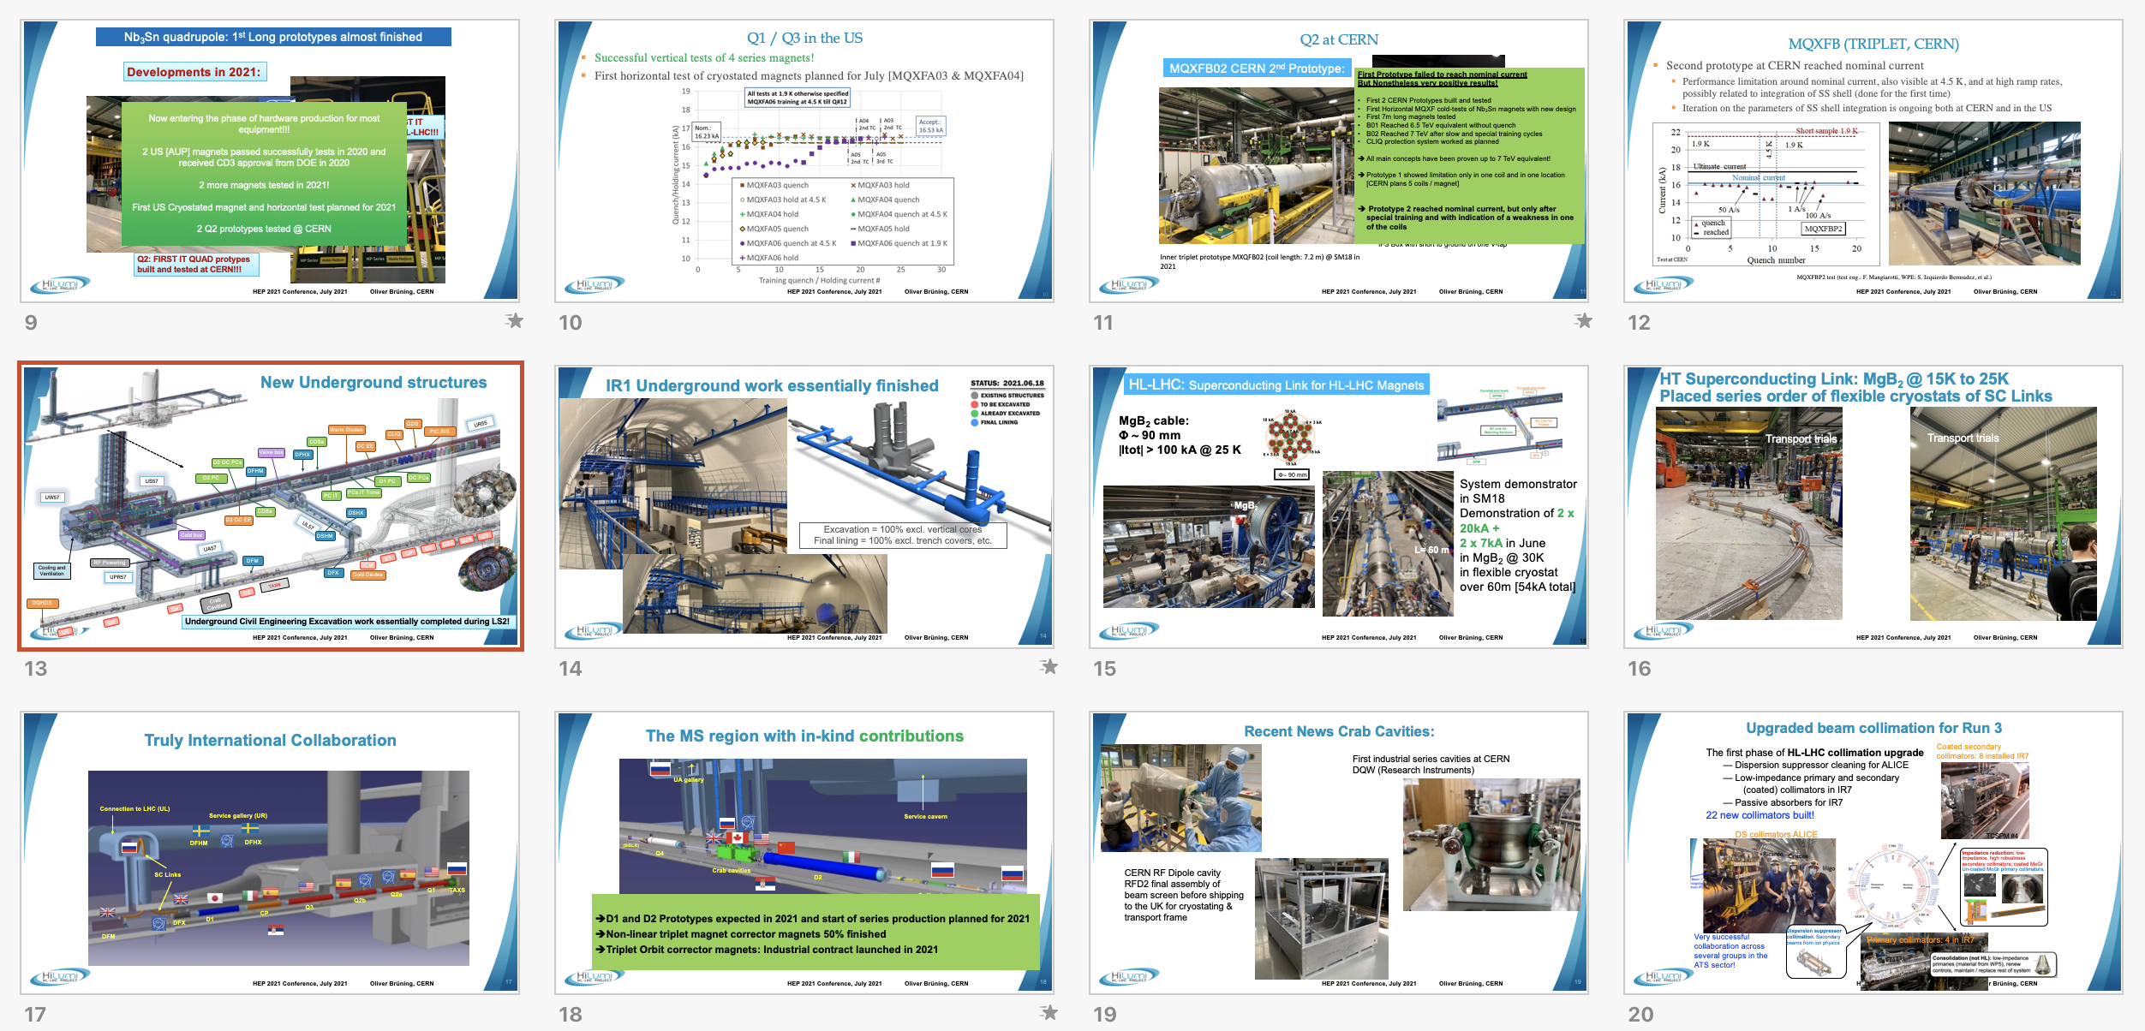
HL LHC
HL LHC the key energy frontier accelerator the next two decades
Please see status at: https://indico.desy.de/event/28202/contributions/105488/ (Oliver Brüning, EPS meeting July 2021)

Slide 13
Yellow
HL – LHC
  Higher luminosities, improved detectors, improved analysis
Other accelerators very important too: Neutrinos, SuperKEKb, the neutrino facilities, EIC, dark sector studies, light dark matter, etc ..
Seems reasonable to assume that next large accelerator in particle physics will be an e+e- collider in the 250-500 GeV range (ILC, CLIC, CEPC, FCC-ee), hopefully following directly after or possibly overlapping with HL-LHC
  Physics case clear, technologies are there, “hesitations” are due to costs and perceived link to the machine after
  In particular, the large circular e+e- machines are linked in time, design and funding to proton colliders after
But what is the next next accelerator – at much higher energies ? Physics motivations can be made (are they sufficient to approve such a large project?) and provide design study guidance, even though HL-LHC and a Higgs factory might (hopefully will) change the outlook
  Hadrons (~100 TeV or above), upgrading an e+e- LC collider (length/technology) or Muons (aiming for 10 TeV or above)

Slide 14
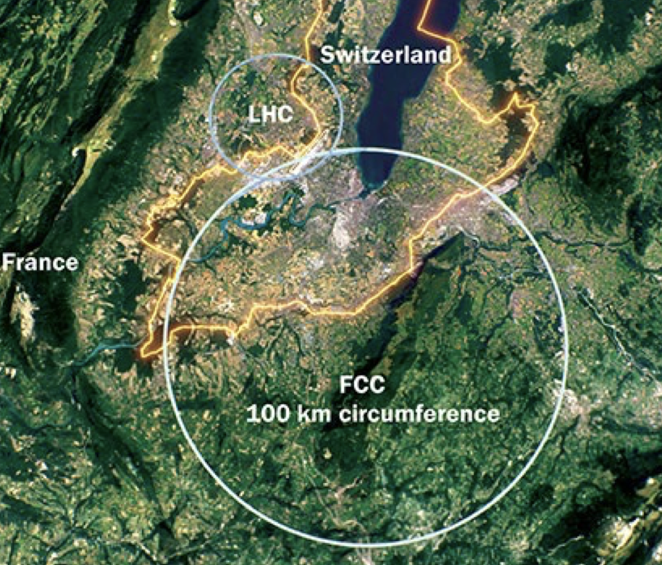
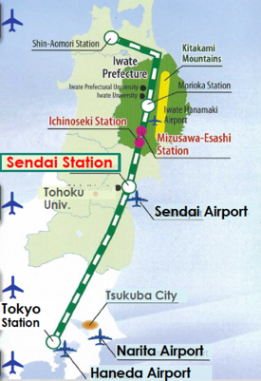
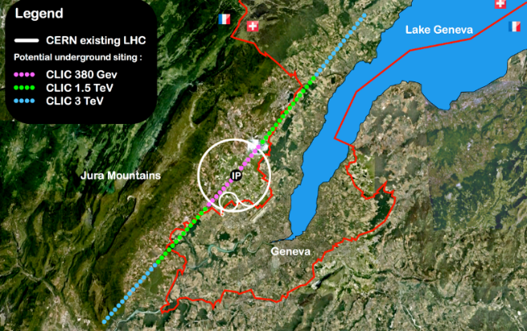
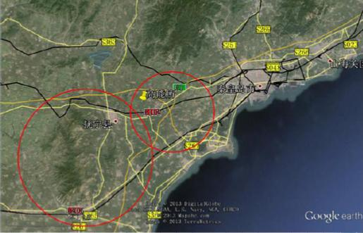

Next: A Higgs factory
Need e+e- collisions at least at 250 GeV, four alternatives:
ILC in Japan (linear) FCC at CERN (ring)
CLIC at CERN (linear) CEPC in China (ring)
Linear colliders: 13 (Higgs) -> 50 (max) km
Rings ~100km, can be used for protons
after
14

Slide 15

Linear Colliders
CLIC
ILC
15
Notes:
15

Slide 16


Generic Linear Collider
The key parameters: Energy and luminosity
The critical steps:
Create low emittance beams (sources, injector, damping rings, ring to main linac - RTML)
Acceleration in main linac (energy increase per length)
Supply energy as efficient as possible to beam (high power at 1, 1.3 and 12 GHz)
Nano-beams: Squeeze the beam (Beam Delivery System- BDS), i.e. reduce β
16

Slide 17
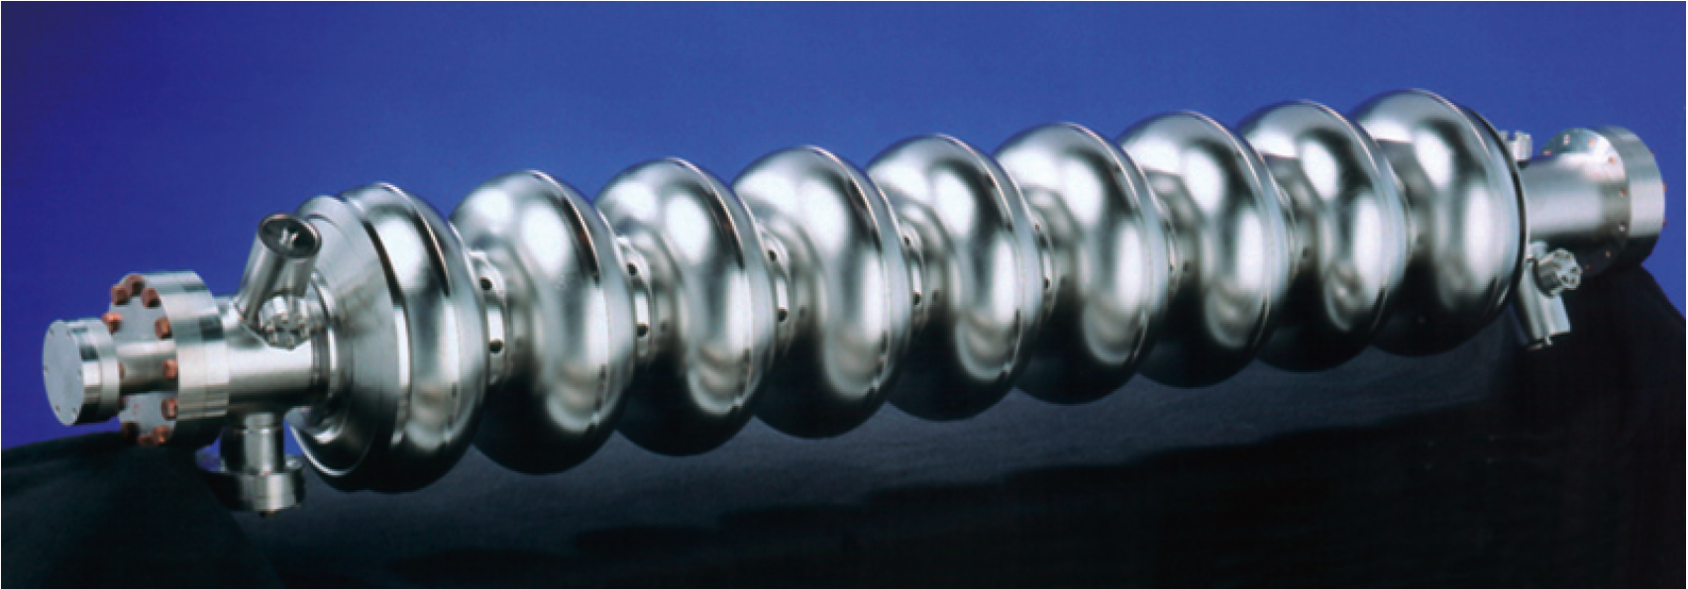
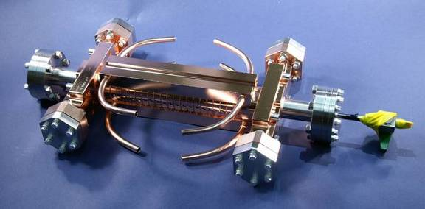
Cavity/Accelerating Structure
ILC cavity
1.3 GHz, superconducting
Target effective operational 31.5MV/m
Target gradient 35MV/m
Q₀≈10¹⁰
Long pulse => low peak power
Large structure dimensions => low WF (wakefields)
Very long pulse train => feedback within train
SC structures => high efficiency
Gradient limited => longer linac
Large number of e+ per pulse
Large DR
CLIC accelerating structure
12 GHz, normal conducting
Target loaded gradient 100MV/m
Target unloaded gradient 120MV/m
Q₀≈6 10³
High gradient => short linac
Small structures => strong wakefields
Generation of high peak RF power (drivebeam)

Slide 18
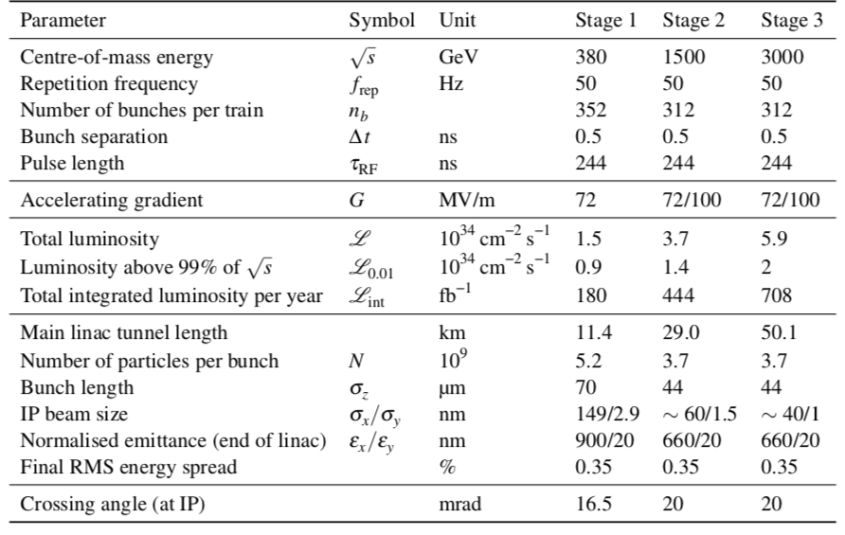
CLIC parameters
18

Slide 19
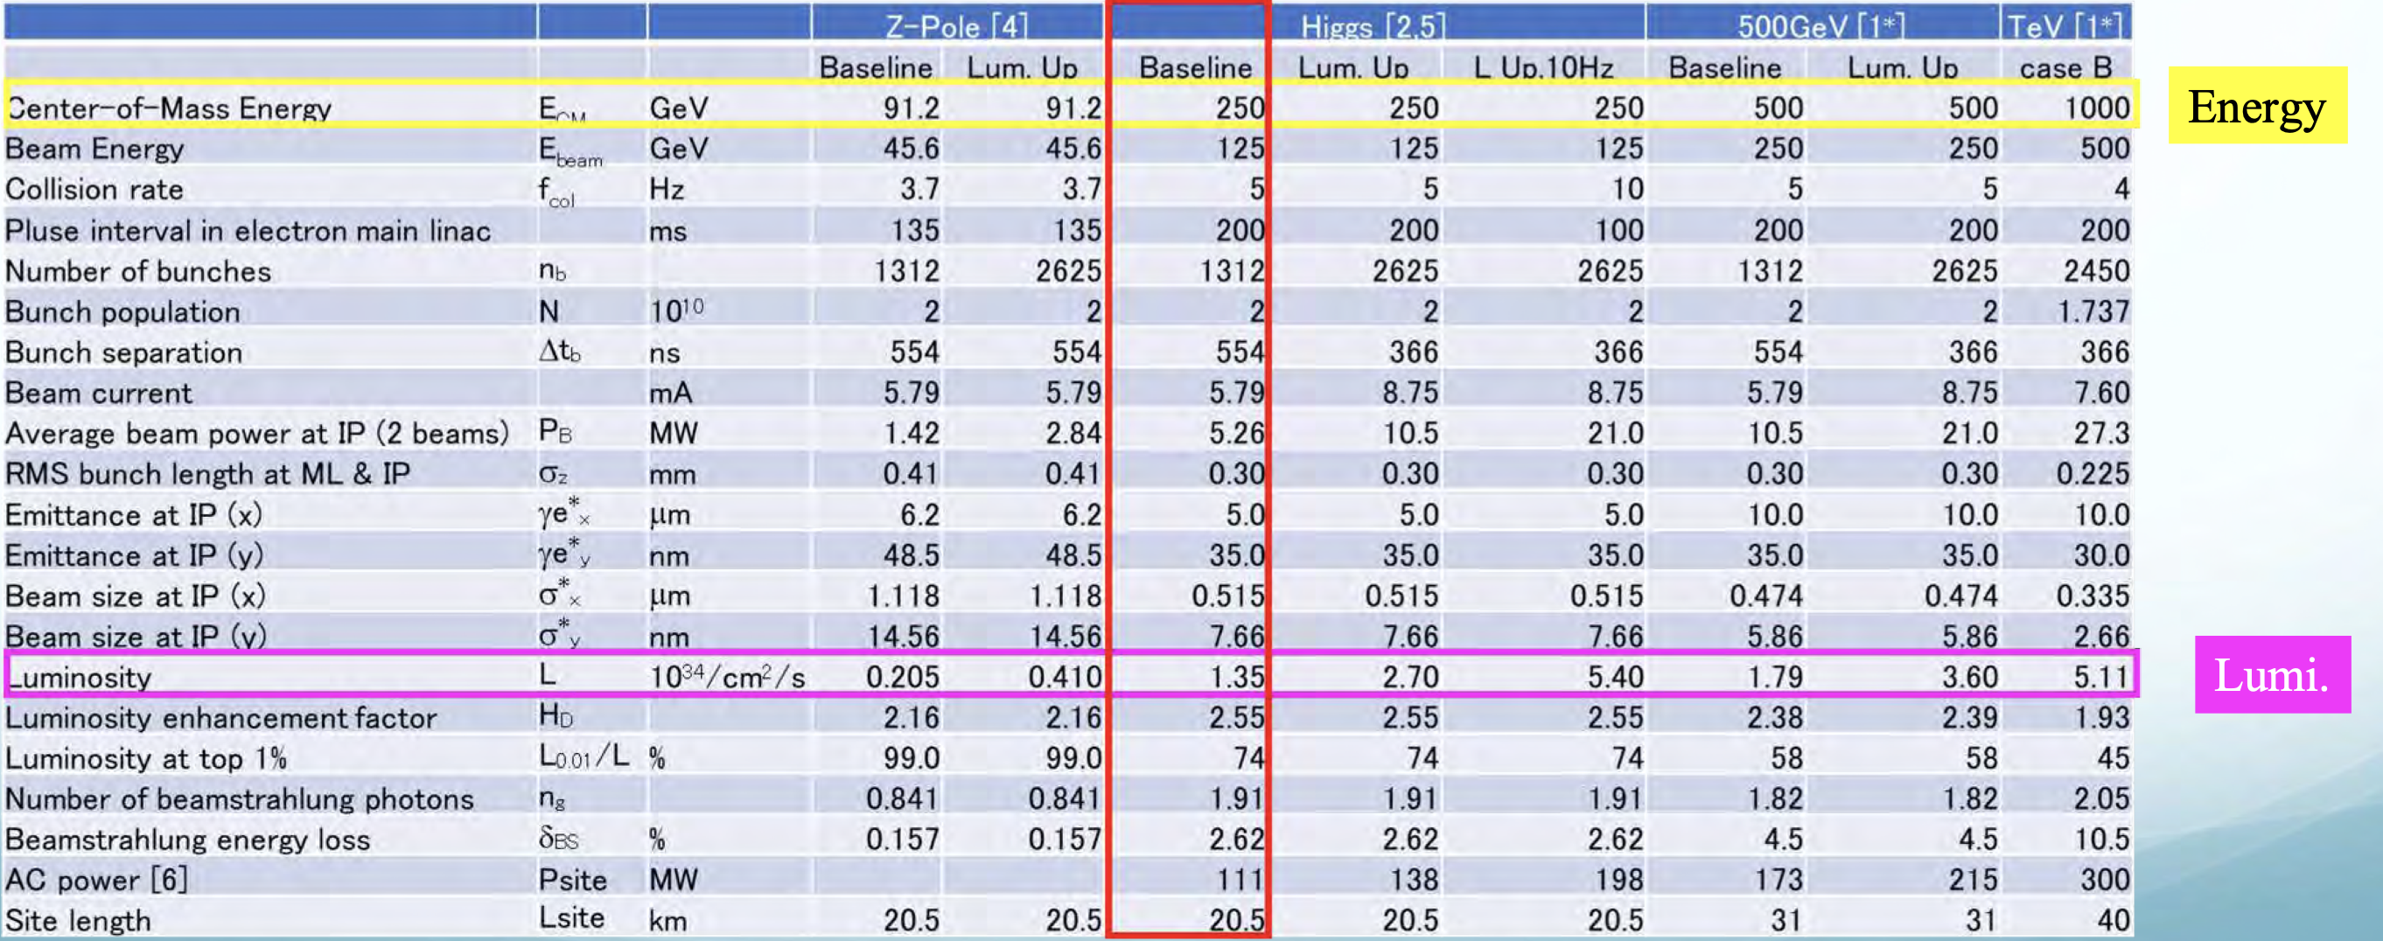
ILC parameters

Slide 20
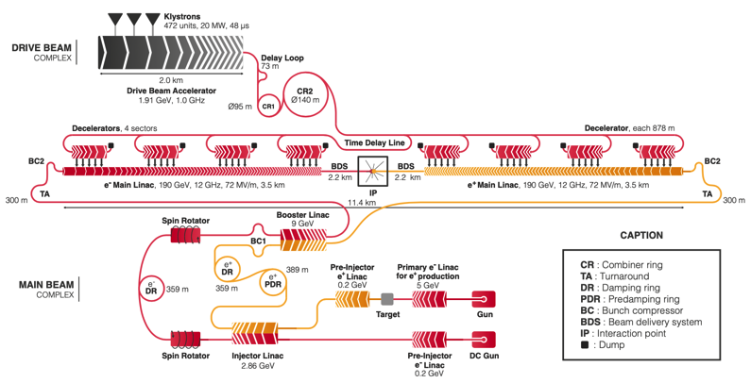
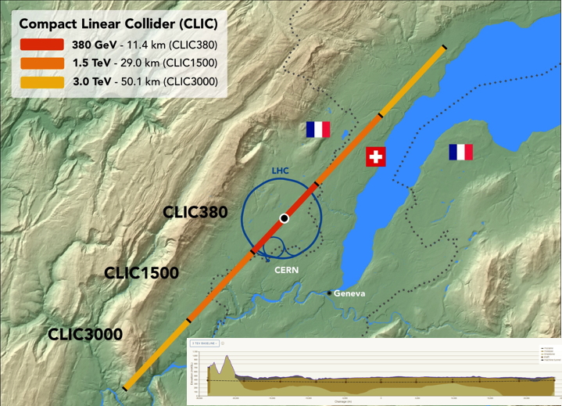
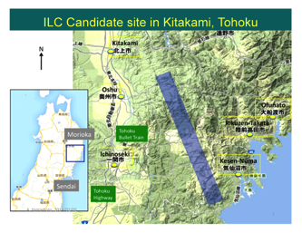
e+e-: Linear Colliders
Linear Collider (LC) proposals for CLIC and ILC are very mature: parameters & design, technically developments, in term of performance verifications, project planning – with strong communities behind
Key features and technical focus of studies:
Initial stages with costs and power similar to LHC, further investments will be staged
Expandable to higher energies – with existing, improved or new RF technologies (as novel acc. technologies) - and in some cases also increased luminosities
RF (energy) and nanobeams (luminosity) main challenges
Strong connection and synergies with light-sources and FEL linacs
Polarized beams foreseen
Can also run a lower energies (Z) and gamma-gamma is possible
Can we hope that Novel Acc. technologies will provide compact
(translating into construction timescales that are not many decades) and relatively cheap high gradient acceleration ? I will come back to this.
20

Slide 21
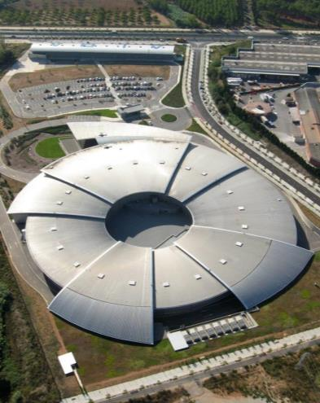
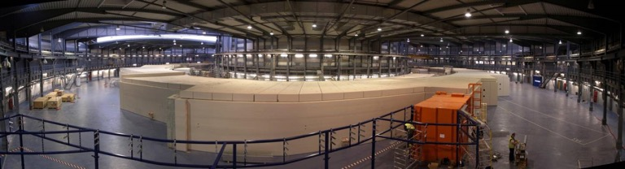
Synchrotron Light Sources: about 50 storage ring based
60‘000 users world-wide
Established, mature technology
From L.Rivkin EPFL

Slide 22
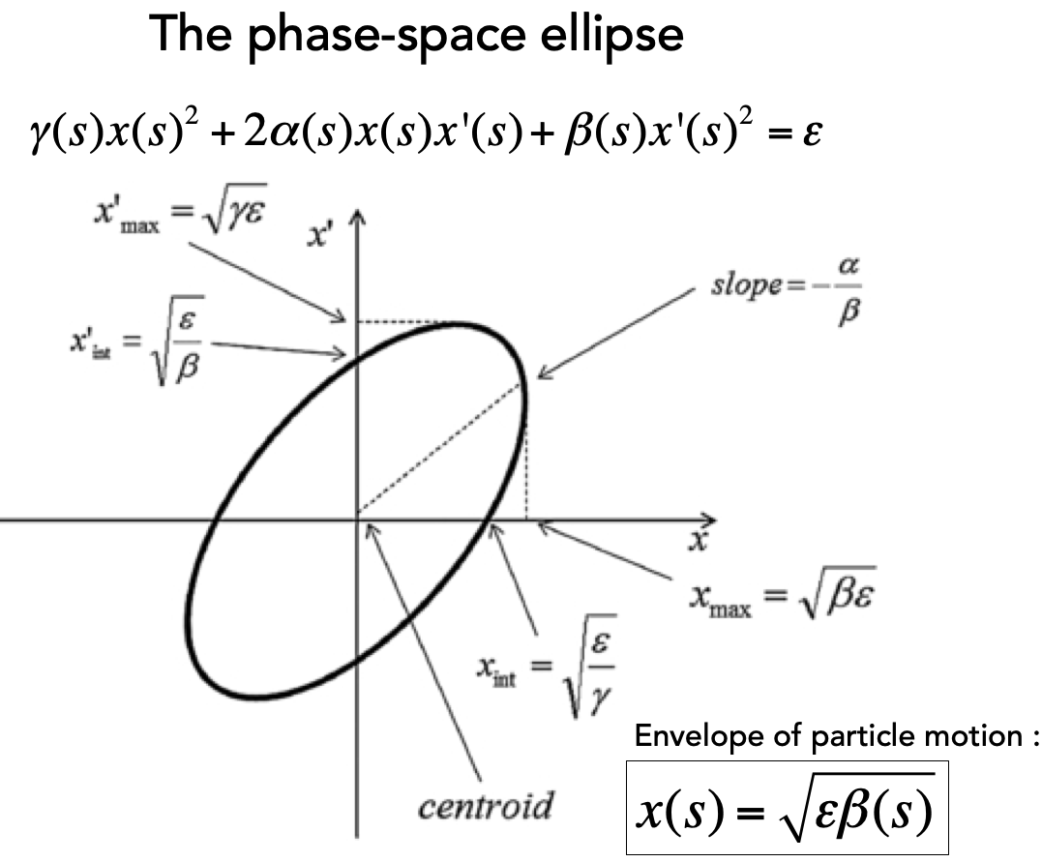
Damping ring, experience from light sources
The damping rings reduce the phase space (emittance ε_{x,y}) of the beam – wigglers to stimulate energy losses (SR)
Light-sources need similar beams (picture: ALBA)
Target and achieved emittance in existing and planned machines
2018
2008
22

Slide 23
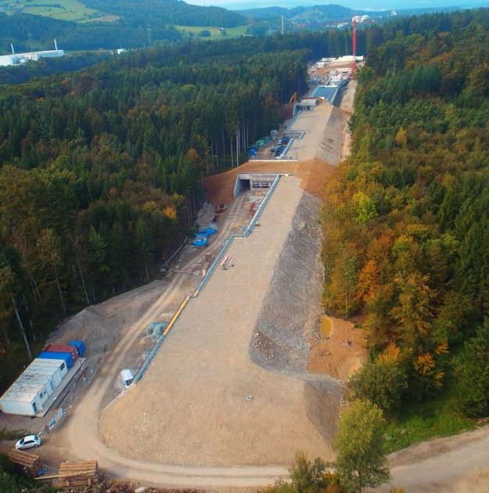
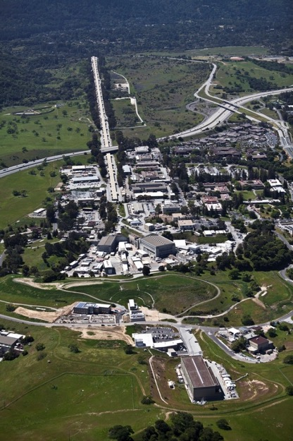
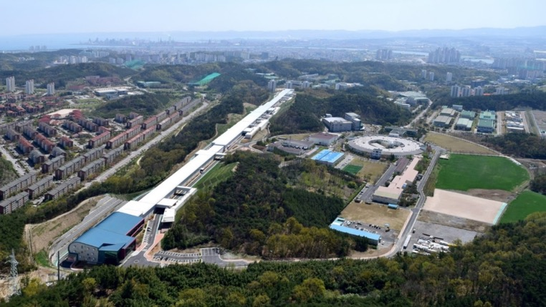
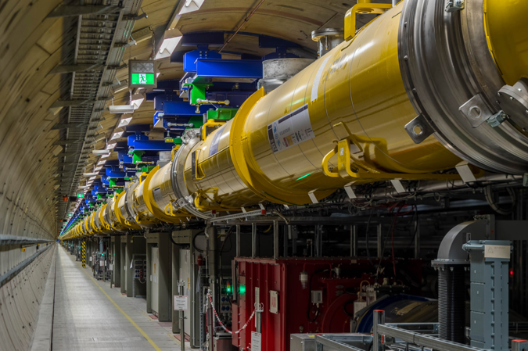
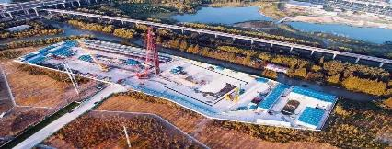

X-Ray Free Electron Lasers
LCLS I, II 2009, 2019
From L.Rivkin EPFL
PAL XFEL 2016
SwissFEL 2017
SHINE, Shanghai, under construction
SACLA 2011
8.5 GeV, 60 Hz NC
European XFEL 2017
DESY, Hamburg

Slide 24
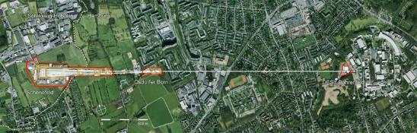


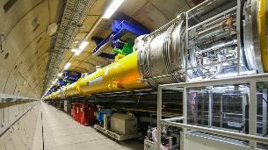
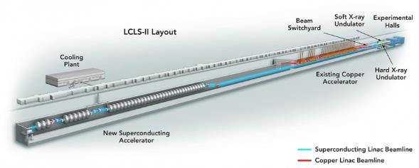
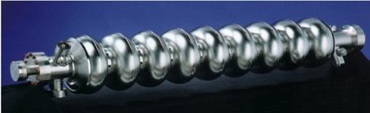
Worldwide large scale SRF accelerators
International Linear Collider (ILC) (Plan)
Euro-XFEL
Operation started from 2017
LCLS-II + HE (under construction)
-100 cryomodules
-800 cavities
-17.5 GeV (Pulsed)
ILC
-35 + 20 cryomodules
-280 + 160 cavities
- 4 + 4 GeV (CW)
DESY
-900 cryomodules
-8,000 cavities
-250 GeV (Pulsed)
Cornell
LAL/Saclay
SLAC
FNAL
INFN
KEK
JLab
SINAP
LCLS-II
SHINE (under construction)
-75 cryomodules
-~600 cavities
- 8 GeV (CW)
1.3GHz 9 cell cavity
ILC slides from S,Michizono and or B.List

Slide 25


Slide 26
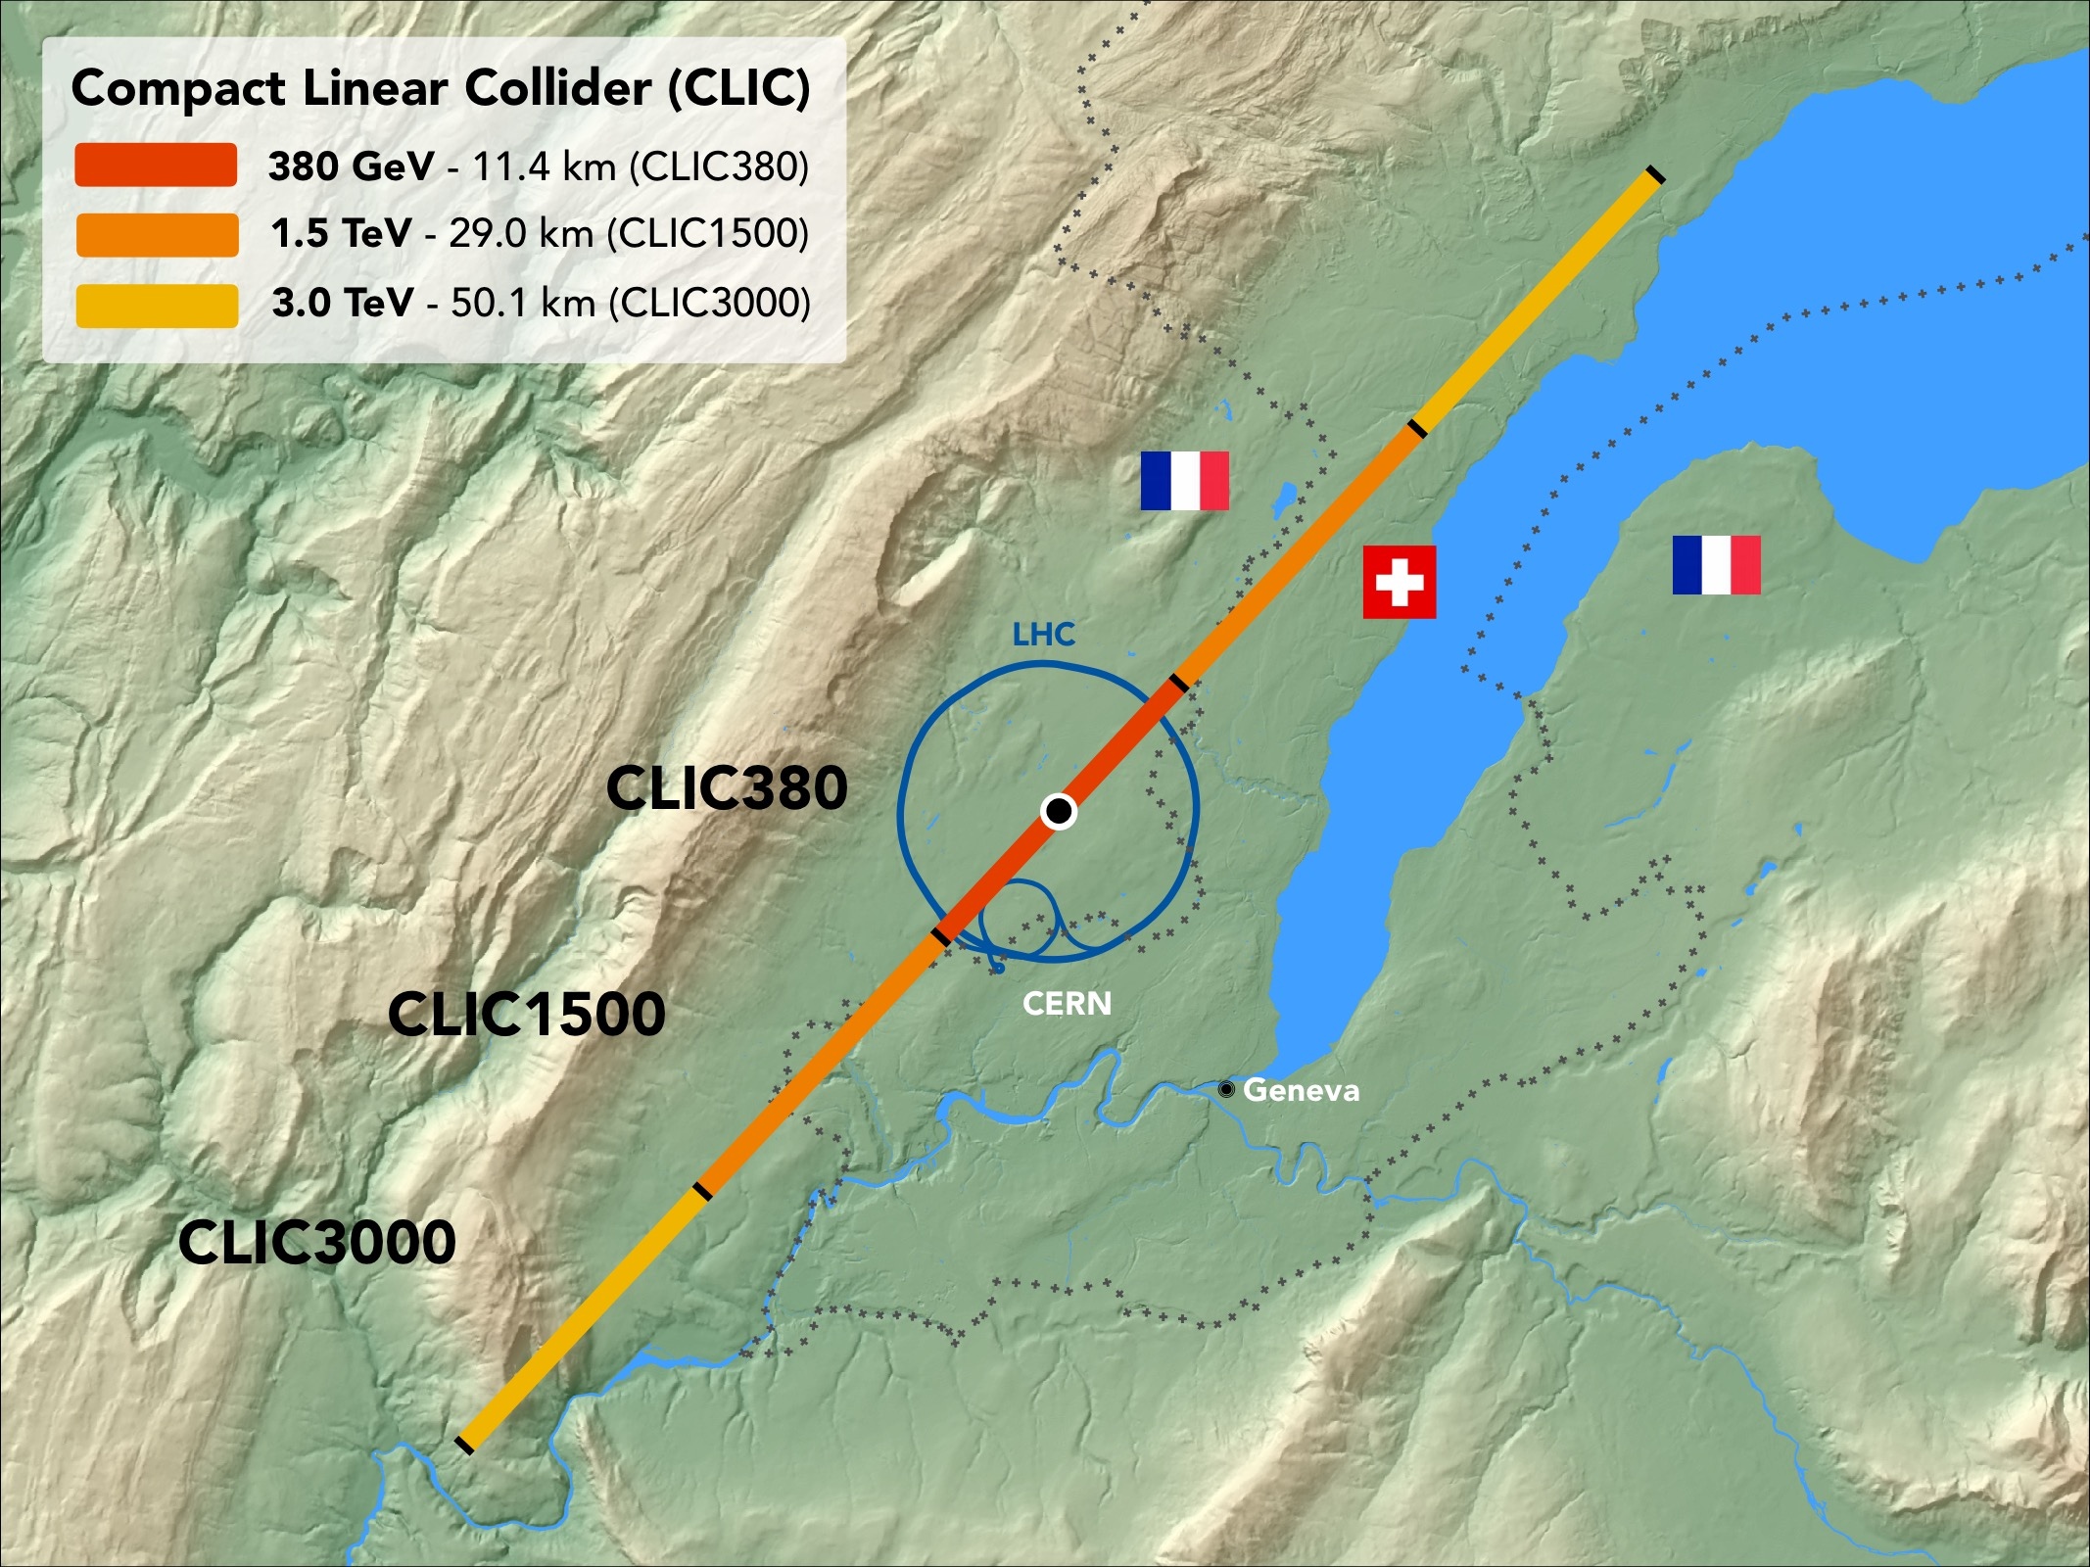
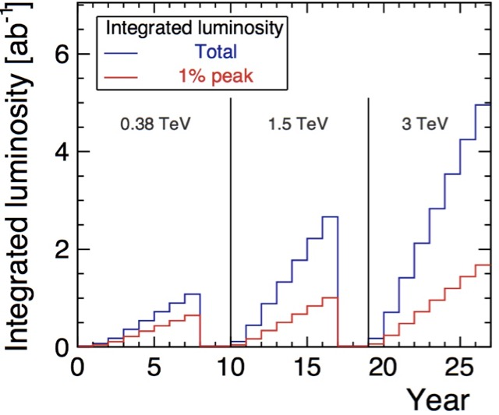
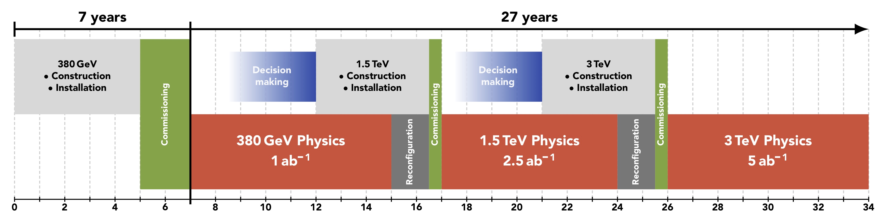
CLIC timeline
Ramp-up and up-time assumptions: arXiv:1810.13022, Bordry et al.
Technology Driven Schedule from start of construction shown above.
A preparation phase of ~5 years is needed before (estimated resource need for this phase is ~4% of overall project costs)
26

Slide 27
CLIC Project Readiness Report (PRR)
Project Readiness Report as a step toward a TDR – for next ESPP
Assuming ESPP in 2026, Project Approval ~ 2028, Project (tunnel) construction can start in ~ 2030.
Focusing on:
The X-band technology readiness for the 380 GeV CLIC initial phase
Optimizing the luminosity at 380 GeV
Improving the power efficiency for both the initial phase and at high energies
More details:
X-band studies: Structure manufacturability and optimized conditioning, interfaces to all connecting systems for large scale production, designs for and support of use in applications from the 1 GeV linac at LNF to medical linacs
Luminosity: beamdynamics studies and related hardware optimisation for nano beams from damping rings to final focus (mechanical and thermal stability, alignment, instrumentation, vacuum systems, stray field control, magnet stability, etc)
Improving damping ring and drive beam RF efficiency, study parameter changes to reduce power at multi-TeV energies maintaining high luminosities

Slide 28
Overall timeline
ILC Pre-laboratory (~4 years)
  Complete all the technical preparation necessary to start the ILC project (infrastructure, environmental impact
  and accelerator facility)
  Prepare scenarios for the regional contributions to and organisation for the ILC.
Large international effort, involving among other many European (including Spanish) participants, to detail the work planned during the Pre-Lab phase. The document can be found at: https://arxiv.org/abs/2106.00602
Currently being evaluated by a panel set up by MEXT (the relevant ministry), 3-6 months process. Need the prelab to move forward in a timely way.
ILC IDT (~1.5 years)
  Prepare the work and deliverables of the ILC Pre-laboratory and work out, with national and regional laboratories, a scenario for their contributions
  Prepare a proposal for the organisation and governance
  of the ILC Pre-laboratory
ILC laboratory
  Construction and commissioning of the ILC (~9-10 years)
  Followed by the operation of the ILC
  Managing the scientific programme of the ILC
28
28

Slide 29
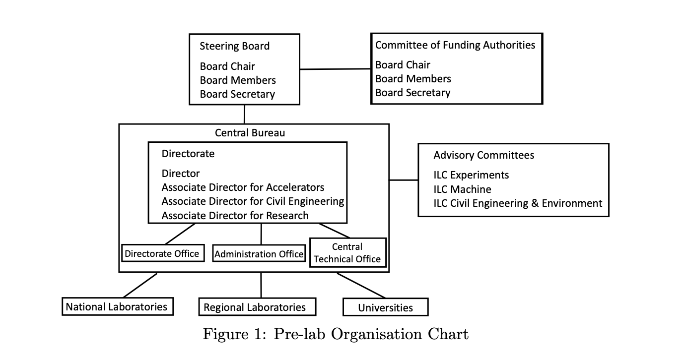


Slide 30






The FCC and CEPC/SPPC integrated programs
inspired by successful LEP – LHC programs at CERN
comprehensive long-term programs maximizing physics opportunities
stage 1: FCC-ee/CEPC (Z, W, H, $\text{t}\overline{\text{t}}$) as Higgs factory, electroweak & top factory at highest luminosities
stage 2: FCC-hh/SPPC (~100/75 TeV) as natural continuation at energy frontier, with ion and eh options
complementary physics
common civil engineering and technical infrastructures
FCC builds on and reuses CERN’s existing infrastructure; CEPC/SPPC are greenfield machines
integrated project allows seamless continuation of HEP after HL-LHC
CEPC
K. Oide
FCC-ee
J. Gao
A. Chance,
D. Schulte
FCC-hh
SPPC
30

Slide 31





similar solutions developed for FCC-ee and CEPC
Double ring colliders with full-energy top-up booster ring,
CEPC evolved from initial 54 km - single-ring design, practically to the FCC-ee 100 km design.
2 (or 4) IPs, 2 RF straights, tapering of arc magnet strengths to match local energy
Asymmetric IR layout to limit SR of incoming beams towards detectors and generate large crossing angle
Common use of RF systems for both beams at highest energy working point $(t\overline{t}$/ZH for FCC-ee/CEPC)
FCC-ee
31

Slide 32

FCC-ee CDR (2018) & CEPC TDR (2021) parameters [CEPC in red]
parameter | Z | WW | ZH | $$t\overline{t}$$
energy/beam [GeV] | 45.6, 45.5 | 80, 80 | 120, 120 | 182.5, 180
bunches/beam | 16640, 11951 | 2000, 1297 | 328, 249 | 48, 35
beam current [mA] | 1390, 803 | 147, 84 | 29, 17 | 5.4, 3.3
luminosity/IP x 10³⁴ cm⁻²s⁻¹ | 230, 115 | 28, 16 | 8.5, 5.0 | 1.6, 0.5
energy loss/turn [GeV] | 0.036, 0.037 | 0.34, 0.36 | 1.72, 1.8 | 9.2, 9.1
synchrotron power [MW] | 100, 60
RF voltage [GV] | 0.1, 0.12 | 0.75, 0.7 | 2.0, 2.2 | 4.0+6.9, 10
rms bunch length (SR/+BS) [mm] | 3.5/12,2.5/8.7 | 3.0/6.0,2.5/4.9 | 3.2/5.3,2.3/3.9 | 2./2.5,2.2/2.9
rms emittance ε_{x/y} [nm/pm] | .27/1,.27/1.4 | .84/1.7,.87/1.7 | .63/1.3, .64/1.3 | 1.5/2.9,1.4/4.7
longit. damping time [turns] | 1273, 1230 | 236, 224 | 70, 67 | 20, 20
vert. IP beta β_{y}* [mm] | 0.8, 0.9 | 1.0, 1.0 | 1.0, 1.0 | 1.6, 2.7
beam lifetime [min] | 68, 80 | 59, 55 | 12, 12 | 12, 18

Slide 33

Presentation by J.Gao, Madrid 27.8
(LINK), also next slide

Slide 34


Slide 35




recent topical FCC reviews, April-June ‘21
SRF: SWELL cavity:
one for all energies ?
FCC-ee injector: conservative approach,
optimized layout
novel SRF cavities (for all energies?)
new optimized injector layout,
8-point placement option, superperiodic,
compatible with 2 or 4 IPs
A. Grudiev, P. Craievich, I. Chaikovska
Placement:
minimizing the risk, define lowest-risk 8-Point option as new placement baseline ;
leave open later choice between 2 and 4 IPs, reduced number of surface sites
I. Syratchev, F. Peauger
J. Gutleber, V. Mertens
35
35

Slide 36


Slide 37



SuperKEKB – pushing luminosity and β*
Design: double ring e⁺e⁻ collider as B-factory at 7(e⁻) & 4(e⁺) GeV; design luminosity $\sim$8 x 10³⁵ cm⁻²s⁻¹; β_{y}* $\sim$0.3 mm;
nano-beam – large crossing angle collision scheme (crab waist w/o sextupoles); beam lifetime$\sim$5 minutes; top-up injection;
e⁺ rate up to $\sim$ 2.5 10¹² /s ; under commissioning
M. Tobiyama, K. Oide
SuperKEKB is demonstrating FCC-ee key concepts
b_{y}* = 0.8 mm achieved in both rings – using the
FCC-ee-style “virtual” crab-waist collision scheme
Y. Funakoshi, Y. Ohnishi, K. Oide
https://indico.desy.de/event/28202/contributions/105486/attachments/67566/84078/EPS-HEP2021_T13_4_SuperKEKB.pdf
L = 3.12 x 10³⁴ cm⁻²s⁻¹ on 22 June ‘21

Slide 38


Slide 39
FCC integrated project technical schedule
1
2
3
4
5
6
7
8
9
10
11
………………..
19
20
~ 15 years operation
7 – 10 years
~ 25 years operation
70
Feasibility Study
EPPSU
~2040:
start of FCC-ee
~2065:
start of FCC-hh
Project preparation &
administrative processes
Permis-sions
Update
Permissions
Funding strategy
Funding and
in-kind contribution agreements
Funding and
in-kind contribution agreements
Geological investigations, infrastructure detailed design and tendering preparation
Tunnel, site and technical infrastructure construction
FCC-ee dismantling, CE & infrastructure adaptations FCC-hh
engineering design, energy efficiency, maintainability
conductors & high-field magnet technology
FCC-ee accelerator R&D and technical design
FCC-ee accelerator construction, installation, commissioning
FCC-hh accelerator R&D and technical design
FCC-hh accelerator construction, installation, commissioning
Set up of international experiment collaborations, detector R&D and concept development
FCC-ee detector technical design
FCC-ee detector
construction, installation, commissioning
FCC-hh detector R&D,
technical design
FCC-hh detector
construction, installation, commissioning
Superconducting wire and magnet R&D, short models
Long model magnets, prototypes, preseries
High-field magnet
industrialization and
series production
39

Slide 41
Higgs factory
Technology in general available for constructing a Higgs factory
Need concentration of resources, and in most of the cases significantly more and new resources compared to current budgets in the various regions proposing these facilities
Power/energy consumptions very high (in particular for the circular options)
Civil engineering also considered a risk, in particular for FCC-ee (hence feasibility study)
Timelines – if one is a bit more realistic - are also a concern

Slide 42


Fermilab site fillers (from Snowmass restart)
Link to presentation:
https://indico.fnal.gov/event/49756/contributions/222364/attachments/146782/187646/PB_Snowmass_EF_Sep2021_final.pdf
Cryogenic operation improves performance
Cahill et al,
PRAB 21.10 (2018): 102002
Fermilab plus C3

Slide 43
Red
HL – LHC
  Higher luminosities, improved detectors, improved analysis
Other accelerators very important too: Neutrinos, SuperKEKb, the neutrino facilities, EIC, dark sector studies, light dark matter, etc ..
Seems reasonable to assume that next large accelerator in particle physics will be an e+e- collider in the 250-500 GeV range (ILC, CLIC, CEPC, FCC-ee), hopefully following directly after or possibly overlapping with HL-LHC
  Physics case clear, technologies are there, “hesitations” are due to costs and perceived link to the machine after
  In particular, the large circular e+e- machines are linked in time, design and funding to proton colliders after
But what is the next next accelerator – at much higher energies ? Physics motivations can be made (are they sufficient to approve such a large project?) and provide design study guidance, even though HL-LHC and a Higgs factory might (hopefully will) change the outlook
  Hadrons (~100 TeV or above), upgrading an e+e- LC collider (length/technology) or Muons (aiming for 10 TeV or above)

Slide 44

The FCC and CEPC/SPPC integrated programs
inspired by successful LEP – LHC programs at CERN
comprehensive long-term programs maximizing physics opportunities
stage 1: FCC-ee/CEPC (Z, W, H, $\text{t}\overline{\text{t}}$) as Higgs factory, electroweak & top factory at highest luminosities
stage 2: FCC-hh/SPPC (~100/75 TeV) as natural continuation at energy frontier, with ion and eh options
complementary physics
common civil engineering and technical infrastructures
FCC builds on and reuses CERN’s existing infrastructure; CEPC/SPPC are greenfield machines
integrated project allows seamless continuation of HEP after HL-LHC
CEPC
K. Oide
FCC-ee
J. Gao
A. Chance,
D. Schulte
FCC-hh
SPPC
44

Slide 45


Circular hadron colliders: FCC-hh and SppC
circumference $\sim$100 km, two high-luminosity experiments up to 3 (1) x 10³⁵ cm⁻²s⁻¹, two additional experiments possibly combined with injection section, collimation insertions (betatron and momentum cleaning), extraction/dump insertion, RF insertion,
values in brackets refer to CEPC
FCC-hh
SppC
new injector chain,
simultaneous operation with e+e- collider
based on existing CERN injector chain,
Luminosity goal ~20 ab-1 per main IP within 25 years
Slide from M.Benedikt: Link

Slide 46


Slide 47

FCC-hh (pp) & SPPC collider parameters
parameter | FCC-hh |  | SPPC | HL-LHC | LHC
collision energy cms [TeV] | 100 |  | 75 | 14 | 14
dipole field [T] | 16 |  | 12 | 8.33 | 8.33
circumference [km] | 97.75 |  | 100 | 26.7 | 26.7
beam current [A] | 0.5 |  | 0.73 | 1.1 | 0.58
bunch intensity [10¹¹] | 1 | 1 | 1.5 | 2.2 | 1.15
bunch spacing [ns] | 25 | 25 | 25 | 25 | 25
synchr. rad. power / ring [kW] | 2400 |  | 1200 | 7.3 | 3.6
SR power / length [W/m/ap.] | 28.4 |  | 14 | 0.33 | 0.17
long. emit. damping time [h] | 0.54 |  | 1.2 | 12.9 | 12.9
beta* [m] | 1.1 | 0.3 | 0.75 | 0.15 (min.) | 0.55
normalized emittance [mm] | 2.1 |  | 2.4 | 2.5 | 3.75
peak luminosity [10³⁴ cm⁻²s⁻¹] | 5 | 30 | 10 | 5 (lev.) | 1
events/bunch crossing | 170 | 1000 | $\sim$300 | 132 | 27
stored energy/beam [GJ] | 8.4 |  | 9.1 | 0.7 | 0.36

Slide 48





Challenges for hadron colliders
High stored energy in the beam ~8-9 GJ
  Beam handling and dumping
  Collimation cleaning system optimisation
High synchrotron radiation inside magnets several MW
  Beam screen design and cryogenic efficiency
FCC Secondary Collimator
FCC dump pattern
max power density
115 Wcm⁻³
Beam screen prototype
LHC pattern
R&D on new materials, kickers & generators, vacuum systems, cryogenic system, electron lenses, ….
Slide from M.Benedikt: Link

Slide 49

See EPS talk by P.Vedrine: https://indico.desy.de/event/28202/contributions/105817/

Slide 50


FCC-hh: 14.5 T Nb₃Sn magnet tested at FNAL
84% on the laodline at 1.9 K
92% on the loadline at 4.2 K
60-mm aperture
4-layer graded coil
15 T dipole demonstrator
Staged approach: In first step pre-stressed for 14 T
Second test in June 2020 with additional pre-stress reached 14.5 T
A. Zlobin et al.
50

Slide 51




Also from presentation by J.Gao, Madrid 27.8
(LINK)

Slide 52



Smaller:
Does HTS at higher field allow a using a smaller circumference, more flexible in the long run ?
Larger:
Not the first large proton collider considered (not mentioning SSC):
Larger rings have been considered in the past.
VLHC: smaller diameter tunnel and weaker magnets (and luminosities would need a boost)
Link to a fairly complete study in 2001
And what about: From the Eloisatron to the Pevatron ?
52

Slide 53
In summary:
Proton main challenge: magnets for large scale production in 12-16 Tesla range as needed to approach 100 TeV to be expected by ~20??
Is 100 TeV the right number ?
Cost and power challenges large (~17 MCHF even after FCC-ee, energy use a factor 3 higher than CERN today), CEPC/SppC less costly but nevertheless a large step
Let us look at leptons – electrons and then muons:
LC option: ILC can be stretched to 1 TeV, CLIC to 3 TeV – new technologies to go much higher energies
Muons: favourable for several TeV but has it own challenges

Slide 54
Proposed Lepton Colliders
Luminosity per facility
R&D required towards higher energies (or improvement of 3 TeV)
Reduction of cost per GeV (improved NC acceleration, novel acceleration technologies)
Improved power consumption (higher RF to beam efficiency, higher beam quality)

Slide 55
e+e-: Linear Colliders
Linear Collider (LC) proposals for CLIC and ILC are very mature: parameters & design, technically developments, in term of performance verifications, project planning – with strong communities behind
Key features and technical focus of studies:
Initial stages with costs and power similar to LHC, further investments will be staged
Expandable to higher energies – with existing, improved or new RF technologies (as novel acc. technologies) - and in some cases also increased luminosities
RF (energy) and nanobeams (luminosity) main challenges
Strong connection and synergies with light-sources and FEL linacs
Polarized beams foreseen
Can also run a lower energies (Z) and gamma-gamma is possible
Can we hope that Novel Acc. technologies will provide compact (translating into construction timescales that are not many decades) and relatively cheap high gradient acceleration ?
Benisque September 2021

Slide 56

Beamstrahlung Optimisation
I_{beam}
Use very short bunches?
R=s_{x}/s_{y}
Need to be consistent with main linac and BDS. Shorter bunches:
coherent pair creation, even trident cascade
background is deflected more into the detector
Notes:
Red: as classical formula
R is 1 for flat beams and 2 for round
Short bunches (see spare slides)

Slide 57
CLIC Efficiency
Mains
Drive beam
0.97x0.9
Modulators
PETS
0.89
0.98
Klystrons
Waveguides
0.7
0.92
Waveguide
RF structures
0.985
0.44x0.64
DB RF structures
Main beam
0.95
Total drive beam to main beam efficiency
0.22
Drive beam
Total 12.7%
Adding overheads etc: 11%
Total wall plug to drive beam efficiency
0.58
From talk by D.Schulte, CERN, February 2017

Slide 58
Luminosities and power
A 10 TeV e+e- collider (independent of RF technology) using CLIC beam currents (average) will have beam power of ~100 MW, with 12% efficiency plus other “contributions” this requires a 1 GW+ facility
Assuming one can keep the even smaller “nanobeams” well behaved the luminosity will be well above 10³⁵
Some extra flexibility for LCs (single pass colliders) ?
Where/how can we get “cheap” power ?
  Sun/wind power installation expected at 1 CHF-EURO-dollar / watt
  But need sunny/windy site otherwise energy output (running time) not sufficient
  Well suited for LCs – single pass
Study done for CLIC project implementation plan (by Fraunhofer) to see how making use of periods with low prices would reduce the energy bill
Also how much sun/wind could supply energy if around 10% of accelerator costs in such facilities (taking into account the power need as for a normal running year)
Benasque September 2021
Steinar Stapnes
58

Slide 59


Towards TeV beams with new technology ?
1.7 GeV energy gain in 30 cm of pre-ionized Li vapor plasma.
2% energy spread
Up to 30% wake-to-bunch energy transfer efficiency (mean 18%).
A possible witness beams:
Electrons: 10¹⁰ particles @ 1 TeV ~few kJ
Existing driver beams options :
Lasers: up to 40 J/pulse
Electron driver: up to 60 J/bunch
Proton driver: SPS 19 kJ/bunch, LHC 300 kJ/bunch
While GeV acceleration in plasmas has been demonstrated for with both lasers and electron beams, reaching TeV scales requires staging of many drivers and plasma cells. Challenging.
Plasma cell
Plasma cell
Plasma cell
Plasma cell
Plasma cell
Plasma cell
Witness beam
Drive beam: electron/laser
Current focus on “small scale” applications – for LCs a long way to go:
Electrons and Positrons, staging, energy efficiency, suitable beam-parameters and luminosity
However – disruptive technologies so (always) very important to pursue (and cost in this case likely less)
Mostly from E.Adli
Benasque September 2021
Steinar Stapnes
59

Slide 60


Slide 62
Challenges of LC
Electron beam with collider quality
1-100 GV/m acceleration, 15000 nC/s charge delivered, sub-micron transverse emittances,
10⁻⁴ rel. energy spread, spin polarization.
Deliverables: on injectors, numerical simulations, repetition rate, efficiency, beam loading, emittance preservation, energy spread control, polarization, staging, … were proposed.
Conceptual design very compact collider
with physics case, self-consistent machine parameter set, realistic assessment of feasibility issues, performance, size and cost.
Deliverables on a coordinated international design study, including beam delivery, luminosity and interaction region design were proposed.
Intermediate steps towards a particle physics collider and synergy
with progress in photon science and lower energy applications.
Deliverables for intermediate implementation steps were proposed.
Solution for positron acceleration
with parameters similar to electron bunches.
Deliverables: on numerical simulations, proof-of-principle experiments were proposed.

Slide 63

Erik Adli, ELBA 2019: https://agenda.infn.it/event/17304/contributions/99080/

Slide 64
Muons
The luminosity per beam power is about constant in linear colliders
It can increase in muon colliders
Strategy CLIC:
Keep all parameters at IP constant
(charge, norm. emittances, betafunctions, bunch length)
Linear increase of luminosity with energy (beam size reduction)
Strategy muon collider:
Keep all parameters at IP constant
With exception of bunch length and betafunction
Quadratic increase of luminosity with energy (beam size reduction)
Notes:
CLIC – some degradation in beam quality (synchrotron radiation)
Muon – same improvement with energy (linear), plus optimization of bunch length and betafunction possible with energy providing another E dependence (divided by power)

Slide 65
Proton-driven Muon Collider Concept
The muon collider has been developed by the MAP collaboration mainly in the US
Muon cooling demonstration by MICE in the UK, some effort on alternative mainly at INFN
MAP collaboration
Short, intense proton bunches to produce hadronic showers
Muon are captured, bunched and then cooled by
ionisation cooling in matter
Collision
Acceleration to collision energy
Protons produce pions
Pions decay to muons
Not as mature as linear collider, but performing study to make informed decision by 2025

Slide 66
Luminosity Goals
Target integrated luminosities
Long-term development
Aim to have muon collider as option for the next European project (or in some other region), if required (e.g. higgs factory somewhere else)
Tentative target parameters Scaled from MAP parameters
Comparison:
CLIC at 3 TeV: 28 MW
Parameter | Unit | 3 TeV | 10 TeV | 14 TeV
L | 10³⁴ cm⁻²s⁻¹ | 1.8 | 20 | 40
N | 10¹² | 2.2 | 1.8 | 1.8
f_{r} | Hz | 5 | 5 | 5
P_{beam} | MW | 5.3 | 14.4 | 20
C | km | 4.5 | 10 | 14
<B> | T | 7 | 10.5 | 10.5
ε_{L} | MeV m | 7.5 | 7.5 | 7.5
σ_{E} / E | % | 0.1 | 0.1 | 0.1
σ_{z} | mm | 5 | 1.5 | 1.07
β | mm | 5 | 1.5 | 1.07
ε | μm | 25 | 25 | 25
σ_{x,y} | μm | 3.0 | 0.9 | 0.63

Slide 67

Cooling Concept
MAP collaboration
Limit muon decay, cavities with high gradient in a magnetic field tests much better than design values but need to develop
Compact integration to minimise muon loss
Minimise betafunction with strongest solenoids (40+ T)
32 T achieved, 40+ T planned

Slide 68

Cooling: The Emittance Path
Target
Y
Specification
Front End
•
•
•
For acceleration to
multi-TeV collider
For acceleration to NuMAX (325MHz injector acceptance 3mm,24mm)
Phase
Rotator
Exit Front End
(15mm,45mm)
Initial Cooling
Longitudinal Emittance (mm)
Final
Cooling
post-merge 6D Cooling
pre-merge
6D Cooling
For acceleration
to Higgs Factory
Bunch Merge
Transverse Emittance (microns)
MAP collaboration

Slide 69


Cooling Challenges and Status
Cavities with very high accelerating gradient in strong magnetic field
Very strong solenoids (> 30 T) for the final cooling
simplified: Luminosity is proportional to the field
Integrated system test
MuCool: >50 MV/m in 5 T field
Two solutions
Copper cavities filled with hydrogen
Be end caps
NHFML
32 T solenoid with low-temperature HTS
We would like to push even further
Plans for 40+ T exist
MICE
(UK)

Slide 70
Neutrino Flux Mitigation
Legal limit 1 mSv/year
MAP goal < 0.1 mSv/year
Our goal: arcs below threshold for legal procedure < 10 μSv/year
LHC achieved < 5 μSv/year
3 TeV, 200 m deep tunnel is about OK
arc
Need mitigation of arcs at 10+ TeV: idea of Mokhov, Ginneken to move beam in aperture
our approach: move collider ring components, e.g. vertical bending with 1% of main field
Opening angle ± 1 mradian
14 TeV, in 200 m deep tunnel comparable to LHC case
~2 x 600 m
t₁
15 cm
Need to study mover system, magnet, connections
and impact on beam
s₁
neutrinos
t₂
Working on different approaches for experimental insertion

Slide 71

MICE (in the UK)
Nature volume 578, pages 53-59 (2020)
More particles at smaller amplitude after absorber
is put in place
More complete experiment with higher statistics, more than one stage required
Integration of magnets, RF, absorbers, vacuum is engineering challenge
Principle of ionisation cooling has been demonstrated

Slide 72
The LEMMA Scheme
Key concept:
Produce muon beam using a positron beam
No cooling required
Compared to proton-driver:
Much smaller emittance (40 nm vs. 25 μm)
Much lower muon current (10¹¹ s⁻¹ vs.3 x 10¹³ s⁻¹)
Relatively new: many challenges to address

Slide 73



https://muoncollider.web.cern.ch/
EPS presentation (D.Schulte):
https://indico.cern.ch/event/577856/contributions/3420383/attachments/1880104/3097424/Muon_EPS_new.pdf

Slide 74



Power and energy, for CLIC and others
Power estimate made bottom up in great detail (concentrating on 380 GeV systems)
Further savings possible, main target damping ring RF
Need to look also more closely at 1.5 and 3 TeV numbers – these numbers are from the CDR in 2012 – margin at 15% level estimated at that time
Main/drivebeam linac RF dominate, but injectors, DR, infrastructure and magnets significant
ILC is around 120 MW (at 250 GeV)
CERN is currently consuming ~1.2 TWh yearly (~90% in accelerators)
This is a generic future collider problem:
FCC-ee and hh are around 1.9 TWh and 4 TWh
~

Slide 75


Slide 76

Clickable link: https://indico.cern.ch/event/995633/contributions/4275159/attachments/2208757/3755756/telnov-lcws21.pdf
This slide and next from L.Rivkin, EPS (link)

Slide 77


Slide 78
Cost considerations
CLIC 380 GeV: 6 BCHF (CE+infra (2), Main linac incl Drivebeam (3), Injectors(1))
From 380 GeV to 1.5 TeV, add 5.1 BCHF (drive-beam RF upgrade and lengthening of ML)
From 1.5 TeV to 3 TeV, add 7.3 BCHF (second drive-beam complex and lengthening of ML)
Labour estimate: ~11500 FTE years for the 380 GeV construction
ILC 250: ~5 B, Labour: ~10000 FTEy
FCC-hh: 24 BCHF (or 11.5+17 BCHF if FCC-ee is included first)
Labour estimate: …
Note: a typical estimate in the past from several machines for labour: Price/1.9 MCHF = FTE years
In addition operational costs: Power plus hardware plus personnel (we know that most of CERN’s resources go into operating lab and facilities currently, and it is heavily dominated by personnel costs)
Furthermore: De-commissioning cost might be significant if need to make use of same space or need to remove activated parts on the time-scale of these projects
Overall the cost/resources are our largest “problem”, keeping costs down will be essential

Slide 79
More than ever R&D and good new ideas are needed
Proton road
Electron road
Muon road
The first (HL) and second (Higgs) step are in sight
Beyond:
We should make all attempt to open doors to future accelerator options and keep them open
any technology prediction with a 50y time window is at best uncertain
Probably none of these roads are affordable given the current particle physics budgets, so either we reduce costs and come together world-wide to build these accelerators
Higgs factory
LHC and HL LHC
Thanks to all the sources mentioned in the slides, and all the sources they have used

