Slide 1
Laudatio
(personal y parcial) de la
Profesora Teresa Rodrigo Anoro
I. Vila

Slide 2
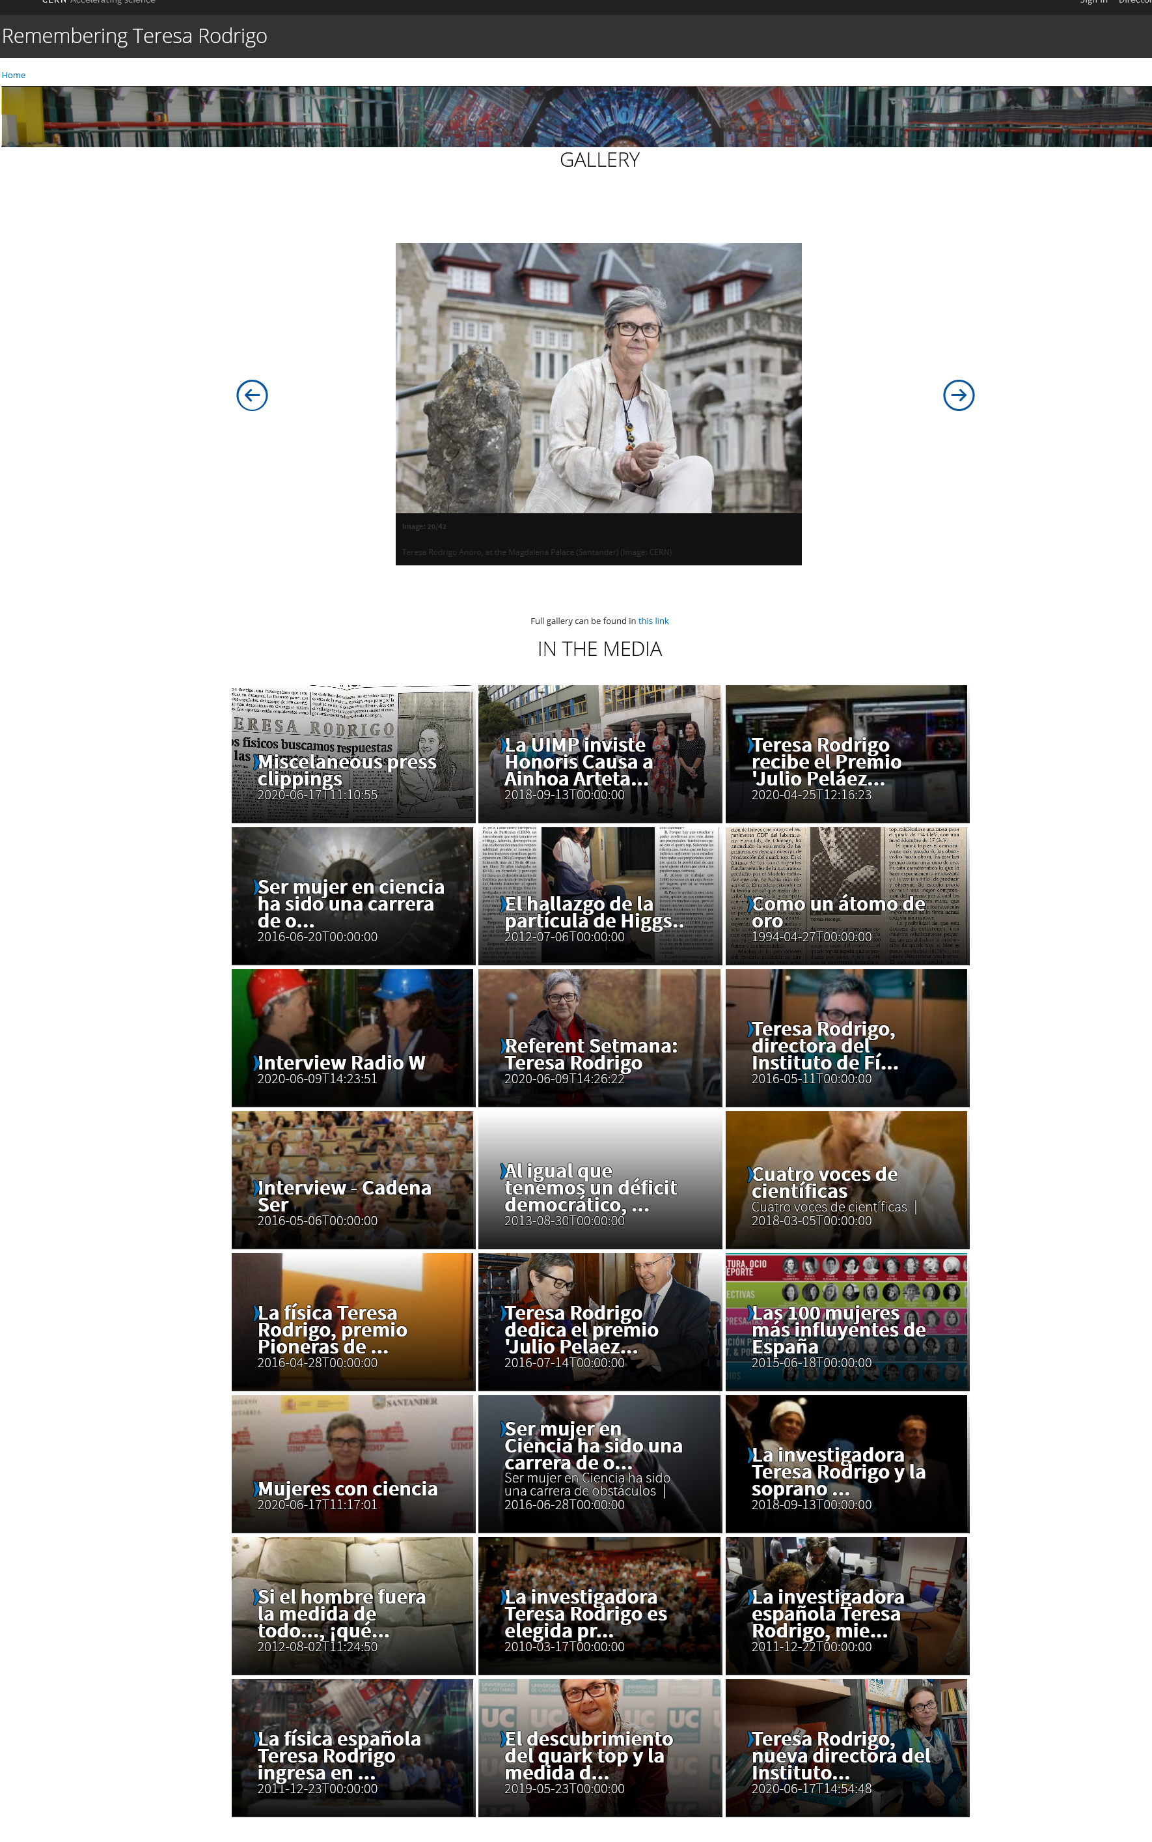
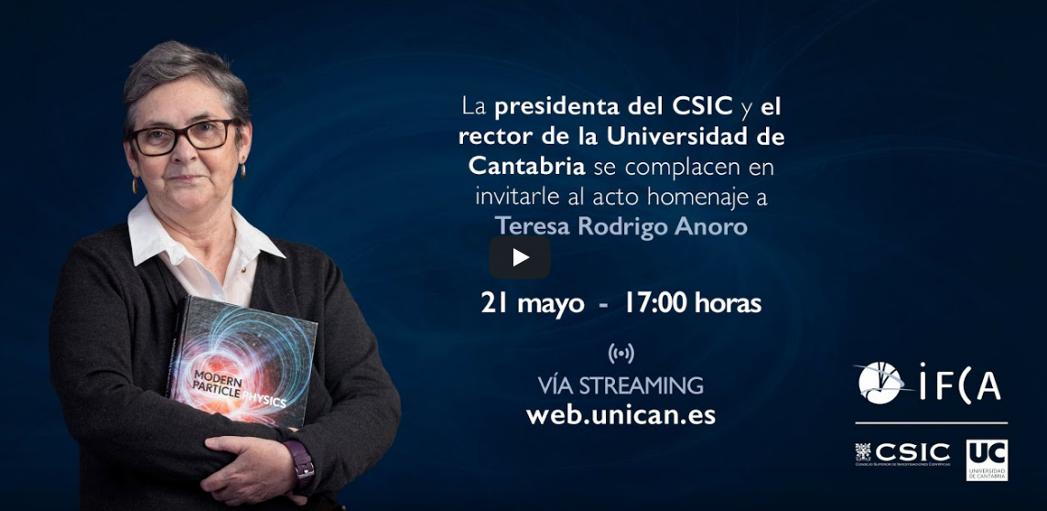
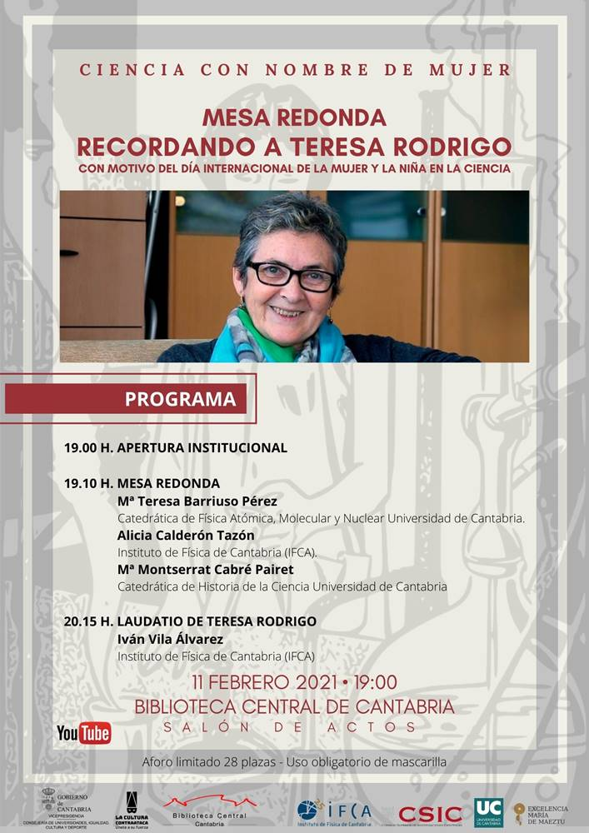
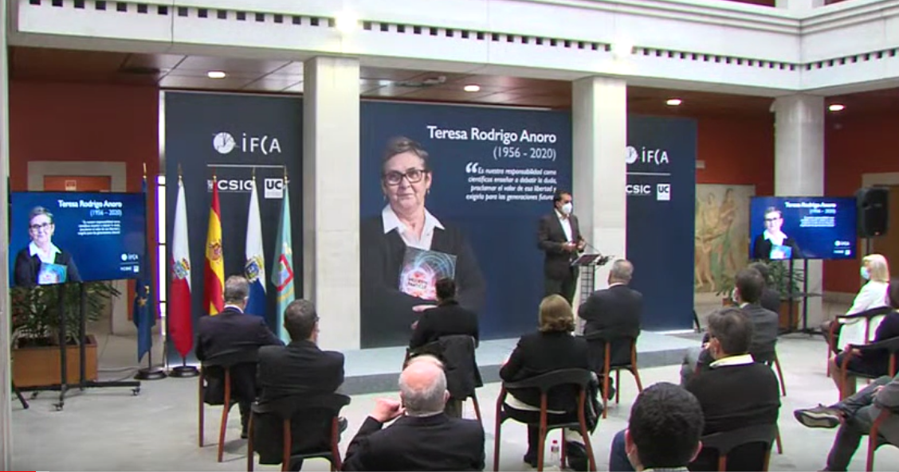
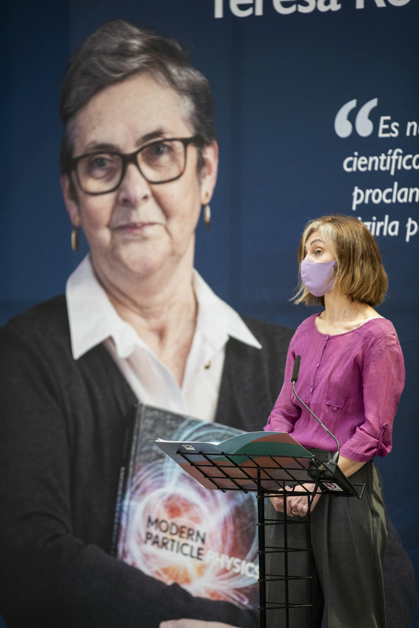
https://tributetoteresarodrigo.web.cern.ch/
https://www.youtube.com/watch?v=CWoLzMtc6cI&t=308s
https://www.youtube.com/watch?v=iD2VdXwXdIM

