Slide 1

A double-target-BEC array atomtronic rotation sensor
^{1,2}Mark Edwards, ¹Oluwatobi Adeniji, ¹Charles Henry and ²Charles W. Clark
¹Georgia Southern University
²NIST and Joint Quantum Institute
Atomtronics@Benasque2022
02 May 2022
$$ = NSF and NIST

Slide 2
Quantum sensors in positioning, navigation, and timing
Global Navigation Satellite Systems such as GPS can be jammed, spoofed, or be unavailable (deep under the ocean or solar flares).
Most commercial air and seagoing vessels have onboard inertial navigation systems (INSs) that can determine position and attitude using dead reckoning without the need for receiving external signals.
Long-time operation of such INSs suffer from parameter drift which leads to position and attitude errors that grow with time.
Secondary sensors with lower sample rates can be used periodically to re-calibrate the primary sensor’s parameters.
Quantum sensors which measure accelerations and rotation velocities can serve in this capacity.

Slide 3
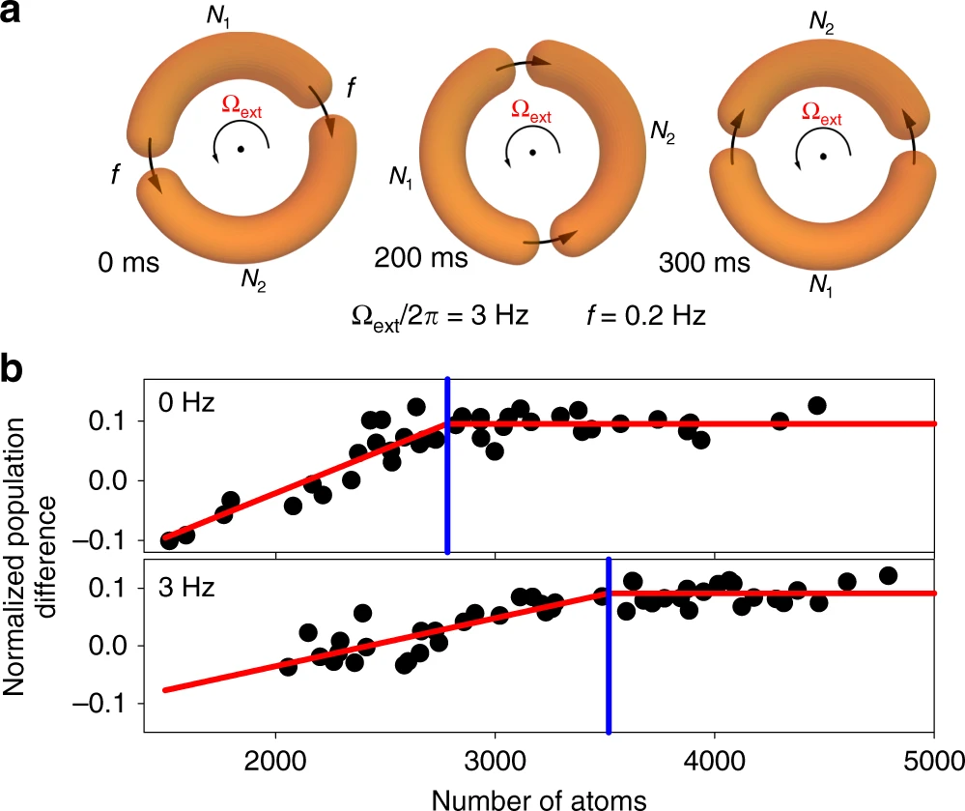
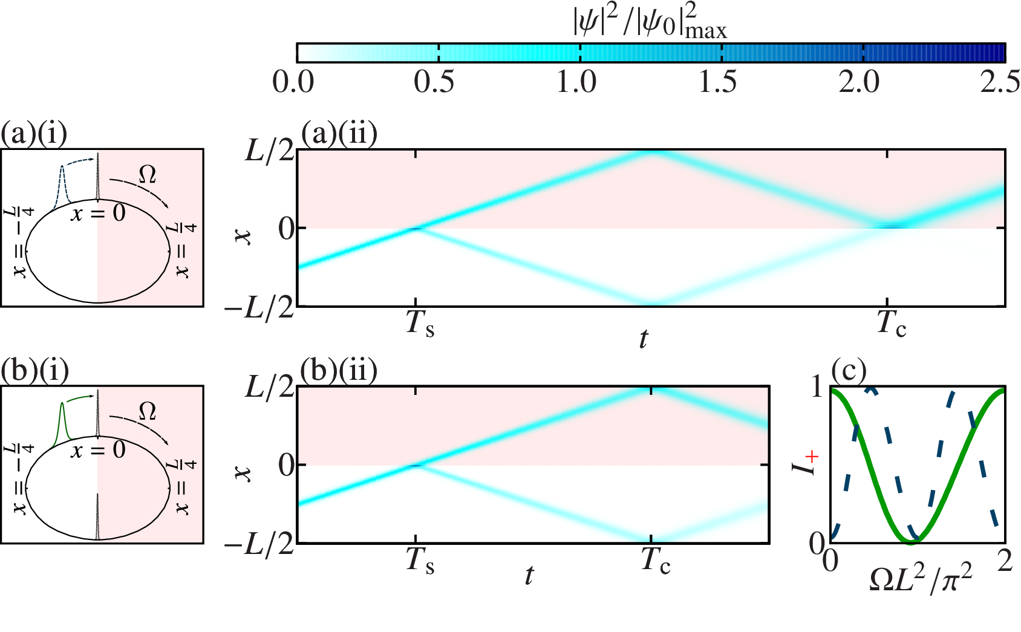
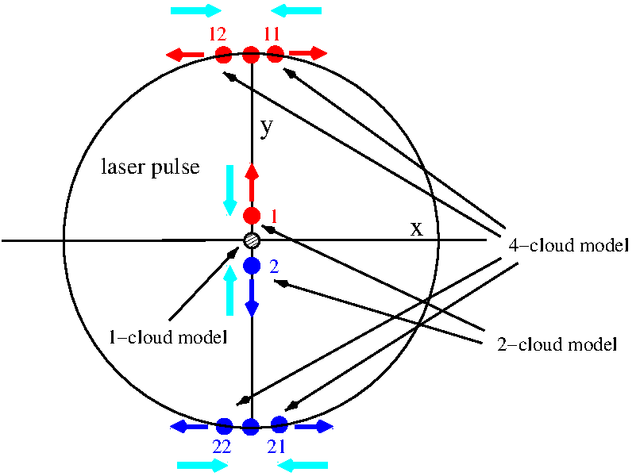
Atomtronic circuits can be rotation sensors
Atomtronic SQUIDS
(Ryu, et al., Nat Commun 11, 3338 (2020))
Solitons in ring BECs
(Helm, et al., PRL 114, 134101 (2015))
Virginia dual-Sagnac atom interferometer (Moan, et al., PRL 124, 120403 (2020))

Slide 4
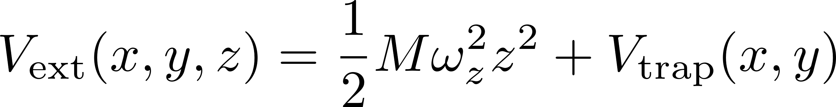
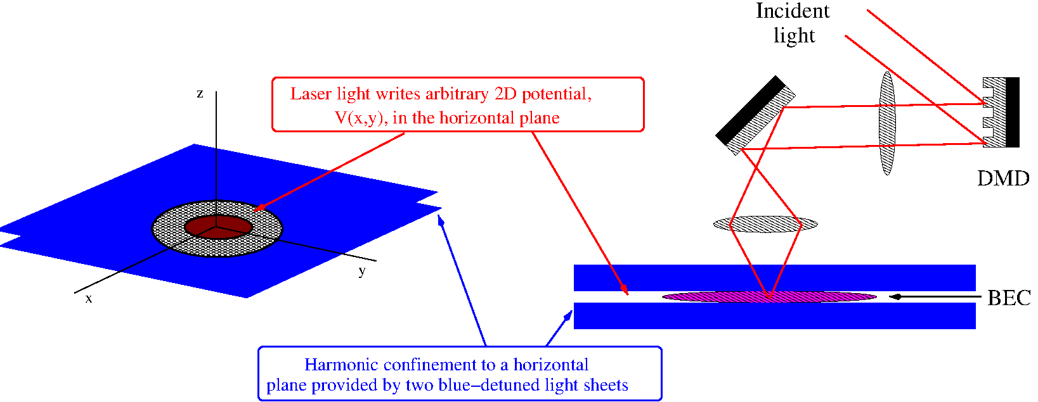
Atomtronic setup: the ultracold-atom gas is compressed into a thin horizontal sheet
The full potential felt by the condensate atoms is a vertical harmonic potential plus an arbitrary 2D potential, V_{trap}(x,y), in the horizontal plane.

Slide 5
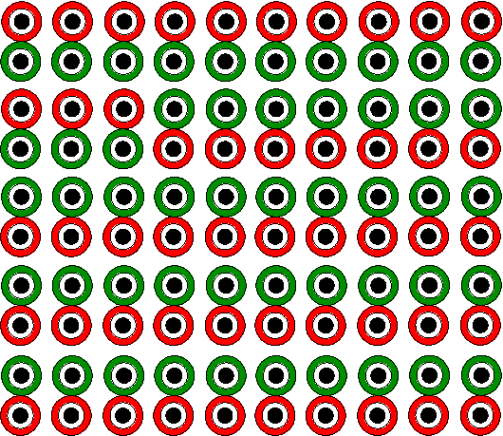
Atomtronic rotation sensor idea: array of double-target BECs
We propose an atomtronic rotation sensor design that consists of a rectangular array of Bose-Einstein condensates each confined in a double-target potential.
Red = no flow
Green = flow

Slide 6


Target and double-target trap potentials
The target potential is a 2D well potential surrounded by a ring-shaped channel potential. In this trap a ring-shaped condensate is formed that surrounds a disk-shaped condensate. The disk condensate will be used as a phase reference to detect if circulation is present in the ring.
The double-target potential consists of two overlapping target potentials. Circulation (or flow) can be induced in one of the rings as shown here by, e.g., phase imprint.

Slide 7
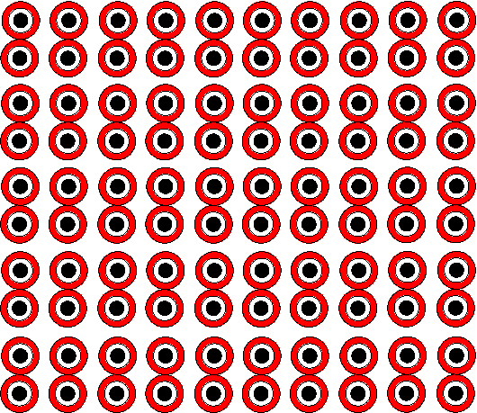
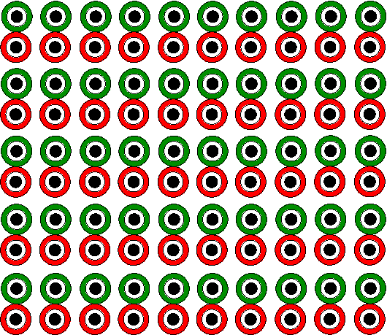
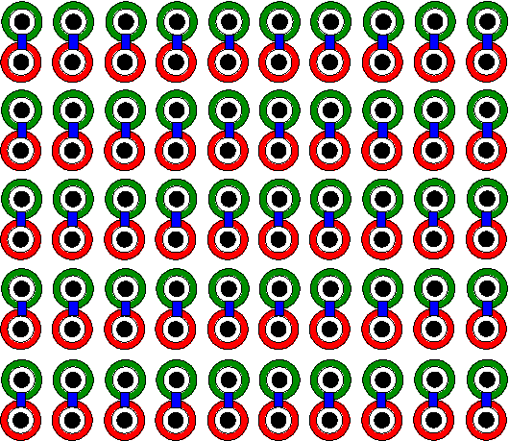
Double-target BEC sensor operation
1. Setup: a rectangular array of double-target BECs is created with no flow anywhere.
2. Initialization: flow is induced in the top-ring BEC of each double-target potential.
3. Measurement: barriers are raised, left on, and then lowered in the overlap region of each double-target potential. Each barrier has a different maximum strength.
We assume that these steps take place in a reference frame that is rotating at speed, Ω_{R} , with respect to the “fixed stars”. The purpose of the sensor is to measure Ω_{R} .

Slide 8
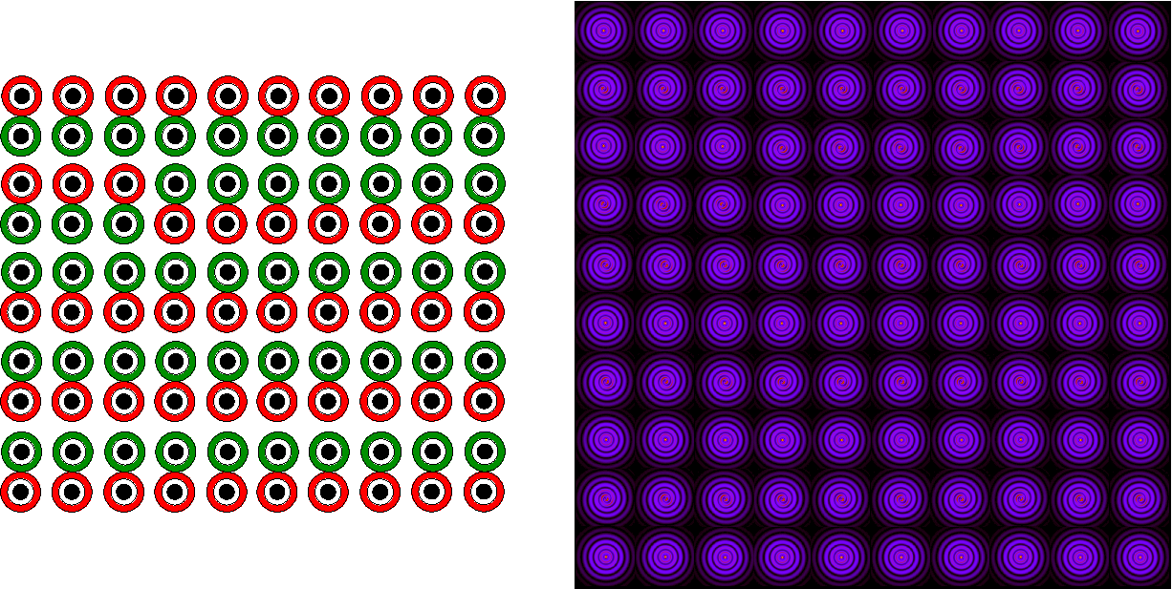
Double-target BEC sensor readout
4. Readout: After measurement, the circulation in some double-target BECs has transferred from the top ring to the bottom ring and some have not. By looking at which ones have transferred their circulation and which ones didn’t, a lower and an upper bound is placed on the rotating-frame speed, Ω_{R}. The final circulation can be detected by turning off the 2D trap potential and allowing the ring BECs to overlap the disk BECs. If the ring has flow, the interference will be a spiral and, if not, the interference will be concentric rings.
trap release

Slide 9
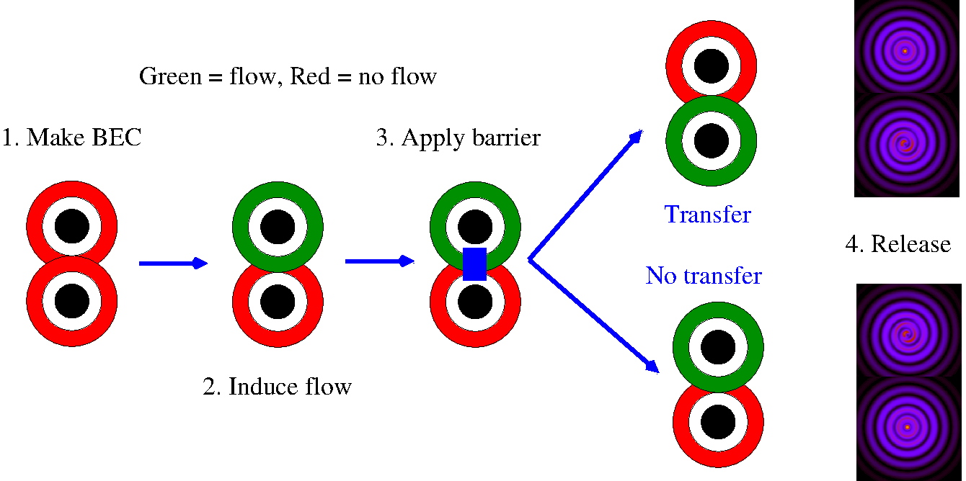
1x1 double-target-BEC necessary characteristics for correct sensor operation
Circulation transfer must put a lower bound on Ω_{R}.
No transfer must put an upper bound on Ω_{R}.
The critical value of Ω_{R} at which transfer occurs, Ω_{c} , must correspond to a unique value of U_{b,max}.
Transfer behavior must be independent of the distance of the array from the rotation axis.
Each member of the double-target array must behave independently of all the other array members.
Readout must be derived from a single density image.
Does the 1x1 double-target BEC satisfy all these characteristics?

Slide 10
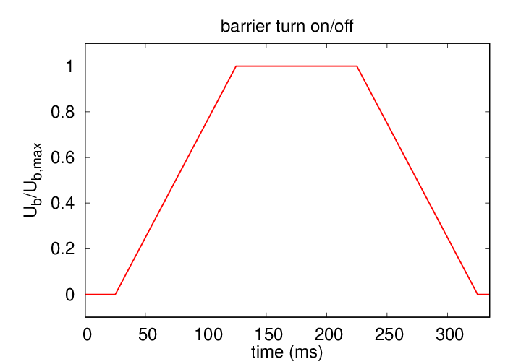
1x1 double-target BEC simulation characteristics
Double-target trap:
  BEC atomic species: ²³Na
  166,667 atoms per double-target BEC
  Ring midtrack radius = 22.5 μm
  Disk radius = Ring width = 5 μm
  Trap depth = 209.2 nK
Barrier characteristics
  2D Gaussian barrier widths = 11.25 μm
  Ramp-on, hold, ramp-off times = 100 ms
  Max barrier height, U_{b,max} , variable
Condensate behavior model
  2D Rotating-frame Gross-Pitaevskii equation
phase imprint
release
ramp on
hold
ramp off

Slide 11
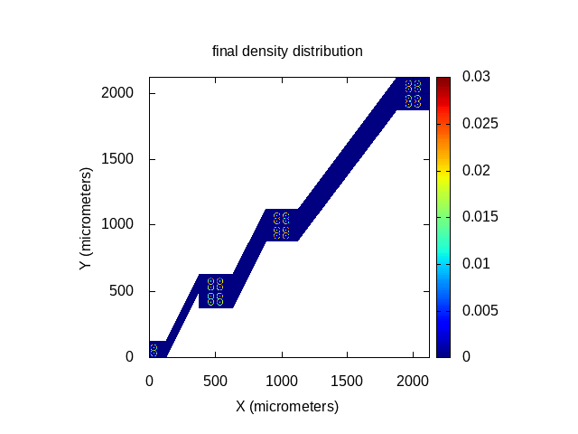
1x1 and 2x2 double-target BEC rotation-axis behavior
Transfer behavior of array members must be independent of the distance of array to the rotation axis.
We studied the transfer behavior for array centers at (0,0) mm, (0.5,0.5) mm, (1.0,1.0) mm, and (2.0,2.0) mm.
Both 1x1 and 2x2 arrays were studied.
We found that the transfer behavior did depend on the distance.
The transfer behavior did not change at distances which were large compared to the array size.

Slide 12
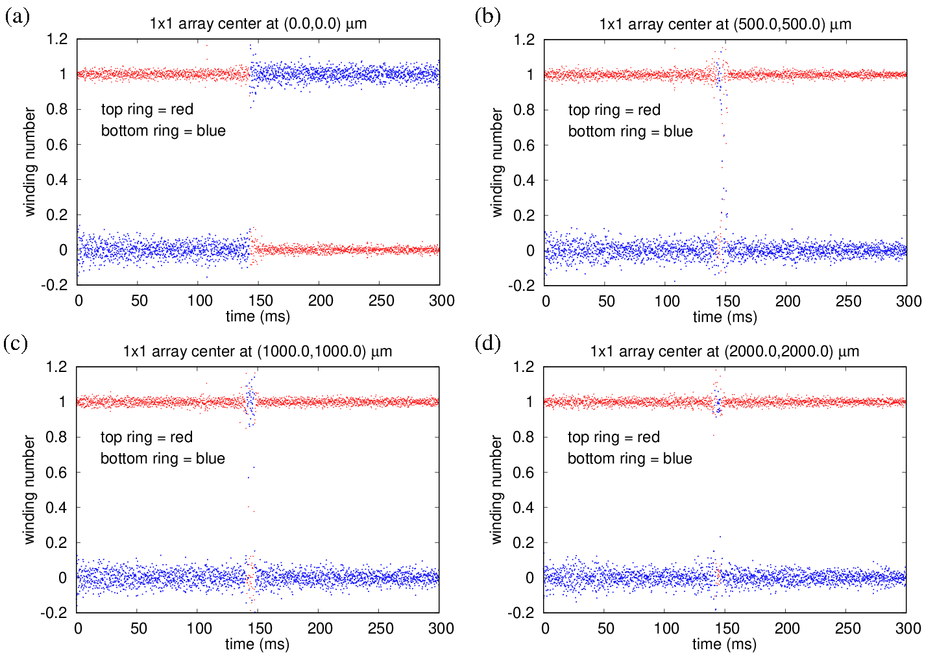
Rotation-axis results for a 1x1 double-target BEC array

Slide 13
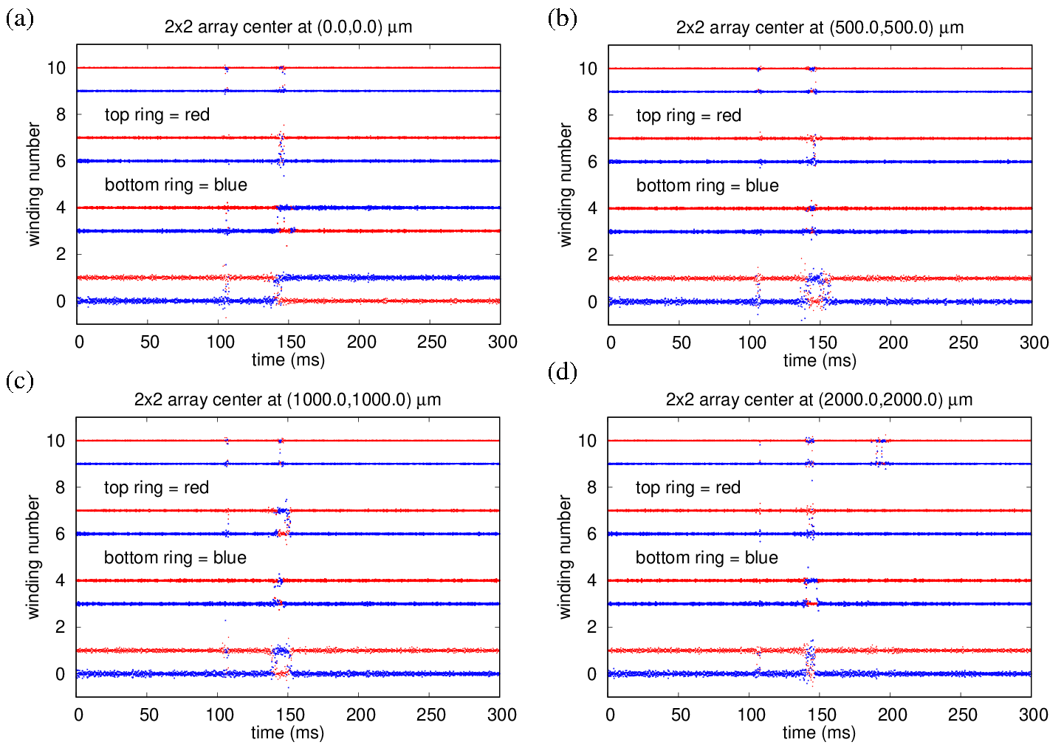
Rotation-axis results for a 2x2 double-target BEC array

Slide 14
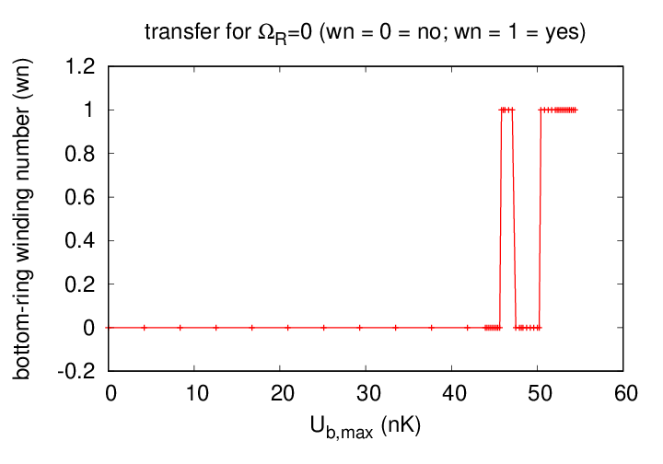
Transfer behavior of a 1x1 double-target BEC array at zero rotation
Far from the rotation axis and when Ω_{R}=0 and for maximum barrier strengths, U_{b,max}< U_{b,max,c} , there is no transfer.
Thus, by setting U_{b,max} closer to U_{b,max,c} , the transfer behavior can be tuned to be sensitive to smaller values of Ω_{R} .
Thus, for values of U_{b,max} < U_{b,max,c} , there is a critical rotation speed, Ω_{c}(U_{b,max}) below which transfer does not occur and above which transfer does occur.
U_{b,max,c} = 45.8 nK

Slide 15
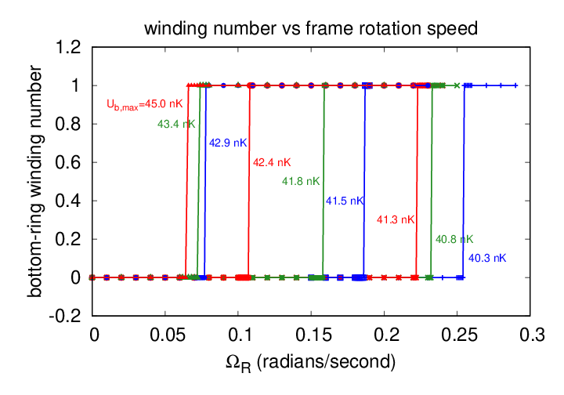
Each value of U_{b,max} corresponds to a unique Ω_{c}
Each value of U_{b,max} corresponds to a unique value of the critical rotation speed, Ω_{c} , for circulation transfer. Note that Ω_{c} decreases as U_{b,max} increases.
Ω_{c4} = 0.240 rad/sec
Ω_{c1} = 0.062 rad/sec
Ω_{c3} = 0.150 rad/sec
Ω_{c2} = 0.072 rad/sec

Slide 16
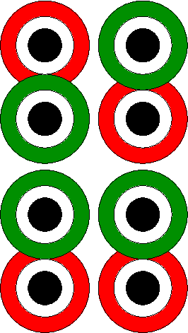
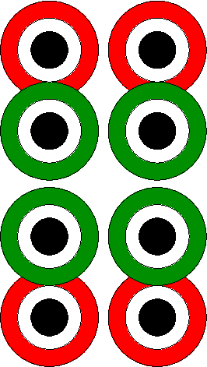
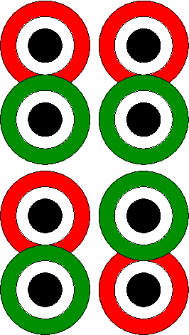
Designing a double-target BEC rotation sensor
We can use the 1x1 double-target BEC array results to design a 2x2 array to be sensitive to rotation speeds in the range Ω_{c1} < Ω_{R} < Ω_{c4} . We do this by raising barriers of different heights across the overlap regions of different members of the array.
Ω_{c1} < Ω_{R} < Ω_{c2}
U_{b,max,1} , Ω_{c1}
U_{b,max,2} , Ω_{c2}
Ω_{c2} < Ω_{R} < Ω_{c3}
U_{b,max,3} , Ω_{c3}
U_{b,max,4} , Ω_{c4}
Ω_{c3} < Ω_{R} < Ω_{c4}

Slide 17
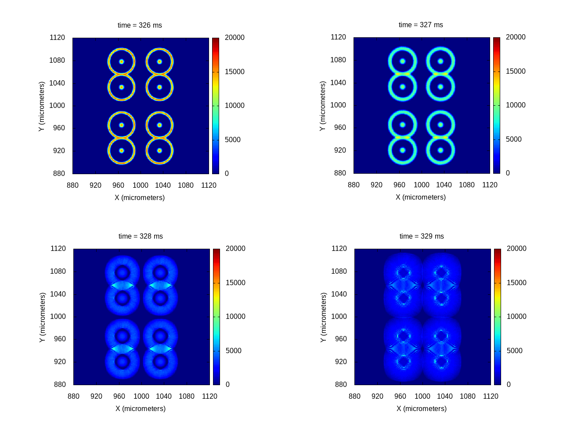
Turn off 2D potential for readout
After turning off the trap potential both the rings and the disks expand and they eventually overlap. This produces concentric rings if flow is not present and spirals if flow is present.

Slide 18
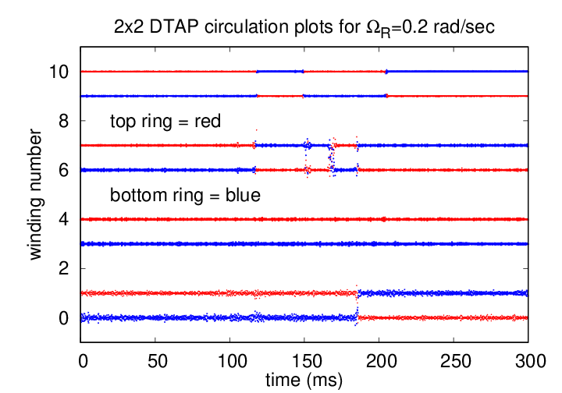
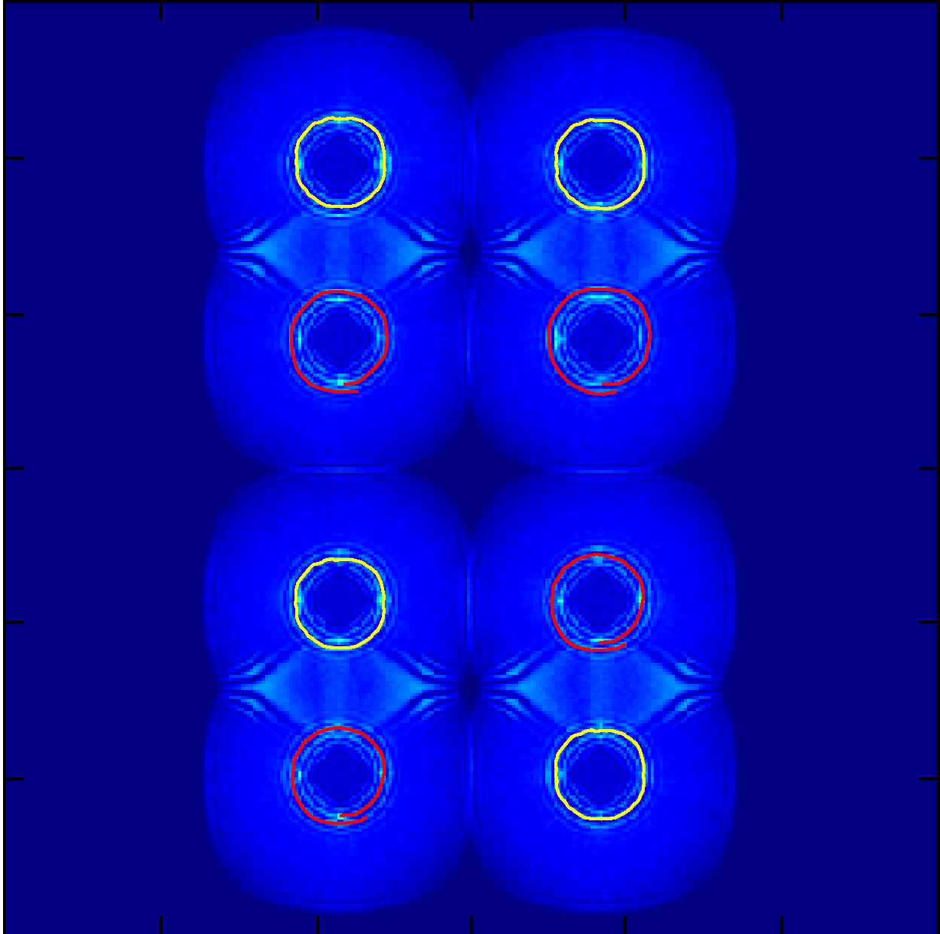
2x2 rotation sensor simulation
Ω_{R} = 0.2 rad/sec
Final Release Density
Yellow=circles, red=spirals

Slide 19
Summary and Future Work
We propose an atomtronic rotation sensor based on an array of double-target BECs that are subjected to potential barriers of varying strengths.
Sensor operation consists of setup, initialization, measurement and readout steps.
The sensor can be designed to be sensitive to different ranges of rotating-frame speeds by studying the behavior of a single BEC pair.
Readout can be performed with a single density measurement.
Further work will include:
  Investigating the possible sensitivity ranges and how they depend on target geometry.
  Sensor operation when the sense of the frame rotation is unknown.
  Exploring the maximum practical size of the double-target BEC array.

Slide 20


Edwards Research Group and Collaborators
Edwards Research Group
Oluwatobi Adeniji
Charles Henry
Colson Sapp
Andie Smith
JQI/NIST Theory Collaborators
Charles Clark
Yi-Hsieh Wang
Ted Jacobson
University of Newcastle, UK
Tom Bland
Nick Proukakis
JQI/NIST Experimental Collaborators
Gretchen Campbell
Bill Phillips
Wendell Hill III
Steve Eckel
Fred Jendrzejewski
Chris Lobb
Taras Shevchenko National University of Kyiv, Ukraine
Alexander Yakimenko
O. Chelpanova
I. Yatsuta
A. Oliinyk

