Slide 1
Plasmonic antenna platforms for multicolor single-molecule studies with high-throughput
Nanolight 2022
Ediz Herkert
Prof. María F. García-Parajo
Single Molecule Biophotonics

Slide 2
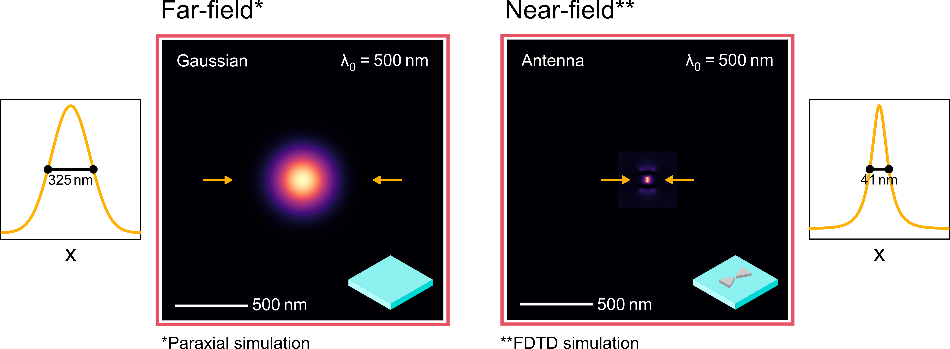
How to detect single molecules?
Notes:
Coarse categorization in far-field and near-field methods
Far field: source far away from specimen -> diffraction limit
Near field: source close to speciment (sub-wvl) -> no diffraction limit
I contrast to that nanoantenna provide directly sub-diffraction illumination volume

Slide 3
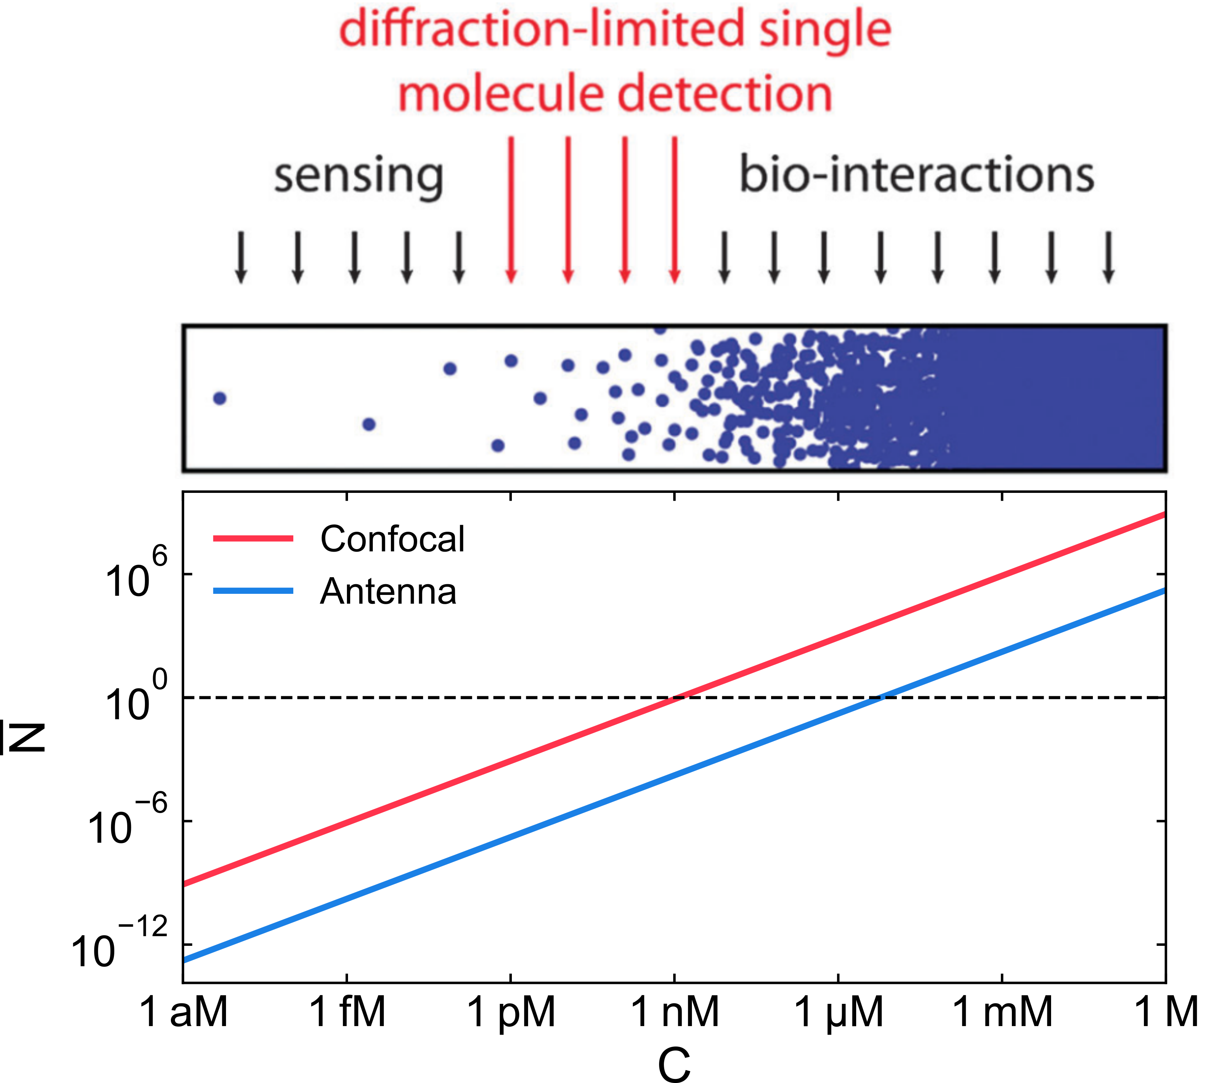
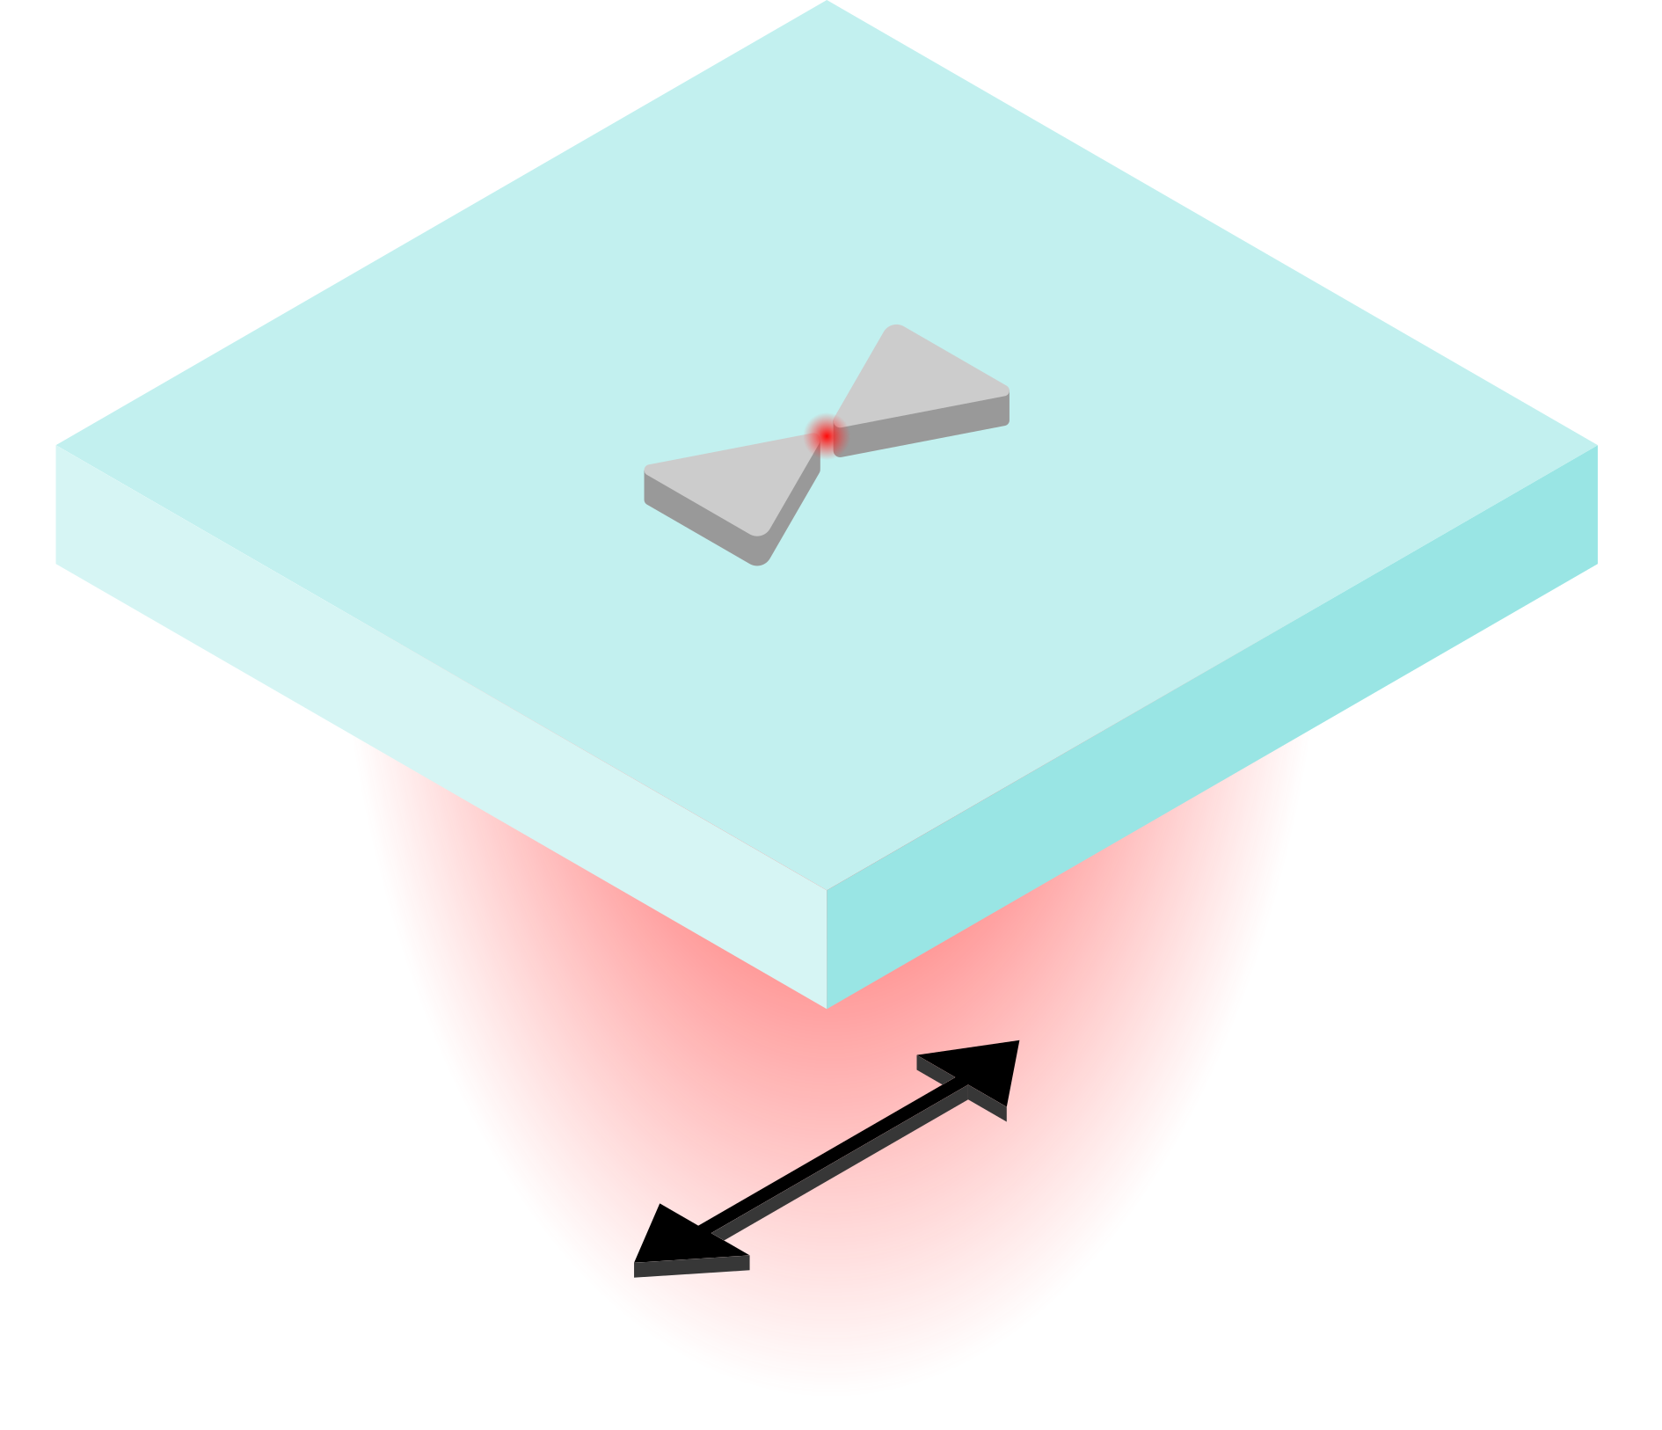
Why nanoantennas for life sciences?
Anger et al., Phys. Rev. Lett, 96, 3-6 (2006)
Field-confinement
Field-enhancement
LDOS modification
$$γ∝{\left|p\right|}^{2}⋅ρ(r, ω)$$
Holzmeister et al., Chem. Soc. Rev., 43, 1014-1028 (2014)
Notes:
Why are nanoantennas important?
Diffraction limit prohibits to observe bio-interactions
Nanoantennas provide to access this regine and offer three advantages
Fermi‘s golden rule + purcell effect

Slide 4
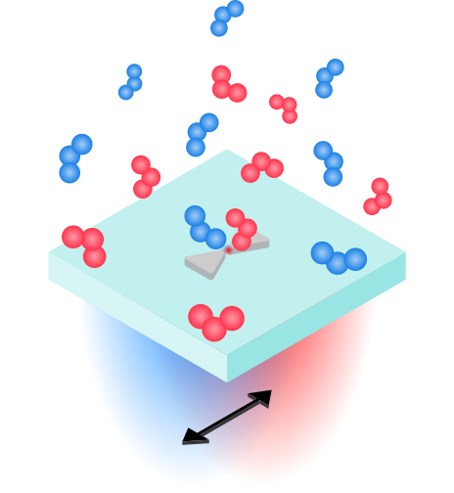
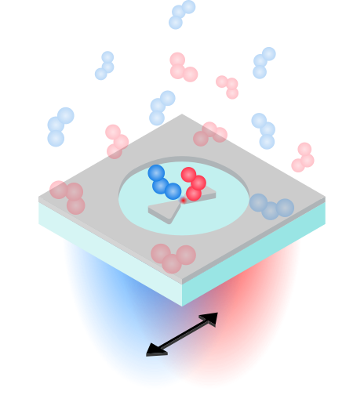
What are challenges in fluorescence experiments with nanoantennas?
EBL-based Al-Antenna-in-Box (Al-AiB)
Multiplexed multicolor excitation
Broadband resonance of Al-bowtie arrays
Fluorescent background
Al-aperture
Chemical interactions between molecules & metal
Ultrathin Al₂O₃ passivation layer (~3 nm)
Notes:
Explanation of AiB
~10,000 antennas

Slide 5
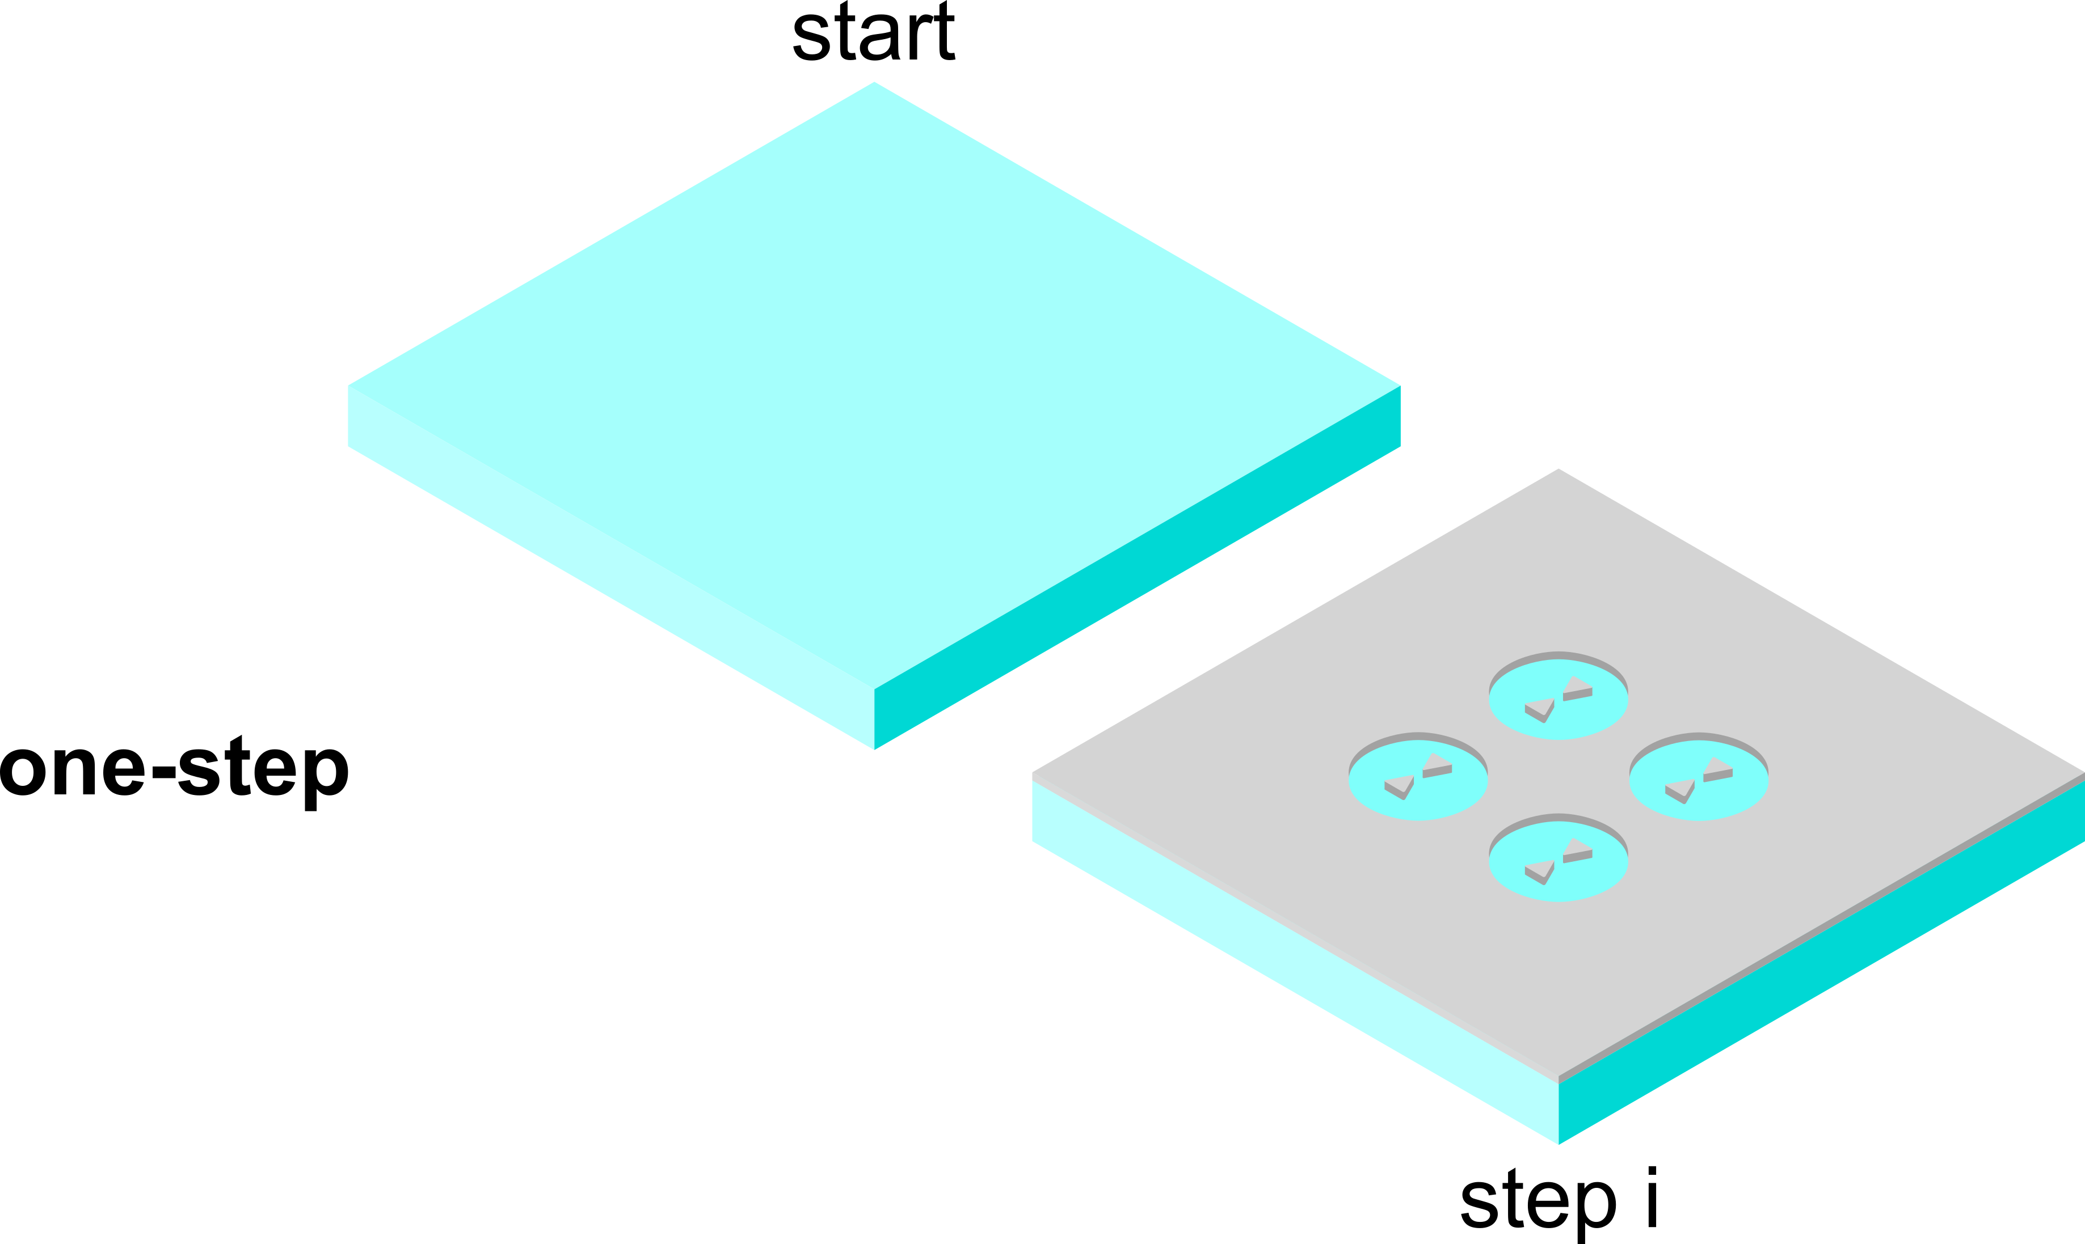
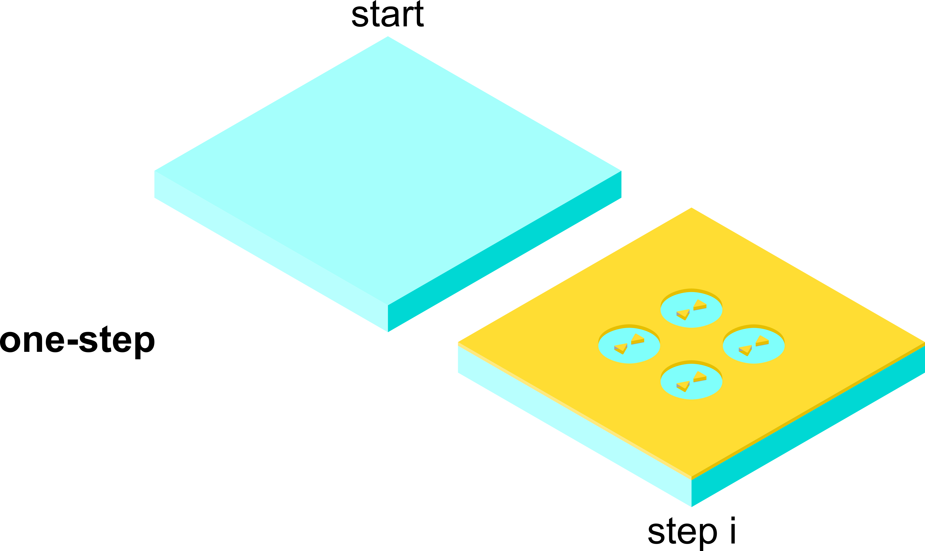
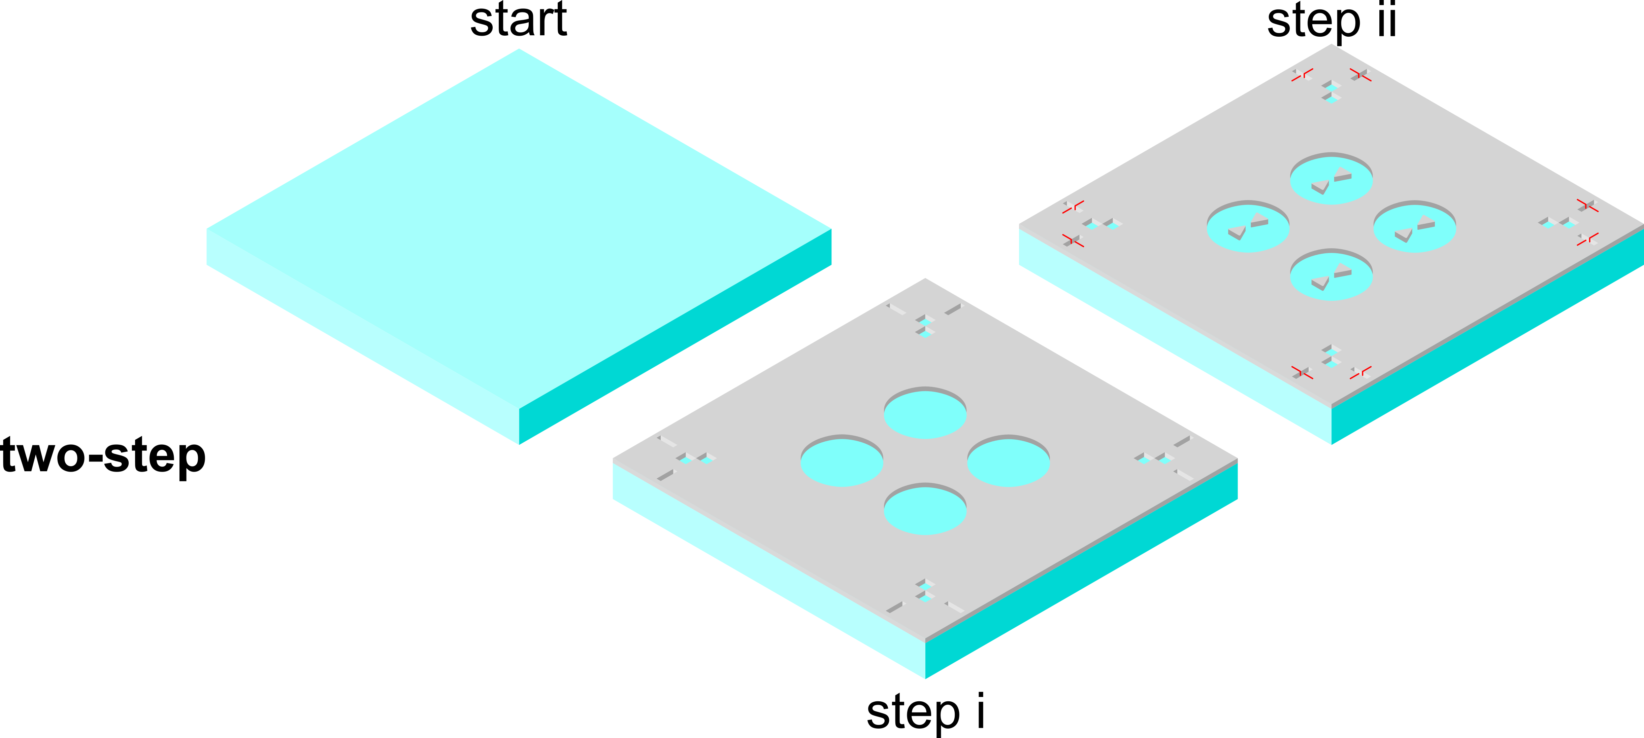
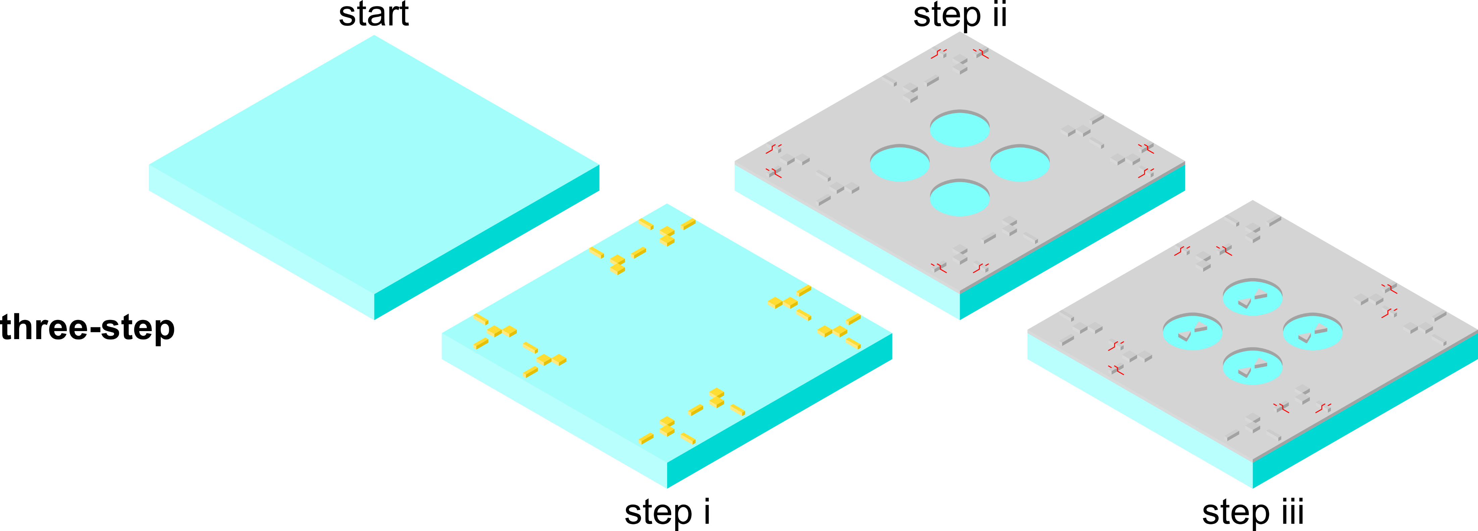
How to fabricate Al-AiBs?
Flauraud et al., Nano Lett., 17, 1703-1710 (2017)

Slide 6
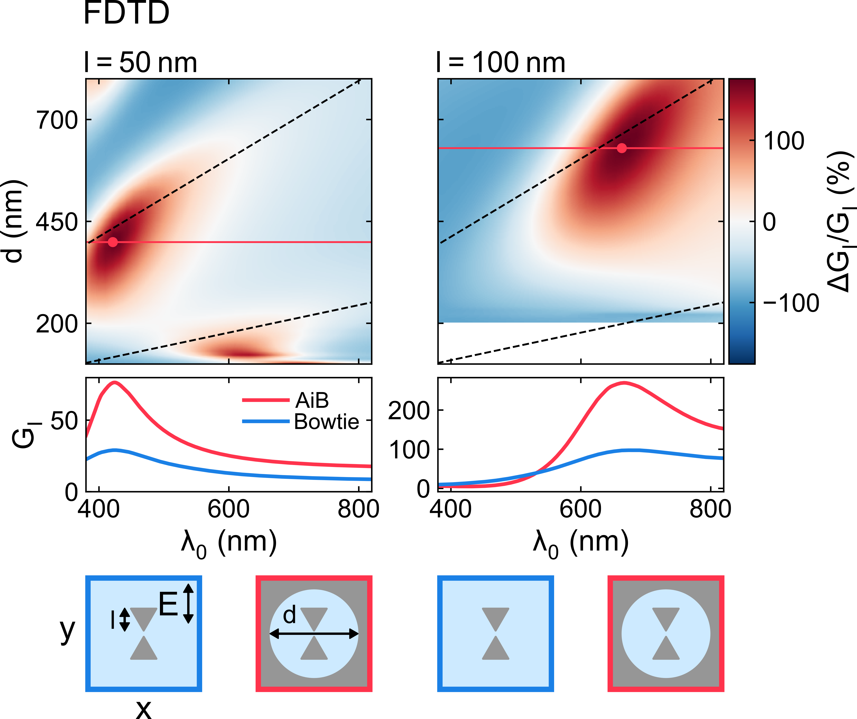
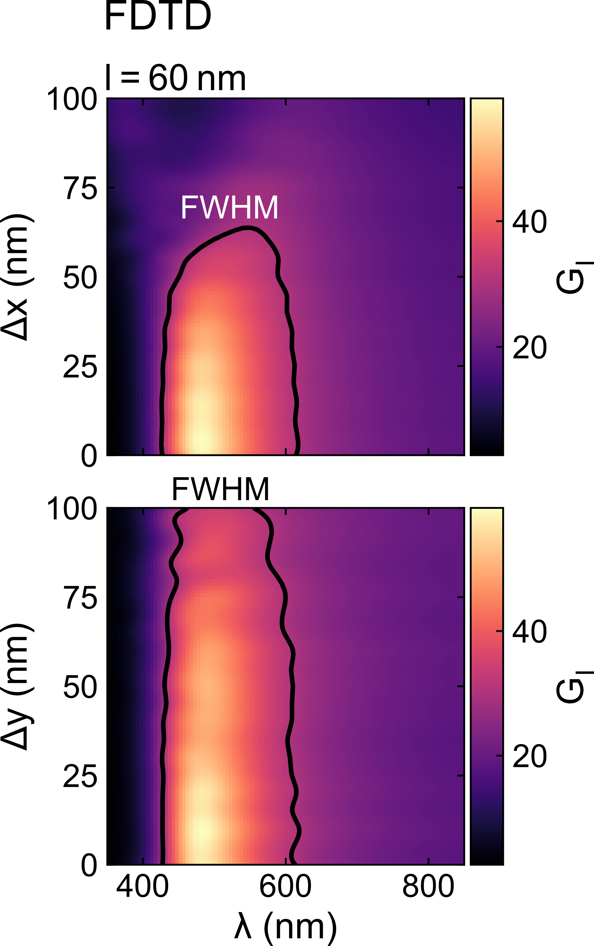
How to design multicolor AiBs?
Notes:
This means that the bowtie length and aperture diameter are the parameter to optimize
FDTD simulations show gain in intensity enhancement as function of the aperture diameter
Dashed line indicates modes of empty aperture
Red line is the optimal aperture choice for given length
2x more intensity-enhancement & tunability over full VIS
Not only background suppression but also intensity enhancement
In regard to the fabrication the sensitivity of the IE to displacement is important
Displacement up to 50nm can be accepted

Slide 7
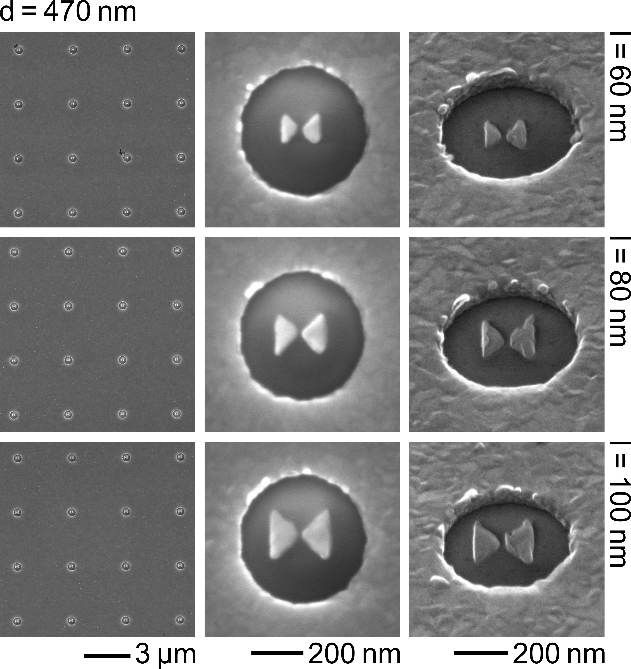
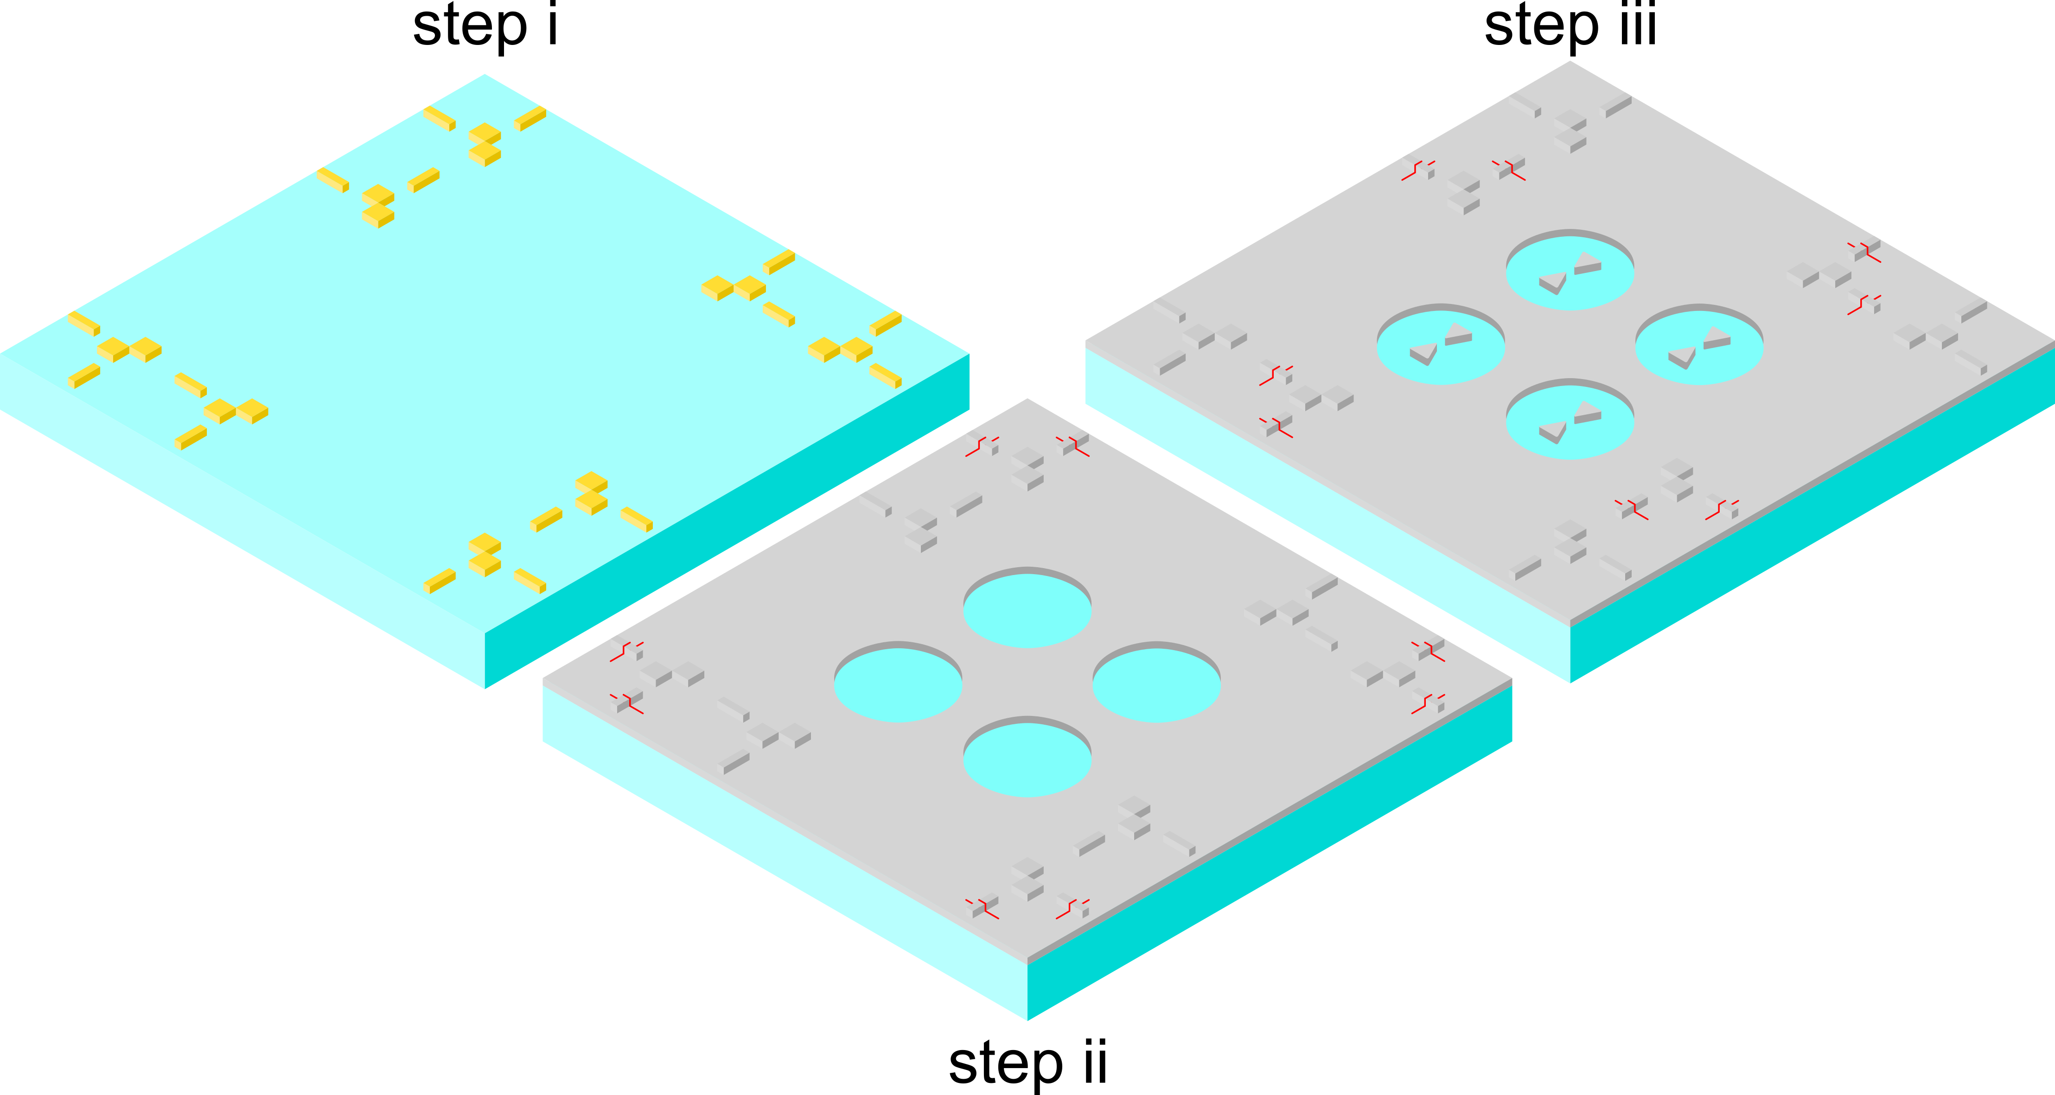
How accurately can we fabricate Al-AiBs?
Notes:
Difficulty of design that process based on negative resist is preferable but offered resolution is too low
Combination of negative and positive resist with intra-writefield alignment yielded best results
Process allows to fabricate large-area structures with previously identified requirements
Objective can be considered finished as biocompatibility will only become important for last objective

Slide 8
How to confirm multicolor fluorescence enhancement of Al-AiBs?
Notes:
Preliminary experiments with simple bowties and immobilized AF647 carried out
Same power used
Hint for higher photostability
Two types of experiments w. bowties & AiBs to demonstrate advantages

Slide 9
What is the multicolor fluorescence enhancement of Al-apertures?

Slide 10
What is the multicolor fluorescence enhancement of Al-apertures?

Slide 11
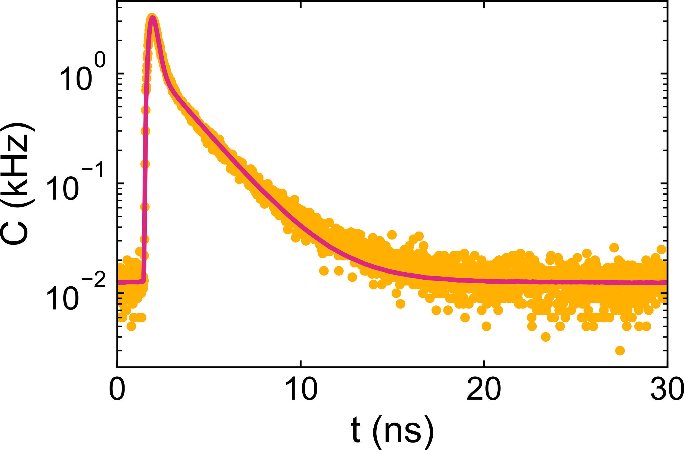
What is the multicolor fluorescence enhancement of Al-apertures?
$$C_{fit}=R\left(t\right)∗F\left(t\right)+c_{0}$$
$$F\left(t\right)=\sum_{i}{a_{i}e^{−\frac{t}{τ_{i}}}}$$
$$b_{i}=a_{i}τ_{i}$$
Instrument response function: $R\left(t\right)$
Multiexponential decay: $F(t)$

Slide 12
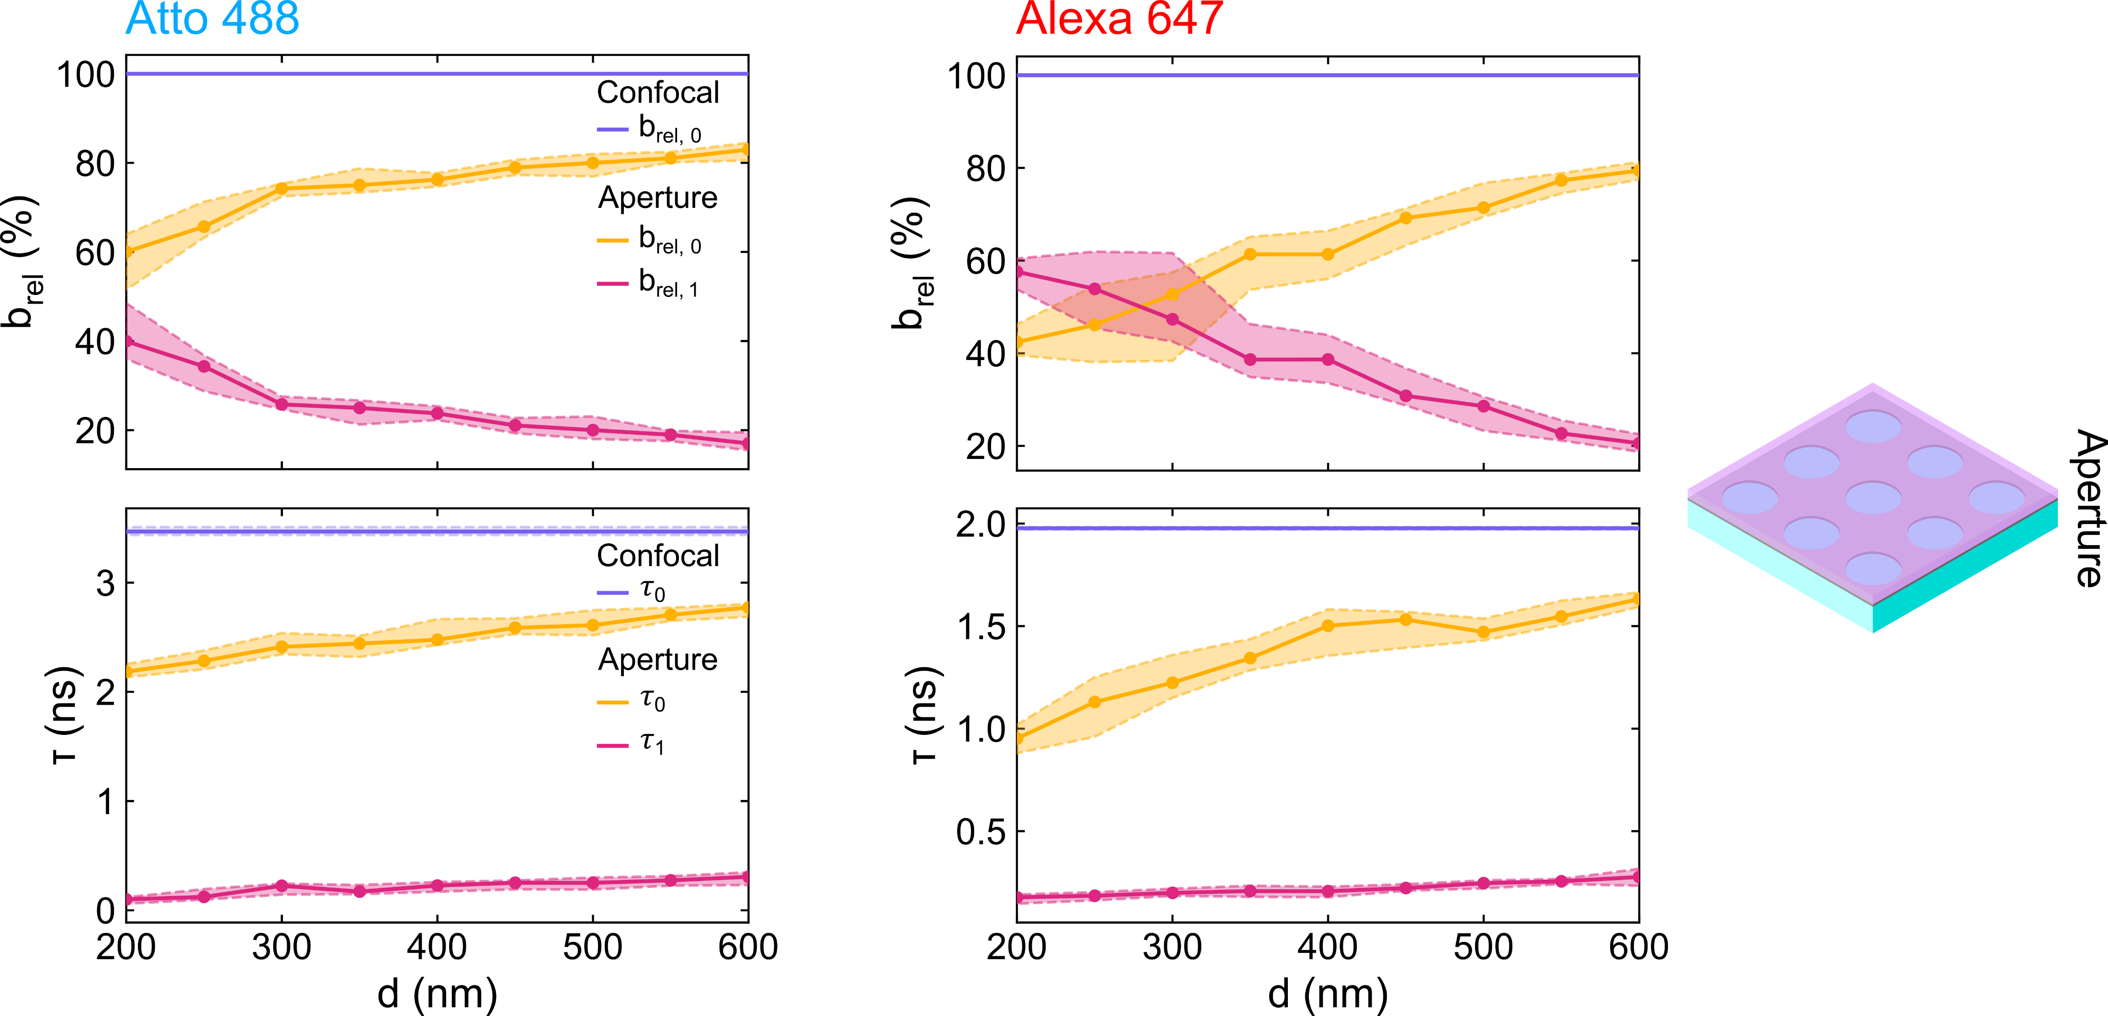
What is the multicolor fluorescence enhancement of Al-apertures?

Slide 13
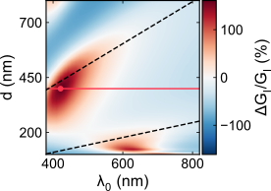
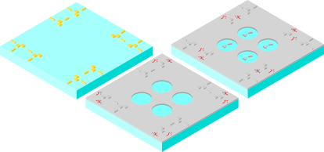
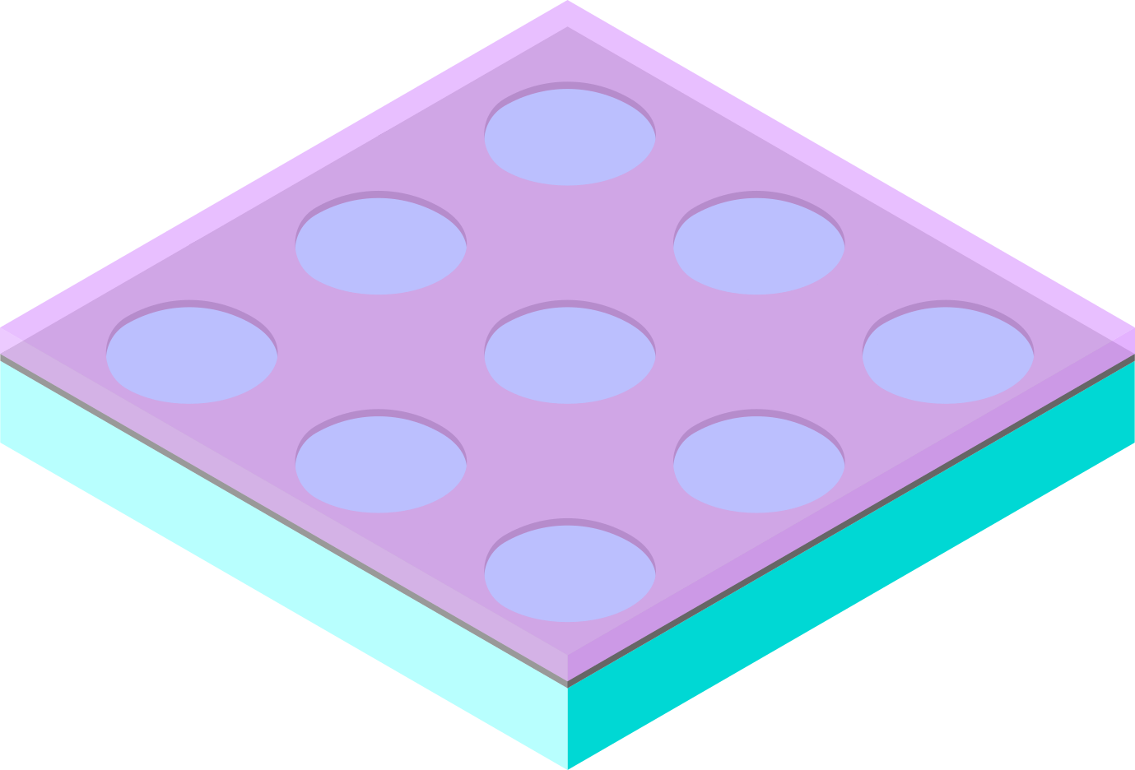
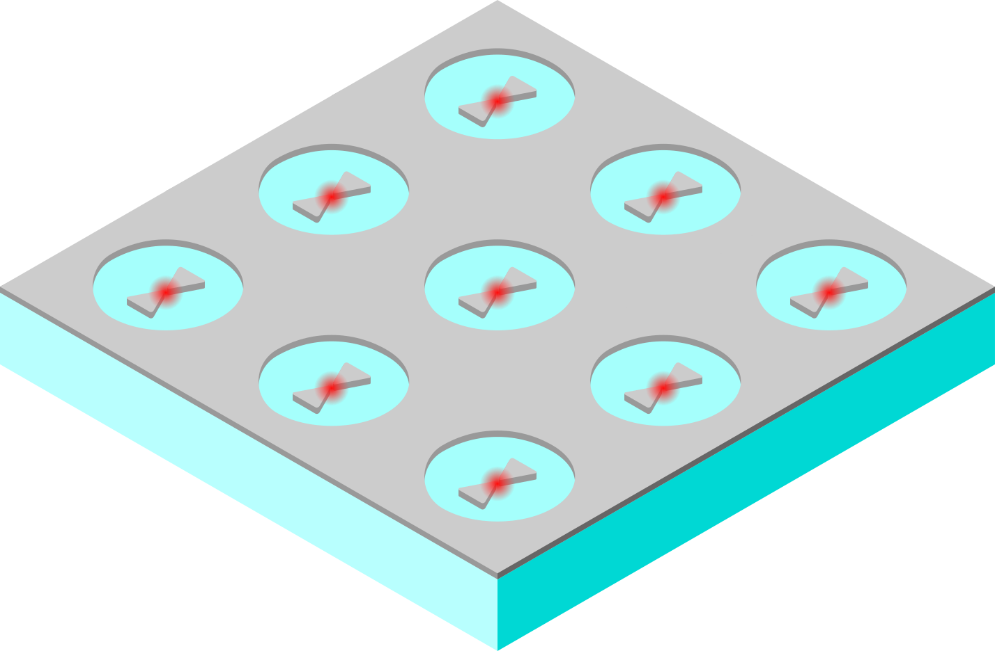
What did we learn and where do we go next?
Optimization
Fabrication
Validation
(Ongoing)
Multiplexing (Outlook)
Background reduction & stronger broadband excitation
3-step EBL process
Fabrication of ~10,000 Al-AiBs w. required geometrical parameters
For Al-apertures:
Fluorescence reduction
Metal induced quenching
Widefield excitation
sCMOS readout

Slide 14
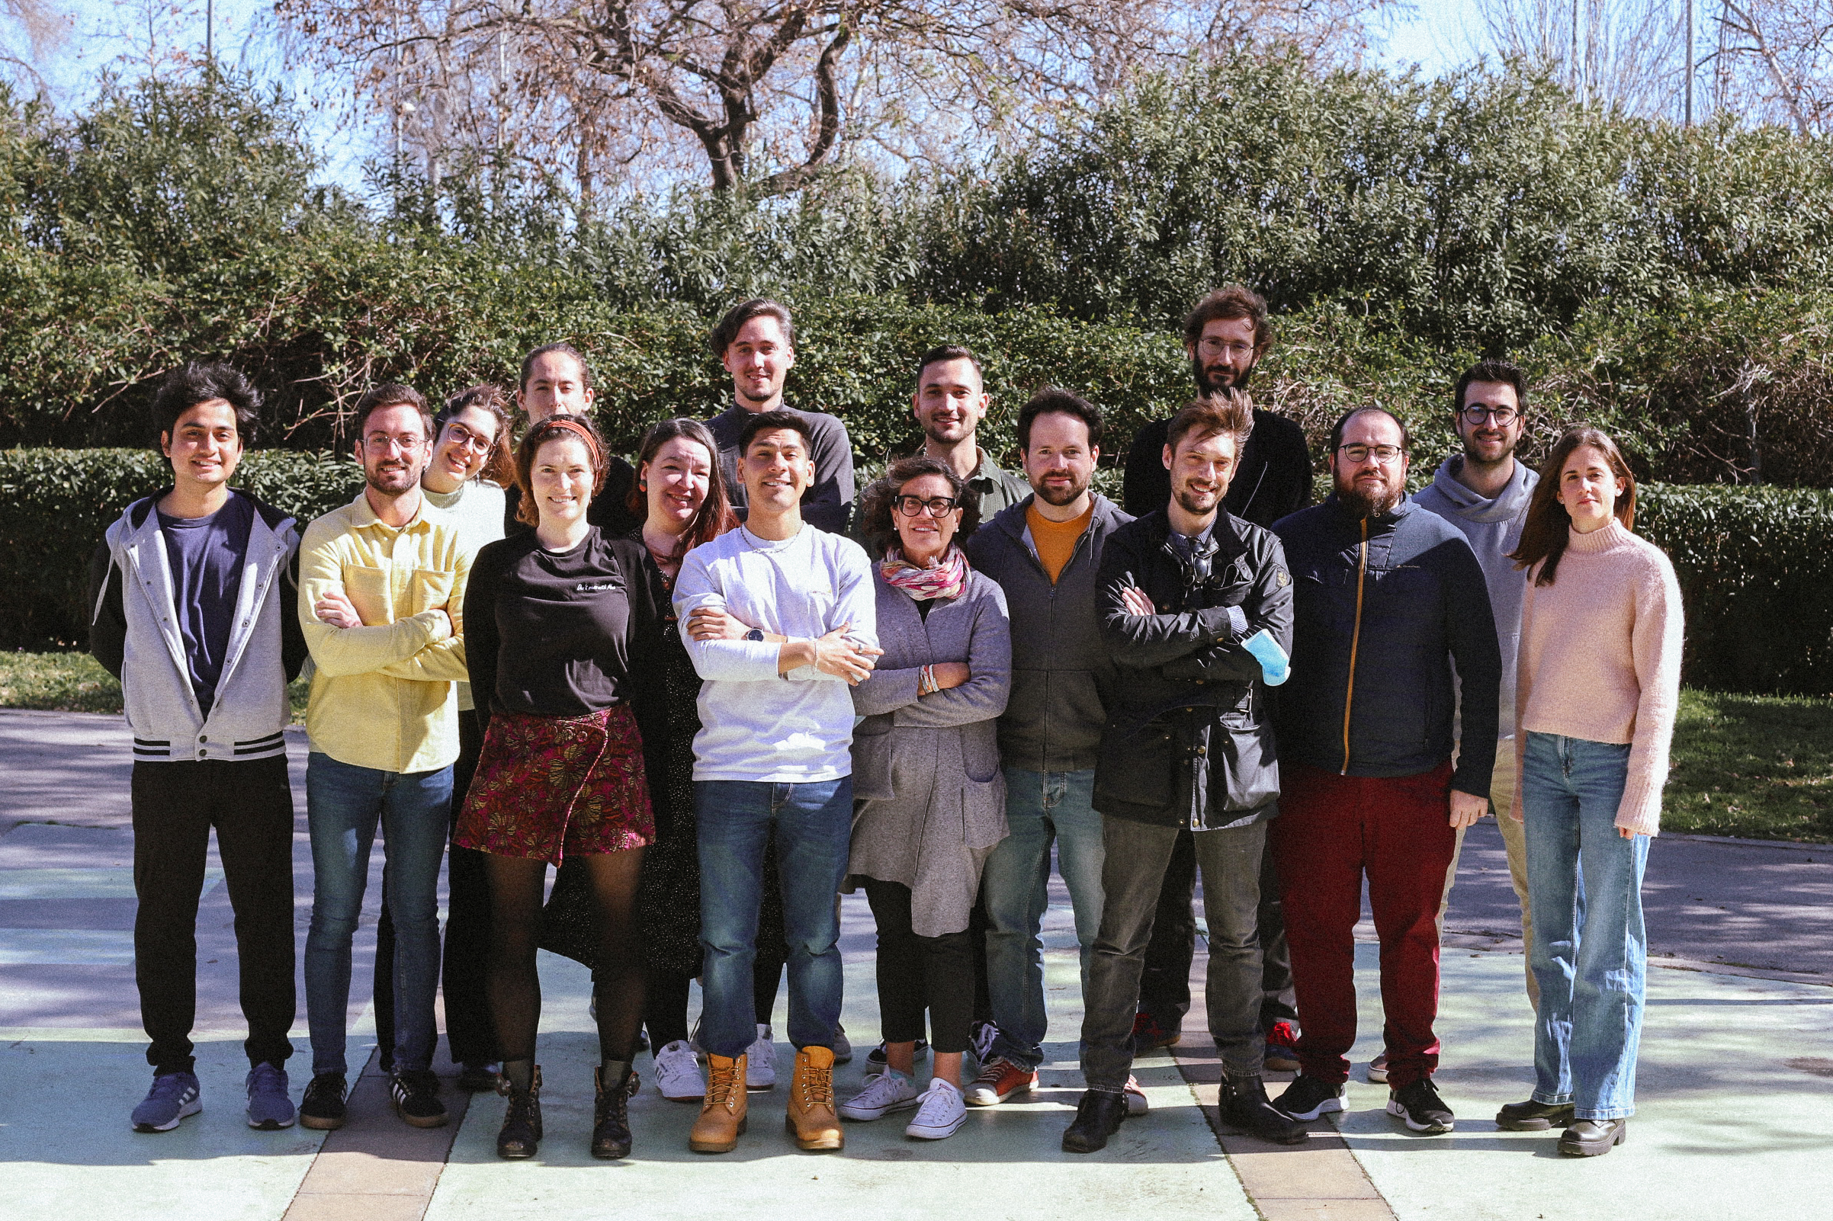
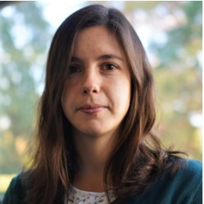
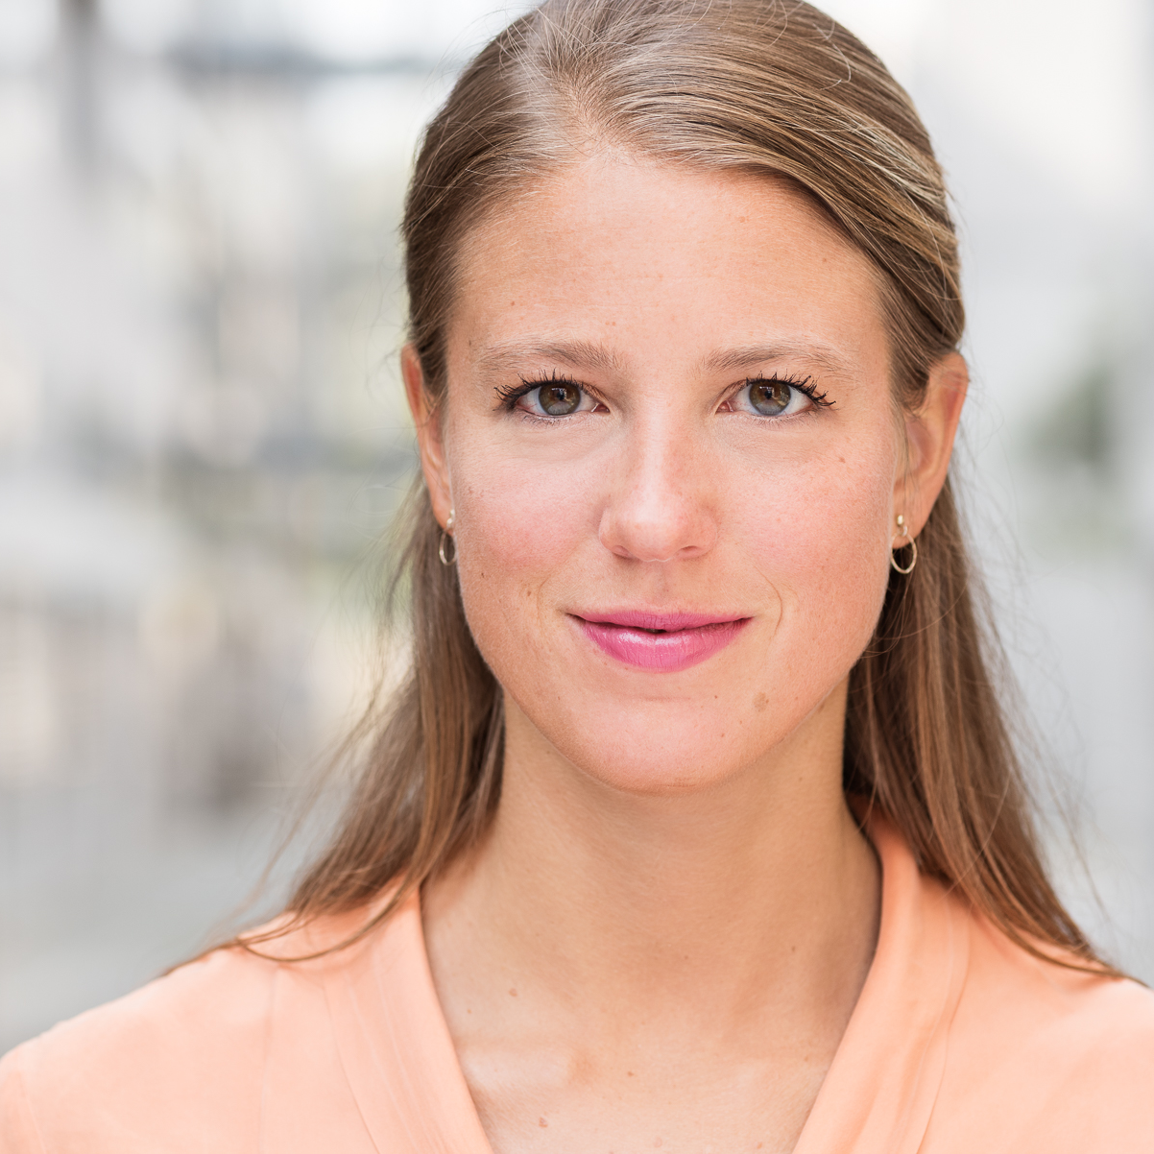
Single Molecule Biophotonics
Maria Sanz-Paz
Pamina Winkler
This project has received funding from the European Union’s Horizon 2020 research and innovation program under the Marie Sklodowska-Curie grant agreement No 812992.

