Slide 1

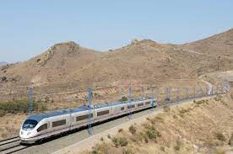
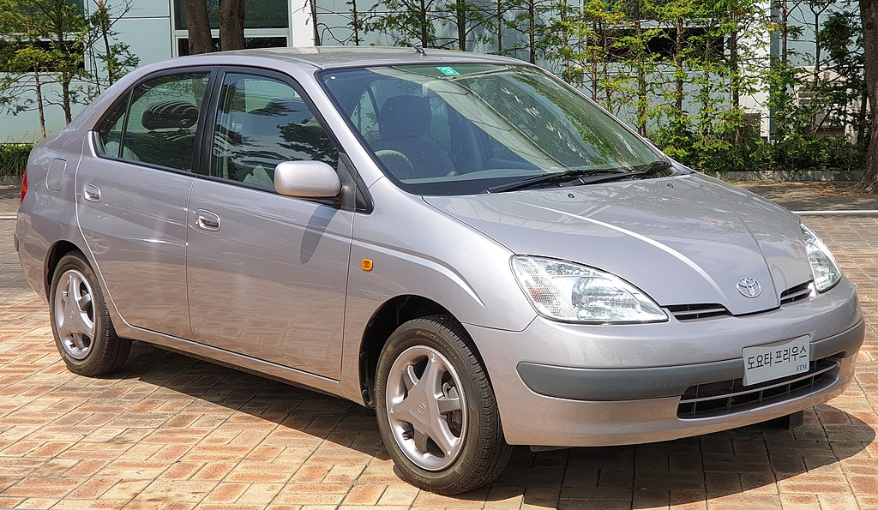
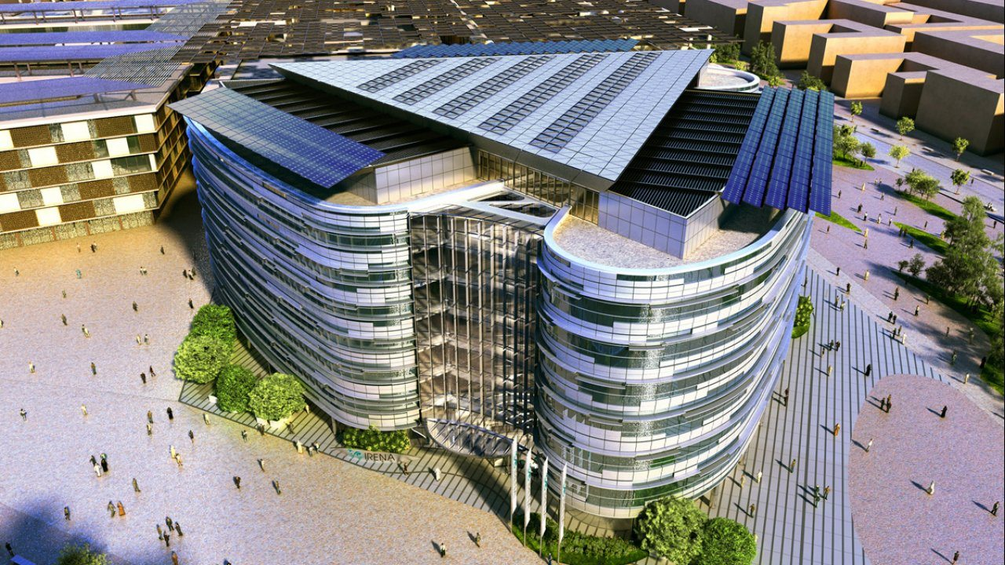


Digital Twins, Inverse Problems and
New Paradigms for Model Based
Systems Engineering
John A. Burns, Eugene M. Cliff and Terry L. Herdman
Interdisciplinary Center for Applied Mathematics
Virginia Tech
Blacksburg, Virginia 24061-0531
Planes Trains Automobiles
& Buildings
IX Partial Differential Equations, Optimal Design and Numerics
Centro de Ciencias de Benasque Pedro Pascual
Benasque, Spain
August 25, 2022

Slide 2
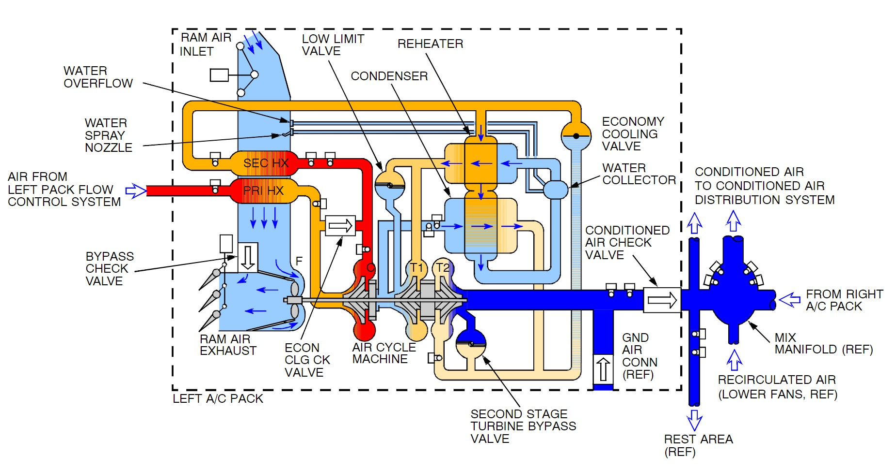
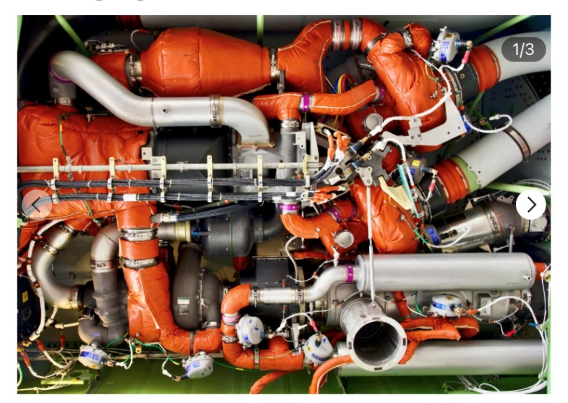
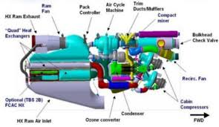
Planes are Complex Systems
Not as impressive as Gȕnter’s gas networks …. but

Slide 3
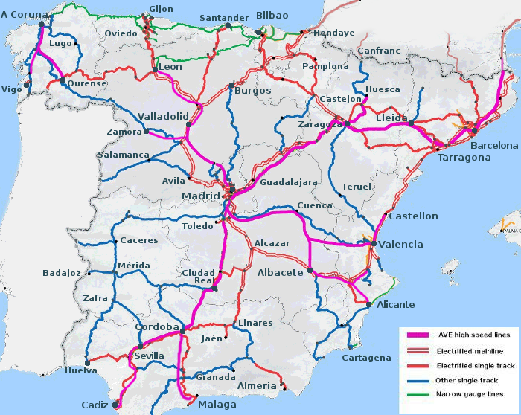
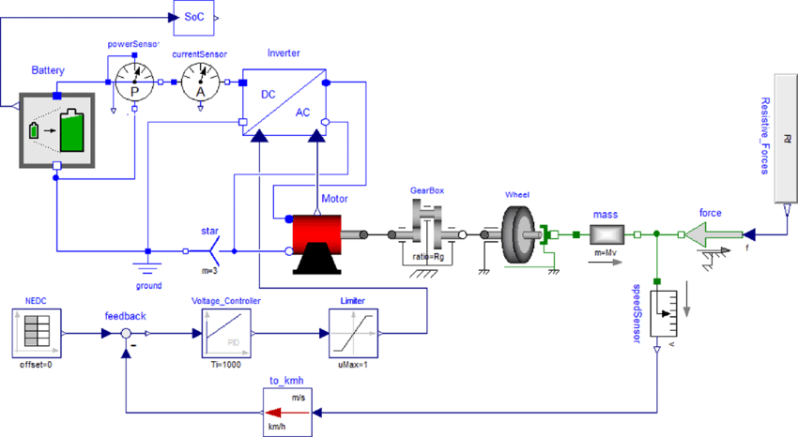
Train Networks & Electric Cars are Complex Systems
Not as impressive as Gȕnter’s gas networks …. but
First Prius was designed with Modelica

Slide 4
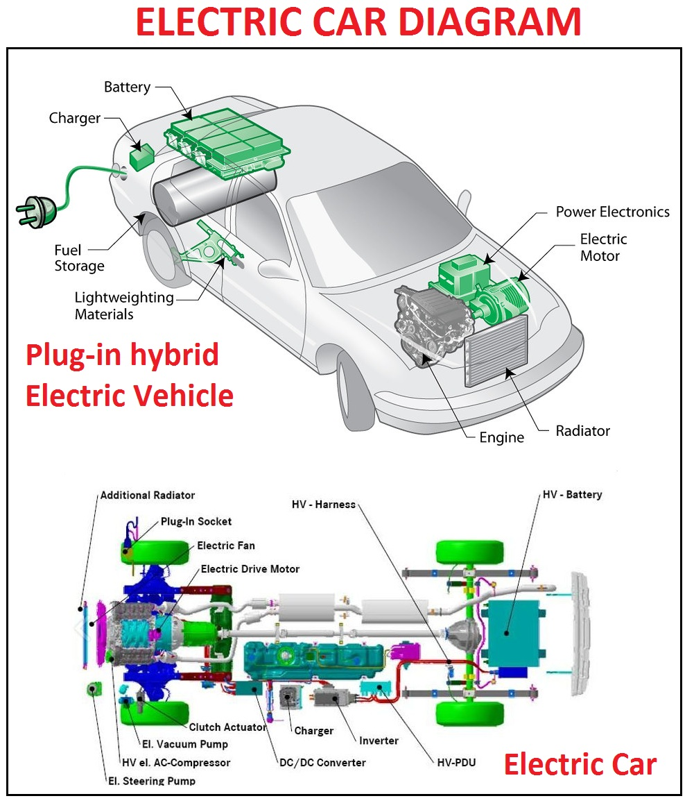
A Paradigm for Modeling Complex Systems
[4] Jonas Hellgren, Modelling of hybrid electric vehicles in Modelica for virtual prototyping, Proceedings of the 2nd International Modelica Conference (2002), 247—256.

Slide 5
A Paradigm for Modeling Complex Systems
The basic idea is that one first develops finite dimensional mathematical / computational models of fundamental physical components (a library of domain models) and then employs a high level language such as Modelica or Simscape to assembling these fundamental components into a complex finite dimensional system level model.
[4] Jonas Hellgren, Modelling of hybrid electric vehicles in Modelica for virtual prototyping, Proceedings of the 2nd International Modelica Conference (2002), 247—256.

Slide 6
Modeling, Design & Control of Whole Building Systems
Not as impressive as Gȕnter’s gas networks …. but
Extremely complex systems with huge impact on energy & climate
See https://www.youtube.com/watch?v=2no9g1CZfTA

Slide 7
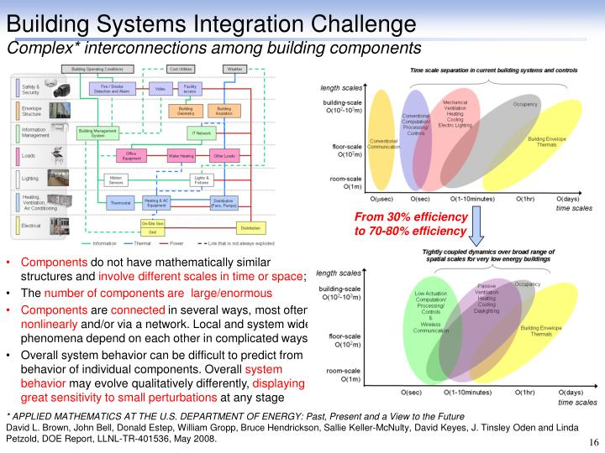
Modeling, Design & Control of Whole Building Systems

Slide 8
The Digital Twin Revolution
https://info.microsoft.com/rs/157-GQE-382/images/Microsoft%27s%20Digital%20Twin%20%27How-To%27%20Whitepaper.pdf

Slide 9
Is The Concept of a Digital Twin a “New Idea”?
What is a Digital Twin?
[1] Azad M. Madni, Carla C. Madni, and Scott D. Lucero. Leveraging digital twin technology in model-based systems engineering. Systems, 7(1):7, 2019.
[2] Louise Wright and Stuart Davidson. How to tell the difference between a model and a digital twin. Advanced Modeling and Simulation in Engineering Sciences, 7(1):1–13, 2020.
Rough definition
Most definitions require that a digital twin be a virtual representation that serves as the real-time digital counterpart of a physical object or process.
As noted in [2], by definition “ ... a digital twin has to be associated with a physical object that actually exists: a digital twin without a physical twin is a model.”
Thus, a digital twin is a model with additional requirements:
• It is a model of a physical object (usually a “computational model”),
• There is an evolving set of (available) data relating to the object
• One must have a means of dynamically updating / adapting the model in
accordance with the data.
(Three decades ago, this process would be called real-time system identification.)

Slide 10
Is The Concept of a Digital Twin a “New Idea”?
Thus, a digital twin is a model with additional requirements:
• It is a model of a physical object (usually a “computational model”),
• There is an evolving set of (available) data relating to the object
• One must have a means of dynamically updating / adapting the model in
accordance with the data.
(Three decades ago, this process would be called real-time system identification.)
… and even more requirements:
• It is a (math / computational) model of a physical system that is suitable
for simulation & control & optimization & engineering design.
… and with limitations:
• Since there must be a physical object that the digital twin represents, a
digital twin is only useful in the prototyping stage of an engineering design
process.
• There is no science / methodology for constructing digital twins (models)
that are guaranteed to meet these requirements.
Developing a computational model (digital twin) that is suitable for multiple use (i.e., for simulation & control & optimization & engineering design & …) is a very challenging (maybe impossible to solve) problem.

Slide 11

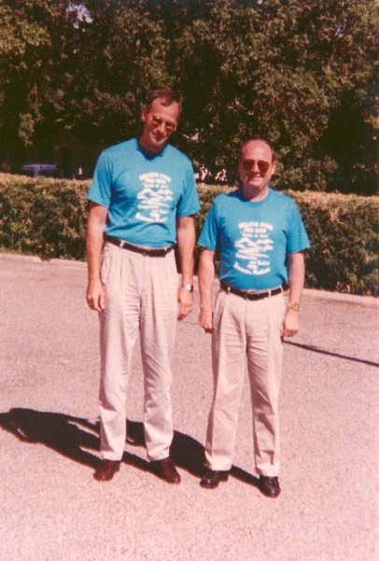
Is The Concept of a Digital Twin a “New Idea”?
We have no general methodology and no theory on how to do this.
Recent work suggest one approach is to develop “digital twin models” specifically for a particular use (e.g., control or optimization or design, …)
[3] Qingfei Min, Yangguang Lu, Zhiyong Liu, Chao Su, and Bo Wang. Machine learning based digital twin frame-work for production optimization in petrochemical industry. International Journal of Information Management, 49:502–519, 2019.
The following twin pairs are 99.9% “identical” (genetic makeup)
Which twin would you pick to optimize scoring on your basketball team?
Modelling for X (where X is the use case)

Slide 12
Modelling for X
What is Modelling for X?
Developing a model for a specific problem and knowing how the model will be used is called “modeling for X” where X denotes the problem to be solved (i.e., simulation, control, optimization, design, …).
During the past 75 years we have made huge progress in modeling for “(accurate) simulation” of PDEs. Even “real-time simulation” can be achieved with new numerical methods and GPU computing.
During the past 25 years we have made use of model reduction to develop models for (rapid) simulation & control & optimization of certain PDEs.
We have mostly ignored issues such as:
Consistent approximations for optimization (dual convergence, etc.)
Taking into account the availability of software (Ipopt, MINLP, DFO, etc.)
Keeping up with software environments that enable model creation
It is important to decide how the models are to be used at each step of the workflow.
Here we focus on “science-based component” modeling” where first principle laws / equations are used as the basic mathematical model.

Slide 13
Modelling for X
Modelling for X: A paradigm shift in MBD for Complex Systems
Step 1. Develop libraries of finite dimensional mathematical / computational models (hopefully digital twins) of fundamental physical components and build a library of component models.
Step 2. Employ high level language (block diagrams or other modeling paradigms) and physical connections to assembling fundamental components into a complex finite dimensional system model.
Step 3. Use the system level model for “everything” - a system level digital twin.
There are (at least) two misconceptions that, although they sound very reasonable, can cause model based design control, optimization and design methods to fail. In rough terms these may be described by:
(M1) If all the component models are digital twins, then the corresponding system level model will also be a digital twin of the system..
(M2) If one builds a system from “optimally designed” components, then the resulting system will be “optimal”.
(M2) is extremely important because of the paradigm shift in MBD.

Slide 14
Implications of New Software Environments
Modelling for X: A paradigm shift in MBD for Complex Systems
The past two decades have seen a growth of software environments for component model creation, assembly into system level models, simulation and post-processing. Typical examples include:
• Dymola - a multi-engineering modeling and simulation tool available through Dassault Systemes is based on the modeling language Modelica.
• SimscapeTM - a MathWorks® product that enables the assembly of component models into system level models within the Simulink® environment.
There are several similar commercial, open source and proprietary industrial tools.
This paradigm is a “approximate – assemble – design” methodolgy
For example, one would build a model of a vapor-compression systems (VCS) by assembling component models of heat exchangers, compressors, evaporators, condensers, expansion valves …
?? What could possibly go wrong ??

Slide 15
Connecting Component Models into System Models
COMPONENT 1
COMPONENT 2
COMPONENT 3
COMPONENT 4
COMPONENT 5
connecting components = connecting models (digital twins)
?? What happens to control system properties ??

Slide 16
A Warning About Composite Systems for Control
(Σ_{a}) and (Σ_{b}) are controllable but the composite system
(Σ_{c}) is not even stabilizable
[5] A. Bacciotti & G. Baccari, A, A Version of the Hautus’ Test for Tanden Connections of Linear Systems, IEEE Transactions on Automatic Control, (1995) Vol 40, 111-114.
Probably only happens with made up examples … right?
NO!
[6] J. A. Burns & L. Zietsman, Control of a Thermal Fluid Heat Exchanger with Actuator Dynamics, 2016 IEEE 55th Conference on Decision and Control, 3131-3135.

Slide 17
Components to System
COMPONENT 1
COMPONENT 2
COMPONENT 3
COMPONENT 4
COMPONENT 5
EACH COMPONENT HAS MULTIPLE “DIGITAL TWIN” - MODELS
SYSTEM FROM COMPONENTS
THIS COMPOSITE SYSTEM MAY NOT BE A “DIGITAL TWIN”

Slide 18
Components to System
EXPANSION VALVE
EVAPORATOR
HEAT EXCHANGER
CONDENSER
COMPRESSOR
EACH COMPONENT HAS MULTIPLE “DIGITAL TWIN” - MODELS
VAPOR-COMPRESSION CYCLE (SYSTEM)
THIS COMPOSITE SYSTEM MAY NOT BE A “DIGITAL TWIN”

Slide 19
Basic Vapor Compression System
MOTOR
CONDENSER
Heat Exchangers (HX)
EXPANSION
VALVE
COMPRESSOR
actuator dynamics
EVAPORATOR
Dynamic modelling is difficult … especially at low flow conditions

Slide 20
Component Library
PIPE FLOW
CONDENSER
EXPANSION
VALVE
COMPRESSOR
EVAPORATOR

Slide 21
System Constructed from Components
PIPE FLOW
Heat Exchanger (HX)
CONDENSER
EXPANSION
VALVE
COMPRESSOR
EVAPORATOR

Slide 22
Even Components Are Systems
PIPE FLOW
HEAT EXCHANGER (HX)
CONDENSER
[4] J. Ward MacArthur and Eric W. Grald, Unsteady compressible two-phase flow model for predicting cyclic heat pump performance and a comparison with experimental data. Int. J. of Refrigeration, Vol. 12, (1989), 29–41.
fluid flow is one-dimensional (horizontal);
viscous dissipation is negligible;
spatial variations in pressure are negligible;
axial conduction is negligible;
work associated with the rate of change of pressure with respect to time is negligible;
cross-sectional area of the flow stream is constant
pressure drop along the heat exchanger are negligible,
“small” … so ignore
“small” … so ignore
“small” … so ignore
The “modeling simplifications” above are root causes of many problems
with existing “digital twin models” used for control and optimization.

Slide 23
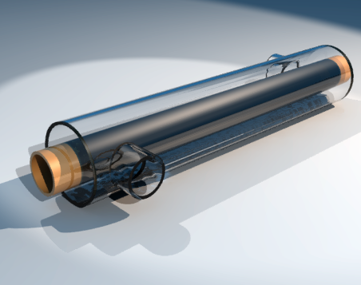
Parameter Estimation & Math Model Selection
counter flow HX
Linear models of components
“small” = 0
axial conduction assumption
Inputs / controls or parameters

Slide 24
Parameter Estimation & Math Model Selection
Model a
“calibration” parameters
“known” unknowns
system outputs
Model 0

Slide 25
Parameter Estimation & Math Model Selection
Model a
Model 0

Slide 26
Parameter Estimation with the Null Model
Model a

Slide 27
Parameter Estimation with the Null Model
Model 0

Slide 28
Parameter Estimation with the Null Model
Model 0
known “unknowns”
known “unknowns”
“unknown” unknowns
There are very powerful Bayesian methods to deal with this problem

Slide 29
Model Discrepancy Method(s)
[7] Jenny Brynjarsdottir and Anthony O’Hagan. Learning about physical parameters: The importance of model discrepancy. Inverse Problems, 30(11):114007, 2014
“Important findings” from this paper
  If model discrepancy is ignored, then predictions (both interpolations and extrapolations) and inferences about parameters are biased, and this bias persists with increasing numbers of observations.
  If model discrepancy is modelled in a simple, uninformative way, then the interpolations are unbiased but the extrapolations and inferences about the parameters will still be typically biased.
  In order to obtain realistic learning about model parameters, or to extrapolate outside the range of the observations, it is important not just to incorporate model discrepancy but also to model carefully the available prior information about it.

Slide 30
Structured Model Discrepancy (SMD)
[7] Jenny Brynjarsdottir and Anthony O’Hagan. Learning about physical parameters: The importance of model discrepancy. Inverse Problems, 30(11):114007, 2014
[8] M. J. Bayarri, J. O. Berger, R. Paulo, J. Sacks, J. A. Cafeo, J. Cavendish, Chin-Hsu Lin, and Jian Tu. A framework for validation of computer models. Technometrics, 49(2):138–154, 2007.

Slide 31
Structured Model Discrepancy (SMD)
[7] Jenny Brynjarsdottir and Anthony O’Hagan. Learning about physical parameters: The importance of model discrepancy. Inverse Problems, 30(11):114007, 2014

Slide 32
Constrained Structured Model Discrepancy (SMD)
Model 0

Slide 33
Physics Based Model Form (PMF)
[9] J. A. Burns, E. M. Cliff and T. L. Herdman, Identification of Dynamical Systems with Structured Uncertainty, Journal of Inverse Problems in Science and Engineering, 26, (2017), 280--321.
[10] J. A. Burns, E. M. Cliff and T. L. Herdman, Parameter Estimation of a Thermal Fluid System, (with E. M. Cliff and T. L. Herdman), Proceedings of the 2018 American Control Conference, (2018) Milwaukee, WI, 122--127.
Model Form a
“calibration” parameters
“known” unknowns
“natural physics based constraints”

Slide 34
Constrained Estimation Problems PMF & SMD
Problem [1] - PMF
Problem [2] - SMD

Slide 35
Two Issues: System Type & Approximations
Model a
must approximate the PDE system ...
finite elements, finite difference, finite volume etc.

Slide 36
Two Issues: System Type & Approximations
Model a
[11] P. Deuring, R. Eymard, and M. Mildner, L²-stability independent of diffusion for a finite element - finite volume discretization of a linear convection-diffusion equation, SIAM Journal on Numerical Analysis, 53 (2015), 508--526

Slide 37
Two Issues: System Type & Approximations
Model a
combined finite element – finite volume approximation
A constrained identification problem …
Very hard but raises some interesting questions

Slide 38
Numerical Results for the HX System (Ipopt)
Model a (with noise at the boundary)
system measurements

Slide 39
Numerical Results for the HX System (Ipopt)
Model a (with noise at the boundary)
system measurements
used SMD without and with priors on

Slide 40
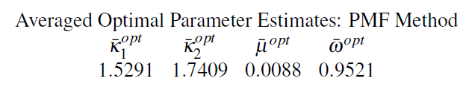
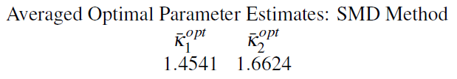
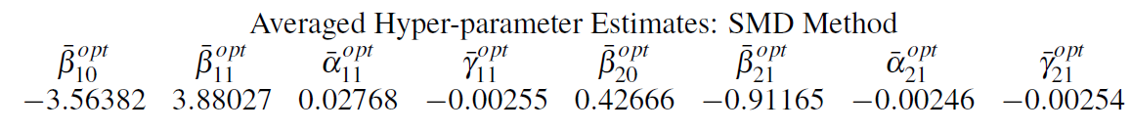
Numerical Results for the HX System (Ipopt)
without priors on
Data fits and model predictions

Slide 41
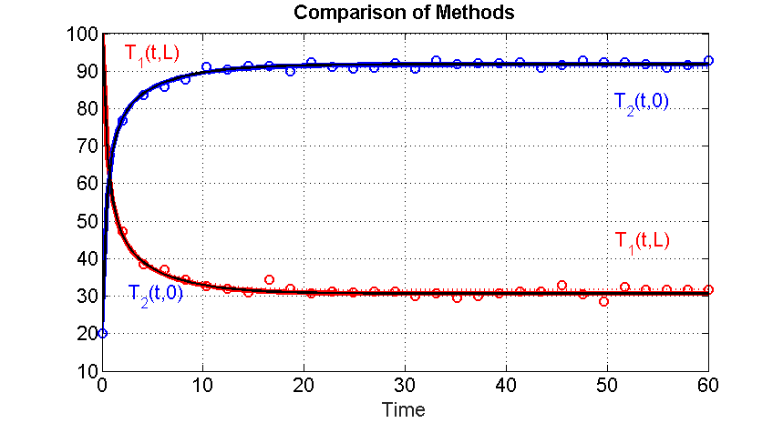
Data Fits for 0 ≤ t ≤ 60
PMF and SMD both produce good fits

Slide 42
PMF vs. SMD Results
Frequency Plots for k₁
PMF and SMD both produce good estimates

Slide 43
PMF vs. SMD Results
Frequency Plots for k₂
PMF and SMD both produce good estimates

Slide 44
PMF Results
Frequency Plots for ω and μ
SMD does not estimate ω nor μ
What about prediction for t > 60 ?

Slide 45
PMF vs. SMD Results

Slide 46
PMF vs. SMD Results
Although the SMD produces the correct qualitative behavior, qualitative
predictions are still “biased” … needs work … needs statistical approach.

Slide 47
Summary
New high level software environments are enabling a paradigm where one develops complex system models by connection finite dimensional component level computational models that exist in a component library.
Even, the component math models can be complex (PDEs, etc.) and require approximations to generate finite dimensional computational models of the component.
Ideally, one would construct component digital twins for each component so that at the component level these models are suitable for “everything” … simulation, control, optimization and design
IN GENERAL WE DON’T KNOW HOW TO DO THIS
But, we have made progress on component “modeling for X” where X is:
  Accurate and real time simulation
  Approximate – then – design for control and optimization
We don’t know how to extend these to system level models

Slide 48
Summary
One issue is the problem of estimating model type and parameters from evolving data
Model discrepancy methods are useful, but need good “priors” and still need to address the prediction issues
Using the “physics” can help guide model selection, discrepancy structure and constraints, but does not solve all the problems
Using constrained NLS can help avoid the problem of non-physical parameter estimates (tight bounds better)
Huge challenges
And
Exciting opportunities for mathematics.
THANKS FOR YOUR ATTENTION

