Slide 1

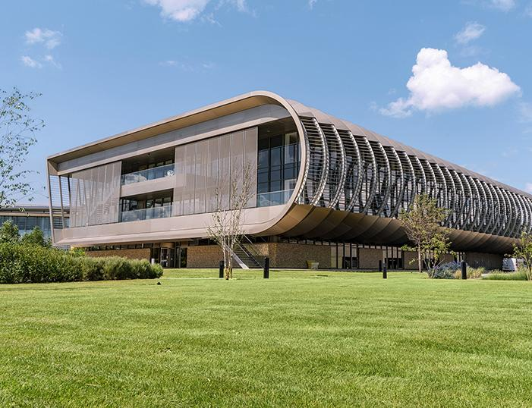

Rfam and RNAcentral
Resources for RNA Researchers
Blake Sweeney
Benasque RNA 2022

Slide 2

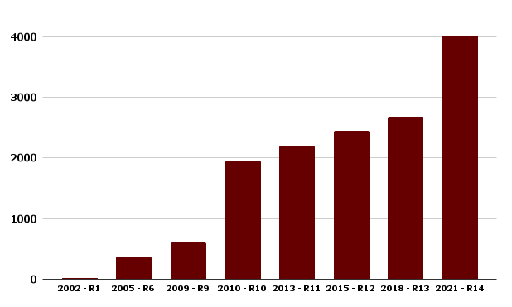
The RNA families database
4,069 families`
rfam.org

Slide 3
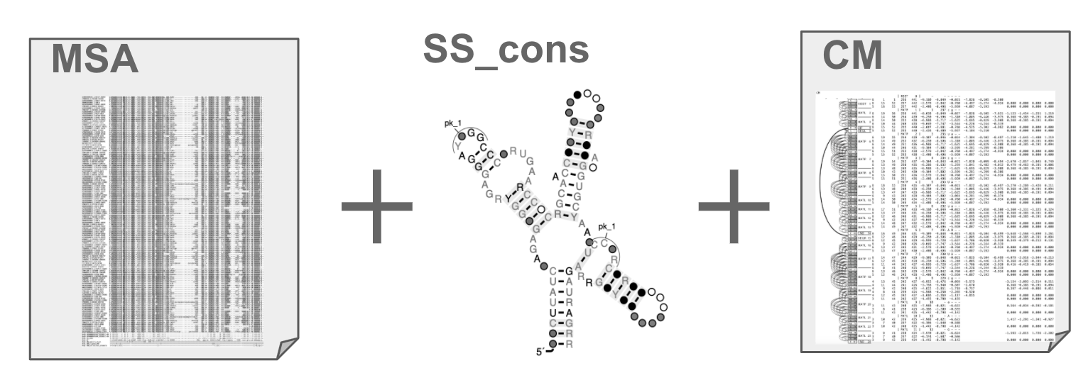
Rfam is a collection of ncRNA families
Multiple Sequence Alignment
Consensus
Secondary Structure
Covariance Model

Slide 4
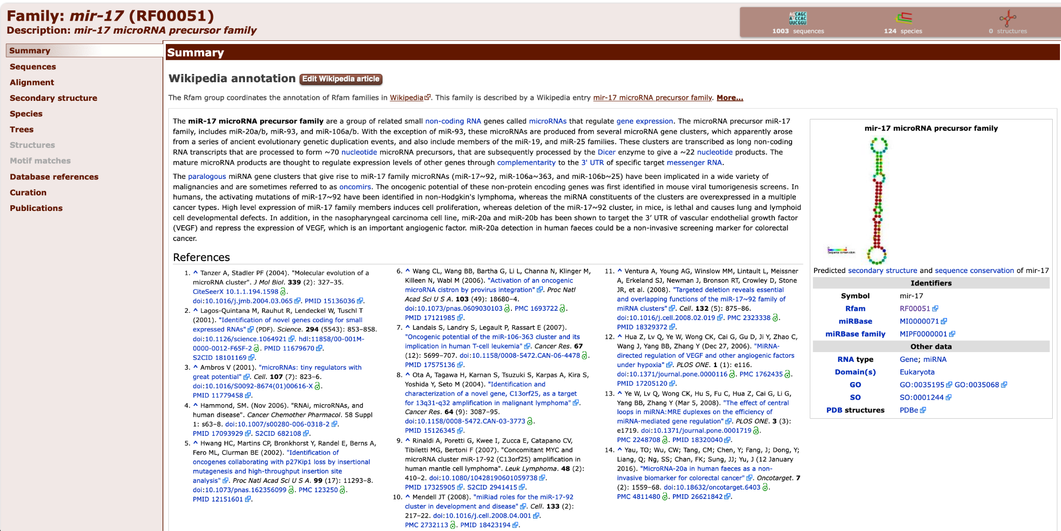

Slide 5



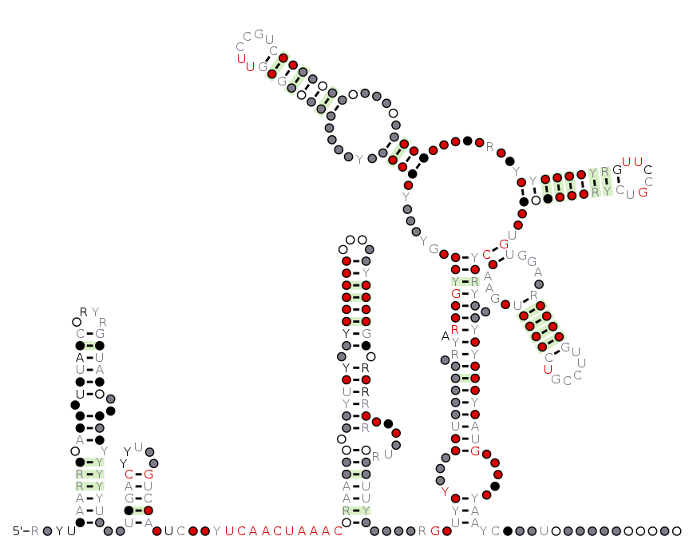


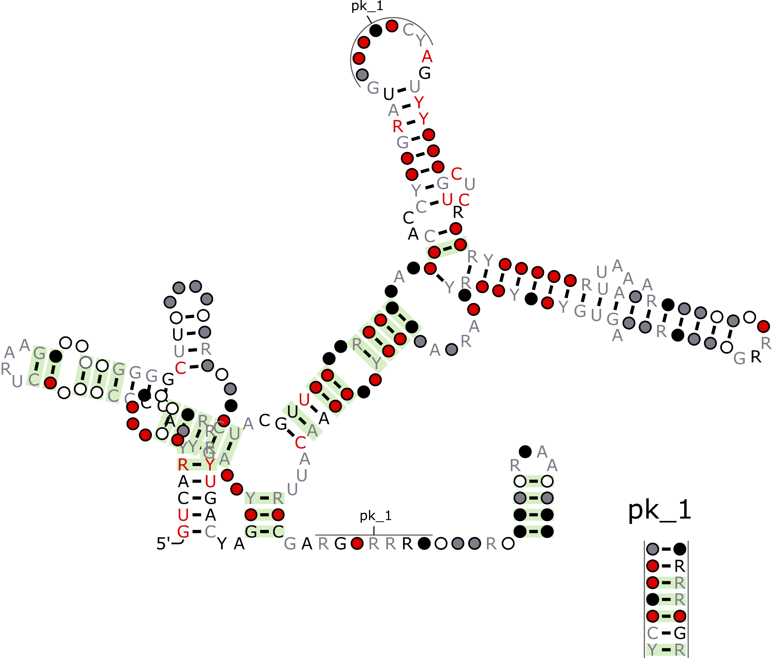
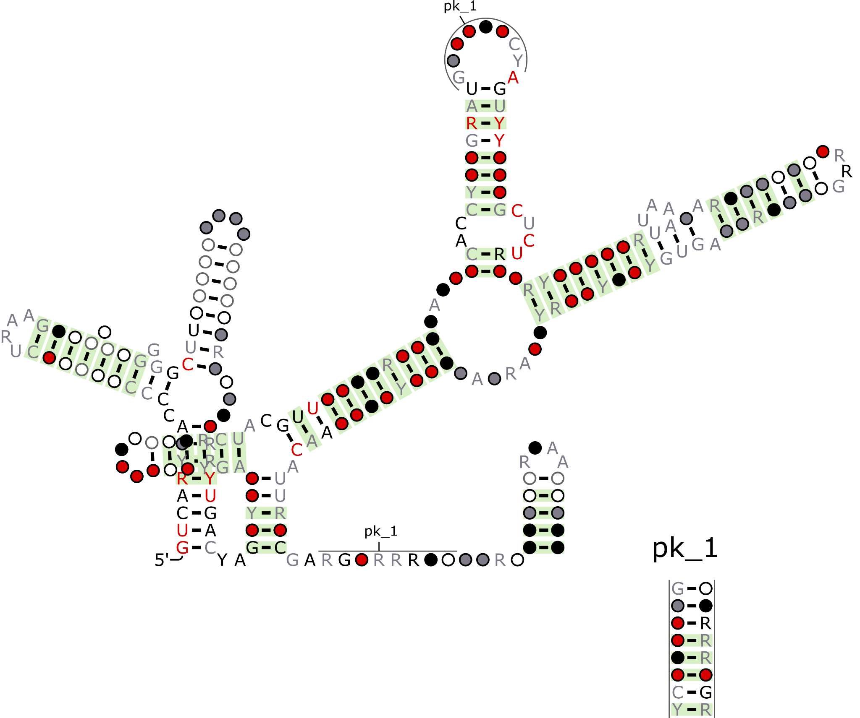
microRNAs families
3D integration
Virus families
R-scape improvements

Slide 6
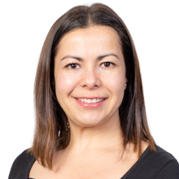
3D integration
R-scape improvements
Nancy Ontiveros Palacios

Slide 7
microRNAs families
Virus families

Slide 8
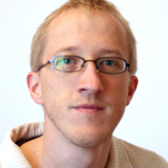
microRNAs families
Sam Griffiths-Jones
Virus families

Slide 9
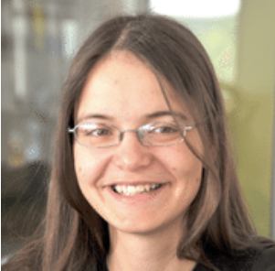
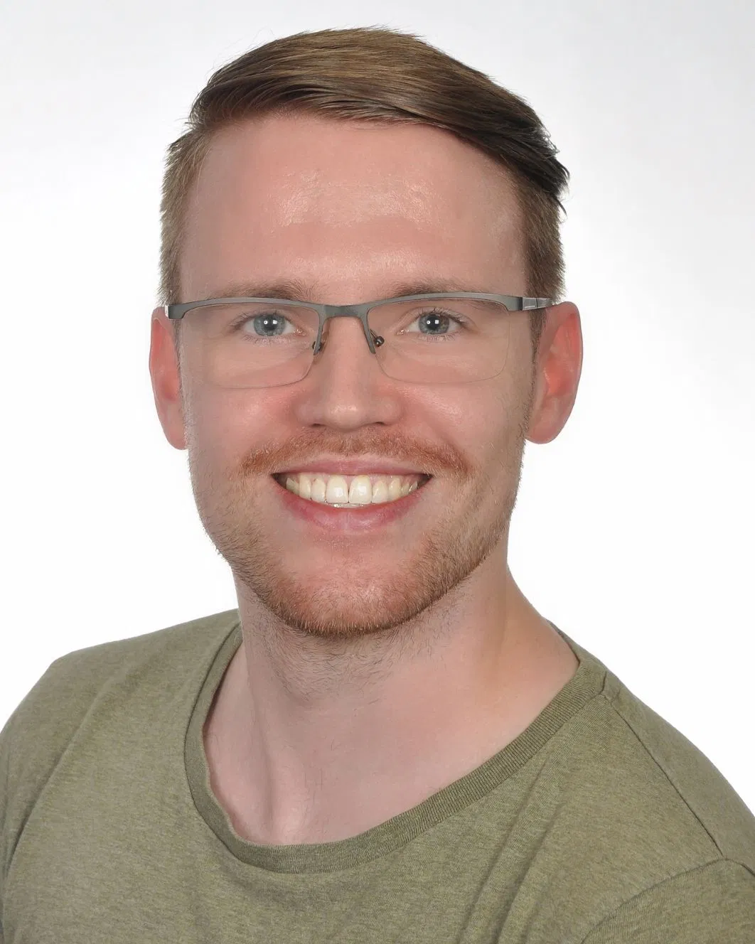
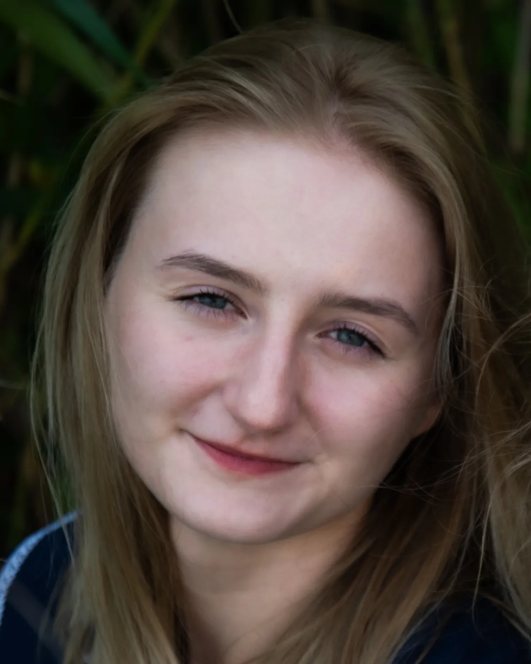


microRNAs families
Sam Griffiths-Jones
Virus families
Prof Manja Marz
Kevin Lamkiewicz
Sandra Triebel

Slide 10
EVBC is providing Rfam with alignments

Slide 11
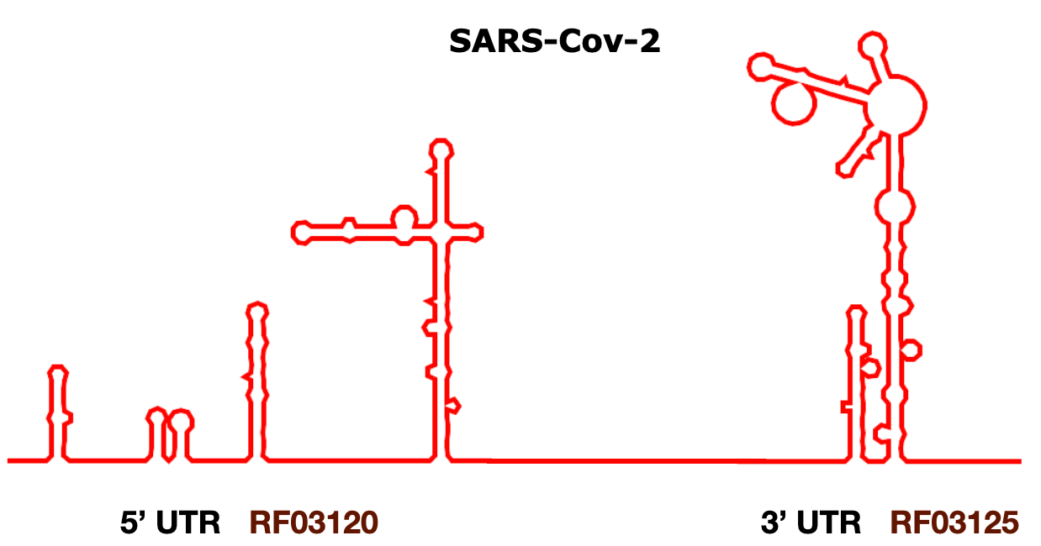
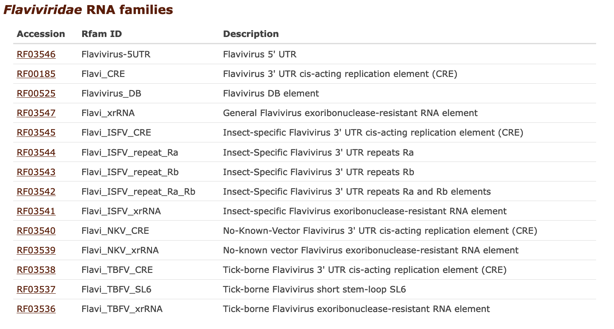
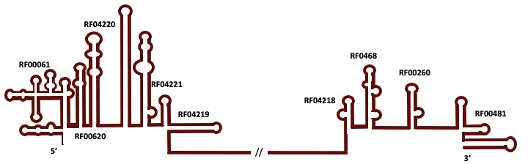
Rfam is creating new viral families
View all updated viral families at: https://rfam.org/viruses
Hepacivirus families
Notes:
27 April mini release of Coronavirus

Slide 12
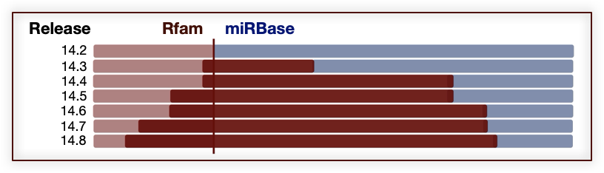
Rfam is synchronizing miRNAs with miRBase

Slide 13
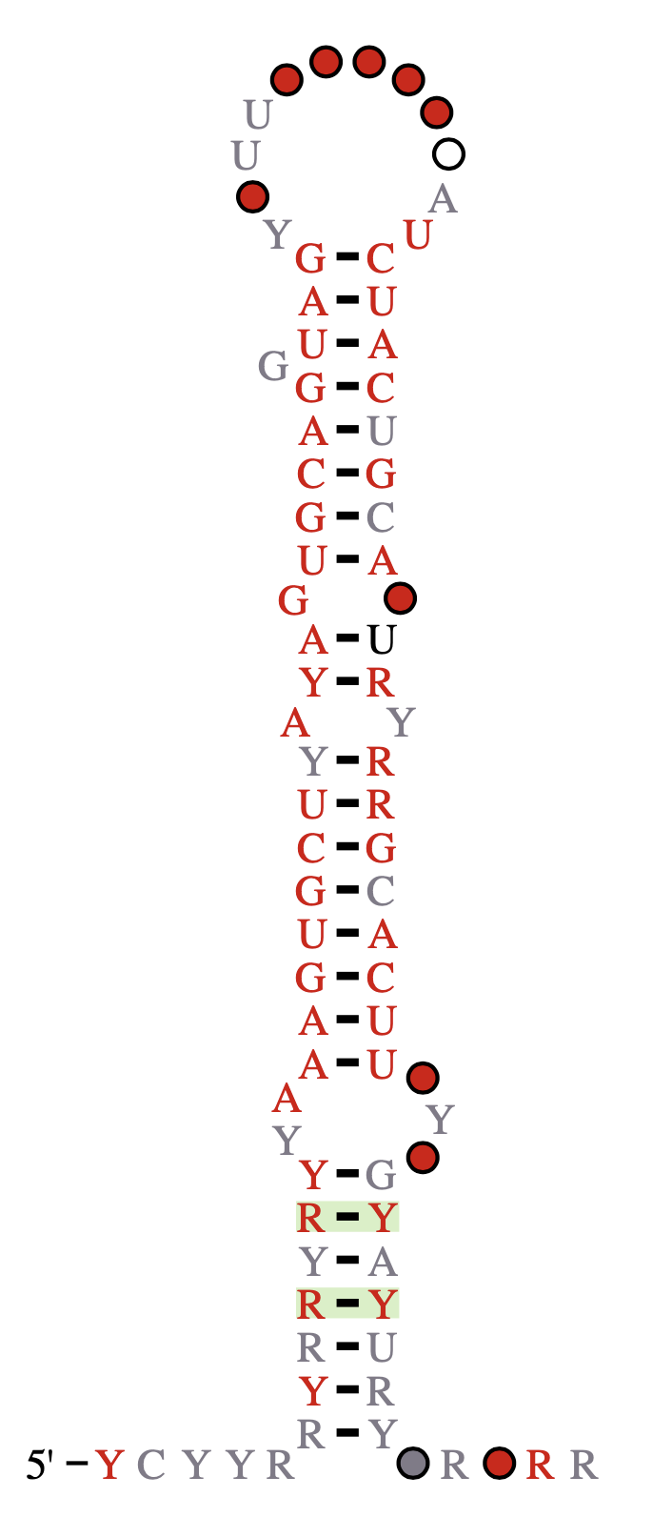
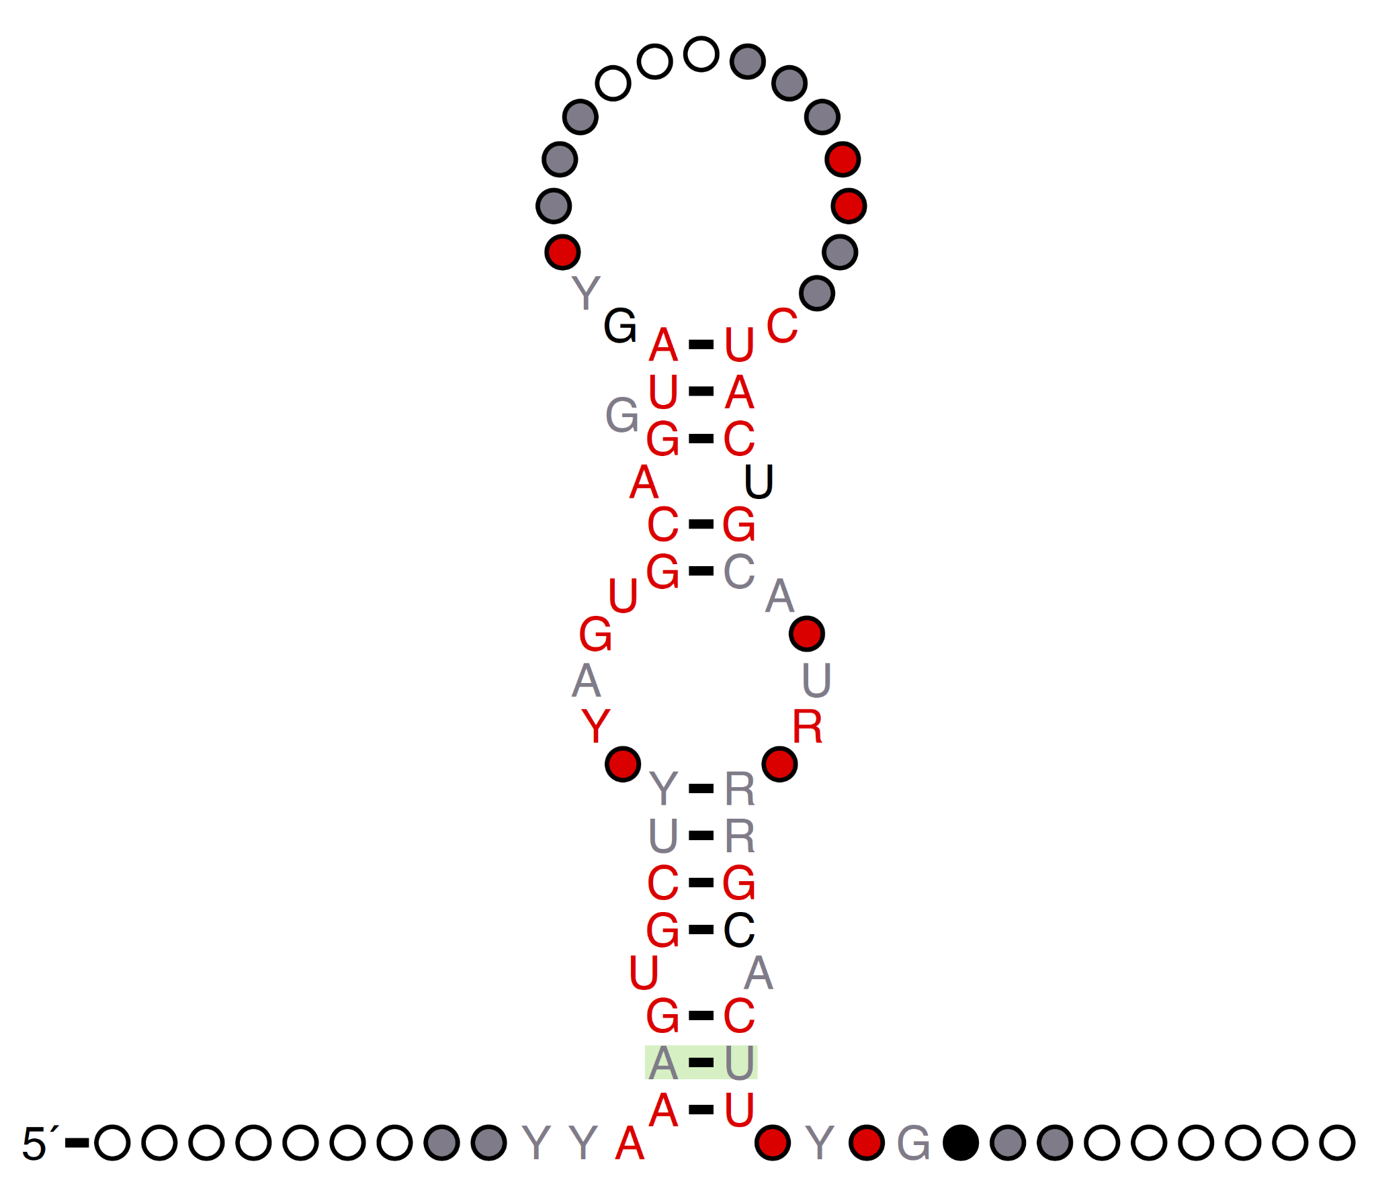
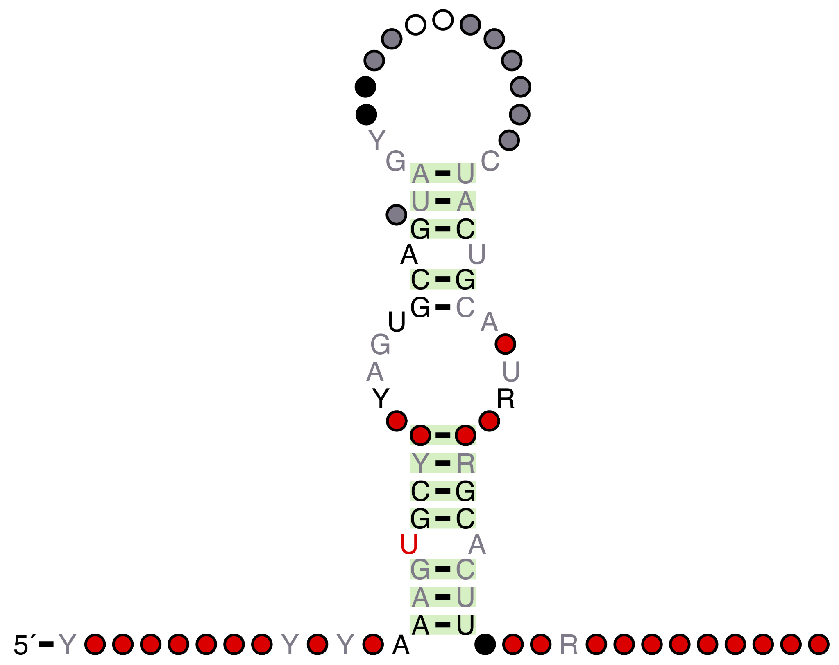
Example miRNA: mir-17
Previous 2D
Current 2D
R-scape analysis

Slide 14

Rfam is working toward weekly preview releases
Have begun producing some data weekly
Our goal is to provide all families weekly alongside standard frozen releases
Please come chat if you have specific requests
Emma Cooke

Slide 15
RNAcentral
The database of RNA sequences
rnacentral.org

Slide 16
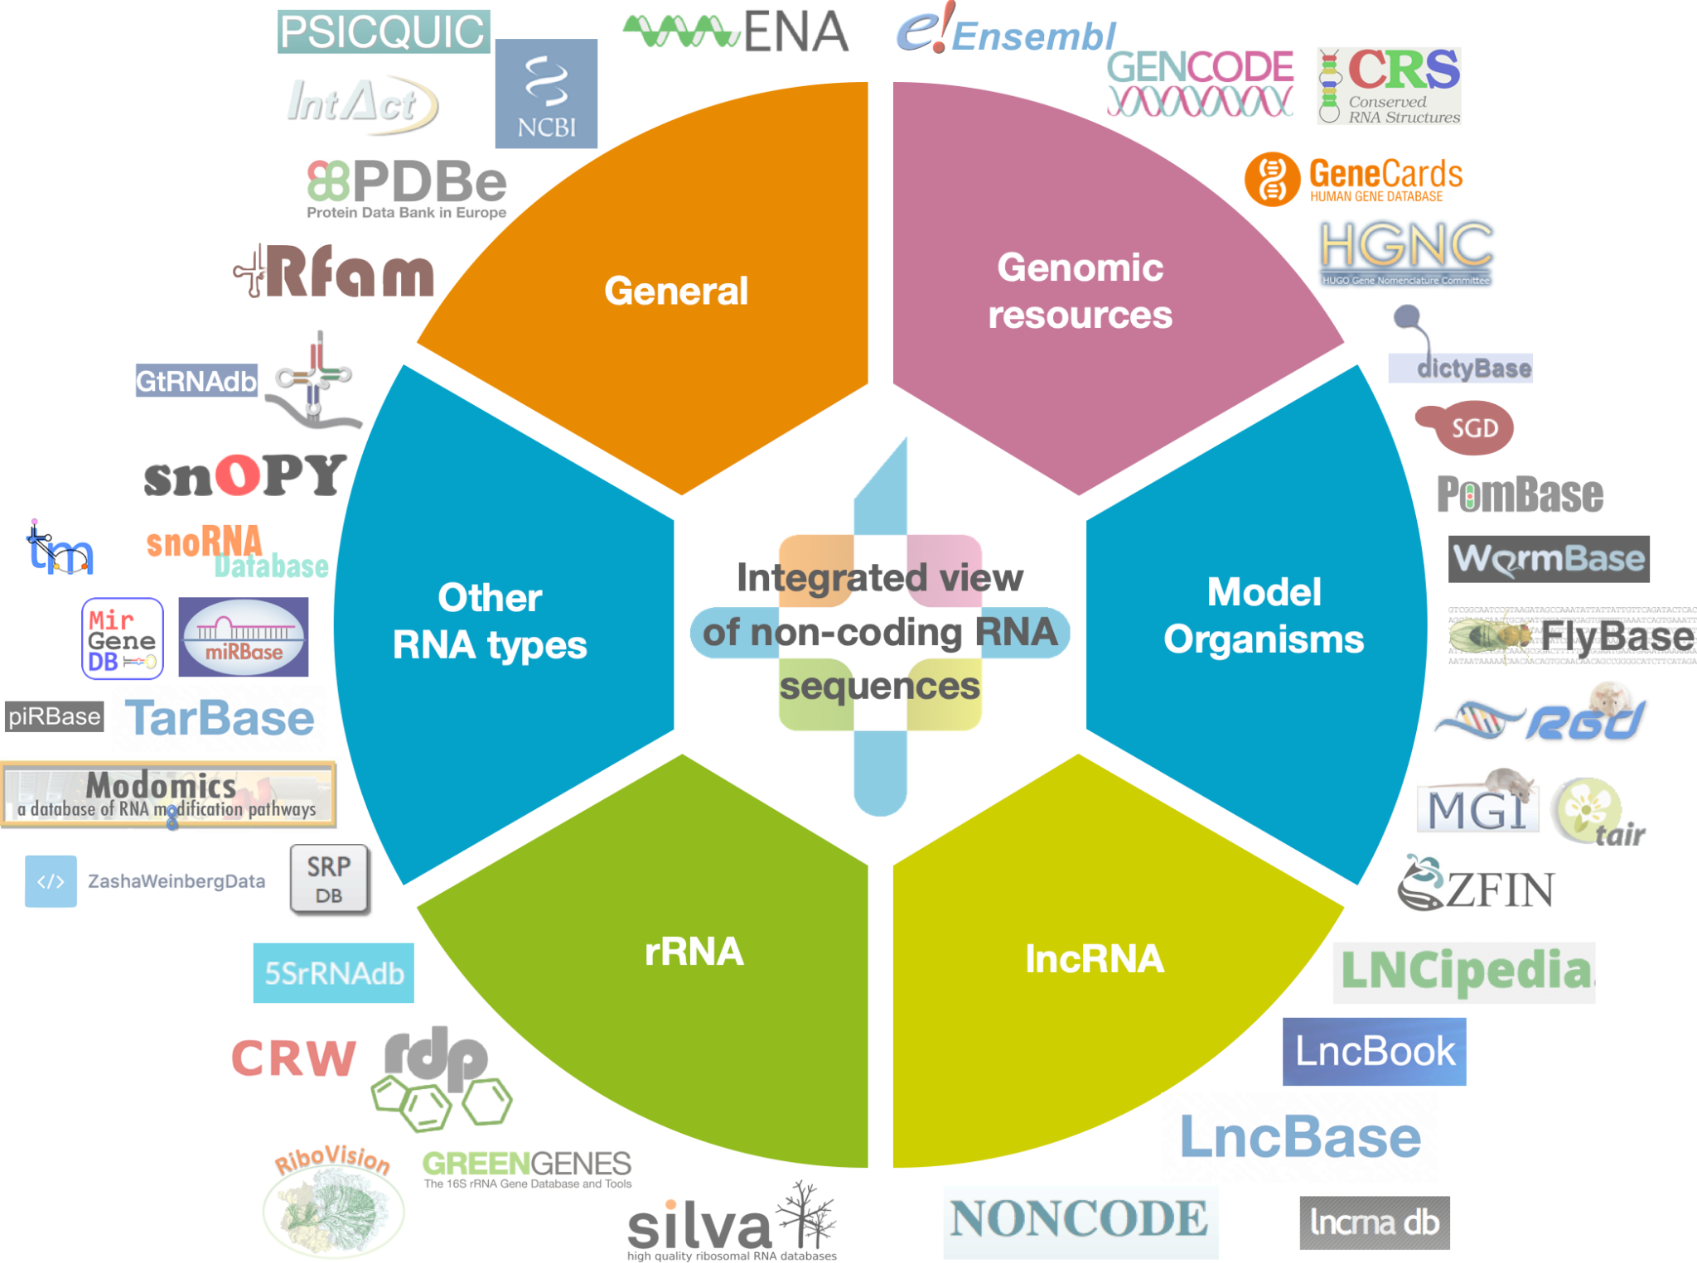

Slide 17
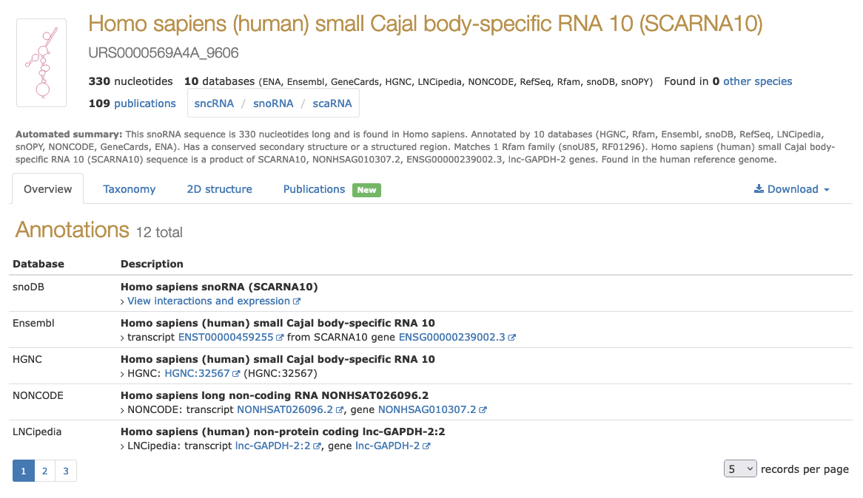

Slide 18
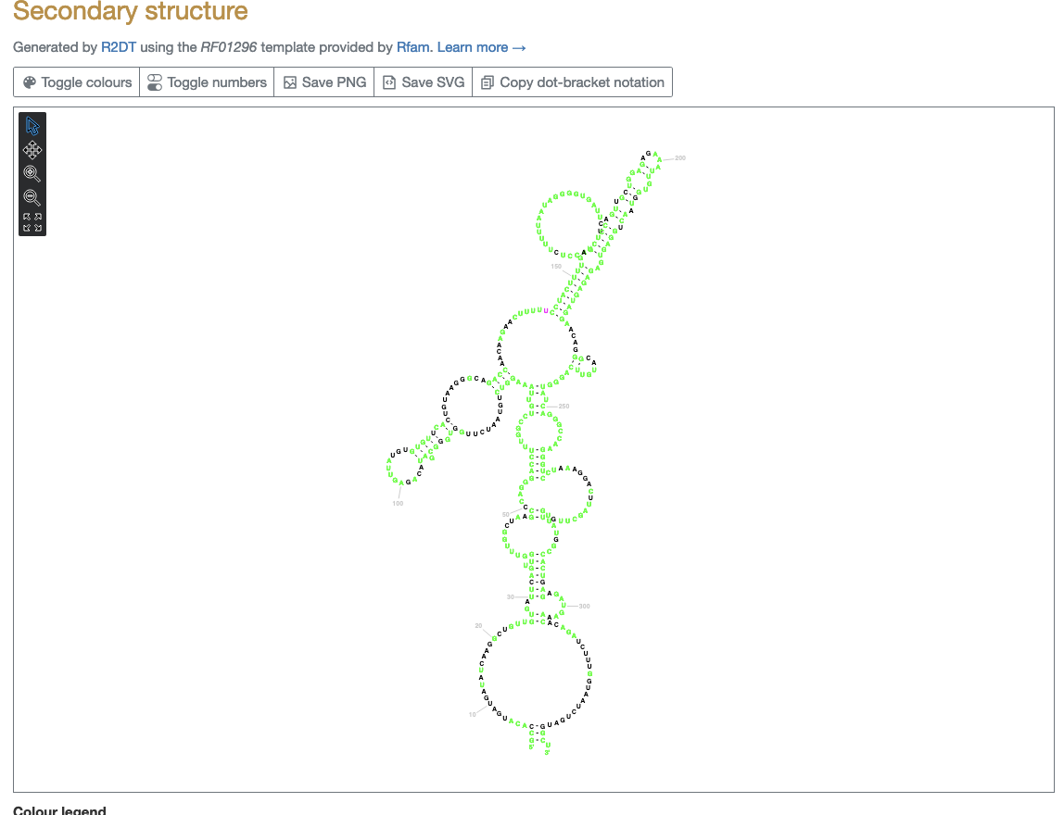
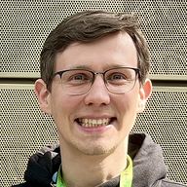
RNAcentral provides R2DT secondary structures
Anton Petrov

Slide 19





RNAcentral provides several tools
01
Retrieve large amounts of data
FTP Archive
02
Access the latest data programmatically
REST API
03
Query the data using SQL syntax
Public database
04
Search for similar sequences
Sequence search
05
Connect scientific literature with RNAcentral
LitScan

Slide 20
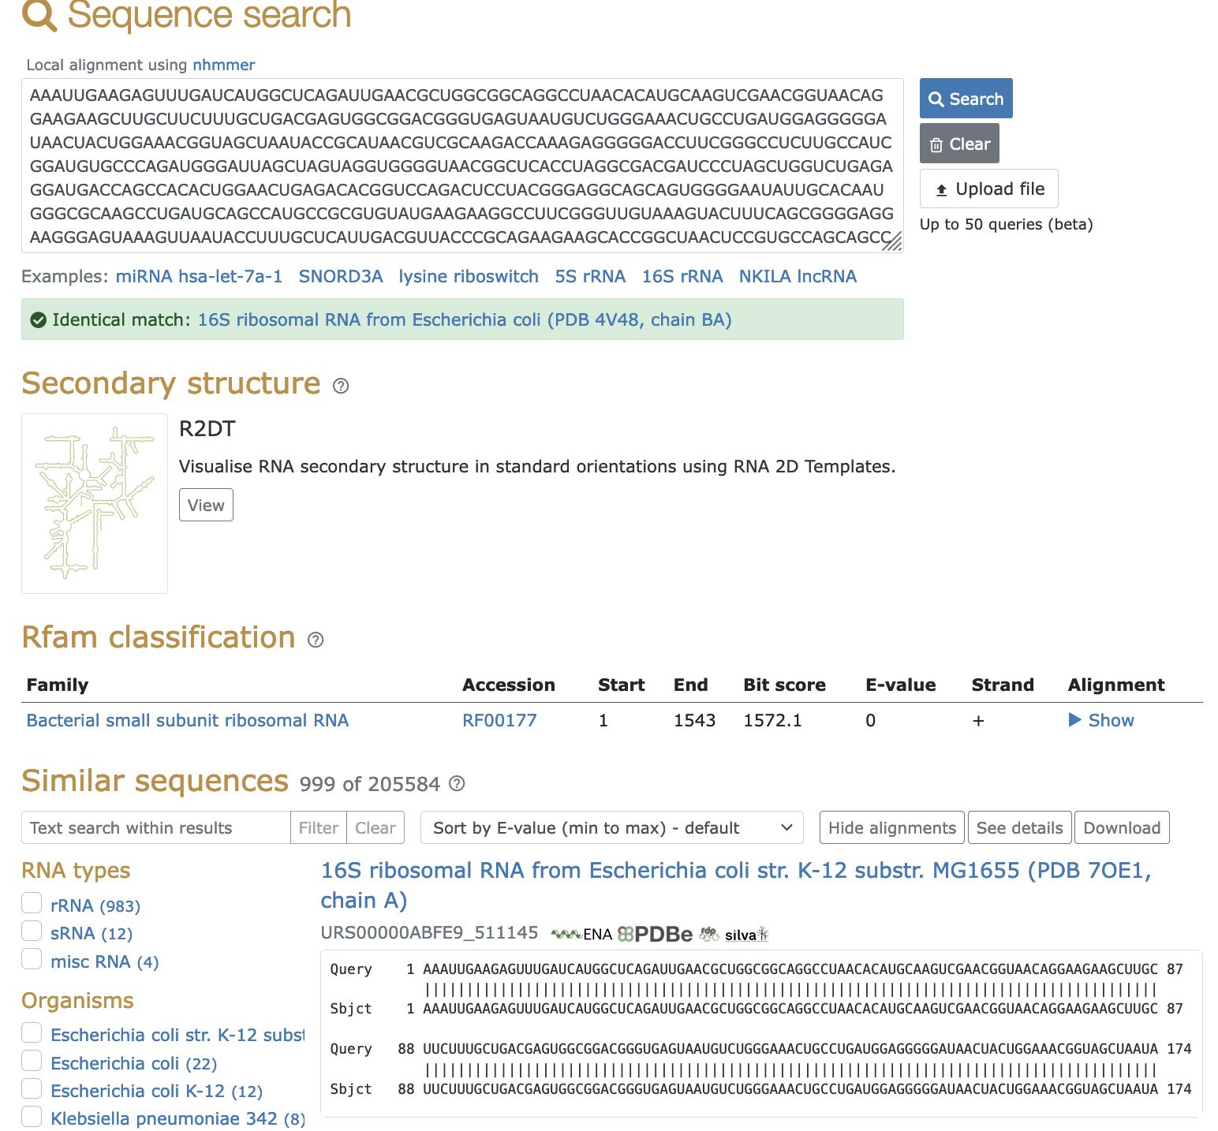
RNAcentral has a powerful sequence search

Slide 21
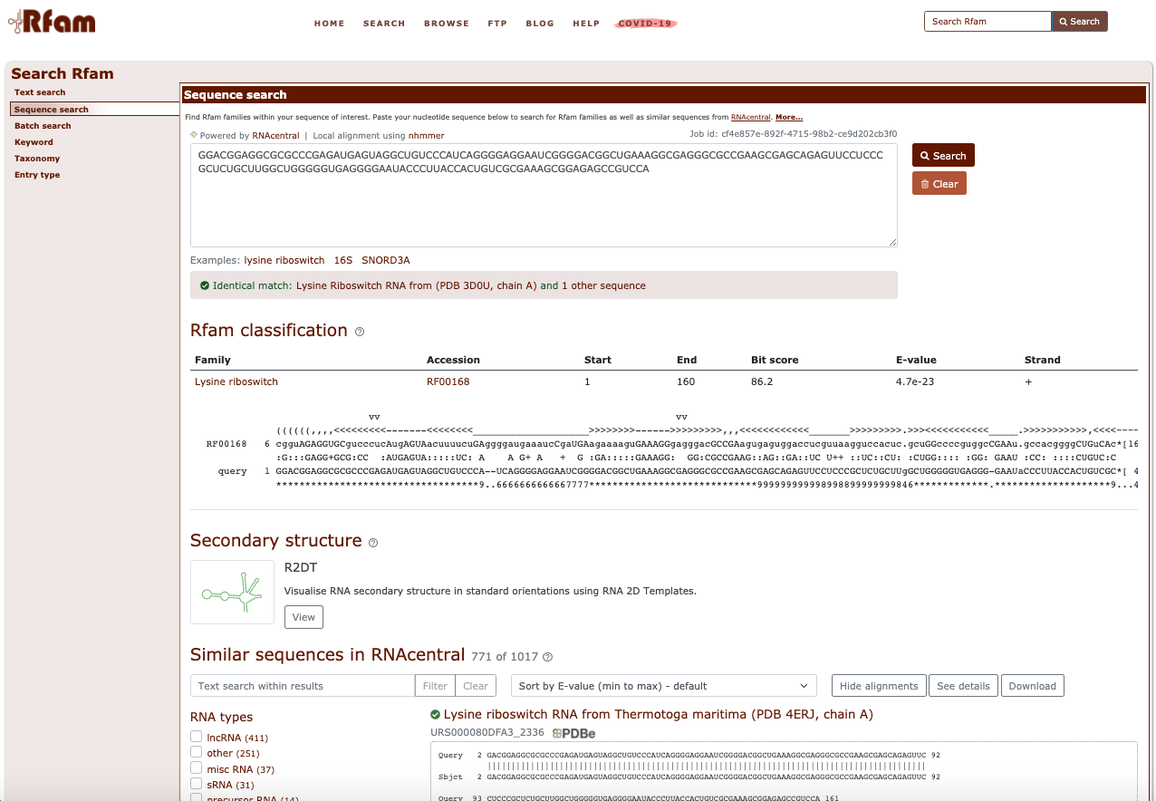
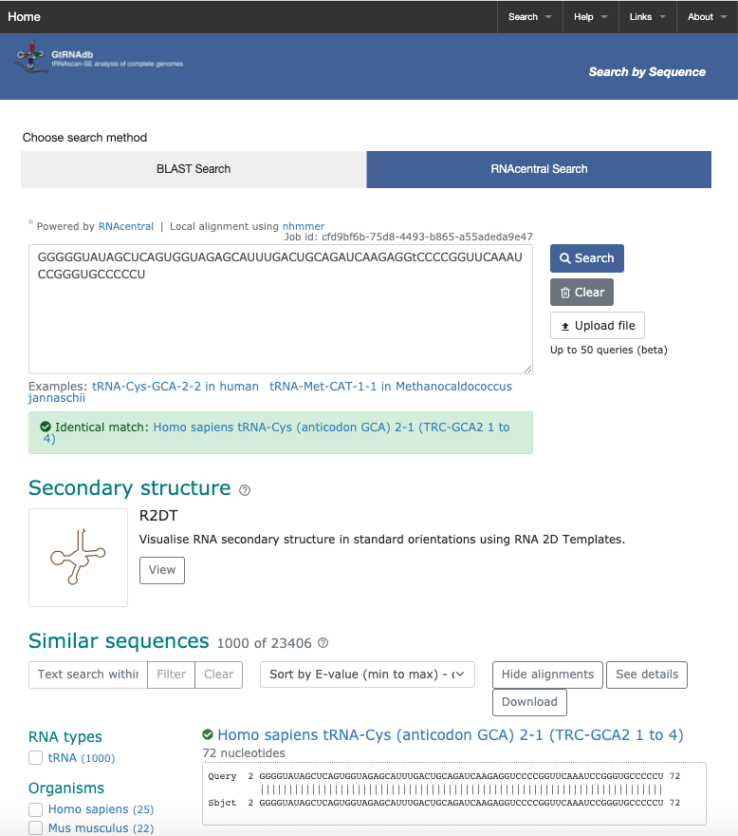
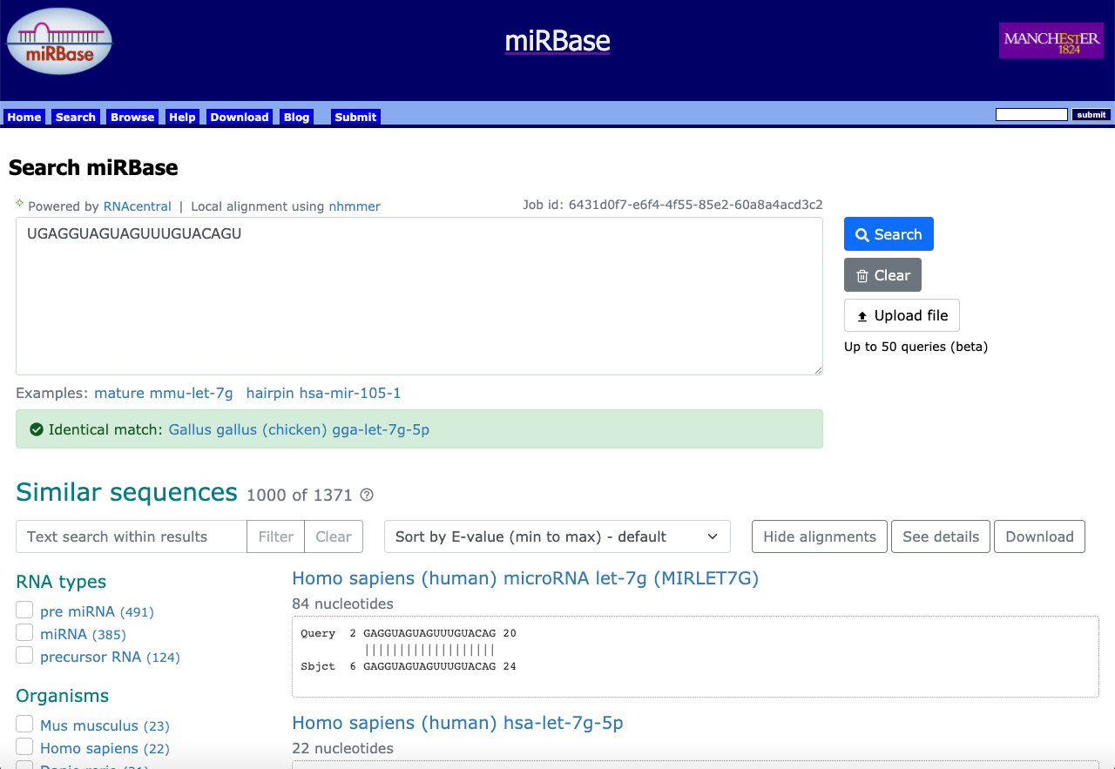
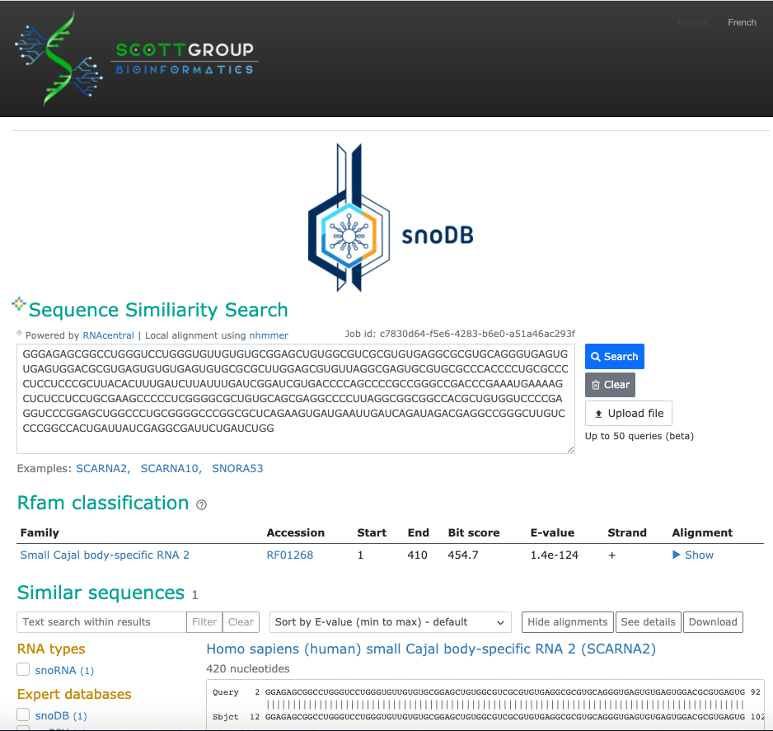
Sequence search is embedded in other sites

Slide 22
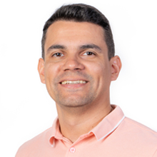
LitScan is RNAcentral’s text mining pipeline
01
04
02
Carlos Ribas
03

Slide 23
How does LitScan work
Select terms
01
Search articles
Expert database provide thousands of terms
7.8M full text articles in Europe PMC
04
02
Make results available
Extract data
EBI Search + embeddable component
03
Get a sentence with the term and other data

Slide 24
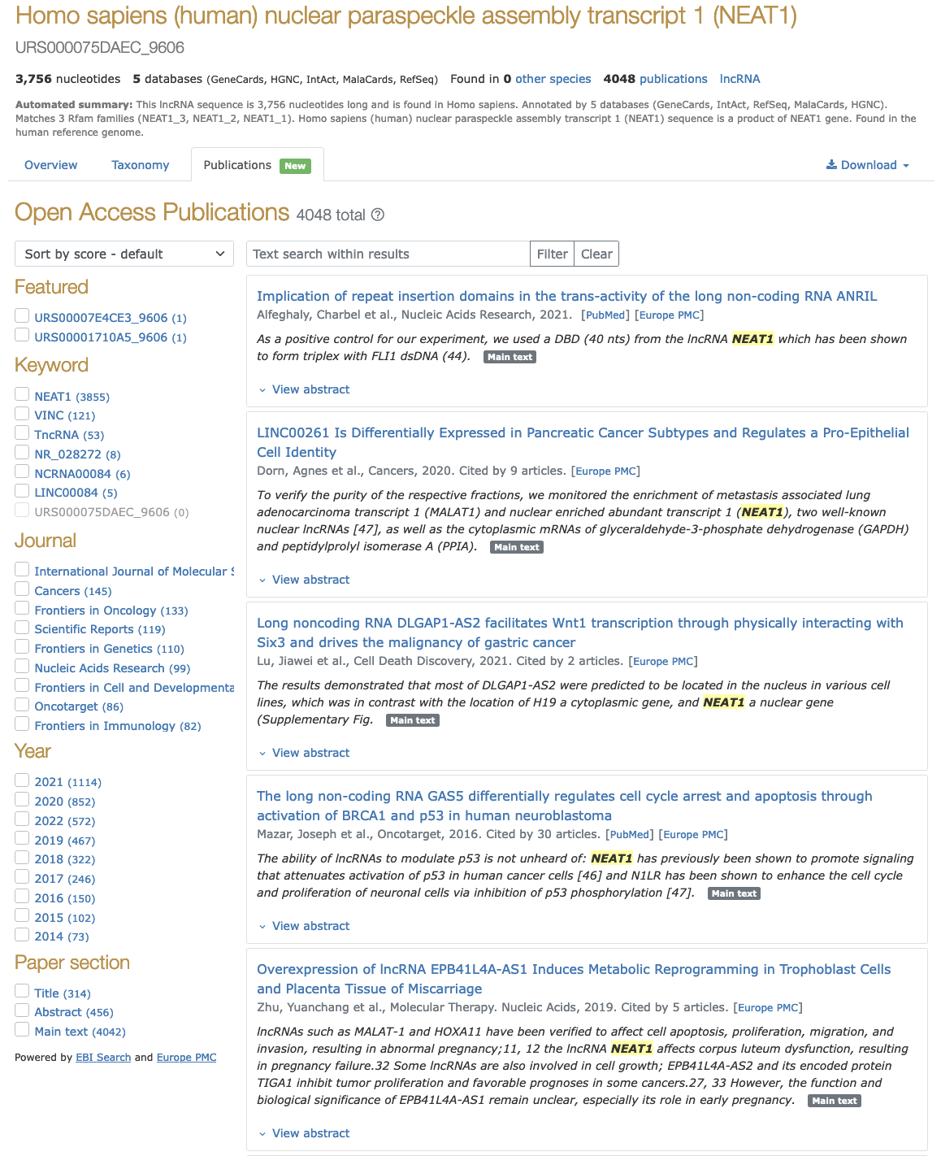

Slide 25
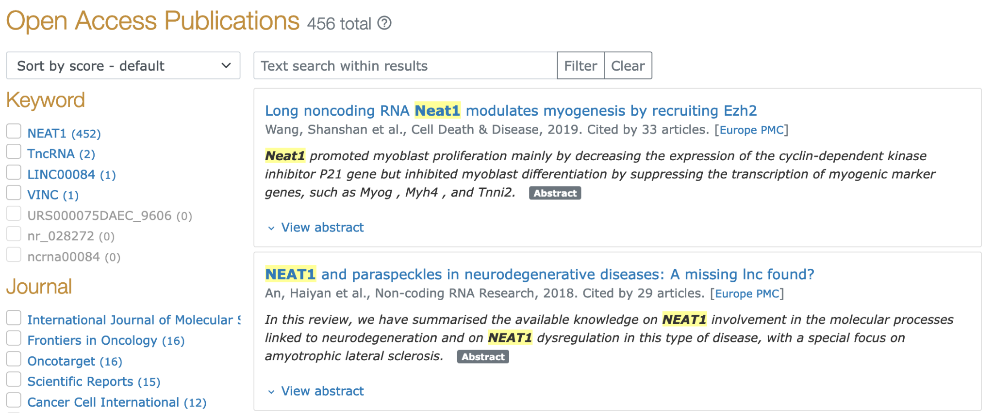

Slide 26
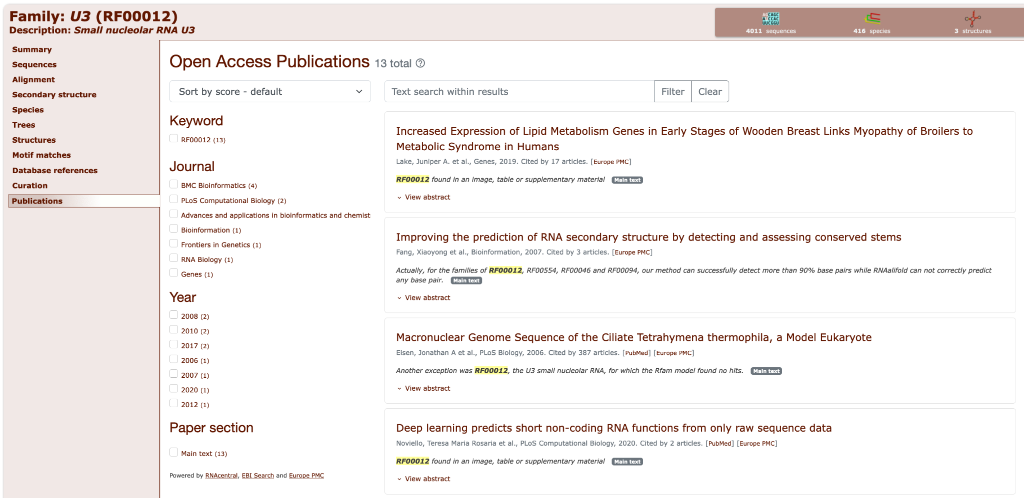
LitScan is an embeddable widget

Slide 27

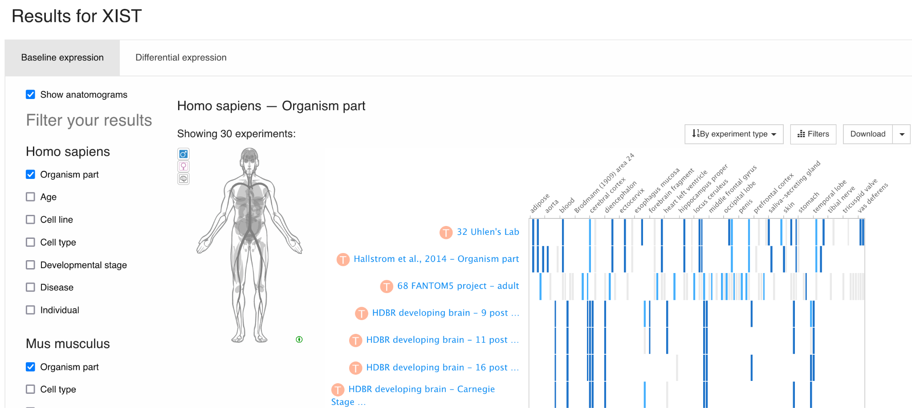

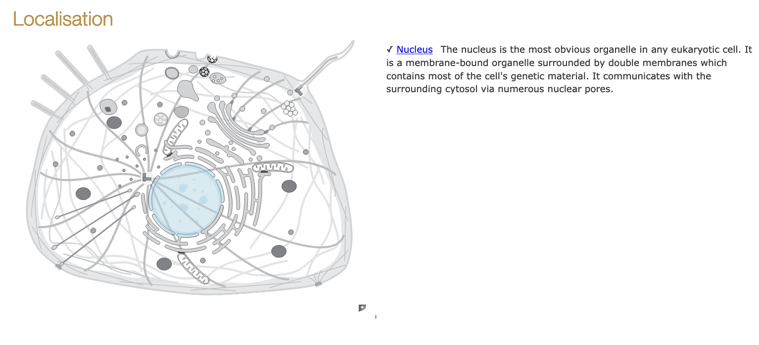
RNAcentral is aiming toward biological context
Andrew Green

Slide 28



Thank you
Alex Bateman
Anton Petrov
Eric Nawrocki
Nancy Ontiveros
Emma Cooke
Rfam collaborators:
Elena Rivas
Sam Griffiths-Jones
Prof Manja Marz
Kevin Lamkiewicz
Sandra Triebel
RNAcentral Consortium

