Slide 1
RNA motif models with structure: PRIESSTESS
Quaid Morris
August 9th
RNA Benasque 2022

Slide 2
Outline
Intro:
  ”Interesting” RNA-protein interactions
  RNA-protein in vitro binding assays
  “Biophysically-inspired” models of RNA-protein interaction
PRIESSTESS, a new RNA sequence-structure model
  Method description
  Generalization results
  Stuff we tried that didn’t work

Slide 3
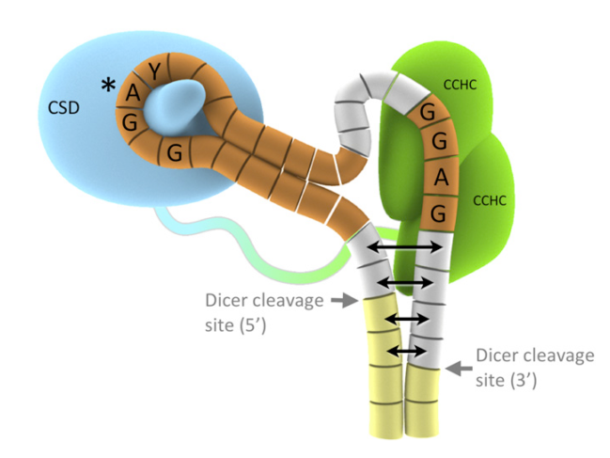
More complex RNA interaction
Lin28
pre-let-7
Adapted from (Nam et al, Cell 2011)

Slide 4
Inferring motifs for “hard” RBPs
Co-crystal of SLBP with target
Tong lab (Science 2013),
Hall lab (PNAS 2014)
(Battle, Doudna RNA 2001)
Constructed by aligning histone mRNAs

Slide 5
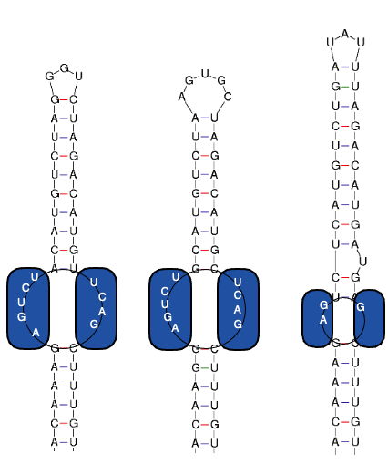
LARP6 binds both sides of an internal loop
COL1A1
5’ UTR
COL1A2
5’ UTR
COL3A1
5’ UTR
Derived from Zhang et al. (2016)

Slide 6
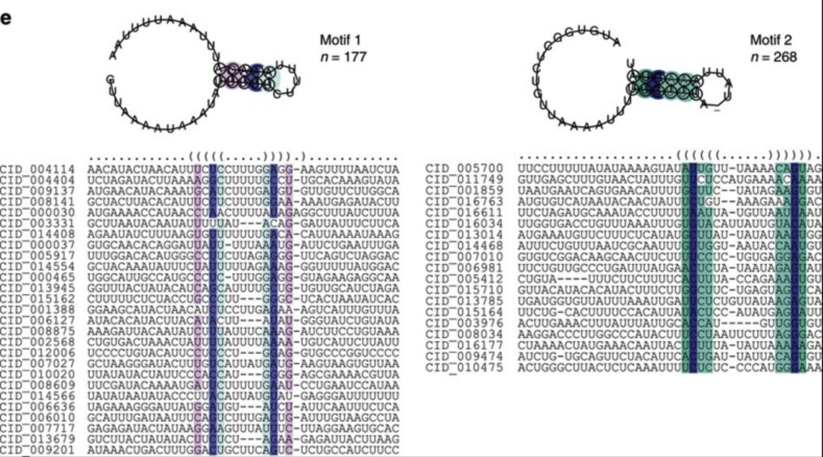
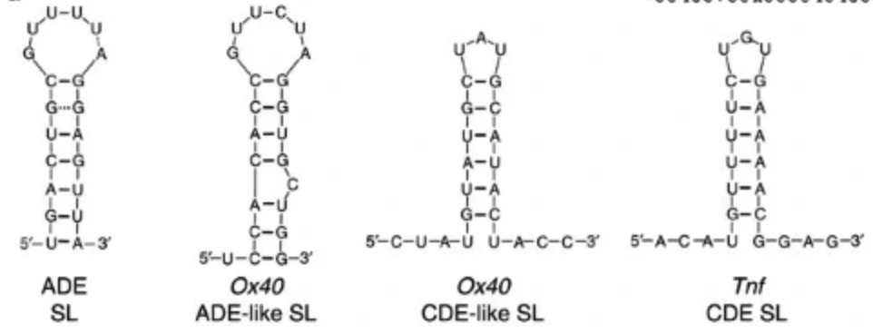
Roquin-1 binds two different stem-loops
Derived from Murakawa et al. (2015) and Janowski et al (2016)

Slide 7
Take-aways
Most RBPs don’t recognize RNA structures, they bind “parts of structures” or ”the absence of structure”
The RNA sequences they recognize can be non-local (e.g. LARP6), and in different structural contexts (U1A)
They can bind multiple motifs (Roquin)

Slide 8
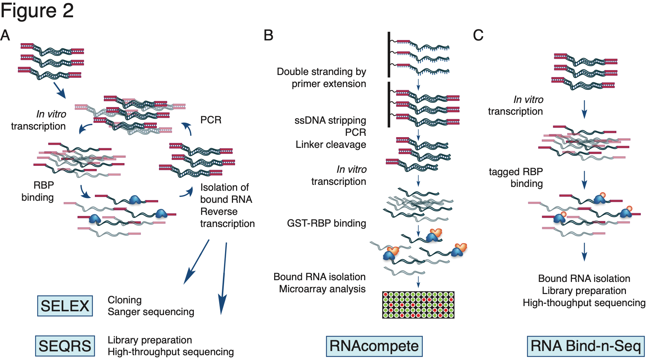
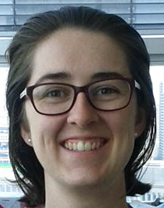
Data source: In vitro RBP binding assays
SELEX
RNAcompete
RNA Bind-n-seq (Burge lab)
70 RBPs
+HTR-SELEX: ~100 RBPs
Jolma et al 2020
Laverty et al 2022?
~400 RBPs
Ray et al, 2013
Sasse et al, 2023?
Dr Kate Cook
~80 RBPs
Dominguez et al, 2018
(adapted from Cook et al, Brief Funct Genomics 2015)

Slide 11
1.5d RNA structure representations
BEAR/BEAM: (Pietrosanto et al, NAR 2016) Helmer-Citterich & Ferre groups

Slide 12
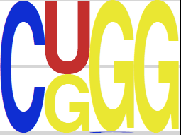
1.5D “RNA” motif models
=
base identity
×
Structural context preference
Binding site score
PSSM
MEMERIS (2006) [Backofen]
“Hackermüller/Stadler model”
{
1 if preferred context
0 otherwise
×

Slide 13
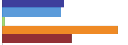
1.5D “RNA” motif models
=
base identity
×
Structural context preference
Binding site score
PSSM
MEMERIS (2006) [Backofen]
“Hackermüller/Stadler model”
{
1 if preferred context
0 otherwise
×
Hairpin loop
Bulge loop
Multiloop
External loop
Paired
RNAcontext (2010)
[Kazan / Morris / Hughes]
×
0 0.5 1
Relative preference

Slide 14
1.5D “RNA” motif models
=
base identity
×
Structural context preference
Binding site score
PSSM
MEMERIS (2006) [Backofen]
“Hackermüller/Stadler model”
{
1 if preferred context
0 otherwise
×
Hairpin loop
Bulge loop
Multiloop
External loop
Paired
RNAcontext (2010)
[Kazan / Morris / Hughes]
×
0 0.5 1
Relative preference
SmartIV (2017) [Mandel]

Slide 15
1.5D “RNA” motif models
=
base identity
×
Structural context preference
Binding site score
PSSM
MEMERIS (2006) [Backofen]
“Hackermüller/Stadler model”
{
1 if preferred context
0 otherwise
×
Hairpin loop
Bulge loop
Multiloop
External loop
Paired
RNAcontext (2010)
[Kazan / Morris / Hughes]
×
0 0.5 1
Relative preference
SmartIV (2017) [Mandel]
RNAcompete-S
[Morris /Hughes]
×
See also: BEAM (Pietrosanto et al, NAR 2016), RCK (Orenstein, Berger 2016), AptaTRACE (Dao,…, Przytycka, 2016) and (Lin, Bundschuh, NAR 2015)

Slide 16
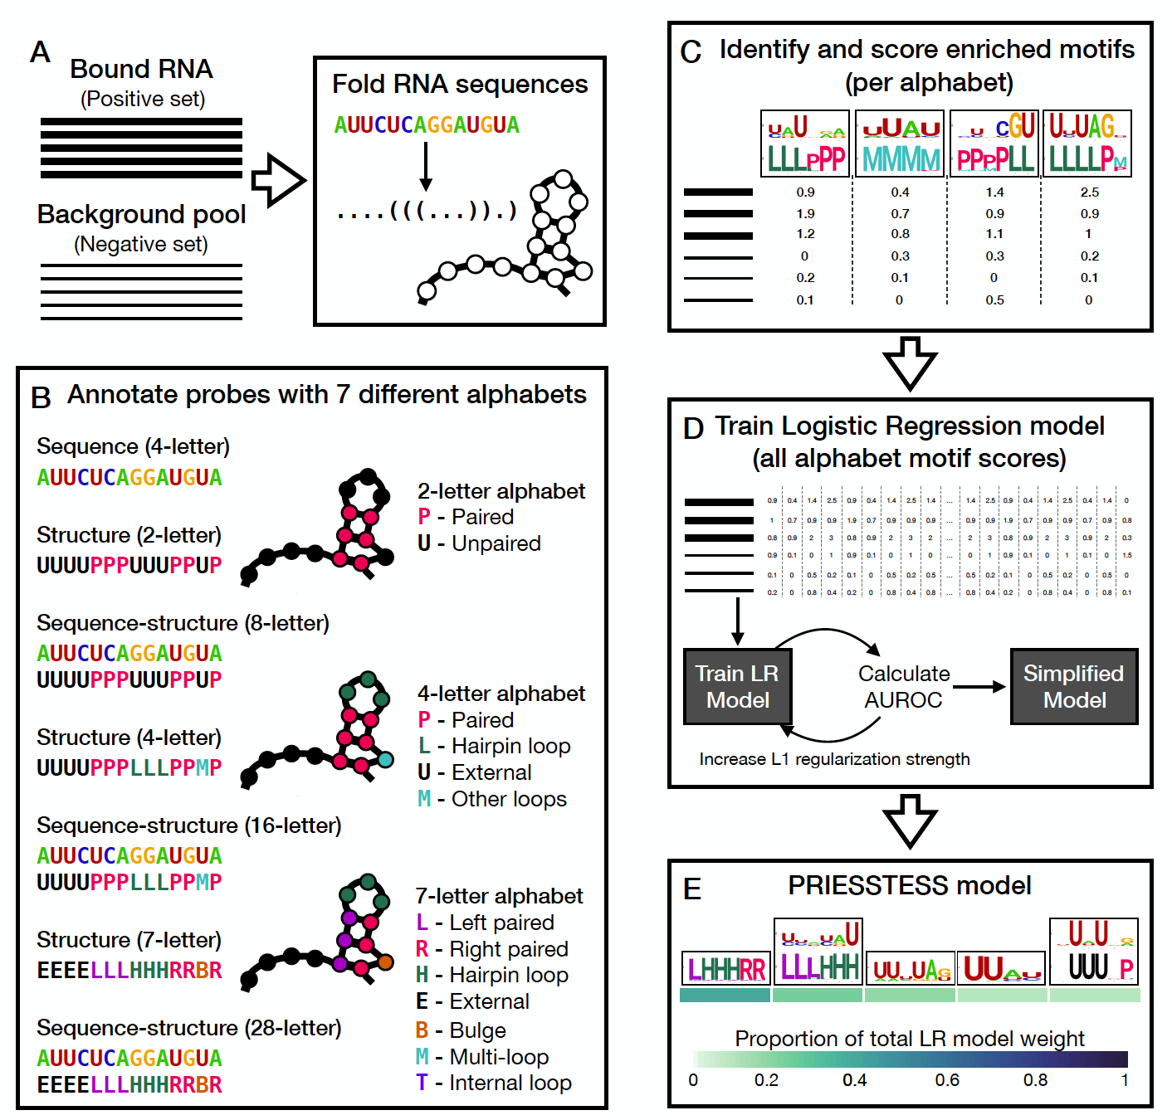
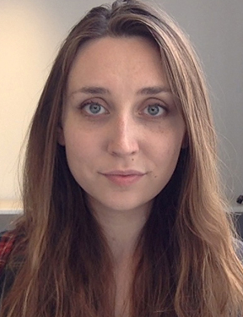
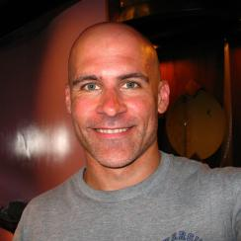
PRIESSTESS method for fitting RNA sequence & structure models
Dr Arttu Jolma
Kaitlin Laverty
Prof. Tim Hughes
(Utoronto)

Slide 17
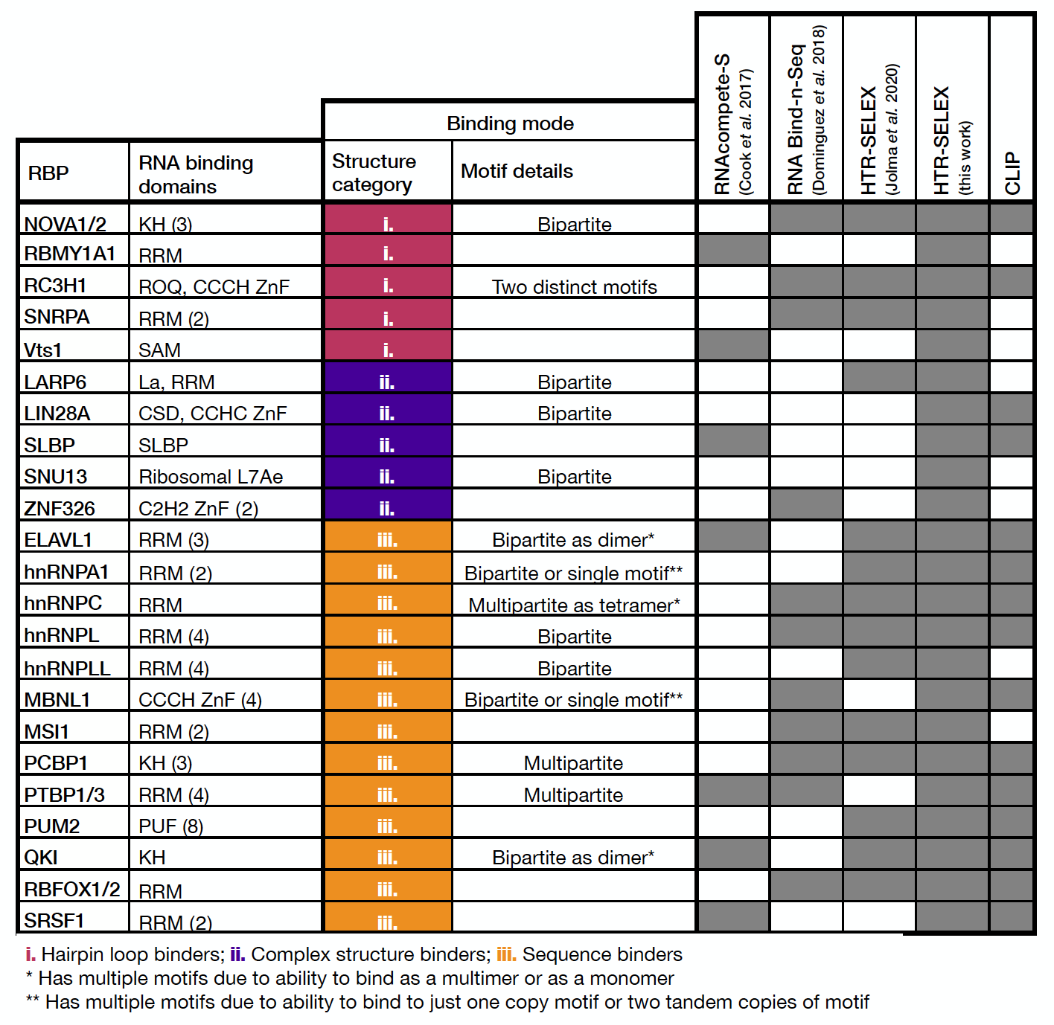
Curated list of “hard” RBP motif finding & generalization tasks
w/ new HTR-SELEX data

Slide 18
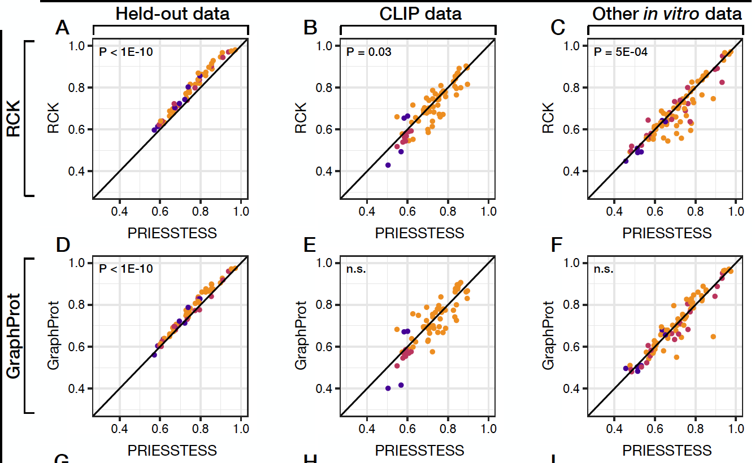
Higher capacity motif methods better on held out data, from same assay
But don’t generalize to new data any better

Slide 19
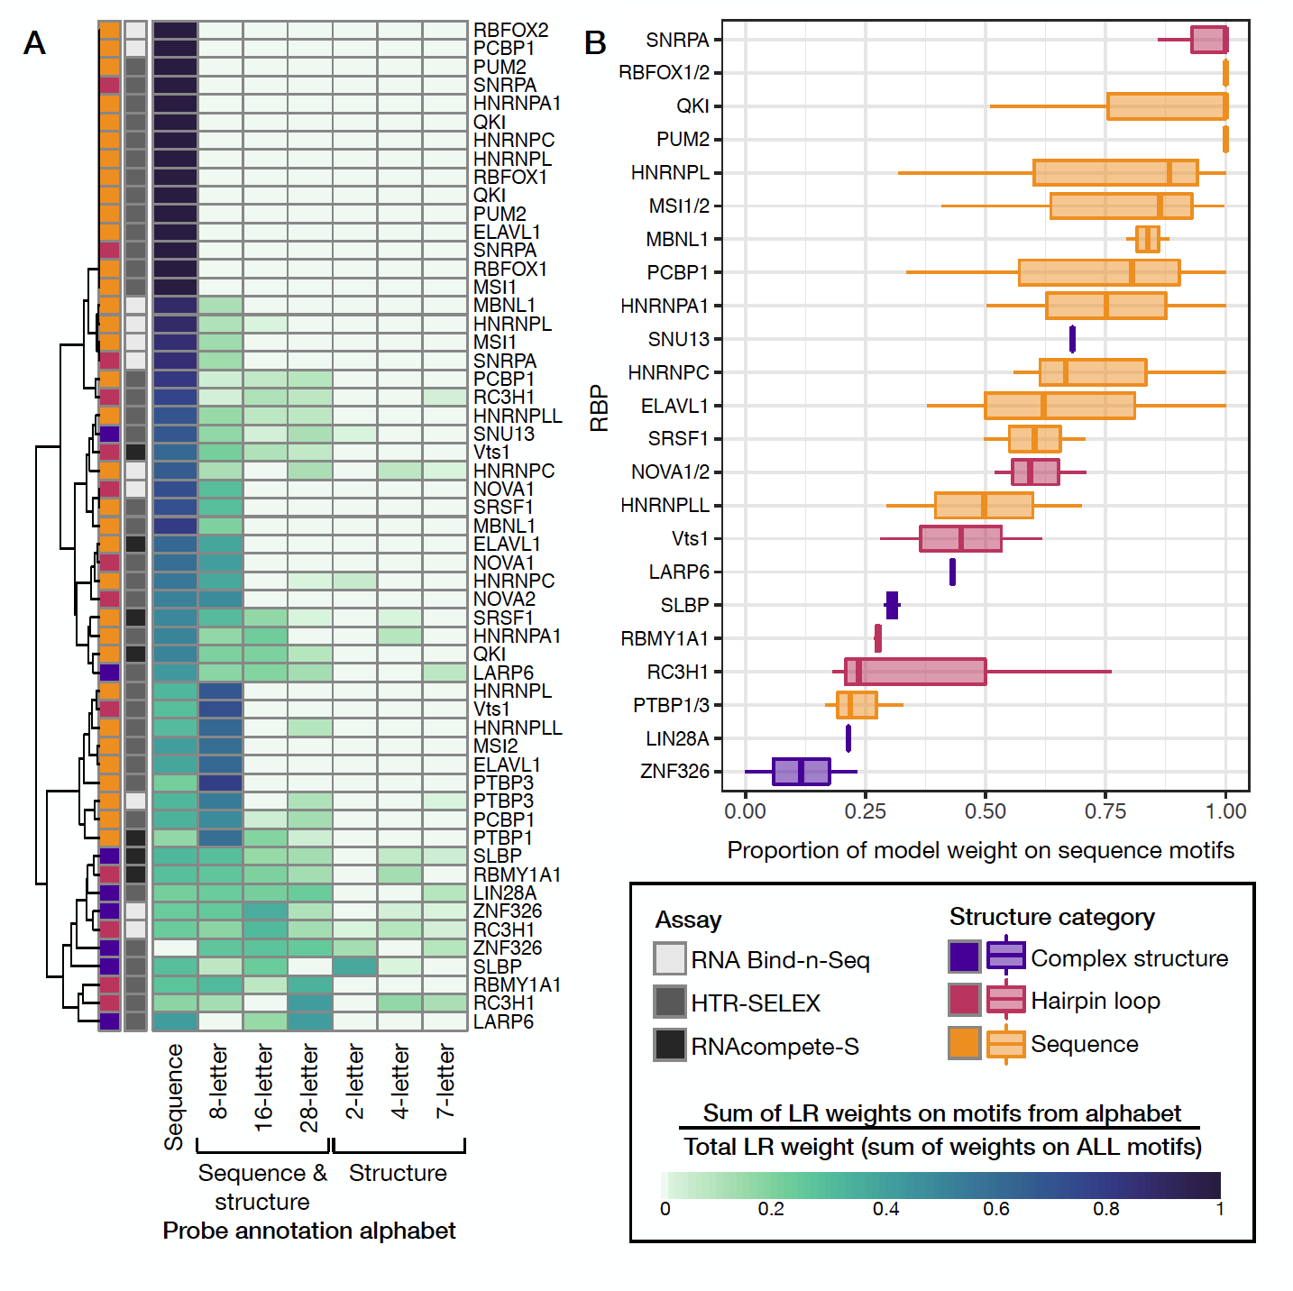
PRIESSTESS identifies which RBPs have structural preferences, with one notable exception (SNRPA/U1A)

Slide 20
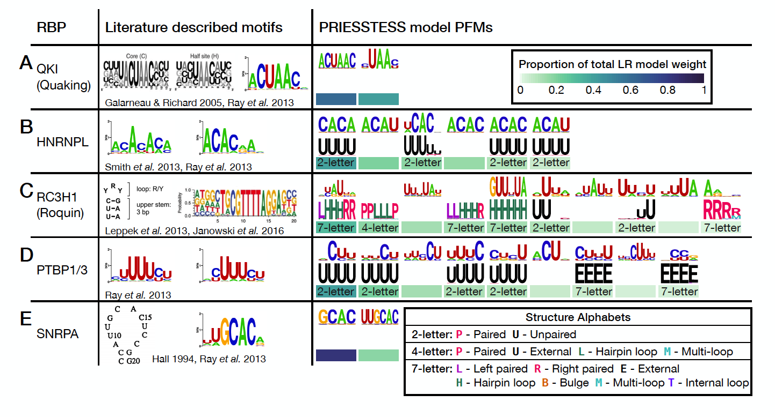
PRIESSTESS motif model examples

Slide 21
PRIESSTESS motif model examples
RBP
Literature
PRIESSTESS model

Slide 22
PRIESSTESS motif model examples

Slide 23
PRIESSTESS summary
Framework for fitting RNA sequence-structure models
Readily interpretable, generalizes as well as, or better, than more complex, less interpretable methods
Reproduces known structural preferences
HMMs don’t help

Slide 24
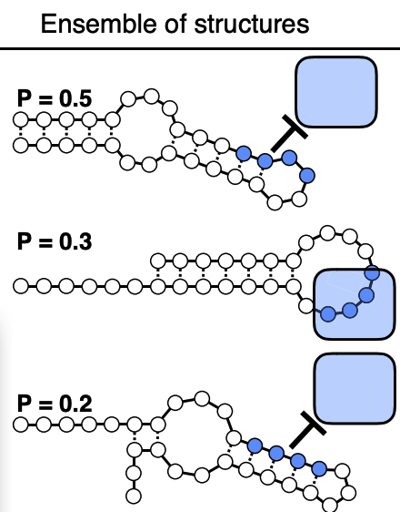
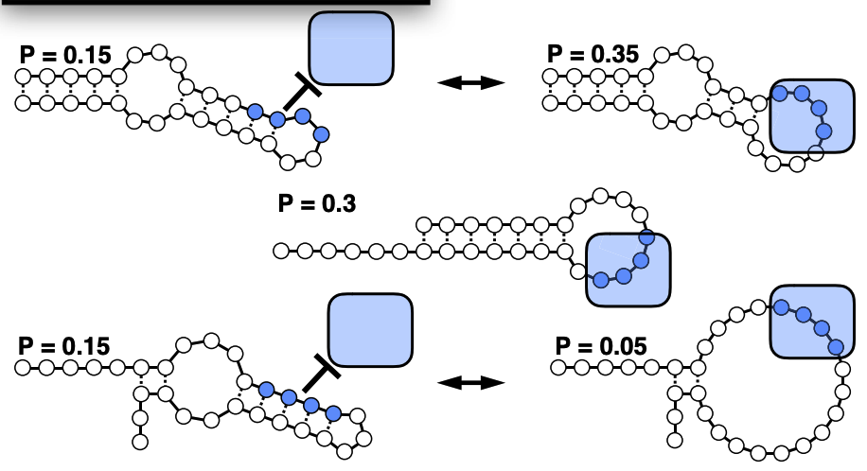
Better biophysical models of RNA-protein interaction
RNA structure not altered by RBP
RNA structure altered by RBP
VS
Hackermüller-Stadler model
Probability of binding = 0.3
RNA-protein ensemble model
Probability of binding = 0.7
See Ralf Bundschuh, OSU

