Slide 1
Immunostimulatory viral-like features
in genomic repeats
Simona Cocco
Andrea Di Gioacchino Ecole Normale Supérieure, Paris
Rémi Monasson
Benjamin Greenbaum MSKCC- New York
Petr Sulc Arizona State University USA
Benasque, Aug 12th 2022

Slide 2
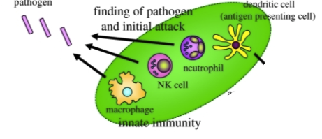

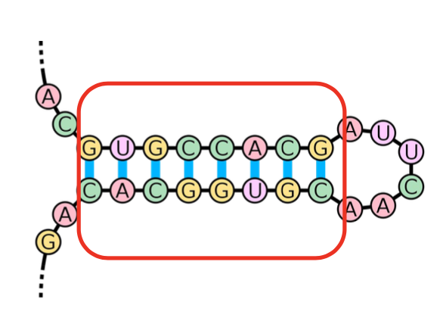

Innate immune system recognizes pathogens associated molecular patterns (PAMPs)
Pathogen Recognizing Receptors PRR
(e.g.Toll receptors , RIG-I-like helicases (eg. MDA5,ZAP ).
recognize Parhogen Associated molecular patterns (PAMP)
anomalous RNA/DNA motif usage, dsRNA, etc…
CGAAAUUGA-CG-AUAACCGACG
cytokines
(Type I IFN)
Notation: CG->CpG
Other PAMPS: eg: -UUUU- Long dsDNA: .
Notes:
The Innate imm
Patterns typical of pathogens not present in the hosts.
Cytokines: small proteines released by the cells og the immune system which trigger inflammation and respond to infections.
Type I IFNs are the key cytokines that mediate antiviral responses. Secreted IFNs bind and activate the type I IFN receptor mediate both innate immune responses and the subsequent development of adaptive immunity to viruses ( induce maturation of dendritic cella, enhance antibody responses in B cells)
the subse- quent development of an adaptive immunity triggered by the production of T helper cells one and pro-inflammatory cytokines.

Slide 3
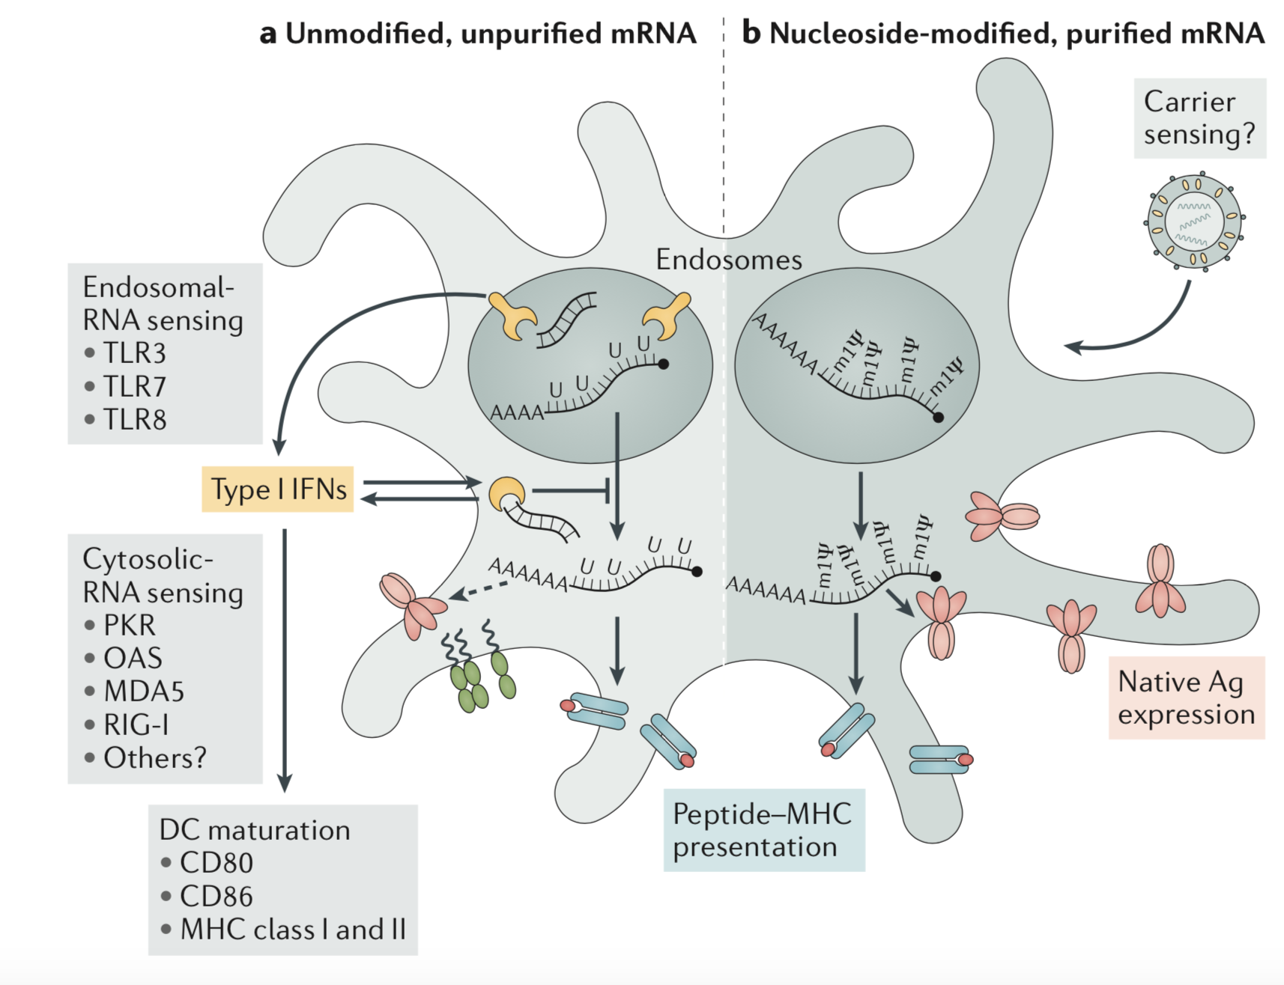
Innate immune sensing of mRNA vaccines
mRNA vaccines- a new era in vaccinology,N. Pardi et al. M. Nature Review 2018
Notes:
The incorporation of chemically modified nucleosides, such as pseudouridine, 1-methylpseudouridine, 5-methylcytidine and others, into mRNA transcripts, usually to suppress innate immune sensing and/or to improve translation. Also optimization of codon usage is important; sometimes CpG rich sequences can be used as adjuvants to hrlp the development of the adaptive immune response triggered by the production of T helper-cell and pro-inflammatory citokines.

Slide 4
Plan of the talk
Study evolution of CpG motifs (through the definition of CpG force) in viral RNA adapting to the Innate human system following jump from different hosts (Spanish flu and covid19 virus)
Quantify propensity to form double strand RNA through definition of ds-force
Identify anomalous (PAMP-like) RNA repeats with large CpG or ds forces in human genome
Notes:
Take a detour to expalin a formalism introduced on influenza virus to characterize the fact trhat some moti
Importance of some patterns in viral sequences which trigger the Innate immune system leading to recognition and the

Slide 5
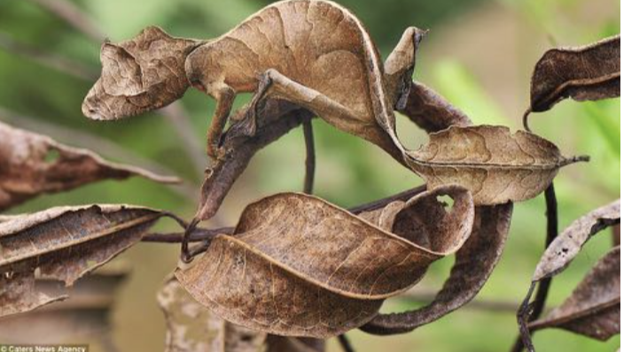
Statistics of nucleotidic motifs in genomes
Counting the number of dinucleotides (UpU, CpG..)
motifs and compare to single nucleotides occurrence.
Same for trinucleotides.. [Karlin, et. al., Ann Rev Micro (1994) 48: 619.]
CpG under-represented in mammals,
Pervasive CpG suppression in mammals ssRNA viruses: Human RNA
viruses mimic Human RNA . [Greenbaum, et. al, PLoS Path, 2008]
( courtesy of B. Greenbaum)

Slide 6
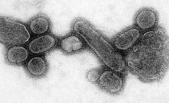
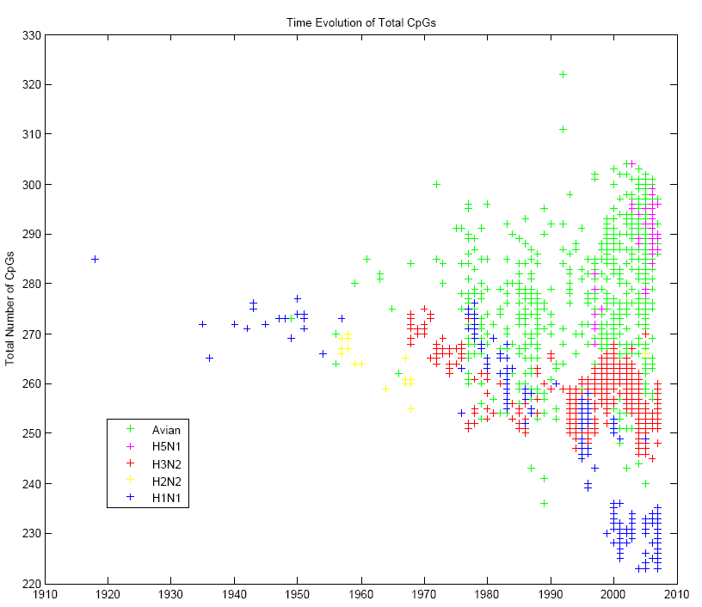
CpG Evolution in Influenza virus
Avian: 969 Birds sequences
4 strains that likely jumped from
avian host to human:
Human sequences:
H1N1: (1918) 674
H2N2:(1957) 24 .
H3N2: (1968) 1499
H5N1 : (1996) 65 (Hong Kong)
Birds have a different immune system, not responding to sequences with large number of CpG motifs
Virus has adapted in Humans to avoid the human immune system
Spanish flu
Total number of CpG
year
Greenbaum, et. al, PLoS Path, 2008
Notes:
H3 and H2 are reassortants with 3 and 2 avian segmants

Slide 7
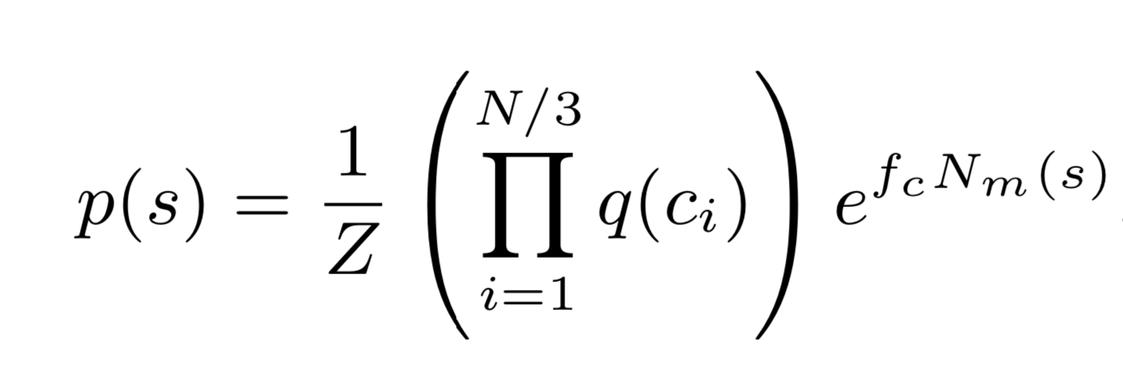
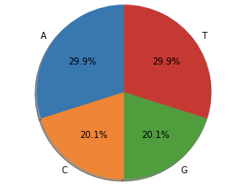
CpG Force on a RNA sequence
L
( n_{i} )
CG
CG
Null model /Prior Information
CpG Selective Force
Reference Nucleotide bias :
f_{CG} such that the <N_{GC}>=N^{obs}
A
U
f_{CG}>0: more
f_{CG}<0: less
CpG than expected
with null model
C
G
B. Greenbaum, S.C, A. Levine, R.M, PNAS 2014
Notes:
For each sequence we compute the CG force such that the observed number of CpG in the sequence is equal to the average number of CpG according to the probability of a sequence

Slide 8
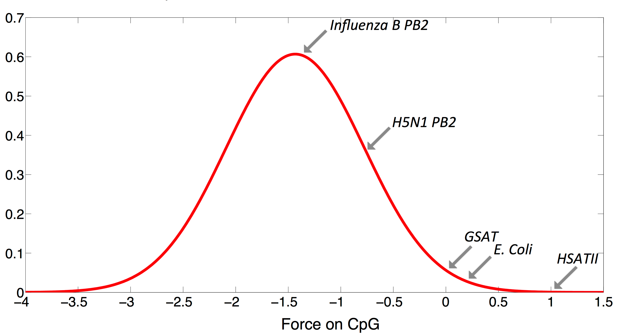
Human and Viral GpG Forces
SARS-Cov2
H1N1 1918
Distribution from Gencode
EBV
Type 1 Interferon
gene family
Genomic repeats
f_{CG}

Slide 9
Human and Viral GpG Forces
SARS-Cov2
H1N1 1918
Distribution from Gencode
EBV
Type 1 Interferon
gene family
f_{CG}

Slide 10
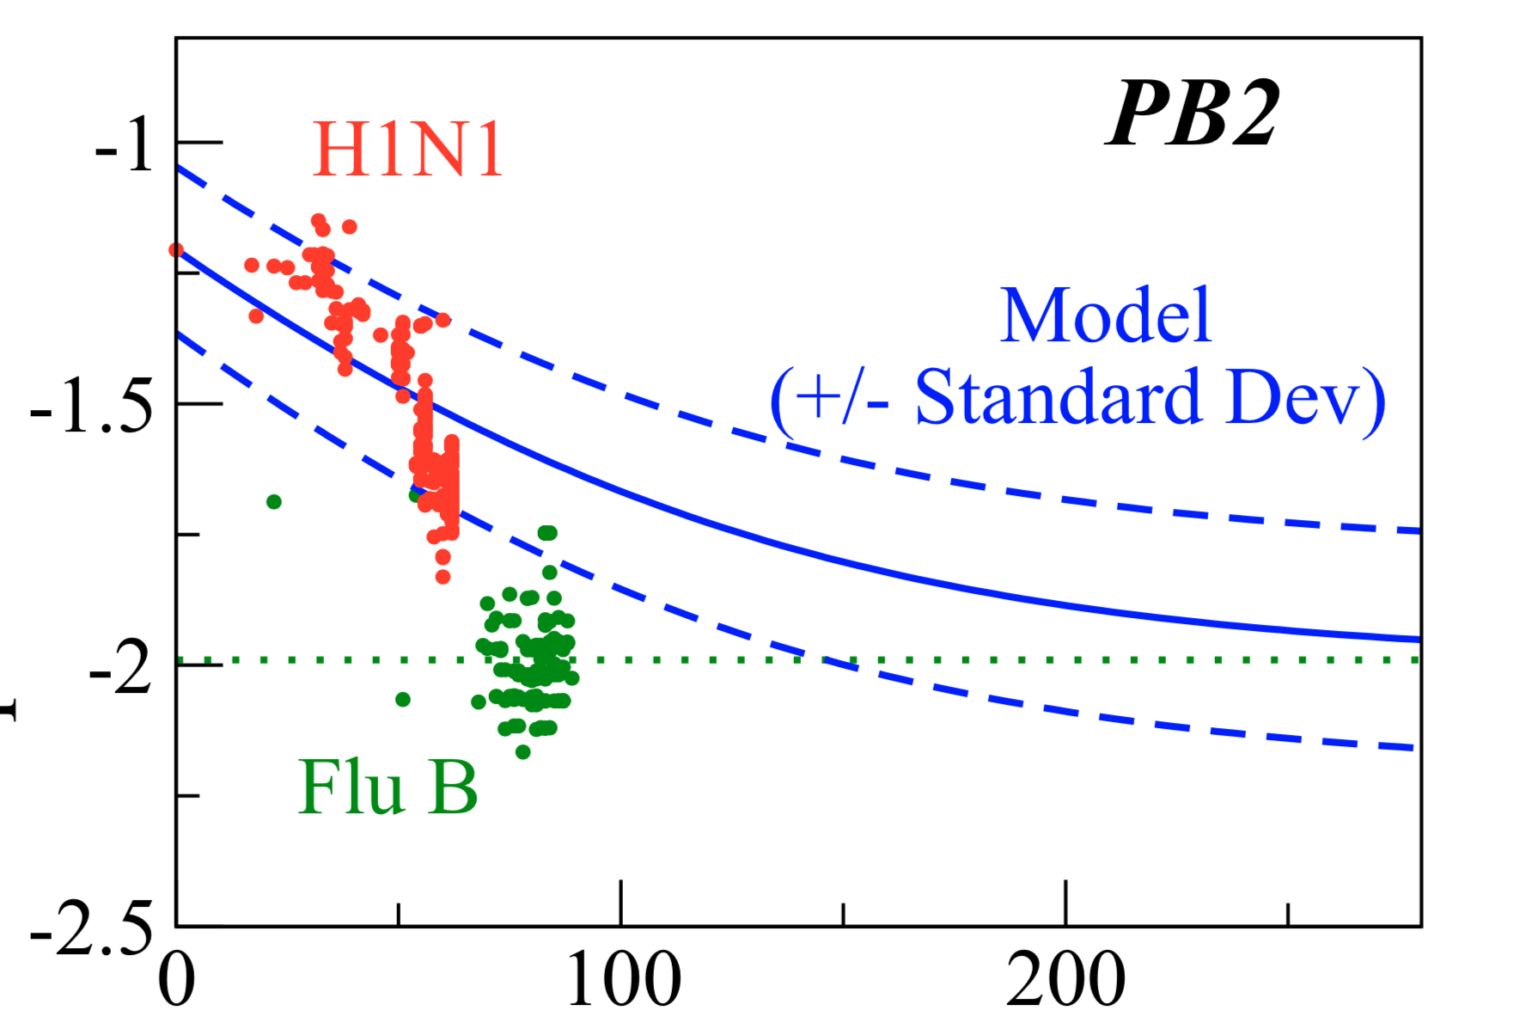
The CpG force captures evolution in CpG number through synonymous mutations
Spanish flu
dN _{CG}(t)
𝛕
= - (f_{CG} (N(t)) -f_{eq})
d t
Total Number of CpG
years
Time to become ‘self’ is ~ 100-300 years
B. Greenbaum, S.C, A. Levine, R.M, PNAS 2014

Slide 11
Human and Viral GpG Forces
SARS-Cov2
Distribution from Gencode
EBV
Type 1 Interferon
gene family
f_{CG}
Mettere H1N1 al posto..

Slide 12
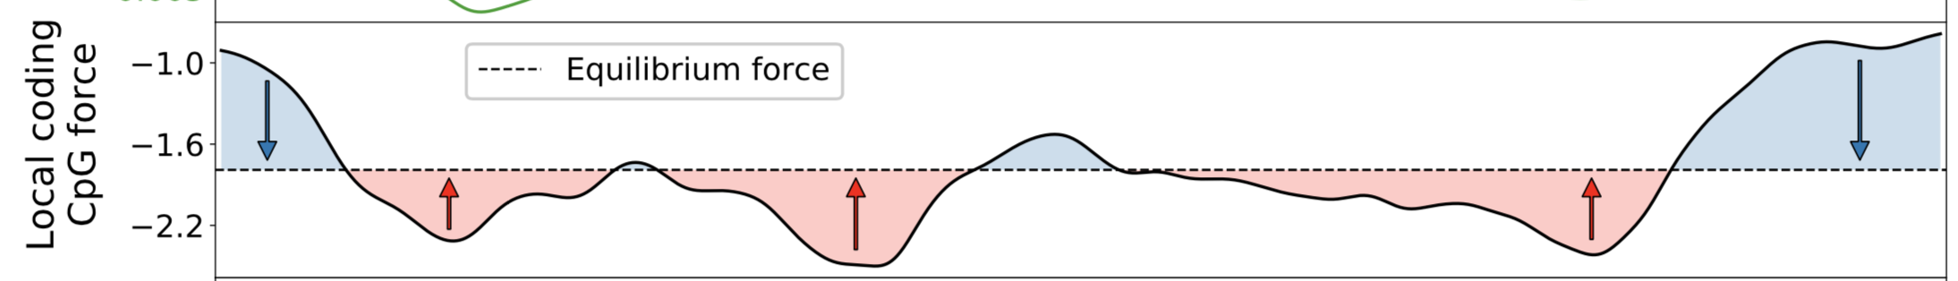
Local CpG force and predictions for synonymous mutations in SARS-CoV-2
f_{CG}
f_{eq}
(hCoV)
(hCoV)
f_{eq}
Trend confirmed by the first 1 years of evolution of SARS-COv2
[talk by A Di Gioacchino]
[A. Di Gioacchino, et al MBE 2020]
Notes:
CpG Landscape is strongly hetereogeneous along the genome
Ancestral Wuhan sequence
Decrease CpG number

Slide 13
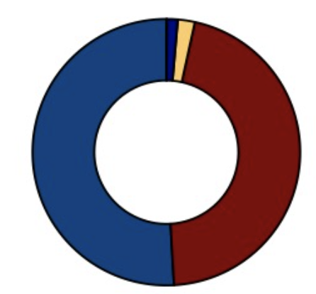
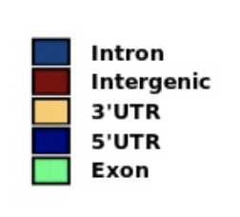
Human and Viral CpG Forces
SARS-Cov2
Distribution from Gencode
EBV
Type 1 Interferon
gene family
f_{CG}
HSATII LnCRNA Core Element (14 Times in 180 Bases)
CCAUU-CG-AUUCC
Notes:
In average each

Slide 14
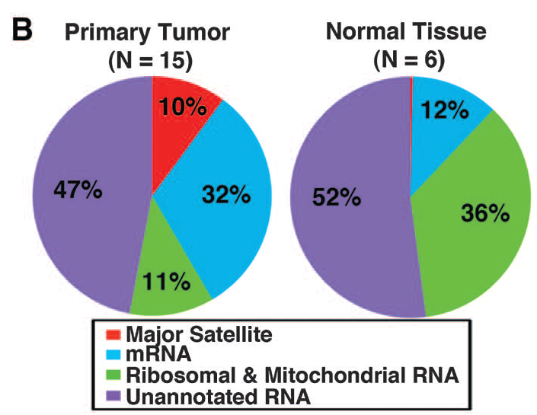
Abundant transcription of ncRNA within Tumors
D. Ting, et al., Science 2011
LncRNA
Experimental Confirmation that GSAT HSATII activate the innate immune response
in Human DC and murine macrophages
D. Tanne et al., PNAS 2015
Notes:
Satellite are repeated non coding RNA sequences which are the main component of highly packed DNA chromatin in centrosemes

Slide 15
Questions
Systematically study immunogenic power of genomic inserts
Can we detect an evolutionary trend and relaxation to the equilibrium force, or there is a pressure to maintain them ‘immunogenic’?
Extend the approach to double-strand force.
Notes:
Disregulation is happening

Slide 16
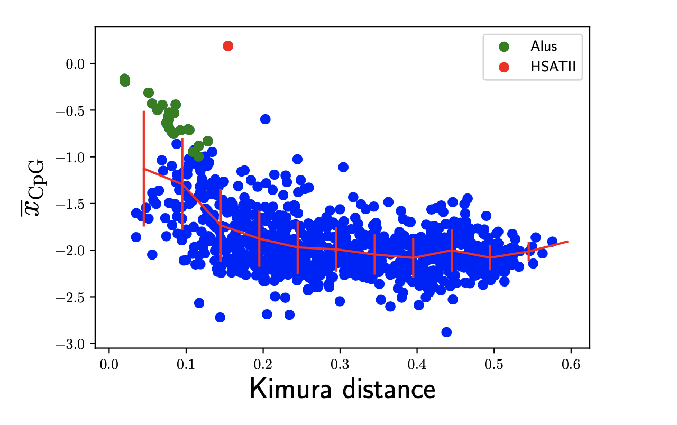
Evolution of CpG forces in repeated elements
f_{CG}
from consensus sequences
→
As proxy for time
P.Sulc et al BiorXiv 2022
Notes:
1077 consensus repeats
32 Alu co
About 104 famiglie of Alu
An hamming distance in which transition mutation to similar nucleotide
Or transvertion are taken into account

Slide 17
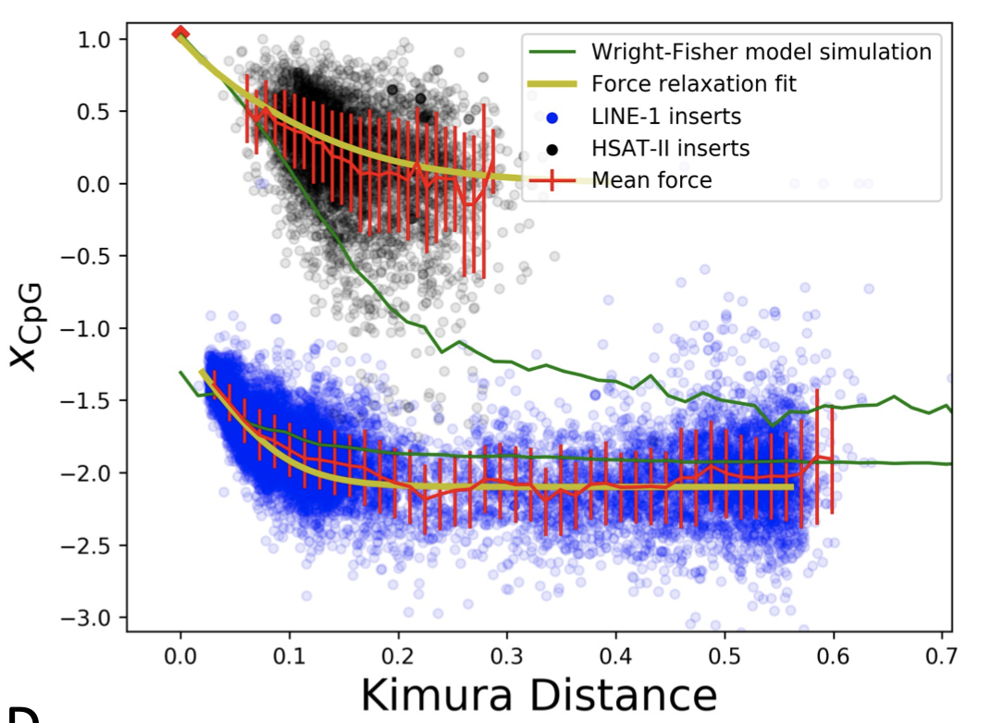
Evolution of Cpg forces in LINE-1 and HSAT-II inserts
f_{CG}
P.Sulc et al BiorXiv 2022
Notes:
In media, ciascun repeat appare 1674 come insert nel genoma, con una grande standard deviation (~3118). Come esempio specifico, HSATII appare 4491 volte come insert.

Slide 18
Evolution of Cpg forces in LINE-1 and HSAT-II inserts
dN _{CG}(t)
𝛕
dt
= - (f_{CG} (N(t)) -f_{rel})
Wright-Fisher Model with transition and transversion mutational costs
f_{CG}
In HSATII there is no relaxation to the average CpG force: additional selective pressure
to keep CpG high.
P.Sulc et al BiorXiv 2022
Notes:
In media, ciascun repeat appare 1674 come insert nel genoma, con una grande standard deviation (~3118). Come esempio specifico, HSATII appare 4491 volte come insert.

Slide 19
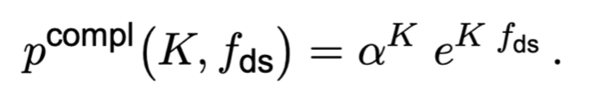
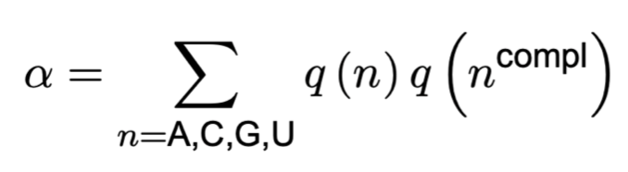
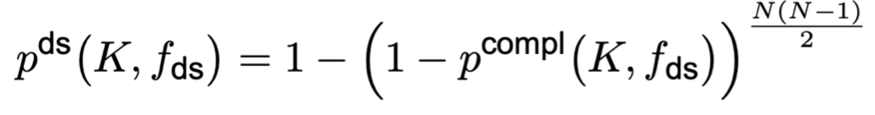
Double-strand (ds) forces
Probability that a pair of K bases are complementary under a ds-force xds
A
T
C
G
Probability that there is at least 2 complementary segments of K bases in a sequence
of length L
N=L/K
For each sequence and its maximal complementarity length K we compute f_{ds}
f_{ds}>0:
f_{ds}<0:
K larger than expected
K smaller than expected
Notes:
Chiamare x->f
F-> q
Riscriverlo

Slide 20
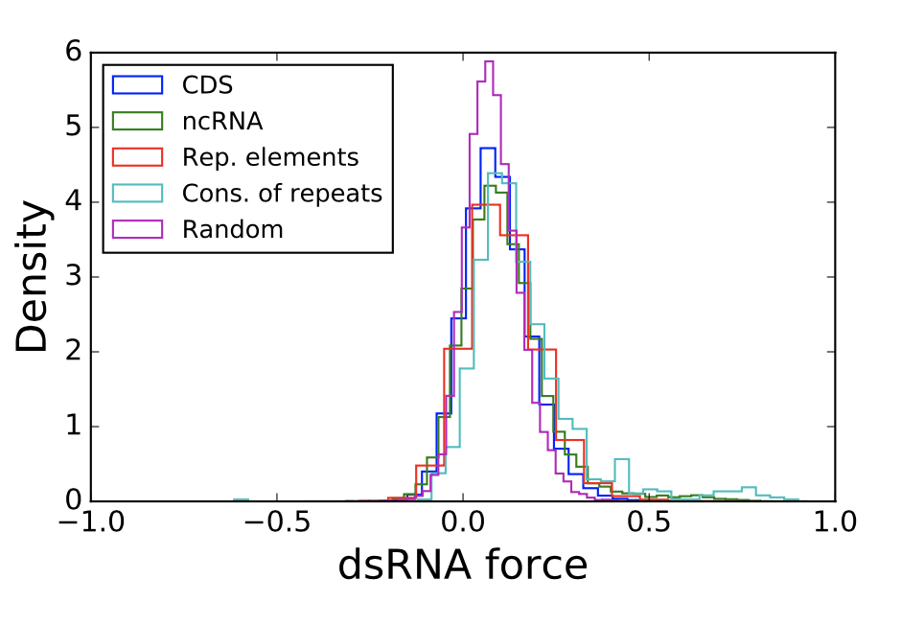
Double-strand Forces on Genomic Repeats
Density
Density
dsRNA force
No deviation to the null model apart from consensus of repeats
P.Sulc et al BiorXiv 2022

Slide 21
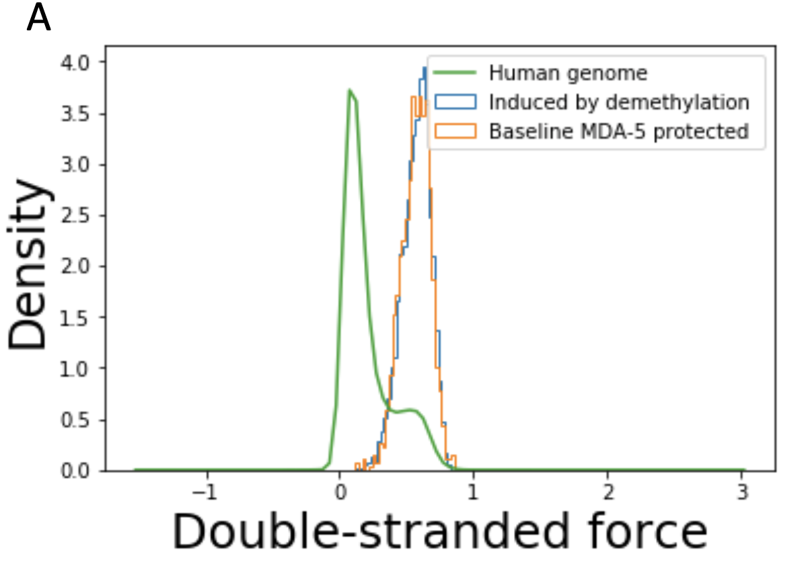
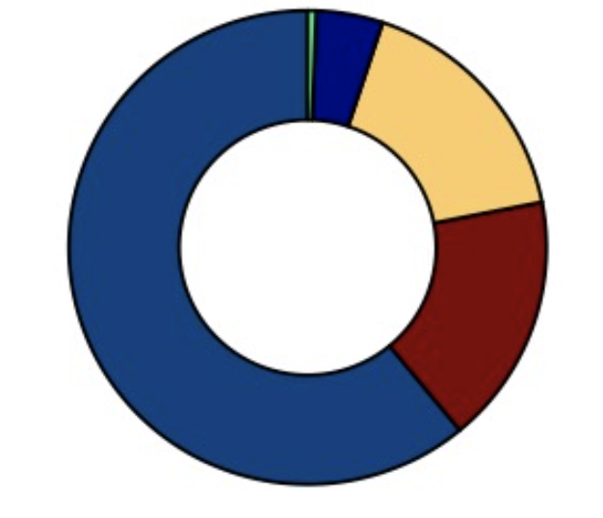
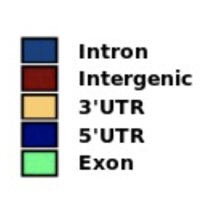
Double-strand Forces on sliding windows
of 3000 nt on genome
L=3000 f^{ds}=0 : K=12 bp,
^{fds}=0.7: K=25 bp,
Density
dsRNA force
Alu inserts followed by its complementary insert
Experimental validations:
RNASeq in human cells under demethylation drugs and MDA5 pulled down
RNA Seq in human cells under drug causing intron retention during slicing
Chen, Ishak, De Carvalho Cancer Discovery 2021
P.Sulc et al BiorXiv 2022
Notes:
Alu are SINE

Slide 22
Conclusion
Our formalism allows us to fish immunogenic repeats possibly involved in the immune response stimulation and in immune therapies against cancer
Highest CpG forces in Alu and HSATII families.
Alu inserts make tandem along the genome with complementary sequences with high double-strand force.
In HSATII the CpG content is kept high despite expected relaxation dynamics. This could be due to positive selection for CpG maintenance:
CpG are essential for methylation, but also a check point mechanism
against dysregulation.
Repeats Mimic Immunostimulatory Viral Features Across a Vast Evolutionary Landscape. P. Sulc et al BiorXiv 2021.11.04.467016

