Slide 1
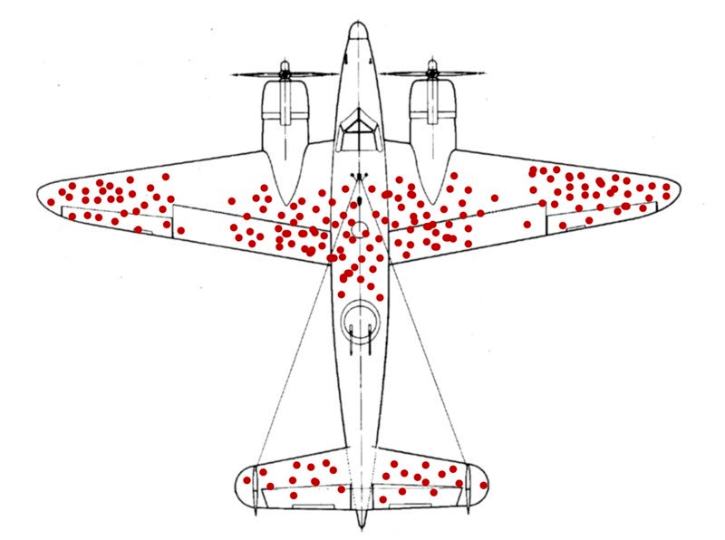
What do air fights have to do with G-Quads?
OR:
Fantastic RNA G-Quads: What they do and where to find them?
Yoseph Barash
Department of Genetics, Computer & Information Science
University of Pennsylvania

Slide 2
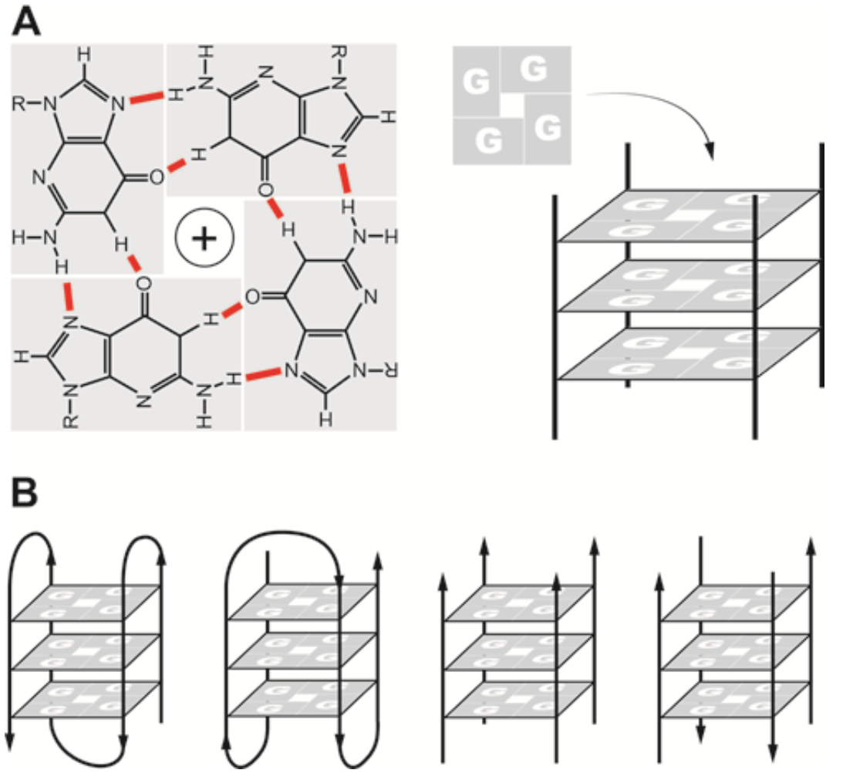
G-Quadruplexes
G-quadruplexes (G4s) are stable secondary structures composed of stacked “quadruplex” guanine repeats
First discovered in telomeres of DNA
Relatively less is known about their biological function and importance in RNA
5’
3’
GGG-N(1-7)-GGG-N(1-7)-GGG-N(1-7)-GGG
Rhodes, D., Lipps, H. Nucleic Acids Research, 43, 18, 2015. 8627-8637.

Slide 3
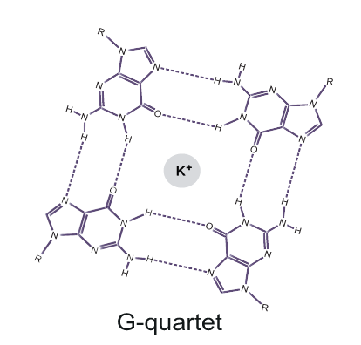
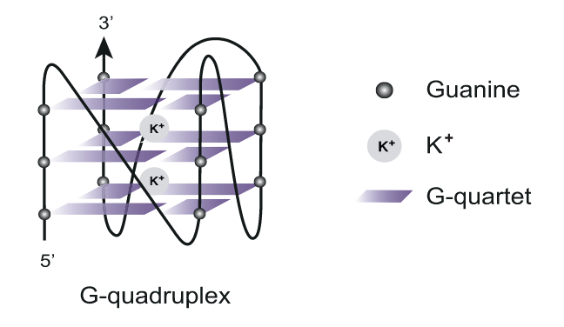
RNA stacked G structure subtypes
5’
Canonical G4 sequence
3’
GGG-N(1-7)-GGG-N(1-7)-GGG-N(1-7)-GGG
G-tract
loop
G-tract
loop
G-tract
loop
G-tract
Subcategories of non-canonical RNA G4s (rG4s)
Source: RNA G-quadruplexes (rG4s): genomics and biological functions (Lyu et al., 2021)
Notes:
First things first, a G-quadruplex, or G4, is a secondary structure that exists in both DNA and RNA. In this project, we’ll be focusing on RNA G4s or rG4s. The standard or canonical G4 sequence looks like this, a repeat of consecutive G’s followed by a sequence of any nucleotide of length one to seven. A G4 sequence forms a four stranded planar quadruplex structure called a G-quartet, and when two or more G-quartets stack on top of each other, they form a G4. For rG4s, besides the canonical G4, there are also non canonical G4 structures and within non canonical structures, there are subcategories or subtypes of rG4s
Be able to answer about dna g4
45s

Slide 4
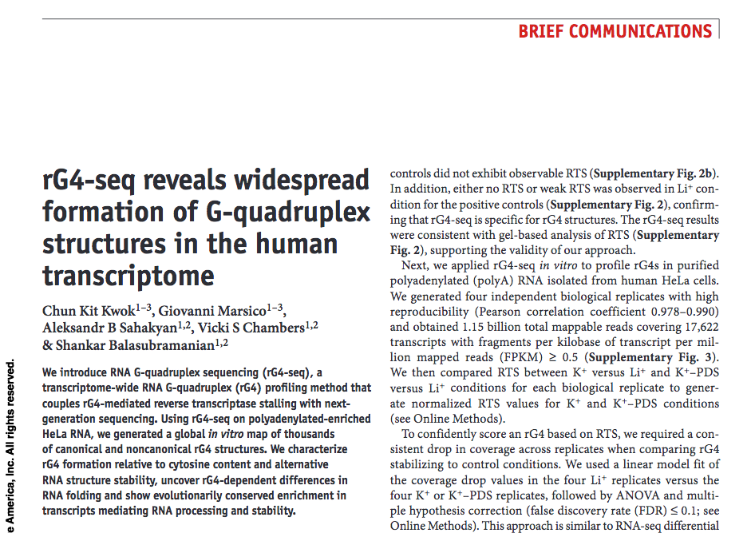
5’UTR
CDS
3’UTR

Slide 5
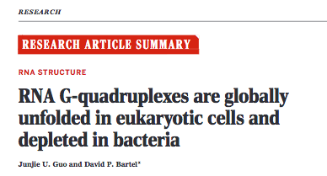
5’UTR
CDS
3’UTR

Slide 7
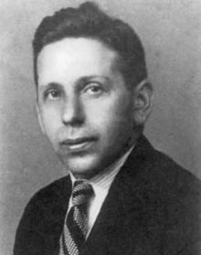
Negative Selection, and Survivorship Bias
Abraham Wald (1902-1950)
wikipedia
Notes:
Abraham Wald's Work on Aircraft Survivability
Citation: Mangel, Samaniego, J. Am. Stat. Assoc. 1984

Slide 8
Negative Selection, and Survivorship Bias
Damage is not tolerated
Patterns of damage on planes that were destroyed were not observed
Patterns of observed damage on planes reflected regions where damage could be tolerated
Regions depleted of observed damage represented the most vulnerable components of the airplanes
Damage is tolerated
Notes:
Citation: Mangel, Samaniego, J. Am. Stat. Assoc. 1984

Slide 9
Hypothesis
RNA G-quadruplexes are regulatory features in UTRs
Is there evidence of heightened selective pressure acting on UTR G4s?
Are UTR G4s enriched for functional and disease associations?
Notes:
Chronology: how did I get involved in working on G-quadruplex?
“We followed the science”

Slide 10
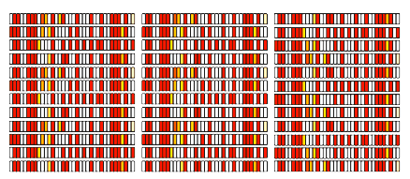
We can assess sequence constraint in a genomic region by:
Reduction in allele frequencies
Enrichment for rare variation
Negative selection continuously removes variation from regions that do not tolerate it
Thus regions that are depleted of variation are also more likely to be functional, and serve important biological roles
Notes:
Citation: Mangel, Samaniego, J. Am. Stat. Assoc. 1984

Slide 11
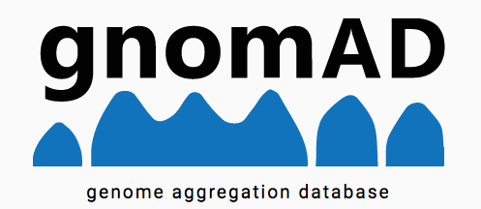
5’
3’
GGG-N(1-7)-GGG-N(1-7)-GGG-(N(1-7)-GGG
UTR
UTR
UTR
UTR
UTR
pG4
Allele frequencies
> 15K whole-genome sequences
UTR without pG4
GGG
Allele frequencies
Notes:
Citation: Mangel, Samaniego, J. Am. Stat. Assoc. 1984

Slide 12
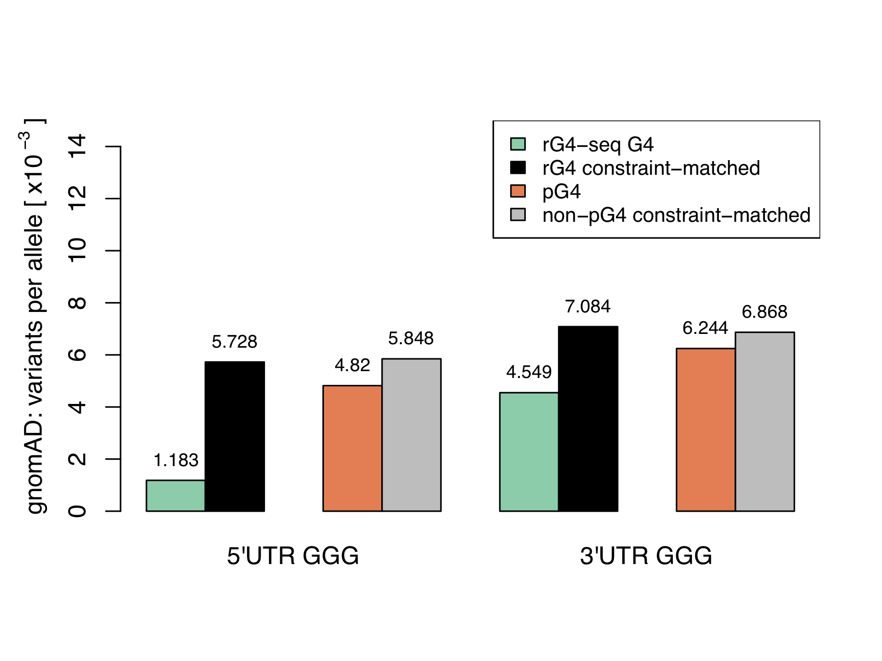
5’
3’
GGG-N(1-7)-GGG-N(1-7)-GGG-(N(1-7)-GGG
UTR
UTR
UTR
UTR
UTR
***
***
pG4
***
***
Allele frequencies
UTR without pG4
GGG
Allele frequencies
*** P<<2e-16
Notes:
Citation: Mangel, Samaniego, J. Am. Stat. Assoc. 1984

Slide 13
Enrichment for rare variants
Fit a mutability-adjusted proportion of singletons (MAPS) model using synonymous mutations
Assess proportion of singletons compared to expectation from sequence context
Notes:
Need to update this figure!
LOEUF stands for the "loss-of-function observed/expected upper bound fraction." It is a conservative estimate of the observed/expected ratio, based on the upper bound of a Poisson-derived confidence interval around the ratio

Slide 14
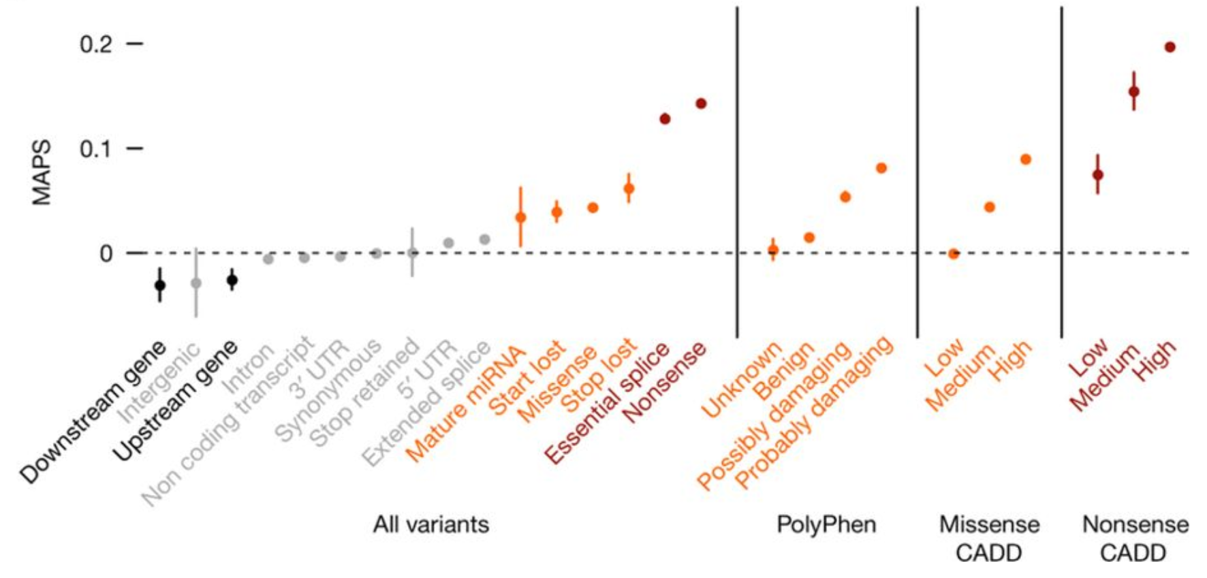
Increasing
negative selection
Lek et al. Nature 2016
Notes:
Many classes of functional variation in proteins
Variation in UTRs doesn’t appear to be significantly under negative selection
The problem is that, like in the CDS, not all variation in UTRs is the same!

Slide 15
Do pG4 variants more frequently change gene expression?
Are common SNPs in UTR pG4 more likely to be annotated as cis-eQTLs in GTEx compared to non-pG4 SNPs
cis-eQTL: a variant associated with change in gene expression on the same DNA strand
Map GTEx v7 cis-eQTLs to UTRs, are UTR pG4 more likely to harbor cis-eQTLs?
Notes:
Need to update this figure!

Slide 16
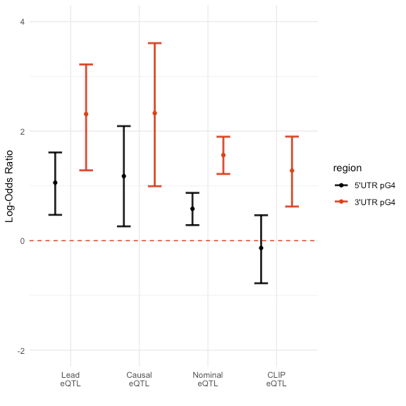
UTR pG4 are enriched for functional associations

Slide 17
Patterns of shared targets hint at regulatory modules
Overlap between RBP - gene targets reveals new regulatory modules
GO:0016032
Viral Process
Notes:
Need to update this figure!

Slide 18
Notes:
Change the arrow to represent direction of transcription

Slide 19
Assessing functional associations of UTR pG4
Combined analysis of gnomAD, GTEx, ClinVar, ENCODE
We find enrichment for cis-eQTL and RNA-protein binding interactions in UTR pG4 sequences
Our results suggest that disruption of these UTR G-quadruplex may be associated with phenotypic variation
Our results provide further evidence that UTR pG4 are functional elements in RNAs
Approach might be applied to other noncoding features in the genome to identify patterns of functional variation with implications for biology
Points to the need to consider such affects/elements when assessing deleterious mutations.

Slide 20
David Lee
Louis Ghanem
Acknowledgements

Slide 21
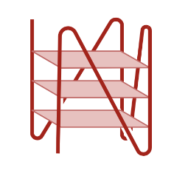
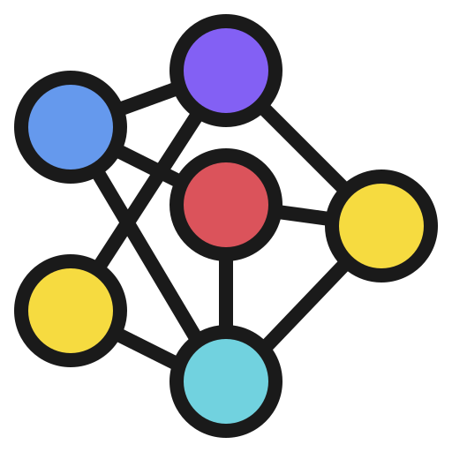
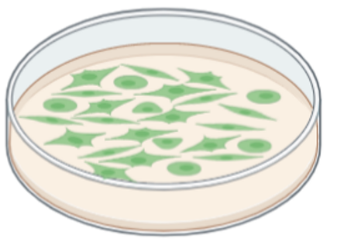
Mapping RNA G4s and G4-deleterious single nucleotide variants (SNVs)
How to detect rG4s?
How to study the effects of SNVs on rG4s?
Associated diseases?
1.
2.
3.
4.
High throughput mapping of transcriptome-wide putative rG4
Train a model to accurately predict rG4 focused on 5’UTR
Analyze phenotype association of rG4 deleterious variants
Perform experimental validation
Notes:
Now knowing the regulatory importance of rG4s, how can we detect and study g4s? More particularly, my research questions are then how can we first, predict the formation of rg4s at a large scale, and then study the effects of single nucleotide variants that break the predicted g4 formations? And what are the associated diseases for these g4 deleterious variants?
To answer these questions, this project is divided into four steps. First, we want to get the dataset of high throughput mapping of transcriptome-wide putative rG4, and then use this data to train a model to accurately predict rg4 focused on 5’utr. Next, we want to analyze phenotype association of rG4 deleterious variants predicted by the model. Lastly, we want to perform experimental validation on the rG4 deleterious variants
27s

Slide 22
G4mer: transformer-based model for rG4 prediction
Simplified G4mer model
Training
Prediction
G4 classification
G4 subcategory classification
Rg4-seeker (Frank et al NAR 2021):
Transcriptome-wide rG4 data
GRCh38 gff annotation file: 5’UTR sequences
last hidden state
Get 5’utr regions of fixed length
Transformer encoder
Original sequence: GGCGGCGGAGTCTCCC...
Sub sequence 1: GGCGGCGGAGTCTCCC…
Sub sequence 2: GCGGCGGAGTCTCCC…
Sub sequence 3: CGGCGGAGTCTCCC…
Sub sequence 4: GGCGGAGTCTCCC…
…………
embedding
tokenized
ATCGAT TCGATC CGATCG …
Input sequence
ATCGATCG…
Notes:
Rg4Seeker from Kwok’s group.
With that in mind, we want to be able to get insights about the g4 themselves and their roles. We want to be able to interpret the results in meaningful ways, like which locations are more important, which subtypes, etc, and predict genetic variants that break rG4s in 5’UTRs. For this purpose we introduce our model called G4mer. Here, we fine-tuned a bert model that is transformer-based using rg4seeker data we just showed for rG4 prediction. Next, we want to study rG4s in the 5’utr regions. So after obtaining the model, we’ll then use the model to find predicted rG4s in 5’utr regions. To get sequences to be predicted for the presence of rG4s, we then take all the 5’UTR regions, break them down into sequences of fix length to feed into G4mer and obtain 5’UTR regions that are predicted to contain G4 which we will include in our analyses later
We hypothesize that a transformer based model would be good at modeling rG4s because of the advantage that transformer has in capturing more complicated structures or relationships in the input. Since rG4s can be subcategorized into different categories with varying structures and lengths, a transformer-based model is then able to overcome this
40s

Slide 23
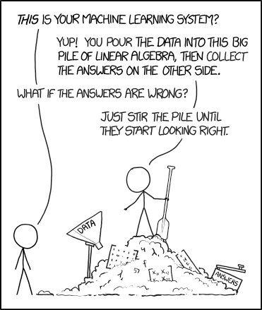
How we get it to work…
Notes:
With that in mind, we want to be able to get insights about the g4 themselves and their roles. We want to be able to interpret the results in meaningful ways, like which locations are more important, which subtypes, etc, and predict genetic variants that break rG4s in 5’UTRs. For this purpose we introduce our model called G4mer. Here, we fine-tuned a bert model that is transformer-based using rg4seeker data we just showed for rG4 prediction. Next, we want to study rG4s in the 5’utr regions. So after obtaining the model, we’ll then use the model to find predicted rG4s in 5’utr regions. To get sequences to be predicted for the presence of rG4s, we then take all the 5’UTR regions, break them down into sequences of fix length to feed into G4mer and obtain 5’UTR regions that are predicted to contain G4 which we will include in our analyses later
We hypothesize that a transformer based model would be good at modeling rG4s because of the advantage that transformer has in capturing more complicated structures or relationships in the input. Since rG4s can be subcategorized into different categories with varying structures and lengths, a transformer-based model is then able to overcome this
40s

Slide 24
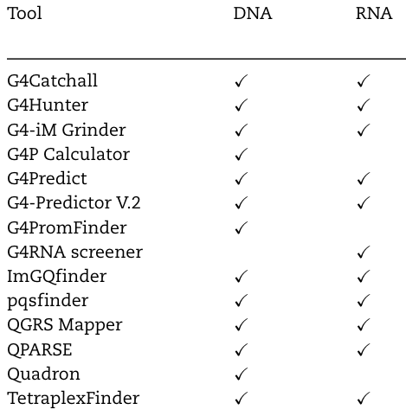
Algorithms developed to detect potential G4s
Source: How bioinformatics resources work with G4 RNAs (Miskiewicz et al., 2016)
Notes:
While there have been many other computational models developed to detect g4 in dna and/or rna, most of them only provide predictions. However we would like to also perform variant interpretation. Before going into variant interpretation, we first looked into how G4mer performs and evaluated G4mer against a state of the art convolutional neural network based model called G4detector.
20s

Slide 25
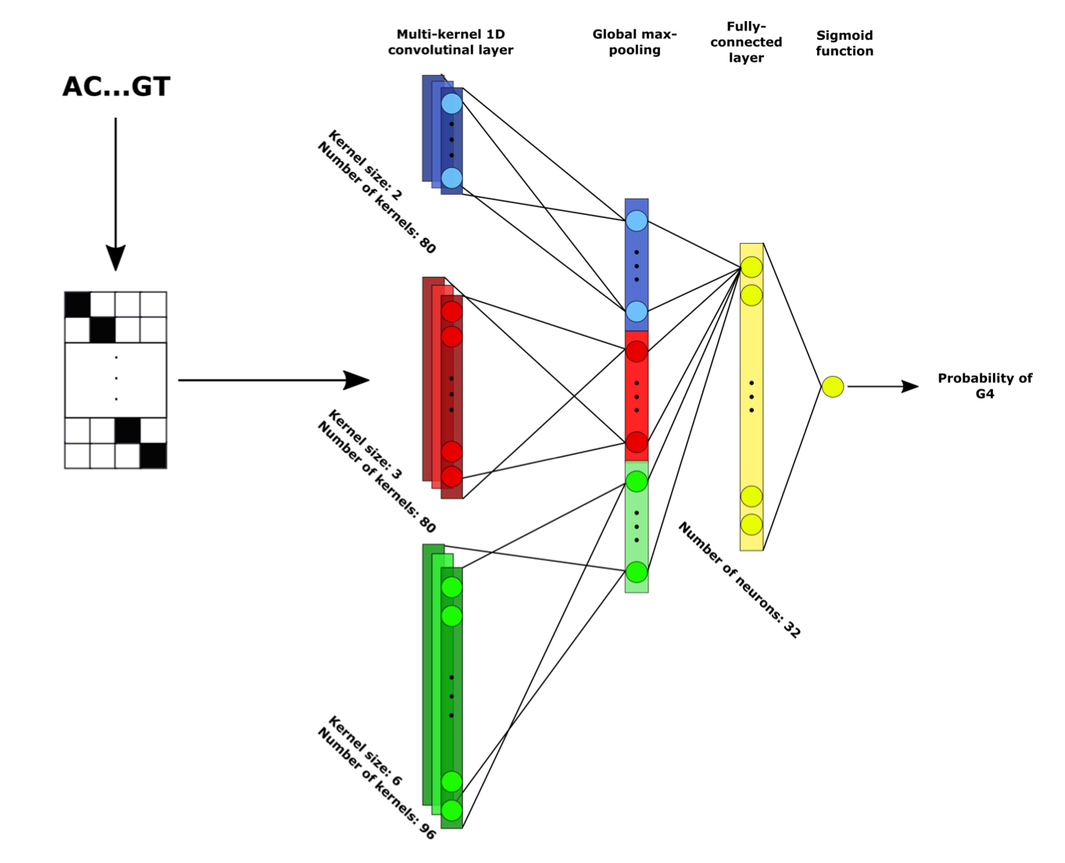
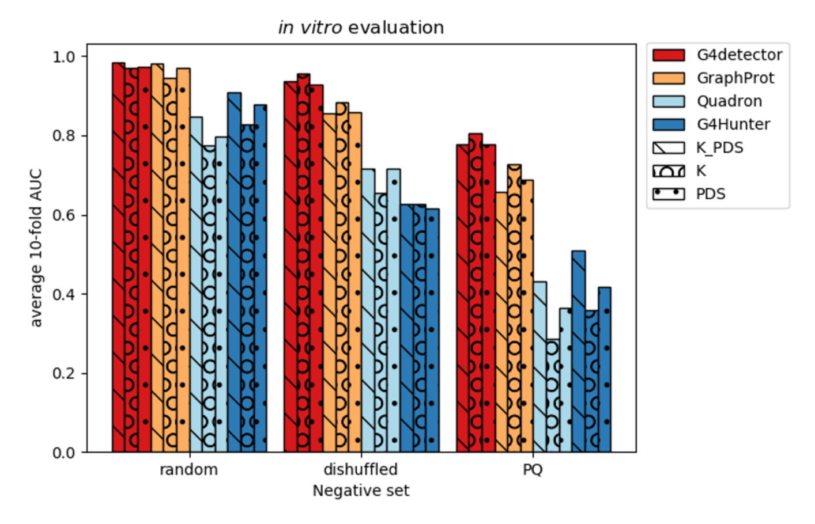
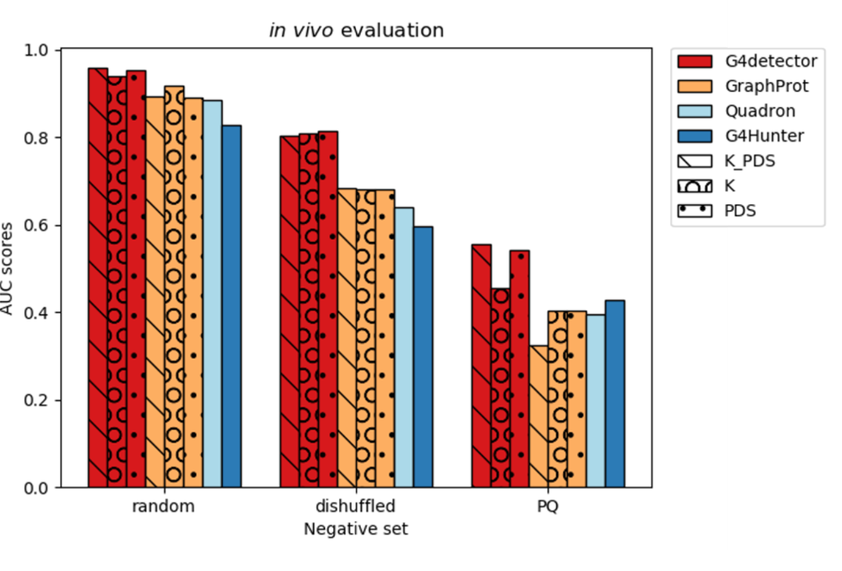
G4Detector: convolutional neural network-based model
One-hot encoded input sequence: matrix of 0’s and 1’s
Convolutional neural network (CNN) architecture
Source: G4detector: Convolutional Neural Network to Predict DNA G-quadruplexes (Barshai et al., 2021)
Notes:
G4 detector is a convolutional neural network or CNN based model that has been shown to outperform other existing models. Here, G4Detector performance is represented by the bars in red, and they showed that they have the best performance for both in vitro and in vivo G4 datasets. G4detector was originally built to predict DNA G4s, but in order to perform a true comparison with our model, we retrained it on the same RNA G4 data as G4mer.
20s

Slide 26
G4mer transformer-based model vs state-of-the-art model
Binary: Predict if a given sequence contains a potential G4
Multiclass: Predict if a given sequence contains a G4, if so, which subcategory
 | G4mer (Transformer) |  | G4Detector (CNN)
 | Accuracy | AUC | Accuracy | AUC
Binary
Multiclass (70nt)
Multiclass (200nt)
Notes:
So for our evaluation, we trained both G4mer and G4Detector on rg4-seeker data, and compared their performances for three different tasks. The first task is a binary classification, where the models predict if a given sequence contains a potential G4. The other two tasks are multiclass classification, where the models predict if a given sequence contains a g4 and which subcategory it belongs to. We performed two multiclass classifications for different input sequence lengths.

Slide 27
G4mer transformer-based model vs state-of-the-art model
Binary: Predict if a given sequence contains a potential G4
Multiclass: Predict if a given sequence contains a G4, if so, which subcategory
 | G4mer (Transformer) |  | G4Detector (CNN)
 | Accuracy | AUC | Accuracy | AUC
Binary | 0.97 | 0.99 | 0.91 | 0.96
Multiclass (70nt)
Multiclass (200nt)
Notes:
For binary classification, G4mer only slightly outperforms G4Detector .
Animation one row at a time
1m 35s

Slide 28
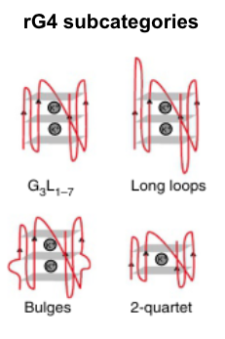
G4mer transformer-based model vs state-of-the-art model
Binary: Predict if a given sequence contains a potential G4
Multiclass: Predict if a given sequence contains a G4, if so, which subcategory
 | G4mer (Transformer) |  | G4Detector (CNN)
 | Accuracy | AUC | Accuracy | AUC
Binary | 0.97 | 0.99 | 0.91 | 0.96
Multiclass (70nt) | 0.83 | 0.89 | 0.55 | 0.79
Multiclass (200nt)
Notes:
However for multiclass classification, G4Detector struggled to accurately predict rG4 into subcategories, with accuracy of 0.55 for input length of 70 nucleotides. Meanwhile G4mer performs with an accuracy of around 0.3 higher, at 0.83.

Slide 29
G4mer transformer-based model vs state-of-the-art model
Binary: Predict if a given sequence contains a potential G4
Multiclass: Predict if a given sequence contains a G4, if so, which subcategory
 | G4mer (Transformer) |  | G4Detector (CNN)
 | Accuracy | AUC | Accuracy | AUC
Binary | 0.97 | 0.99 | 0.91 | 0.96
Multiclass (70nt) | 0.83 | 0.89 | 0.55 | 0.79
Multiclass (200nt) | 0.81 | 0.88 | 0.49 | 0.73
Notes:
We also tried a different input sequence length of 200 nucleotides and while both model performances drop, a larger drop is seen for G4Detector for both accuracy and AUC. This shows that G4mer is better at predicting G4 subcategories and is more resilient to the changes in the length of the input sequence
Overall, for all the tasks, G4mer outperforms G4Detector, especially for multiclass classification of categorizing rG4s into subtypes.

Slide 30
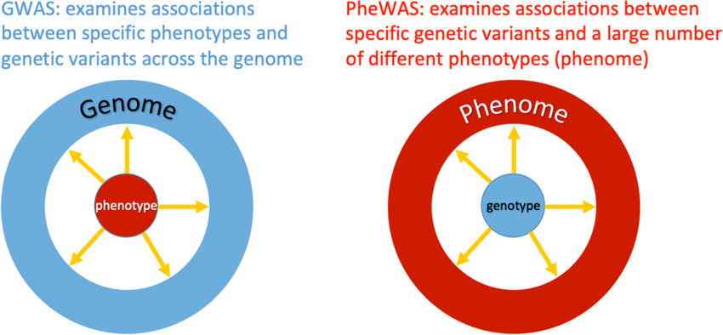
G4 deleterious variant analysis with GWAS and PheWAS
Sources: Neuroimaging PheWAS (Phenome-Wide Association Study): A Free Cloud-Computing Platform for Big-Data, Brain-Wide Imaging Association Studies (Zhao et al., 2021)
Notes:
After validating that our model G4mer performs accurately in predicting rG4, next we move on to variant interpretation using gwas and phewas variants. Both GWAS and Phewas are phenotype and variant association studies but have different approaches. GWAS starts with a single phenotype and examines associations between phenotype and genetic variants across the genome. Phewas is the inverse of that where a set of variants is tested individually to determine each variants’ associations with multiple different phenotypes.

Slide 31
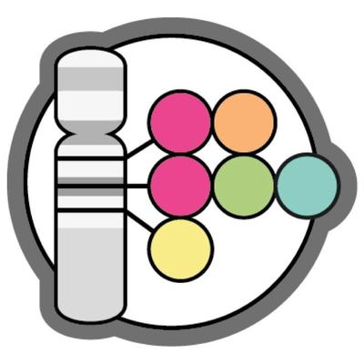
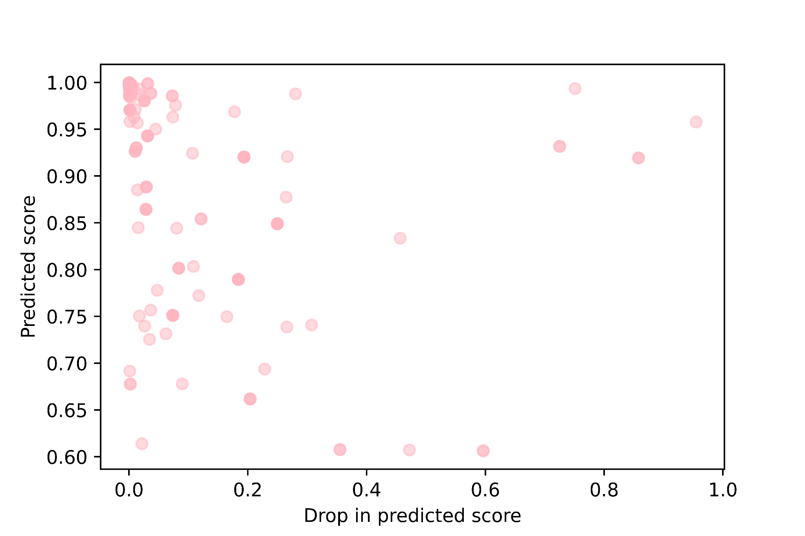
Phenotypes associated with G4 deleterious GWAS variants
GWAS catalog
Heel bone mineral density
Eczema
2022-04-07
Wildtype region prediction score for G4
5’UTR variants
SNP1
SNP2
…
mRNA
5’
exon
3’
UTR
intron
UTR
wildtype regions
mutated regions
G4mer
183 hits
Wildtype regions predicted scores for G4
-
Mutated regions
Predicted scores for G4
=
Notes:
To analyze existing GWAS hits that are G4 deleterious, we downloaded GWAS hits from the GWAS catalog. We take all GWAS hits in the 5’UTR region. For each hit, g4mer predicted if an rG4 would form in the presence of the wild-type and the alternative allele, obtaining a prediction score for each. We then plotted the prediction scores of the wild type alleles on the Y axis, and the delta of the scores on the X axis. We expected most variants will not affect the formation of rG4s since most GWAS hits are not located in the UTRs. However, this analysis highlights variants with regions that are highly predicted to contain g4s and the GWAS hit causes a great drop in the predicted score or delta. This is seen on the right side of the plot.
Update the visuals and explanation on how this is done
Show process first. Don’t show the lines too distracting, make a better flow chart
Expectation most not g4, but we look at the ones that did
Take all high scoring gwas hits, run through g4mer, get scores
Explain that most gwas hits are not in 5’utr g4, but for those that hit windows of high scoring g4, we can add the variant and get the change in predicted score
Overall i found x SNPs that are in a window of strong g4 hits
Add Eczema
Feeding variants of significance of a threshold
Is this the sentinel snp in that region?
Manhattan plot of that snp’s area and see if it’s the peak of the plot -> sentinel snp
Magnifying glass
Darker color

Slide 32
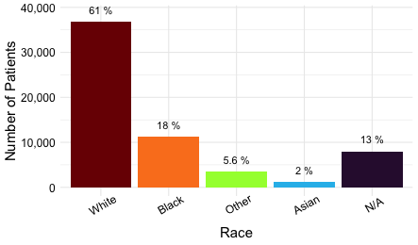
Performing PheWAS analysis using Penn Medicine BioBank (PMBB)
Exclusion criteria
Related individuals (up to 2nd degree relatedness)
Singletons
Variants with missing genotypes
Phenotypes with less than 5 cases
43,731 participants whole exome sequences & EHR
Eur
Afr
Other
Asian
N/A
Ancestry
Sources: Penn Medicine BioBank
Notes:
Turning to phewas, (transition from gwas to phewas)To perform phewas analysis, we obtained samples from the penn medicine biobank. PMBB has over 43 thousand participants of different ancestries. After quality check we’re left with around 40 thousand samples. Association analyses were performed only for European and African ancestries due to the limitation in sample sizes of other ancestry groups. In preparation for the analysis, we applied our exclusion criteria and excluded related individuals, singletons, and phenotypes with less than 5 cases in the PMBB. Similar to gwas, we take PMBB variants and find those that are G4 deleterious using G4mer

Slide 33
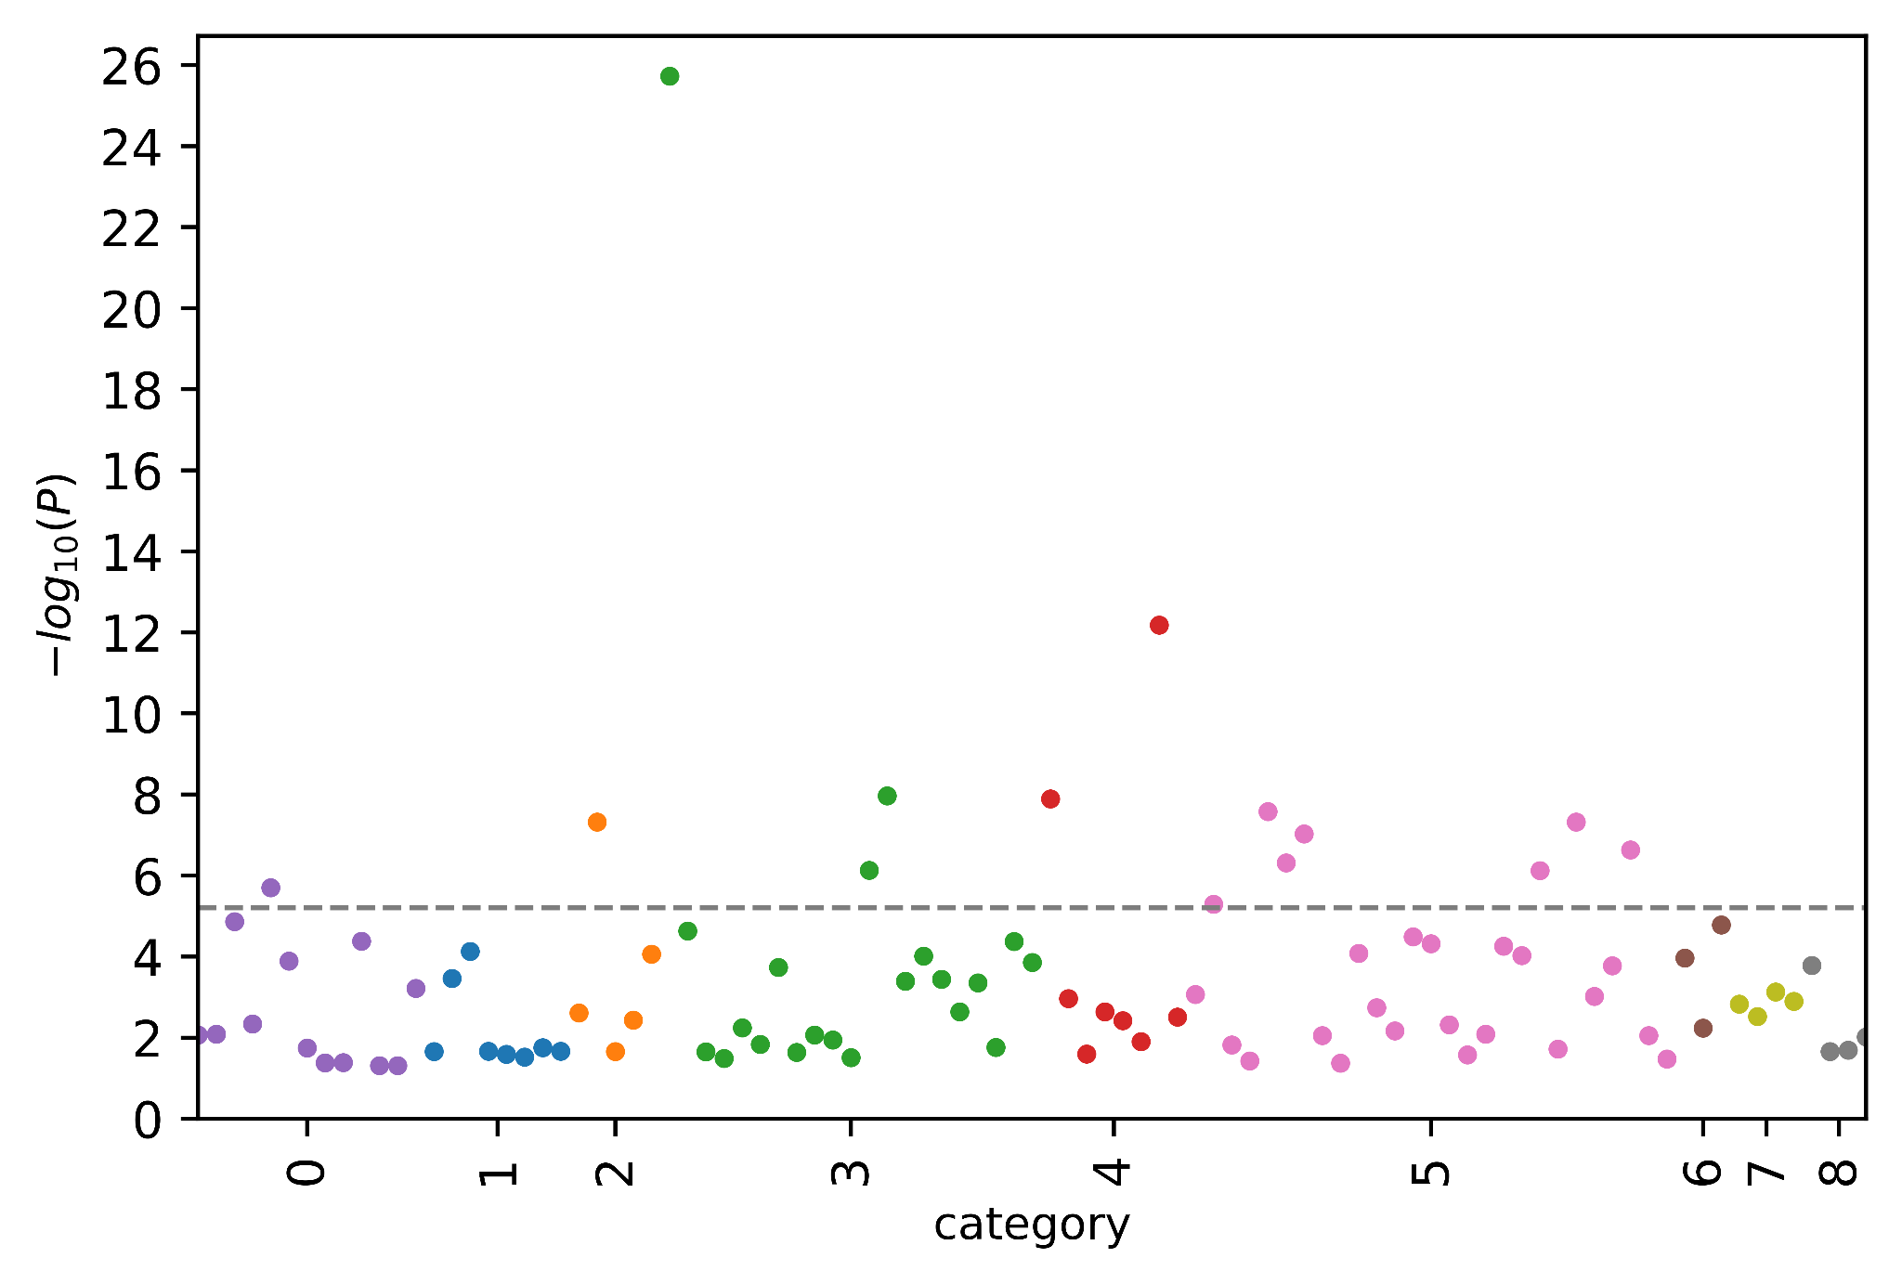
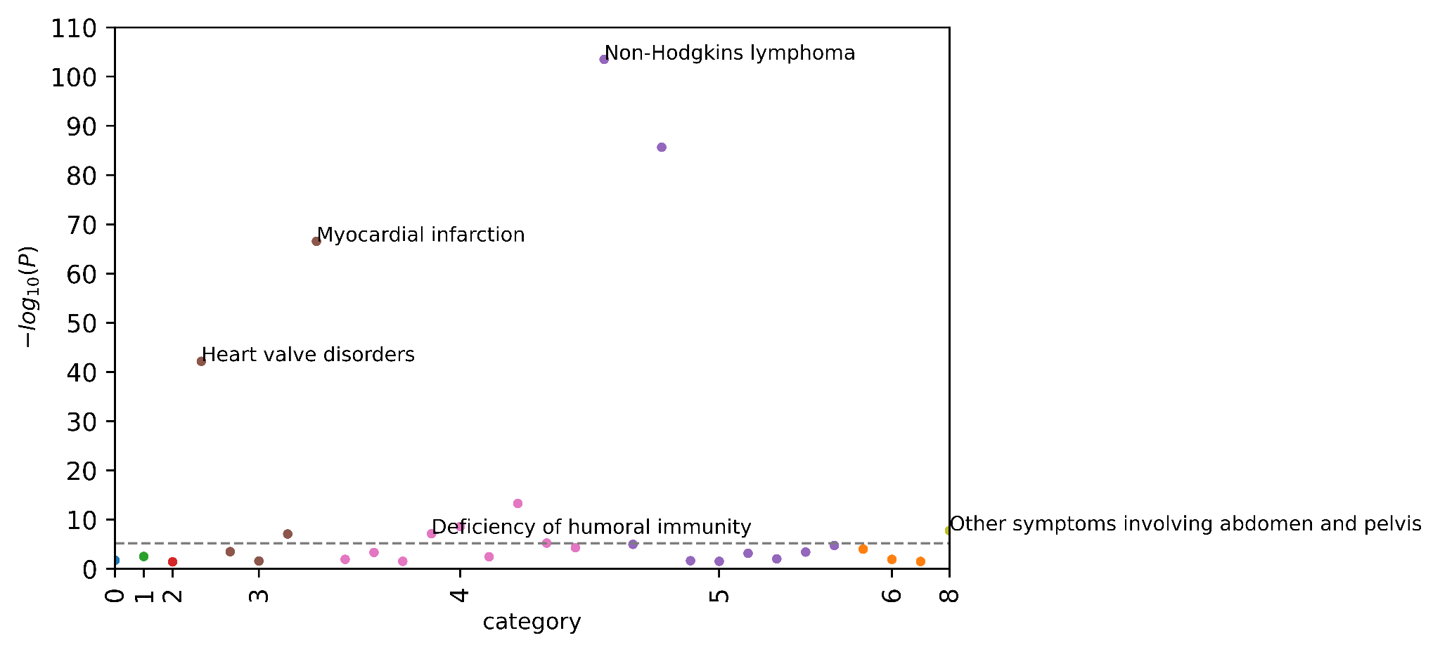
PheWAS analysis
SUPT4H1
KRT15
Cerebrovascular disease
N=93
N=30
Bonferroni adjusted significance
Deficiency of humoral immunity
ocular
genitourinary
ocular
neoplasms
genitourinary
neurological
respiratory
neurological
respiratory
circulatory system
circulatory system
hematopoietic and immune
hematopoietic and immune
endocrine/metabolic
endocrine/metabolic
neoplasms
digestive
Notes:
After obtaining rg4 deleterious variants with g4mer, we then ran phewas for these. An output example of our phewas analysis is a variant in the African ancestry population, appearing in 93 samples. This variant is in SUPT4H1 gene with two phenotypes significantly associated with it, passing the threshold for bonferroni adjusted significance. The two phenotypes associated with this variants are circulatory and immune related diseases, which have not been studied before in relation to this gene and would be interesting to look into. Another example is a variant in the European ancestry population, appearing in 30 samples. This variant is in KRT15, which has been associated with cancers. In our phewas result, we find that the variant is most strongly associated with cancerous diseases, with the top disease being non-hodgkins lymphoma, which is a type of cancer that forms in the lymph system.
From these two phewas plots, we see how G4mer has the potential to uncover g4 deleterious variants with association to disease that is not yet studied. Furhter, t it also has the potential to find g4 deleterious variants with association to diseases that confirms what has already been studied.

Slide 34
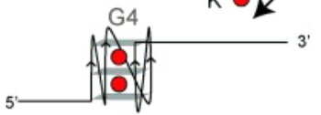
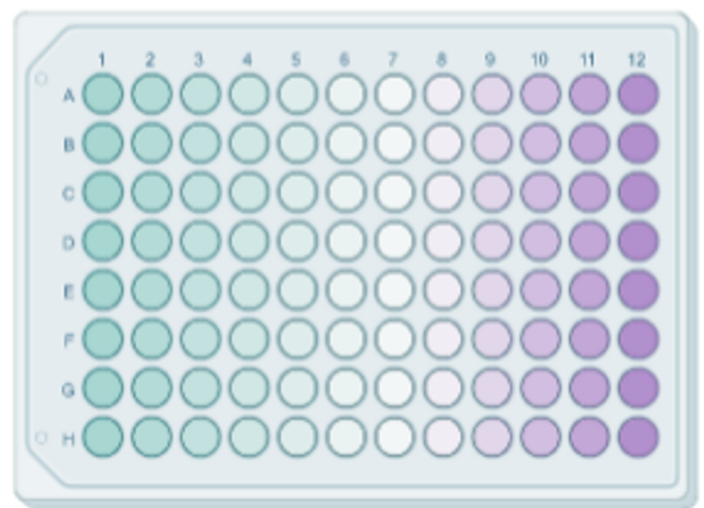
Future work: more PheWAS/GWAS analyses and experimental validations
Experimental validation of G4 deleterious variants
wildtype 5’utr G4
mutated 5’utr G4
Extend and finalize GWAS and PheWAS associations
Investigate relations of rG4 subtypes and locations in the gene
Experimentally validate rG4 deleterious variants
3’
5’
3’
5’
Quantitatively measure changes in protein expression
Reproduce associations in UK Biobank
Notes:
For our future work, we want to extend and finalize gwas and phewas associations, investigate relations of rG4s to subtypes and specific locations in the gene. we will also be performing experimental validation in our lab, measuring the effect on the protein level of the associated gene in the absence and presence of the G4 deleterious variants we predicted with G4mer. Lastly, we will be reproducing disease associations in uk biobank.

Slide 35
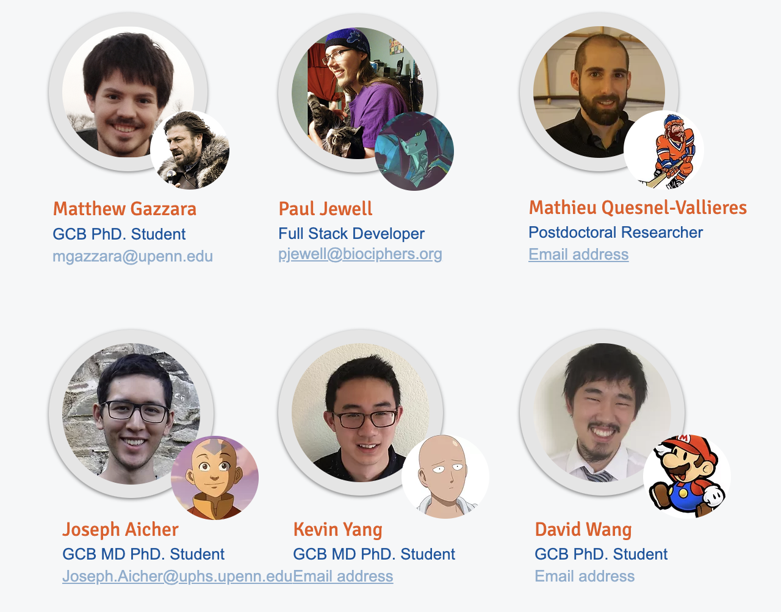
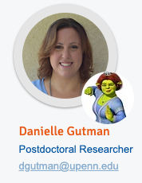
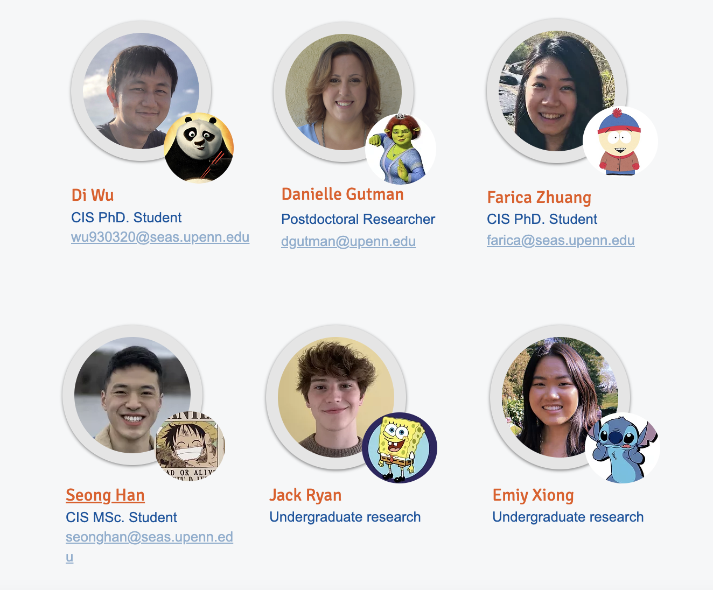
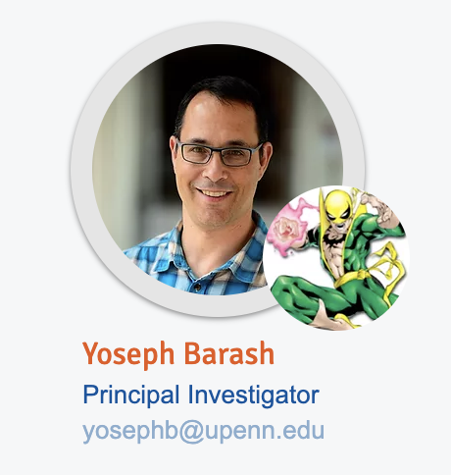
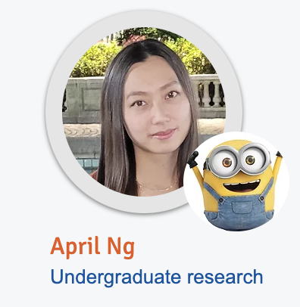
Acknowledgement
Notes:
With that, I would like to thank my colleagues in Biociphers lab, especially my advisor Yoseph, as well as my colleagues Danielle and Paul for being an amazing collaborators and contributosr and Paul for contributing to the phewas analysis. Thank you!
15s

