Slide 1

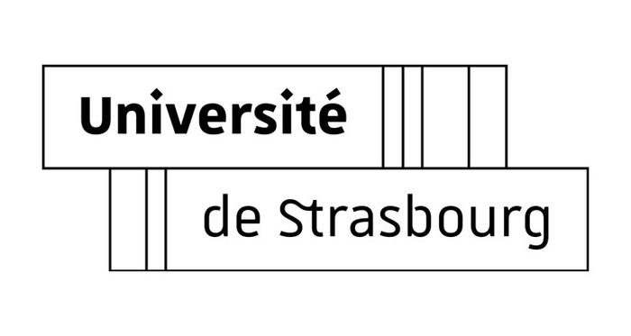


Interactions between Gs and Us
in translation
Eric Westhof
Architecture & Réactivité de l’ARN,
Institut de Biologie Moléculaire et Cellulaire, CNRS
Université de Strasbourg,
France
2022
Notes:
Good morning
I am very grateful to the organizers of this meeting for the invitation.
It is very unfortunate we cannot meet in person and enjoy beautiful Croatia and Slovenia.
Hopefully in a near future
I cahnged the topic from last year due to the pandemic and I would like to describe some parts of the mol biology of coronavirus that are not often discussed
I will report on a specific mechanism of translation control in betacoronaviruses.
We will look at RNA sequences in the first hundred nts of the 5’UTR RNA genome and at the sequences of the first protein being synthetized by the virus during cellular infection.

Slide 2
Usual GoU wobble : U moves toward the Major Groove
2 Å

Slide 3
Watson-Crick/Watson-Crick cis pairs are isosteric
for the complementary bases (A/U et G/C)
GoU cis WC/WC is not isosteric with U-G cis WC/WC : GoU = UoG

Slide 4
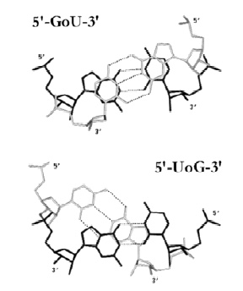
GoU
versus
UoG
^{5’}UoG ^{5’}UoG ^{5’}GoU
GoU_{5’} UoG_{5’} UoG_{5’}
> >
Notes:
5

Slide 5
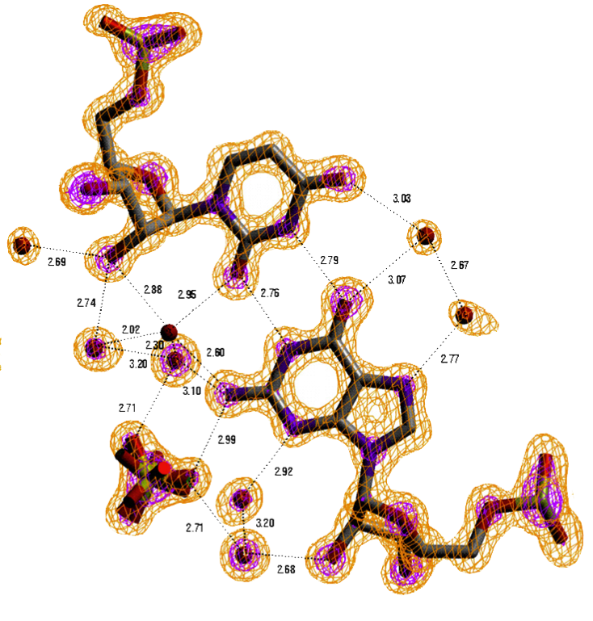
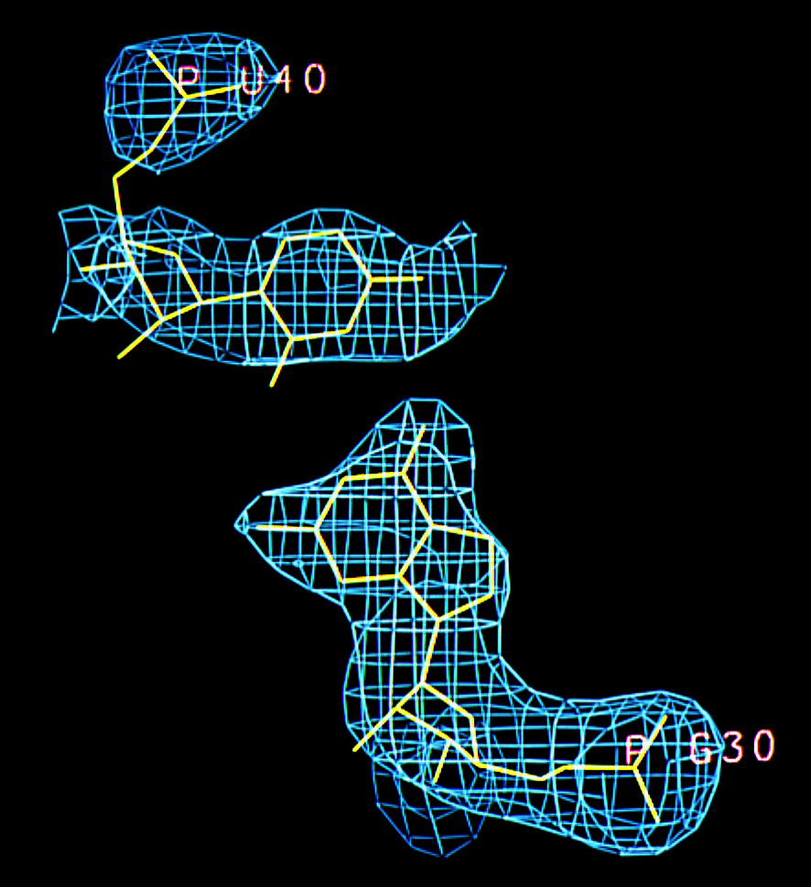
0.97 Å
(1999)
3.0 Å
(1985)
Masquida, B. et al. RNA 10, 1384 (1999)
Westhof, E., Dumas, P. & Moras, D. (1985) J Mol Biol, 184, 119.
Notes:
1

Slide 6
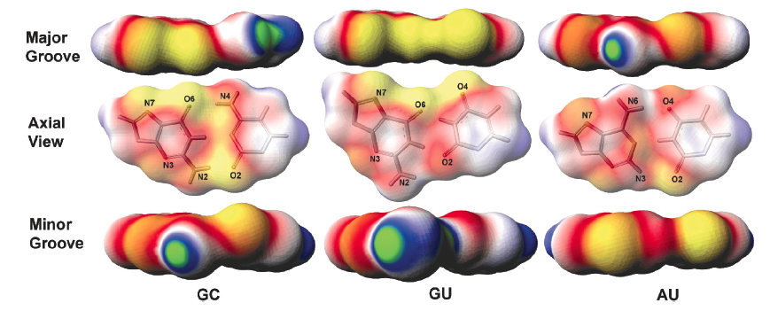
yellow most negative (-1.7 kT/e) green is the most positive (1.7 kT/e)
White is neutral. Red and blue represent negative and positive potentials, respectively
Xu et al. Nucleic Acids Research (2007) 35, 3836. doi:10.1093/nar/gkm274

Slide 7
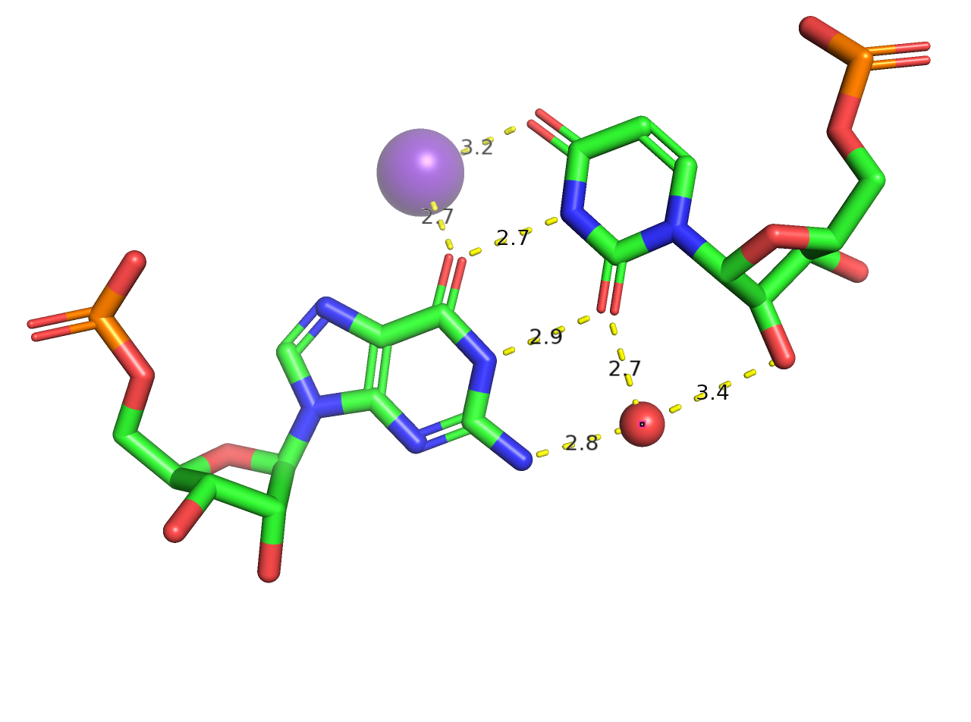
K⁺
Ow

Slide 8
Tight helix-helix
contact via a
GoU pair
PDB 4jrt

Slide 9
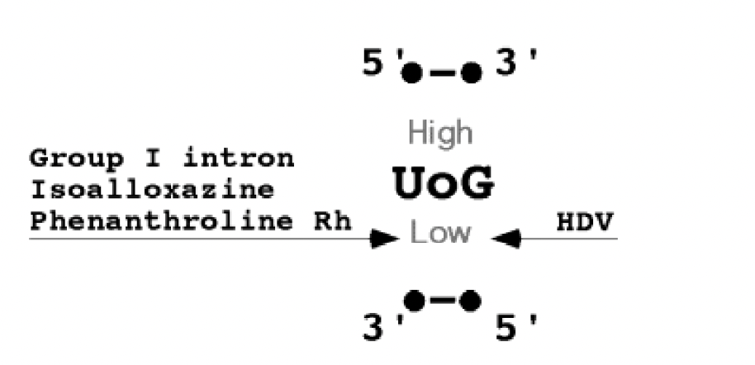
Importance of GoU pairs in catalytic RNAs
Masquida, B & Westhof, E RNA (2000), 6:9–15.

Slide 10
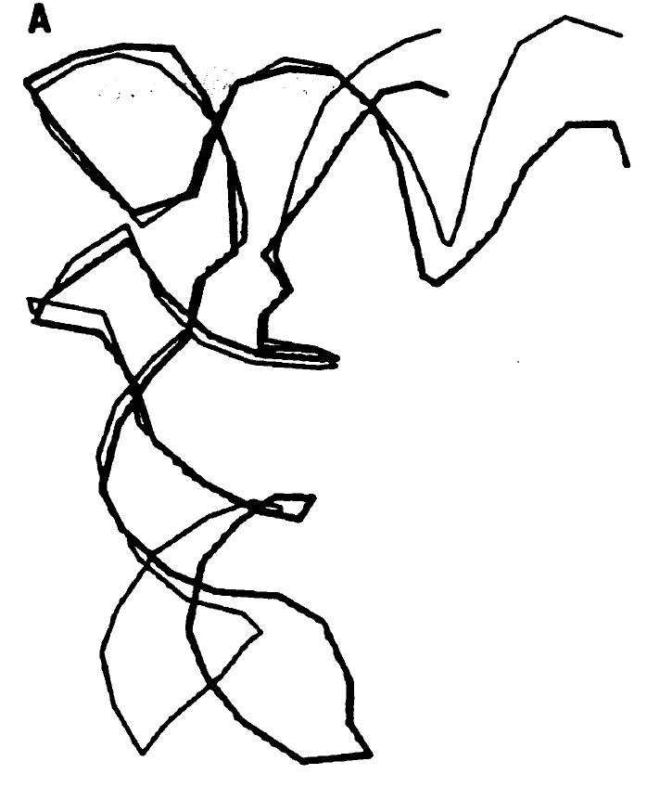
Bending plane in helical segments: without and with aminoacyl tRNA
synthetase
G30oU40
Ruff, M et al. Science 252, 1682-9 (1991)
Westhof, E et al. J. Mol. Biol. 184, 119 (1985)

Slide 11
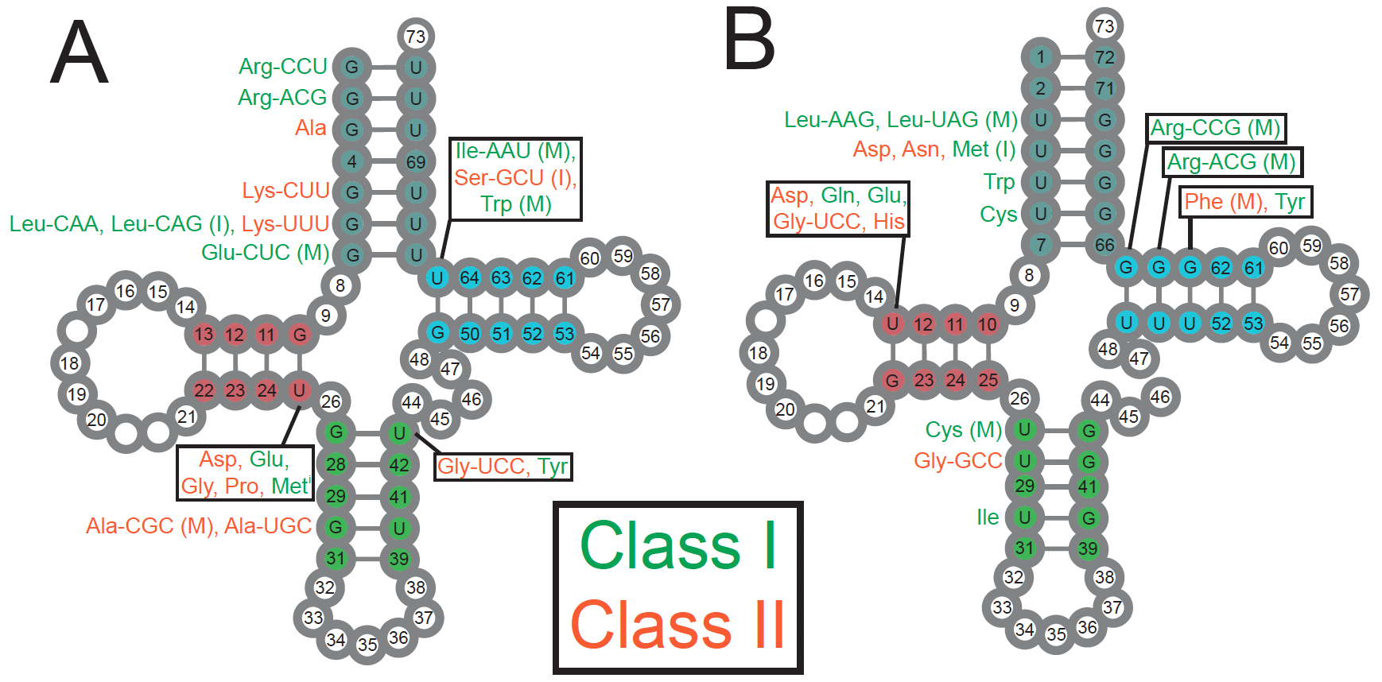
Eukaryotic tRNAs
GoU
UoG
Westhof, E. et al. Nucleic Acids Research, accepted.

Slide 12
GoU pairs in RNA modules
and
ends of helices

Slide 13
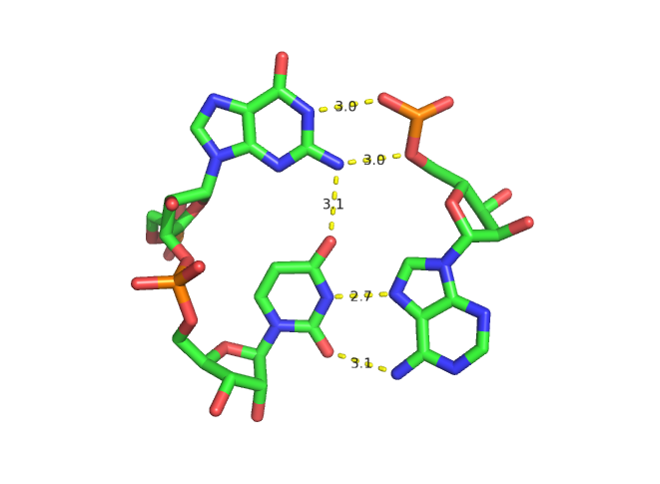
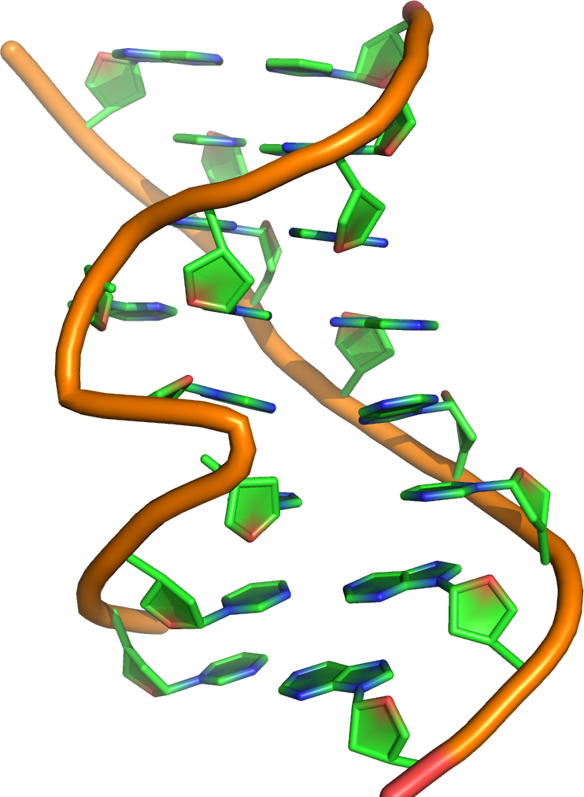

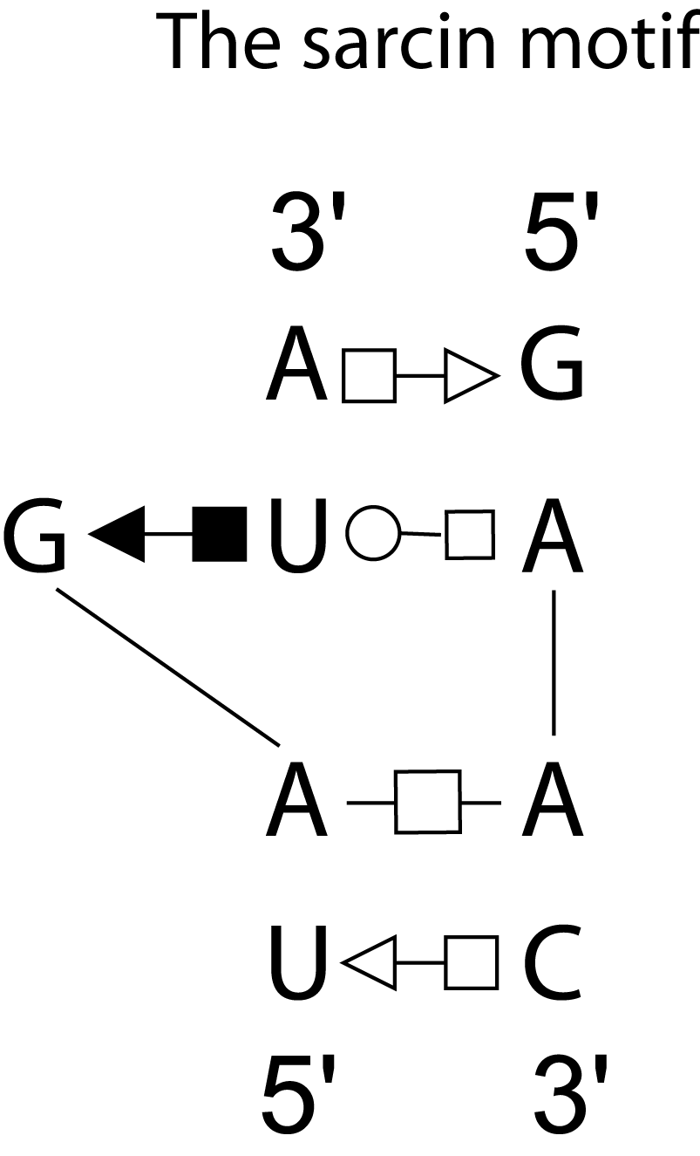
G-U platform
Sarcin module

Slide 14
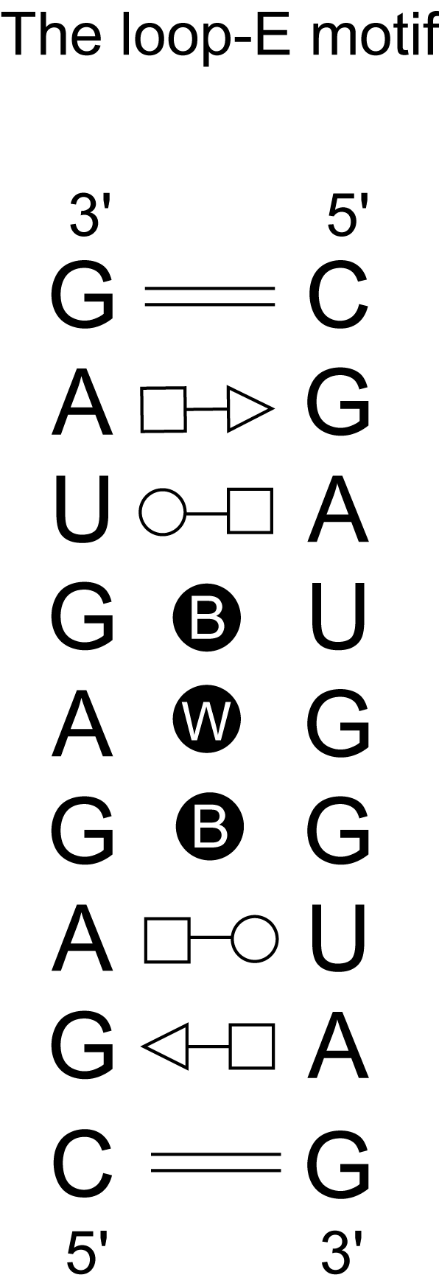
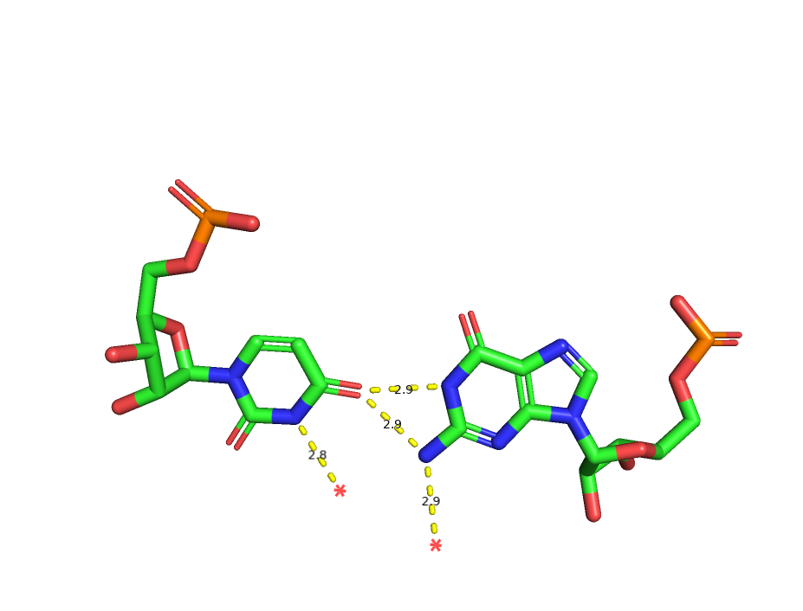
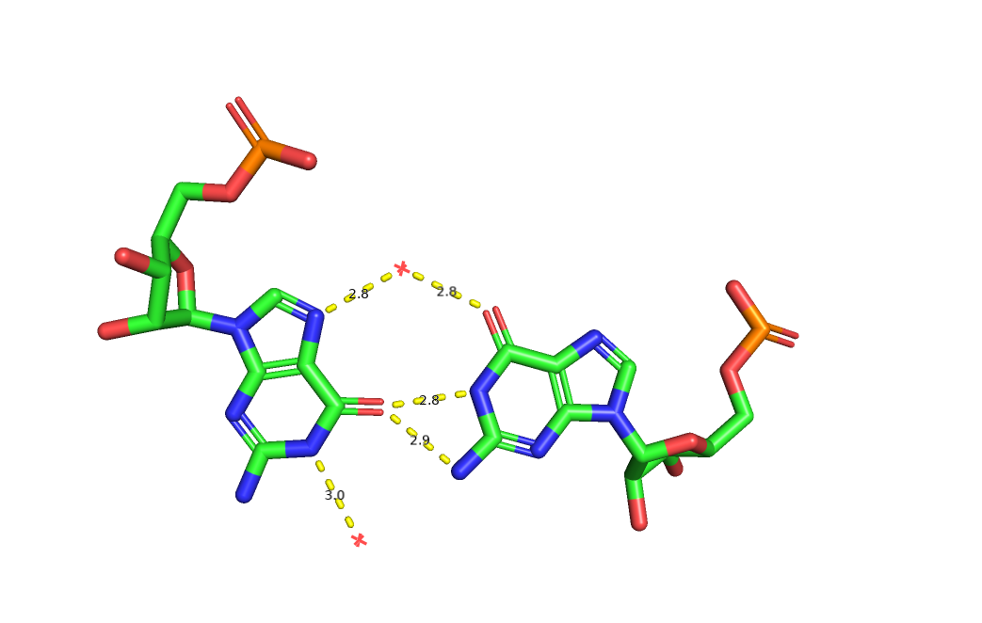
Bifurcated GoU pair
Bacterial loop E, 354d
Cell (1997) 91: 705
O4
O6

Slide 15
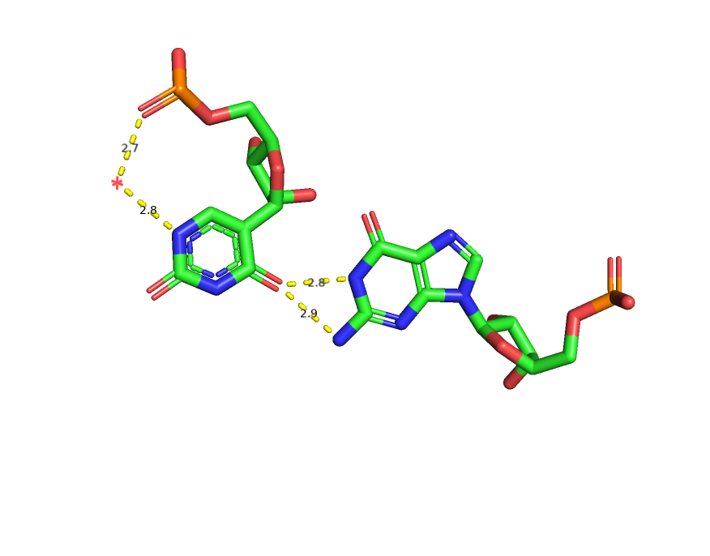
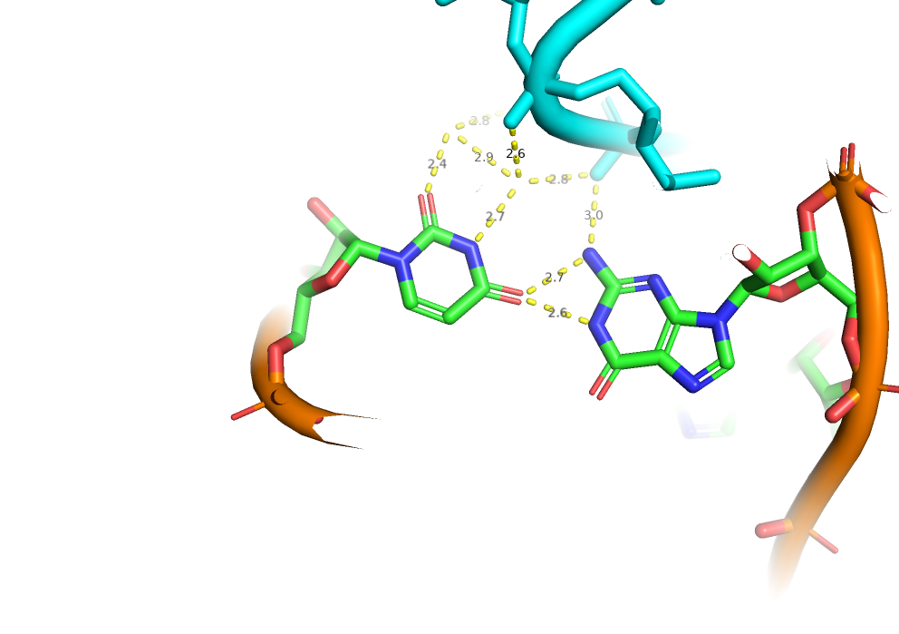
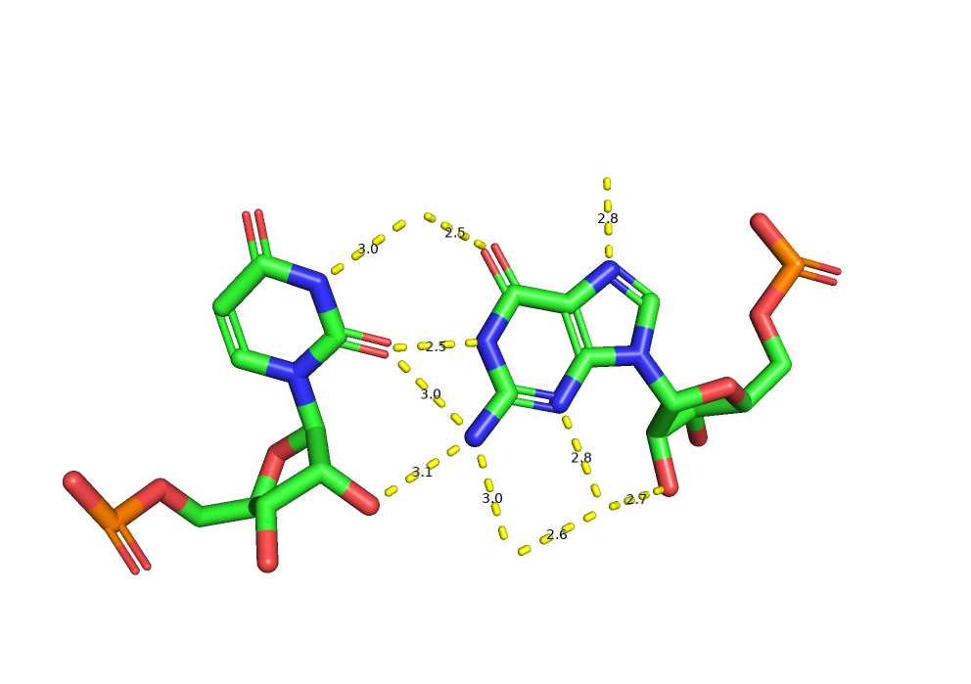
Bifurcated pairs with O4(U) or O2(U)
trans
O2(U)
O4(Psi)
O4
cis
O2
Watson et al. eLife 2020;9:e60482. DOI: https://doi.org/10.7554/eLife.60482

Slide 16
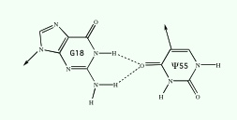
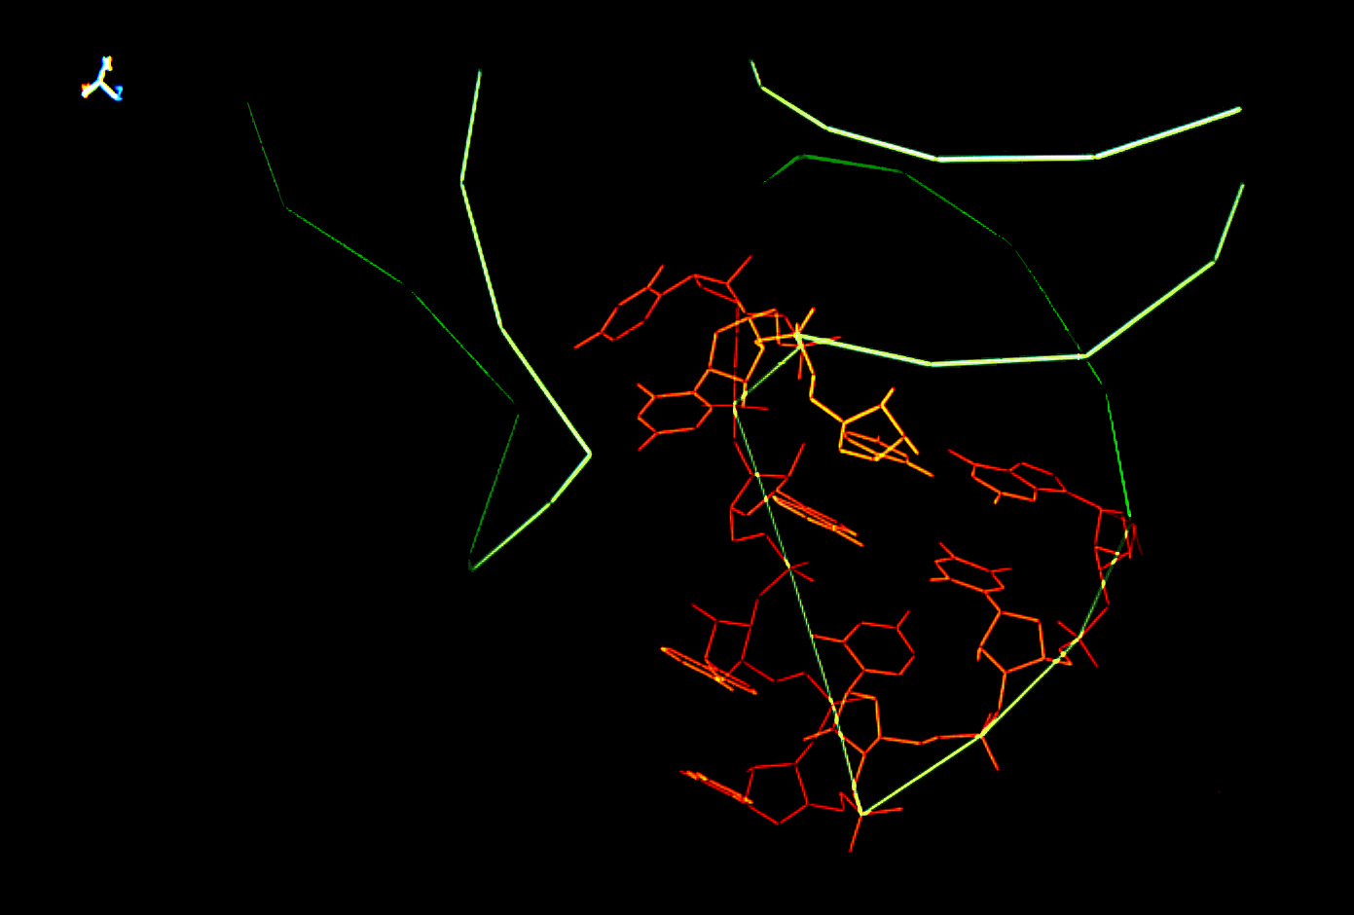
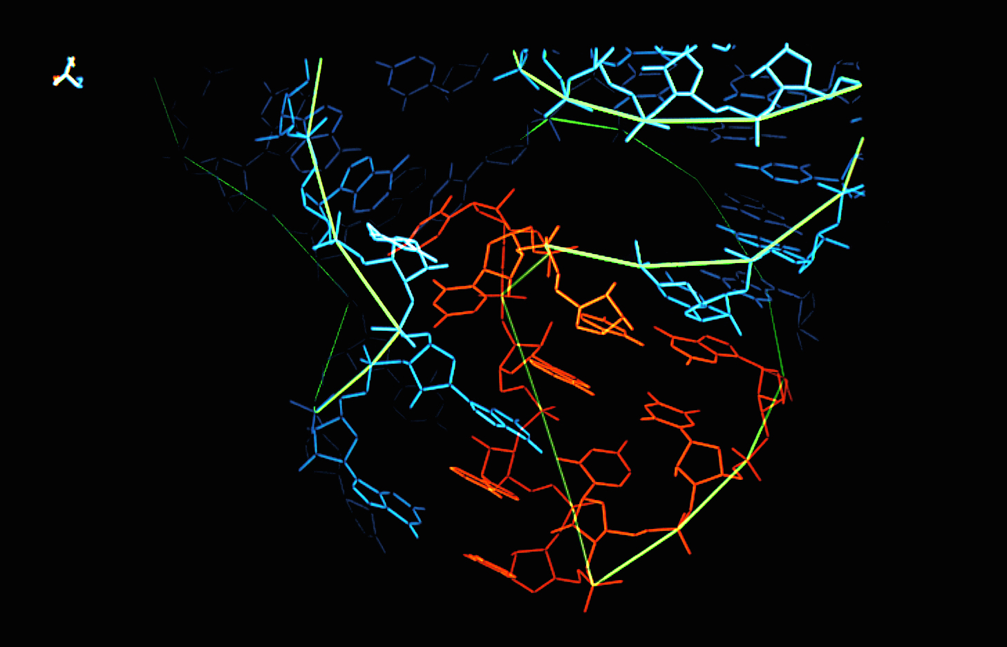

Slide 17
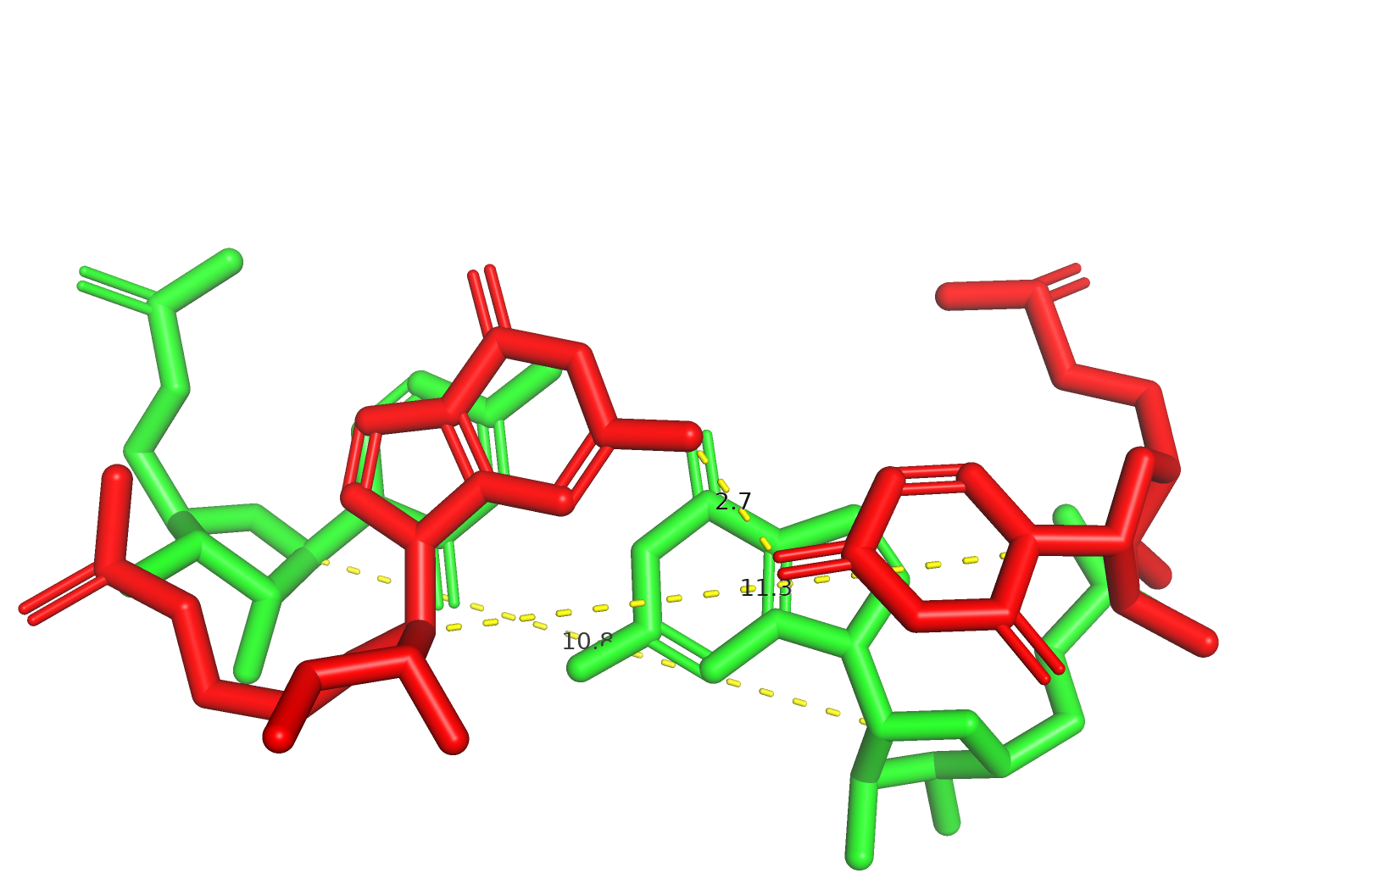
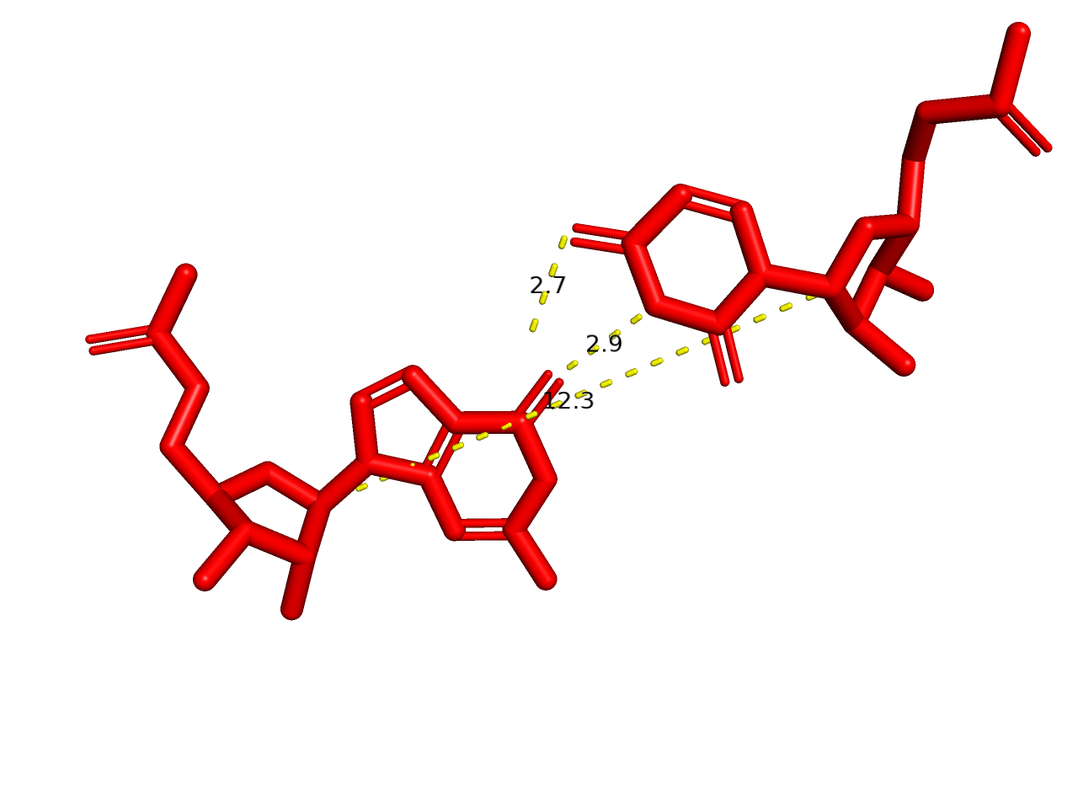
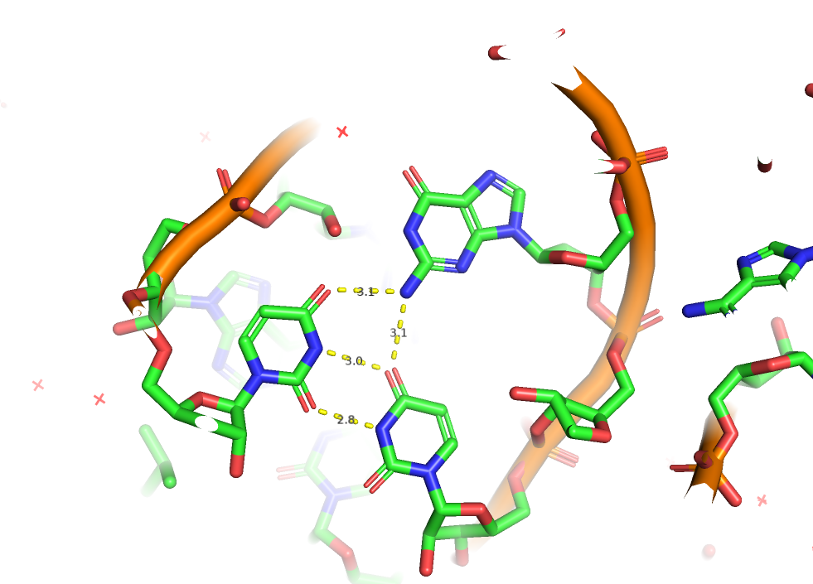
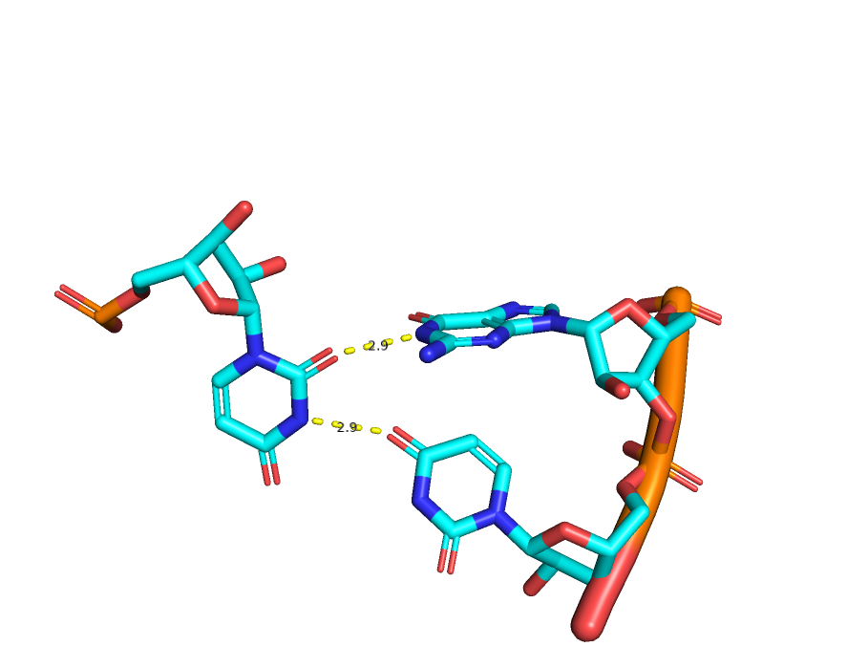
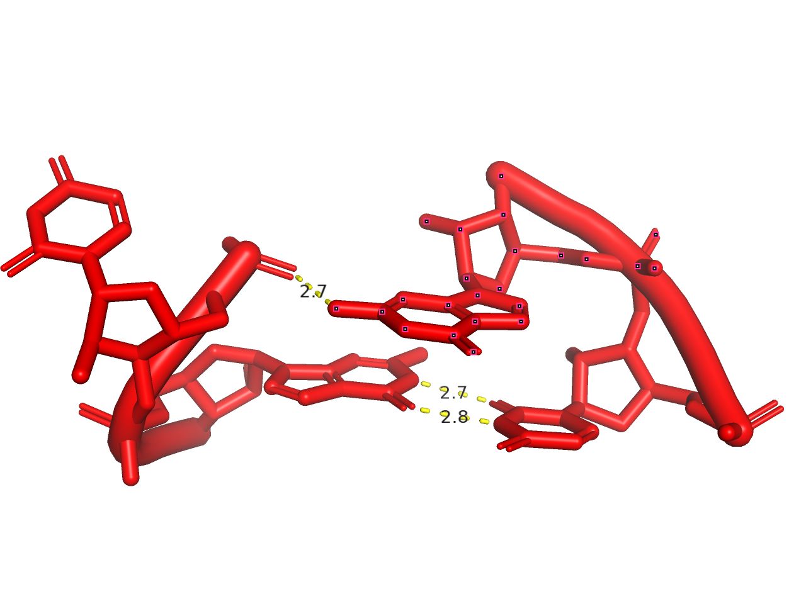
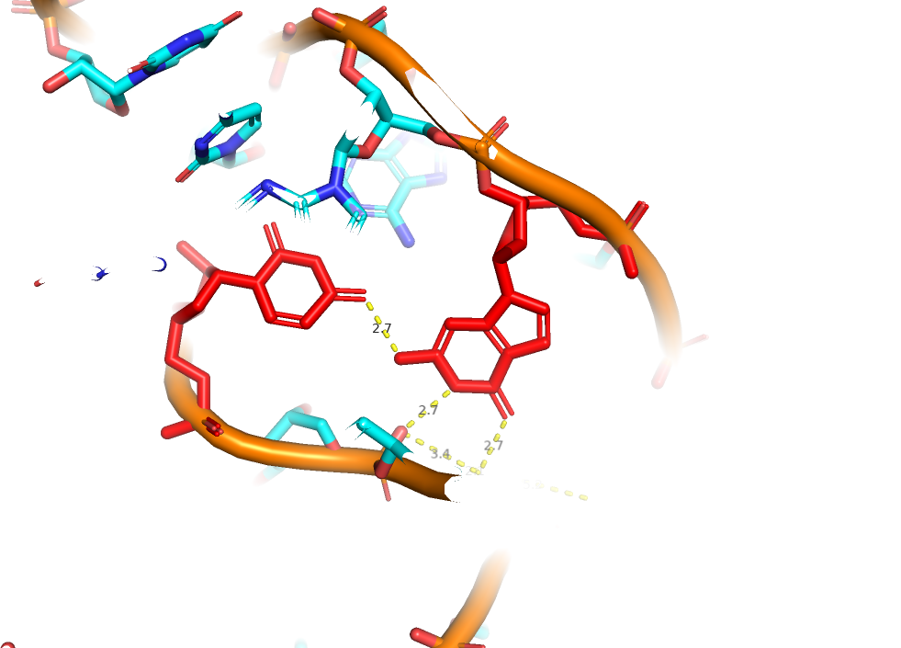
One H-bond pairs
Opened pairs
Watson et al. eLife 2020;9:e60482. DOI: https://doi.org/10.7554/eLife.60482

Slide 18
GoU pairs in TRANSLATION
and
Roles of tautomerism

Slide 19
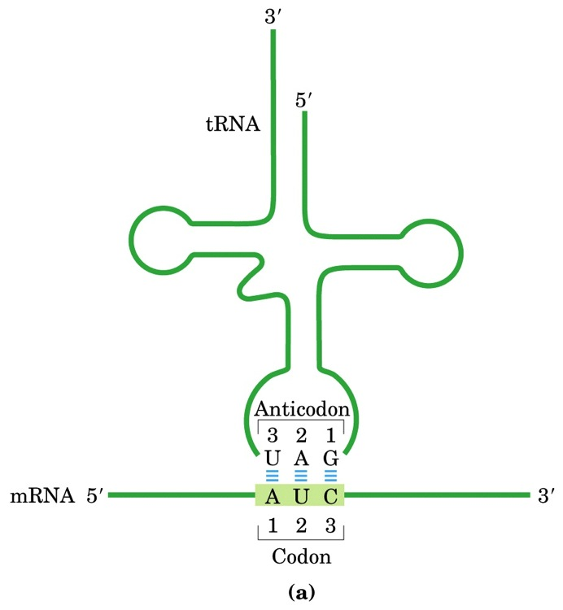
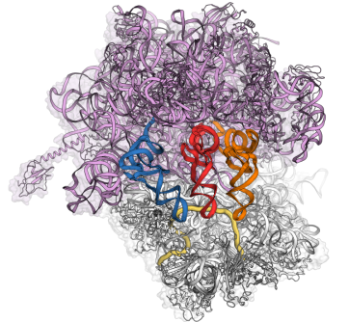
Amino acid
ARNt
36-35-34
ARNm

Slide 20
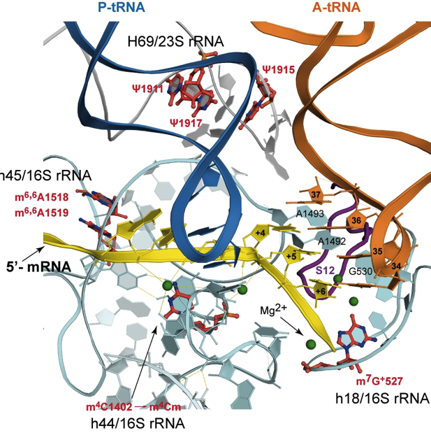
E P A
The
Ribosomal
GRIP
h
« The main factor in fidelity is active site tightness » E.T. Kool
Adapted from Demeshkina et al Nature 484, 2012

Slide 21
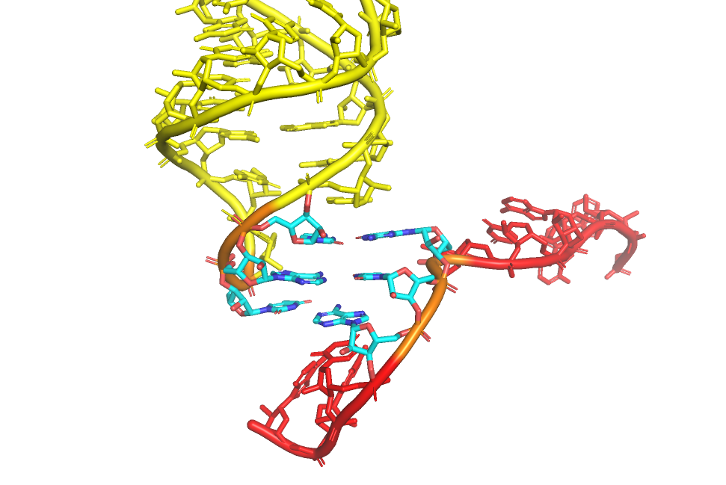
ARNt
5’
3’
32
*
*
38
5’
ARNm
R37
*
5’
36
1
U33
36
1
35
2
35
34
34
2
*
3
3
3’
3’

Slide 22
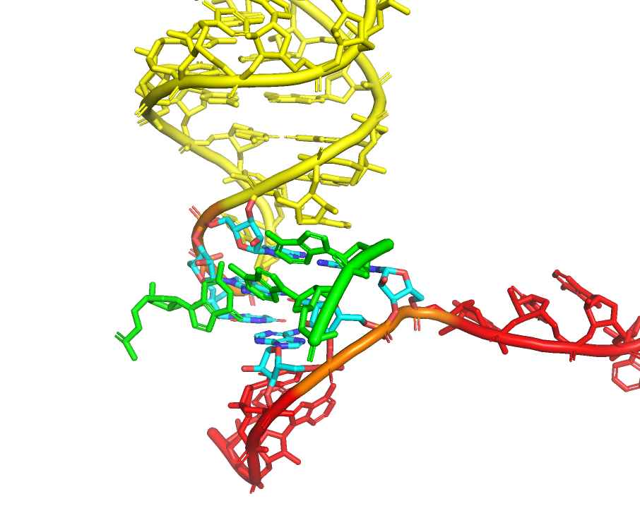
5’
36
1
35
34
2
3
3’

Slide 23
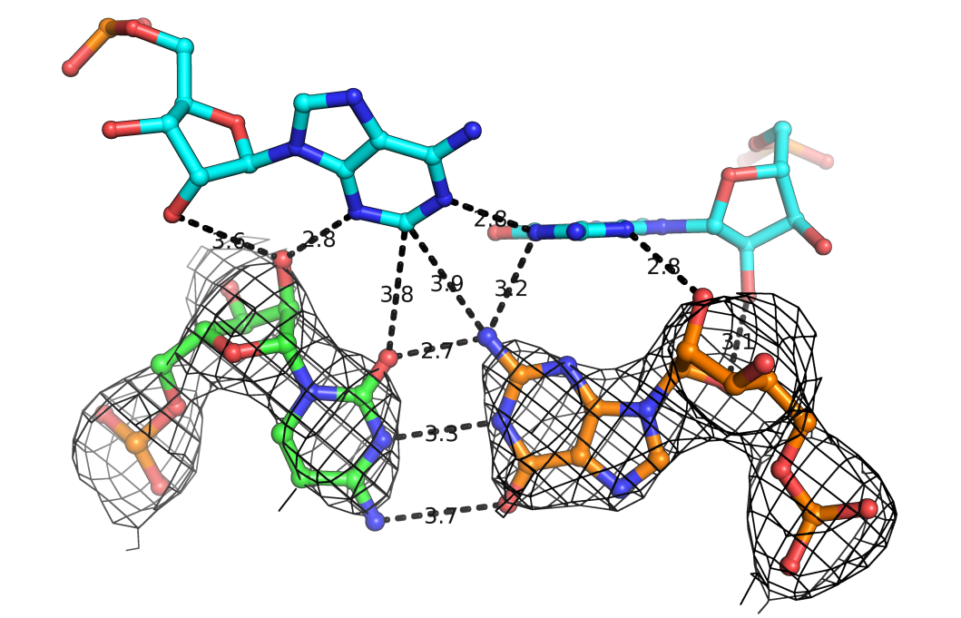
C(+5)=G35 mRNA_ tRNA

Slide 24
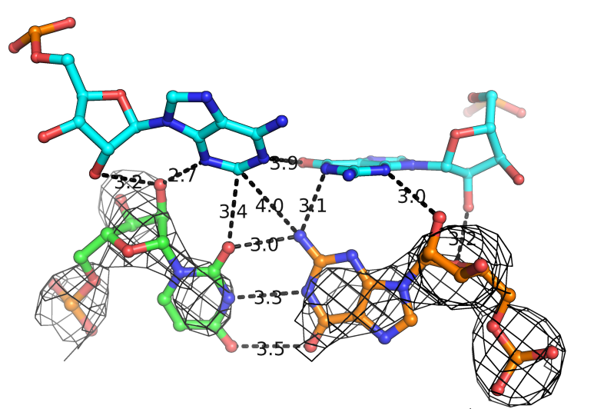
U(+5)oG35 mRNA_ tRNA

Slide 25
Rozov, et al. Nature Comm. 6, 7251 (2015)

Slide 26
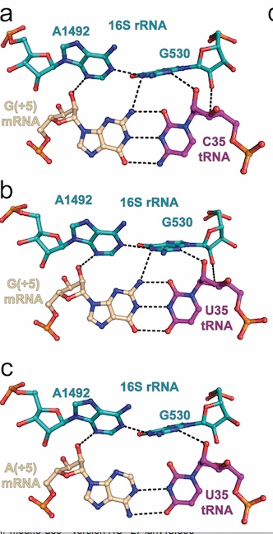
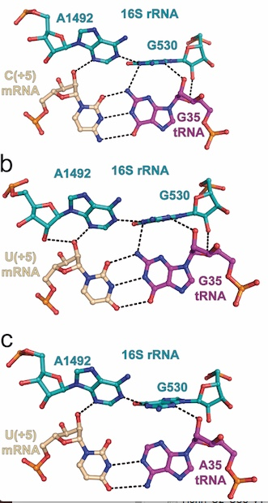
2nd position
+2/+5 - 35

Slide 27
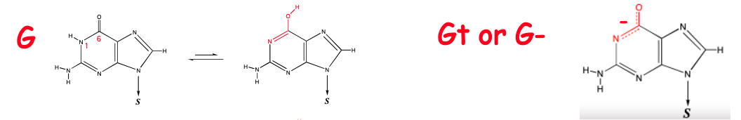
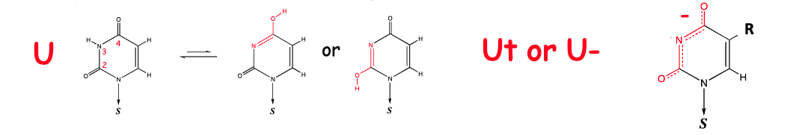
GoU pair in Watson-Crick-like geometry
with keto-enol tautomerism of U (left) or G (right)

Slide 28
Tautomeric Watson-Crick-like GoU pairs at 1st and 2nd positions: the most frequent occurrences of miscoding or translation errors
(1 in 10⁴⁾
Tautomeric ratio : 1 in 10⁴

Slide 29
tRNA
Ribosomal decoding center
5’
3’
16S rRNA
32
*
*
38
3’
5’
A1913
5’
mRNA
R37
*
C
G
U33
36
1
A1493
A
35
2
A1492
34
*
3
G
C
K⁺
C1054
5’
3’
3’
G530
C518
U531
G530
The third position is recognized asymmetrically
with the ribosome binding to the codon base
*
means often modified

Slide 30
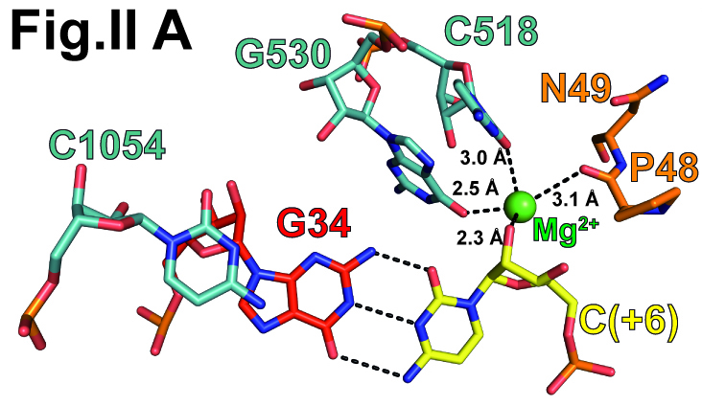
The decoding site holds tightly the 3rd codon base
S12
K⁺
C(+3)

Slide 31
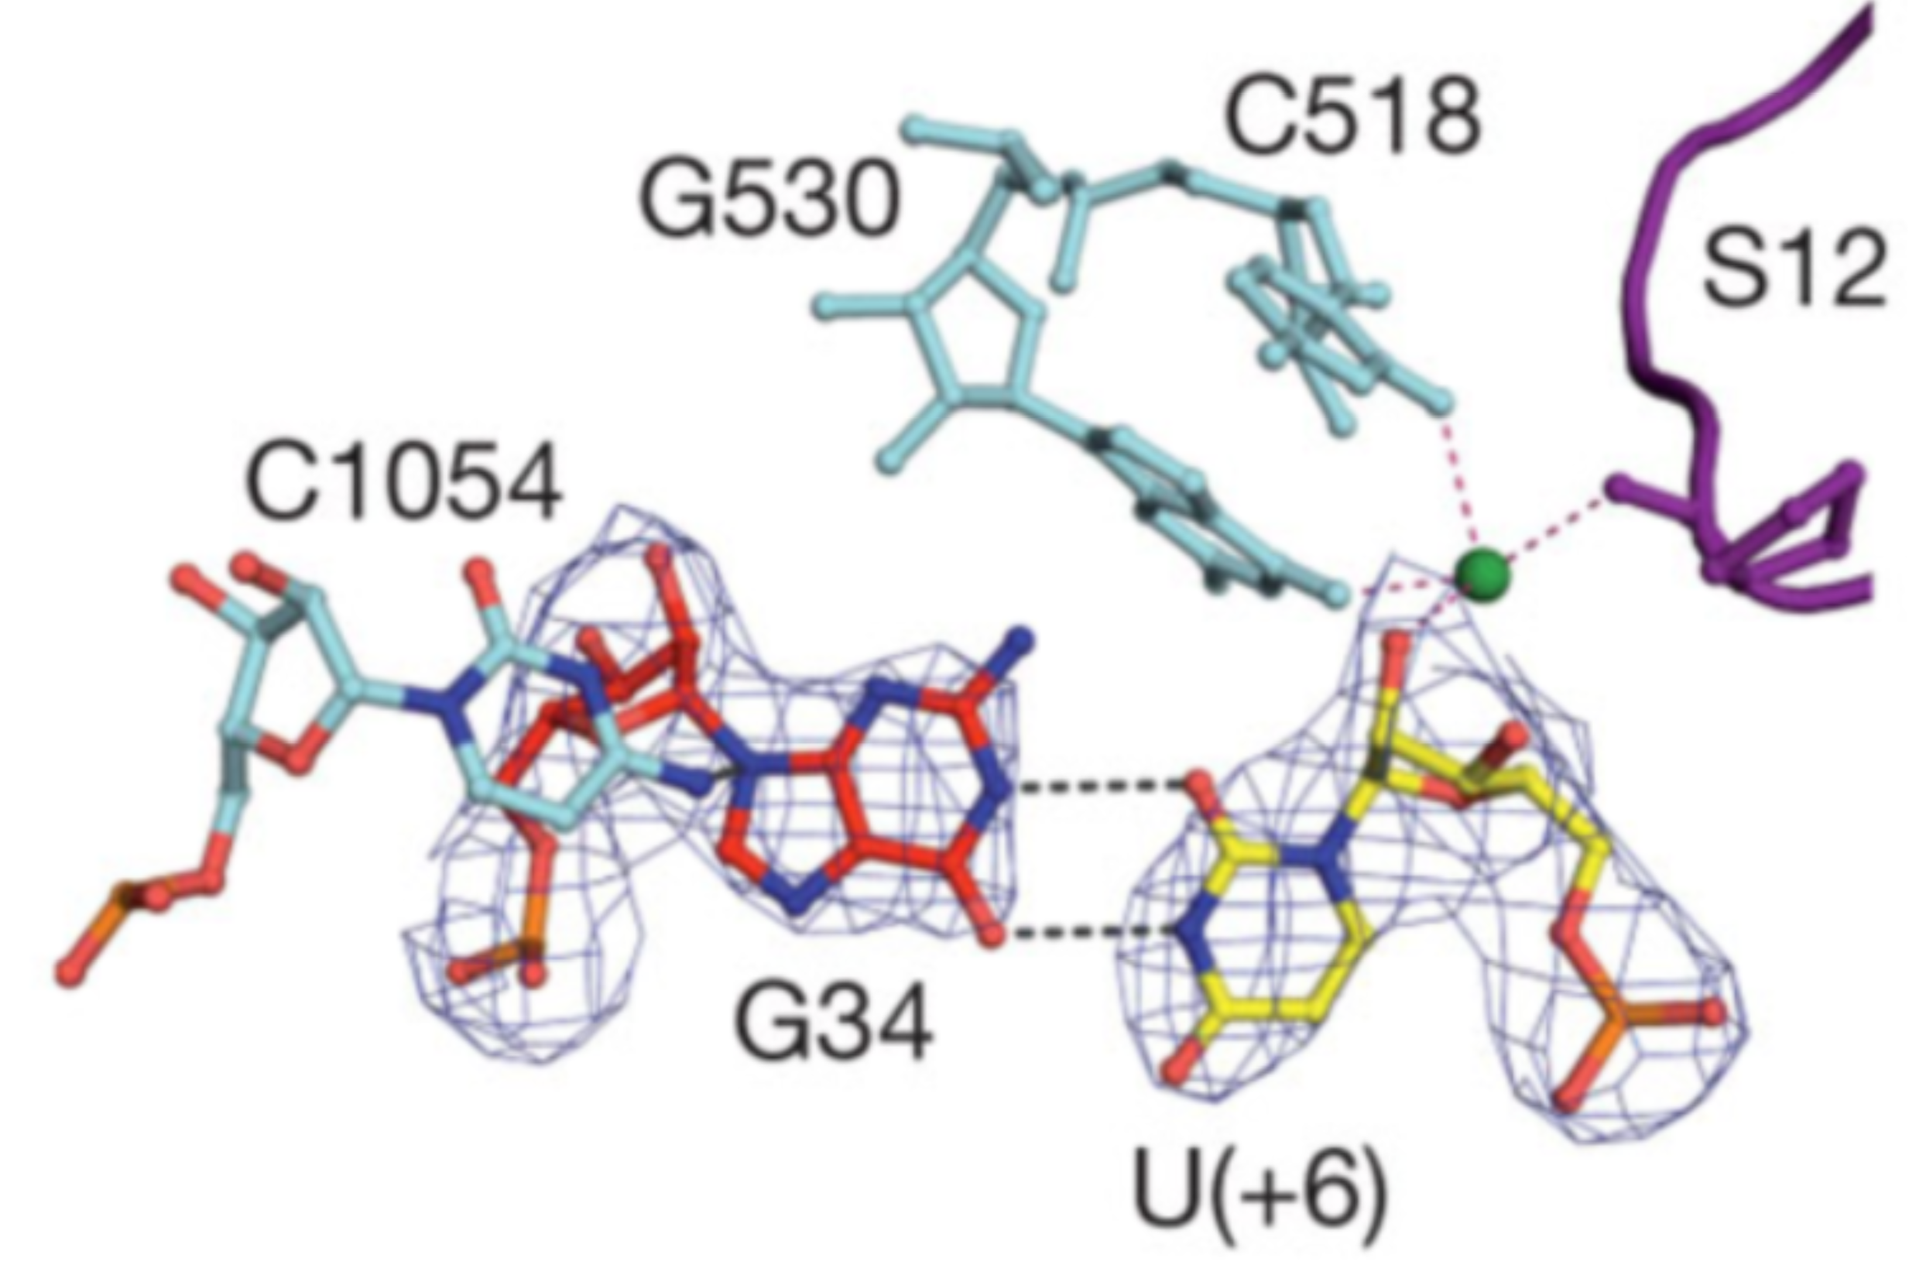
K⁺
U(+3)
Demeshkina, et al, Nature 2012
Rozov et al, Nature Comm. 2019

Slide 32
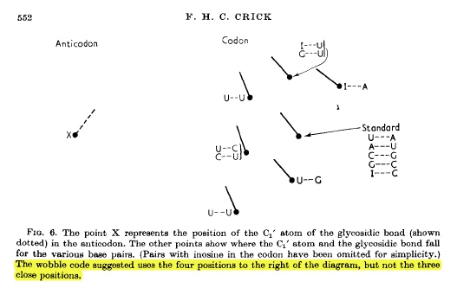
Simplified Fig.6 from F.H.C. Crick J. Mol. Biol. (1966) 19, 548-555
( )
34 +3

Slide 33
mnm⁵s²U
Rozov, et al. Nature Comm. 6, 7251 (2015)

Slide 34
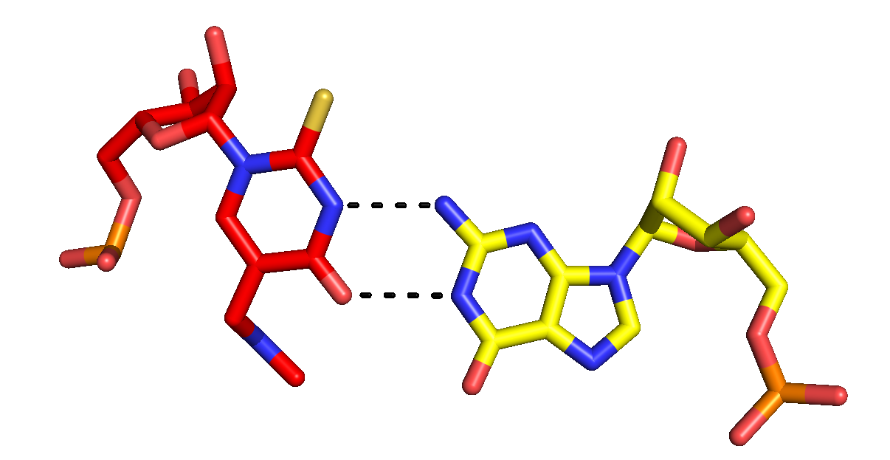
G+3
U34*
U34*
Anionic GoU pair
Minor Groove
Rozov, et al. Nature Comm. 7, 10457(2016)

Slide 36
G34oU(+3) and U34*oG(+3) are isosteric !
U+3
G+3
U34*
G34
G34
C+3
ANTICODON
CODON
U(+3)
G34
G34oU(+3)
G(+3)
U34*
U34*G(+3)

Slide 37
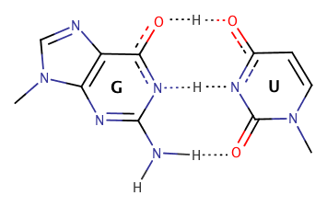
Back to isostericity
U
Tautomeric GoUs
G
G
U

Slide 38
G34-Y3
U34*-G3
V34 = cmo⁵U34
S34 = mnm⁵s²U34
M = K⁺ ,NATURE COMMUNICATIONS | (2019) 10:2519
Trends in Biochemical Sciences (2016) 41, 798

Slide 39
Three flavours of GoU pairs
Standard U
Usual GoU wobble pair
Watson-Crick-like
GoU tautomeric pair
Minor Groove GoU pair
Increase in
ribosomal
constraints
Modified U

Slide 40


UPR 9002 du CNRS,
Architecture et Réactivité de l’ARN,
Institut de Biologie Moléculaire et Cellulaire,
Université de Strasbourg
Gulnara & Marat Yusupov, N. Demeshkina, A. Rozov (IGBMC)
Jamie Cate, Zoe Watson (Berkeley)
Todd Lowe, Patricia Chan, Bryan Thorlow (UC Santa Cruz)

Slide 41
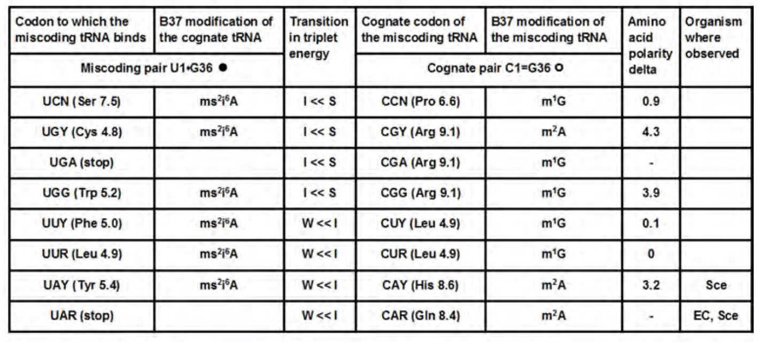

Slide 42
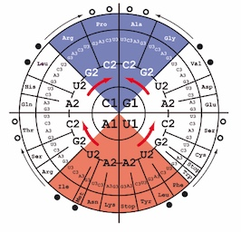
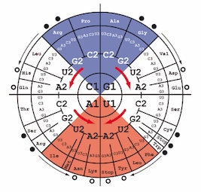
Cognate pair C(+2) = G35
V
Miscoding pair U(+2) o G35
Cognate pair A(+2) - U35
V
Miscoding pair G(+2) o U35
Observed most frequently
A modified tRNA binding to a « stronger » codon

Slide 43
Cognate pair A(+2)-U35 > Miscoding pair G(+2)oU35

Slide 44
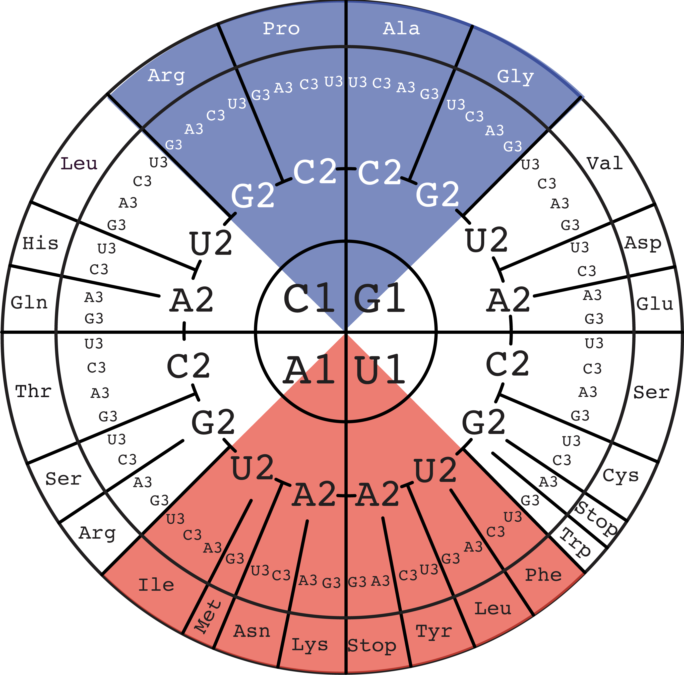
G/C-rich RNA world with oldest amino acids
Strong tRNA binding
Increasing stability of network interactions
Increase in A/U and amino acid diversity
coupled with modification enzymes
Weak tRNA
binding
Grosjean, H. and E. Westhof (2016). "An integrated, structure- and energy-based view of the genetic code." Nucleic Acids Res 44: 8020-8040.

