Slide 1
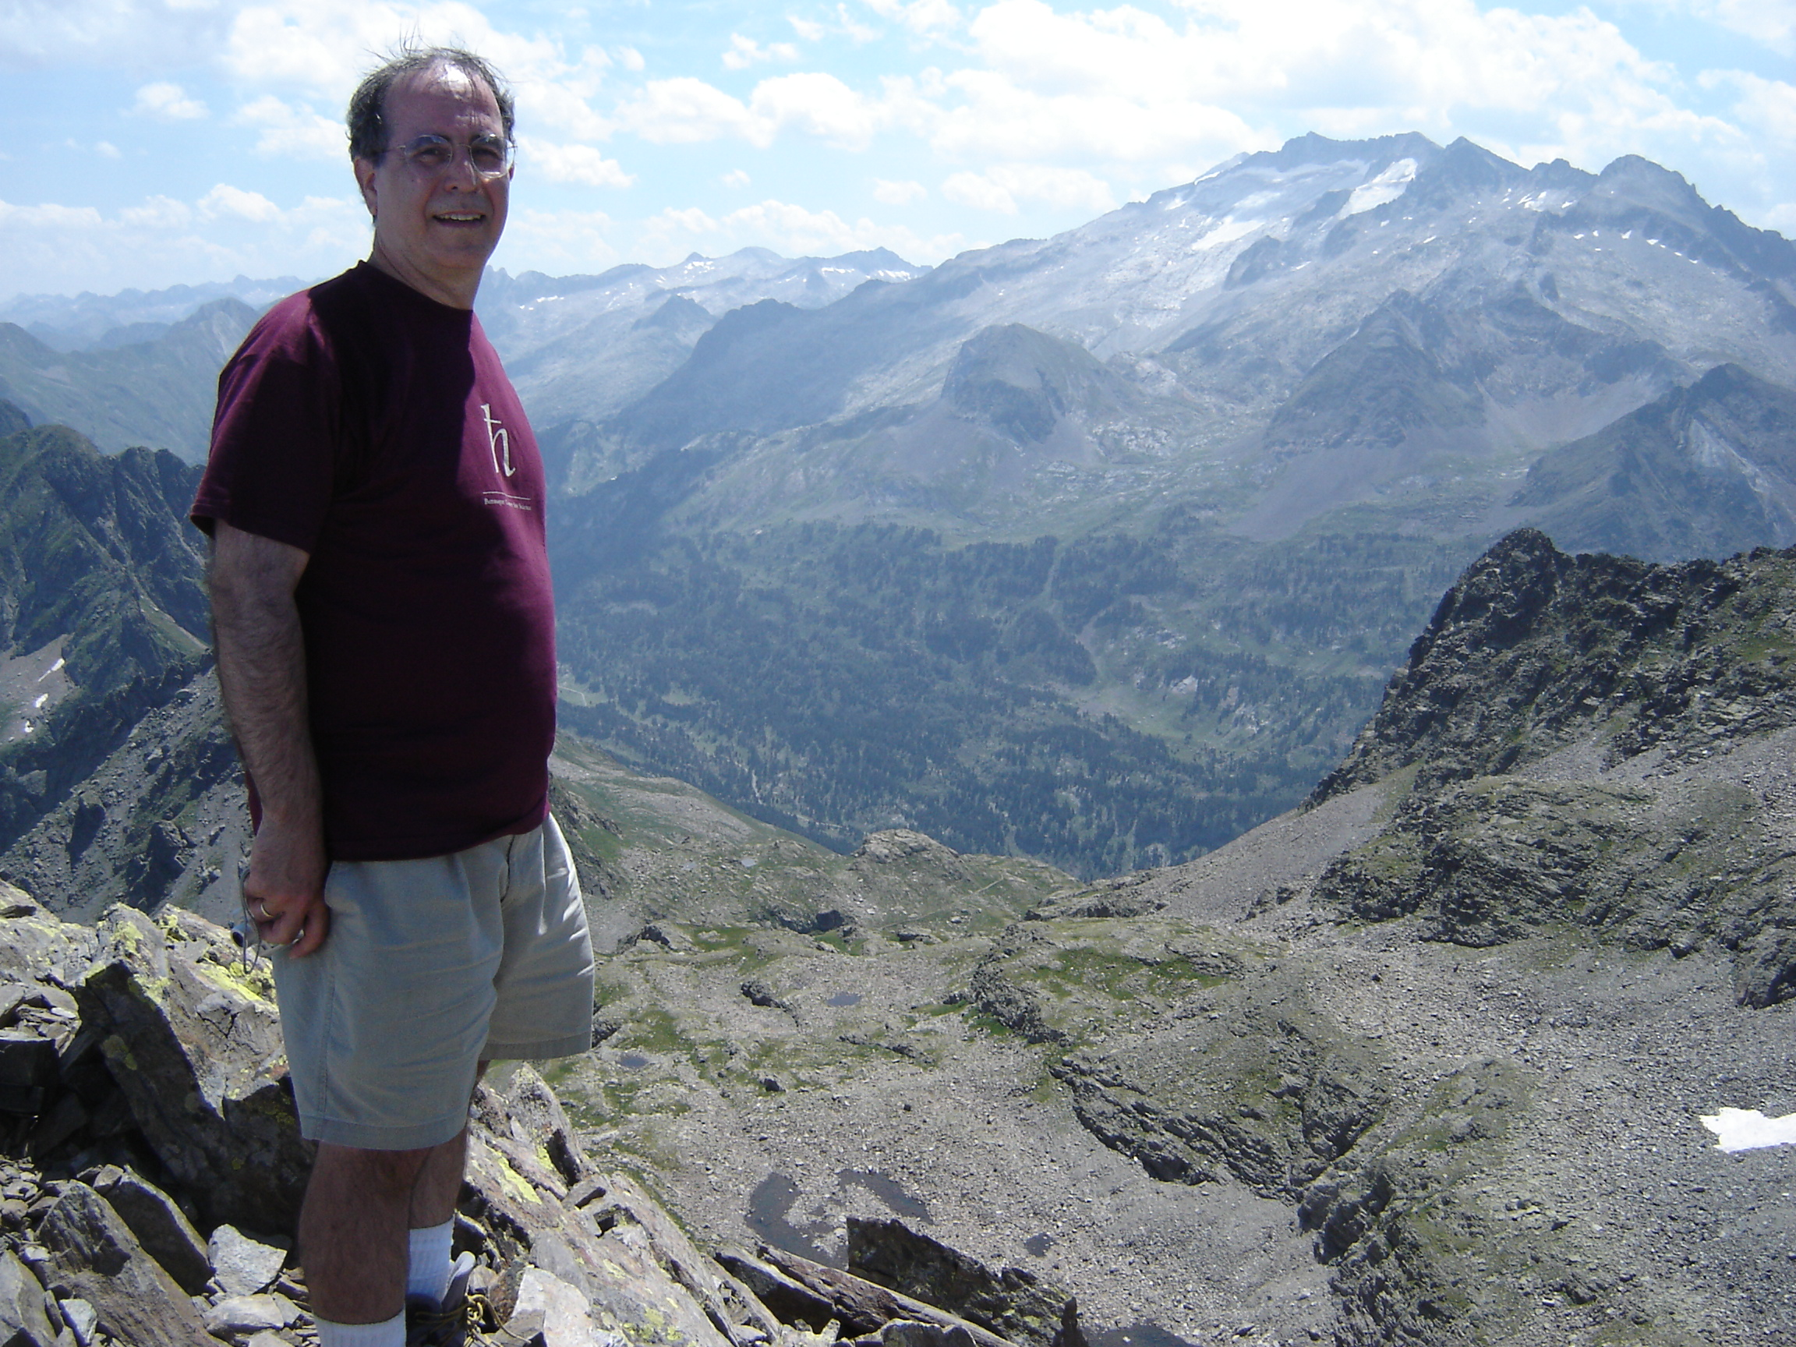
My time with Neocles Leontis and updates on our work
Neocles B. Leontis 1955-2020
Craig L. Zirbel
Bowling Green State University
Benasque
18 August 2022
Neocles in Benasque, on a peak near La Glera with Aneto in the background, 22 July 2006
Notes:
0:30

Slide 2
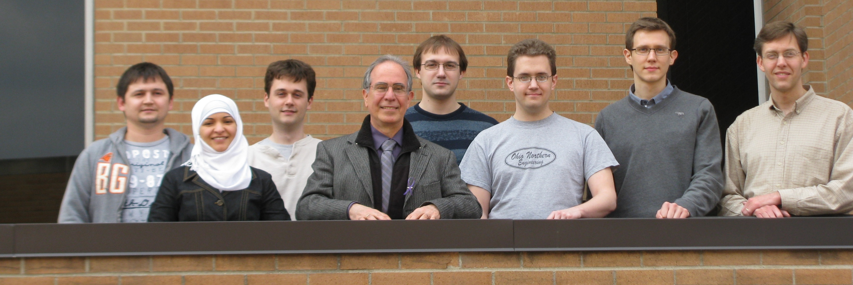
My time with Neocles Leontis
We worked together from 1999 to 2020
Wrote 27 papers together (with many other authors)
Jointly mentored 13 PhD students, 6+ undergraduates, 3+ high school students
Craig L. Zirbel | My time with Neocles Leontis | Benasque 2022-08-18
Notes:
1:15

Slide 3
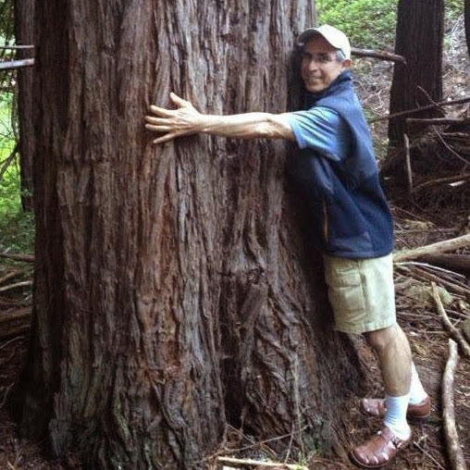
Teaching
Neocles loved working with and encouraging students
The last text he wrote to a student and me (about KV to PP):
  Next week I’ll show you the key role played by proline mutations in production of new vaccines! Very cool. Thanks to NIH research American socialist state rises to the rescue once again!
Redwood stand near Stanford, June 2013
Craig L. Zirbel | My time with Neocles Leontis | Benasque 2022-08-18
Notes:
2:15

Slide 4
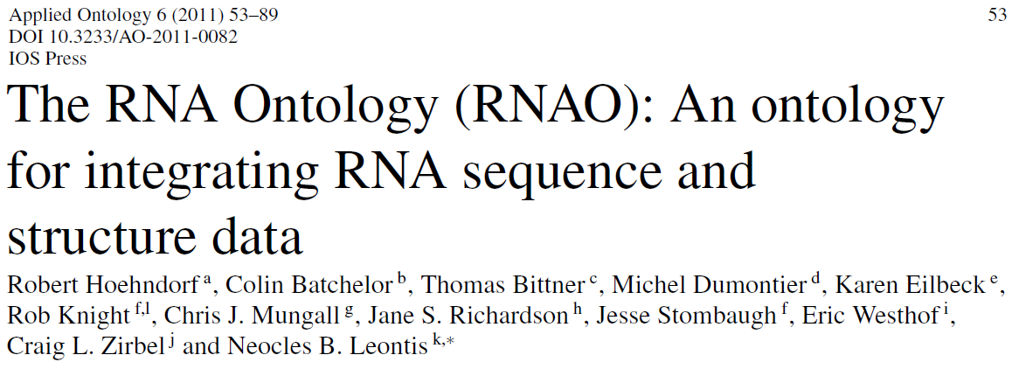
RNA Ontology Consortium
NSF Research Coordination Grant from 2004
2006 invitation
  2009 Cambridge
  2009 Madison
  2010 Cambridge
  2010 Seattle
  2010 Strasbourg
2011 Ontology paper
Craig L. Zirbel | My time with Neocles Leontis | Benasque 2022-08-18
Notes:
4:00 Big ideas, cutting edge of things

Slide 5
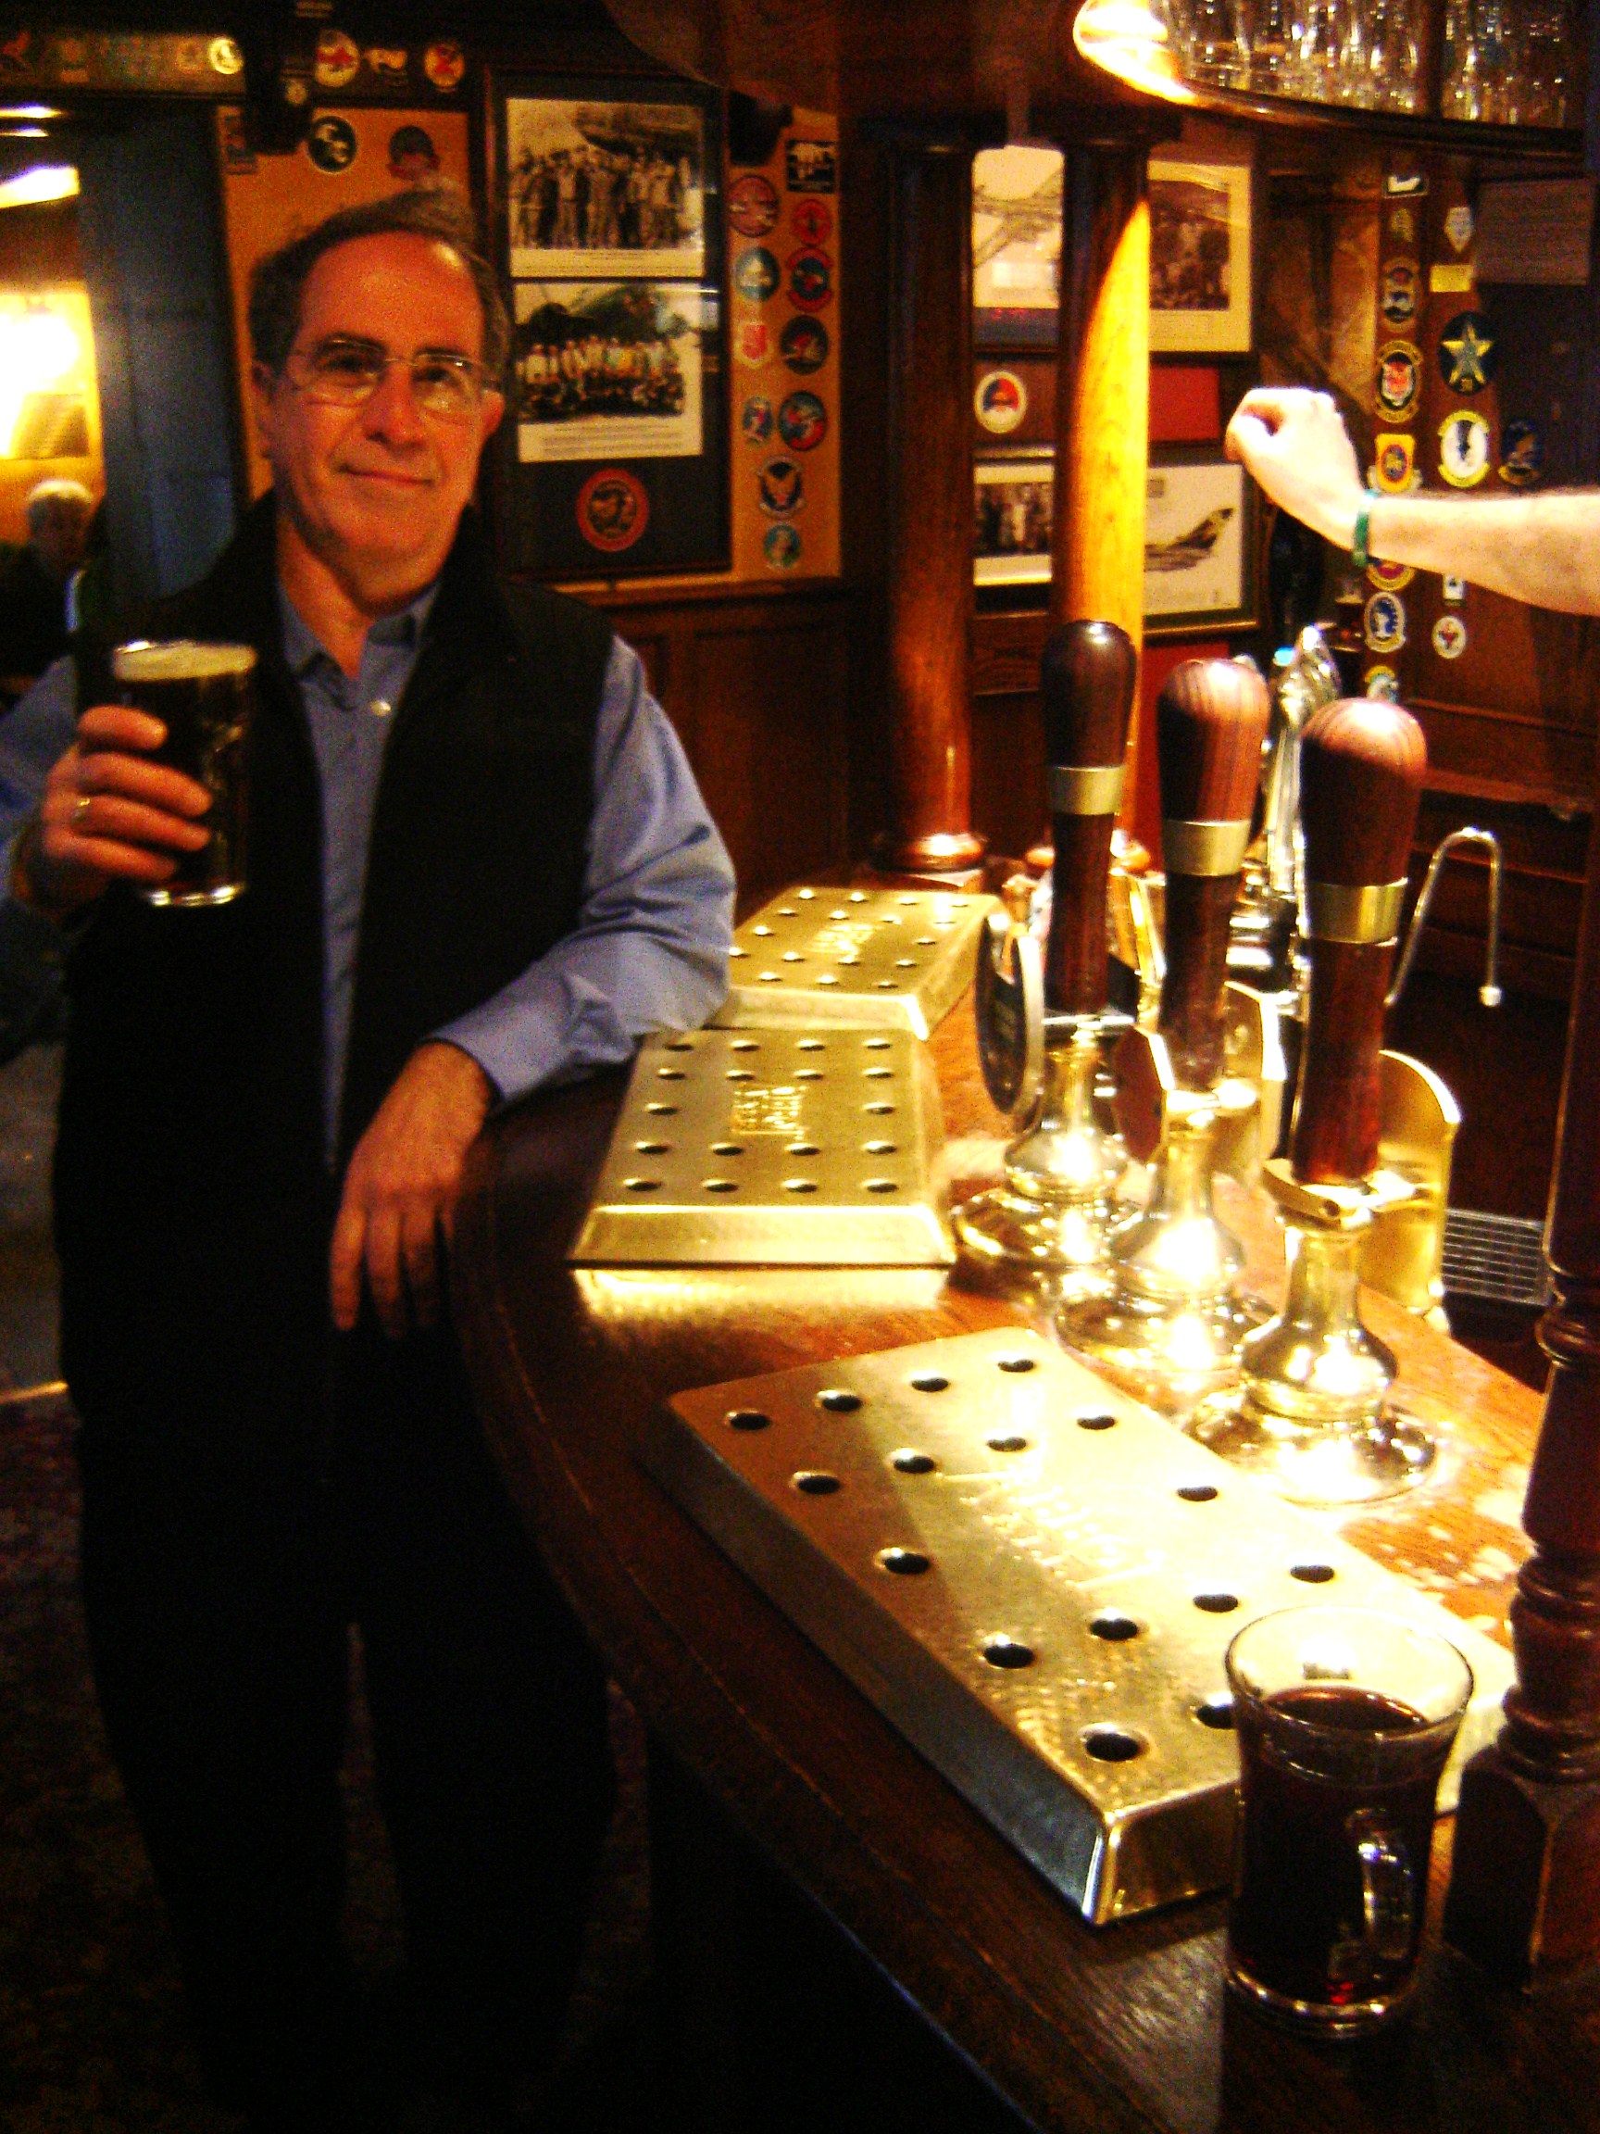
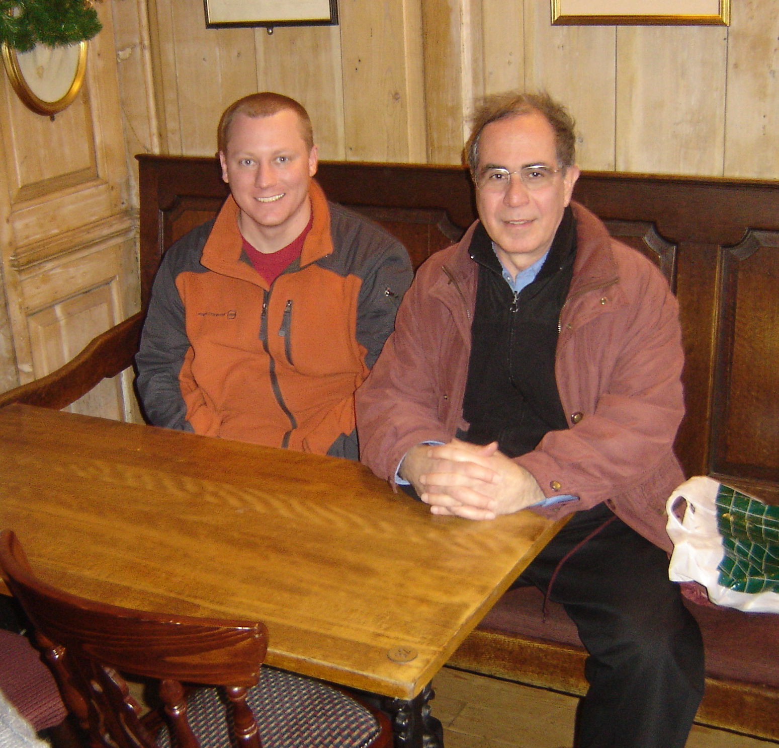
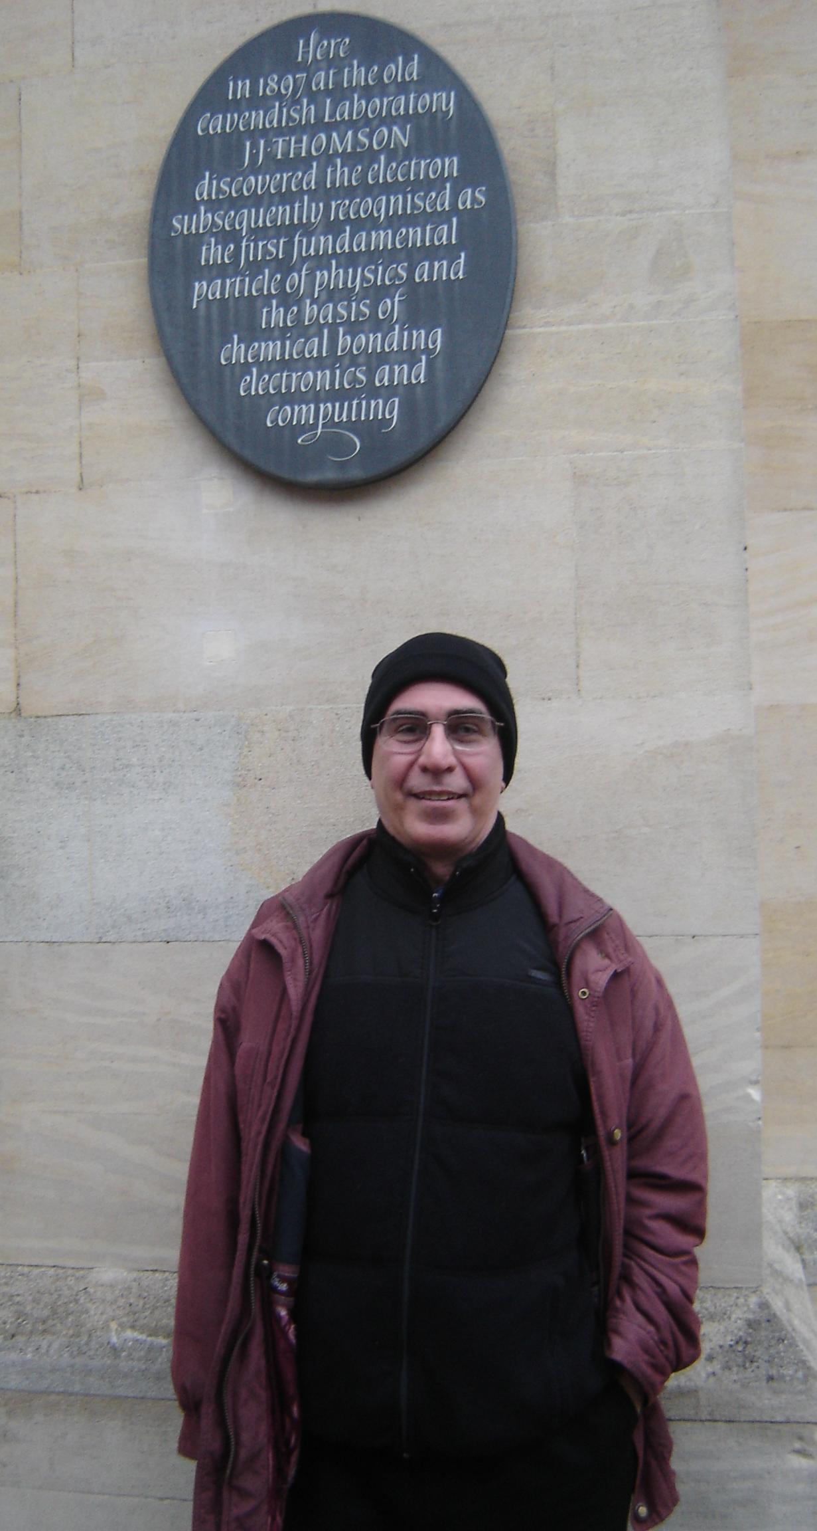
2009 RNA Ontology meetings in Cambridge
Neocles with PhD student Jesse Stombaugh at The Eagle in January 2009
Craig L. Zirbel | My time with Neocles Leontis | Benasque 2022-08-18

Slide 6
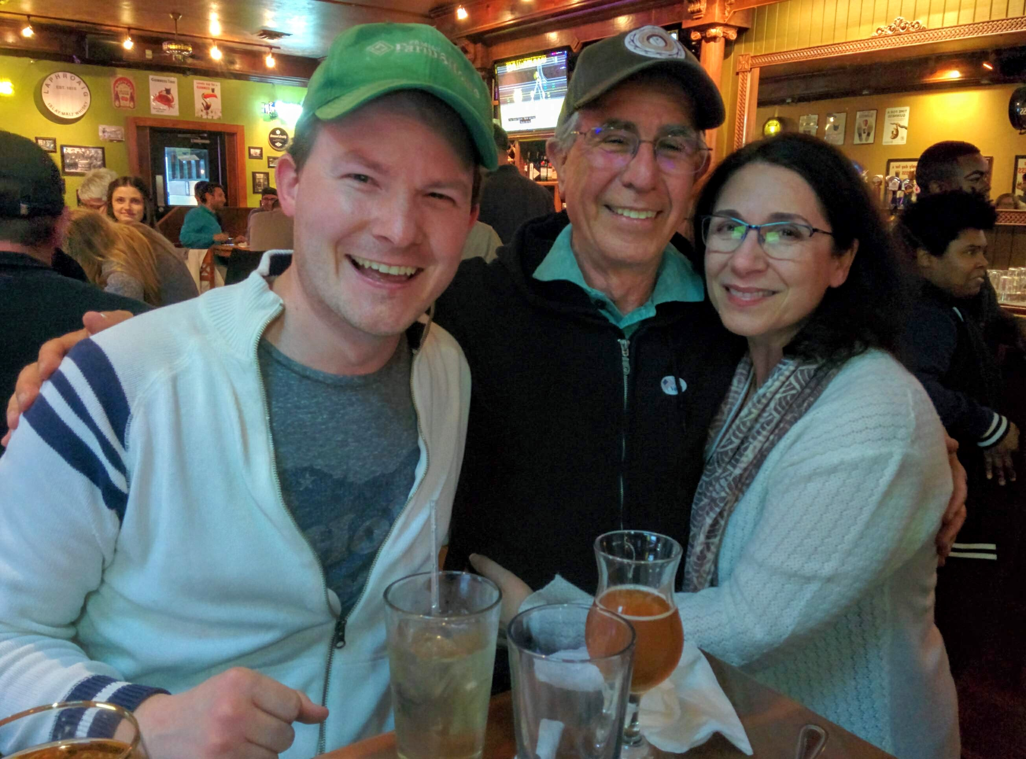
A few more things that Neocles led the way on …
Faculty Senate Chair
Innovative Teaching Group
Diet and health interest and support group
Home energy audits for homes in Bowling Green
  and for people renting apartments!
President’s Council on Sustainability
  BGSU carbon neutrality pledge
  Investigating geothermal heating for BGSU, long before it was cool
Neocles, his wife Vassiliki, and his campaign manager after winning the Democratic primary for Bowling Green City Council in May 2019.
Craig L. Zirbel | My time with Neocles Leontis | Benasque 2022-08-18
Notes:
6:30

Slide 7
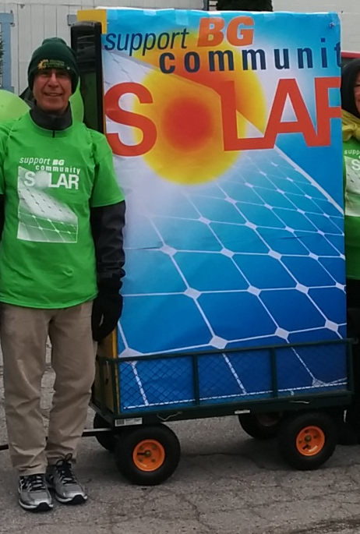
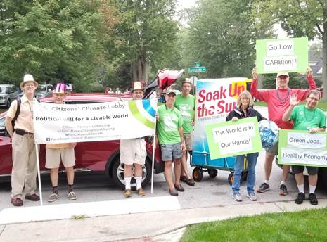
Energy and climate
Craig L. Zirbel | My time with Neocles Leontis | Benasque 2022-08-18
Notes:
7:00

Slide 8
Overview of our work together
RNA 3D structure and the sequence-structure relationship
  Special focus on non-Watson-Crick basepairs
  and other base-specific interactions like base-phosphate, -ribose
Build tools for people to learn about and use 3D structures
The tools mine the 3D structure database
  … so they get stronger as more 3D structures are solved
Craig L. Zirbel | Update on our work | Benasque 2022-08-18
Notes:
8:20

Slide 9
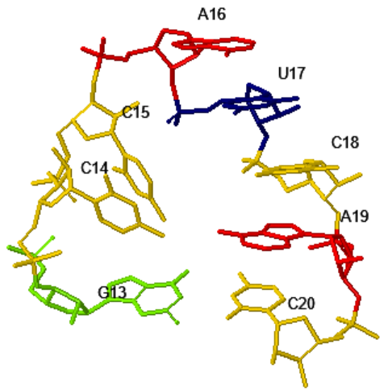
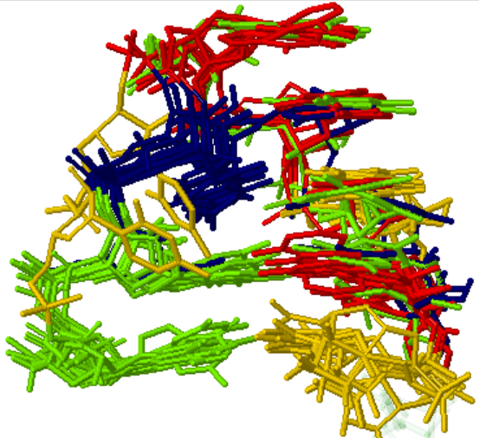
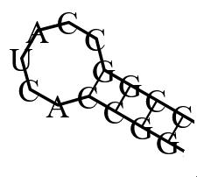
Hairpin loop
5’
3’
HL_6UFM_004
Selected instances from hairpin loop motif group HL_93727.4
Craig L. Zirbel | Update on our work | Benasque 2022-08-18
Notes:
9:11

Slide 10
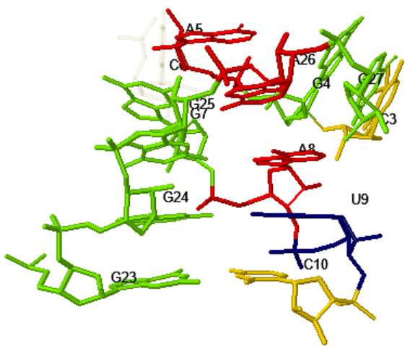
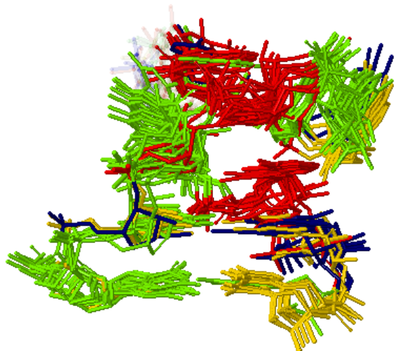
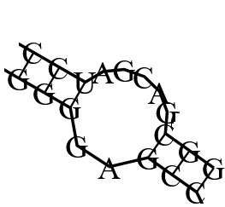
Internal loop
3’
5’
5’
3’
Selected instances from hairpin loop motif group IL_29549.8
IL_6UFM_001
Craig L. Zirbel | Update on our work | Benasque 2022-08-18
Notes:
10:20

Slide 11
RNA 3D Motif Atlas
Every four weeks, we collect the HL and IL instances from x-ray 3.5Å
Group them by overall geometry and basepair annotations
  314 hairpin loop groups
  324 internal loop groups
Now: Annotating instances manually, learning about inhomogeneity
Now: Recoding in Python
Soon: Annotate HL and IL in cryo-em, NMR, and lower-res structures
Later: Add additional motif types
Craig L. Zirbel | Update on our work | Benasque 2022-08-18
Notes:
12:00

Slide 12
JAR3D for sequence -> motif inference
Model the sequence variability of each HL and IL motif group with SCFG
Score input sequence(s) against each model, report the best match
Thus, map known or novel sequence(s) to the best-matching known geometry
Craig L. Zirbel | Update on our work | Benasque 2022-08-18

Slide 13
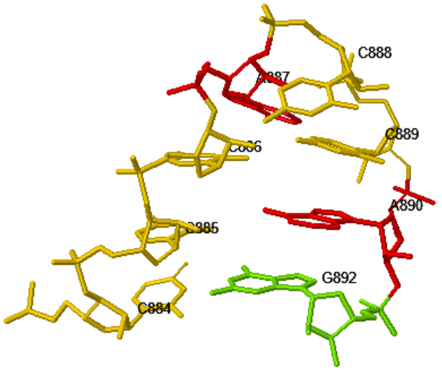
JAR3D: Hairpin loop from T-box riboswitch
3D structure from 6UFM, 2019-12-04
5’
3’
GCCAUCAC
JAR3D 1.4 or 3.2
Instance HL_4Y4O_128 from the motif group
HL_13145.1
Craig L. Zirbel | Update on our work | Benasque 2022-08-18

Slide 14
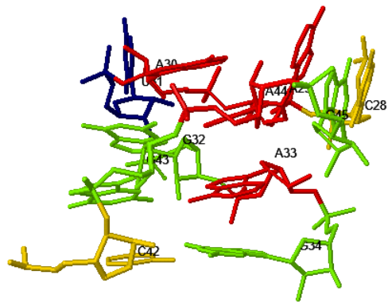
JAR3D: Internal loop from T-box riboswitch
3’
5’
3D structure from 6UFM, 2019-12-04
5’
3’
CGACGAU*GGAG
JAR3D 1.4
July 1, 2013
One instance from motif group IL_77263.1
IL_77263.1
Craig L. Zirbel | Update on our work | Benasque 2022-08-18

Slide 15
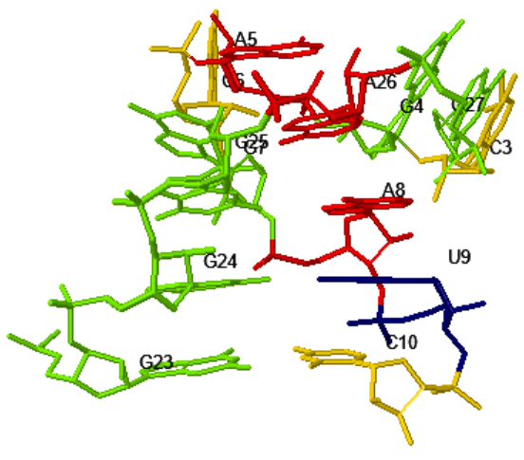
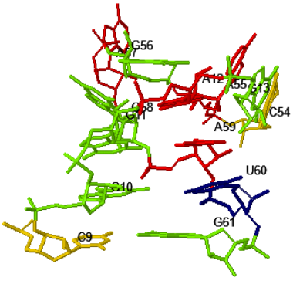
JAR3D: Internal loop from T-box riboswitch
3’
5’
3D structure from 6UFM, 2019-12-04
5’
3’
CGACGAUC*GGGAG
JAR3D 1.4,
July 1, 2013
Instance IL_1T0K_001 from the motif group
IL_65553.5
Craig L. Zirbel | Update on our work | Benasque 2022-08-18
Notes:
14:15

Slide 16
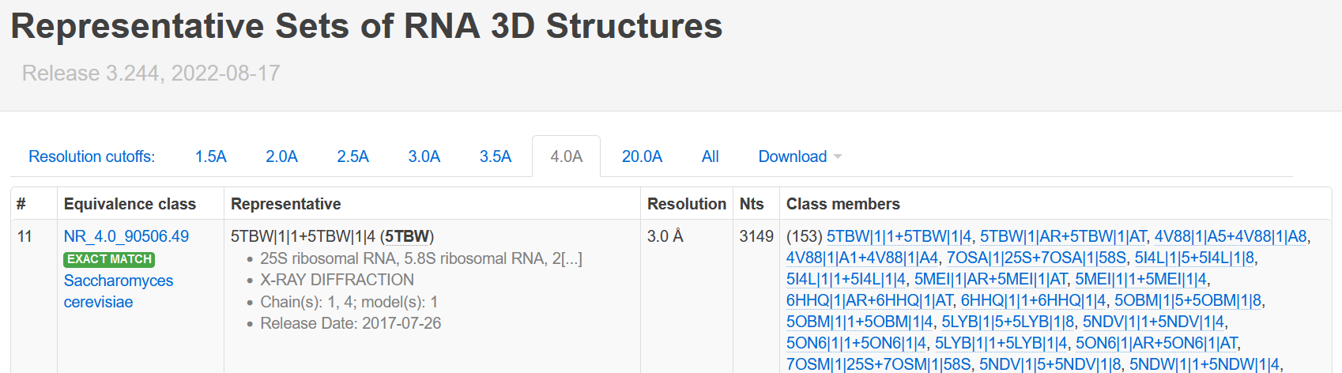
Representative sets of RNA 3D structures
Redundancy in RNA 3D structures in PDB
Group structures by species, sequence, and geometry
  Equivalence class of structures
Craig L. Zirbel | Update on our work | Benasque 2022-08-18

Slide 17

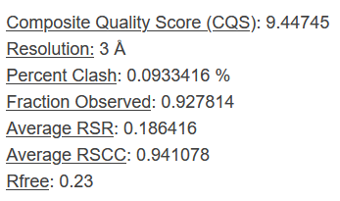
Representative sets of RNA 3D structures
Sort members by linear combination of six quality indicators:
  Resolution
  Percent clash
  1 - Fraction of the experimental sequence observed
  Average RSR
  1 - Average RSCC
  Rfree
Available for x-ray only
Craig L. Zirbel | Update on our work | Benasque 2022-08-18
Notes:
17:25

Slide 18
FR3D
FR3D = Find RNA 3D
Search for small RNA motifs on the WebFR3D server
Many recent improvements in the runtime and output
Soon: Search for DNA and for modified RNA and DNA nucleotides
Soon: Ability to run locally on mmCIF and PDB files
  https://github.com/BGSU-RNA/fr3d-python
Example from the spliceosome structure:
This is a FR3D symbolic query; search the 2.5Å representative set
1
cWW
2
cHS
3
GC
>4
Craig L. Zirbel | Update on our work | Benasque 2022-08-18

Slide 19
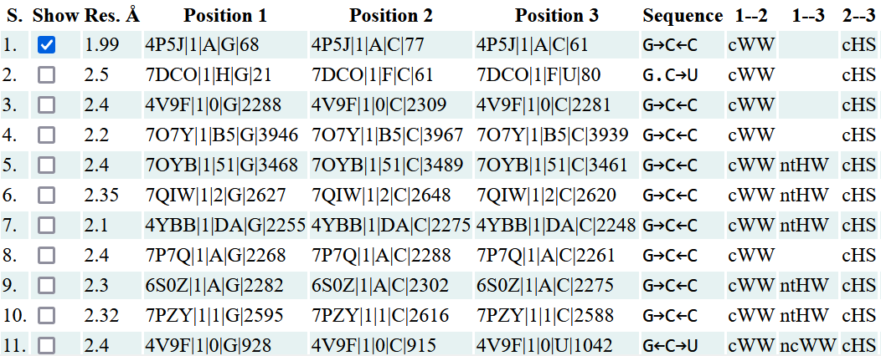
WebFR3D
1
cWW
2
cHS
3
GC
>4
FR3D output
Found 21 candidates from 972 of 972 files in 22 seconds. See and modify query | See CSV output
Craig L. Zirbel | Update on our work | Benasque 2022-08-18

Slide 20
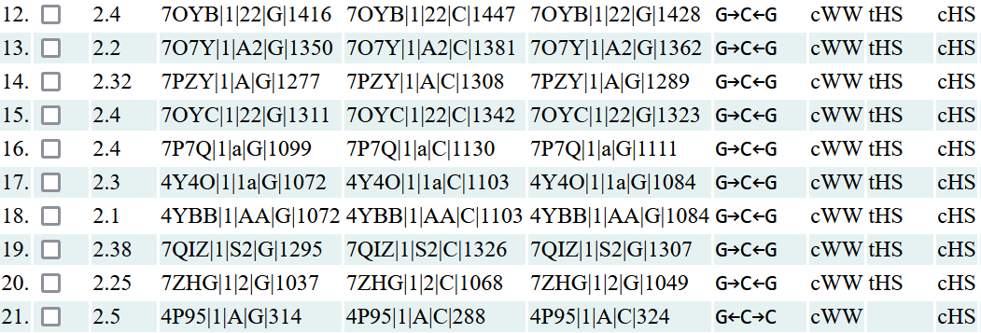
WebFR3D
1
cWW
2
cHS
3
GC
>4
FR3D output
Found 21 candidates from 972 of 972 files in 22 seconds. See and modify query | See CSV output
Craig L. Zirbel | Update on our work | Benasque 2022-08-18

Slide 21
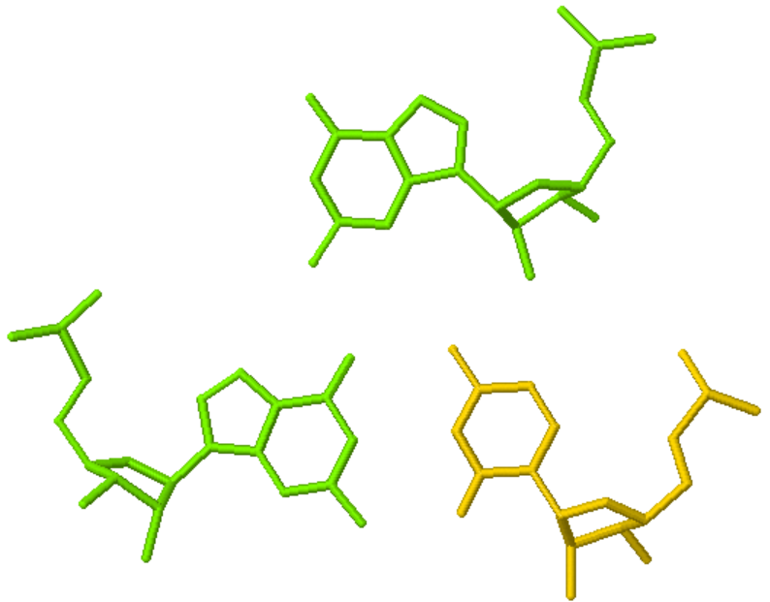
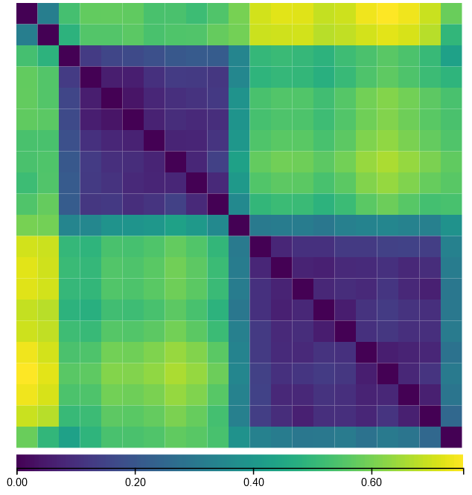
WebFR3D
1
cWW
2
cHS
3
GC
>4
FR3D output
Found 21 candidates from 972 of 972 files in 22 seconds. See and modify query | See CSV output
3
1
2
Coordinates of individual instances or superpositions
All-versus-all geometric comparison
Craig L. Zirbel | Update on our work | Benasque 2022-08-18
Notes:
20:30

Slide 22
WebFR3D
Continued example from the spliceosome structure
  Search for stacked base triples
1
cWW
2
cHS
3
GC
>4
stack
stack
=1
=1
4
cWW
5
pair
6
Craig L. Zirbel | Update on our work | Benasque 2022-08-18
Notes:
20:30

Slide 23
FR3D annotations
Available for all RNA-containing 3D structures at rna.bgsu.edu
Now: being ported to Python
Soon: run FR3D locally to annotate mmCIF or PDB files with:
  Basepairs using Leontis-Westhof symbols
  Base stacking
  Base-phosphate and base-ribose interactions
  Backbone oxygens stacking on bases
  RNA including modified nucleotides
  DNA including modified nucleotides
  https://github.com/BGSU-RNA/fr3d-python
Craig L. Zirbel | Update on our work | Benasque 2022-08-18
Notes:
21:20

Slide 24

Nucleic Acid Knowledgebase (NAKB)
Collaboration with Helen Berman and Cathy Lawson at NDB
NAKB is designed to be a one-stop-shop for RNA and DNA 3D structure information, and will replace NDB
New search that is tuned to nucleic acids
Links out to RNA and DNA-specific annotation resources
  Look for ways to link to and from your site
Try it and send Cathy feedback
http://www-dev-2.nakb.org/
Funding from NIH
Craig L. Zirbel | Update on our work | Benasque 2022-08-18
Notes:
22:45

Slide 25
Contributors
RNA 3D Motif Atlas
  Anton Petrov
  Seyoung Ree
  Adam Coger
  Vy Nguyen
JAR3D
  Michael Sarver
  Meg Pirrung
  James Roll
  Anton Petrov
Representative sets
  Anton Petrov
  Blake Sweeney
  Jamie Cannone
FR3D and WebFR3D
  Jesse Stombaugh
  Michael Sarver
  William Xi
  Jacob Mitchell
NAKB
  Cathy Lawson
  Helen Berman
Funding
  NIH R01GM085328
Craig L. Zirbel | Update on our work | Benasque 2022-08-18

Slide 26
Thank you!
To Neocles
To Elena and Eric
To all of you
Craig L. Zirbel | Update on our work | Benasque 2022-08-18
Notes:
23:00

