Slide 1
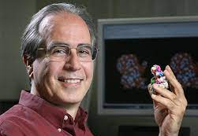
Neocles LEONTIS
1955 - 2020
doi:10.1261/rna.078673.121

Slide 2
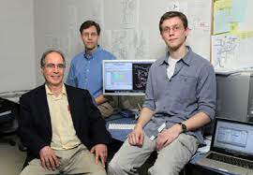

Slide 3

July 22, 2006

Slide 4
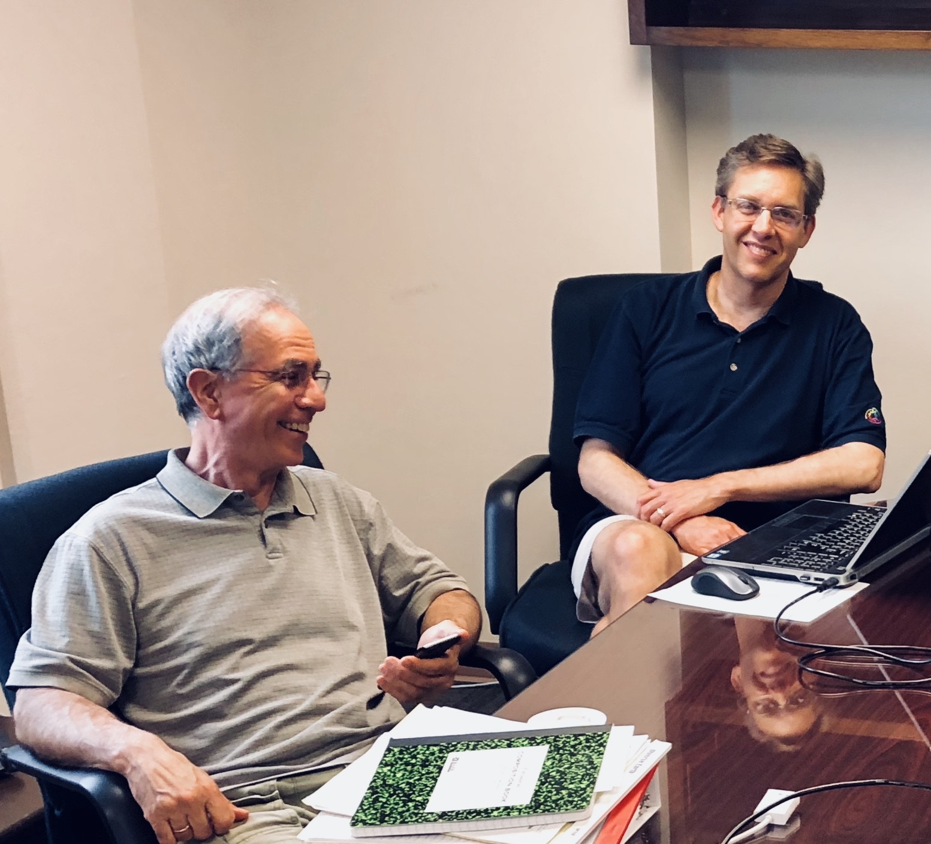
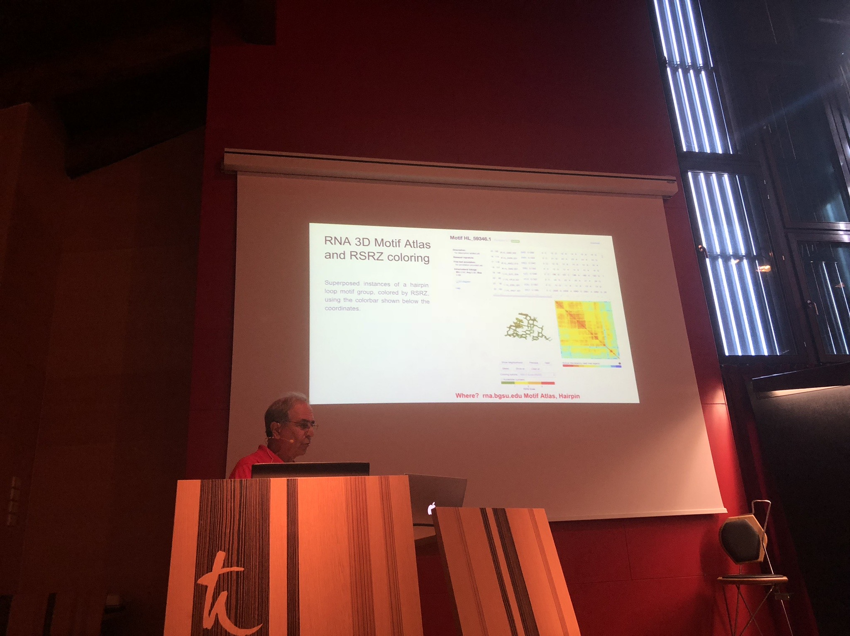
Benasque 2018

Slide 5
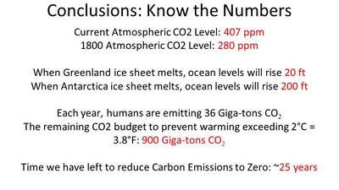

Slide 6
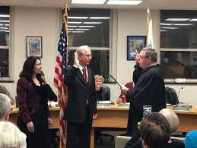
Bowling Green City Council

Slide 7
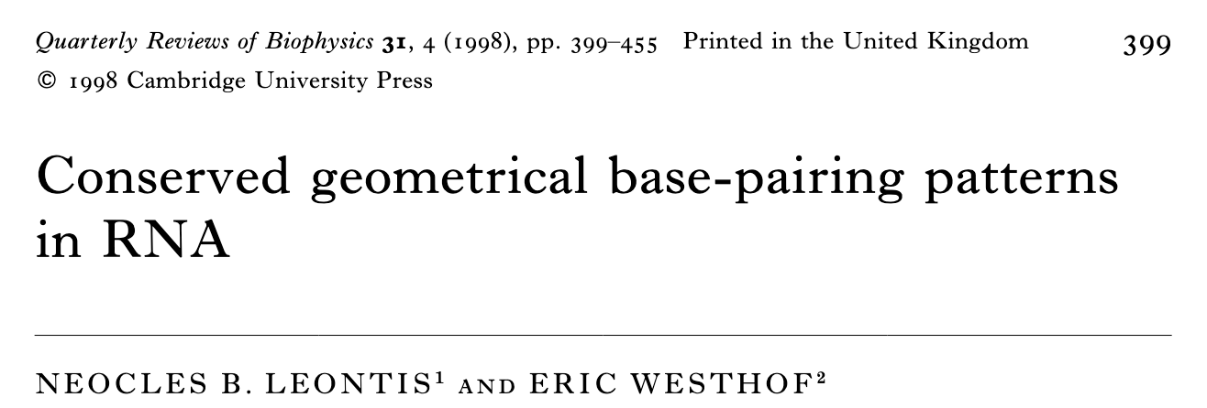
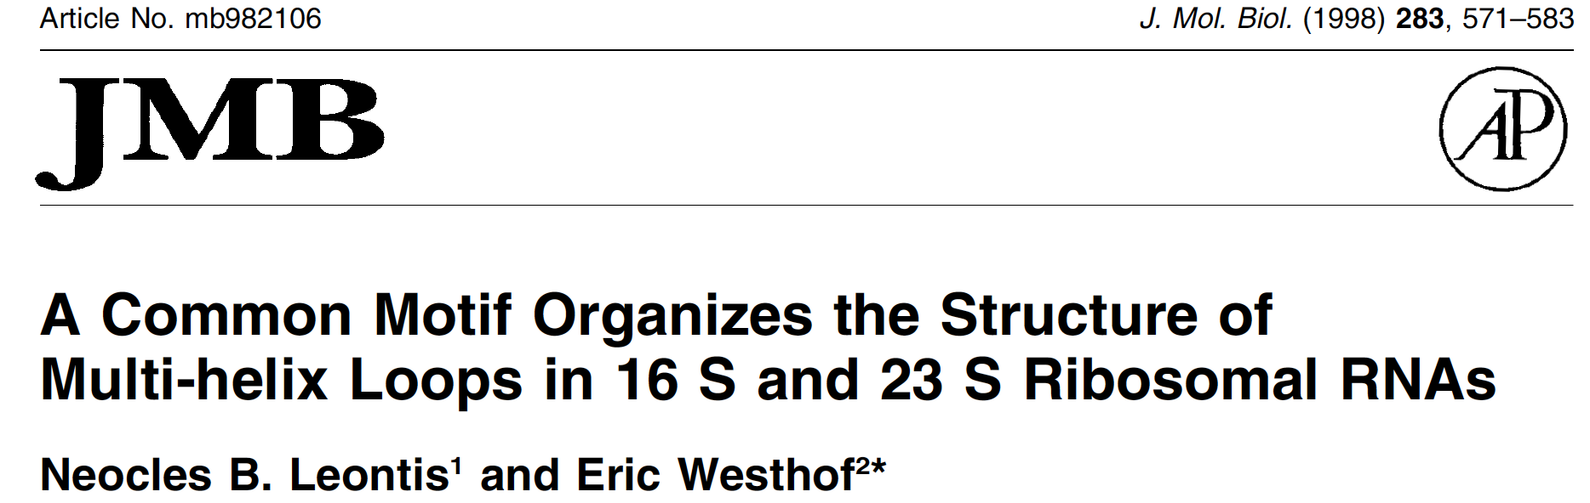
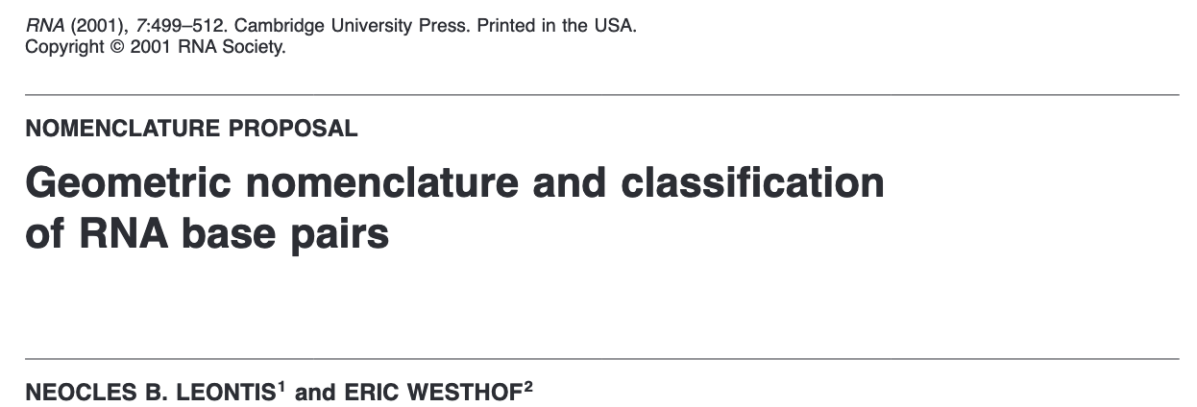

Slide 8
Each base has three edges available for H-bonding

Slide 9
Edge-to-Edge Pairing Families
Watson-Crick
Hoogsteen
Sugar-edge
}
{
Watson-Crick
Hoogsteen
Sugar-edge
}
{
Cis
Trans
=
12 Basic Families
RNA 7, 499 (2001)

Slide 10
How to Annotate ?

Slide 11
3D
2D
3D
3D

Slide 12
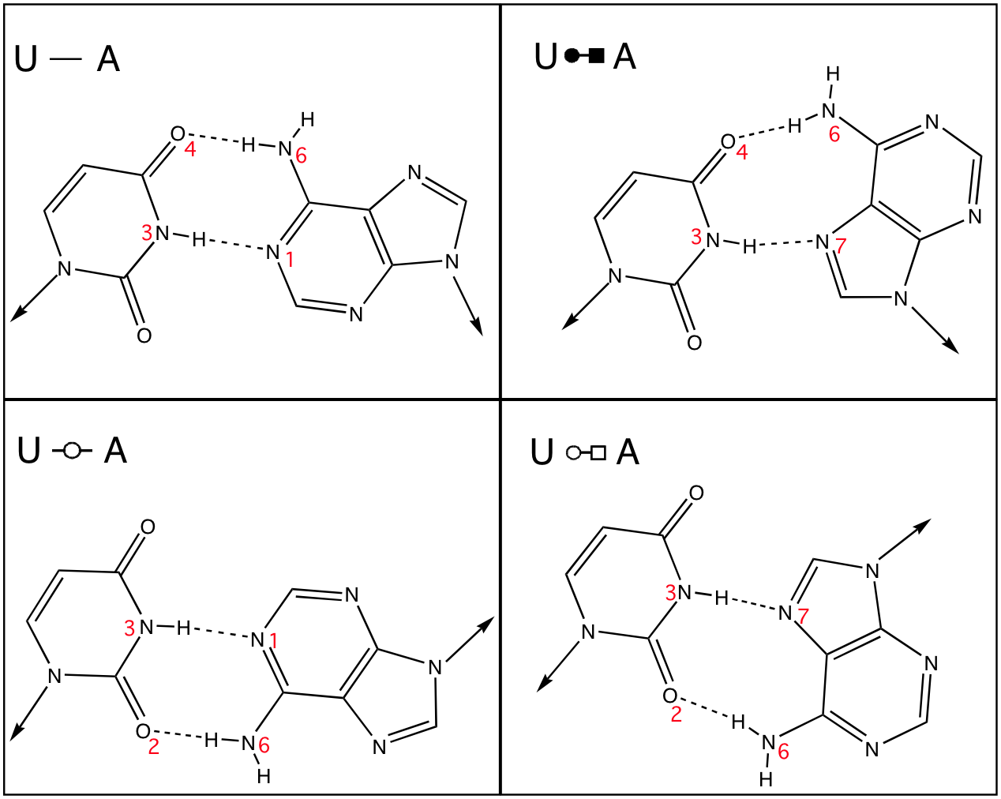

Slide 13
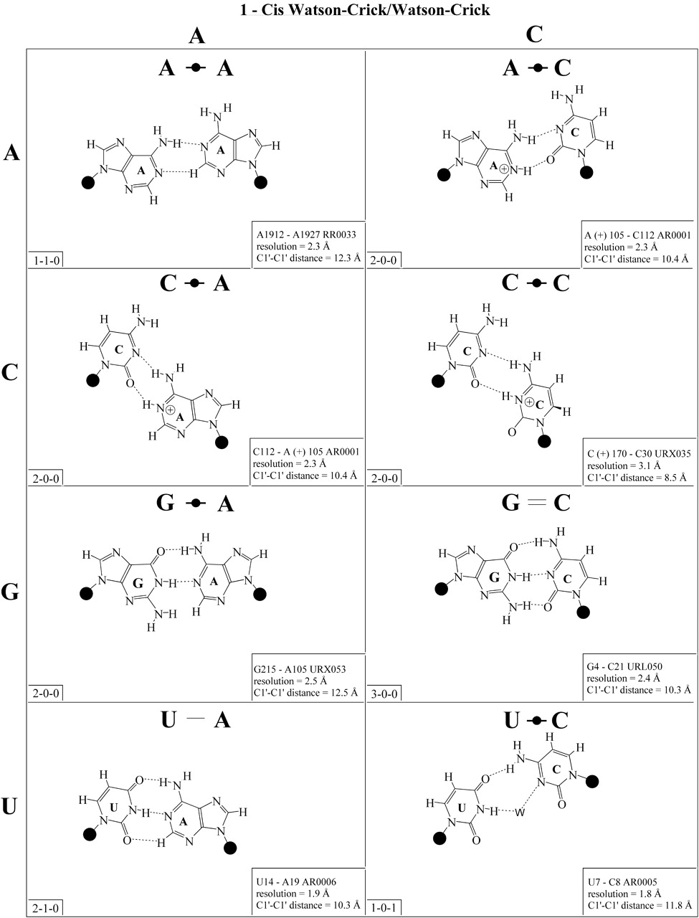
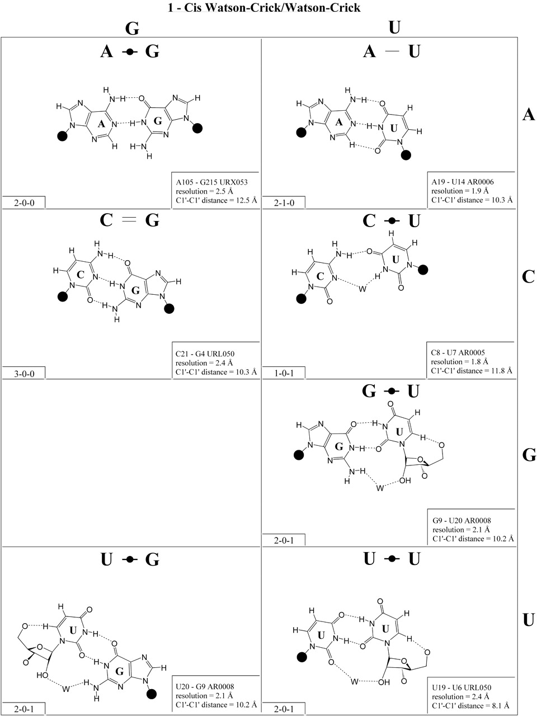

Nucl. Acids Res. 2002 30:3497-3531
Copyright restrictions may apply.

Slide 14
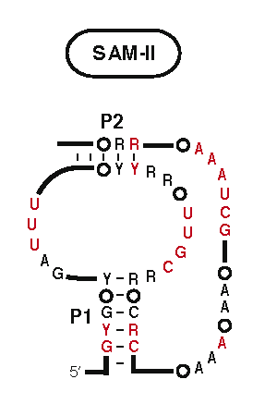
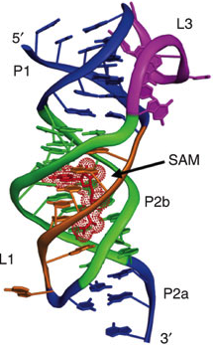
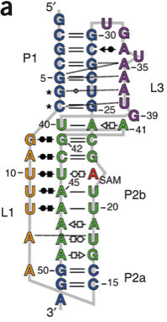
Structure of the SAM-II riboswitch bound to
S-adenosylmethionine
Gilbert, Rambo, Van Tyne, & Batey, Nature Struct & Mol Biol 15, 177 (2008)

Slide 15
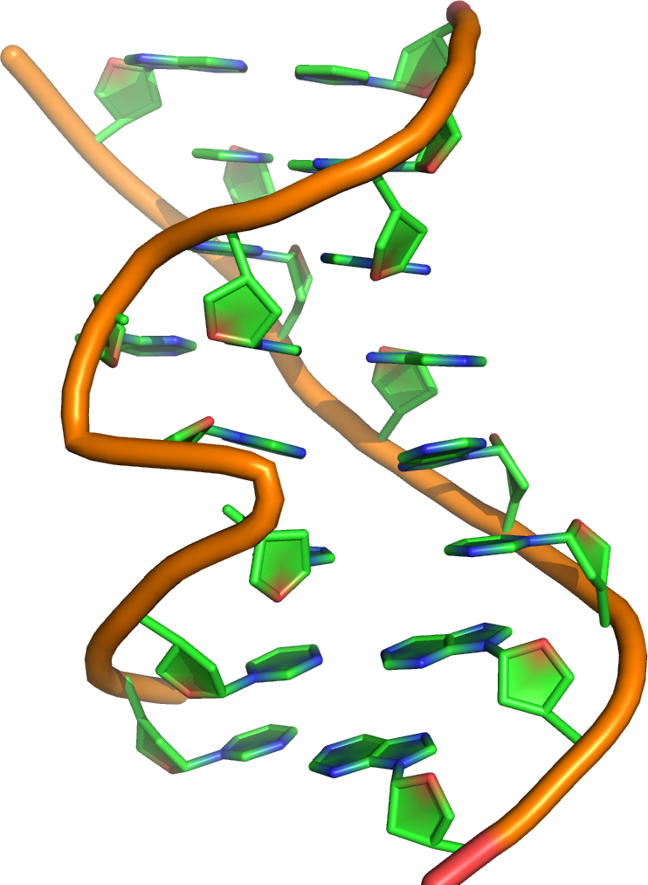
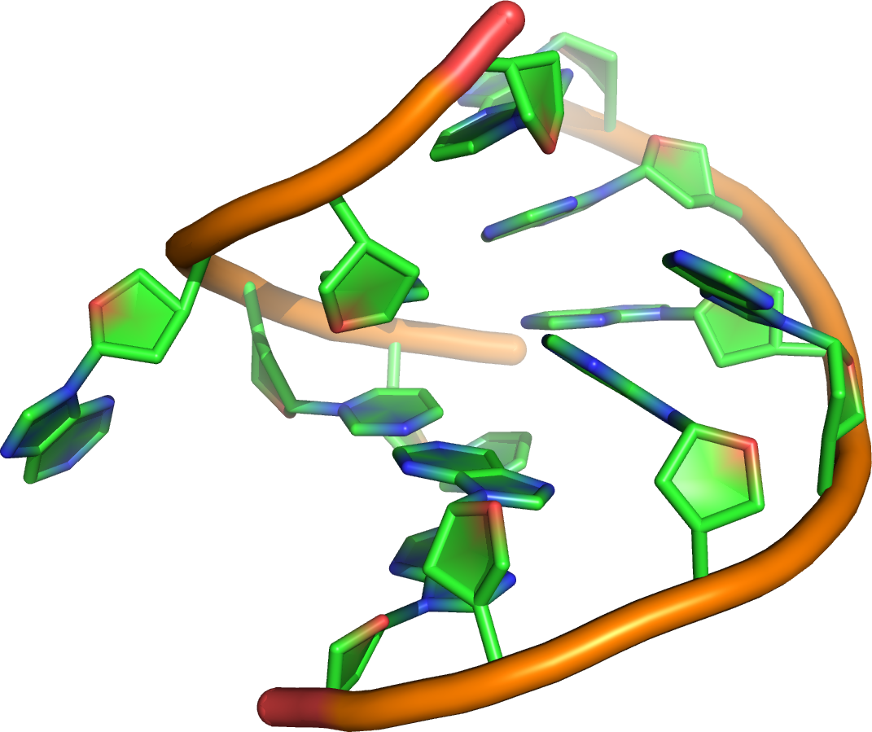
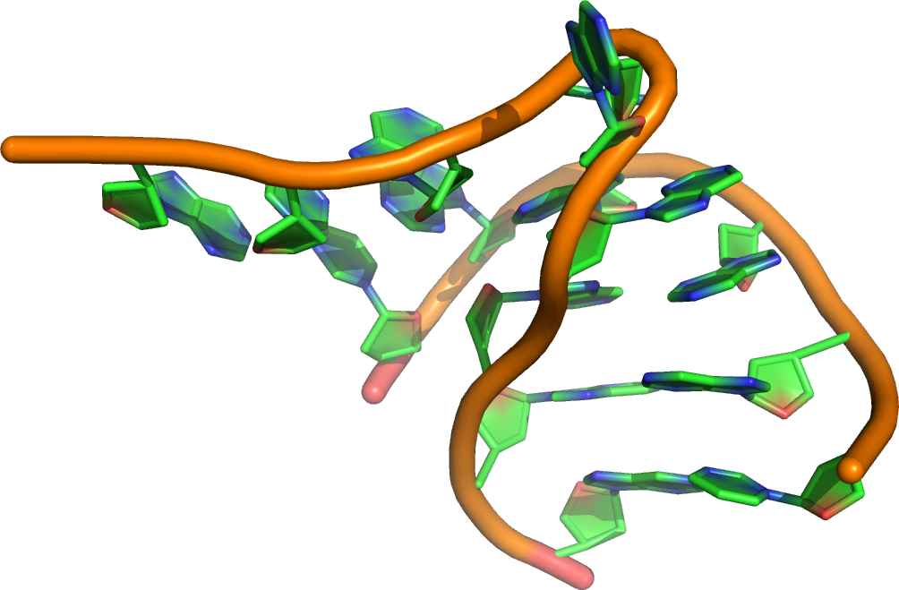
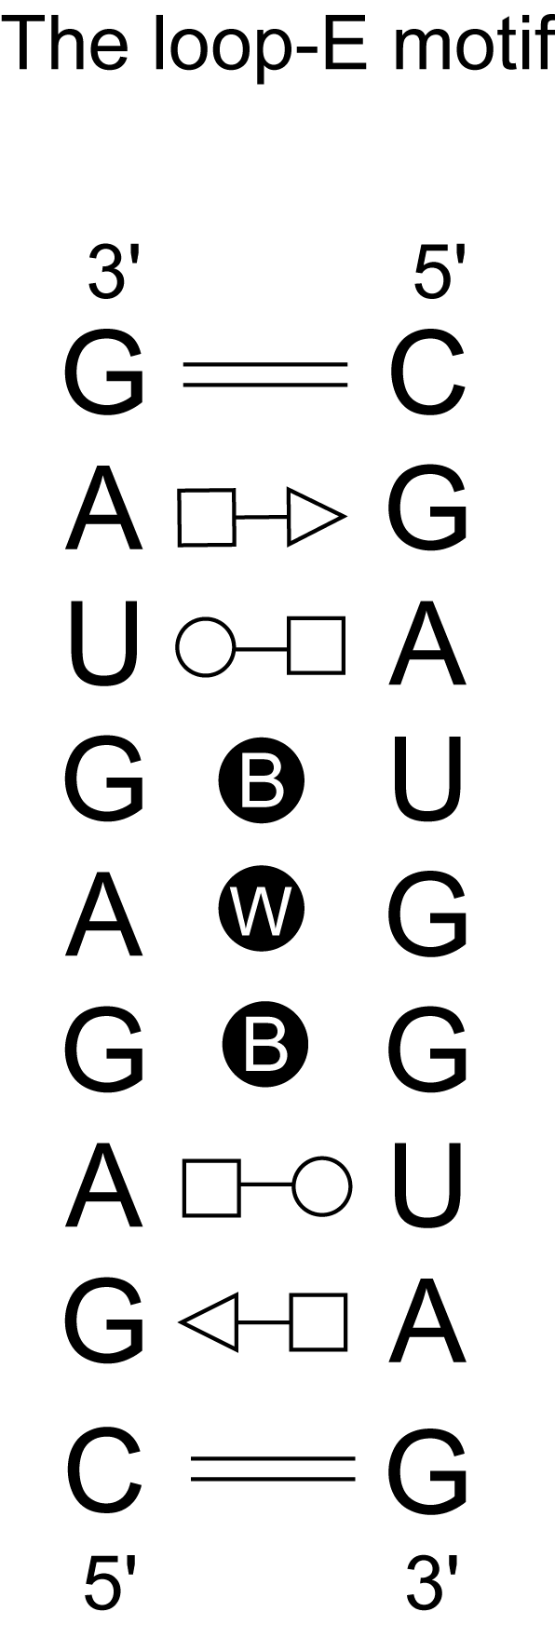
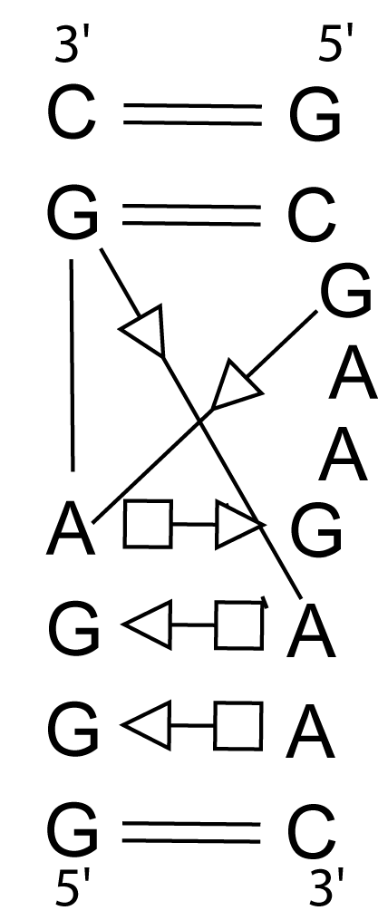
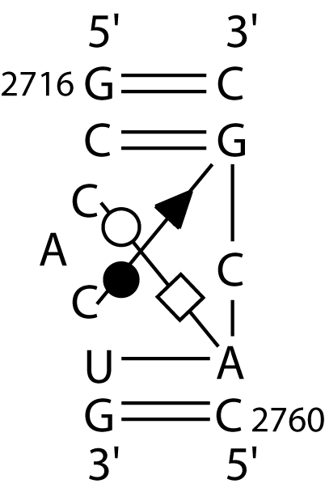
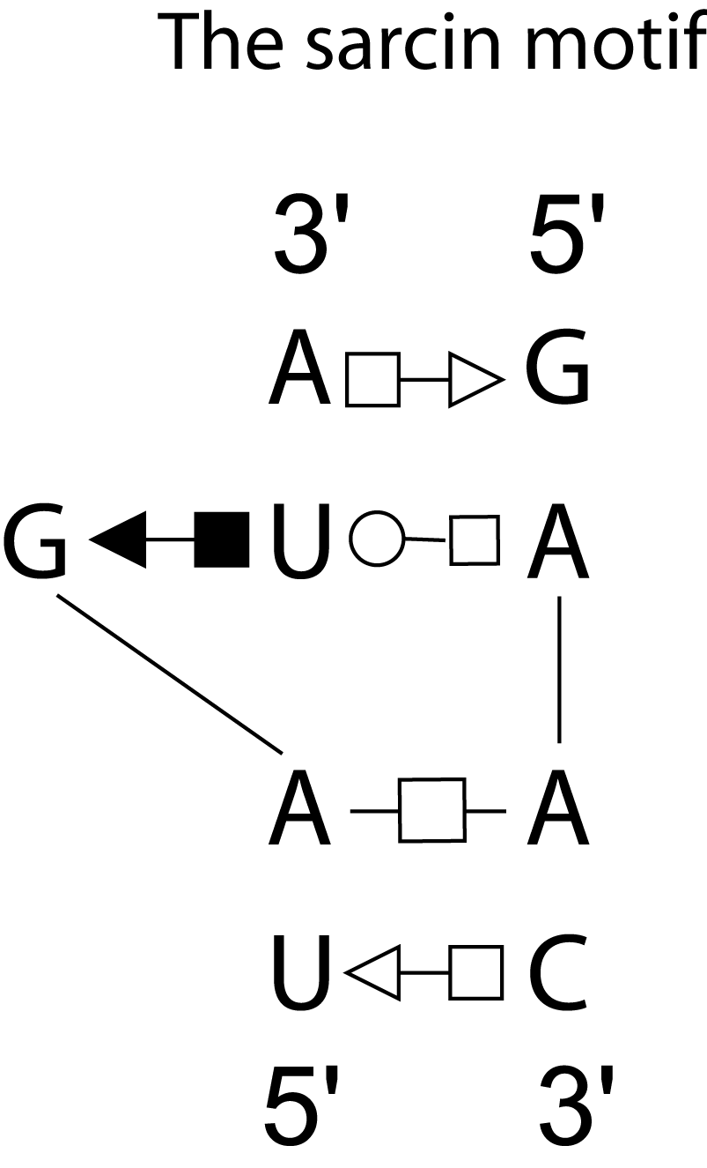
A MODULE is an ensemble of ordered non-Watson-Crick basepairs.
Loop-E
K-turn
C-module
G-Bulge

Slide 16
Definition of a module
A structutrally functional unit that is capable of maintaining its intrinsic properties irrespective of what it is connected to..

Slide 17
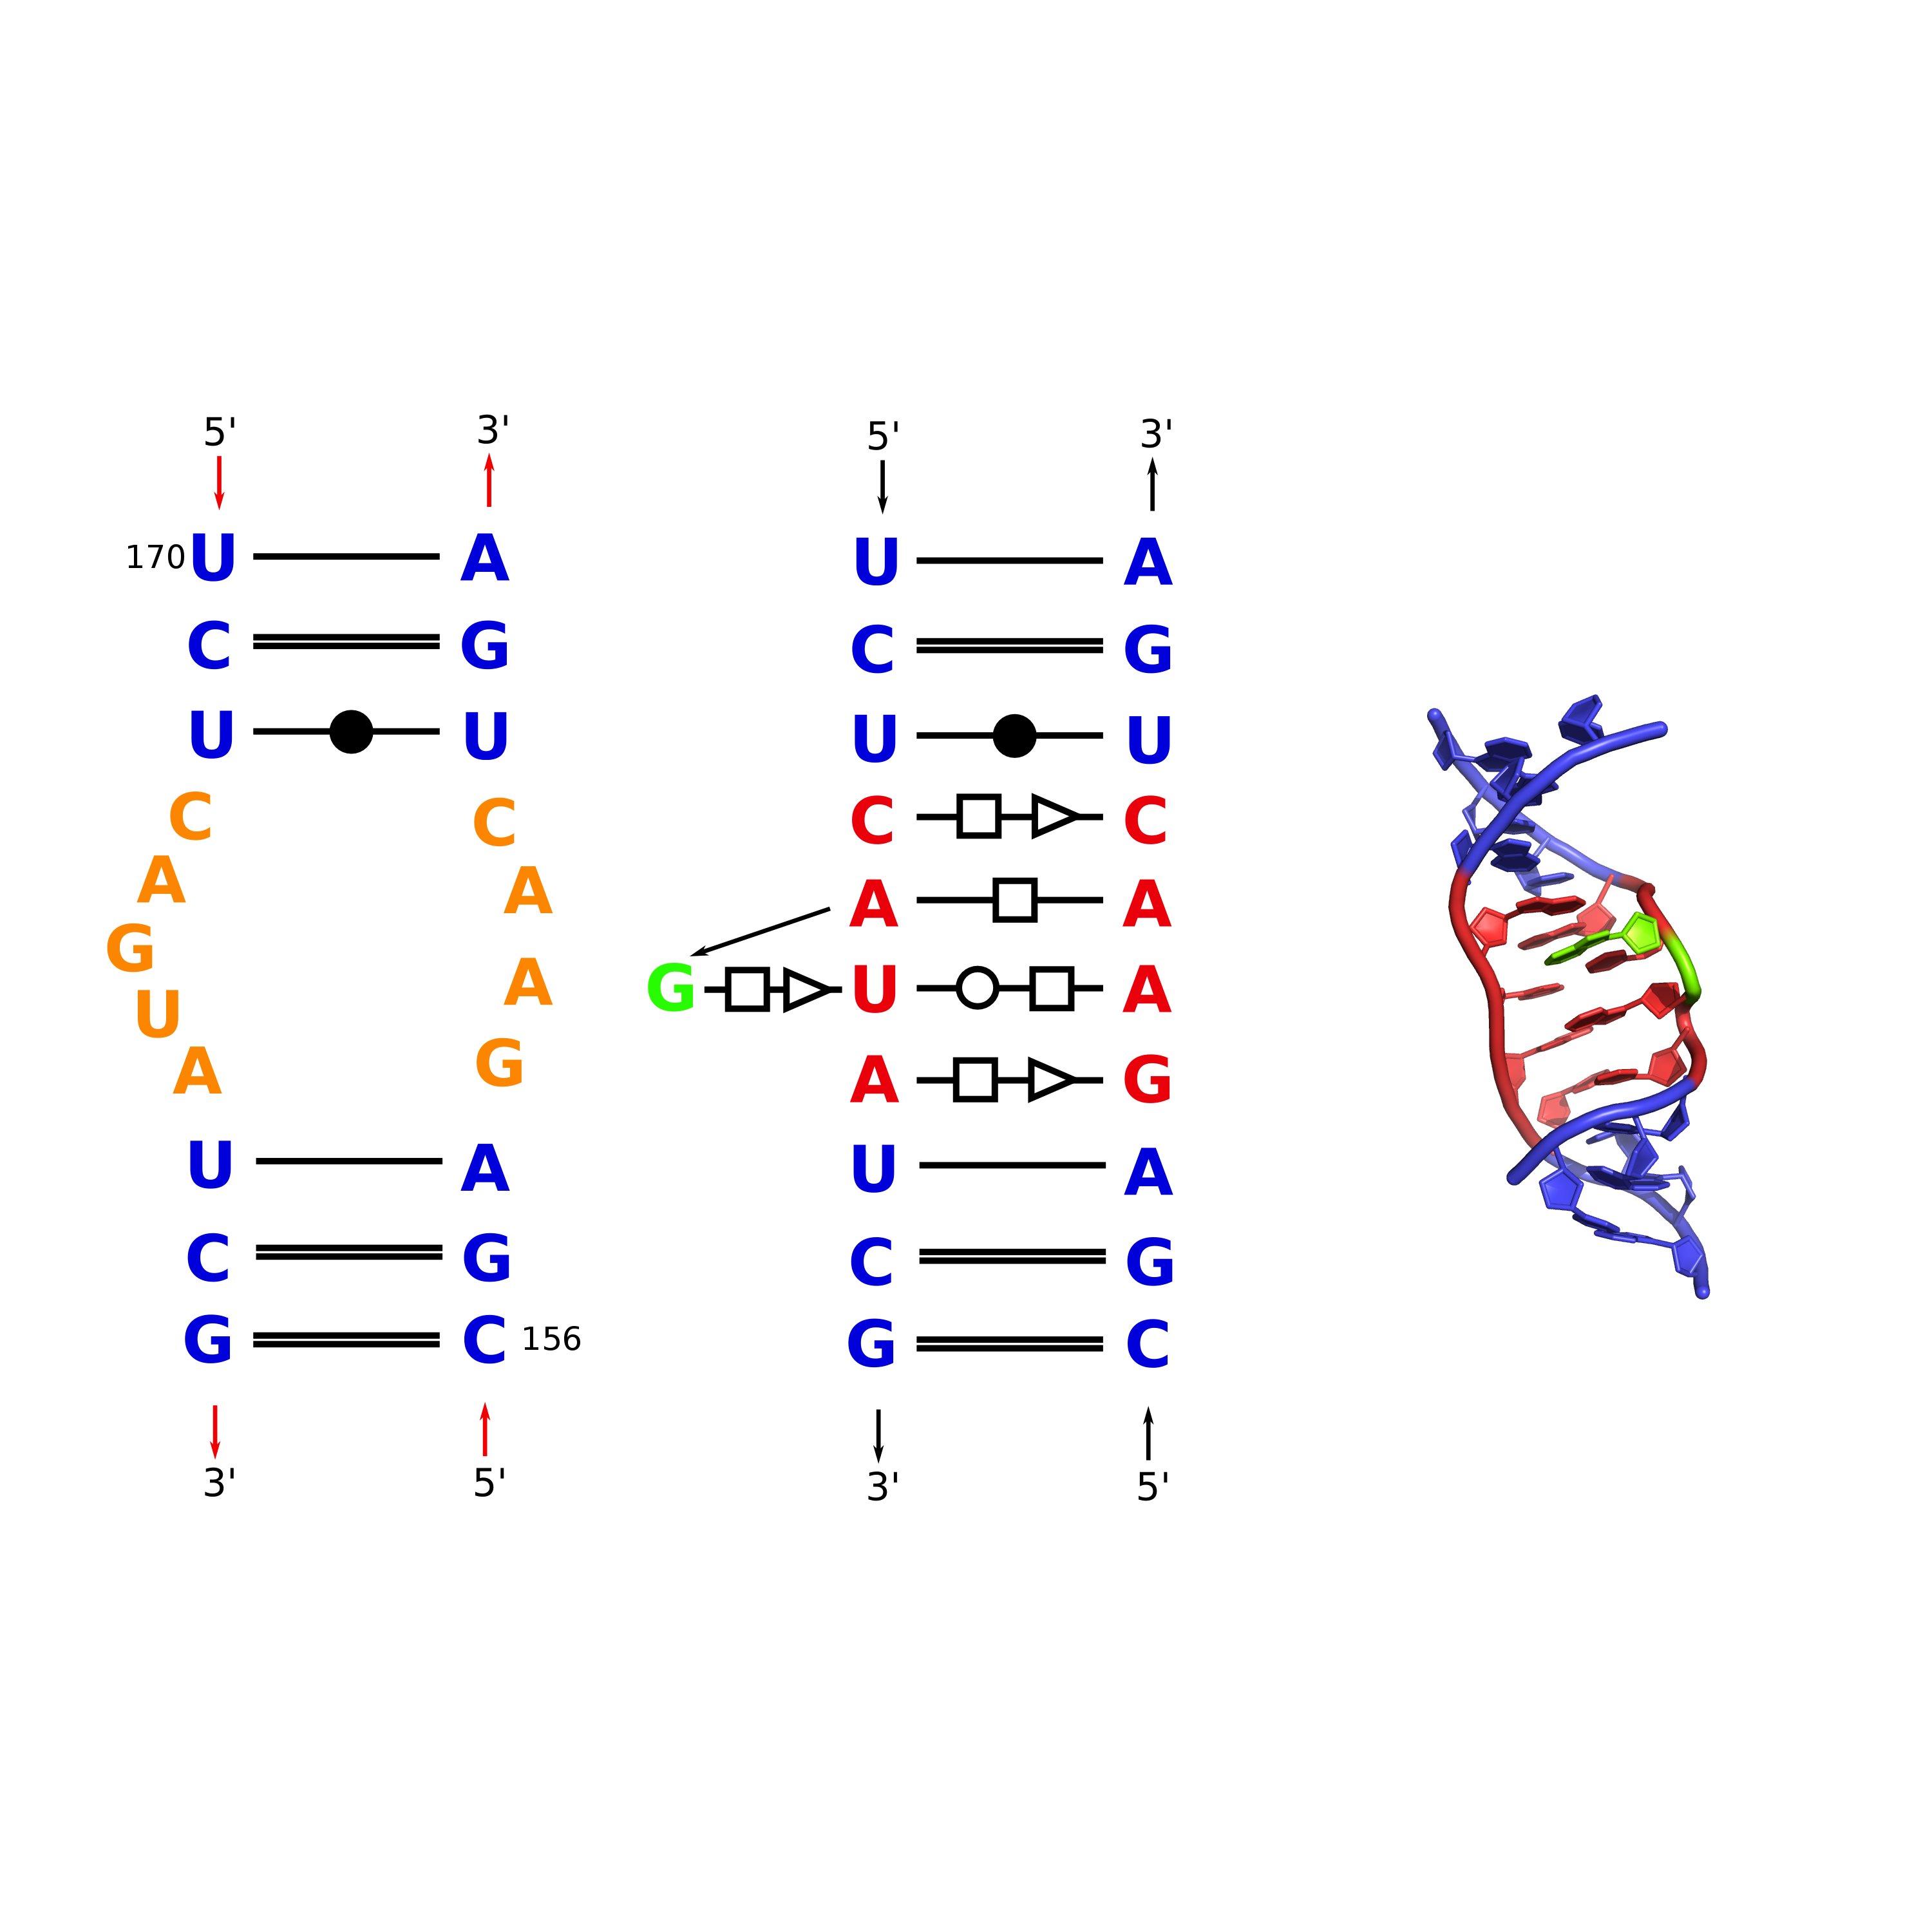
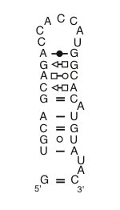
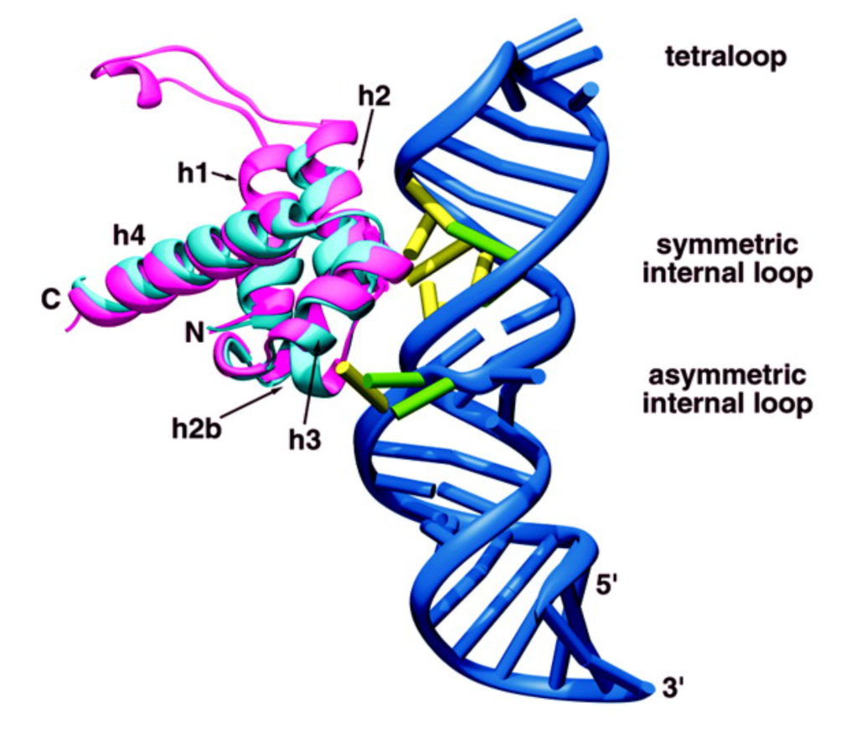
Limited number of identical modules
Occurrence in all types of RNAs across all kingdoms of life
Modules organize internal loops, junctions, bind ligands and proteins
Modules are key to RNA self-assembly

