Slide 1
Time-dependent density functional theory
(TDDFT)

Slide 2
Basic theorems of TDDFT
Linear response regime:
-- Calculation of photo-absorption spectra
Beyond the linear regime:
-- Laser-driven spin dynamics
-- Time-dependent transport
OUTLINE

Slide 3
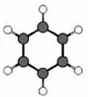
What do we want to describe?
System in laser field:
Generic situation
(t)
Z_{α} e²
|r_{j}-R_{α}|
→
→
+ r_{j}·E(t)·sin ωt

Slide 4
What do we want to describe?
System in laser field:
Generic situation
(t)
Z_{α} e²
|r_{j}-R_{α}|
→
→
+ r_{j}·E(t)·sin ωt
Electronic transport: Generic situation
central region C
left lead L
right lead R
Bias between L and R is turned on: U(t)
V

Slide 5
(t)
Z_{α} e²
|r_{j}-R_{α}|
→
→
+ r_{j}·E(t)·sin ωt
Strong laser (v_{laser}(t) ≥ v_{en}) :
Non-perturbative solution of full TDSE required
Weak laser (v_{laser}(t) << v_{en}) :
Calculate 1. Linear density response ρ₁(r t)
2. Dynamical polarizability
3. Photo-absorption cross section
→

Slide 6
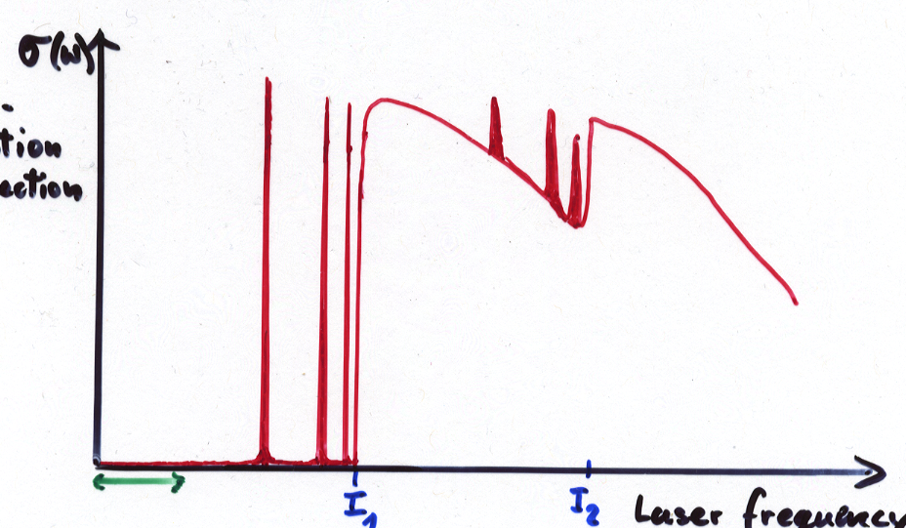
Photo-absorption in weak lasers
continuum states
σ(ω)
unoccupied bound states
I₁
photo-absorption cross section
I₂
occupied bound states
Laser frequency ω

Slide 7
Basic theorems of TDDFT
(E. Runge, E.K.U.G., PRL 52, 997 (1984))
1-1 correspondence (TD analogue of Hohenberg-Kohn theorem):
The time-dependent density determines uniquely the time-dependent external potential and hence all physical observables for fixed initial state.
TDKS theorem:
The time-dependent density of the interacting system of interest can be calculated as density
of an auxiliary non-interacting (KS) system
with the local potential

Slide 8
Basic theorems of TDDFT
(E. Runge, E.K.U.G., PRL 52, 997 (1984))
1-1 correspondence (TD analogue of Hohenberg-Kohn theorem):
The time-dependent density determines uniquely the time-dependent external potential and hence all physical observables for fixed initial state.
TDKS theorem:
The time-dependent density of the interacting system of interest can be calculated as density
of an auxiliary non-interacting (KS) system
with the local potential

Slide 9
Proof of the 1-1 correspondence between and
define maps
G
potentials
wave functions
densities
solve tdSE with fixed
to be shown that G is invertible for fixed Ψo

Slide 10
ρ(r t)
to be shown that is impossible
i.e. v(r t) ≠ v’(r t) + c(t) ⇒ ρ(r t) ≠ ρ’(r t)
→
→
→
→
proof (basic idea):

Slide 11
use
and
→
continuity equation
equation of motion for j
to show that there exists an integer k>0 such that
ρ(t)
ρ’(t)
⇒ ρ and ρ’ will become different
from each other infinitesimally
later than t₀
ρ(t)
t₀ t

Slide 12
Simplest possible approximation for
Adiabatic Local Density Approximation (ALDA)
= xc potential of static homogeneous e-gas

Slide 13
Simplest possible approximation for
Adiabatic Local Density Approximation (ALDA)
= xc potential of static homogeneous e-gas
Any approximate ground-state-DFT xc functional can be used to generate an adiabatic approximation for TDDFT

Slide 14
LINEAR RESPONSE THEORY
t = t₀ : Interacting system in ground state of potential v₀(r) with density ρ₀(r)
t > t₀ : Switch on perturbation v₁(r t) (with v₁(r t₀)=0).
Density: ρ(r t) = ρ₀(r) + δρ(r t)
Consider functional ρ[v](r t) defined by solution of interacting TDSE
Functional Taylor expansion of ρ[v] around v_{o}:
…

Slide 15
ρ₁(r,t) = linear density response of interacting system
= density-density response function of interacting system
Lehmann representation of the full response function
with the exact many-body eigenfunctions and energies of the initial unperturbed interacting system Hamiltnian
⇒ The exact linear density response
has poles at the exact excitation energies Ω = E_{m} - E₀
ρ₁ (ω) = χ (ω) v₁

Slide 16
Analogous function ρ_{s}[v_{s}](r t) for non-interacting system
= density-density response function of non-interacting system
χ_{S} (r,r’,ω) has also poles as function of ω, but at the non-interacting
single-particle (KS) excitation energies.

Slide 17
GOAL: Find a way to calculate ρ₁(r t) without explicitly evaluating χ(r t,r't') of the interacting system
starting point: Definition of xc potential
v_{xc} is well-defined through the non-interacting and the interacting 1-1 mapping.
1-1 mapping for interacting particles
1-1 mapping for non-interacting particles

Slide 18
GOAL: Find a way to calculate ρ₁(r t) without explicitly evaluating χ(r t,r't') of the interacting system
starting point: Definition of xc potential
v_{xc} is well-defined through the non-interacting and the interacting 1-1 mapping.
1-1 mapping for interacting particles
1-1 mapping for non-interacting particles
for fixed Ψ₀
for fixed Φ₀

Slide 22
χ_{S} •
• χ

Slide 23
χ_{S} •
• χ

Slide 24
Act with this operator equation on arbitrary v₁(r t) and use χ v₁ = ρ₁ :
Exact integral equation for ρ₁(r t), to be solved iteratively
Need approximation for
(either for f_{xc} directly or for v_{xc})

Slide 25
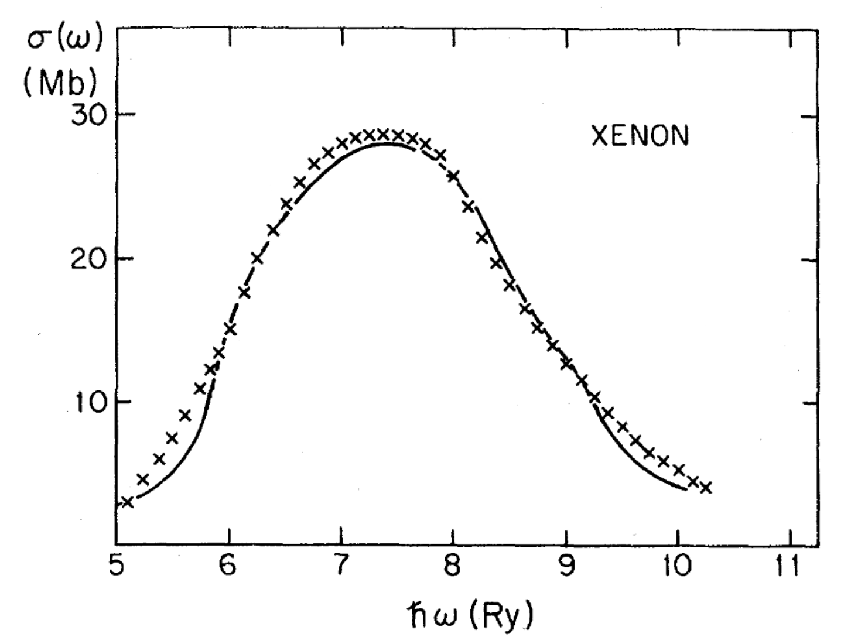
Total photoabsorption cross section of the Xe atom versus photon energy in the vicinity of the 4d threshold.
Solid line: self-consistent time-dependent KS calculation [A. Zangwill and P. Soven, Phys. Rev. A 21, 1561 (1980)]; crosses: experimental data [R. Haensel, G. Keitel, P. Schreiber, and C. Kunz, Phys. Rev. 188, 1375 (1969)].

Slide 26
Photo-absorption in weak lasers
continuum states
Previous slide
σ(ω)
unoccupied bound states
I₁
photo-absorption cross section
I₂
occupied bound states
Laser frequency ω

Slide 27
Photo-absorption in weak lasers
Discrete poles
continuum states
σ(ω)
unoccupied bound states
I₁
photo-absorption cross section
I₂
occupied bound states
Laser frequency ω

Slide 28
Looking at those frequencies, Ω, for which ρ₁(ω) has poles,
leads to a (non-linear) eigenvalue equation
M. Petersilka, U. J. Gossmann, E.K.U.G., PRL 76, 1212 (1996)
T. Grabo, M. Petersilka, EKUG, J. Mol. Struc. (Theochem) 501, 353 (2000)
M.E. Casida, Recent Advances in Density Functional Methods I, 155 (1996)
where
double index

Slide 29
TDDFT
from: M. Petersilka, U. J. Gossmann, E.K.U.G., PRL 76, 1212 (1996)

Slide 30
Excitation energies of CO molecule [mH]
State | Ω_{expt} _{KS} | KS-transition | Δϵ_{KS} | TDDFT
A ¹Π | 312.7 | 5σ→2π | 252.3 | 310.2
a ³Π | 232.3 |  |  | 221.4
I ¹Σ⁻ | 363.1 | 1π→2π | 362.6 | 362.6
e ³Σ⁻ | 363.1 |  |  | 362.6
a’ ³Σ⁺ | 312.7 |  |  | 314.9
D ¹Δ | 375.9 |  |  | 380.7
d ³Δ | 344.0 |  |  | 339.6
Molecular excitation energies from time-dependent density-functional theory
T Grabo, M Petersilka, EKU Gross, J Mol Struc-Theochem 501, 353 (2000).

Slide 31
Failures of ALDA in the linear response regime
H₂ dissociation is incorrect:
(see: Gritsenko, van Gisbergen, Görling, Baerends, J. Chem. Phys. 113, 8478 (2000))
(in ALDA)
response of long chains strongly overestimated
(see: Champagne et al., J. Chem. Phys. 109, 10489 (1998) and 110, 11664 (1999))
in periodic solids, whereas,
for insulators, divergent.
charge-transfer excitations not properly described
(see: Dreuw et al., J. Chem. Phys. 119, 2943 (2003))

Slide 32
Failures of ALDA in the linear response regime
H₂ dissociation is incorrect:
(see: Gritsenko, van Gisbergen, Görling, Baerends, J. Chem. Phys. 113, 8478 (2000))
(in ALDA)
response of long chains strongly overestimated
(see: Champagne et al., J. Chem. Phys. 109, 10489 (1998) and 110, 11664 (1999))
in periodic solids, whereas,
for insulators, divergent.
charge-transfer excitations not properly described
(see: Dreuw et al., J. Chem. Phys. 119, 2943 (2003))
These difficulties have largely been solved by xc functionals more advanced than ALDA

Slide 33
Linear-response TDDFT is now being used to predict
and to interpret experimental optical spectra in essentially all corners of physics and chemistry.
Some examples:

Slide 34
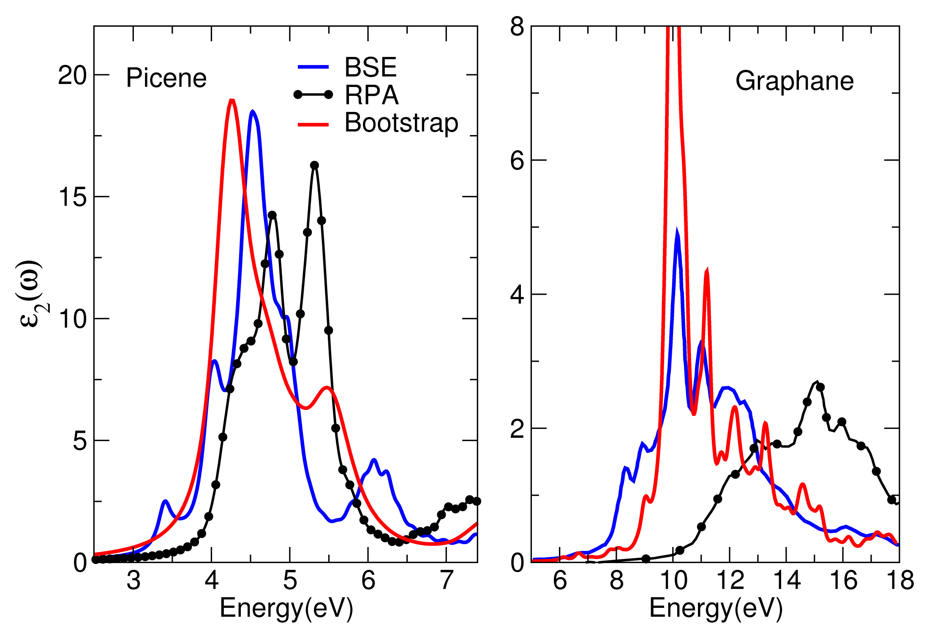
TDDFT
RPA
BSE

Slide 36
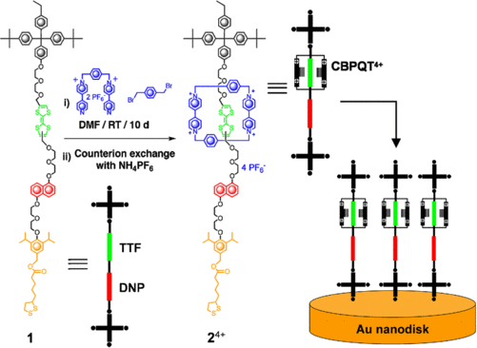
DOI: 10.1109/SENSOR.2009.5285604

Slide 38
Beyond the linear regime: Real-time TDDFT
prediction of electron dynamics
far from equilibrium

Slide 39
Ultrafast laser-driven spin dynamics in solids

Slide 40
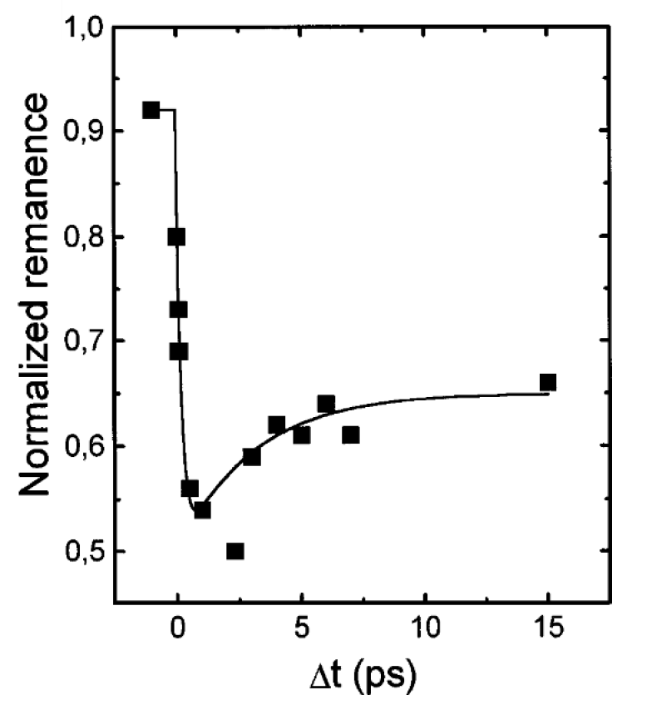
First experiment on ultrafast laser induced demagnetization
Beaurepaire et al, PRL 76, 4250 (1996)

Slide 41
First experiment on ultrafast laser induced demagnetization
Beaurepaire et al, PRL 76, 4250 (1996)
Demagnetization in less than 100 fs has been demonstrated experimentally

Slide 42
Non-collinear-Spin TDDFT with Spin-Orbit-Coupling
(weakly relativistic limit of relativistic TDDFT)
where are Pauli spinors

Slide 43
Non-collinear-Spin TDDFT with Spin-Orbit-Coupling
(weakly relativistic limit of relativistic TDDFT)
Universal
functionals
of ρ and m
where are Pauli spinors

Slide 44
Quantity of prime interest:
vector field of spin magnetization

Slide 45
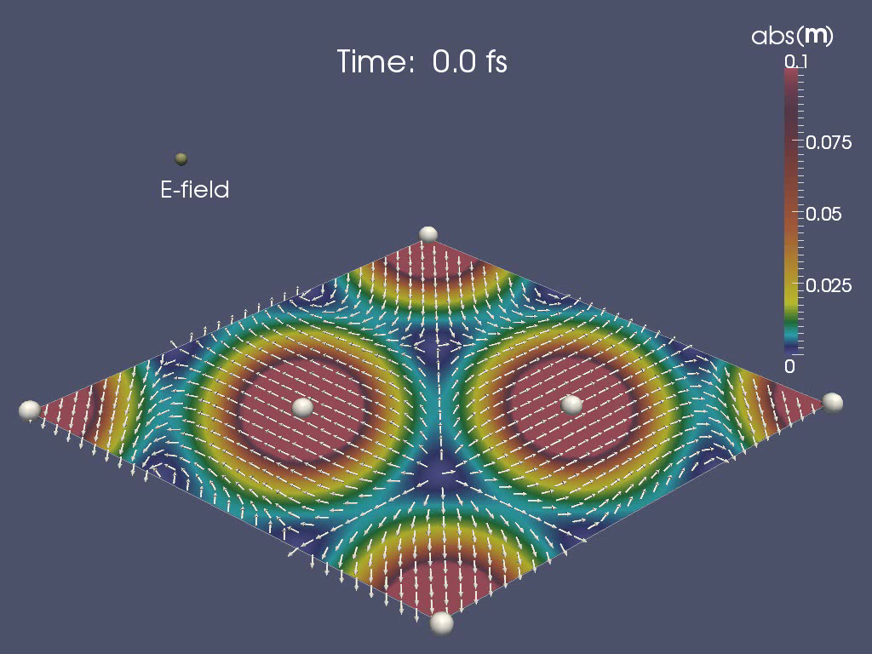
Quantity of prime interest:
vector field of spin magnetization
Cr monolayer in ground state

Slide 47
Aspects of the numerical implementation
Wave length of laser in the visible regime
(very large compared to unit cell)
Dipole approximation is made
(i.e. electric field of laser is assumed to be spatially constant)
Laser can be described by a purely time-dependent vector potential
Periodicity of the TDKS Hamiltonian is preserved!
Implementation in ELK code (FLAPW) (http://elk.sourceforge.net/)

Slide 48
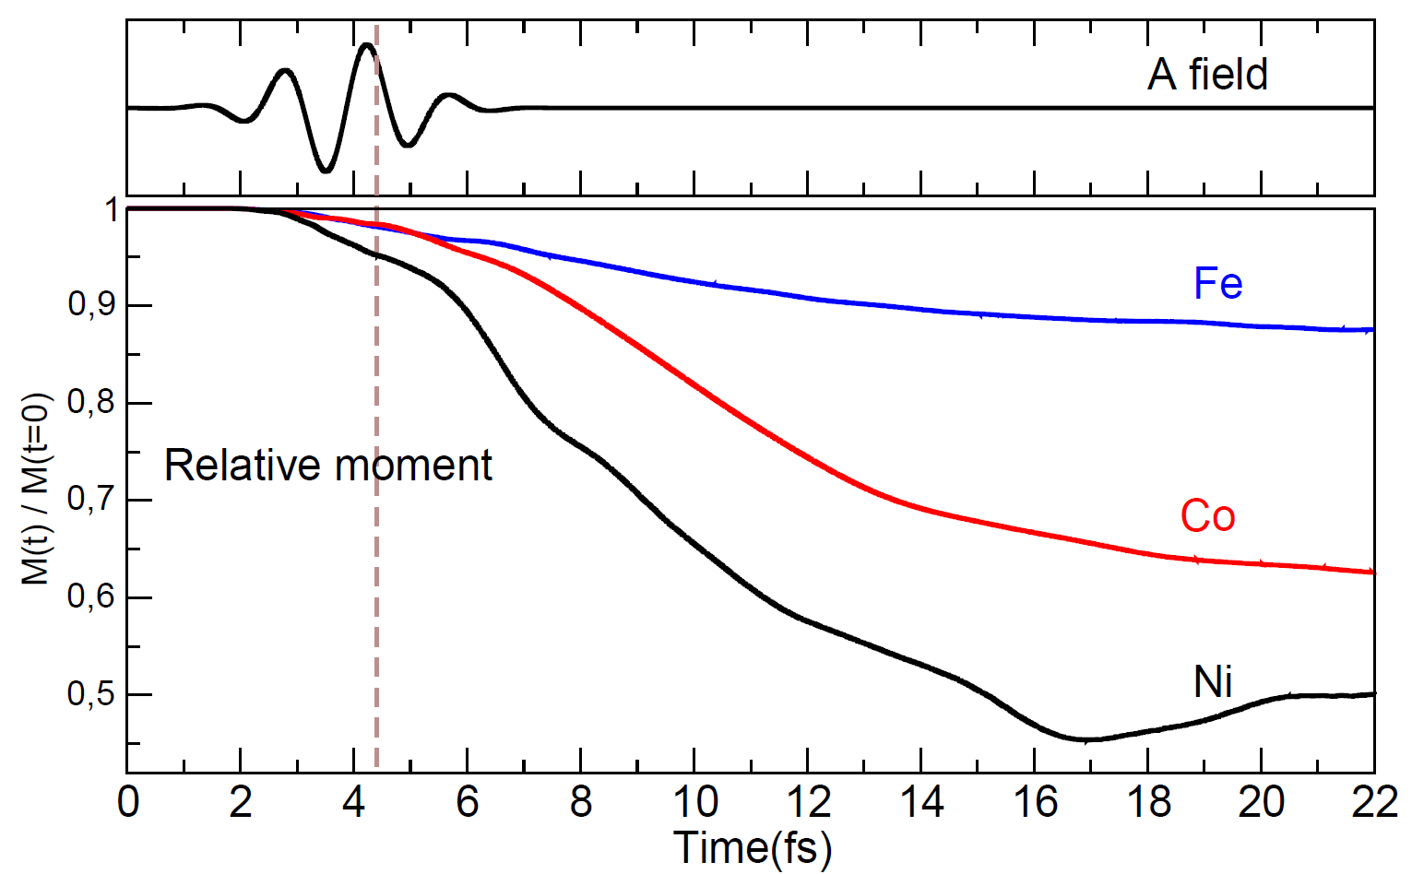
Demagnetization in Fe, Co, and Ni
K. Krieger, K. Dewhurst, P. Elliott, S. Sharma, E.K.U.G., JCTC 11, 4870 (2015)

Slide 49
Analysis of the results

Slide 50
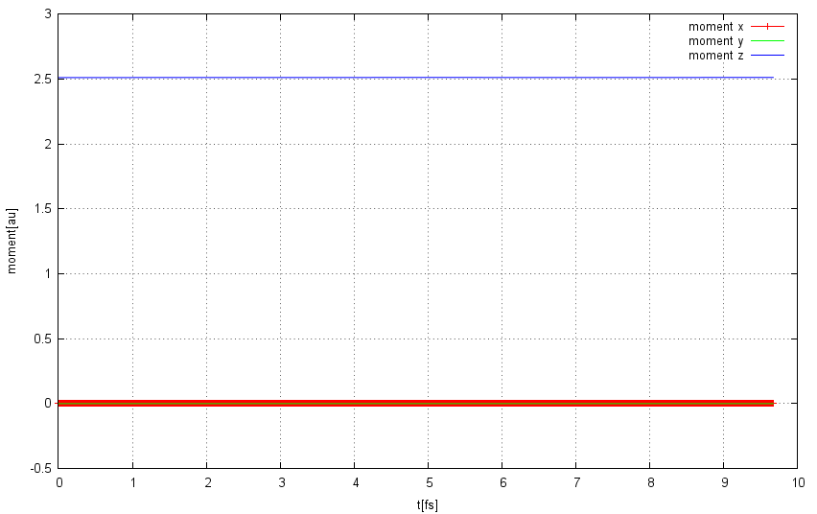
Calculation without spin-orbit coupling
components of spin moment

Slide 51
Exact equation of motion
spin current tensor

Slide 52
Exact equation of motion
local spin torque
(m x B_{xc} )_{z}
SOC
"continuity"
spin current tensor

Slide 53
Exact equation of motion
local spin torque
(m x B_{xc} )_{z}
SOC
"continuity"
spin current tensor
Dynamics of total moment: Integrate over the unit cell

Slide 54
Exact equation of motion for total moment
SOC
=0
spin current tensor

Slide 55
Exact equation of motion for total moment
Global torque
exerted by B_{xc}
= 0 (zero
torque
theorem)
SOC
=0
spin current tensor

Slide 56
Exact equation of motion for total moment
Global torque
exerted by B_{xc}
= 0 (zero
torque
theorem)
SOC
=0
spin current tensor
SOC is the only term which can change the total moment!

Slide 57
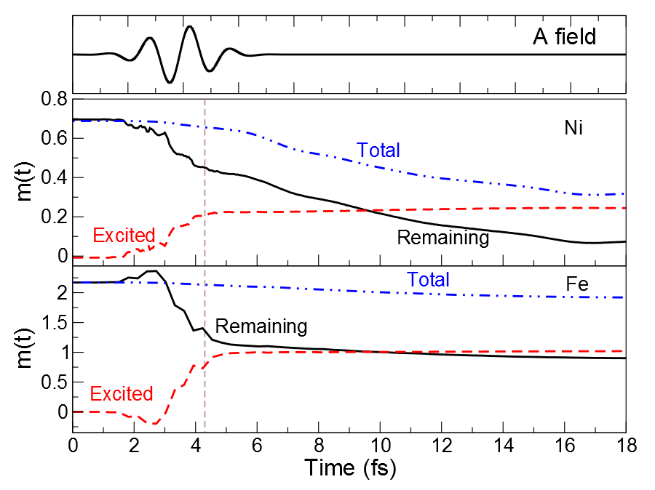

Slide 58
Demagnetization occurs in two steps:
- Initial excitation by laser moves magnetization from atomic region
into interstitial region. Total Moment is basically conserved
during this phase.
- Spin-Orbit term drives demagnetization of the more localized
electrons until stabilization at lower moment is achieved
This is a local mechanism, hence occurs in this form in essentially
all systems, e.g. magnetic clusters (Sanvito et al) or
magnetic mono-layer / few-layer systems

Slide 59
Beyond 3D bulk

Slide 60
Cr monolayer

Slide 64
Experimental confirmation:
Spin Flips versus Spin Transport in Nonthermal Electrons Excited by Ultrashort Optical Pulses in Transition Metals,
V. Shokeen, M. Sanchez Piaia, J.-Y. Bigot, T. Mueller, P. Elliott, J.K. Dewhurst, S. Sharma, E. K. U. Gross, Phys. Rev. Lett. 119, 107203 (2017).
Review article:
Time-Dependent Density Functional Theory for Spin Dynamics,
P. Elliott, M. Stamenova, J. Simoni, S. Sharma, S. Sanvito, and E.K.U. Gross, in: Handbook of Materials Modeling, W. Andreoni, S. Yip eds, Springer (2020), p. 841

Slide 65
Optical intersublattice spin transfer
(OISTR)
P. Elliott, T. Mueller, K. Dewhurst, S. Sharma, E.K.U.Gross,
Scientific Reports 6, 38911 (2016)
K. Dewhurst, P. Elliott, S. Shallcross, E.K.U. Gross, S. Sharma,
Nano Lett. 18, 1842 (2018)
OISTR was first predicted with TDDFT and later found experimentally
(Aeschlimann group, Kaiserslautern, 2018)

Slide 66
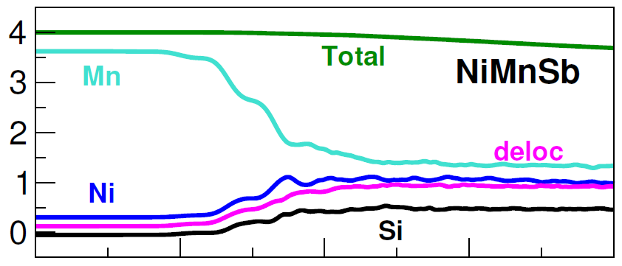
M (t) (μ_{B})
Sb
Time (fs)
Global moment |M(t)| nearly preserved. Local moments change.
Laser parameters: ω= 2.72 eV, a FWHM of 2.42 fs, and fluence of 93.5 mJ/cm2, giving a peak intensity of 1 × 1014 W/cm2.

Slide 67
NiMnSb

Slide 69
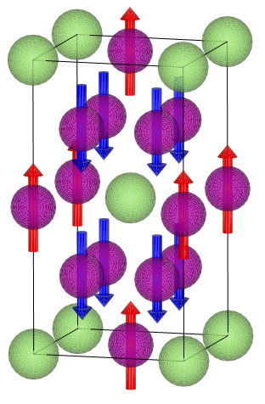
Mn₃Ga (ferri-magnet)
Ga
Mn
TDDFT prediction for Mn₃Ga: ferri → ferro transition within 4 fs

Slide 70
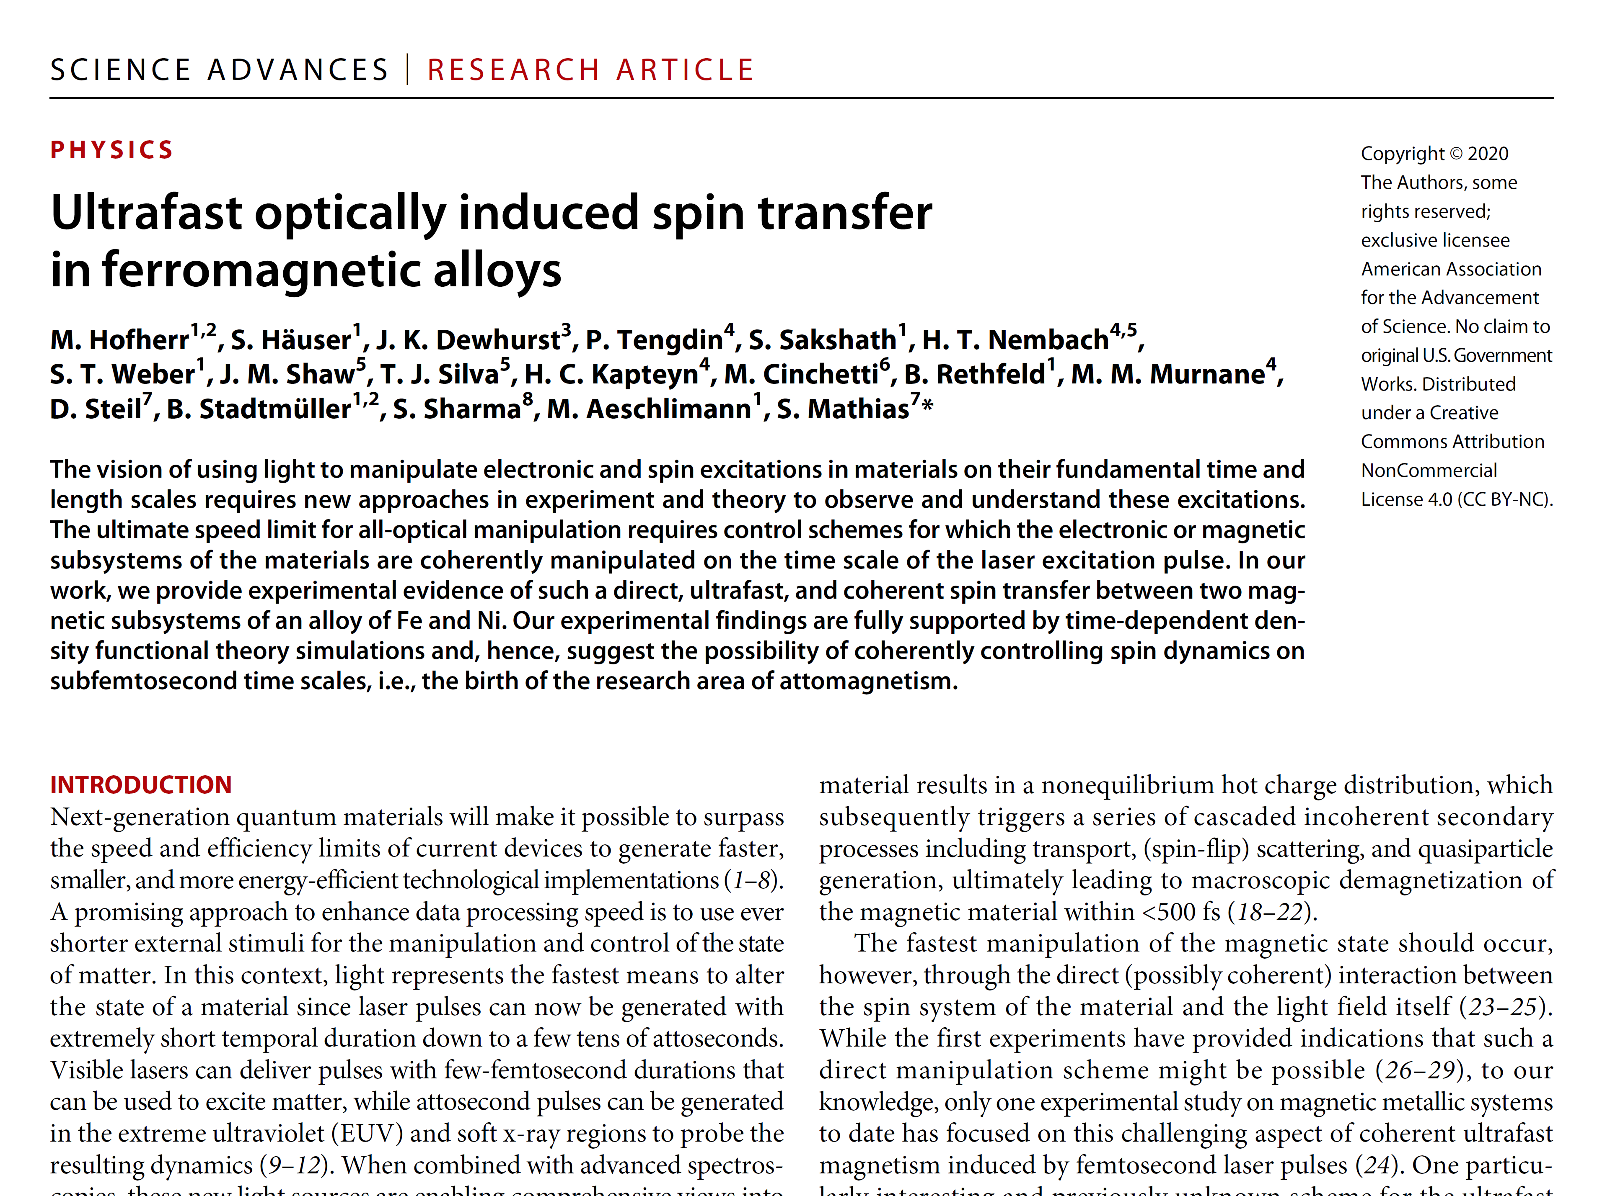

Slide 72
Electronic transport with TDDFT
central region C
left lead L
right lead R
Bias between L and R is turned on: U(t)
V for large t

Slide 73
Electronic transport with TDDFT
central region C
left lead L
right lead R
Bias between L and R is turned on: U(t)
V for large t
Questions:
After switching-on, does one always reach a steady state?
Is the steady state unique?
How to deal with time-dependent external fields?

Slide 74
Electronic transport with TDDFT
central region C
left lead L
right lead R
TDKS equation
v_{xc}[ρ (r’t’)](r t)

Slide 75
Electronic transport with TDDFT
central region C
left lead L
right lead R
TDKS equation

Slide 76
Effective TDKS Equation for the central (molecular) region only
S. Kurth, G. Stefanucci, C.O. Almbladh, A. Rubio, E.K.U.G., Phys. Rev. B 72, 035308 (2005)
source term: L → C and R → C charge injection
memory term: C → L → C and C → R → C hopping
Note: So far, no approximation has been made.

Slide 77
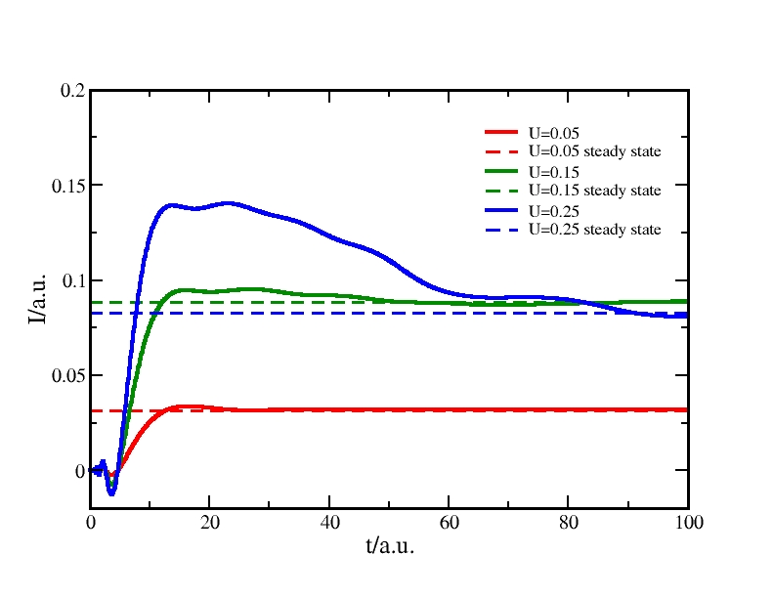
Numerical examples for non-interacting electrons
Recovering the Landauer steady state
left lead
central region
right lead
U
V(x)
U
Time evolution of current in response to bias switched on at time t = 0, Fermi energy ε_{F} = 0.3 a.u.
Steady state coincides with Landauer formula
and is reached after a few femtoseconds

Slide 78
Can there be more than one steady state?

Slide 79
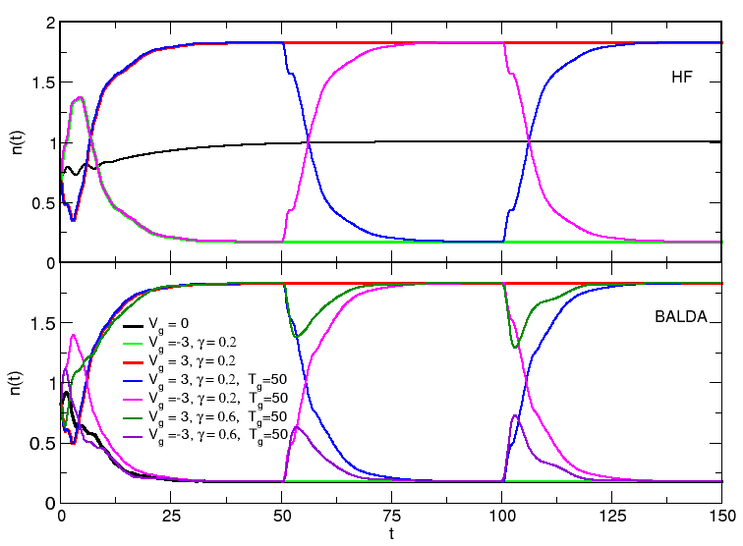
Multi-stability in TDHF and TDDFT for one-site Anderson model
E. Khosravi, A.M. Uimonen, A. Stan, G. Stefanucci, S. Kurth,
R. van Leeuwen, E.K.U.G. Phys. Rev. B 85, 075103 (2012)

Slide 80
Is there always a steady state?

Slide 81
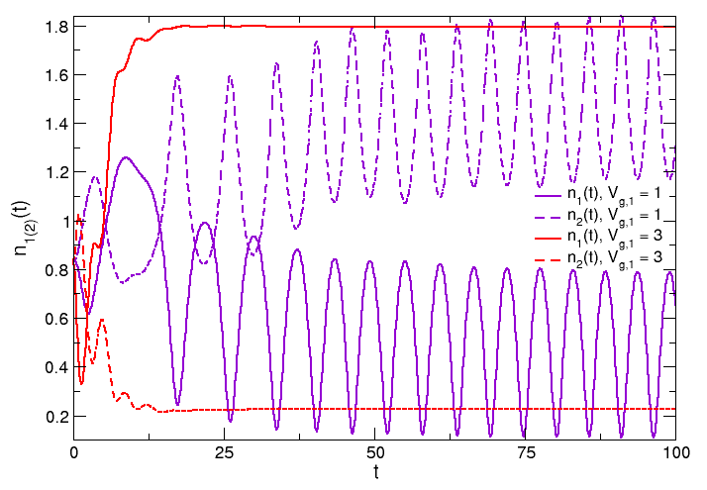
No steady state in two-site Anderson model

Slide 82
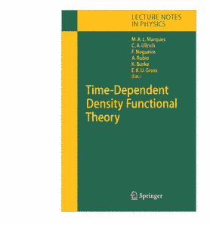
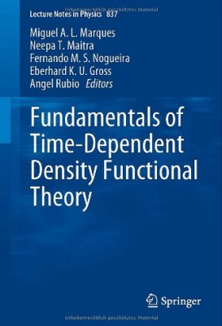
Lecture Notes in Physics 706
(Springer, 2006)
Lecture Notes in Physics 837
(Springer, 2012)

