Slide 1

Memory-Dependence in Real-Time TDDFT
Neepa T. Maitra
Rutgers University at Newark

Slide 2
Plan
Introduction to what is memory in TDDFT
-- the adiabatic approximation
Approximations including memory and some exact conditions
Some examples
-- field-free superposition state dynamics
-- charge-transfer dynamics
-- electron-atom scattering

Slide 3
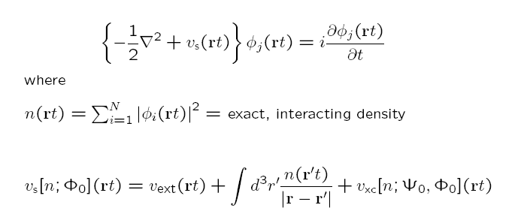
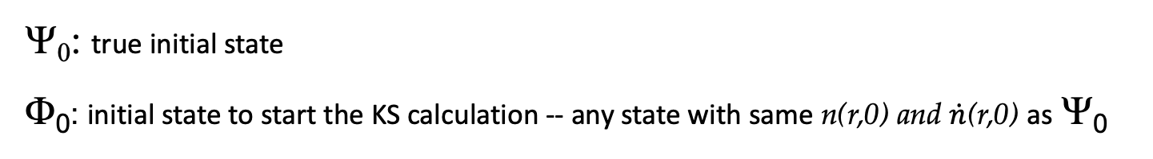
How did memory come in?
Ψ₀
Runge-Gross:
n v_{ext}
true system
1-1
Φ₀
n v_{s}
KS system
1-1
Hartree is naturally adiabatic – depends only on instantaneous density
Actually, v_{ext} [n,Ψ₀] (rt)
History: n(r t’<t) and initial states Ψ₀ and Φ₀ of true and KS systems
but v_{ext}(rt) is prescribed by problem at hand, so functional dependence not explicit
Ψ₀: true initial state
Φ₀: initial state to start the KS calculation -- any state with same n(r,0) and $\dot{n}$(r,0) as Ψ₀
usually choose Slater determinant but not necessary

Slide 4
Memory
Functional depends on history, n(r t’<t), and initial states Ψ₀ and Φ₀ of true and KS systems
Also, for a general observable: A[n; Φ₀]
Special, and common, case:
Ψ₀ = Ψ_{GS}
Φ₀ = Φ_{GS}
Then, by the Hohenberg-Kohn theorem, Ψ₀ = Ψ₀[n(0)] and Φ₀ = Φ₀ [n(0)]
-- no explicit initial-state-dependence → v_{xc}[n](r,t) (but still history-dependent)
e.g. linear response regime.

Slide 5
The Adiabatic Approximation
Almost all calculations today ignore memory, and use an
adiabatic approximation:
input instantaneous density into a ground-state approximation
Example:

Slide 6
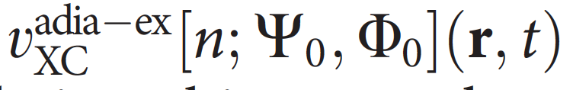
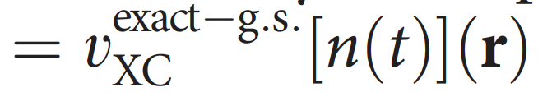
The Adiabatic Approximation
Almost all calculations today ignore memory, and use an
adiabatic approximation:
input instantaneous density into a ground-state approximation
Two sources of error:
Adiabatic approximation itself
Ground-state functional approximation
To disentangle, study “adiabatically-exact” potential (see examples soon!)

Slide 7
Plan
Introduction to what is memory in TDDFT
-- the adiabatic approximation
Approximations including memory and some exact conditions
Some examples
-- field-free superposition state dynamics
-- charge-transfer dynamics
-- electron-atom scattering

Slide 8

Development of Memory-Dependent Functionals…
linear-response kernel of the uniform electron gas at finite frequency
Gross-Kohn (1985)
Phys. Rev. Lett. 55, 2850 (1985)
Non-adiabatic -- time-non-local although spatially local; “finite-frequency LDA”
Violates exact conditions: harmonic potential theorem, zero-force theorem
Notes:
GK assumes slowly varying GS density (so can use hom kernel) as well as slowly varying density-response (q=0)

Slide 9
A couple of exact conditions in TDDFT:
(i) Harmonic Potential Theorem (Dobson (PRL 73, 2244, (1994); Vignale PRL 74, 3233, (1995))
N electrons in a harmonic well subject to a TD uniform electric field, E(t)
→ density rigidly sloshes back and forth following classical center of mass
n(r,t) = n_{GS}(r – r_{CM}(t))
→ v_{xc}(r,t) = v_{xc}^{GS}(r – r_{CM}(t))
Instead, GK finds an n-dependent shift in the frequency of the CM motion, and a damping of the oscillations.
One way to think about why is that when you only look locally at the density at r, you can’t tell difference between sloshing motion and local compression/rarefaction …sketch.
Notes:
HPT violation: Dobson found GK gives an n-dep shift in the CM motion which becomes damped. Problem is because local density can’t distinguish btn compression/rarefaction (squeezing, breathing, as in a long-wavelength plasmon) and global translation (sloshing). GK “chooses” breathing, so get dissipation where there is none.

Slide 10

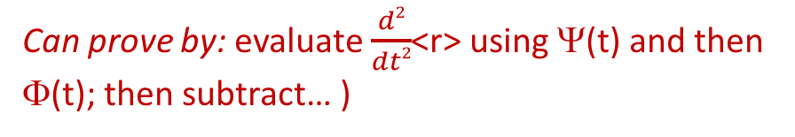
A couple of exact conditions in TDDFT:
(ii) Zero Force Theorem (Vignale PRL 74, 3233, (1995); Phys. Lett. A, 209, 206 (1995) )
xc field cannot exert a net force on itself
Can prove by: evaluate $\frac{d2}{dt2}$<r> using Ψ(t) and then Φ(t); then subtract… )
(exercise! Prove this !)
Linear response regime:
Using GK:
f_{xc}^{unif}[n₀(r)](q=0,ω)
ω-dependent
ω-independent
The exact conditions imply time-non-locality → spatially non-local n-dependence, i.e. a local density approximation with memory does not exist.
even in limit of slowly-varying densities → “ultra-non-locality”
Chap. 24 by G. Vignale, in Fundamentals of TDDFT, (Springer 2012)
Notes:
HPT violation: Dobson found GK gives an n-dep shift in the CM motion which becomes damped. Problem is because local density can’t distinguish btn compression/rarefaction (squeezing, breathing, as in a long-wavelength plasmon) and global translation (sloshing). GK “chooses” breathing, so get dissipation where there is none.

Slide 11
… Development of Memory-Dependent Functionals
Vignale-Kohn (VK) (1996) – spatially local approx in terms of the current-density, j(r,t) → TD-current-density-FT Phys. Rev. Lett. 77, 2037 (1996); Vignale, Ullrich, Conti, , PRL 79, 4878 (1997)
Ψ₀
Based on map:
j A_{ext}
1-1
VK constructed from dynamical longitudinal and transverse responses to slowly-varying perturbations of uniform electron liquid; involves Navier-Stokes-like eqn with complex viscosity coefficients.
Non-adiabatic, and satisfies harmonic potential theorem, zero-force theorems…
Similar concept was proposed by Dobson-Bünner-Gross (1997)
Phys. Rev. Lett. 79, 1905 (1997)
Apply Gross-Kohn in frame that moves along with local velocity of electron fluid: memory resides with the fluid element.
Spatially-local relative to where a fluid element at (r,t) was at earlier times t’, R’(t’|r,t) .
Agrees with VK in 1D.
R’,t’
r,t
Notes:
The xc potential at a time t (now) depends on the density at earlier times t’ . But at these earlier times a small volume element of the system, which
is now located at r, was located at a different position r’. The local current density contains information like this – could estimate from current-density at one point in space where that fluid element was earlier.

Slide 12
… A little more about Vignale-Kohn and TDCDFT…
Note that RG’s 1st step was j ←→ v_{ext}
Using A instead of v makes it easier to satisfy non-interacting representability: many currents of interacting systems in scalar potentials can only be reproduced by a non-interacting systems in vector potentials
Note that spatially local current j dependence → spatially ultra-nonlocal dependence on density n
E.g.
So even for static response (no memory), VK can help when spatial-non-locality important.
Some success for: correcting overestimate of LDA polarizabilities in long-chain polymers, dissipation in extended systems, spin-Coulomb drag, stopping power in metals….BUT problems for finite systems due to spurious damping

Slide 13
… Other Memory-Dependent Functionals
Lagrangian frame memory action functional
Y. Kurzweil & R. Baer (J. Chem. Phys. 121 8731 (2004).
Time-dependent deformation functional theory
I. V. Tokatly (Phys. Rev. B 71 (2005), Phys. Rev. B 75, 125105 (2007); Chap. 25 in Fundamentals of TDDFT (Springer, 2012)
Finite systems
Initial-state dependent
Orbital functionals v_{xc}[{φ_{i}(t)}]
H. Wijewardane and C. A. Ullrich, Phys. Rev. Lett. 100, 056404 (2008)
Approximations based on an exact decomposition of the xc potential
Fuks, Lacombe, Nielsen, Maitra, Phys. Chem. Chem. Phys. 20, 26145 (2018).
L. Lacombe and N. T. Maitra, J. Chem. Theory and Comput. 15, 1672 (2019).

Slide 14
Another exact condition: “Memory” condition
History and initial-state dependence are entangled
v_{xc} [n_{t’} ; Ψ₀ = Ψ(t’), Φ₀ = Φ(t’) ] (r,t) independent of t’ (for t >t’)
density n_{t’} defined only from t’ onward
n (t)
t’
t’
t’
t
Maitra, Burke, Woodward, PRL 89, 023002 (2002)
This is a very hard condition to satisfy for non-adiabatic functionals.
Question for you! Does ALDA satisfy this? Do you think VK satisfies this?
When finding exact xc potentials for a given model dynamics, this condition is useful to generalize your results! It says for any dynamics that reaches the instantaneous interacting and KS states Ψ(t), Φ(t), your exact xc potential applies.

Slide 15
We will next look at some systems where we can find the exact TD xc potential, and compare with the adiabatic approximation.
To do this, we need a system for which we can find the exact interacting wavefunction from which we obtain the time-dependent density.
Then the question is what is the Kohn-Sham potential that reproduces this density evolution?

Slide 16
Plan
Introduction to what is memory in TDDFT
-- the adiabatic approximation
Approximations including memory and some exact conditions
Some examples
-- field-free superposition state dynamics
-- charge-transfer dynamics
-- electron-atom scattering

Slide 17
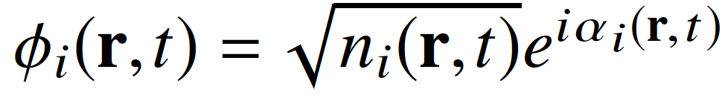
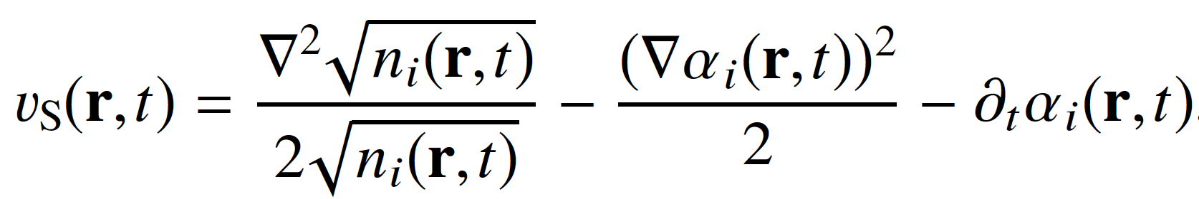
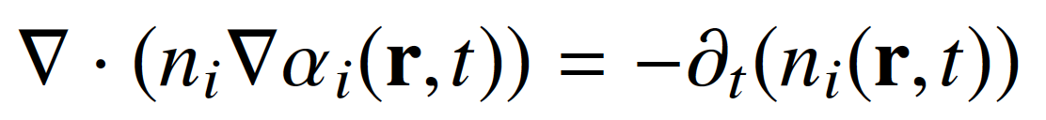
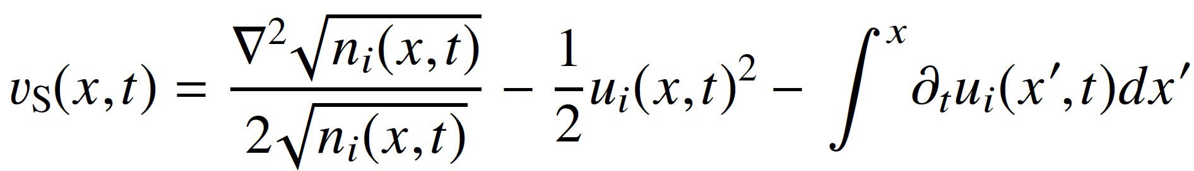
Finding the exact xc potential for a given known density-evolution
Generally, not so easy.
One can show:
into TDKS
orbital-density and orbital-phase of any one of the occupied orbitals
Exercise: show this!
where
In 1D, can express in terms of orbital-density and orbital-”velocity”, u_{i} = j_{i} /n_{i}
So, problem becomes finding the exact KS orbitals -- generally difficult, but possible, Nielsen, Ruggenthaler, van Leeuwen, Europhys. Lett. 101, 33001 (2013)
One easy case: 2 electrons spin-singlet in 1D, in a doubly-occupied KS orbital
n_{i}(x,t) → ½ n(x,t), the exact density, and u_{i}(x,t)→ j(x,t)/n(x,t), where j is the exact current-density

Slide 18
Expression directly for the exact exchange-correlation potential …
Those expressions are directly for v_{s}; to find v_{xc} we must subtract Hartree and v_{ext}
But there is also an expression directly for v_{xc}:
Equate equation of motion for $∂^{2}$n(r,t)/$∂t^{2}$ coming from interacting system,
with that of the KS system, and then subtract →
Exact expression for the TD exchange-correlation potential
TD one-body density-matrix: interacting, KS
TD exchange-correlation hole

Slide 19
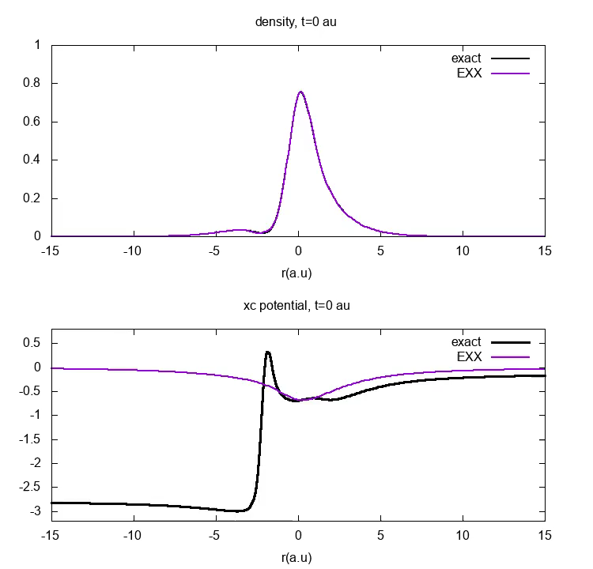

A simple example of memory-dependence: Field-Free Evolution of Superposition State in 1D He
These large step and peak features cannot be captured by even the best adiabatic approximation, v_{xc}^{A-ex} …

Slide 20
v_{xc}
Adiabatic approximations, even adiabatically-exact, lack the dynamical step and look really different
Notes:
They seem to look quite different. Which is surprising that they get the dynamics even remotely; the step is even bigger than the external potential well. But actually to get a better idea of the effect of these structures on the dynamics, should look at the local force.

Slide 21
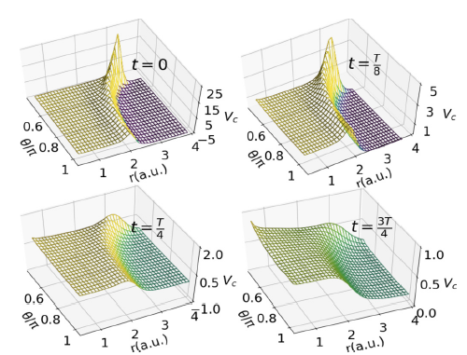



The large non-adiabatic features are not a consequence of 1D – they are equally present in real 3D systems,
e.g. 50:50 superposition state 1¹S₀ : 2¹P₁ in the He atom
D. Dar, L. Lacombe, J. Feist, N. T. Maitra, Phys. Rev. A. 104, 032821 (2021)
Notes:
That’s 1D, does it really happen like that in real atoms and molecules? Analgous problem for the real 3D He atom. PhD student Davood Dar heroically inverted the TDKS system for the analogous dynamics in the real 3D He atom – found equally present

Slide 22
Non-adiabatic features in v_{c} appear generically in non-perturbative dynamics: resonantly-driven processes, charge-transfer dynamics, field-free evolution of non-stationary states, quasiparticle propagation in wires…
…but missing in all adiabatic approximations
E.g.
Elliott, Fuks, Rubio, Maitra, PRL 109, 266404 (2012)
Ramsden, Godby, PRL 109, 036402 (2012)
…
N. T. Maitra, Perspective in J. Chem. Phys. 144, 220901 (2016)
D. Dar, L. Lacombe, N. T. Maitra, Chem. Phys. Rev. 3, 031307 (2022)
What is the impact on dynamics?? Propagate with adiabatically-exact approximation to compare…
Notes:
Say what the example is

Slide 23
Another Example: Charge-transfer dynamics out of the ground-state
LiCN molecule
S. Ragunathan, M. Nest, J. Chem. Th. Comput. 7 2492 (2011).
J. I. Fuks, P. Elliott, A Rubio, N. T. Maitra J. Phys. Chem. Lett. 4, 735 (2013)
J.I. Fuks and Maitra, Phys. Rev. A. 89, 062502 (2014); Phys. Chem. Chem. Phys. 16, 14504 (2014)
EXX
ω = 0.5177
ω^{adia-ex} = 0.5187
Despite extremely accurate CT excitation energies, CT is not achieved by the adiabatically-exact approximation.

Slide 24
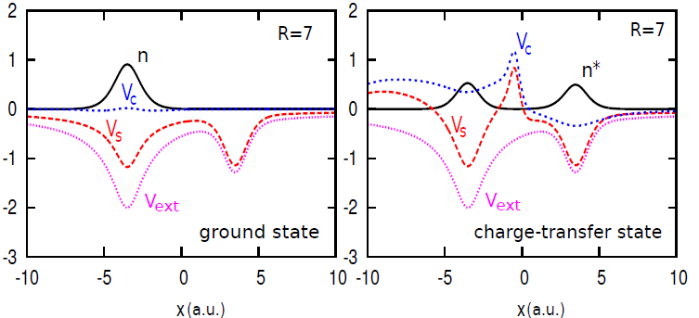
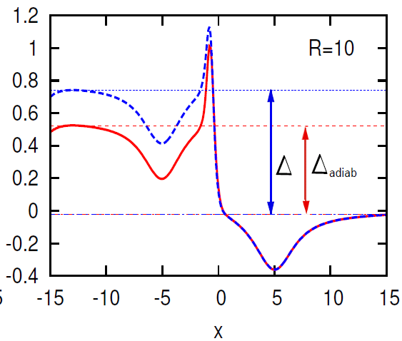
But charge-transfer out of the ground-state is challenging for KS, since a single KS orbital must always describe both the transferring electron and one that stays...
Step features build up in time – even v_{c}^{adia-ex} fails to correctly capture
v_{c}
adia-exact v_{c}
Correlation potential in the final CT state, as R→ ∞
N. T. Maitra, Topical Review on Charge Transfer in TDDFT in J. Phys. Cond. Matt. 29, 423001 (2017)

Slide 25
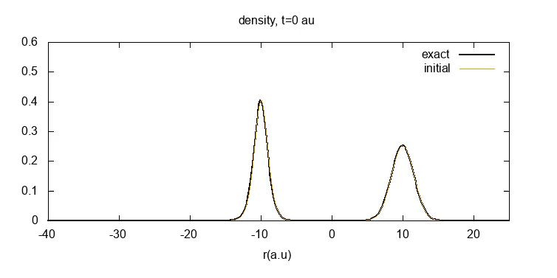

A final example: Time-Resolved e-H scattering
reflection
How do the TDDFT approximations do?
Choice of initial spin-singlet KS wavefunction:
Slater determinant (one orbital, doubly-occupied)
Two-orbital state: one for the electron in the atom, one for the incoming
t/fs
Y. Suzuki, L. Lacombe, K. Watanabe, N. T. Maitra, PRL 119, 263401 (2017)
L. Lacombe, Y. Suzuki, K. Watanabe, N. T. Maitra, Eur. Phys. J. B. 91, 96 (2018)

Slide 26
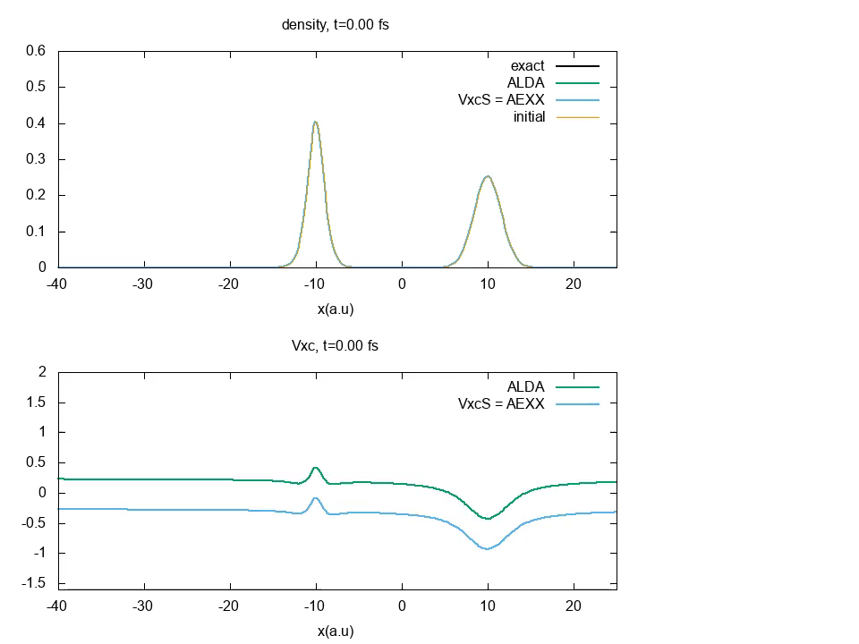
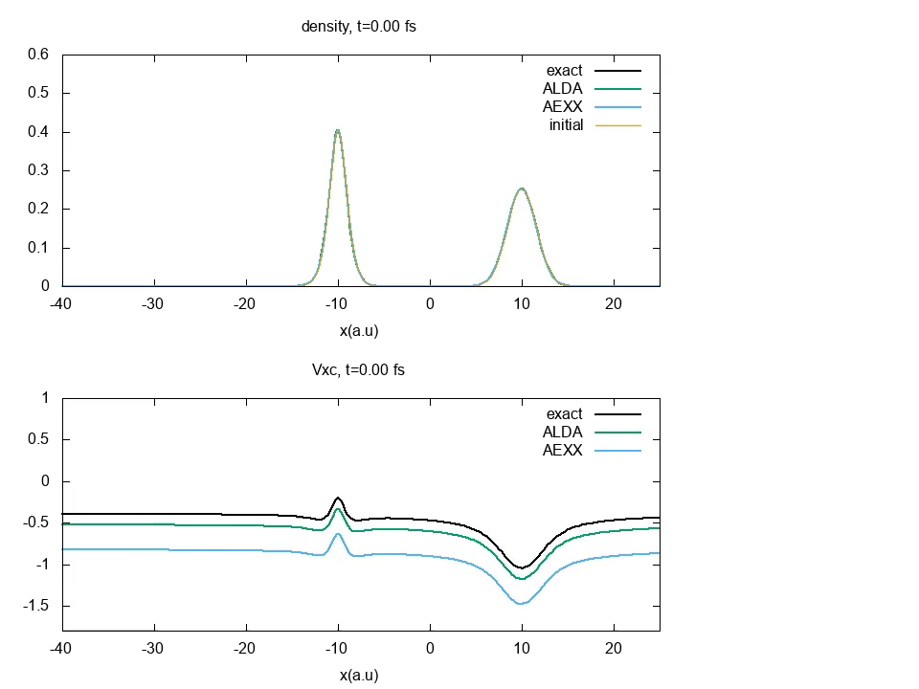
Time-Resolved e-H scattering
Choice (1) Slater determinant
Although ALDA and AEXX densities don’t show unphysical oscillations for choice (2), they overspread and ultimately fail to scatter – v_{xc} lacks crucial peak and valley structures.
Same trend for elastic case – here scattering coeffs extracted from linear response using AEXX are good but time-resolved calculation fails!
Choice (2) Two-orbital state
reflection
t/fs
Y. Suzuki, L. Lacombe, K. Watanabe, N. T. Maitra, PRL 119, 263401 (2017)
L. Lacombe, Y. Suzuki, K. Watanabe, N. T. Maitra, Eur. Phys. J. B. 91, 96 (2018)

Slide 27
Short summary so far: memory in non-perturbative dynamics
The exact functional depends on the history of the density, the initial state, and choice of KS initial state. Neglect of this memory-dependence responsible for some failures
-- Resonantly driven dynamics (another exact cond, not discussed here, is violated)
-- Charge-transfer dynamics out of the ground-state
Generically, dynamical steps and peaks appear in v_{c} that require non-adiabatic density-dependence
  -- impact on ensuing dynamics can be large, but not always
Approximations giving good response can give bad non-perturbative dynamics
-- probing the functional in a very different domain.
With a judicious choice of Φ₀ the adiabatic approx can better approximate v_{xc}
But the adiabatic approximation has provided useful results and interpretation in many applications, especially for heavily-integrated observables…and two-electrons may be the worst case… a better understanding of non-adiabatic effects is still needed

