Slide 1



Real-time TDDFT
for extremely nonlinear and ultrafast phenomena
Shunsuke A. Sato
1. Center for Computational Sciences, University of Tsukuba, Japan
2. Max Planck Institute for the Structure and Dynamics of Matter, Hamburg

Slide 2
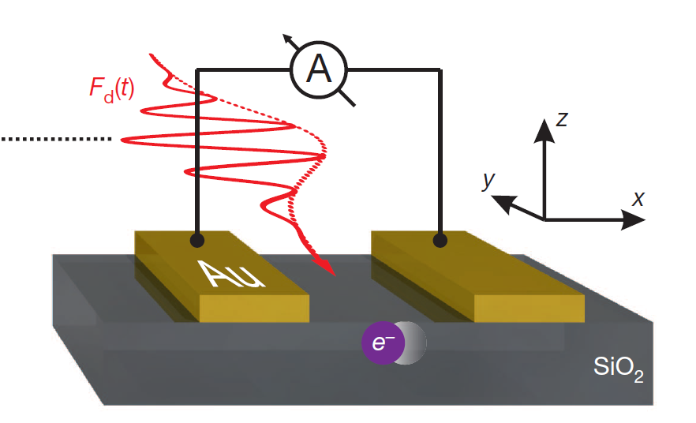
Introduction to extremely nonlinear and ultrafast phenomena
Attosecond science for solids
Intense and fs laser pulses induce nonlinear ultrafast phenomena in solids.
Opt-electronic device
about 500nm
Our research aim
Agustin Schiffrin, et al, Nature 493,70 (2013)
To understand the microscopic mechanism of such strongly-nonlinear ultrafast phenomena in solids.
For this aim, we employ the first-principles calculation based on
time-dependent density functional theory (TDDFT).

Slide 3


Time-dependent Kohn-Sham equation for solids
Time-dependent Kohn-Sham equation with uniform electric fields in the length gauge
$$i\frac{∂}{∂t}ψ_{j}\left(r,t\right)=\left[\frac{p^{2}}{2}+{\hat{v}}_{ion}+v_{Hxc}\left[ρ\left(r,t\right)\right]+E\left(t\right)⋅r\right]ψ_{j}\left(r,t\right)$$
Gauge transformation
$$ψ_{j}\left(r,t\right)=e^{iA\left(t\right)⋅r}{\tilde{ψ}}_{j}\left(r,t\right)$$
Time-dependent Kohn-Sham equation with uniform electric fields in the velocigy gauge
$$i\frac{∂}{∂t}{\tilde{ψ}}_{j}\left(r,t\right)=\left[\frac{{\left(p+A\left(t\right)\right)}^{2}}{2}+{e^{−iA\left(t\right)⋅r}\hat{v}}_{ion}e^{iA\left(t\right)⋅r}+v_{Hxc}\left[ρ\left(r,t\right)\right]\right]{\tilde{ψ}}_{j}\left(r,t\right)$$
Bloch theorem
$${\tilde{ψ}}_{j}\left(r,t\right)=e^{ik⋅r}u_{bk}\left(r,t\right)$$
$$i\frac{∂}{∂t}u_{bk}\left(r,t\right)=\left[\frac{{\left(p+k+A\left(t\right)\right)}^{2}}{2}+{e^{−i\{k+A\left(t\right)\}⋅r}\hat{v}}_{ion}e^{i\{k+A\left(t\right)\}⋅r}+v_{Hxc}\left[ρ\left(r,t\right)\right]\right]u_{bk}\left(r,t\right)$$

Slide 4



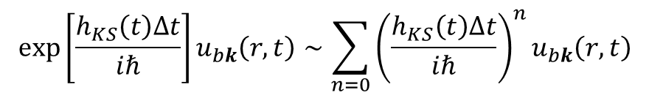
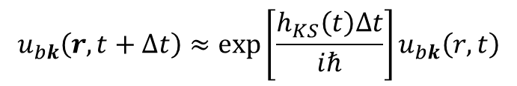
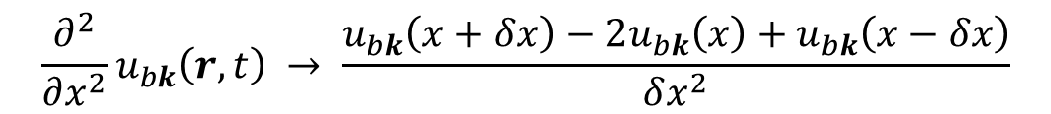
How to solve the TDKS equations
We employ real-time and real-space method.
Real-scape method (Finite-difference method in space)
$$u_{bk}\left(r,t\right) →u_{bk}\left(r_{i},t\right)$$
$$\frac{∂^{2}}{∂x^{2}}u_{bk}\left(r,t\right) → \frac{u_{bk}\left(x+δx\right)−2u_{bk}\left(x\right)+u_{bk}\left(x−δx\right)}{δx^{2}}$$
Real-time method (Finite-difference method in time)
$$u_{bk}\left(r,t+Δt\right)≈\exp\left[\frac{h_{KS}\left(t\right)Δt}{iℏ}\right]u_{bk}\left(r,t\right)$$
We usually employ 4th order Taylor expansion method.
Yabana group@Japan
http://salmon-tddft.jp
$$\exp\left[\frac{h_{KS}\left(t\right)Δt}{iℏ}\right]u_{bk}\left(r,t\right)∼{\sum_{n=0}{{\left(\frac{h_{KS}\left(t\right)Δt}{iℏ}\right)}^{n}}u}_{bk}\left(r,t\right)$$

Slide 5
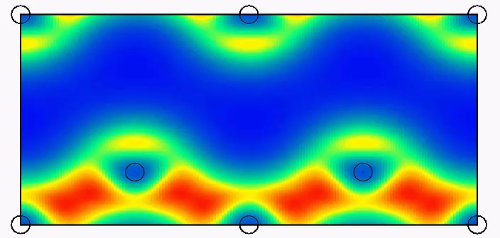
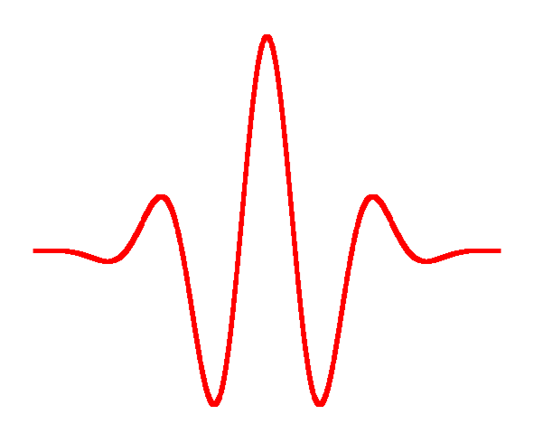
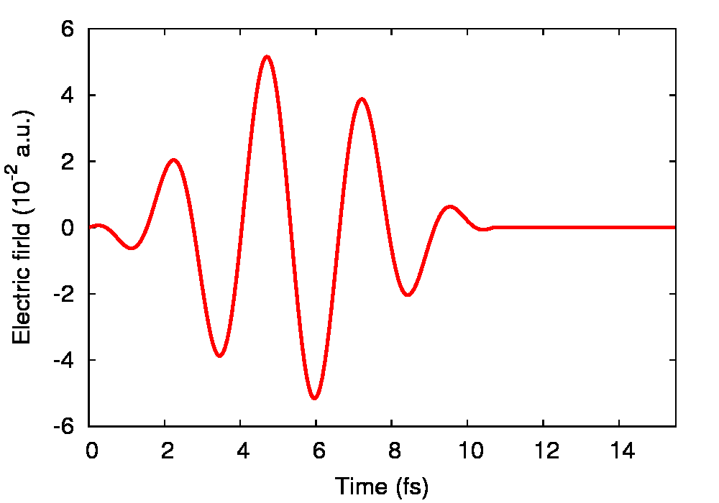
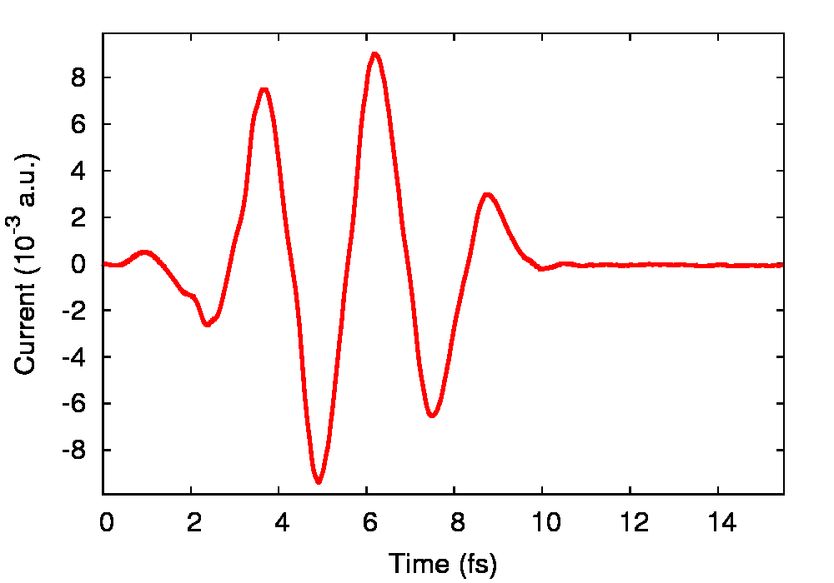
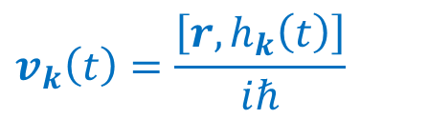
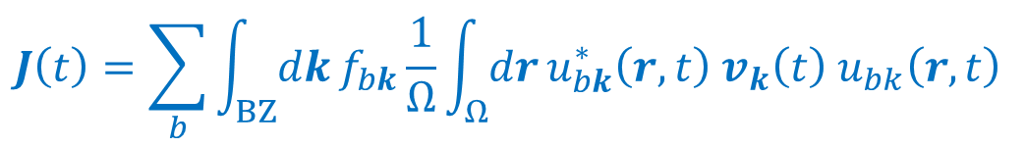
Electron dynamics calculation (RT-TDDFT)
Electron density in Si
Bulk Si
Laser polarization
Laser pulse
Si atoms
$$J\left(t\right)=\sum_{b}{\int_{BZ}{dk}f_{bk}\frac{1}{Ω}\int_{Ω}{dr}}u_{bk}^{∗}\left(r,t\right) v_{k}\left(t\right){ u}_{bk}\left(r,t\right)$$
Output
Input
Laser fields
Electric current
$$v_{k}\left(t\right)=\frac{\left[r,h_{k}\left(t\right)\right]}{iℏ}$$

Slide 6
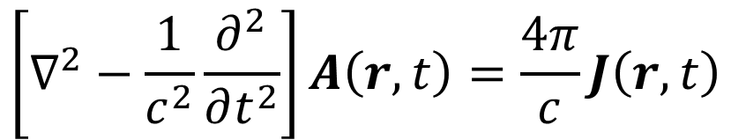




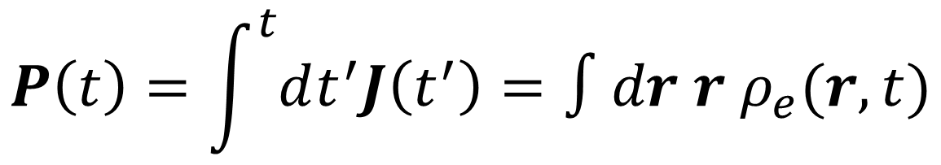

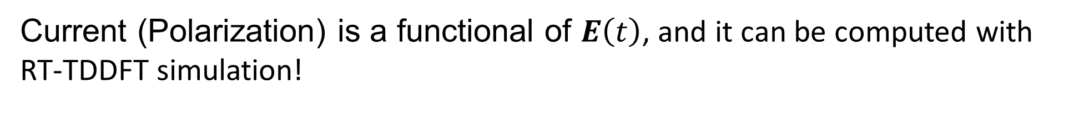
Real-time TDDFT simulation
Input
Output
Maxwell equation
$$E\left(t\right)$$
$$J\left(t\right)$$
$$\left[∇^{2}−\frac{1}{c^{2}}\frac{∂^{2}}{∂t^{2}}\right]A\left(r,t\right)=\frac{4π}{c}J\left(r,t\right)$$
Input
Output
$$P\left(t\right)=\int^{t}{dt^{′}J\left(t^{′}\right)}=∫dr r ρ_{e}(r,t)$$
$$E\left(t\right)$$
Polarization
(for isolated systems)
Current (Polarization) is a functional of $E\left(t\right)$, and it can be computed with RT-TDDFT simulation!
$$J\left(t\right)=J\left[E\right]\left(t\right),$$
$$P\left(t\right)=J\left[E\right]\left(t\right)$$

Slide 7
Expansion of current
$$J\left[E\right]\left(t\right)=\int_{−∞}^{∞}{dt′} σ^{(1)}\left(t,t^{′}\right)E\left(t^{′}\right)+\int_{−∞}^{∞}{dt′}\int_{−∞}^{∞}{dt′′}σ^{(2)}\left(t,t^{′},t^{′′}\right)E\left(t^{′}\right)E\left(t^{′}′\right)+⋯$$
If a system has a translational symmetry in time:
$$=\int_{−∞}^{∞}{dt′} σ^{(1)}\left(t−t^{′}\right)E\left(t^{′}\right)+\int_{−∞}^{∞}{dt′}\int_{−∞}^{∞}{dt′′}σ^{(2)}\left(t−t^{′},t−t^{′′}\right)E\left(t^{′}\right)E\left(t^{′}′\right)+⋯$$
First order (linear) response
Second order response

Slide 8
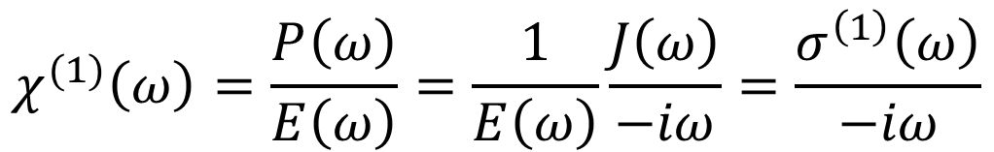
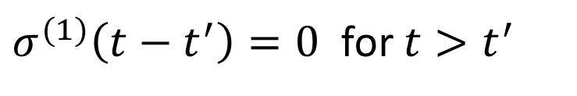

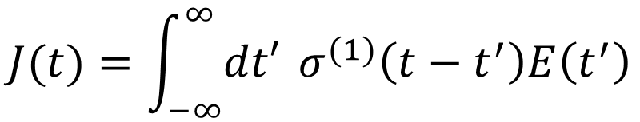
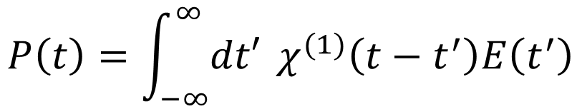
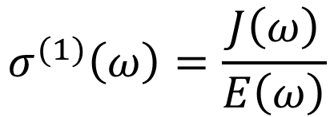

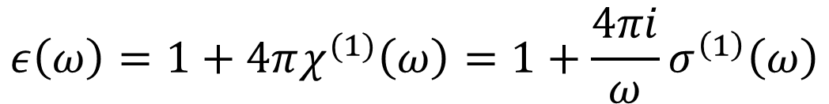
Linear response
Causality
$$J(t)=\int_{−∞}^{∞}{dt′} σ^{(1)}\left(t−t^{′}\right)E\left(t^{′}\right)$$
$σ^{(1)}\left(t−t^{′}\right)=0$ for $t>t^{′}$
Fourier transform
Optical conductivity
$$σ^{(1)}\left(ω\right)=\frac{J\left(ω\right)}{E\left(ω\right)}$$
$$J(ω)= σ^{(1)}\left(ω\right)E\left(ω\right)$$
$$P\left(t\right)=\int_{−∞}^{∞}{dt′} χ^{(1)}\left(t−t^{′}\right)E\left(t^{′}\right)$$
$$χ^{(1)}\left(ω\right)=\frac{P\left(ω\right)}{E\left(ω\right)}=\frac{1}{E\left(ω\right)}\frac{J\left(ω\right)}{−iω}=\frac{σ^{\left(1\right)}\left(ω\right)}{−iω}$$
Fourier transform
$$P(ω)= χ^{(1)}\left(ω\right)E\left(ω\right)$$
$$ε\left(ω\right)=1+4πχ^{(1)}\left(ω\right)=1+\frac{4πi}{ω}σ^{\left(1\right)}\left(ω\right)$$

Slide 9
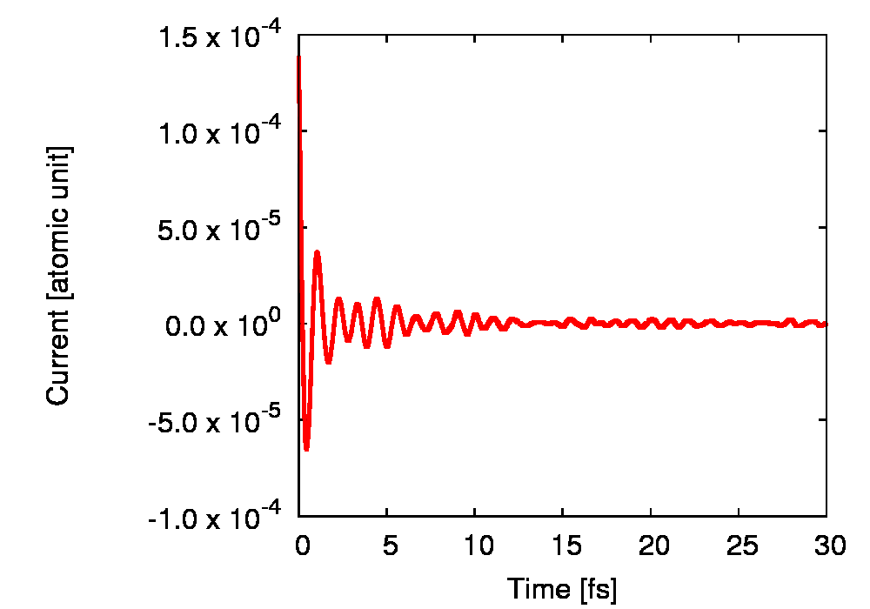
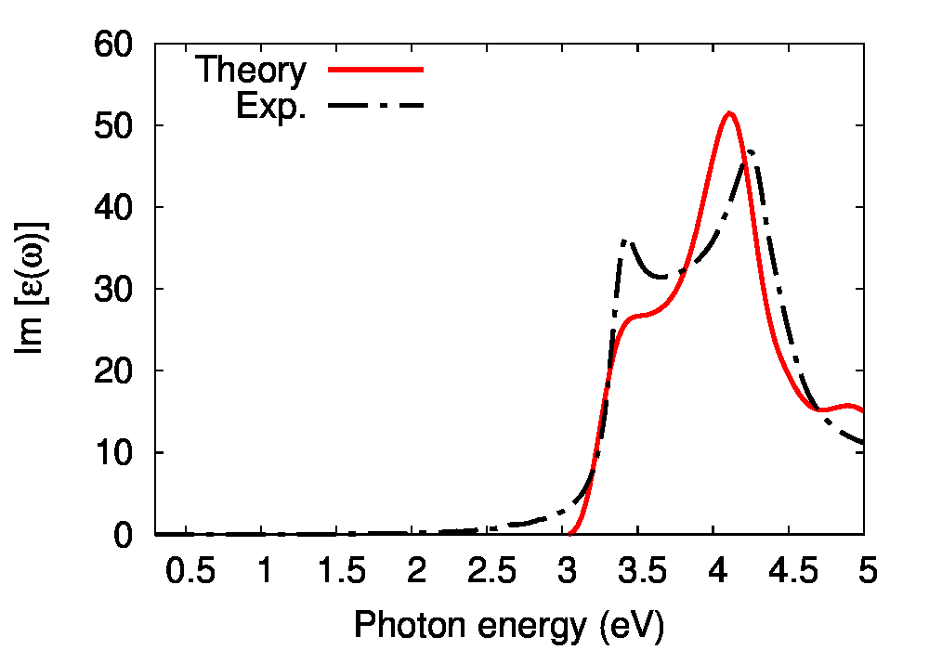
Application of TDDFT to linear response
How to evaluate dielectric function with RT-TDDFT
1st step:
calculate electron dynamics under a small distortion, $E\left(t\right)=E_{0}δ\left(t\right)$.
2nd step:
evaluate electric current, $J\left(t\right)$, as a function of time.
3rd step:
evaluate optical properties by Fourier analysis:
$σ\left(ω\right)=\frac{J\left(ω\right)}{E\left(ω\right)}, ε\left(ω\right)=1+4πχ(ω)=1+4πiσ\left(ω\right)/ω$
Dielectric function of Si
(Becke-Jonson meta-GGA is used)
Electric current under the distortion
Silicon

Slide 10

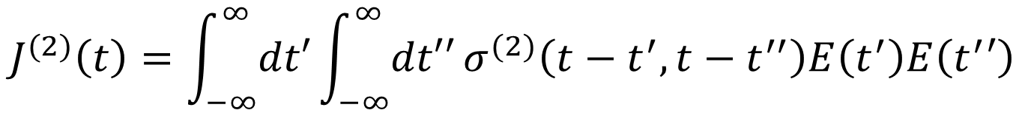
Nonlinear response (Nonlinear optics)
2nd order nonlinear current
$$J^{(2)}\left(t\right)=\int_{−∞}^{∞}{dt′}\int_{−∞}^{∞}{dt′′}σ^{(2)}\left(t−t^{′},t−t^{′′}\right)E\left(t^{′}\right)E\left(t^{′}′\right)$$
$$E\left(t\right)=E_{0}\cos\left(ωt\right)$$
$$J^{(2)}\left(t\right)=\int_{−∞}^{t}{dt′}\int_{−∞}^{t}{dt′′}σ^{(2)}\left(t−t^{′},t−t^{′′}\right)E_{0}\cos\left(ωt′\right)E_{0}\cos\left(ωt′′\right)$$
$$=\frac{E_{0}^{2}}{4}\int_{−∞}^{t}{dt^{′}}\int_{−∞}^{t}{dt^{′′}}σ^{\left(2\right)}\left(t−t^{′},t−t^{′′}\right)\left(e^{iωt^{′}}+e^{−iωt^{′}}\right)\left(e^{iωt^{′′}}+e^{−iωt^{′′}}\right)$$
$$=\frac{E_{0}^{2}}{4}\left[σ^{\left(2\right)}\left(−ω,−ω\right)e^{i2ωt}+σ^{\left(2\right)}\left(ω, ω\right)e^{−i2ωt}+σ^{\left(2\right)}\left(ω, −ω\right)+σ^{\left(2\right)}\left(−ω, ω\right)\right]$$
Second harmonic generation
Photovoltaic effect

Slide 11
First observation of nonlinear optical (Second harmonic generation)
P. A. Franken, A. E. Hill, C. W. Peters, and G. Weinreich, Phys. Rev. Lett. 7, 118 (1961)
David Lindley, Physics 7, 112
https://physics.aps.org/articles/v7/112
“ Ironically, the faint spot did not appear in the figure in Physical Review Letters because someone at the printing company thought it was a blemish and erased it, says Weinreich.”

Slide 12
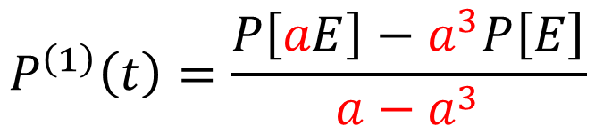
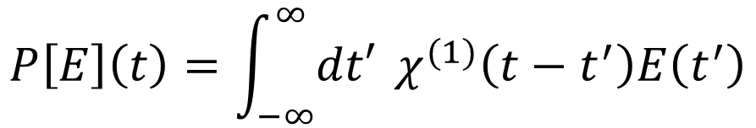
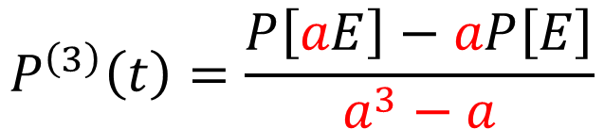
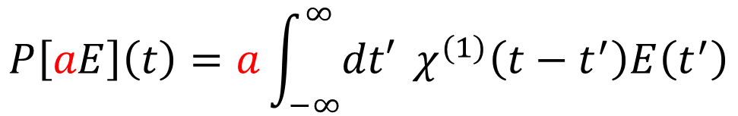
Nonlinear response (Nonlinear optics) from RT-TDDFT simulation
$$P\left[E\right]\left(t\right)=\int_{−∞}^{∞}{dt′} χ^{(1)}\left(t−t^{′}\right)E\left(t^{′}\right)$$
$$+\int_{−∞}^{∞}{dt^{′}}\int_{−∞}^{∞}{dt^{′′}}χ^{\left(3\right)}\left(t−t^{′},t−t^{′′},t−t^{′′′}\right)E\left(t^{′}\right)E\left(t^{′}′\right)E\left(t^{′′′}\right)+⋯$$
$$P\left[aE\right]\left(t\right)=a\int_{−∞}^{∞}{dt′} χ^{(1)}\left(t−t^{′}\right)E\left(t^{′}\right)$$
$$+a^{3}\int_{−∞}^{∞}{dt^{′}}\int_{−∞}^{∞}{dt^{′′}}χ^{\left(3\right)}\left(t−t^{′},t−t^{′′},t−t^{′′′}\right)E\left(t^{′}\right)E\left(t^{′}′\right)E\left(t^{′′′}\right)+⋯$$
$$P^{\left(1\right)}\left(t\right)=\frac{P\left[aE\right]−a^{3}P\left[E\right]}{a−a^{3}}$$
$$P^{\left(3\right)}\left(t\right)=\frac{P\left[aE\right]−aP\left[E\right]}{a^{3}−a}$$

Slide 13
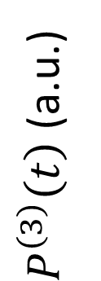


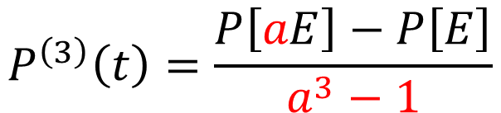
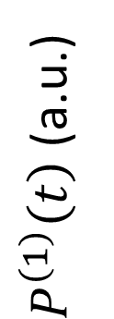
Nonlinear response (Nonlinear optics) from RT-TDDFT simulation
Application to diamond
M. Uemoto, et al., J. Chem. Phys. 150, 094101 (2019)
Laser parameters:
$P^{\left(1\right)}\left(t\right)$ (a.u.)
Photon energy = 1.55 eV
Pulse duration = 16 fs
We compute the polarization:
$$P\left[E\right]\left(t\right),P\left[aE\right]\left(t\right)$$
$$P^{\left(1\right)}\left(t\right)=\frac{P\left[aE\right]−a^{3}P\left[E\right]}{a−a^{3}}$$
$P^{\left(3\right)}\left(t\right)$ (a.u.)
$$P^{\left(3\right)}\left(t\right)=\frac{P\left[aE\right]−P\left[E\right]}{a^{3}−1}$$

Slide 14
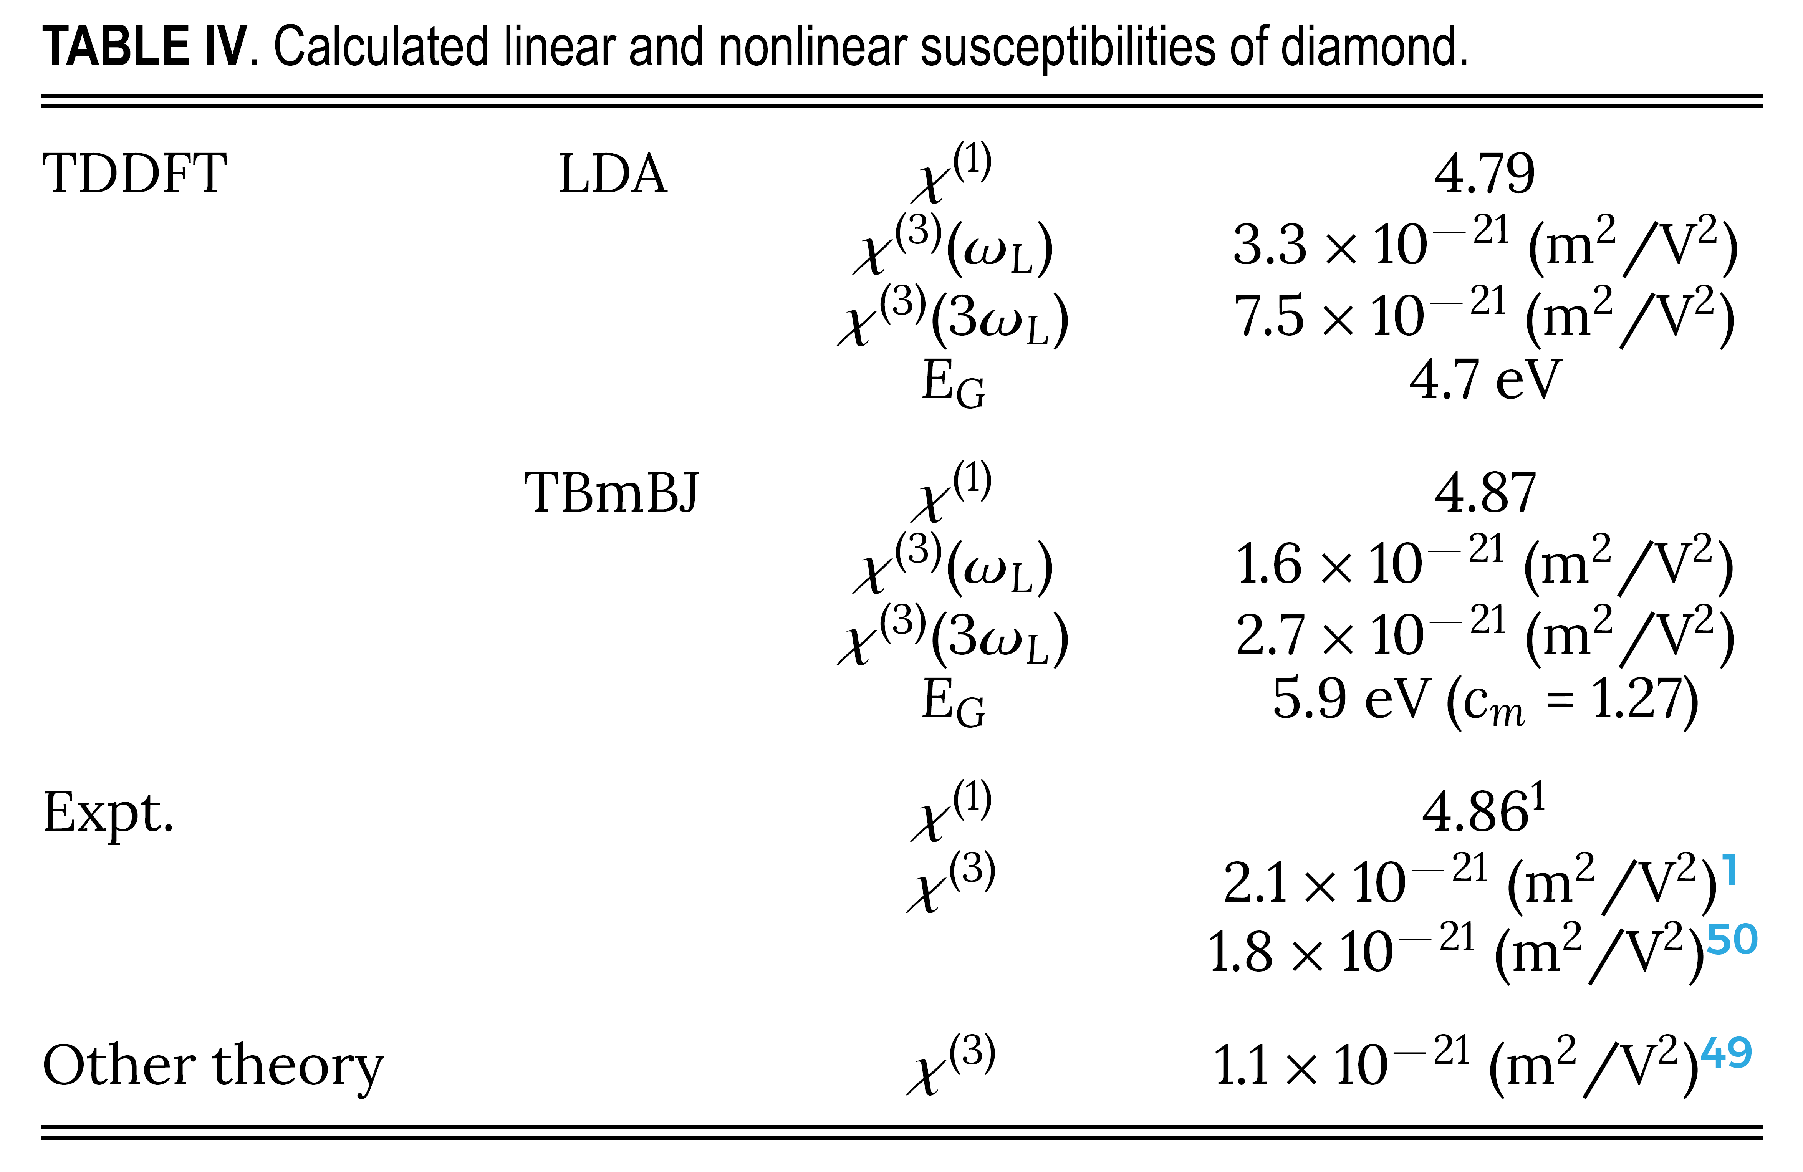
Nonlinear response (Nonlinear optics) from RT-TDDFT simulation
Response of diamond
M. Uemoto, et al., J. Chem. Phys. 150, 094101 (2019)
$P^{\left(1\right)}\left(t\right)$ (a.u.)
$P^{\left(3\right)}\left(t\right)$ (a.u.)

Slide 15
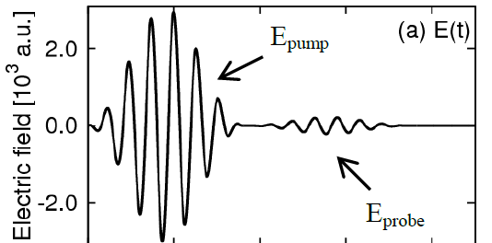

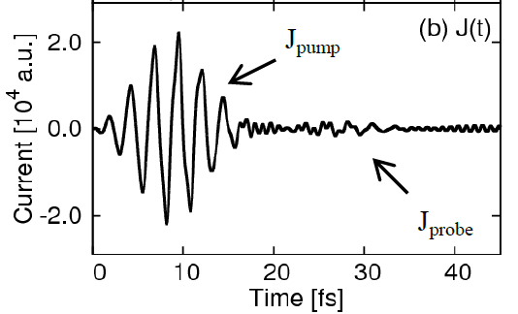


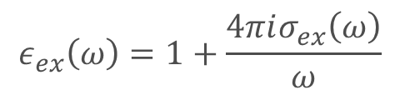
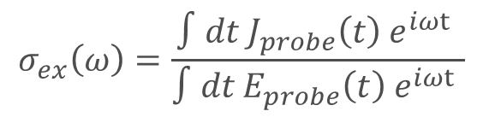
Numerical pump-probe experiments
S.A.S. et al, Phys. Rev. B 89, 064304 (2014).
We can conduct pump-probe experiments with the first-principles calculation.
Electric field
1st step:
calculating electron dynamics under pump and probe pulses.
$$E\left(t\right)=E_{pump}\left(t\right)+E_{probe}\left(t\right)$$
2nd step:
evaluate electric current as a function of time
$$J\left(t\right)=J_{pump}\left(t\right)+J_{probe}\left(t\right)$$
3rd step:
evaluate optical properties by Fourier analysis:
Electric current
$$σ_{ex}\left(ω\right)=\frac{∫dt J_{probe}\left(t\right) e^{iωt} }{∫dt E_{probe}\left(t\right) e^{iωt} }$$
$$ε_{ex}\left(ω\right)=1+\frac{4πiσ_{ex}\left(ω\right)}{ω}$$

Slide 16
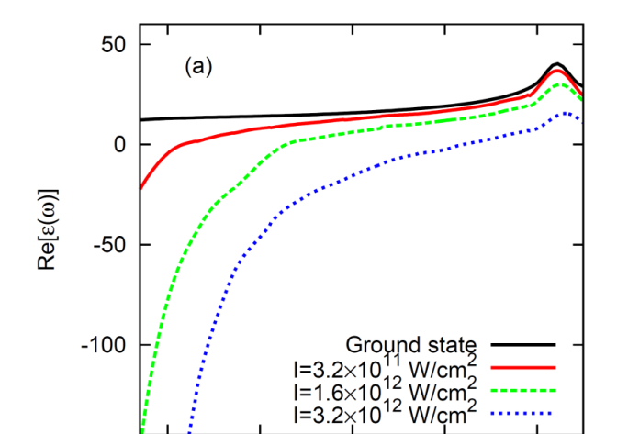
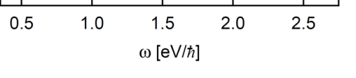


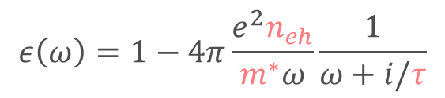





Numerical pump-probe experiments
S.A.S. et al, Phys. Rev. B 89, 064304 (2014).
Dielectric function of laser-excited silicon
Ground state
$$J_{probe}$$
$$J_{pump}$$
$3.2×{10}^{11}$ W/cm²
$1.6×{10}^{12}$ W/cm²
$$J_{pump}$$
$3.2×{10}^{12}$ W/cm²
The dielectric function shows metallic behavior due to photo-excited carrier
$$J_{probe}$$
$$ε\left(ω\right)=1−4π\frac{e^{2}n_{eh}}{m^{∗}ω}\frac{1}{ω+i/τ}$$
Drude model

Slide 17
Application to attosecond physics!
But before that…

Slide 18
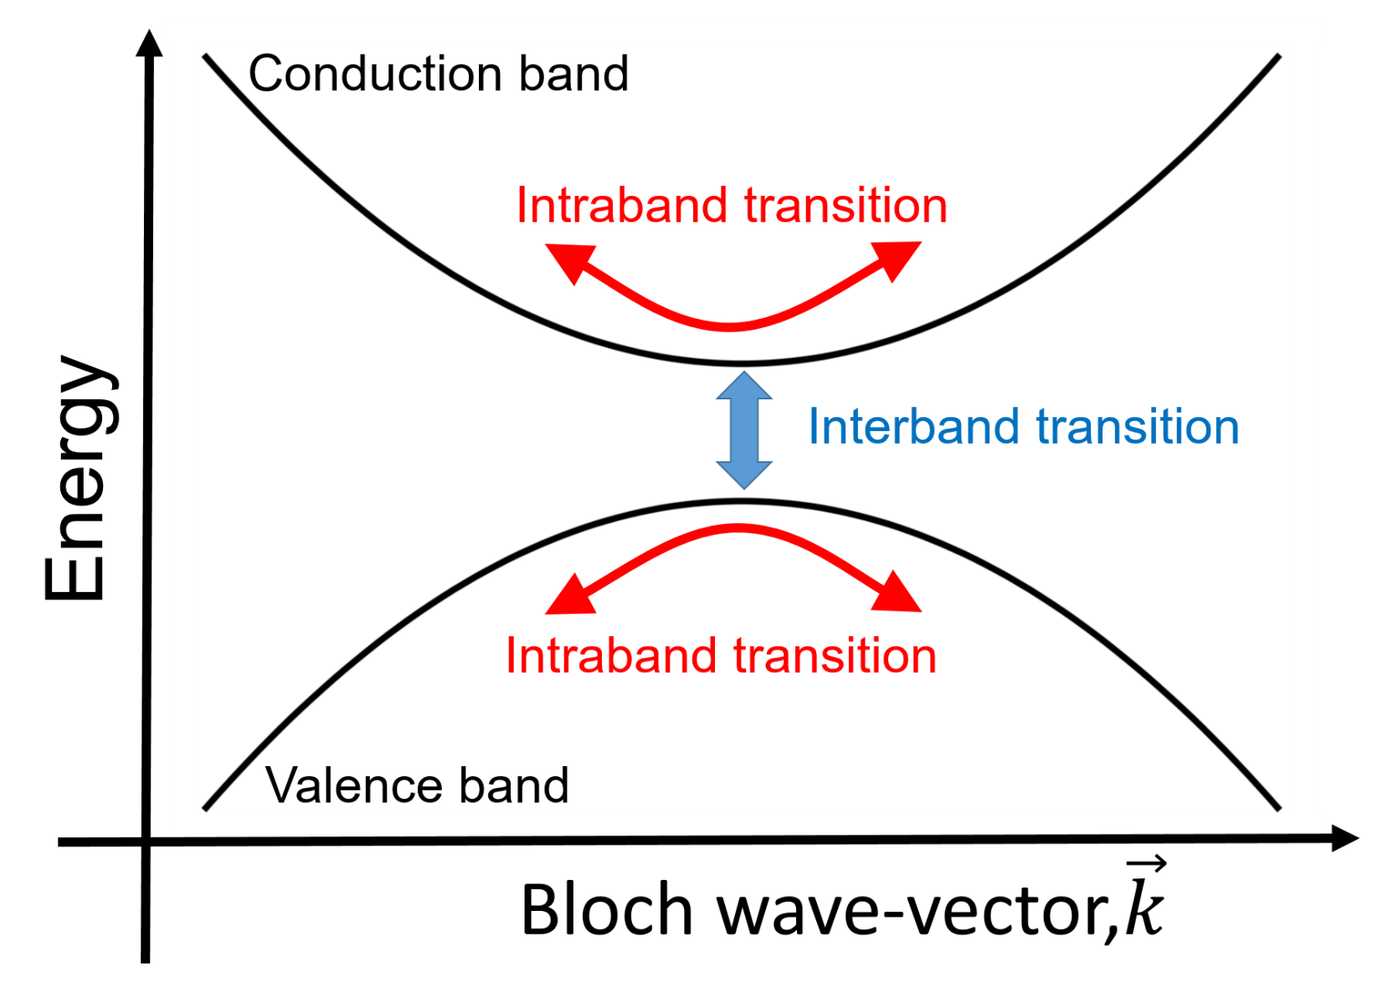
Laser-induced Intra-band transition and inter-band transition
Inter-band transition
- Photo-absorption semiconductor
Intra-band transition
electron
- Origin of metallic current
- Bloch oscillation

Slide 19
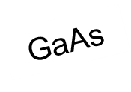
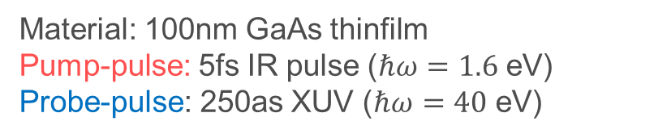
Attosecond transient absorption spectroscopy (GaAs)
The experiments were done in Prof. Keller’s experimental group@ETH Zurich
F. Schlaepfer, et al, Nature Physics 14, 560 (2018).
Experimental setup
Material: 100nm GaAs thinfilm
Pump-pulse: 5fs IR pulse ($ℏω=1.6$ eV)
Probe-pulse: 250as XUV ($ℏω=40$ eV)
Bnad gap: 1.42 eV

Slide 20
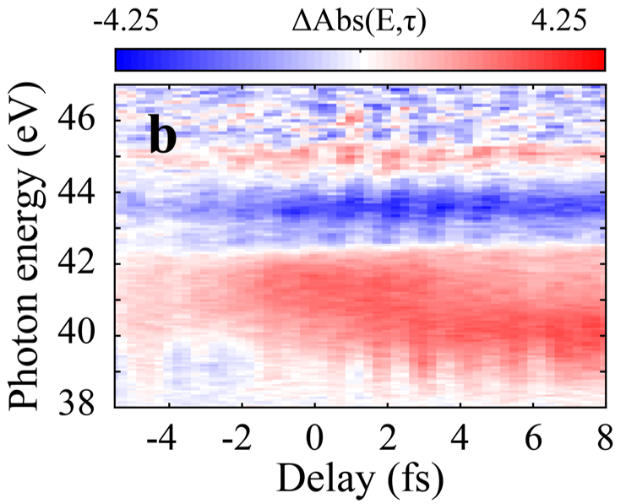
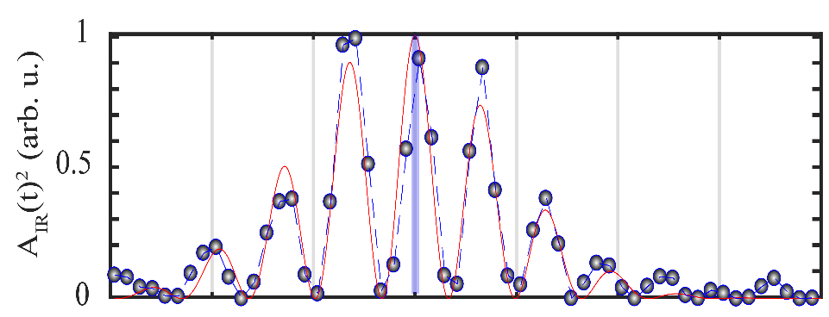

Attosecond transient absorption spectroscopy (GaAs)
Experiment
$A^{2}\left(t\right)$ (arb. unit)
Delay (fs)

Slide 21
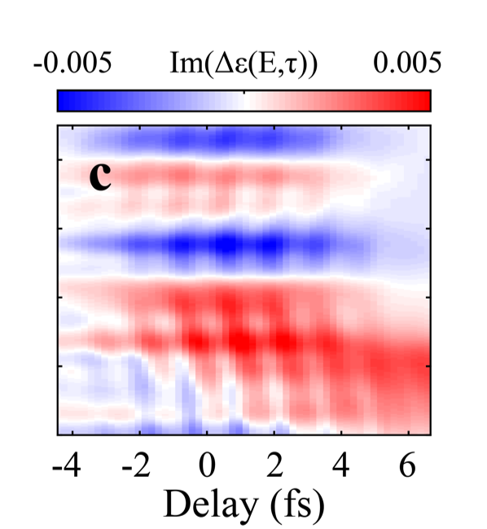
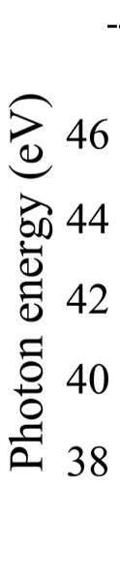







Numerical pump-probe experiments
Reference calculation w/o pump
Theory
Input
Output
$$E_{probe}^{XUV}\left(t\right)$$
$$J_{probe}\left(t\right)$$
$$ε_{eq}\left(ω\right)$$
Pump-probe calculation
Input
Output
$$E_{pump}^{IR}\left(t\right)+E_{probe}^{XUV}\left(t−τ_{delay}\right)$$
$$Im\left[ε_{ex}\left(ω,τ_{delay}\right)−ε_{eq}\left(ω\right)\right]$$
$$J_{pump}\left(t\right)+J_{probe}\left(t\right)$$
$$ε_{ex}\left(ω,τ_{delay}\right)$$

Slide 22
Attosecond transient absorption spectroscopy (GaAs)
Experiment
Theory
So nice!
But, do we need theory?
$A^{2}\left(t\right)$ (arb. unit)
Delay (fs)

Slide 23
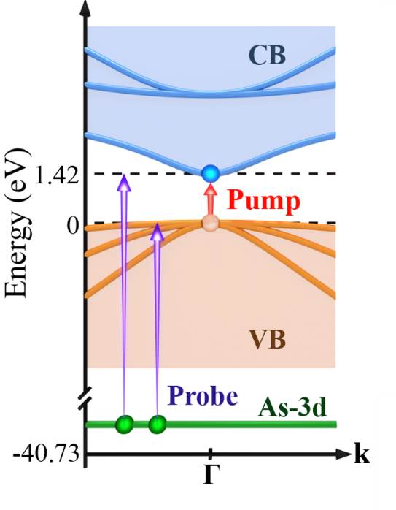
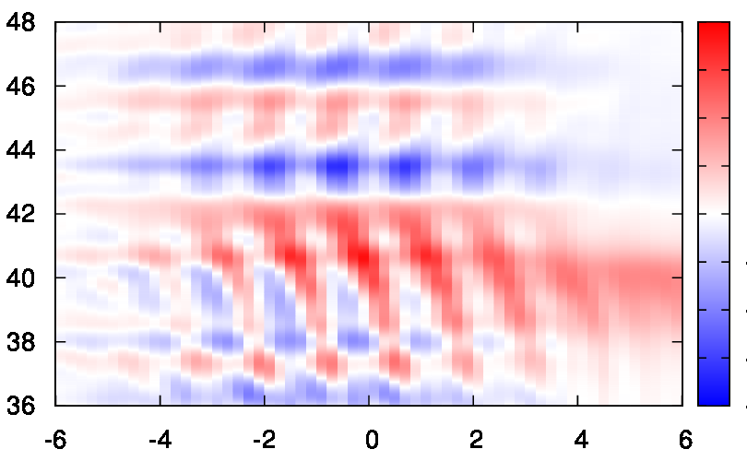
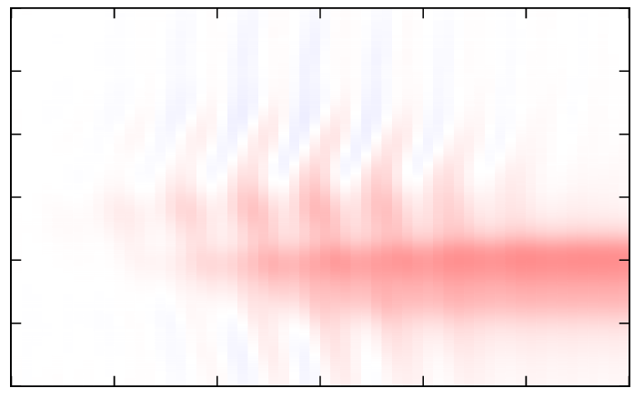
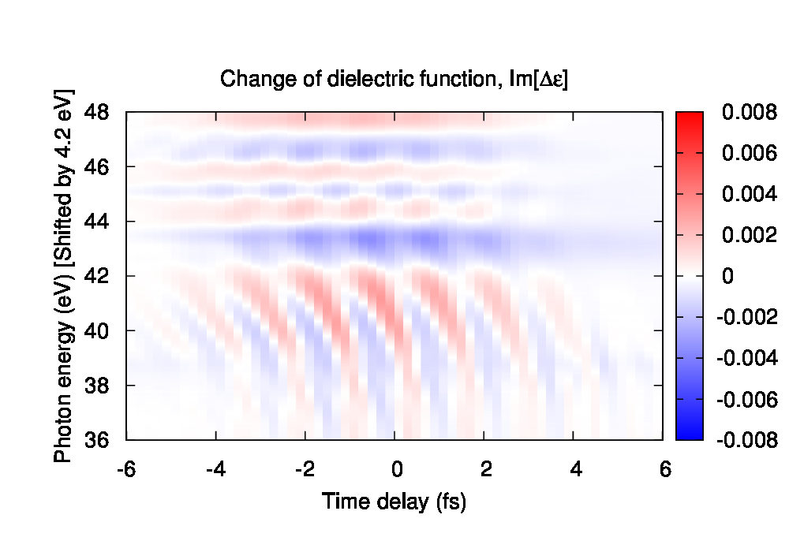
Towards microscopic understanding
Orbital decomposition analysis
Electronic structure of GaAs
Theoretical signal
Photon energy (eV)
Time delay (fs)
As-3d to valence bands
As-3d to conduction bands

Slide 24
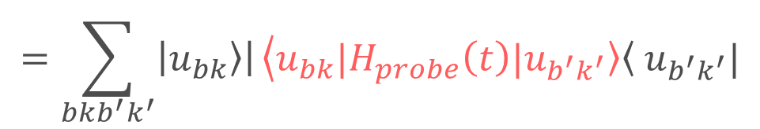
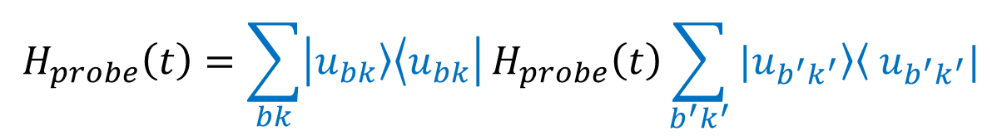
Orbital decomposition analysis
Probe Hamiltonian decomposition
$$H\left(t\right)=H_{0}+H_{pump}\left(t\right)+H_{probe}(t)$$
$$H_{probe}\left(t\right)=\sum_{bk}{\left|\left.u_{bk}\right\rangle \left\langle u_{bk}\right.\right|}H_{probe}\left(t\right)\sum_{b^{′}k^{′}}{|\left.u_{b^{′}k^{′}}\right\rangle \left\langle \right.u_{b^{′}k^{′}}|}$$
$$=\sum_{bkb^{′}k^{′}}{\left|\left.u_{bk}\right\rangle \right|}\left\langle u_{bk}\right.|H_{probe}\left(t\right)|\left.u_{b^{′}k^{′}}\right\rangle \left\langle \right.u_{b^{′}k^{′}}|$$
As-3d to valence
Photon energy (eV)
As-3d to conduction
Time delay (fs)

Slide 25
Towards microscopic understanding
Orbital decomposition analysis
Electronic structure of GaAs
Theoretical signal
Photon energy (eV)
Time delay (fs)
As-3d to valence bands
As-3d to conduction bands

Slide 26




Transition from As-3d to conduction bands
Parabolic 3-band model
Theoretical signal (As-3d to conduction)
Electronic structure of GaAs
E
Conduction band
Intra-band
Conduction bottom
Photon energy (ev)
$$Im\left[Δε\left(ω\right)\right]$$
Inter-band
Intra-band
Fishbone structure!
$E^{2}\left(t\right)$ (arb. Unit)
Valence band
As-3d band
k

Slide 27



Transition from As-3d to conduction bands
First-principle
3-band model
Photon energy [eV]
Intra-band only (3-band model)
Inter-band only (3-band model)
27

Slide 28

Summary of microscopic interpretation (GaAs)
Experiment
Theory
F. Schlaepfer, et al, Nature Physics 14, 560 (2018).
Intra-band
Inter-band
Intra-band
Transition from As-3d to valence and conduction bands is dominant.
Long-lasting signal originates from the electron (hole) created by the pump (inter-band transition).
Transient signal originates from the IR-induced intra-band transition.
Intra-band transition can be dominant even in the resonant condition, where the pump photon-energy matches to the band gap.

Slide 29


Summary
Take-home messages
RT-TDDFT simulation can be seen a machinery to evaluate the current/polarization as a functional of electric fields:
The computed current/polarization contains all orders of the nonlinear contributions in addition to the linear response. Hence, by analyzing the results of RT-TDDFT simulation, one can evaluate all order of linear/nonlinear optical properties of systems.
I introduced a numerical pump-probe scheme which mimics the real-experimental scheme with RT-TDDFT simulations for applications of ultrafast phenomena and nonequilibrium physics.
$$J\left(t\right)=J\left[E\right]\left(t\right),$$
$$P\left(t\right)=J\left[E\right]\left(t\right)$$
Take-home messages (more general?)
The TDDFT simulation can:
Be directly comparable with experimental results.
Provide microscopic insights into phenomena.
Make a bridge between experiments and simplified models for further understanding.

Slide 30
Thank you for your attention!!
And, enjoy the school & workshop!!

