Slide 1
Regge pole description of scattering by dirty black holes
Shiqian Hu
Theoretical Particle Physics and Cosmology
King’s College London
Analogue Gravity in 2023, Benasque
Phys. Rev. D 107, 064028 (2023)
with Theo Torres, Mohamed Ould El Hadj and Ruth Gregory

Slide 2
Optical Scattering phenomena
Rainbow
Incident light rays
Glory
42.4
40.7
Incident light rays

Slide 3
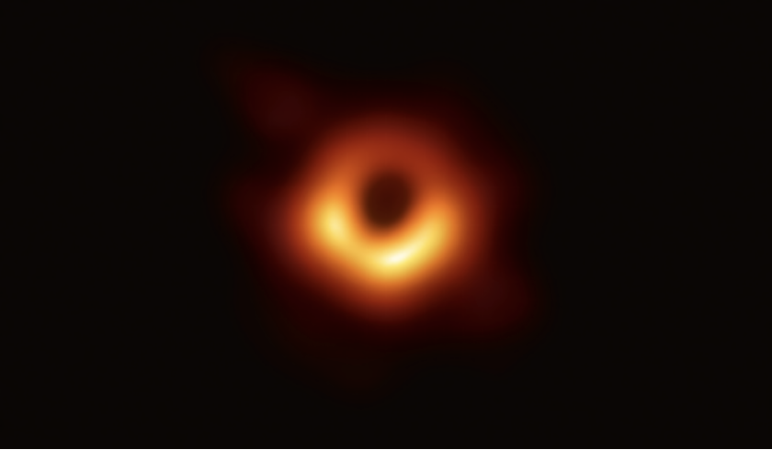
Scattering phenomena in black hole
Water droplet ¹
Rainbow
Glory
Dirty Black holes ²
Black hole with surroundings:
The presence of matter and fields around black holes
¹ John A. Adam, Physics Reports 356 (2002) 229–365
² M. Visser, Phys. Rev. D 46, 2445-2451 (1992)

Slide 4
Dirty black hole
The spacetime is given by two distinct Schwarzschild geometries:
$$R_{s}$$
$$\dot{R_{s}}=\ddot{R_{s}}=0$$
$$P=ω E$$
$$∞$$
$$M_{−}$$
$$M_{+}$$

Slide 5
Locations of shell
The minimum value of $R_{s}$, ($M_{+}=M_{−}$)
$$R_{s,min}=\frac{1+4ω}{2ω}M_{±}$$
Different locations of the shell:
$R_{s}<3M_{−}, (ω>\frac{1}{2})$
The shell lies inside the inner light ring
$3M_{−}≤R_{s}≤3M_{+},(\frac{\sqrt{3}−1}{4}<ω≤1)$ Config. 1
The shell lies between the light-rings
$R_{s}>3M_{+}, (ω<\frac{1}{2})$ Config. 2
The shell lies out the outer light ring
Inner light ring $3M_{−}$
Outer light ring $3M_{+}$

Slide 6
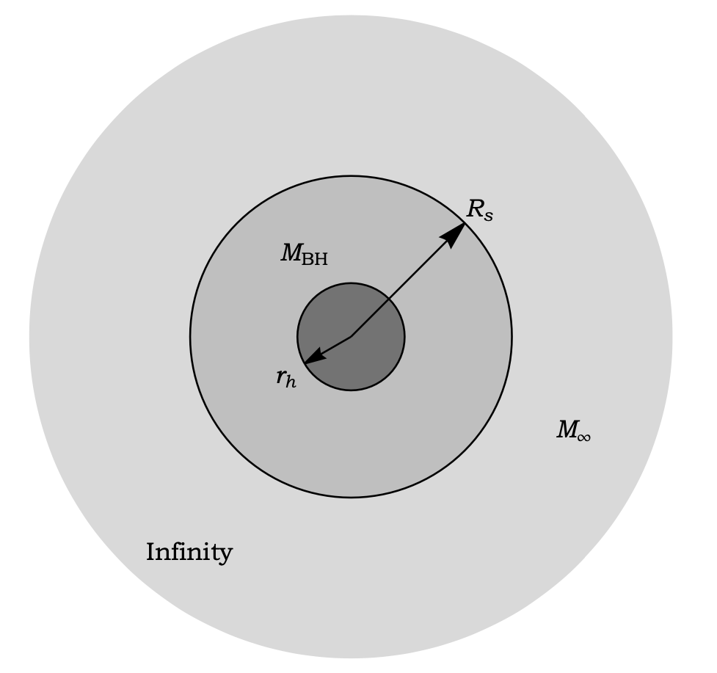
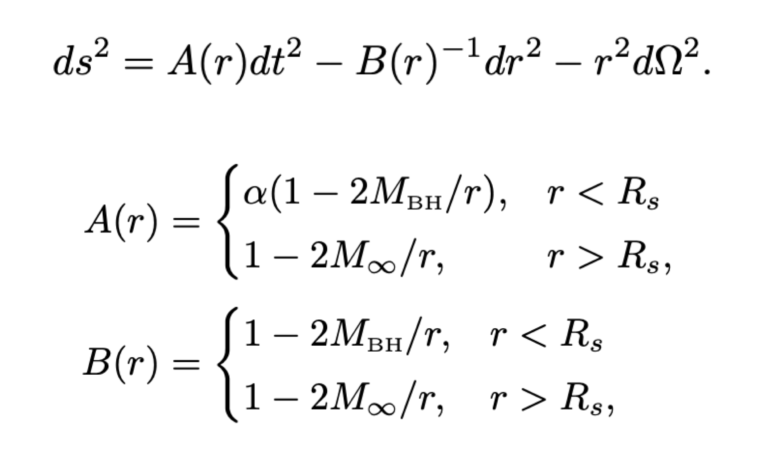
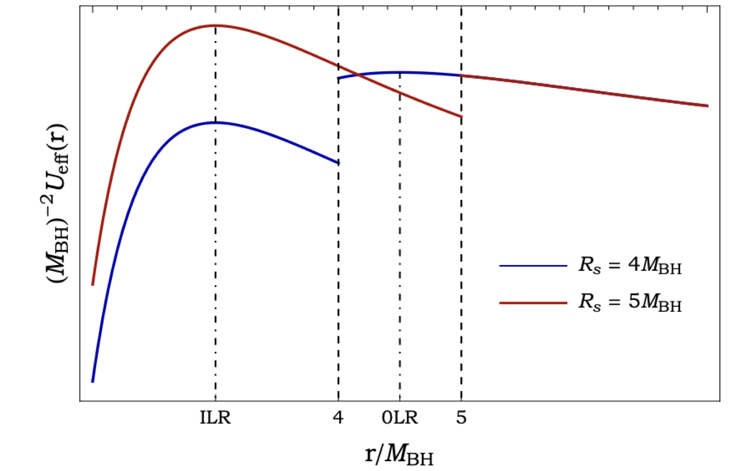
Change of notation
The metric is given by a global coordinate system $(t,r,θ,φ)$
$$α=\frac{R_{s}−2M_{∞}}{R_{s}−2M_{BH}}$$
The equation of motion of a null geodesic
$$M_{∞}=1.5M_{BH}$$

Slide 7
Critical effects in DBH spacetimes
Classical scattering cross section and geodesic deflection angle

Slide 8
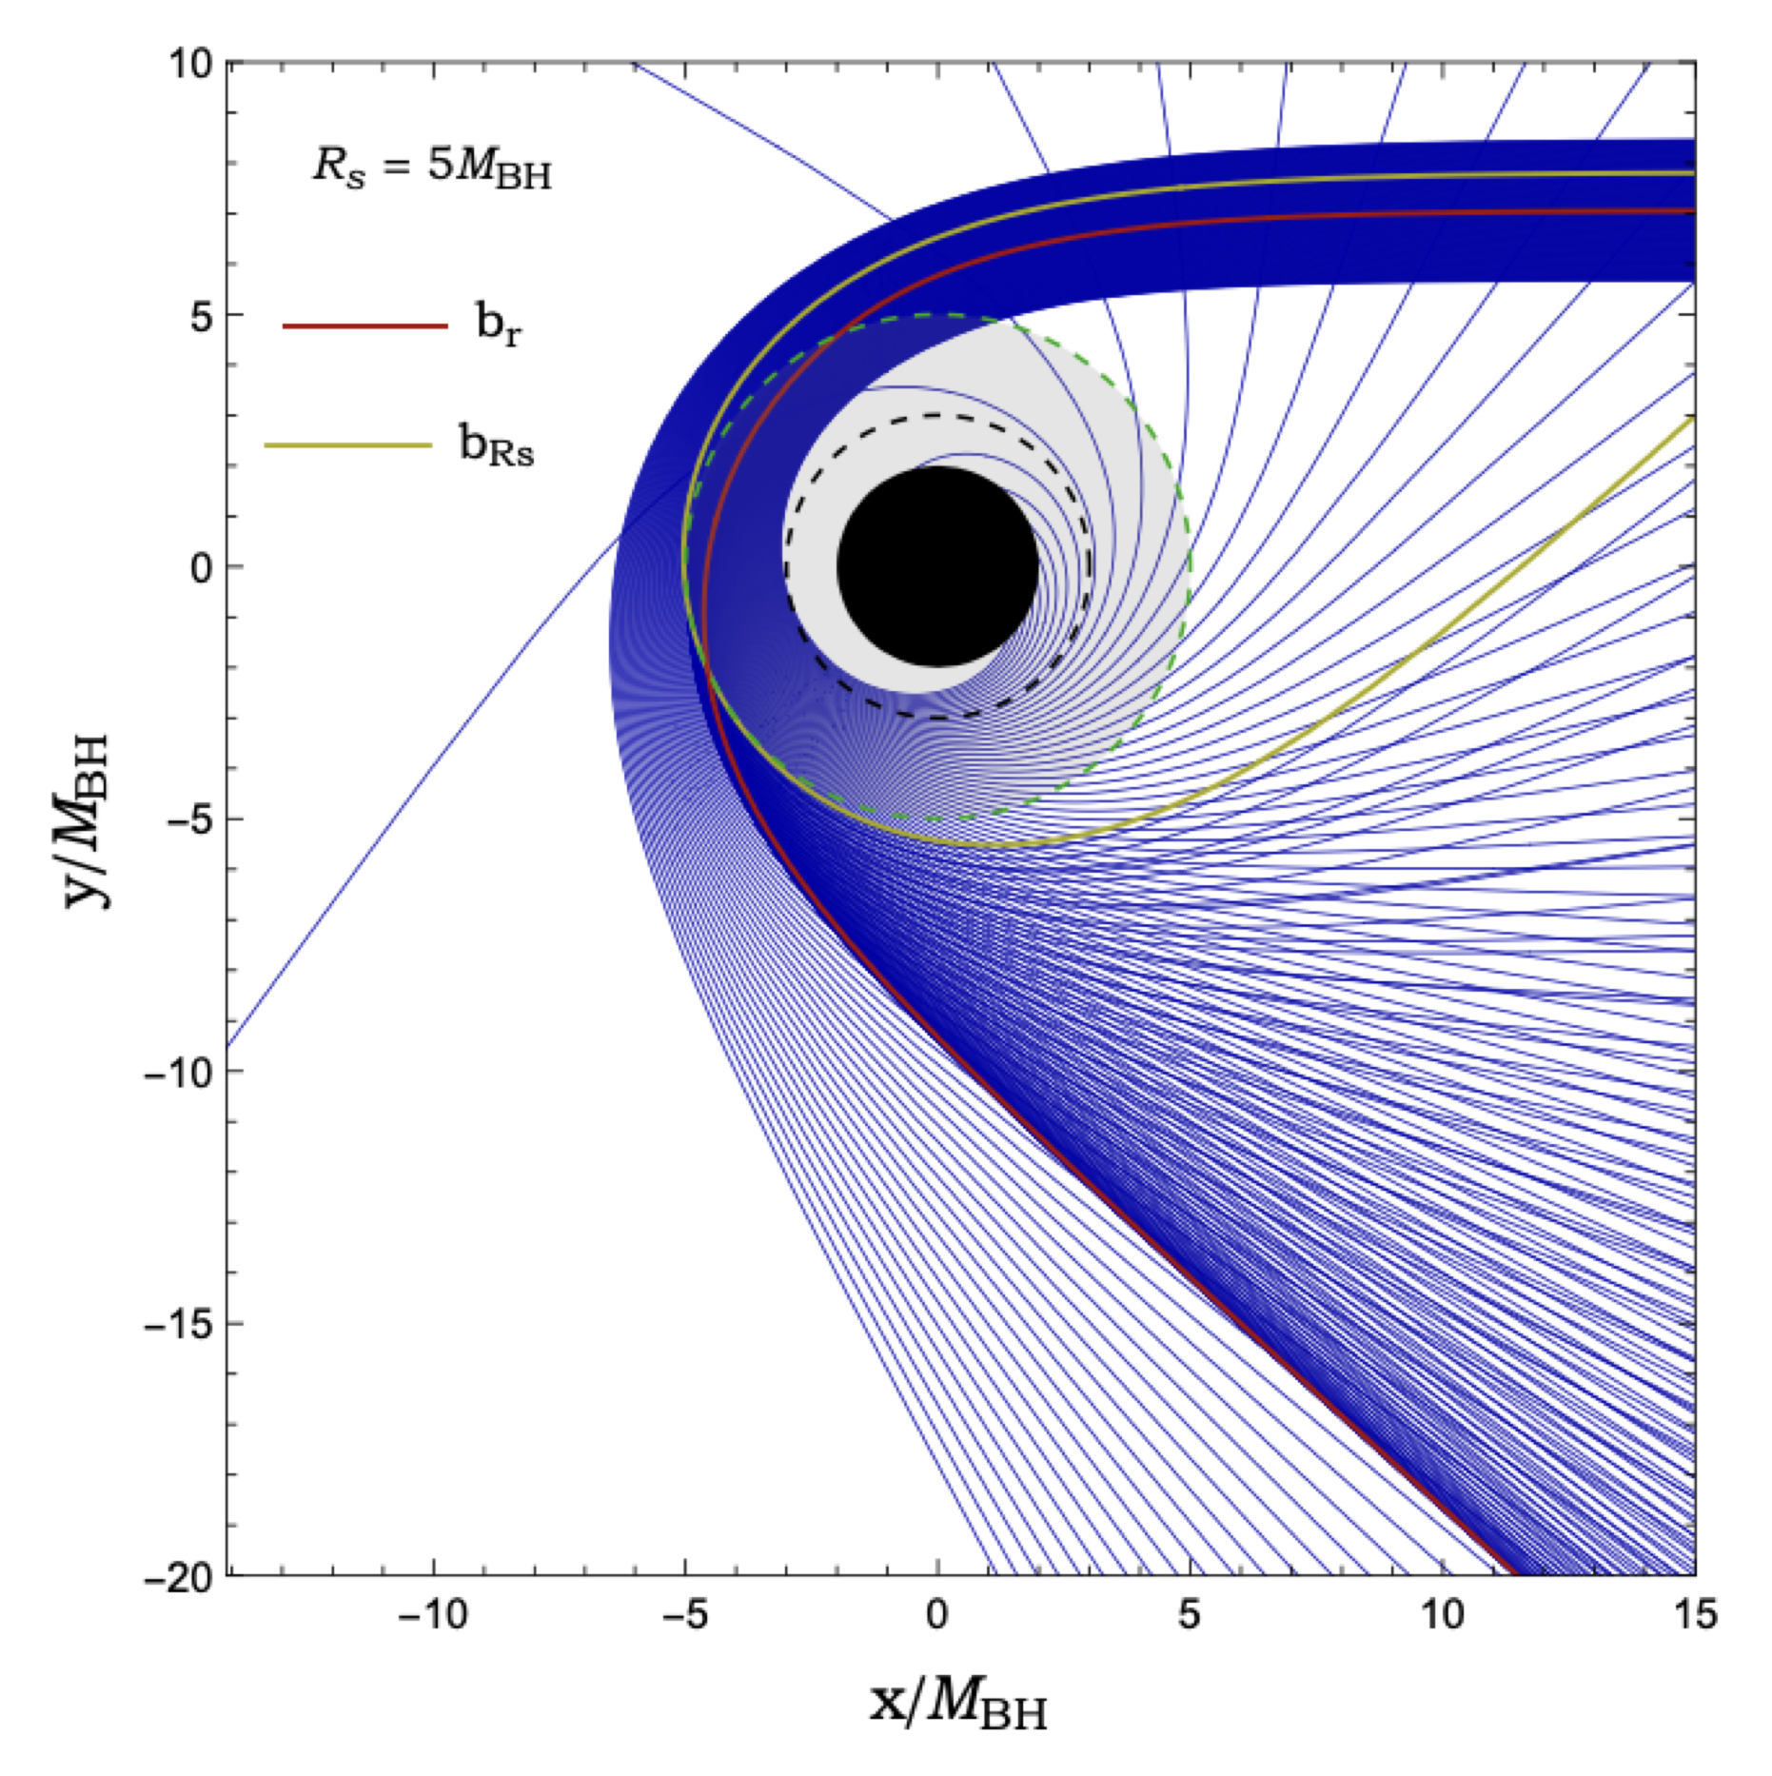
Critical effects in DBH spacetimes
Null geodesics scattered by a DBH
Rainbow Ray: Impact parameter $b_{r}$ leads a divergence for $θ≠0 or π$
Graze Ray: $b_{R_{s}}$ leads to a singular point where the scatter has a discontinuity

Slide 9
Waves on a dirty black hole spacetime
We consider a scalar field, $φ(x)$, propagating on the DBH spacetime
Radial equation and effective potential
Tortoise coordinate
The solutions defined by their behavior at the horizon $r=2M_{BH}$, and at spatial infinity $r→+∞$
Boundary condition on the eigenfunctions $φ_{ωl}$ at the shell

Slide 10
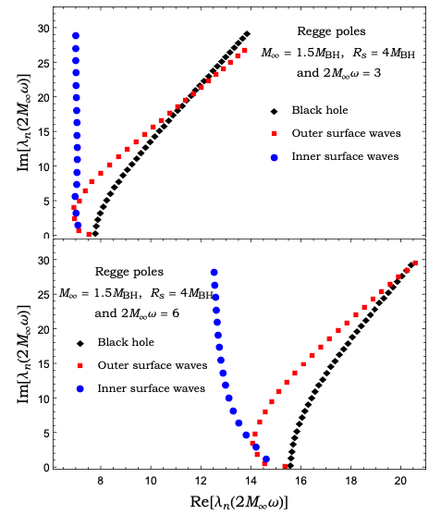
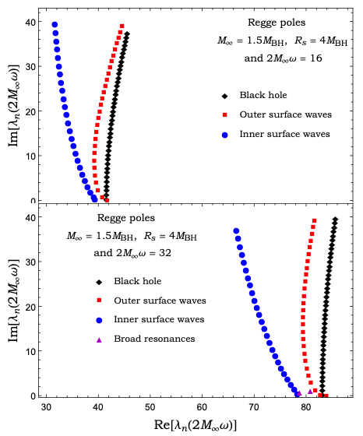
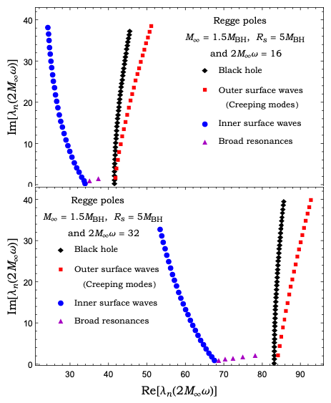
Resonances of the dirty black holes

Slide 11
The differential scattering cross section
Partial waves expansion
CAM representation of the scattering amplitude
[Antoine Folacci and Mohamed Ould El Hadj, Phys. Rev. D 99, 104079 (2019)]
The background integral contribution and the second term

Slide 12
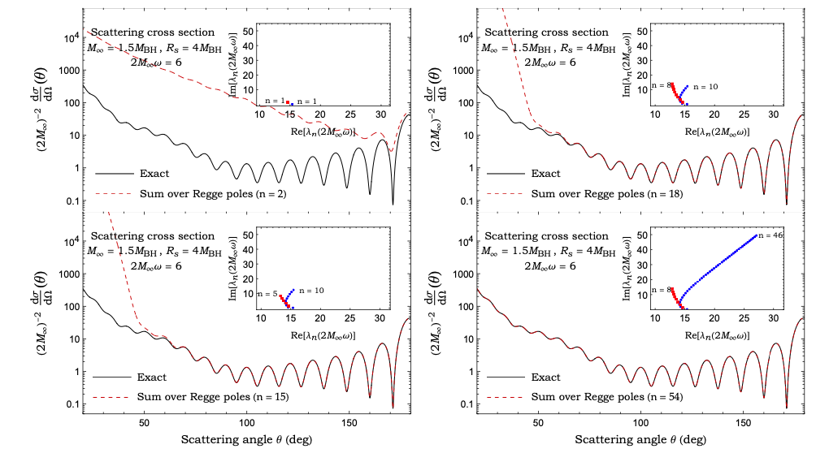
Scattering cross section

Slide 13
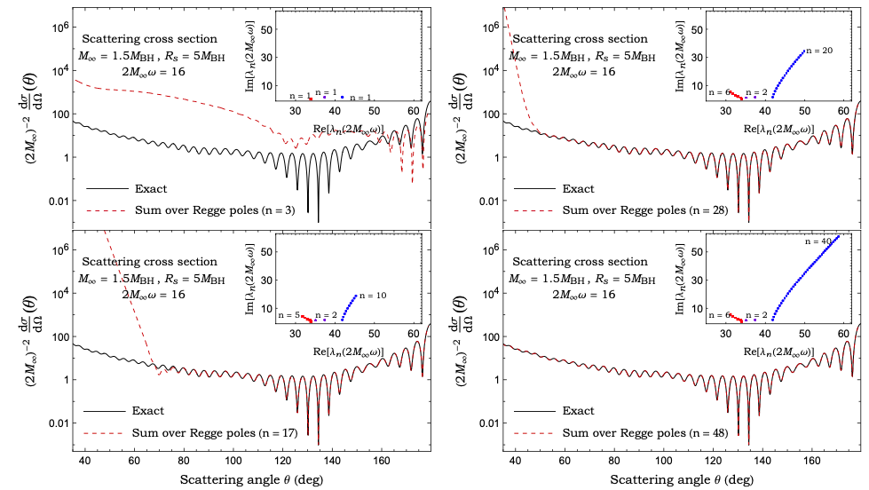
Scattering cross section

Slide 14
Conclusions
The critical effects of scattering in a dirty black hole spacetime by showing the scattered null geodesics
The Regge pole spectrum of different DBH configurations
The existence of two branches are associated with the inner light-ring and with either the outer light-ring or the shell depending on the DBH configuration.
The possible existence of a third branch with a nearly constant imaginary part.
The complex angular momentum representation of the scattering with the identification of RP spectrum

Slide 15
Thanks for your attention.

