Slide 1
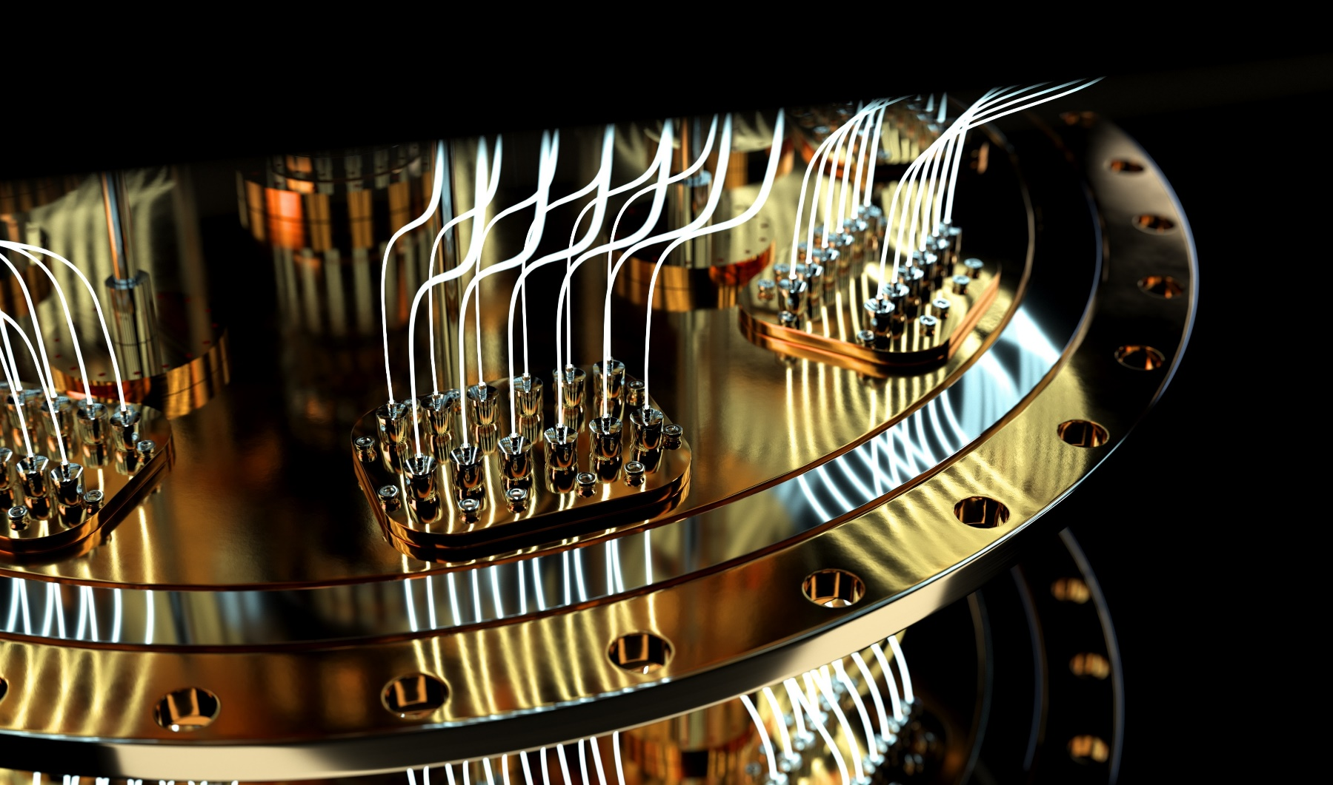
Spring School on Superconducting Qubit Technology Benasque 2023
INTRODUCTION TO SUPERCONDUCTING QUBITS
From
Fundamentals
to
Practical Modeling
Jens Koch
Dept. of Physics & Astronomy
Northwestern University
Jens Koch
Northwestern University

Slide 2
1
2
3
introduction
a short conceptual
overview
circuit quantization
transmon & fluxonium

Slide 3
1
introduction
a short conceptual
overview

Slide 4
Questions for the experienced & restless:
How does the offset charge ng enter the classical equations of motion of the Cooper pair box/transmon?
The Cooper pair box/transmon Hamiltonian looks like that of a fictitious particle in a 1d periodic potential. Yet, eigenstates are different here from the Bloch waves of a 1d crystal.
How so & why?

Slide 5
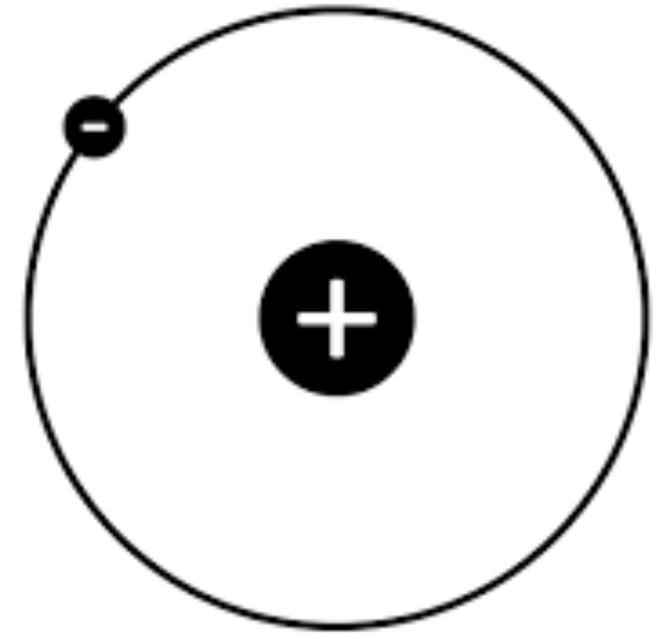
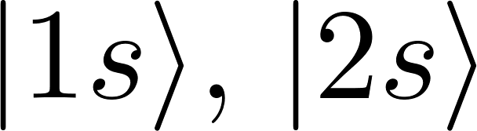
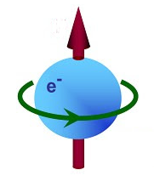



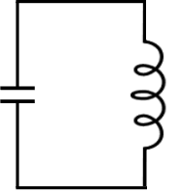
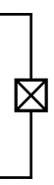
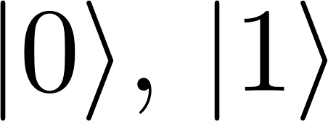
atoms
ions
NV centers
quantum
computing
hardware
spins
photons
superconducting
circuits
and cavities

Slide 6
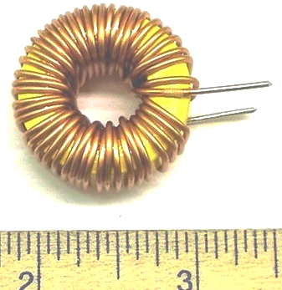
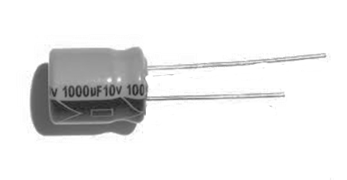

Building quantum bits from circuits
C
L
energy dissipation,
interaction with the environment inevitable
dramatically reduces
quantum effects

Slide 7
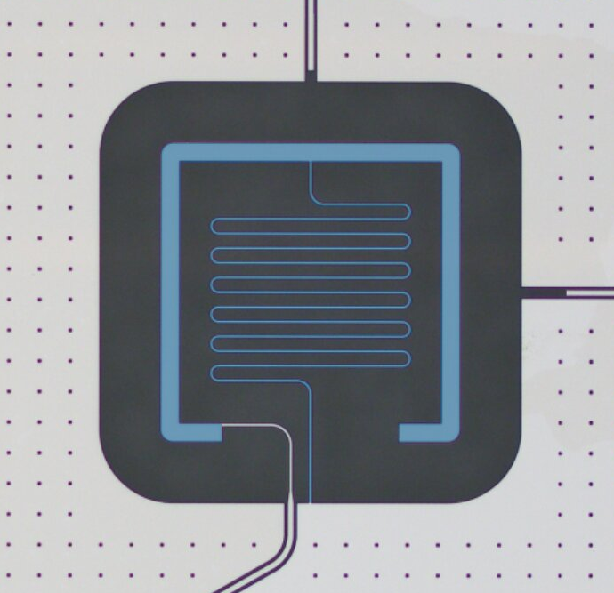
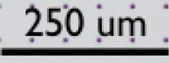
Building quantum bits from superconducting circuits
C
L

Slide 8
Building quantum bits from superconducting circuits
E
superconductor
“forest” of
states
► dissipationless (no Ohmic resistance)
► provides nonlinearity via Josephson effect
► OK to use dirty materials
2Δ ~ 1 meV
superconducting gap

Slide 9

Building quantum bits from superconducting circuits
■ discrete energy levels
■ anharmonic spectrum
■ coupling to EM field

Slide 11
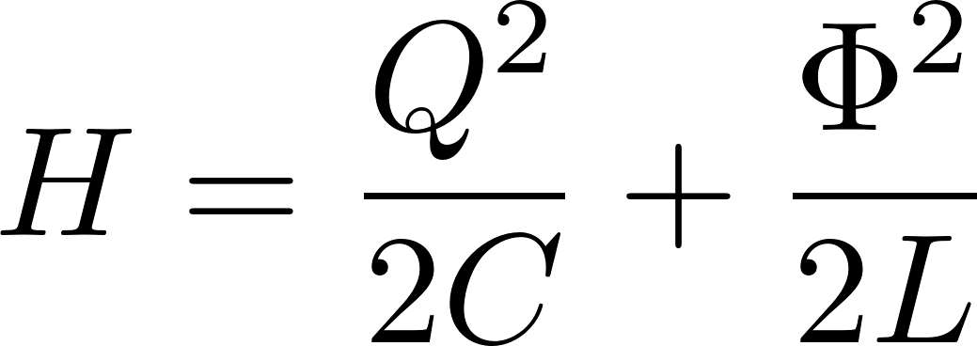


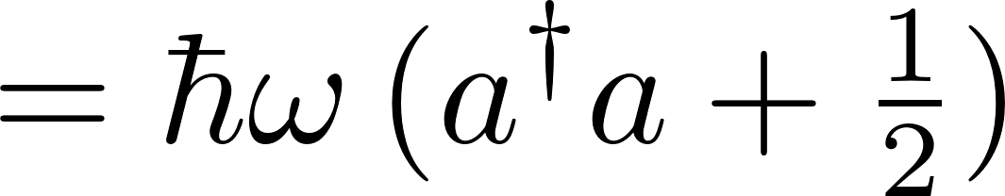
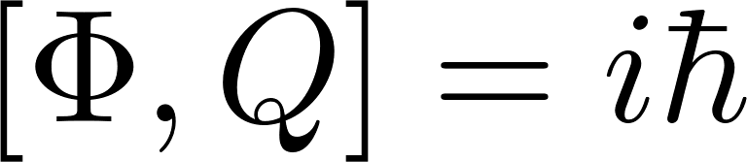
Ф
Q
++++
- - - -
charging
energy
inductive
energy

Slide 12

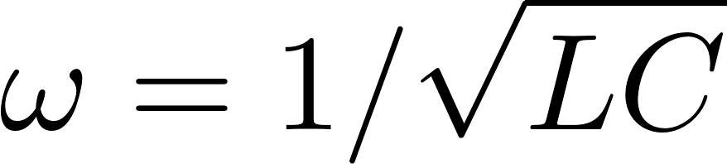

Slide 13
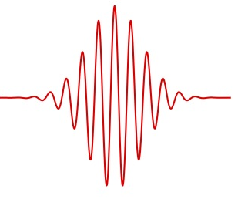
Quantum
LC oscillator
as a qubit?
not a good qubit…
need nonlinearity

Slide 14
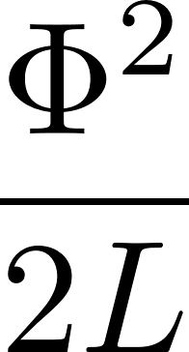
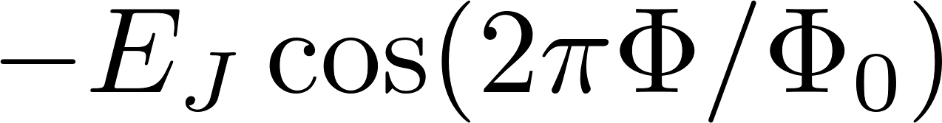

Slide 16


Slide 17
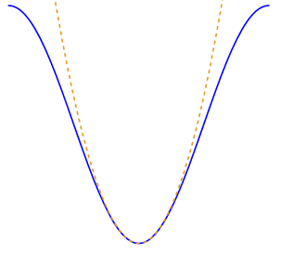
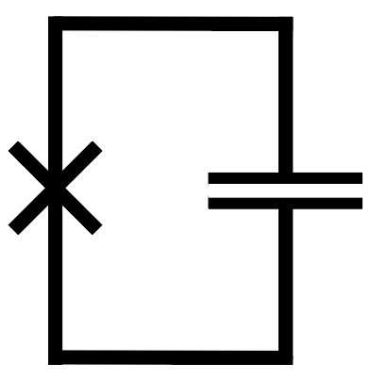



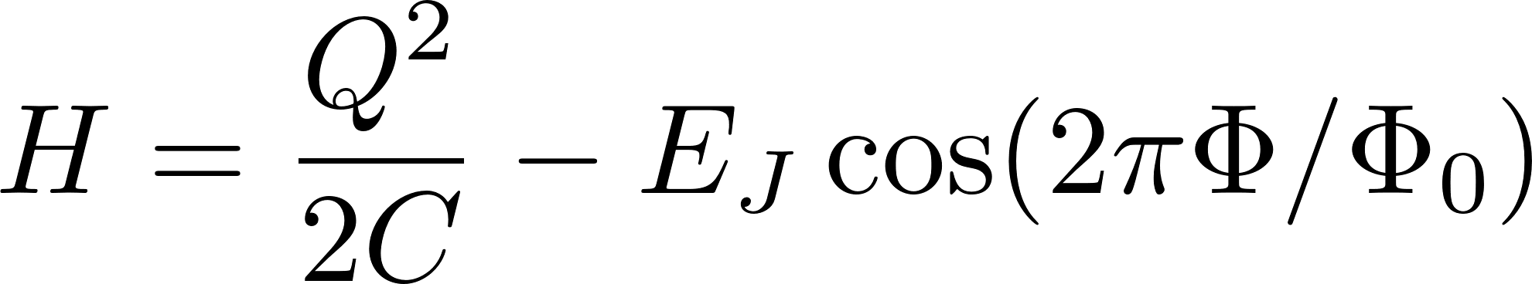

From LC oscillator to transmon
Introduce nonlinearity:
replace inductor with
Josephson junction

Slide 18
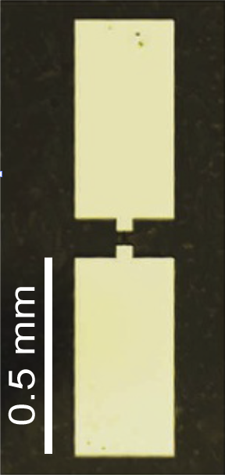
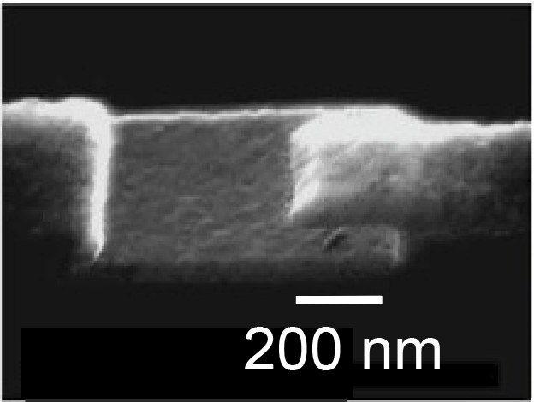
Transmon qubit
Nb
Al
AlOx
Al
sapphire

Slide 19
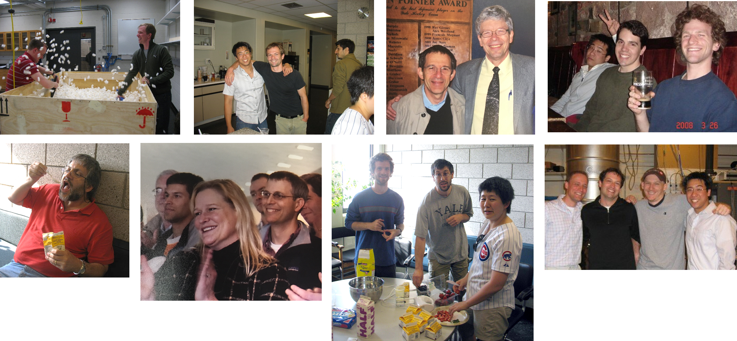

TRANSMON
T
R
A
N
S
M
O
N
~ 2007

Slide 20

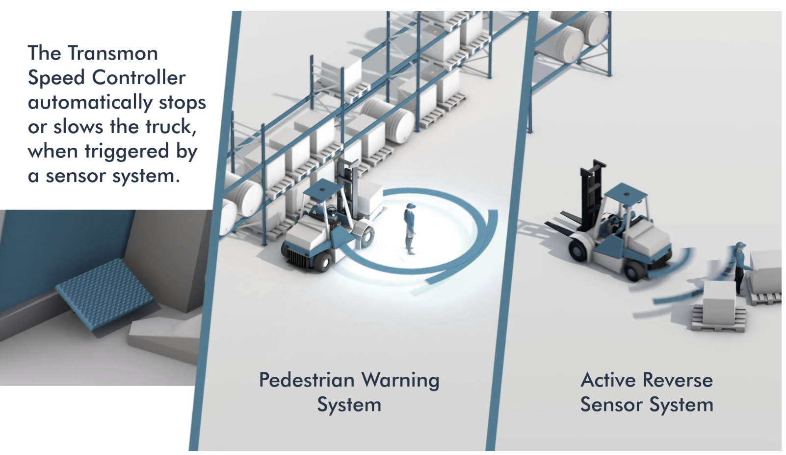
established in 1996, Transmon Engineering Ltd has remained at the forefront of the forklift and materials handling sector
https://www.transmon.co.uk/

Slide 21

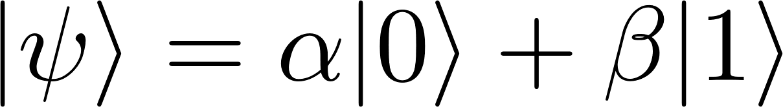

noise
QUBIT
DECOHERENCE
/ ERRORS
1/f charge noise
1/f flux noise
critical current noise
dielectric loss
photon shot noise
Purcell decay
nonequilibrium quasiparticles
…
Your qubit ran into a problem that it couldn’t
handle, and now it needs to restart.
HBAR_DIED_A_HORRIBLE_DEATH
Notes:
Until quantum error correction is in place, we care about noise and ways to mitigate it. No qubit is ever alone in the universe. Every qubit couples - hopefully weakly – to uncontrolled degrees of freedom in the environment. For superconducting qubits, a variety of important noise channels are known (though not necessarily well understood in their microscopic origin).
The presence of noise reduces gate fidelities and ultimately leads to errors in the execution of a quantum algorithm. So without some strategy for handling errors, a future quantum computer will keep crashing with a blue screen like this: …
To try and rescue hbar from this horrible death, it is helpful to remember and distinguish the two primary modes of decoherence – so allow me to run through a very quick recap.

Slide 22




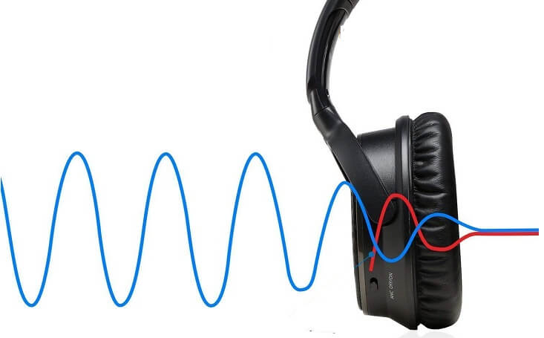
error mitigation strategies
…
 ❶
reduce noise
(materials science, fabrication,
microwave engineering, …)
 ❷
intrinsic noise protection
(develop circuits that are insensitive to noise)
 ❸
active quantum error correction
(monitor for errors, apply correction steps
when required in feedback loop)

Slide 23
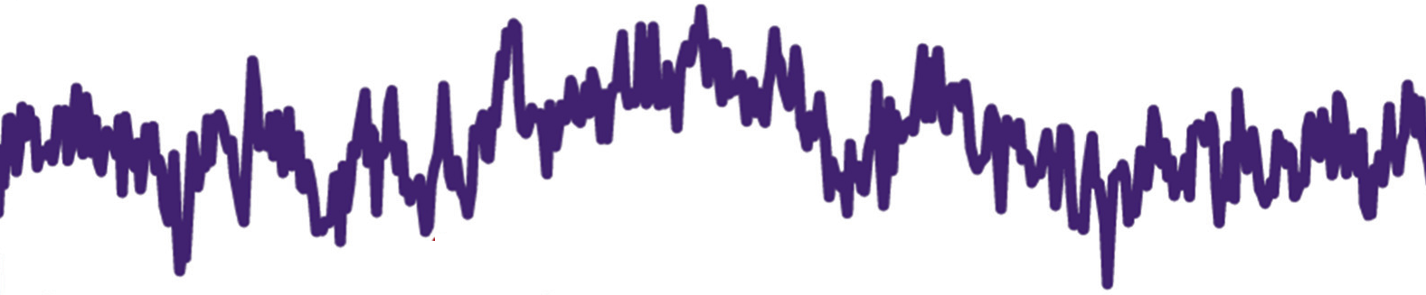
1/f noise
charge noise Cooper pair box
flux noise rf SQUID qubit, 3-junction flux qubit

Slide 24
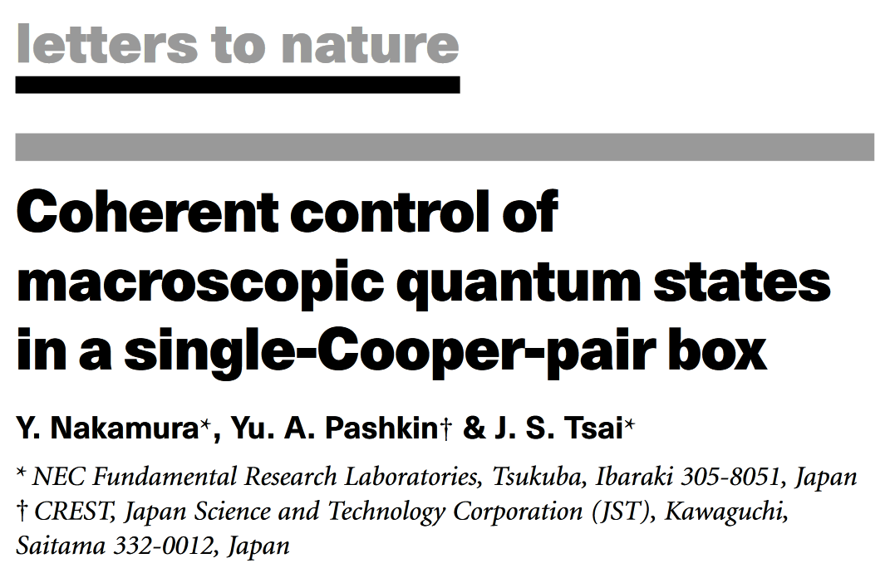
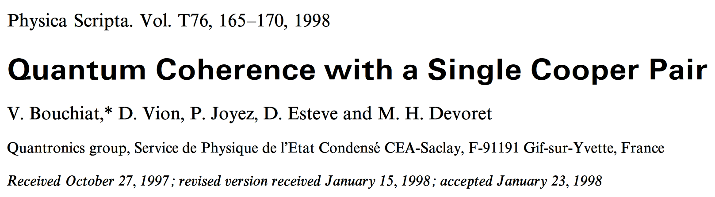
Cooper pair box

Slide 25
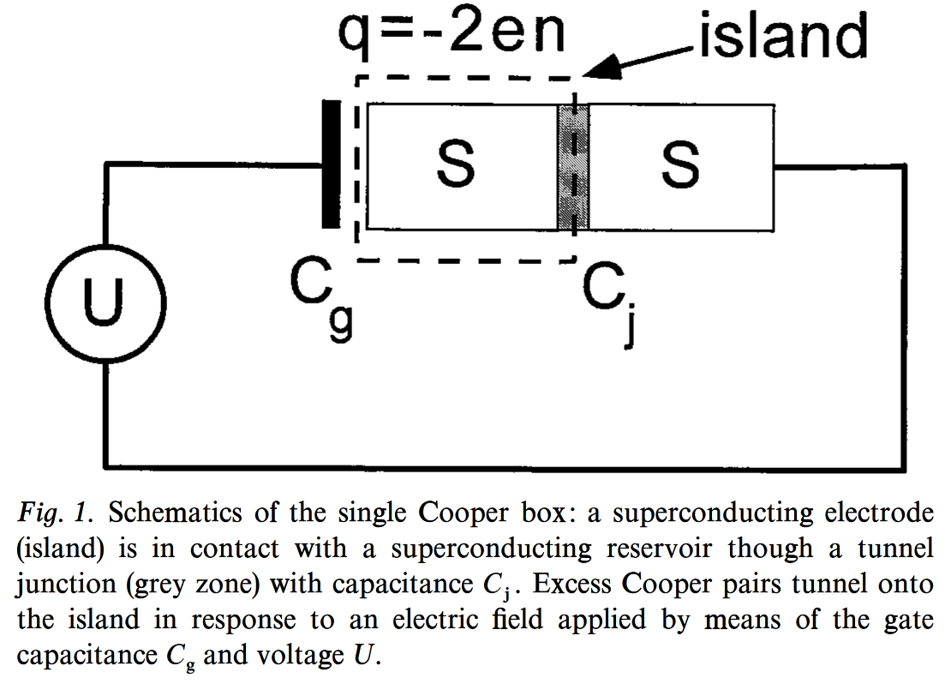
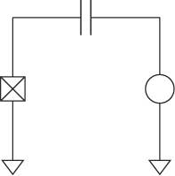


Cooper pair box
V Bouchiat et al., Phys. Scr. 1998, 165 (1998)

Slide 26
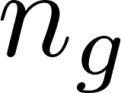
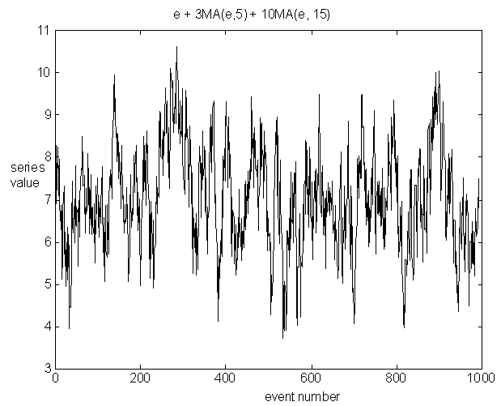


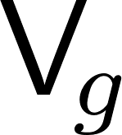


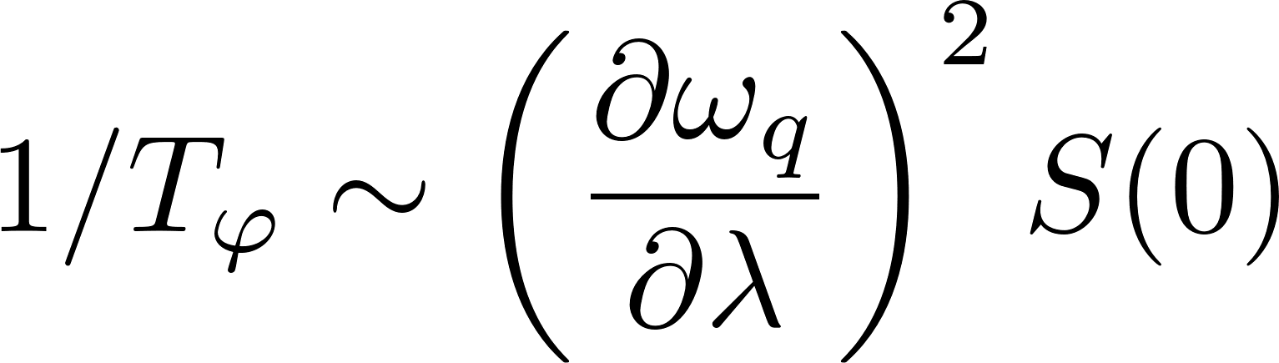

charge noise
dephasing
energy
► dephasing
n_{g}

Slide 27
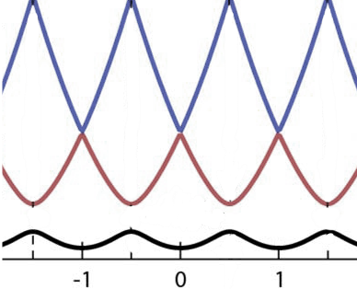
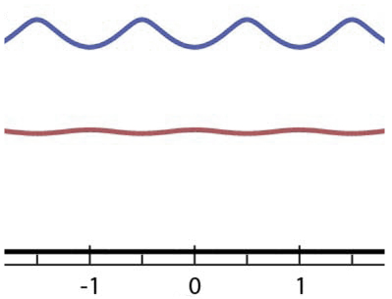
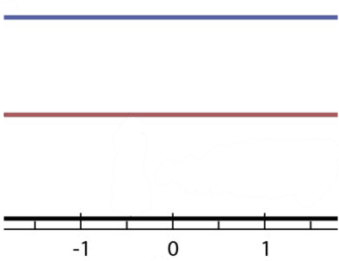
Flattening the spectrum for charge noise protection
energy
energy
energy
n_{g}
n_{g}
n_{g}
increase E_{J} / E_{C}

Slide 28
2
circuit quantization
from circuit diagram to Hamiltonian

Slide 29
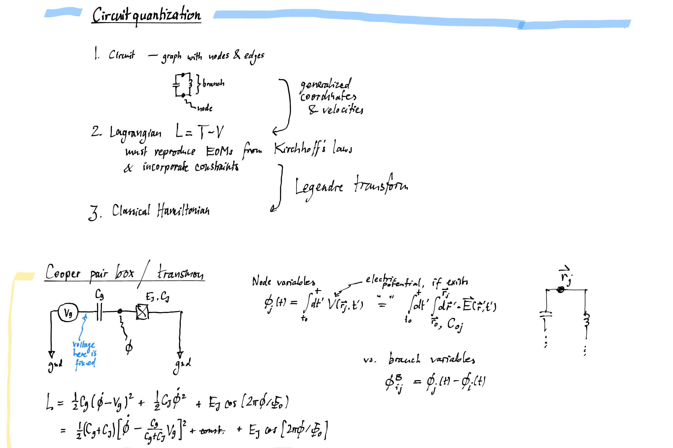

Slide 30
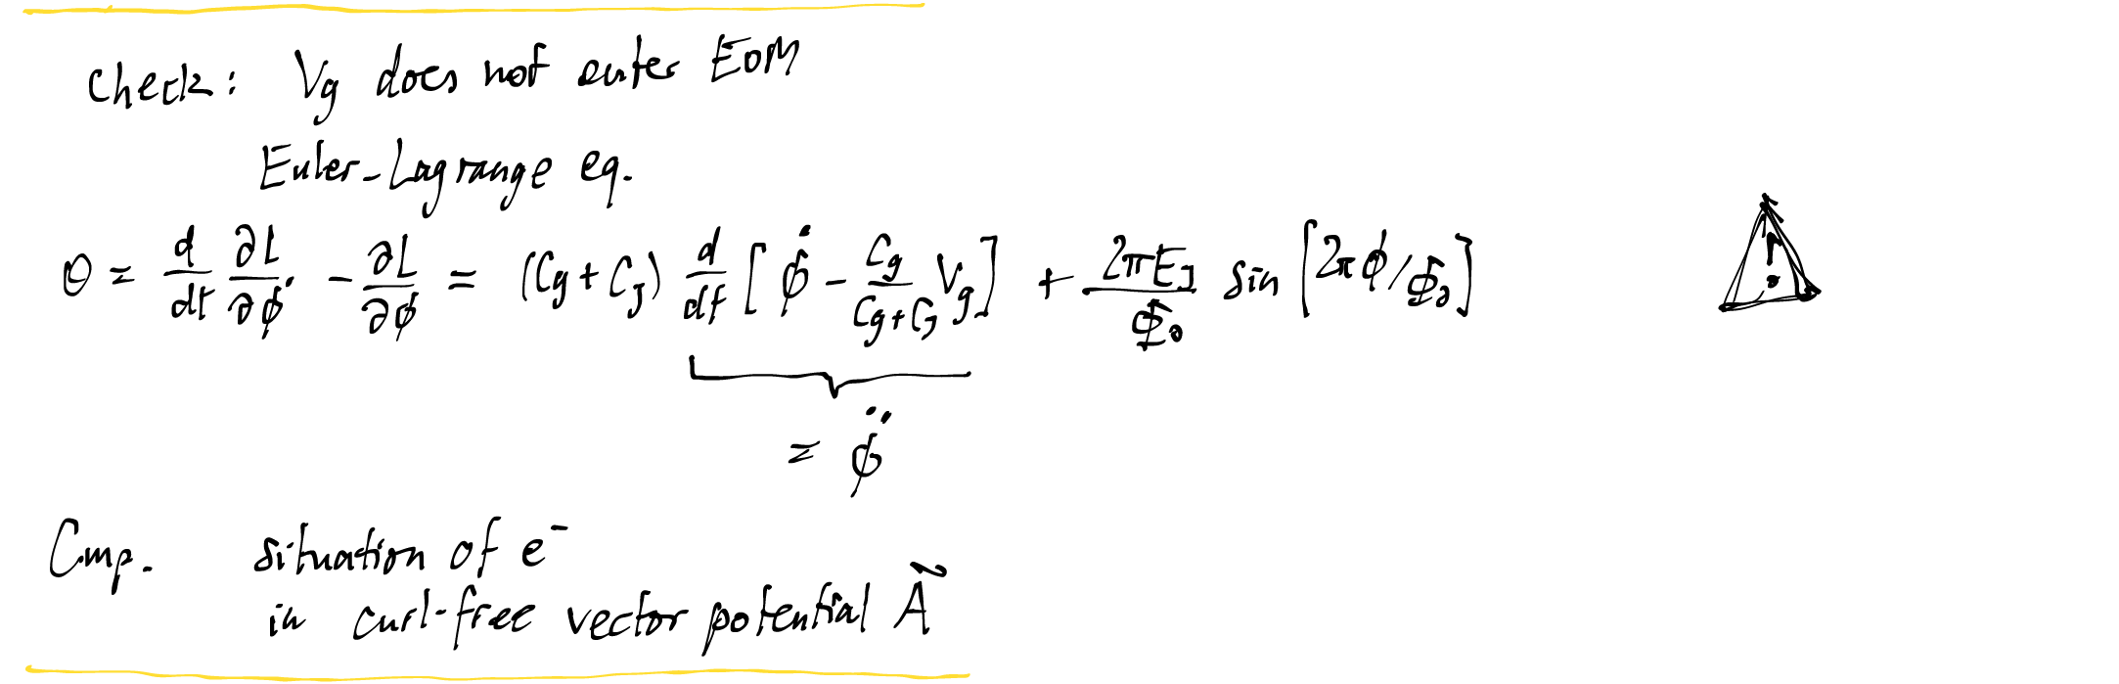

Slide 31
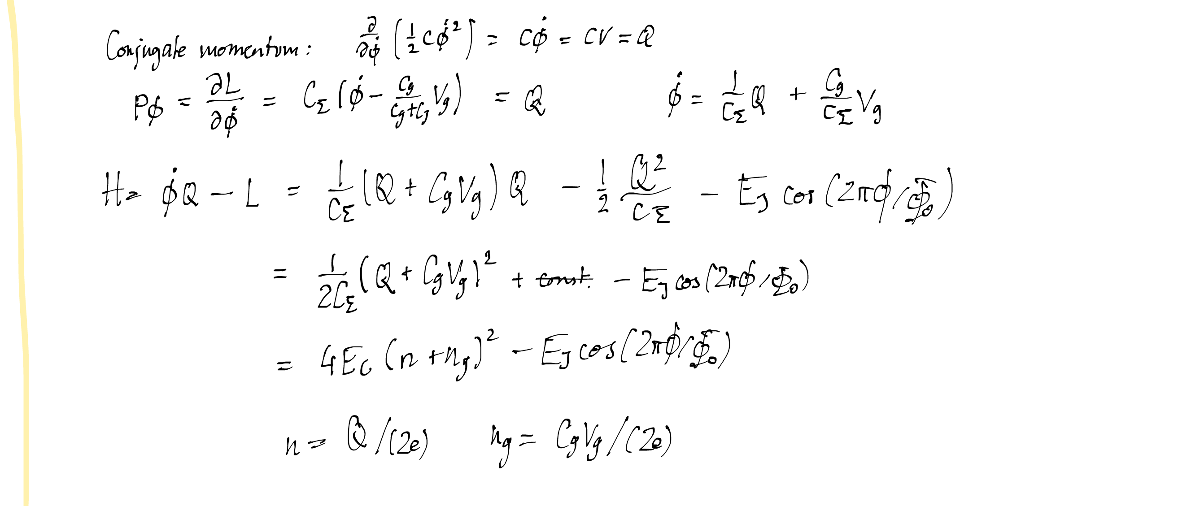

Slide 32
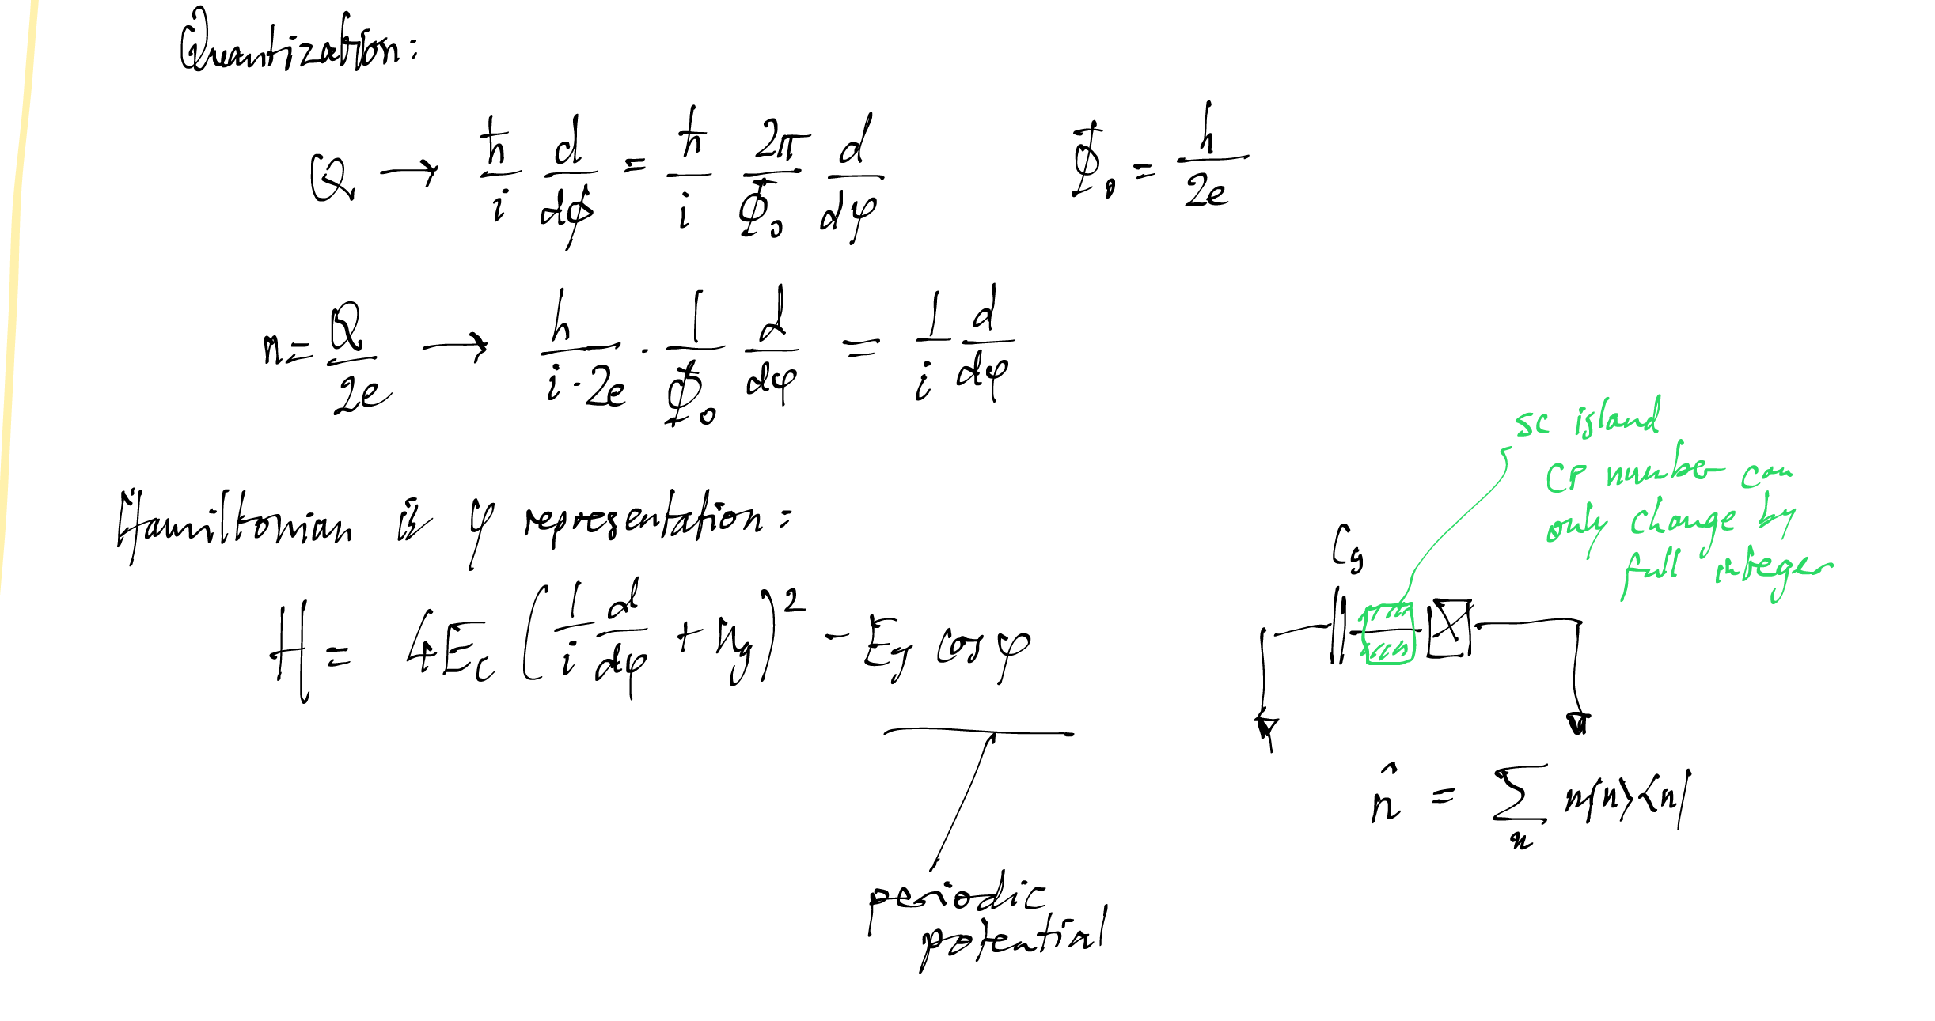

Slide 33
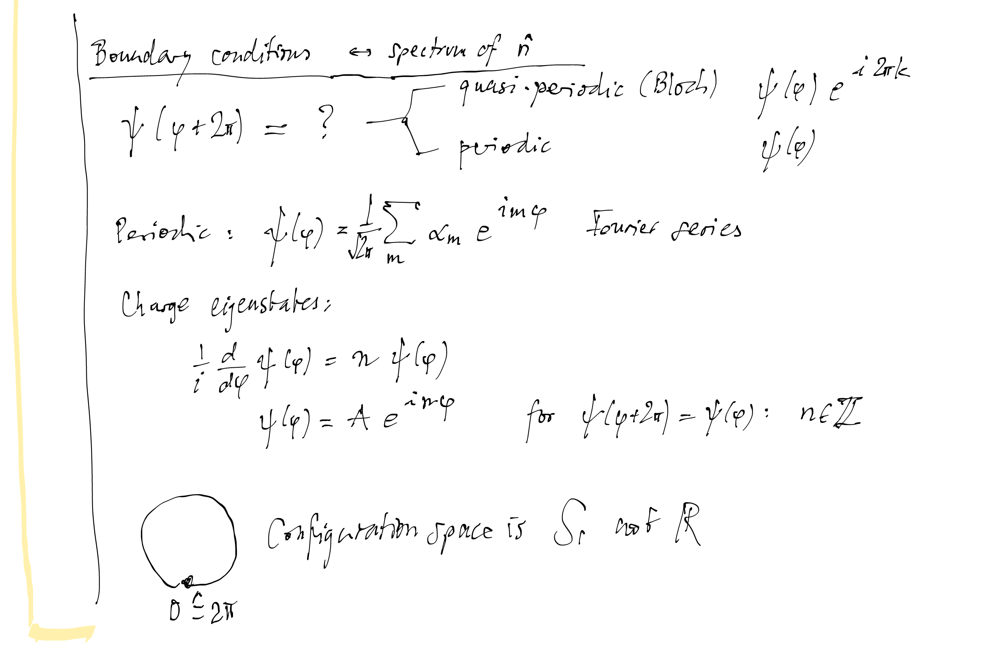

Slide 34
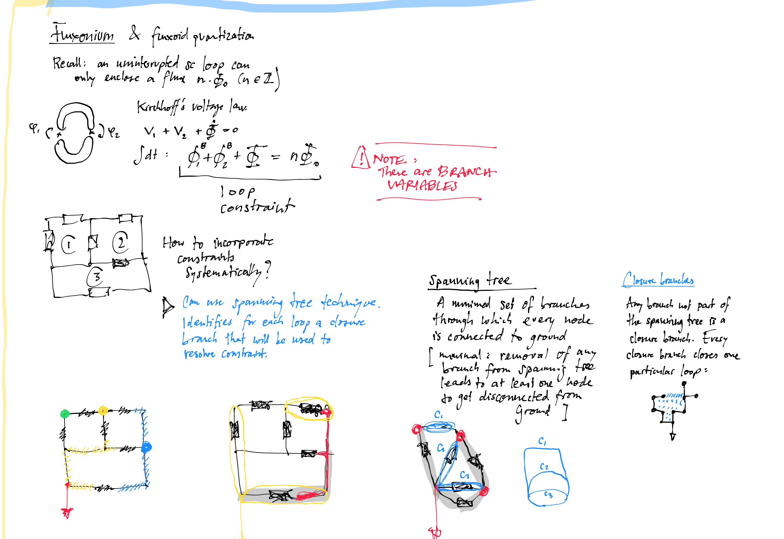

Slide 35
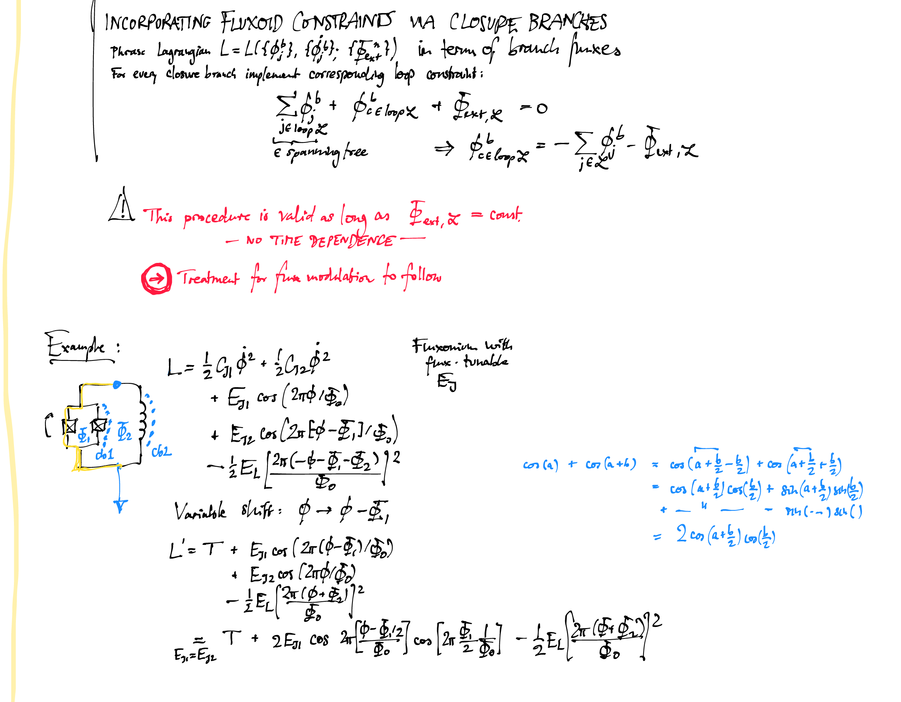

Slide 36
1
introduction
a short conceptual
overview
2
circuit quantization
node variables, branch variables, “collective” variables
external magnetic flux & loop constraints
(Kirchhoff’s voltage law & flux quantization)
periodic vs. extended degrees of freedom
(boundary conditions matter!)
free (cyclic) and frozen modes
automating circuit quantization
(scqubits.Circuit)
circuit quantization for time-dependent magn. flux
3
transmon & fluxonium
4
noise, decoherence
& noise protection
5
composite
circuit QED systems

Slide 37
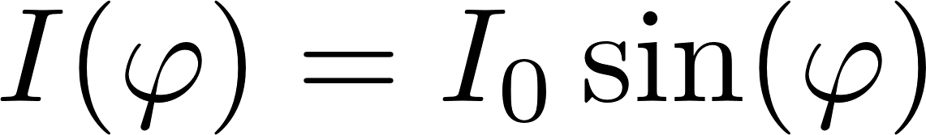

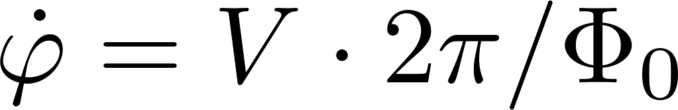
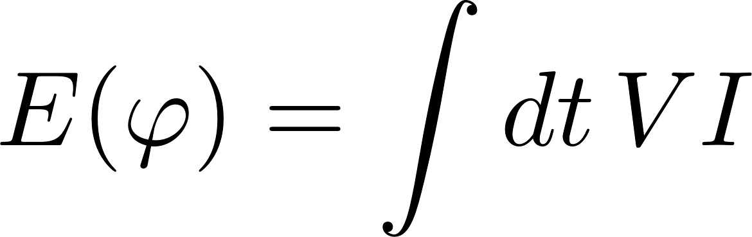
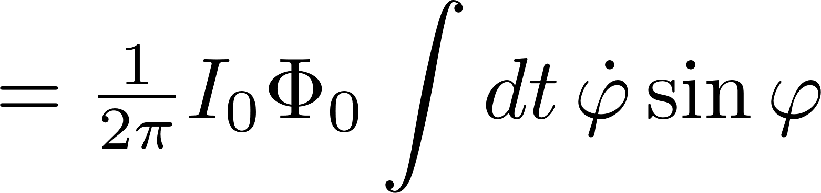




Josephson effect
insulator
superconductor
superconductor

Slide 38





Circuit elements
circuit element | constitutive relation | energy

Slide 39




Circuit elements
circuit element | constitutive relation | energy

Slide 40





Circuit elements
circuit element | constitutive relation | energy
➙
“generalized flux” variables

Slide 41
1
introduction
a short conceptual
overview
2
circuit quantization
3
transmon & fluxonium
charge regime (CPB) vs. transmon regime
charge dispersion and anharmonicity
effective model for low-lying levels
(Taylor expansion of cosine)
transmon
4
insensitivity to dc offset charge
plasmon vs. fluxon transitions
heavy fluxonium, blochnium
noise, decoherence
& noise protection
fluxonium
5
composite
circuit QED systems

Slide 42
1
introduction
a short conceptual
overview
2
circuit quantization
3
transmon & fluxonium
4
noise, decoherence
& noise protection
T₁ depolarization (relaxation & excitation)
protection via localization/disjoint support
T_{φ} pure dephasing
protection via “flattening” energy levels
circuits with simultaneous protection,
e.g. 0-pi circuit
5
composite
circuit QED systems

Slide 43
1
introduction
a short conceptual
overview
2
circuit quantization
3
transmon & fluxonium
5
4
composite
circuit QED systems
noise, decoherence
& noise protection
dispersive regime
readout and control
interfacing scqubits/QuTiP for simulating time dynamics

Slide 44





Superconducting Qubits in Python
121,130
# downloads
via conda
Open source
( BSD license)
19 releases
>2,000 commits
>29,000 lines of code
2 papers
URL: tiny.cc/qubit
Air Force Office for
Scientific Research
FA9550-20-1-0271
2020
2021
2022
2023

Slide 45
docs: tiny.cc/qubit
INSTALL
conda install –c conda-forge scqubits
pip install scqubits

Slide 46
Companion jupyter notebook:
tinyurl.com/bnsq2023

Slide 47

circuit quantization (cont’d)
?
Hamiltonian
Devoret (1997) Quantum Fluctuations in Electrical Circuits Quantum Fluctuations, Les Houches, Session LXIII
Vool & Devoret, Int. J. Circ. Theor. Appl. 45 897–934 (2017)
Burkard, Koch, and DiVincenzo, Phys. Rev. B 69 064503 (2004)

Slide 48

circuit analysis: variable classification

Slide 49







Kirchhoff’s loop rule and magnetic flux
Kirchhoff’s voltage law for loop:
×
×

Slide 50

circuit
quantization

Slide 51
scqubits
custom circuit analysis,
quantization & solver
toy example: zero-pi
zp_yaml = """
branches:
- [JJ, 1, 2, EJ = 10, 20]
- [JJ, 3, 4, EJ, 20]
- [L, 2, 3, 0.008]
- [L, 4, 1, 0.008]
- [C, 1, 3, 0.02]
- [C, 2, 4, 0.02]
"""

Slide 52


scqubits
custom circuit analysis,
quantization & solver

Slide 53
scqubits
custom circuit analysis,
quantization & solver

Slide 54



scqubits
custom circuit analysis,
quantization & solver
offset charges
ext. flux
composite systems of custom and known circuits
multi-dim. parameter sweeps
lots of visualization routines
[noise: upcoming release]

