Slide 1

Persistent current oscillations in a double-ring quantum gas
¹Mark Edwards,
²T. Bland, ³I. V. Yatsuta, ⁴Y. O. Nikolaieva, ⁴A. O. Oliinyk, ⁴A. I. Yakimenko, ⁵N. P. Proukakis
¹Georgia Southern University, ²Universität Innsbruck, ³Weizmann Institute of Science,
⁴Taras Shevchenko National University of Kyiv, ⁵University of Newcastle
Atomtronics@Benasque2024
02 May 2024
$$ = NSF and NIST

Slide 2
Quantum sensors in positioning, navigation, and timing
Global Navigation Satellite Systems such as GPS can be jammed, spoofed, or be unavailable (deep under the ocean or solar flares).
Most commercial air and seagoing vessels have onboard inertial navigation systems (INSs) that can determine position and attitude using dead reckoning without the need for receiving external signals.
Long-time operation of such INSs suffer from parameter drift which leads to position and attitude errors that grow with time.
Secondary sensors with lower sample rates can be used to re-calibrate the primary sensor’s parameters.
Quantum sensors which measure accelerations and rotation velocities can serve in this capacity.

Slide 3
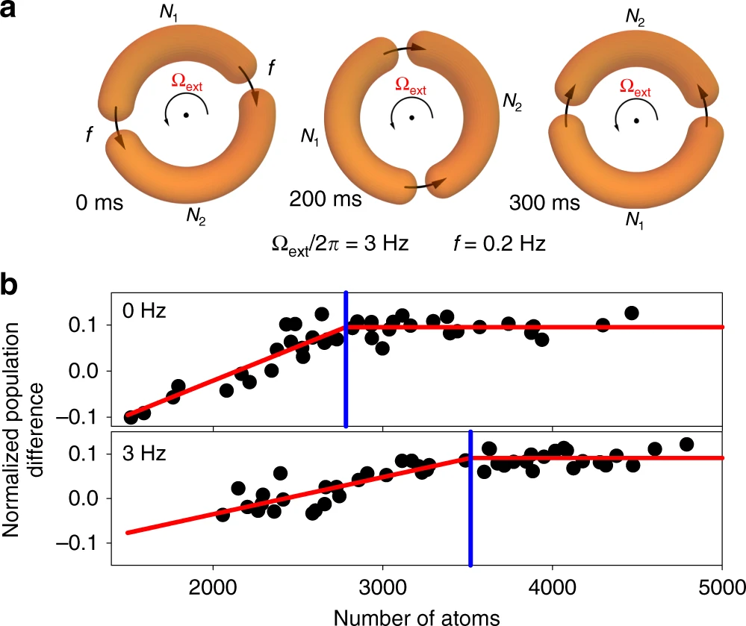
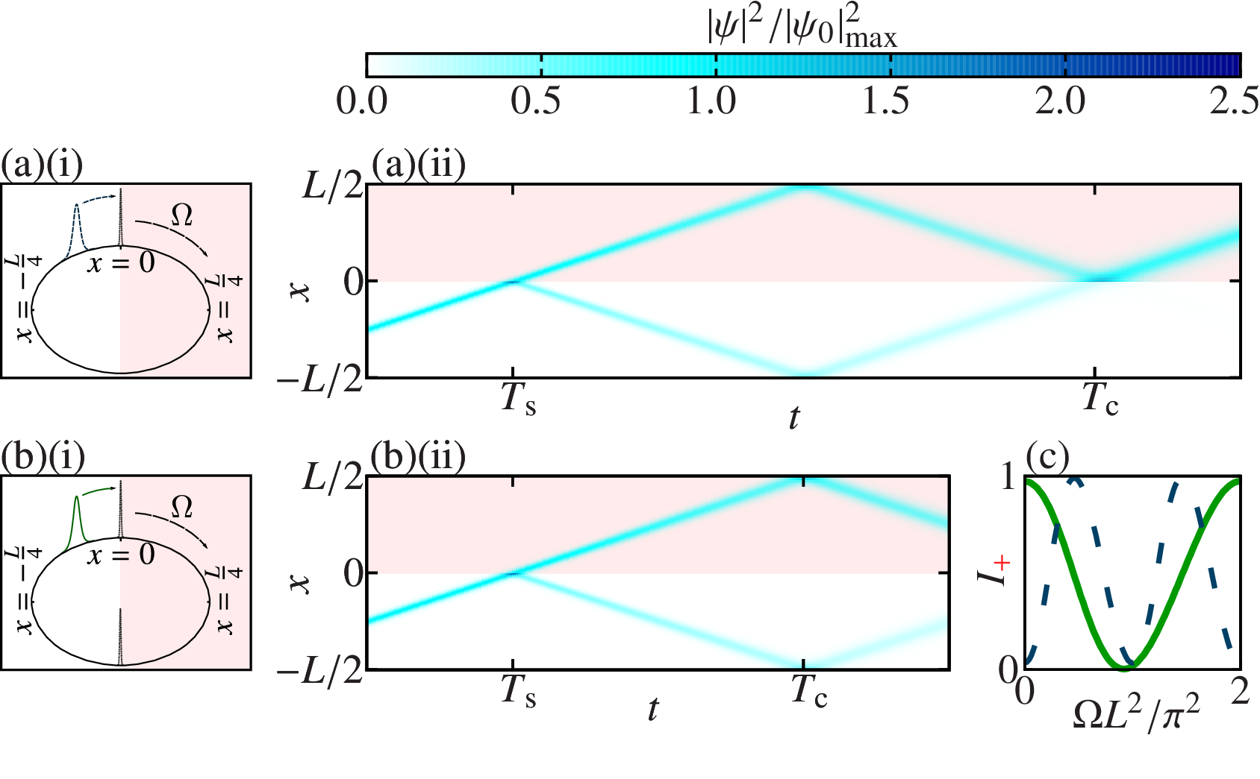
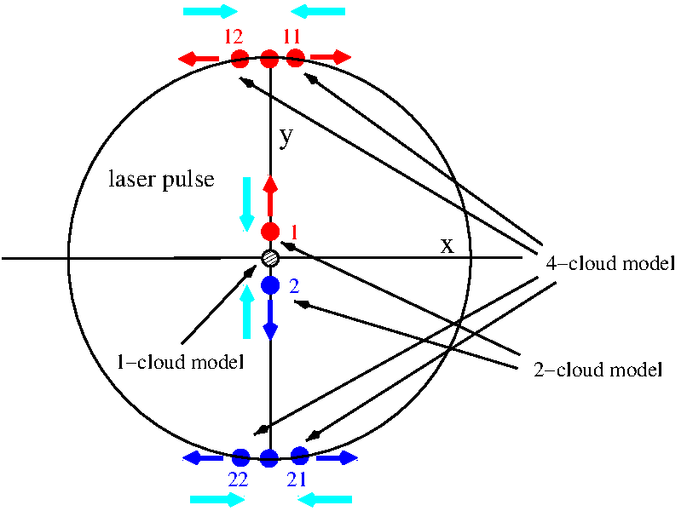
Atomtronic circuits can be rotation sensors
Atomtronic SQUIDS
(Ryu, et al., Nat Commun 11, 3338 (2020))
Solitons in ring BECs
(Helm, et al., PRL 114, 134101 (2015))
Virginia dual-Sagnac atom interferometer (Moan, et al., PRL 124, 120403 (2020))

Slide 4
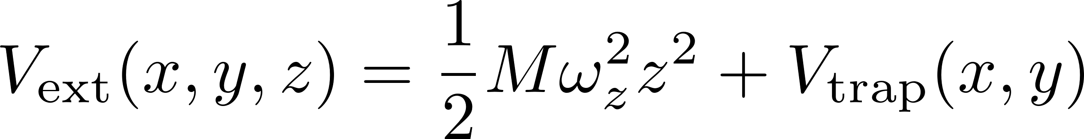
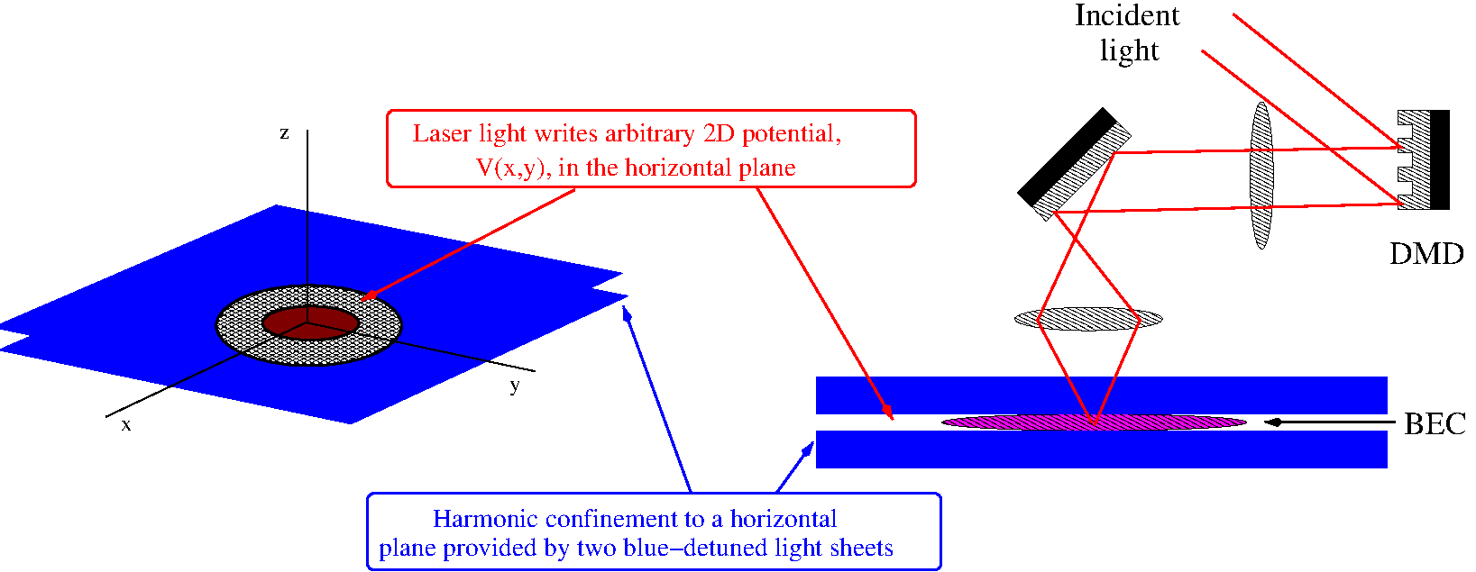
Atomtronic setup: the ultracold-atom gas is compressed into a thin horizontal sheet
The full potential felt by the condensate atoms is a vertical harmonic potential plus an arbitrary 2D potential, V_{trap}(x,y), in the horizontal plane.

Slide 5
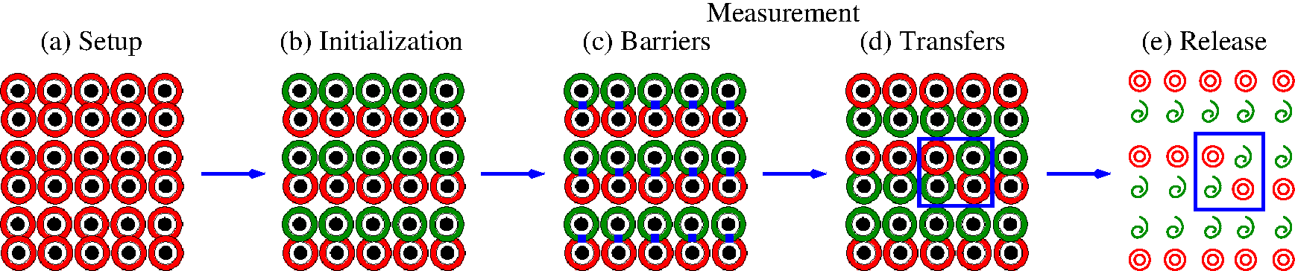
Double-target BEC array rotation sensor

Slide 6
To facilitate the design of this kind of sensor it is essential to understand the dynamics of persistent currents in a double-ring BEC controlled by a tunable weak link applied at the overlap region of the two rings.

Slide 7
Double-Ring BEC Persistent Currents: Zero-temperature, Mean-Field Results

Slide 8
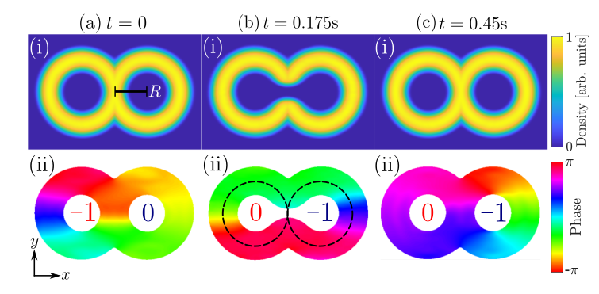
Double-Ring BEC Setup Sequence
Obtain zero-barrier BEC ground state.
Imprint 2π clockwise phase winding in left ring.
Allow 100 ms evolution for thermalization.
4. Ramp on weak link over 0.1 seconds.
5. Keep weak link on for 0.2 seconds.
6. Ramp off weak link over 0.2 seconds.

Slide 9
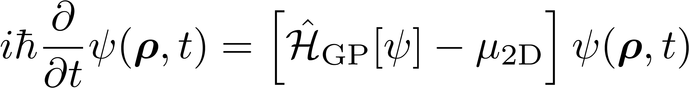
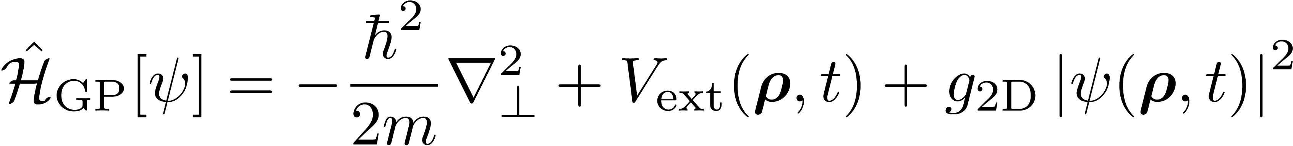
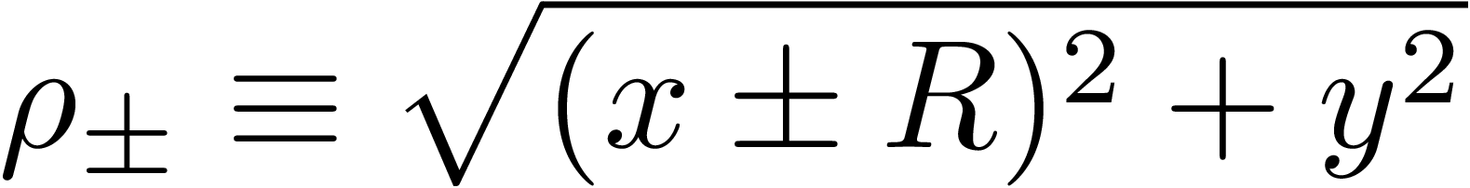
2D Mean-field Model Equations
Zero-Temperature Gross-Pitaevskii Equation

Slide 10
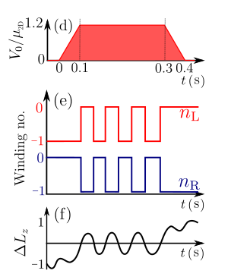
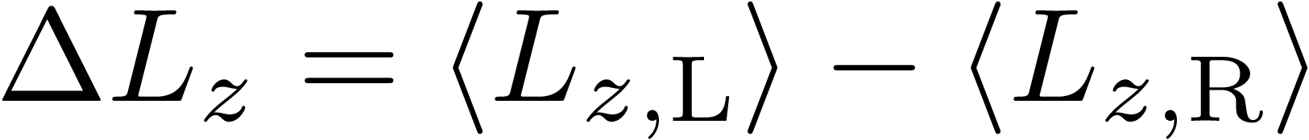
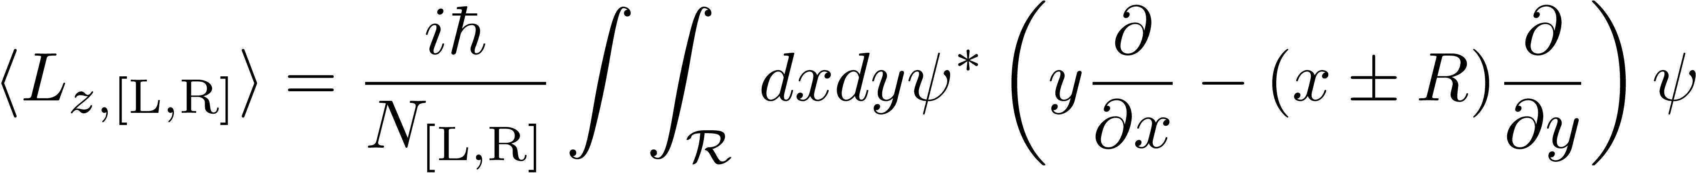
Double-Ring 2D GPE Dynamics
The weak link is ramped up to its maximum value over 0.1 seconds, held constant for 0.2 seconds, and then ramped off over an additional 0.1 seconds.
The maximum height of the weak link is 1.2 times the chemical potential of the original double-ring BEC.
Winding numbers in left (n_{L}) and right (n_{R}) rings oscillate once the weak link exceeds a critical strength.
The timing of closing the gate sets the final position of the persistent current.

Slide 11
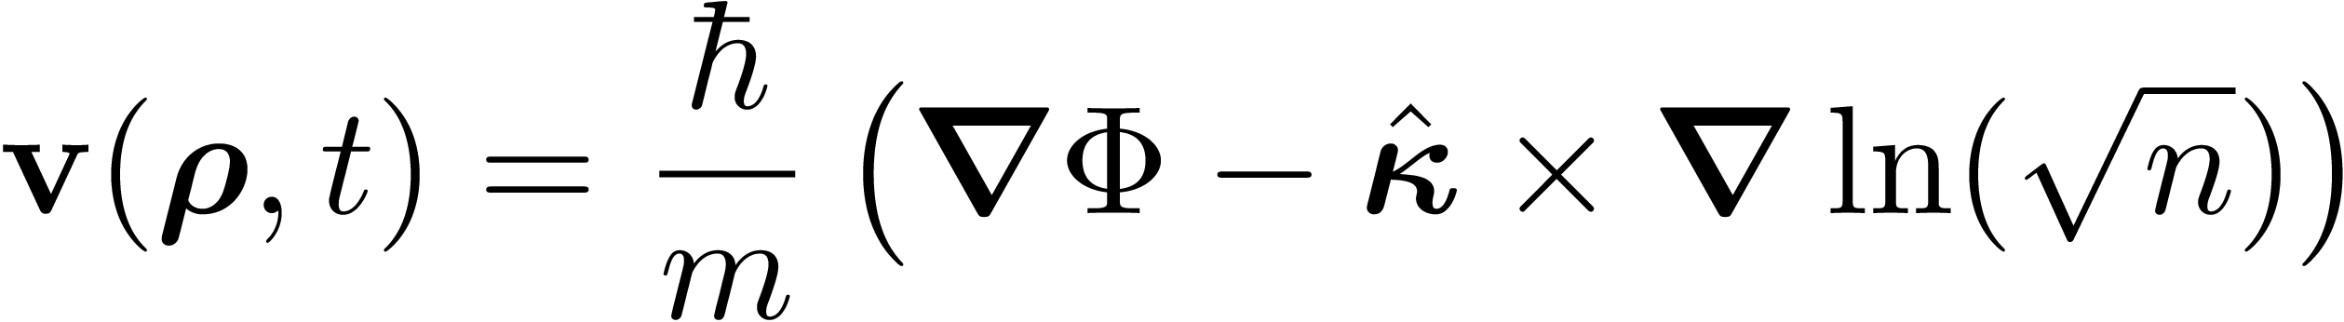
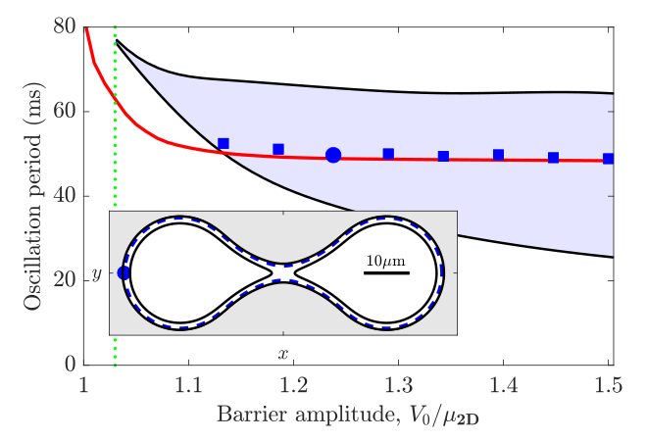
Kinetic Model of Vortex Motion
[Groszek, et al., PRA 86, 013631 (2018)]
Use the stationary GPE solution for fixed barrier height, V₀, choose a vortex starting position at lowest-density point on inside-edge of annulus and iteratively solve for the vortex motion. The shortest time for a path in which the vortex traverses both rings gives the oscillation period.

Slide 12
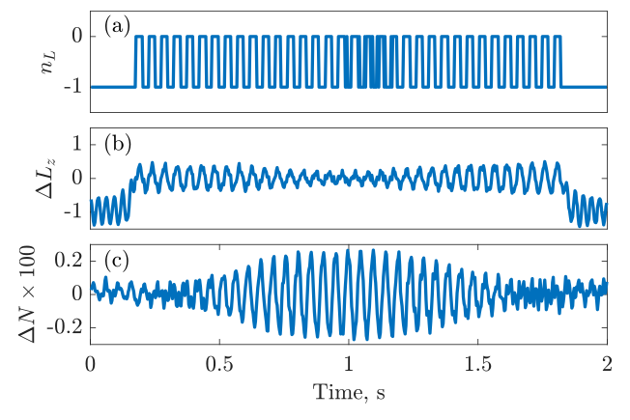
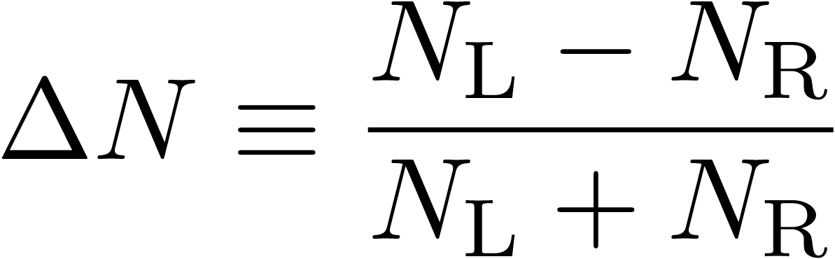
Long-time Number-Imbalance Beating Effect
Preparation of the initial state can cause a small population difference between the atom numbers of the left (N_{L}) and right (N_{R}) rings.
This leads to a small difference between the period of the angular momentum difference (ΔL_{z}) and the number difference (ΔΝ) between the left and right rings.
Thus there is a beating effect between these two oscillating quantities that only shows up for long evolution times.

Slide 13
Double-Ring BEC Persistent Currents: Phenomenological Finite-T Results

Slide 14
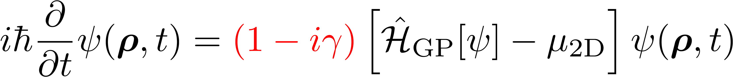
GPE with Phenomenological Damping
Damped Gross-Pitaevskii Equation
phenomenological damping parameter

Slide 15
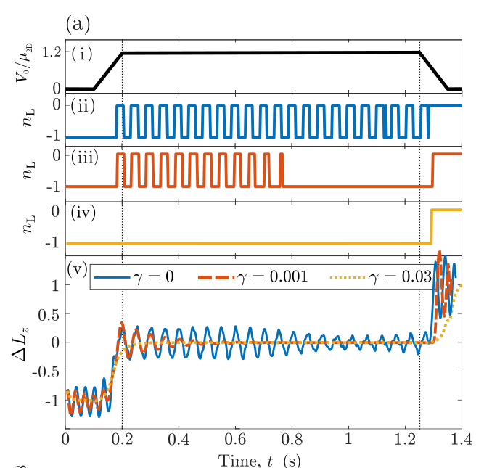
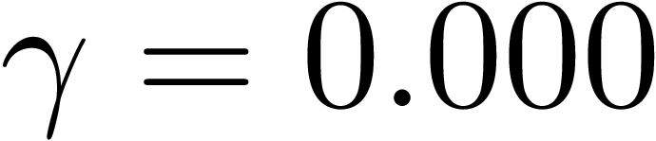
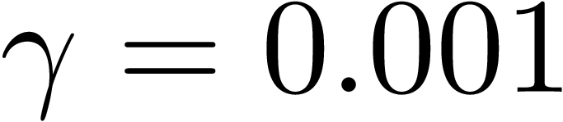
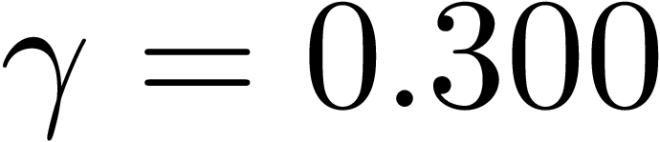
Effects of Damping on Persistent Currents
Actual experiments are conducted at low, but non-zero temperature.
In this case both dissipation and fluctuations are present.
The net effect of this is to damp or even completely suppress persistent-current oscillations.
For zero damping, oscillations continue indefinitely for as long as the barrier height exceeds the chemical potential.
For light damping, oscillations are cut off after a finite lifetime.
For heavy damping, oscillations do not occur at all.
Evaluation of ΔL_{z} shows that the vortex becomes trapped at the center of the system and, as the gate is closed, it gets forced into a randomly chosen ring.

Slide 16
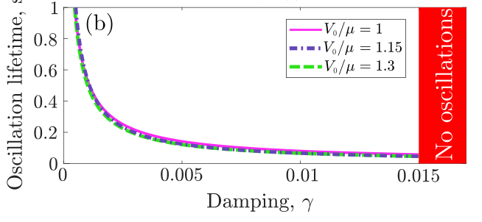
Oscillation Lifetime vs Damping

Slide 17
Double-Ring BEC Persistent Currents: Finite-T Stochastic-Projected GPE Results

Slide 18
GPE with Damping and Thermal Fluctuations
Stochastic, Projected Gross-Pitaevskii Equation (SP-GPE)
mode cutoff projection operator
complex Gaussian noise

Slide 19
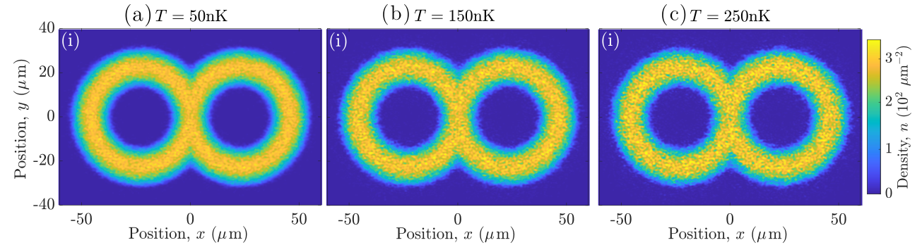
Equilibrium SP-GPE Density Profiles
Equilibrium SP-GPE density profiles
In the SP-GPE formalism, the energy modes are divided into low-energy modes (with occupation greater than one) and high-energy modes.
The order parameter (ψ(ρ,t)) describes the low-energy-modes contribution while the high-energy modes act as a heat bath at temperature, T.
The SP-GPE solution is no longer the “condensate wave function.”

Slide 20
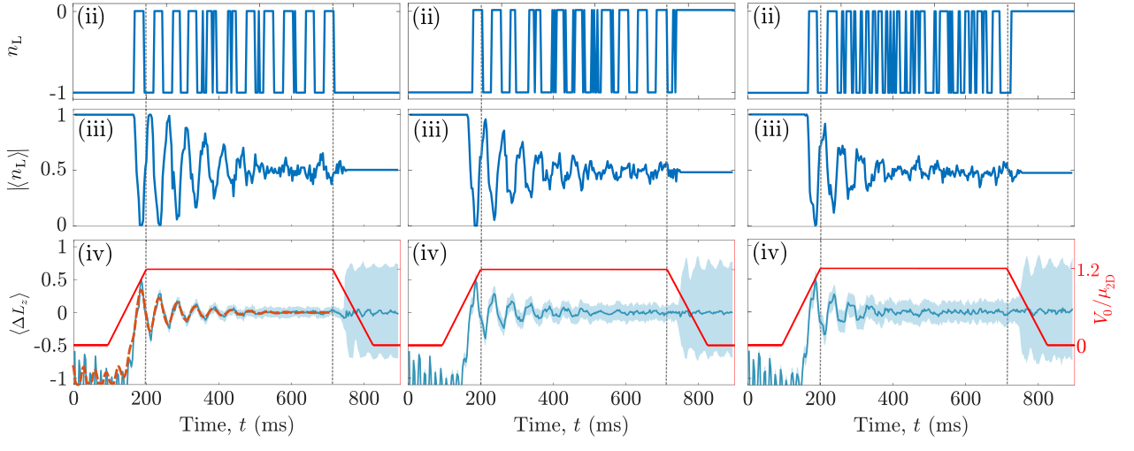
Effects of Thermal Fluctuations
Fluctuations reduce the visibility of the persistent current oscillations.
They essentially shift the phase of the oscillations.
(ii) Single-trajectory winding number oscillations for T = 50, 150, and 250 nK for γ = 0.001 shown at right.
(iii) 100-run winding number oscillations.
(iv) Mean angular momentum difference between rings.
50 nK
150 nK
250 nK

Slide 21
Double-Ring BEC Persistent Currents: 3D Collisionless ZNG Results

Slide 22
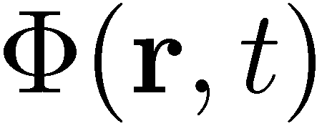
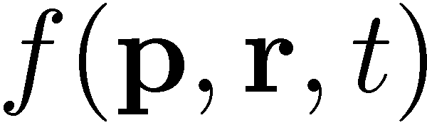
ZNG Model
(Zaremba-Nikuni-Griffin)
The ZNG theory describes the behavior of a thermal equilibrium system that is subject to a weak, external perturbation.
Assumes that the ultracold atom system consists of a Bose-Einstein condensate plus a non-condensate part that is modeled as a classical gas.
Accounts for time-dependent condensate and non-condensate behavior and allows for both time-dependent atom clouds to affect each other.
Quantities that describe the system are the condensate wave function, called and the single-particle distribution function, called .

Slide 23
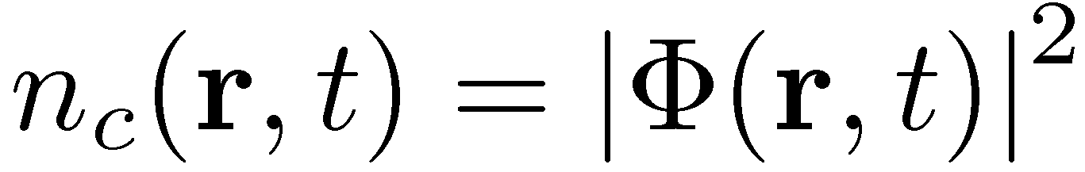
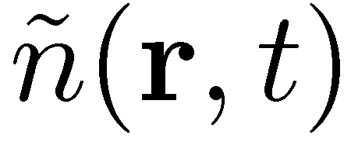
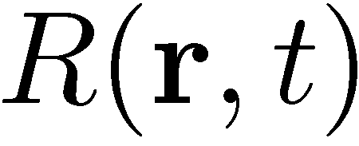
ZNG condensate behavior
The condensate wave function is governed by the Generalized Gross-Pitaevskii (GGP) equation:
where
is the condensate density,
is the non-condensate density, and is the local rate at which
the condensate gains or loses atoms due to collisions with non-
condensate atoms.

Slide 24


ZNG non-condensate behavior
The single-particle distribution function is defined as follows:
the number of non-condensate atoms having momentum in a volume of d³p around p and located within a volume d³r of r .
From this definition we see that the non-condensate density is:

Slide 25
Quantum Boltzmann equation
The single-particle distribution function satisfies the Quantum Boltzmann equation (QBE). We can understand this equation in the following way:
This equation says that particles located at ( r , p ) at time t , will have different momenta and/or locations at time t+dt due to 3 possible reasons:
Diffusion – they are already in motion so their position may change.
Force – there is an external force so their momentum may change.
Collisions – they collide with another particle of the gas during the time dt .

Slide 26
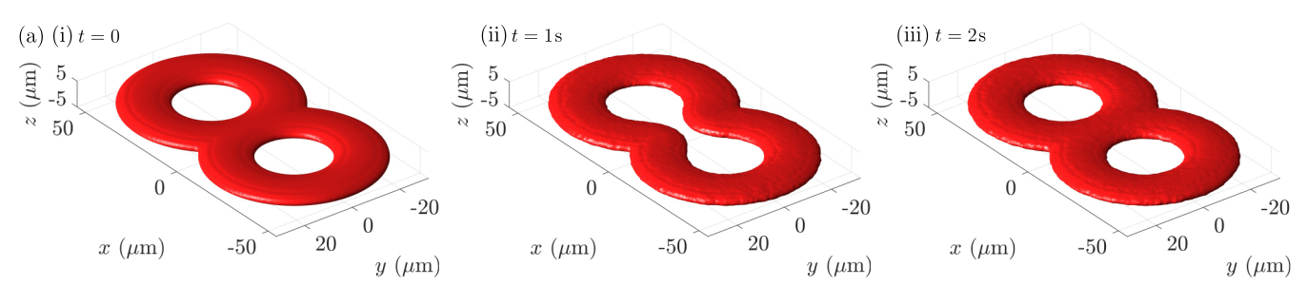
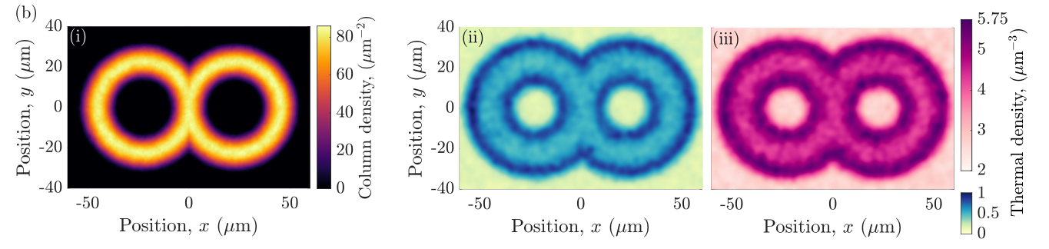
ZNG Condensate and Non-condensate Densities
(a) Condensate density isosurfaces vs time for (i) t=0, (ii) t=1s, and (iii) t=2s
(b) (i) Initial condensate column density for T=300 nK. Thermal cloud density slices in xy plane for (ii) T=100 nK, (iii) T=300 nK.

Slide 27
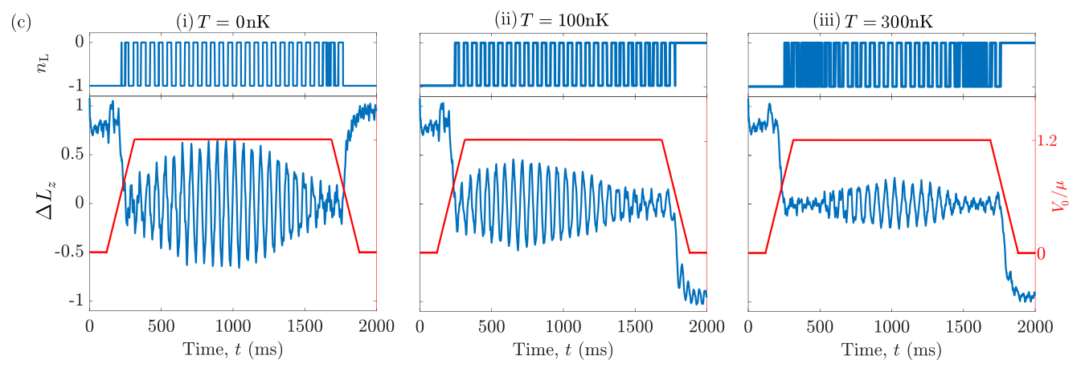
Persistent-Current Oscillations in ZNG

Slide 28
Summary
We have theoretically studied the periodic transfer of persistent current between the two rings of a BEC trapped in a double-ring potential when a weak link is applied in the ring overlap region.
At zero-temperature, mean-field results show that persistent-current oscillations continue indefinitely as long as the weak link height exceeds the condensate chemical potential
When damping is present in the system, light damping causes the persistent-current oscillations to have a finite lifetime. Heavy damping can stop the oscillations altogether.
Thermal fluctuations reduce the visibility of the oscillations which essentially shifts the phase of the oscillations.
Most of the features found in the 2D analyses were also observed in the 3D collisionless ZNG model.
Our results pave the way for the design of quantum sensors for precision navigation and metrology.

Slide 29


Edwards Research Group and Collaborators
Edwards Research Group
Samuel Oni
Eduard Pretorius
JQI/NIST Theory Collaborators
Charles Clark
Yi-Hsieh Wang
Ted Jacobson
University of Newcastle, UK
Tom Bland
Nick Proukakis
JQI/NIST Experimental Collaborators
Gretchen Campbell
Bill Phillips
Wendell Hill III
Steve Eckel
Fred Jendrzejewski
Chris Lobb
Taras Shevchenko National University of Kyiv, Ukraine
Alexander Yakimenko
O. Chelpanova
I. Yatsuta
A. Oliinyk

