Slide 1
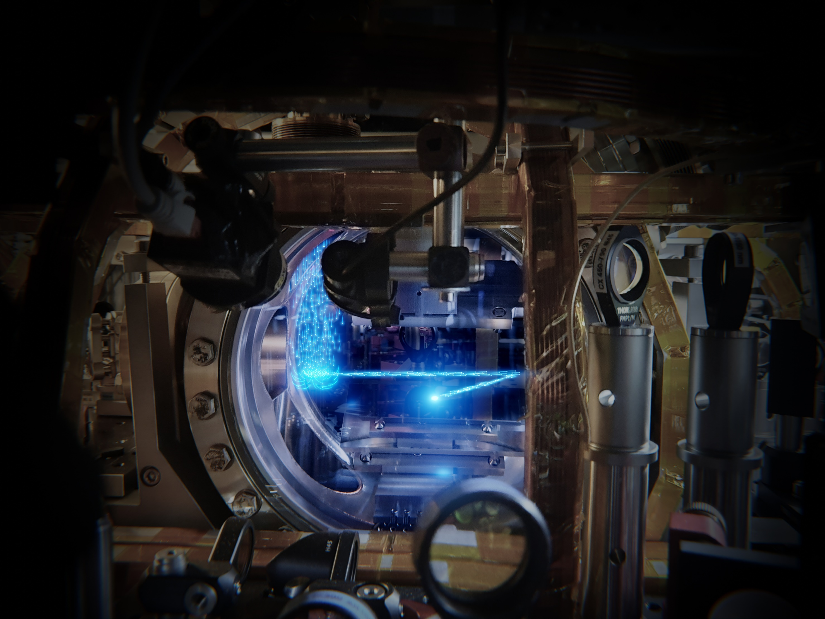

Continuous Bose-Einstein condensation & continuously operating clocks
Continuous Bose-Einstein condensation & superradiant clocks
Florian Schreck
Florian Schreck
Florian Schreck
University of Amsterdam
University of Amsterdam
University of Amsterdam

Slide 2


Slide 3
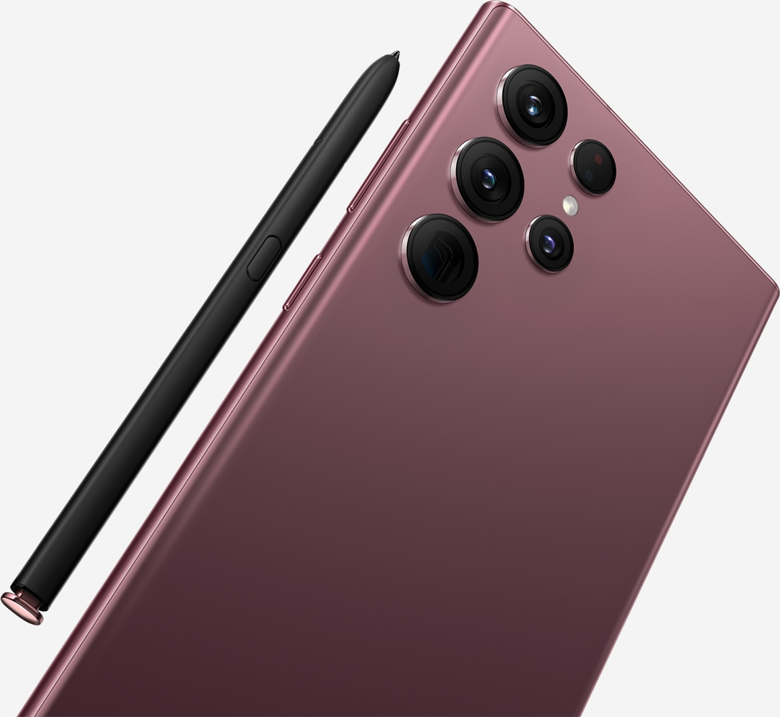

Slide 4

Classical vs quantum sensors
Pendulum
Atom
Highest accuracy
High transition frequency optical transitions
Narrow transition mHz linewidth
Large signal use many atoms
Undisturbed by other atoms use gas of atoms
No Doppler shift cool atoms to standstill

Slide 5

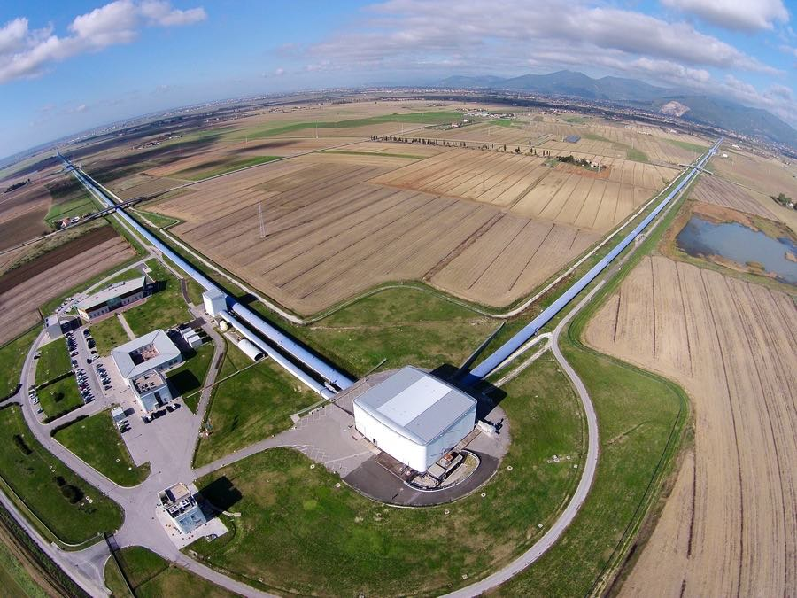
Atom interferometry
Laser interferometer
Atom interferometer
position
atoms
Laser
laser pulses
Gravitational wave detection
time
Detection of
acceleration (gravity, gravity gradient)
rotation
Also profits from ultracold atoms
The Virgo collaboration/CCO 1.0

Slide 6

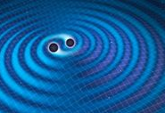
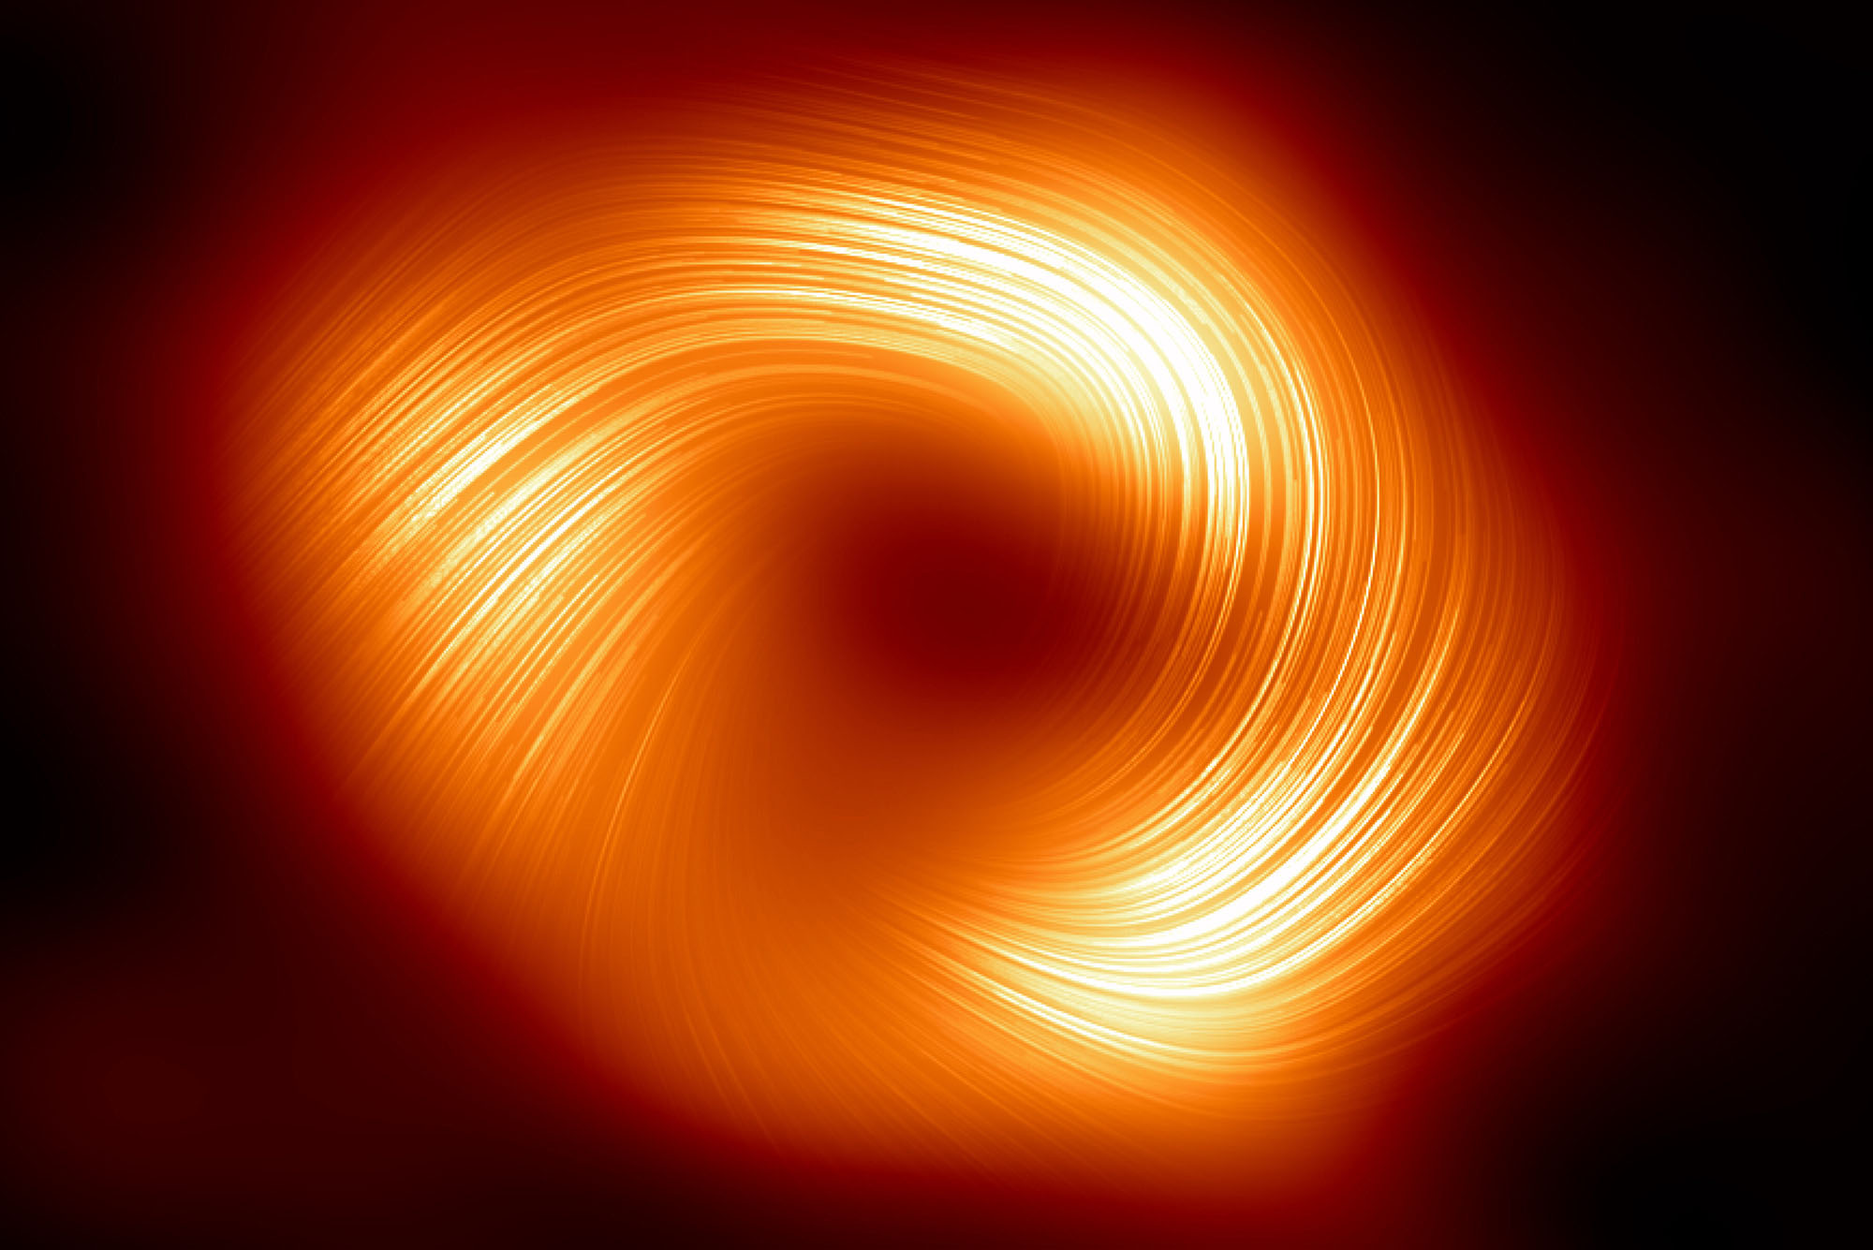
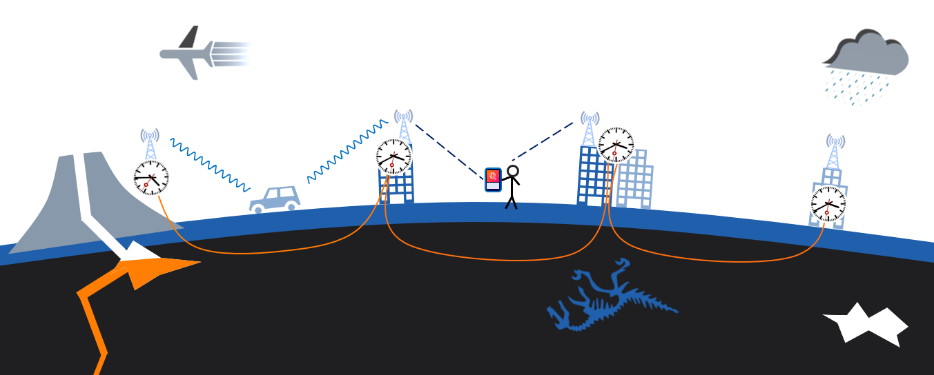

Applications of optical clocks and atom interferometers
Science: test of fundamental physics, radioastronomy, gravitational wave detection,
many-body quantum physics
Optical clocks
Equivalence of free fall
©Turtle Rock Scientific LLC
Gravitational waves
© Mark Garlick, Getty
Radioastronomy
Black hole at centre of Milky Way © EHT
Society: network synchronization, positioning, geodesy, navigation, underground exploration
Atom interferometers
Adapted from Teledyne e2v

Slide 7
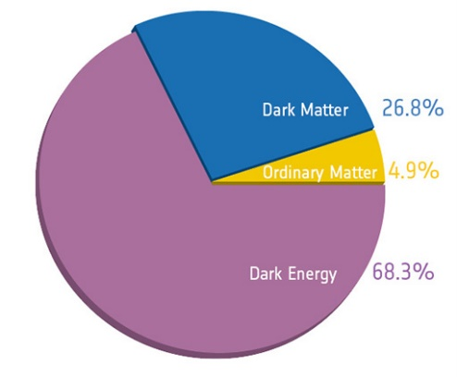
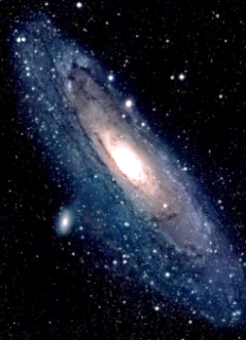

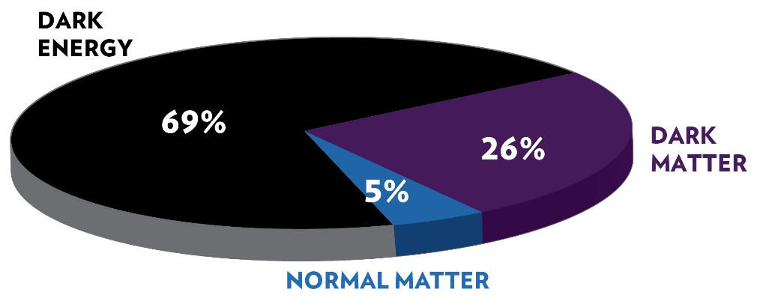
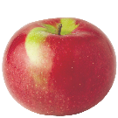
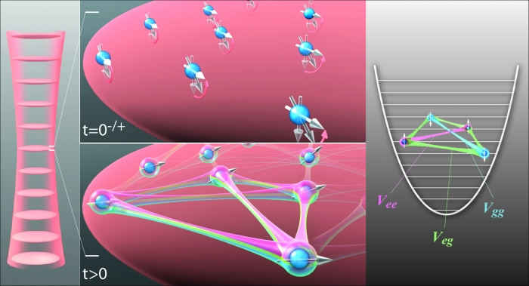
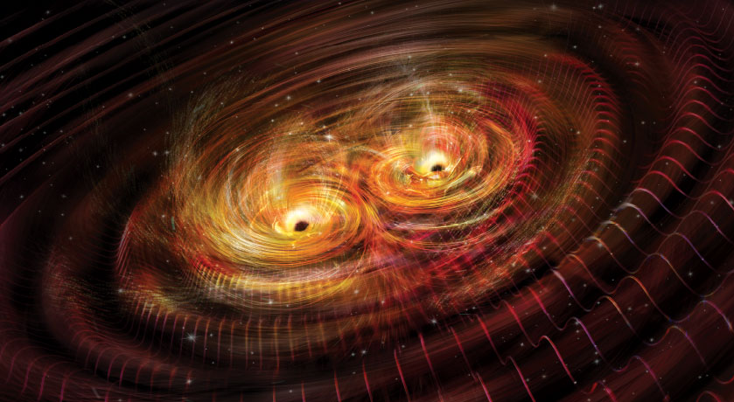
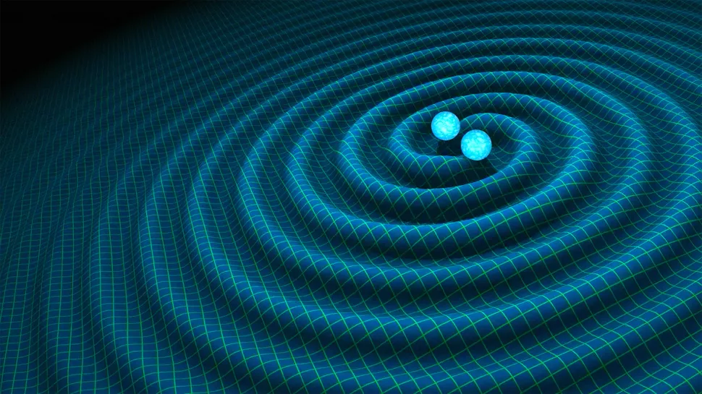
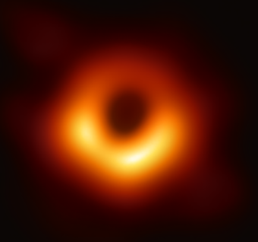
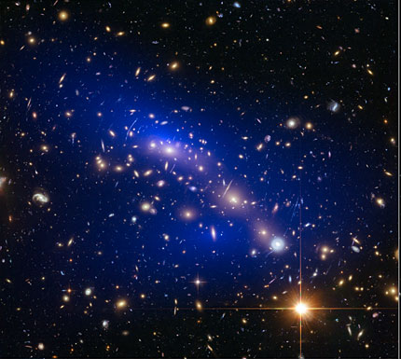
Applications
Fundamental science
Tests of relativity
QED tests
Beyond Standard Model physics
Do fundamental constants change?
Dark matter searches
Explore many-body physics
happening in quantum sensors:
spin models, gauge fields,…
Astronomy
Jun Ye, Ana-Maria Rey groups, JILA
Infrasound gravitational wave detectors
Very-long baseline interferometry
Nicolle Rager Fuller
Society
Network synchronization
Navigation
Underground exploration
NASA
Event Horizon Telescope

Slide 8
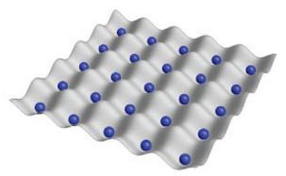

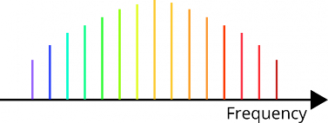
Improving clocks: from pulsed to continuous operation
Frequency reference
ultracold Sr atoms in lattice
Blue laser cooling
Red laser cooling
Interrogate
Blue laser cooling
Red laser cooling
Interrogate
…
time
Flywheel
Clockwork
optical resonator
optical frequency comb
keeps frequency while ultracold atoms are prepared
translates optical frequency into radiowave frequency
laser

Slide 9
Improving clocks: from pulsed to continuous operation
Frequency reference
ultracold Sr atoms in lattice
Blue laser cooling
Red laser cooling
Interrogate
Blue laser cooling
Red laser cooling
Interrogate
…
measure continuously
time
Flywheel
Clockwork
optical resonator
optical frequency comb
keeps frequency while ultracold atoms are prepared
translates optical frequency into radiowave frequency
make do with less stable resonator
laser

Slide 10
Challenge: measurement deadtime
Ultracold atoms only intermittently available
Blue laser cooling
Red laser cooling
Interrogate
Blue laser cooling
Red laser cooling
Interrogate
…
time
Measure fluctuating quantity
Result
True average
Error!
measurement time
dead time
Solution for inertial sensors: combine classical high-bandwidth sensor with atomic high-accuracy sensor

Slide 11
Challenge: measurement deadtime
Ultracold atoms only intermittently available
Blue laser cooling
Red laser cooling
Interrogate
Blue laser cooling
Red laser cooling
Interrogate
Challenges
…
Continuous ultracold atom source
time
High atom flux
Measure fluctuating quantity
High density
Result
True average
The ultimate source
Error!
A continuous atom laser
measurement time
dead time
Solution for inertial sensors: combine classical high-bandwidth sensor with atomic high-accuracy sensor

Slide 12

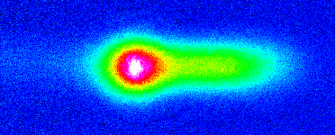
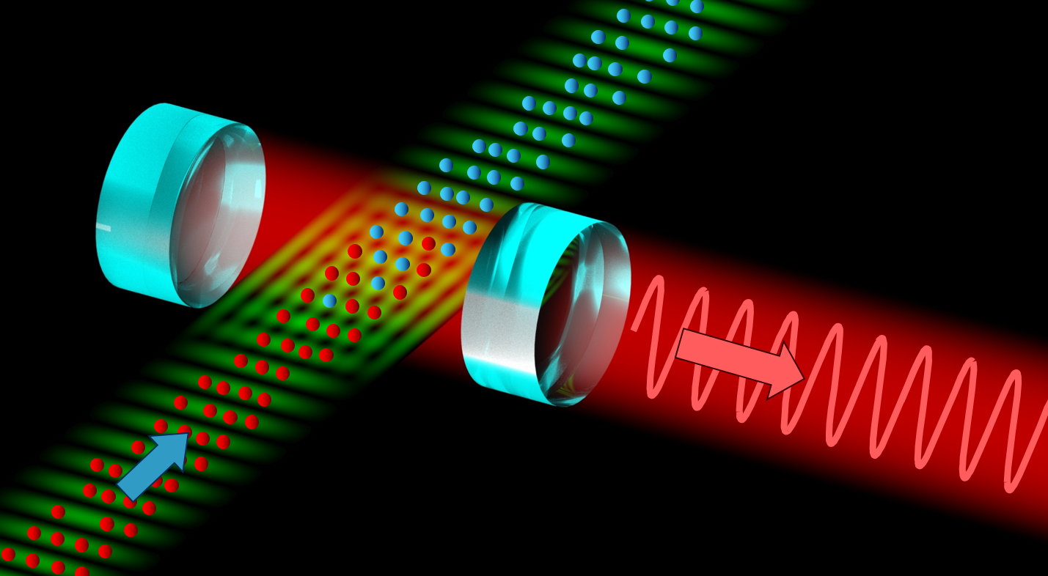
Outline
µK Sr beam in the dark
Continuous BEC
100µm
Continuous clocks
Continuous-wave atom laser
frequency & time
acceleration & rotation

Slide 13
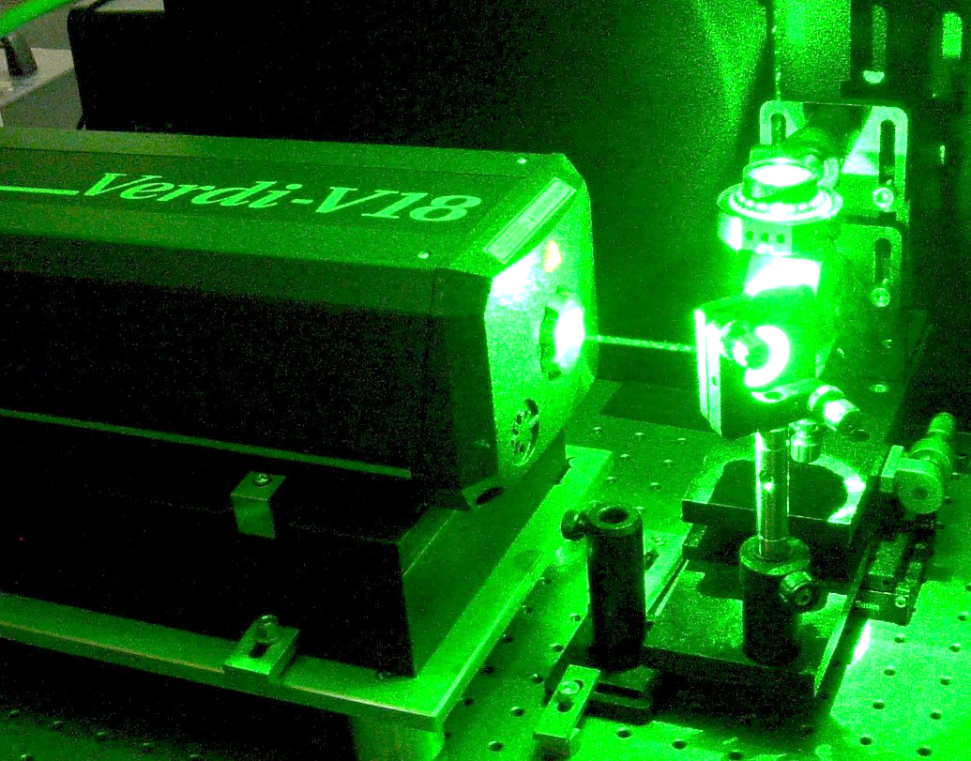
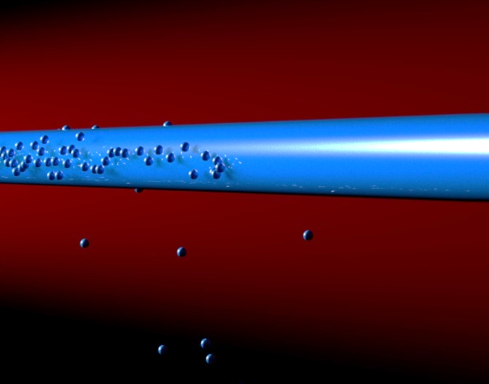
Optical and atom laser beams
Laser beam
Advantages of laser beams
Better
brightness
divergence
spatial mode structure
coherence
Light
Matter
Optical laser
Atom laser
Laser interferometer
Atom interferometer
N.P. Robins et al., Atom lasers: Production, properties and prospects for precision inertial measurement, Phys. Rep. 529, 265 (2013)

Slide 14
Continuous Bose-Einstein condensation
Optical laser
Atom laser
Optical cavity
Atom cavity (trap)
Pumping
replenish atoms
laser cooling
Pumping
Gain
(e.g. stimulated emission)
Gain
(e.g. Bose-enhanced scattering)
BEC
Outcoupler
Outcoupler
(e.g. transfer to
untrapped state)
N.P. Robins et al., Atom lasers: Production, properties and prospects for precision inertial measurement, Phys. Rep. 529, 265 (2013)

Slide 15


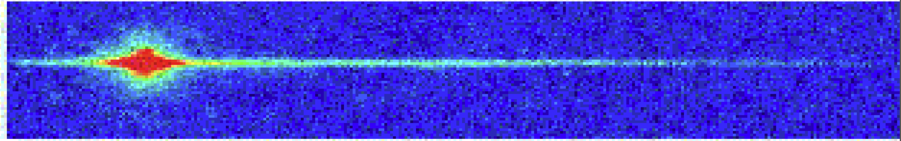
State-of-the-art: pulsed atom laser
Laser
cooling
Evaporative
cooling
Bose Einstein
condensation
Outcoupling
Depletion
time
Free falling atom lasers
Laser emission
Only pulsed operation
MIT
1997
LMU
1999
NIST
1999
Guided atom laser
Institut d’Optique 2006

Slide 16
Our goal: continuous atom laser
Laser
cooling
Evaporative
cooling
Bose Einstein
condensation
Challenges
outcoupling
Poor laser cooling performance of alkalis and chromium
space
BEC incompatible with laser cooling
Steps towards goal
Periodically replenish BEC
Ketterle group, Science 296, 2193 (2002)
Continuous evaporation
Guéry-Odelin group, PR A 72, 033411 (2005)
Raithel group, PR A 73, 033622 (2006)
Pumping mechanism
Close group, nature physics 4, 731 (2008)
Continuous trap loading
Pfau, Griesmaier group, New J. Phys. 15 093012 (2013)
Klempt group, J. Phys. B 48, 165301 (2015)

Slide 17
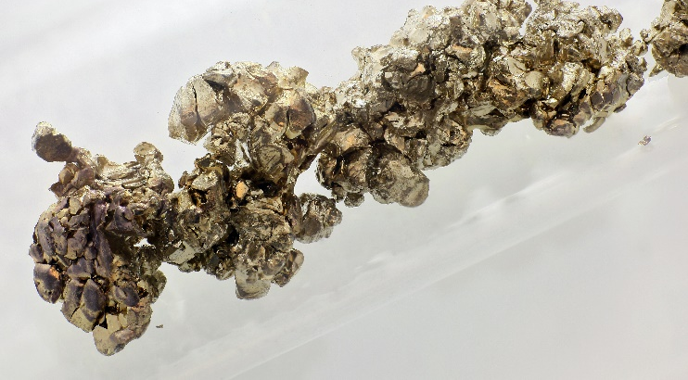
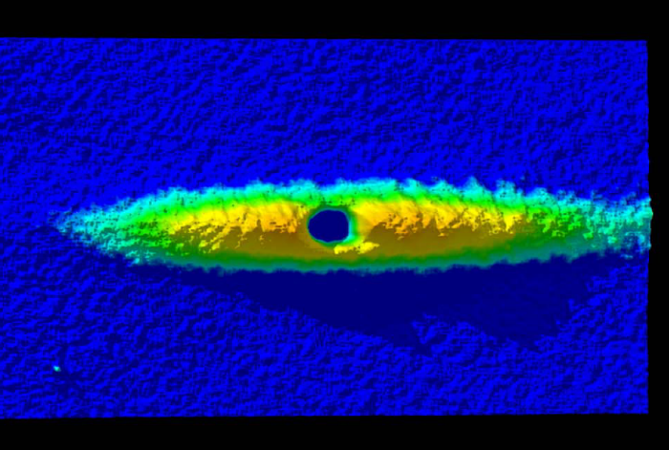
Our tricks
Strontium
Laser cooling
on narrow transition
Transparency beam
Cool to BEC
Protect BEC from photons

Slide 18
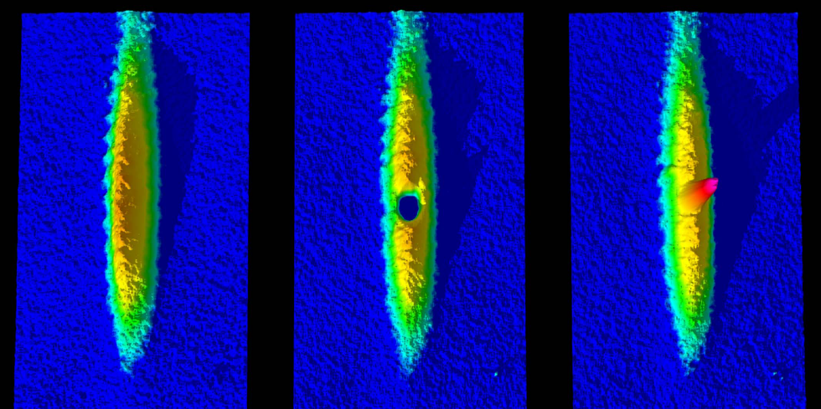

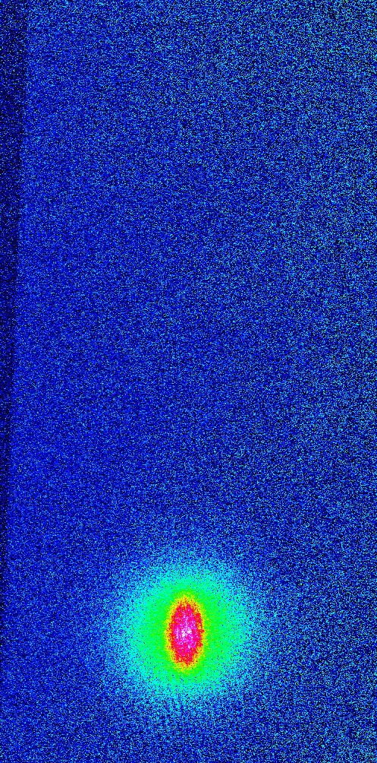
BEC in laser cooled cloud
Combine three techniques
Laser cooling
on narrow transition
Dimple trick
Transparency beam
BEC
Phase-space density = 0.1
Increase phase-space density
Protect BEC from laser cooling light
Sr gas in dipole trap
BEC in laser cooled cloud
Phys. Rev. Lett. 110, 263003 (2013)

Slide 19
Continuous atom laser
New requirements
1) Pumping: replenish atoms
BEC
2) Outcoupling
Challenge: BEC not protected from blue photons

Slide 20
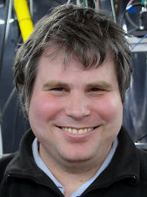
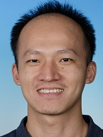
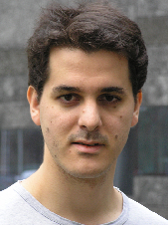
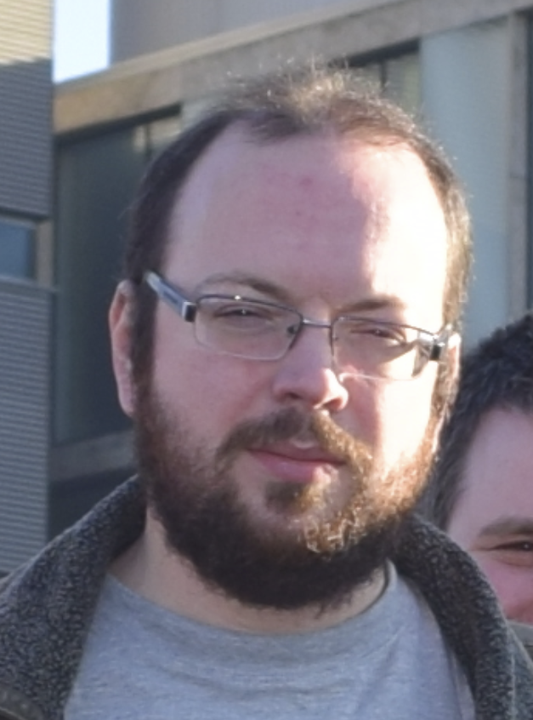
Blue stray light protection
Sr beam
source
blue Zeeman slower
blue 2D MOT
Shayne Bennetts
Chun-Chia Chen
Rodrigo González Escudero
Benjamin Pasquiou
red 2D molasses
atomic beam
continuous-wave BEC
red MOT
dipole guide
future atom laser
red Zeeman slower
Challenge: BEC not protected from blue photons

Slide 21
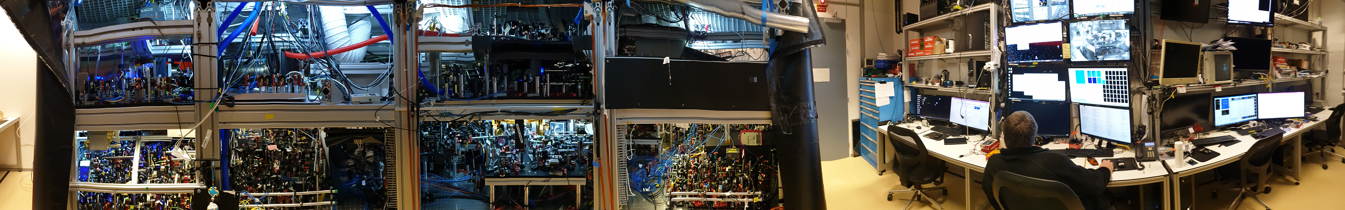
Design and construction
Sr beam
source
Zeeman slower
blue 2D MOT
Shayne Bennetts
Chun-Chia Chen
Rodrigo González Escudero
Benjamin Pasquiou
red 2D molasses
atomic beam
continuous-wave BEC
red MOT
dipole guide
future atom laser
red Zeeman slower

Slide 22


Slide 23
In situ
1mm

Slide 24
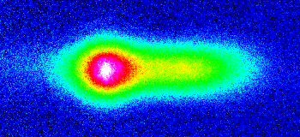
In situ
1mm
18 ms expansion
cw BEC
Nature 606, 683 (2022)

Slide 25
In situ
1mm

Slide 26
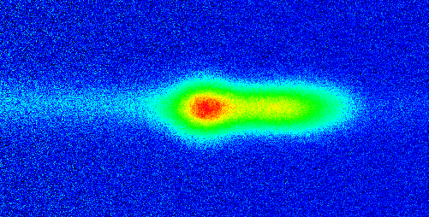
In situ
1mm
18 ms expansion
1mm

Slide 27
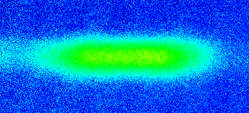
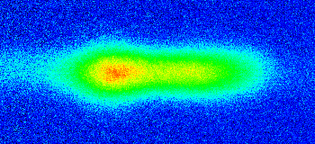
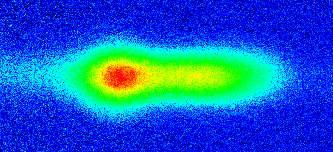
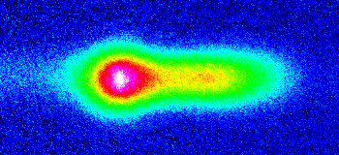
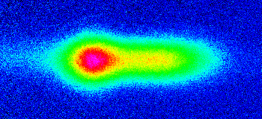
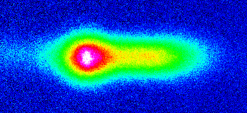
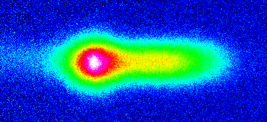
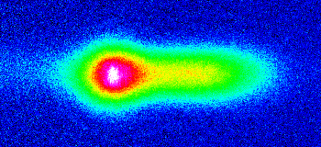
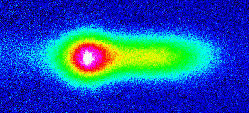
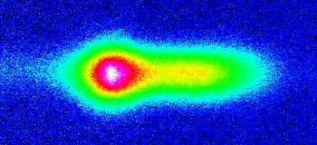
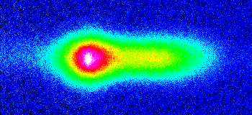
BEC in steady-state?
30
t (s)
0
2
5
15
60
1.1s
1.5s
2.0s
9.5s
2.4s
3.4s
5s
13.5s
15s
30s
60s
45s

Slide 28
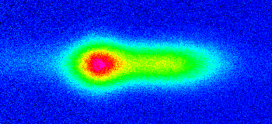
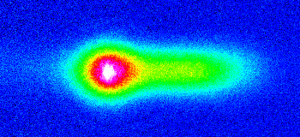
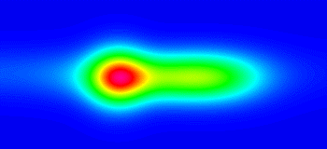
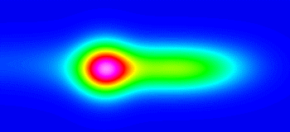


BEC detection
Nature 606, 683 (2022)
Image after 18ms expansion
2.4s
15s
Thermal fit
3 Gaussians + Gauss tube
Fit residue
BEC!
1mm

Slide 29
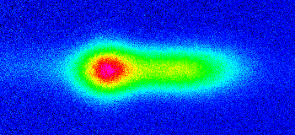
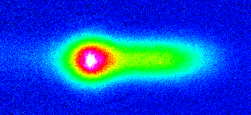




BEC detection
Nature 606, 683 (2022)
Image after 18ms expansion
2.4s
15s
Thermal + BEC fit
3 Gaussians + Gauss tube + TF
Fit residue
1mm
Notes:
Benjamin’s fit 2020 02 28
191226 S1018 P0121 2.4s
191226 S1018 P0084 15s

Slide 30
Characterization of steady-state
Nature 606, 683 (2022)
BEC: N = 7.4(2.4) x 10³ ⁸⁴Sr atoms
Replenishment rate 10⁵ atoms/s
Dimple: N = 6.9(4) x 10⁵ T_{vertical} = 1.08(3) μK
Reservoir: N = 7.3(1.8) x 10⁵
Loading rate 1.1(4) x 10⁶ atoms/s
Model assuming thermalized gas does not describe data.
Model assuming enhanced occupation of higher trap states fits data.
Signature of driven, dissipative nature of system?
Future direction: driven-dissipative many-body physics
BEC purity oscillations
new critical exponents
unusual quantum phases, especially in lower dimensions
Phys. Rev. Lett. 88, 170403 (2002), Phys. Rev. A 93, 033617 (2016)
Phys. Rev. Lett. 110, 195301 (2013)
Phys. Rev. Lett. 118, 085301 (2017)
Driven-dissipative BECs created with
exciton-polaritons Rev. Mod. Phys. 82, 1489 (2010)
magnons Nat. Phys. 4, 198 (2008)
photons Nature 468, 545 (2010)

Slide 31



Creating an atom laser beam
Atom cavity (trap)
Pumping
replenish atoms
Davide
Natale
Benjamin Pasquiou
laser cooling
Junyu He
potential
metastable state
Gain
(e.g. Bose-enhanced scattering)
ground state
BEC
outcoupler
gravity
Freely falling
atom laser beam
Add outcoupling mechanism
e.g. Raman transfer to untrapped, metastable state
N.P. Robins et al., Atom lasers: Production, properties and prospects for precision inertial measurement, Phys. Rep. 529, 265 (2013)

Slide 32
Coherent 3-photon transfer to metastable state
¹S₀ – ³P₀ Rabi oscillations

Slide 33
Outline
µK Sr beam in the dark
Continuous BEC
100µm
Continuous clocks
Continuous-wave atom laser
frequency & time
acceleration & rotation

Slide 34
Challenge: measurement deadtime
Ultracold atoms only intermittently available
Blue laser cooling
Red laser cooling
Interrogate
Blue laser cooling
Red laser cooling
Interrogate
…
time
Measure fluctuating quantity
Result
True average
Error!
measurement time
dead time
Solution for inertial sensors: combine classical high-bandwidth sensor with atomic high-accuracy sensor

Slide 35





Fast increase of measurement precision
Measurement precision over time
With dead time
total measurement time
Uninterrupted measurement time
dead time
Fourier limited precision
Precision after averaging
Continuous measurement
measurement time t
Fourier limit
Precision
Opportunity to reach 10⁻¹⁸ precision in 100 s instead of 10 000 s !
Need high signal-to-noise to work, i.e. high atom flux

Slide 36
Challenges
Continuous ultracold atom source
High atom flux
High density
A very good source
Continuous ultracold beam

Slide 37
Continuous superradiant clock
Continuous ultracold strontium beam in
Clock laser beam out
See also James Thompson group, JILA
Pulsed superradiant emission on Sr clock line
Science Advances, 2, e1601231 (2016)

Slide 38

Superradiant clock
Passive clock
Active, superradiant clock
ultracold Sr atoms in lattice
laser
Continuous ultracold strontium beam in
Clock laser beam out

Slide 39



Comparison to standard laser
Standard laser: frequency stability from length of cavity
good-cavity regime:
cavity mode
gain profile
Superradiant clock laser: frequency stability from ensemble spin of atoms
bad-cavity regime:
cavity mode
gain profile

Slide 40
Active optical clock
Goal: photons from mHz linewidth transition
Challenges:
minutes of excited state lifetime
emission into 4π
Solution: enhance emission into single mode by superradiance
Proposals:
Jingbiao Chen, arXiv:physics/0512096 (2005), Chinese Science Bulletin 54, 348 (2009)
D. Meiser, J. Ye, D. R. Carlson, M. J. Holland, PRL 102, 163601 (2009)
Pulsed demonstration:
M. A. Norcia, M. N. Winchester, J. R. K. Cline and J. K. Thompson, Science Advances, 2, e1601231 (2016)

Slide 41





Phased array of N emitters
Closer spaced than wavelength
Random phase
Closer spaced than wavelength
Same phase
Spaced wavelength/2 along axis
Alternating phase
Electric field
Electric field (arb. units.)
Random interference
Constructive interference
Constructive interference along axis
E-field ~ Sqrt(N)
E-field ~ N
Power ~ N
Power ~ N²
Power along axis ~ N²

Slide 42








How is superradiance established?
Bloch vector
E-field

Slide 43

How can superradiance be maintained?

Slide 44


V1: kHz-transition superradiant Sr laser
H. Liu, S. B. Jäger, X. Yu, S. Touzard, A. Shankar, M. J. Holland, and T. L. Nicholson
Rugged mHz-Linewidth Superradiant Laser Driven by a Hot Atomic Beam
PRL 125, 253602 (2020)
Cavity
Laser output
Pump to lasing state
Camila
Beli-Silva
Velocity selective pump to metastable state
Push
Francesca Famà
Sr oven

Slide 45

V1: kHz-transition superradiant Sr laser
Atoms in metastable state = “no atoms”
Atoms in lasing state
Cavity
amplified
by 2.3
Probe in
Amplifier output
~10 nW
Pump to lasing state
Output power (arb. units)
Velocity selective pump to metastable state
Push
Sr oven
Probe detuning from cavity mode (MHz)

Slide 46

V2: Continuous superradiant mHz clock
Continuous ultracold strontium beam in
Clock laser beam out
Pulsed superradiant emission on Sr clock line
James Thompson group, JILA, Science Advances, 2, e1601231 (2016)

Slide 47


V2: Continuous superradiant mHz clock
Continuously operating red ⁸⁸Sr MOT
Benedikt
Heizenreder
5 mm
Sheng Zhou
Flux = 3 x 10⁸ atoms/s
Atom number = 5.5 x 10⁸
Ananya Sitaram

Slide 48

Zero-deadtime clock
Scott
Wolzak
Sumit
Sarkar
András Gácsbaranyi

Slide 49


Zero-deadtime clock
So far: interlace two clocks to measure without deadtime
Ludlow group, Nature Photonics 11, 48 (2017)
Here: integrate several interrogation zones into one clock apparatus to measure without deadtime
much simpler construction, straight forward to implement four interrogation zones
steady-state ultracold atom source
4
1
2
1
2
3
Interrogation zones
Alternative schemes: continuous Ramsey spectroscopy, Hidetoshi Katori, Appl. Phys. Express 14, 072006 (2021)
continuous cavity spectroscopy, JILA clock groups, PR A 92, 053820 (2015)

Slide 50
Multi-ensemble, zero-deadtime clock operating principle
Goal: phase-lock clock laser to atoms clock precision scales as 1/(total measurement time)
Ramsey fringes of ensembles (1) and (2): fast cycling, short Ramsey time
Error free measurement range
1
1st, fast lock
large error free range
because of large Ramsey fringe period
low precision
because of finite atom number S/N and shallow slope of Ramsey fringe
Fraction
excited
atoms
0
f_{laser} - f_{atoms}
0
Ramsey fringes of ensembles (3) and (4): slow cycling, long Ramsey time
Error free measurement range
2nd , slow lock
small error free range
high precision
1
Fraction
excited
atoms
long Ramsey time with small error only possible because clock laser pre-stabilized by fast lock
0
f_{laser} - f_{atoms}
0

Slide 51
Summary
µK Sr beam in the dark
Continuous BEC
100µm
Continuous clocks
Continuous-wave atom laser
frequency & time
acceleration & rotation

Slide 52











Our projects
Quantum sensing
Quantum simulation
Continuous atom laser
RbSr molecules
Quantum Flagship
Continuous Clocks
Rydberg coupled Sr atoms
M. J. Holland &
T. L. Nicholson
groups

Slide 53






















atomlaser
clocks
András Gácsbaranyi (PhD)
RbSr
Scott Wolzak (master)
Digvijay
(PhD)
Ananya Sitaram (postdoc)
Mehrdad Zarei (postdoc)
Noah Wach (master)
Davide Natale (PhD)
Sr tweezer
Rodrigo Gonzáles Escudero
(postdoc)
Ivo Knottnerus
(PhD)
Benjamin Pasquiou
(former Co-PI,
now CNRS)
Premjith Thekkeppat
(PhD)
Stefan Alaric
Schäffer
(former
postdoc)
Robert Spreeuw
(PI)
Francesca Famà
(PhD)
Benedikt Heizenreder
(PhD)
Klaasjan van Druten
(PI)
Shayne Bennetts
(PhD, postdoc,
PI in Taiwan)
Sheng Zhou
(PhD)
Junyu He
(postdoc)
Florian Schreck
(PI)
Philippe Bouyer
(PI)
Camila Beli Silva
(PhD)
Alex Urech
(postdoc)
Sumit Sarkar
(postdoc)
Chun-Chia Cheng
(former PhD/PD,
PI in Taiwan)
Yu Chih Tseng
(PhD)
Programme QuSim 2.0
Zwaartekracht QCS
Quantum Flagship
Veni & Vici
NWA Startimpuls II QuNav
Jiří Minář
(theory postdoc)
This project has received funding from the European Union’s Horizon 2020 and Horizon Europe research and innovation programmes ​​under grant agreement No 820404 (iqClock project), No 860579 (MoSaiQC project), No 101080166 (AQuRA project) and No 101070144 (EuRyQa).
Matteusz Borkowski
(research assistant)

Slide 54





Funding
This project has received funding from the European Union’s Horizon 2020 research and innovation programme ​​under grant agreement No 820404 (iqClock project).
This project has received funding from the European Union’s Horizon 2020 research and innovation programme ​​under grant agreement No 860579 (MoSaiQC project).
This publication has received funding under Horizon Europe programme HORIZON-CL4-2021-DIGITAL-EMERGING-01-30 via the project 101070144 (EuRyQa)
Notes:
Add Stefan’s funding source here

