Slide 1
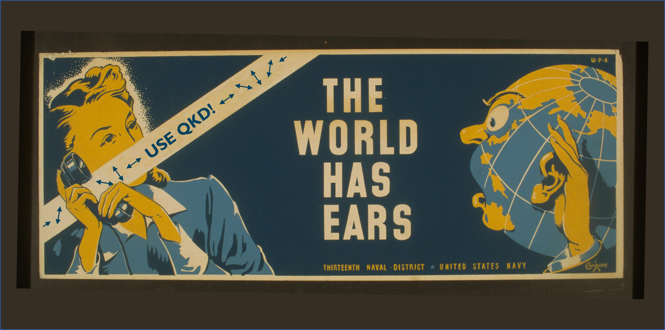
Quantum Resistance and the Internet of Things
Charles W. Clark
Joint Quantum Institute, National Institute of Standards and Technology and University of Maryland
Atomtronics 2024, Benasque 22 May 2024

Slide 2
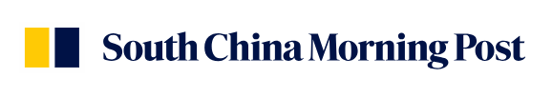
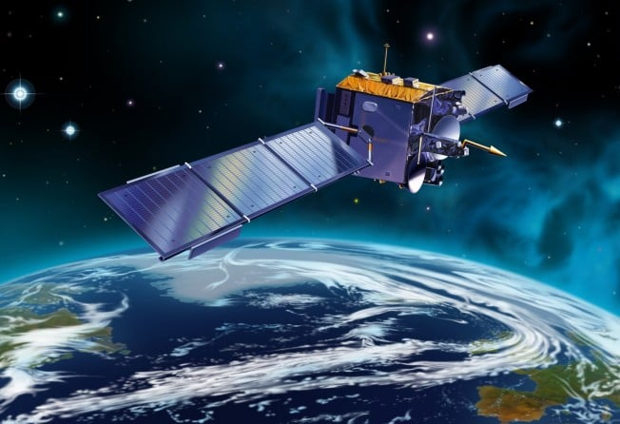
China and Russia test ‘hack-proof’ quantum communication link for BRICS countries
Victoria Bela Published: 8:00pm, 30 Dec, 2023
SCMP
Scientists in Russia and China have established quantum
communication encrypted with the help of secure keys transmitted by China’s quantum satellite, showing that a BRICS quantum communication network may be technically feasible.
The scientists were able to span 3,800km (2,360 miles) between a ground station close to Moscow and another near Urumqi in China’s western Xinjiang region to send two encoded images secured by quantum keys.
The first “full cycle” quantum communication test between the two countries was successfully conducted last year, said Alexey Fedorov, of Russia’s National University of Science and Technology (MISIS) and the Russian Quantum Centre (RQC), Russia’s leading institution
in charge of creating a quantum computer, on December 14.
Bridging the vast distance is possible with the help of China’s quantum satellite Mozi, which has opened pathways to develop national and international quantum communication networks.
2

Slide 3
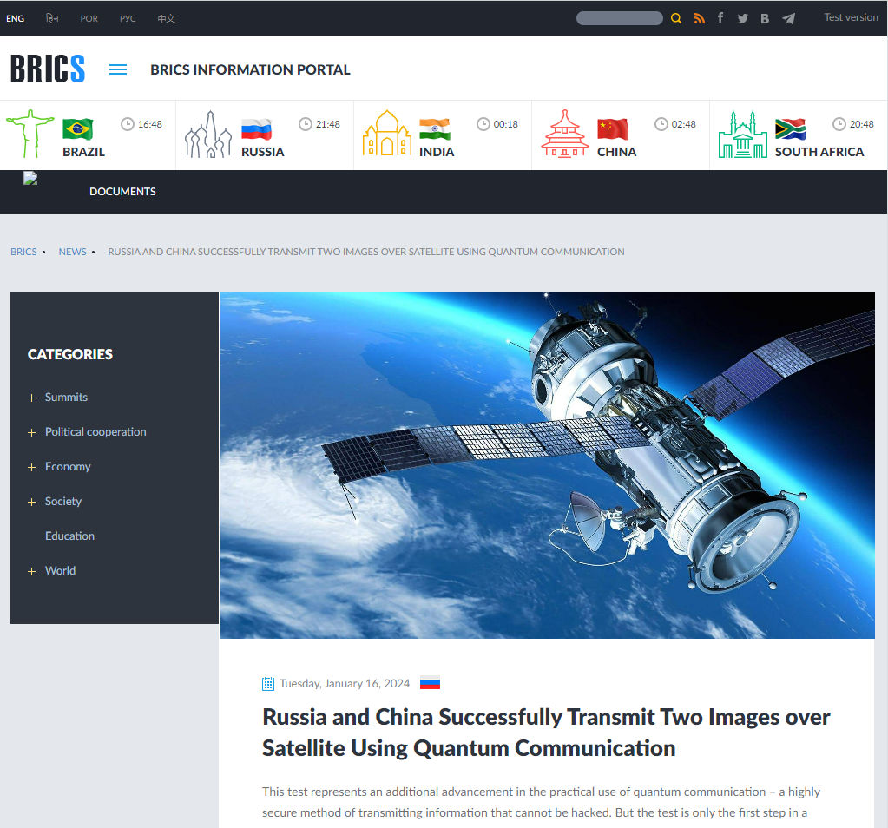
Quantum Resistance and the Internet of Things
Charles W. Clark
Joint Quantum Institute, National Institute of Standards and Technology and University of Maryland
TBA, Fermilab 25 January 2024
Other Members
Egypt Ethiopia Iran United Arab Emirates
Founders
Brazil Russia India China South Africa
Applicants (2024)
Algeria
Bahrain
Bangladesh
Belarus
Bolivia
Cuba
Kazakhstan
Kuwait
Nigeria
Pakistan
Palestine
Senegal
Thailand
Venezuela
Vietnam
January 16, 2024
3

Slide 4
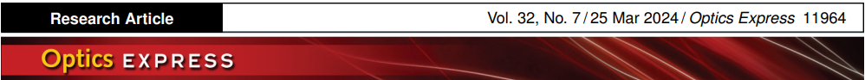
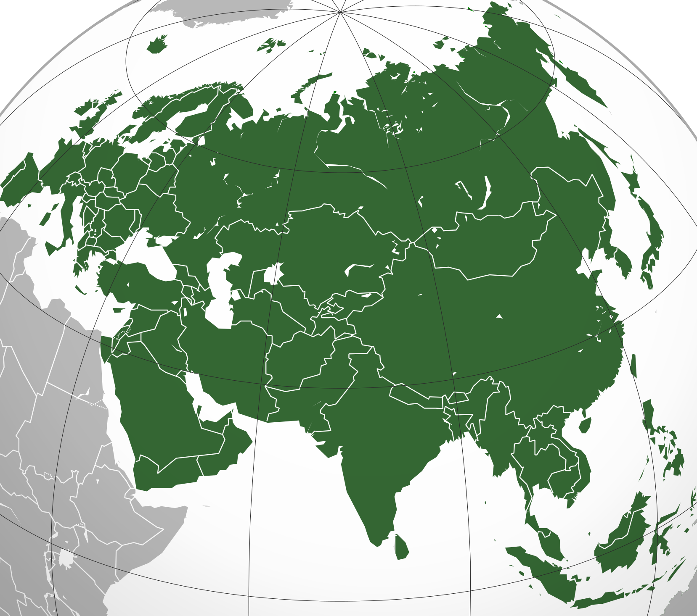
Eurasian-Scale Experimental Satellite-based Quantum Key Distribution with Detector Efficiency Mismatch Analysis
E U R A S I A
Aleksandr V. Khmelev,^{1, 2, 3, ∗}
Alexey V. Duplinsky,^{3, 4} Ruslan M. Bakhshaliev,³
Egor I. Ivchenko,^{1, 2, 3, 5} Liubov V. Pismeniuk,³
Vladimir F. Mayboroda,⁵ Ivan S. Nesterov,^{1, 3}
Arkadiy N. Chernov,^{1, 2, 3, 5} Anton S. Trushechkin,^{5, 6} Evgeniy O. Kiktenko,^{1, 5} Vladimir L. Kurochkin,^{1, 2, 3, 5,}† and Aleksey K. Fedorov^{1, 5,}‡
¹Russian Quantum Center
²Moscow Institute of Physics and Technology
³QSpace Technologies, Moscow
⁴HSE University, Moscow
⁵Steklov Mathematical Institute of Russian Academy of Sciences
BRICS
⁶National University of Science and Technology MISIS, Moscow
4

Slide 5
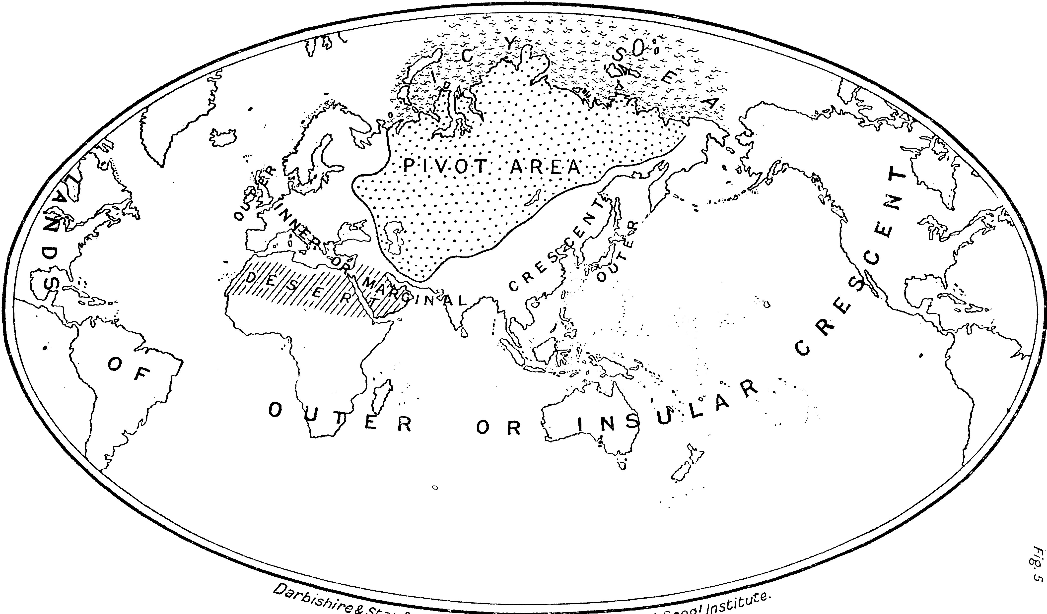
The Geographical Pivot of History
H. J. MacKinder MP, PC
(1861 - 1947)
Ch. Ch. Oxon.
Geographic Journal XXIII
(4),421 (1904)
5
“in the post- Columbian age, we shall again have to deal with a closed political system . . . of worldwide scope. Every explosion of social forces . . . will be sharply re- echoed from the far side of the globe, and weak elements in the political and economic organism of the world will be shattered in consequence.”

Slide 6
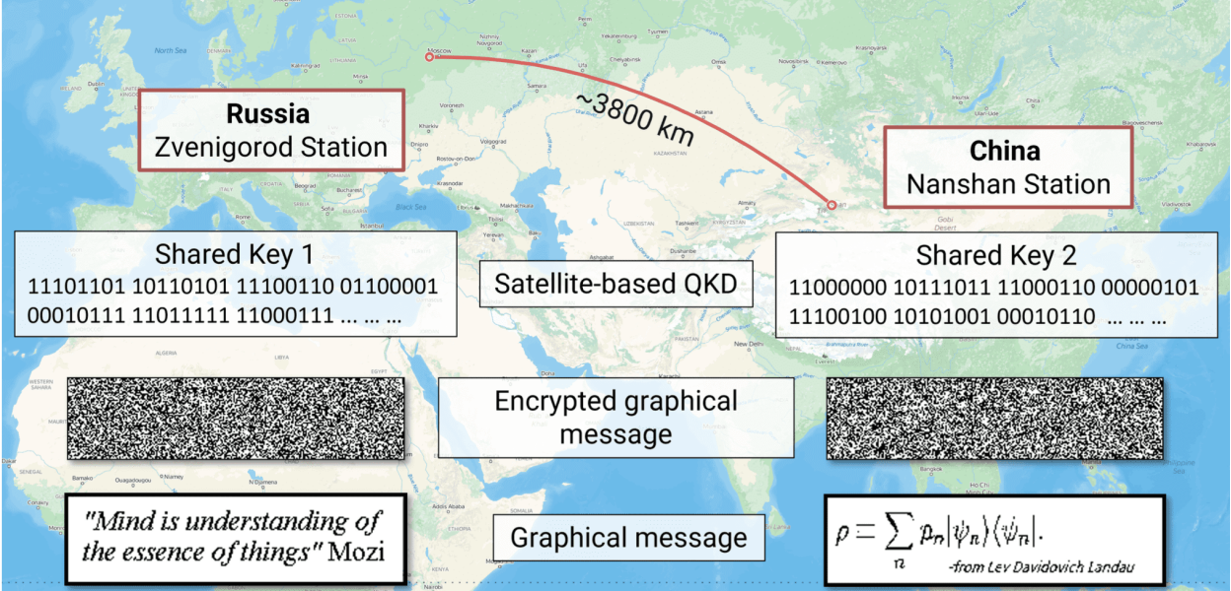
One-time-pad graphical message encryption and decryption between Zvenigorod (Russia) and Nanshan (China) ground stations. Each side used a basic bitwise XOR operation to encrypt/decrypt the image, with shared secret keys of 2 KB.
6

Slide 7
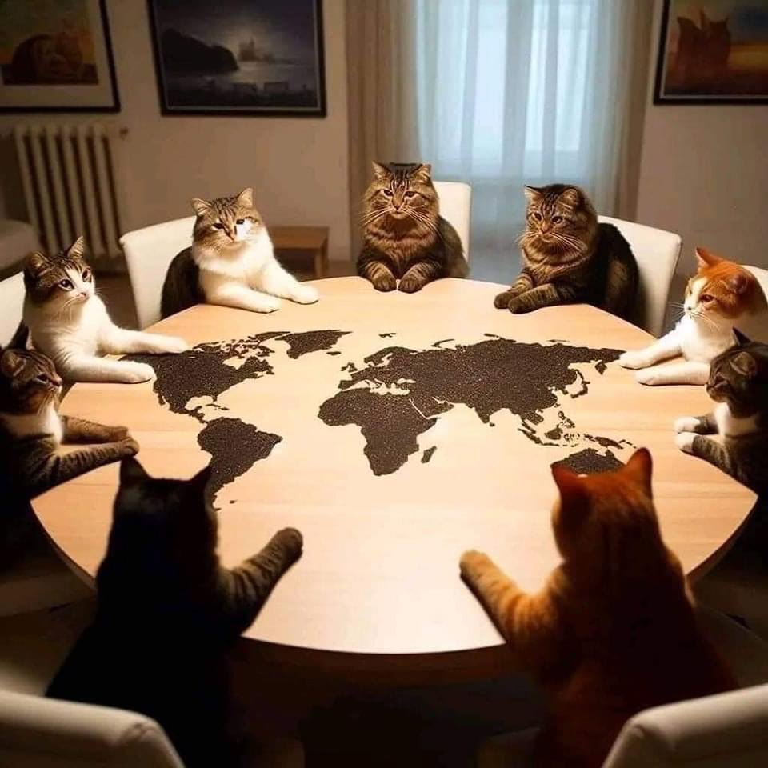
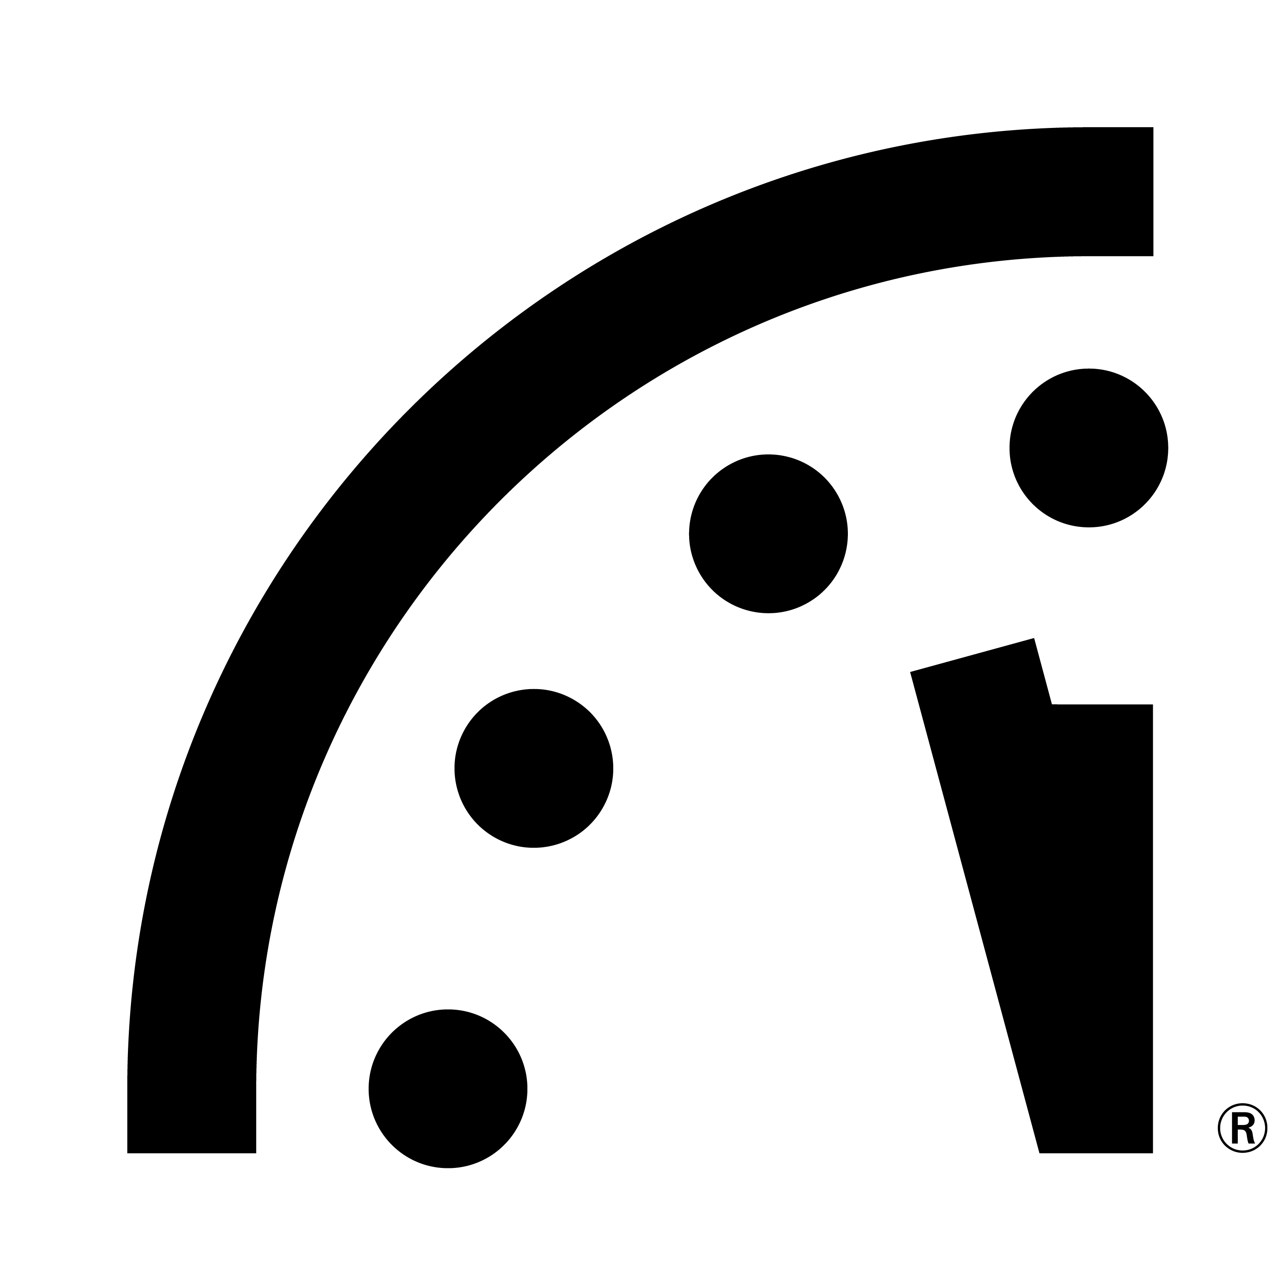
The United Nations Security Council
continues its watch on Eurasia
  Where are we?
  How did we get there?
  Where are we going?
7

Slide 8
Quantum Resistance and the Internet of Things
Charles W. Clark
Joint Quantum Institute, National Institute of Standards and Technology and University of Maryland
Atomtronics 2024, Benasque 22 May 2024
Secure encryption over insecure channels
Public key infrastructure (PKI)
Quantum threat to PKI
Quantum cryptography
Post-quantum encryption
Quantum random numbers
8

Slide 9
Quantum Resistance and the Internet of Things
Charles W. Clark
Joint Quantum Institute, National Institute of Standards and Technology and University of Maryland
Atomtronics 2024, Benasque 22 May 2024
Secure encryption over insecure channels
Public key infrastructure (PKI)
Quantum threat to PKI
Quantum cryptography
Post-quantum encryption
Quantum random numbers
9
9

Slide 10
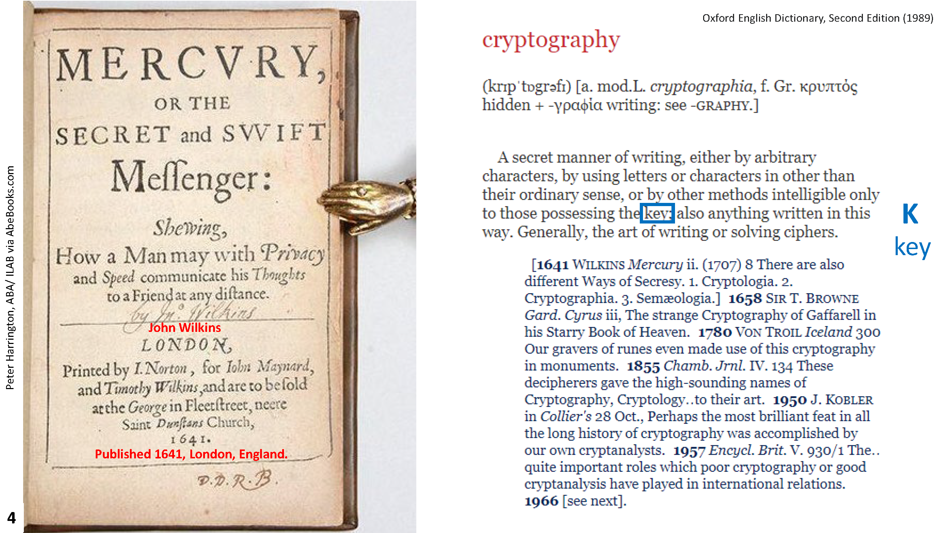
10

Slide 11
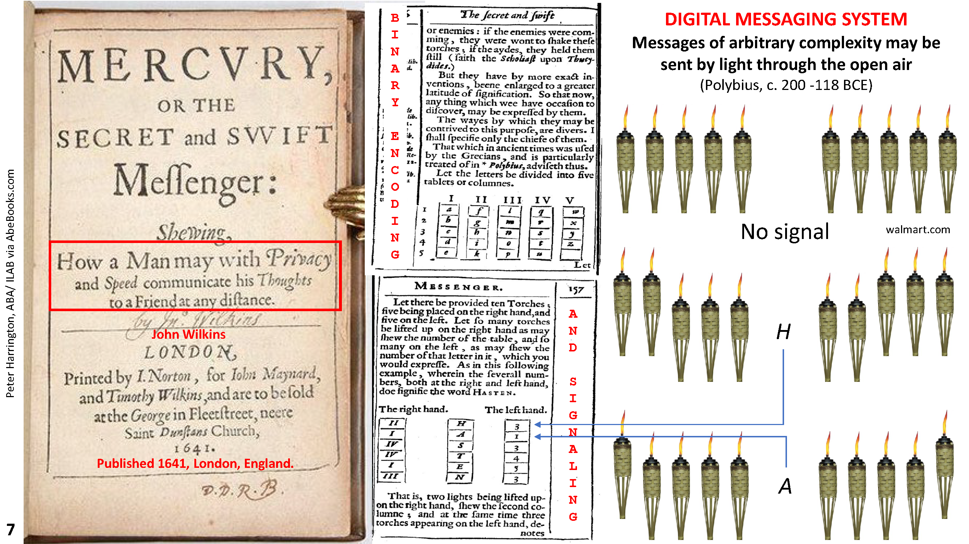
11

Slide 12
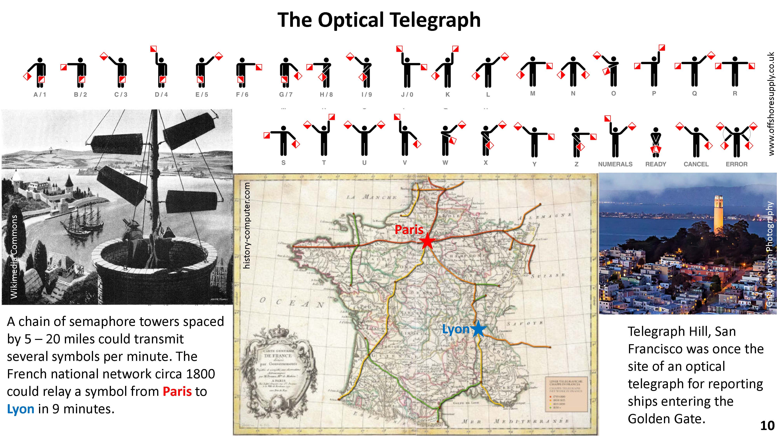
12

Slide 13
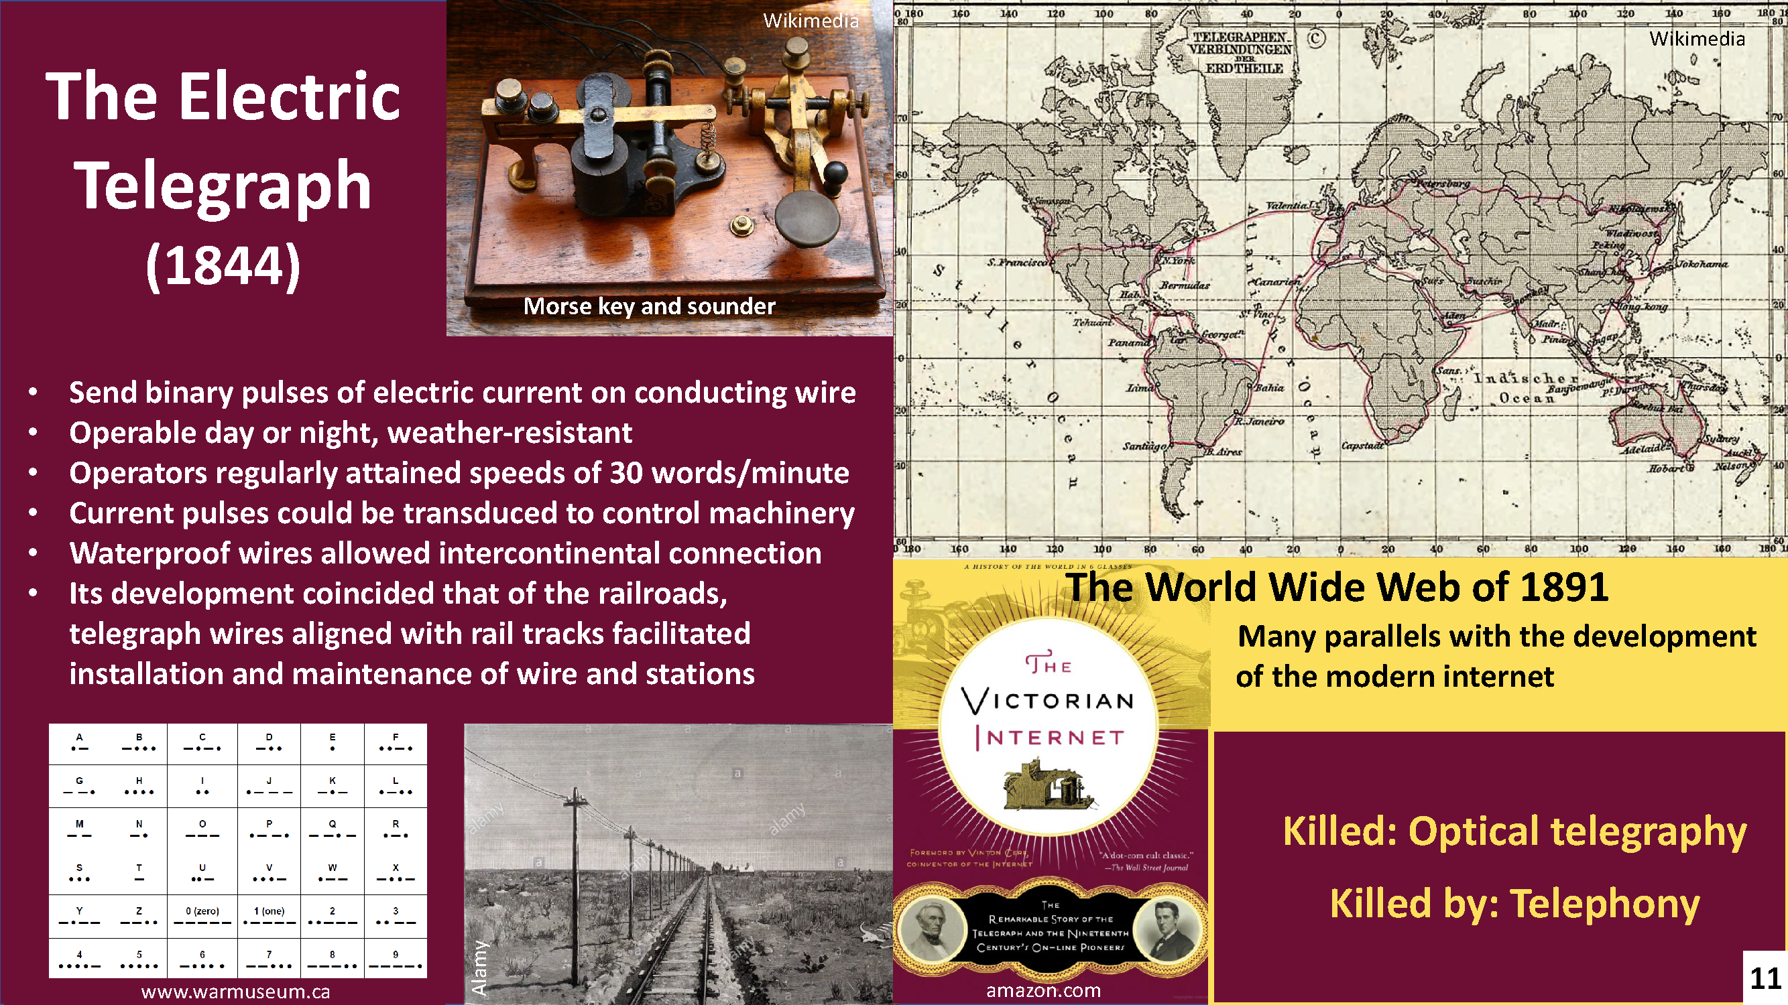
13

Slide 14
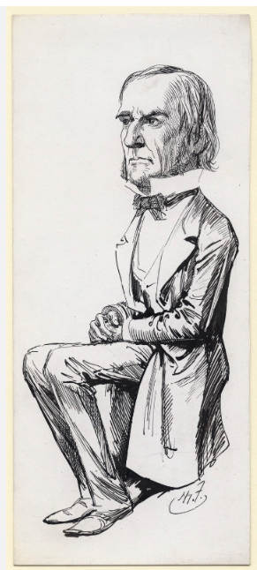
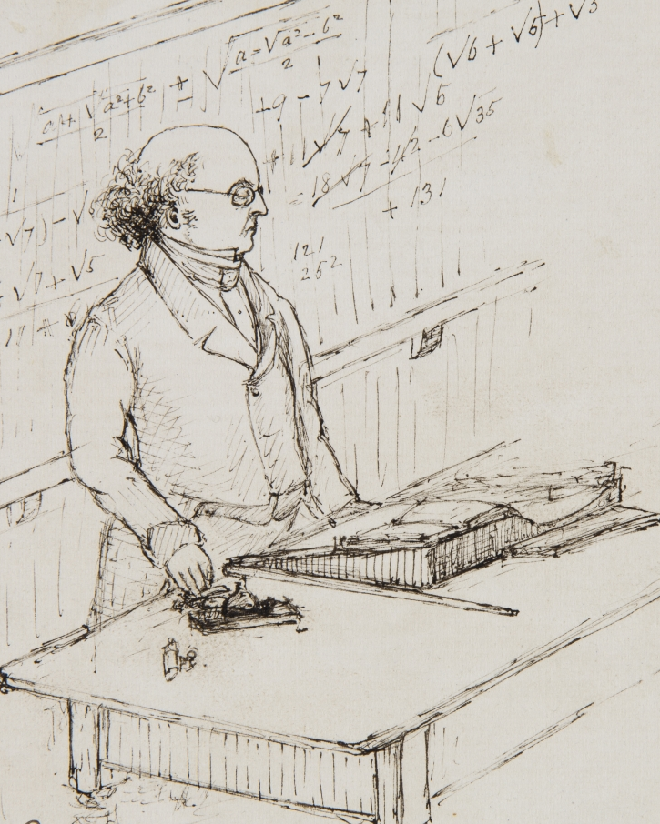
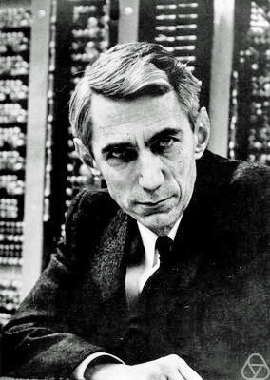
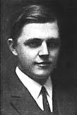
Mathematical Logic
Cryptography
Uncertain provenance
Special Collections, University College London
Konrad Jacobs, Erlangen
National Portrait Gallery, London
Gilbert Vernam
1890–1960
Augustus De Morgan
1806–1871
Claude Shannon
1916–2001
George Boole
1815–1864
The link: Machines
14

Slide 15
Boolean Algebra
Variables A,B take values of 0 or 1
Key binary operations
AND ∧
OR ∨
XOR ⊕
“multiplication”
“addition”
Exclusive OR
National Portrait Gallery, London
A | B | A ∧ B
0 | 0 | 0
0 | 1 | 0
1 | 0 | 0
1 | 1 | 1
A | B | A ∨ B
0 | 0 | 0
0 | 1 | 1
1 | 0 | 1
1 | 1 | 1
A | B | A ⊕ B
0 | 0 | 0
0 | 1 | 1
1 | 0 | 1
1 | 1 | 0
George Boole
1815–1864
Truth Tables
15

Slide 16
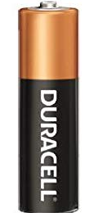
Boolean logic AND implemented with electromechanical switches: A ∧ B
Input setting: switches open (0) or closed(1); output 0 or 1
0
0
0
1
A
B
A
B
LED
LED
A | B | A ∧ B
0 | 0 | 0
0 | 1 | 0
1 | 0 | 0
1 | 1 | 1
1
0
1
1
A
B
A
B
LED
LED
16

Slide 17
Boolean logic OR implemented with electromechanical switches: A ∨ B
Input setting: switches open (0) or closed(1); output 0 or 1
0
0
A
0
A
1
B
B
LED
LED
A | B | A ∨ B
0 | 0 | 0
0 | 1 | 1
1 | 0 | 1
1 | 1 | 1
1
1
A
0
A
1
B
B
LED
LED
17

Slide 18
Boolean XOR (exclusive OR) implemented with electromechanical switches: A ⊕ B
Input setting: switches open (0) or closed(1); output 0 or 1; 0 if alike, 1 if different
?
?
A
B
A
LED
LED
A | B | A ⊕ B
0 | 0 | 0
0 | 1 | 1
1 | 0 | 1
1 | 1 | 0
?
?
A
B
A
B
LED
LED
18

Slide 19
Boolean XOR (exclusive OR) implemented with electromechanical switches: A ⊕ B
Input setting: switches open (0) or closed(1); output 0 or 1; 0 if alike, 1 if different
0
A
0
B
A
0
1
B
LED
LED
A | B | A ⊕ B
0 | 0 | 0
0 | 1 | 1
1 | 0 | 1
1 | 1 | 0
1
0
1
A
B
A
1
B
LED
LED
19

Slide 20
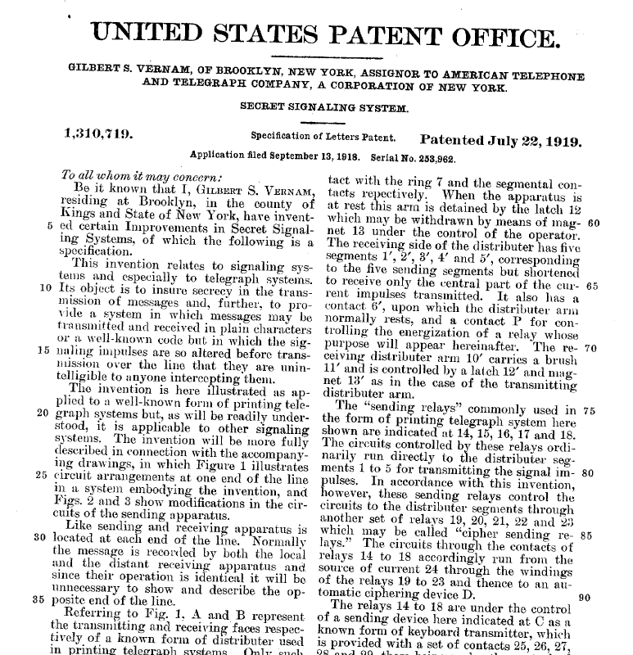
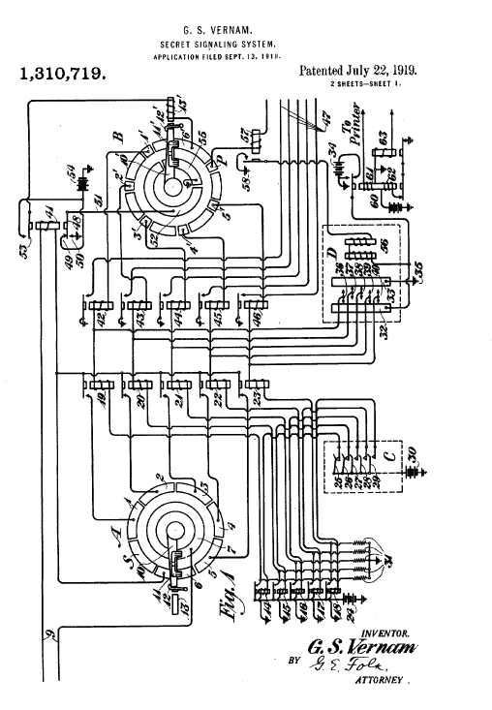
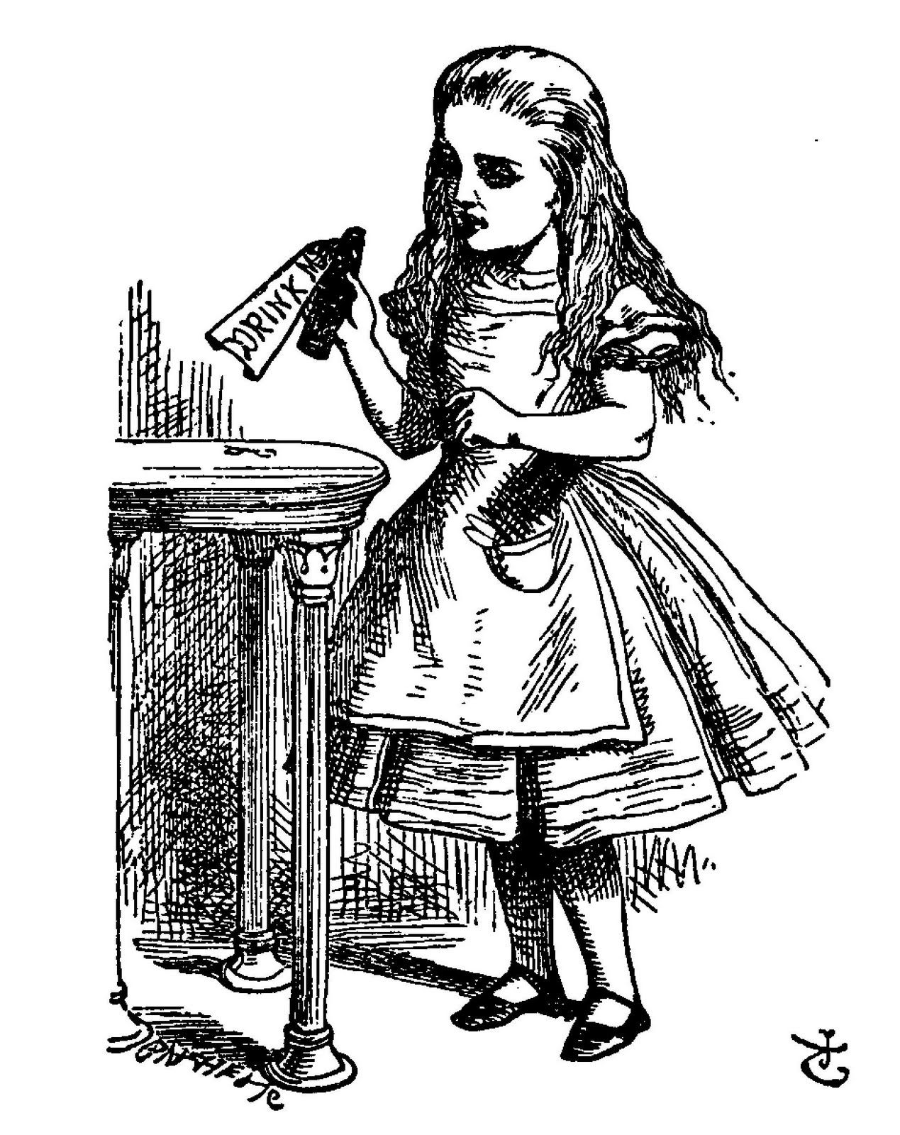

Vernam cipher
Workhorse of quantum cryptography
Plaintext M : Message from Alice to Bob
Key K : Encryption key that is shared secret of Alice and Bob
K
M
1 | 0 | 1 | 0 | 1 | 0 | 0 | 0
K
0 | 0 | 1 | 1 | 1 | 0 | 1 | 0
Alice
K
Bob
K
0 | 0 | 1 | 1 | 1 | 0 | 1 | 0
Gilbert Vernam
1890–1960
20

Slide 21
Vernam cipher
Workhorse of quantum cryptography
Plaintext M : Message from Alice to Bob
Key K : Encryption key that is shared secret of Alice and Bob
Ciphertext C : Encrypted message sent on public channel
K
M
1 | 0 | 1 | 0 | 1 | 0 | 0 | 0
K
0 | 0 | 1 | 1 | 1 | 0 | 1 | 0
Alice
M XOR K = M ⊕ K = C
1 | 0 | 0 | 1 | 0 | 0 | 1 | 0
K
Bob
K
0 | 0 | 1 | 1 | 1 | 0 | 1 | 0
Gilbert Vernam
1890–1960
21

Slide 22
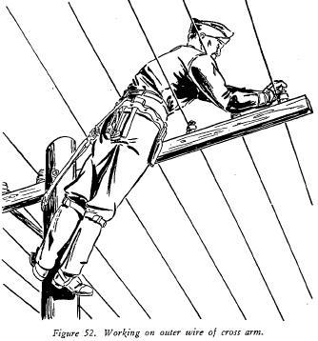
Vernam cipher
Workhorse of quantum cryptography
Plaintext M : Message from Alice to Bob
Key K : Encryption key that is shared secret of Alice and Bob
Ciphertext C : Encrypted message sent on public channel
K
M
1 | 0 | 1 | 0 | 1 | 0 | 0 | 0
K
0 | 0 | 1 | 1 | 1 | 0 | 1 | 0
Alice
M XOR K = M ⊕ K = C
1 | 0 | 0 | 1 | 0 | 0 | 1 | 0
K
Eve
C
1 | 0 | 0 | 1 | 0 | 0 | 1 | 0
Bob
K
0 | 0 | 1 | 1 | 1 | 0 | 1 | 0
Gilbert Vernam
1890–1960
22

Slide 23
Vernam cipher
Workhorse of quantum cryptography
Plaintext M : Message from Alice to Bob
Key K : Encryption key that is shared secret of Alice and Bob
Ciphertext C : Encrypted message sent on public channel
K
M
1 | 0 | 1 | 0 | 1 | 0 | 0 | 0
K
0 | 0 | 1 | 1 | 1 | 0 | 1 | 0
Alice
M XOR K = M ⊕ K = C
1 | 0 | 0 | 1 | 0 | 0 | 1 | 0
K
Eve
C
1 | 0 | 0 | 1 | 0 | 0 | 1 | 0
Bob
K
0 | 0 | 1 | 1 | 1 | 0 | 1 | 0
C ⊕ K = M
1 | 0 | 1 | 0 | 1 | 0 | 0 | 0
Gilbert Vernam
1890–1960
The same K serves to encrypt and decrypt the message via XOR!
23

Slide 24
Vernam cipher
Workhorse of quantum cryptography
Plaintext M : Message from Alice to Bob
Key K : Encryption key that is shared secret of Alice and Bob
Ciphertext C : Encrypted message sent on public channel
K
M
1 | 0 | 1 | 0 | 1 | 0 | 0 | 0
K
0 | 0 | 1 | 1 | 1 | 0 | 1 | 0
Alice
M XOR K = M ⊕ K = C
1 | 0 | 0 | 1 | 0 | 0 | 1 | 0
K
Eve
C
1 | 0 | 0 | 1 | 0 | 0 | 1 | 0
Bob
K
0 | 0 | 1 | 1 | 1 | 0 | 1 | 0
U⊕(V⊕W) = (U⊕V)⊕W =
U⊕V⊕W = V⊕U⊕W
C ⊕ K = M
1 | 0 | 1 | 0 | 1 | 0 | 0 | 0
Gilbert Vernam
1890–1960
Associativity
Commutativity
The same K serves to encrypt and decrypt the message via XOR!
24

Slide 25

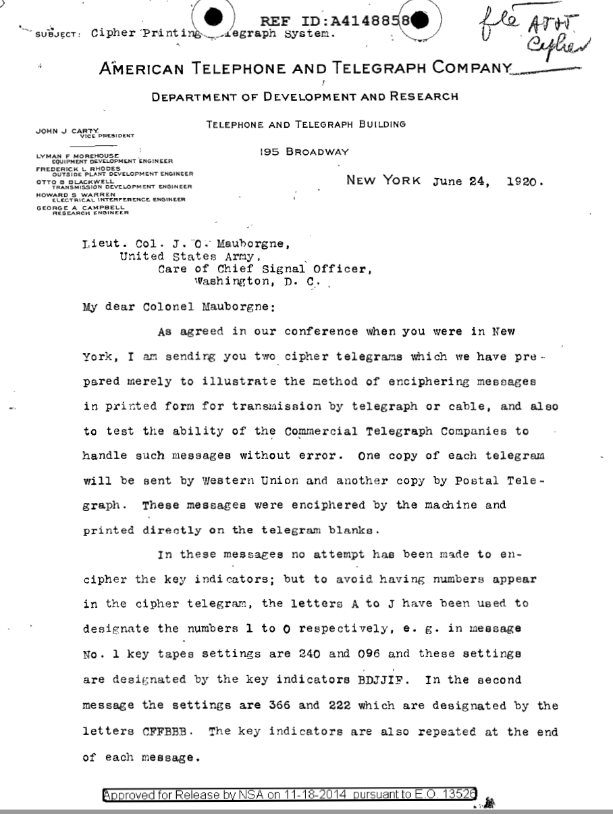
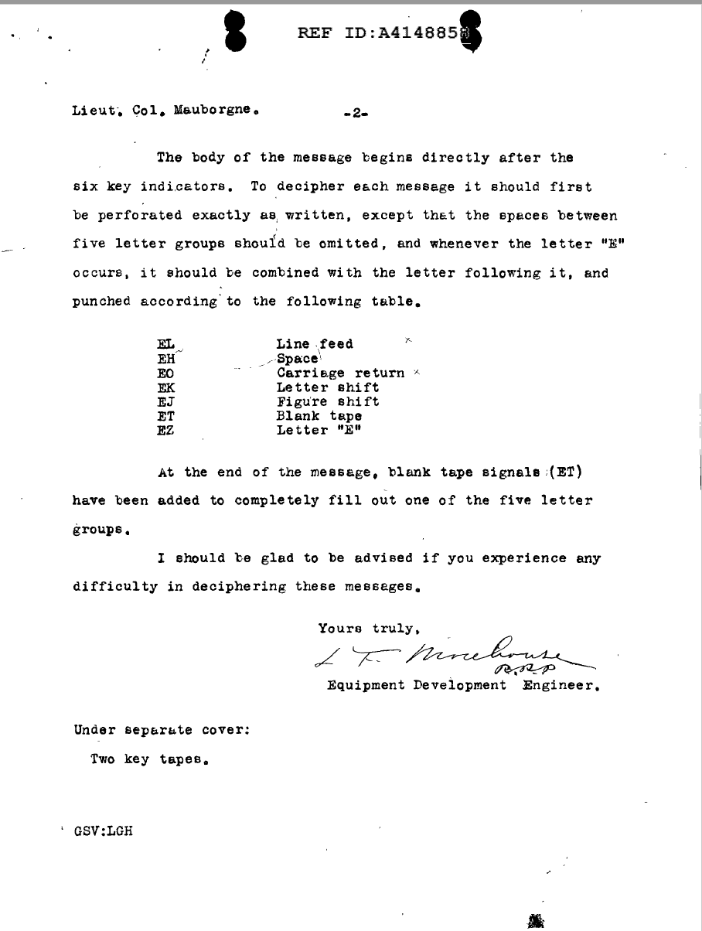
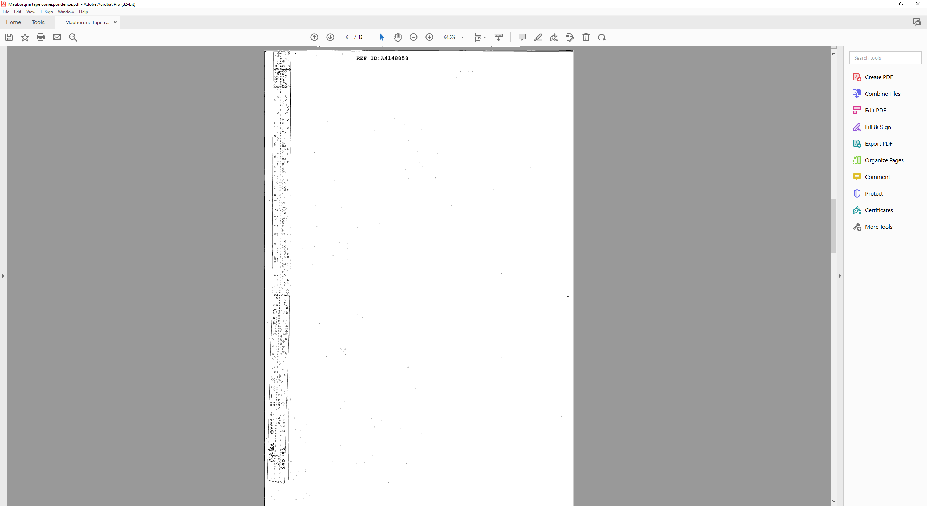

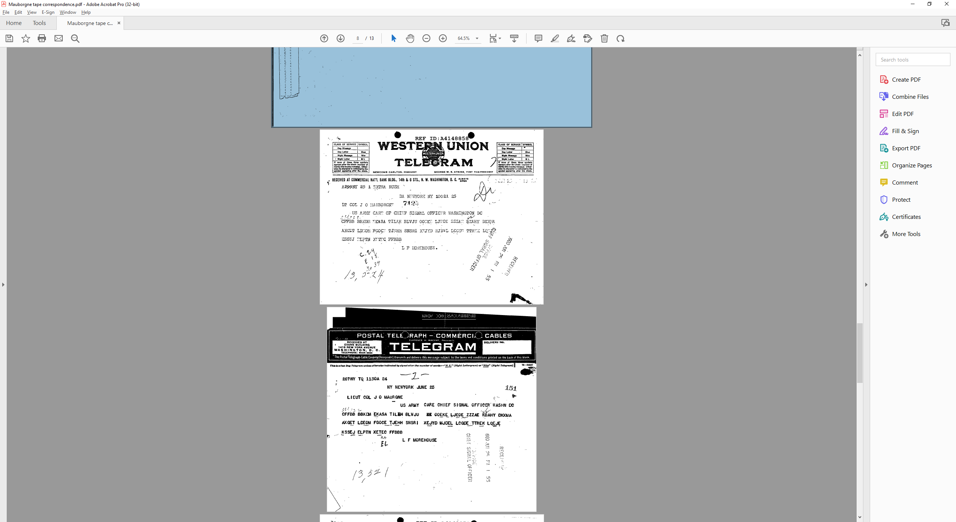
Demonstration of Vernam cipher over the public telegraph system
25

Slide 26
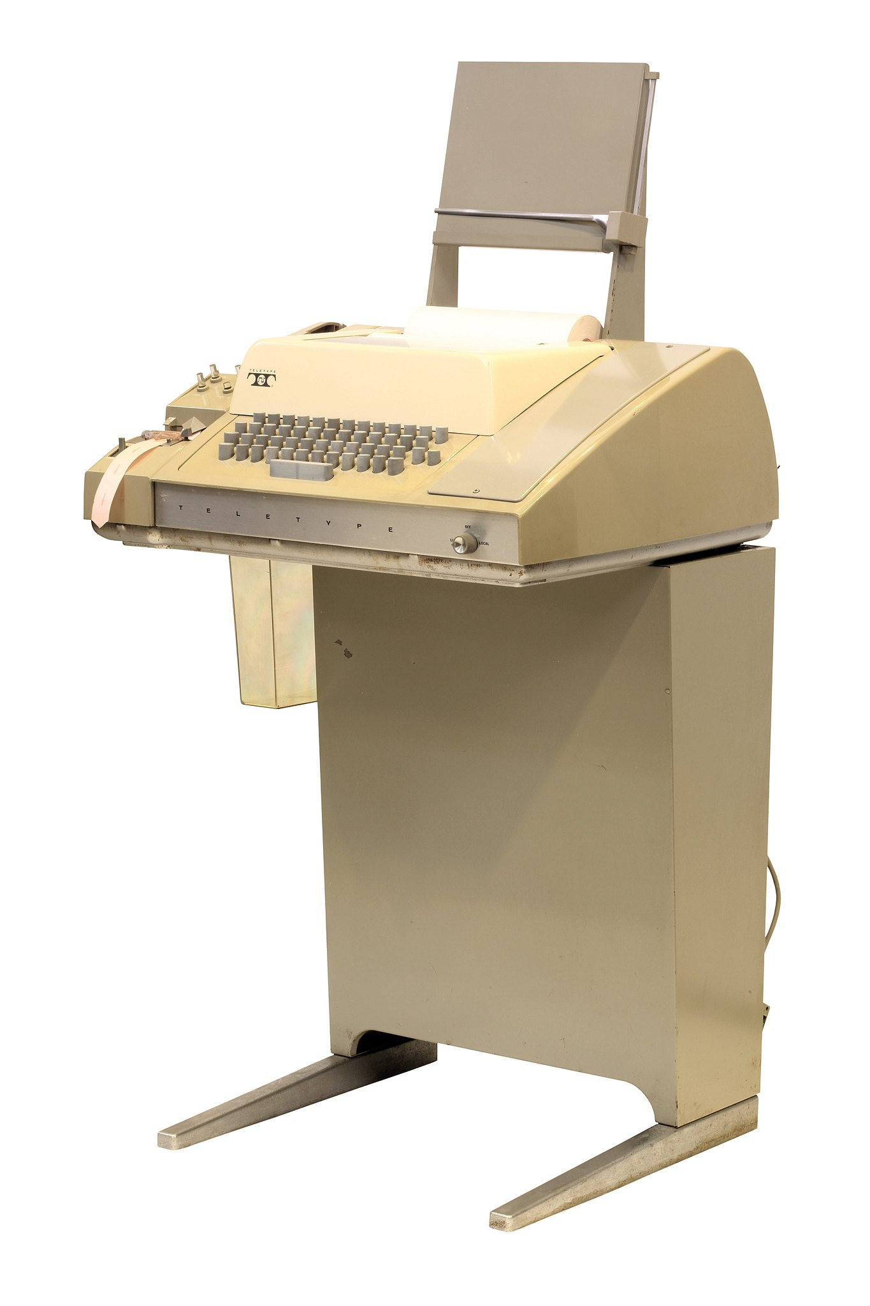
Demonstration of Vernam cipher over the public telegraph system
Wikimedia
National Security Agency
Teletype
Model 33
J. O. Mauborgne
Jacquard loom (1804), Calahan stock ticker (1867), Hollerith punched cards (1884)
National Security Agency
26

Slide 27
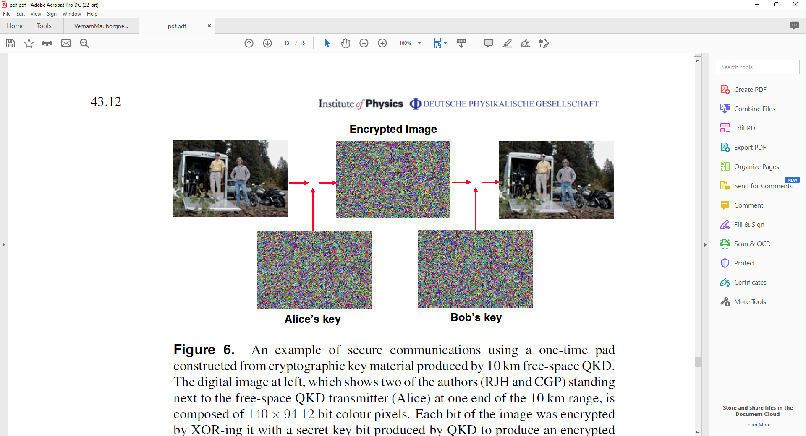
Example: Vernam encryption/decryption of an image
Data from “Practical free-space quantum key distribution over 10 km in daylight and at night,” R. J. Hughes, J. E. Nordholt, D. Derkacs, C. G. Peterson, New J. Phys. 4, 43 (2002). The message M is a 12-bit color digital image of 140 × 94 pixels. K was generated by quantum cryptography. The cyphertext C was transmitted by Alice to Bob by free-space optical telegraphy.
M
K
M ⊕ K = C
M ⊕ K = C
K
Eve
K
K
C
Alice
Bob
C ⊕ K = M
Exercise. Show that for any given image M and given cyphertext C, there is a K for which C ⊕ K = M.
An implication of this is that Eve can record any public C, and then produce a key K that yields an M of her choice.
27

Slide 28
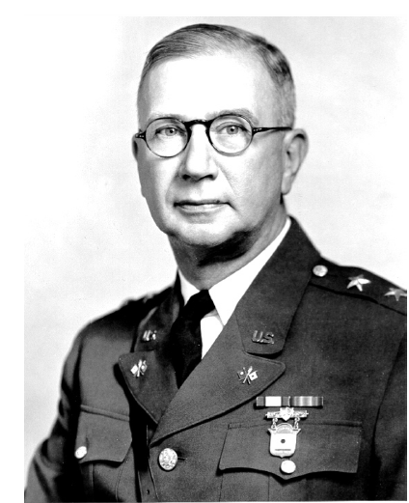
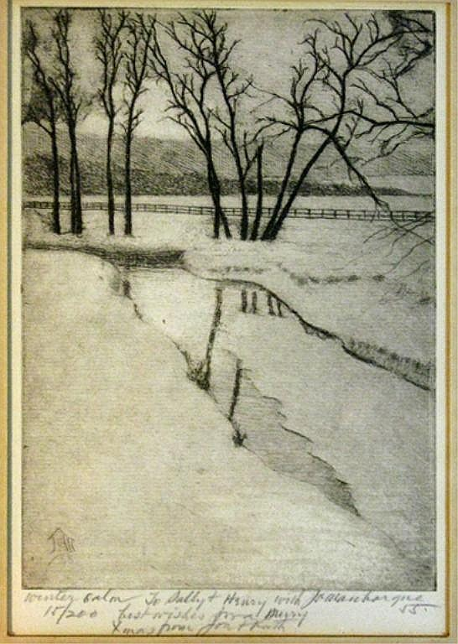
Outline
“Vernam had invented the unbreakable cipher: “one-time tape” (OTT) for on-line TTY encryption. In 1919 he was granted a patent, perhaps one of the most important in the history of cryptography.”
Securing Record Communications: The TSEC/KW-26
Melville Klein, National Security Agency
invaluable.com
Joseph O. Mauborgne
1881–1971
Claude Shannon
1916–2001
Chief, Army Signal Corps
Trained at Corcoran Gallery and Art Institute of Chicago
Winter (etching)
J. O. Mauborgne 1947
Mauborgne conjectured that Vernam encryption with a random key K would be unbreakable.
28

Slide 29
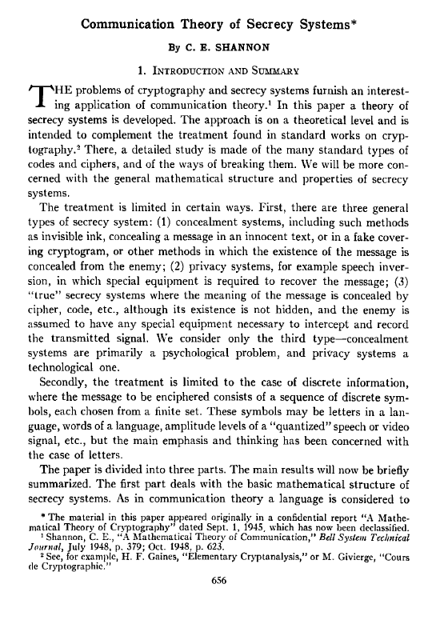
Bell System Tech. J. 28, 656 (1949)
Vernam cipher
Workhorse of quantum cryptography
The Vernam cipher is secure if:
The digits of K are truly random
K must have at least as many digits as M
No part of K may ever be reused
K must remain secret to Alice and Bob
Plaintext M : Message from Alice to Bob
Key K : Encryption key that is shared secret of Alice and Bob
Ciphertext C : Encrypted message sent on public channel
K
M
1 | 0 | 1 | 0 | 1 | 0 | 0 | 0
K
0 | 0 | 1 | 1 | 1 | 0 | 1 | 0
Alice
M XOR K = M ⊕ K = C
1 | 0 | 0 | 1 | 0 | 0 | 1 | 0
K
Eve
C
1 | 0 | 0 | 1 | 0 | 0 | 1 | 0
Bob
K
0 | 0 | 1 | 1 | 1 | 0 | 1 | 0
C ⊕ K = M
1 | 0 | 1 | 0 | 1 | 0 | 0 | 0
Claude Shannon
1916–2001
The same K serves to encrypt and decrypt the message via XOR!
29

Slide 30
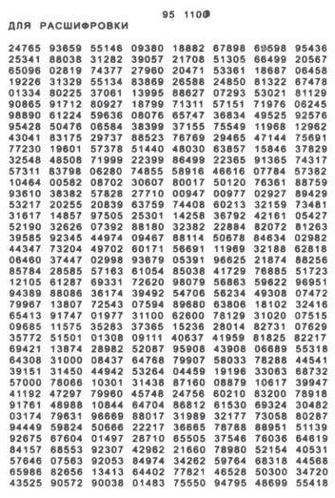
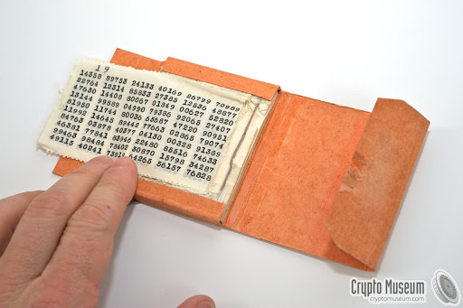
Bell System Tech. J. 28, 656 (1949)
The One-Time Pad
The Vernam cipher is secure if:
The digits of K are truly random
K must have at least as many digits as M
No part of K may ever be reused
K must remain secret to Alice and Bob
Alice and Bob have identical copies of key K.
Number groups of K are used sequentially, once, and discarded.
Example starting with first row of K. Alice’s plaintext M: a c e
Alphabetic position 1 3 5
27465 93659 55146
+ 1 3 5
= 27466 93662 55151
which is the ciphertext C.
Bob calculates C - K :
27466 93662 55151
- 27465 93659 55146 = 1 3 5
a c e
cryptomuseum.com
Claude Shannon
1916–2001
30

Slide 31
Bell System Tech. J. 28, 656 (1949)
What could possibly go wrong?
The Vernam cipher is secure if:
The digits of K are truly random
K must have at least as many digits as M
No part of K may ever be reused
K must remain secret to Alice and Bob
Cryptographers require large number of pairs of unique one-time pads (OTPs).
Problems of secure production, distribution and custody.
Printer of Soviet OTPs made production mistake, repeated keys. Compromised OTPs used for radio transmissions from Washington, DC embassy during 1943-1945. Analyzed by NSA cryptanalysts
cryptomuseum.com
Claude Shannon
1916–2001
for nearly 40 years (the Venona project). Final
report, published 1995, revealed details of Soviet espionage.
31

Slide 32
Killed: Optical telegraphy
Killed by: Telephony, radio
32

Slide 33
Killed: Optical telegraphy
Killed by: Telephony, radio
Resurrected by atomic, molecular, optical and electronic technology
Killed: Optical telegraphy
Killed by: Telephony, radio
Resurrected by atomic, molecular, optical and semiconductor physics
33
33

Slide 34
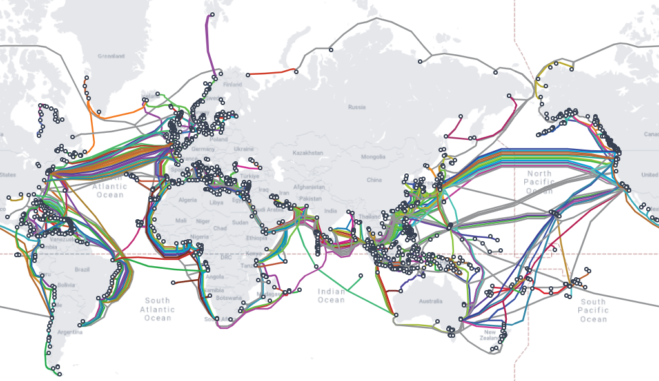
The Earth’s undersea fiber-optical communication network
Image: TeleGeography
1.4 million km of submarine fiber channels worldwide
34

Slide 35
Quantum Resistance and the Internet of Things
Charles W. Clark
Joint Quantum Institute, National Institute of Standards and Technology and University of Maryland
Atomtronics 2024, Benasque 22 May 2024
Secure encryption over insecure channels
Public key infrastructure (PKI)
Quantum threat to PKI
Quantum cryptography
Post-quantum encryption
Quantum random numbers
35

Slide 36
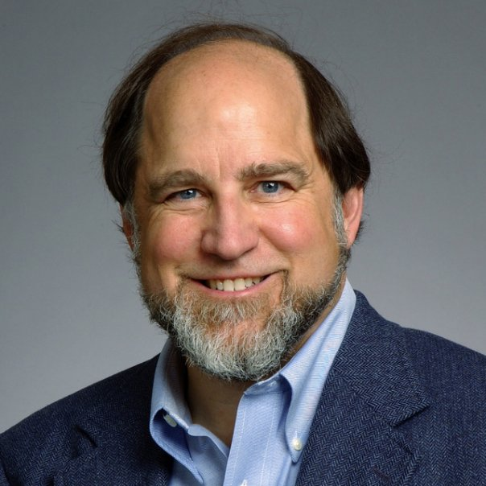
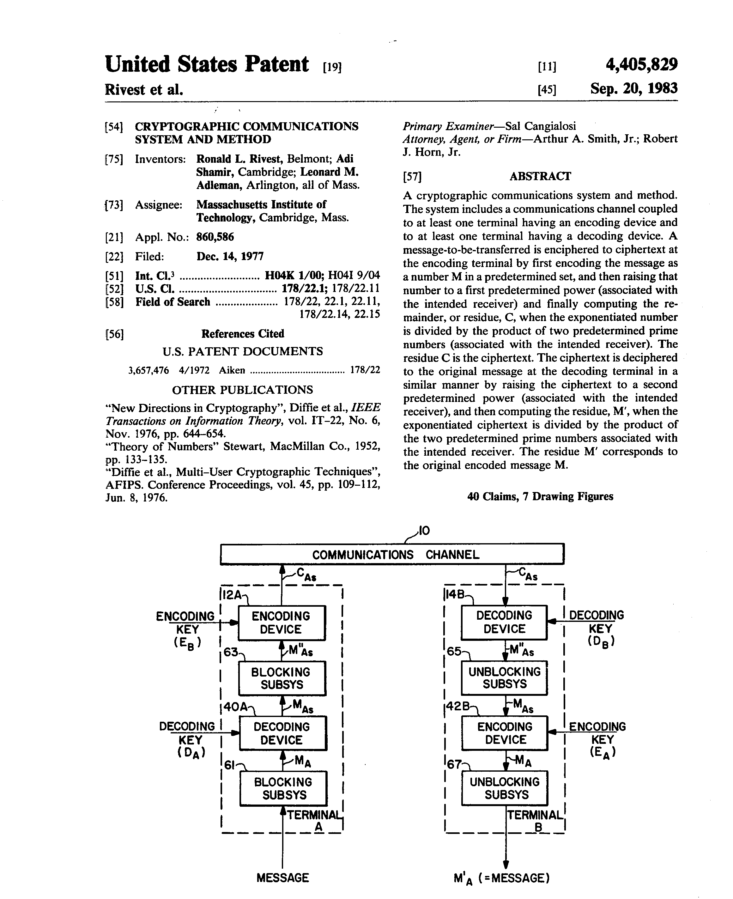
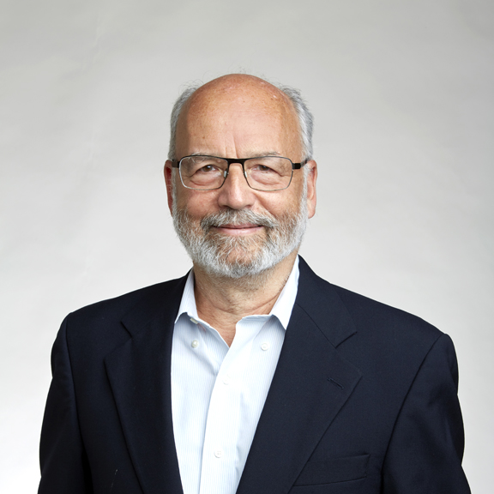
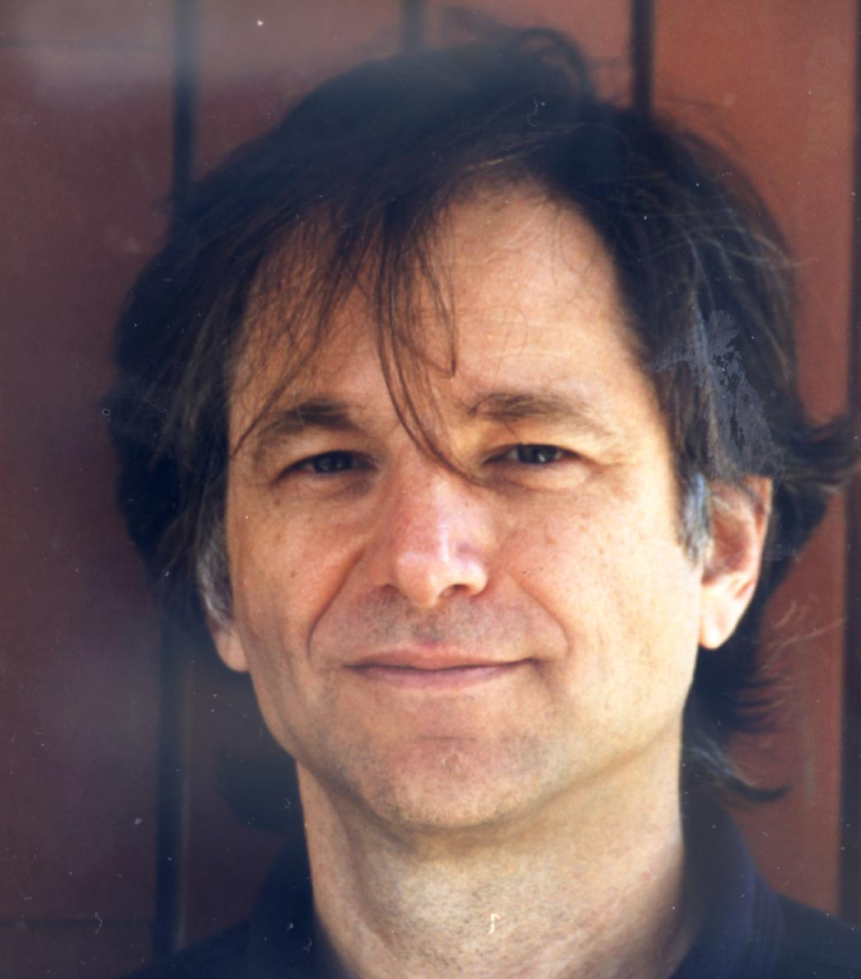
Awesome Privacy
Pseudo-randomness via algorithmic complexity
Rivest-Shamir-Adleman (RSA) encryption
Ronald L. Rivest
Now the basis of Internet public-key infrastructure (PKI)
Encryption key is public
Decryption key is private
Difficulty of breaking RSA encryption is the same as finding the prime factors of a large number.
Adi Shamir
100 = 10 × 10 = 2 × 2 × 5 × 5
101 = 101
102 = 2 × 51 = 2 × 3 × 17
103 = 103
104 = 2 × 52 = 2 × 2 × 2 × 13
Ronald L. Rivest - Own work, CC BY-SA 4.0
Leonard M. Adleman
Adi Shamir, Credit: The Royal Society
36
Leonard M. Adleman, CC BY-SA 3.0

Slide 37
Discrete Logarithm Problem
It’s hard to solve for m in the modular arithmetic equation for integers
Ronald L. Rivest
(m^{e})^{d} = m (mod n)
m is the integer message
n, e are integers that determine the public encryption key, a large integer. e.g. 1024 digits long
d is the integer private decryption key
Bob and Alice share their public encryption keys and keep private their decryption keys.
Adi Shamir
Ronald L. Rivest - Own work, CC BY-SA 4.0
Leonard M. Adleman
Adi Shamir, Credit: The Royal Society
37
Leonard M. Adleman, CC BY-SA 3.0

Slide 38
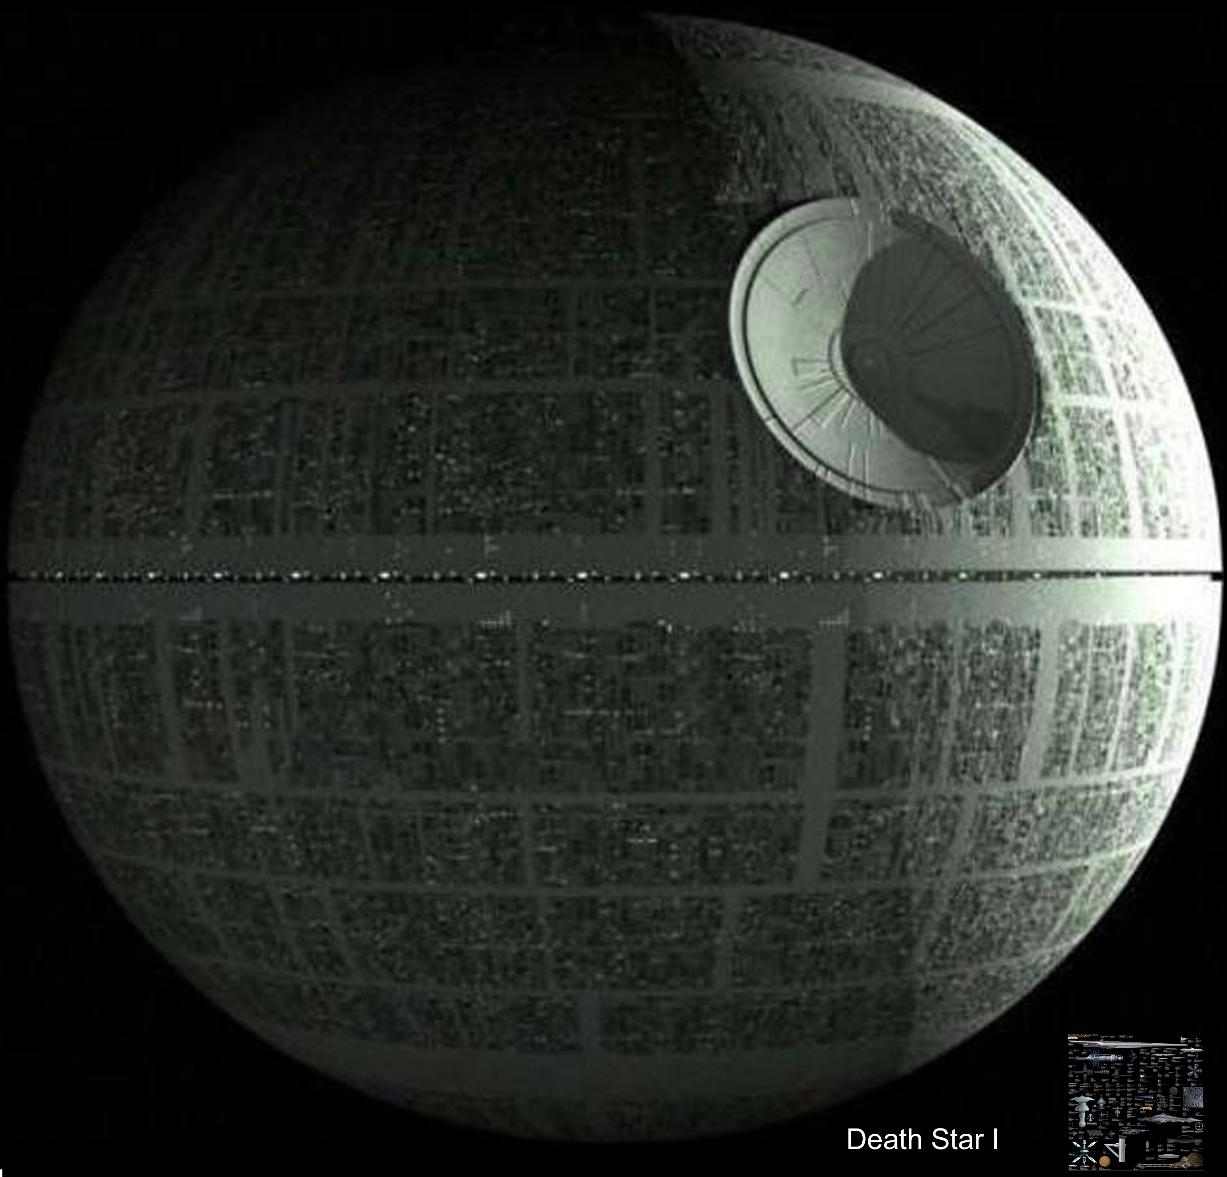
Now witness the firepower of this fully armed and operational Death Star
How many computations, C (N), are required to find the prime factors of a number, N ?
102 = 2 × 51 = 2 × 3 × 17
103 = 103
104 = 2 × 52 = 2 × 2 × 2 × 13
www.wallpapername.com
Brute force search: C (N) ∼ N ^{1/2}
Best proven result: C (N) ∼ N ^{1/3}
This doesn’t sound so bad. But think of it in terms of the number, n , of bits in the binary representation of N.
C (N) ∼ 2 ^{n/3}
The cryptologist has a permanent advantage over the cryptanalyst. Attack is futile.
Asymmetric warfare
If the world’s most powerful computer can just break n-bit RSA, add 30 bits to make it 1000 times harder!
As of 15 May 2024, the largest publicly known factored RSA number was 829 bits (250 decimal digits, RSA-250). Published 1991, factored 2020.
38

Slide 39
Quantum Resistance and the Internet of Things
Charles W. Clark
Joint Quantum Institute, National Institute of Standards and Technology and University of Maryland
Atomtronics 2024, Benasque 22 May 2024
Secure encryption over insecure channels
Public key infrastructure (PKI)
Quantum threat to PKI
Quantum cryptography
Post-quantum encryption
Quantum random numbers
39

Slide 40
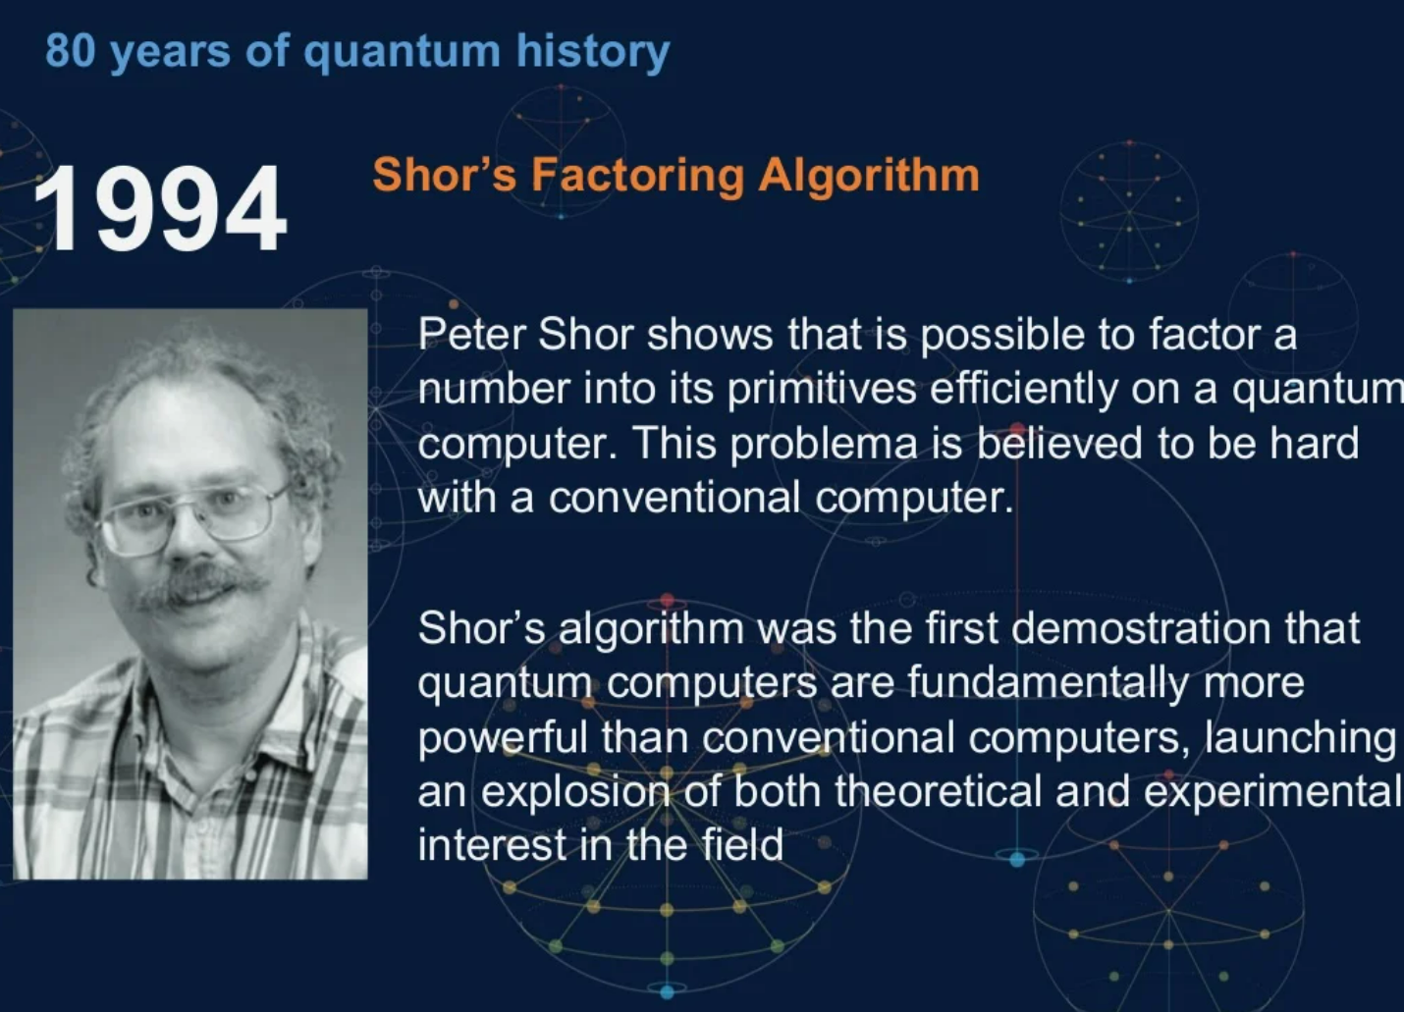
IBM | CWC
All classical methods known to find prime factors of an integer N have a cost that grows exponentially with the number of digits of N.
The difficulty of cracking Rivest-Shamir-Adleman public key cryptography is the same as that of finding prime factors of an integer. NIST now recommends use of 2048-bit cryptographic keys.
40

Slide 41
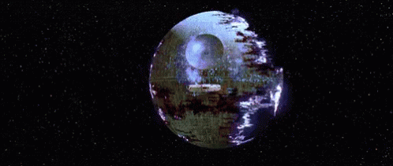
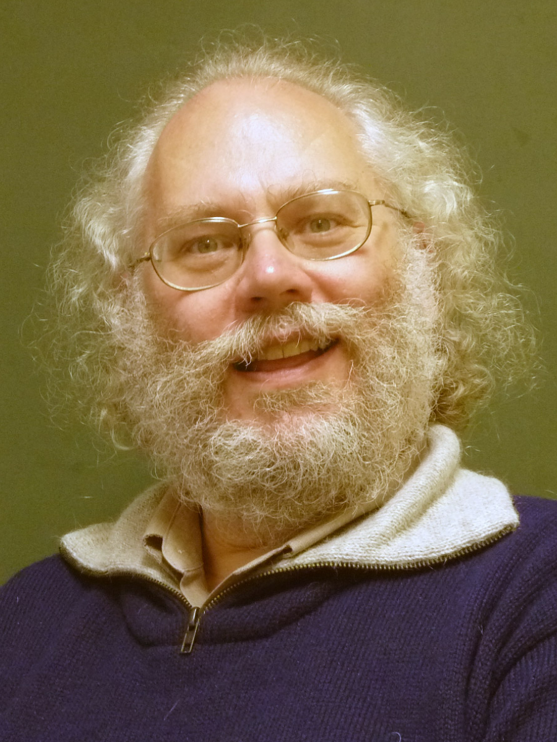
Now witness the firepower of this fully armed and operational Death Star
Factoring a 2048-bit integer (cracking RSA)
tenor.com
Quantum:
5 * 10¹¹ operations
with ≈ 4000 qubits
quantum memory
24 hrs with
10-million-qubit memory
using a 10Mhz processor
with 1 in 100000 error
Source: Digicert
The cryptologist has a permanent advantage over the cryptanalyst. Attack is futile.
Gheorghiu & Mosca 2019
Peter W. Shor
National Academy of Engineering
41
41

Slide 42
Quantum Resistance and the Internet of Things
Charles W. Clark
Joint Quantum Institute, National Institute of Standards and Technology and University of Maryland
Atomtronics 2024, Benasque 22 May 2024
Secure encryption over insecure channels
Public key infrastructure (PKI)
Quantum threat to PKI
Quantum cryptography
Post-quantum encryption
Quantum random numbers
42

Slide 43
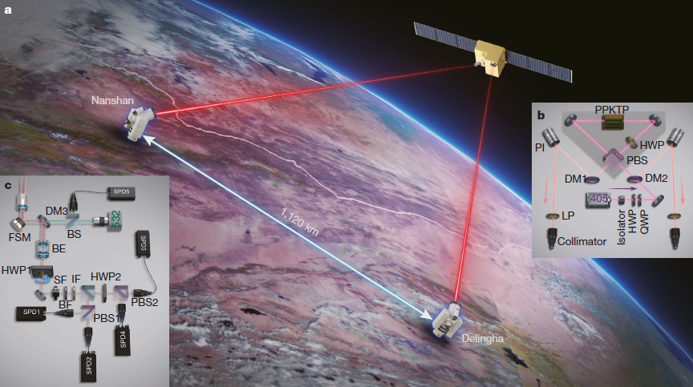
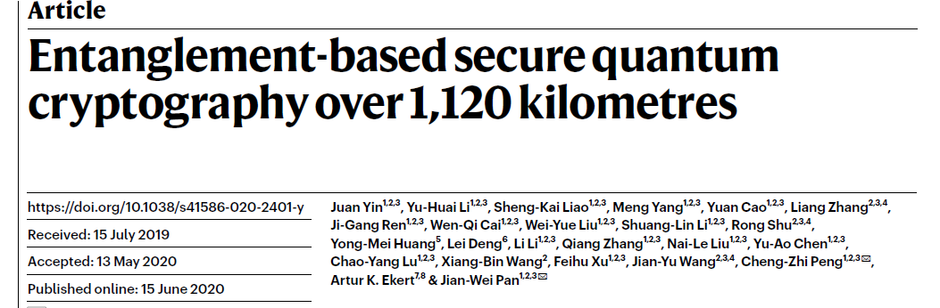
MISC 302: Introduction to Military Training Management
Morgan State University, 13 April 2021
Learning outcomes
June 2020
Published report of quantum cryptography conducted over free-space optical (FSO) link between two network nodes (ground stations) in Delingha and Nanshan, People’s Republic of China.
Entangled photon pairs are produced aboard a satellite orbiting at 500 km altitude. One photon of each pair is sent to Delingha, the other to Nanshan.
The two ground stations play the role of Alice and Bob in the BBM92 cryptographic protocol. Using their photons, Alice and Bob create a shared secret key, K, that can be used for secure communication between them on a public channel.
Nature 582 , 501 (25 June 2020)
copy in http://j.mp/MSU_ROTC
43

Slide 44
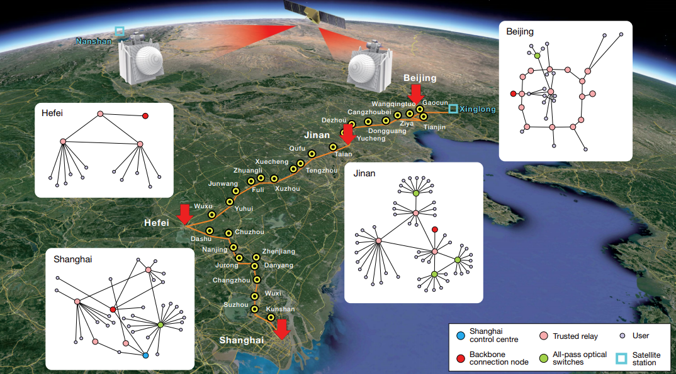
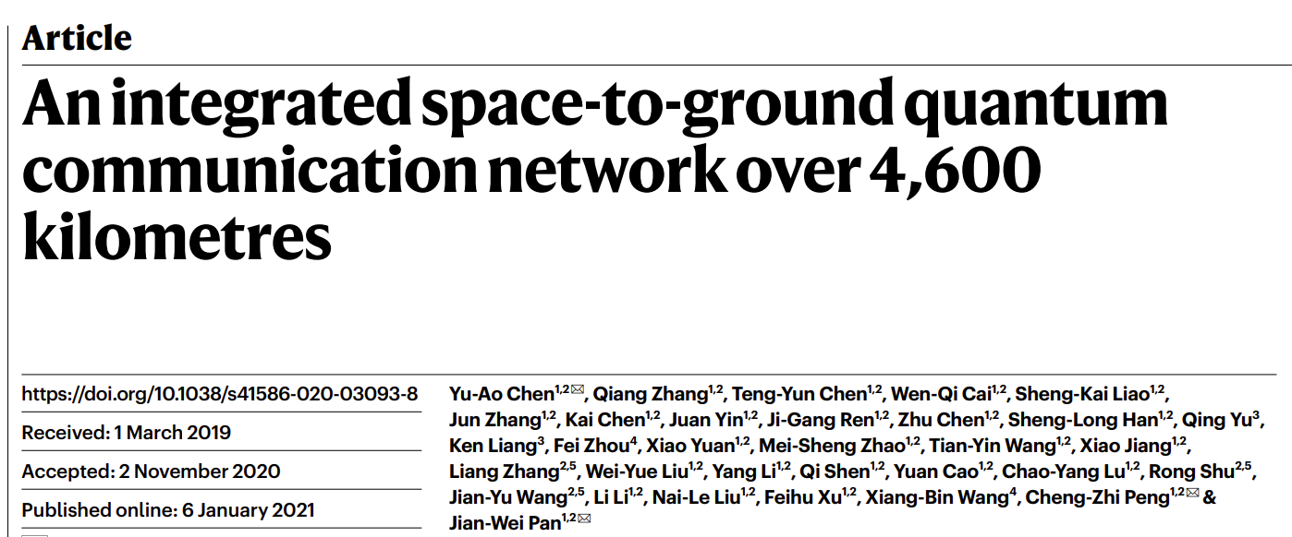

MISC 302: Introduction to Military Training Management
Morgan State University, 13 April 2021
January 2021
Published report of 4,600 km quantum communication network connecting Beijing and Shanghai, PRC.
These two reports come from a large team headed by Prof. Jian-Wei Pan. They are the most complex and technologically advanced implementations of quantum networking and demonstrate a long-term, national commitment to advancing that field.
Nature 589 , 214 (14 January 2021)
copy in http://j.mp/MSU_ROTC
Broadcast of National People's Congress in Beijing on 5 March 2021, announcing quantum technology in PRC’s 14th Five Year Plan.
The US Government has a parallel National Quantum Initiative.
Qilai Shen/Bloomberg/Getty
44

Slide 45
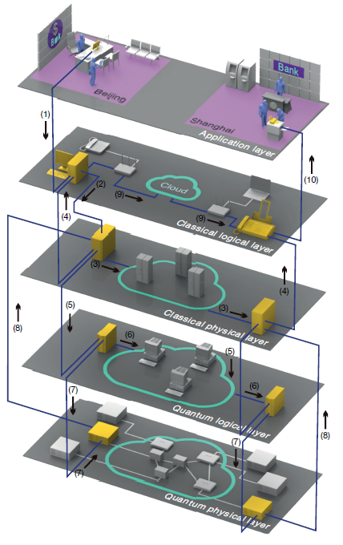
Application layer
Classical logical layer
Classical physical layer
Pan 2021
Quantum logical layer
Nature 589 , 214 (14 January 2021)
copy in http://j.mp/MSU_ROTC
Quantum physical layer
A large network provides an engineering testbed for complex hybrid quantum/classical networks, and a training platform for skilled personnel.
45

Slide 46
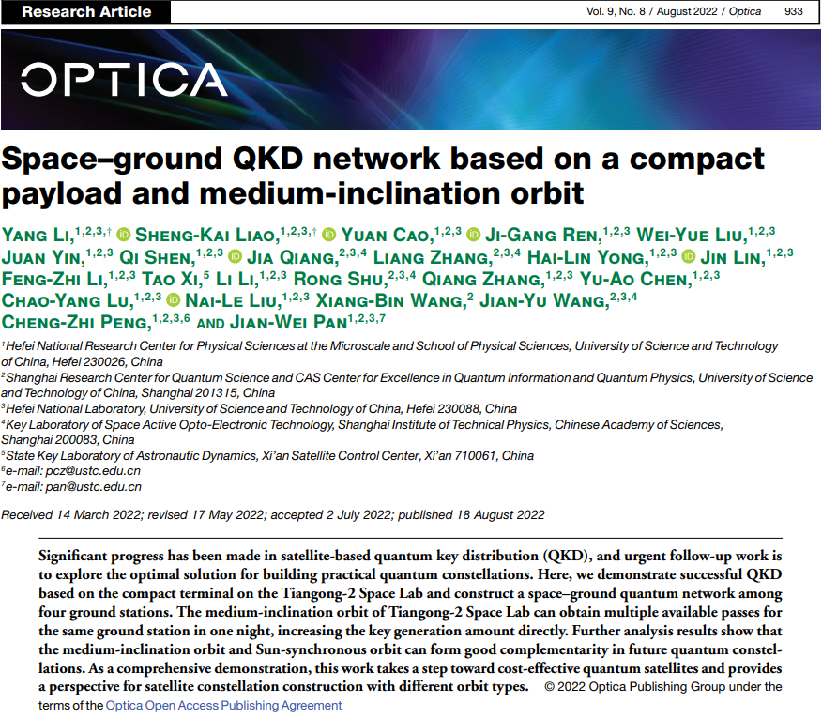
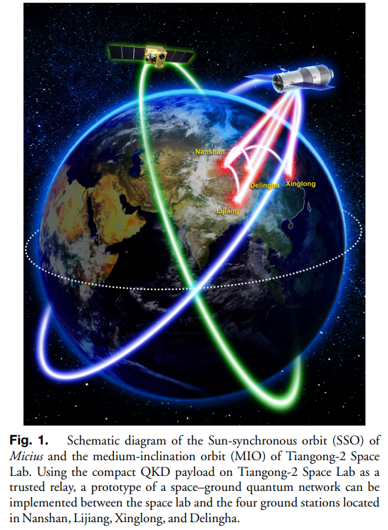

Time For Action: We Must Fail Before We Can Succeed
Logan Scott, Inside GNSS, August 2, 2022
The Chinese have an experimentalist’s approach to engineering. In the early days of BeiDou (ca. 1999), the system comprised of two aging comms grade bent-pipe transponders in GEO with orbital station keeping so bad it could have been a feature of the system.
In the intervening years, the Chinese have assembled a superb and diverse national PNT architecture, often using inferior parts. Got bad clocks? Add in a crosslink. Oh, and that’s a whole new set of capabilities. The Chinese deploy loosely integrated but diverse systems and leave it up to the user community to figure out how best to use the tools in the toolbox. This is missing in our current policy.”
“There is a common misconception that spending money and following processes is the same thing as making progress. Endless streams of studies, recommendations and PowerPoint presentations are often mistaken as being the end product . . . In the current environment, GPS would [only] be a slide deck with well over 1,200 slides, maybe more . . .
August, 2022
”Well, Benny, now that we know the thing can fly, all we have to do is improve its range a bit.” - Simon Ramo, founder of TRW, after watching a Vanguard rocket rise about 6 inches off the launch pad before toppling over and exploding spectacularly.
46

Slide 47

Time For Action: We Must Fail Before We Can Succeed
Logan Scott, Inside GNSS, August 2, 2022
The Chinese have an experimentalist’s approach to engineering. In the early days of BeiDou (ca. 1999), the system comprised of two aging comms grade bent-pipe transponders in GEO with orbital station keeping so bad it could have been a feature of the system.
In the intervening years, the Chinese have assembled a superb and diverse national PNT architecture, often using inferior parts. Got bad clocks? Add in a crosslink. Oh, and that’s a whole new set of capabilities. The Chinese deploy loosely integrated but diverse systems and leave it up to the user community to figure out how best to use the tools in the toolbox. This is missing in our current policy.”
September 6, 2022
“There is a common misconception that spending money and following processes is the same thing as making progress. Endless streams of studies, recommendations and PowerPoint presentations are often mistaken as being the end product . . . In the current environment, GPS would [only] be a slide deck with well over 1,200 slides, maybe more . . .
They all said I’d never make it as a comedian.
Well, nobody’s laughing now!
”Well, Benny, now that we know the thing can fly, all we have to do is improve its range a bit.” - Simon Ramo, founder of TRW, after watching a Vanguard rocket rise about 6 inches off the launch pad before toppling over and exploding spectacularly.
They
47

Slide 48
Create one-time pad on demand using public classical and quantum telecommunication channels.
The digits of K are truly random
K must have at least as many digits as M
No part of K may ever be reused
K must remain secret to Alice and Bob
Quantum cryptography is classical Vernam cryptography using a quantum-generated OTP key
K
0 | 0 | 1 | 1 | 1 | 0 | 1 | 0
Alice and Bob perform independent
measurements on quantum states that lead to the generation of a common random bit stream K.
Alice
Q
Eve
K
0 | 0 | 1 | 1 | 1 | 0 | 1 | 0
Bob
48

Slide 49
Quantum Resistance and the Internet of Things
Charles W. Clark
Joint Quantum Institute, National Institute of Standards and Technology and University of Maryland
Atomtronics 2024, Benasque 22 May 2024
Secure encryption over insecure channels
Public key infrastructure (PKI)
Quantum threat to PKI
Quantum cryptography
Post-quantum encryption
Quantum random numbers
49

Slide 50

The National Security Agency generally deprecates QKD as a practical security measure
50

Slide 51

The National Security Agency has released a suite of
quantum-resistant (QR) algorithms
These QR algorithms are not known to be susceptible to quantum attack.
Nor are they known to be unsusceptible to quantum attack.
U/OO/194427-22 | PP-22-1338 | SEP 2022 Ver. 1.0
51

Slide 52

Quantum-resistant algorithms are implemented on existing platforms and derive their security through mathematical complexity. These algorithms used in cryptographic protocols provide the means for assuring the confidentiality, integrity, and authentication of a transmission—even against a potential future quantum computer. The National Institute of Standards and Technology (NIST) is presently conducting a rigorous selection process to identify quantum-resistant (or post-quantum) algorithms for standardization¹. Once NIST completes its selection process, NSA will issue updated guidance through CNSSP-15.
- Mike Mosca
Promulgation of new data standards can take decades.
52

Slide 53

“It’s really hard to prove that something is really hard.” – Umesh Vazirani
18 April 2024
An afternoon conversation with Lily Chen and Dustin Moody of the NIST Post-Quantum Cryptography project, and some visitors.
They outlined lattice-based cryptography.
Good candidate for PQC, but a preprint had appeared the previous week that suggested that lattice methods might be susceptible to quantum attack.
“Still needs to be verified, but the author is among the best people in the field, so there is some concern.”
That evening, I tracked the paper down . . .
Originally posted 10 April 2024

Slide 54
Quantum Resistance and the Internet of Things
Charles W. Clark
Joint Quantum Institute, National Institute of Standards and Technology and University of Maryland
Atomtronics 2024, Benasque 22 May 2024
Secure encryption over insecure channels
Public key infrastructure (PKI)
Quantum threat to PKI
Quantum cryptography
Post-quantum encryption
Quantum random numbers
54

Slide 55


Familiar Optical Beamsplitters
Subject’s right palm and forearm can be seen from outside. About 8% of the light incident on them is reflected back into the room by the household window.
Criminal, Netflix (2019)
Suspects see a mirror, which reflects 90% of the bright light in the interrogation room, transmits 10% to the dim observation chamber
Structured visions
Smokin’ Jo, window, Wolfgang Tilmans (1995)
55
55

Slide 56
Quantum Theory of Optical Beamsplitters
Subject’s right palm and forearm can be seen from outside. About 8% of the light incident on them is reflected back into the room by the household window.
Light is made of individual, indivisible photons. When a photon encounters a glass/air surface it will be either
transmitted in its entirety with a probability of 96 % , or
reflected in its entirety with a probability of 4 %
Quantum theory provides no prediction as to whether a given photon will be transmitted or reflected, and the random nature of the process can be tested experimentally.
Structured visions
Smokin’ Jo, window, Wolfgang Tilmans (1995)
56
56

Slide 57
Quantum Theory of Optical Beamsplitters
As we see it with our slow eyes:
Transmitted intensity
10
1
Reflected intensity
0.1
Time
As it actually is:
Time
Structured visions
Smokin’ Jo, window, Wolfgang Tilmans (1995)
57
57

Slide 58

A polarizing beam splitter (PBS): The Wollaston Prism
An ideal Wollaston prism: If a beam of vertically polarized light is input, the output beam maintains its polarization but is deflected by an angle.
Wikimedia (modified)
A horizontally polarized input beam also maintains its polarization and is deflected by a different angle.
58

Slide 59

A polarizing beam splitter (PBS): The Wollaston Prism
$$D=\frac{H+V}{\sqrt{2}}$$
D
V
H
Wikimedia (modified)
What happens to an input beam with diagonal polarization D ?
59

Slide 60
When a single photon enters the Wollaston prism, we get either one photon of V or one photon of H as output.
These events are found to be randomly distributed with probabilities p = |D ⋅ V |² and |D ⋅ H |² , respectively.
60

Slide 61



61

Slide 62
Cited 684 times as of May 15, 2024
62

Slide 63


Cited 684 times as of May 15, 2024
M ⊕ K = C
Including by this 2021 paper from the Alibaba Cloud Intelligence Business Group
M ⊕U⊕V⊕W⊕X = C
63

Slide 64

World’s largest publicly-traded firms by market capitalization in 2021
9
*
Source: Statista
64

Slide 65

65

Slide 66



Random bit rate 4 Mbit/s ± 10%
Thermal noise contribution < 1%
Storage temperature - 25 to + 85°C
Dimensions 61 mm x 31 mm x 114 mm
USB specification 2.0
Requirement PC with available USB connector
Power Via USB port
66

Slide 67

Schematic of a quantum random number generator developed by Anametric, Inc., Austin, TX
https://anametric.com/
Used with permission of Anametric, Inc.
67
67

Slide 68


ACM Queue 20(3), 18-40 (2022)
68

Slide 69
Quantum Resistance and the Internet of Things
Charles W. Clark
Joint Quantum Institute, National Institute of Standards and Technology and University of Maryland
Atomtronics 2024, Benasque 22 May 2024
Secure encryption over insecure channels
Public key infrastructure (PKI)
Quantum threat to PKI
Quantum cryptography
Post-quantum encryption
Quantum random numbers
69

