Slide 1
HIGH-PERFORMANCE ATOM INTERFEROMETRY IN HARMONIC TRAPS
Cass Sackett
University of Virginia

Slide 2

Topics
Bragg interferometer gyroscope in a TOP trap
Noise limitations and modeling
Quantum vs. semi-classical phase calculation
Current status and plans

Slide 3
Trapped atoms for interferometry
Pros:
  Compact apparatus, no free fall distance
  Confined wave packets don’t expand
Supports long interrogation times
Cons:
  Get phase noise from trapping fields
  Requires BEC
Try to minimize resulting problems
Understand when trapped atoms are beneficial

Slide 4

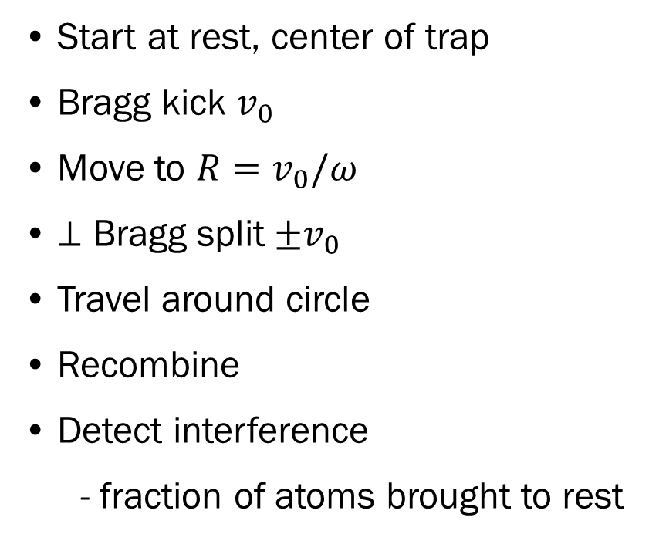
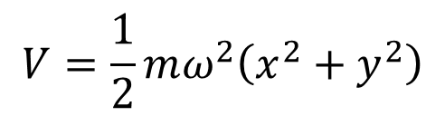
BIGTOP concept
$$V=\frac{1}{2}mω^{2}\left(x^{2}+y^{2}\right)$$
Cylindrical harmonic trap
Start at rest, center of trap
Bragg kick $v_{0}$
Move to $R=v_{0}/ω$
$⊥$ Bragg split $±v_{0}$
Travel around circle
Recombine
Detect interference
  - fraction of atoms brought to rest
y
$${N \sim cos}^{2}{φ}/2$$
x

Slide 5
Dual interferometers
y
Actually two simultaneous interferometers
Rotation phase is differential
Most other effects common
  Acceleration
  Bragg laser noise
  Trapping potential
x

Slide 6
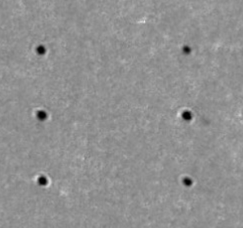
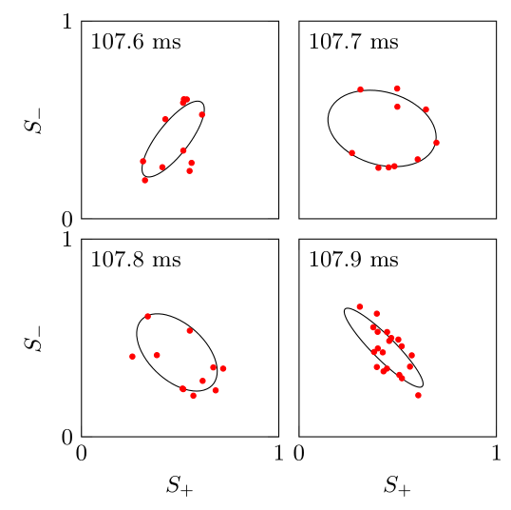



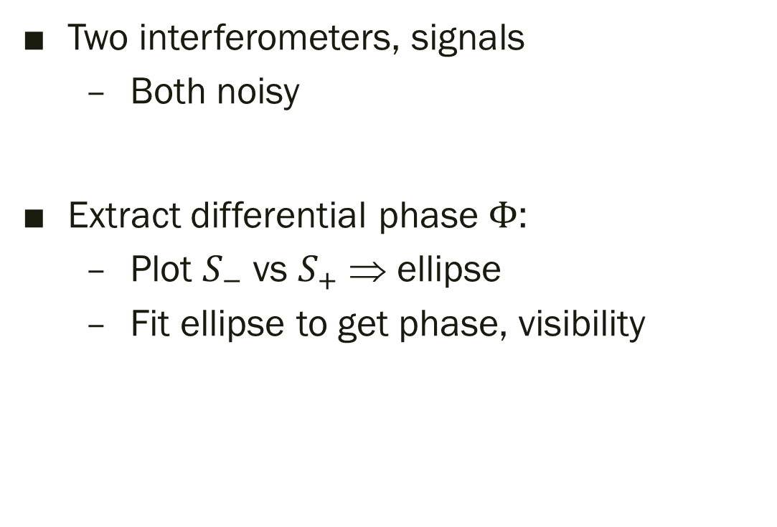






Phase determination
Absorption image:
$$+$$
$$−$$
$$N_{0}$$
$$S_{±}=\frac{N_{0}\left(±\right)}{N\left(±\right)}$$
Two interferometers, signals
  Both noisy
Extract differential phase $Φ$:
  Plot $S_{−}$ vs $S_{+}$ ⇒ ellipse
  Fit ellipse to get phase, visibility
$$Δφ=1.1±0.2$$
$$1.7±0.2$$
$$Φ$$
$$2.0±0.3$$
$$2.5±0.2$$

Slide 7
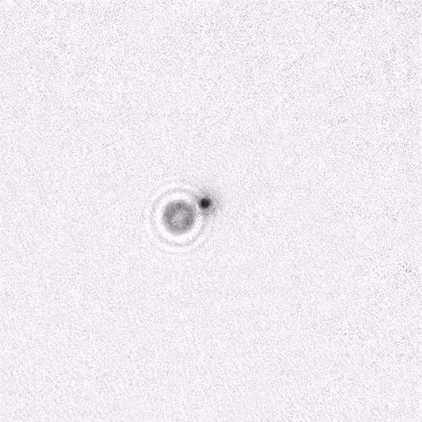
Interferometer movie
mirror
atoms
y
x
1 mm
to camera
probe
laser

Slide 8
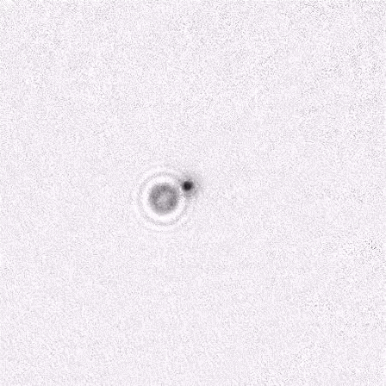
Interferometer movie
mirror
atoms
1 mm
to camera
probe
laser

Slide 9
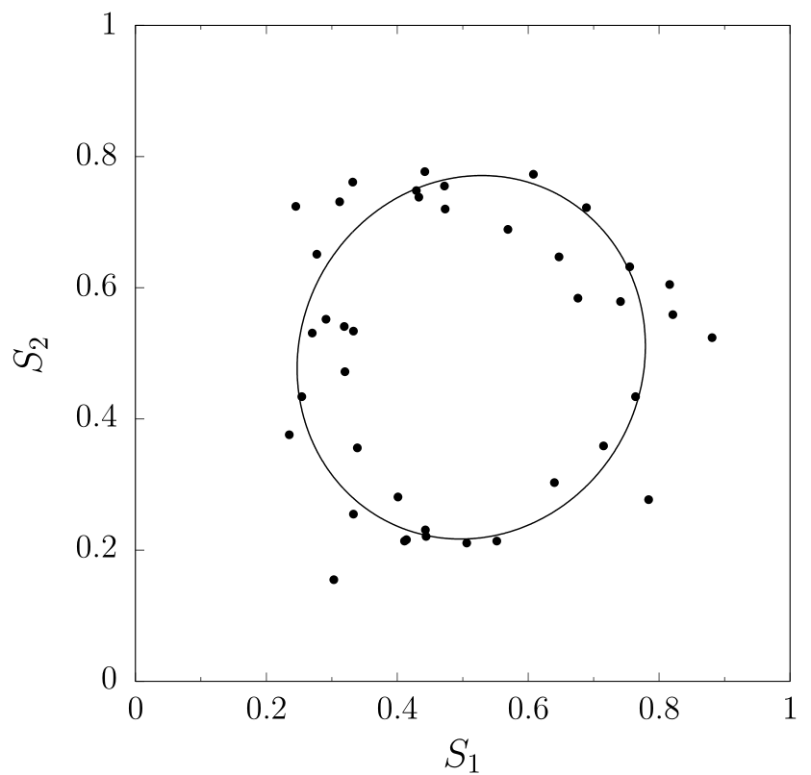
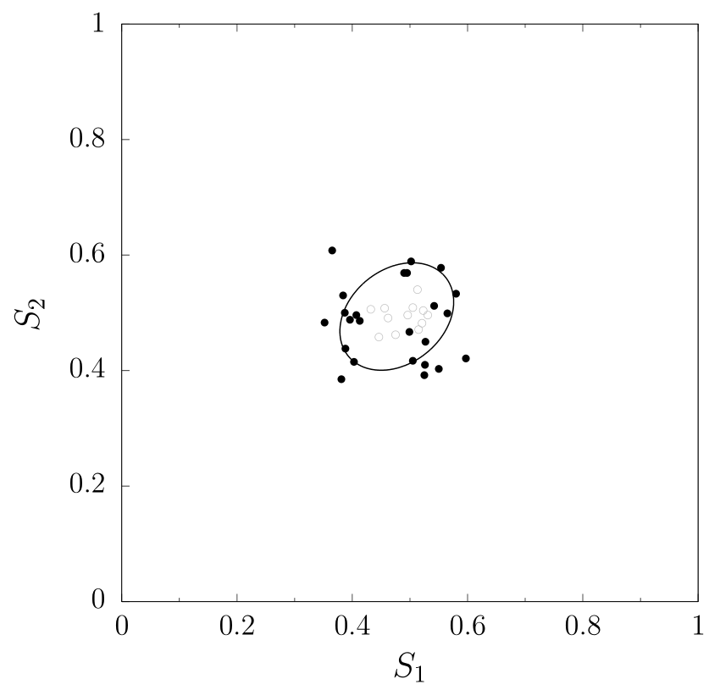

Interference
one orbit:
two orbits:
Noise:
$$σ=0.03$$
Visibility = 0.51
Phase = 1.47(3) rad
Visibility = 0.2
Phase = 1.8(5) rad

Slide 10
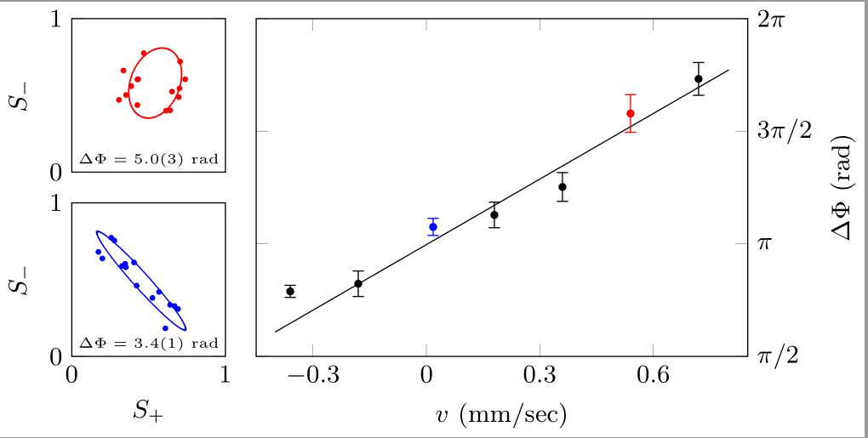

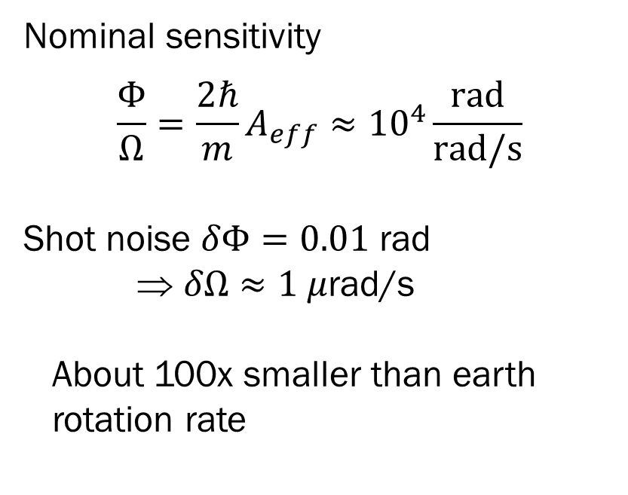
Rotation sensing
${10}^{−4}$ rad
Observe Sagnac effect by rotating table:
Nominal sensitivity
$$\frac{Φ}{Ω}=\frac{2ℏ}{m}A_{eff}≈{10}^{4}\frac{rad}{rad/s}$$
Shot noise $δΦ=0.01$ rad
⇒ $δΩ≈1 μ$rad/s
About 100x smaller than earth rotation rate

Slide 11
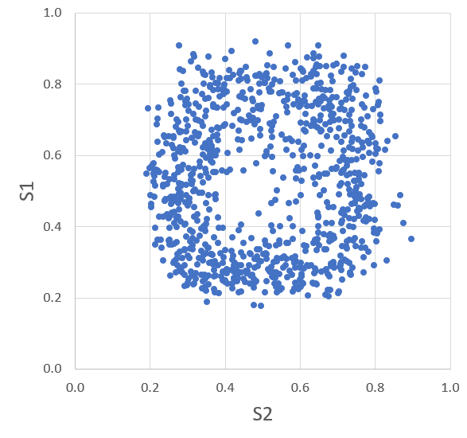
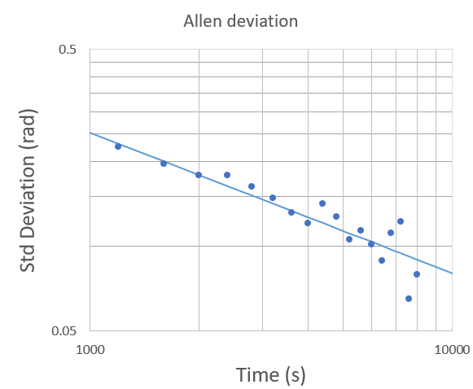

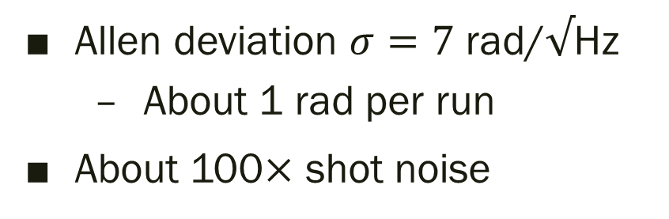
Noise Performance
One-orbit data, appx 1000 runs:
Run for 24 hours, get large data set
Allen deviation $σ=7$ rad/$√$Hz
  About 1 rad per run
About 100$×$ shot noise
$$Φ$$
80 s per run

Slide 12
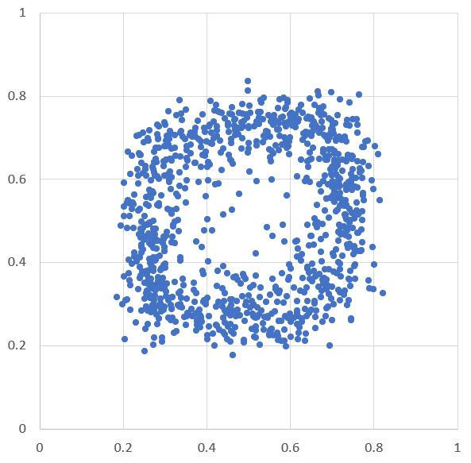
Noise source?
Data:
Many possibilities:
  Phase noise from trap
  Detection/imaging
  Bragg laser fluctuations
  BEC production
  Motion of initial BEC
  Ellipse fitting procedure
Appears to be phase noise from trap
Simulation with phase noise:

Slide 13
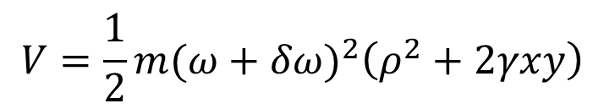
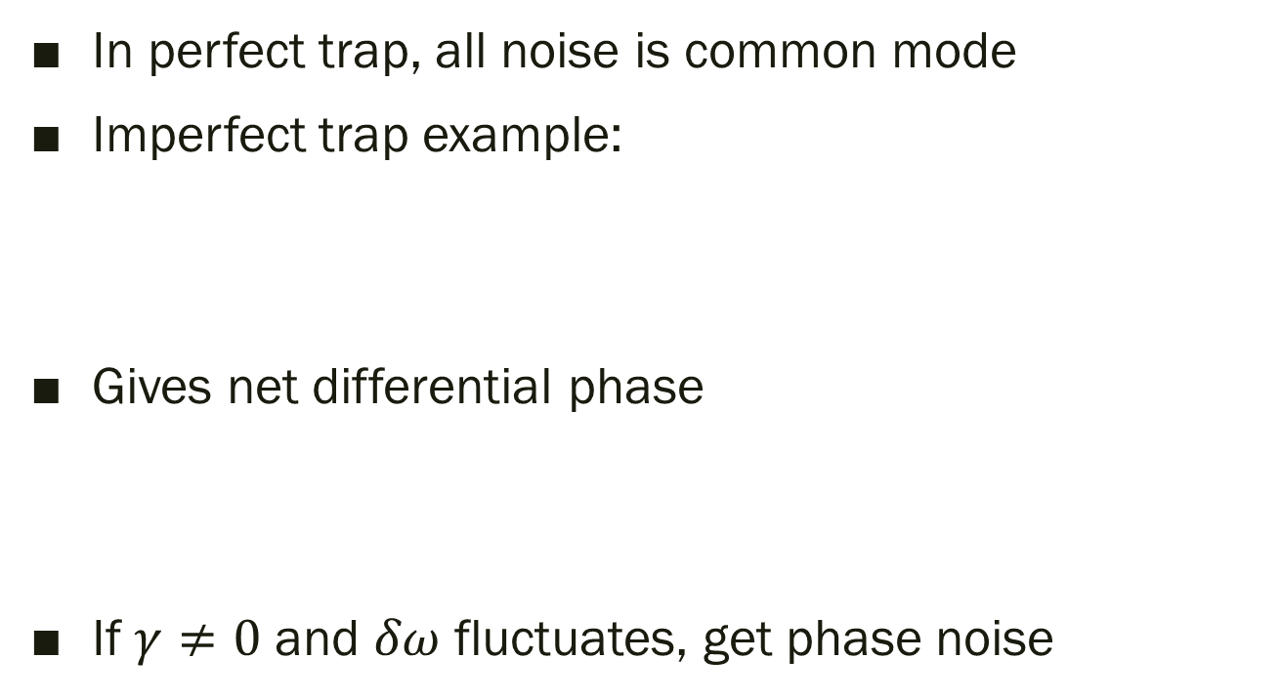
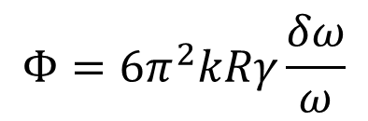
Noise modeling
y
In perfect trap, all noise is common mode
Imperfect trap example:
Gives net differential phase
If $γ≠0$ and $δω$ fluctuates, get phase noise
$$V=\frac{1}{2}m{(ω+δω)}^{2}\left(ρ^{2}+2γxy\right)$$
x
$$Φ={6π}^{2}kRγ\frac{δω}{ω}$$

Slide 14
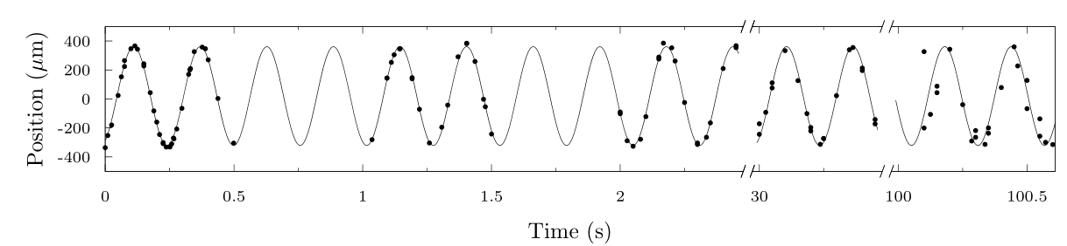
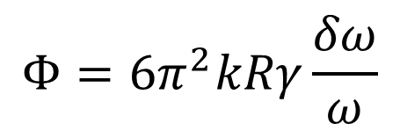

Noise modeling
$$Φ={6π}^{2}kRγ\frac{δω}{ω}$$
Can set $γ$ in experiment
  Estimate $\left|γ\right|<0.02$ from observing trajectories
Observe $δω/ω≈{10}^{−4}$ using long oscillations
  Attribute to current driver noise
Leads to $δΦ≈0.9$ rad, reasonable agreement

Slide 15

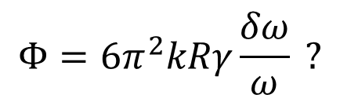


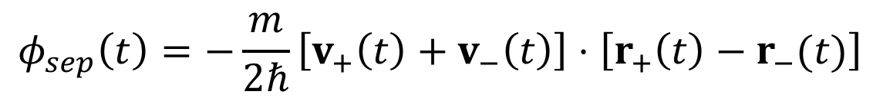

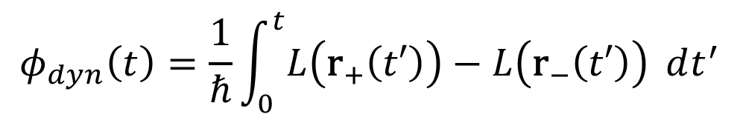
Phase calculation
$$r_{+}(t)$$
$$Φ={6π}^{2}kRγ\frac{δω}{ω} ?$$
How did we calculate
Semi-classical model: $Δφ=φ_{dyn}+φ_{pos}+φ_{sep}$
$r_{+}(t)$ and $r_{−}(t)$ are classical particle trajectories for two arms
$$r_{−}(t)$$
$$φ_{dyn}\left(t\right)=\frac{1}{ℏ}\int_{0}^{t}{L\left({\text{r}}_{+}\left(t′\right)\right)−L\left({\text{r}}_{−}\left(t′\right)\right)} dt^{′}$$
$$φ_{pos}\left(t\right)=\vec{k}⋅\left[2\text{r}\left(0\right)−r_{+}\left(t\right)−r_{−}\left(t\right)\right]$$
$$φ_{sep}\left(t\right)=−\frac{m}{2ℏ}\left[v_{+}\left(t\right)+v_{−}\left(t\right)\right]⋅\left[r_{+}\left(t\right)−r_{−}(t)\right]$$

Slide 16
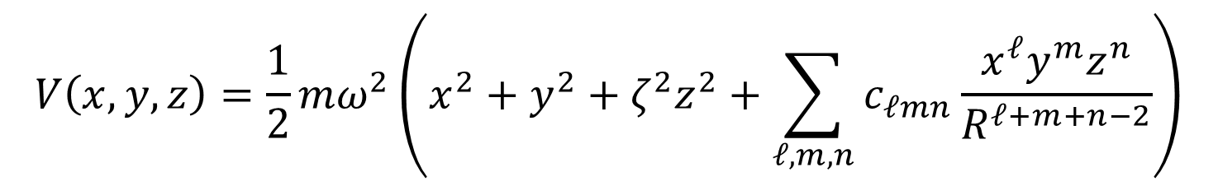

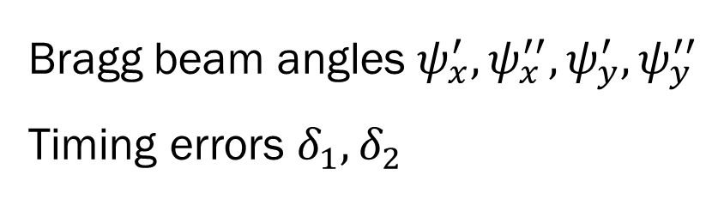
Phase calculation
Evaluate $φ_{dyn}, φ_{pos}, φ_{sep}$ for both interferometers
Differential phase is $Φ=$ ${Δφ}_{left}−{Δφ}_{right}$
Include many possible error terms:
Numerically evaluate sensitivities, fit to analytic formulas
$$V\left(x,y,z\right)=\frac{1}{2}mω^{2}\left(x^{2}+y^{2}+ζ^{2}z^{2}+\sum_{ℓ,m,n}{c_{ℓmn}\frac{x^{ℓ}y^{m}z^{n}}{R^{ℓ+m+n−2}}}\right)$$
Bragg beam angles $ψ_{x}^{′}, ψ_{x}^{′′}, ψ_{y}^{′}, ψ_{y}^{′′}$
Timing errors $δ_{1}, δ_{2}$
Terms to 4th order

Slide 17
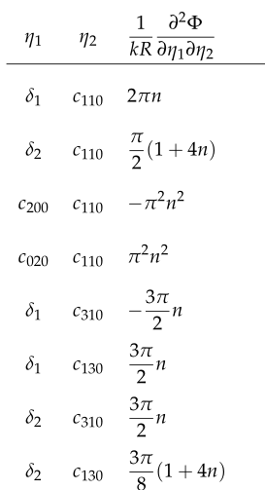
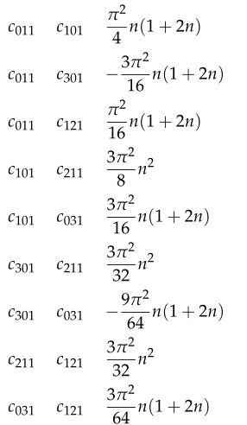
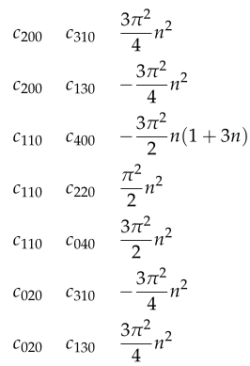
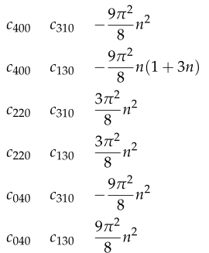
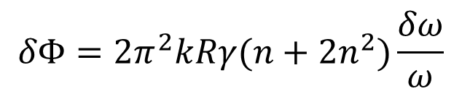
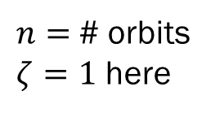
Semiclassical phase errors
$n=$ # orbits
$ζ=1$ here
Second-order dependence on many terms
$$δΦ={2π}^{2}kRγ(n+2n^{2})\frac{δω}{ω}$$
Most terms involve anharmonicity

Slide 18
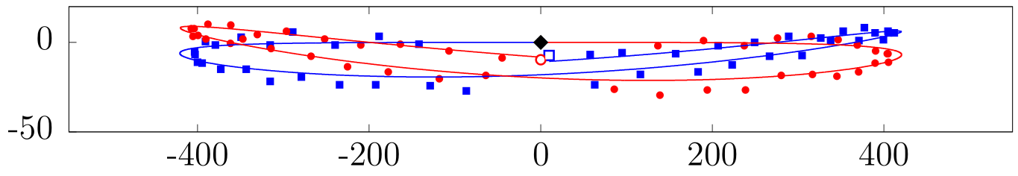
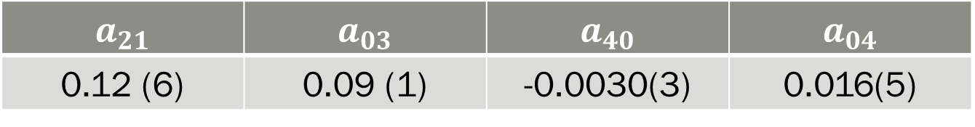

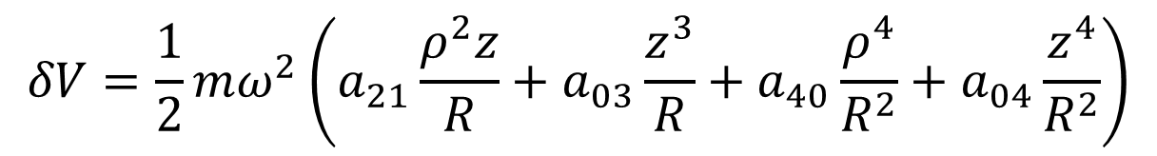

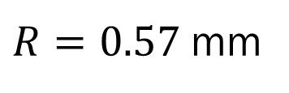
Anharmonicity
Measure by observing atom trajectories
Large terms:
$z$ ($μ$m)
$x$ ($μ$m)
$$δV=\frac{1}{2}mω^{2}\left(a_{21}\frac{ρ^{2}z}{R}+a_{03}\frac{z^{3}}{R}+a_{40}\frac{ρ^{4}}{R^{2}}+a_{04}\frac{z^{4}}{R^{2}}\right)$$
$$a_{21}$$ | $$a_{03}$$ | $$a_{40}$$ | $$a_{04}$$
0.12 (6) | 0.09 (1) | -0.0030(3) | 0.016(5)
$R=0.57$mm

Slide 19
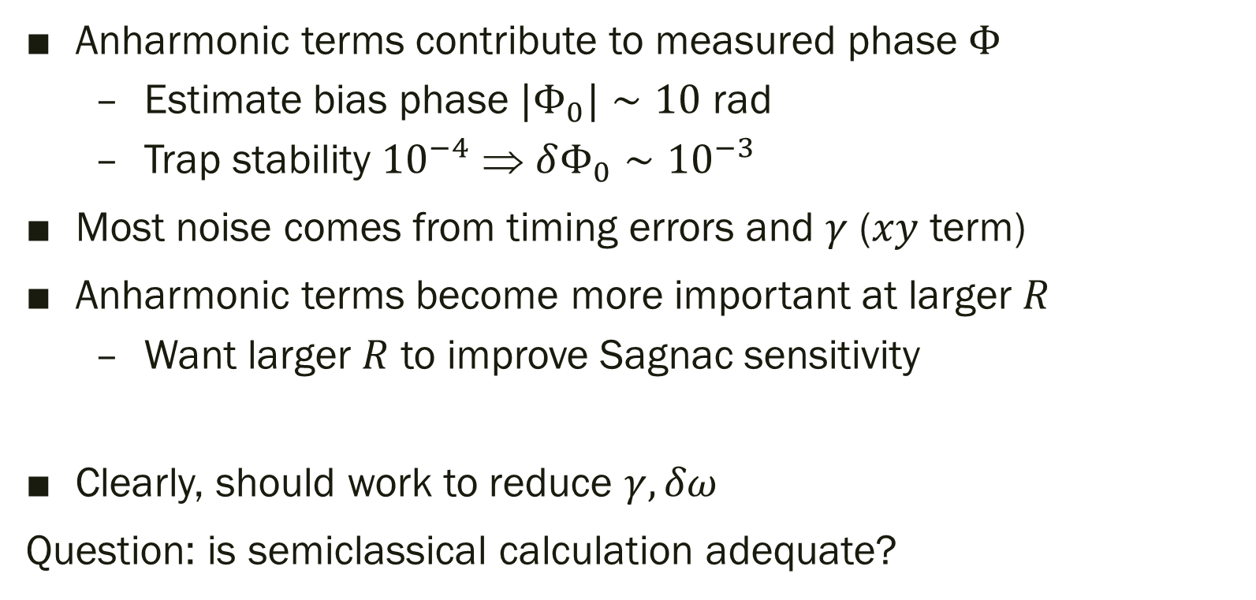
Anharmonicity
Anharmonic terms contribute to measured phase $Φ$
  Estimate bias phase ${|Φ}_{0}|∼10$ rad
  Trap stability ${10}^{−4}$ ⇒ $δΦ_{0}∼{10}^{−3}$
Most noise comes from timing errors and $γ$ ($xy$ term)
Anharmonic terms become more important at larger $R$
  Want larger $R$ to improve Sagnac sensitivity
Clearly, should work to reduce $γ, δω$
Question: is semiclassical calculation adequate?

Slide 20
Semiclassical approximation
SC is exact in harmonic trap with no interactions
  Can model packets as coherent states, evolve classically
⇒ We have anharmonicities, interactions
Can model quantum behavior numerically
  Challenging over large spatial volume
  Mark Edwards: variational Gaussian approach
Analytical results nice
  Possible without interactions?

Slide 21
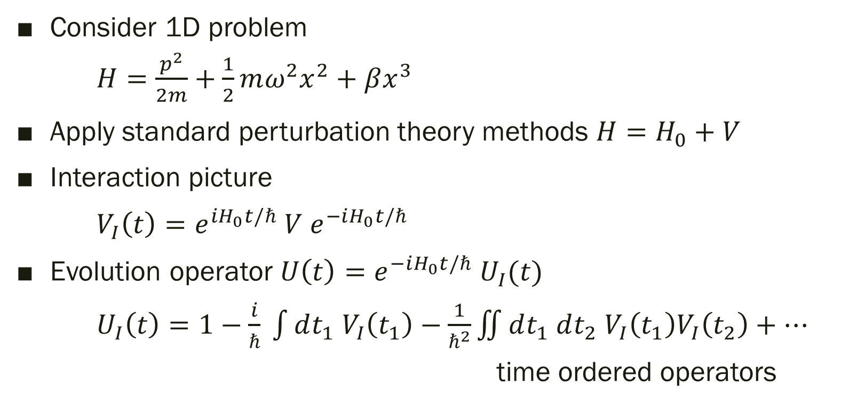
Beyond semiclassical
Consider 1D problem
  $H=\frac{p^{2}}{2m}+\frac{1}{2}mω^{2}x^{2}+βx^{3}$
Apply standard perturbation theory methods $H=H_{0}+V$
Interaction picture
$V_{I}\left(t\right)=e^{iH_{0}t/ℏ} V e^{−iH_{0}t/ℏ}$
Evolution operator $U\left(t\right)=e^{−iH_{0}t/ℏ} U_{I}(t)$
$U_{I}\left(t\right)=1−\frac{i}{ℏ} \int{dt_{1} V_{I}\left(t_{1}\right)}−\frac{1}{ℏ^{2}}\iint{dt_{1} dt_{2} V_{I}\left(t_{1}\right)V_{I}\left(t_{2}\right)}+…$
  time ordered operators

Slide 22
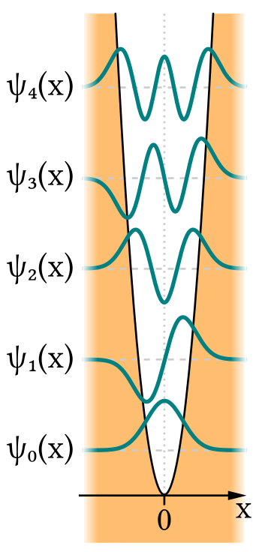
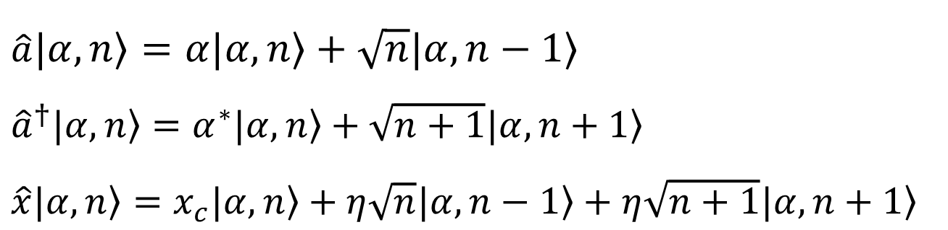

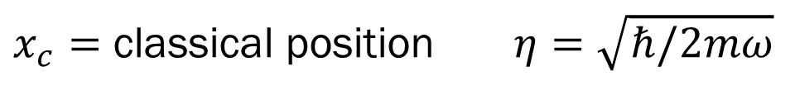
Generalized coherent states
Basis states for calculation
$\left.|α,n\right\rangle ≡D\left(α\right)$ $\left.|0,n\right\rangle$
$\left.|0,n\right\rangle$ is $n$th eigenstate of harmonic oscillator $H_{0}$
$D\left(α\right)$ is normal displacement operator
  Oscillating version of $ψ_{n}(x)$
Properties:
$\hat{a}\left.|α,n\right\rangle =α\left.|α,n\right\rangle +\sqrt{n}\left.|α,n−1\right\rangle$
${\hat{a}}^{†}\left.|α,n\right\rangle =α^{∗}\left.|α,n\right\rangle +\sqrt{n+1}\left.|α,n+1\right\rangle$
$\hat{x}\left.|α,n\right\rangle =x_{c}\left.|α,n\right\rangle +η\sqrt{n}\left.|α,n−1\right\rangle +η\sqrt{n+1}\left.|α,n+1\right\rangle$
$x_{c}=$ classical position $η=\sqrt{ℏ/2mω}$

Slide 23

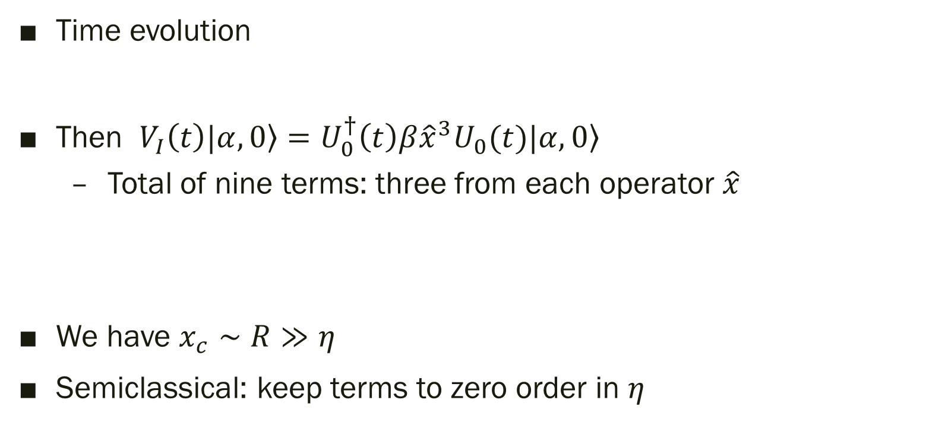
Beyond semiclassical
$$U_{0}(t)\left.|α,n\right\rangle =e^{−i\left(n+1/2\right)ωt}\left.|αe^{−iωt},n\right\rangle$$
Time evolution
Then $V_{I}\left(t\right)\left.|α,0\right\rangle =U_{0}^{†}\left(t\right)β{\hat{x}}^{3}U_{0}(t)\left.|α,0\right\rangle$
  Total of nine terms: three from each operator $\hat{x}$
We have $x_{c}∼R≫η$
Semiclassical: keep terms to zero order in $η$
$$=β\left[{(x}_{c}^{3}+3η^{2}x_{c})\left.|α,0\right\rangle +3η\left(x_{c}^{2}+η^{2}\right)\left.|α,1\right\rangle +3\sqrt{2}η^{2}x_{c}\left.|α,2\right\rangle +\sqrt{6}η^{3}\left.|α,3\right\rangle \right]$$

Slide 24
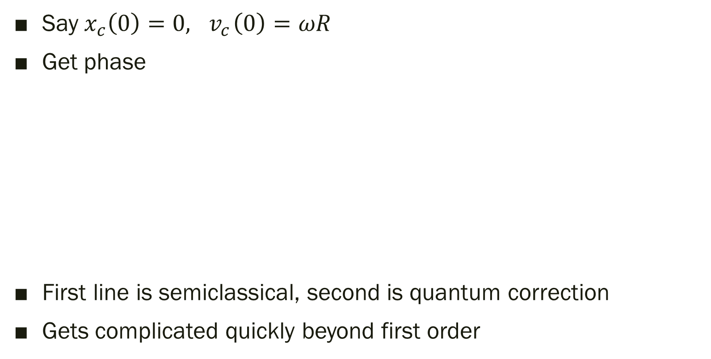
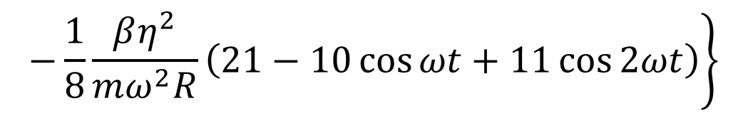
Cubic phase
Say $x_{c}\left(0\right)=0, { v}_{c}\left(0\right)=ωR$
Get phase
First line is semiclassical, second is quantum correction
Gets complicated quickly beyond first order
$$φ(t)=\frac{mωR^{2}}{ℏ}\left\{\frac{1}{4}\sin{ωt}+\frac{1}{3}\frac{βR}{mω^{2}}\left(1−3\cos{ωt}+3\cos{2ωt}−\cos{3ωt}\right)\right.$$
$$\left.−\frac{1}{8}\frac{βη^{2}}{mω^{2}R}\left(21−10\cos{ωt}+11\cos{2ωt}\right)\right\}$$

Slide 25
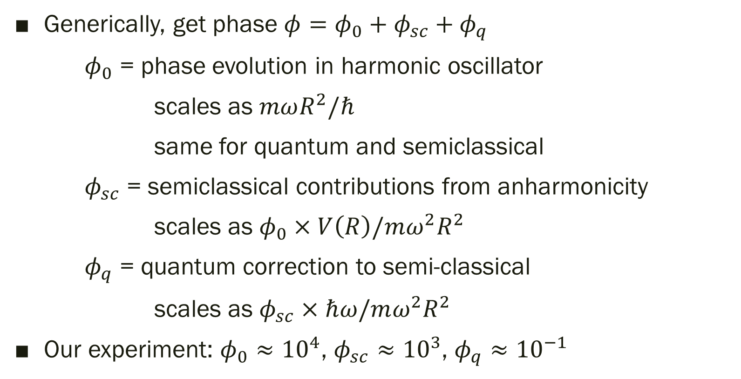
Quantum corrections
Generically, get phase $φ=φ_{0}+φ_{sc}+φ_{q}$
$φ_{0}$ = phase evolution in harmonic oscillator
scales as $mωR^{2}/ℏ$
same for quantum and semiclassical
$φ_{sc}$ = semiclassical contributions from anharmonicity
scales as $φ_{0}×V\left(R\right)/mω^{2}R^{2}$
$φ_{q}$ = quantum correction to semi-classical
scales as $φ_{sc}×ℏω/mω^{2}R^{2}$
Our experiment: $φ_{0}≈{10}^{4}$, $φ_{sc}≈{10}^{3}$, $φ_{q}≈{10}^{−1}$

Slide 26
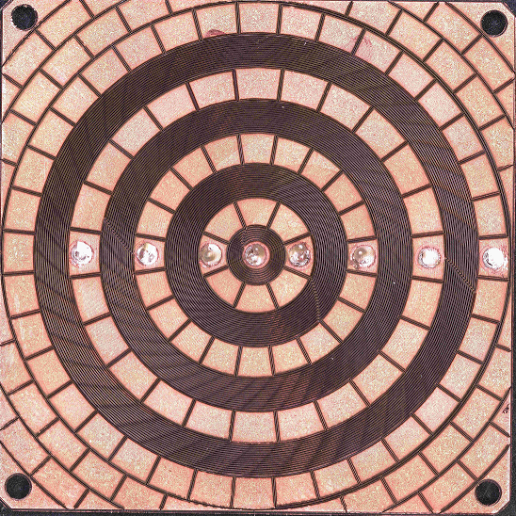
Current status and improvements
Quantum effects small enough to ignore
  (for now)
Focus on improving sensitivity and stability
Working to implement atom chip system
  Better control over trap potential
  Faster BEC production
  Avoid eddy currents
Tried to implement with new compact vacuum/optical system
  Limited success
35 mm

Slide 27

Apparatus
Existing system has coils in vacuum, mounted on SS flange
Change to coils in air, atoms in glass cell

Slide 28

Apparatus
Transfer atoms to coil using optical tweezers
Aim for bigger condensates as well

Slide 29


Performance goals
Trap frequency 3.3 Hz ⇒ 2.0 Hz
  Enclosed area 2.7 mm²
# orbits 2 ⇒ 5
  Sagnac area 54 mm²
Cycle time 80 s ⇒ 5 s
Trap stability ${10}^{−4} \text{⇒}$ ${10}^{−6}$
Trap asymmetry ${10}^{−2}$ ⇒ ${10}^{−4}$
Phase noise ⇒ 0.02 rad/shot
Would give ARW parameter ${10}^{−3}$ deg/$√$hr, bias stability ${10}^{−4}$ deg/hr
Better than unclassified INS sensors

Slide 30
Conclusions
Demonstrate good interferometer performance with trapped atoms
  Coherence over mm distance, seconds time
See significant technical noise
  Understand how to improve
Assessed adequacy of semi-classical approximation
Implementing new system based on atom chip

Slide 31



Credits
Current:
  Marybeth Beydler
  Liz Larson
  Zekun Chu
  Valeria Ramirez Cruz
  Itzal de Urioste Terrazas
Former:
  Eddie Moan
  Adam Fallon
  Zhe Luo
  Bob Leonard
Collaborators:
  Jason Williams (JPL)
  Rob Thompson (JPL)
  Eric Imhof (Northrop)
  Mark Edwards (GSU)
  Tom Gallagher (UVA)

Slide 32
Credits
Postdoc: Eddie Moan
Grad students: Marybeth Beydler, Seth Berl, Zhe Luo
Undergrads: Aaron Osborne, Malcolm Schlossberg
Collaborators:
Funding:
Eric Imhof (Northrop Grumman)
Evan Salim (ColdQuanta)
Jim Stickney (Space Dynamics Lab)
Mark Edwards (GSU)

