Slide 1



Measurement-induced gauge protection in digital quantum simulations of LGTs
Edoardo Ballini
Supervisor: Philipp Hauke
Funded by the European Union. Views and opinions expressed are however those of the author(s) only and do not necessarily reflect those of the European Union or the European Commission. Neither the European Union nor the granting authority can be held responsible for them.

Slide 2
Quantum simulations of lattice gauge theories
LGT
Standard model
Quantum spin liquids
Topological quantum computation
Strongly constrained dynamics
Fundamental physics
Condensed matter
Classical optimization
Quantum information
Quantum simulations of many-body physics

Slide 3
Quantum simulations of lattice gauge theories
Classical simulations allowed us to understand a lot.
The «infamous» sign problem interdicts systems with high matter densities and real time evolutions.
Quantum computations are by design not affected by sign problems!
Fundamental physics
Standard model
LGT

Slide 4
Outline
Brief introduction to LGTs and local symmetries;
Time evolution and gauge breaking errors;
Abelian toy model: digital gauge protection, quantum Zeno effect and analogous continuous formulation; On arxiv soon!
Non-Abelian toy model: qudit-based formulation and digital gauge protection;
Conclusions.

Slide 5
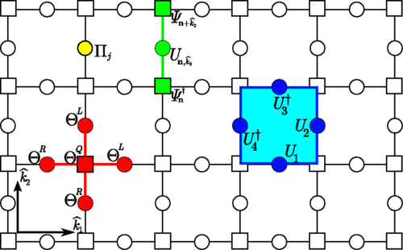

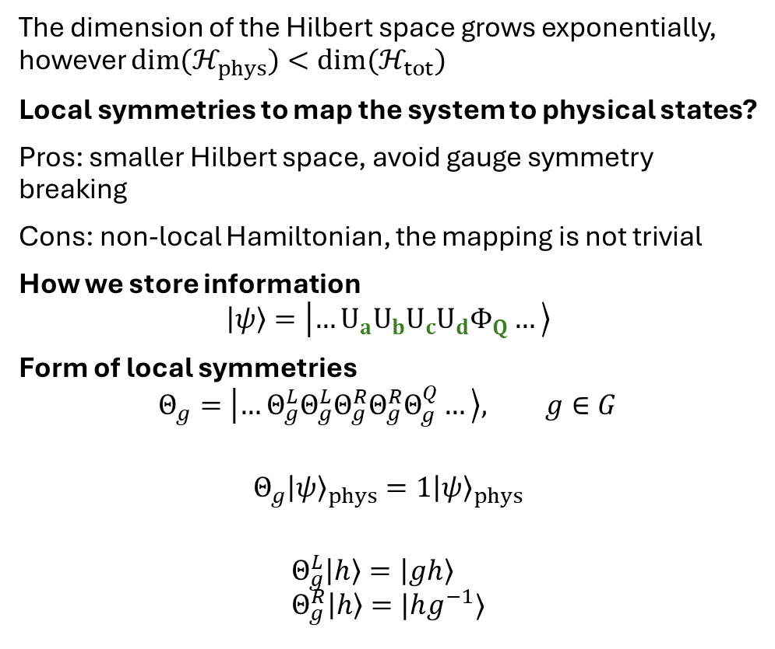
Quantum simulations of lattice gauge theories
Matter fields
The dimension of the Hilbert space grows exponentially, however $dim(ℋ_{phys})<dim(ℋ_{tot})$
Local symmetries to map the system to physical states?
Pros: smaller Hilbert space, avoid gauge symmetry breaking
Cons: non-local Hamiltonian, the mapping is not trivial
How we store information
$$\left|ψ\right\rangle =\left|…U_{a}U_{b}U_{c}U_{d}Φ_{Q}…\right\rangle$$
Form of local symmetries
$$Θ_{g}=\left|…Θ_{g}^{L}Θ_{g}^{L}Θ_{g}^{R}Θ_{g}^{R}Θ_{g}^{Q}…\right\rangle , g∈G$$
$$Θ_{g}{\left|ψ\right\rangle }_{phys}=1{\left|ψ\right\rangle }_{phys}$$
$$Θ_{g}^{L}\left|h\right\rangle =\left|gh\right\rangle \\ Θ_{g}^{R}\left|h\right\rangle =|hg^{−1}⟩$$
Gauge fields
b
c
d
a
Zohar and Burrello, PRD, 2015
Local symmetry, eg $∇⋅E=−ρ$
Permutations matrices

Slide 6
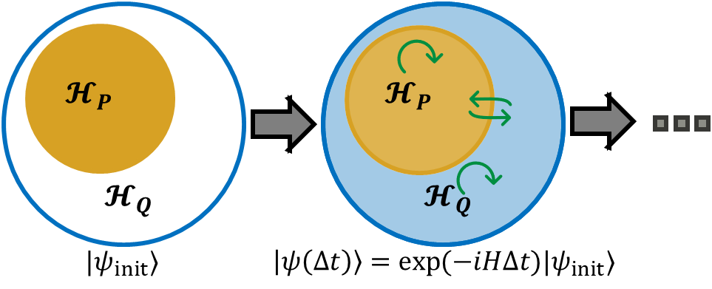
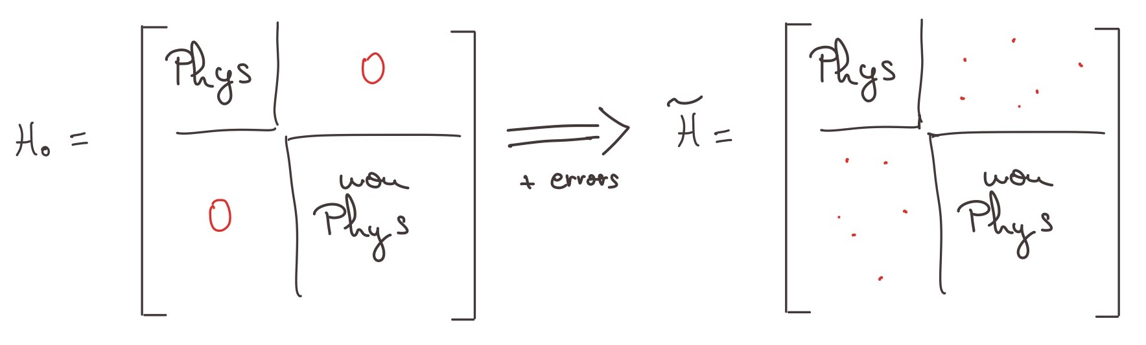


Quantum simulations of lattice gauge theories: time evolution
$H=∑H_{j}$
$$∼\prod_{j}{exp(−iH_{j}Δt)}$$
$$Θ_{g,v}{\left|ψ\right\rangle }_{phys}=1{\left|ψ\right\rangle }_{phys}$$
$$∀ g,v$$

Slide 7
Quantum simulations of lattice gauge theories: time evolution
$H=∑H_{j}$
$$∼\prod_{j}{exp(−iH_{j}Δt)}$$
How do we detect and suppress errors?
Abelian LGT:
  Post-selection: check if the final state satisfies local symmetries;
  Engineered dissipation: stochastic driving;
  Effective Hamiltonian: energy penalty
Nonabelian LGT:
  Local symmetry generators do not commute
  Post-selection?

Slide 8
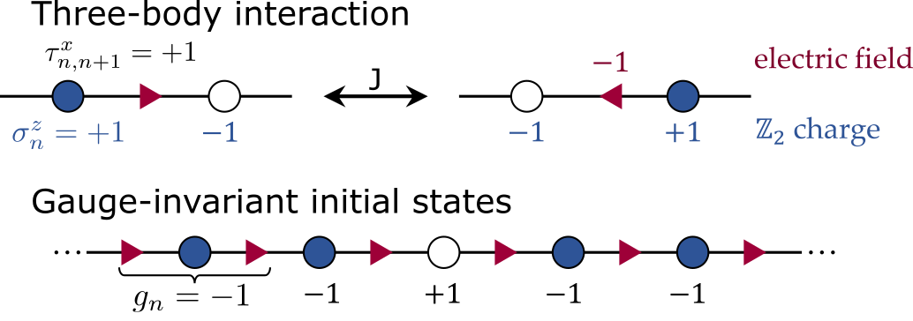
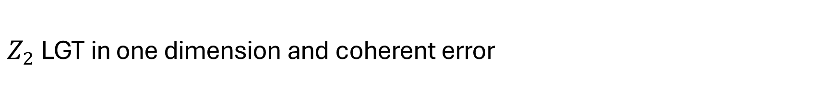

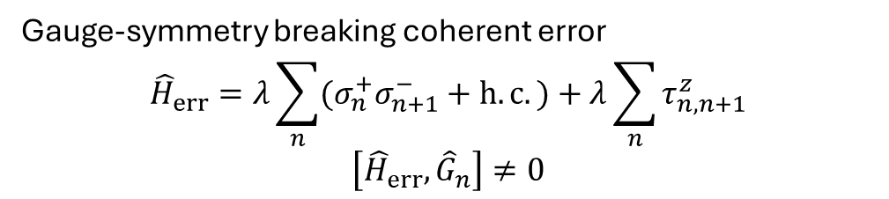
$Z_{2}$ LGT in one dimension and coherent error
Digital quantum simulation
Local gauge charge ${\hat{G}}_{n}=−τ_{n−1,n}^{x}σ_{n}^{z}τ_{n,n+1}^{x}$ $\left[{\hat{H}}_{0},{\hat{G}}_{n}\right]=0$pen $−iℏ\left[\hat{H},ρ\right]+γ\sum_{n}{{\hat{G}}_{n}ρ{\hat{G}}_{n}^{†}−\frac{1}{2}\left\{{\hat{G}}_{n}^{†}{\hat{G}}_{n},ρ\right\}}=ℒρ$
Coupling with classical noisy fields* $⇒$ engineered dissipation
Continuous measurements of local charges $⇒$ quantum trajectories
Qubit number
Gauge-symmetry breaking coherent error
$${\hat{H}}_{err}=λ\sum_{n}{(σ_{n}^{+}σ_{n+1}^{−}+h.c.)}+λ\sum_{n}{τ_{n,n+1}^{z}}$$
$$\left[{\hat{H}}_{err},{\hat{G}}_{n}\right]≠0$$
Qubit number

Slide 9
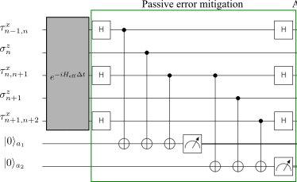
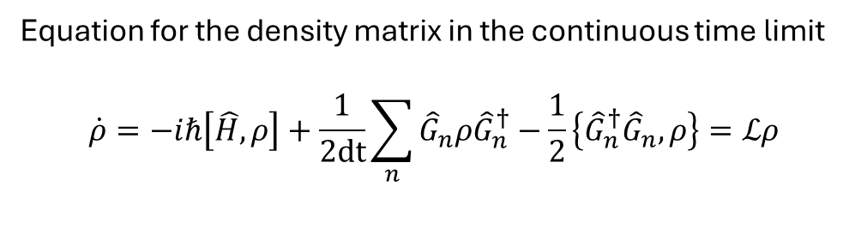
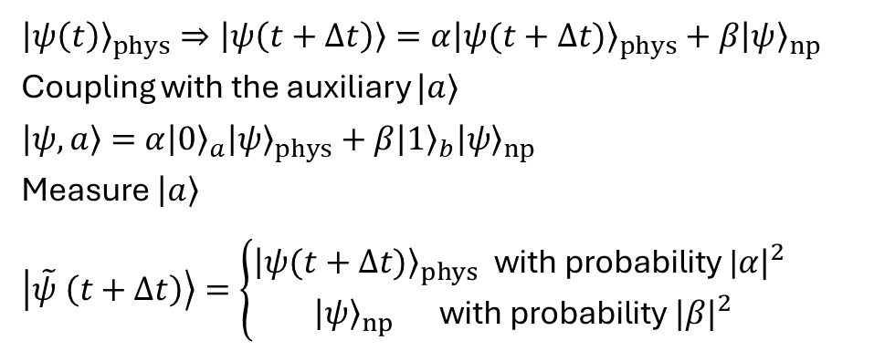
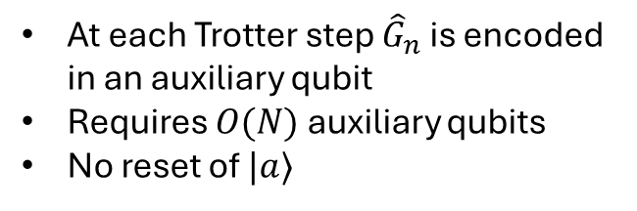

Measurement-induced gauge protection in digital quantum simulations
Dynamical post-selection approach
$${\left|ψ\left(t\right)\right\rangle }_{phys}⇒\left|ψ\left(t+Δt\right)\right\rangle =α{\left|ψ(t+Δt)\right\rangle }_{phys}+β{\left|ψ\right\rangle }_{np }$$
Coupling with the auxiliary $|a⟩$
$\left|ψ, a\right\rangle =$ $α{\left|0\right\rangle }_{a}{\left|ψ\right\rangle }_{phys}+β{{\left|1\right\rangle }_{b}\left|ψ\right\rangle }_{np }$
Measure $\left|a\right\rangle$
$$\left|\tilde{ψ} \left(t+Δt\right)\right\rangle =\left\{\begin{aligned}{\left|ψ(t+Δt)\right\rangle }_{phys} \text{with} \text{probability} \text{|}{α|}^{2} \\ {\left|ψ\right\rangle }_{np} \text{with} \text{probability} {|β|}^{2}\end{aligned}\right.$$
$$n_{t}$$
keep
discard
Equation for the density matrix in the continuous time limit
$$\dot{ρ}=−iℏ\left[\hat{H},ρ\right]+\frac{1}{2dt}\sum_{n}{{\hat{G}}_{n}ρ{\hat{G}}_{n}^{†}−\frac{1}{2}\left\{{\hat{G}}_{n}^{†}{\hat{G}}_{n},ρ\right\}}=ℒρ$$
At each Trotter step ${\hat{G}}_{n}$ is encoded in an auxiliary qubit
Requires $O(N)$ auxiliary qubits
No reset of $|a⟩$
The average time between two consecutive
measurements of the same local charge

Slide 10

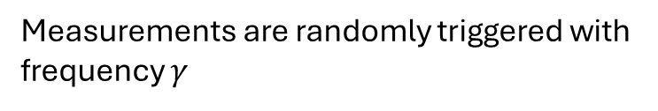
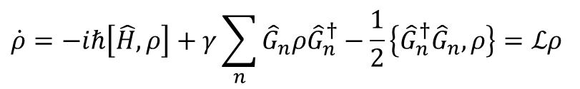
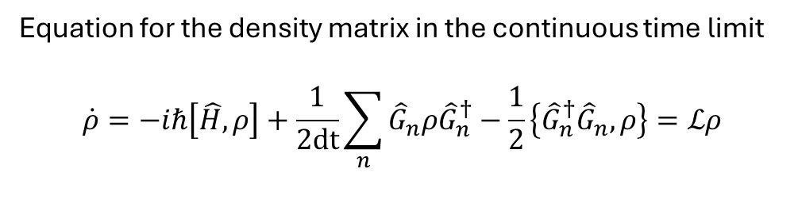
Measurement-induced gauge protection in digital quantum simulations
Continuous measurement in analog
quantum system
Dynamical post-selection approach
$$n_{t}$$
Error 404:
Experimental knowledge not found
Equation for the density matrix in the continuous time limit
$$\dot{ρ}=−iℏ\left[\hat{H},ρ\right]+\frac{1}{2dt}\sum_{n}{{\hat{G}}_{n}ρ{\hat{G}}_{n}^{†}−\frac{1}{2}\left\{{\hat{G}}_{n}^{†}{\hat{G}}_{n},ρ\right\}}=ℒρ$$
$$\dot{ρ}=−iℏ\left[\hat{H},ρ\right]+γ\sum_{n}{{\hat{G}}_{n}ρ{\hat{G}}_{n}^{†}−\frac{1}{2}\left\{{\hat{G}}_{n}^{†}{\hat{G}}_{n},ρ\right\}}=ℒρ$$
The average time between two consecutive
measurements of the same local charge
Measurements are randomly triggered with frequency $γ$

Slide 11
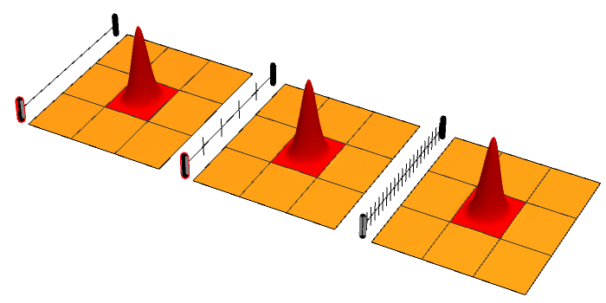
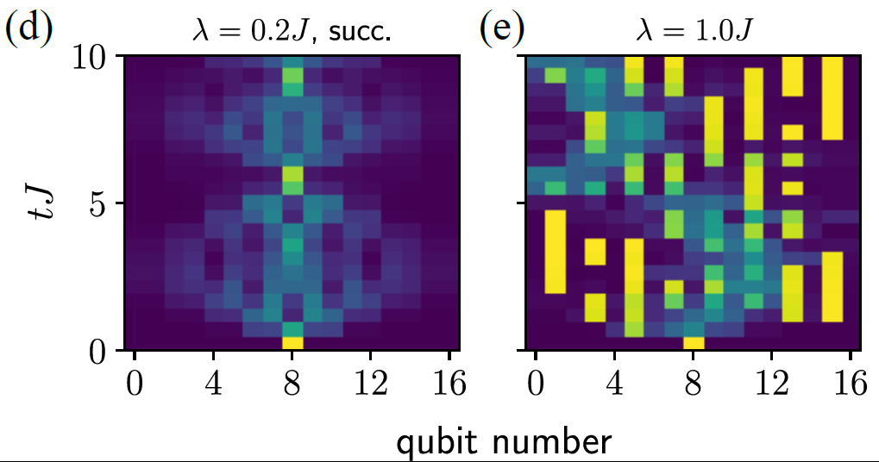
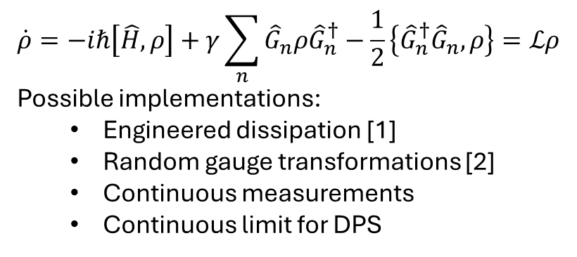
Measurement-induced gauge protection in digital quantum simulations
Quantum Zeno regime
$$\dot{ρ}=−iℏ\left[\hat{H},ρ\right]+γ\sum_{n}{{\hat{G}}_{n}ρ{\hat{G}}_{n}^{†}−\frac{1}{2}\left\{{\hat{G}}_{n}^{†}{\hat{G}}_{n},ρ\right\}}=ℒρ$$
Possible implementations:
  Engineered dissipation [1]
  Random gauge transformations [2]
  Continuous measurements
  Continuous limit for DPS
Dark states
Quantum Zeno transition between protected and chaotic phases
[1] Stanningel et al. PRL 112 (2014)
[2] Lamm et al. arxiv:2005.12688
By JozumBjada - Own work, CC BY-SA 4.0, https://commons.wikimedia.org/w/index.php?curid=112625244

Slide 12
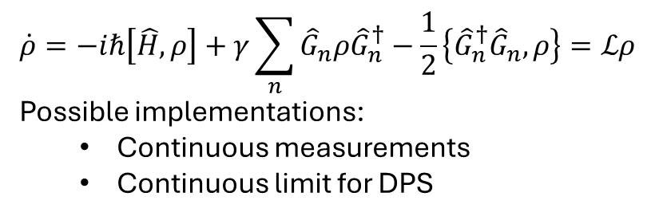
Measurement-induced gauge protection in digital quantum simulations
violations of gauge symmetries
$$\dot{ρ}=−iℏ\left[\hat{H},ρ\right]+γ\sum_{n}{{\hat{G}}_{n}ρ{\hat{G}}_{n}^{†}−\frac{1}{2}\left\{{\hat{G}}_{n}^{†}{\hat{G}}_{n},ρ\right\}}=ℒρ$$
Possible implementations:
  Continuous measurements
  Continuous limit for DPS
Digital vs Analog: same ensemble average, different stochastic trajectories
gauge violation suppressed

Slide 13
Measurement-induced gauge protection in digital quantum simulations
$$\dot{ρ}=−iℏ\left[\hat{H},ρ\right]+γ\sum_{n}{{\hat{G}}_{n}ρ{\hat{G}}_{n}^{†}−\frac{1}{2}\left\{{\hat{G}}_{n}^{†}{\hat{G}}_{n},ρ\right\}}=ℒρ$$
Possible implementations:
  Continuous measurements
  Continuous limit for DPS
Average gauge drift common for all trajectories
Digital vs Analog: same ensemble average, different stochastic trajectories

Slide 14
Measurement-induced gauge protection in digital quantum simulations
$$\dot{ρ}=−iℏ\left[\hat{H},ρ\right]+γ\sum_{n}{{\hat{G}}_{n}ρ{\hat{G}}_{n}^{†}−\frac{1}{2}\left\{{\hat{G}}_{n}^{†}{\hat{G}}_{n},ρ\right\}}=ℒρ$$
Possible implementations:
  Continuous measurements
  Continuous limit for DPS
Digital vs Analog: same ensemble average, different stochastic trajectories

Slide 15
Measurement-induced gauge protection in digital quantum simulations
$$\dot{ρ}=−iℏ\left[\hat{H},ρ\right]+γ\sum_{n}{{\hat{G}}_{n}ρ{\hat{G}}_{n}^{†}−\frac{1}{2}\left\{{\hat{G}}_{n}^{†}{\hat{G}}_{n},ρ\right\}}=ℒρ$$
Possible implementations:
  Continuous measurements
  Continuous limit for DPS
Digital vs Analog: same ensemble average, different stochastic trajectories

Slide 16
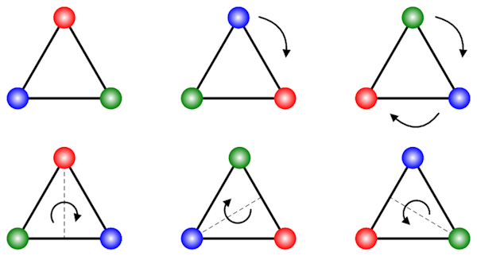
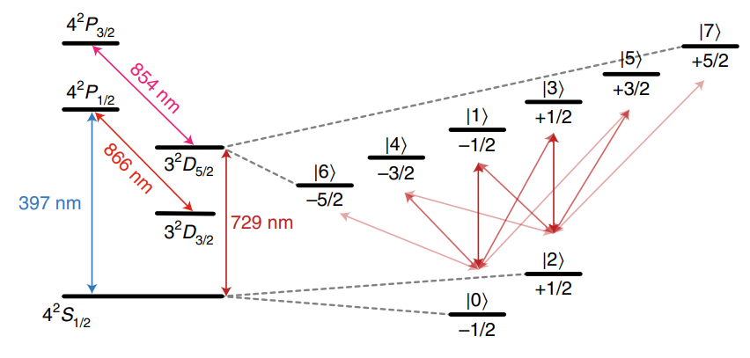
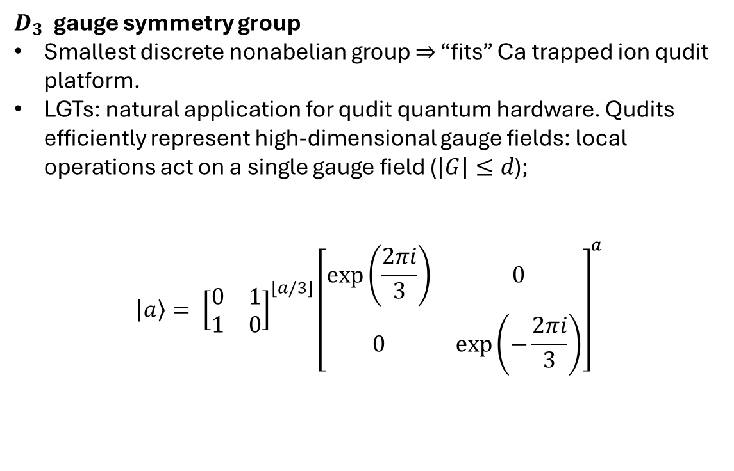

Nonabelian LGT: $D_{3}$ and a qudit approach
$D_{3}$ gauge symmetry group
Smallest discrete nonabelian group $⇒$ “fits” Ca trapped ion qudit platform.
LGTs: natural application for qudit quantum hardware. Qudits efficiently represent high-dimensional gauge fields: local operations act on a single gauge field ($\left|G\right|≤d$);
$$\left|a\right\rangle = {\left[\begin{matrix}0 & 1 \\ 1 & 0\end{matrix}\right]}^{⌊a/3⌋}{\left[\begin{matrix}\exp\left(\frac{2πi}{3}\right) & 0 \\ 0 & \exp\left(−\frac{2πi}{3}\right)\end{matrix}\right]}^{a}$$
*Ringbauer et al, Nat Phys 18 (2022)

Slide 17




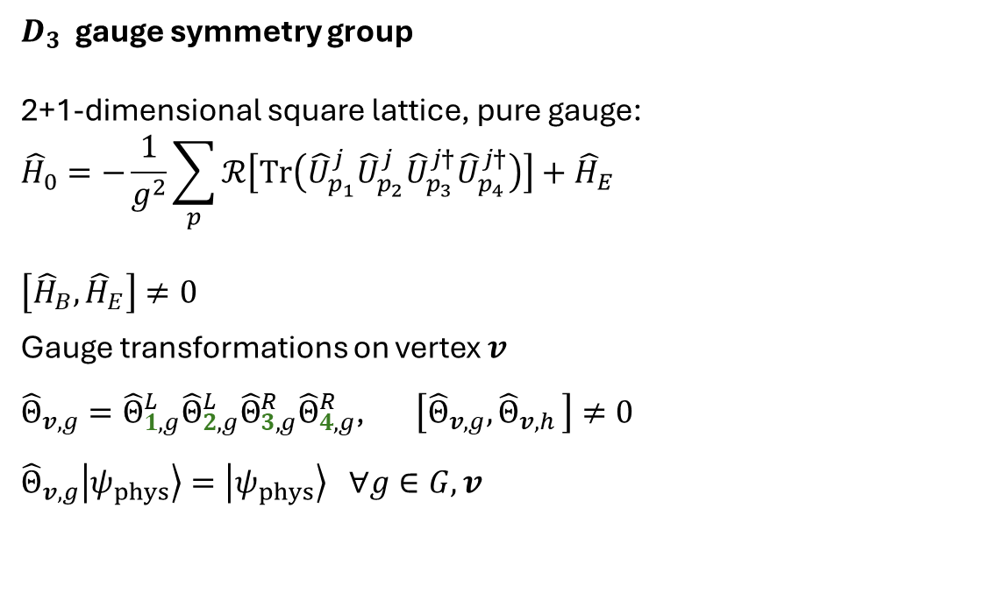





Nonabelian LGT
$D_{3}$ gauge symmetry group
2+1-dimensional square lattice, pure gauge:
$${\hat{H}}_{0}=−\frac{1}{g^{2}}\sum_{p}{ℛ\left[Tr\left({\hat{U}}_{p_{1}}^{j}{\hat{U}}_{p_{2}}^{j}{\hat{U}}_{p_{3}}^{j†}{\hat{U}}_{p_{4}}^{j†}\right)\right]}+{\hat{H}}_{E}$$
$$\left[{\hat{H}}_{B},{\hat{H}}_{E}\right]≠0$$
Gauge transformations on vertex $v$
${\hat{Θ}}_{v,g}={\hat{Θ}}_{1,g}^{L}{\hat{Θ}}_{2,g}^{L}{\hat{Θ}}_{3,g}^{R}{\hat{Θ}}_{4,g}^{R}$, $\left[{\hat{Θ}}_{v,g}, {\hat{Θ}}_{v,h }\right]≠0$
$${\hat{Θ}}_{v,g}\left|ψ_{phys}\right\rangle =\left|ψ_{phys}\right\rangle ∀g∈G,v$$
$${\hat{H}}_{B}$$
$${\hat{H}}_{E}$$
$$2$$
$${\hat{H}}_{B}$$
$$3$$
$$v$$
$${\hat{Θ}}_{v,g}$$
$$1$$
$$4$$

Slide 18







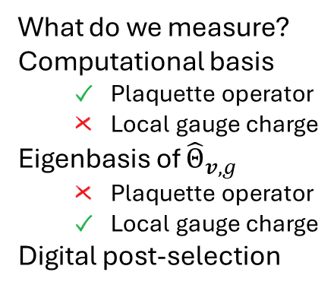





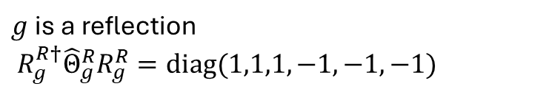

















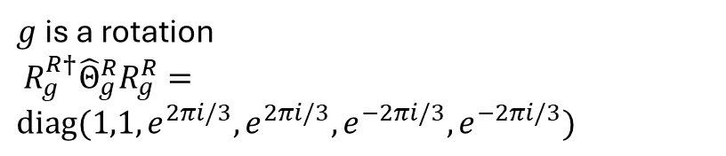
Nonabelian LGT
What do we measure?
Computational basis
  Plaquette operator
  Local gauge charge
Eigenbasis of ${\hat{Θ}}_{v,g}$
  Plaquette operator
  Local gauge charge
Digital post-selection
auxiliary qudit
$$R_{g}^{R}$$
$$R_{g}^{R}$$
$$|3⟩$$
$$|4⟩$$
$$|5⟩$$
$g$ is a reflection
$R_{g}^{R†}{\hat{Θ}}_{g}^{R}R_{g}^{R}=diag(1,1,1,−1,−1,−1)$
$$=$$
$${\left|aux\right\rangle }_{d=2}$$
$$𝒪$$
$${\left|aux\right\rangle }_{d=2}$$
$$⨁$$
$$⨁$$
$$⨁$$
$g$ is a rotation
$R_{g}^{R†}{\hat{Θ}}_{g}^{R}R_{g}^{R}=diag(1,1,e^{2πi/3},e^{2πi/3},e^{−2πi/3},e^{−2πi/3})$
$$R_{g}^{R}$$
$$R_{g}^{R}$$
$$|2⟩$$
$$|3⟩$$
$$|4⟩$$
$$|5⟩$$
$$=$$
$${\left|aux\right\rangle }_{d=3}$$
$$𝒪$$
$${\left|aux\right\rangle }_{d=3}$$
$$⊕_{3}1$$
$$⊕_{3}1$$
$⊕_{3}$-1
$⊕_{3}$-1

Slide 19
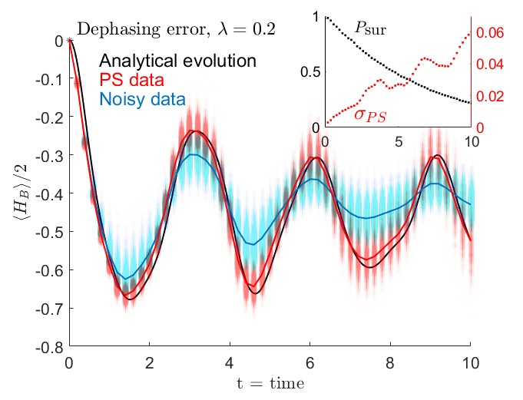

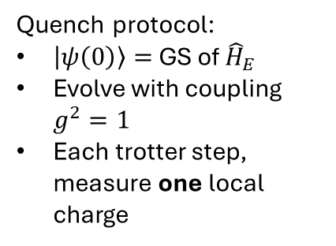
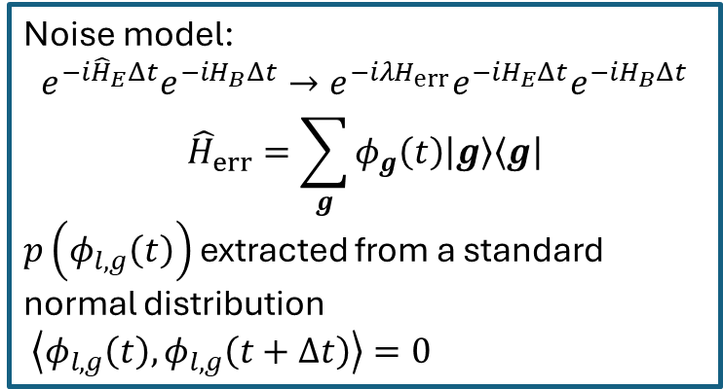

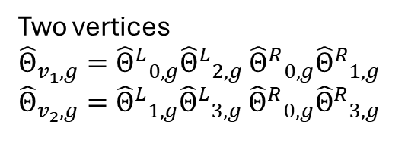

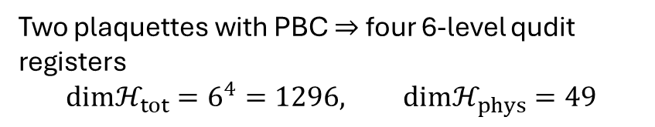



Numerical benchmarks
Noise model:
$$e^{−i{\hat{H}}_{E}Δt}e^{−iH_{B}Δt}→e^{−iλH_{err}}e^{−iH_{E}Δt}e^{−iH_{B}Δt}$$
$${\hat{H}}_{err}=\sum_{g}{φ_{g}\left(t\right)\left|g\right\rangle \left\langle g\right|}$$
$p\left(φ_{l,g}\left(t\right)\right)$ extracted from a standard normal distribution
$\left\langle φ_{l,g}\left(t\right),φ_{l,g}\left(t+Δt\right)\right\rangle =0$
Two plaquettes with PBC $⇒$ four 6-level qudit registers
$$dimℋ_{tot}=6^{4}=1296, dimℋ_{phys}=49$$
$$U_{2}$$
$$U_{3}$$
$$v_{1}$$
$$U_{0}$$
$$v_{2}$$
$$U_{1}$$
Quench protocol:
$\left|ψ\left(0\right)\right\rangle =$ GS of ${\hat{H}}_{E}$
Evolve with coupling $g^{2}=1$
Each trotter step, measure one local charge
Two vertices
${\hat{Θ}}_{v_{1},g}={{\hat{Θ}}^{L}}_{0,g}{{\hat{Θ}}^{L}}_{2,g}$ ${{\hat{Θ}}^{R}}_{0,g}{{\hat{Θ}}^{R}}_{1,g}$
${\hat{Θ}}_{v_{2},g}={{\hat{Θ}}^{L}}_{1,g}{{\hat{Θ}}^{L}}_{3,g}$ ${{\hat{Θ}}^{R}}_{0,g}{{\hat{Θ}}^{R}}_{3,g}$

Slide 20
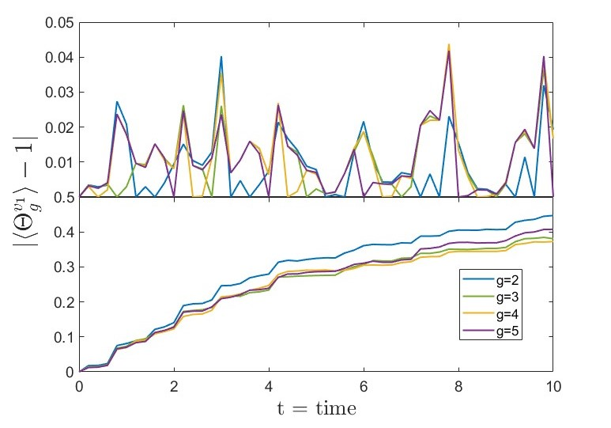
Numerical benchmarks
Two plaquettes with PBC $⇒$ four 6-level qudit registers
$$dimℋ_{tot}=6^{4}=1296, dimℋ_{phys}=49$$
$$U_{2}$$
$$U_{3}$$
$$v_{1}$$
$$U_{0}$$
$$v_{2}$$
$$U_{1}$$
Quench protocol:
$\left|ψ\left(0\right)\right\rangle =$ GS of ${\hat{H}}_{E}$
Evolve with coupling $g^{2}=1$
Each trotter step, measure one local charge
Two vertices
${\hat{Θ}}_{v_{1},g}={{\hat{Θ}}^{L}}_{0,g}{{\hat{Θ}}^{L}}_{2,g}$ ${{\hat{Θ}}^{R}}_{0,g}{{\hat{Θ}}^{R}}_{1,g}$
${\hat{Θ}}_{v_{2},g}={{\hat{Θ}}^{L}}_{1,g}{{\hat{Θ}}^{L}}_{3,g}$ ${{\hat{Θ}}^{R}}_{0,g}{{\hat{Θ}}^{R}}_{3,g}$

Slide 21
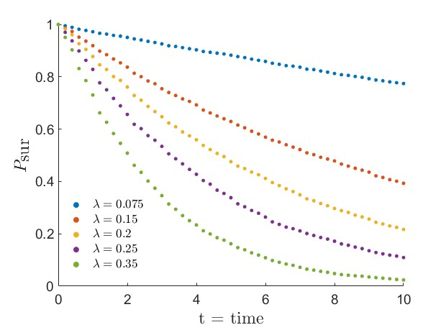
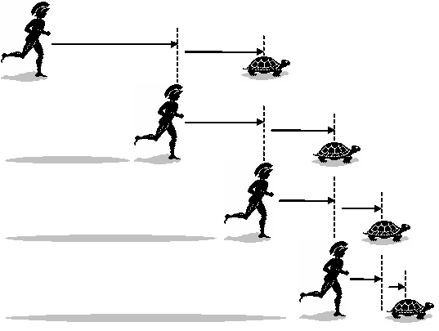

Numerical benchmarks:
Survival probability
Noise model:
$$e^{−i{\hat{H}}_{E}Δt}e^{−iH_{B}Δt}→e^{−iλH_{err}}e^{−iH_{E}Δt}e^{−iH_{B}Δt}$$
$${\hat{H}}_{err}=\sum_{g}{φ_{g}\left(t\right)\left|g\right\rangle \left\langle g\right|}$$
$p\left(φ_{l,g}\left(t\right)\right)$ extracted from a standard normal distribution
$\left\langle φ_{l,g}\left(t\right),φ_{l,g}\left(t+Δt\right)\right\rangle =0$

Slide 22
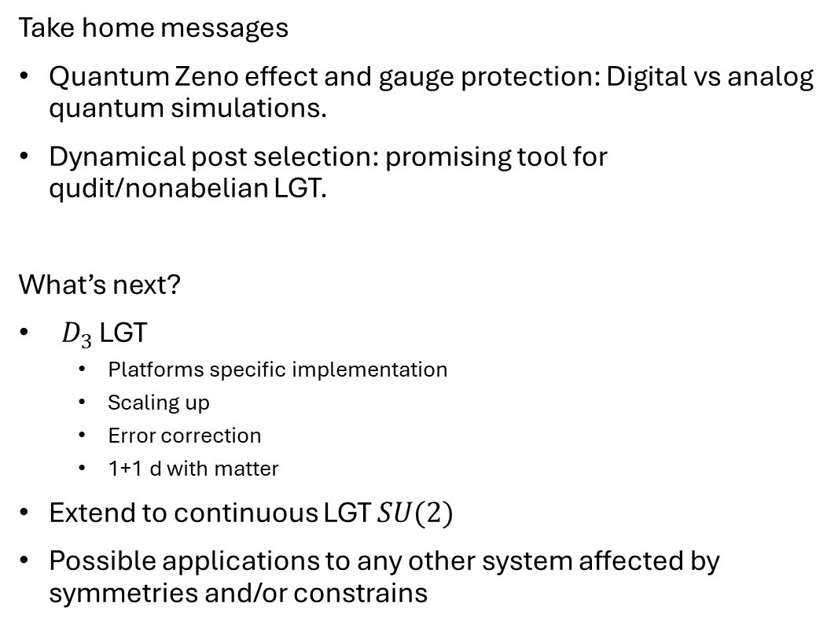
Conclusions & outlook
Take home messages
Quantum Zeno effect and gauge protection: Digital vs analog quantum simulations.
Dynamical post selection: promising tool for qudit/nonabelian LGT.
What’s next?
$D_{3}$ LGT
  Platforms specific implementation
  Scaling up
  Error correction
  1+1 d with matter
Extend to continuous LGT $SU(2)$
Possible applications to any other system affected by symmetries and/or constrains

Slide 23
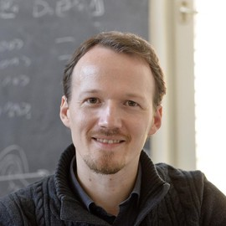
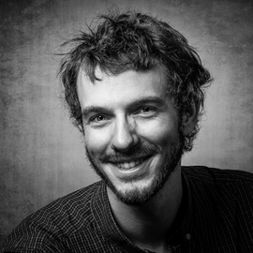





Acknowledgements
PI: Philipp Hauke
Matteo Wauters
Alberto Biella
Funded by the European Union. Views and opinions expressed are however those of the author(s) only and do not necessarily reflect those of the European Union or the European Commission. Neither the European Union nor the granting authority can be held responsible for them.

