Slide 1





Phys.Rept. 658 (2016) 1
Departamento de Física Teórica
Institute of Particle & Cosmos Physics (IPARCOS)
Universidad Complutense de Madrid
f₀(1370) and f₀(980) controversies from dispersive data analysis
J. R. Peláez
In collaboration with
For the f₀(1370): A.Rodas, J.Ruiz de Elvira. Phys.Rev.Lett. 130 (2023) 5, 051902.
For the f₀(980): V. Burkert, V. Crede, E. Klempt, K.V. Nikonov, J.A. Oller (see his talk), J. Ruiz de Elvira,
A.V. Sarantsev, L. Tiator, U. Thoma, R. Workman. Phys.Lett.B 844 (2023) 138070
Excited QCD 2024- Benasque Science Center, Jan 14 - Jan 20, 2024
Supported by:

Slide 2
The f₀(1370)
Motivation: Candidate to complete the controversial scalar nonet above 1 GeV,
interesting for studies of lightest glueball and its mixing scheme.
Controversy: Not present in original $ππ→ππ$experiments in the 70’s
but found in later models (Froggat at al. Martin et al., Au, Morgan &Pennington, Kaminski, Lesniak & Maillet, Tornqvist, Janssen, Albaladejo& Oller, Oset & Molina,etc…)
Seen in other reactions (from pp scattering, heavier meson decays, etc), but widely different parameters
Large model-dependences and/or caveats in most determinations:
- Naïve models for resonance parameterizations: Isobar, Breit-Wigners
- Specific parameterizations with a priori relations between pole and residue
(Breit Wigners again)
- Choice of decay channels
- Multi body channels as quasi two body…
- “tree level dynamics” (resonances or lagrangian constants)
etc…

Slide 3
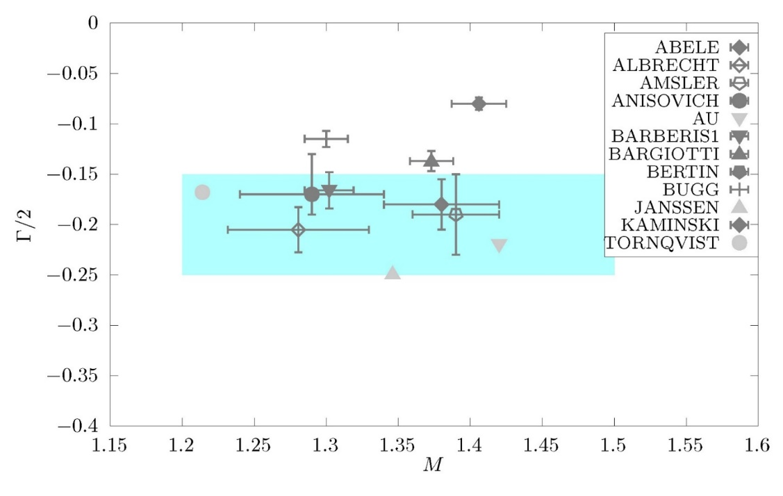


The f₀(1370) controversy very very briefly
PDG1984- Still called $ε\left(1300\right)$
PDG1986- f₀(1300) “averages meaningless”
PDG1988- f₀(1400), crude estimates
PDG1994- f₀(1370) (due to Crystal Barrell)
PDG1996 until 2021: same T-matrix pole
(1200-1500)-i(150-250) MeV
PDG2021: T-matrix pole sample
PDG2023 update:
(1200-1440)-i(60-300) MeV
By far the worst determined scalar above 1 GeV. Existence still controversial
“…there is still an ongoing debate whether the f₀(1370) exists…” S. Ropertz, C. Hanhart and B. Kubis, Eur. Phys. J. C 78 (2018) no.12, 1000.
“…the existence of f0(1370) is not beyond doubt…”, E. Klempt and A. Zaitsev, Phys. Rept. 454 (2007), 1
PDG still quotes Breit-Wigner parameters. No partial widths.
Surprisingly…
KK-mode masses>1300-1350 MeV
$ππ$-mode masses down to1200 MeV

Slide 4
Our work: JRP, A.Rodas, J.Ruiz de Elvira. Phys.Rev.Lett. 130 (2023) 5, 051902.
Data-Driven Forward Dispersion Relations (FDR)
Or partial-wave dispersion relations (Roy or Roy-Steiner)
(phase+elasticity)
Model independent constraints on data description
Enhanced precision
+
Analytic methods for the continuation to the complex plane in the contiguous sheet
avoiding specific parameterizations
(only phase and elasticity)
Reduced Model dependence or independence for pole determinations
We have already done this for the σ/f₀(500), κ/K₀*(700)
and for strange resonances below 2 GeV

Slide 5

We choose to analyze meson-meson data because it has
THE MOST STRINGENT ANALYTICITY CONSTRAINTS
- 1st Step: Unconstrained fits to data
- 2nd Step: Check dispersion relations. Discard too bad data
- 3rd Step: Constrained fits to data
- 4th Step: Extract resonances with dispersive or analytic methods (This Work)
Steps 1,2,3: already published dispersively Constrained Fits to Data (CFD):
$− ππ→ππ$ with Forward Dispersion relations and Roy equations
García Martin, Kaminski, JRP, Ruiz de Elvira, Yndurain, Phys.Rev.D 83 (2011) 074004
$− ππ→K\overline{K}$ with Roy-Steiner Equations
JRP, A. Rodas, Eur.Phys.J.C 78 (2018) 11, 897 & Phys.Rept. 969 (2022) 1-126

Slide 6
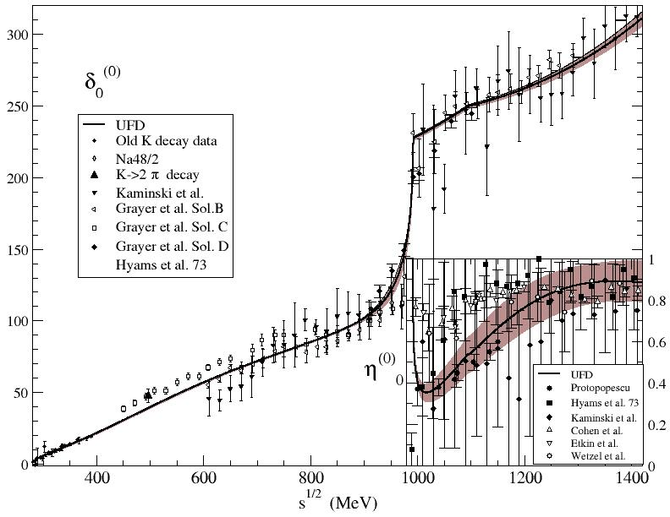
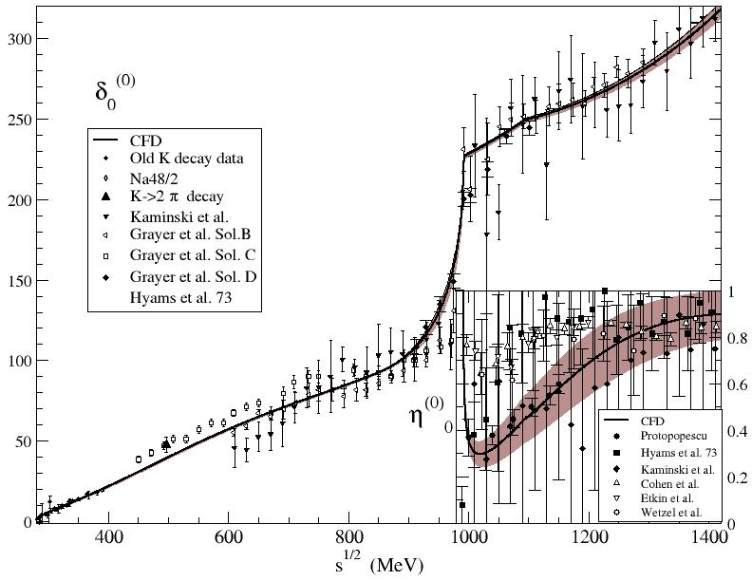
$ππ→ππ$ S0 wave: from uncostrained to constrained
No clear resonance shape in f₀(1370) region
Only sizable change in f₀(980) region

Slide 7
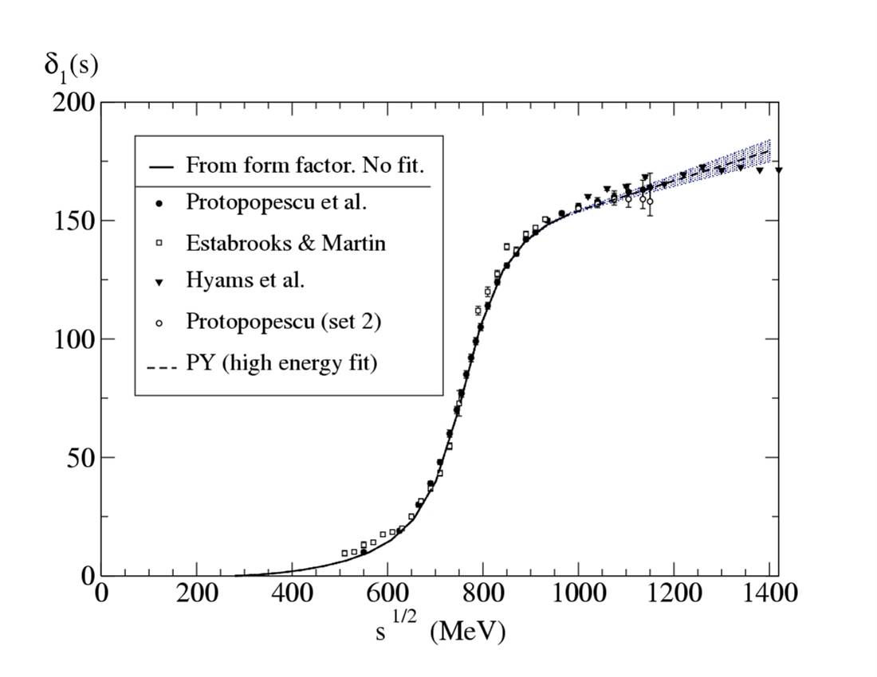
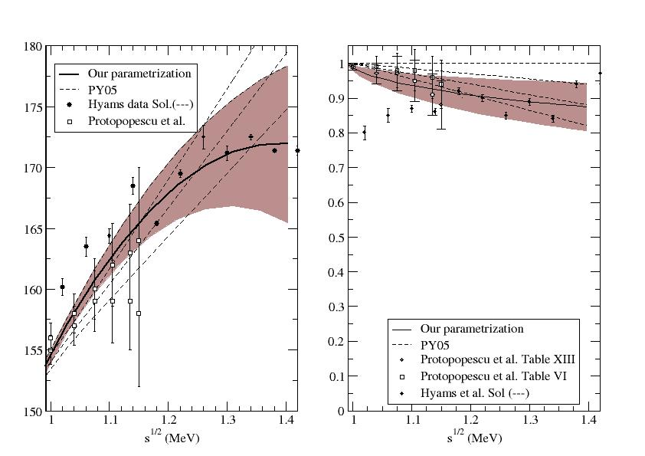
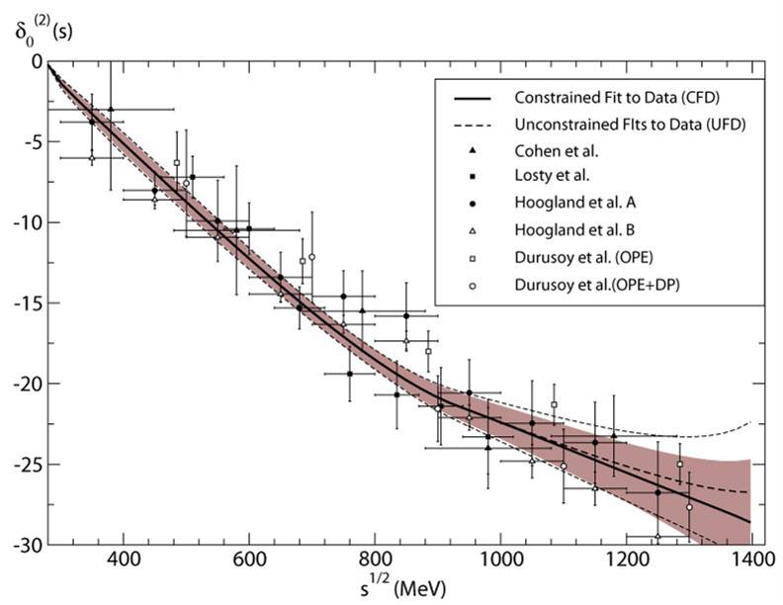
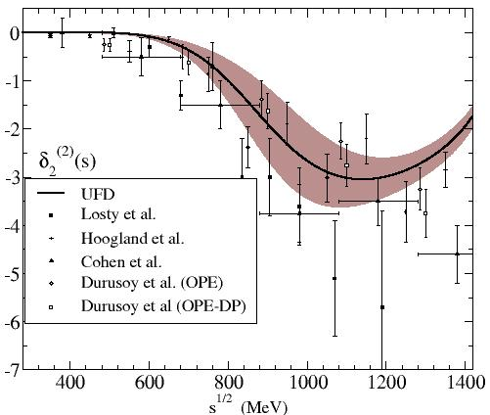
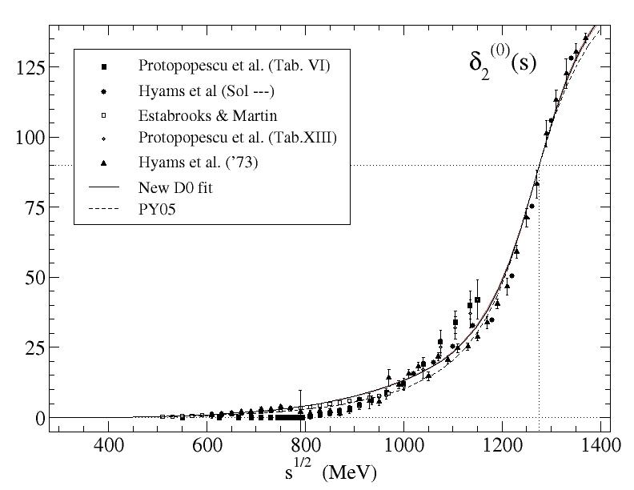
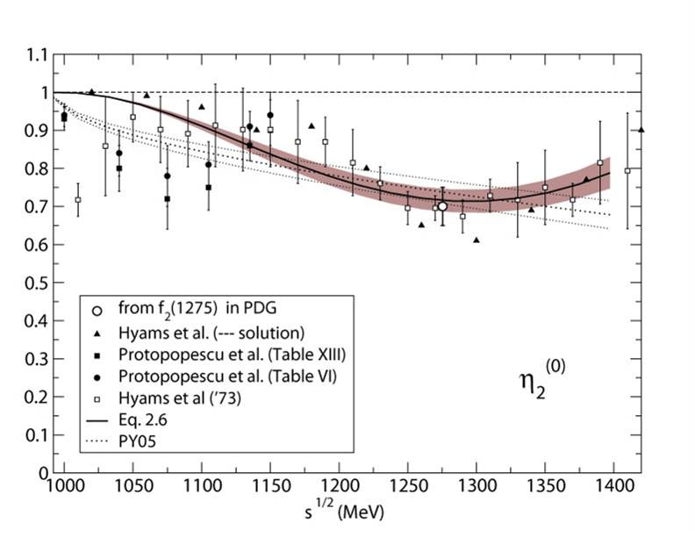
We also constrained the other $ππ→ππ$ S, P, D, F waves
Detailed analysis of statistical and systematic errors

Slide 8
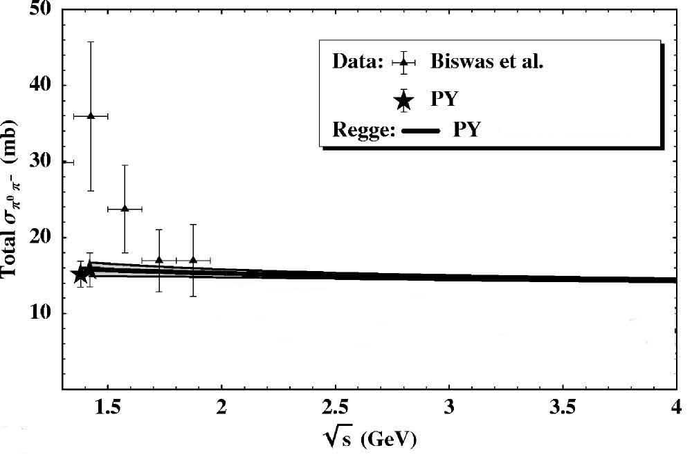
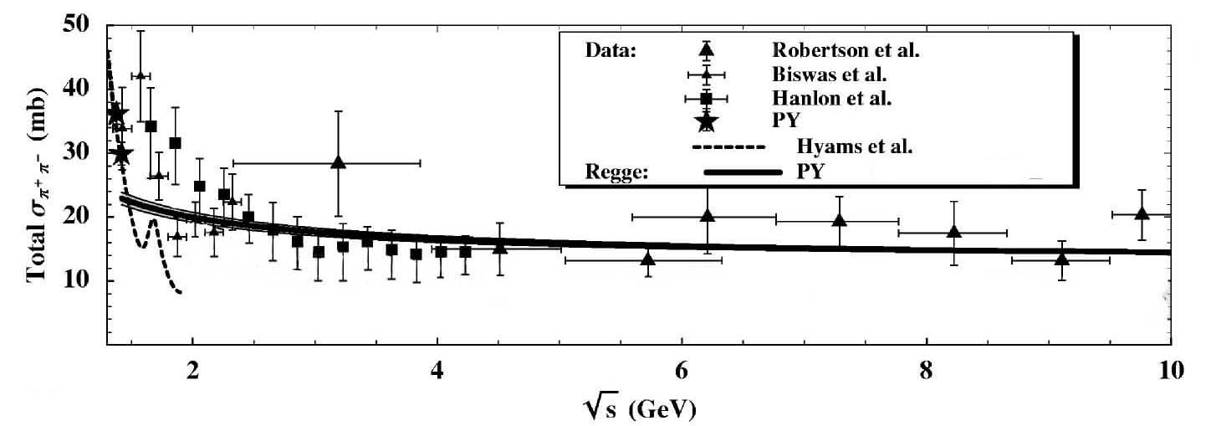
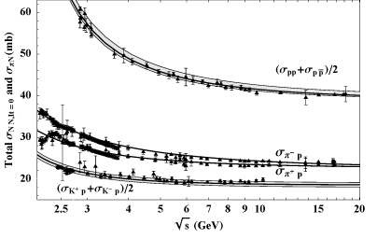
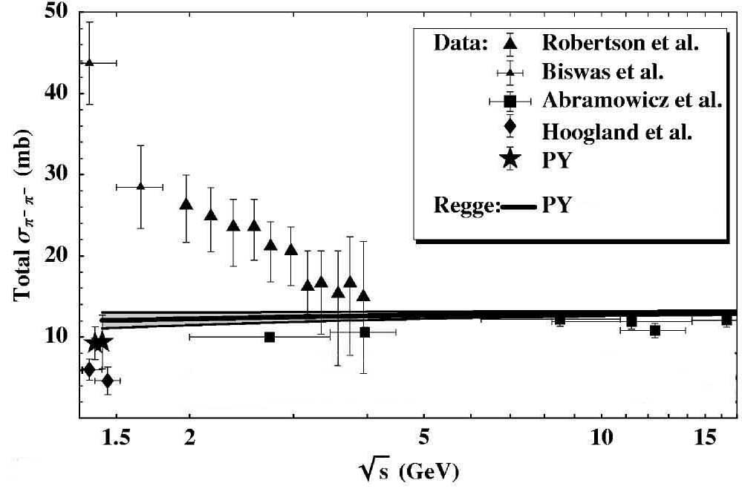

Fits for High $ππ→ππ$ energies
Above 1.42 GeV.
Regge parametrizations of cross section data
Factorization
JRP, F.J.Ynduráin. PRD69,114001 (2004)

Slide 9
SECOND STEP: Check dispersion relations: ππ→ππ
In general, data does not satisfy well DR. Sometimes very badly indeed
FDRs
Roy
GKPY

Slide 10
THIRD STEP: Use dispersion relations as constraints for the fits: ππ→ππ
Very good fulfillment: Constrained Fits to Data
FDRs
Roy
GKPY

Slide 11
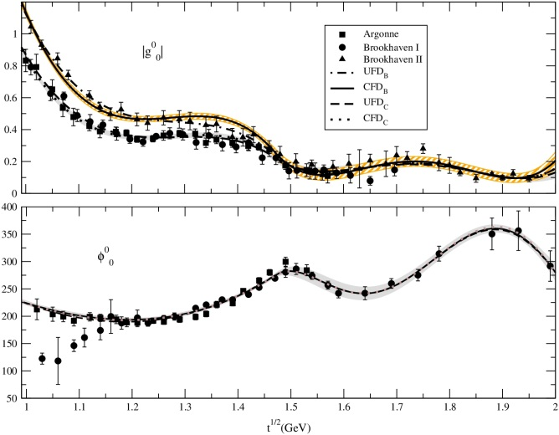
Similarly for ππ→KK Roy Steiner Equations
I=0,J=0, CFD
JRP, A.Rodas, Eur.Phys.J. C78 (2018)
No clear resonance peak in f₀(1370) region
I=0,J=0, Roy-Steiner eqs. Well satisfied up to 1.47 GeV

Slide 12
FOURTH STEP: Extract resonances from dispersive or analytic methods
Data-Driven Dispersion Relations
on amplitude or partial waves (phase+elasticity)
Model independent constraints on data description
Enhanced precision
+
Analytic methods for continuation to complex plane
avoiding specific parameterizations

Slide 13
Analytic continuation to Contiguous Riemann sheet
Dispersion relations provide model-independent analytic continuation to first Riemann sheet
For elastic resonances and partial waves, contiguous sheet= second sheet and S^{II}=1/S^{I}
OK for σ/f₀(500), κ/K₀*(700), but NOT f₀(1370),
To reach the contiguous sheet in the inelastic case or withour partial waves, we need an analytic continuation to the second sheet by means of general analytic functions reproducing the Dispersion Relation on the real axis or the upper-half complex plane.
Several methods in the literature:
Sequences of Padés
Continued Fractions
Conformal expansions
Laurent-Pietarinen expansions
etc…
These methods avoid specific parameterizations, have convergence theorems, etc…

Slide 14
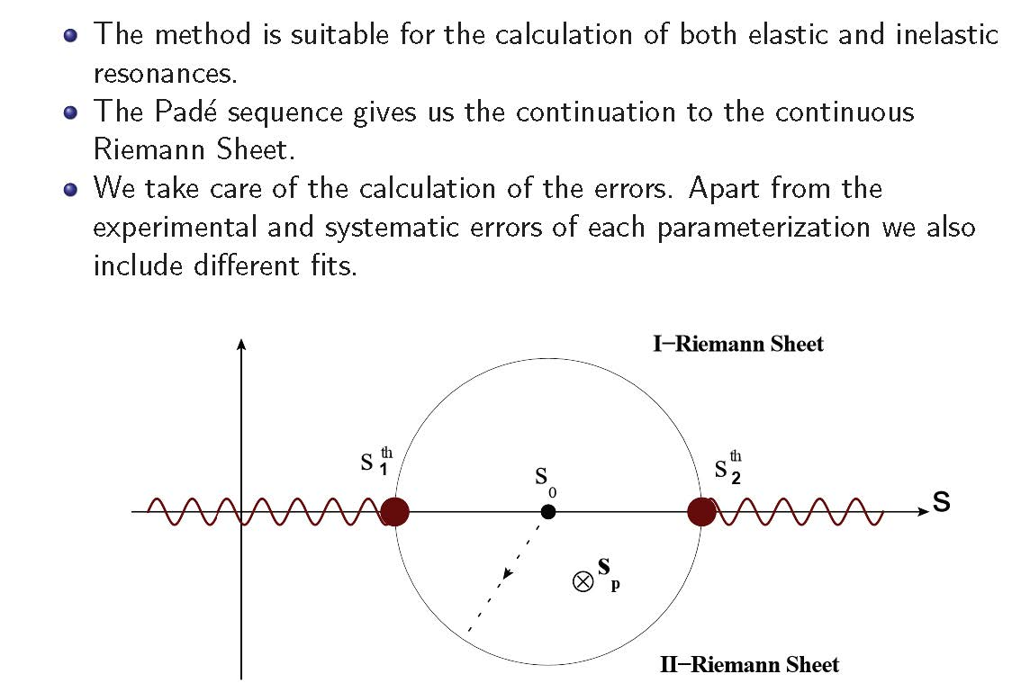
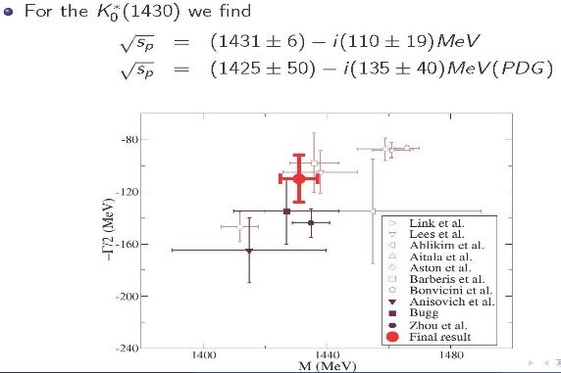
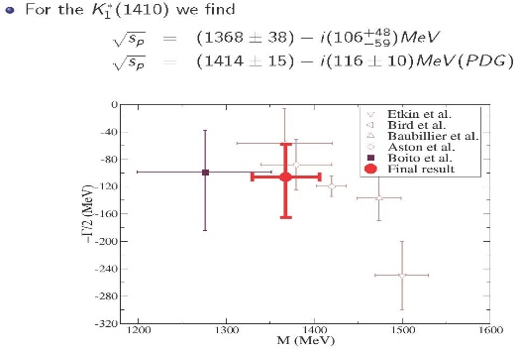
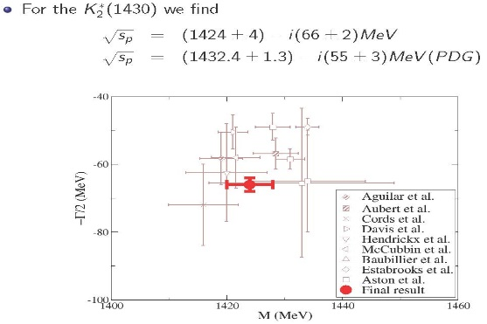
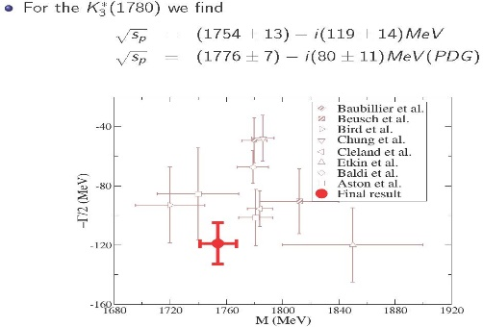
Padé sequences
Almost model independent: Does not assume any particular functional form
But requires a few derivatives. There are powerful convergence theorems
Based on previous works by P.Masjuan, J.J. Sanz Cillero, I. Caprini, J.Ruiz de Elvira, JRP, A.Rodas & J. Ruiz de Elvira. Eur. Phys. J. C (2017)
CAVEAT: If very high derivatives of the continued function needed, poor convergence
Succesfully applied to strange resonances
from πK scattering in inelastic region
JRP, A.Rodas & J. Ruiz de Elvira. Eur. Phys. J. C (2017) 77:91

Slide 15
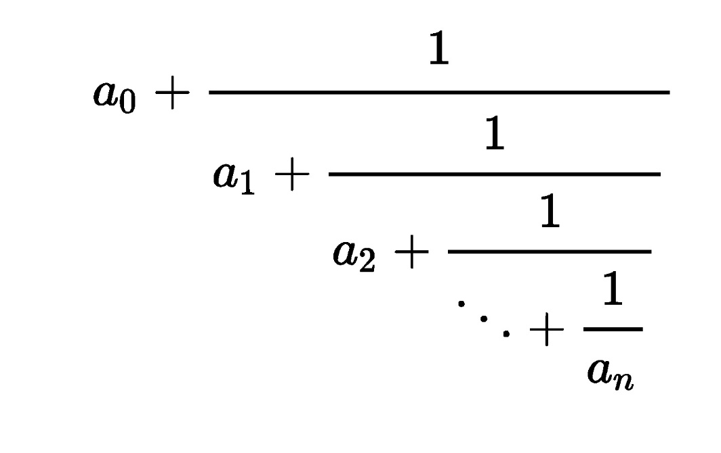
Continued fractions
We now use:
Once again, no specific simple functional form assumed
More stable and accurate than Padés, since no derivatives needed.
We have considered from 6 up to 50 terms or even more
When Padé sequences converge, perfect agreement
Actually, could be rewritten as a Padé

Slide 16
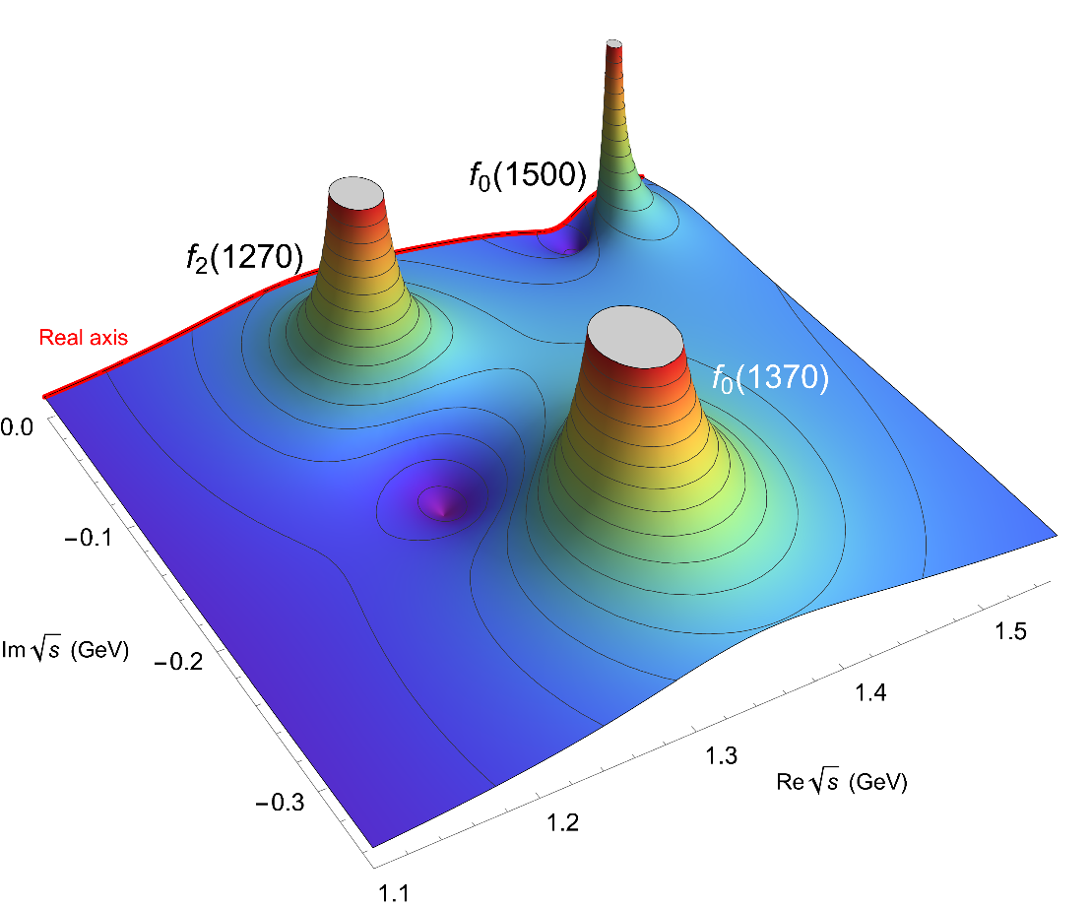
Pole from ππ→ ππ
Roy equations (PARTIAL WAVES) applicability <1.1 GeV. (But see later). The f₀(1370) lies beyond
However, Forward Dispersion Relations applicability up to 1.42 GeV in our fits.
Complication, we see the isoscalar-wave with all spins, J=0,2,…
Even f₀(1500) seen!!!,
Although not partial-wave
data used beyond 1.42 GeV
(Just a Regge description of
cross sections)
f₂(1270)
f₀(1370) seen behind
Unfortunately, with just a few derivatives on the real axis, the Padé method does
not converge well behind the f₂(1270).
But continued fractions provide nice and stable pole description
New
Method!

Slide 17
Forward Dispersion Relations ARE SIMPLE.
Complete isospin set of 3 Forward Dispersion Relations (FDR) for :
Two s-u symmetric amplitudes. F₀₊≡ π⁰π⁺→π⁰π⁺, F₀₀ ≡π⁰π⁰ →π⁰π⁰
One subtraction
Only depend on two isospin states. Positivity of imaginary part
The I_{t}=1 s-u antisymmetric amplitude
At threshold is the Olsson sum rule
Roy Eqs.
written for partial waves
MUCH MORE CUMBERSOME

Slide 18
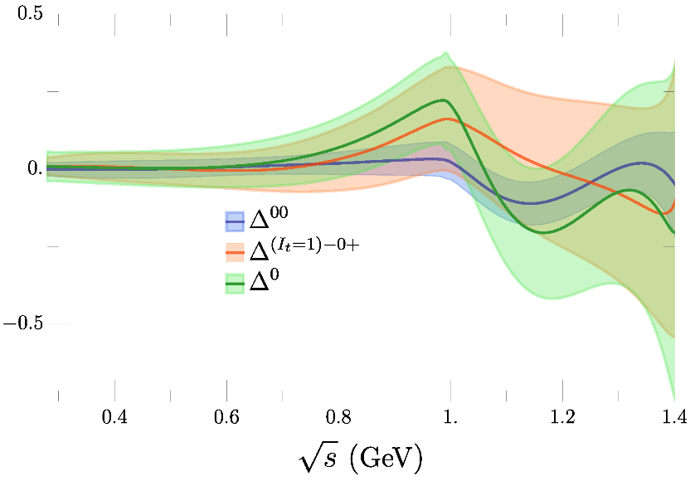
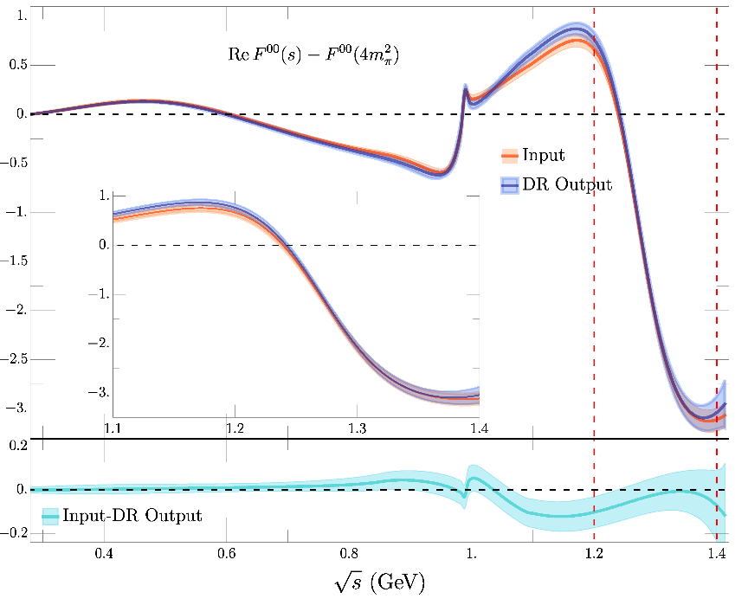
There are three independent FDRs: The most precise FDR is F⁰⁰
Region of interest

Slide 19
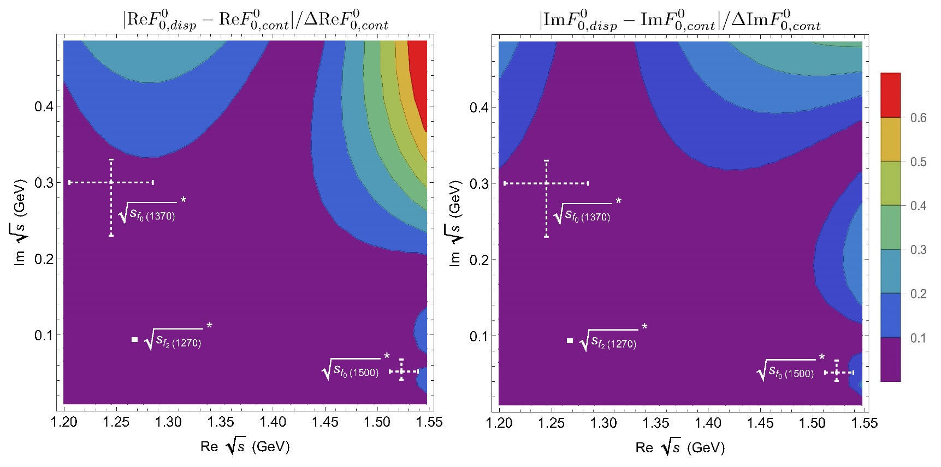
We can test how well the continued fractions fare against the FDR output in the first Riemann sheet (in the conjugated region of interest)
The difference is less than 10% of the estimated uncertainty from continued fractions
Of course, we need the contiguous sheet in the lower-half plane. The upper-half plane is just a test.

Slide 20
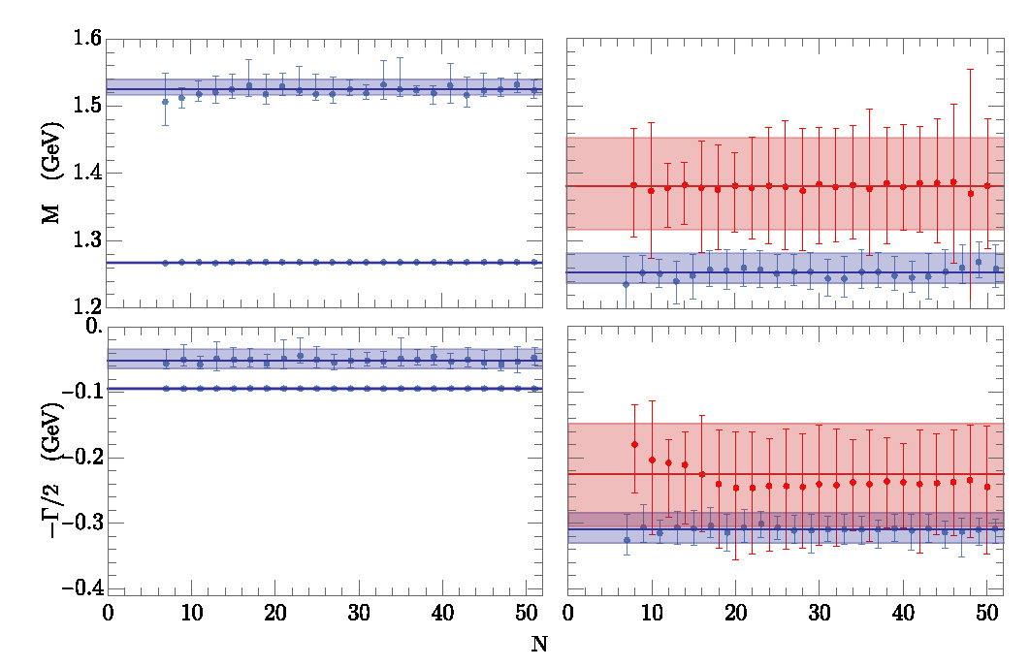
Then we match the FDR output to continued fractions with N=6 to 50 and look for poles
in the lower-half plane of the second sheet. We find three:
f₀(1370)
Mass
f₀(1500)
f₀(1500)
Masses
Masses
f₂(1270)
f₂(1270)
f₀(1500)
f₀(1500)
f₀(1370)
Width
f₂(1270)
f₂(1270)
Widths
Widths
Remarkably stable against N and systematic uncertainties!

Slide 21
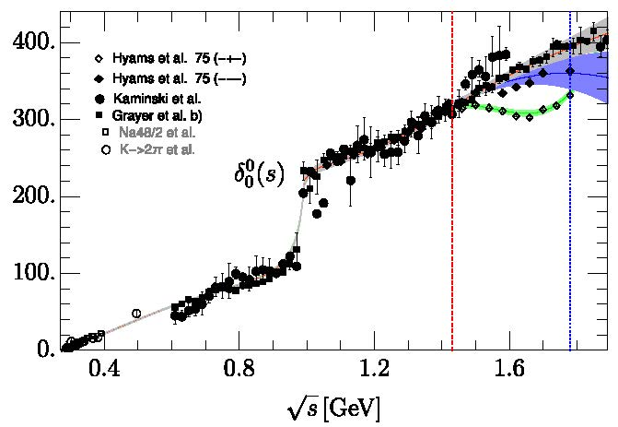
$ππ→ππ$ S0 wave: “Global fit” up to 2 GeV JRP, A.Rodas, J.Ruiz de ElviraEur.Phys.J.C 79 (2019) 12, 1008
Our “old” Constrained fit to data (CFD) was a “piece-wise”function up to 1.42 GeV
Recently we have provided a “Global Fit” in terms of analytic functions,
consistent with the CFD and DR up to 1.4 GeV as well as in the complex plane
in the elastic region and the dispersive σ/f₀(500) and f₀(980) poles.
And continuously extended beyond 1.4 GeV to different data sets and f₀(1500) scenarios
This “Global fit” is actually slightly better
with respect to Dispersion Relations

Slide 22
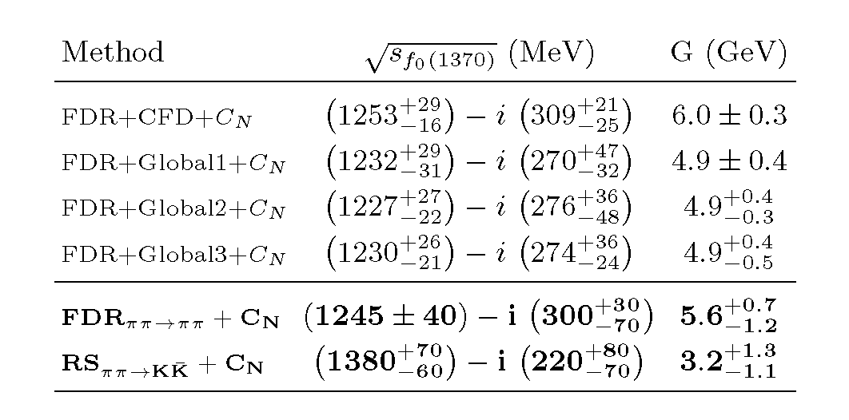
Pole from ππ→ ππ. FDR+C_{N}
For ππ we use both inputs
Piece-wise Constrained fit to data (CFD)
3 Global “Constrained fits to data”
Our final FDR+C_{N} result covers them all

Slide 23
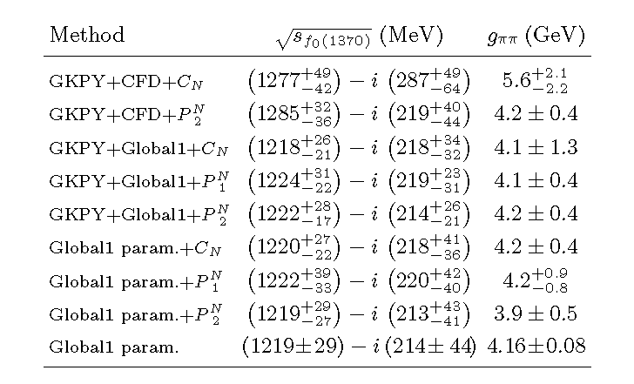
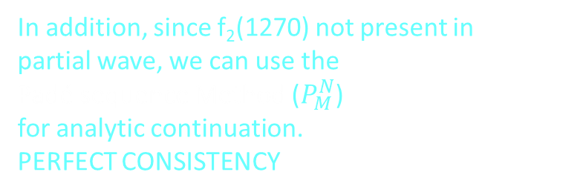
Further checks
- Even though Roy-like Eqs. (GKPY) not rigorously valid above 1.1 GeV,
Their extrapolation is still pretty decent up to a few 100s MeV beyond.
If we extrapolate them to get the pole:
PERFECT CONSISTENCY
This confirms the scalar assignment
In addition, since f₂(1270) not present in
partial wave, we can use the
Padé sequence Method ($P_{M}^{N}$)
for analytic continuation.
PERFECT CONSISTENCY
- If you want a simple analytic form consistent with data up to 2 GeV, dispersion relations up to 1.42 GeV and Roy eqs. applicability region in the complex plane, as well as the dispersive poles for σ/f₀(500), f₀(980) and this f₀(1370), use our “Global fit”
Also, f₀(1370) poles consistent with explicit pole in parameterization or with different
analytic continuation methods

Slide 24
Pole from ππ→KK. Roy Steiner+C_{N}
Roy-Steiner ππ→KK equations applicability proved up to 1.47 GeV
Nice because they constrain the relevant S0 partial wave
Unfortunately the f₀(1370) couples less strongly to KK
However, we always find a pole in the S0-wave around 1300 MeV, for both CFD solutions.
But large uncertainty completely dominated by choice of matching point t_{m}
for Mushkelishvili-Omnés input in Roy-Steiner formalism.

Slide 25
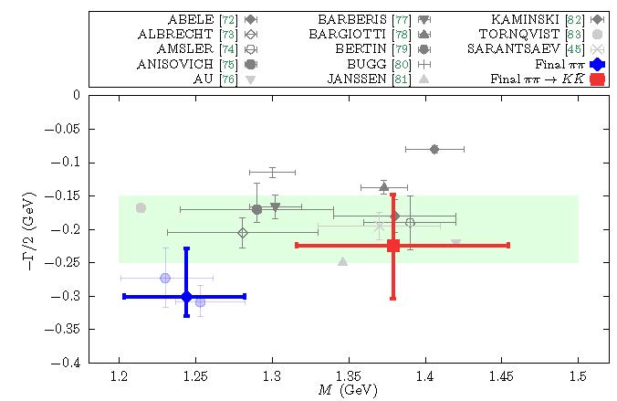


FINAL RESULTS:
“2σ” tension on the mass
between $ππ$ and KK modes
$ππ$-mode lighter as hinted @PDG
The very high-mass region 1500 MeV of the PDG estimate is disfavored
Recent upgrade of our pole searching
algorithm. In ArXive soon

Slide 26
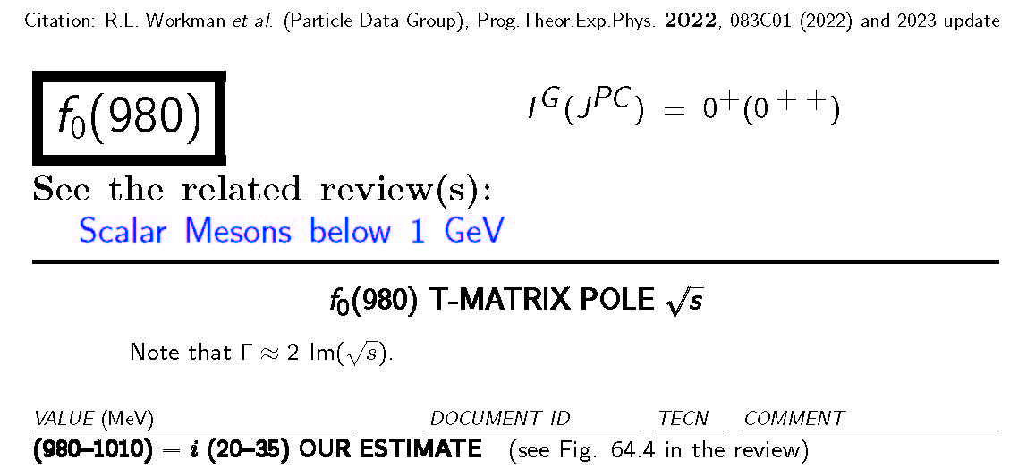

The f₀(980) width and branching ratio controversy
$Γ$=40-70 MeV
However…
In addition:
π π Branching ratios
from 0.52 to 0.84

Slide 27




The f₀(980) width and branching ratio controversy
f₀(980) pole from our ππ→ππ 2011 dipersive data analysis. Recent caveat:
Pole at $\left(996±7−i {25}_{−6}^{+10}\right)MeV$
$Γ$_{pole} =${50}_{−15}^{+20}$ MeV
$Γ$_{ππ} =${100}_{−17}^{+20}$ MeV
with a residue
$\left|g_{ππ}\right|$=2.3$±$0.2 GeV
The part is bigger than the whole ???
NO, because the pole is in the 2nd sheet, not adjacent above KK threshold
The usual identifications between
pole position, mass and width do not hold

Slide 28
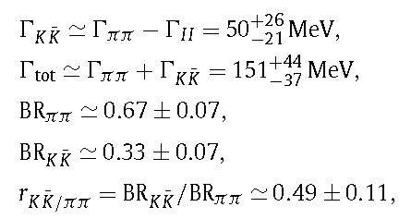


The f₀(980) width and branching ratio controversy
Relation between pole position and mass and width, when two channels present
3rd sheet (adjacent above KK-threshold):
$\sqrt{s_{pole}}\sim M−iΓ_{tot}$/2= $M−i(Γ_{ππ}+Γ_{KK})$/2
The usual definition
2nd sheet (not adjacent above KK-threshold)
$\sqrt{s_{pole}}\sim M−iΓ_{II}$/2= $M−i(Γ_{ππ}−Γ_{KK})$/2
(see J.A. Oller talk)
Plugging in the dispersive numbers
<1, OK!!!
We suspect this effect might be behind
some of the large discrepancies at PDG
(in progress)

Slide 29


Summary: Dispersive/analytic approaches aim at reducing model-dependences
For the f₀(1370) pole:
New method to determine resonance poles from data with
Forward Dispersion Relations and analytic continuation techniques
(instead of the usual partial-wave dispersion relations, whose region of applicability is limited)
Well suited for the inelastic region in $ππ$ scattering, yields a f₀(1370) pole in the low-mass, larger-width region of PDG estimate.
Consistency checks and simple parameterizations provided.
Also found in partial-wave Roy-Steiner equations from $ππ→KK$ data. Less precise than previous one and within PDG estimate.
Small “2σ” tension between the two determinations. (also hints @ PDG)
Given reduced model dependence this tension must be due to inconsistencies
between $ππ→ππ$ and $ππ→KK$ data sets.
For the f₀(980):
Model-independent determination of controversial Branching ratio.
Beware of non-usual pole-mass-width relations if pole in non-adjacent sheet

Slide 30
SPARE SLIDES

Slide 31
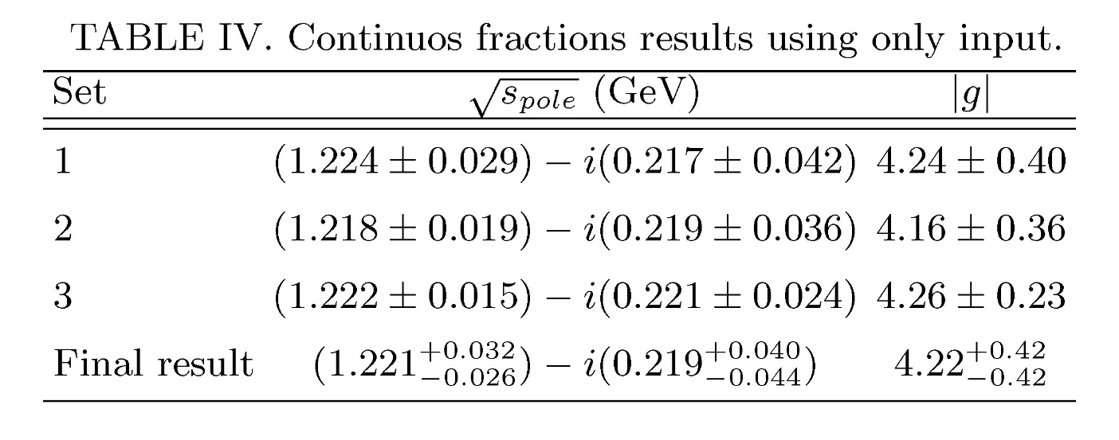
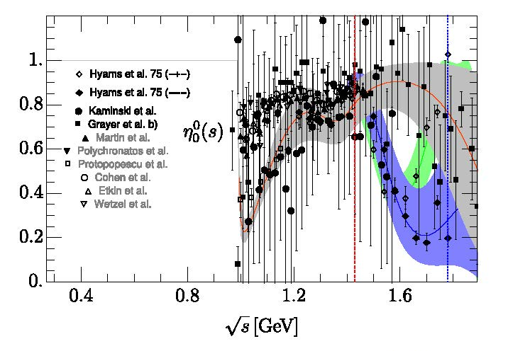
How the f0(1500) influences the result?
few MeV difference in pole
Depending on different data
above 1.4 GeV

Slide 32
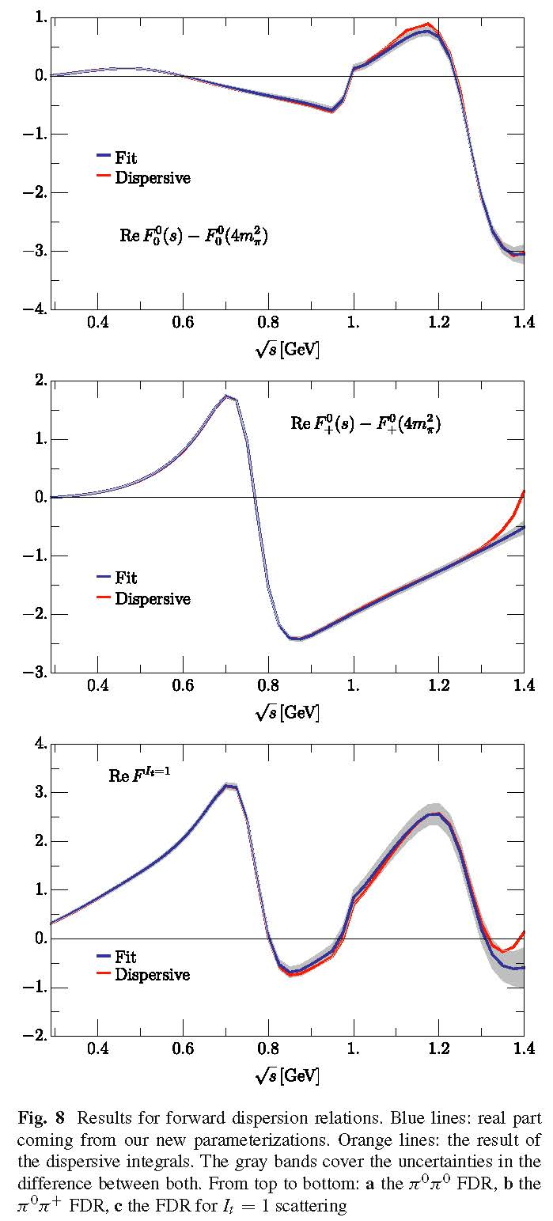
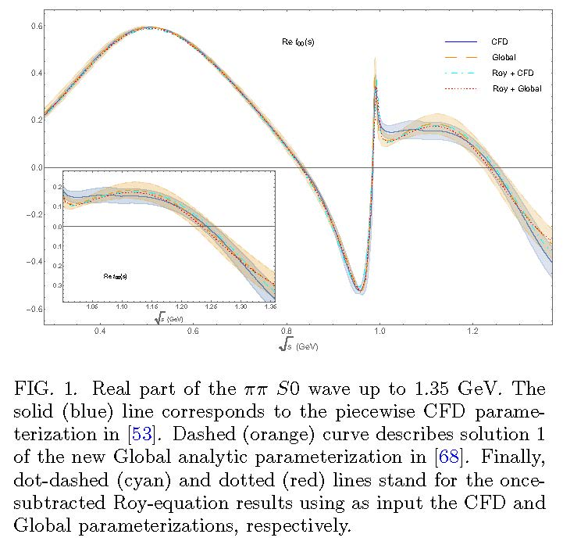

$ππ→ππ$ S0 wave: “Global fit” up to 2 GeV
This “Global fit” is actually slightly better
with respect to Dispersion Relations
We will provide results for both

Slide 33
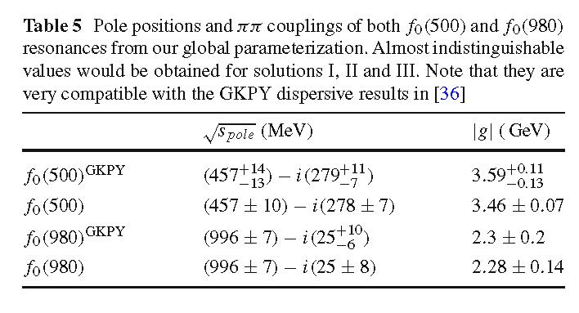
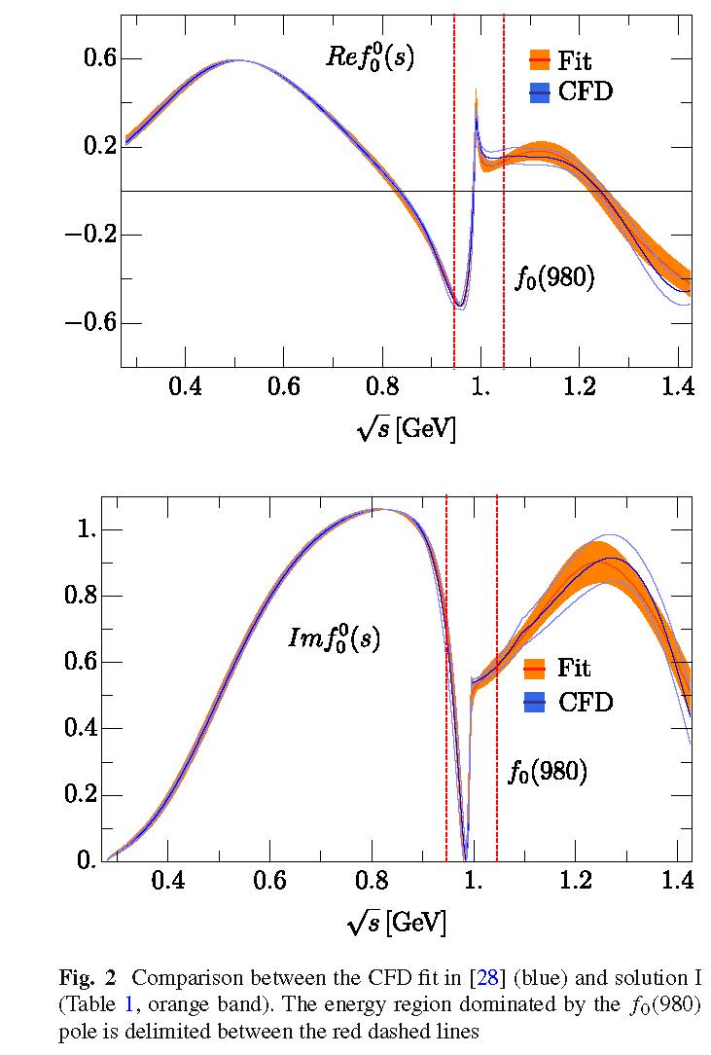

Slide 34
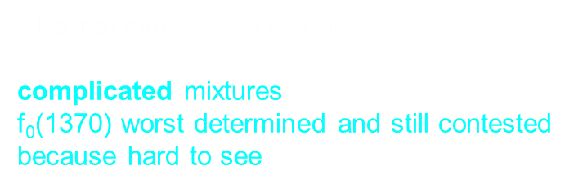

Non-ordinary spectroscopic classification
Lightest scalar SU(3) multiplets <2 GeV. Accepted picture at RPP
Light scalar nonet <1 GeV:
κ/K*₀(700)
σ
a₀
Non-strange heavier!!
Hugely Inverted $q\overline{q}$ hierarchy.
Cryptoexotics? (R.Jaffe 1976)
σ/f₀(500) and f₀(980) octet/singlet mixtures
κ/$K_{0}^{∗}$ (700) only recently “well established at PDG”
Only in 2021 on-line update “Needs Confirmation”
f₀
f₀ Singlet
f₀
a₀(980)
Scalar nonet >1 GeV:
One extra state f₀(1370), f₀(1500), f₀(1710) for just one nonet above 1 GeV
K*₀ (1430)
f₀ singlet
f₀
f₀
a₀(1450)
A$lso, not quite q\overline{q}$ hierarchy
complicated mixtures
f₀(1370) worst determined and still contested
because hard to see
+ glueball?

Slide 35
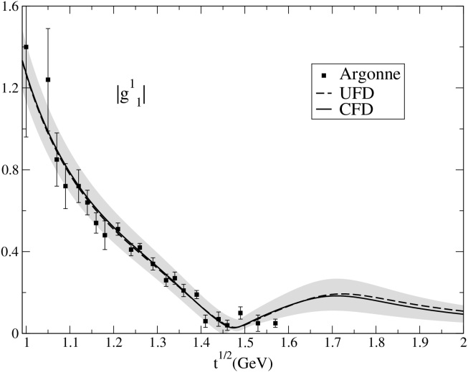
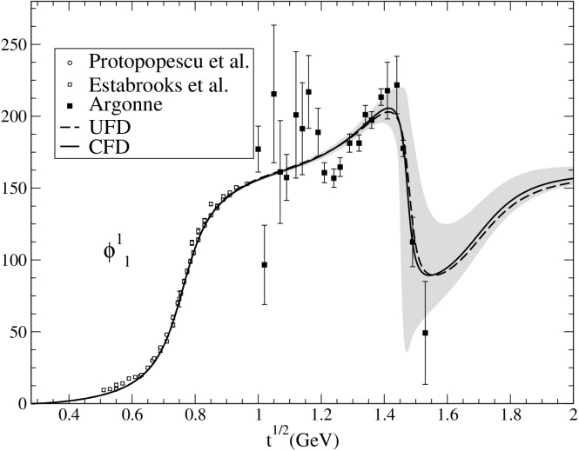
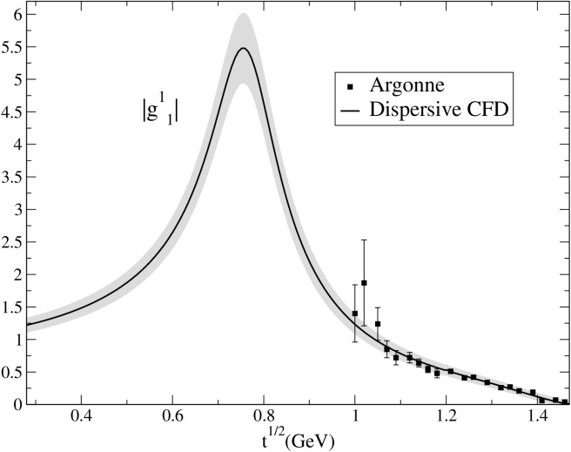
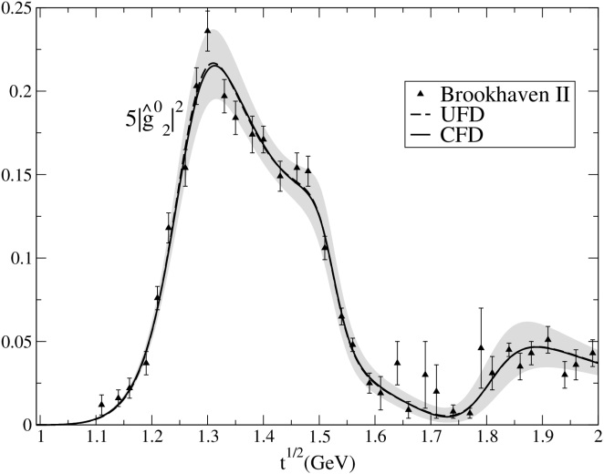
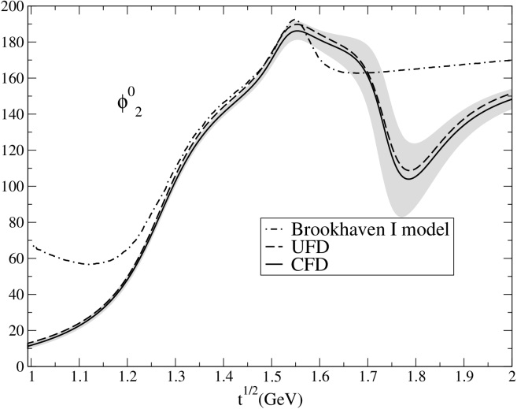
ππ→KK Hiperbolic Dispersion Relations
JRP, A.Rodas, Eur.Phys.J. C78 (2018)
Constarined SIMPLE FITS TO ππ→KK DATA, including systematic uncertainties.
Other waves
UFD already good
UFD Inconsistent with HDR
If not constrained
35

Slide 36
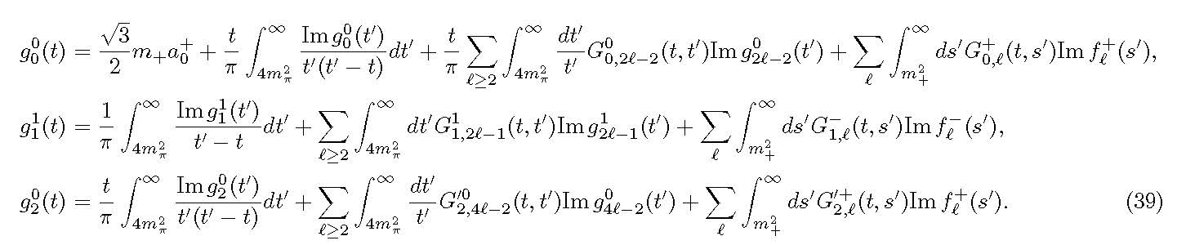
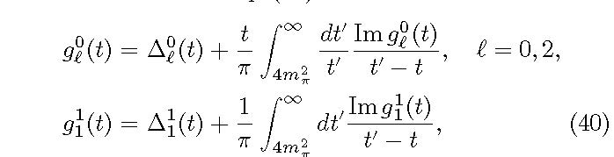
πK→πK and ππ→KK Hyperbolic Dispersion Relations (HDR)
g^{I}_{J} $=$π$\text{π}→KK$ partial waves. We study (I,J)=(0,0),(1,1),(0,2)
f^{I}_{J} $=K\text{π}→K\text{π} \text{partial} \text{waves}\text{. }\text{Taken} \text{from} \text{previous} \text{dispersive} \text{study}$
JRP, A. Rodas PRD 2018
$G_{J,J′}^{I}$(t,t’) =integral kernels, depend on a parameter
Lowest # of subtractions. Odd pw decouple from even pw.
Δ(t) depend on higher waves
or on Kπ→Kπ.
Integrals from
2π threshold !
“Unphysical region”
Solve in descending J order
We have used models for higher waves, but give very small contributions

Slide 37
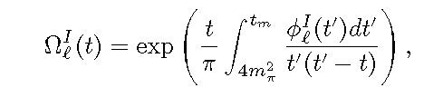

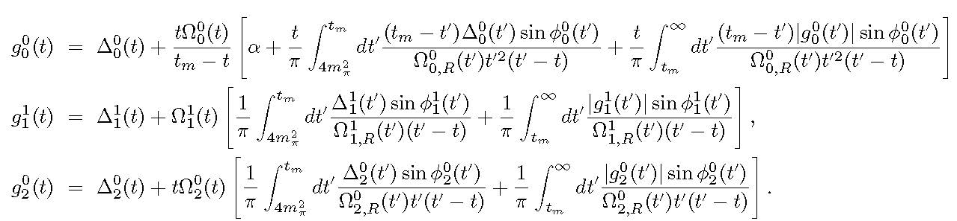
ππ→KK Hyperbolic Dispersion Relations (HDR)
For unphysical region below KK threshold, we used Omnés function
This is the form of our HDR: Roy-Steiner+Omnés formalism
Dominant source
oferror for f0(1370)
We can now check how well these HDR are satisfied

Slide 38


ππ→KK constrained consistent with Roy-Steiner eqs.
JRP, A.Rodas, Eur.Phys.J. C78 (2018)
Two possible solutions for S0 wave
HDR S0-wave
Constrained fits
are consistent with
Roy Steiner Eqs.
HDR S0-wave

Slide 39

The f₀(1370)
- f₀(1370) candidate to complete the controversial scalar nonet above 1 GeV,
Interesting for studies of lightest glueball and its mixing scheme.
Main problem: Strong model dependence in determinations from data.
PDG1984- Still called $ε\left(1300\right)$
PDG1986- f₀(1300) “averages meaningless”
PDG1988- f₀(1400), crude estimates
PDG1994- f₀(1370) (due to Crystal Barrell)
- PDG1996 until 2021: Same T-matrix pole
(1200-1500)-i(150-250) MeV
- By far the worst determined scalar above 1 GeV. Moreover:
- “Unfortunately, regardless of the year-long efforts, the scalar isoscalar spectrum is still not fully resolved: e.g. there is still an ongoing debate whether the f₀(1370) exists or not ...”
S. Ropertz, C. Hanhart and B. Kubis, Eur. Phys. J. C 78 (2018) no.12, 1000.
- “However, the existence of f0(1370) is not beyond doubt”, and “As a conclusion, we do not consider the f0(1370) as established resonance”. E. Klempt and A. Zaitsev, Phys. Rept. 454 (2007), 1
One of their main concerns is “the absence of any measured f₀(1370) phase motion”

Slide 40

Problems
- Not evident or present in original $ππ→ππ$experiments in the 70’s but found in later models. (Froggat at al. Martin et al., Au, Morgan &Pennington, Kaminski, Lesniak & Maillet, Tornqvist, Janssen, Albaladejo& Oller, etc…)
Data: extracted from πN→ππN, large systematic uncertainties and inconsistencies.
- Seen in other reactions (from pp scattering, heavier meson decays, etc), but widely different pole determinations
Large model-dependences:
- naïve models often used for parameterizations and resonance poles
- Specific parameterizations with a priori relations between pole and residue
- Isobars
- Breit Wigners
- Choice of decay channels
- Multi body channels as quasi two body…
- “tree level dynamics” (resonances or lagrangian constants)
PDG still quotes Breit-Wigner parameters. No partial widths.
Surprisingly…
lists KK-mode masses>1350 MeV whereas many in $ππ$-mode down to 1200MeV

Slide 41



The f₀(1370) controversy very very briefly. Most recent developments
- PDG2021: T-matrix pole sample
Latest two entries@PDG:
M-i Γ/2= (1280.6 ± 1.6 ± 47.4)− i(205.2 ± 1.7 ± 20.7) ($p\overline{p}$, Crystal Barrell Collab. 2020)
M-i Γ/2= (1290 ± 50)−i(${170}_{−40}^{+20}$) ($p\overline{p}$, πN, Anisovich & Sarantsev 2009)
Very recently:
M-i Γ/2= (1370 ±40)− i(195 ±20) (J/ψ, $p\overline{p}$, πN, …Sarantsev,Denisenko,Thoma, Klempt PLB816 2021)
No evidence in J/ψ radiative decays (BESIII). Too tiny glueball component?

Slide 42




Strange resonance poles from CFD: Using Padé sequences JRP, A.Rodas & J. Ruiz de Elvira. Eur. Phys. J. C (2017)
The method can be used for inelastic resonances. Provides resonance parameters WITHOUT ASSUMING SPECIFIC FUNCTIONAL FORM. We only used our constrained data fits in the real axis. Note thatt these are built piecewise, could be polynomials in some patches…
BUT the analytic continuation was made with Padé sequences. No model
Using Padé Sequences, the kappa:
JRP, A.Rodas & J. Ruiz de Elvira. Eur. Phys. J. C (2017) 77:91
(670±18)-i(295± 28) MeV
Consistent with full dispersive value: (648±7)-i(280±16) MeV

